Slide 1
Informed Consent Why is This Topic Important?
Obligation to be Truthful
Engenders Patient Trust
Develops Patient Autonomy
Integrity of the Profession
Notes:
Obligation to be Truthful
Engenders Patient Trust
Develops Patient Autonomy
Integrity of the Profession

Slide 2
Code of Ethics - Rule 2
Informed Consent
The performance of medical or surgical procedures shall be preceded by appropriate informed consent. When obtaining informed consent, pertinent medical facts and recommendations consistent with good medical practice must be presented in understandable terms to the patient or to the person responsible for the patient. Such information should include alternative modes of treatment, the objectives, risks, and possible complications of such a treatment, and the consequences of no treatment. The operating ophthalmologist must personally confirm with the patient or patient surrogate their (his or her) comprehension of this information."
Notes:
Four elements of Informed consent:
Beneficence – do what’s right
Non-maleficence – don’t do what’s wrong
Justice – include all relevant info – different for each patient
Autonomy (self governance) (some say truth-telling) – help the patient make informed decisions

Slide 3
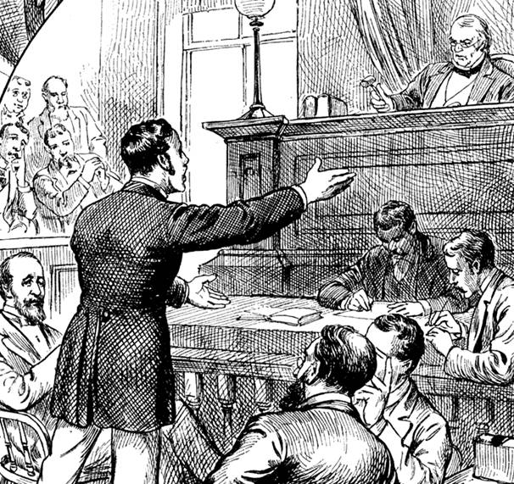
4 Historical Facts About Informed Consent
1. A 1914 U.S. Supreme Court case, Schoendorff v. Society of New York Hospital, "first established that the patient was an active participant in the treatment decision process“. Mrs. Schoendorff agreed to an "ether examination" to identify a lump causing a “disorder of the stomach”. While the patient was under anesthesia, the surgeon removed a revealed fibroid tumor… an infection, gangrene and the amputation of several fingers allegedly resulted from the operation.
Court decision, “In the case at hand, the wrong complained of is not merely negligence. It is trespass. Every human being of adult years and sound mind has a right to determine what shall be done with his own body; and a surgeon who performs an operation without his patient's consent commits an assault, for which he is liable in damages.”*
* https://en.wikipedia.org/wiki/Schloendorff_v._Society_of_New_York_Hospital
Notes:
1. A 1914 U.S. Supreme Court case, Schoendorff v. Society of New York Hospital, "first established that the patient was an active participant in the treatment decision process“.
Mrs. Schoendorff agreed to an "ether examination" to identify a lump causing a “disorder of the stomach”. While the patient was under anesthesia, the surgeon removed a revealed fibroid tumor… an infection, gangrene and the amputation of several fingers allegedly resulted from the operation.
Court decision,
“In the case at hand, the wrong complained of is not merely negligence. It is trespass. Every human being of adult years and sound mind has a right to determine what shall be done with his own body; and a surgeon who performs an operation without his patient's consent commits an assault, for which he is liable in damages.” ¹

Slide 4
4 Historical Facts About Informed Consent
2. A key figure in the more recent development of consent is Henrietta Lacks, an impoverished Maryland cancer patient who in 1951 had tissue from her cervix removed for what would prove to be groundbreaking medical research (HeLa cells) — but without her knowledge or consent or the subsequent phenomenal financial gains that researchers enjoyed from developing and selling cell lines that originated with Mrs. Lacks.
Notes:
2. A key figure in the more recent development of consent is Henrietta Lacks,
an impoverished Maryland cancer patient who in 1951 had tissue from her cervix removed for what would prove to be groundbreaking medical research (HeLa cells) —
but without her knowledge or consent or the
subsequent phenomenal financial gains that researchers enjoyed from developing and selling cell lines that originated with Mrs. Lacks.

Slide 5
4 Historical Facts About Informed Consent
3. The actual phrase, "informed consent," is credited to an American lawyer, Paul G. Gebhard, who, in a 1957 friend of the court brief, employed the phrase in a medical malpractice case. In the case, a patient contended that a surgeon at a Stanford University hospital had not fully disclosed all risks in a recommended aortography.
Mr. Gebhard wrote, “…each patient presents a separate problem, that the patient's mental and emotional condition is important and in certain cases may be crucial, and that in discussing the element of risk a certain amount of discretion must be employed consistent with the full disclosure of facts necessary to an informed consent.”
http://law.justia.com/cases/california/court-of-appeal/2d/154/560.html
Notes:
The actual phrase, "informed consent," is credited to an American lawyer, Paul G. Gebhard, who, in a 1957 friend of the court brief,
employed the phrase in a medical malpractice case. In the case, a patient contended that a surgeon at a Stanford University hospital had not fully disclosed all risks in a recommended aortography.
Mr. Gebhard wrote, “…each patient presents a separate problem, that the patient's mental and emotional condition is important and in certain cases may be crucial, and that in discussing the element of risk a
certain amount of discretion must be employed consistent with the full disclosure of facts necessary to an informed consent.”

Slide 6
4 Historical Facts About Informed Consent
4. Cornerstone documents on informed consent/human research in the aftermath of WWII
Nuremburg Code 1949 – Post-Nazi era in response to evidence of human experimentation
Necessary, important, well designed research, risks commensurate with benefits, avoidance of unnecessary suffering or injury, termination for risk of imminent harm or death, voluntary consent of research subjects, permission to “opt out” at any time
Declaration of Helsinki 1964 - Voluntary cooperation special research informed consent
Primacy of patients’ interests, clear research protocols, research combined with medical care
Belmont Report 1979 - Practice vs. research, patient benefit
Defined elements of informed consent, boundaries between practice and research
Notes:
4. Cornerstone documents on informed consent/human research in the aftermath of WWII
Nuremburg Code 1949 – Post-Nazi era in response to evidence of human experimentation
Necessary, important, well designed research, risks commensurate with benefits, avoidance of unnecessary suffering or injury, termination for risk of imminent harm or death, voluntary consent of research subjects, permission to “opt out” at any time
Declaration of Helsinki 1964 - Voluntary cooperation special research informed consent
Primacy of patients’ interests, clear research protocols, research combined with medical care
Belmont Report 1979 - Practice vs. research, patient benefit
Defined elements of informed consent, boundaries between practice and research

Slide 7
Origins of Informed Consent Philosophical Perspective
Beneficence
Obligation to maximize benefit
Obligation to minimize harm
Non-maleficence
Doctrine of “primum non nocere”
No deliberate harm
Justice:
Equals should be treated equally
Autonomy (self governance)
Notes:
Four elements of Informed consent:
Beneficence
Non-maleficence
Justice
Autonomy (self governance) (some say truth-telling)

Slide 8
Origins of Informed Consent The Medical Perspective
Origins of medical ethics in antiquity
Highly developed ethical standards
Common themes
Hippocrates (400 BCE)
Primacy of patient welfare
Honesty
Sanctity of life
Not informed consent
Notes:
Origins of medical ethics in antiquity
Highly developed ethical standards
Common themes
Hippocrates (400 BCE)
Primacy of patient welfare
Honesty
Sanctity of life
**Not informed consent**

Slide 9
Principles of Informed Consent
Informed consent is a dialogue:
An assessment of patient competence to decide
Disclosure of relevant information
An assessment patients’comprehension
Affirmatively obtain consent from patient or surrogate
Informed consent occurs before a patient or surrogate signs anything
It’s a dialogue, not a signature on a document
Notes:
Principles of Informed Consent
1- Is the patient competent
2- Disclose relevant information
3- Assess patients’comprehension
4- Surgeon must obtain consent from patient or surrogate
It’s a dialogue, not a signature on a document

Slide 10
Ophthalmic Mutual Insurance Company (OMIC)
OMIC developed hundreds of procedure-specific informed consent forms that can be downloaded and personalized for your use.
Not just for OMIC members
On the AAO ethics website and at www.omic.com
Notes:
OMIC developed hundreds of procedure-specific information consent forms that can be downloaded and personalized for your use.
Not just for OMIC members
On the AAO ethics website and at www.omic.com

Slide 11
From OMIC
Poor informed consent continues to be a frequent and serious allegation in claims and lawsuits against ophthalmologists. Despite the availability of procedure-specific informed consent documents from OMIC, an alarming number of insureds still do not use them and simply rely on the hospital or surgicenter’s consent form to cover their exposure. Unfortunately, these generic documents focus on the risks of anesthesia and rarely address ophthalmic-specific risks.
Informed consent documentation is so critical to the successful defense of a malpractice claim that it bears revisiting.
Informed Consent Revisited, https://www.omic.com/informed-consent-revisited/
Notes:
Poor informed consent continues to be a frequent and serious allegation in claims and lawsuits against ophthalmologists.
Despite the availability of procedure-specific informed consent documents from OMIC,
an alarming number of insureds still do not use them and simply rely on the hospital or surgicenter’s consent form to cover their exposure. Unfortunately, these generic documents focus on the risks of anesthesia and rarely address ophthalmic-specific risks.
Informed consent documentation is so critical to the successful defense of a malpractice claim that it bears revisiting.

Slide 12
Thank you -
General Inquiries & Submissions ethics@aao.org
The Redmond Ethics Center https://www.aao.org/clinical-education/redmond-ethics-center

