Slide 1
AAO Code of Ethics Rule of the Month
Rule 9. Medical and Surgical Procedures

Slide 2
Why is This Topic Important?
Patient safety, welfare, and rights
Trust in and integrity of the profession
Notes:
Obligation to be Truthful
Engenders Patient Trust
Develops Patient Autonomy
Integrity of the Profession

Slide 3
Code of Ethics - Rule 9
Medical and Surgical Procedures
An ophthalmologist must not misrepresent the service that is performed or the charges made for that service. An ophthalmologist must not inappropriately alter the medical record.
Notes:
Four elements of Informed consent:
Beneficence – do what’s right
Non-maleficence – don’t do what’s wrong
Justice – include all relevant info – different for each patient
Autonomy (self governance) (some say truth-telling) – help the patient make informed decisions

Slide 4
First Key Provision of Rule 9
The primary provision of Rule 9 is to ensure that the treatment or service performed is factually and accurately represented to the patient, including all related costs.
This entails both the physician-led informed consent process as well as pertinent cost-related information shared with the patient by the ophthalmologist and practice staff.

Slide 5
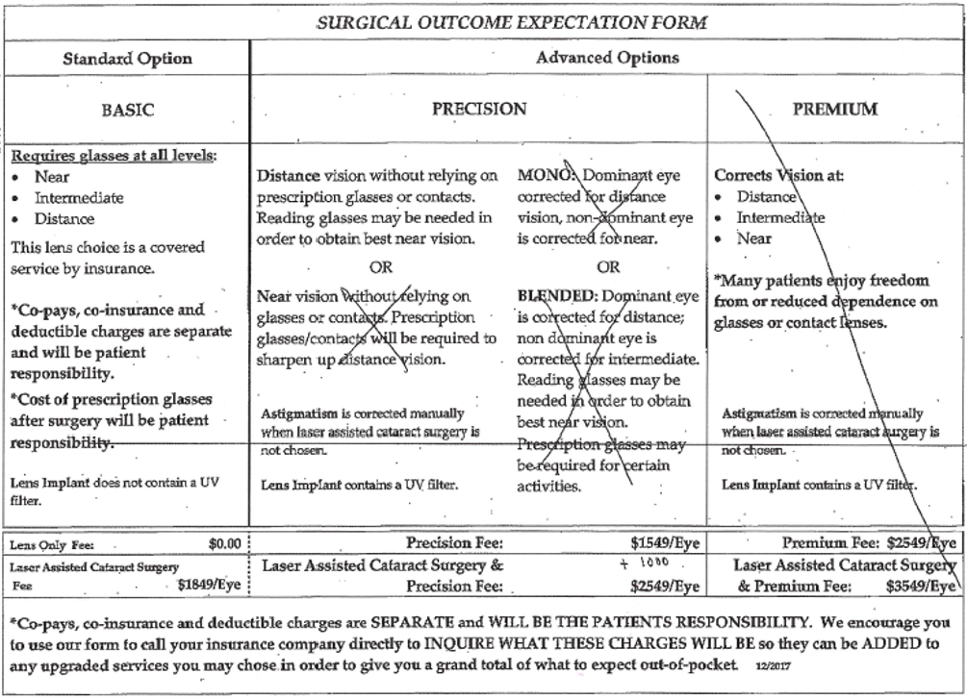
Misrepresenting Services Provided
Knowingly misrepresenting information about the type, scope, or nature of the medical treatment or service provided may be considered fraud^{1.}
In today’s health insurance milieu, fees play a significant role in patient decisions to undergo treatments and services. Don’t let patients be surprised by an incomplete discussion of fees or an inaccurate representation of the agreed upon treatment plan.
¹ https://www.justice.gov/usao-wdmi/health-care-fraud

Slide 6
Second Key Provision of Rule 9
Do not inappropriately alter the medical record.
There is a correct process for amending medical records, electronic and otherwise.
Even additions and comments made by well-meaning physicians who are attempting to clarify or elaborate on previous notes can compromise the integrity of a medical record.²
Learn the correct process and use it.
² https://www.texmed.org/Template.aspx?id=3930

Slide 7
Code of Ethics - Principle 5
Fees for Ophthalmological Services
Fees for ophthalmological services must not exploit patients or others who pay for the services.
Note: Unlike the Rules of the Code of Ethics, the Principles are not enforceable. They are aspirational models of exemplary professional conduct for all members of the AAO.

Slide 8
Additional References Related to the Code of Ethics
Principles of the Code
1. Ethics in Ophthalmology
2. Providing Ophthalmological Services
7. An Ophthalmologist’s Responsibility
Rules of The Code
Rule 2. Informed Consent
Rule 11. Commercial Relationships
Rule 15. Conflict of Interest
Advisory Opinion, Informed Consent
Advisory Opinion, Determining the Need for Medical or Surgical Intervention
Information Statement, Unique Competence of the Ophthalmologist
Redmond Ethics Center, see Fundamental Issues in Patient Care

Slide 9
Thank you -
General Inquiries & Submissions ethics@aao.org
The Redmond Ethics Center https://www.aao.org/clinical-education/redmond-ethics-center

