Slide 1
AAO Code of Ethics Rule of the Month
Rule 8. Postoperative Care

Slide 2
Postoperative Care Why is This Topic Important?
Patient safety, welfare, and rights
Trust in and integrity of the profession
Notes:
Obligation to be Truthful
Engenders Patient Trust
Develops Patient Autonomy
Integrity of the Profession

Slide 3
Code of Ethics - Rule 8
Postoperative Care
The providing of postoperative eye care until the patient has recovered is integral to patient management. The operating ophthalmologist should provide those aspects of postoperative eye care within the unique competence of the ophthalmologist (which do not include those permitted by law to be performed by auxiliaries). Otherwise, the operating ophthalmologist must make arrangements before surgery for referral of the patient to another ophthalmologist, with the patient's approval and that of the other ophthalmologist. The operating ophthalmologist may make different arrangements for the provision of those aspects of postoperative eye care within the unique competence of the ophthalmologist in special circumstances, such as emergencies or when no ophthalmologist is available, so long as the patient's welfare and rights are the primary considerations. Fees should reflect postoperative eye care arrangements with advance disclosure to the patient.
Notes:
Four elements of Informed consent:
Beneficence – do what’s right
Non-maleficence – don’t do what’s wrong
Justice – include all relevant info – different for each patient
Autonomy (self governance) (some say truth-telling) – help the patient make informed decisions

Slide 4
First Key Provision of Rule 8
The primary goal of Rule 8 is to ensure that the patient is adequately served throughout the vulnerable period following surgery.
The fundamental provision of the rule is that the operating ophthalmologist provide those aspects of postoperative care that are "within the unique competence of the ophthalmologist."

Slide 5
Defining Unique Competence
The unique competence of ophthalmologists is broadly based on medical knowledge, judgment, communication skills, professionalism, and tradition, and ophthalmologists consistently apply their competence using their ophthalmologic medical and surgical skills.¹
¹Ethics Information Statement, The Unique Competence of the Ophthalmologist

Slide 6
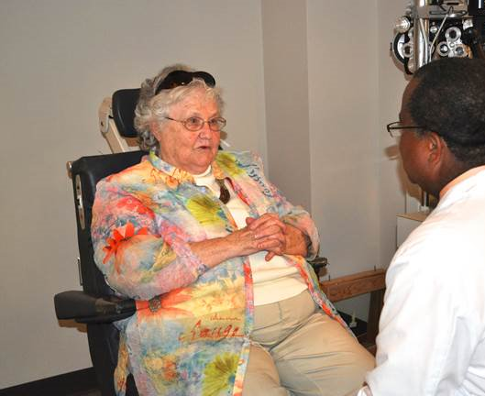
Preference for Continuity of Care
In general, a patient is best served by having postoperative care provided by the physician who best knows their condition, the specifics of the surgical procedure, and the possible complications associated with the procedure and the patient.

Slide 7
Second Key Provision of Rule 8
If unable to personally provide the postoperative care, the ophthalmologist must arrange before surgery (except in emergencies) for postoperative care to be provided by another qualified professional who is acceptable to the patient.
If appropriate arrangements cannot be made, then the ophthalmologist should not perform the surgery (except in emergencies).
See Rule of Ethics 7, Delegation of Services for more information.

Slide 8
Third and Fourth Key Provisions of Rule 8
The third key provision in Rule 8 is that flexibility is permitted to allow different postoperative care arrangements in emergencies or when no competent ophthalmologist is available.
Finally, the rule requires that the patient be informed prior to surgery how the postoperative care arrangements will affect the fees for services.

Slide 9
Applicable Principles, Rules, and Advisory Opinions of the Code of Ethics
Principles of the Code
1. Ethics in Ophthalmology
2. Providing Ophthalmological Services
7. An Ophthalmologist’s Responsibility
Rules of The Code
Rule 2. Informed Consent
Rule 7. Delegation of Services
Rule 9. Medical and Surgical Procedures
Rule 11. Commercial Relationships
Rule 15. Conflict of Interest
Advisory Opinion, Postoperative Care
Policy Statement, An Ophthalmologist’s Duties Concerning Postoperative Care
Redmond Ethics Center, see Fundamental Issues in Patient Care

Slide 10
Thank you -
General Inquiries & Submissions ethics@aao.org
The Redmond Ethics Center https://www.aao.org/clinical-education/redmond-ethics-center

