Slide 1
AAO Code of Ethics Rule of the Month
Rule 6. Pretreatment Assessment

Slide 2
Pretreatment Assessment Why is This Topic Important?
Patient safety, compliance, and well-being
Trust in and integrity of the profession
Notes:
Obligation to be Truthful
Engenders Patient Trust
Develops Patient Autonomy
Integrity of the Profession

Slide 3
Code of Ethics - Rule 6
Pretreatment Assessment
Treatment (including but not limited to surgery) shall be recommended only after a careful consideration of the patient's physical, social, emotional and occupational needs. The ophthalmologist must evaluate and determine the need for treatment for each patient. If the pretreatment evaluation is performed by another health care provider, the ophthalmologist must assure that the evaluation accurately documents the ophthalmic findings and the indications for treatment. Recommendation of unnecessary treatment or withholding of necessary treatment is unethical.
Notes:
Four elements of Informed consent:
Beneficence – do what’s right
Non-maleficence – don’t do what’s wrong
Justice – include all relevant info – different for each patient
Autonomy (self governance) (some say truth-telling) – help the patient make informed decisions

Slide 4
Components of Rule 6 Pretreatment Assessment
Treatment shall be recommended only after a careful consideration of the patient’s physical, social, emotional and occupational needs.
If the pretreatment evaluation is performed by another health care provider, the ophthalmologist must assure that the evaluation is accurate.
Recommending unnecessary treatment or withholding of necessary treatment is unethical.

Slide 5
What Does Assessment Mean?
Document your findings accurately and without bias.
Falsifying or “stretching” the facts is a serious ethical and legal risk.
Include non-physical factors in your overall assessment.
A well-rounded assessment is more likely to lead to a successful outcome.

Slide 6
Non-Physical Factors of Pretreatments Assessment
Demographic factors such as age, ethnicity, gender identity, education, marital and socio-economic status
Psychosocial factors: beliefs, motivation, attitude
Employment status or occupation
Health literacy

Slide 7
Historical Revisions to Rule 6
Formerly titled “Preoperative Assessment”, with focus on:
Personal evaluation by physician
Findings are accurately documented
Surgery is appropriate to condition
Unnecessary surgery is unethical
The managed care era brought revisions, including:
Review of auxiliaries’ recommendations for accuracy
Declaring the withholding of necessary treatment as unethical

Slide 8
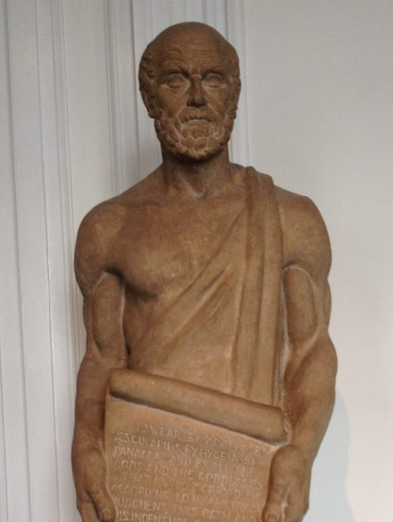
Hippocratic Contributions to Modern Pretreatment Assessment Practices
Hippocratic physicians were required to give complete and detailed medical histories and examinations.
The overall assessment of these recordings interpreted the final diagnosis and determined the type of treatment of the disease.
Hippocrates contributed to our current practices by declaring that medicine should depend on detailed observation, reason and experience in order to establish diagnosis, prognosis and treatment.¹
¹ Grammaticos Ph, Diamantis A. Useful known and unknown views of the father of modern medicine, Hippocrates and his teacher Democritus. Hell J Nucl Med. 2008;11(1):2–4.

Slide 9
Applicable Principles and Rules of the Code of Ethics
Principles of the Code
Principle 1. Ethics in Ophthalmology
Principle 2. Providing Ophthalmological Services
Principle 7. An Ophthalmologist’s Responsibility
Rules of The Code
Rule 1. Competence
Rule 2. Informed Consent

Slide 10
Thank you -
General Inquiries & Submissions ethics@aao.org
The Redmond Ethics Center https://www.aao.org/clinical-education/redmond-ethics-center

