Slide 1
ICD-10 Presentation
5/21/15
Tracy Pila, CMSS
Administrative director
Arbor Centers for EyeCare

Slide 2
Financial Interest
I do not have any financial interest in any product, website, or photo mentioned in this presentation.

Slide 3
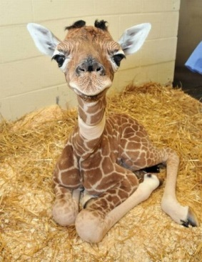
Introduction
W55.39
Contact With Giraffe or Other Hoof stock

Slide 4
Introduction
Why are we changing to ICD-10?
The rest of the WORLD (yes, world) is currently using ICD-10.
The United States is the only country not using ICD-10.
But the United States is the only country using ICD-10 for reimbursement.
Why does that matter?
The World Health Organization (WHO) releases information about disease populations, etc. and our statistics don't get counted since our codes do not match.
For example, WHO reports on the number of Ebola cases throughout the world.
Even though the United States had a few reported cases, our current ICD-9 codes don't even include Ebola in them - so our statistics don't match and our coding isn't accurate.

Slide 5
Introduction
How is it different from ICD-9?
The current set of ICD-9 codes we use are outdated and newer codes have not been added in years.
ICD-10 is also much more specific than ICD-9.
ICD-10 will now have codes for severity of diseases/problems and also for location.
In ICD-10, we will code H25.11 for a nuclear sclerotic cataract in the right eye, H25.12 for a nuclear sclerotic cataract in the left eye, and H25.13 for a nuclear sclerotic cataract in both eyes.

Slide 6
Is it really that scary?
For doctors, not really!
While the change seems overwhelming, our EMR provider has made this transition relatively easy with their ICD-10 solution.
Almost everything you need to code will be built into EMR, just like it is now.
You will also have access to a user-specific favorites list in case you need to reference your most commonly used codes.
You will also be able to see other users’ lists as well.

Slide 7
ICD-10 Basics
V91.07XD:
Burn due to water-skis on fire, subsequent encounter

Slide 8
ICD-10 Basics
Go-Live date is October 1, 2015
Going from about 15,000 codes to around 70,000 codes
Combination of letters and numbers, up to 7 digits
Location and severity, and visit type (initial, subsequent, etc.) now included
All insurance companies will be using ICD-10 EXCEPT for worker’s comp. and auto insurance

Slide 9
Coding Information
R46.1:
Bizarre personal appearance

Slide 10
Coding Information
First character of all code sets will be a letter
H indicates an eye code
X indicates a place holder code
Unspecified codes may result in lower or non-payment
V codes are now Z codes

Slide 11
Coding, continued…
Modifiers will NOT go away!
RT/LT codes still need to be attached to CPT codes for surgeries, lasers and diagnostic testing, even if the ICD-10 code specifies laterality.
For example, when coding cataract surgery, you will still code 66984-RT along with the lateral cataract diagnosis.
Trauma will need to be coded to the 7th character and will usually require several codes.
Not every code specifies laterality…
POAG is NOT coded per eye but by severity whereas OHTN IS coded per eye but NOT by severity. Glaucoma associated with inflammation codes using both.
Cannot add a lateral code if it is not needed.
Cannot code per eye for POAG, even if stage is different per eye.

Slide 12
Coding, continued…
Laterality
Eye-Specific
0/9 – unspecified
1 – Right Eye
2 – Left Eye
3 – Both Eyes
Lid-Specific
1 – RUL
2 – RLL
3 – Right unspecified lid
4 – LUL
5 – LLL
6 – Left unspecified lid
9 – unspecified eye and lid

Slide 13
Coding, continued…
1-to-1
Some codes have a 1-to-1 crossover, meaning that one code in ICD-9 converts directly to one ICD-10 code.
Macular Degeneration (Non-Exudative)
ICD-9 = 362.51
ICD-10 = H35.31
“And” means and… or can mean or…
Sections H43-H44 in the coding book are labeled as “Disorders of the Vitreous Body and Globe”
And actually means OR here.

Slide 14
Coding, continued…
Higher severity codes should be coded first, then lower severity second.
Types of Encounters – 7th Digits
A – Initial encounter
D – Subsequent encounter
S – Sequela
Can now code for the reason for non-compliance
Non-compliance due to financial hardship

Slide 15
Most Difficult?
Glaucoma, trauma, and oculoplastics have been rumored to have the most difficult transition to ICD-10 due to the increase in codes.
Glaucoma is coded per eye, per severity, and sometimes both.
Oculoplastic codes now have 4 codes (one per lid) to replace one code previously used in ICD-9.
Trauma codes need to not only include the injury, but the location in which it happened, status during injury, etc. (See trauma slide)

Slide 16
Using Unspecified Codes
Unspecified Coding
Unspecified codes do NOT have 1-to-1 crossover codes.
Unspecified codes may be paid at a lower level or not at all in ICD-10.

Slide 17
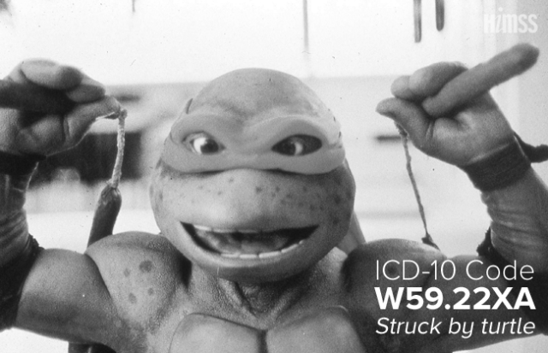
Transition
W59.22XA
Struck by Turtle

Slide 18
Coding Analysis (Each practice to determine best way to analyze this information.)
How many codes are we actually talking about?
Pulled reports for the last 2 years for each doctor individually.
Sorted each report from most commonly used to least commonly used codes.
Highlighted each doctor’s coding analysis by the following:
Top 80% used = green
Top 80%-90% = blue
Top 90% - Top 50 codes used = pink
Most doctors had under 50 codes that were their “top used” codes.
Gave us an idea of what each doctor uses so we are prepared for the transition.

Slide 19
EMR Changes
How has your EMR company transitioned to ICD-10?
Start the transition sooner rather than later so that the changes are easier once October 1st is here.
Does the EMR company provide any training (webinars, handouts, on-site, etc.)?
How will your staff and doctors be aware of the changes?

Slide 20
Staff Training
Billing
Surgery Scheduling
Clinic Coordinators
Technicians
Scribes
Front Desk
Call Center

Slide 21
The Transition Plan
Weekly communication to all staff with announcements
In-person meetings to introduce all staff to ICD-10
“Super-User” team consisting of technicians and scribes that will learn more and be the “go-to” staff members during the transition

Slide 22
Specialty-Specific
W56.41
Bitten by Shark

Slide 23
Cataracts H25 – H28 Codes
Coded per eye.
Changed wording from senile to mature.
Cause of cataract needs to be coded if secondary to drug or other disorder.
If coding traumatic cataract, need to list external cause of cataract as well (see trauma slide).

Slide 24
Cornea H15 – H22 Codes
Unspecified codes will now be replaced with specific disorder codes, per eye (in most cases).
For example, Corneal Ulcer (unsp.) – 370.00 – will now be coded with specifics as to location (central), type (perforated), and eye.
Corneal problems caused by external causes will need codes specifying HOW the injury happened.

Slide 25
Diabetes E11 Codes
Type II will need to be coded with insulin use.
250.00 has a 1-to-1 match with E11.9
Instead of coding 250.50 with NPDR/PDR/CSME code(s), each of these combinations now has its own code
Type II diabetes with moderate NPDR with macular edema (previously 3 separate codes) is now E11.321.
Also need to code Z79.4 for Insulin use.

Slide 26
Eyelid, Lacrimal, Orbit H00 – H05 Codes
Codes are split up per eye and/or lid
Lid-Specific
1 – RUL
2 – RLL
3 – Right unspecified lid
4 – LUL
5 – LLL
6 – Left unspecified lid
9 – unspecified eye and lid

Slide 27
Glaucoma H40 – H42 Codes
Some glaucoma diagnoses are coded per eye, some are coded by severity, and some are coded using BOTH.
Glaucoma associated with ocular inflammation is coded by eye AND severity, splitting this one code (365.62) into 15 possible codes.
If severity is worse in one eye than the other, but there isn’t a lateral code, then two codes should be given, the most severe first.
Glaucoma caused by medication use will also need additional code for adverse effect to identify the drug.

Slide 28
Post-Operative Coding H59 Codes
Post-operative (following cataract surgery) diagnoses will be different than pre-0perative.
Bullous keratopathy, right eye – H18.11
Post-operative bullous keratopathy, right eye – H59.011
CME not occurring after cataract surgery, right eye – H35.351
CME following cataract surgery, right eye – H59.031

Slide 29
Retina H30 – H36 Codes
Most are coded per eye or have direct 1-to-1 matches.
Detachment is now considered a “break” in ICD-10 language.
Diagnoses caused by injuries will have to be coded using external cause codes.
Plaquenil use can be coded for previous, current, and/or long-term use.

Slide 30
Trauma S00 – T88 Codes
External causes of injuries will be the most difficult to code as you will need to identify:
The injury
place of occurrence
Activity
status.
This will not just be coding major trauma but also corneal abrasions, traumatic cataracts, etc.

Slide 31
Trauma, continued…
Corneal abrasion will need the following:
Injury (corneal abrasion)
Place injury happened (park, work, etc.)
Activity (working, playing sports, etc.)
Status (student, military, etc.)
7th Character indicating initial or subsequent encounter

Slide 32
For Example
From Community Visionary Health Group:
A 10 year old male presents to the emergency room after being hit in the eye with a baseball. He was playing baseball at the local public park after school. After examination, the physician indicates a closed orbital floor fracture.
This scenario requires 4 codes.

Slide 33
Example, continued…
A 10 year old male presents to the emergency room after being hit in the eye with a baseball. He was playing baseball at the local public park after school. After examination, the physician indicates a closed orbital floor fracture.
S02.3XXA – Fracture of orbital floor, initial encounter
W21.03XA – Struck by baseball, initial encounter
Y92.830 – Public park as place of occurrence
Y99.8 – Other external cause status (not a student or at work, etc.)

Slide 34
EMR Changes
Z73.4
Inadequate social skills

Slide 35
New EMN Specifically for Trauma
Make new EMR forms for trauma with all questions needed to be asked
Questions needed will be free-text with a note to Billing to code for:
Injury (corneal abrasion)
Place injury happened (park, work, etc.)
Activity (working, playing sports, etc.)
Status (student, military, etc.)
Techs will need to ask these questions for the exam to be billed appropriately.

Slide 36
Diabetics
Will need to document medication use at every visit.
Make new diabetic history box in EMR that asks specific medication use and history.
Techs will need to ask these questions for the exam to be billed appropriately.

Slide 37
Surgical Billing
Option 1:
Create new surgical billing sheets including ICD-10 codes.
Option 2:
Start using Intraoperative Note in EMR for all surgical billing.
During or after surgery

Slide 38
Learning More
R06.5
Habitual Mouth Breathing

Slide 39
More Information
Billing staff has ICD-10 coding books and the following:
Fee sheets with ICD-10 codes
AAO find a code online
AAPC Top 50 Ophthalmology Codes cheat sheets
AGS Quick coding tips

Slide 40
Apps and Websites
https://www.findacode.com/
Works by code and by name of disease
ICD10stat
AAPC Code translator
www.aapc.com/icd-10/codes/index.aspx
www.icd10data.com
cms.gov/icd10 -- electronic version of ICD 10
aapc.com
ahima.org
cdc.gov/nchs/icd.htm
who.int/en/
AAO has an entire section of their site dedicated to ICD-10

Slide 41
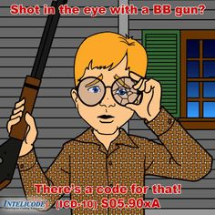
Next Steps
S05.90XA
Shot in the Eye With a BB Gun

Slide 42
What do we do next?
Who will help each doctor with the transition? (Tech, scribe)
Meet with doctors individually to go over unspecified codes for further details.
Think about the EMR changes and how to make the transition easy.
Think about your own training and transition plan – what can we do to help? What do you need? When can we do this?

Slide 43
Go-Live Week
End clinic early (or cut back a little).
Gives doctors time at the end of the day to go back to anything they could not finish.
Make sure all coding is complete.
Have billers and super users available to help all week.

Slide 44
Weeks Following Go-Live
Monitor denials
Track and report on them
Teach doctors and scribes what they are doing wrong
Make any necessary EMR changes

Slide 45
Thank You!

Slide 46
Picture References
Giraffe
www.buzzfeed.com
Water Skis / Turtle / Shark / Darth Vader / Cow Bell
http://blog.himss.org/2014/09/18/10-ways-to-relate-icd10-nhitweek/
Bizarre Personal Appearance / Social Skills
http://www.icd10illustrated.com/
BB Gun (Christmas Story)
www.pinterest.com

