Slide 1
Q
Pediatric Pre-Septal Cellulitis
Common occurrence, or rare?

Slide 2
A
Pediatric Pre-Septal Cellulitis
Common occurrence, or rare? Common

Slide 3
Q
Pediatric Pre-Septal Cellulitis
Common occurrence, or rare? Common
Presentation: Eyelid edema and erythema

Slide 4
A
Pediatric Pre-Septal Cellulitis
Common occurrence, or rare? Common
Presentation: Eyelid edema and erythema

Slide 5
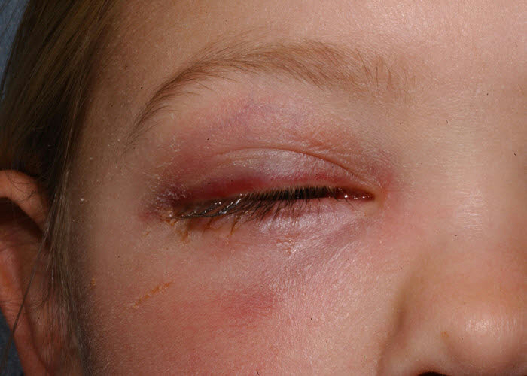
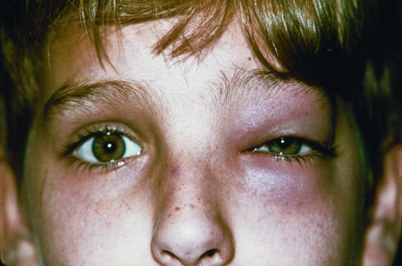
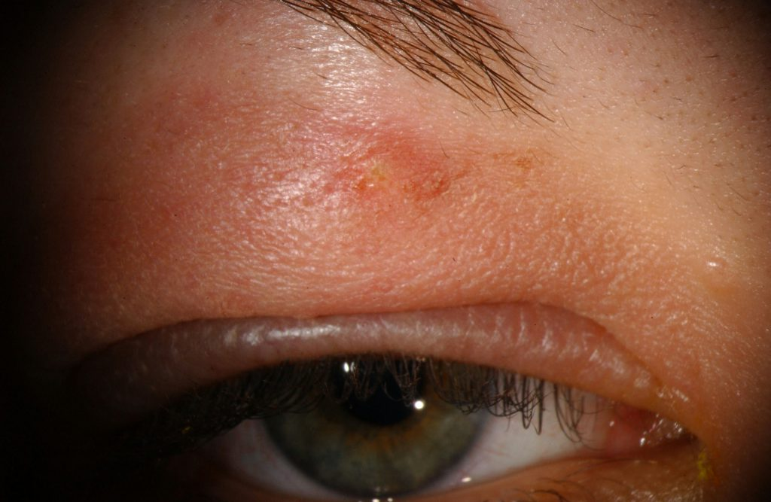
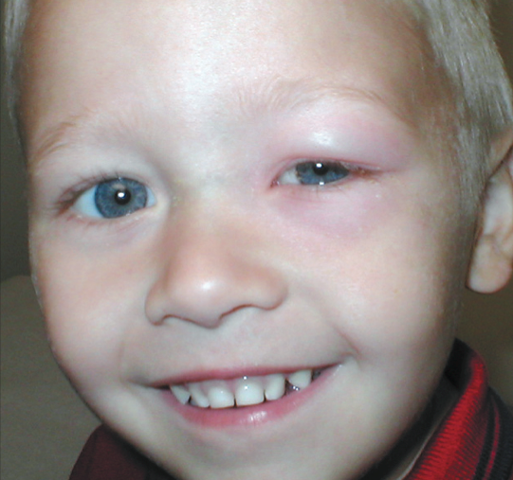
Pre-septal cellulitis

Slide 6
Q
Pediatric Pre-Septal Cellulitis
Common occurrence, or rare? Common
Presentation: Eyelid edema and erythema
Can the edema spread to the forehead?

Slide 7
A
Pediatric Pre-Septal Cellulitis
Common occurrence, or rare? Common
Presentation: Eyelid edema and erythema
Can the edema spread to the forehead? Yes

Slide 8
Q
Pediatric Pre-Septal Cellulitis
Common occurrence, or rare? Common
Presentation: Eyelid edema and erythema
Can the edema spread to the forehead? Yes
Can it spread to the lids of the fellow eye?

Slide 9
A
Pediatric Pre-Septal Cellulitis
Common occurrence, or rare? Common
Presentation: Eyelid edema and erythema
Can the edema spread to the forehead? Yes
Can it spread to the lids of the fellow eye? Yes

Slide 10
Q
Pediatric Pre-Septal Cellulitis
Common occurrence, or rare? Common
Presentation: Eyelid edema and erythema
Pertinent negatives on exam:
?
?
?

Slide 11
Q/A
Pediatric Pre-Septal Cellulitis
Common occurrence, or rare? Common
Presentation: Eyelid edema and erythema
Pertinent negatives on exam:
No proptosis
No limitations of, or pain with, ocular motility
No change in vision

Slide 12
A
Pediatric Pre-Septal Cellulitis
Common occurrence, or rare? Common
Presentation: Eyelid edema and erythema
Pertinent negatives on exam:
No proptosis
No limitations of, or pain with, ocular motility
No change in vision

Slide 13
Q
Pediatric Pre-Septal Cellulitis
Three common mechanisms:
1) Post-skin break
2) 2º to ocular/periocular infection:
conjunctivitis
impetigo
zoster
3) 2º to respiratory-related infection

Slide 14
Q/A
Pediatric Pre-Septal Cellulitis
Three common mechanisms:
1) Post-skin break
2) 2º to ocular/periocular infection:
conjunctivitis
impetigo
zoster
3) 2º to respiratory-related infection
Post…(two words)
two/words
two-words

Slide 15
A
Pediatric Pre-Septal Cellulitis
Three common mechanisms:
1) Post-skin break
2) 2º to ocular/periocular infection:
conjunctivitis
impetigo
zoster
3) 2º to respiratory-related infection

Slide 16
Q
Pediatric Pre-Septal Cellulitis
Three common mechanisms:
1) Post-skin break
2) 2º to ocular/periocular infection:
conjunctivitis
impetigo
zoster
3) 2º to respiratory-related infection
What sort of events qualify as a ‘skin break’?
Penetrating trauma (duh), but also insect bites, scrapes, scratches, etc
Very generally speaking, which bugs are involved in pre-septal cellulitis 2ndry to a break in the skin?
Skin flora

Slide 17
A
Pediatric Pre-Septal Cellulitis
Three common mechanisms:
1) Post-skin break
2) 2º to ocular/periocular infection:
conjunctivitis
impetigo
zoster
3) 2º to respiratory-related infection
What sort of events qualify as a ‘skin break’?
Penetrating trauma (duh), but also insect bites, scrapes, scratches, etc
Very generally speaking, which bugs are involved in pre-septal cellulitis 2ndry to a break in the skin?
Skin flora

Slide 18
Pre-septal cellulitis 2ndry to insect bite

Slide 19
Q
Pediatric Pre-Septal Cellulitis
Three common mechanisms:
1) Post-skin break
2) 2º to ocular/periocular infection:
conjunctivitis
impetigo
zoster
3) 2º to respiratory-related infection
What sort of events qualify as a ‘skin break’?
Penetrating trauma (duh), but also insect bites, scrapes, scratches, etc
Very generally speaking, which bugs are involved in pre-septal cellulitis 2ndry to a break in the skin?
Skin flora

Slide 20
A
Pediatric Pre-Septal Cellulitis
Three common mechanisms:
1) Post-skin break
2) 2º to ocular/periocular infection:
conjunctivitis
impetigo
zoster
3) 2º to respiratory-related infection
What sort of events qualify as a ‘skin break’?
Penetrating trauma (duh), but also insect bites, scrapes, scratches, etc
Very generally speaking, which bugs are involved in pre-septal cellulitis 2ndry to a break in the skin?
Skin flora

Slide 21
Q
Pediatric Pre-Septal Cellulitis
Three common mechanisms:
1) Post-skin break
2) 2º to ocular/periocular infection:
conjunctivitis
impetigo
zoster
3) 2º to respiratory-related infection
What sort of events qualify as a ‘skin break’?
Penetrating trauma (duh), but also insect bites, scrapes, scratches, etc
Very generally speaking, which bugs are involved in pre-septal cellulitis 2ndry to a break in the skin?
Skin flora
Which two skin-flora bugs are most likely to be implicated?
Staph and Strep species

Slide 22
A
Pediatric Pre-Septal Cellulitis
Three common mechanisms:
1) Post-skin break
2) 2º to ocular/periocular infection:
conjunctivitis
impetigo
zoster
3) 2º to respiratory-related infection
What sort of events qualify as a ‘skin break’?
Penetrating trauma (duh), but also insect bites, scrapes, scratches, etc
Very generally speaking, which bugs are involved in pre-septal cellulitis 2ndry to a break in the skin?
Skin flora
Which two skin-flora bugs are most likely to be implicated?
Staph and Strep species

Slide 23
Q
Pediatric Pre-Septal Cellulitis
Three common mechanisms:
1) Post-skin break
2) 2º to ocular/periocular infection:
conjunctivitis
impetigo
zoster
3) 2º to respiratory-related infection
common Peds infection 1
common Peds infections 2&3
common Peds infection 4

Slide 24
A
Pediatric Pre-Septal Cellulitis
Three common mechanisms:
1) Post-skin break
2) 2º to ocular/periocular infection:
Conjunctivitis
Impetigo; zoster
Stye
3) 2º to respiratory-related infection

Slide 25
Q
Pediatric Pre-Septal Cellulitis
Three common mechanisms:
1) Post-skin break
2) 2º to ocular/periocular infection:
Conjunctivitis
Impetigo; zoster
Stye
3) 2º to respiratory-related infection
Is the conjunctivitis viral, or bacterial?
It can be either

Slide 26
A
Pediatric Pre-Septal Cellulitis
Three common mechanisms:
1) Post-skin break
2) 2º to ocular/periocular infection:
Conjunctivitis
Impetigo; zoster
Stye
3) 2º to respiratory-related infection
Is the conjunctivitis viral, or bacterial?
It can be either

Slide 27
Q
Pediatric Pre-Septal Cellulitis
Three common mechanisms:
1) Post-skin break
2) 2º to ocular/periocular infection:
Conjunctivitis
Impetigo; zoster
Stye
3) 2º to respiratory-related infection
Which specific viral conjunctivitis is the classic cause?
Epidemic keratoconjunctivitis (EKC)
Is the conjunctivitis viral, or bacterial?
It can be either

Slide 28
A
Pediatric Pre-Septal Cellulitis
Three common mechanisms:
1) Post-skin break
2) 2º to ocular/periocular infection:
Conjunctivitis
Impetigo; zoster
Stye
3) 2º to respiratory-related infection
Which specific viral conjunctivitis is the classic cause?
Epidemic keratoconjunctivitis (EKC)
Is the conjunctivitis viral, or bacterial?
It can be either

Slide 29
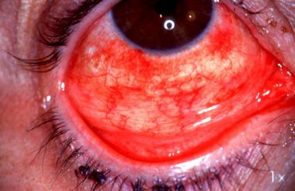
EKC

Slide 30
Q
Pediatric Pre-Septal Cellulitis
Three common mechanisms:
1) Post-skin break
2) 2º to ocular/periocular infection:
Conjunctivitis
Impetigo; zoster
Stye
3) 2º to respiratory-related infection
Which specific viral conjunctivitis is the classic cause?
Epidemic keratoconjunctivitis (EKC)
Is the conjunctivitis viral, or bacterial?
It can be either
Which specific bacterial conjunctivitis is the classic cause?
MRSA

Slide 31
A
Pediatric Pre-Septal Cellulitis
Three common mechanisms:
1) Post-skin break
2) 2º to ocular/periocular infection:
Conjunctivitis
Impetigo; zoster
Stye
3) 2º to respiratory-related infection
Which specific viral conjunctivitis is the classic cause?
Epidemic keratoconjunctivitis (EKC)
Is the conjunctivitis viral, or bacterial?
It can be either
Which specific bacterial conjunctivitis is the classic cause?
MRSA

Slide 32
Q
Pediatric Pre-Septal Cellulitis
Three common mechanisms:
1) Post-skin break
2) 2º to ocular/periocular infection:
Conjunctivitis
Impetigo; zoster
Stye
3) 2º to respiratory-related infection
Which specific viral conjunctivitis is the classic cause?
Epidemic keratoconjunctivitis (EKC)
What sort of virus (ie, which family) is responsible for EKC?
It is an adenovirus
In terms of its presentation, is EKC…
…associated with an URTI, or fever, HA & pharyngitis? URTI
…unilateral, or bilateral? Bilateral (by day 7 or so)
…follicular, or papillary? Follicular
…caused by serotypes 3&7, or by 8, 19 & 37? 8, 19 & 37
…associated with a significant corneal complication? Yes
…associated with lymphadenopathy? Yes
Is the conjunctivitis viral, or bacterial?
It can be either
Which specific bacterial conjunctivitis is the classic cause?
MRSA

Slide 33
A
Pediatric Pre-Septal Cellulitis
Three common mechanisms:
1) Post-skin break
2) 2º to ocular/periocular infection:
Conjunctivitis
Impetigo; zoster
Stye
3) 2º to respiratory-related infection
Which specific viral conjunctivitis is the classic cause?
Epidemic keratoconjunctivitis (EKC)
What sort of virus (ie, which family) is responsible for EKC?
It is an adenovirus
In terms of its presentation, is EKC…
…associated with an URTI, or fever, HA & pharyngitis? URTI
…unilateral, or bilateral? Bilateral (by day 7 or so)
…follicular, or papillary? Follicular
…caused by serotypes 3&7, or by 8, 19 & 37? 8, 19 & 37
…associated with a significant corneal complication? Yes
…associated with lymphadenopathy? Yes
Is the conjunctivitis viral, or bacterial?
It can be either
Which specific bacterial conjunctivitis is the classic cause?
MRSA

Slide 34
Q
Pediatric Pre-Septal Cellulitis
Three common mechanisms:
1) Post-skin break
2) 2º to ocular/periocular infection:
Conjunctivitis
Impetigo; zoster
Stye
3) 2º to respiratory-related infection
Which specific viral conjunctivitis is the classic cause?
Epidemic keratoconjunctivitis (EKC)
What sort of virus (ie, which family) is responsible for EKC?
It is an adenovirus
In terms of its presentation, is EKC…
…associated with an URTI, or fever, HA & pharyngitis? URTI
…unilateral, or bilateral? Bilateral (by day 7 or so)
…follicular, or papillary? Follicular
…caused by serotypes 3&7, or by 8, 19 & 37? 8, 19 & 37
…associated with a significant corneal complication? Yes
…associated with lymphadenopathy? Yes
Is the conjunctivitis viral, or bacterial?
It can be either
Which specific bacterial conjunctivitis is the classic cause?
MRSA

Slide 35
A
Pediatric Pre-Septal Cellulitis
Three common mechanisms:
1) Post-skin break
2) 2º to ocular/periocular infection:
Conjunctivitis
Impetigo; zoster
Stye
3) 2º to respiratory-related infection
Which specific viral conjunctivitis is the classic cause?
Epidemic keratoconjunctivitis (EKC)
What sort of virus (ie, which family) is responsible for EKC?
It is an adenovirus
In terms of its presentation, is EKC…
…associated with an URTI, or fever, HA & pharyngitis? URTI
…unilateral, or bilateral? Bilateral (by day 7 or so)
…follicular, or papillary? Follicular
…caused by serotypes 3&7, or by 8, 19 & 37? 8, 19 & 37
…associated with a significant corneal complication? Yes
…associated with lymphadenopathy? Yes
Is the conjunctivitis viral, or bacterial?
It can be either
Which specific bacterial conjunctivitis is the classic cause?
MRSA

Slide 36
Q
Pediatric Pre-Septal Cellulitis
Three common mechanisms:
1) Post-skin break
2) 2º to ocular/periocular infection:
Conjunctivitis
Impetigo; zoster
Stye
3) 2º to respiratory-related infection
Which specific viral conjunctivitis is the classic cause?
Epidemic keratoconjunctivitis (EKC)
What sort of virus (ie, which family) is responsible for EKC?
It is an adenovirus
In terms of its presentation, is EKC…
…associated with an URTI, or fever, HA & pharyngitis? URTI
…unilateral, or bilateral? Bilateral (by day 7 or so)
…follicular, or papillary? Follicular
…caused by serotypes 3&7, or by 8, 19 & 37? 8, 19 & 37
…associated with a significant corneal complication? Yes
…associated with lymphadenopathy? Yes
Is the conjunctivitis viral, or bacterial?
It can be either
Which specific bacterial conjunctivitis is the classic cause?
MRSA

Slide 37
A
Pediatric Pre-Septal Cellulitis
Three common mechanisms:
1) Post-skin break
2) 2º to ocular/periocular infection:
Conjunctivitis
Impetigo; zoster
Stye
3) 2º to respiratory-related infection
Which specific viral conjunctivitis is the classic cause?
Epidemic keratoconjunctivitis (EKC)
What sort of virus (ie, which family) is responsible for EKC?
It is an adenovirus
In terms of its presentation, is EKC…
…associated with an URTI, or fever, HA & pharyngitis? URTI
…unilateral, or bilateral? Bilateral (by day 7 or so)
…follicular, or papillary? Follicular
…caused by serotypes 3&7, or by 8, 19 & 37? 8, 19 & 37
…associated with a significant corneal complication? Yes
…associated with lymphadenopathy? Yes
Is the conjunctivitis viral, or bacterial?
It can be either
Which specific bacterial conjunctivitis is the classic cause?
MRSA

Slide 38
Q
Pediatric Pre-Septal Cellulitis
Three common mechanisms:
1) Post-skin break
2) 2º to ocular/periocular infection:
Conjunctivitis
Impetigo; zoster
Stye
3) 2º to respiratory-related infection
Which specific viral conjunctivitis is the classic cause?
Epidemic keratoconjunctivitis (EKC)
What sort of virus (ie, which family) is responsible for EKC?
It is an adenovirus
In terms of its presentation, is EKC…
…associated with an URTI, or fever, HA & pharyngitis? URTI
…unilateral, or bilateral? Bilateral (by day 7 or so)
…follicular, or papillary? Follicular
…caused by serotypes 3&7, or by 8, 19 & 37? 8, 19 & 37
…associated with a significant corneal complication? Yes
…associated with lymphadenopathy? Yes
Is the conjunctivitis viral, or bacterial?
It can be either
Which specific bacterial conjunctivitis is the classic cause?
MRSA

Slide 39
A
Pediatric Pre-Septal Cellulitis
Three common mechanisms:
1) Post-skin break
2) 2º to ocular/periocular infection:
Conjunctivitis
Impetigo; zoster
Stye
3) 2º to respiratory-related infection
Which specific viral conjunctivitis is the classic cause?
Epidemic keratoconjunctivitis (EKC)
What sort of virus (ie, which family) is responsible for EKC?
It is an adenovirus
In terms of its presentation, is EKC…
…associated with an URTI, or fever, HA & pharyngitis? URTI
…unilateral, or bilateral? Bilateral (by day 7 or so)
…follicular, or papillary? Follicular
…caused by serotypes 3&7, or by 8, 19 & 37? 8, 19 & 37
…associated with a significant corneal complication? Yes
…associated with lymphadenopathy? Yes
Is the conjunctivitis viral, or bacterial?
It can be either
Which specific bacterial conjunctivitis is the classic cause?
MRSA

Slide 40
Q
Pediatric Pre-Septal Cellulitis
Three common mechanisms:
1) Post-skin break
2) 2º to ocular/periocular infection:
Conjunctivitis
Impetigo; zoster
Stye
3) 2º to respiratory-related infection
Which specific viral conjunctivitis is the classic cause?
Epidemic keratoconjunctivitis (EKC)
What sort of virus (ie, which family) is responsible for EKC?
It is an adenovirus
In terms of its presentation, is EKC…
…associated with an URTI, or fever, HA & pharyngitis? URTI
…unilateral, or bilateral? Bilateral (by day 7 or so)
…follicular, or papillary? Follicular
…caused by serotypes 3&7, or by 8, 19 & 37? 8, 19 & 37
…associated with a significant corneal complication? Yes
…associated with lymphadenopathy? Yes
Is the conjunctivitis viral, or bacterial?
It can be either
Which specific bacterial conjunctivitis is the classic cause?
MRSA

Slide 41
A
Pediatric Pre-Septal Cellulitis
Three common mechanisms:
1) Post-skin break
2) 2º to ocular/periocular infection:
Conjunctivitis
Impetigo; zoster
Stye
3) 2º to respiratory-related infection
Which specific viral conjunctivitis is the classic cause?
Epidemic keratoconjunctivitis (EKC)
What sort of virus (ie, which family) is responsible for EKC?
It is an adenovirus
In terms of its presentation, is EKC…
…associated with an URTI, or fever, HA & pharyngitis? URTI
…unilateral, or bilateral? Bilateral (by day 7 or so)
…follicular, or papillary? Follicular
…caused by serotypes 3&7, or by 8, 19 & 37? 8, 19 & 37
…associated with a significant corneal complication? Yes
…associated with lymphadenopathy? Yes
Is the conjunctivitis viral, or bacterial?
It can be either
Which specific bacterial conjunctivitis is the classic cause?
MRSA

Slide 42
Q
Pediatric Pre-Septal Cellulitis
Three common mechanisms:
1) Post-skin break
2) 2º to ocular/periocular infection:
Conjunctivitis
Impetigo; zoster
Stye
3) 2º to respiratory-related infection
Which specific viral conjunctivitis is the classic cause?
Epidemic keratoconjunctivitis (EKC)
What sort of virus (ie, which family) is responsible for EKC?
It is an adenovirus
In terms of its presentation, is EKC…
…associated with an URTI, or fever, HA & pharyngitis? URTI
…unilateral, or bilateral? Bilateral (by day 7 or so)
…follicular, or papillary? Follicular
…caused by serotypes 3&7, or by 8, 19 & 37? 8, 19 & 37
…associated with a significant corneal complication? Yes
…associated with lymphadenopathy? Yes
Is the conjunctivitis viral, or bacterial?
It can be either
Which specific bacterial conjunctivitis is the classic cause?
MRSA

Slide 43
A
Pediatric Pre-Septal Cellulitis
Three common mechanisms:
1) Post-skin break
2) 2º to ocular/periocular infection:
Conjunctivitis
Impetigo; zoster
Stye
3) 2º to respiratory-related infection
Which specific viral conjunctivitis is the classic cause?
Epidemic keratoconjunctivitis (EKC)
What sort of virus (ie, which family) is responsible for EKC?
It is an adenovirus
In terms of its presentation, is EKC…
…associated with an URTI, or fever, HA & pharyngitis? URTI
…unilateral, or bilateral? Bilateral (by day 7 or so)
…follicular, or papillary? Follicular
…caused by serotypes 3&7, or by 8, 19 & 37? 8, 19 & 37
…associated with a significant corneal complication? Yes
…associated with lymphadenopathy? Yes
Is the conjunctivitis viral, or bacterial?
It can be either
Which specific bacterial conjunctivitis is the classic cause?
MRSA

Slide 44
Q
Pediatric Pre-Septal Cellulitis
Three common mechanisms:
1) Post-skin break
2) 2º to ocular/periocular infection:
Conjunctivitis
Impetigo; zoster
Stye
3) 2º to respiratory-related infection
Which specific viral conjunctivitis is the classic cause?
Epidemic keratoconjunctivitis (EKC)
What sort of virus (ie, which family) is responsible for EKC?
It is an adenovirus
In terms of its presentation, is EKC…
…associated with an URTI, or fever, HA & pharyngitis? URTI
…unilateral, or bilateral? Bilateral (by day 7 or so)
…follicular, or papillary? Follicular
…caused by serotypes 3&7, or by 8, 19 & 37? 8, 19 & 37
…associated with a significant corneal complication? Yes
…associated with lymphadenopathy? Yes
Is the conjunctivitis viral, or bacterial?
It can be either
Which specific bacterial conjunctivitis is the classic cause?
MRSA

Slide 45
A
Pediatric Pre-Septal Cellulitis
Three common mechanisms:
1) Post-skin break
2) 2º to ocular/periocular infection:
Conjunctivitis
Impetigo; zoster
Stye
3) 2º to respiratory-related infection
Which specific viral conjunctivitis is the classic cause?
Epidemic keratoconjunctivitis (EKC)
What sort of virus (ie, which family) is responsible for EKC?
It is an adenovirus
In terms of its presentation, is EKC…
…associated with an URTI, or fever, HA & pharyngitis? URTI
…unilateral, or bilateral? Bilateral (by day 7 or so)
…follicular, or papillary? Follicular
…caused by serotypes 3&7, or by 8, 19 & 37? 8, 19 & 37
…associated with a significant corneal complication? Yes
…associated with lymphadenopathy? Yes
Is the conjunctivitis viral, or bacterial?
It can be either
Which specific bacterial conjunctivitis is the classic cause?
MRSA

Slide 46
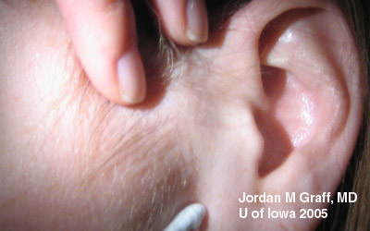
EKC: Preauricular lymphadenopathy

Slide 47
Q
Pediatric Pre-Septal Cellulitis
Three common mechanisms:
1) Post-skin break
2) 2º to ocular/periocular infection:
Conjunctivitis
Impetigo; zoster
Stye
3) 2º to respiratory-related infection
Which specific viral conjunctivitis is the classic cause?
Epidemic keratoconjunctivitis (EKC)
What sort of virus (ie, which family) is responsible for EKC?
It is an adenovirus
In terms of its presentation, is EKC…
…associated with an URTI, or fever, HA & pharyngitis? URTI
…unilateral, or bilateral? Bilateral (by day 7 or so)
…follicular, or papillary? Follicular
…caused by serotypes 3&7, or by 8, 19 & 37? 8, 19 & 37
…associated with a significant corneal complication? Yes
…associated with lymphadenopathy? Yes
Is the conjunctivitis viral, or bacterial?
It can be either
Which specific bacterial conjunctivitis is the classic cause?
MRSA
What is the ‘significant corneal finding’ associated with EKC?
Subepithelial infiltrates (SEIs)
In what sense are they significant?
They can cause discomfort and decreased acuity, and can persist for years

Slide 48
A
Pediatric Pre-Septal Cellulitis
Three common mechanisms:
1) Post-skin break
2) 2º to ocular/periocular infection:
Conjunctivitis
Impetigo; zoster
Stye
3) 2º to respiratory-related infection
Which specific viral conjunctivitis is the classic cause?
Epidemic keratoconjunctivitis (EKC)
What sort of virus (ie, which family) is responsible for EKC?
It is an adenovirus
In terms of its presentation, is EKC…
…associated with an URTI, or fever, HA & pharyngitis? URTI
…unilateral, or bilateral? Bilateral (by day 7 or so)
…follicular, or papillary? Follicular
…caused by serotypes 3&7, or by 8, 19 & 37? 8, 19 & 37
…associated with a significant corneal complication? Yes
…associated with lymphadenopathy? Yes
Is the conjunctivitis viral, or bacterial?
It can be either
Which specific bacterial conjunctivitis is the classic cause?
MRSA
What is the ‘significant corneal finding’ associated with EKC?
Subepithelial infiltrates (SEIs)
In what sense are they significant?
They can cause discomfort and decreased acuity, and can persist for years

Slide 49
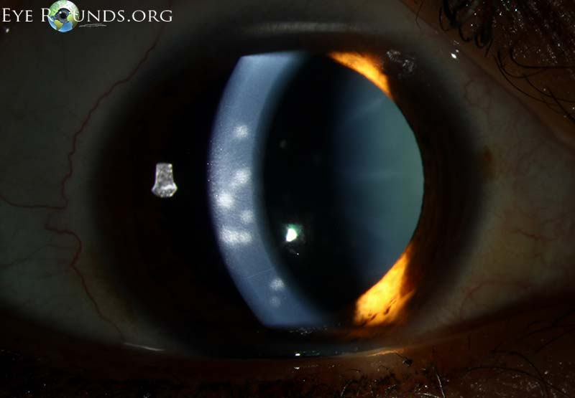
EKC: Subepithelial infiltrates

Slide 50
Q
Pediatric Pre-Septal Cellulitis
Three common mechanisms:
1) Post-skin break
2) 2º to ocular/periocular infection:
Conjunctivitis
Impetigo; zoster
Stye
3) 2º to respiratory-related infection
Which specific viral conjunctivitis is the classic cause?
Epidemic keratoconjunctivitis (EKC)
What sort of virus (ie, which family) is responsible for EKC?
It is an adenovirus
In terms of its presentation, is EKC…
…associated with an URTI, or fever, HA & pharyngitis? URTI
…unilateral, or bilateral? Bilateral (by day 7 or so)
…follicular, or papillary? Follicular
…caused by serotypes 3&7, or by 8, 19 & 37? 8, 19 & 37
…associated with a significant corneal complication? Yes
…associated with lymphadenopathy? Yes
Is the conjunctivitis viral, or bacterial?
It can be either
Which specific bacterial conjunctivitis is the classic cause?
MRSA
What is the ‘significant corneal finding’ associated with EKC?
Subepithelial infiltrates (SEIs)
In what sense are they significant?
They can cause discomfort and decreased acuity, and can persist for years

Slide 51
Q/A
Pediatric Pre-Septal Cellulitis
Three common mechanisms:
1) Post-skin break
2) 2º to ocular/periocular infection:
Conjunctivitis
Impetigo; zoster
Stye
3) 2º to respiratory-related infection
Which specific viral conjunctivitis is the classic cause?
Epidemic keratoconjunctivitis (EKC)
What sort of virus (ie, which family) is responsible for EKC?
It is an adenovirus
In terms of its presentation, is EKC…
…associated with an URTI, or fever, HA & pharyngitis? URTI
…unilateral, or bilateral? Bilateral (by day 7 or so)
…follicular, or papillary? Follicular
…caused by serotypes 3&7, or by 8, 19 & 37? 8, 19 & 37
…associated with a significant corneal complication? Yes
…associated with lymphadenopathy? Yes
Is the conjunctivitis viral, or bacterial?
It can be either
Which specific bacterial conjunctivitis is the classic cause?
MRSA
What is the ‘significant corneal finding’ associated with EKC?
Subepithelial infiltrates (SEIs)
In what sense are they significant?
They can cause discomfort and decreased acuity, and can persist for years
unit of time

Slide 52
A
Pediatric Pre-Septal Cellulitis
Three common mechanisms:
1) Post-skin break
2) 2º to ocular/periocular infection:
Conjunctivitis
Impetigo; zoster
Stye
3) 2º to respiratory-related infection
Which specific viral conjunctivitis is the classic cause?
Epidemic keratoconjunctivitis (EKC)
What sort of virus (ie, which family) is responsible for EKC?
It is an adenovirus
In terms of its presentation, is EKC…
…associated with an URTI, or fever, HA & pharyngitis? URTI
…unilateral, or bilateral? Bilateral (by day 7 or so)
…follicular, or papillary? Follicular
…caused by serotypes 3&7, or by 8, 19 & 37? 8, 19 & 37
…associated with a significant corneal complication? Yes
…associated with lymphadenopathy? Yes
Is the conjunctivitis viral, or bacterial?
It can be either
Which specific bacterial conjunctivitis is the classic cause?
MRSA
What is the ‘significant corneal finding’ associated with EKC?
Subepithelial infiltrates (SEIs)
In what sense are they significant?
They can cause discomfort and decreased acuity, and can persist for years

Slide 53
Q
Pediatric Pre-Septal Cellulitis
Three common mechanisms:
1) Post-skin break
2) 2º to ocular/periocular infection:
Conjunctivitis
Impetigo; zoster
Stye
3) 2º to respiratory-related infection
Which specific viral conjunctivitis is the classic cause?
Epidemic keratoconjunctivitis (EKC)
What sort of virus (ie, which family) is responsible for EKC?
It is an adenovirus
In terms of its presentation, is EKC…
…associated with an URTI, or fever, HA & pharyngitis? URTI
…unilateral, or bilateral? Bilateral (by day 7 or so)
…follicular, or papillary? Follicular
…caused by serotypes 3&7, or by 8, 19 & 37? 8, 19 & 37
…associated with a significant corneal complication? Yes
…associated with lymphadenopathy? Yes
Is the conjunctivitis viral, or bacterial?
It can be either
What condition, caused by adenovirus serotypes 3 and 7, presents with conjunctivitis, fever, HA and pharyngitis?
Pharyngoconjunctival fever (PCF)
Which specific bacterial conjunctivitis is the classic cause?
MRSA

Slide 54
A
Pediatric Pre-Septal Cellulitis
Three common mechanisms:
1) Post-skin break
2) 2º to ocular/periocular infection:
Conjunctivitis
Impetigo; zoster
Stye
3) 2º to respiratory-related infection
Which specific viral conjunctivitis is the classic cause?
Epidemic keratoconjunctivitis (EKC)
What sort of virus (ie, which family) is responsible for EKC?
It is an adenovirus
In terms of its presentation, is EKC…
…associated with an URTI, or fever, HA & pharyngitis? URTI
…unilateral, or bilateral? Bilateral (by day 7 or so)
…follicular, or papillary? Follicular
…caused by serotypes 3&7, or by 8, 19 & 37? 8, 19 & 37
…associated with a significant corneal complication? Yes
…associated with lymphadenopathy? Yes
Is the conjunctivitis viral, or bacterial?
It can be either
What condition, caused by adenovirus serotypes 3 and 7, presents with conjunctivitis, fever, HA and pharyngitis?
Pharyngoconjunctival fever (PCF)
Which specific bacterial conjunctivitis is the classic cause?
MRSA

Slide 55
Q
Pediatric Pre-Septal Cellulitis
Three common mechanisms:
1) Post-skin break
2) 2º to ocular/periocular infection:
Conjunctivitis
Impetigo; zoster
Stye
3) 2º to respiratory-related infection:
URTI
sinusitis
infection 1
infection 2

Slide 56
A
Pediatric Pre-Septal Cellulitis
Three common mechanisms:
1) Post-skin break
2) 2º to ocular/periocular infection:
Conjunctivitis
Impetigo; zoster
Stye
3) 2º to respiratory-related infection:
URTI
sinusitis

Slide 57
Q
Pediatric Pre-Septal Cellulitis
Three common mechanisms:
1) Post-skin break
2) 2º to ocular/periocular infection:
Conjunctivitis
Impetigo; zoster
Stye
3) 2º to respiratory-related infection:
URTI
sinusitis
What are the two common bacteria involved?
1) Staph
2) Strep
What important bug must you consider?
H. flu
How should you go about ‘considering’ it?
By inquiring whether the child has been vaccinated against it

Slide 58
A
Pediatric Pre-Septal Cellulitis
Three common mechanisms:
1) Post-skin break
2) 2º to ocular/periocular infection:
Conjunctivitis
Impetigo; zoster
Stye
3) 2º to respiratory-related infection:
URTI
sinusitis
What are the two common bacteria involved?
1) Staph
2) Strep
What important bug must you consider?
H. flu
How should you go about ‘considering’ it?
By inquiring whether the child has been vaccinated against it

Slide 59
Q
Pediatric Pre-Septal Cellulitis
Three common mechanisms:
1) Post-skin break
2) 2º to ocular/periocular infection:
Conjunctivitis
Impetigo; zoster
Stye
3) 2º to respiratory-related infection:
URTI
sinusitis
What are the two common bacteria involved?
1) Staph
2) Strep
What other bacterium must also be considered?
H. flu
How should you go about ‘considering’ it?
By inquiring whether the child has been vaccinated against it

Slide 60
A
Pediatric Pre-Septal Cellulitis
Three common mechanisms:
1) Post-skin break
2) 2º to ocular/periocular infection:
Conjunctivitis
Impetigo; zoster
Stye
3) 2º to respiratory-related infection:
URTI
sinusitis
What are the two common bacteria involved?
1) Staph
2) Strep
What other bacterium must also be considered?
H flu
How should you go about ‘considering’ it?
By inquiring whether the child has been vaccinated against it

Slide 61
Q
Pediatric Pre-Septal Cellulitis
Three common mechanisms:
1) Post-skin break
2) 2º to ocular/periocular infection:
Conjunctivitis
Impetigo; zoster
Stye
3) 2º to respiratory-related infection:
URTI
sinusitis
What are the two common bacteria involved?
1) Staph
2) Strep
What other bacterium must also be considered?
H flu
How should you go about ‘considering’ it?
By inquiring whether the child has been vaccinated against it

Slide 62
A
Pediatric Pre-Septal Cellulitis
Three common mechanisms:
1) Post-skin break
2) 2º to ocular/periocular infection:
Conjunctivitis
Impetigo; zoster
Stye
3) 2º to respiratory-related infection:
URTI
sinusitis
What are the two common bacteria involved?
1) Staph
2) Strep
What other bacterium must also be considered?
H flu
How should you go about ‘considering’ it?
By inquiring whether the child has been vaccinated against it

Slide 63
Q
Pediatric Pre-Septal Cellulitis
Three common mechanisms:
1) Post-skin break
2) 2º to ocular/periocular infection:
Conjunctivitis
Impetigo; zoster
Stye
3) 2º to respiratory-related infection:
URTI
sinusitis
Some experts would argue that if an unmistakable precipitating event such as these isn’t readily identified, then a diagnosis of pre-septal cellulitis should not be made, and instead imaging should be pursued to rule out an orbital cellulitis

Slide 64
A
Pediatric Pre-Septal Cellulitis
Three common mechanisms:
1) Post-skin break
2) 2º to ocular/periocular infection:
Conjunctivitis
Impetigo; zoster
Stye
3) 2º to respiratory-related infection:
URTI
sinusitis
Some experts would argue that if an unmistakable precipitating event such as these isn’t readily identified, then a diagnosis of pre-septal cellulitis should not be made, and instead imaging should be pursued to rule out an orbital cellulitis

Slide 65
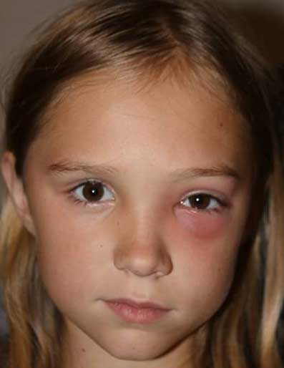
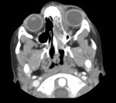
Orbital cellulitis misdiagnosed as pre-septal
https://webeye.ophth.uiowa.edu/eyeforum/cases/103-Pediatric-Orbital-Cellulitis.htm

Slide 66
Q
Pediatric Pre-Septal Cellulitis
Three common mechanisms:
1) Post-skin break
2) 2º to ocular/periocular infection:
Conjunctivitis
Impetigo; zoster
Stye
3) 2º to respiratory-related infection:
URTI
sinusitis
Treatment
Outpatient, PO abx if: >1 yr , nonsevere, no systemic signs
> age
additional finding

Slide 67
A
Pediatric Pre-Septal Cellulitis
Three common mechanisms:
1) Post-skin break
2) 2º to ocular/periocular infection:
Conjunctivitis
Impetigo; zoster
Stye
3) 2º to respiratory-related infection:
URTI
sinusitis
Treatment
Outpatient, PO abx if: >1 yr , nonsevere, no systemic signs

Slide 68
Q
Pediatric Pre-Septal Cellulitis
Three common mechanisms:
1) Post-skin break
2) 2º to ocular/periocular infection:
Conjunctivitis
Impetigo; zoster
Stye
3) 2º to respiratory-related infection:
URTI
sinusitis
Treatment
Outpatient, PO abx if: >1 yr , nonsevere, no systemic signs
Inpatient, IV abx and imaging if: <1 yr , severe, septic
< age
additional
finding

Slide 69
A
Pediatric Pre-Septal Cellulitis
Three common mechanisms:
1) Post-skin break
2) 2º to ocular/periocular infection:
Conjunctivitis
Impetigo; zoster
Stye
3) 2º to respiratory-related infection:
URTI
sinusitis
Treatment
Outpatient, PO abx if: >1 yr , nonsevere, no systemic signs
Inpatient, IV abx and imaging if: <1 yr , severe, septic

Slide 70
Pediatric Pre-Septal Cellulitis
Three common mechanisms:
1) Post-skin break
2) 2º to ocular/periocular infection:
Conjunctivitis
Impetigo; zoster
Stye
3) 2º to respiratory-related infection:
URTI
sinusitis
Treatment
Outpatient, PO abx if: >1 yr , nonsevere, no systemic signs
Inpatient, IV abx and imaging if: <1 yr , severe, septic
Note: Some clinicians prefer ‘2’ as the age cutoff for out- vs inpatient management
2 yr
2 yr

Slide 71
Q
Is it pre-septal cellulitis, or post-septal, ie, orbital cellulitis? The ability to reliably differentiate between the two is a must-have (both out in the real world as well as on the OKAP and Board exams). Several findings will clue you in one way or the other--identify them below!
Signs/Symptoms | Preseptal Cellulitis | Orbital Cellulitis
Proptosis | ? | ?
Lid edema | Yes | Yes
Red eye | Never | Yes
Lethargy | Can be present | Yes
Decreased visual function | Never | Usually
Fever | Can be present | Usually
Chemosis | Never | Usually
APD present | Never | Can be present
Elevated IOP | Never | Can be present
Pain with EOMs | Never | Usually
Limited motility | Never | Usually
APD present | Never | Can be present
Elevated IOP | Never | Can be present
Pain with EOMs | Never | Usually
Limited motility | Never | Usually

Slide 72
A
Is it pre-septal cellulitis, or post-septal, ie, orbital cellulitis? The ability to reliably differentiate between the two is a must-have (both out in the real world as well as on the OKAP and Board exams). Several findings will clue you in one way or the other--identify them below!
Signs/Symptoms | Preseptal Cellulitis | Orbital Cellulitis
Proptosis | Never | Usually
Lid edema | Yes | Yes
Red eye | Never | Yes
Lethargy | Can be present | Yes
Decreased visual function | Never | Usually
Fever | Can be present | Usually
Chemosis | Never | Usually
APD present | Never | Can be present
Elevated IOP | Never | Can be present
Pain with EOMs | Never | Usually
Limited motility | Never | Usually
APD present | Never | Can be present
Elevated IOP | Never | Can be present
Pain with EOMs | Never | Usually
Limited motility | Never | Usually

Slide 73
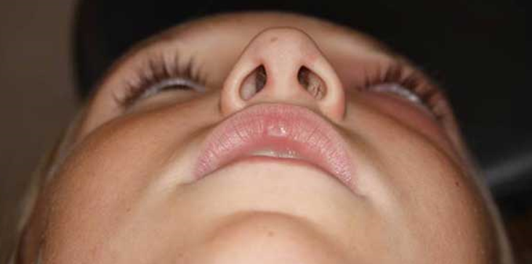
2 mm proptosis OS
Orbital cellulitis misdiagnosed as pre-septal
https://webeye.ophth.uiowa.edu/eyeforum/cases/103-Pediatric-Orbital-Cellulitis.htm

Slide 74
Q
Is it pre-septal cellulitis, or post-septal, ie, orbital cellulitis? The ability to reliably differentiate between the two is a must-have (both out in the real world as well as on the OKAP and Board exams). Several findings will clue you in one way or the other--identify them below!
Signs/Symptoms | Preseptal Cellulitis | Orbital Cellulitis
Proptosis | Never | Usually
Lid edema | ? | ?
Red eye | Never | Yes
Lethargy | Can be present | Yes
Decreased visual function | Never | Usually
Fever | Can be present | Usually
Chemosis | Never | Usually
APD present | Never | Can be present
Elevated IOP | Never | Can be present
Pain with EOMs | Never | Usually
Limited motility | Never | Usually
APD present | Never | Can be present
Elevated IOP | Never | Can be present
Pain with EOMs | Never | Usually
Limited motility | Never | Usually

Slide 75
A
Is it pre-septal cellulitis, or post-septal, ie, orbital cellulitis? The ability to reliably differentiate between the two is a must-have (both out in the real world as well as on the OKAP and Board exams). Several findings will clue you in one way or the other--identify them below!
Signs/Symptoms | Preseptal Cellulitis | Orbital Cellulitis
Proptosis | Never | Usually
Lid edema | Yes | Yes
Red eye | Never | Yes
Lethargy | Can be present | Yes
Decreased visual function | Never | Usually
Fever | Can be present | Usually
Chemosis | Never | Usually
APD present | Never | Can be present
Elevated IOP | Never | Can be present
Pain with EOMs | Never | Usually
Limited motility | Never | Usually
APD present | Never | Can be present
Elevated IOP | Never | Can be present
Pain with EOMs | Never | Usually
Limited motility | Never | Usually

Slide 76
Q
Is it pre-septal cellulitis, or post-septal, ie, orbital cellulitis? The ability to reliably differentiate between the two is a must-have (both out in the real world as well as on the OKAP and Board exams). Several findings will clue you in one way or the other--identify them below!
Signs/Symptoms | Preseptal Cellulitis | Orbital Cellulitis
Proptosis | Never | Usually
Lid edema | Yes | Yes
Red eye | ? | ?
Lethargy | Can be present | Yes
Decreased visual function | Never | Usually
Fever | Can be present | Usually
Chemosis | Never | Usually
APD present | Never | Can be present
Elevated IOP | Never | Can be present
Pain with EOMs | Never | Usually
Limited motility | Never | Usually
APD present | Never | Can be present
Elevated IOP | Never | Can be present
Pain with EOMs | Never | Usually
Limited motility | Never | Usually

Slide 77
A
Is it pre-septal cellulitis, or post-septal, ie, orbital cellulitis? The ability to reliably differentiate between the two is a must-have (both out in the real world as well as on the OKAP and Board exams). Several findings will clue you in one way or the other--identify them below!
Signs/Symptoms | Preseptal Cellulitis | Orbital Cellulitis
Proptosis | Never | Usually
Lid edema | Yes | Yes
Red eye | Never | Yes
Lethargy | Can be present | Yes
Decreased visual function | Never | Usually
Fever | Can be present | Usually
Chemosis | Never | Usually
APD present | Never | Can be present
Elevated IOP | Never | Can be present
Pain with EOMs | Never | Usually
Limited motility | Never | Usually
APD present | Never | Can be present
Elevated IOP | Never | Can be present
Pain with EOMs | Never | Usually
Limited motility | Never | Usually

Slide 78
Q
Is it pre-septal cellulitis, or post-septal, ie, orbital cellulitis? The ability to reliably differentiate between the two is a must-have (both out in the real world as well as on the OKAP and Board exams). Several findings will clue you in one way or the other--identify them below!
Signs/Symptoms | Preseptal Cellulitis | Orbital Cellulitis
Proptosis | Never | Usually
Lid edema | Yes | Yes
Red eye | Never | Yes
Lethargy | ? | ?
Decreased visual function | Never | Usually
Fever | Can be present | Usually
Chemosis | Never | Usually
APD present | Never | Can be present
Elevated IOP | Never | Can be present
Pain with EOMs | Never | Usually
Limited motility | Never | Usually
APD present | Never | Can be present
Elevated IOP | Never | Can be present
Pain with EOMs | Never | Usually
Limited motility | Never | Usually

Slide 79
A
Is it pre-septal cellulitis, or post-septal, ie, orbital cellulitis? The ability to reliably differentiate between the two is a must-have (both out in the real world as well as on the OKAP and Board exams). Several findings will clue you in one way or the other--identify them below!
Signs/Symptoms | Preseptal Cellulitis | Orbital Cellulitis
Proptosis | Never | Usually
Lid edema | Yes | Yes
Red eye | Never | Yes
Lethargy | Can be present | Yes
Decreased visual function | Never | Usually
Fever | Can be present | Usually
Chemosis | Never | Usually
APD present | Never | Can be present
Elevated IOP | Never | Can be present
Pain with EOMs | Never | Usually
Limited motility | Never | Usually
APD present | Never | Can be present
Elevated IOP | Never | Can be present
Pain with EOMs | Never | Usually
Limited motility | Never | Usually

Slide 80
Q
Is it pre-septal cellulitis, or post-septal, ie, orbital cellulitis? The ability to reliably differentiate between the two is a must-have (both out in the real world as well as on the OKAP and Board exams). Several findings will clue you in one way or the other--identify them below!
Signs/Symptoms | Preseptal Cellulitis | Orbital Cellulitis
Proptosis | Never | Usually
Lid edema | Yes | Yes
Red eye | Never | Yes
Lethargy | Can be present | Yes
Decreased visual function | ? | ?
Fever | Can be present | Usually
Chemosis | Never | Usually
APD present | Never | Can be present
Elevated IOP | Never | Can be present
Pain with EOMs | Never | Usually
Limited motility | Never | Usually
APD present | Never | Can be present
Elevated IOP | Never | Can be present
Pain with EOMs | Never | Usually
Limited motility | Never | Usually

Slide 81
A
Is it pre-septal cellulitis, or post-septal, ie, orbital cellulitis? The ability to reliably differentiate between the two is a must-have (both out in the real world as well as on the OKAP and Board exams). Several findings will clue you in one way or the other--identify them below!
Signs/Symptoms | Preseptal Cellulitis | Orbital Cellulitis
Proptosis | Never | Usually
Lid edema | Yes | Yes
Red eye | Never | Yes
Lethargy | Can be present | Yes
Decreased visual function | Never | Usually
Fever | Can be present | Usually
Chemosis | Never | Usually
APD present | Never | Can be present
Elevated IOP | Never | Can be present
Pain with EOMs | Never | Usually
Limited motility | Never | Usually
APD present | Never | Can be present
Elevated IOP | Never | Can be present
Pain with EOMs | Never | Usually
Limited motility | Never | Usually

Slide 82
Q
Is it pre-septal cellulitis, or post-septal, ie, orbital cellulitis? The ability to reliably differentiate between the two is a must-have (both out in the real world as well as on the OKAP and Board exams). Several findings will clue you in one way or the other--identify them below!
Signs/Symptoms | Preseptal Cellulitis | Orbital Cellulitis
Proptosis | Never | Usually
Lid edema | Yes | Yes
Red eye | Never | Yes
Lethargy | Can be present | Yes
Decreased visual function | Never | Usually
Fever | Can be present | Usually
Chemosis | Never | Usually
What specifically does ‘visual function’ refer to here?
--
--
APD present | Never | Can be present
Elevated IOP | Never | Can be present
Pain with EOMs | Never | Usually
Limited motility | Never | Usually
APD present | Never | Can be present
Elevated IOP | Never | Can be present
Pain with EOMs | Never | Usually
Limited motility | Never | Usually

Slide 83
A
Is it pre-septal cellulitis, or post-septal, ie, orbital cellulitis? The ability to reliably differentiate between the two is a must-have (both out in the real world as well as on the OKAP and Board exams). Several findings will clue you in one way or the other--identify them below!
Signs/Symptoms | Preseptal Cellulitis | Orbital Cellulitis
Proptosis | Never | Usually
Lid edema | Yes | Yes
Red eye | Never | Yes
Lethargy | Can be present | Yes
Decreased visual function | Never | Usually
Fever | Can be present | Usually
Chemosis | Never | Usually
What specifically does ‘visual function’ refer to here?
--Visual acuity
--Color vision (specifically, desaturation)
APD present | Never | Can be present
Elevated IOP | Never | Can be present
Pain with EOMs | Never | Usually
Limited motility | Never | Usually
APD present | Never | Can be present
Elevated IOP | Never | Can be present
Pain with EOMs | Never | Usually
Limited motility | Never | Usually

Slide 84
Q
Is it pre-septal cellulitis, or post-septal, ie, orbital cellulitis? The ability to reliably differentiate between the two is a must-have (both out in the real world as well as on the OKAP and Board exams). Several findings will clue you in one way or the other--identify them below!
Signs/Symptoms | Preseptal Cellulitis | Orbital Cellulitis
Proptosis | Never | Usually
Lid edema | Yes | Yes
Red eye | Never | Yes
Lethargy | Can be present | Yes
Decreased visual function | Never | Usually
Fever | ? | ?
Chemosis | Never | Usually
APD present | Never | Can be present
Elevated IOP | Never | Can be present
Pain with EOMs | Never | Usually
Limited motility | Never | Usually
APD present | Never | Can be present
Elevated IOP | Never | Can be present
Pain with EOMs | Never | Usually
Limited motility | Never | Usually

Slide 85
A
Is it pre-septal cellulitis, or post-septal, ie, orbital cellulitis? The ability to reliably differentiate between the two is a must-have (both out in the real world as well as on the OKAP and Board exams). Several findings will clue you in one way or the other--identify them below!
Signs/Symptoms | Preseptal Cellulitis | Orbital Cellulitis
Proptosis | Never | Usually
Lid edema | Yes | Yes
Red eye | Never | Yes
Lethargy | Can be present | Yes
Decreased visual function | Never | Usually
Fever | Can be present | Usually
Chemosis | Never | Usually
APD present | Never | Can be present
Elevated IOP | Never | Can be present
Pain with EOMs | Never | Usually
Limited motility | Never | Usually
APD present | Never | Can be present
Elevated IOP | Never | Can be present
Pain with EOMs | Never | Usually
Limited motility | Never | Usually

Slide 86
Q
Is it pre-septal cellulitis, or post-septal, ie, orbital cellulitis? The ability to reliably differentiate between the two is a must-have (both out in the real world as well as on the OKAP and Board exams). Several findings will clue you in one way or the other--identify them below!
Signs/Symptoms | Preseptal Cellulitis | Orbital Cellulitis
Proptosis | Never | Usually
Lid edema | Yes | Yes
Red eye | Never | Yes
Lethargy | Can be present | Yes
Decreased visual function | Never | Usually
Fever | Can be present | Usually
Chemosis | ? | ?
APD present | Never | Can be present
Elevated IOP | Never | Can be present
Pain with EOMs | Never | Usually
Limited motility | Never | Usually
APD present | Never | Can be present
Elevated IOP | Never | Can be present
Pain with EOMs | Never | Usually
Limited motility | Never | Usually

Slide 87
A
Is it pre-septal cellulitis, or post-septal, ie, orbital cellulitis? The ability to reliably differentiate between the two is a must-have (both out in the real world as well as on the OKAP and Board exams). Several findings will clue you in one way or the other--identify them below!
Signs/Symptoms | Preseptal Cellulitis | Orbital Cellulitis
Proptosis | Never | Usually
Lid edema | Yes | Yes
Red eye | Never | Yes
Lethargy | Can be present | Yes
Decreased visual function | Never | Usually
Fever | Can be present | Usually
Chemosis | Never | Usually
APD present | Never | Can be present
Elevated IOP | Never | Can be present
Pain with EOMs | Never | Usually
Limited motility | Never | Usually
APD present | Never | Can be present
Elevated IOP | Never | Can be present
Pain with EOMs | Never | Usually
Limited motility | Never | Usually

Slide 88
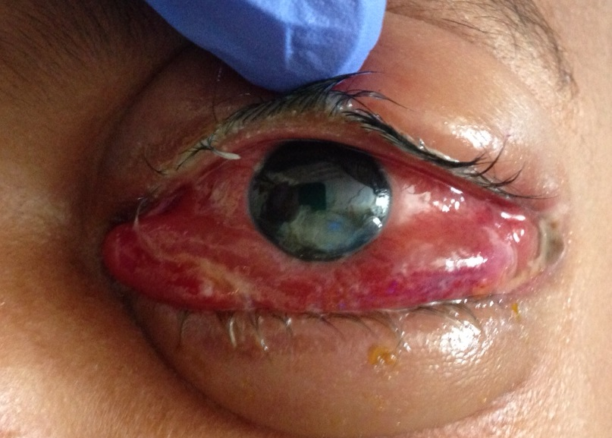
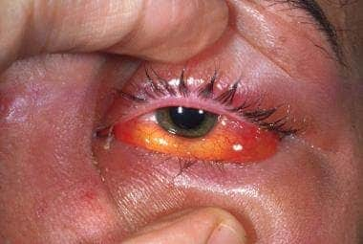
Orbital cellulitis: Chemosis

Slide 89
Q
Is it pre-septal cellulitis, or post-septal, ie, orbital cellulitis? The ability to reliably differentiate between the two is a must-have (both out in the real world as well as on the OKAP and Board exams). Several findings will clue you in one way or the other--identify them below!
Signs/Symptoms | Preseptal Cellulitis | Orbital Cellulitis
Proptosis | Never | Usually
Lid edema | Yes | Yes
Red eye | Never | Yes
Lethargy | Can be present | Yes
Decreased visual function | Never | Usually
Fever | Can be present | Usually
Chemosis | Never | Usually
APD | ? | ?
Elevated IOP | Never | Can be present
Pain with EOMs | Never | Usually
Limited motility | Never | Usually
APD present | Never | Can be present
Elevated IOP | Never | Can be present
Pain with EOMs | Never | Usually
Limited motility | Never | Usually

Slide 90
A
Is it pre-septal cellulitis, or post-septal, ie, orbital cellulitis? The ability to reliably differentiate between the two is a must-have (both out in the real world as well as on the OKAP and Board exams). Several findings will clue you in one way or the other--identify them below!
Signs/Symptoms | Preseptal Cellulitis | Orbital Cellulitis
Proptosis | Never | Usually
Lid edema | Yes | Yes
Red eye | Never | Yes
Lethargy | Can be present | Yes
Decreased visual function | Never | Usually
Fever | Can be present | Usually
Chemosis | Never | Usually
APD | Never | Can be present
Elevated IOP | Never | Can be present
Pain with EOMs | Never | Usually
Limited motility | Never | Usually
APD present | Never | Can be present
Elevated IOP | Never | Can be present
Pain with EOMs | Never | Usually
Limited motility | Never | Usually

Slide 91
Q
Is it pre-septal cellulitis, or post-septal, ie, orbital cellulitis? The ability to reliably differentiate between the two is a must-have (both out in the real world as well as on the OKAP and Board exams). Several findings will clue you in one way or the other--identify them below!
Signs/Symptoms | Preseptal Cellulitis | Orbital Cellulitis
Proptosis | Never | Usually
Lid edema | Yes | Yes
Red eye | Never | Yes
Lethargy | Can be present | Yes
Decreased visual function | Never | Usually
Fever | Can be present | Usually
Chemosis | Never | Usually
APD | Never | Can be present
Elevated IOP | ? | ?
Pain with EOMs | Never | Usually
Limited motility | Never | Usually
APD present | Never | Can be present
Elevated IOP | Never | Can be present
Pain with EOMs | Never | Usually
Limited motility | Never | Usually

Slide 92
A
Is it pre-septal cellulitis, or post-septal, ie, orbital cellulitis? The ability to reliably differentiate between the two is a must-have (both out in the real world as well as on the OKAP and Board exams). Several findings will clue you in one way or the other--identify them below!
Signs/Symptoms | Preseptal Cellulitis | Orbital Cellulitis
Proptosis | Never | Usually
Lid edema | Yes | Yes
Red eye | Never | Yes
Lethargy | Can be present | Yes
Decreased visual function | Never | Usually
Fever | Can be present | Usually
Chemosis | Never | Usually
APD | Never | Can be present
Elevated IOP | Never | Can be present
Pain with EOMs | Never | Usually
Limited motility | Never | Usually
APD present | Never | Can be present
Elevated IOP | Never | Can be present
Pain with EOMs | Never | Usually
Limited motility | Never | Usually

Slide 93
Q
Is it pre-septal cellulitis, or post-septal, ie, orbital cellulitis? The ability to reliably differentiate between the two is a must-have (both out in the real world as well as on the OKAP and Board exams). Several findings will clue you in one way or the other--identify them below!
Signs/Symptoms | Preseptal Cellulitis | Orbital Cellulitis
Proptosis | Never | Usually
Lid edema | Yes | Yes
Red eye | Never | Yes
Lethargy | Can be present | Yes
Decreased visual function | Never | Usually
Fever | Can be present | Usually
Chemosis | Never | Usually
APD | Never | Can be present
Elevated IOP | Never | Can be present
Pain with EOMs | Never | Usually
Limited motility | Never | Usually
APD present | Never | Can be present
Elevated IOP | Never | Can be present
Pain with EOMs | Never | Usually
Limited motility | Never | Usually
What is the mechanism responsible for increasing IOP?
Orbital congestion →compression of vortex veins →increased EVP →increased IOP

Slide 94
Q/A
Is it pre-septal cellulitis, or post-septal, ie, orbital cellulitis? The ability to reliably differentiate between the two is a must-have (both out in the real world as well as on the OKAP and Board exams). Several findings will clue you in one way or the other--identify them below!
Signs/Symptoms | Preseptal Cellulitis | Orbital Cellulitis
Proptosis | Never | Usually
Lid edema | Yes | Yes
Red eye | Never | Yes
Lethargy | Can be present | Yes
Decreased visual function | Never | Usually
Fever | Can be present | Usually
Chemosis | Never | Usually
APD | Never | Can be present
Elevated IOP | Never | Can be present
Pain with EOMs | Never | Usually
Limited motility | Never | Usually
APD present | Never | Can be present
Elevated IOP | Never | Can be present
Pain with EOMs | Never | Usually
Limited motility | Never | Usually
What is the mechanism responsible for increasing IOP?
Orbital congestion →compression of vortex veins →increased EVP →increased IOP
two words
abb.

Slide 95
A
Is it pre-septal cellulitis, or post-septal, ie, orbital cellulitis? The ability to reliably differentiate between the two is a must-have (both out in the real world as well as on the OKAP and Board exams). Several findings will clue you in one way or the other--identify them below!
Signs/Symptoms | Preseptal Cellulitis | Orbital Cellulitis
Proptosis | Never | Usually
Lid edema | Yes | Yes
Red eye | Never | Yes
Lethargy | Can be present | Yes
Decreased visual function | Never | Usually
Fever | Can be present | Usually
Chemosis | Never | Usually
APD | Never | Can be present
Elevated IOP | Never | Can be present
Pain with EOMs | Never | Usually
Limited motility | Never | Usually
APD present | Never | Can be present
Elevated IOP | Never | Can be present
Pain with EOMs | Never | Usually
Limited motility | Never | Usually
What is the mechanism responsible for increasing IOP?
Orbital congestion →compression of vortex veins →increased EVP →increased IOP
EVP = episcleral venous pressure

Slide 96
Q
Is it pre-septal cellulitis, or post-septal, ie, orbital cellulitis? The ability to reliably differentiate between the two is a must-have (both out in the real world as well as on the OKAP and Board exams). Several findings will clue you in one way or the other--identify them below!
Signs/Symptoms | Preseptal Cellulitis | Orbital Cellulitis
Proptosis | Never | Usually
Lid edema | Yes | Yes
Red eye | Never | Yes
Lethargy | Can be present | Yes
Decreased visual function | Never | Usually
Fever | Can be present | Usually
Chemosis | Never | Usually
APD | Never | Can be present
Elevated IOP | Never | Can be present
Pain with EOMs | ? | ?
Limited motility | Never | Usually
APD present | Never | Can be present
Elevated IOP | Never | Can be present
Pain with EOMs | Never | Usually
Limited motility | Never | Usually
(EOMs = extraocular muscle movements)

Slide 97
A
Is it pre-septal cellulitis, or post-septal, ie, orbital cellulitis? The ability to reliably differentiate between the two is a must-have (both out in the real world as well as on the OKAP and Board exams). Several findings will clue you in one way or the other--identify them below!
Signs/Symptoms | Preseptal Cellulitis | Orbital Cellulitis
Proptosis | Never | Usually
Lid edema | Yes | Yes
Red eye | Never | Yes
Lethargy | Can be present | Yes
Decreased visual function | Never | Usually
Fever | Can be present | Usually
Chemosis | Never | Usually
APD | Never | Can be present
Elevated IOP | Never | Can be present
Pain with EOMs | Never | Usually
Limited motility | Never | Usually
APD present | Never | Can be present
Elevated IOP | Never | Can be present
Pain with EOMs | Never | Usually
Limited motility | Never | Usually

Slide 98
Q
Is it pre-septal cellulitis, or post-septal, ie, orbital cellulitis? The ability to reliably differentiate between the two is a must-have (both out in the real world as well as on the OKAP and Board exams). Several findings will clue you in one way or the other--identify them below!
Signs/Symptoms | Preseptal Cellulitis | Orbital Cellulitis
Proptosis | Never | Usually
Lid edema | Yes | Yes
Red eye | Never | Yes
Lethargy | Can be present | Yes
Decreased visual function | Never | Usually
Fever | Can be present | Usually
Chemosis | Never | Usually
APD | Never | Can be present
Elevated IOP | Never | Can be present
Pain with EOMs | Never | Usually
Limited motility | ? | ?
APD present | Never | Can be present
Elevated IOP | Never | Can be present
Pain with EOMs | Never | Usually
Limited motility | Never | Usually

Slide 99
A
Is it pre-septal cellulitis, or post-septal, ie, orbital cellulitis? The ability to reliably differentiate between the two is a must-have (both out in the real world as well as on the OKAP and Board exams). Several findings will clue you in one way or the other--identify them below!
Signs/Symptoms | Preseptal Cellulitis | Orbital Cellulitis
Proptosis | Never | Usually
Lid edema | Yes | Yes
Red eye | Never | Yes
Lethargy | Can be present | Yes
Decreased visual function | Never | Usually
Fever | Can be present | Usually
Chemosis | Never | Usually
APD | Never | Can be present
Elevated IOP | Never | Can be present
Pain with EOMs | Never | Usually
Limited motility | Never | Usually
APD present | Never | Can be present
Elevated IOP | Never | Can be present
Pain with EOMs | Never | Usually
Limited motility | Never | Usually

Slide 100
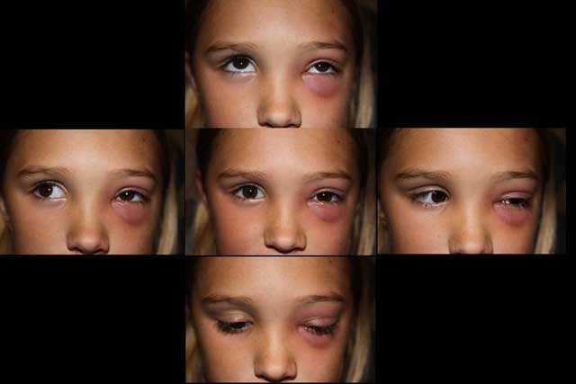
Reduced elevation, adduction, abduction
Orbital cellulitis: EOM limitations
https://webeye.ophth.uiowa.edu/eyeforum/cases/103-Pediatric-Orbital-Cellulitis.htm

Slide 101
Q
Is it pre-septal cellulitis, or post-septal, ie, orbital cellulitis? The ability to reliably differentiate between the two is a must-have (both out in the real world as well as on the OKAP and Board exams). Several findings will clue you in one way or the other--identify them below!
Signs/Symptoms | Preseptal Cellulitis | Orbital Cellulitis
Proptosis | Never | Usually
Lid edema | Yes | Yes
Red eye | Never | Yes
Lethargy | Can be present | Yes
Decreased visual function | Never | Usually
Fever | Can be present | Usually
Chemosis | Never | Usually
APD | Never | Can be present
Elevated IOP | Never | Can be present
Pain with EOMs | Never | Usually
Limited motility | Never | Usually
APD present | Never | Can be present
Elevated IOP | Never | Can be present
Pain with EOMs | Never | Usually
Tenderness on palpation | ? | ?

Slide 102
A
Is it pre-septal cellulitis, or post-septal, ie, orbital cellulitis? The ability to reliably differentiate between the two is a must-have (both out in the real world as well as on the OKAP and Board exams). Several findings will clue you in one way or the other--identify them below!
Signs/Symptoms | Preseptal Cellulitis | Orbital Cellulitis
Proptosis | Never | Usually
Lid edema | Yes | Yes
Red eye | Never | Yes
Lethargy | Can be present | Yes
Decreased visual function | Never | Usually
Fever | Can be present | Usually
Chemosis | Never | Usually
APD | Never | Can be present
Elevated IOP | Never | Can be present
Pain with EOMs | Never | Usually
Limited motility | Never | Usually
APD present | Never | Can be present
Elevated IOP | Never | Can be present
Pain with EOMs | Never | Usually
Tenderness on palpation | Never | Usually

Slide 103
Is it pre-septal cellulitis, or post-septal, ie, orbital cellulitis? The ability to reliably differentiate between the two is a must-have (both out in the real world as well as on the OKAP and Board exams). Several findings will clue you in one way or the other--identify them below!
So, it’s orbital cellulitis if the globe is involved…
Signs/Symptoms | Preseptal Cellulitis | Orbital Cellulitis
Proptosis | Never | Usually
Lid edema | Yes | Yes
Red eye | Never | Yes
Lethargy | Can be present | Yes
Decreased visual function | Never | Usually
Fever | Can be present | Usually
Chemosis | Never | Usually
APD | Never | Can be present
Elevated IOP | Never | Can be present
Pain with EOMs | Never | Usually
Limited motility | Never | Usually
APD present | Never | Can be present
Elevated IOP | Never | Can be present
Pain with EOMs | Never | Usually
Tenderness on palpation | Never | Usually

Slide 104
Is it pre-septal cellulitis, or post-septal, ie, orbital cellulitis? The ability to reliably differentiate between the two is a must-have (both out in the real world as well as on the OKAP and Board exams). Several findings will clue you in one way or the other--identify them below!
or if orbital signs are present…
Signs/Symptoms | Preseptal Cellulitis | Orbital Cellulitis
Proptosis | Never | Usually
Lid edema | Yes | Yes
Red eye | Never | Yes
Lethargy | Can be present | Yes
Decreased visual function | Never | Usually
Fever | Can be present | Usually
Chemosis | Never | Usually
APD | Never | Can be present
Elevated IOP | Never | Can be present
Pain with EOMs | Never | Usually
Limited motility | Never | Usually
APD present | Never | Can be present
Elevated IOP | Never | Can be present
Pain with EOMs | Never | Usually
Tenderness on palpation | Never | Usually

Slide 105
Is it pre-septal cellulitis, or post-septal, ie, orbital cellulitis? The ability to reliably differentiate between the two is a must-have (both out in the real world as well as on the OKAP and Board exams). Several findings will clue you in one way or the other--identify them below!
Or if visual function is affected
Signs/Symptoms | Preseptal Cellulitis | Orbital Cellulitis
Proptosis | Never | Usually
Lid edema | Yes | Yes
Red eye | Never | Yes
Lethargy | Can be present | Yes
Decreased visual function | Never | Usually
Fever | Can be present | Usually
Chemosis | Never | Usually
APD | Never | Can be present
Elevated IOP | Never | Can be present
Pain with EOMs | Never | Usually
Limited motility | Never | Usually
APD present | Never | Can be present
Elevated IOP | Never | Can be present
Pain with EOMs | Never | Usually
Tenderness on palpation | Never | Usually

