Slide 1
Q
All of the following are in the differential for an intraconal mass except:
Cavernous hemangioma
Capillary hemangioblastoma
Hemangiopericytoma
Fibrous histiocytoma
Schwannoma

Slide 2
A
All of the following are in the differential for an intraconal mass except:
Cavernous hemangioma
Capillary hemangioblastoma
Hemangiopericytoma
Fibrous histiocytoma
Schwannoma

Slide 3
Q
All of the following are in the differential for an intraconal mass except:
Cavernous hemangioma
Capillary hemangioblastoma
Hemangiopericytoma
Fibrous histiocytoma
Schwannoma
The oddball here is capillary hemangioblastoma, which is a retinal lesion associated with von Hippel-Lindau disease.
location
eponym-eponym

Slide 4
A
All of the following are in the differential for an intraconal mass except:
Cavernous hemangioma
Capillary hemangioblastoma
Hemangiopericytoma
Fibrous histiocytoma
Schwannoma
The oddball here is capillary hemangioblastoma, which is a retinal lesion associated with von Hippel-Lindau disease.

Slide 5
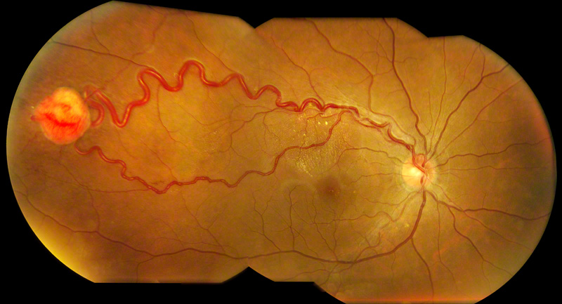
Capillary hemangioblastoma in von Hippel-Lindau dz

Slide 6
Q
All of the following are in the differential for an intraconal mass except:
Cavernous hemangioma
Capillary hemangioblastoma
Hemangiopericytoma
Fibrous histiocytoma
Schwannoma
The oddball here is capillary hemangioblastoma, which is a retinal lesion associated with von Hippel-Lindau disease.
In a word, what sort of condition is von Hippel-Landau disease?

Slide 7
A
All of the following are in the differential for an intraconal mass except:
Cavernous hemangioma
Capillary hemangioblastoma
Hemangiopericytoma
Fibrous histiocytoma
Schwannoma
The oddball here is capillary hemangioblastoma, which is a retinal lesion associated with von Hippel-Lindau disease.
In a word, what sort of condition is von Hippel-Landau disease?
A phakomatosis

Slide 8
Q
All of the following are in the differential for an intraconal mass except:
Cavernous hemangioma
Capillary hemangioblastoma
Hemangiopericytoma
Fibrous histiocytoma
Schwannoma
The oddball here is capillary hemangioblastoma, which is a retinal lesion associated with von Hippel-Lindau disease.
Phakomatoses are known also as what sort of syndrome?
Neurocutaneous syndromes
In a word, what sort of condition is von Hippel-Landau disease?
A phakomatosis

Slide 9
A
All of the following are in the differential for an intraconal mass except:
Cavernous hemangioma
Capillary hemangioblastoma
Hemangiopericytoma
Fibrous histiocytoma
Schwannoma
The oddball here is capillary hemangioblastoma, which is a retinal lesion associated with von Hippel-Lindau disease.
Phakomatoses are known also as what sort of syndrome?
Neurocutaneous syndromes
In a word, what sort of condition is von Hippel-Landau disease?
A phakomatosis

Slide 10
Q
All of the following are in the differential for an intraconal mass except:
Cavernous hemangioma
Capillary hemangioblastoma
Hemangiopericytoma
Fibrous histiocytoma
Schwannoma
The oddball here is capillary hemangioblastoma, which is a retinal lesion associated with von Hippel-Lindau disease.
Phakomatoses are known also as what sort of syndrome?
Neurocutaneous syndromes
In a word, what sort of condition is von Hippel-Landau disease?
A phakomatosis
Phakomatoses have both eye and skin findings. The retinal hemangioblastoma is the eye finding in von Hippel-Lindau; what is the skin finding?
Got ‘em! There is none (despite this, it’s still considered a phakomatosis)
duh

Slide 11
A
All of the following are in the differential for an intraconal mass except:
Cavernous hemangioma
Capillary hemangioblastoma
Hemangiopericytoma
Fibrous histiocytoma
Schwannoma
The oddball here is capillary hemangioblastoma, which is a retinal lesion associated with von Hippel-Lindau disease.
Phakomatoses are known also as what sort of syndrome?
Neurocutaneous syndromes
In a word, what sort of condition is von Hippel-Landau disease?
A phakomatosis
Phakomatoses have both eye and skin findings. The retinal hemangioblastoma is the eye finding in von Hippel-Lindau; what is the skin finding?
Got ‘em! There is none (despite this, it’s still considered a phakomatosis)

Slide 12
Q
All of the following are in the differential for an intraconal mass except:
Cavernous hemangioma
Capillary hemangioblastoma
Hemangiopericytoma
Fibrous histiocytoma
Schwannoma
The oddball here is capillary hemangioblastoma, which is a retinal lesion associated with von Hippel-Lindau disease.
Phakomatoses are known also as what sort of syndrome?
Neurocutaneous syndromes
In a word, what sort of condition is von Hippel-Landau disease?
A phakomatosis
Phakomatoses have both eye and skin findings. The retinal hemangioblastoma is the eye finding in von Hippel-Lindau; what is the skin finding?
Got ‘em! There is none (despite this, it’s still considered a phakomatosis)

Slide 13
A
All of the following are in the differential for an intraconal mass except:
Cavernous hemangioma
Capillary hemangioblastoma
Hemangiopericytoma
Fibrous histiocytoma
Schwannoma
The oddball here is capillary hemangioblastoma, which is a retinal lesion associated with von Hippel-Lindau disease.
Phakomatoses are known also as what sort of syndrome?
Neurocutaneous syndromes
In a word, what sort of condition is von Hippel-Landau disease?
A phakomatosis
Phakomatoses have both eye and skin findings. The retinal hemangioblastoma is the eye finding in von Hippel-Lindau; what is the skin finding?
Got ‘em! There is none (despite this, it’s still considered a phakomatosis)

Slide 14
Q
All of the following are in the differential for an intraconal mass except:
Cavernous hemangioma
Capillary hemangioblastoma
Hemangiopericytoma
Fibrous histiocytoma
Schwannoma
In general, how will an intraconal mass present?
With one or (usually) more of the following:
--Proptosis
--Pain
--Diplopia
(If the optic nerve is involved, vision will be affected as well)
The oddball here is capillary hemangioblastoma, which is a retinal lesion associated with von Hippel-Lindau disease.

Slide 15
A
All of the following are in the differential for an intraconal mass except:
Cavernous hemangioma
Capillary hemangioblastoma
Hemangiopericytoma
Fibrous histiocytoma
Schwannoma
In general, how will an intraconal mass present?
With one or (usually) more of the following:
--?
--?
--?
(If the optic nerve is involved, vision will be affected as well)
The oddball here is capillary hemangioblastoma, which is a retinal lesion associated with von Hippel-Lindau disease.

Slide 16
Q
All of the following are in the differential for an intraconal mass except:
Cavernous hemangioma
Capillary hemangioblastoma
Hemangiopericytoma
Fibrous histiocytoma
Schwannoma
In general, how will an intraconal mass present?
With one or (usually) more of the following:
--Proptosis
--Pain
--Diplopia
(If the optic nerve is involved, vision will be affected as well)
The oddball here is capillary hemangioblastoma, which is a retinal lesion associated with von Hippel-Lindau disease.

Slide 17
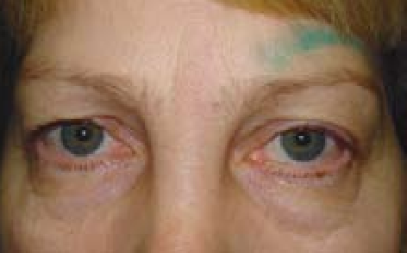
Intraconal mass OS producing proptosis

Slide 18
Q/A
All of the following are in the differential for an intraconal mass except:
Cavernous hemangioma
Capillary hemangioblastoma
Hemangiopericytoma
Fibrous histiocytoma
Schwannoma
In general, how will an intraconal mass present?
With one or (usually) more of the following:
--Proptosis
--Pain
--Diplopia
(If the optic nerve is involved, vision will be affected as well)
two words
The oddball here is capillary hemangioblastoma, which is a retinal lesion associated with von Hippel-Lindau disease.

Slide 19
A
All of the following are in the differential for an intraconal mass except:
Cavernous hemangioma
Capillary hemangioblastoma
Hemangiopericytoma
Fibrous histiocytoma
Schwannoma
In general, how will an intraconal mass present?
With one or (usually) more of the following:
--Proptosis
--Pain
--Diplopia
(If the optic nerve is involved, vision will be affected as well)
The oddball here is capillary hemangioblastoma, which is a retinal lesion associated with von Hippel-Lindau disease.

Slide 20
Q
All of the following are in the differential for an intraconal mass except:
Cavernous hemangioma
Capillary hemangioblastoma
Hemangiopericytoma
Fibrous histiocytoma
Schwannoma
In general, how will an intraconal mass present?
With one or (usually) more of the following:
--Proptosis
--Pain
--Diplopia
(If the optic nerve is involved, vision will be affected as well)
How else might an intraconal tumor directly impact vision?
By pushing against/compressing the back of the eye
How would such compression manifest on DFE?
The macula would have retinal striae
The oddball here is capillary hemangioblastoma, which is a retinal lesion associated with von Hippel-Lindau disease.

Slide 21
A
All of the following are in the differential for an intraconal mass except:
Cavernous hemangioma
Capillary hemangioblastoma
Hemangiopericytoma
Fibrous histiocytoma
Schwannoma
In general, how will an intraconal mass present?
With one or (usually) more of the following:
--Proptosis
--Pain
--Diplopia
(If the optic nerve is involved, vision will be affected as well)
How else might an intraconal tumor directly impact vision?
By pushing against/compressing the back of the eye
How would such compression manifest on DFE?
The macula would have retinal striae
The oddball here is capillary hemangioblastoma, which is a retinal lesion associated with von Hippel-Lindau disease.

Slide 22
Q
All of the following are in the differential for an intraconal mass except:
Cavernous hemangioma
Capillary hemangioblastoma
Hemangiopericytoma
Fibrous histiocytoma
Schwannoma
In general, how will an intraconal mass present?
With one or (usually) more of the following:
--Proptosis
--Pain
--Diplopia
(If the optic nerve is involved, vision will be affected as well)
How else might an intraconal tumor directly impact vision?
By pushing against/compressing the back of the eye
How would such compression manifest on DFE?
The macula would have retinal striae
The oddball here is capillary hemangioblastoma, which is a retinal lesion associated with von Hippel-Lindau disease.

Slide 23
Q/A
All of the following are in the differential for an intraconal mass except:
Cavernous hemangioma
Capillary hemangioblastoma
Hemangiopericytoma
Fibrous histiocytoma
Schwannoma
In general, how will an intraconal mass present?
With one or (usually) more of the following:
--Proptosis
--Pain
--Diplopia
(If the optic nerve is involved, vision will be affected as well)
How else might an intraconal tumor directly impact vision?
By pushing against/compressing the back of the eye
How would such compression manifest on DFE?
The macula would have retinal striae
The oddball here is capillary hemangioblastoma, which is a retinal lesion associated with von Hippel-Lindau disease.
two words

Slide 24
A
All of the following are in the differential for an intraconal mass except:
Cavernous hemangioma
Capillary hemangioblastoma
Hemangiopericytoma
Fibrous histiocytoma
Schwannoma
In general, how will an intraconal mass present?
With one or (usually) more of the following:
--Proptosis
--Pain
--Diplopia
(If the optic nerve is involved, vision will be affected as well)
How else might an intraconal tumor directly impact vision?
By pushing against/compressing the back of the eye
How would such compression manifest on DFE?
The macula would have retinal striae
The oddball here is capillary hemangioblastoma, which is a retinal lesion associated with von Hippel-Lindau disease.

Slide 25
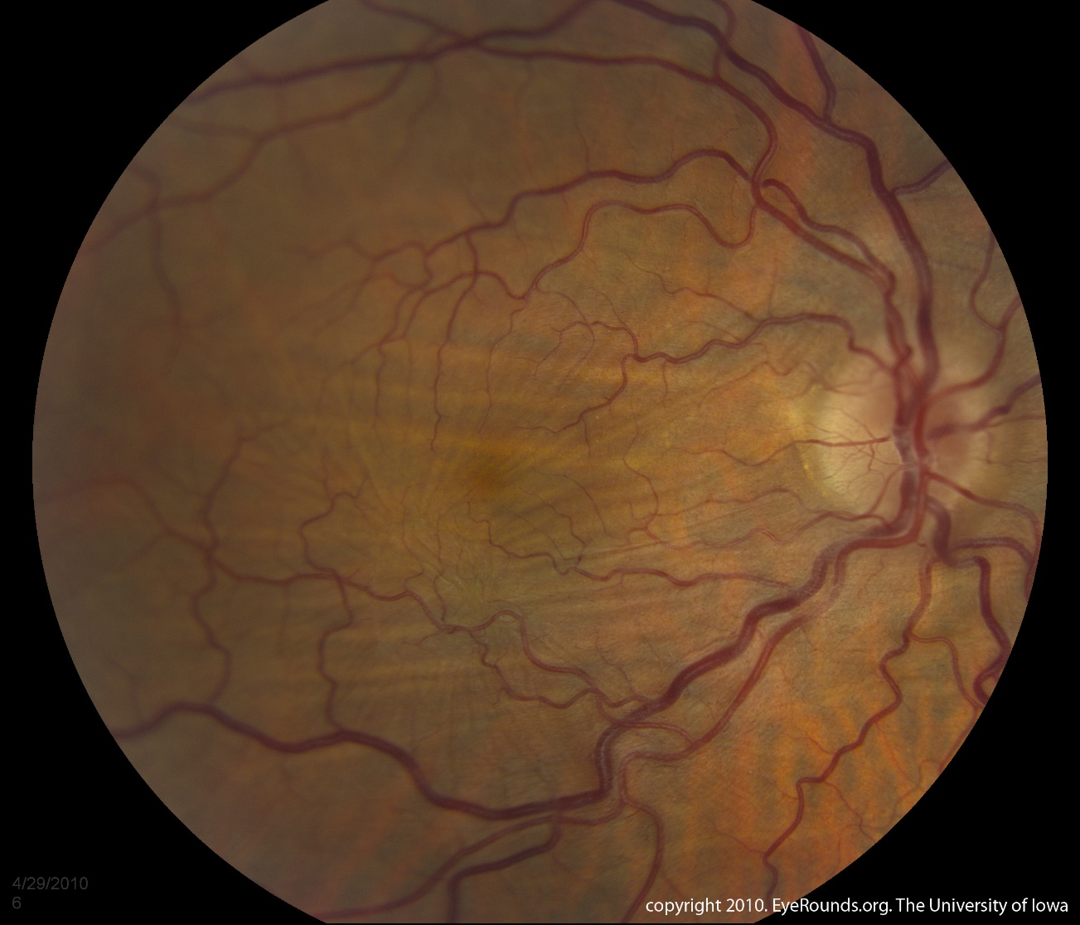
Fundus photo demonstrating retinal striae in a pt with an intraconal cavernous hemangioma compressing the posterior pole

Slide 26
Q
All of the following are in the differential for an intraconal mass except:
Cavernous hemangioma
Capillary hemangioblastoma
Hemangiopericytoma
Fibrous histiocytoma
Schwannoma
In general, how will an intraconal mass present?
With one or (usually) more of the following:
--Proptosis
--Pain
--Diplopia
(If the optic nerve is involved, vision will be affected as well)
How else might an intraconal tumor directly impact vision?
By pushing against/compressing the back of the eye
How would such compression manifest on DFE?
The macula would have retinal striae
The oddball here is capillary hemangioblastoma, which is a retinal lesion associated with von Hippel-Lindau disease.
In addition to impacting vision, what other negative effect might such compression produce?
IOP elevation
What would be the mechanism for this?
Impeding blood flow through the vortex veins

Slide 27
A
All of the following are in the differential for an intraconal mass except:
Cavernous hemangioma
Capillary hemangioblastoma
Hemangiopericytoma
Fibrous histiocytoma
Schwannoma
In general, how will an intraconal mass present?
With one or (usually) more of the following:
--Proptosis
--Pain
--Diplopia
(If the optic nerve is involved, vision will be affected as well)
How else might an intraconal tumor directly impact vision?
By pushing against/compressing the back of the eye
How would such compression manifest on DFE?
The macula would have retinal striae
The oddball here is capillary hemangioblastoma, which is a retinal lesion associated with von Hippel-Lindau disease.
In addition to impacting vision, what other negative effect might such compression produce?
IOP elevation
What would be the mechanism for this?
Impeding blood flow through the vortex veins

Slide 28
Q
All of the following are in the differential for an intraconal mass except:
Cavernous hemangioma
Capillary hemangioblastoma
Hemangiopericytoma
Fibrous histiocytoma
Schwannoma
In general, how will an intraconal mass present?
With one or (usually) more of the following:
--Proptosis
--Pain
--Diplopia
(If the optic nerve is involved, vision will be affected as well)
How else might an intraconal tumor directly impact vision?
By pushing against/compressing the back of the eye
How would such compression manifest on DFE?
The macula would have retinal striae
The oddball here is capillary hemangioblastoma, which is a retinal lesion associated with von Hippel-Lindau disease.
In addition to impacting vision, what other negative effect might such compression produce?
IOP elevation
What would be the mechanism for this?
Impeding blood flow through the vortex veins

Slide 29
Q/A
All of the following are in the differential for an intraconal mass except:
Cavernous hemangioma
Capillary hemangioblastoma
Hemangiopericytoma
Fibrous histiocytoma
Schwannoma
In general, how will an intraconal mass present?
With one or (usually) more of the following:
--Proptosis
--Pain
--Diplopia
(If the optic nerve is involved, vision will be affected as well)
How else might an intraconal tumor directly impact vision?
By pushing against/compressing the back of the eye
How would such compression manifest on DFE?
The macula would have retinal striae
The oddball here is capillary hemangioblastoma, which is a retinal lesion associated with von Hippel-Lindau disease.
In addition to impacting vision, what other negative effect might such compression produce?
IOP elevation
What would be the mechanism for this?
Impeding blood flow through the vortex veins
two words

Slide 30
A
All of the following are in the differential for an intraconal mass except:
Cavernous hemangioma
Capillary hemangioblastoma
Hemangiopericytoma
Fibrous histiocytoma
Schwannoma
In general, how will an intraconal mass present?
With one or (usually) more of the following:
--Proptosis
--Pain
--Diplopia
(If the optic nerve is involved, vision will be affected as well)
How else might an intraconal tumor directly impact vision?
By pushing against/compressing the back of the eye
How would such compression manifest on DFE?
The macula would have retinal striae
The oddball here is capillary hemangioblastoma, which is a retinal lesion associated with von Hippel-Lindau disease.
In addition to impacting vision, what other negative effect might such compression produce?
IOP elevation
What would be the mechanism for this?
Impeding blood flow through the vortex veins

Slide 31
All of the following are in the differential for an intraconal mass except:
Cavernous hemangioma
Capillary hemangioblastoma
Hemangiopericytoma
Fibrous histiocytoma
Schwannoma
The oddball here is capillary hemangioblastoma, which is a retinal lesion associated with von Hippel-Lindau disease. Re the others:
No question yet—keep going

Slide 32
Q
All of the following are in the differential for an intraconal mass except:
Cavernous hemangioma
Capillary hemangioblastoma
Hemangiopericytoma
Fibrous histiocytoma
Schwannoma
The oddball here is capillary hemangioblastoma, which is a retinal lesion associated with von Hippel-Lindau disease. Re the others:
--Cavernous hemangioma is the most common intraorbital tumor in adults, and is usually intraconal.
intraconal differential tumor

Slide 33
A
All of the following are in the differential for an intraconal mass except:
Cavernous hemangioma
Capillary hemangioblastoma
Hemangiopericytoma
Fibrous histiocytoma
Schwannoma
The oddball here is capillary hemangioblastoma, which is a retinal lesion associated with von Hippel-Lindau disease. Re the others:
--Cavernous hemangioma is the most common intraorbital tumor in adults, and is usually intraconal.

Slide 34
Q
All of the following are in the differential for an intraconal mass except:
Cavernous hemangioma
Capillary hemangioblastoma
Hemangiopericytoma
Fibrous histiocytoma
Schwannoma
aka…?
FYI: Cavernous hemangiomas are known also by what other name?
‘Cavernous venous malformations’
The oddball here is capillary hemangioblastoma, which is a retinal lesion associated with von Hippel-Lindau disease. Re the others:
--Cavernous hemangioma is the most common intraorbital tumor in adults, and is usually intraconal.

Slide 35
A
All of the following are in the differential for an intraconal mass except:
Cavernous hemangioma
Capillary hemangioblastoma
Hemangiopericytoma
Fibrous histiocytoma
Schwannoma
aka…cavernous venous malformations
FYI: Cavernous hemangiomas are known also by what other name?
Cavernous venous malformations (CVM)*
The oddball here is capillary hemangioblastoma, which is a retinal lesion associated with von Hippel-Lindau disease. Re the others:
--Cavernous hemangioma is the most common intraorbital tumor in adults, and is usually intraconal.
*One section of the most recent (at the time of this writing) version of the Plastics book indicates that cavernous venous malformations is now the preferred nomenclature. That said, other current BCSC volumes continue to use the term cavernous hemangioma (as do other sections of the Plastics book, for that matter). Caveat emptor.

Slide 36
Q
All of the following are in the differential for an intraconal mass except:
Cavernous hemangioma
Capillary hemangioblastoma
Hemangiopericytoma
Fibrous histiocytoma
Schwannoma
aka…cavernous venous malformations
How does cavernous hemangioma present?
With slowly progressive proptosis
Is the proptosis slow, or rapid?
Slow
Is there a gender predilection?
Yes, it is more common in women
Is it benign, or malignant?
Benign
The oddball here is capillary hemangioblastoma, which is a retinal lesion associated with von Hippel-Lindau disease. Re the others:
--Cavernous hemangioma is the most common intraorbital tumor in adults, and is usually intraconal.

Slide 37
A
All of the following are in the differential for an intraconal mass except:
Cavernous hemangioma
Capillary hemangioblastoma
Hemangiopericytoma
Fibrous histiocytoma
Schwannoma
aka…cavernous venous malformations
How does cavernous hemangioma present?
With slowly progressive proptosis
Is the proptosis slow, or rapid?
Slow
Is there a gender predilection?
Yes, it is more common in women
Is it benign, or malignant?
Benign
The oddball here is capillary hemangioblastoma, which is a retinal lesion associated with von Hippel-Lindau disease. Re the others:
--Cavernous hemangioma is the most common intraorbital tumor in adults, and is usually intraconal.

Slide 38
Q
All of the following are in the differential for an intraconal mass except:
Cavernous hemangioma
Capillary hemangioblastoma
Hemangiopericytoma
Fibrous histiocytoma
Schwannoma
aka…cavernous venous malformations
How does cavernous hemangioma present?
With slowly progressive proptosis
Is the proptosis slow, or rapid?
Slow
Is there a gender predilection?
Yes, it is more common in women
Is it benign, or malignant?
Benign
The oddball here is capillary hemangioblastoma, which is a retinal lesion associated with von Hippel-Lindau disease. Re the others:
--Cavernous hemangioma is the most common intraorbital tumor in adults, and is usually intraconal.

Slide 39
A
All of the following are in the differential for an intraconal mass except:
Cavernous hemangioma
Capillary hemangioblastoma
Hemangiopericytoma
Fibrous histiocytoma
Schwannoma
aka…cavernous venous malformations
How does cavernous hemangioma present?
With slowly progressive proptosis
Is the proptosis slow, or rapid?
Slow
Is there a gender predilection?
Yes, it is more common in women
Is it benign, or malignant?
Benign
The oddball here is capillary hemangioblastoma, which is a retinal lesion associated with von Hippel-Lindau disease. Re the others:
--Cavernous hemangioma is the most common intraorbital tumor in adults, and is usually intraconal.

Slide 40
Q
All of the following are in the differential for an intraconal mass except:
Cavernous hemangioma
Capillary hemangioblastoma
Hemangiopericytoma
Fibrous histiocytoma
Schwannoma
aka…cavernous venous malformations
How does cavernous hemangioma present?
With slowly progressive proptosis
Is the proptosis slow, or rapid?
Slow
Is there a gender predilection?
Yes, it is more common in women
Is it benign, or malignant?
Benign
The oddball here is capillary hemangioblastoma, which is a retinal lesion associated with von Hippel-Lindau disease. Re the others:
--Cavernous hemangioma is the most common intraorbital tumor in adults, and is usually intraconal.

Slide 41
Q/A
All of the following are in the differential for an intraconal mass except:
Cavernous hemangioma
Capillary hemangioblastoma
Hemangiopericytoma
Fibrous histiocytoma
Schwannoma
aka…cavernous venous malformations
How does cavernous hemangioma present?
With slowly progressive proptosis
Is the proptosis slow, or rapid?
Slow
Is there a gender predilection?
Yes, it is more common in ♀
Is it benign, or malignant?
Benign
The oddball here is capillary hemangioblastoma, which is a retinal lesion associated with von Hippel-Lindau disease. Re the others:
--Cavernous hemangioma is the most common intraorbital tumor in adults, and is usually intraconal.

Slide 42
A
All of the following are in the differential for an intraconal mass except:
Cavernous hemangioma
Capillary hemangioblastoma
Hemangiopericytoma
Fibrous histiocytoma
Schwannoma
aka…cavernous venous malformations
How does cavernous hemangioma present?
With slowly progressive proptosis
Is the proptosis slow, or rapid?
Slow
Is there a gender predilection?
Yes, it is more common in ♀
Is it benign, or malignant?
Benign
The oddball here is capillary hemangioblastoma, which is a retinal lesion associated with von Hippel-Lindau disease. Re the others:
--Cavernous hemangioma is the most common intraorbital tumor in adults, and is usually intraconal.

Slide 43
Q
All of the following are in the differential for an intraconal mass except:
Cavernous hemangioma
Capillary hemangioblastoma
Hemangiopericytoma
Fibrous histiocytoma
Schwannoma
aka…cavernous venous malformations
How does cavernous hemangioma present?
With slowly progressive proptosis
Is the proptosis slow, or rapid?
Slow
Is there a gender predilection?
Yes, it is more common in ♀
Is it benign, or malignant?
Benign
The oddball here is capillary hemangioblastoma, which is a retinal lesion associated with von Hippel-Lindau disease. Re the others:
--Cavernous hemangioma is the most common intraorbital tumor in adults, and is usually intraconal.

Slide 44
A
All of the following are in the differential for an intraconal mass except:
Cavernous hemangioma
Capillary hemangioblastoma
Hemangiopericytoma
Fibrous histiocytoma
Schwannoma
aka…cavernous venous malformations
How does cavernous hemangioma present?
With slowly progressive proptosis
Is the proptosis slow, or rapid?
Slow
Is there a gender predilection?
Yes, it is more common in ♀
Is it benign, or malignant?
Benign
How does it appear on imaging?
As a well-encapsulated mass
The oddball here is capillary hemangioblastoma, which is a retinal lesion associated with von Hippel-Lindau disease. Re the others:
--Cavernous hemangioma is the most common intraorbital tumor in adults, and is usually intraconal.

Slide 45
Q
All of the following are in the differential for an intraconal mass except:
Cavernous hemangioma
Capillary hemangioblastoma
Hemangiopericytoma
Fibrous histiocytoma
Schwannoma
aka…cavernous venous malformations
How does cavernous hemangioma present?
With slowly progressive proptosis
Is the proptosis slow, or rapid?
Slow
Is there a gender predilection?
Yes, it is more common in ♀
Is it benign, or malignant?
Benign
How does it appear on imaging?
As a well-encapsulated mass
The oddball here is capillary hemangioblastoma, which is a retinal lesion associated with von Hippel-Lindau disease. Re the others:
--Cavernous hemangioma is the most common intraorbital tumor in adults, and is usually intraconal.

Slide 46
A
All of the following are in the differential for an intraconal mass except:
Cavernous hemangioma
Capillary hemangioblastoma
Hemangiopericytoma
Fibrous histiocytoma
Schwannoma
aka…cavernous venous malformations
How does cavernous hemangioma present?
With slowly progressive proptosis
Is the proptosis slow, or rapid?
Slow
Is there a gender predilection?
Yes, it is more common in ♀
Is it benign, or malignant?
Benign
How does it appear on imaging?
As a well-encapsulated mass
The oddball here is capillary hemangioblastoma, which is a retinal lesion associated with von Hippel-Lindau disease. Re the others:
--Cavernous hemangioma is the most common intraorbital tumor in adults, and is usually intraconal.

Slide 47
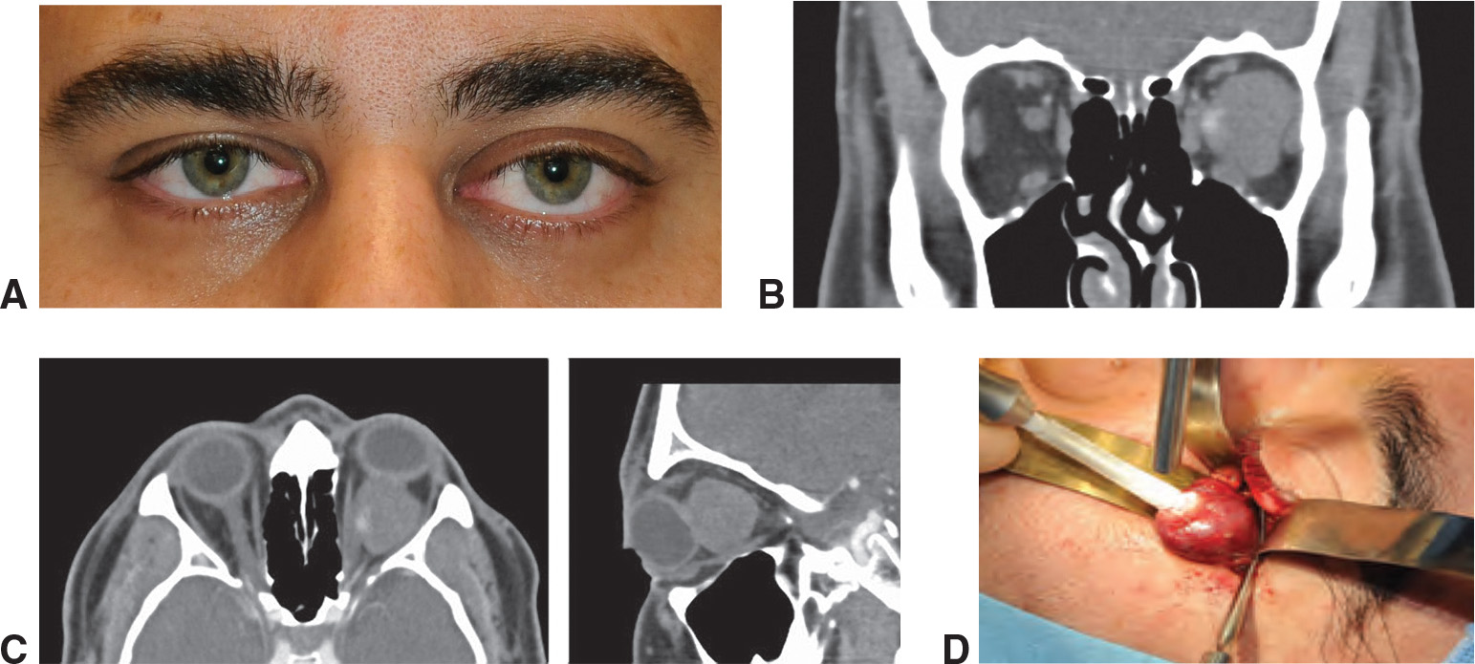
Cavernous hemangioma. A, Proptosis of the left eye as a result. B, Coronal CT shows a well-circumscribed lesion the muscle cone. C, Axial (left) and sagittal (right) CT show the mass. D, Intraoperative traction with a cryoprobe facilitates complete removal of the mass.

Slide 48
All of the following are in the differential for an intraconal mass except:
Cavernous hemangioma
Capillary hemangioblastoma
Hemangiopericytoma
Fibrous histiocytoma
Schwannoma
aka…cavernous venous malformations
For more on cavernous hemangiomas, see slide-set O10
How does cavernous hemangioma present?
With slowly progressive proptosis
Is the proptosis slow, or rapid?
Slow
Is there a gender predilection?
Yes, it is more common in ♀
Is it benign, or malignant?
Benign
How does it appear on imaging?
As a well-encapsulated mass
The oddball here is capillary hemangioblastoma, which is a retinal lesion associated with von Hippel-Lindau disease. Re the others:
--Cavernous hemangioma is the most common intraorbital tumor in adults, and is usually intraconal.

Slide 49
Q
All of the following are in the differential for an intraconal mass except:
Cavernous hemangioma
Capillary hemangioblastoma
Hemangiopericytoma
Fibrous histiocytoma
Schwannoma
The oddball here is capillary hemangioblastoma, which is a retinal lesion associated with von Hippel-Lindau disease. Re the others:
--Cavernous hemangioma is the most common intraorbital tumor in adults, and is usually intraconal.
--Hemangiopericytoma is a locally aggressive proliferation of vascular pericytes.
intraconal differential tumor

Slide 50
A
All of the following are in the differential for an intraconal mass except:
Cavernous hemangioma
Capillary hemangioblastoma
Hemangiopericytoma
Fibrous histiocytoma
Schwannoma
The oddball here is capillary hemangioblastoma, which is a retinal lesion associated with von Hippel-Lindau disease. Re the others:
--Cavernous hemangioma is the most common intraorbital tumor in adults, and is usually intraconal.
--Hemangiopericytoma is a locally aggressive proliferation of vascular pericytes.

Slide 51
Q
All of the following are in the differential for an intraconal mass except:
Cavernous hemangioma
Capillary hemangioblastoma
Hemangiopericytoma
Fibrous histiocytoma
Schwannoma
Is hemangiopericytoma a common, or rare tumor?
Rare
Does it tend to occur in children, or adults?
Adults, usually in the fifth decade
How does it appear on imaging?
As a well-encapsulated mass
Is it benign, or malignant?
Benign. But it must be excised en bloc, as it can undergo malignant transformation and actually metastasize (like a pleomorphic adenoma )
The oddball here is capillary hemangioblastoma, which is a retinal lesion associated with von Hippel-Lindau disease. Re the others:
--Cavernous hemangioma is the most common intraorbital tumor in adults, and is usually intraconal.
--Hemangiopericytoma is a locally aggressive proliferation of vascular pericytes.

Slide 52
A
All of the following are in the differential for an intraconal mass except:
Cavernous hemangioma
Capillary hemangioblastoma
Hemangiopericytoma
Fibrous histiocytoma
Schwannoma
Is hemangiopericytoma a common, or rare tumor?
Rare
Does it tend to occur in children, or adults?
Adults, usually in the fifth decade
How does it appear on imaging?
As a well-encapsulated mass
Is it benign, or malignant?
Benign. But it must be excised en bloc, as it can undergo malignant transformation and actually metastasize (like a pleomorphic adenoma )
The oddball here is capillary hemangioblastoma, which is a retinal lesion associated with von Hippel-Lindau disease. Re the others:
--Cavernous hemangioma is the most common intraorbital tumor in adults, and is usually intraconal.
--Hemangiopericytoma is a locally aggressive proliferation of vascular pericytes.

Slide 53
Q
All of the following are in the differential for an intraconal mass except:
Cavernous hemangioma
Capillary hemangioblastoma
Hemangiopericytoma
Fibrous histiocytoma
Schwannoma
Is hemangiopericytoma a common, or rare tumor?
Rare
Does it tend to occur in children, or adults?
Adults, usually in the fifth decade
How does it appear on imaging?
As a well-encapsulated mass
Is it benign, or malignant?
Benign. But it must be excised en bloc, as it can undergo malignant transformation and actually metastasize (like a pleomorphic adenoma )
The oddball here is capillary hemangioblastoma, which is a retinal lesion associated with von Hippel-Lindau disease. Re the others:
--Cavernous hemangioma is the most common intraorbital tumor in adults, and is usually intraconal.
--Hemangiopericytoma is a locally aggressive proliferation of vascular pericytes.

Slide 54
A
All of the following are in the differential for an intraconal mass except:
Cavernous hemangioma
Capillary hemangioblastoma
Hemangiopericytoma
Fibrous histiocytoma
Schwannoma
Is hemangiopericytoma a common, or rare tumor?
Rare
Does it tend to occur in children, or adults?
Adults, usually in the fifth decade
How does it appear on imaging?
As a well-encapsulated mass
Is it benign, or malignant?
Benign. But it must be excised en bloc, as it can undergo malignant transformation and actually metastasize (like a pleomorphic adenoma )
The oddball here is capillary hemangioblastoma, which is a retinal lesion associated with von Hippel-Lindau disease. Re the others:
--Cavernous hemangioma is the most common intraorbital tumor in adults, and is usually intraconal.
--Hemangiopericytoma is a locally aggressive proliferation of vascular pericytes.

Slide 55
Q
All of the following are in the differential for an intraconal mass except:
Cavernous hemangioma
Capillary hemangioblastoma
Hemangiopericytoma
Fibrous histiocytoma
Schwannoma
Is hemangiopericytoma a common, or rare tumor?
Rare
Does it tend to occur in children, or adults?
Adults, usually in the fifth decade
How does it appear on imaging?
As a well-encapsulated mass
Is it benign, or malignant?
Benign. But it must be excised en bloc, as it can undergo malignant transformation and actually metastasize (like a pleomorphic adenoma )
The oddball here is capillary hemangioblastoma, which is a retinal lesion associated with von Hippel-Lindau disease. Re the others:
--Cavernous hemangioma is the most common intraorbital tumor in adults, and is usually intraconal.
--Hemangiopericytoma is a locally aggressive proliferation of vascular pericytes.

Slide 56
A
All of the following are in the differential for an intraconal mass except:
Cavernous hemangioma
Capillary hemangioblastoma
Hemangiopericytoma
Fibrous histiocytoma
Schwannoma
Is hemangiopericytoma a common, or rare tumor?
Rare
Does it tend to occur in children, or adults?
Adults, usually in the fifth decade
How does it appear on imaging?
As a well-encapsulated mass
Is it benign, or malignant?
Benign. But it must be excised en bloc, as it can undergo malignant transformation and actually metastasize (like a pleomorphic adenoma )
The oddball here is capillary hemangioblastoma, which is a retinal lesion associated with von Hippel-Lindau disease. Re the others:
--Cavernous hemangioma is the most common intraorbital tumor in adults, and is usually intraconal.
--Hemangiopericytoma is a locally aggressive proliferation of vascular pericytes.

Slide 57
Q
All of the following are in the differential for an intraconal mass except:
Cavernous hemangioma
Capillary hemangioblastoma
Hemangiopericytoma
Fibrous histiocytoma
Schwannoma
Is hemangiopericytoma a common, or rare tumor?
Rare
Does it tend to occur in children, or adults?
Adults, usually in the fifth decade
How does it appear on imaging?
As a well-encapsulated mass
Is it benign, or malignant?
Benign. But it must be excised en bloc, as it can undergo malignant transformation and actually metastasize (like a pleomorphic adenoma )
The oddball here is capillary hemangioblastoma, which is a retinal lesion associated with von Hippel-Lindau disease. Re the others:
--Cavernous hemangioma is the most common intraorbital tumor in adults, and is usually intraconal.
--Hemangiopericytoma is a locally aggressive proliferation of vascular pericytes.

Slide 58
A
All of the following are in the differential for an intraconal mass except:
Cavernous hemangioma
Capillary hemangioblastoma
Hemangiopericytoma
Fibrous histiocytoma
Schwannoma
Is hemangiopericytoma a common, or rare tumor?
Rare
Does it tend to occur in children, or adults?
Adults, usually in the fifth decade
How does it appear on imaging?
As a well-encapsulated mass
Is it benign, or malignant?
Benign. But it must be excised en bloc, as it can undergo malignant transformation and actually metastasize (like a pleomorphic adenoma )
The oddball here is capillary hemangioblastoma, which is a retinal lesion associated with von Hippel-Lindau disease. Re the others:
--Cavernous hemangioma is the most common intraorbital tumor in adults, and is usually intraconal.
--Hemangiopericytoma is a locally aggressive proliferation of vascular pericytes.

Slide 59
Q
All of the following are in the differential for an intraconal mass except:
Cavernous hemangioma
Capillary hemangioblastoma
Hemangiopericytoma
Fibrous histiocytoma
Schwannoma
Is hemangiopericytoma a common, or rare tumor?
Rare
Does it tend to occur in children, or adults?
Adults, usually in the fifth decade
How does it appear on imaging?
As a well-encapsulated mass
Is it benign, or malignant?
Benign. But it must be excised en bloc, as it can undergo malignant transformation and actually metastasize (like a pleomorphic adenoma )
The oddball here is capillary hemangioblastoma, which is a retinal lesion associated with von Hippel-Lindau disease. Re the others:
--Cavernous hemangioma is the most common intraorbital tumor in adults, and is usually intraconal.
--Hemangiopericytoma is a locally aggressive proliferation of vascular pericytes.

Slide 60
A
All of the following are in the differential for an intraconal mass except:
Cavernous hemangioma
Capillary hemangioblastoma
Hemangiopericytoma
Fibrous histiocytoma
Schwannoma
Is hemangiopericytoma a common, or rare tumor?
Rare
Does it tend to occur in children, or adults?
Adults, usually in the fifth decade
How does it appear on imaging?
As a well-encapsulated mass
Is it benign, or malignant?
Benign. But it must be excised en bloc, as it can undergo malignant transformation and actually metastasize (like a pleomorphic adenoma )
The oddball here is capillary hemangioblastoma, which is a retinal lesion associated with von Hippel-Lindau disease. Re the others:
--Cavernous hemangioma is the most common intraorbital tumor in adults, and is usually intraconal.
--Hemangiopericytoma is a locally aggressive proliferation of vascular pericytes.

Slide 61
Q
All of the following are in the differential for an intraconal mass except:
Cavernous hemangioma
Capillary hemangioblastoma
Hemangiopericytoma
Fibrous histiocytoma
Schwannoma
Is hemangiopericytoma a common, or rare tumor?
Rare
Does it tend to occur in children, or adults?
Adults, usually in the fifth decade
How does it appear on imaging?
As a well-encapsulated mass
Is it benign, or malignant?
Benign. But it must be excised en bloc, as it can undergo malignant transformation and actually metastasize (like a pleomorphic adenoma )
The oddball here is capillary hemangioblastoma, which is a retinal lesion associated with von Hippel-Lindau disease. Re the others:
--Cavernous hemangioma is the most common intraorbital tumor in adults, and is usually intraconal.
--Hemangiopericytoma is a locally aggressive proliferation of vascular pericytes.
two words

Slide 62
A
All of the following are in the differential for an intraconal mass except:
Cavernous hemangioma
Capillary hemangioblastoma
Hemangiopericytoma
Fibrous histiocytoma
Schwannoma
Is hemangiopericytoma a common, or rare tumor?
Rare
Does it tend to occur in children, or adults?
Adults, usually in the fifth decade
How does it appear on imaging?
As a well-encapsulated mass
Is it benign, or malignant?
Benign. But it must be excised en bloc, as it can undergo malignant transformation and actually metastasize (like a pleomorphic adenoma )
The oddball here is capillary hemangioblastoma, which is a retinal lesion associated with von Hippel-Lindau disease. Re the others:
--Cavernous hemangioma is the most common intraorbital tumor in adults, and is usually intraconal.
--Hemangiopericytoma is a locally aggressive proliferation of vascular pericytes.

Slide 63
Q
All of the following are in the differential for an intraconal mass except:
Cavernous hemangioma
Capillary hemangioblastoma
Hemangiopericytoma
Fibrous histiocytoma
Schwannoma
Is hemangiopericytoma a common, or rare tumor?
Rare
Does it tend to occur in children, or adults?
Adults, usually in the fifth decade
How does it appear on imaging?
As a well-encapsulated mass
Is it benign, or malignant?
Benign. But it must be excised en bloc, as it can undergo malignant transformation and actually metastasize (like a pleomorphic adenoma )
The oddball here is capillary hemangioblastoma, which is a retinal lesion associated with von Hippel-Lindau disease. Re the others:
--Cavernous hemangioma is the most common intraorbital tumor in adults, and is usually intraconal.
--Hemangiopericytoma is a locally aggressive proliferation of vascular pericytes.
orbital tumor (two words)

Slide 64
A
All of the following are in the differential for an intraconal mass except:
Cavernous hemangioma
Capillary hemangioblastoma
Hemangiopericytoma
Fibrous histiocytoma
Schwannoma
Is hemangiopericytoma a common, or rare tumor?
Rare
Does it tend to occur in children, or adults?
Adults, usually in the fifth decade
How does it appear on imaging?
As a well-encapsulated mass
Is it benign, or malignant?
Benign. But it must be excised en bloc, as it can undergo malignant transformation and actually metastasize (like a pleomorphic adenoma )
The oddball here is capillary hemangioblastoma, which is a retinal lesion associated with von Hippel-Lindau disease. Re the others:
--Cavernous hemangioma is the most common intraorbital tumor in adults, and is usually intraconal.
--Hemangiopericytoma is a locally aggressive proliferation of vascular pericytes.

Slide 65
All of the following are in the differential for an intraconal mass except:
Cavernous hemangioma
Capillary hemangioblastoma
Hemangiopericytoma
Fibrous histiocytoma
Schwannoma
Is hemangiopericytoma a common, or rare tumor?
Rare
Does it tend to occur in children, or adults?
Adults, usually in the fifth decade
How does it appear on imaging?
As a well-encapsulated mass
Is it benign, or malignant?
Benign. But it must be excised en bloc, as it can undergo malignant transformation and actually metastasize (like a pleomorphic adenoma )
The oddball here is capillary hemangioblastoma, which is a retinal lesion associated with von Hippel-Lindau disease. Re the others:
--Cavernous hemangioma is the most common intraorbital tumor in adults, and is usually intraconal.
--Hemangiopericytoma is a locally aggressive proliferation of vascular pericytes.
Note: Like cavernous hemangioma

Slide 66
All of the following are in the differential for an intraconal mass except:
Cavernous hemangioma
Capillary hemangioblastoma
Hemangiopericytoma
Fibrous histiocytoma
Schwannoma
Is hemangiopericytoma a common, or rare tumor?
Rare
Does it tend to occur in children, or adults?
Adults, usually in the fifth decade
How does it appear on imaging?
As a well-encapsulated mass
Is it benign, or malignant?
Benign. But it must be excised en bloc, as it can undergo malignant transformation and actually metastasize (like a pleomorphic adenoma )
The oddball here is capillary hemangioblastoma, which is a retinal lesion associated with von Hippel-Lindau disease. Re the others:
--Cavernous hemangioma is the most common intraorbital tumor in adults, and is usually intraconal.
--Hemangiopericytoma is a locally aggressive proliferation of vascular pericytes.
Note: Not like cavernous hemangioma

Slide 67
Q
All of the following are in the differential for an intraconal mass except:
Cavernous hemangioma
Capillary hemangioblastoma
Hemangiopericytoma
Fibrous histiocytoma
Schwannoma
The oddball here is capillary hemangioblastoma, which is a retinal lesion associated with von Hippel-Lindau disease. Re the others:
--Cavernous hemangioma is the most common intraorbital tumor in adults, and is usually intraconal.
--Hemangiopericytoma is a locally aggressive proliferation of vascular pericytes.
--Fibrous histiocytoma is a mesenchymal tumor that can be benign, locally aggressive or metastatic.
intraconal differential tumor

Slide 68
A
All of the following are in the differential for an intraconal mass except:
Cavernous hemangioma
Capillary hemangioblastoma
Hemangiopericytoma
Fibrous histiocytoma
Schwannoma
The oddball here is capillary hemangioblastoma, which is a retinal lesion associated with von Hippel-Lindau disease. Re the others:
--Cavernous hemangioma is the most common intraorbital tumor in adults, and is usually intraconal.
--Hemangiopericytoma is a locally aggressive proliferation of vascular pericytes.
--Fibrous histiocytoma is a mesenchymal tumor that can be benign, locally aggressive or metastatic.

Slide 69
Q
All of the following are in the differential for an intraconal mass except:
Cavernous hemangioma
Capillary hemangioblastoma
Hemangiopericytoma
Fibrous histiocytoma
Schwannoma
The oddball here is capillary hemangioblastoma, which is a retinal lesion associated with von Hippel-Lindau disease. Re the others:
--Cavernous hemangioma is the most common intraorbital tumor in adults, and is usually intraconal.
--Hemangiopericytoma is a locally aggressive proliferation of vascular pericytes.
--Fibrous histiocytoma is a mesenchymal tumor that can be benign, locally aggressive or metastatic.
Is fibrous histiocytoma a common, or uncommon entity?
Uncommon
Histologically, fibrous hystiocytoma is very similar to another lesion on the list. Which one?
Hemangiopericytoma

Slide 70
A
All of the following are in the differential for an intraconal mass except:
Cavernous hemangioma
Capillary hemangioblastoma
Hemangiopericytoma
Fibrous histiocytoma
Schwannoma
The oddball here is capillary hemangioblastoma, which is a retinal lesion associated with von Hippel-Lindau disease. Re the others:
--Cavernous hemangioma is the most common intraorbital tumor in adults, and is usually intraconal.
--Hemangiopericytoma is a locally aggressive proliferation of vascular pericytes.
--Fibrous histiocytoma is a mesenchymal tumor that can be benign, locally aggressive or metastatic.
Is fibrous histiocytoma a common, or uncommon entity?
Uncommon
Histologically, fibrous hystiocytoma is very similar to another lesion on the list. Which one?
Hemangiopericytoma

Slide 71
Q
All of the following are in the differential for an intraconal mass except:
Cavernous hemangioma
Capillary hemangioblastoma
Hemangiopericytoma
Fibrous histiocytoma
Schwannoma
The oddball here is capillary hemangioblastoma, which is a retinal lesion associated with von Hippel-Lindau disease. Re the others:
--Cavernous hemangioma is the most common intraorbital tumor in adults, and is usually intraconal.
--Hemangiopericytoma is a locally aggressive proliferation of vascular pericytes.
--Fibrous histiocytoma is a mesenchymal tumor that can be benign, locally aggressive or metastatic.
Is fibrous histiocytoma a common, or uncommon entity?
Uncommon
Histologically, fibrous hystiocytoma is very similar to another lesion on the list. Which one?
Hemangiopericytoma

Slide 72
A
All of the following are in the differential for an intraconal mass except:
Cavernous hemangioma
Capillary hemangioblastoma
Hemangiopericytoma
Fibrous histiocytoma
Schwannoma
The oddball here is capillary hemangioblastoma, which is a retinal lesion associated with von Hippel-Lindau disease. Re the others:
--Cavernous hemangioma is the most common intraorbital tumor in adults, and is usually intraconal.
--Hemangiopericytoma is a locally aggressive proliferation of vascular pericytes.
--Fibrous histiocytoma is a mesenchymal tumor that can be benign, locally aggressive or metastatic.
Is fibrous histiocytoma a common, or uncommon entity?
Uncommon
Histologically, fibrous hystiocytoma is very similar to another lesion on the list. Which one?
Hemangiopericytoma

Slide 73
Q
All of the following are in the differential for an intraconal mass except:
Cavernous hemangioma
Capillary hemangioblastoma
Hemangiopericytoma
Fibrous histiocytoma
Schwannoma
The oddball here is capillary hemangioblastoma, which is a retinal lesion associated with von Hippel-Lindau disease. Re the others:
--Cavernous hemangioma is the most common intraorbital tumor in adults, and is usually intraconal.
--Hemangiopericytoma is a locally aggressive proliferation of vascular pericytes.
--Fibrous histiocytoma is a mesenchymal tumor that can be benign, locally aggressive or metastatic.
--Schwannoma is a benign tumor of peripheral nerves.
intraconal differential tumor

Slide 74
A
All of the following are in the differential for an intraconal mass except:
Cavernous hemangioma
Capillary hemangioblastoma
Hemangiopericytoma
Fibrous histiocytoma
Schwannoma
The oddball here is capillary hemangioblastoma, which is a retinal lesion associated with von Hippel-Lindau disease. Re the others:
--Cavernous hemangioma is the most common intraorbital tumor in adults, and is usually intraconal.
--Hemangiopericytoma is a locally aggressive proliferation of vascular pericytes.
--Fibrous histiocytoma is a mesenchymal tumor that can be benign, locally aggressive or metastatic.
--Schwannoma is a benign tumor of peripheral nerves.

Slide 75
Q
All of the following are in the differential for an intraconal mass except:
Cavernous hemangioma
Capillary hemangioblastoma
Hemangiopericytoma
Fibrous histiocytoma
Schwannoma
The oddball here is capillary hemangioblastoma, which is a retinal lesion associated with von Hippel-Lindau disease. Re the others:
--Cavernous hemangioma is the most common intraorbital tumor in adults, and is usually intraconal.
--Hemangiopericytoma is a locally aggressive proliferation of vascular pericytes.
--Fibrous histiocytoma is a mesenchymal tumor that can be benign, locally aggressive or metastatic.
--Schwannoma is a benign tumor of peripheral nerves.
What is the other name for a schwannoma?
A neurilemoma
What is its syndromic association?
Neurofibromatosis type 1 (NF1)

Slide 76
A
All of the following are in the differential for an intraconal mass except:
Cavernous hemangioma
Capillary hemangioblastoma
Hemangiopericytoma
Fibrous histiocytoma
Schwannoma
The oddball here is capillary hemangioblastoma, which is a retinal lesion associated with von Hippel-Lindau disease. Re the others:
--Cavernous hemangioma is the most common intraorbital tumor in adults, and is usually intraconal.
--Hemangiopericytoma is a locally aggressive proliferation of vascular pericytes.
--Fibrous histiocytoma is a mesenchymal tumor that can be benign, locally aggressive or metastatic.
--Schwannoma is a benign tumor of peripheral nerves.
What is the other name for a schwannoma?
A neurilemoma
What is its syndromic association?
Neurofibromatosis type 1 (NF1)

Slide 77
Q
All of the following are in the differential for an intraconal mass except:
Cavernous hemangioma
Capillary hemangioblastoma
Hemangiopericytoma
Fibrous histiocytoma
Schwannoma
The oddball here is capillary hemangioblastoma, which is a retinal lesion associated with von Hippel-Lindau disease. Re the others:
--Cavernous hemangioma is the most common intraorbital tumor in adults, and is usually intraconal.
--Hemangiopericytoma is a locally aggressive proliferation of vascular pericytes.
--Fibrous histiocytoma is a mesenchymal tumor that can be benign, locally aggressive or metastatic.
--Schwannoma is a benign tumor of peripheral nerves.
What is the other name for a schwannoma?
A neurilemoma
What is its syndromic association?
Neurofibromatosis type 1 (NF1)

Slide 78
A
All of the following are in the differential for an intraconal mass except:
Cavernous hemangioma
Capillary hemangioblastoma
Hemangiopericytoma
Fibrous histiocytoma
Schwannoma
The oddball here is capillary hemangioblastoma, which is a retinal lesion associated with von Hippel-Lindau disease. Re the others:
--Cavernous hemangioma is the most common intraorbital tumor in adults, and is usually intraconal.
--Hemangiopericytoma is a locally aggressive proliferation of vascular pericytes.
--Fibrous histiocytoma is a mesenchymal tumor that can be benign, locally aggressive or metastatic.
--Schwannoma is a benign tumor of peripheral nerves.
What is the other name for a schwannoma?
A neurilemoma
What is its syndromic association?
Neurofibromatosis type 1 (NF1)

