Slide 1
Advertising Claims: Definitions, Risks and the need for Substantiation

Slide 2
Advertising The Ethical Perspective
Never mislead, by commission or omission
Never misinform
Never trick or deceive
On medical details
On economic details
Never exaggerate qualifications

Slide 3
AAO Code of Ethics, Rule 13
13. Communications to the Public. Communications to the public must be accurate. They must not convey false, untrue, deceptive, or misleading information through statements, testimonials, photographs, graphics or other means. They must not omit material information without which the communications would be deceptive. Communications must not appeal to an individual's anxiety in an excessive or unfair way; and they must not create unjustified expectations of results. If communications refer to benefits or other attributes of ophthalmic procedures that involve significant risks, realistic assessments of their safety and efficacy must also be included, as well as the availability of alternatives and, where necessary to avoid deception, descriptions and/or assessments of the benefits or other attributes of those alternatives. Communications must not misrepresent an ophthalmologist's credentials, training, experience or ability, and must not contain material claims of superiority that cannot be substantiated. If a communication results from payment by an ophthalmologist, this must be disclosed unless the nature, format or medium makes it apparent.

Slide 4
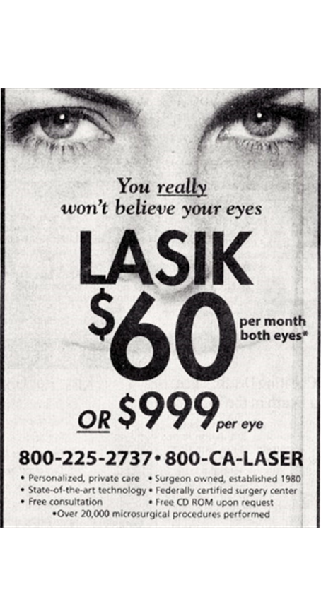
Rule 13, Communications to the Public Highlights
No false, deceptive or misleading information
No deceptive omissions
No appeals to patients’ anxiety
Must not create unjustified expectations of results
Must disclose risks
Must not misrepresent credentials
No unsubstantiated claims of superiority
Notes:
When the Code of Ethics was written in the early 80’s
felt it was essential to be approved by the FTC
Rule 13 was part of the original Code
that FTC approved in 1983,
The Code was adopted by the Academy in November 1983
Went into effect January 1984.
Rule 13 governs advertising by members of the AAO
The close parallels to FTC law are obvious
(read)

Slide 5
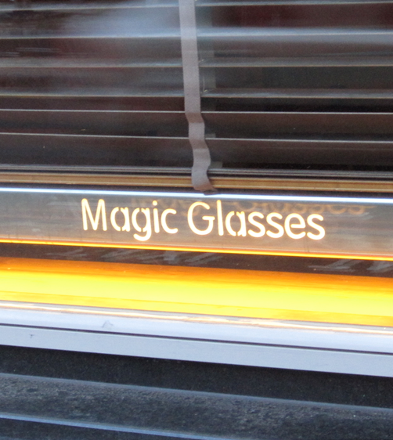
Advertising: Types of Claims
Express claims - specifically states support
“Studies show”
“Clinical research proves”
General claims – non-specific global claims
“medically proven”
Implied Claims - suggests something is true
“Throw away your glasses” (or related graphic)
Notes:
5
Express Claims -advertiser must document that research was conducted, prior to the advertisement, and that the research was performed in an objective manner using generally accepted research methods in the scientific community.
Claim: “95% of LASIK patients achieve 20/40 vision or better.”
If this claim is based on a clinical study, the surgeon making the claim needs to be sure the study is scientifically reliable, that he or she is performing the same surgery using the same protocol as was used in the study, and that the surgeon’s outcomes do not vary significantly from the reported results.
General claim (such as “medically proven”) usually requires at least two well-controlled clinical tests.
(1) the study subjects are suitable for study, assigned to test groups to minimize bias, and are controlled for variables;
(2) if comparative, the study is documented as a double-blind study; and
(3) a protocol identifies the objectives of the study, explanation of the study methods, and describes the use and comparison of the control to the study drug or procedure.
Implied Claim. The advertiser should:
1. give a source of the claim
or
2. avoid such a claim
And
The claim should not exceed the data from the source from which the claim is made.

Slide 6
Practical Advertising: Substantiation
Applies to all claims, expressed or implied
Advertising claims must be substantiable
Documentation sufficient to support the claim
Objective fact, not anecdotal
Competent, reliable science
Substantiation must be available at time of claim is made

Slide 7
Practical Advertising: Claims of Superiority
Must be subject to objective substantiation
“More than 1000 procedures per year”
“Board certified”
Puffery or exaggeration, e.g. “Best service in the galaxy”
Common in non-medical advertising
May be considered unethical in medical advertising

Slide 8
Practical Advertising Patient Testimonials
State law varies - May be illegal (TX, IL, NY)¹
Must convey typical results
Must note that not all patient may have the same results
Must disclose possible complications
Must include alternatives
1) OMIC Publication Archives

Slide 9
Short Case Study
The Case of Golden Eyecare

Slide 10
Review This Ad

Slide 11
Golden Eyecare “The Leading Eye Care Provider”
Implication that the Golden EyeCare practice is superior (the “leader”) to all the other ophthalmology practices in the Tri-State area.
Unable to realistically substantiate this claim without access to all business and surgical databases of each practice in that entire area.

Slide 12
Golden Eyecare “Performed Over 40,000 LASIK Procedures”
An express claim intended to imply a level of experience for the surgeons in the group.
Misleading if, as a group, they have performed 40,000 LASIK procedures, but one relatively new surgeon has performed a much low number.
May disadvantage the competitor down the street who is in solo practice, but has experience and volume.

Slide 13
Golden Eyecare “Visual Freedom…Only takes a Few Minutes”
Potential to created unrealistic patient expectations of permanence.
May fall into an “express” or “implied” claim per FTC guidelines.
Advertisers must have proof to back up claims that consumers may reasonably understand from an ad.
Implies freedom from corrective lenses for a lifetime.

Slide 14
Enforcement and Perils: FTC Remedies for Serious Cases
In particularly egregious cases, the Federal Trade Commission (FTC) can:
Order the advertiser to cease and desist from running an advertisement
Can collect civil penalties up to $40,000
Require retractions, corrective advertising
Some states allow the public to collect statutory penalties, e.g., New York allows up to $50 per false ad; these penalties can add up quickly depending on the ad distribution.
The public may also sue for damages to recover money paid for services that were falsely advertised and may make malpractice claims claim for outcomes that differ from those promised in an ad.

Slide 15
FDA Letters to Eye Care Professionals (2009 and 2011)
“The FDA has received complaints that eye care professionals’ advertisements for LASIK procedures and FDA-approved lasers used for the LASIK procedures failed to inform consumers of the indications, limitations, and risks associated with LASIK procedures.
The FDA believes that eliminating deceptive or misleading health-related advertising claims is an important part of protecting the public health.
In determining whether the advertisement is misleading, the FDA takes into account not only representations made or suggested by statement, word, or design, but also the extent to which the advertisement fails to reveal facts … with respect to consequences which may result from the use of the device…”

Slide 16
What Do You Think?
What advertising is misleading and what is informative?
What claims of superiority are truly substantiatable?
Can balanced advertising demonstrate both risks and benefits of surgical procedures?
How does a practice promote qualifications of providers without making claims of superiority that cannot be substantiated?

