Slide 1
Q
Photoablative Surgery Issues
?
?
Two very broad categories of post-surgical issues

Slide 2
A
Photoablative Surgery Issues
Optical Issues
Structural Issues
Two very broad categories of post-surgical issues

Slide 3
Q
Photoablative Surgery Issues
Optical Issues
Structural
?
?
?
Three basic ways you can have a suboptimal visual outcome

Slide 4
A
Photoablative Surgery Issues
Optical Issues
Structural
Overcorrection
Undercorrection
Aberrations
Three basic ways you can have a suboptimal visual outcome

Slide 5
Q
Photoablative Surgery Issues
Optical Issues
Structural
Overcorrection
Undercorrection
Aberrations
What is the most common cause of overcorrection?

Slide 6
Q/A
Photoablative Surgery Issues
Optical Issues
Structural
Overcorrection
Undercorrection
Aberrations
What is the most common cause of overcorrection?
Stromal dehydration
moisture state

Slide 7
A
Photoablative Surgery Issues
Optical Issues
Structural
Overcorrection
Undercorrection
Aberrations
What is the most common cause of overcorrection?
Stromal dehydration

Slide 8
Q
Photoablative Surgery Issues
Optical Issues
Structural
Overcorrection
Undercorrection
Aberrations
What is the most common cause of overcorrection?
Stromal dehydration
How does stromal dehydration lead to overcorrection?

Slide 9
A
Photoablative Surgery Issues
Optical Issues
Structural
Overcorrection
Undercorrection
Aberrations
What is the most common cause of overcorrection?
Stromal dehydration
How does stromal dehydration lead to overcorrection?
If the stroma is dehydrated, it ablates more readily, and thus more tissue is removed per laser burst

Slide 10
Q
Photoablative Surgery Issues
Optical Issues
Structural
Overcorrection
Undercorrection
Aberrations
What is the most common cause of overcorrection?
Stromal dehydration
How does stromal dehydration lead to overcorrection?
If the stroma is dehydrated, it ablates more readily, and thus more tissue is removed per laser burst
What surgical factors are common causes of stromal dehydration?
--?
--?

Slide 11
A
Photoablative Surgery Issues
Optical Issues
Structural
Overcorrection
Undercorrection
Aberrations
What is the most common cause of overcorrection?
Stromal dehydration
How does stromal dehydration lead to overcorrection?
If the stroma is dehydrated, it ablates more readily, and thus more tissue is removed per laser burst
What surgical factors are common causes of stromal dehydration?
--Allowing too much time to pass between denuding the epithelium/cutting the flap, and ablating the stroma
--Humidity and/or temperature in the excimer room being outside of the manufacturer’s recommendations

Slide 12
Q
Photoablative Surgery Issues
Optical Issues
Structural
Overcorrection
Undercorrection
Aberrations
What is the most common cause of overcorrection?
Stromal dehydration
How does stromal dehydration lead to overcorrection?
If the stroma is dehydrated, it ablates more readily, and thus more tissue is removed per laser burst
What surgical factors are common causes of stromal dehydration?
--Allowing too much time to pass between denuding the epithelium/cutting the flap, and ablating the stroma
--Humidity and/or temperature in the excimer room being outside of the manufacturer’s recommendations
If a pt is overcorrected, how soon should surgical correction be undertaken?

Slide 13
A
Photoablative Surgery Issues
Optical Issues
Structural
Overcorrection
Undercorrection
Aberrations
What is the most common cause of overcorrection?
Stromal dehydration
How does stromal dehydration lead to overcorrection?
If the stroma is dehydrated, it ablates more readily, and thus more tissue is removed per laser burst
What surgical factors are common causes of stromal dehydration?
--Allowing too much time to pass between denuding the epithelium/cutting the flap, and ablating the stroma
--Humidity and/or temperature in the excimer room being outside of the manufacturer’s recommendations
If a pt is overcorrected, how soon should surgical correction be undertaken?
As many pts experience some degree of spontaneous regression over the first 3-6 months, it is prudent to allow several months to pass before intervening

Slide 14
Q
Photoablative Surgery Issues
Optical Issues
Structural
Overcorrection
Undercorrection
Aberrations
What are the most common causes of undercorrection?
--?
--?

Slide 15
A
Photoablative Surgery Issues
Optical Issues
Structural
Overcorrection
Undercorrection
Aberrations
What are the most common causes of undercorrection?
--High degrees of pre-op myopia or hyperopia
--Spontaneous regression

Slide 16
Q
Photoablative Surgery Issues
Optical Issues
Structural
Overcorrection
Undercorrection
Aberrations
What are the most common causes of undercorrection?
--High degrees of pre-op myopia or hyperopia
--Spontaneous regression
What steps can be taken to reduce or even reverse regression leading to undercorrection?
--?
--?

Slide 17
Q/A
Photoablative Surgery Issues
Optical Issues
Structural
Overcorrection
Undercorrection
Aberrations
What are the most common causes of undercorrection?
--High degrees of pre-op myopia or hyperopia
--Spontaneous regression
What steps can be taken to reduce or even reverse regression leading to undercorrection?
--Use of MMC at the time of ablation
--Heavy topical steroid use in the post-op period if regression is noted to be ongoing
abb.

Slide 18
A
Photoablative Surgery Issues
Optical Issues
Structural
Overcorrection
Undercorrection
Aberrations
What are the most common causes of undercorrection?
--High degrees of pre-op myopia or hyperopia
--Spontaneous regression
What steps can be taken to reduce or even reverse regression leading to undercorrection?
--Use of MMC at the time of ablation
--Heavy topical steroid use in the post-op period if regression is noted to be ongoing

Slide 19
Q
Photoablative Surgery Issues
Optical Issues
Structural
Overcorrection
Undercorrection
Aberrations
What are the most common causes of undercorrection?
--High degrees of pre-op myopia or hyperopia
--Spontaneous regression
What steps can be taken to reduce or even reverse regression leading to undercorrection?
--Use of MMC at the time of ablation
--Heavy topical steroid use in the post-op period if regression is noted to be ongoing
If a pt is undercorrected, at what point should surgical correction be undertaken?

Slide 20
Q/A
Photoablative Surgery Issues
Optical Issues
Structural
Overcorrection
Undercorrection
Aberrations
What are the most common causes of undercorrection?
--High degrees of pre-op myopia or hyperopia
--Spontaneous regression
What steps can be taken to reduce or even reverse regression leading to undercorrection?
--Use of MMC at the time of ablation
--Heavy topical steroid use in the post-op period if regression is noted to be ongoing
If a pt is undercorrected, at what point should surgical correction be undertaken?
Once the refraction has stabilized, which usually takes at least 3 months
#

Slide 21
A
Photoablative Surgery Issues
Optical Issues
Structural
Overcorrection
Undercorrection
Aberrations
What are the most common causes of undercorrection?
--High degrees of pre-op myopia or hyperopia
--Spontaneous regression
What steps can be taken to reduce or even reverse regression leading to undercorrection?
--Use of MMC at the time of ablation
--Heavy topical steroid use in the post-op period if regression is noted to be ongoing
If a pt is undercorrected, at what point should surgical correction be undertaken?
Once the refraction has stabilized, which usually takes at least 3 months

Slide 22
Q
Photoablative Surgery Issues
Optical Issues
Structural
Overcorrection
Undercorrection
Aberrations
What are the most common causes of undercorrection?
--High degrees of pre-op myopia or hyperopia
--Spontaneous regression
What steps can be taken to reduce or even reverse regression leading to undercorrection?
--Use of MMC at the time of ablation
--Heavy topical steroid use in the post-op period if regression is noted to be ongoing
If a pt is undercorrected, at what point should surgical correction be undertaken?
Once the refraction has stabilized, which usually takes at least 3 months
What other complication, if present, should prompt the surgeon to wait even longer?

Slide 23
A
Photoablative Surgery Issues
Optical Issues
Structural
Overcorrection
Undercorrection
Aberrations
What are the most common causes of undercorrection?
--High degrees of pre-op myopia or hyperopia
--Spontaneous regression
What steps can be taken to reduce or even reverse regression leading to undercorrection?
--Use of MMC at the time of ablation
--Heavy topical steroid use in the post-op period if regression is noted to be ongoing
If a pt is undercorrected, at what point should surgical correction be undertaken?
Once the refraction has stabilized, which usually takes at least 3 months
What other complication, if present, should prompt the surgeon to wait even longer?
Post-op haze—if present, it portends a higher risk for further regression and/or haze formation

Slide 24
Q
Photoablative Surgery Issues
Optical Issues
Structural
Overcorrection
Undercorrection
Aberrations
What are the most common causes of undercorrection?
--High degrees of pre-op myopia or hyperopia
--Spontaneous regression
What steps can be taken to reduce or even reverse regression leading to undercorrection?
--Use of MMC at the time of ablation
--Heavy topical steroid use in the post-op period if regression is noted to be ongoing
If a pt is undercorrected, at what point should surgical correction be undertaken?
Once the refraction has stabilized, which usually takes at least 3 months
What other complication, if present, should prompt the surgeon to wait even longer?
Post-op haze—if present, it portends a higher risk for further regression and/or haze formation. In such cases, the prudent course is to wait at least 6-12 months prior to re-treating.
# to #

Slide 25
A
Photoablative Surgery Issues
Optical Issues
Structural
Overcorrection
Undercorrection
Aberrations
What are the most common causes of undercorrection?
--High degrees of pre-op myopia or hyperopia
--Spontaneous regression
What steps can be taken to reduce or even reverse regression leading to undercorrection?
--Use of MMC at the time of ablation
--Heavy topical steroid use in the post-op period if regression is noted to be ongoing
If a pt is undercorrected, at what point should surgical correction be undertaken?
Once the refraction has stabilized, which usually takes at least 3 months
What other complication, if present, should prompt the surgeon to wait even longer?
Post-op haze—if present, it portends a higher risk for further regression and/or haze formation. In such cases, the prudent course is to wait at least 6-12 months prior to re-treating.

Slide 26
Q
Photoablative Surgery Issues
Optical Issues
Structural
Overcorrection
Undercorrection
Aberrations
What factors are associated with the presence of post-op aberrations?
--?
--?
--?

Slide 27
Q/A
Photoablative Surgery Issues
Optical Issues
Structural
Overcorrection
Undercorrection
Aberrations
What factors are associated with the presence of post-op aberrations?
--High degrees of pre-op myopia, hyperopia, or astigmatism
--A smaller ablation zone
--The presence of aberrations pre-op
smaller v larger

Slide 28
A
Photoablative Surgery Issues
Optical Issues
Structural
Overcorrection
Undercorrection
Aberrations
What factors are associated with the presence of post-op aberrations?
--High degrees of pre-op myopia, hyperopia, or astigmatism
--A smaller ablation zone
--The presence of aberrations pre-op

Slide 29
Q
Photoablative Surgery Issues
Optical Issues
Structural
Overcorrection
Undercorrection
Aberrations
What factors are associated with the presence of post-op aberrations?
--High degrees of pre-op myopia, hyperopia, or astigmatism
--A smaller ablation zone
--The presence of aberrations pre-op
Which higher-order aberration is most contributory to pt symptoms?

Slide 30
A
Photoablative Surgery Issues
Optical Issues
Structural
Overcorrection
Undercorrection
Aberrations
What factors are associated with the presence of post-op aberrations?
--High degrees of pre-op myopia, hyperopia, or astigmatism
--A smaller ablation zone
--The presence of aberrations pre-op
Which higher-order aberration is most contributory to pt symptoms?
Spherical aberration

Slide 31
Q
Photoablative Surgery Issues
Optical Issues
Structural
Overcorrection
Undercorrection
Aberrations
What factors are associated with the presence of post-op aberrations?
--High degrees of pre-op myopia, hyperopia, or astigmatism
--A smaller ablation zone
--The presence of aberrations pre-op
Which higher-order aberration is most contributory to pt symptoms?
Spherical aberration
Speaking of pt symptoms…Three tend to occur most frequently. What are they?
--?
--?
--?

Slide 32
A
Photoablative Surgery Issues
Optical Issues
Structural
Overcorrection
Undercorrection
Aberrations
What factors are associated with the presence of post-op aberrations?
--High degrees of pre-op myopia, hyperopia, or astigmatism
--A smaller ablation zone
--The presence of aberrations pre-op
Which higher-order aberration is most contributory to pt symptoms?
Spherical aberration
Speaking of pt symptoms…Three tend to occur most frequently. What are they?
--Glare
--Haloes
--Ghost images

Slide 33
Q
Photoablative Surgery Issues
Optical Issues
Structural
Overcorrection
Undercorrection
Aberrations
What factors are associated with the presence of post-op aberrations?
--High degrees of pre-op myopia, hyperopia, or astigmatism
--A smaller ablation zone
--The presence of aberrations pre-op
Which higher-order aberration is most contributory to pt symptoms?
Spherical aberration
Speaking of pt symptoms…Three tend to occur most frequently. What are they?
--Glare
--Haloes
--Ghost images
Under what lighting condition are these more likely to occur?

Slide 34
A
Photoablative Surgery Issues
Optical Issues
Structural
Overcorrection
Undercorrection
Aberrations
What factors are associated with the presence of post-op aberrations?
--High degrees of pre-op myopia, hyperopia, or astigmatism
--A smaller ablation zone
--The presence of aberrations pre-op
Which higher-order aberration is most contributory to pt symptoms?
Spherical aberration
Speaking of pt symptoms…Three tend to occur most frequently. What are they?
--Glare
--Haloes
--Ghost images
Under what lighting condition are these more likely to occur?
Dim

Slide 35
Q
Photoablative Surgery Issues
Optical Issues
Structural
Overcorrection
Undercorrection
Aberrations
Why are they more prevalent in dim lighting conditions?
Probably because the larger pupil size brings into play aberrations induced at the edge of the ablation zone
Why would the edge of the ablation zone be particularly prone to producing aberrations?
Because the power of the cornea can shift markedly at the junction of treated and untreated cornea. This is especially true of hyperopic ablations, in which the midperiphery has been extensively ablated in order to steepen the central cornea.
What can be done to minimize the risk of this?
Creation of a ‘blend zone’ at the edge of the ablation so as not to have such an abrupt transition in corneal power
What factors are associated with the presence of post-op aberrations?
--High degrees of pre-op myopia, hyperopia, or astigmatism
--A smaller ablation zone
--The presence of aberrations pre-op
Which higher-order aberration is most contributory to pt symptoms?
Spherical aberration
Speaking of pt symptoms…Three tend to occur most frequently. What are they?
--Glare
--Haloes
--Ghost images
Under what lighting condition are these more likely to occur?
Dim

Slide 36
A
Photoablative Surgery Issues
Optical Issues
Structural
Overcorrection
Undercorrection
Aberrations
Why are they more prevalent in dim lighting conditions?
Most commonly, because the larger pupil size brings into play aberrations induced at the edge of the ablation zone
Why would the edge of the ablation zone be particularly prone to producing aberrations?
Because the power of the cornea can shift markedly at the junction of treated and untreated cornea. This is especially true of hyperopic ablations, in which the midperiphery has been extensively ablated in order to steepen the central cornea.
What can be done to minimize the risk of this?
Creation of a ‘blend zone’ at the edge of the ablation so as not to have such an abrupt transition in corneal power
What factors are associated with the presence of post-op aberrations?
--High degrees of pre-op myopia, hyperopia, or astigmatism
--A smaller ablation zone
--The presence of aberrations pre-op
Which higher-order aberration is most contributory to pt symptoms?
Spherical aberration
Speaking of pt symptoms…Three tend to occur most frequently. What are they?
--Glare
--Haloes
--Ghost images
Under what lighting condition are these more likely to occur?
Dim

Slide 37
Q
Photoablative Surgery Issues
Optical Issues
Structural
Overcorrection
Undercorrection
Aberrations
Why are they more prevalent in dim lighting conditions?
Most commonly, because the larger pupil size brings into play aberrations induced at the edge of the ablation zone
Why would the edge of the ablation zone be particularly prone to producing aberrations?
Because the power of the cornea can shift markedly at the junction of treated and untreated cornea. This is especially true of hyperopic ablations, in which the midperiphery has been extensively ablated in order to steepen the central cornea.
What can be done to minimize the risk of this?
Creation of a ‘blend zone’ at the edge of the ablation so as not to have such an abrupt transition in corneal power
What factors are associated with the presence of post-op aberrations?
--High degrees of pre-op myopia, hyperopia, or astigmatism
--A smaller ablation zone
--The presence of aberrations pre-op
Which higher-order aberration is most contributory to pt symptoms?
Spherical aberration
Speaking of pt symptoms…Three tend to occur most frequently. What are they?
--Glare
--Haloes
--Ghost images
Under what lighting condition are these more likely to occur?
Dim

Slide 38
A
Photoablative Surgery Issues
Optical Issues
Structural
Overcorrection
Undercorrection
Aberrations
Why are they more prevalent in dim lighting conditions?
Most commonly, because the larger pupil size brings into play aberrations induced at the edge of the ablation zone
Why would the edge of the ablation zone be particularly prone to producing aberrations?
Because the power of the cornea can shift markedly at the junction of treated and untreated cornea. This is especially true of hyperopic ablations, in which the midperiphery has been extensively ablated in order to steepen the central cornea.
What can be done to minimize the risk of this?
Creation of a ‘blend zone’ at the edge of the ablation so as not to have such an abrupt transition in corneal power
What factors are associated with the presence of post-op aberrations?
--High degrees of pre-op myopia, hyperopia, or astigmatism
--A smaller ablation zone
--The presence of aberrations pre-op
Which higher-order aberration is most contributory to pt symptoms?
Spherical aberration
Speaking of pt symptoms…Three tend to occur most frequently. What are they?
--Glare
--Haloes
--Ghost images
Under what lighting condition are these more likely to occur?
Dim

Slide 39
Q
Photoablative Surgery Issues
Optical Issues
Structural
Overcorrection
Undercorrection
Aberrations
Why are they more prevalent in dim lighting conditions?
Most commonly, because the larger pupil size brings into play aberrations induced at the edge of the ablation zone
Why would the edge of the ablation zone be particularly prone to producing aberrations?
Because the power of the cornea can shift markedly at the junction of treated and untreated cornea. This is especially true of hyperopic ablations, in which the midperiphery has been extensively ablated in order to steepen the central cornea.
What can be done to minimize the risk of this?
Creation of a ‘blend zone’ at the edge of the ablation so as not to have such an abrupt transition in corneal power
What factors are associated with the presence of post-op aberrations?
--High degrees of pre-op myopia, hyperopia, or astigmatism
--A smaller ablation zone
--The presence of aberrations pre-op
Which higher-order aberration is most contributory to pt symptoms?
Spherical aberration
myopic vs hyperopic
steepen vs flatten
Speaking of pt symptoms…Three tend to occur most frequently. What are they?
--Glare
--Haloes
--Ghost images
Under what lighting condition are these more likely to occur?
Dim

Slide 40
A
Photoablative Surgery Issues
Optical Issues
Structural
Overcorrection
Undercorrection
Aberrations
Why are they more prevalent in dim lighting conditions?
Most commonly, because the larger pupil size brings into play aberrations induced at the edge of the ablation zone
Why would the edge of the ablation zone be particularly prone to producing aberrations?
Because the power of the cornea can shift markedly at the junction of treated and untreated cornea. This is especially true of hyperopic ablations, in which the midperiphery has been extensively ablated in order to steepen the central cornea.
What can be done to minimize the risk of this?
Creation of a ‘blend zone’ at the edge of the ablation so as not to have such an abrupt transition in corneal power
What factors are associated with the presence of post-op aberrations?
--High degrees of pre-op myopia, hyperopia, or astigmatism
--A smaller ablation zone
--The presence of aberrations pre-op
Which higher-order aberration is most contributory to pt symptoms?
Spherical aberration
Speaking of pt symptoms…Three tend to occur most frequently. What are they?
--Glare
--Haloes
--Ghost images
Under what lighting condition are these more likely to occur?
Dim

Slide 41
Q
Photoablative Surgery Issues
Optical Issues
Structural
Overcorrection
Undercorrection
Aberrations
Why are they more prevalent in dim lighting conditions?
Most commonly, because the larger pupil size brings into play aberrations induced at the edge of the ablation zone
Why would the edge of the ablation zone be particularly prone to producing aberrations?
Because the power of the cornea can shift markedly at the junction of treated and untreated cornea. This is especially true of hyperopic ablations, in which the midperiphery has been extensively ablated in order to steepen the central cornea.
What can be done to minimize the risk of this?
Creation of a ‘blend zone’ at the edge of the ablation so as not to have such an abrupt transition in corneal power
What factors are associated with the presence of post-op aberrations?
--High degrees of pre-op myopia, hyperopia, or astigmatism
--A smaller ablation zone
--The presence of aberrations pre-op
Which higher-order aberration is most contributory to pt symptoms?
Spherical aberration
Speaking of pt symptoms…Three tend to occur most frequently. What are they?
--Glare
--Haloes
--Ghost images
Under what lighting condition are these more likely to occur?
Dim

Slide 42
Q/A
Photoablative Surgery Issues
Optical Issues
Structural
Overcorrection
Undercorrection
Aberrations
Why are they more prevalent in dim lighting conditions?
Most commonly, because the larger pupil size brings into play aberrations induced at the edge of the ablation zone
Why would the edge of the ablation zone be particularly prone to producing aberrations?
Because the power of the cornea can shift markedly at the junction of treated and untreated cornea. This is especially true of hyperopic ablations, in which the midperiphery has been extensively ablated in order to steepen the central cornea.
What can be done to minimize the risk of this?
Creation of a ‘blend zone’ at the edge of the ablation so as not to have such an abrupt transition in corneal power
What factors are associated with the presence of post-op aberrations?
--High degrees of pre-op myopia, hyperopia, or astigmatism
--A smaller ablation zone
--The presence of aberrations pre-op
Which higher-order aberration is most contributory to pt symptoms?
Spherical aberration
Speaking of pt symptoms…Three tend to occur most frequently. What are they?
--Glare
--Haloes
--Ghost images
Under what lighting condition are these more likely to occur?
Dim
two words

Slide 43
A
Photoablative Surgery Issues
Optical Issues
Structural
Overcorrection
Undercorrection
Aberrations
Why are they more prevalent in dim lighting conditions?
Most commonly, because the larger pupil size brings into play aberrations induced at the edge of the ablation zone
Why would the edge of the ablation zone be particularly prone to producing aberrations?
Because the power of the cornea can shift markedly at the junction of treated and untreated cornea. This is especially true of hyperopic ablations, in which the midperiphery has been extensively ablated in order to steepen the central cornea.
What can be done to minimize the risk of this?
Creation of a ‘blend zone’ at the edge of the ablation so as not to have such an abrupt transition in corneal power
What factors are associated with the presence of post-op aberrations?
--High degrees of pre-op myopia, hyperopia, or astigmatism
--A smaller ablation zone
--The presence of aberrations pre-op
Which higher-order aberration is most contributory to pt symptoms?
Spherical aberration
Speaking of pt symptoms…Three tend to occur most frequently. What are they?
--Glare
--Haloes
--Ghost images
Under what lighting condition are these more likely to occur?
Dim

Slide 44
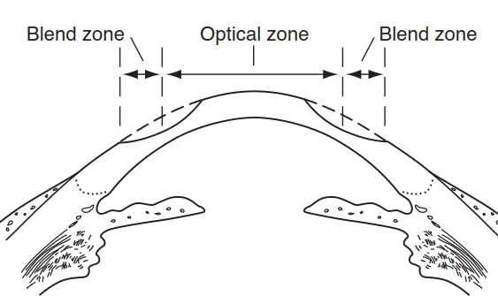
Correction of hyperopia by steepening the central corneal optical zone and blending the periphery

Slide 45
Photoablative Surgery Issues
al Issues
Structural Issues
Next we will look at structural post-op issues

Slide 46
Q
Photoablative Surgery Issues
al Issues
Structural Issues
?
?
?
?
?
Five non-visual problems you may encounter post-op

Slide 47
A
Photoablative Surgery Issues
al Issues
Structural Issues
Central
islands
Decentered
ablations
Steroid-induced
IOP elevation
Central toxic
keratopathy
Infectious
keratitis
Five non-visual problems you may encounter post-op

Slide 48
Q
Photoablative Surgery Issues
al Issues
Structural Issues
Central
islands
Decentered
ablations
Steroid-induced
IOP elevation
Central toxic
keratopathy
Infectious
keratitis
In this context, what is a central island?

Slide 49
A
Photoablative Surgery Issues
al Issues
Structural Issues
Central
islands
Decentered
ablations
Steroid-induced
IOP elevation
Central toxic
keratopathy
Infectious
keratitis
In this context, what is a central island?
A small (<1 mm) area of elevation (at least 1D’s worth) within the area of flattening after myopic ablation

Slide 50
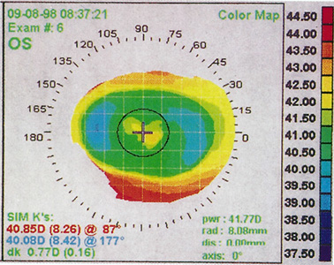
Central island

Slide 51
Q
Photoablative Surgery Issues
al Issues
Structural Issues
Central
islands
Decentered
ablations
Steroid-induced
IOP elevation
Central toxic
keratopathy
Infectious
keratitis
In this context, what is a central island?
A small (<1 mm) area of elevation (at least 1D’s worth) within the area of flattening after myopic ablation
In terms of symptoms, how does a central island manifest?

Slide 52
A
Photoablative Surgery Issues
al Issues
Structural Issues
Central
islands
Decentered
ablations
Steroid-induced
IOP elevation
Central toxic
keratopathy
Infectious
keratitis
In this context, what is a central island?
A small (<1 mm) area of elevation (at least 1D’s worth) within the area of flattening after myopic ablation
In terms of symptoms, how does a central island manifest?
As degraded central vision, which may include decreased acuity and monocular diplopia

Slide 53
Q
Photoablative Surgery Issues
al Issues
Structural Issues
Central
islands
Decentered
ablations
Steroid-induced
IOP elevation
Central toxic
keratopathy
Infectious
keratitis
In this context, what is a central island?
A small (<1 mm) area of elevation (at least 1D’s worth) within the area of flattening after myopic ablation
In terms of symptoms, how does a central island manifest?
As degraded central vision, which may include decreased acuity and monocular diplopia
Are central islands a common phenomenon?

Slide 54
A
Photoablative Surgery Issues
al Issues
Structural Issues
Central
islands
Decentered
ablations
Steroid-induced
IOP elevation
Central toxic
keratopathy
Infectious
keratitis
In this context, what is a central island?
A small (<1 mm) area of elevation (at least 1D’s worth) within the area of flattening after myopic ablation
In terms of symptoms, how does a central island manifest?
As degraded central vision, which may include decreased acuity and monocular diplopia
Are central islands a common phenomenon?
Not with current excimer technology, no

Slide 55
Q
Photoablative Surgery Issues
al Issues
Structural Issues
Central
islands
Decentered
ablations
Steroid-induced
IOP elevation
Central toxic
keratopathy
Infectious
keratitis
In this context, what is a central island?
A small (<1 mm) area of elevation (at least 1D’s worth) within the area of flattening after myopic ablation
In terms of symptoms, how does a central island manifest?
As degraded central vision, which may include decreased acuity and monocular diplopia
Are central islands a common phenomenon?
Not with current excimer technology, no
Is the presence of a central island an indication for an immediate surgical revision?

Slide 56
A
Photoablative Surgery Issues
al Issues
Structural Issues
Central
islands
Decentered
ablations
Steroid-induced
IOP elevation
Central toxic
keratopathy
Infectious
keratitis
In this context, what is a central island?
A small (<1 mm) area of elevation (at least 1D’s worth) within the area of flattening after myopic ablation
In terms of symptoms, how does a central island manifest?
As degraded central vision, which may include decreased acuity and monocular diplopia
Are central islands a common phenomenon?
Not with current excimer technology, no
Is the presence of a central island an indication for an immediate surgical revision?
Many will regress spontaneously, so no

Slide 57
Q
Photoablative Surgery Issues
al Issues
Structural Issues
Central
islands
Decentered
ablations
Steroid-induced
IOP elevation
Central toxic
keratopathy
Infectious
keratitis
What are common causes of a decentered ablation?
--?
--?
--?

Slide 58
A
Photoablative Surgery Issues
al Issues
Structural Issues
Central
islands
Decentered
ablations
Steroid-induced
IOP elevation
Central toxic
keratopathy
Infectious
keratitis
What are common causes of a decentered ablation?
--Loss of fixation by the operative eye
--Poor pre-op head positioning by the surgeon
--Failure to ensure the operative eye is oriented perpendicular to the laser

Slide 59
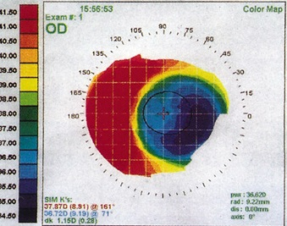
Visual axis
Decentered ablation

Slide 60
Q
Photoablative Surgery Issues
al Issues
Structural Issues
Central
islands
Decentered
ablations
Steroid-induced
IOP elevation
Central toxic
keratopathy
Infectious
keratitis
What are common causes of a decentered ablation?
--Loss of fixation by the operative eye
--Poor pre-op head positioning by the surgeon
--Failure to ensure the operative eye is oriented perpendicular to the laser
Is decentration more common with myopic, or hyperopic ablations?

Slide 61
A
Photoablative Surgery Issues
al Issues
Structural Issues
Central
islands
Decentered
ablations
Steroid-induced
IOP elevation
Central toxic
keratopathy
Infectious
keratitis
What are common causes of a decentered ablation?
--Loss of fixation by the operative eye
--Poor pre-op head positioning by the surgeon
--Failure to ensure the operative eye is oriented perpendicular to the laser
Is decentration more common with myopic, or hyperopic ablations?
Hyperopic

Slide 62
Q
Photoablative Surgery Issues
al Issues
Structural Issues
Central
islands
Decentered
ablations
Steroid-induced
IOP elevation
Central toxic
keratopathy
Infectious
keratitis
What are common causes of a decentered ablation?
--Loss of fixation by the operative eye
--Poor pre-op head positioning by the surgeon
--Failure to ensure the operative eye is oriented perpendicular to the laser
Is decentration more common with myopic, or hyperopic ablations?
Hyperopic
Is decentration more visually significant with myopic, or hyperopic ablations?

Slide 63
A
Photoablative Surgery Issues
al Issues
Structural Issues
Central
islands
Decentered
ablations
Steroid-induced
IOP elevation
Central toxic
keratopathy
Infectious
keratitis
What are common causes of a decentered ablation?
--Loss of fixation by the operative eye
--Poor pre-op head positioning by the surgeon
--Failure to ensure the operative eye is oriented perpendicular to the laser
Is decentration more common with myopic, or hyperopic ablations?
Hyperopic
Is decentration more visually significant with myopic, or hyperopic ablations?
Hyperopic

Slide 64
Q
Photoablative Surgery Issues
al Issues
Structural Issues
Central
islands
Decentered
ablations
Steroid-induced
IOP elevation
Central toxic
keratopathy
Infectious
keratitis
What are common causes of a decentered ablation?
--Loss of fixation by the operative eye
--Poor pre-op head positioning by the surgeon
--Failure to ensure the operative eye is oriented perpendicular to the laser
Is decentration more common with myopic, or hyperopic ablations?
Hyperopic
Is decentration more visually significant with myopic, or hyperopic ablations?
Hyperopic
Will decentration regress spontaneously like a central island?

Slide 65
A
Photoablative Surgery Issues
al Issues
Structural Issues
Central
islands
Decentered
ablations
Steroid-induced
IOP elevation
Central toxic
keratopathy
Infectious
keratitis
What are common causes of a decentered ablation?
--Loss of fixation by the operative eye
--Poor pre-op head positioning by the surgeon
--Failure to ensure the operative eye is oriented perpendicular to the laser
Is decentration more common with myopic, or hyperopic ablations?
Hyperopic
Is decentration more visually significant with myopic, or hyperopic ablations?
Hyperopic
Will decentration regress spontaneously like a central island?
No, it must be addressed surgically

Slide 66
Q
Photoablative Surgery Issues
al Issues
Structural Issues
Central
islands
Decentered
ablations
Steroid-induced
IOP elevation
Central toxic
keratopathy
Infectious
keratitis
What is the main risk factor for steroid-induced IOP elevation?

Slide 67
A
Photoablative Surgery Issues
al Issues
Structural Issues
Central
islands
Decentered
ablations
Steroid-induced
IOP elevation
Central toxic
keratopathy
Infectious
keratitis
What is the main risk factor for steroid-induced IOP elevation?
Use after surgery for a prolonged period of time

Slide 68
Q
Photoablative Surgery Issues
al Issues
Structural Issues
Central
islands
Decentered
ablations
Steroid-induced
IOP elevation
Central toxic
keratopathy
Infectious
keratitis
What is the main risk factor for steroid-induced IOP elevation?
Use after surgery for a prolonged period of time
Which class of procedure is at increased risk?

Slide 69
A
Photoablative Surgery Issues
al Issues
Structural Issues
Central
islands
Decentered
ablations
Steroid-induced
IOP elevation
Central toxic
keratopathy
Infectious
keratitis
What is the main risk factor for steroid-induced IOP elevation?
Use after surgery for a prolonged period of time
Which class of procedure is at increased risk?
Surface ablation procedures

Slide 70
Q
Photoablative Surgery Issues
al Issues
Structural Issues
Central
islands
Decentered
ablations
Steroid-induced
IOP elevation
Central toxic
keratopathy
Infectious
keratitis
What is the main risk factor for steroid-induced IOP elevation?
Use after surgery for a prolonged period of time
Which class of procedure is at increased risk?
Surface ablation procedures
Why surface procedures?

Slide 71
A
Photoablative Surgery Issues
al Issues
Structural Issues
Central
islands
Decentered
ablations
Steroid-induced
IOP elevation
Central toxic
keratopathy
Infectious
keratitis
What is the main risk factor for steroid-induced IOP elevation?
Use after surgery for a prolonged period of time
Which class of procedure is at increased risk?
Surface ablation procedures
Why surface procedures?
Because steroids are often used for months afterwards to prevent haze formation

Slide 72
Q
Photoablative Surgery Issues
al Issues
Structural Issues
Central
islands
Decentered
ablations
Steroid-induced
IOP elevation
Central toxic
keratopathy
Infectious
keratitis
What is the main risk factor for steroid-induced IOP elevation?
Use after surgery for a prolonged period of time
Which class of procedure is at increased risk?
Surface ablation procedures
Why surface procedures?
Because steroids are often used for months afterwards to prevent haze formation
Why is managing IOP after photoablative surgery especially challenging?

Slide 73
A
Photoablative Surgery Issues
al Issues
Structural Issues
Central
islands
Decentered
ablations
Steroid-induced
IOP elevation
Central toxic
keratopathy
Infectious
keratitis
What is the main risk factor for steroid-induced IOP elevation?
Use after surgery for a prolonged period of time
Which class of procedure is at increased risk?
Surface ablation procedures
Why surface procedures?
Because steroids are often used for months afterwards to prevent haze formation
Why is managing IOP after photoablative surgery especially challenging?
Because altered corneal thickness and curvature renders applanation tonometry artifactually low. Fluid under a LASIK flap can do the same.

Slide 74
A
Photoablative Surgery Issues
al Issues
Structural Issues
Central
islands
Decentered
ablations
Steroid-induced
IOP elevation
Central toxic
keratopathy
Infectious
keratitis
What is the main risk factor for steroid-induced IOP elevation?
Use after surgery for a prolonged period of time
Which class of procedure is at increased risk?
Surface ablation procedures
Why surface procedures?
Because steroids are often used for months afterwards to prevent haze formation
Why is managing IOP after photoablative surgery especially challenging?
Because altered corneal thickness and curvature renders applanation tonometry artifactually low. Fluid under a LASIK flap can do the same. The only method of measuring IOP that is reliable after photoablative refractive surgery is dynamic contour tonometry.
two words

Slide 75
A
Photoablative Surgery Issues
al Issues
Structural Issues
Central
islands
Decentered
ablations
Steroid-induced
IOP elevation
Central toxic
keratopathy
Infectious
keratitis
What is the main risk factor for steroid-induced IOP elevation?
Use after surgery for a prolonged period of time
Which class of procedure is at increased risk?
Surface ablation procedures
Why surface procedures?
Because steroids are often used for months afterwards to prevent haze formation
Why is managing IOP after photoablative surgery especially challenging?
Because altered corneal thickness and curvature renders applanation tonometry artifactually low. Fluid under a LASIK flap can do the same. The only method of measuring IOP that is reliable after photoablative refractive surgery is dynamic contour tonometry.

Slide 76
Q
Photoablative Surgery Issues
al Issues
Structural Issues
Central
islands
Decentered
ablations
Steroid-induced
IOP elevation
Central toxic
keratopathy
Infectious
keratitis
What is central toxic keratopathy?

Slide 77
A
Photoablative Surgery Issues
al Issues
Structural Issues
Central
islands
Decentered
ablations
Steroid-induced
IOP elevation
Central toxic
keratopathy
Infectious
keratitis
What is central toxic keratopathy?
The development of acute, nonprogressive central corneal opacification in the immediate post-op period

Slide 78
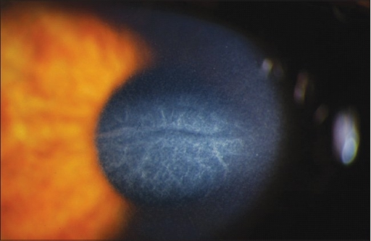
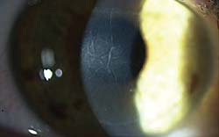
Central toxic keratopathy

Slide 79
A
Photoablative Surgery Issues
al Issues
Structural Issues
Central
islands
Decentered
ablations
Steroid-induced
IOP elevation
Central toxic
keratopathy
Infectious
keratitis
What is central toxic keratopathy?
The development of acute, nonprogressive central corneal opacification in the immediate post-op period
Is it rare, or common?

Slide 80
A
Photoablative Surgery Issues
al Issues
Structural Issues
Central
islands
Decentered
ablations
Steroid-induced
IOP elevation
Central toxic
keratopathy
Infectious
keratitis
What is central toxic keratopathy?
The development of acute, nonprogressive central corneal opacification in the immediate post-op period
Is it rare, or common?
Rare

Slide 81
A
Photoablative Surgery Issues
al Issues
Structural Issues
Central
islands
Decentered
ablations
Steroid-induced
IOP elevation
Central toxic
keratopathy
Infectious
keratitis
What is central toxic keratopathy?
The development of acute, nonprogressive central corneal opacification in the immediate post-op period
Is it rare, or common? Inflammatory, or noninflammatory?
Rare

Slide 82
A
Photoablative Surgery Issues
al Issues
Structural Issues
Central
islands
Decentered
ablations
Steroid-induced
IOP elevation
Central toxic
keratopathy
Infectious
keratitis
What is central toxic keratopathy?
The development of acute, nonprogressive central corneal opacification in the immediate post-op period
Is it rare, or common? Inflammatory, or noninflammatory?
Rare. Noninflammatory.

Slide 83
Q
Photoablative Surgery Issues
al Issues
Structural Issues
Central
islands
Decentered
ablations
Steroid-induced
IOP elevation
Central toxic
keratopathy
Infectious
keratitis
What is central toxic keratopathy?
The development of acute, nonprogressive central corneal opacification in the immediate post-op period
Is it rare, or common? Inflammatory, or noninflammatory?
Rare. Noninflammatory.
What is the cause?

Slide 84
A
Photoablative Surgery Issues
al Issues
Structural Issues
Central
islands
Decentered
ablations
Steroid-induced
IOP elevation
Central toxic
keratopathy
Infectious
keratitis
What is central toxic keratopathy?
The development of acute, nonprogressive central corneal opacification in the immediate post-op period
Is it rare, or common? Inflammatory, or noninflammatory?
Rare. Noninflammatory.
What is the cause?
It is unknown as of this writing

Slide 85
Q
Photoablative Surgery Issues
al Issues
Structural Issues
Central
islands
Decentered
ablations
Steroid-induced
IOP elevation
Central toxic
keratopathy
Infectious
keratitis
What is central toxic keratopathy?
The development of acute, nonprogressive central corneal opacification in the immediate post-op period
Is it rare, or common? Inflammatory, or noninflammatory?
Rare. Noninflammatory.
What is the cause?
It is unknown as of this writing
In addition to haze formation, what other undesirable effect does it have?

Slide 86
Q/A
Photoablative Surgery Issues
al Issues
Structural Issues
Central
islands
Decentered
ablations
Steroid-induced
IOP elevation
Central toxic
keratopathy
Infectious
keratitis
What is central toxic keratopathy?
The development of acute, nonprogressive central corneal opacification in the immediate post-op period
Is it rare, or common? Inflammatory, or noninflammatory?
Rare. Noninflammatory.
What is the cause?
It is unknown as of this writing
In addition to haze formation, what other undesirable effect does it have?
It causes flattening of the anterior cornea, thereby producing a hyperopic shift
flattening v steepening
myopic v hyperopic

Slide 87
Q/A
Photoablative Surgery Issues
al Issues
Structural Issues
Central
islands
Decentered
ablations
Steroid-induced
IOP elevation
Central toxic
keratopathy
Infectious
keratitis
What is central toxic keratopathy?
The development of acute, nonprogressive central corneal opacification in the immediate post-op period
Is it rare, or common? Inflammatory, or noninflammatory?
Rare. Noninflammatory.
What is the cause?
It is unknown as of this writing
In addition to haze formation, what other undesirable effect does it have?
It causes flattening of the anterior cornea, thereby producing a hyperopic shift

Slide 88
Q
Photoablative Surgery Issues
al Issues
Structural Issues
Central
islands
Decentered
ablations
Steroid-induced
IOP elevation
Central toxic
keratopathy
Infectious
keratitis
What is central toxic keratopathy?
The development of acute, nonprogressive central corneal opacification in the immediate post-op period
Is it rare, or common? Inflammatory, or noninflammatory?
Rare. Noninflammatory.
What is the cause?
It is unknown as of this writing
In addition to haze formation, what other undesirable effect does it have?
It causes flattening of the anterior cornea, thereby producing a hyperopic shift
How is it treated?

Slide 89
A
Photoablative Surgery Issues
al Issues
Structural Issues
Central
islands
Decentered
ablations
Steroid-induced
IOP elevation
Central toxic
keratopathy
Infectious
keratitis
What is central toxic keratopathy?
The development of acute, nonprogressive central corneal opacification in the immediate post-op period
Is it rare, or common? Inflammatory, or noninflammatory?
Rare. Noninflammatory.
What is the cause?
It is unknown as of this writing
In addition to haze formation, what other undesirable effect does it have?
It causes flattening of the anterior cornea, thereby producing a hyperopic shift
How is it treated?
Hypertonic solutions have been proposed, but their efficacy remains unproven

Slide 90
Q
Photoablative Surgery Issues
al Issues
Structural Issues
Central
islands
Decentered
ablations
Steroid-induced
IOP elevation
Central toxic
keratopathy
Infectious
keratitis
Which is more vulnerable to post-op infection—surface ablation, or LASIK?

Slide 91
A
Photoablative Surgery Issues
al Issues
Structural Issues
Central
islands
Decentered
ablations
Steroid-induced
IOP elevation
Central toxic
keratopathy
Infectious
keratitis
Which is more vulnerable to post-op infection—surface ablation, or LASIK?
Surface ablation

Slide 92
Q
Photoablative Surgery Issues
al Issues
Structural Issues
Central
islands
Decentered
ablations
Steroid-induced
IOP elevation
Central toxic
keratopathy
Infectious
keratitis
Which is more vulnerable to post-op infection—surface ablation, or LASIK?
Surface ablation
Why are surface-based procedures at greater risk for infection?

Slide 93
A
Photoablative Surgery Issues
al Issues
Structural Issues
Central
islands
Decentered
ablations
Steroid-induced
IOP elevation
Central toxic
keratopathy
Infectious
keratitis
Which is more vulnerable to post-op infection—surface ablation, or LASIK?
Surface ablation
Why are surface-based procedures at greater risk for infection?
Because the surgical technique involves creating a huge epi defect, thereby stripping the cornea of one of its primary defenses (ie, an intact epithelium)

Slide 94
A
Photoablative Surgery Issues
al Issues
Structural Issues
Central
islands
Decentered
ablations
Steroid-induced
IOP elevation
Central toxic
keratopathy
Infectious
keratitis
Which is more vulnerable to post-op infection—surface ablation, or LASIK?
Surface ablation
Why are surface-based procedures at greater risk for infection?
Because the surgical technique involves creating a huge epi defect, thereby stripping the cornea of one of its primary defenses (ie, an intact epithelium). Further, post-op management of surface surgery involves BCLs as well as long-term steroid use, both of which further the risk of bacterial infection.

Slide 95
Q
Photoablative Surgery Issues
al Issues
Structural Issues
Central
islands
Decentered
ablations
Steroid-induced
IOP elevation
Central toxic
keratopathy
Infectious
keratitis
Which is more vulnerable to post-op infection—surface ablation, or LASIK?
Surface ablation
Why are surface-based procedures at greater risk for infection?
Because the surgical technique involves creating a huge epi defect, thereby stripping the cornea of one of its primary defenses (ie, an intact epithelium). Further, post-op management of surface surgery involves BCLs as well as long-term steroid use, both of which further the risk of bacterial infection.
Which bugs are most commonly implicated?

Slide 96
A
Photoablative Surgery Issues
al Issues
Structural Issues
Central
islands
Decentered
ablations
Steroid-induced
IOP elevation
Central toxic
keratopathy
Infectious
keratitis
Which is more vulnerable to post-op infection—surface ablation, or LASIK?
Surface ablation
Why are surface-based procedures at greater risk for infection?
Because the surgical technique involves creating a huge epi defect, thereby stripping the cornea of one of its primary defenses (ie, an intact epithelium). Further, post-op management of surface surgery involves BCLs as well as long-term steroid use, both of which further the risk of bacterial infection.
Which bugs are most commonly implicated?
Gram+ lid flora: S aureus (including MRSA), Strep pneumoniae and viridans spp.

Slide 97
A
Photoablative Surgery Issues
al Issues
Structural Issues
Central
islands
Decentered
ablations
Steroid-induced
IOP elevation
Central toxic
keratopathy
Infectious
keratitis
Which is more vulnerable to post-op infection—surface ablation, or LASIK?
Surface ablation
Why are surface-based procedures at greater risk for infection?
Because the surgical technique involves creating a huge epi defect, thereby stripping the cornea of one of its primary defenses (ie, an intact epithelium). Further, post-op management of surface surgery involves BCLs as well as long-term steroid use, both of which further the risk of bacterial infection.
Which bugs are most commonly implicated?
Gram+ lid flora: S aureus (including MRSA), Strep pneumoniae and viridans spp. Less commonly, atypical mycobacteria, Nocardia, and various fungal species have been found.

Slide 98
Q
Photoablative Surgery Issues
al Issues
Structural Issues
Central
islands
Decentered
ablations
Steroid-induced
IOP elevation
Central toxic
keratopathy
Infectious
keratitis
Which is more vulnerable to post-op infection—surface ablation, or LASIK?
Surface ablation
Why are surface-based procedures at greater risk for infection?
Because the surgical technique involves creating a huge epi defect, thereby stripping the cornea of one of its primary defenses (ie, an intact epithelium). Further, post-op management of surface surgery involves BCLs as well as long-term steroid use, both of which further the risk of bacterial infection.
Which bugs are most commonly implicated?
Gram+ lid flora: S aureus (including MRSA), Strep pneumoniae and viridans spp. Less commonly, atypical mycobacteria, Nocardia, and various fungal species have been found.
Are flap-based procedures immune to infection?

Slide 99
A
Photoablative Surgery Issues
al Issues
Structural Issues
Central
islands
Decentered
ablations
Steroid-induced
IOP elevation
Central toxic
keratopathy
Infectious
keratitis
Which is more vulnerable to post-op infection—surface ablation, or LASIK?
Surface ablation
Why are surface-based procedures at greater risk for infection?
Because the surgical technique involves creating a huge epi defect, thereby stripping the cornea of one of its primary defenses (ie, an intact epithelium). Further, post-op management of surface surgery involves BCLs as well as long-term steroid use, both of which further the risk of bacterial infection.
Which bugs are most commonly implicated?
Gram+ lid flora: S aureus (including MRSA), Strep pneumoniae and viridans spp. Less commonly, atypical mycobacteria, Nocardia, and various fungal species have been found.
Are flap-based procedures immune to infection?
Definitely not. Bugs sequestered under the flap are shielded from the antimicrobial content of the tear film.

Slide 100
A
Photoablative Surgery Issues
al Issues
Structural Issues
Central
islands
Decentered
ablations
Steroid-induced
IOP elevation
Central toxic
keratopathy
Infectious
keratitis
Which is more vulnerable to post-op infection—surface ablation, or LASIK?
Surface ablation
Why are surface-based procedures at greater risk for infection?
Because the surgical technique involves creating a huge epi defect, thereby stripping the cornea of one of its primary defenses (ie, an intact epithelium). Further, post-op management of surface surgery involves BCLs as well as long-term steroid use, both of which further the risk of bacterial infection.
Which bugs are most commonly implicated?
Gram+ lid flora: S aureus (including MRSA), Strep pneumoniae and viridans spp. Less commonly, atypical mycobacteria, Nocardia, and various fungal species have been found.
Are flap-based procedures immune to infection?
Definitely not. Bugs sequestered under the flap are shielded from the antimicrobial content of the tear film. Treatment requires lifting the flap, scraping it for C&S, and irrigating with abx prior to re-placement.

Slide 101
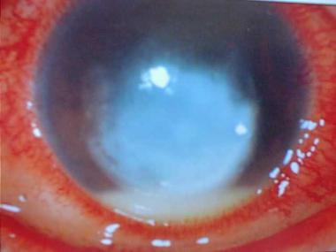
Infectious keratitis after LASIK

Slide 102
Q
Photoablative Surgery Issues
Optical Issues
Structural Issues
?
Finally: We would be remiss if we didn’t at least mention one of the most common post-photoablative issues:

Slide 103
A
Photoablative Surgery Issues
Optical Issues
Structural Issues
DES
Finally: We would be remiss if we didn’t at least mention one of the most common post-photoablative issues: DES

Slide 104
Q
Photoablative Surgery Issues
Optical Issues
Structural Issues
DES
Finally: We would be remiss if we didn’t at least mention one of the most common post-photoablative issues: DES
What is the typical course of photoablation-induced DES?

Slide 105
Q/A
Photoablative Surgery Issues
Optical Issues
Structural Issues
DES
Finally: We would be remiss if we didn’t at least mention one of the most common post-photoablative issues: DES
What is the typical course of photoablation-induced DES?
Most pts return to their baseline tear-state by post-op month 6
# + unit of time

Slide 106
A
Photoablative Surgery Issues
Optical Issues
Structural Issues
DES
Finally: We would be remiss if we didn’t at least mention one of the most common post-photoablative issues: DES
What is the typical course of photoablation-induced DES?
Most pts return to their baseline tear-state by post-op month 6

Slide 107
Q
Photoablative Surgery Issues
Optical Issues
Structural Issues
DES
Finally: We would be remiss if we didn’t at least mention one of the most common post-photoablative issues: DES
What is the typical course of photoablation-induced DES?
Most pts return to their baseline tear-state by post-op month 6
What is the most prudent way to address it?

Slide 108
A
Photoablative Surgery Issues
Optical Issues
Structural Issues
DES
Finally: We would be remiss if we didn’t at least mention one of the most common post-photoablative issues: DES
What is the typical course of photoablation-induced DES?
Most pts return to their baseline tear-state by post-op month 6
What is the most prudent way to address it?
Pre-operatively, by tuning up the pt’s ocular surface

Slide 109
A
Photoablative Surgery Issues
Optical Issues
Structural Issues
DES
Finally: We would be remiss if we didn’t at least mention one of the most common post-photoablative issues: DES
What is the typical course of photoablation-induced DES?
Most pts return to their baseline tear-state by post-op month 6
What is the most prudent way to address it?
Pre-operatively, by tuning up the pt’s ocular surface; and post-operatively, by treating it aggressively

Slide 110
Q
Surface Ablation Issues I: Sterile Infiltrates
What post-surgical maneuver after surface ablation puts the pt at increased risk for sterile infiltrates?
(Note: There is some degree of overlap between the following questions and those from the previous section)

Slide 111
Q/A
Surface Ablation Issues I: Sterile Infiltrates
What post-surgical maneuver after surface ablation puts the pt at increased risk for sterile infiltrates?
The use of a BCL , especially in conjunction with the use of topical NSAIDs without concurrent topical steroids
abb.
word + abb.
two words

Slide 112
A
Surface Ablation Issues I: Sterile Infiltrates
What post-surgical maneuver after surface ablation puts the pt at increased risk for sterile infiltrates?
The use of a BCL , especially in conjunction with the use of topical NSAIDs without concurrent topical steroids

Slide 113
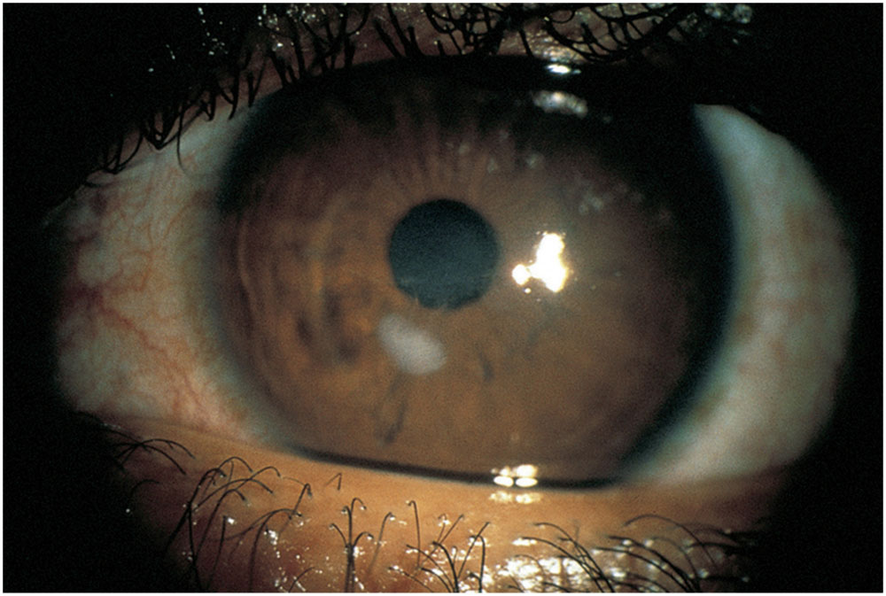
Post-surface ablation sterile infiltrates

Slide 114
Q
Surface Ablation Issues I: Sterile Infiltrates
What post-surgical maneuver after surface ablation puts the pt at increased risk for sterile infiltrates?
The use of a BCL , especially in conjunction with the use of topical NSAIDs without concurrent topical steroids
What are the keys to management of sterile infiltrates?
Make sure it’s sterile (ie, that it’s not infectious )
Add topical steroids and taper topical NSAIDs

Slide 115
Q/A
Surface Ablation Issues I: Sterile Infiltrates
What post-surgical maneuver after surface ablation puts the pt at increased risk for sterile infiltrates?
The use of a BCL , especially in conjunction with the use of topical NSAIDs without concurrent topical steroids
What are the keys to management of sterile infiltrates?
Make sure it’s sterile (ie, that it’s not infectious )
Add topical steroids and taper topical NSAIDs
word
word
two words
word + abb.

Slide 116
A
Surface Ablation Issues I: Sterile Infiltrates
What post-surgical maneuver after surface ablation puts the pt at increased risk for sterile infiltrates?
The use of a BCL , especially in conjunction with the use of topical NSAIDs without concurrent topical steroids
What are the keys to management of sterile infiltrates?
Make sure it’s sterile (ie, that it’s not infectious )
Add topical steroids and taper topical NSAIDs

Slide 117
Q
Surface Ablation Issues II: Haze
Post-surface-ablation haze can be divided into two categories based on time of onset—what are they?
?
?

Slide 118
A
Surface Ablation Issues II: Haze
Post-surface-ablation haze can be divided into two categories based on time of onset—what are they?
Early onset
Late onset

Slide 119
Q
Surface Ablation Issues II: Haze
Post-surface-ablation haze can be divided into two categories based on time of onset—what are they?
Early onset. ?
Late onset. ?
For each, how long after surgery until it appears?

Slide 120
A
Surface Ablation Issues II: Haze
Post-surface-ablation haze can be divided into two categories based on time of onset—what are they?
Early onset. A couple of weeks.
Late onset. Six to twelve months.
For each, how long after surgery until it appears?

Slide 121
Q
Surface Ablation Issues II: Haze
Post-surface-ablation haze can be divided into two categories based on time of onset—what are they?
Early onset. A couple of weeks. ?
Late onset. Six to twelve months. ?
For each, how long after surgery until it appears?
For each, at what level in the K is the haze located?

Slide 122
A
Surface Ablation Issues II: Haze
Post-surface-ablation haze can be divided into two categories based on time of onset—what are they?
Early onset. A couple of weeks. Subepithelial.
Late onset. Six to twelve months. Anterior stroma.
For each, how long after surgery until it appears?
For each, at what level in the K is the haze located?

Slide 123
Q
Surface Ablation Issues II: Haze
Post-surface-ablation haze can be divided into two categories based on time of onset—what are they?
Early onset. A couple of weeks. Subepithelial.
Late onset. Six to twelve months. Anterior stroma.
For each, how long after surgery until it appears?
For each, at what level in the K is the haze located?
What are the risk factors for development of severe haze?
?
?

Slide 124
Q/A
Surface Ablation Issues II: Haze
Post-surface-ablation haze can be divided into two categories based on time of onset—what are they?
Early onset. A couple of weeks. Subepithelial.
Late onset. Six to twelve months. Anterior stroma.
For each, how long after surgery until it appears?
For each, at what level in the K is the haze located?
What are the risk factors for development of severe haze?
Deep ablation
Small ablation zone
deep vs shallow
small vs large

Slide 125
A
Surface Ablation Issues II: Haze
Post-surface-ablation haze can be divided into two categories based on time of onset—what are they?
Early onset. A couple of weeks. Subepithelial.
Late onset. Six to twelve months. Anterior stroma.
For each, how long after surgery until it appears?
For each, at what level in the K is the haze located?
What are the risk factors for development of severe haze?
Deep ablation
Small ablation zone

Slide 126
Q
Surface Ablation Issues II: Haze
Post-surface-ablation haze can be divided into two categories based on time of onset—what are they?
Early onset. A couple of weeks. Subepithelial.
Late onset. Six to twelve months. Anterior stroma.
For each, how long after surgery until it appears?
For each, at what level in the K is the haze located?
What are the risk factors for development of severe haze?
Deep ablation
Small ablation zone
How is haze treated?

Slide 127
Q/A
Surface Ablation Issues II: Haze
Post-surface-ablation haze can be divided into two categories based on time of onset—what are they?
Early onset. A couple of weeks. Subepithelial.
Late onset. Six to twelve months. Anterior stroma.
For each, how long after surgery until it appears?
For each, at what level in the K is the haze located?
What are the risk factors for development of severe haze?
Deep ablation
Small ablation zone
How is haze treated?
Increase steroid use. If this fails…

Slide 128
A
Surface Ablation Issues II: Haze
Post-surface-ablation haze can be divided into two categories based on time of onset—what are they?
Early onset. A couple of weeks. Subepithelial.
Late onset. Six to twelve months. Anterior stroma.
For each, how long after surgery until it appears?
For each, at what level in the K is the haze located?
What are the risk factors for development of severe haze?
Deep ablation
Small ablation zone
How is haze treated?
Increase steroid use. If this fails…
Debridement in conjunction with topical MMC

Slide 129
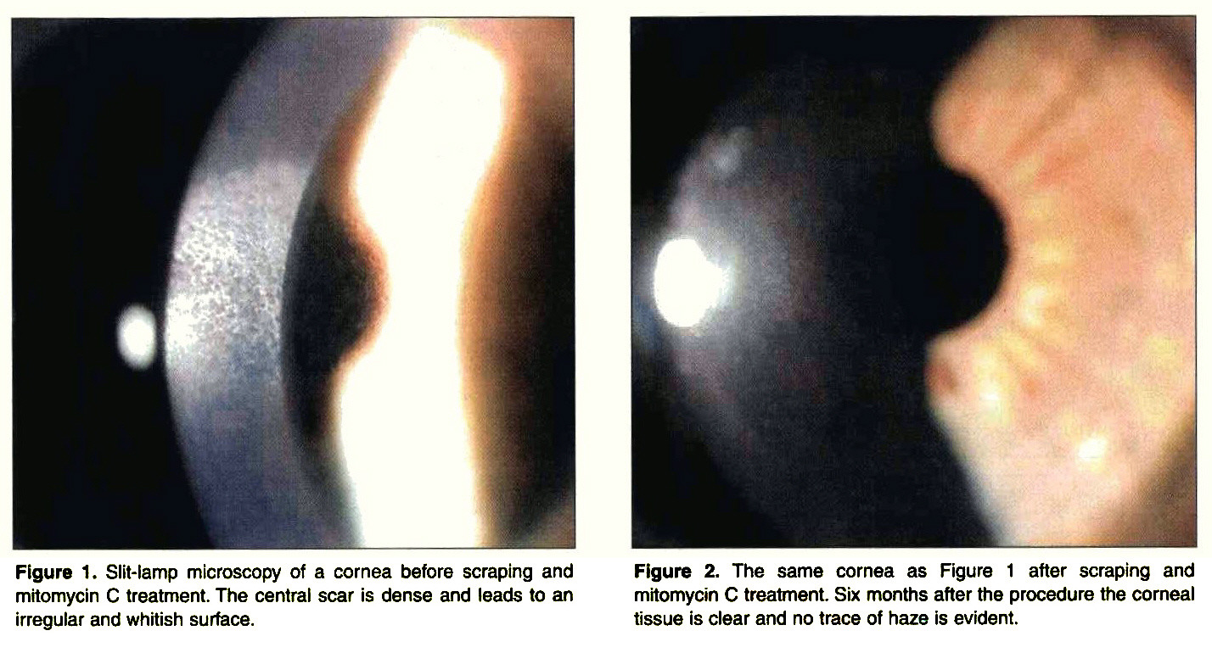
Post-surface ablation corneal haze: Pre- and post tx

Slide 130
Q
LASIK Issues I: Cutting The Flap
Cutting the flap with a microkeratome…problems
Adequate suction induces an IOP of at least 65 mmHg
#

Slide 131
A
LASIK Issues I: Cutting The Flap
Cutting the flap with a microkeratome…problems
Adequate suction induces an IOP of at least 65 mmHg

Slide 132
Q
LASIK Issues I: Cutting The Flap
Cutting the flap with a microkeratome…problems
Adequate suction induces an IOP of at least 65 mmHg
Inadequate suction ↑ the risk of a thin flap or buttonhole
flap prob 1
flap prob 2

Slide 133
A
LASIK Issues I: Cutting The Flap
Cutting the flap with a microkeratome…problems
Adequate suction induces an IOP of at least 65 mmHg
Inadequate suction ↑ the risk of a thin flap or buttonhole

Slide 134
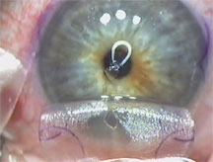
LASIK flap: Buttonhole

Slide 135
Q
LASIK Issues I: Cutting The Flap
Cutting the flap with a microkeratome…problems
Adequate suction induces an IOP of at least 65 mmHg
Inadequate suction ↑ the risk of a thin flap or buttonhole
A steep (>46D) cornea ↑ the risk of a thin flap or buttonhole as well
descriptive term, and specifics

Slide 136
A
LASIK Issues I: Cutting The Flap
Cutting the flap with a microkeratome…problems
Adequate suction induces an IOP of at least 65 mmHg
Inadequate suction ↑ the risk of a thin flap or buttonhole
A steep (>46D) cornea ↑ the risk of a thin flap or buttonhole as well

Slide 137
Q
LASIK Issues I: Cutting The Flap
Cutting the flap with a microkeratome…problems
Adequate suction induces an IOP of at least 65 mmHg
Inadequate suction ↑ the risk of a thin flap or buttonhole
A steep (>46D) cornea ↑ the risk of a thin flap or buttonhole as well
A flat (<41D) cornea ↑ the risk of a free cap
flap prob 3

Slide 138
A
LASIK Issues I: Cutting The Flap
Cutting the flap with a microkeratome…problems
Adequate suction induces an IOP of at least 65 mmHg
Inadequate suction ↑ the risk of a thin flap or buttonhole
A steep (>46D) cornea ↑ the risk of a thin flap or buttonhole as well
A flat (<41D) cornea ↑ the risk of a free cap

Slide 139
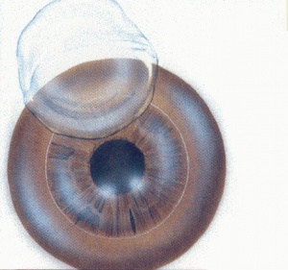
LASIK flap: Free cap

Slide 140
Q
LASIK Issues I: Cutting The Flap
Cutting the flap with a microkeratome…problems
Adequate suction induces an IOP of at least 65 mmHg
Inadequate suction ↑ the risk of a thin flap or buttonhole
A steep (>46D) cornea ↑ the risk of a thin flap or buttonhole as well
A flat (<41D) cornea ↑ the risk of a free cap
How do you manage a…
Thin flap/buttonhole? Stop the procedure; re-cut in 3-6 months
Free cap? Place in antidessication chamber; finish the procedure; re-place the cap +/- sutures

Slide 141
A
LASIK Issues I: Cutting The Flap
Cutting the flap with a microkeratome…problems
Adequate suction induces an IOP of at least 65 mmHg
Inadequate suction ↑ the risk of a thin flap or buttonhole
A steep (>46D) cornea ↑ the risk of a thin flap or buttonhole as well
A flat (<41D) cornea ↑ the risk of a free cap
How do you manage a…
Thin flap/buttonhole? Stop the procedure; re-cut in 3-6 months
Free cap? Place in antidessication chamber; finish the procedure; re-place the cap +/- sutures

Slide 142
Q
LASIK Issues I: Cutting The Flap
Cutting the flap with a microkeratome…problems
Adequate suction induces an IOP of at least 65 mmHg
Inadequate suction ↑ the risk of a thin flap or buttonhole
A steep (>46D) cornea ↑ the risk of a thin flap or buttonhole as well
A flat (<41D) cornea ↑ the risk of a free cap
How do you manage a…
Thin flap/buttonhole? Stop the procedure; re-cut in 3-6 months
Free cap? Place in antidessication chamber; finish the procedure; re-place the cap +/- sutures

Slide 143
A
LASIK Issues I: Cutting The Flap
Cutting the flap with a microkeratome…problems
Adequate suction induces an IOP of at least 65 mmHg
Inadequate suction ↑ the risk of a thin flap or buttonhole
A steep (>46D) cornea ↑ the risk of a thin flap or buttonhole as well
A flat (<41D) cornea ↑ the risk of a free cap
How do you manage a…
Thin flap/buttonhole? Stop the procedure; re-cut in 3-6 months
Free cap? Place in antidessication chamber; finish the procedure; re-place the cap +/- sutures

Slide 144
Q
LASIK Issues II: Flap Striae and Dislocation
Flap Striae
Two broad
category of striae
?
?

Slide 145
A
LASIK Issues II: Flap Striae and Dislocation
Flap Striae
Two broad
category of striae
Macrostriae
Microstriae

Slide 146
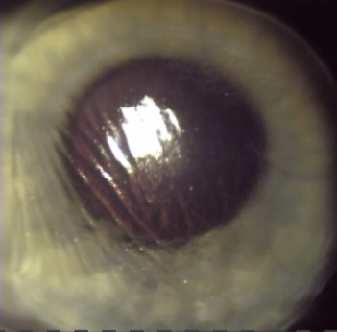
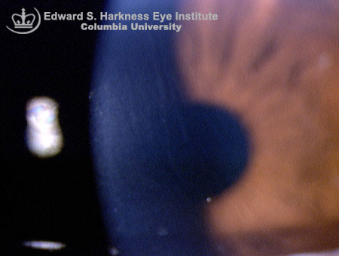
A
LASIK Issues II: Flap Striae and Dislocation
Flap Striae
Two broad
category of striae
Macrostriae
Microstriae

Slide 147
Q
LASIK Issues II: Flap Striae and Dislocation
Flap Striae
Two broad
category of striae
Macrostriae
Microstriae
What are the two main risk factors for striae?
--?Thin flaps
--?Deep ablations

Slide 148
Q/A
LASIK Issues II: Flap Striae and Dislocation
Flap Striae
Two broad
category of striae
Macrostriae
Microstriae
What are the two main risk factors for striae?
--Thin flaps
--Deep ablations
thin vs thick
deep v shallow

Slide 149
A
LASIK Issues II: Flap Striae and Dislocation
Flap Striae
Two broad
category of striae
Macrostriae
Microstriae
What are the two main risk factors for striae?
--Thin flaps
--Deep ablations

Slide 150
Q
LASIK Issues II: Flap Striae and Dislocation
Flap Striae
Two broad
category of striae
Macrostriae
Microstriae
Do all striae require treatment?
No. If BCVA and subjective VA are good, folds can be observed

Slide 151
A
LASIK Issues II: Flap Striae and Dislocation
Flap Striae
Two broad
category of striae
Macrostriae
Microstriae
Do all striae require treatment?
No. If BCVA and subjective VA are good, folds can be observed

Slide 152
Q
LASIK Issues II: Flap Striae and Dislocation
Flap Striae
Two broad
category of striae
Macrostriae
Microstriae
Extent of flap involved

Slide 153
A
LASIK Issues II: Flap Striae and Dislocation
Flap Striae
Two broad
category of striae
Macrostriae
Microstriae
Full flap
Extent of flap involved
Bowman’s layer only

Slide 154
Q
LASIK Issues II: Flap Striae and Dislocation
Flap Striae
Two broad
category of striae
Macrostriae
Microstriae
Full flap
Extent of flap involved
Bowman’s layer only
Clinically significant?

Slide 155
A
LASIK Issues II: Flap Striae and Dislocation
Flap Striae
Two broad
category of striae
Macrostriae
Microstriae
Full flap
Extent of flap involved
Bowman’s layer only
Always
Clinically significant?
Rarely

Slide 156
Q
LASIK Issues II: Flap Striae and Dislocation
Flap Striae
Two broad
category of striae
Macrostriae
Microstriae
Full flap
Extent of flap involved
Bowman’s layer only
Always
Clinically significant?
Rarely
Cause

Slide 157
A
LASIK Issues II: Flap Striae and Dislocation
Flap Striae
Two broad
category of striae
Macrostriae
Microstriae
Full flap
Extent of flap involved
Bowman’s layer only
Always
Clinically significant?
Rarely
Flap slippage
Cause
Flap contracture

Slide 158
Q
LASIK Issues II: Flap Striae and Dislocation
Flap Striae
Two broad
category of striae
Macrostriae
Microstriae
Full flap
Extent of flap involved
Bowman’s layer only
Always
Clinically significant?
Rarely
Flap slippage
Cause
Flap contracture
What is probably the most common cause of flap slippage leading to macrostriae?
Eyelid squeezing by the pt upon removal of the speculum

Slide 159
A
LASIK Issues II: Flap Striae and Dislocation
Flap Striae
Two broad
category of striae
Macrostriae
Microstriae
Full flap
Extent of flap involved
Bowman’s layer only
Always
Clinically significant?
Rarely
Flap slippage
Cause
Flap contracture
What is probably the most common cause of flap slippage leading to macrostriae?
Eyelid squeezing by the pt upon removal of the speculum

Slide 160
Q
LASIK Issues II: Flap Striae and Dislocation
Flap Striae
Two broad
category of striae
Macrostriae
Microstriae
Full flap
Extent of flap involved
Bowman’s layer only
Always
Clinically significant?
Rarely
Flap slippage
Cause
Flap contracture
A pt has multiple macrostriae, all oriented parallel to one another. They stem from the hinge. What is the likely cause?
Frank slippage of the flap. Re-place it immediately!
Why must slippage be addressed immediately?
Because if left in place, folds quickly become permanent
How quickly?
Within roughly 24 hours

Slide 161
A
LASIK Issues II: Flap Striae and Dislocation
Flap Striae
Two broad
category of striae
Macrostriae
Microstriae
Full flap
Extent of flap involved
Bowman’s layer only
Always
Clinically significant?
Rarely
Flap slippage
Cause
Flap contracture
A pt has multiple macrostriae, all oriented parallel to one another. They stem from the hinge. What is the likely cause?
Frank slippage of the flap. Re-place it immediately!
Why must slippage be addressed immediately?
Because if left in place, folds quickly become permanent
How quickly?
Within roughly 24 hours

Slide 162
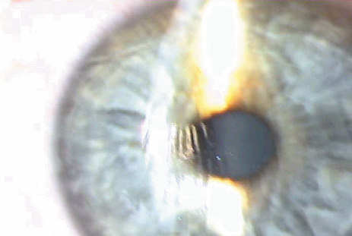
LASIK flap: Folds from flap slippage

Slide 163
Q
LASIK Issues II: Flap Striae and Dislocation
Flap Striae
Two broad
category of striae
Macrostriae
Microstriae
Full flap
Extent of flap involved
Bowman’s layer only
Always
Clinically significant?
Rarely
Flap slippage
Cause
Flap contracture
A pt has multiple macrostriae, all oriented parallel to one another. They stem from the hinge. What is the likely cause?
Frank slippage of the flap. Re-place it immediately!
Why must slippage be addressed immediately?
Because if left in place, folds quickly become permanent
How quickly?
Within roughly 24 hours

Slide 164
A
LASIK Issues II: Flap Striae and Dislocation
Flap Striae
Two broad
category of striae
Macrostriae
Microstriae
Full flap
Extent of flap involved
Bowman’s layer only
Always
Clinically significant?
Rarely
Flap slippage
Cause
Flap contracture
A pt has multiple macrostriae, all oriented parallel to one another. They stem from the hinge. What is the likely cause?
Frank slippage of the flap. Re-place it immediately!
Why must slippage be addressed immediately?
Because if left in place, folds quickly become permanent
How quickly?
Within roughly 24 hours

Slide 165
Q
LASIK Issues II: Flap Striae and Dislocation
Flap Striae
Two broad
category of striae
Macrostriae
Microstriae
Full flap
Extent of flap involved
Bowman’s layer only
Always
Clinically significant?
Rarely
Flap slippage
Cause
Flap contracture
A pt has multiple macrostriae, all oriented parallel to one another. They stem from the hinge. What is the likely cause?
Frank slippage of the flap. Re-place it immediately!
Why must slippage be addressed immediately?
Because if left in place, folds quickly become permanent
How quickly?
Within roughly 24 hours

Slide 166
A
LASIK Issues II: Flap Striae and Dislocation
Flap Striae
Two broad
category of striae
Macrostriae
Microstriae
Full flap
Extent of flap involved
Bowman’s layer only
Always
Clinically significant?
Rarely
Flap slippage
Cause
Flap contracture
A pt has multiple macrostriae, all oriented parallel to one another. They stem from the hinge. What is the likely cause?
Frank slippage of the flap. Re-place it immediately!
Why must slippage be addressed immediately?
Because if left in place, folds quickly become permanent
How quickly?
Within roughly 24 hours

Slide 167
Q
LASIK Issues II: Flap Striae and Dislocation
Flap Striae
Two broad
category of striae
Macrostriae
Microstriae
Full flap
Extent of flap involved
Bowman’s layer only
Always
Clinically significant?
Rarely
Flap slippage
Cause
Flap contracture
Gutter status

Slide 168
A
LASIK Issues II: Flap Striae and Dislocation
Flap Striae
Two broad
category of striae
Macrostriae
Microstriae
Full flap
Extent of flap involved
Bowman’s layer only
Always
Clinically significant?
Rarely
Flap slippage
Cause
Flap contracture
Widened
Gutter status
Unaffected

Slide 169
Q
LASIK Issues II: Flap Striae and Dislocation
Flap Striae
Two broad
category of striae
Macrostriae
Microstriae
Full flap
Extent of flap involved
Bowman’s layer only
Always
Clinically significant?
Rarely
Flap slippage
Cause
Flap contracture
Widened
Gutter status
Unaffected
Why do macrostriae tend to widen the flap gutter?
Because the folds reduce the surface area the flap can cover

Slide 170
A
LASIK Issues II: Flap Striae and Dislocation
Flap Striae
Two broad
category of striae
Macrostriae
Microstriae
Full flap
Extent of flap involved
Bowman’s layer only
Always
Clinically significant?
Rarely
Flap slippage
Cause
Flap contracture
Widened
Gutter status
Unaffected
Why do macrostriae tend to widen the flap gutter?
Because the folds reduce the surface area the flap can cover

Slide 171
Q
LASIK Issues II: Flap Striae and Dislocation
Flap Striae
Two broad
category of striae
Macrostriae
Microstriae
Full flap
Extent of flap involved
Bowman’s layer only
Always
Clinically significant?
Rarely
Flap slippage
Cause
Flap contracture
Widened
Gutter status
Unaffected
Acute treatment

Slide 172
A
LASIK Issues II: Flap Striae and Dislocation
Flap Striae
Two broad
category of striae
Macrostriae
Microstriae
Full flap
Extent of flap involved
Bowman’s layer only
Always
Clinically significant?
Rarely
Flap slippage
Cause
Flap contracture
Widened
Gutter status
Unaffected
Lift and replace
Acute treatment
Observation; lubrication

Slide 173
Q
LASIK Issues II: Flap Striae and Dislocation
Flap Striae
Two broad
category of striae
Macrostriae
Microstriae
Full flap
Extent of flap involved
Bowman’s layer only
Always
Clinically significant?
Rarely
Flap slippage
Cause
Flap contracture
Widened
Gutter status
Unaffected
Lift and replace
Acute treatment
Observation; lubrication
Classic description

Slide 174
A
LASIK Issues II: Flap Striae and Dislocation
Flap Striae
Two broad
category of striae
Macrostriae
Microstriae
Full flap
Extent of flap involved
Bowman’s layer only
Always
Clinically significant?
Rarely
Flap slippage
Cause
Flap contracture
Widened
Gutter status
Unaffected
Lift and replace
Acute treatment
Observation; lubrication
‘Skewed carpet’
Classic description
‘Cracked mud’

Slide 175
Q
LASIK Issues II: Flap Striae and Dislocation
Flap Striae
Two broad
category of striae
Macrostriae
Microstriae
Full flap
Extent of flap involved
Bowman’s layer only
Always
Clinically significant?
Rarely
Flap slippage
Cause
Flap contracture
Widened
Gutter status
Unaffected
Lift and replace
Acute treatment
Observation; lubrication
‘Skewed carpet’
Classic description
‘Cracked mud’
What clinical maneuver helps bring out the cracked mud appearance?
Instillation of fluorescein. The microstriae will be visualized as areas of negative staining

Slide 176
Q/A
LASIK Issues II: Flap Striae and Dislocation
Flap Striae
Two broad
category of striae
Macrostriae
Microstriae
Full flap
Extent of flap involved
Bowman’s layer only
Always
Clinically significant?
Rarely
Flap slippage
Cause
Flap contracture
Widened
Gutter status
Unaffected
Lift and replace
Acute treatment
Observation; lubrication
‘Skewed carpet’
Classic description
‘Cracked mud’
What clinical maneuver helps bring out the cracked mud appearance?
Instillation of fluorescein. The microstriae will be visualized as areas of negative staining
positive vs negative

Slide 177
A
LASIK Issues II: Flap Striae and Dislocation
Flap Striae
Two broad
category of striae
Macrostriae
Microstriae
Full flap
Extent of flap involved
Bowman’s layer only
Always
Clinically significant?
Rarely
Flap slippage
Cause
Flap contracture
Widened
Gutter status
Unaffected
Lift and replace
Acute treatment
Observation; lubrication
‘Skewed carpet’
Classic description
‘Cracked mud’
What clinical maneuver helps bring out the cracked mud appearance?
Instillation of fluorescein. The microstriae will be visualized as areas of negative staining

Slide 178
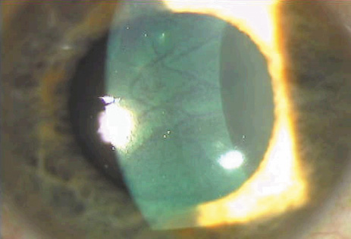
Microstriae: ‘Cracked mud’ appearance after fluorescein instillation

Slide 179
Q
LASIK Issues II: Flap Striae and Dislocation
Flap Striae
Two broad
category of striae
Macrostriae
Microstriae
Full flap
Extent of flap involved
Bowman’s layer only
Always
Clinically significant?
Rarely
Flap slippage
Cause
Flap contracture
Widened
Gutter status
Unaffected
Lift and replace
Acute treatment
Observation; lubrication
‘Skewed carpet’
Classic description
‘Cracked mud’
Visible w/ direct illumination

Slide 180
A
LASIK Issues II: Flap Striae and Dislocation
Flap Striae
Two broad
category of striae
Macrostriae
Microstriae
Full flap
Extent of flap involved
Bowman’s layer only
Always
Clinically significant?
Rarely
Flap slippage
Cause
Flap contracture
Widened
Gutter status
Unaffected
Lift and replace
Acute treatment
Observation; lubrication
‘Skewed carpet’
Classic description
‘Cracked mud’
Yes
Visible w/ direct illumination
No

Slide 181
Q
LASIK Issues II: Flap Striae and Dislocation
Flap Striae
Two broad
category of striae
Macrostriae
Microstriae
Full flap
Extent of flap involved
Bowman’s layer only
Always
Clinically significant?
Rarely
Flap slippage
Cause
Flap contracture
Widened
Gutter status
Unaffected
Lift and replace
Acute treatment
Observation; lubrication
‘Skewed carpet’
Classic description
‘Cracked mud’
Yes
Visible w/ direct illumination
No
A pt is found to have circumferential striae. What was likely her pre-op refractive status?
High myopia
Are circumferential striae more or less concerning than other types of striae?
Less. They usually resolve spontaneously.

Slide 182
A
LASIK Issues II: Flap Striae and Dislocation
Flap Striae
Two broad
category of striae
Macrostriae
Microstriae
Full flap
Extent of flap involved
Bowman’s layer only
Always
Clinically significant?
Rarely
Flap slippage
Cause
Flap contracture
Widened
Gutter status
Unaffected
Lift and replace
Acute treatment
Observation; lubrication
‘Skewed carpet’
Classic description
‘Cracked mud’
Yes
Visible w/ direct illumination
No
A pt is found to have circumferential striae. What was likely her pre-op refractive status?
High myopia
Are circumferential striae more or less concerning than other types of striae?
Less. They usually resolve spontaneously.

Slide 183
Q
LASIK Issues II: Flap Striae and Dislocation
Flap Striae
Two broad
category of striae
Macrostriae
Microstriae
Full flap
Extent of flap involved
Bowman’s layer only
Always
Clinically significant?
Rarely
Flap slippage
Cause
Flap contracture
Widened
Gutter status
Unaffected
Lift and replace
Acute treatment
Observation; lubrication
‘Skewed carpet’
Classic description
‘Cracked mud’
Yes
Visible w/ direct illumination
No
A pt is found to have circumferential striae. What was likely her pre-op refractive status?
High myopia
Are circumferential striae more or less concerning than other types of striae?
Less. They usually resolve spontaneously.

Slide 184
A
LASIK Issues II: Flap Striae and Dislocation
Flap Striae
Two broad
category of striae
Macrostriae
Microstriae
Full flap
Extent of flap involved
Bowman’s layer only
Always
Clinically significant?
Rarely
Flap slippage
Cause
Flap contracture
Widened
Gutter status
Unaffected
Lift and replace
Acute treatment
Observation; lubrication
‘Skewed carpet’
Classic description
‘Cracked mud’
Yes
Visible w/ direct illumination
No
A pt is found to have circumferential striae. What was likely her pre-op refractive status?
High myopia
Are circumferential striae more or less concerning than other types of striae?
Less. They usually resolve spontaneously.

Slide 185
Q
LASIK Issues II: Flap Striae and Dislocation
Flap dislocation
Early
Often occurs on post-op day 1
#

Slide 186
A
LASIK Issues II: Flap Striae and Dislocation
Flap dislocation
Early
Often occurs on post-op day 1

Slide 187
Q
LASIK Issues II: Flap Striae and Dislocation
Flap dislocation
Early
Often occurs on post-op day 1
In immediate post-op period, adhesion between flap epithelium and tarsal conj can be stronger than tensile strength of epithelial bridge across flap gutter
two words

Slide 188
A
LASIK Issues II: Flap Striae and Dislocation
Flap dislocation
Early
Often occurs on post-op day 1
In immediate post-op period, adhesion between flap epithelium and tarsal conj can be stronger than tensile strength of epithelial bridge across flap gutter

Slide 189
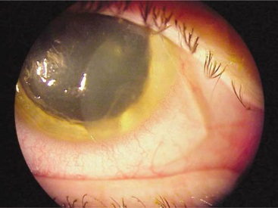
LASIK flap: Early post-op dislocation

Slide 190
Q
LASIK Issues II: Flap Striae and Dislocation
Flap dislocation
Early
Often occurs on post-op day 1
In immediate post-op period, adhesion between flap epithelium and tarsal conj can be stronger than tensile strength of epithelial bridge across flap gutter
Late
Usually secondary to blunt trauma
two words

Slide 191
A
LASIK Issues II: Flap Striae and Dislocation
Flap dislocation
Early
Often occurs on post-op day 1
In immediate post-op period, adhesion between flap epithelium and tarsal conj can be stronger than tensile strength of epithelial bridge across flap gutter
Late
Usually secondary to blunt trauma

Slide 192
Q
LASIK Issues II: Flap Striae and Dislocation
Flap dislocation
Early
Often occurs on post-op day 1
In immediate post-op period, adhesion between flap epithelium and tarsal conj can be stronger than tensile strength of epithelial bridge across flap gutter
Late
Usually secondary to blunt trauma
Some healing/scarring occurs at the edge of the flap, but essentially none at the rest of the flap/stroma interface
location
location

Slide 193
A
LASIK Issues II: Flap Striae and Dislocation
Flap dislocation
Early
Often occurs on post-op day 1
In immediate post-op period, adhesion between flap epithelium and tarsal conj can be stronger than tensile strength of epithelial bridge across flap gutter
Late
Usually secondary to blunt trauma
Some healing/scarring occurs at the edge of the flap, but essentially none at the rest of the flap/stroma interface

Slide 194
Q
LASIK Issues II: Flap Striae and Dislocation
Flap dislocation
Early
Often occurs on post-op day 1
In immediate post-op period, adhesion between flap epithelium and tarsal conj can be stronger than tensile strength of epithelial bridge across flap gutter
Late
Usually secondary to blunt trauma
Some healing/scarring occurs at the edge of the flap, but essentially none at the rest of the flap/stroma interface
Lack of extensive healing means flap is always vulnerable to dislocation from blunt force
vulnerable vs resistant

Slide 195
A
LASIK Issues II: Flap Striae and Dislocation
Flap dislocation
Early
Often occurs on post-op day 1
In immediate post-op period, adhesion between flap epithelium and tarsal conj can be stronger than tensile strength of epithelial bridge across flap gutter
Late
Usually secondary to blunt trauma
Some healing/scarring occurs at the edge of the flap, but essentially none at the rest of the flap/stroma interface
Lack of extensive healing means flap is always vulnerable to dislocation from blunt force

Slide 196
Q
LASIK Issues II: Flap Striae and Dislocation
Flap dislocation
Early
Often occurs on post-op day 1
In immediate post-op period, adhesion between flap epithelium and tarsal conj can be stronger than tensile strength of epithelial bridge across flap gutter
Late
Usually secondary to blunt trauma
Some healing/scarring occurs at the edge of the flap, but essentially none at the rest of the flap/stroma interface
Lack of extensive healing means flap is always vulnerable to dislocation from blunt force
Treatment: Re-place flap ASAP!

Slide 197
A
LASIK Issues II: Flap Striae and Dislocation
Flap dislocation
Early
Often occurs on post-op day 1
In immediate post-op period, adhesion between flap epithelium and tarsal conj can be stronger than tensile strength of epithelial bridge across flap gutter
Late
Usually secondary to blunt trauma
Some healing/scarring occurs at the edge of the flap, but essentially none at the rest of the flap/stroma interface
Lack of extensive healing means flap is always vulnerable to dislocation from blunt force
Treatment: Re-place flap ASAP!

Slide 198
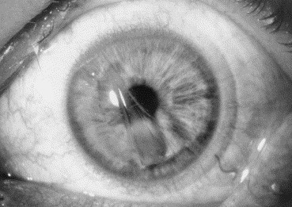
LASIK flap: Late, traumatic dislocation

Slide 199
Q
LASIK Issues III: DLK
DLK…
…stands for diffuse lamellar keratitis

Slide 200
A
LASIK Issues III: DLK
DLK…
…stands for diffuse lamellar keratitis

Slide 201
Q
LASIK Issues III: DLK
DLK…
…stands for diffuse lamellar keratitis
aka Sands of Sahara for its grainy appearance
funny nickname

Slide 202
A
LASIK Issues III: DLK
DLK…
…stands for diffuse lamellar keratitis
aka Sands of Sahara for its grainy appearance

Slide 203
Q
LASIK Issues III: DLK
DLK…
…stands for diffuse lamellar keratitis
aka Sands of Sahara for its grainy appearance
…is a noninfectious inflammation of the flap-bed interface
infectious vs non-

Slide 204
A
LASIK Issues III: DLK
DLK…
…stands for diffuse lamellar keratitis
aka Sands of Sahara for its grainy appearance
…is a noninfectious inflammation of the flap-bed interface

Slide 205
Q
LASIK Issues III: DLK
DLK…
…stands for diffuse lamellar keratitis
aka Sands of Sahara for its grainy appearance
…is a noninfectious inflammation of the flap-bed interface
…is probably 2º to contamination of the interface (with rust, RBCs, bacterial products, etc)
very general process
important
LASIK location

Slide 206
A
LASIK Issues III: DLK
DLK…
…stands for diffuse lamellar keratitis
aka Sands of Sahara for its grainy appearance
…is a noninfectious inflammation of the flap-bed interface
…is probably 2º to contamination of the interface (with rust, RBCs, bacterial products, etc)

Slide 207
Q
LASIK Issues III: DLK
DLK…
…stands for diffuse lamellar keratitis
aka Sands of Sahara for its grainy appearance
…is a noninfectious inflammation of the flap-bed interface
…is probably 2º to contamination of the interface (with rust, RBCs, bacterial products, etc)
1…
2…
3 possible culprits

Slide 208
A
LASIK Issues III: DLK
DLK…
…stands for diffuse lamellar keratitis
aka Sands of Sahara for its grainy appearance
…is a noninfectious inflammation of the flap-bed interface
…is probably 2º to contamination of the interface (with rust, RBCs, bacterial products, etc)

Slide 209
Q
LASIK Issues III: DLK
DLK…
…stands for diffuse lamellar keratitis
aka Sands of Sahara for its grainy appearance
…is a noninfectious inflammation of the flap-bed interface
…is probably 2º to contamination of the interface (with rust, RBCs, bacterial products, etc)
In a nutshell: DLK represents the accumulation of WBCs in the potential sub-flap space secondary to anterior stromal inflammation that develops in response to the presence in the interface of a mechanical or toxic insult
abb.
K layer (two words)

Slide 210
A
LASIK Issues III: DLK
DLK…
…stands for diffuse lamellar keratitis
aka Sands of Sahara for its grainy appearance
…is a noninfectious inflammation of the flap-bed interface
…is probably 2º to contamination of the interface (with rust, RBCs, bacterial products, etc)
In a nutshell: DLK represents the accumulation of WBCs in the potential sub-flap space secondary to anterior stromal inflammation that develops in response to the presence in the interface of a mechanical or toxic insult

Slide 211
Q
LASIK Issues III: DLK
DLK…
…stands for diffuse lamellar keratitis
aka Sands of Sahara for its grainy appearance
…is a noninfectious inflammation of the flap-bed interface
…is probably 2º to contamination of the interface (with rust, RBCs, bacterial products, etc)
…has 4 grades:

Slide 212
Q
LASIK Issues III: DLK
DLK…
…stands for diffuse lamellar keratitis
aka Sands of Sahara for its grainy appearance
…is a noninfectious inflammation of the flap-bed interface
…is probably 2º to contamination of the interface (with rust, RBCs, bacterial products, etc)
…has 4 grades:
 | Interface appearance | Effect on vision | Treatment
Grade 1
Grade 2
Grade 3
Grade 4
? ? ?

Slide 213
A
LASIK Issues III: DLK
DLK…
…stands for diffuse lamellar keratitis
aka Sands of Sahara for its grainy appearance
…is a noninfectious inflammation of the flap-bed interface
…is probably 2º to contamination of the interface (with rust, RBCs, bacterial products, etc)
…has 4 grades:
 | Interface appearance | Effect on vision | Treatment
Grade 1 | Granules peripherally | None | Steroid drop q1º
 | Granules peripherally + centrally | None | PF q1º + PO prednisone
Grade 3 | Dense central granules | Decreased | PF q1º + PO prednisone + lift flap and irrigate
Grade 4 | Scarring | Decreased | No good tx

Slide 214
Q
LASIK Issues III: DLK
DLK…
…stands for diffuse lamellar keratitis
aka Sands of Sahara for its grainy appearance
…is a noninfectious inflammation of the flap-bed interface
…is probably 2º to contamination of the interface (with rust, RBCs, bacterial products, etc)
…has 4 grades:
 | Interface appearance | Effect on vision | Treatment
Grade 1 | Granules peripherally | None | Steroid drop q1º
Grade 2 | Granules peripherally + centrally | None | PF q1º + PO prednisone
Grade 3 | Dense central granules | Decreased | PF q1º + PO prednisone + lift flap and irrigate
Grade 4 | Scarring | Decreased | No good tx
? ? ?

Slide 215
A
LASIK Issues III: DLK
DLK…
…stands for diffuse lamellar keratitis
aka Sands of Sahara for its grainy appearance
…is a noninfectious inflammation of the flap-bed interface
…is probably 2º to contamination of the interface (with rust, RBCs, bacterial products, etc)
…has 4 grades:
 | Interface appearance | Effect on vision | Treatment
Grade 1 | Granules peripherally | None | Steroid drop q1º
Grade 2 | Granules peripherally + centrally | None | PF q1º + PO prednisone
 | Dense central granules | Decreased | PF q1º + PO prednisone + lift flap and irrigate
Grade 4 | Scarring | Decreased | No good tx

Slide 216
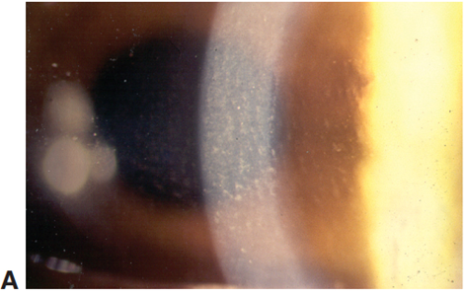
Diffuse lamellar keratitis (DLK). A, Grade 2 DLK. Note accumulation of inflammatory cells in the fine ridges created by the oscillating microkeratome blade.

Slide 217
Q
LASIK Issues III: DLK
DLK…
…stands for diffuse lamellar keratitis
aka Sands of Sahara for its grainy appearance
…is a noninfectious inflammation of the flap-bed interface
…is probably 2º to contamination of the interface (with rust, RBCs, bacterial products, etc)
…has 4 grades:
 | Interface appearance | Effect on vision | Treatment
Grade 1 | Granules peripherally | None | Steroid drop q1º
Grade 2 | Granules peripherally + centrally | None | PF q1º + PO prednisone
Grade 3 | Dense central granules | Decreased | PF q1º + PO prednisone + lift flap and irrigate
Grade 4 | Scarring | Decreased | No good tx
? ? ?

Slide 218
A
LASIK Issues III: DLK
DLK…
…stands for diffuse lamellar keratitis
aka Sands of Sahara for its grainy appearance
…is a noninfectious inflammation of the flap-bed interface
…is probably 2º to contamination of the interface (with rust, RBCs, bacterial products, etc)
…has 4 grades:
 | Interface appearance | Effect on vision | Treatment
Grade 1 | Granules peripherally | None | Steroid drop q1º
Grade 2 | Granules peripherally + centrally | None | PF q1º + PO prednisone
Grade 3 | Dense central granules | Decreased | PF q1º + PO prednisone + lift flap and irrigate
 | Scarring | Decreased | No good tx

Slide 219
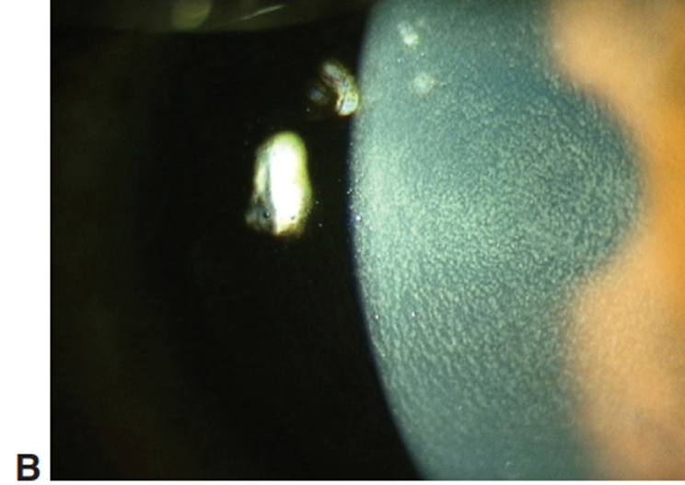
Diffuse lamellar keratitis (DLK). A, Grade 2 DLK. Note accumulation of inflammatory cells in the fine ridges created by the oscillating microkeratome blade. B, Stage 3 DLK showing dense accumulation of inflammatory cells centrally.

Slide 220
Q
LASIK Issues III: DLK
DLK…
…stands for diffuse lamellar keratitis
aka Sands of Sahara for its grainy appearance
…is a noninfectious inflammation of the flap-bed interface
…is probably 2º to contamination of the interface (with rust, RBCs, bacterial products, etc)
…has 4 grades:
 | Interface appearance | Effect on vision | Treatment
Grade 1 | Granules peripherally | None | Steroid drop q1º
Grade 2 | Granules peripherally + centrally | None | PF q1º + PO prednisone
Grade 3 | Dense central granules | Decreased | PF q1º + PO prednisone + lift flap and irrigate
Grade 4 | Scarring | Decreased | No good tx
? ? ?

Slide 221
A
LASIK Issues III: DLK
DLK…
…stands for diffuse lamellar keratitis
aka Sands of Sahara for its grainy appearance
…is a noninfectious inflammation of the flap-bed interface
…is probably 2º to contamination of the interface (with rust, RBCs, bacterial products, etc)
…has 4 grades:
 | Interface appearance | Effect on vision | Treatment
Grade 1 | Granules peripherally | None | Steroid drop q1º
Grade 2 | Granules peripherally + centrally | None | PF q1º + PO prednisone
Grade 3 | Dense central granules | Decreased | PF q1º + PO prednisone + lift flap and irrigate
Grade 4 | Scarring | Decreased | No good tx

Slide 222
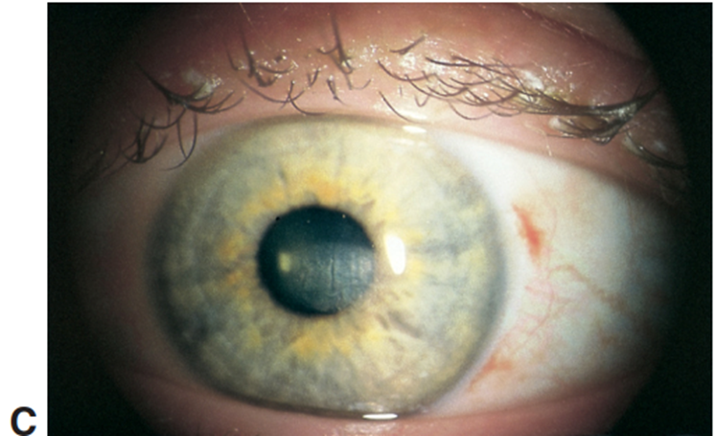
Diffuse lamellar keratitis (DLK). A, Grade 2 DLK. Note accumulation of inflammatory cells in the fine ridges created by the oscillating microkeratome blade. B, Grade 3 DLK showing dense accumulation of inflammatory cells centrally. C, Grade 4 DLK with central scar and folds.

Slide 223
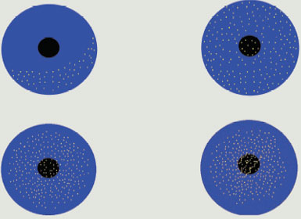
LASIK Issues III: DLK
Grade 1
Grade 2
Grade 3
Grade 4
 | Interface appearance | Effect on vision | Treatment
Grade 1 | Granules peripherally | None | Steroid drop q1º
Grade 2 | Granules peripherally + centrally | None | PF q1º + PO prednisone
Grade 3 | Dense central granules | Decreased | PF q1º + PO prednisone + lift flap and irrigate
Grade 4 | Scarring | Decreased | No good tx

Slide 224
LASIK Issues III: DLK
Grade 1
Grade 2
Grade 3
Grade 4
 | Interface appearance | Effect on vision | Treatment
Grade 1 | Granules peripherally | None | Steroid drop q1º
Grade 2 | Granules peripherally + centrally | None | PF q1º + PO prednisone
Grade 3 | Dense central granules | Decreased | PF q1º + PO prednisone + lift flap and irrigate
Grade 4 | Scarring | Decreased | No good tx
Because you really don’t want DLK to progress to Grade 4… The Refractive Surgery book recommends that ‘the surgeon should have a low threshold for irrigating under the flap in suspected cases of severe DLK’

Slide 225
LASIK Issues III: DLK
Grade 1
Grade 2
Grade 3
Grade 4
 | Interface appearance | Effect on vision | Treatment
Grade 1 | Granules peripherally | None | Steroid drop q1º
Grade 2 | Granules peripherally + centrally | None | PF q1º + PO prednisone
Grade 3 | Dense central granules | Decreased | PF q1º + PO prednisone + lift flap and irrigate
Grade 4 | Scarring | Decreased | No good tx
Because you really don’t want DLK to progress to Grade 4… The Refractive Surgery book recommends that ‘the surgeon should have a low threshold for irrigating under the flap in suspected cases of severe DLK’

Slide 226
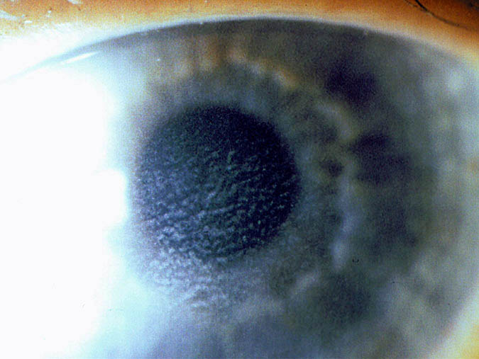
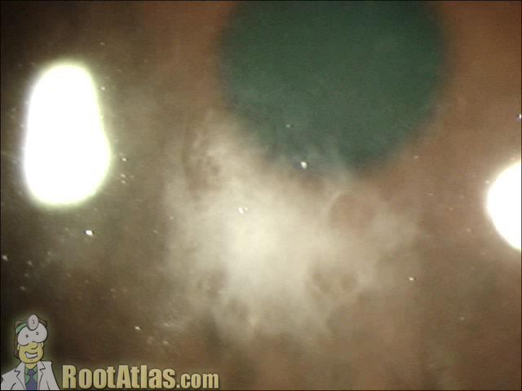
LASIK Issues III: DLK
Stage 3
Stage 4
More DLK pics

Slide 227
Q
LASIK Issues III: DLK
DLK vs Infectious Keratitis after LASIK
 | DLK | Infectious Keratitis
Time of onset (post-op) | ? | ?
Location | Peripheral (initially) | Can be anywhere
Depth of involvement | Limited to interface | Extends into flap and/or underlying stroma
Photosensitivity? | Yes | Yes
Conj injection? | Yes | Yes

Slide 228
A
LASIK Issues III: DLK
DLK vs Infectious Keratitis after LASIK
 | DLK | Infectious Keratitis
Time of onset (post-op) | Usually <24 hrs, no more than 3 days | At least 2-3 days
Location | Peripheral (initially) | Can be anywhere
Depth of involvement | Limited to interface | Extends into flap and/or underlying stroma
Photosensitivity? | Yes | Yes
Conj injection? | Yes | Yes

Slide 229
Q
LASIK Issues III: DLK
DLK vs Infectious Keratitis after LASIK
 | DLK | Infectious Keratitis
Time of onset (post-op) | Usually <24 hrs, no more than 3 days | At least 2-3 days
Location | ? | ?
Depth of involvement | Limited to interface | Extends into flap and/or underlying stroma
Photosensitivity? | Yes | Yes
Conj injection? | Yes | Yes

Slide 230
A
LASIK Issues III: DLK
DLK vs Infectious Keratitis after LASIK
 | DLK | Infectious Keratitis
Time of onset (post-op) | Usually <24 hrs, no more than 3 days | At least 2-3 days
Location | Peripheral (initially) | Can be anywhere
Depth of involvement | Limited to interface | Extends into flap and/or underlying stroma
Photosensitivity? | Yes | Yes
Conj injection? | Yes | Yes

Slide 231
Q
LASIK Issues III: DLK
DLK vs Infectious Keratitis after LASIK
 | DLK | Infectious Keratitis
Time of onset (post-op) | Usually <24 hrs, no more than 3 days | At least 2-3 days
Location | Peripheral (initially) | Can be anywhere
Depth of involvement | ? | ?
Photosensitivity? | Yes | Yes
Conj injection? | Yes | Yes

Slide 232
A
LASIK Issues III: DLK
DLK vs Infectious Keratitis after LASIK
 | DLK | Infectious Keratitis
Time of onset (post-op) | Usually <24 hrs, no more than 3 days | At least 2-3 days
Location | Peripheral (initially) | Can be anywhere
Depth of involvement | Limited to interface | Extends into flap and/or underlying stroma
Photosensitivity? | Yes | Yes
Conj injection? | Yes | Yes

Slide 233
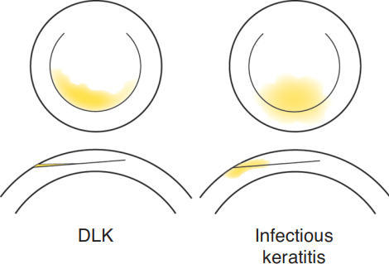
LASIK Issues III: DLK
DLK is differentiated from infectious keratitis by the confinement of the infiltrate to the interface alone in DLK

Slide 234
Q
LASIK Issues III: DLK
DLK vs Infectious Keratitis after LASIK
 | DLK | Infectious Keratitis
Time of onset (post-op) | Usually <24 hrs, no more than 3 days | At least 2-3 days
Location | Peripheral (initially) | Can be anywhere
Depth of involvement | Limited to interface | Extends into flap and/or underlying stroma
Photosensitivity? | ? | ?
Conj injection? | Yes | Yes

Slide 235
A
LASIK Issues III: DLK
DLK vs Infectious Keratitis after LASIK
 | DLK | Infectious Keratitis
Time of onset (post-op) | Usually <24 hrs, no more than 3 days | At least 2-3 days
Location | Peripheral (initially) | Can be anywhere
Depth of involvement | Limited to interface | Extends into flap and/or underlying stroma
Photosensitivity? | Yes | Yes
Conj injection? | Yes | Yes

Slide 236
Q
LASIK Issues III: DLK
DLK vs Infectious Keratitis after LASIK
 | DLK | Infectious Keratitis
Time of onset (post-op) | Usually <24 hrs, no more than 3 days | At least 2-3 days
Location | Peripheral (initially) | Can be anywhere
Depth of involvement | Limited to interface | Extends into flap and/or underlying stroma
Photosensitivity? | Yes | Yes
Conj injection? | ? | ?

Slide 237
A
LASIK Issues III: DLK
DLK vs Infectious Keratitis after LASIK
 | DLK | Infectious Keratitis
Time of onset (post-op) | Usually <24 hrs, no more than 3 days | At least 2-3 days
Location | Peripheral (initially) | Can be anywhere
Depth of involvement | Limited to interface | Extends into flap and/or underlying stroma
Photosensitivity? | Yes | Yes
Conj injection? | Yes | Yes

Slide 238
Q
LASIK Issues III: DLK
DLK vs Infectious Keratitis after LASIK
 | DLK | Infectious Keratitis
Time of onset (post-op) | Usually <24 hrs, no more than 3 days | At least 2-3 days
Location | Peripheral (initially) | Can be anywhere
Depth of involvement | Limited to interface | Extends into flap and/or underlying stroma
Photosensitivity? | Yes | Yes
Conj injection? | Yes | Yes
AC reaction? | ? | ?

Slide 239
A
LASIK Issues III: DLK
DLK vs Infectious Keratitis after LASIK
 | DLK | Infectious Keratitis
Time of onset (post-op) | Usually <24 hrs, no more than 3 days | At least 2-3 days
Location | Peripheral (initially) | Can be anywhere
Depth of involvement | Limited to interface | Extends into flap and/or underlying stroma
Photosensitivity? | Yes | Yes
Conj injection? | Yes | Yes
AC reaction? | Rare | Common

Slide 240
Q
LASIK Issues III: DLK
DLK vs Infectious Keratitis after LASIK
 | DLK | Infectious Keratitis
Time of onset (post-op) | 10-14 days | At least 2-3 days
Location | Peripheral (initially) | Can be anywhere
Depth of involvement | Limited to interface | Extends into flap and/or underlying stroma
Photosensitivity? | Yes | Yes
Conj injection? | Yes | Yes
Your LASIK pt looks great—until two weeks or so post-op, when she develops what appears to be DLK. Should you crank up the steroids?
Not until we rule out pressure-induced stromal keratopathy (PISK)
Briefly, what is PISK?
An accumulation in the flap-stroma interface of aqueous transudated across the endothelium by a steroid-induced elevation in IOP
Is PISK common, or rare?
Rare
What is the tx?
Rapid steroid taper + glaucoma meds as needed to control IOP
AC reaction? | Rare | Common

Slide 241
Q/A
LASIK Issues III: DLK
DLK vs Infectious Keratitis after LASIK
?
?
 | DLK | Infectious Keratitis
Time of onset (post-op) | 10-14 days | At least 2-3 days
Location | Peripheral (initially) | Can be anywhere
Depth of involvement | Limited to interface | Extends into flap and/or underlying stroma
Photosensitivity? | Yes | Yes
Conj injection? | Yes | Yes
Your LASIK pt looks great—until two weeks or so post-op, when she develops what appears to be DLK. Should you crank up the steroids?
Not until you rule out pressure-induced stromal keratopathy (PISK)
Briefly, what is PISK?
An accumulation in the flap-stroma interface of aqueous transudated across the endothelium by a steroid-induced elevation in IOP
Is PISK common, or rare?
Rare
What is the tx?
Rapid steroid taper + glaucoma meds as needed to control IOP
four words
AC reaction? | Rare | Common

Slide 242
A
LASIK Issues III: DLK
pressure-induced stromal keratopathy
DLK vs Infectious Keratitis after LASIK
PISK
 | DLK | Infectious Keratitis
Time of onset (post-op) | 10-14 days | At least 2-3 days
Location | Peripheral (initially) | Can be anywhere
Depth of involvement | Limited to interface | Extends into flap and/or underlying stroma
Photosensitivity? | Yes | Yes
Conj injection? | Yes | Yes
Your LASIK pt looks great—until two weeks or so post-op, when she develops what appears to be DLK. Should you crank up the steroids?
Not until you rule out pressure-induced stromal keratopathy (PISK)
Briefly, what is PISK?
An accumulation in the flap-stroma interface of aqueous transudated across the endothelium by a steroid-induced elevation in IOP
Is PISK common, or rare?
Rare
What is the tx?
Rapid steroid taper + glaucoma meds as needed to control IOP
AC reaction? | Rare | Common

Slide 243
Q
LASIK Issues III: DLK
pressure-induced stromal keratopathy
DLK vs Infectious Keratitis after LASIK
PISK
 | DLK | Infectious Keratitis
Time of onset (post-op) | 10-14 days | At least 2-3 days
Location | Peripheral (initially) | Can be anywhere
Depth of involvement | Limited to interface | Extends into flap and/or underlying stroma
Photosensitivity? | Yes | Yes
Conj injection? | Yes | Yes
Your LASIK pt looks great—until two weeks or so post-op, when she develops what appears to be DLK. Should you crank up the steroids?
Not until you rule out pressure-induced stromal keratopathy (PISK)
What is PISK?
An accumulation in the flap-stroma interface of aqueous transudated across the endothelium by a steroid-induced elevation in IOP
Is PISK common, or rare?
Rare
What is the tx?
Rapid steroid taper + glaucoma meds as needed to control IOP
AC reaction? | Rare | Common

Slide 244
Q/A
LASIK Issues III: DLK
pressure-induced stromal keratopathy
DLK vs Infectious Keratitis after LASIK
PISK
 | DLK | Infectious Keratitis
Time of onset (post-op) | 10-14 days | At least 2-3 days
Location | Peripheral (initially) | Can be anywhere
Depth of involvement | Limited to interface | Extends into flap and/or underlying stroma
Photosensitivity? | Yes | Yes
Conj injection? | Yes | Yes
Your LASIK pt looks great—until two weeks or so post-op, when she develops what appears to be DLK. Should you crank up the steroids?
Not until you rule out pressure-induced stromal keratopathy (PISK)
What is PISK?
An accumulation in the flap-stroma interface of aqueous transudated across the endothelium by a steroid-induced elevation in IOP
Is PISK common, or rare?
Rare
What is the tx?
Rapid steroid taper + glaucoma meds as needed to control IOP
two words
AC reaction? | Rare | Common

Slide 245
A
LASIK Issues III: DLK
pressure-induced stromal keratopathy
DLK vs Infectious Keratitis after LASIK
PISK
 | DLK | Infectious Keratitis
Time of onset (post-op) | 10-14 days | At least 2-3 days
Location | Peripheral (initially) | Can be anywhere
Depth of involvement | Limited to interface | Extends into flap and/or underlying stroma
Photosensitivity? | Yes | Yes
Conj injection? | Yes | Yes
Your LASIK pt looks great—until two weeks or so post-op, when she develops what appears to be DLK. Should you crank up the steroids?
Not until you rule out pressure-induced stromal keratopathy (PISK)
What is PISK?
An accumulation in the flap-stroma interface of aqueous transudated across the endothelium by a steroid-induced elevation in IOP
Is PISK common, or rare?
Rare
What is the tx?
Rapid steroid taper + glaucoma meds as needed to control IOP
AC reaction? | Rare | Common

Slide 246
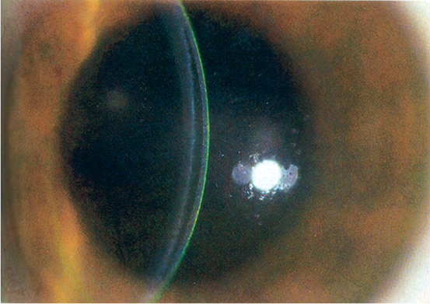
LASIK Issues III: DLK
PISK. Note the presence of an optically clear, fluid-filled space between the flap and stromal bed.

Slide 247
LASIK Issues III: DLK
pressure-induced stromal keratopathy
DLK vs Infectious Keratitis after LASIK
PISK
 | DLK | Infectious Keratitis
Time of onset (post-op) | 10-14 days | At least 2-3 days
Location | Peripheral (initially) | Can be anywhere
Depth of involvement | Limited to interface | Extends into flap and/or underlying stroma
Photosensitivity? | Yes | Yes
Conj injection? | Yes | Yes
Your LASIK pt looks great—until two weeks or so post-op, when she develops what appears to be DLK. Should you crank up the steroids?
Not until you rule out pressure-induced stromal keratopathy (PISK)
What is PISK?
An accumulation in the flap-stroma interface of aqueous transudated across the endothelium by a steroid-induced elevation in IOP
Is PISK common, or rare?
Rare
What is the tx?
Rapid steroid taper + glaucoma meds as needed to control IOP
This is why PISK doesn’t appear before 10 days at the earliest—it takes that long (or longer) for IOP to rise in response to steroids
AC reaction? | Rare | Common

Slide 248
Q
LASIK Issues III: DLK
pressure-induced stromal keratopathy
DLK vs Infectious Keratitis after LASIK
PISK
 | DLK | Infectious Keratitis
Time of onset (post-op) | 10-14 days | At least 2-3 days
Location | Peripheral (initially) | Can be anywhere
Depth of involvement | Limited to interface | Extends into flap and/or underlying stroma
Photosensitivity? | Yes | Yes
Conj injection? | Yes | Yes
Your LASIK pt looks great—until two weeks or so post-op, when she develops what appears to be DLK. Should you crank up the steroids?
Not until you rule out pressure-induced stromal keratopathy (PISK)
What is PISK?
An accumulation in the flap-stroma interface of aqueous transudated across the endothelium by a steroid-induced elevation in IOP
Is PISK common, or rare?
Rare
What is the tx?
Rapid steroid taper + glaucoma meds as needed to control IOP
AC reaction? | Rare | Common

Slide 249
A
LASIK Issues III: DLK
pressure-induced stromal keratopathy
DLK vs Infectious Keratitis after LASIK
PISK
 | DLK | Infectious Keratitis
Time of onset (post-op) | 10-14 days | At least 2-3 days
Location | Peripheral (initially) | Can be anywhere
Depth of involvement | Limited to interface | Extends into flap and/or underlying stroma
Photosensitivity? | Yes | Yes
Conj injection? | Yes | Yes
Your LASIK pt looks great—until two weeks or so post-op, when she develops what appears to be DLK. Should you crank up the steroids?
Not until you rule out pressure-induced stromal keratopathy (PISK)
What is PISK?
An accumulation in the flap-stroma interface of aqueous transudated across the endothelium by a steroid-induced elevation in IOP
Is PISK common, or rare?
Rare
What is the tx?
Rapid steroid taper + glaucoma meds as needed to control IOP
AC reaction? | Rare | Common

Slide 250
Q
LASIK Issues III: DLK
pressure-induced stromal keratopathy
DLK vs Infectious Keratitis after LASIK
PISK
 | DLK | Infectious Keratitis
Time of onset (post-op) | 10-14 days | At least 2-3 days
Location | Peripheral (initially) | Can be anywhere
Depth of involvement | Limited to interface | Extends into flap and/or underlying stroma
Photosensitivity? | Yes | Yes
Conj injection? | Yes | Yes
Your LASIK pt looks great—until two weeks or so post-op, when she develops what appears to be DLK. Should you crank up the steroids?
Not until you rule out pressure-induced stromal keratopathy (PISK)
What is PISK?
An accumulation in the flap-stroma interface of aqueous transudated across the endothelium by a steroid-induced elevation in IOP
Is PISK common, or rare?
Rare
What is the tx?
Rapid steroid taper + glaucoma meds as needed to control IOP
AC reaction? | Rare | Common

Slide 251
A
LASIK Issues III: DLK
pressure-induced stromal keratopathy
DLK vs Infectious Keratitis after LASIK
PISK
 | DLK | Infectious Keratitis
Time of onset (post-op) | 10-14 days | At least 2-3 days
Location | Peripheral (initially) | Can be anywhere
Depth of involvement | Limited to interface | Extends into flap and/or underlying stroma
Photosensitivity? | Yes | Yes
Conj injection? | Yes | Yes
Your LASIK pt looks great—until two weeks or so post-op, when she develops what appears to be DLK. Should you crank up the steroids?
Not until you rule out pressure-induced stromal keratopathy (PISK)
What is PISK?
An accumulation in the flap-stroma interface of aqueous transudated across the endothelium by a steroid-induced elevation in IOP
Is PISK common, or rare?
Rare
What is the tx?
Rapid steroid taper + glaucoma meds as needed to control IOP
AC reaction? | Rare | Common

Slide 252
Q
LASIK Issues III: DLK
pressure-induced stromal keratopathy
DLK vs Infectious Keratitis after LASIK
PISK
 | DLK | Infectious Keratitis
Time of onset (post-op) | 10-14 days | At least 2-3 days
Location | Peripheral (initially) | Can be anywhere
Depth of involvement | Limited to interface | Extends into flap and/or underlying stroma
Photosensitivity? | Yes | Yes
Conj injection? | Yes | Yes
Your LASIK pt looks great—until two weeks or so post-op, when she develops what appears to be DLK. Should you crank up the steroids?
Not until we rule out pressure-induced stromal keratopathy (PISK)
What is PISK?
An accumulation in the flap-stroma interface of aqueous transudated across the endothelium by a steroid-induced elevation in IOP
Is PISK common, or rare?
Rare
What is the tx?
Rapid steroid taper + glaucoma meds as needed to control IOP
Her IOP is normal. Is it safe to assume this is just (very) late-onset DLK?
Not necessarily—it depends on how IOP was measured
It was checked via the gold standard of IOP measurement—Goldmann applanation. Now can I assume it’s late-onset DLK?
Mos def not. The presence of a layer of fluid beneath the flap renders applanation tonometry readings falsely low. When PISK is on the DDx, always check IOP with a Tono-Pen (or other device that doesn’t rely on applanation).
Can PISK result in severe vision loss? What is the mechanism of vision loss?
Indeed it can. Straight up uncontrolled, severe glaucoma.
AC reaction? | Rare | Common

Slide 253
A
LASIK Issues III: DLK
pressure-induced stromal keratopathy
DLK vs Infectious Keratitis after LASIK
PISK
 | DLK | Infectious Keratitis
Time of onset (post-op) | 10-14 days | At least 2-3 days
Location | Peripheral (initially) | Can be anywhere
Depth of involvement | Limited to interface | Extends into flap and/or underlying stroma
Photosensitivity? | Yes | Yes
Conj injection? | Yes | Yes
Your LASIK pt looks great—until two weeks or so post-op, when she develops what appears to be DLK. Should you crank up the steroids?
Not until we rule out pressure-induced stromal keratopathy (PISK)
What is PISK?
An accumulation in the flap-stroma interface of aqueous transudated across the endothelium by a steroid-induced elevation in IOP
Is PISK common, or rare?
Rare
What is the tx?
Rapid steroid taper + glaucoma meds as needed to control IOP
Her IOP is normal. Is it safe to assume this is just (very) late-onset DLK?
Not necessarily—it depends on how IOP was measured
It was checked via the gold standard of IOP measurement—Goldmann applanation. Now can I assume it’s late-onset DLK?
Mos def not. The presence of a layer of fluid beneath the flap renders applanation tonometry readings falsely low. When PISK is on the DDx, always check IOP with a Tono-Pen (or other device that doesn’t rely on applanation).
Can PISK result in severe vision loss? What is the mechanism of vision loss?
Indeed it can. Straight up uncontrolled, severe glaucoma.
AC reaction? | Rare | Common

Slide 254
Q
LASIK Issues III: DLK
pressure-induced stromal keratopathy
DLK vs Infectious Keratitis after LASIK
PISK
 | DLK | Infectious Keratitis
Time of onset (post-op) | 10-14 days | At least 2-3 days
Location | Peripheral (initially) | Can be anywhere
Depth of involvement | Limited to interface | Extends into flap and/or underlying stroma
Photosensitivity? | Yes | Yes
Conj injection? | Yes | Yes
Your LASIK pt looks great—until two weeks or so post-op, when she develops what appears to be DLK. Should you crank up the steroids?
Not until we rule out pressure-induced stromal keratopathy (PISK)
What is PISK?
An accumulation in the flap-stroma interface of aqueous transudated across the endothelium by a steroid-induced elevation in IOP
Is PISK common, or rare?
Rare
What is the tx?
Rapid steroid taper + glaucoma meds as needed to control IOP
Her IOP is normal. Is it safe to assume this is just (very) late-onset DLK?
Not necessarily—it depends on how IOP was measured
It was checked via the gold standard of IOP measurement—Goldmann applanation. Now can I assume it’s late-onset DLK?
Mos def not. The presence of a layer of fluid beneath the flap renders applanation tonometry readings falsely low. When PISK is on the DDx, always check IOP with a Tono-Pen (or other device that doesn’t rely on applanation).
Can PISK result in severe vision loss? What is the mechanism of vision loss?
Indeed it can. Straight up uncontrolled, severe glaucoma.
AC reaction? | Rare | Common

Slide 255
A
LASIK Issues III: DLK
pressure-induced stromal keratopathy
DLK vs Infectious Keratitis after LASIK
PISK
 | DLK | Infectious Keratitis
Time of onset (post-op) | 10-14 days | At least 2-3 days
Location | Peripheral (initially) | Can be anywhere
Depth of involvement | Limited to interface | Extends into flap and/or underlying stroma
Photosensitivity? | Yes | Yes
Conj injection? | Yes | Yes
Your LASIK pt looks great—until two weeks or so post-op, when she develops what appears to be DLK. Should you crank up the steroids?
Not until we rule out pressure-induced stromal keratopathy (PISK)
What is PISK?
An accumulation in the flap-stroma interface of aqueous transudated across the endothelium by a steroid-induced elevation in IOP
Is PISK common, or rare?
Rare
What is the tx?
Rapid steroid taper + glaucoma meds as needed to control IOP
Her IOP is normal. Is it safe to assume this is just (very) late-onset DLK?
Not necessarily—it depends on how IOP was measured
It was checked via the gold standard of IOP measurement—Goldmann applanation. Now can I assume it’s late-onset DLK?
Mos def not. The presence of a layer of fluid beneath the flap renders applanation tonometry readings falsely low. When PISK is on the DDx, always check IOP with a Tono-Pen (or other device that doesn’t rely on applanation).
Can PISK result in severe vision loss? What is the mechanism of vision loss?
Indeed it can. Straight up uncontrolled, severe glaucoma.
AC reaction? | Rare | Common

Slide 256
A
LASIK Issues III: DLK
pressure-induced stromal keratopathy
DLK vs Infectious Keratitis after LASIK
PISK
 | DLK | Infectious Keratitis
Time of onset (post-op) | 10-14 days | At least 2-3 days
Location | Peripheral (initially) | Can be anywhere
Depth of involvement | Limited to interface | Extends into flap and/or underlying stroma
Photosensitivity? | Yes | Yes
Conj injection? | Yes | Yes
Your LASIK pt looks great—until two weeks or so post-op, when she develops what appears to be DLK. Should you crank up the steroids?
Not until we rule out pressure-induced stromal keratopathy (PISK)
What is PISK?
An accumulation in the flap-stroma interface of aqueous transudated across the endothelium by a steroid-induced elevation in IOP
Is PISK common, or rare?
Rare
What is the tx?
Rapid steroid taper + glaucoma meds as needed to control IOP
Her IOP is normal. Is it safe to assume this is just (very) late-onset DLK?
Not necessarily—it depends on how IOP was measured
It was checked via the gold standard of IOP measurement—Goldmann applanation. Now can I assume it’s late-onset DLK?
Mos def not. The presence of a layer of fluid beneath the flap renders applanation tonometry readings falsely low. When PISK is on the DDx, always check IOP with a Tono-Pen (or other device that doesn’t rely on applanation).
Can PISK result in severe vision loss? What is the mechanism of vision loss?
Indeed it can. Straight up uncontrolled, severe glaucoma.
AC reaction? | Rare | Common

Slide 257
Q
LASIK Issues III: DLK
pressure-induced stromal keratopathy
DLK vs Infectious Keratitis after LASIK
PISK
 | DLK | Infectious Keratitis
Time of onset (post-op) | 10-14 days | At least 2-3 days
Location | Peripheral (initially) | Can be anywhere
Depth of involvement | Limited to interface | Extends into flap and/or underlying stroma
Photosensitivity? | Yes | Yes
Conj injection? | Yes | Yes
Your LASIK pt looks great—until two weeks or so post-op, when she develops what appears to be DLK. Should you crank up the steroids?
Not until we rule out pressure-induced stromal keratopathy (PISK)
What is PISK?
An accumulation in the flap-stroma interface of aqueous transudated across the endothelium by a steroid-induced elevation in IOP
Is PISK common, or rare?
Rare
What is the tx?
Rapid steroid taper + glaucoma meds as needed to control IOP
Her IOP is normal. Is it safe to assume this is just (very) late-onset DLK?
Not necessarily—it depends on how IOP was measured
It was checked via the gold standard of IOP measurement—Goldmann applanation. Now can I assume it’s late-onset DLK?
Mos def not. The presence of a layer of fluid beneath the flap renders applanation tonometry readings falsely low. When PISK is on the DDx, always check IOP with a Tono-Pen (or other device that doesn’t rely on applanation).
Can PISK result in severe vision loss? What is the mechanism of vision loss?
Indeed it can. Straight up uncontrolled, severe glaucoma.
AC reaction? | Rare | Common

Slide 258
A
LASIK Issues III: DLK
pressure-induced stromal keratopathy
DLK vs Infectious Keratitis after LASIK
PISK
 | DLK | Infectious Keratitis
Time of onset (post-op) | 10-14 days | At least 2-3 days
Location | Peripheral (initially) | Can be anywhere
Depth of involvement | Limited to interface | Extends into flap and/or underlying stroma
Photosensitivity? | Yes | Yes
Conj injection? | Yes | Yes
Your LASIK pt looks great—until two weeks or so post-op, when she develops what appears to be DLK. Should you crank up the steroids?
Not until we rule out pressure-induced stromal keratopathy (PISK)
What is PISK?
An accumulation in the flap-stroma interface of aqueous transudated across the endothelium by a steroid-induced elevation in IOP
Is PISK common, or rare?
Rare
What is the tx?
Rapid steroid taper + glaucoma meds as needed to control IOP
Her IOP is normal. Is it safe to assume this is just (very) late-onset DLK?
Not necessarily—it depends on how IOP was measured
It was checked via the gold standard of IOP measurement—Goldmann applanation. Now can I assume it’s late-onset DLK?
Mos def not. The presence of a layer of fluid beneath the flap renders applanation tonometry readings falsely low. When PISK is on the DDx, always check IOP with a Tono-Pen (or other device that doesn’t rely on applanation).
Can PISK result in severe vision loss? What is the mechanism of vision loss?
Indeed it can. Straight up uncontrolled, severe glaucoma.
AC reaction? | Rare | Common

Slide 259
Q
LASIK Issues III: DLK
pressure-induced stromal keratopathy
DLK vs Infectious Keratitis after LASIK
PISK
 | DLK | Infectious Keratitis
Time of onset (post-op) | 10-14 days | At least 2-3 days
Location | Peripheral (initially) | Can be anywhere
Depth of involvement | Limited to interface | Extends into flap and/or underlying stroma
Photosensitivity? | Yes | Yes
Conj injection? | Yes | Yes
Your LASIK pt looks great—until two weeks or so post-op, when she develops what appears to be DLK. Should you crank up the steroids?
Not until we rule out pressure-induced stromal keratopathy (PISK)
What is PISK?
An accumulation in the flap-stroma interface of aqueous transudated across the endothelium by a steroid-induced elevation in IOP
Is PISK common, or rare?
Rare
What is the tx?
Rapid steroid taper + glaucoma meds as needed to control IOP
Her IOP is normal. Is it safe to assume this is just (very) late-onset DLK?
Not necessarily—it depends on how IOP was measured
It was checked via the gold standard of IOP measurement—Goldmann applanation. Now can I assume it’s late-onset DLK?
Mos def not. The presence of a layer of fluid beneath the flap renders applanation tonometry readings falsely low. When PISK is on the DDx, always check IOP with a Tono-Pen (or other device that doesn’t rely on applanation).
Can PISK result in severe vision loss? What is the mechanism of vision loss?
Indeed it can. Straight up uncontrolled, severe glaucoma.
AC reaction? | Rare | Common

Slide 260
A
LASIK Issues III: DLK
pressure-induced stromal keratopathy
DLK vs Infectious Keratitis after LASIK
PISK
 | DLK | Infectious Keratitis
Time of onset (post-op) | 10-14 days | At least 2-3 days
Location | Peripheral (initially) | Can be anywhere
Depth of involvement | Limited to interface | Extends into flap and/or underlying stroma
Photosensitivity? | Yes | Yes
Conj injection? | Yes | Yes
Your LASIK pt looks great—until two weeks or so post-op, when she develops what appears to be DLK. Should you crank up the steroids?
Not until we rule out pressure-induced stromal keratopathy (PISK)
What is PISK?
An accumulation in the flap-stroma interface of aqueous transudated across the endothelium by a steroid-induced elevation in IOP
Is PISK common, or rare?
Rare
What is the tx?
Rapid steroid taper + glaucoma meds as needed to control IOP
Her IOP is normal. Is it safe to assume this is just (very) late-onset DLK?
Not necessarily—it depends on how IOP was measured
It was checked via the gold standard of IOP measurement—Goldmann applanation. Now can I assume it’s late-onset DLK?
Mos def not. The presence of a layer of fluid beneath the flap renders applanation tonometry readings falsely low. When PISK is on the DDx, always check IOP with a Tono-Pen (or other device that doesn’t rely on applanation).
Can PISK result in severe vision loss? What is the mechanism of vision loss?
Indeed it can. Straight up uncontrolled, severe glaucoma.
AC reaction? | Rare | Common

Slide 261
Photoablative Surgery: Other Issues
These patients should give you pause before proceeding with ablative keratorefractive surgery:

Slide 262
Q
Photoablative Surgery: Other Issues
These patients should give you pause before proceeding with ablative keratorefractive surgery:
The patient with a POcHx of HSV keratitis
infection

Slide 263
A
Photoablative Surgery: Other Issues
These patients should give you pause before proceeding with ablative keratorefractive surgery:
The patient with a POcHx of HSV keratitis

Slide 264
Q
Photoablative Surgery: Other Issues
These patients should give you pause before proceeding with ablative keratorefractive surgery:
The patient with a POcHx of HSV keratitis
What is the concern re operating on patients with a history of HSV keratitis?

Slide 265
A
Photoablative Surgery: Other Issues
These patients should give you pause before proceeding with ablative keratorefractive surgery:
The patient with a POcHx of HSV keratitis
What is the concern re operating on patients with a history of HSV keratitis?
Re-activation of the virus

Slide 266
Q
Photoablative Surgery: Other Issues
These patients should give you pause before proceeding with ablative keratorefractive surgery:
The patient with a POcHx of HSV keratitis
The patient with a POcHx of DES
abb.

Slide 267
A
Photoablative Surgery: Other Issues
These patients should give you pause before proceeding with ablative keratorefractive surgery:
The patient with a POcHx of HSV keratitis
The patient with a POcHx of DES

Slide 268
Q
Photoablative Surgery: Other Issues
These patients should give you pause before proceeding with ablative keratorefractive surgery:
The patient with a POcHx of HSV keratitis
The patient with a POcHx of DES
The patient with PMHx of rheumatoid arthritis
two words

Slide 269
A
Photoablative Surgery: Other Issues
These patients should give you pause before proceeding with ablative keratorefractive surgery:
The patient with a POcHx of HSV keratitis
The patient with a POcHx of DES
The patient with PMHx of rheumatoid arthritis

Slide 270
Q
Photoablative Surgery: Other Issues
These patients should give you pause before proceeding with ablative keratorefractive surgery:
The patient with a POcHx of HSV keratitis
The patient with a POcHx of DES
The patient with PMHx of rheumatoid arthritis
Generally speaking, to what undesirable post-op state does RA (and other connective-tissue conditions) contribute?

Slide 271
A
Photoablative Surgery: Other Issues
These patients should give you pause before proceeding with ablative keratorefractive surgery:
The patient with a POcHx of HSV keratitis
The patient with a POcHx of DES
The patient with PMHx of rheumatoid arthritis
Generally speaking, to what undesirable post-op state does RA (and other connective-tissue conditions) contribute?
That of poor/delayed wound healing

Slide 272
Q
Photoablative Surgery: Other Issues
These patients should give you pause before proceeding with ablative keratorefractive surgery:
The patient with a POcHx of HSV keratitis
The patient with a POcHx of DES
The patient with PMHx of rheumatoid arthritis
Generally speaking, to what undesirable post-op state does RA (and other connective-tissue conditions) contribute?
That of poor/delayed wound healing
What medical condition, vastly more common than RA, is also associated with poor wound healing?

Slide 273
A
Photoablative Surgery: Other Issues
These patients should give you pause before proceeding with ablative keratorefractive surgery:
The patient with a POcHx of HSV keratitis
The patient with a POcHx of DES
The patient with PMHx of rheumatoid arthritis
Generally speaking, to what undesirable post-op state does RA (and other connective-tissue conditions) contribute?
That of poor/delayed wound healing
What medical condition, vastly more common than RA, is also associated with poor wound healing?
Diabetes

Slide 274
Q
Photoablative Surgery: Other Issues
These patients should give you pause before proceeding with ablative keratorefractive surgery:
The patient with a POcHx of HSV keratitis
The patient with a POcHx of DES
The patient with PMHx of rheumatoid arthritis
Generally speaking, to what undesirable post-op state does RA (and other connective-tissue conditions) contribute?
That of poor/delayed wound healing
What medical condition, vastly more common than RA, is also associated with poor wound healing?
Diabetes
What dreaded post-op complication—an extreme manifestation of poor wound healing—can occur in post-photoablative RA patients?

Slide 275
A
Photoablative Surgery: Other Issues
These patients should give you pause before proceeding with ablative keratorefractive surgery:
The patient with a POcHx of HSV keratitis
The patient with a POcHx of DES
The patient with PMHx of rheumatoid arthritis
Generally speaking, to what undesirable post-op state does RA (and other connective-tissue conditions) contribute?
That of poor/delayed wound healing
What medical condition, vastly more common than RA, is also associated with poor wound healing?
Diabetes
What dreaded post-op complication—an extreme manifestation of poor wound healing—can occur in post-photoablative RA patients?
Wound melt

Slide 276
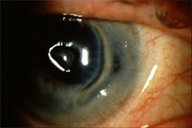
Photoablative Surgery: Other Issues
Post-LASIK corneal melt in an RA pt

Slide 277
Q
Photoablative Surgery: Other Issues
These patients should give you pause before proceeding with ablative keratorefractive surgery:
The patient with a POcHx of HSV keratitis
The patient with a POcHx of DES
The patient with PMHx of rheumatoid arthritis
Generally speaking, to what undesirable post-op state does RA (and other connective-tissue conditions) contribute?
That of poor/delayed wound healing
What medical condition, vastly more common than RA, is also associated with poor wound healing?
Diabetes
What ocular condition frequently co-exists with RA, such that the outcome of photoablative surgery may be suboptimal even in the absence of poor healing and/or a wound melt?
DES
What dreaded post-op complication—an extreme manifestation of poor wound healing—can occur in post-photoablative RA patients?
Wound melt

Slide 278
A
Photoablative Surgery: Other Issues
These patients should give you pause before proceeding with ablative keratorefractive surgery:
The patient with a POcHx of HSV keratitis
The patient with a POcHx of DES
The patient with PMHx of rheumatoid arthritis
Generally speaking, to what undesirable post-op state does RA (and other connective-tissue conditions) contribute?
That of poor/delayed wound healing
What medical condition, vastly more common than RA, is also associated with poor wound healing?
Diabetes
What ocular condition frequently co-exists with RA, such that the outcome of photoablative surgery may be suboptimal even in the absence of poor healing and/or a wound melt?
DES
What dreaded post-op complication—an extreme manifestation of poor wound healing—can occur in post-photoablative RA patients?
Wound melt

Slide 279
Q
Photoablative Surgery: Other Issues
These patients should give you pause before proceeding with ablative keratorefractive surgery:
The patient with a POcHx of HSV keratitis
The patient with a POcHx of DES
The patient with PMHx of rheumatoid arthritis
Generally speaking, to what undesirable post-op state does RA (and other connective-tissue conditions) contribute?
That of poor/delayed wound healing
Speaking of delayed corneal wound healing…Certain medications are notorious for inducing this, and thus their use is a relative contraindication to photoablative surgery. What are they?
--?
--?
--?
--?
--?
What ocular condition frequently co-exists with RA, such that the outcome of photoablative surgery may be suboptimal even in the absence of poor healing and/or a wound melt?
DES
(used to treat migraines and cluster HAs)
(used to treat acne)
(used to treat ventricular arrhythmias)
(used to treat symptoms of menopause, and/or osteoporosis prevention)
What ocular condition frequently co-exists with RA, such that the outcome of photoablative surgery may be suboptimal even in the absence of poor healing and/or a wound melt?
DES
(OTC; used to treat allergic conditions)

Slide 280
A
Photoablative Surgery: Other Issues
These patients should give you pause before proceeding with ablative keratorefractive surgery:
The patient with a POcHx of HSV keratitis
The patient with a POcHx of DES
The patient with PMHx of rheumatoid arthritis
Generally speaking, to what undesirable post-op state does RA (and other connective-tissue conditions) contribute?
That of poor/delayed wound healing
Speaking of delayed corneal wound healing…Certain medications are notorious for inducing this, and thus their use is a relative contraindication to photoablative surgery. What are they?
--Sumatriptan
--Isotretinoin
--Amiodarone
--HRT
--Antihistamines
What ocular condition frequently co-exists with RA, such that the outcome of photoablative surgery may be suboptimal even in the absence of poor healing and/or a wound melt?
DES
(used to treat migraines and cluster HAs)
(used to treat acne)
(used to treat ventricular arrhythmias)
(used to treat symptoms of menopause, and/or osteoporosis prevention)
What ocular condition frequently co-exists with RA, such that the outcome of photoablative surgery may be suboptimal even in the absence of poor healing and/or a wound melt?
DES
(OTC; used to treat allergic conditions)

Slide 281
Photoablative Surgery: Other Issues
These patients should give you pause before proceeding with ablative keratorefractive surgery:
The patient with a POcHx of HSV keratitis
The patient with a POcHx of DES
The patient with PMHx of rheumatoid arthritis
Generally speaking, to what undesirable post-op state does RA (and other connective-tissue conditions) contribute?
That of poor/delayed wound healing
Speaking of delayed corneal wound healing…Certain medications are notorious for inducing this, and thus their use is a relative contraindication to photoablative surgery. What are they?
--Sumatriptan
--Isotretinoin
--Amiodarone
--HRT
--Antihistamines
Note: It’s unclear how strong a contraindication to surgery these meds should be considered. One highly-placed Academy resource states they “are believed to cause delayed corneal wound healing, and caution should be used in pts who take them.” But the Refractive Surgery book states that, whereas these meds “traditionally have been thought to increase the risk of poor corneal healing,” in actuality “there is no evidence for this association in the peer-reviewed literature.” So, how should you answer questions related to this topic? Very carefully. Caveat emptor.
What ocular condition frequently co-exists with RA, such that the outcome of photoablative surgery may be suboptimal even in the absence of poor healing and/or a wound melt?
DES
What ocular condition frequently co-exists with RA, such that the outcome of photoablative surgery may be suboptimal even in the absence of poor healing and/or a wound melt?
DES
No question—proceed when ready

Slide 282
Photoablative Surgery: Other Issues
These patients should give you pause before proceeding with ablative keratorefractive surgery:
The patient with a POcHx of HSV keratitis
The patient with a POcHx of DES
The patient with PMHx of rheumatoid arthritis
Generally speaking, to what undesirable post-op state does RA (and other connective-tissue conditions) contribute?
That of poor/delayed wound healing
Speaking of delayed corneal wound healing…Certain medications are notorious for inducing this, and thus their use is a relative contraindication to photoablative surgery. What are they?
--Sumatriptan
--Isotretinoin
--Amiodarone
--HRT
--Antihistamines
Note: It’s unclear how strong a contraindication to surgery these meds should be considered. One highly-placed Academy resource states they “are believed to cause delayed corneal wound healing, and caution should be used in pts who take them.” But the Refractive Surgery book states that, whereas these meds “traditionally have been thought to increase the risk of poor corneal healing,” in actuality “there is no evidence for this association in the peer-reviewed literature.” So, how should you answer questions related to this topic? Very carefully. Caveat emptor.
What ocular condition frequently co-exists with RA, such that the outcome of photoablative surgery may be suboptimal even in the absence of poor healing and/or a wound melt?
DES
What ocular condition frequently co-exists with RA, such that the outcome of photoablative surgery may be suboptimal even in the absence of poor healing and/or a wound melt?
DES
No question—proceed when ready

Slide 283
Photoablative Surgery: Other Issues
These patients should give you pause before proceeding with ablative keratorefractive surgery:
The patient with a POcHx of HSV keratitis
The patient with a POcHx of DES
The patient with PMHx of rheumatoid arthritis
Generally speaking, to what undesirable post-op state does RA (and other connective-tissue conditions) contribute?
That of poor/delayed wound healing
Speaking of delayed corneal wound healing…Certain medications are notorious for inducing this, and thus their use is a relative contraindication to photoablative surgery. What are they?
--Sumatriptan
--Isotretinoin
--Amiodarone
--HRT
--Antihistamines
Note: It’s unclear how strong a contraindication to surgery these meds should be considered. One highly-placed Academy resource states they “are believed to cause delayed corneal wound healing, and caution should be used in pts who take them.” But the Refractive Surgery book states that, whereas these meds “traditionally have been thought to increase the risk of poor corneal healing,” in actuality “there is no evidence for this association in the peer-reviewed literature.” So, how should you answer questions related to this topic? Very carefully. Caveat emptor.
What ocular condition frequently co-exists with RA, such that the outcome of photoablative surgery may be suboptimal even in the absence of poor healing and/or a wound melt?
DES
What ocular condition frequently co-exists with RA, such that the outcome of photoablative surgery may be suboptimal even in the absence of poor healing and/or a wound melt?
DES
No question—proceed when ready

Slide 284
Q
Photoablative Surgery: Other Issues
These patients should give you pause before proceeding with ablative keratorefractive surgery:
The patient with a POcHx of HSV keratitis
The patient with a POcHx of DES
The patient with PMHx of rheumatoid arthritis
Generally speaking, to what undesirable post-op state does RA (and other connective-tissue conditions) contribute?
That of poor/delayed wound healing
Speaking of delayed corneal wound healing…Certain medications are notorious for inducing this, and thus their use is a relative contraindication to photoablative surgery. What are they?
--Sumatriptan
--Isotretinoin
--Amiodarone
--HRT
--Antihistamines
What ocular condition frequently co-exists with RA, such that the outcome of photoablative surgery may be suboptimal even in the absence of poor healing and/or a wound melt?
DES
In addition to delaying wound healing, isotretinoin contributes to suboptimal photoablative outcomes by exacerbating another condition known to negatively impact them—what condition?
Isotretinoin can damage meibomian glands, thereby worsening DES
What ocular condition frequently co-exists with RA, such that the outcome of photoablative surgery may be suboptimal even in the absence of poor healing and/or a wound melt?
DES

Slide 285
Q/A
Photoablative Surgery: Other Issues
These patients should give you pause before proceeding with ablative keratorefractive surgery:
The patient with a POcHx of HSV keratitis
The patient with a POcHx of DES
The patient with PMHx of rheumatoid arthritis
Generally speaking, to what undesirable post-op state does RA (and other connective-tissue conditions) contribute?
That of poor/delayed wound healing
Speaking of delayed corneal wound healing…Certain medications are notorious for inducing this, and thus their use is a relative contraindication to photoablative surgery. What are they?
--Sumatriptan
--Isotretinoin
--Amiodarone
--HRT
--Antihistamines
What ocular condition frequently co-exists with RA, such that the outcome of photoablative surgery may be suboptimal even in the absence of poor healing and/or a wound melt?
DES
In addition to delaying wound healing, isotretinoin contributes to suboptimal photoablative outcomes by exacerbating another condition known to negatively impact them—what condition?
Isotretinoin can damage meibomian glands, thereby worsening DES
What ocular condition frequently co-exists with RA, such that the outcome of photoablative surgery may be suboptimal even in the absence of poor healing and/or a wound melt?
DES

Slide 286
A
Photoablative Surgery: Other Issues
These patients should give you pause before proceeding with ablative keratorefractive surgery:
The patient with a POcHx of HSV keratitis
The patient with a POcHx of DES
The patient with PMHx of rheumatoid arthritis
Generally speaking, to what undesirable post-op state does RA (and other connective-tissue conditions) contribute?
That of poor/delayed wound healing
Speaking of delayed corneal wound healing…Certain medications are notorious for inducing this, and thus their use is a relative contraindication to photoablative surgery. What are they?
--Sumatriptan
--Isotretinoin
--Amiodarone
--HRT
--Antihistamines
What ocular condition frequently co-exists with RA, such that the outcome of photoablative surgery may be suboptimal even in the absence of poor healing and/or a wound melt?
DES
In addition to delaying wound healing, isotretinoin contributes to suboptimal photoablative outcomes by exacerbating another condition known to negatively impact them—what condition?
Isotretinoin can damage meibomian glands, thereby worsening DES
What ocular condition frequently co-exists with RA, such that the outcome of photoablative surgery may be suboptimal even in the absence of poor healing and/or a wound melt?
DES

Slide 287
Q
Photoablative Surgery: Other Issues
These patients should give you pause before proceeding with ablative keratorefractive surgery:
The patient with a POcHx of HSV keratitis
The patient with a POcHx of DES
The patient with PMHx of rheumatoid arthritis
The patient whose pre-op exam suggests the possibility of forme fruste keratoconus or other ectatic disorder
three words
one word

Slide 288
A
Photoablative Surgery: Other Issues
These patients should give you pause before proceeding with ablative keratorefractive surgery:
The patient with a POcHx of HSV keratitis
The patient with a POcHx of DES
The patient with PMHx of rheumatoid arthritis
The patient whose pre-op exam suggests the possibility of forme fruste keratoconus or other ectatic disorder

Slide 289
Q
Photoablative Surgery: Other Issues
These patients should give you pause before proceeding with ablative keratorefractive surgery:
The patient with a POcHx of HSV keratitis
The patient with a POcHx of DES
The patient with PMHx of rheumatoid arthritis
The patient whose pre-op exam suggests the possibility of forme fruste keratoconus or other ectatic disorder
Of these four conditions, which one is probably most widely regarded as a
contraindication to keratorefractive surgery?

Slide 290
A
Photoablative Surgery: Other Issues
These patients should give you pause before proceeding with ablative keratorefractive surgery:
The patient with a POcHx of HSV keratitis
The patient with a POcHx of DES
The patient with PMHx of rheumatoid arthritis
The patient whose pre-op exam suggests the possibility of forme fruste keratoconus or other ectatic disorder
Of these four conditions, which one is probably most widely regarded as a
contraindication to keratorefractive surgery?
Keratoconus—forme fruste or otherwise

Slide 291
Photoablative Surgery: Other Issues
These patients should give you pause before proceeding with ablative keratorefractive surgery:
The patient with a POcHx of HSV keratitis
The patient with a POcHx of DES
The patient with PMHx of rheumatoid arthritis
The patient whose pre-op exam suggests the possibility of forme fruste keratoconus or other ectatic disorder
This assertion is technically incorrect. Keratoconus is certainly a contraindication for RK as well as keratoablative procedures such as LASIK and PRK. However, there is a keratorefractive procedure that is not only not contraindicated in keratoconus, it is used to treat keratoconus. What is it?
Corneal inlay (ie, Intacs) procedure
Of these four conditions, which one is probably most widely regarded as a
contraindication to keratorefractive surgery?
Keratoconus—forme fruste or otherwise
No question—proceed when ready

Slide 292
Photoablative Surgery: Other Issues
These patients should give you pause before proceeding with ablative keratorefractive surgery:
The patient with a POcHx of HSV keratitis
The patient with a POcHx of DES
The patient with PMHx of rheumatoid arthritis
The patient whose pre-op exam suggests the possibility of forme fruste keratoconus or other ectatic disorder
This assertion is technically incorrect. Keratoconus is certainly a contraindication for RK as well as keratoablative procedures such as LASIK and PRK. However, there is a keratorefractive procedure that is not only not contraindicated in keratoconus, it is used to treat keratoconus. What is it?
Corneal inlay (ie, Intacs) procedure
Of these four conditions, which one is probably most widely regarded as a
contraindication to keratorefractive surgery?
Keratoconus—forme fruste or otherwise
No question—proceed when ready

Slide 293
Q
Photoablative Surgery: Other Issues
These patients should give you pause before proceeding with ablative keratorefractive surgery:
The patient with a POcHx of HSV keratitis
The patient with a POcHx of DES
The patient with PMHx of rheumatoid arthritis
The patient whose pre-op exam suggests the possibility of forme fruste keratoconus or other ectatic disorder
This assertion is technically incorrect. Keratoconus is certainly a contraindication for RK as well as keratoablative procedures such as LASIK and PRK. However, there is a keratorefractive procedure that is not only not contraindicated in keratoconus, it is used to treat keratoconus. What is it?
Corneal inlay (ie, Intacs) procedure
Of these four conditions, which one is probably most widely regarded as a
contraindication to keratorefractive surgery?
Keratoconus—forme fruste or otherwise

Slide 294
A
Photoablative Surgery: Other Issues
These patients should give you pause before proceeding with ablative keratorefractive surgery:
The patient with a POcHx of HSV keratitis
The patient with a POcHx of DES
The patient with PMHx of rheumatoid arthritis
The patient whose pre-op exam suggests the possibility of forme fruste keratoconus or other ectatic disorder
This assertion is technically incorrect. Keratoconus is certainly a contraindication for RK as well as keratoablative procedures such as LASIK and PRK. However, there is a keratorefractive procedure that is not only not contraindicated in keratoconus, it is used to treat keratoconus. What is it?
Corneal inlay (ie, Intacs) procedure
Of these four conditions, which one is probably most widely regarded as a
contraindication to keratorefractive surgery?
Keratoconus—forme fruste or otherwise

Slide 295
Photoablative Surgery: Other Issues
These patients should give you pause before proceeding with ablative keratorefractive surgery:
The patient with a POcHx of HSV keratitis
The patient with a POcHx of DES
The patient with PMHx of rheumatoid arthritis
The patient whose pre-op exam suggests the possibility of forme fruste keratoconus or other ectatic disorder
For more on corneal inlays, see slide-set RS9
This assertion is technically incorrect. Keratoconus is certainly a contraindication for RK as well as keratoablative procedures such as LASIK and PRK. However, there is a keratorefractive procedure that is not only not contraindicated in keratoconus, it is used to treat keratoconus. What is it?
Corneal inlay (ie, Intacs) procedure
Of these four conditions, which one is probably most widely regarded as a
contraindication to keratorefractive surgery?
Keratoconus—forme fruste or otherwise
No question—proceed when ready

Slide 296
Photoablative Surgery: Other Issues
These patients should give you pause before proceeding with ablative keratorefractive surgery:
The patient with a POcHx of HSV keratitis
The patient with a POcHx of DES
The patient with PMHx of rheumatoid arthritis
The patient whose pre-op exam suggests the possibility of forme fruste keratoconus or other ectatic disorder
This assertion is technically incorrect. Keratoconus is certainly a contraindication for RK as well as keratoablative procedures such as LASIK and PRK. However, there is a keratorefractive procedure that is not only not contraindicated in keratoconus, it is used to treat keratoconus. What is it?
Corneal inlay (ie, Intacs) procedure
Of these four conditions, which one is probably most widely regarded as a
contraindication to keratorefractive surgery?
Keratoconus—forme fruste or otherwise
BTW, even this is not universal—there are good and honorable surgeons who will perform keratoablative refractive surgery on select forme fruste patients
No question—proceed when ready

Slide 297
Q
Photoablative Surgery: Other Issues
These patients should give you pause before proceeding with ablative keratorefractive surgery:
The patient with a POcHx of HSV keratitis
The patient with a POcHx of DES
The patient with PMHx of rheumatoid arthritis
The patient whose pre-op exam suggests the possibility of forme fruste keratoconus or other ectatic disorder
The pt who is immunocompromised
general health status

Slide 298
A
Photoablative Surgery: Other Issues
These patients should give you pause before proceeding with ablative keratorefractive surgery:
The patient with a POcHx of HSV keratitis
The patient with a POcHx of DES
The patient with PMHx of rheumatoid arthritis
The patient whose pre-op exam suggests the possibility of forme fruste keratoconus or other ectatic disorder
The pt who is immunocompromised

Slide 299
Q
Photoablative Surgery: Other Issues
These patients should give you pause before proceeding with ablative keratorefractive surgery:
The patient with a POcHx of HSV keratitis
The patient with a POcHx of DES
The patient with PMHx of rheumatoid arthritis
The patient whose pre-op exam suggests the possibility of forme fruste keratoconus or other ectatic disorder
The pt who is immunocompromised
When you hear ‘immunocompromised,’ two health scenarios should spring to mind—what are they?
--?
--?

Slide 300
A
Photoablative Surgery: Other Issues
These patients should give you pause before proceeding with ablative keratorefractive surgery:
The patient with a POcHx of HSV keratitis
The patient with a POcHx of DES
The patient with PMHx of rheumatoid arthritis
The patient whose pre-op exam suggests the possibility of forme fruste keratoconus or other ectatic disorder
The pt who is immunocompromised
When you hear ‘immunocompromised,’ two health scenarios should spring to mind—what are they?
--HIV/AIDS
--Cancer

Slide 301
Q
Photoablative Surgery: Other Issues
These patients should give you pause before proceeding with ablative keratorefractive surgery:
The patient with a POcHx of HSV keratitis
The patient with a POcHx of DES
The patient with PMHx of rheumatoid arthritis
The patient whose pre-op exam suggests the possibility of forme fruste keratoconus or other ectatic disorder
The pt who is immunocompromised
When you hear ‘immunocompromised,’ two health scenarios should spring to mind—what are they?
--HIV/AIDS
--Cancer
Why are immunocompromised pts relatively poor candidates for surgery?

Slide 302
A
Photoablative Surgery: Other Issues
These patients should give you pause before proceeding with ablative keratorefractive surgery:
The patient with a POcHx of HSV keratitis
The patient with a POcHx of DES
The patient with PMHx of rheumatoid arthritis
The patient whose pre-op exam suggests the possibility of forme fruste keratoconus or other ectatic disorder
The pt who is immunocompromised
When you hear ‘immunocompromised,’ two health scenarios should spring to mind—what are they?
--HIV/AIDS
--Cancer
Why are immunocompromised pts relatively poor candidates for surgery?
Because they are at increased risk of post-op infection

Slide 303
Q
Photoablative Surgery: Other Issues
These patients should give you pause before proceeding with ablative keratorefractive surgery:
The patient with a POcHx of HSV keratitis
The patient with a POcHx of DES
The patient with PMHx of rheumatoid arthritis
The patient whose pre-op exam suggests the possibility of forme fruste keratoconus or other ectatic disorder
The pt who is immunocompromised
The pt who is pregnant or breastfeeding
condition
related activity

Slide 304
A
Photoablative Surgery: Other Issues
These patients should give you pause before proceeding with ablative keratorefractive surgery:
The patient with a POcHx of HSV keratitis
The patient with a POcHx of DES
The patient with PMHx of rheumatoid arthritis
The patient whose pre-op exam suggests the possibility of forme fruste keratoconus or other ectatic disorder
The pt who is immunocompromised
The pt who is pregnant or breastfeeding

Slide 305
Q
Photoablative Surgery: Other Issues
These patients should give you pause before proceeding with ablative keratorefractive surgery:
The patient with a POcHx of HSV keratitis
The patient with a POcHx of DES
The patient with PMHx of rheumatoid arthritis
The patient whose pre-op exam suggests the possibility of forme fruste keratoconus or other ectatic disorder
The pt who is immunocompromised
The pt who is pregnant or breastfeeding
Why are these contraindications to refractive surgery? (Hint: It has nothing to do with any systemic meds given to relax the pt for surgery.)

Slide 306
Q/A
Photoablative Surgery: Other Issues
These patients should give you pause before proceeding with ablative keratorefractive surgery:
The patient with a POcHx of HSV keratitis
The patient with a POcHx of DES
The patient with PMHx of rheumatoid arthritis
The patient whose pre-op exam suggests the possibility of forme fruste keratoconus or other ectatic disorder
The pt who is immunocompromised
The pt who is pregnant or breastfeeding
Why are these contraindications to refractive surgery? (Hint: It has nothing to do with any systemic meds given to relax the pt for surgery.)
Both can affect the hydration and/or refractive state of the cornea

Slide 307
A
Photoablative Surgery: Other Issues
These patients should give you pause before proceeding with ablative keratorefractive surgery:
The patient with a POcHx of HSV keratitis
The patient with a POcHx of DES
The patient with PMHx of rheumatoid arthritis
The patient whose pre-op exam suggests the possibility of forme fruste keratoconus or other ectatic disorder
The pt who is immunocompromised
The pt who is pregnant or breastfeeding
Why are these contraindications to refractive surgery? (Hint: It has nothing to do with any systemic meds given to relax the pt for surgery.)
Both can affect the hydration and/or refractive state of the cornea

Slide 308
Q
Photoablative Surgery: Other Issues
These patients should give you pause before proceeding with ablative keratorefractive surgery:
The patient with a POcHx of HSV keratitis
The patient with a POcHx of DES
The patient with PMHx of rheumatoid arthritis
The patient whose pre-op exam suggests the possibility of forme fruste keratoconus or other ectatic disorder
The pt who is immunocompromised
The pt who is pregnant or breastfeeding
Why are these contraindications to refractive surgery? (Hint: It has nothing to do with any systemic meds given to relax the pt for surgery.)
Both can affect the hydration and/or refractive state of the cornea
How long after pregnancy (or breastfeeding) should one wait before performing keratorefractive surgery?

Slide 309
A
Photoablative Surgery: Other Issues
These patients should give you pause before proceeding with ablative keratorefractive surgery:
The patient with a POcHx of HSV keratitis
The patient with a POcHx of DES
The patient with PMHx of rheumatoid arthritis
The patient whose pre-op exam suggests the possibility of forme fruste keratoconus or other ectatic disorder
The pt who is immunocompromised
The pt who is pregnant or breastfeeding
Why are these contraindications to refractive surgery? (Hint: It has nothing to do with any systemic meds given to relax the pt for surgery.)
Both can affect the hydration and/or refractive state of the cornea
How long after pregnancy (or breastfeeding) should one wait before performing keratorefractive surgery?
Most surgeons wait at least 3 months

Slide 310
Photoablative Surgery: Speaking of Ectasia…
In this context, what does ectasia refer to?

Slide 311
Photoablative Surgery: Speaking of Ectasia…
In this context, what does ectasia refer to? A noninflammatory, progressive disorder of corneal biomechanics which leads to thinning and warping

Slide 312
Photoablative Surgery: Speaking of Ectasia…
In this context, what does ectasia refer to? A noninflammatory, progressive disorder of corneal biomechanics which leads to thinning and warping
Ectatic disorders include pellucid marginal degeneration, keratoglobus , Terrien marginal degeneration , KCN
three words
one word
different three words
abb.

Slide 313
Photoablative Surgery: Speaking of Ectasia…
In this context, what does ectasia refer to? A noninflammatory, progressive disorder of corneal biomechanics which leads to thinning and warping
Ectatic disorders include pellucid marginal degeneration, keratoglobus , Terrien marginal degeneration , KCN

Slide 314
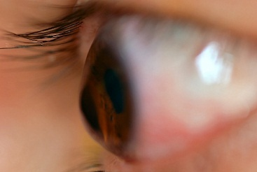
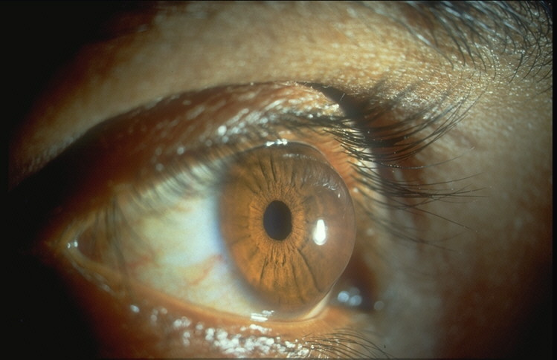
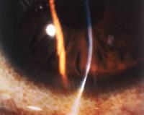
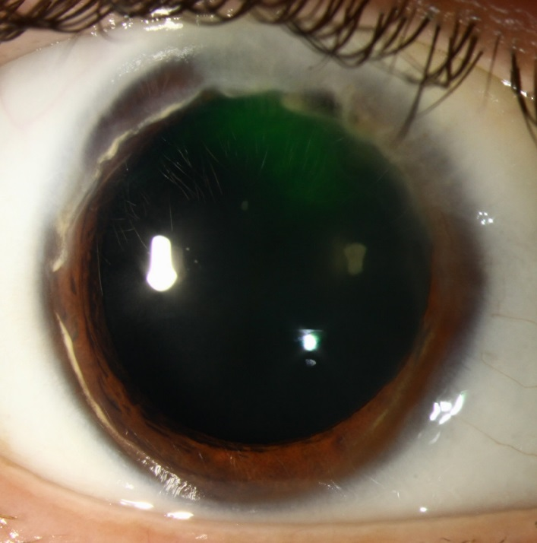
KCN
Keratoglobus
Pellucid marginal degeneration
Terrien marginal degeneration

Slide 315
Photoablative Surgery: Speaking of Ectasia…
In this context, what does ectasia refer to? A noninflammatory, progressive disorder of corneal biomechanics which leads to thinning and warping
Ectatic disorders include pellucid marginal degeneration, keratoglobus , Terrien marginal degeneration , KCN
Is post-surgery ectasia more common after LASIK, or surface procedures?

Slide 316
Photoablative Surgery: Speaking of Ectasia…
In this context, what does ectasia refer to? A noninflammatory, progressive disorder of corneal biomechanics which leads to thinning and warping
Ectatic disorders include pellucid marginal degeneration, keratoglobus , Terrien marginal degeneration , KCN
Is post-surgery ectasia more common after LASIK, or surface procedures? LASIK, by a mile

Slide 317
Photoablative Surgery: Speaking of Ectasia…
In this context, what does ectasia refer to? A noninflammatory, progressive disorder of corneal biomechanics which leads to thinning and warping
Ectatic disorders include pellucid marginal degeneration, keratoglobus , Terrien marginal degeneration , KCN
Is post-surgery ectasia more common after LASIK, or surface procedures? LASIK, by a mile
While there are many risk factors, two dwarf the others in importance. What are they?
A too-thin residual stromal bed (RSB)
A cornea predisposed to ectasia (ie, biomechanically abnormal)

Slide 318
Photoablative Surgery: Speaking of Ectasia…
In this context, what does ectasia refer to? A noninflammatory, progressive disorder of corneal biomechanics which leads to thinning and warping
Ectatic disorders include pellucid marginal degeneration, keratoglobus , Terrien marginal degeneration , KCN
Is post-surgery ectasia more common after LASIK, or surface procedures? LASIK, by a mile
While there are many risk factors, two dwarf the others in importance. What are they?
A too-thin residual stromal bed (RSB)
A cornea predisposed to ectasia (ie, biomechanically abnormal)

Slide 319
Photoablative Surgery: Speaking of Ectasia…
In this context, what does ectasia refer to? A noninflammatory, progressive disorder of corneal biomechanics which leads to thinning and warping
Ectatic disorders include pellucid marginal degeneration, keratoglobus , Terrien marginal degeneration , KCN
Is post-surgery ectasia more common after LASIK, or surface procedures? LASIK, by a mile
While there are many risk factors, two dwarf the others in importance. What are they?
A too-thin residual stromal bed (RSB)
A cornea predisposed to ectasia (ie, biomechanically abnormal)
What is the tx?

Slide 320
Photoablative Surgery: Speaking of Ectasia…
In this context, what does ectasia refer to? A noninflammatory, progressive disorder of corneal biomechanics which leads to thinning and warping
Ectatic disorders include pellucid marginal degeneration, keratoglobus , Terrien marginal degeneration , KCN
Is post-surgery ectasia more common after LASIK, or surface procedures? LASIK, by a mile
While there are many risk factors, two dwarf the others in importance. What are they?
A too-thin residual stromal bed (RSB)
A cornea predisposed to ectasia (ie, biomechanically abnormal)
What is the tx? RGPs; CXL +/- ICRS; PK

