Slide 1
Case Study 1
Lack of Cooperativeness

Slide 2
Case History
45 yo F involved in an MVA in 2002
Patient sustained chemical injury OU at the time of the MVA
Presumed to be secondary to:
sulphuric acid from a ruptured car battery,
sodium hydroxide (alkali) from a deployed airbag

Slide 3
Case History
EMS arrived at the scene 10 minutes after the accident occurred
Patient complained of burning of the eyes and face
Ocular irrigation was not performed at the scene, during transport to the hospital, or promptly upon arrival to the hospital
Patient developed bilateral severe corneal opacification and limbal stem cell damage
Notes:
3

Slide 4
Case History
Patient sues County Fire Department, ambulance service and hospital for failure to perform ocular irrigation
County Fire Department and hospital settle
Suit against the ambulance service is ongoing
Notes:
4

Slide 5
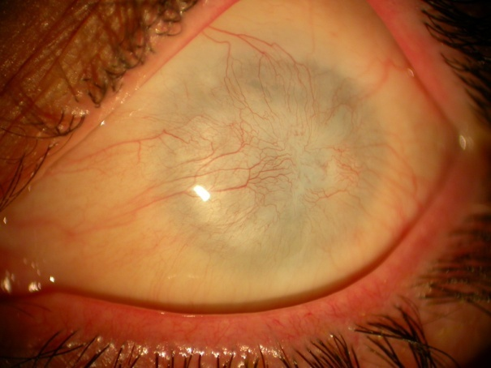
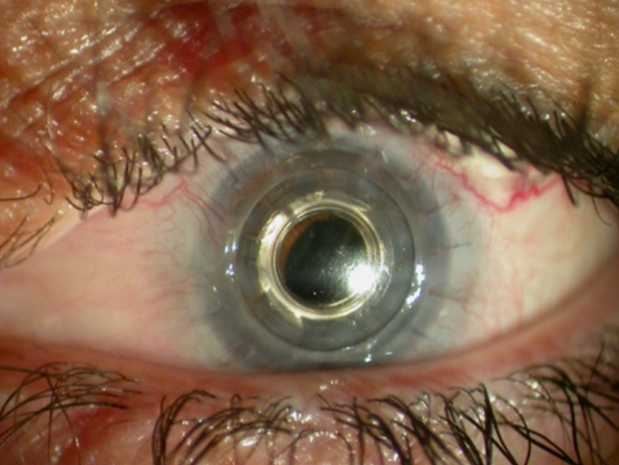
Case History
Patient referred to Dr. AA for management of bilateral corneal stem cell deficiency and corneal opacification, OS>OD
Cadaveric and living-related keratolimbal stem cell transplantation performed OD
CE,PCIOL and Boston type I keratoprosthesis implantation performed OS
Notes:
5

Slide 6
Case History
Dr. AA asked by plaintiff’s attorney to provide deposition as treating physician
Dr. AA agrees
Defense experts contend that the “full extent of damage” to the plaintiff’s cornea occurred in the first 3 to 5 minutes of exposure to the chemicals
Therefore, failure to perform ocular irrigation at the scene, in the ambulance, and upon arrival at the hospital did not affect the final clinical outcome
Notes:
6

Slide 7
Case History
Dr. AA asked to provide a declaration, refuting the statements made by the defense experts
A review of the literature did not reveal any reports concerning the utility of performing ocular irrigation at various time points following an ocular acidic or alkali chemical exposure, in regard to prevention of subsequent adverse sequelae
Notes:
7

Slide 8
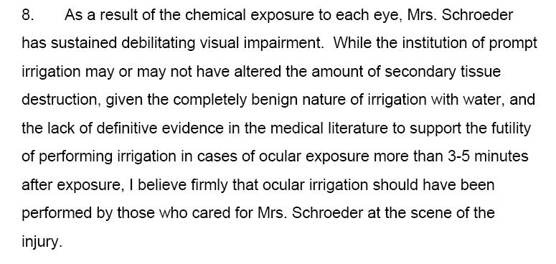
Dr. AA’s Declaration
Notes:
8

Slide 9
Response to Declaration
Plaintiff’s attorney sent Dr. AA a letter, stating that the declaration was “inadequate” and that it should be rewritten to indicate that failure to perform irrigation at the accident scene, in the ambulance and upon arrival to the hospital resulted in additional injury to the plaintiff’s eyes
Dr. AA responded that he could not revise the declaration accordingly as he was unable to find evidence in the scientific literature to support such a statement

Slide 10
Just the Check, Please
No response was received from the plaintiff’s attorney
Dr. AA submitted a bill to the plaintiff’s attorney for time spent researching the literature and preparing the declaration ($1100)
Notes:
10

Slide 11
Plaintiff’s Attorney’s Response
Dr. AA received an email response from the plaintiff’s attorney, in all capital letters, criticizing Dr. AA’s “lack of cooperativeness” and questioning why he should have to pay for a declaration that was “most unhelpful” to his case
Attorney advised Dr. AA that he should submit his bill to the patient, as no settlement was awarded in the case against the ambulance company
Notes:
11

Slide 12
Rule 16. Expert Testimony
Expert Testimony should be provided in an objective manner using medical knowledge to form expert medical opinions. Nonmedical factors (such as solicitation of business from attorneys, competition with other physicians, and personal bias unrelated to professional expertise) should not bias testimony. It is unethical for a physician to accept compensation that is contingent upon the outcome of litigation. False, deceptive or misleading expert testimony is unethical. For purposes of this Rule, expert testimony shall include oral testimony provided under oath, affidavits and declarations used in court proceedings and certificates of merit signed, ratified or otherwise adopted by the physician.

Slide 13
What do you think?
Where does Dr. AA’s expert testimony – or the plaintiff attorney’s actions -- fall on the Rule 16 spectrum?

Slide 14
Case Study 2
The primary reason is to make more money

Slide 15
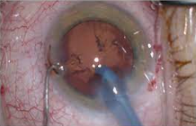
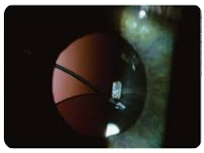
Report of a Case
Dr. S performs routine phacoemulsification cataract extraction (PCE)
Surgery complicated by posterior capsular rupture and vitreous loss
Anterior vitrectomy performed and sulcus-based IOL placed
Patient developed postoperative endophthalmitis
Treated with vitreous tap and intravitreal antibiotic injection

Slide 16
Report of a Case
Patient’s postoperative VAcc 20/100
The patient files a malpractice suit against Dr. S
The plaintiff’s attorney retains Dr. E as an expert witness
Dr. E retired from ophthalmology 5 years previously
Currently serving as expert witness in four separate cases

Slide 17
In His Deposition
In his deposition, Dr. E states that:
Compared with ECCE, PCE associated with a higher incidence of complications such as:
Capsular rupture and vitreous loss
Retinal detachment
Pseudophakic corneal edema
Postoperative endophthalmitis

Slide 18
Further…
In his deposition, Dr. E states that:
The intra- and postoperative complications associated with the cataract extraction in this case resulted directly from the cataract extraction technique (phacoemulsification)
The primary reason that many surgeons perform phacoemulsification is to make more money, i.e., to perform more cases in a given amount of time

Slide 19
Rule 16. Expert Testimony
Expert Testimony should be provided in an objective manner using medical knowledge to form expert medical opinions. Nonmedical factors (such as solicitation of business from attorneys, competition with other physicians, and personal bias unrelated to professional expertise) should not bias testimony. It is unethical for a physician to accept compensation that is contingent upon the outcome of litigation. False, deceptive or misleading expert testimony is unethical. For purposes of this Rule, expert testimony shall include oral testimony provided under oath, affidavits and declarations used in court proceedings and certificates of merit signed, ratified or otherwise adopted by the physician.

Slide 20
What Do You Think?
Where does Dr. E’s expert testimony fall on the Rule 16 spectrum?
Could it be used by either the plaintiff or defense side of the case?
Was he showing any sort of bias?

