Slide 1
Q
For each statement, identify with which it is associated:
Horizontal corneal lines, or Vertical corneal lines
Associated with congenital glaucoma: ?
V
H
ertical
orizontal

Slide 2
A
For each statement, identify with which it is associated:
Horizontal corneal lines, or Vertical corneal lines
Associated with congenital glaucoma: Horizontal
V
H
ertical
orizontal
igh IOP

Slide 3
Q
For each statement, identify with which it is associated:
Horizontal corneal lines, or Vertical corneal lines
Associated with congenital glaucoma: Horizontal
What is the name for the horizontal corneal finding associated with congenital glaucoma?
Haab striae
What do Haab striae look like?
A pair of parallel lines that taper and meet at their ends
Haab striae represent what sort of pathology, ie, which corneal structure is damaged, and in what way?
Tears in Descemet’s secondary to corneal stretching
What is the mechanism?
Mechanical deformation caused by the elevated IOP
V
H
ertical
orizontal
igh IOP

Slide 4
A
For each statement, identify with which it is associated:
Horizontal corneal lines, or Vertical corneal lines
Associated with congenital glaucoma: Horizontal
What is the name for the horizontal corneal finding associated with congenital glaucoma?
Haab striae
What do Haab striae look like?
A pair of parallel lines that taper and meet at their ends
Haab striae represent what sort of pathology, ie, which corneal structure is damaged, and in what way?
Tears in Descemet’s secondary to corneal stretching
What is the mechanism?
Mechanical deformation caused by the elevated IOP
V
H
ertical
orizontal
igh IOP
Haab

Slide 5
Q
For each statement, identify with which it is associated:
Horizontal corneal lines, or Vertical corneal lines
Associated with congenital glaucoma: Horizontal
What is the name for the horizontal corneal finding associated with congenital glaucoma?
Haab striae
What do Haab striae look like?
A pair of parallel lines that taper and meet at their ends
Haab striae represent what sort of pathology, ie, which corneal structure is damaged, and in what way?
Tears in Descemet’s secondary to corneal stretching
What is the mechanism?
Mechanical deformation caused by the elevated IOP
Can Haab striae develop in children whose glaucoma commences after birth?
Yes, they appear in pts with glaucoma onset up to age 4 years
V
H
ertical
orizontal
igh IOP
Haab

Slide 6
Q/A
For each statement, identify with which it is associated:
Horizontal corneal lines, or Vertical corneal lines
Associated with congenital glaucoma: Horizontal
What is the name for the horizontal corneal finding associated with congenital glaucoma?
Haab striae
What do Haab striae look like?
A pair of parallel lines that taper and meet at their ends
Haab striae represent what sort of pathology, ie, which corneal structure is damaged, and in what way?
Tears in Descemet’s secondary to corneal stretching
What is the mechanism?
Mechanical deformation caused by the elevated IOP
Can Haab striae develop in children whose glaucoma commences after birth?
Yes, they appear in pts with glaucoma onset up to age 4 years
V
H
ertical
orizontal
igh IOP
Haab

Slide 7
A
For each statement, identify with which it is associated:
Horizontal corneal lines, or Vertical corneal lines
Associated with congenital glaucoma: Horizontal
What is the name for the horizontal corneal finding associated with congenital glaucoma?
Haab striae
What do Haab striae look like?
A pair of parallel lines that taper and meet at their ends
Haab striae represent what sort of pathology, ie, which corneal structure is damaged, and in what way?
Tears in Descemet’s secondary to corneal stretching
What is the mechanism?
Mechanical deformation caused by the elevated IOP
Can Haab striae develop in children whose glaucoma commences after birth?
Yes, they appear in pts with glaucoma onset up to age 4 years
V
H
ertical
orizontal
igh IOP
Haab

Slide 8
Q
For each statement, identify with which it is associated:
Horizontal corneal lines, or Vertical corneal lines
Associated with congenital glaucoma: Horizontal
What is the name for the horizontal corneal finding associated with congenital glaucoma?
Haab striae
What do Haab striae look like?
A pair of parallel lines that taper and meet at their ends
Haab striae represent what sort of pathology, ie, which corneal structure is damaged, and in what way?
Tears in Descemet’s secondary to corneal stretching
What is the mechanism?
Mechanical deformation caused by the elevated IOP
V
H
ertical
orizontal
igh IOP
Haab

Slide 9
A
For each statement, identify with which it is associated:
Horizontal corneal lines, or Vertical corneal lines
Associated with congenital glaucoma: Horizontal
What is the name for the horizontal corneal finding associated with congenital glaucoma?
Haab striae
What do Haab striae look like?
Parallel lines that taper and meet at their ends
Haab striae represent what sort of pathology, ie, which corneal structure is damaged, and in what way?
Tears in Descemet’s secondary to corneal stretching
What is the mechanism?
Mechanical deformation caused by the elevated IOP
V
H
ertical
orizontal
igh IOP
Haab

Slide 10
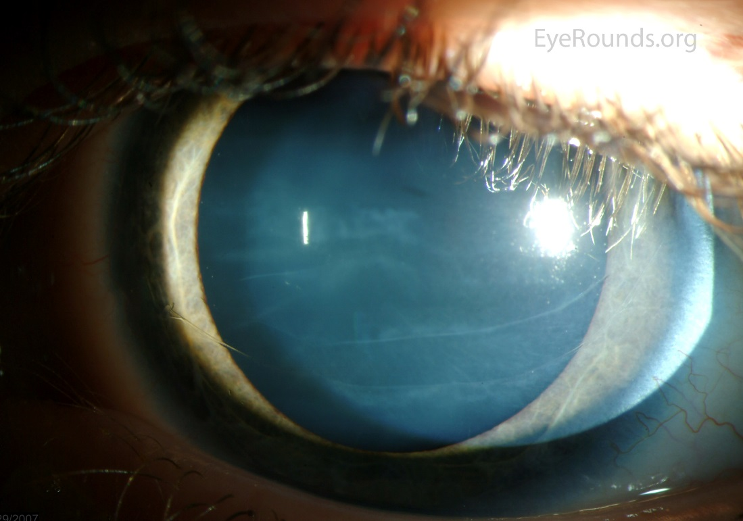
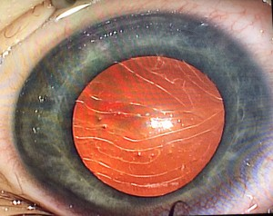
For each statement, identify with which it is associated:
Horizontal corneal lines, or Vertical corneal lines
Haab striae in congenital glaucoma

Slide 11
Q
For each statement, identify with which it is associated:
Horizontal corneal lines, or Vertical corneal lines
Associated with congenital glaucoma: Horizontal
What is the name for the horizontal corneal finding associated with congenital glaucoma?
Haab striae
What do Haab striae look like?
Parallel lines that taper and meet at their ends
Haab striae represent what sort of pathology, ie, which corneal structure is damaged, and in what way?
Tears in Descemet’s secondary to corneal stretching
What is the mechanism?
Mechanical deformation caused by the elevated IOP
V
H
ertical
orizontal
igh IOP
Haab

Slide 12
A
For each statement, identify with which it is associated:
Horizontal corneal lines, or Vertical corneal lines
Associated with congenital glaucoma: Horizontal
What is the name for the horizontal corneal finding associated with congenital glaucoma?
Haab striae
What do Haab striae look like?
Parallel lines that taper and meet at their ends
Haab striae represent what sort of pathology, ie, which corneal structure is damaged, and in what way?
Tears in Descemet’s secondary to corneal stretching
What is the mechanism?
Mechanical deformation caused by the elevated IOP
V
H
ertical
orizontal
igh IOP
Haab

Slide 13
Q
For each statement, identify with which it is associated:
Horizontal corneal lines, or Vertical corneal lines
Associated with congenital glaucoma: Horizontal
What is the name for the horizontal corneal finding associated with congenital glaucoma?
Haab striae
What do Haab striae look like?
Parallel lines that taper and meet at their ends
Haab striae represent what sort of pathology, ie, which corneal structure is damaged, and in what way?
Tears in Descemet’s secondary to corneal stretching
What is the mechanism?
Mechanical deformation caused by the elevated IOP
V
H
ertical
orizontal
igh IOP
Haab

Slide 14
A
For each statement, identify with which it is associated:
Horizontal corneal lines, or Vertical corneal lines
Associated with congenital glaucoma: Horizontal
What is the name for the horizontal corneal finding associated with congenital glaucoma?
Haab striae
What do Haab striae look like?
Parallel lines that taper and meet at their ends
Haab striae represent what sort of pathology, ie, which corneal structure is damaged, and in what way?
Tears in Descemet’s secondary to corneal stretching
What is the mechanism?
Mechanical deformation caused by the elevated IOP
V
H
ertical
orizontal
igh IOP
Haab

Slide 15
Q
For each statement, identify with which it is associated:
Horizontal corneal lines, or Vertical corneal lines
Associated with congenital glaucoma: Horizontal
Associated with birth trauma: ?
V
H
ertical
orizontal
igh IOP
Haab

Slide 16
A
For each statement, identify with which it is associated:
Horizontal corneal lines, or Vertical corneal lines
Associated with congenital glaucoma: Horizontal
Associated with birth trauma: Vertical
V
H
ertical
orizontal
igh IOP
Haab
agina

Slide 17
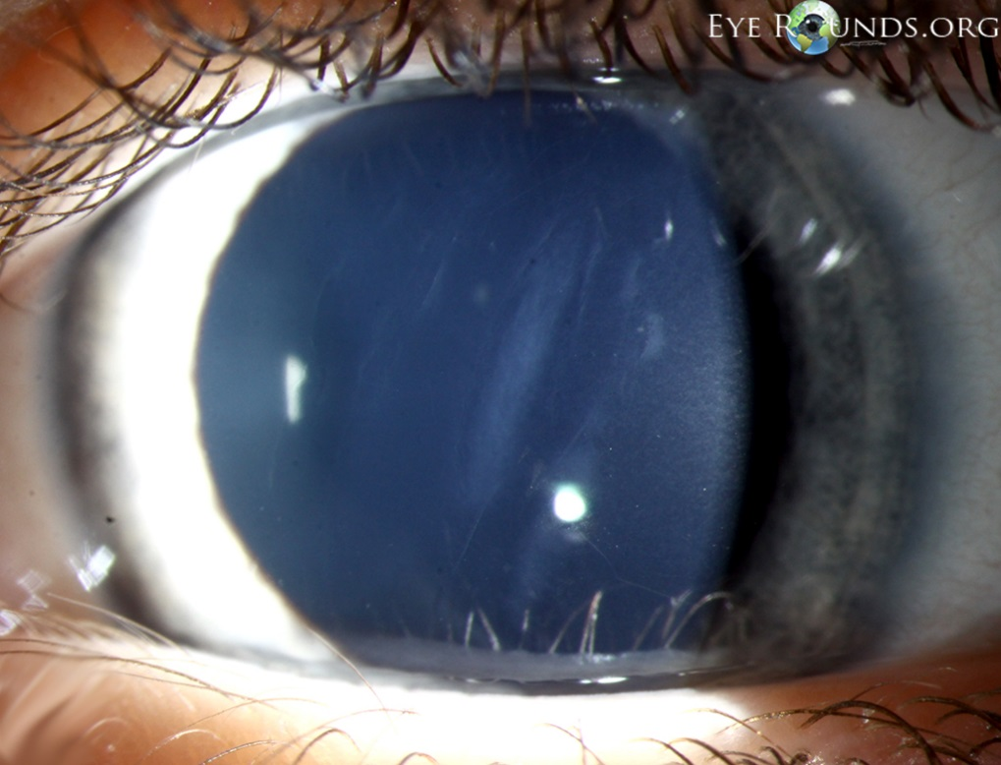
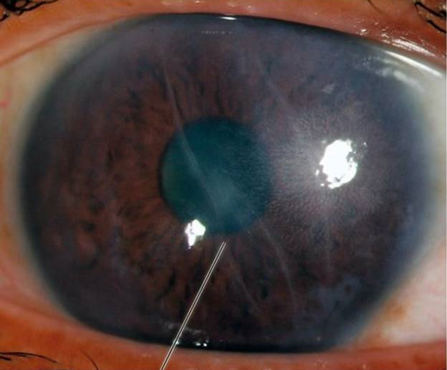
For each statement, identify with which it is associated:
Horizontal corneal lines, or Vertical corneal lines
Vertical striae related to birth trauma

Slide 18
Q
For each statement, identify with which it is associated:
Horizontal corneal lines, or Vertical corneal lines
Associated with congenital glaucoma: Horizontal
Associated with birth trauma: Vertical
What is the pathology underlying these breaks, ie, which corneal structure is damaged, and in what way?
The same as Haab striae: Tears in Descemet’s secondary to pressure on the cornea
What specific birth-event is the classic cause?
Forceps delivery
V
H
ertical
orizontal
igh IOP
Haab
agina

Slide 19
A
For each statement, identify with which it is associated:
Horizontal corneal lines, or Vertical corneal lines
Associated with congenital glaucoma: Horizontal
Associated with birth trauma: Vertical
What is the pathology underlying these breaks, ie, which corneal structure is damaged, and in what way?
The same as Haab striae: Tears in Descemet’s secondary to pressure on the cornea
What specific birth-event is the classic cause?
Forceps delivery
V
H
ertical
orizontal
igh IOP
Haab
agina

Slide 20
Q
For each statement, identify with which it is associated:
Horizontal corneal lines, or Vertical corneal lines
Associated with congenital glaucoma: Horizontal
Associated with birth trauma: Vertical
What is the pathology underlying these breaks, ie, which corneal structure is damaged, and in what way?
The same as Haab striae: Tears in Descemet’s secondary to pressure on the cornea
What specific birth-event is the classic cause?
Forceps delivery
V
H
ertical
orizontal
igh IOP
Haab
agina

Slide 21
A
For each statement, identify with which it is associated:
Horizontal corneal lines, or Vertical corneal lines
Associated with congenital glaucoma: Horizontal
Associated with birth trauma: Vertical
What is the pathology underlying these breaks, ie, which corneal structure is damaged, and in what way?
The same as Haab striae: Tears in Descemet’s secondary to pressure on the cornea
What specific birth-event is the classic cause?
Forceps delivery
V
H
ertical
orizontal
igh IOP
Haab
agina

Slide 22
Q
For each statement, identify with which it is associated:
Horizontal corneal lines, or Vertical corneal lines
Associated with congenital glaucoma: Horizontal
Associated with birth trauma: Vertical
Corneal stress lines in keratoconus: ?
V
H
ertical
orizontal
igh IOP
Haab
agina

Slide 23
A
For each statement, identify with which it is associated:
Horizontal corneal lines, or Vertical corneal lines
Associated with congenital glaucoma: Horizontal
Associated with birth trauma: Vertical
Corneal stress lines in keratoconus: Vertical
V
H
ertical
orizontal
igh IOP
Haab
agina

Slide 24
Q
For each statement, identify with which it is associated:
Horizontal corneal lines, or Vertical corneal lines
Associated with congenital glaucoma: Horizontal
Associated with birth trauma: Vertical
Corneal stress lines in keratoconus: Vertical
What is the name for the vertical corneal finding associated with KCN?
Vogt striae
What do Vogt striae look like?
Fine parallel lines
V
H
ertical
orizontal
igh IOP
Haab
agina

Slide 25
A
For each statement, identify with which it is associated:
Horizontal corneal lines, or Vertical corneal lines
Associated with congenital glaucoma: Horizontal
Associated with birth trauma: Vertical
Corneal stress lines in keratoconus: Vertical
What is the name for the vertical corneal finding associated with KCN?
Vogt striae
What do Vogt striae look like?
Fine parallel lines
V
H
ertical
orizontal
igh IOP
Haab
agina
ogt

Slide 26
Q
For each statement, identify with which it is associated:
Horizontal corneal lines, or Vertical corneal lines
Associated with congenital glaucoma: Horizontal
Associated with birth trauma: Vertical
Corneal stress lines in keratoconus: Vertical
What is the name for the vertical corneal finding associated with KCN?
Vogt striae
What do Vogt striae look like?
Fine parallel lines
V
H
ertical
orizontal
igh IOP
Haab
agina
ogt

Slide 27
A
For each statement, identify with which it is associated:
Horizontal corneal lines, or Vertical corneal lines
Associated with congenital glaucoma: Horizontal
Associated with birth trauma: Vertical
Corneal stress lines in keratoconus: Vertical
What is the name for the vertical corneal finding associated with KCN?
Vogt striae
What do Vogt striae look like?
Fine parallel lines
V
H
ertical
orizontal
igh IOP
Haab
agina
ogt

Slide 28
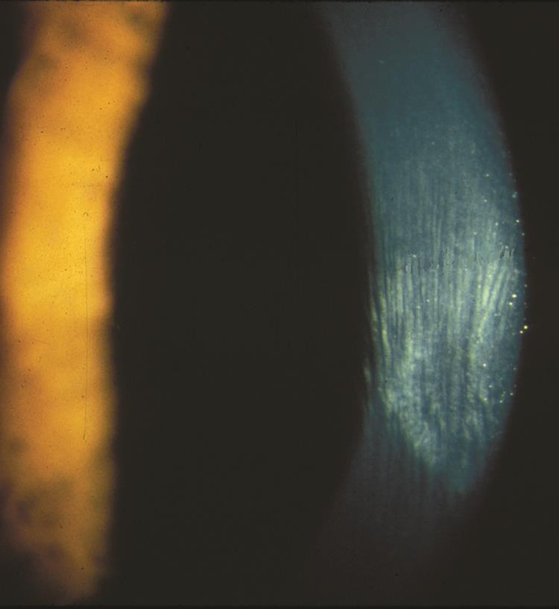
For each statement, identify with which it is associated:
Horizontal corneal lines, or Vertical corneal lines
Vogt striae

Slide 29
Q
For each statement, identify with which it is associated:
Horizontal corneal lines, or Vertical corneal lines
Associated with congenital glaucoma: Horizontal
Associated with birth trauma: Vertical
Corneal stress lines in keratoconus: Vertical
In terms of depth, where in the cornea are Vogt striae found?
The deep stroma
Relative to the KCN cone, where are they found?
At its apex
Applying pressure to the cornea causes Vogt striae to do what?
To disappear
What is the name for the vertical corneal finding associated with KCN?
Vogt striae
What do Vogt striae look like?
Fine parallel lines
V
H
ertical
orizontal
igh IOP
Haab
agina
ogt

Slide 30
A
For each statement, identify with which it is associated:
Horizontal corneal lines, or Vertical corneal lines
Associated with congenital glaucoma: Horizontal
Associated with birth trauma: Vertical
Corneal stress lines in keratoconus: Vertical
In terms of depth, where in the cornea are Vogt striae found?
The deep stroma
Relative to the KCN cone, where are they found?
At its apex
Applying pressure to the cornea causes Vogt striae to do what?
To disappear
What is the name for the vertical corneal finding associated with KCN?
Vogt striae
What do Vogt striae look like?
Fine parallel lines
V
H
ertical
orizontal
igh IOP
Haab
agina
ogt

Slide 31
Q
For each statement, identify with which it is associated:
Horizontal corneal lines, or Vertical corneal lines
Associated with congenital glaucoma: Horizontal
Associated with birth trauma: Vertical
Corneal stress lines in keratoconus: Vertical
In terms of depth, where in the cornea are Vogt striae found?
The deep stroma
Relative to the KCN cone, where are they found?
At its apex
Applying pressure to the cornea causes Vogt striae to do what?
To disappear
What is the name for the vertical corneal finding associated with KCN?
Vogt striae
What do Vogt striae look like?
Fine parallel lines
V
H
ertical
orizontal
igh IOP
Haab
agina
ogt

Slide 32
A
For each statement, identify with which it is associated:
Horizontal corneal lines, or Vertical corneal lines
Associated with congenital glaucoma: Horizontal
Associated with birth trauma: Vertical
Corneal stress lines in keratoconus: Vertical
In terms of depth, where in the cornea are Vogt striae found?
The deep stroma
Relative to the KCN cone, where are they found?
At its apex
Applying pressure to the cornea causes Vogt striae to do what?
To disappear
What is the name for the vertical corneal finding associated with KCN?
Vogt striae
What do Vogt striae look like?
Fine parallel lines
V
H
ertical
orizontal
igh IOP
Haab
agina
ogt

Slide 33
Q
For each statement, identify with which it is associated:
Horizontal corneal lines, or Vertical corneal lines
Associated with congenital glaucoma: Horizontal
Associated with birth trauma: Vertical
Corneal stress lines in keratoconus: Vertical
In terms of depth, where in the cornea are Vogt striae found?
The deep stroma
Relative to the KCN cone, where are they found?
At its apex
Applying pressure to the cornea causes Vogt striae to do what?
To disappear
What is the name for the vertical corneal finding associated with KCN?
Vogt striae
What do Vogt striae look like?
Fine parallel lines
V
H
ertical
orizontal
igh IOP
Haab
agina
ogt

Slide 34
A
For each statement, identify with which it is associated:
Horizontal corneal lines, or Vertical corneal lines
Associated with congenital glaucoma: Horizontal
Associated with birth trauma: Vertical
Corneal stress lines in keratoconus: Vertical
In terms of depth, where in the cornea are Vogt striae found?
The deep stroma
Relative to the KCN cone, where are they found?
At its apex
Applying pressure to the cornea causes Vogt striae to do what?
To disappear
What is the name for the vertical corneal finding associated with KCN?
Vogt striae
What do Vogt striae look like?
Fine parallel lines
V
H
ertical
orizontal
igh IOP
Haab
agina
ogt

Slide 35
Q
For each statement, identify with which it is associated:
Horizontal corneal lines, or Vertical corneal lines
Associated with congenital glaucoma: Horizontal
Associated with birth trauma: Vertical
Corneal stress lines in keratoconus: Vertical
In terms of depth, where in the cornea are Vogt striae found?
The deep stroma
Relative to the KCN cone, where are they found?
At its apex
Applying pressure to the cornea causes Vogt striae to do what?
To disappear
In one word, what sort of condition is KCN?
A corneal ectasia
When you hear ‘corneal ectasia,’ four conditions should come to mind. What are the other three?
--KCN
--Pellucid marginal degeneration
--Keratoglobus
--Post keratoablative refractive surgery
What is the name for the vertical corneal finding associated with KCN?
Vogt striae
What do Vogt striae look like?
Fine parallel lines
V
H
ertical
orizontal
igh IOP
Haab
agina
ogt

Slide 36
A
For each statement, identify with which it is associated:
Horizontal corneal lines, or Vertical corneal lines
Associated with congenital glaucoma: Horizontal
Associated with birth trauma: Vertical
Corneal stress lines in keratoconus: Vertical
In terms of depth, where in the cornea are Vogt striae found?
The deep stroma
Relative to the KCN cone, where are they found?
At its apex
Applying pressure to the cornea causes Vogt striae to do what?
To disappear
In one word, what sort of condition is KCN?
A corneal ectasia
When you hear ‘corneal ectasia,’ four conditions should come to mind. What are the other three?
--KCN
--Pellucid marginal degeneration
--Keratoglobus
--Post keratoablative refractive surgery
What is the name for the vertical corneal finding associated with KCN?
Vogt striae
What do Vogt striae look like?
Fine parallel lines
V
H
ertical
orizontal
igh IOP
Haab
agina
ogt

Slide 37
Q
For each statement, identify with which it is associated:
Horizontal corneal lines, or Vertical corneal lines
Associated with congenital glaucoma: Horizontal
Associated with birth trauma: Vertical
Corneal stress lines in keratoconus: Vertical
In terms of depth, where in the cornea are Vogt striae found?
The deep stroma
Relative to the KCN cone, where are they found?
At its apex
Applying pressure to the cornea causes Vogt striae to do what?
To disappear
In one word, what sort of condition is KCN?
A corneal ectasia
When you hear ‘corneal ectasia,’ four conditions should come to mind. What are the other three?
--KCN
--
--
--
What is the name for the vertical corneal finding associated with KCN?
Vogt striae
What do Vogt striae look like?
Fine parallel lines
V
H
ertical
orizontal
igh IOP
Haab
agina
ogt

Slide 38
A
For each statement, identify with which it is associated:
Horizontal corneal lines, or Vertical corneal lines
Associated with congenital glaucoma: Horizontal
Associated with birth trauma: Vertical
Corneal stress lines in keratoconus: Vertical
In terms of depth, where in the cornea are Vogt striae found?
The deep stroma
Relative to the KCN cone, where are they found?
At its apex
Applying pressure to the cornea causes Vogt striae to do what?
To disappear
In one word, what sort of condition is KCN?
A corneal ectasia
When you hear ‘corneal ectasia,’ four conditions should come to mind. What are the other three?
--KCN
--Pellucid marginal degeneration
--Keratoglobus
--Post keratoablative refractive surgery
What is the name for the vertical corneal finding associated with KCN?
Vogt striae
What do Vogt striae look like?
Fine parallel lines
V
H
ertical
orizontal
igh IOP
Haab
agina
ogt

Slide 39
For each statement, identify with which it is associated:
Horizontal corneal lines, or Vertical corneal lines
Associated with congenital glaucoma: Horizontal
Associated with birth trauma: Vertical
Corneal stress lines in keratoconus: Vertical
For more on KCN, see slide-set K38
For more on corneal ectasias, see slide-set K12
In terms of depth, where in the cornea are Vogt striae found?
The deep stroma
Relative to the KCN cone, where are they found?
At its apex
Applying pressure to the cornea causes Vogt striae to do what?
To disappear
In one word, what sort of condition is KCN?
A corneal ectasia
When you hear ‘corneal ectasia,’ four conditions should come to mind. What are the other three?
--KCN
--Pellucid marginal degeneration
--Keratoglobus
--Post keratoablative refractive surgery
What is the name for the vertical corneal finding associated with KCN?
Vogt striae
What do Vogt striae look like?
Fine parallel lines
V
H
ertical
orizontal
igh IOP
Haab
agina
ogt

Slide 40
Q
For each statement, identify with which it is associated:
Horizontal corneal lines, or Vertical corneal lines
Associated with congenital glaucoma: Horizontal
Associated with birth trauma: Vertical
Corneal stress lines in keratoconus: Vertical
A corneal finding in PPMD: Horizontal
Before we get to the next corneal line…
In the context of corneal conditions, what does PPMD stand for?
Posterior polymorphous dystrophy
The BCSC Cornea book divvies the corneal dystrophies into four categories. What are they?
--Epithelial and subepithelial
--Epithelial-stromal TGFBI
--Stromal
--Endothelial
To which category does PPMD belong?
Endothelial
V
H
ertical
orizontal
igh IOP
Haab
agina
ogt

Slide 41
A
For each statement, identify with which it is associated:
Horizontal corneal lines, or Vertical corneal lines
Associated with congenital glaucoma: Horizontal
Associated with birth trauma: Vertical
Corneal stress lines in keratoconus: Vertical
A corneal finding in PPMD: Horizontal
Before we get to the next corneal line…
In the context of corneal conditions, what does PPMD stand for?
Posterior polymorphous dystrophy
The BCSC Cornea book divvies the corneal dystrophies into four categories. What are they?
--Epithelial and subepithelial
--Epithelial-stromal TGFBI
--Stromal
--Endothelial
To which category does PPMD belong?
Endothelial
V
H
ertical
orizontal
igh IOP
Haab
agina
ogt

Slide 42
Q
For each statement, identify with which it is associated:
Horizontal corneal lines, or Vertical corneal lines
Associated with congenital glaucoma: Horizontal
Associated with birth trauma: Vertical
Corneal stress lines in keratoconus: Vertical
A corneal finding in PPMD: Horizontal
Before we get to the next corneal line…
In the context of corneal conditions, what does PPMD stand for?
Posterior polymorphous dystrophy
The BCSC Cornea book divvies the corneal dystrophies into four categories. What are they?
--
--
--
--Endothelial
To which category does PPMD belong?
Endothelial
V
H
ertical
orizontal
igh IOP
Haab
agina
ogt

Slide 43
A
For each statement, identify with which it is associated:
Horizontal corneal lines, or Vertical corneal lines
Associated with congenital glaucoma: Horizontal
Associated with birth trauma: Vertical
Corneal stress lines in keratoconus: Vertical
A corneal finding in PPMD: Horizontal
Before we get to the next corneal line…
In the context of corneal conditions, what does PPMD stand for?
Posterior polymorphous dystrophy
The BCSC Cornea book divvies the corneal dystrophies into four categories. What are they?
--Epithelial and subepithelial
--Epithelial-stromal TGFBI
--Stromal
--Endothelial
To which category does PPMD belong?
Endothelial
V
H
ertical
orizontal
igh IOP
Haab
agina
ogt

Slide 44
Q
For each statement, identify with which it is associated:
Horizontal corneal lines, or Vertical corneal lines
Associated with congenital glaucoma: Horizontal
Associated with birth trauma: Vertical
Corneal stress lines in keratoconus: Vertical
A corneal finding in PPMD: Horizontal
Before we get to the next corneal line…
In the context of corneal conditions, what does PPMD stand for?
Posterior polymorphous dystrophy
The BCSC Cornea book divvies the corneal dystrophies into four categories. What are they?
--Epithelial and subepithelial
--Epithelial-stromal TGFBI
--Stromal
--Endothelial
To which category does PPMD belong?
Endothelial
V
H
ertical
orizontal
igh IOP
Haab
agina
ogt

Slide 45
A
For each statement, identify with which it is associated:
Horizontal corneal lines, or Vertical corneal lines
Associated with congenital glaucoma: Horizontal
Associated with birth trauma: Vertical
Corneal stress lines in keratoconus: Vertical
A corneal finding in PPMD: Horizontal
Before we get to the next corneal line…
In the context of corneal conditions, what does PPMD stand for?
Posterior polymorphous dystrophy
The BCSC Cornea book divvies the corneal dystrophies into four categories. What are they?
--Epithelial and subepithelial
--Epithelial-stromal TGFBI
--Stromal
--Endothelial
To which category does PPMD belong?
Endothelial
V
H
ertical
orizontal
igh IOP
Haab
agina
ogt

Slide 46
Q
For each statement, identify with which it is associated:
Horizontal corneal lines, or Vertical corneal lines
Associated with congenital glaucoma: Horizontal
Associated with birth trauma: Vertical
Corneal stress lines in keratoconus: Vertical
A corneal finding in PPMD: ?
Next question
V
H
ertical
orizontal
igh IOP
Haab
agina
ogt

Slide 47
A
For each statement, identify with which it is associated:
Horizontal corneal lines, or Vertical corneal lines
Associated with congenital glaucoma: Horizontal
Associated with birth trauma: Vertical
Corneal stress lines in keratoconus: Vertical
A corneal finding in PPMD: Horizontal
V
H
ertical
orizontal
igh IOP
Haab
agina
ogt

Slide 48
Q
For each statement, identify with which it is associated:
Horizontal corneal lines, or Vertical corneal lines
Associated with congenital glaucoma: Horizontal
Associated with birth trauma: Vertical
Corneal stress lines in keratoconus: Vertical
A corneal finding in PPMD: Horizontal
What is the name for the horizontal corneal finding in PPMD?
Snail tracks
What do snail tracks look like?
Parallel lines, often with a scalloped contour
V
H
ertical
orizontal
igh IOP
Haab
agina
ogt

Slide 49
A
For each statement, identify with which it is associated:
Horizontal corneal lines, or Vertical corneal lines
Associated with congenital glaucoma: Horizontal
Associated with birth trauma: Vertical
Corneal stress lines in keratoconus: Vertical
A corneal finding in PPMD: Horizontal
What is the name for the horizontal corneal finding in PPMD?
Snail tracks
What do snail tracks look like?
Parallel lines, often with a scalloped contour
V
H
ertical
orizontal
igh IOP
Haab
agina
ogt

Slide 50
Q
For each statement, identify with which it is associated:
Horizontal corneal lines, or Vertical corneal lines
Associated with congenital glaucoma: Horizontal
Associated with birth trauma: Vertical
Corneal stress lines in keratoconus: Vertical
A corneal finding in PPMD: Horizontal
What is the name for the horizontal corneal finding in PPMD?
Snail tracks
What do snail tracks look like?
Parallel lines, often with a scalloped contour
V
H
ertical
orizontal
igh IOP
Haab
agina
ogt

Slide 51
A
For each statement, identify with which it is associated:
Horizontal corneal lines, or Vertical corneal lines
Associated with congenital glaucoma: Horizontal
Associated with birth trauma: Vertical
Corneal stress lines in keratoconus: Vertical
A corneal finding in PPMD: Horizontal
What is the name for the horizontal corneal finding in PPMD?
Snail tracks
What do snail tracks look like?
Parallel lines, often with a scalloped contour
V
H
ertical
orizontal
igh IOP
Haab
agina
ogt

Slide 52
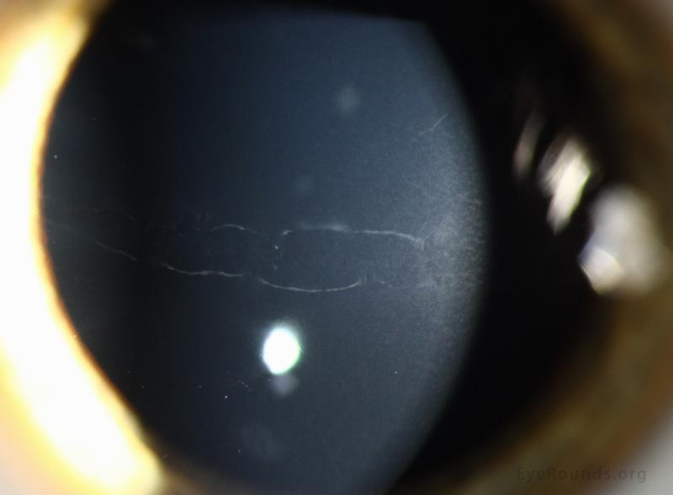
For each statement, identify with which it is associated:
Horizontal corneal lines, or Vertical corneal lines
Snail tracks in PPMD

Slide 53
Q
For each statement, identify with which it is associated:
Horizontal corneal lines, or Vertical corneal lines
Associated with congenital glaucoma: Horizontal
Associated with birth trauma: Vertical
Corneal stress lines in keratoconus: Vertical
A corneal finding in PPMD: Horizontal
In addition to snail tracks, PPMD presents with two other exam findings. What are they?
--Linear band-shaped opacities (ie, snail tracks)
--
--
What is the name for the horizontal corneal finding in PPMD?
Snail tracks
What do snail tracks look like?
Parallel lines, often with a scalloped contour
V
H
ertical
orizontal
igh IOP
Haab
agina
ogt

Slide 54
A
For each statement, identify with which it is associated:
Horizontal corneal lines, or Vertical corneal lines
Associated with congenital glaucoma: Horizontal
Associated with birth trauma: Vertical
Corneal stress lines in keratoconus: Vertical
A corneal finding in PPMD: Horizontal
In addition to snail tracks, PPMD presents with two other exam findings. What are they?
--Linear band-shaped opacities (ie, snail tracks)
--Vesicular lesions
--Diffuse opacities
What is the name for the horizontal corneal finding in PPMD?
Snail tracks
What do snail tracks look like?
Parallel lines, often with a scalloped contour
V
H
ertical
orizontal
igh IOP
Haab
agina
ogt

Slide 55
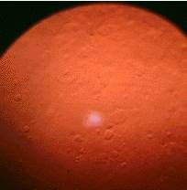
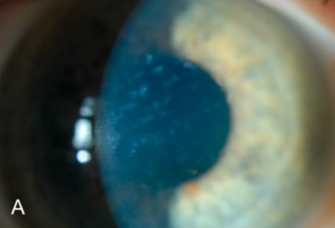
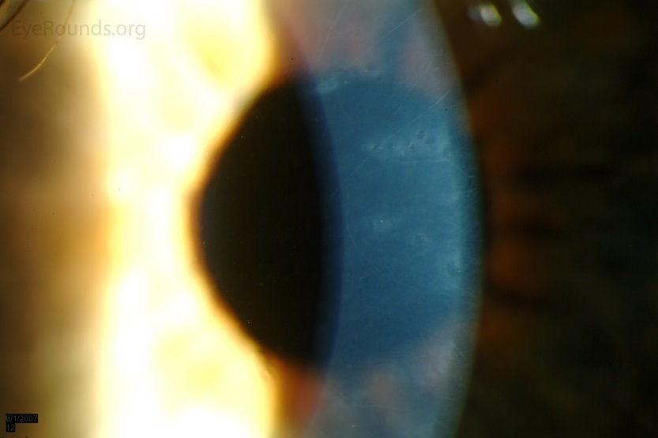
55
For each statement, identify with which it is associated:
Horizontal corneal lines, or Vertical corneal lines
Vesicular lesions
Diffuse opacities
PPMD

Slide 56
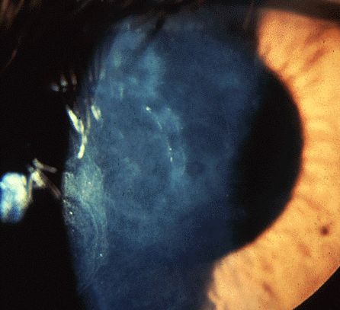
56
For each statement, identify with which it is associated:
Horizontal corneal lines, or Vertical corneal lines
PPMD. Its clinical appearance is notoriously variable—don’t commit any one image to memory as representing it!

Slide 57
Q
For each statement, identify with which it is associated:
Horizontal corneal lines, or Vertical corneal lines
Associated with congenital glaucoma: Horizontal
Associated with birth trauma: Vertical
Corneal stress lines in keratoconus: Vertical
A corneal finding in PPMD: Horizontal
In addition to snail tracks, PPMD presents with two other exam findings. What are they?
--Linear band-shaped opacities (ie, snail tracks)
--Vesicular lesions
--Diffuse opacities
What is the name for the horizontal corneal finding in PPMD?
Snail tracks
What do snail tracks look like?
Parallel lines, often with a scalloped contour
How can PPMD band lesions be distinguished from Haab striae?
Recall that Haab striae represent breaks in Descemet’s membrane, and thus have a beginning and an end; ie, they taper and meet at their ends. In contrast, the bands of PPMD are not breaks in Descemet’s, and therefore do not meet at their terminuses.
V
H
ertical
orizontal
igh IOP
Haab
agina
ogt

Slide 58
A
For each statement, identify with which it is associated:
Horizontal corneal lines, or Vertical corneal lines
Associated with congenital glaucoma: Horizontal
Associated with birth trauma: Vertical
Corneal stress lines in keratoconus: Vertical
A corneal finding in PPMD: Horizontal
In addition to snail tracks, PPMD presents with two other exam findings. What are they?
--Linear band-shaped opacities (ie, snail tracks)
--Vesicular lesions
--Diffuse opacities
What is the name for the horizontal corneal finding in PPMD?
Snail tracks
What do snail tracks look like?
Parallel lines, often with a scalloped contour
How can PPMD band lesions be distinguished from Haab striae?
Recall that Haab striae represent breaks in Descemet’s membrane, and thus have a beginning and an end; ie, they taper and meet at their ends. In contrast, the bands of PPMD are not breaks in Descemet’s, and therefore do not meet at their terminuses.
V
H
ertical
orizontal
igh IOP
Haab
agina
ogt

Slide 59
A
For each statement, identify with which it is associated:
Horizontal corneal lines, or Vertical corneal lines
Associated with congenital glaucoma: Horizontal
Associated with birth trauma: Vertical
Corneal stress lines in keratoconus: Vertical
A corneal finding in PPMD: Horizontal
In addition to snail tracks, PPMD presents with two other exam findings. What are they?
--Linear band-shaped opacities (ie, snail tracks)
--Vesicular lesions
--Diffuse opacities
What is the name for the horizontal corneal finding in PPMD?
Snail tracks
What do snail tracks look like?
Parallel lines, often with a scalloped contour
How can PPMD band lesions be distinguished from Haab striae?
Recall that Haab striae represent breaks in Descemet’s membrane, and thus have a beginning and an end; ie, they taper and meet at their ends. In contrast, the bands of PPMD are not breaks in Descemet’s, and therefore do not meet at their terminuses.
V
H
ertical
orizontal
igh IOP
Haab
agina
ogt

Slide 60
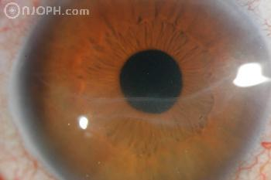
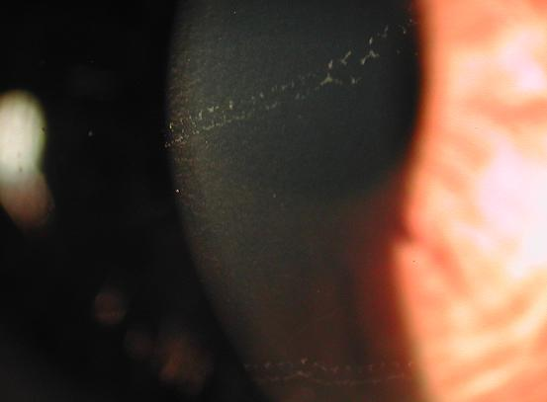
60
For each statement, identify with which it is associated:
Horizontal corneal lines, or Vertical corneal lines
Haab’s striae (note that the lines taper and meet)
Snail tracks in PPMD
(the lines don’t meet)

Slide 61
Q
For each statement, identify with which it is associated:
Horizontal corneal lines, or Vertical corneal lines
Associated with congenital glaucoma: Horizontal
Associated with birth trauma: Vertical
Corneal stress lines in keratoconus: Vertical
A corneal finding in PPMD: Horizontal
A manifestation of corneal transplant rejection:
V
H
ertical
orizontal
igh IOP
Haab
agina
ogt

Slide 62
A
For each statement, identify with which it is associated:
Horizontal corneal lines, or Vertical corneal lines
Associated with congenital glaucoma: Horizontal
Associated with birth trauma: Vertical
Corneal stress lines in keratoconus: Vertical
A corneal finding in PPMD: Horizontal
A manifestation of corneal transplant rejection: Horizontal
V
H
ertical
orizontal
igh IOP
Haab
agina
ogt

Slide 63
Q
For each statement, identify with which it is associated:
Horizontal corneal lines, or Vertical corneal lines
Associated with congenital glaucoma: Horizontal
Associated with birth trauma: Vertical
Corneal stress lines in keratoconus: Vertical
A corneal finding in PPMD: Horizontal
A manifestation of corneal transplant rejection: Horizontal
What is the name of the line associated with PK rejection?
Khodadoust line
Rejection of which layer of the cornea (ie, epithelial, stromal, etc) is heralded by the presence of a Khodadoust line?
The endothelium
Of what is the line composed?
Inflammatory precipitates
V
H
ertical
orizontal
igh IOP
Haab
agina
ogt

Slide 64
A
For each statement, identify with which it is associated:
Horizontal corneal lines, or Vertical corneal lines
Associated with congenital glaucoma: Horizontal
Associated with birth trauma: Vertical
Corneal stress lines in keratoconus: Vertical
A corneal finding in PPMD: Horizontal
A manifestation of corneal transplant rejection: Horizontal
What is the name of the line associated with PK rejection?
Khodadoust line
Rejection of which layer of the cornea (ie, epithelial, stromal, etc) is heralded by the presence of a Khodadoust line?
The endothelium
Of what is the line composed?
Inflammatory precipitates
V
H
ertical
orizontal
igh IOP
Haab
agina
ogt

Slide 65
Q
For each statement, identify with which it is associated:
Horizontal corneal lines, or Vertical corneal lines
Associated with congenital glaucoma: Horizontal
Associated with birth trauma: Vertical
Corneal stress lines in keratoconus: Vertical
A corneal finding in PPMD: Horizontal
A manifestation of corneal transplant rejection: Horizontal
What is the name of the line associated with PK rejection?
Khodadoust line
Rejection of which layer of the cornea (ie, epithelial, stromal, etc) is heralded by the presence of a Khodadoust line?
The endothelium
Of what is the line composed?
Inflammatory precipitates
V
H
ertical
orizontal
igh IOP
Haab
agina
ogt

Slide 66
A
For each statement, identify with which it is associated:
Horizontal corneal lines, or Vertical corneal lines
Associated with congenital glaucoma: Horizontal
Associated with birth trauma: Vertical
Corneal stress lines in keratoconus: Vertical
A corneal finding in PPMD: Horizontal
A manifestation of corneal transplant rejection: Horizontal
What is the name of the line associated with PK rejection?
Khodadoust line
Rejection of which layer of the cornea (ie, epithelial, stromal, etc) is heralded by the presence of a Khodadoust line?
The endothelium
Of what is the line composed?
Inflammatory precipitates
V
H
ertical
orizontal
igh IOP
Haab
agina
ogt

Slide 67
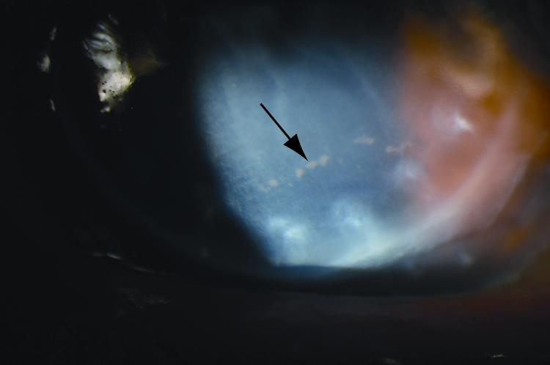
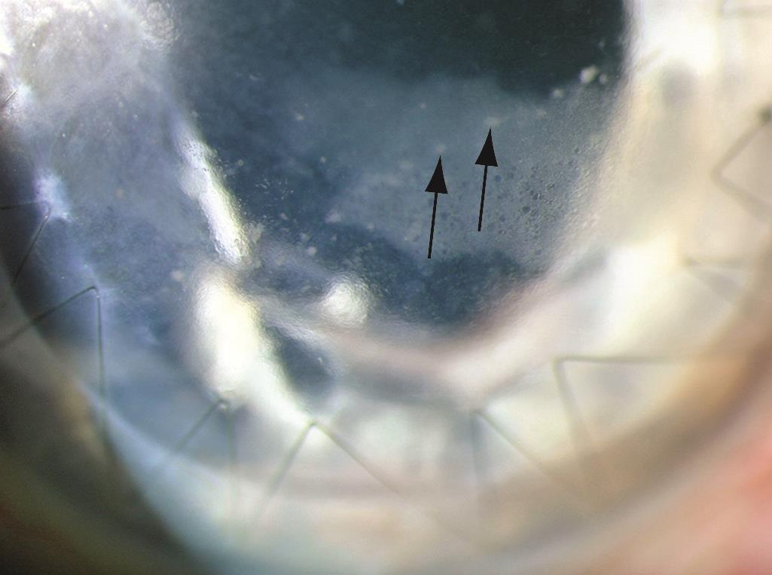
For each statement, identify with which it is associated:
Horizontal corneal lines, or Vertical corneal lines
Khodadoust line

Slide 68
Q
For each statement, identify with which it is associated:
Horizontal corneal lines, or Vertical corneal lines
Associated with congenital glaucoma: Horizontal
Associated with birth trauma: Vertical
Corneal stress lines in keratoconus: Vertical
A corneal finding in PPMD: Horizontal
A manifestation of corneal transplant rejection: Horizontal
What is the name of the line associated with PK rejection?
Khodadoust line
Rejection of which layer of the cornea (ie, epithelial, stromal, etc) is heralded by the presence of a Khodadoust line?
The endothelium
Of what is the line composed?
Inflammatory precipitates
V
H
ertical
orizontal
igh IOP
Haab
agina
ogt

Slide 69
A
For each statement, identify with which it is associated:
Horizontal corneal lines, or Vertical corneal lines
Associated with congenital glaucoma: Horizontal
Associated with birth trauma: Vertical
Corneal stress lines in keratoconus: Vertical
A corneal finding in PPMD: Horizontal
A manifestation of corneal transplant rejection: Horizontal
What is the name of the line associated with PK rejection?
Khodadoust line
Rejection of which layer of the cornea (ie, epithelial, stromal, etc) is heralded by the presence of a Khodadoust line?
The endothelium
Of what is the line composed?
Inflammatory precipitates
V
H
ertical
orizontal
igh IOP
Haab
agina
ogt

