Slide 1
Q
Sympathetic Ophthalmia (SO): Wadda ya know?
Is SO a unilateral, or bilateral disease? It

Slide 2
A
Sympathetic Ophthalmia (SO): Wadda ya know?
Is SO a unilateral, or bilateral disease? It is a bilateral condition

Slide 3
Q
Sympathetic Ophthalmia (SO): Wadda ya know?
Is SO a unilateral, or bilateral disease? It is a bilateral condition
SO is a bilateral panuveitis following ocular injury or surgery in one eye
general condition
event
different event

Slide 4
A
Sympathetic Ophthalmia (SO): Wadda ya know?
Is SO a unilateral, or bilateral disease? It is a bilateral condition
SO is a bilateral panuveitis following ocular injury or surgery in one eye

Slide 5
Q
Sympathetic Ophthalmia (SO): Wadda ya know?
Is SO a unilateral, or bilateral disease? It is a bilateral condition
SO is a bilateral panuveitis following ocular injury or surgery in one eye
Is it granulomatous, or nongranulomatous?
Granulomatous

Slide 6
A
Sympathetic Ophthalmia (SO): Wadda ya know?
Is SO a unilateral, or bilateral disease? It is a bilateral condition
SO is a bilateral panuveitis following ocular injury or surgery in one eye
Is it granulomatous, or nongranulomatous?
Granulomatous

Slide 7
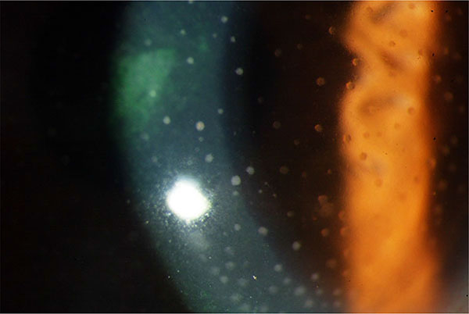
Sympathetic Ophthalmia (SO): Wadda ya know?
SO: Granulomatous KP

Slide 8
Q
Sympathetic Ophthalmia (SO): Wadda ya know?
Is SO a unilateral, or bilateral disease? It is a bilateral condition
SO is a bilateral panuveitis following ocular injury or surgery in one eye
Which is a more common cause: Injury, or surgery?
Back in the day, it was injury by a mile. However, refinements in managing ocular trauma have reduced the post-trauma SO rate to below that after surgery

Slide 9
A
Sympathetic Ophthalmia (SO): Wadda ya know?
Is SO a unilateral, or bilateral disease? It is a bilateral condition
SO is a bilateral panuveitis following ocular injury or surgery in one eye
Which is a more common cause: Injury, or surgery?
Back in the day, it was injury by a mile. However, refinements in managing ocular trauma have reduced the post-trauma SO rate such that it is now below that after surgery.

Slide 10
A
Sympathetic Ophthalmia (SO): Wadda ya know?
Is SO a unilateral, or bilateral disease? It is a bilateral condition
SO is a bilateral panuveitis following ocular injury or surgery in one eye
Which is a more common cause: Injury, or surgery?
Back in the day, it was injury by a mile. However, refinements in managing ocular trauma have reduced the post-trauma SO rate such that it is now below that after surgery.

Slide 11
Q
Sympathetic Ophthalmia (SO): Wadda ya know?
Is SO a unilateral, or bilateral disease? It is a bilateral condition
SO is a bilateral panuveitis following ocular injury or surgery in one eye
Which is a more common cause: Injury, or surgery?
Back in the day, it was injury by a mile. However, refinements in managing ocular trauma have reduced the post-trauma SO rate such that it is now below that after surgery
What is the classic injury-related scenario associated with SO;
ie, what would be seen at the slit-lamp?
Uveal tissue incarcerated in the wound

Slide 12
Q/A
Sympathetic Ophthalmia (SO): Wadda ya know?
Is SO a unilateral, or bilateral disease? It is a bilateral condition
SO is a bilateral panuveitis following ocular injury or surgery in one eye
Which is a more common cause: Injury, or surgery?
Back in the day, it was injury by a mile. However, refinements in managing ocular trauma have reduced the post-trauma SO rate such that it is now below that after surgery
What is the classic injury-related scenario associated with SO;
ie, what would be seen at the slit-lamp?
Uveal tissue incarcerated in the wound

Slide 13
A
Sympathetic Ophthalmia (SO): Wadda ya know?
Is SO a unilateral, or bilateral disease? It is a bilateral condition
SO is a bilateral panuveitis following ocular injury or surgery in one eye
Which is a more common cause: Injury, or surgery?
Back in the day, it was injury by a mile. However, refinements in managing ocular trauma have reduced the post-trauma SO rate such that it is now below that after surgery
What is the classic injury-related scenario associated with SO;
ie, what would be seen at the slit-lamp?
Uveal tissue incarcerated in the wound

Slide 14
Q
Sympathetic Ophthalmia (SO): Wadda ya know?
Is SO a unilateral, or bilateral disease? It is a bilateral condition
SO is a bilateral panuveitis following ocular injury or surgery in one eye
You know that perforating/penetrating injury can result in SO, but what about a contusion?
Yes, globe contusion has resulted in SO

Slide 15
A
Sympathetic Ophthalmia (SO): Wadda ya know?
Is SO a unilateral, or bilateral disease? It is a bilateral condition
SO is a bilateral panuveitis following ocular injury or surgery in one eye
You know that perforating/penetrating injury can result in SO, but what about a contusion?
Yes, globe contusion has resulted in SO (although this is exceedingly rare)

Slide 16
Q
Sympathetic Ophthalmia (SO): Wadda ya know?
Is SO a unilateral, or bilateral disease? It is a bilateral condition
SO is a bilateral panuveitis following ocular injury or surgery in one eye
Which of these surgeries has been associated with SO--
--PPV?
--Cataract surgery?
--Trabeculectomy?
--Cyclocryoablation?
--Cyclophotocoagulation?

Slide 17
A
Sympathetic Ophthalmia (SO): Wadda ya know?
Is SO a unilateral, or bilateral disease? It is a bilateral condition
SO is a bilateral panuveitis following ocular injury or surgery in one eye
Which of these surgeries has been associated with SO--
--PPV!
--Cataract surgery!
--Trabeculectomy!
--Cyclocryoablation!
--Cyclophotocoagulation!
All have been associated with SO!

Slide 18
Q
Sympathetic Ophthalmia (SO): Wadda ya know?
Is SO a unilateral, or bilateral disease? It is a bilateral condition
SO is a bilateral panuveitis following ocular injury or surgery in one eye
Which of these surgeries has been associated with SO--
--PPV?
--Cataract surgery?
--Trabeculectomy?
--Cyclocryoablation?
--Cyclophotocoagulation?
Which surgery carries the highest risk of SO?

Slide 19
A
Sympathetic Ophthalmia (SO): Wadda ya know?
Is SO a unilateral, or bilateral disease? It is a bilateral condition
SO is a bilateral panuveitis following ocular injury or surgery in one eye
Which of these surgeries has been associated with SO--
--PPV!
--Cataract surgery
--Trabeculectomy
--Cyclocryoablation
--Cyclophotocoagulation
Which surgery carries the highest risk of SO?
Vitrectomy

Slide 20
Q
Sympathetic Ophthalmia (SO): Wadda ya know?
Is SO a unilateral, or bilateral disease? It is a bilateral condition
SO is a bilateral panuveitis following ocular injury or surgery in one eye
Which of these surgeries has been associated with SO--
--PPV!
--Cataract surgery
--Trabeculectomy
--Cyclocryoablation
--Cyclophotocoagulation
Which incidence is higher: Post-PPV endophthalmitis, or post-PPV SO?
Post-PPV SO

Slide 21
A
Sympathetic Ophthalmia (SO): Wadda ya know?
Is SO a unilateral, or bilateral disease? It is a bilateral condition
SO is a bilateral panuveitis following ocular injury or surgery in one eye
Which of these surgeries has been associated with SO--
--PPV!
--Cataract surgery
--Trabeculectomy
--Cyclocryoablation
--Cyclophotocoagulation
Which incidence is higher: Post-PPV endophthalmitis, or post-PPV SO?
Post-PPV SO

Slide 22
Q
Sympathetic Ophthalmia (SO): Wadda ya know?
Is SO a unilateral, or bilateral disease? It is a bilateral condition
SO is a bilateral panuveitis following ocular injury or surgery in one eye
Previously injured/operated eye is called the inciting eye

Slide 23
A
Sympathetic Ophthalmia (SO): Wadda ya know?
Is SO a unilateral, or bilateral disease? It is a bilateral condition
SO is a bilateral panuveitis following ocular injury or surgery in one eye
Previously injured/operated eye is called the exciting eye

Slide 24
Q
Sympathetic Ophthalmia (SO): Wadda ya know?
Is SO a unilateral, or bilateral disease? It is a bilateral condition
SO is a bilateral panuveitis following ocular injury or surgery in one eye
Previously injured/operated eye is called the exciting eye
Previously normal eye is called the sympathizing eye

Slide 25
A
Sympathetic Ophthalmia (SO): Wadda ya know?
Is SO a unilateral, or bilateral disease? It is a bilateral condition
SO is a bilateral panuveitis following ocular injury or surgery in one eye
Previously injured/operated eye is called the exciting eye
Previously normal eye is called the sympathizing eye

Slide 26
Q
Sympathetic Ophthalmia (SO): Wadda ya know?
Is SO a unilateral, or bilateral disease? It is a bilateral condition
SO is a bilateral panuveitis following ocular injury or surgery in one eye
Previously injured/operated eye is called the exciting eye
Previously normal eye is called the sympathizing eye
What is the cause of SO?

Slide 27
A
Sympathetic Ophthalmia (SO): Wadda ya know?
Is SO a unilateral, or bilateral disease? It is a bilateral condition
SO is a bilateral panuveitis following ocular injury or surgery in one eye
Previously injured/operated eye is called the exciting eye
Previously normal eye is called the sympathizing eye
What is the cause of SO? Unknown

Slide 28
Q
Sympathetic Ophthalmia (SO): Wadda ya know?
Is SO a unilateral, or bilateral disease? It is a bilateral condition
SO is a bilateral panuveitis following ocular injury or surgery in one eye
Previously injured/operated eye is called the exciting eye
Previously normal eye is called the sympathizing eye
What is the cause of SO? Unknown
That said, we are not completely in the dark vis a vis etiology, so…
Is it infectious, or noninfectious?
Most experts are convinced it is noninfectious
Ok, so it’s immune-related. Is it T-cell, or B-cell mediated?
This one we know--T-cells are the culprit
To what antigens are the T cells responding?
This is less certain, but it seems uveal antigens--specifically, melanin-associated?--play a central role

Slide 29
A
Sympathetic Ophthalmia (SO): Wadda ya know?
Is SO a unilateral, or bilateral disease? It is a bilateral condition
SO is a bilateral panuveitis following ocular injury or surgery in one eye
Previously injured/operated eye is called the exciting eye
Previously normal eye is called the sympathizing eye
What is the cause of SO? Unknown
That said, we are not completely in the dark vis a vis etiology, so…
Is it infectious, or noninfectious?
Most experts are convinced it is noninfectious
Ok, so it’s immune-related. Is it T-cell, or B-cell mediated?
This one we know--T-cells are the culprit
To what antigens are the T cells responding?
This is less certain, but it seems uveal antigens--specifically, melanin-associated?--play a central role

Slide 30
Q
Sympathetic Ophthalmia (SO): Wadda ya know?
Is SO a unilateral, or bilateral disease? It is a bilateral condition
SO is a bilateral panuveitis following ocular injury or surgery in one eye
Previously injured/operated eye is called the exciting eye
Previously normal eye is called the sympathizing eye
What is the cause of SO? Unknown
That said, we are not completely in the dark vis a vis etiology, so…
Is it infectious, or noninfectious?
Most experts are convinced it is noninfectious
Ok, so it’s immune-related. Is it T-cell, or B-cell mediated?
This one we know--T-cells are the culprit
To what antigens are the T cells responding?
This is less certain, but it seems uveal antigens--specifically, melanin-associated?--play a central role

Slide 31
A
Sympathetic Ophthalmia (SO): Wadda ya know?
Is SO a unilateral, or bilateral disease? It is a bilateral condition
SO is a bilateral panuveitis following ocular injury or surgery in one eye
Previously injured/operated eye is called the exciting eye
Previously normal eye is called the sympathizing eye
What is the cause of SO? Unknown
That said, we are not completely in the dark vis a vis etiology, so…
Is it infectious, or noninfectious?
Most experts are convinced it is noninfectious
Ok, so it’s immune-related. Is it T-cell, or B-cell mediated?
This one we know—T-cells are the culprit
To what antigens are the T cells responding?
This is less certain, but it seems uveal antigens--specifically, melanin-associated?--play a central role

Slide 32
Q
Sympathetic Ophthalmia (SO): Wadda ya know?
Is SO a unilateral, or bilateral disease? It is a bilateral condition
SO is a bilateral panuveitis following ocular injury or surgery in one eye
Previously injured/operated eye is called the exciting eye
Previously normal eye is called the sympathizing eye
What is the cause of SO? Unknown
That said, we are not completely in the dark vis a vis etiology, so…
Is it infectious, or noninfectious?
Most experts are convinced it is noninfectious
Ok, so it’s immune-related. Is it T-cell, or B-cell mediated?
This one we know—T-cells are the culprit
To what antigens are the T cells responding?
This is less certain, but it seems uveal antigens--specifically, melanin-associated?--play a central role

Slide 33
A
Sympathetic Ophthalmia (SO): Wadda ya know?
Is SO a unilateral, or bilateral disease? It is a bilateral condition
SO is a bilateral panuveitis following ocular injury or surgery in one eye
Previously injured/operated eye is called the exciting eye
Previously normal eye is called the sympathizing eye
What is the cause of SO? Unknown
That said, we are not completely in the dark vis a vis etiology, so…
Is it infectious, or noninfectious?
Most experts are convinced it is noninfectious
Ok, so it’s immune-related. Is it T-cell, or B-cell mediated?
This one we know—T-cells are the culprit
To what antigens are the T cells responding?
This is less certain, but it seems uveal antigens—specifically melanin-associated—play a central role

Slide 34
Q
Sympathetic Ophthalmia (SO): Wadda ya know?
Is SO a unilateral, or bilateral disease? It is a bilateral condition
SO is a bilateral panuveitis following ocular injury or surgery in one eye
Previously injured/operated eye is called the exciting eye
Previously normal eye is called the sympathizing eye
What is the cause of SO? Unknown
What is the classic presenting complaint?

Slide 35
A
Sympathetic Ophthalmia (SO): Wadda ya know?
Is SO a unilateral, or bilateral disease? It is a bilateral condition
SO is a bilateral panuveitis following ocular injury or surgery in one eye
Previously injured/operated eye is called the exciting eye
Previously normal eye is called the sympathizing eye
What is the cause of SO? Unknown
What is the classic presenting complaint? Impaired near vision (ie, loss of accommodation) in the previously normal eye

Slide 36
Sympathetic Ophthalmia (SO): Wadda ya know?
Is SO a unilateral, or bilateral disease? It is a bilateral condition
SO is a bilateral panuveitis following ocular injury or surgery in one eye
Previously injured/operated eye is called the exciting eye
Previously normal eye is called the sympathizing eye
What is the cause of SO? Unknown
What is the classic presenting complaint? Impaired near vision (ie, loss of accommodation) in the previously normal eye
Take note of this! IMHO, it would make a great Orals question—a pt with a remote hx of ocular trauma presenting with what sounds like early-onset presbyopia.. It would be all too easy to send them out with OTC readers, thereby consigning this hypothetical pt to profound vision loss—and yourself to repeating the Boards.

Slide 37
Sympathetic Ophthalmia (SO): Wadda ya know?
Is SO a unilateral, or bilateral disease? It is a bilateral condition
SO is a bilateral panuveitis following ocular injury or surgery in one eye
Previously injured/operated eye is called the exciting eye
Previously normal eye is called the sympathizing eye
What is the cause of SO? Unknown
What is the classic presenting complaint? Impaired near vision (ie, loss of accommodation) in the previously normal eye
Take note of this! IMHO, it would make a great Orals question—a pt with a remote hx of ocular trauma presenting with what sounds like early-onset presbyopia. It would be all too easy to send them out with OTC readers, thereby consigning this hypothetical pt to profound vision loss—and yourself to repeating the Boards.

Slide 38
Q
Sympathetic Ophthalmia (SO): Wadda ya know?
SO: Treatment/course/prognosis
In a nutshell, treat like any other panuveitis

Slide 39
A
Sympathetic Ophthalmia (SO): Wadda ya know?
SO: Treatment/course/prognosis
In a nutshell, treat like any other panuveitis

Slide 40
Q
Sympathetic Ophthalmia (SO): Wadda ya know?
SO: Treatment/course/prognosis
In a nutshell, treat like any other panuveitis
Local steroids

Slide 41
A
Sympathetic Ophthalmia (SO): Wadda ya know?
SO: Treatment/course/prognosis
In a nutshell, treat like any other panuveitis
Local steroids

Slide 42
Q
Sympathetic Ophthalmia (SO): Wadda ya know?
SO: Treatment/course/prognosis
In a nutshell, treat like any other panuveitis
Local steroids
Is SO steroid responsive?

Slide 43
A
Sympathetic Ophthalmia (SO): Wadda ya know?
SO: Treatment/course/prognosis
In a nutshell, treat like any other panuveitis
Local steroids
Is SO steroid responsive?
Yes, reliably and significantly

Slide 44
Q
Sympathetic Ophthalmia (SO): Wadda ya know?
SO: Treatment/course/prognosis
In a nutshell, treat like any other panuveitis
Local steroids
Cycloplegia for comfort

Slide 45
A
Sympathetic Ophthalmia (SO): Wadda ya know?
SO: Treatment/course/prognosis
In a nutshell, treat like any other panuveitis
Local steroids
Cycloplegia for comfort

Slide 46
Q
Sympathetic Ophthalmia (SO): Wadda ya know?
SO: Treatment/course/prognosis
In a nutshell, treat like any other panuveitis
Local steroids
Cycloplegia for comfort
+/- systemic steroids

Slide 47
A
Sympathetic Ophthalmia (SO): Wadda ya know?
SO: Treatment/course/prognosis
In a nutshell, treat like any other panuveitis
Local steroids
Cycloplegia for comfort
+/- systemic steroids

Slide 48
Q
Sympathetic Ophthalmia (SO): Wadda ya know?
SO: Treatment/course/prognosis
In a nutshell, treat like any other panuveitis
Local steroids
Cycloplegia for comfort
+/- systemic steroids
May need systemic immunomodulation/suppression
(two) related/words

Slide 49
A
Sympathetic Ophthalmia (SO): Wadda ya know?
SO: Treatment/course/prognosis
In a nutshell, treat like any other panuveitis
Local steroids
Cycloplegia for comfort
+/- systemic steroids
May need systemic immunomodulation/suppression

Slide 50
Q
Sympathetic Ophthalmia (SO): Wadda ya know?
SO: Treatment/course/prognosis
In a nutshell, treat like any other panuveitis
Local steroids
Cycloplegia for comfort
+/- systemic steroids
May need systemic immunomodulation/suppression
Should the exciting eye be removed?

Slide 51
A
Sympathetic Ophthalmia (SO): Wadda ya know?
SO: Treatment/course/prognosis
In a nutshell, treat like any other panuveitis
Local steroids
Cycloplegia for comfort
+/- systemic steroids
May need systemic immunomodulation/suppression
Should the exciting eye be removed? Not if it has any potential for useful vision

Slide 52
Q
Sympathetic Ophthalmia (SO): Wadda ya know?
SO: Treatment/course/prognosis
In a nutshell, treat like any other panuveitis
Local steroids
Cycloplegia for comfort
+/- systemic steroids
May need systemic immunomodulation/suppression
Should the exciting eye be removed? Not if it has any potential for useful vision
Can the risk of SO be reduced by prophylactic enucleation?
Yes, if it’s done within about 2 weeks of injury occurrence
Once the process commences, can the course (severity; duration, etc) be mitigated by enucleating the exciting eye?
No

Slide 53
Q/A
Sympathetic Ophthalmia (SO): Wadda ya know?
SO: Treatment/course/prognosis
In a nutshell, treat like any other panuveitis
Local steroids
Cycloplegia for comfort
+/- systemic steroids
May need systemic immunomodulation/suppression
Should the exciting eye be removed? Not if it has any potential for useful vision
Can the risk of SO be reduced by prophylactic enucleation?
Yes, if it’s done within about 2 weeks of injury occurrence
Once the process commences, can the course (severity; duration, etc) be mitigated by enucleating the exciting eye?
No
time period

Slide 54
A
Sympathetic Ophthalmia (SO): Wadda ya know?
SO: Treatment/course/prognosis
In a nutshell, treat like any other panuveitis
Local steroids
Cycloplegia for comfort
+/- systemic steroids
May need systemic immunomodulation/suppression
Should the exciting eye be removed? Not if it has any potential for useful vision
Can the risk of SO be reduced by prophylactic enucleation?
Yes, if it’s done within about 2 weeks of injury occurrence
Once the process commences, can the course (severity; duration, etc) be mitigated by enucleating the exciting eye?
No

Slide 55
Q
Sympathetic Ophthalmia (SO): Wadda ya know?
SO: Treatment/course/prognosis
In a nutshell, treat like any other panuveitis
Local steroids
Cycloplegia for comfort
+/- systemic steroids
May need systemic immunomodulation/suppression
Should the exciting eye be removed? Not if it has any potential for useful vision
Can the risk of SO be reduced by prophylactic enucleation?
Yes, if it’s done within about 2 weeks of injury occurrence
Once the process commences, can the course (severity; duration, etc) be mitigated by enucleating the exciting eye?
No

Slide 56
A
Sympathetic Ophthalmia (SO): Wadda ya know?
SO: Treatment/course/prognosis
In a nutshell, treat like any other panuveitis
Local steroids
Cycloplegia for comfort
+/- systemic steroids
May need systemic immunomodulation/suppression
Should the exciting eye be removed? Not if it has any potential for useful vision
Can the risk of SO be reduced by prophylactic enucleation?
Yes, if it’s done within about 2 weeks of injury occurrence
Once the process commences, can the course (severity, duration, etc) be mitigated by enucleating the exciting eye?
No

Slide 57
Q
Sympathetic Ophthalmia (SO): Wadda ya know?
SO: Treatment/course/prognosis
In a nutshell, treat like any other panuveitis
Local steroids
Cycloplegia for comfort
+/- systemic steroids
May need systemic immunomodulation/suppression
Should the exciting eye be removed? Not if it has any potential for useful vision
evisceration?
Can the risk of SO be reduced by prophylactic enucleation?
Yes, if it’s done within about 2 weeks of injury occurrence
Once the process commences, can the course (severity, duration, etc) be mitigated by enucleating the exciting eye?
No
^
If the injured eye is not salvageable, is evisc a reasonable option?
Tough call, but probably not. Evisc incurs a risk of leaving minute amounts of uveal tissue, and thus does not completely eliminate the risk of inciting SO.

Slide 58
A
Sympathetic Ophthalmia (SO): Wadda ya know?
SO: Treatment/course/prognosis
In a nutshell, treat like any other panuveitis
Local steroids
Cycloplegia for comfort
+/- systemic steroids
May need systemic immunomodulation/suppression
Should the exciting eye be removed? Not if it has any potential for useful vision
evisceration?
Can the risk of SO be reduced by prophylactic enucleation?
Yes, if it’s done within about 2 weeks of injury occurrence
Once the process commences, can the course (severity, duration, etc) be mitigated by enucleating the exciting eye?
No
^
If the injured eye is not salvageable, is evisc a reasonable option?
Tough call, but probably not. Evisc incurs a risk of leaving small amounts of uveal tissue, and thus does not completely eliminate the risk of inciting SO.

Slide 59
Q
Sympathetic Ophthalmia (SO): Wadda ya know?
SO: Treatment/course/prognosis
In a nutshell, treat like any other panuveitis
Local steroids
Cycloplegia for comfort
+/- systemic steroids
May need systemic immunomodulation/suppression
Should the exciting eye be removed? Not if it has any potential for useful vision
What is the course? Chronic--waxing and waning
chronic vs a one-time acute event

Slide 60
A
Sympathetic Ophthalmia (SO): Wadda ya know?
SO: Treatment/course/prognosis
In a nutshell, treat like any other panuveitis
Local steroids
Cycloplegia for comfort
+/- systemic steroids
May need systemic immunomodulation/suppression
Should the exciting eye be removed? Not if it has any potential for useful vision
What is the course? Chronic--waxing and waning

Slide 61
Q
Sympathetic Ophthalmia (SO): Wadda ya know?
SO: Treatment/course/prognosis
In a nutshell, treat like any other panuveitis
Local steroids
Cycloplegia for comfort
+/- systemic steroids
May need systemic immunomodulation/suppression
Should the exciting eye be removed? Not if it has any potential for useful vision
What is the course? Chronic--waxing and waning
What is the prognosis?

Slide 62
A
Sympathetic Ophthalmia (SO): Wadda ya know?
SO: Treatment/course/prognosis
In a nutshell, treat like any other panuveitis
Local steroids
Cycloplegia for comfort
+/- systemic steroids
May need systemic immunomodulation/suppression
Should the exciting eye be removed? Not if it has any potential for useful vision
What is the course? Chronic--waxing and waning
What is the prognosis? Far better than it used to be—with modern steroids/immuno drugs, probability of maintaining useful vision is excellent

Slide 63
Q
Sympathetic Ophthalmia (SO): Wadda ya know?
Fill in the blanks regarding the time course of post-trauma SO:
The onset of SO is very rare before _______.
[length of time
since trauma]

Slide 64
A
Sympathetic Ophthalmia (SO): Wadda ya know?
Fill in the blanks regarding the time course of post-trauma SO:
The onset of SO is very rare before _______.
2 weeks

Slide 65
Q
Sympathetic Ophthalmia (SO): Wadda ya know?
Fill in the blanks regarding the time course of post-trauma SO:
The onset of SO is very rare before _______.
80% declare by_______, and 90% by_____.
2 weeks
[length of time
since trauma]
[length of time
since trauma]

Slide 66
A
Sympathetic Ophthalmia (SO): Wadda ya know?
Fill in the blanks regarding the time course of post-trauma SO:
The onset of SO is very rare before _______.
80% declare by_______, and 90% by_____.
2 weeks
3 months
1 year

Slide 67
Q
Sympathetic Ophthalmia (SO): Wadda ya know?
Fill in the blanks regarding the time course of post-trauma SO:
The onset of SO is very rare before _______.
80% declare by_______, and 90% by_____.
The shortest documented time to onset was ______; the longest, ______.
2 weeks
3 months
1 year
[length of time
since trauma]
[length of time
since trauma]

Slide 68
A
Sympathetic Ophthalmia (SO): Wadda ya know?
Fill in the blanks regarding the time course of post-trauma SO:
The onset of SO is very rare before _______.
80% declare by_______, and 90% by_____.
The shortest documented time to onset was ______; the longest, ______.
2 weeks
3 months
1 year
5 days
66 years

Slide 69
Vogt-Koyanagi-Harada (VKH) Syndrome: Wadda ya know?
Now we will turn our attention to VKH.

Slide 70
Vogt-Koyanagi-Harada (VKH) Syndrome: Wadda ya know?
Now we will turn our attention to VKH. If during this section you find yourself experiencing a strong sense of déjà vu, relax—it’s real, not a glitch in the Matrix.

Slide 71
Q
Vogt-Koyanagi-Harada (VKH) Syndrome: Wadda ya know?
Is VKH a unilateral, or bilateral disease?

Slide 72
A
Vogt-Koyanagi-Harada (VKH) Syndrome: Wadda ya know?
Is VKH a unilateral, or bilateral disease? It is a bilateral condition

Slide 73
Q
Vogt-Koyanagi-Harada (VKH) Syndrome: Wadda ya know?
Is VKH a unilateral, or bilateral disease? It is a bilateral condition
VKH is a bilateral panuveitis absent ocular injury or surgery history

Slide 74
A
Vogt-Koyanagi-Harada (VKH) Syndrome: Wadda ya know?
Is VKH a unilateral, or bilateral disease? It is a bilateral condition
VKH is a bilateral panuveitis absent ocular injury or surgery history

Slide 75
Q
Vogt-Koyanagi-Harada (VKH) Syndrome: Wadda ya know?
Is VKH a unilateral, or bilateral disease? It is a bilateral condition
VKH is a bilateral panuveitis absent ocular injury or surgery history
Is it granulomatous, or nongranulomatous?
Granulomatous

Slide 76
A
Vogt-Koyanagi-Harada (VKH) Syndrome: Wadda ya know?
Is VKH a unilateral, or bilateral disease? It is a bilateral condition
VKH is a bilateral panuveitis absent ocular injury or surgery history
Is it granulomatous, or nongranulomatous?
Granulomatous

Slide 77
Q
Vogt-Koyanagi-Harada (VKH) Syndrome: Wadda ya know?
Is VKH a unilateral, or bilateral disease? It is a bilateral condition
VKH is a bilateral panuveitis absent ocular injury or surgery history
What is the cause of VKH? Unknown

Slide 78
A
Vogt-Koyanagi-Harada (VKH) Syndrome: Wadda ya know?
Is VKH a unilateral, or bilateral disease? It is a bilateral condition
VKH is a bilateral panuveitis absent ocular injury or surgery history
What is the cause of VKH? Unknown

Slide 79
Q
Vogt-Koyanagi-Harada (VKH) Syndrome: Wadda ya know?
Is VKH a unilateral, or bilateral disease? It is a bilateral condition
VKH is a bilateral panuveitis absent ocular injury or surgery history
What is the cause of VKH? Unknown
That said, we are not completely in the dark vis a vis etiology, so…
Is it infectious, or noninfectious?
Most experts are convinced it is noninfectious
Ok, so it’s immune-related. Is it T-cell, or B-cell mediated?
This one we know--T-cells are the culprit
To what antigens are the T cells responding?
The experimental evidence strongly suggests that the antigens in question are associated with melanocytes

Slide 80
A
Vogt-Koyanagi-Harada (VKH) Syndrome: Wadda ya know?
Is VKH a unilateral, or bilateral disease? It is a bilateral condition
VKH is a bilateral panuveitis absent ocular injury or surgery history
What is the cause of VKH? Unknown
That said, we are not completely in the dark vis a vis etiology, so…
Is it infectious, or noninfectious?
Most experts are convinced it is noninfectious
Ok, so it’s immune-related. Is it T-cell, or B-cell mediated?
This one we know--T-cells are the culprit
To what antigens are the T cells responding?
The experimental evidence strongly suggests that the antigens in question are associated with melanocytes

Slide 81
Q
Vogt-Koyanagi-Harada (VKH) Syndrome: Wadda ya know?
Is VKH a unilateral, or bilateral disease? It is a bilateral condition
VKH is a bilateral panuveitis absent ocular injury or surgery history
What is the cause of VKH? Unknown
That said, we are not completely in the dark vis a vis etiology, so…
Is it infectious, or noninfectious?
Most experts are convinced it is noninfectious
Ok, so it’s immune-related. Is it T-cell, or B-cell mediated?
This one we know--T-cells are the culprit
To what antigens are the T cells responding?
The experimental evidence strongly suggests that the antigens in question are associated with melanocytes

Slide 82
A
Vogt-Koyanagi-Harada (VKH) Syndrome: Wadda ya know?
Is VKH a unilateral, or bilateral disease? It is a bilateral condition
VKH is a bilateral panuveitis absent ocular injury or surgery history
What is the cause of VKH? Unknown
That said, we are not completely in the dark vis a vis etiology, so…
Is it infectious, or noninfectious?
Most experts are convinced it is noninfectious
Ok, so it’s immune-related. Is it T-cell, or B-cell mediated?
This one we know—T-cells are the culprit
To what antigens are the T cells responding?
The experimental evidence strongly suggests that the antigens in question are associated with melanocytes

Slide 83
Q
Vogt-Koyanagi-Harada (VKH) Syndrome: Wadda ya know?
Is VKH a unilateral, or bilateral disease? It is a bilateral condition
VKH is a bilateral panuveitis absent ocular injury or surgery history
What is the cause of VKH? Unknown
That said, we are not completely in the dark vis a vis etiology, so…
Is it infectious, or noninfectious?
Most experts are convinced it is noninfectious
Ok, so it’s immune-related. Is it T-cell, or B-cell mediated?
This one we know—T-cells are the culprit
To what antigens are the T cells responding?
The experimental evidence strongly suggests that the antigens in question are associated with melanocytes

Slide 84
Q/A
Vogt-Koyanagi-Harada (VKH) Syndrome: Wadda ya know?
Is VKH a unilateral, or bilateral disease? It is a bilateral condition
VKH is a bilateral panuveitis absent ocular injury or surgery history
What is the cause of VKH? Unknown
That said, we are not completely in the dark vis a vis etiology, so…
Is it infectious, or noninfectious?
Most experts are convinced it is noninfectious
Ok, so it’s immune-related. Is it T-cell, or B-cell mediated?
This one we know—T-cells are the culprit
To what antigens are the T cells responding?
The experimental evidence strongly suggests that the antigens in question are associated with melanocytes
type of cell

Slide 85
A
Vogt-Koyanagi-Harada (VKH) Syndrome: Wadda ya know?
Is VKH a unilateral, or bilateral disease? It is a bilateral condition
VKH is a bilateral panuveitis absent ocular injury or surgery history
What is the cause of VKH? Unknown
That said, we are not completely in the dark vis a vis etiology, so…
Is it infectious, or noninfectious?
Most experts are convinced it is noninfectious
Ok, so it’s immune-related. Is it T-cell, or B-cell mediated?
This one we know—T-cells are the culprit
To what antigens are the T cells responding?
The experimental evidence strongly suggests that the antigens in question are associated with melanocytes

Slide 86
Vogt-Koyanagi-Harada (VKH) Syndrome: Wadda ya know?
Is VKH a unilateral, or bilateral disease? It is a bilateral condition
VKH is a bilateral panuveitis absent ocular injury or surgery history
What is the cause of VKH? Unknown
That said, we are not completely in the dark vis a vis etiology, so…
Is it infectious, or noninfectious?
Most experts are convinced it is noninfectious
Ok, so it’s immune-related. Is it T-cell, or B-cell mediated?
This one we know—T-cells are the culprit
To what antigens are the T cells responding?
The experimental evidence strongly suggests that the antigens in question are associated with melanocytes
As a prominent AAO source puts it, “both [SO and VKH] represent an autoimmune response to tissue pigment”

Slide 87
Q
Vogt-Koyanagi-Harada (VKH) Syndrome: Wadda ya know?
VKH: Treatment/course/prognosis
In a nutshell, treat like any other panuveitis

Slide 88
A
Vogt-Koyanagi-Harada (VKH) Syndrome: Wadda ya know?
VKH: Treatment/course/prognosis
In a nutshell, treat like any other panuveitis

Slide 89
Q
Vogt-Koyanagi-Harada (VKH) Syndrome: Wadda ya know?
VKH: Treatment/course/prognosis
In a nutshell, treat like any other panuveitis
Local steroids

Slide 90
A
Vogt-Koyanagi-Harada (VKH) Syndrome: Wadda ya know?
VKH: Treatment/course/prognosis
In a nutshell, treat like any other panuveitis
Local steroids

Slide 91
Q
Vogt-Koyanagi-Harada (VKH) Syndrome: Wadda ya know?
VKH: Treatment/course/prognosis
In a nutshell, treat like any other panuveitis
Local steroids
Cycloplegia for comfort

Slide 92
A
Vogt-Koyanagi-Harada (VKH) Syndrome: Wadda ya know?
VKH: Treatment/course/prognosis
In a nutshell, treat like any other panuveitis
Local steroids
Cycloplegia for comfort

Slide 93
Q
Vogt-Koyanagi-Harada (VKH) Syndrome: Wadda ya know?
VKH: Treatment/course/prognosis
In a nutshell, treat like any other panuveitis
Local steroids
Cycloplegia for comfort
+/- systemic steroids

Slide 94
A
Vogt-Koyanagi-Harada (VKH) Syndrome: Wadda ya know?
VKH: Treatment/course/prognosis
In a nutshell, treat like any other panuveitis
Local steroids
Cycloplegia for comfort
+/- systemic steroids

Slide 95
Q
Vogt-Koyanagi-Harada (VKH) Syndrome: Wadda ya know?
VKH: Treatment/course/prognosis
In a nutshell, treat like any other panuveitis
Local steroids
Cycloplegia for comfort
+/- systemic steroids
May need systemic immunomodulation/suppression
two related words

Slide 96
A
Vogt-Koyanagi-Harada (VKH) Syndrome: Wadda ya know?
VKH: Treatment/course/prognosis
In a nutshell, treat like any other panuveitis
Local steroids
Cycloplegia for comfort
+/- systemic steroids
May need systemic immunomodulation/suppression

Slide 97
Q
Vogt-Koyanagi-Harada (VKH) Syndrome: Wadda ya know?
VKH: Treatment/course/prognosis
In a nutshell, treat like any other panuveitis
Local steroids
Cycloplegia for comfort
+/- systemic steroids
May need systemic immunomodulation/suppression
What is the course? Chronic--waxing and waning
chronic vs a one-time acute event

Slide 98
A
Vogt-Koyanagi-Harada (VKH) Syndrome: Wadda ya know?
VKH: Treatment/course/prognosis
In a nutshell, treat like any other panuveitis
Local steroids
Cycloplegia for comfort
+/- systemic steroids
May need systemic immunomodulation/suppression
What is the course? Chronic--waxing and waning

Slide 99
Q
Vogt-Koyanagi-Harada (VKH) Syndrome: Wadda ya know?
VKH: Treatment/course/prognosis
In a nutshell, treat like any other panuveitis
Local steroids
Cycloplegia for comfort
+/- systemic steroids
May need systemic immunomodulation/suppression
What is the course? Chronic--waxing and waning
What is the prognosis? Far better than it used to be—with modern steroids/immuno drugs, probability of maintaining useful vision is good.

Slide 100
A
Vogt-Koyanagi-Harada (VKH) Syndrome: Wadda ya know?
VKH: Treatment/course/prognosis
In a nutshell, treat like any other panuveitis
Local steroids
Cycloplegia for comfort
+/- systemic steroids
May need systemic immunomodulation/suppression
What is the course? Chronic--waxing and waning
What is the prognosis? Far better than it used to be—with modern steroids/immuno drugs, probability of maintaining useful vision is good.

Slide 101
Q
Vogt-Koyanagi-Harada (VKH) Syndrome: Wadda ya know?
VKH: Treatment/course/prognosis
In a nutshell, treat like any other panuveitis
Local steroids
Cycloplegia for comfort
+/- systemic steroids
May need systemic immunomodulation/suppression
What is the course? Chronic--waxing and waning
What is the prognosis? Far better than it used to be—with modern steroids/immuno drugs, probability of maintaining useful vision is good.
What factors tend to limit the prognosis in VKH?
The sequelae of the severe intraocular inflammation that characterizes the disease
What are some of these sight-threatening sequelae?
--Secondary angle-closure glaucoma
--Cataracts that are difficult to manage successfully due to intra- and/or post-op complications
--Retinal neovascularization
--Phthisis

Slide 102
A
Vogt-Koyanagi-Harada (VKH) Syndrome: Wadda ya know?
VKH: Treatment/course/prognosis
In a nutshell, treat like any other panuveitis
Local steroids
Cycloplegia for comfort
+/- systemic steroids
May need systemic immunomodulation/suppression
What is the course? Chronic--waxing and waning
What is the prognosis? Far better than it used to be—with modern steroids/immuno drugs, probability of maintaining useful vision is good.
What factors tend to limit the prognosis in VKH?
The sequelae of the severe intraocular inflammation that characterizes the disease
What are some of these sight-threatening sequelae?
--Secondary angle-closure glaucoma
--Cataracts that are difficult to manage successfully due to intra- and/or post-op complications
--Retinal neovascularization
--Phthisis

Slide 103
Q
Vogt-Koyanagi-Harada (VKH) Syndrome: Wadda ya know?
VKH: Treatment/course/prognosis
In a nutshell, treat like any other panuveitis
Local steroids
Cycloplegia for comfort
+/- systemic steroids
May need systemic immunomodulation/suppression
What is the course? Chronic--waxing and waning
What is the prognosis? Far better than it used to be—with modern steroids/immuno drugs, probability of maintaining useful vision is good.
What factors tend to limit the prognosis in VKH?
The sequelae of the severe intraocular inflammation that characterizes the disease
What are some of these sight-threatening sequelae?
--Secondary angle-closure glaucoma
--Cataracts that are difficult to manage successfully due to intra- and/or post-op complications
--Retinal neovascularization
--Phthisis

Slide 104
A
Vogt-Koyanagi-Harada (VKH) Syndrome: Wadda ya know?
VKH: Treatment/course/prognosis
In a nutshell, treat like any other panuveitis
Local steroids
Cycloplegia for comfort
+/- systemic steroids
May need systemic immunomodulation/suppression
What is the course? Chronic--waxing and waning
What is the prognosis? Far better than it used to be—with modern steroids/immuno drugs, probability of maintaining useful vision is good.
What factors tend to limit the prognosis in VKH?
The sequelae of the severe intraocular inflammation that characterizes the disease
What are some of these sight-threatening sequelae?
--Secondary angle-closure glaucoma
--Cataracts that are difficult to manage successfully due to intra- and/or post-op complications
--Retinal neovascularization
--Phthisis

Slide 105
Vogt-Koyanagi-Harada (VKH) Syndrome: Wadda ya know?
VKH is a bilateral condition
VKH is a granulomatous panuveitis
VKH is an autoimmune response to tissue pigment
VKH is steroid responsive
Note the similarities…
Sympathetic Ophthalmia (SO): Wadda ya know?
SO is a bilateral condition
SO is a granulomatous panuveitis
SO is an autoimmune response to tissue pigment
SO is steroid responsive

Slide 106
Vogt-Koyanagi-Harada (VKH) Syndrome: Wadda ya know?
VKH is a bilateral condition
VKH is a granulomatous panuveitis absent ocular injury/surgery history
VKH is an autoimmune response to tissue pigment
VKH is steroid responsive
Note the similarities…
Note the similarities…And the key difference
Sympathetic Ophthalmia (SO): Wadda ya know?
SO is a bilateral condition
SO is a granulomatous panuveitis following ocular injury/surgery
SO is an autoimmune response to tissue pigment
SO is steroid responsive

Slide 107
Vogt-Koyanagi-Harada (VKH) Syndrome: Wadda ya know?
As the Uveitis book puts it, “The numerous clinical and pathological similarities between SO and VKH syndrome suggest that they share a similar immunopathogenesis.” Given this, it likely won’t surprise you that:
Sympathetic Ophthalmia (SO): Wadda ya know?

Slide 108
Vogt-Koyanagi-Harada (VKH) Syndrome: Wadda ya know?
As the Uveitis book puts it, “The numerous clinical and pathological similarities between SO and VKH syndrome suggest that they share a similar immunopathogenesis.” Given this, it likely won’t surprise you that:
Number one on the DDx for VKH: SO.
Number one on the DDx for SO: VKH.
So let’s compare and contrast them!
Sympathetic Ophthalmia (SO): Wadda ya know?

Slide 109
Vogt-Koyanagi-Harada (VKH) Syndrome: Wadda ya know?
As the Uveitis book puts it, “The numerous clinical and pathological similarities between SO and VKH syndrome suggest that they share a similar immunopathogenesis.” Given this, it likely won’t surprise you that:
Number one on the DDx for VKH: SO.
Number one on the DDx for SO: VKH.
So let’s compare and contrast them!
Sympathetic Ophthalmia (SO): Wadda ya know?

Slide 110
Q
SO vs VKH
For each of the following, state whether it is associated with sympathetic ophthalmia (SO), Vogt-Koyanagi-Harada (VKH) disease, or both.
Predilection for adults age 20 – 50:

Slide 111
A
SO vs VKH
For each of the following, state whether it is associated with sympathetic ophthalmia (SO), Vogt-Koyanagi-Harada (VKH) disease, or both.
Predilection for adults age 20 – 50: VKH

Slide 112
Q
SO vs VKH
For each of the following, state whether it is associated with sympathetic ophthalmia (SO), Vogt-Koyanagi-Harada (VKH) disease, or both.
Predilection for adults age 20 – 50: VKH
More common in whites:

Slide 113
A
SO vs VKH
For each of the following, state whether it is associated with sympathetic ophthalmia (SO), Vogt-Koyanagi-Harada (VKH) disease, or both.
Predilection for adults age 20 – 50: VKH
More common in whites: SO

Slide 114
Q
SO vs VKH
For each of the following, state whether it is associated with sympathetic ophthalmia (SO), Vogt-Koyanagi-Harada (VKH) disease, or both.
Predilection for adults age 20 – 50: VKH
More common in whites: SO
Concurrent skin findings common:

Slide 115
A
SO vs VKH
For each of the following, state whether it is associated with sympathetic ophthalmia (SO), Vogt-Koyanagi-Harada (VKH) disease, or both.
Predilection for adults age 20 – 50: VKH
More common in whites: SO
Concurrent skin findings common: VKH

Slide 116
Q
SO vs VKH
For each of the following, state whether it is associated with sympathetic ophthalmia (SO), Vogt-Koyanagi-Harada (VKH) disease, or both.
Predilection for adults age 20 – 50: VKH
More common in whites: SO
Concurrent skin findings common: VKH
How common are skin (and hair) findings in VKH?
They appear in about 1/3 of patients
What is the classic skin finding?
Vitiligo
What is vitiligo?
Depigmentation of the skin

Slide 117
A
SO vs VKH
For each of the following, state whether it is associated with sympathetic ophthalmia (SO), Vogt-Koyanagi-Harada (VKH) disease, or both.
Predilection for adults age 20 – 50: VKH
More common in whites: SO
Concurrent skin findings common: VKH
How common are skin (and hair) findings in VKH?
They appear in about 1/3 of patients
What is the classic skin finding?
Vitiligo
What is vitiligo?
Depigmentation of the skin

Slide 118
Q
SO vs VKH
For each of the following, state whether it is associated with sympathetic ophthalmia (SO), Vogt-Koyanagi-Harada (VKH) disease, or both.
Predilection for adults age 20 – 50: VKH
More common in whites: SO
Concurrent skin findings common: VKH
How common are skin (and hair) findings in VKH?
They appear in about 1/3 of patients
What is the classic skin finding?
Vitiligo
What is vitiligo?
Depigmentation of the skin

Slide 119
A
SO vs VKH
For each of the following, state whether it is associated with sympathetic ophthalmia (SO), Vogt-Koyanagi-Harada (VKH) disease, or both.
Predilection for adults age 20 – 50: VKH
More common in whites: SO
Concurrent skin findings common: VKH
How common are skin (and hair) findings in VKH?
They appear in about 1/3 of patients
What is the classic skin finding?
Vitiligo
What is vitiligo?
Depigmentation of the skin

Slide 120
Q
SO vs VKH
For each of the following, state whether it is associated with sympathetic ophthalmia (SO), Vogt-Koyanagi-Harada (VKH) disease, or both.
Predilection for adults age 20 – 50: VKH
More common in whites: SO
Concurrent skin findings common: VKH
How common are skin (and hair) findings in VKH?
They appear in about 1/3 of patients
What is the classic skin finding?
Vitiligo
What is vitiligo?
Depigmentation of the skin

Slide 121
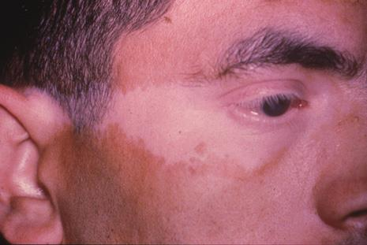
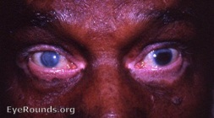
A
SO vs VKH
For each of the following, state whether it is associated with sympathetic ophthalmia (SO), Vogt-Koyanagi-Harada (VKH) disease, or both.
Predilection for adults age 20 – 50: VKH
More common in whites: SO
Concurrent skin findings common: VKH
How common are skin (and hair) findings in VKH?
They appear in about 1/3 of patients
What is the classic skin finding?
Vitiligo
What is vitiligo?
Depigmentation of the skin

Slide 122
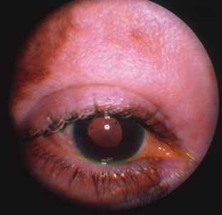
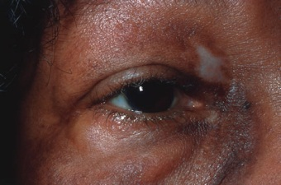
SO vs VKH
A VKH pt early in the dz course
Same pt late in the dz course (and despite aggressive immunosuppressive therapy)

Slide 123
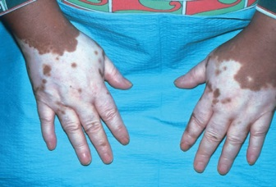
SO vs VKH
VKH: Vitiligo

Slide 124
Q
SO vs VKH
For each of the following, state whether it is associated with sympathetic ophthalmia (SO), Vogt-Koyanagi-Harada (VKH) disease, or both.
Predilection for adults age 20 – 50: VKH
More common in whites: SO
Concurrent skin findings common: VKH
How common are skin (and hair) findings in VKH?
They appear in about 1/3 of patients
What is the classic skin finding?
Vitiligo
What is vitiligo?
Depigmentation of the skin
Vitiligo is not limited to the skin--a classic eye location is the perilimbal region.
What is the eponymous name for this sign?
Sugiura’s sign
In which pt population is it common?
Pts of Japanese ancestry--almost all of them will manifest this finding
Does it occur in Caucasian pts?
Almost never

Slide 125
A
SO vs VKH
For each of the following, state whether it is associated with sympathetic ophthalmia (SO), Vogt-Koyanagi-Harada (VKH) disease, or both.
Predilection for adults age 20 – 50: VKH
More common in whites: SO
Concurrent skin findings common: VKH
How common are skin (and hair) findings in VKH?
They appear in about 1/3 of patients
What is the classic skin finding?
Vitiligo
What is vitiligo?
Depigmentation of the skin
Vitiligo is not limited to the skin--a classic eye location is the perilimbal region.
What is the eponymous name for this sign?
Sugiura’s sign
In which pt population is it common?
Pts of Japanese ancestry--almost all of them will manifest this finding
Does it occur in Caucasian pts?
Almost never

Slide 126
Q
SO vs VKH
For each of the following, state whether it is associated with sympathetic ophthalmia (SO), Vogt-Koyanagi-Harada (VKH) disease, or both.
Predilection for adults age 20 – 50: VKH
More common in whites: SO
Concurrent skin findings common: VKH
How common are skin (and hair) findings in VKH?
They appear in about 1/3 of patients
What is the classic skin finding?
Vitiligo
What is vitiligo?
Depigmentation of the skin
Vitiligo is not limited to the skin--a classic eye location is the perilimbal region.
What is the eponymous name for this sign?
Sugiura’s sign
In which pt population is it common?
Pts of Japanese ancestry--almost all of them will manifest this finding
Does it occur in Caucasian pts?
Almost never

Slide 127
A
SO vs VKH
For each of the following, state whether it is associated with sympathetic ophthalmia (SO), Vogt-Koyanagi-Harada (VKH) disease, or both.
Predilection for adults age 20 – 50: VKH
More common in whites: SO
Concurrent skin findings common: VKH
How common are skin (and hair) findings in VKH?
They appear in about 1/3 of patients
What is the classic skin finding?
Vitiligo
What is vitiligo?
Depigmentation of the skin
Vitiligo is not limited to the skin--a classic eye location is the perilimbal region.
What is the eponymous name for this sign?
Sugiura’s sign
In which pt population is it common?
Pts of Japanese ancestry--almost all of them will manifest this finding
Does it occur in Caucasian pts?
Almost never

Slide 128
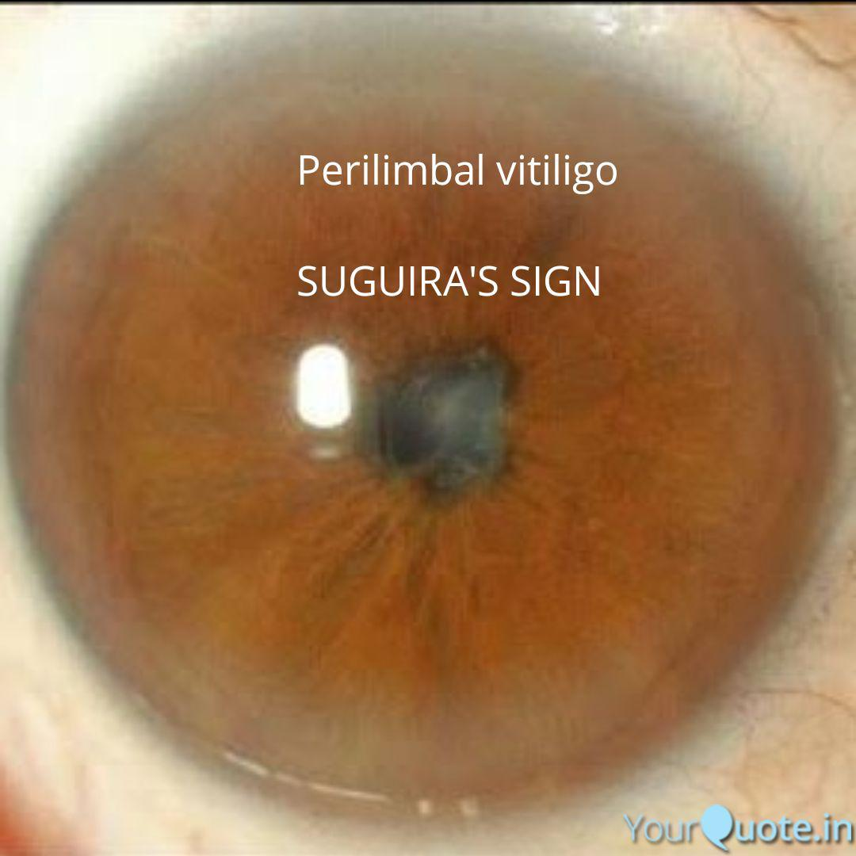
SO vs VKH
Sugiura’s sign

Slide 129
Q
SO vs VKH
For each of the following, state whether it is associated with sympathetic ophthalmia (SO), Vogt-Koyanagi-Harada (VKH) disease, or both.
Predilection for adults age 20 – 50: VKH
More common in whites: SO
Concurrent skin findings common: VKH
How common are skin (and hair) findings in VKH?
They appear in about 1/3 of patients
What is the classic skin finding?
Vitiligo
What is vitiligo?
Depigmentation of the skin
Vitiligo is not limited to the skin--a classic eye location is the perilimbal region.
What is the eponymous name for this sign?
Sugiura’s sign
In which pt population is it common?
Pts of Japanese ancestry--almost all of them will manifest this finding
Does it occur in Caucasian pts?
Almost never

Slide 130
A
SO vs VKH
For each of the following, state whether it is associated with sympathetic ophthalmia (SO), Vogt-Koyanagi-Harada (VKH) disease, or both.
Predilection for adults age 20 – 50: VKH
More common in whites: SO
Concurrent skin findings common: VKH
How common are skin (and hair) findings in VKH?
They appear in about 1/3 of patients
What is the classic skin finding?
Vitiligo
What is vitiligo?
Depigmentation of the skin
Vitiligo is not limited to the skin--a classic eye location is the perilimbal region.
What is the eponymous name for this sign?
Sugiura’s sign
In which pt population is it common?
Pts of Japanese ancestry--almost all of them will manifest this finding
Does it occur in Caucasian pts?
Almost never

Slide 131
Q
SO vs VKH
For each of the following, state whether it is associated with sympathetic ophthalmia (SO), Vogt-Koyanagi-Harada (VKH) disease, or both.
Predilection for adults age 20 – 50: VKH
More common in whites: SO
Concurrent skin findings common: VKH
How common are skin (and hair) findings in VKH?
They appear in about 1/3 of patients
What is the classic skin finding?
Vitiligo
What is vitiligo?
Depigmentation of the skin
Vitiligo is not limited to the skin--a classic eye location is the perilimbal region.
What is the eponymous name for this sign?
Sugiura’s sign
In which pt population is it common?
Pts of Japanese ancestry--almost all of them will manifest this finding
Does it occur in Caucasian pts?
Almost never

Slide 132
A
SO vs VKH
For each of the following, state whether it is associated with sympathetic ophthalmia (SO), Vogt-Koyanagi-Harada (VKH) disease, or both.
Predilection for adults age 20 – 50: VKH
More common in whites: SO
Concurrent skin findings common: VKH
How common are skin (and hair) findings in VKH?
They appear in about 1/3 of patients
What is the classic skin finding?
Vitiligo
What is vitiligo?
Depigmentation of the skin
Vitiligo is not limited to the skin--a classic eye location is the perilimbal region.
What is the eponymous name for this sign?
Sugiura’s sign
In which pt population is it common?
Pts of Japanese ancestry--almost all of them will manifest this finding
Does it occur in Caucasian pts?
Almost never

Slide 133
Q
SO vs VKH
For each of the following, state whether it is associated with sympathetic ophthalmia (SO), Vogt-Koyanagi-Harada (VKH) disease, or both.
Predilection for adults age 20 – 50: VKH
More common in whites: SO
Concurrent skin findings common: VKH
How common are skin (and hair) findings in VKH?
They appear in about 1/3 of patients
What is the classic skin finding?
Vitiligo
What is vitiligo?
Depigmentation of the skin
Vitiligo is not limited to the skin--a classic eye location is the perilimbal region.
What is the eponymous name for this sign?
Sugiura’s sign
In which pt population is it common?
Pts of Japanese ancestry--almost all of them will manifest this finding
Does it occur in Caucasian pts?
Almost never
A ‘perilimbal adjacent’ structure also becomes depigmented. Which one?
The trabecular meshwork
What is the eponymous name for TM depigmentation in VKH?
Ohno’s sign

Slide 134
A
SO vs VKH
For each of the following, state whether it is associated with sympathetic ophthalmia (SO), Vogt-Koyanagi-Harada (VKH) disease, or both.
Predilection for adults age 20 – 50: VKH
More common in whites: SO
Concurrent skin findings common: VKH
How common are skin (and hair) findings in VKH?
They appear in about 1/3 of patients
What is the classic skin finding?
Vitiligo
What is vitiligo?
Depigmentation of the skin
Vitiligo is not limited to the skin--a classic eye location is the perilimbal region.
What is the eponymous name for this sign?
Sugiura’s sign
In which pt population is it common?
Pts of Japanese ancestry--almost all of them will manifest this finding
Does it occur in Caucasian pts?
Almost never
A ‘perilimbal adjacent’ structure also becomes depigmented. Which one?
The trabecular meshwork
What is the eponymous name for TM depigmentation in VKH?
Ohno’s sign

Slide 135
Q
SO vs VKH
For each of the following, state whether it is associated with sympathetic ophthalmia (SO), Vogt-Koyanagi-Harada (VKH) disease, or both.
Predilection for adults age 20 – 50: VKH
More common in whites: SO
Concurrent skin findings common: VKH
How common are skin (and hair) findings in VKH?
They appear in about 1/3 of patients
What is the classic skin finding?
Vitiligo
What is vitiligo?
Depigmentation of the skin
Vitiligo is not limited to the skin--a classic eye location is the perilimbal region.
What is the eponymous name for this sign?
Sugiura’s sign
In which pt population is it common?
Pts of Japanese ancestry--almost all of them will manifest this finding
Does it occur in Caucasian pts?
Almost never
A ‘perilimbal adjacent’ structure also becomes depigmented. Which one?
The trabecular meshwork
What is the eponymous name for TM depigmentation in VKH?
Ohno’s sign

Slide 136
A
SO vs VKH
For each of the following, state whether it is associated with sympathetic ophthalmia (SO), Vogt-Koyanagi-Harada (VKH) disease, or both.
Predilection for adults age 20 – 50: VKH
More common in whites: SO
Concurrent skin findings common: VKH
How common are skin (and hair) findings in VKH?
They appear in about 1/3 of patients
What is the classic skin finding?
Vitiligo
What is vitiligo?
Depigmentation of the skin
Vitiligo is not limited to the skin--a classic eye location is the perilimbal region.
What is the eponymous name for this sign?
Sugiura’s sign
In which pt population is it common?
Pts of Japanese ancestry--almost all of them will manifest this finding
Does it occur in Caucasian pts?
Almost never
A ‘perilimbal adjacent’ structure also becomes depigmented. Which one?
The trabecular meshwork
What is the eponymous name for TM depigmentation in VKH?
Ohno’s sign

Slide 137
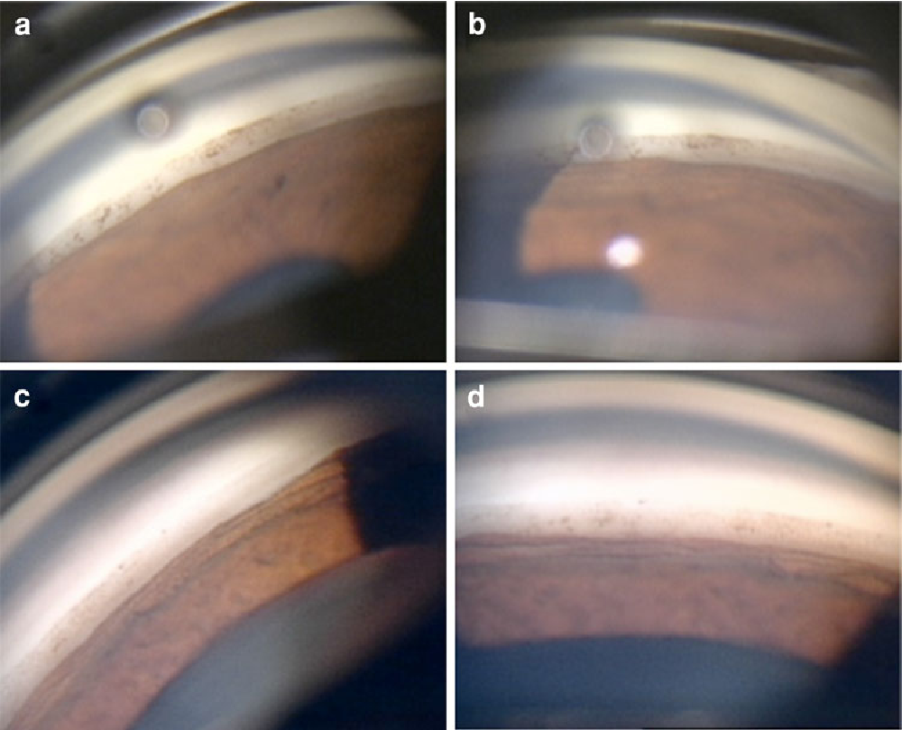
SO vs VKH
Ohno sign. (a, b) Appearance of TM at 1 month after disease onset.
(c, d) Five months after disease onset, TM pigmentation was noticeably reduced.

Slide 138
Q
SO vs VKH
For each of the following, state whether it is associated with sympathetic ophthalmia (SO), Vogt-Koyanagi-Harada (VKH) disease, or both.
Predilection for adults age 20 – 50: VKH
More common in whites: SO
Concurrent skin findings common: VKH
How common are skin (and hair) findings in VKH?
They appear in about 1/3 of patients
What is the classic skin finding?
Vitiligo
What is vitiligo?
Depigmentation of the skin
What are the classic hair findings?
Alopecia and poliosis
What do these terms mean?
Alopecia: Loss of hair
Poliosis: Loss of hair pigmentation

Slide 139
A
SO vs VKH
For each of the following, state whether it is associated with sympathetic ophthalmia (SO), Vogt-Koyanagi-Harada (VKH) disease, or both.
Predilection for adults age 20 – 50: VKH
More common in whites: SO
Concurrent skin findings common: VKH
How common are skin (and hair) findings in VKH?
They appear in about 1/3 of patients
What is the classic skin finding?
Vitiligo
What is vitiligo?
Depigmentation of the skin
What are the classic hair findings?
Alopecia and poliosis
What do these terms mean?
Alopecia: Loss of hair
Poliosis: Loss of hair pigmentation

Slide 140
Q
SO vs VKH
For each of the following, state whether it is associated with sympathetic ophthalmia (SO), Vogt-Koyanagi-Harada (VKH) disease, or both.
Predilection for adults age 20 – 50: VKH
More common in whites: SO
Concurrent skin findings common: VKH
How common are skin (and hair) findings in VKH?
They appear in about 1/3 of patients
What is the classic skin finding?
Vitiligo
What is vitiligo?
Depigmentation of the skin
What are the classic hair findings?
Alopecia and poliosis
What do these terms mean?
Alopecia: Loss of hair
Poliosis: Loss of hair pigmentation

Slide 141
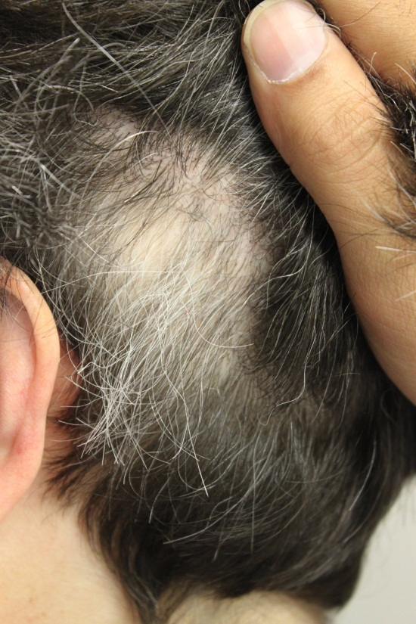
Q/A
SO vs VKH
For each of the following, state whether it is associated with sympathetic ophthalmia (SO), Vogt-Koyanagi-Harada (VKH) disease, or both.
Predilection for adults age 20 – 50: VKH
More common in whites: SO
Concurrent skin findings common: VKH
How common are skin (and hair) findings in VKH?
They appear in about 1/3 of patients
What is the classic skin finding?
Vitiligo
What is vitiligo?
Depigmentation of the skin
What are the classic hair findings?
Alopecia and poliosis
What do these terms mean?
Alopecia: Loss of hair
Poliosis: Loss of hair pigmentation

Slide 142
A
SO vs VKH
For each of the following, state whether it is associated with sympathetic ophthalmia (SO), Vogt-Koyanagi-Harada (VKH) disease, or both.
Predilection for adults age 20 – 50: VKH
More common in whites: SO
Concurrent skin findings common: VKH
How common are skin (and hair) findings in VKH?
They appear in about 1/3 of patients
What is the classic skin finding?
Vitiligo
What is vitiligo?
Depigmentation of the skin
What are the classic hair findings?
Alopecia and poliosis
What do these terms mean?
Alopecia: Loss of hair
Poliosis:

Slide 143
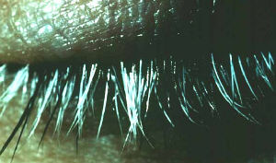
A
SO vs VKH
For each of the following, state whether it is associated with sympathetic ophthalmia (SO), Vogt-Koyanagi-Harada (VKH) disease, or both.
Predilection for adults age 20 – 50: VKH
More common in whites: SO
Concurrent skin findings common: VKH
How common are skin (and hair) findings in VKH?
They appear in about 1/3 of patients
What is the classic skin finding?
Vitiligo
What is vitiligo?
Depigmentation of the skin
What are the classic hair findings?
Alopecia and poliosis
What do these terms mean?
Alopecia: Loss of hair
Poliosis: Loss of hair pigmentation

Slide 144
Q
SO vs VKH
For each of the following, state whether it is associated with sympathetic ophthalmia (SO), Vogt-Koyanagi-Harada (VKH) disease, or both.
Predilection for adults age 20 – 50: VKH
More common in whites: SO
Concurrent skin findings common: VKH
How common are skin (and hair) findings in VKH?
They appear in about 1/3 of patients
What is the classic skin finding?
Vitiligo
What is vitiligo?
Depigmentation of the skin
Do the skin and hair findings precede, coincide with,
or follow the onset of eye inflammation in VKH?
The skin/hair changes generally follow the onset of eye inflammation by a period of weeks

Slide 145
Q/A
SO vs VKH
For each of the following, state whether it is associated with sympathetic ophthalmia (SO), Vogt-Koyanagi-Harada (VKH) disease, or both.
Predilection for adults age 20 – 50: VKH
More common in whites: SO
Concurrent skin findings common: VKH
How common are skin (and hair) findings in VKH?
They appear in about 1/3 of patients
What is the classic skin finding?
Vitiligo
What is vitiligo?
Depigmentation of the skin
Do the skin and hair findings precede, coincide with,
or follow the onset of eye inflammation in VKH?
The skin/hair changes generally follow the onset of eye inflammation by a period of weeks
precede v follow
unit of time

Slide 146
A
SO vs VKH
For each of the following, state whether it is associated with sympathetic ophthalmia (SO), Vogt-Koyanagi-Harada (VKH) disease, or both.
Predilection for adults age 20 – 50: VKH
More common in whites: SO
Concurrent skin findings common: VKH
How common are skin (and hair) findings in VKH?
They appear in about 1/3 of patients
What is the classic skin finding?
Vitiligo
What is vitiligo?
Depigmentation of the skin
Do the skin and hair findings precede, coincide with,
or follow the onset of eye inflammation in VKH?
The skin/hair changes generally follow the onset of eye inflammation by a period of weeks
Remember the pattern:
First: Neurologic
Second: Eye
Third: Integument

Slide 147
Q
SO vs VKH
For each of the following, state whether it is associated with sympathetic ophthalmia (SO), Vogt-Koyanagi-Harada (VKH) disease, or both.
Predilection for adults age 20 – 50: VKH
More common in whites: SO
Concurrent skin findings common: VKH
un
, SO?
^
Do skin findings occur in SO as well?
Yes, but they are much less common

Slide 148
A
SO vs VKH
For each of the following, state whether it is associated with sympathetic ophthalmia (SO), Vogt-Koyanagi-Harada (VKH) disease, or both.
Predilection for adults age 20 – 50: VKH
More common in whites: SO
Concurrent skin findings common: VKH
un
, SO!
^
Do skin findings occur in SO as well?
Yes, but they are much less common

Slide 149
Q
SO vs VKH
For each of the following, state whether it is associated with sympathetic ophthalmia (SO), Vogt-Koyanagi-Harada (VKH) disease, or both.
Predilection for adults age 20 – 50: VKH
More common in whites: SO
Concurrent skin findings common: VKH
CNS involvement rare:

Slide 150
A
SO vs VKH
For each of the following, state whether it is associated with sympathetic ophthalmia (SO), Vogt-Koyanagi-Harada (VKH) disease, or both.
Predilection for adults age 20 – 50: VKH
More common in whites: SO
Concurrent skin findings common: VKH
CNS involvement rare: SO

Slide 151
Q
SO vs VKH
For each of the following, state whether it is associated with sympathetic ophthalmia (SO), Vogt-Koyanagi-Harada (VKH) disease, or both.
Predilection for adults age 20 – 50: VKH
More common in whites: SO
Concurrent skin findings common: VKH
CNS involvement rare: SO
possible in
? Yes!
To be clear: Can CNS involvement occur in SO?
Yes, it’s just much less common

Slide 152
A
SO vs VKH
For each of the following, state whether it is associated with sympathetic ophthalmia (SO), Vogt-Koyanagi-Harada (VKH) disease, or both.
Predilection for adults age 20 – 50: VKH
More common in whites: SO
Concurrent skin findings common: VKH
CNS involvement rare: SO
possible in
? Yes!
To be clear: Can CNS involvement occur in SO?
Yes, it’s just much less common

Slide 153
Q
SO vs VKH
For each of the following, state whether it is associated with sympathetic ophthalmia (SO), Vogt-Koyanagi-Harada (VKH) disease, or both.
Predilection for adults age 20 – 50: VKH
More common in whites: SO
Concurrent skin findings common: VKH
CNS involvement rare:
in VKH
What is the classic sign/symptoms of CNS involvement in VKH?
Auditory issues, particularly tinnitus and dysacusis
In what other ways can CNS involvement manifest?
--Meningeal signs/symptoms
--Headache
Do focal neurologic signs/symptoms occur?
They can, but are rare
Can VKH cause an optic neuropathy?
Yes

Slide 154
Q/A
SO vs VKH
For each of the following, state whether it is associated with sympathetic ophthalmia (SO), Vogt-Koyanagi-Harada (VKH) disease, or both.
Predilection for adults age 20 – 50: VKH
More common in whites: SO
Concurrent skin findings common: VKH
CNS involvement rare:
in VKH
What is the classic sign/symptoms of CNS involvement in VKH?
Auditory issues, particularly tinnitus and dysacusis
In what other ways can CNS involvement manifest?
--Meningeal signs/symptoms
--Headache
Do focal neurologic signs/symptoms occur?
They can, but are rare
Can VKH cause an optic neuropathy?
Yes

Slide 155
A
SO vs VKH
For each of the following, state whether it is associated with sympathetic ophthalmia (SO), Vogt-Koyanagi-Harada (VKH) disease, or both.
Predilection for adults age 20 – 50: VKH
More common in whites: SO
Concurrent skin findings common: VKH
CNS involvement rare:
in VKH
What is the classic sign/symptoms of CNS involvement in VKH?
Auditory issues, particularly tinnitus and dysacusis
In what other ways can CNS involvement manifest?
--Meningeal signs/symptoms
--Headache
Do focal neurologic signs/symptoms occur?
They can, but are rare
Can VKH cause an optic neuropathy?
Yes

Slide 156
Q
SO vs VKH
For each of the following, state whether it is associated with sympathetic ophthalmia (SO), Vogt-Koyanagi-Harada (VKH) disease, or both.
Predilection for adults age 20 – 50: VKH
More common in whites: SO
Concurrent skin findings common: VKH
CNS involvement rare:
in VKH
What is the classic sign/symptoms of CNS involvement in VKH?
Auditory issues, particularly tinnitus and dysacusis
In what other ways can CNS involvement manifest?
--Meningeal signs/symptoms
--Headache
Do focal neurologic signs/symptoms occur?
They can, but are rare
Can VKH cause an optic neuropathy?
Yes

Slide 157
A
SO vs VKH
For each of the following, state whether it is associated with sympathetic ophthalmia (SO), Vogt-Koyanagi-Harada (VKH) disease, or both.
Predilection for adults age 20 – 50: VKH
More common in whites: SO
Concurrent skin findings common: VKH
CNS involvement rare:
in VKH
What is the classic sign/symptoms of CNS involvement in VKH?
Auditory issues, particularly tinnitus and dysacusis
In what other ways can CNS involvement manifest?
--Meningeal signs/symptoms (eg, nuchal rigidity)
--Headache
Do focal neurologic signs/symptoms occur?
They can, but are rare
Can VKH cause an optic neuropathy?
Yes

Slide 158
SO vs VKH
For each of the following, state whether it is associated with sympathetic ophthalmia (SO), Vogt-Koyanagi-Harada (VKH) disease, or both.
Predilection for adults age 20 – 50: VKH
More common in whites: SO
Concurrent skin findings common: VKH
CNS involvement rare:
in VKH
What is the classic sign/symptoms of CNS involvement in VKH?
Auditory issues, particularly tinnitus and dysacusis
In what other ways can CNS involvement manifest?
--Meningeal signs/symptoms (eg, nuchal rigidity)
--Headache
Do focal neurologic signs/symptoms occur?
They can, but are rare
Can VKH cause an optic neuropathy?
Yes
Take special note of this, as prominent AAO sources emphasize the presence of meningeal manifestations in both VKH and SO!

Slide 159
Q
SO vs VKH
For each of the following, state whether it is associated with sympathetic ophthalmia (SO), Vogt-Koyanagi-Harada (VKH) disease, or both.
Predilection for adults age 20 – 50: VKH
More common in whites: SO
Concurrent skin findings common: VKH
CNS involvement rare:
in VKH
What is the classic sign/symptoms of CNS involvement in VKH?
Auditory issues, particularly tinnitus and dysacusis
In what other ways can CNS involvement manifest?
--Meningeal signs/symptoms (eg, nuchal rigidity)
--Headache
Do focal neurologic signs/symptoms occur?
They can, but are rare
Can VKH cause an optic neuropathy?
Yes
Take special note of this, as prominent AAO sources emphasize the presence of meningeal manifestations in both VKH and SO!
These same sources also emphasize a key difference in the temporal relationship between meningeal S/S in VKH vs in SO—what is that difference?
It is this: Meningeal S/S tend to precede ocular inflammation in VKH, but follow it in SO

Slide 160
Q/A
SO vs VKH
For each of the following, state whether it is associated with sympathetic ophthalmia (SO), Vogt-Koyanagi-Harada (VKH) disease, or both.
Predilection for adults age 20 – 50: VKH
More common in whites: SO
Concurrent skin findings common: VKH
CNS involvement rare:
in VKH
What is the classic sign/symptoms of CNS involvement in VKH?
Auditory issues, particularly tinnitus and dysacusis
In what other ways can CNS involvement manifest?
--Meningeal signs/symptoms (eg, nuchal rigidity)
--Headache
Do focal neurologic signs/symptoms occur?
They can, but are rare
Can VKH cause an optic neuropathy?
Yes
Take special note of this, as prominent AAO sources emphasize the presence of meningeal manifestations in both VKH and SO!
These same sources also emphasize a key difference in the temporal relationship between meningeal S/S in VKH vs in SO—what is that difference?
It is this: Meningeal S/S tend to precede ocular inflammation in VKH, but follow it in SO
precede vs follow
precede vs follow

Slide 161
A
SO vs VKH
For each of the following, state whether it is associated with sympathetic ophthalmia (SO), Vogt-Koyanagi-Harada (VKH) disease, or both.
Predilection for adults age 20 – 50: VKH
More common in whites: SO
Concurrent skin findings common: VKH
CNS involvement rare:
in VKH
What is the classic sign/symptoms of CNS involvement in VKH?
Auditory issues, particularly tinnitus and dysacusis
In what other ways can CNS involvement manifest?
--Meningeal signs/symptoms (eg, nuchal rigidity)
--Headache
Do focal neurologic signs/symptoms occur?
They can, but are rare
Can VKH cause an optic neuropathy?
Yes
Take special note of this, as prominent AAO sources emphasize the presence of meningeal manifestations in both VKH and SO!
These same sources also emphasize a key difference in the temporal relationship between meningeal S/S in VKH vs in SO—what is that difference?
It is this: Meningeal S/S tend to precede ocular inflammation in VKH, but follow it in SO

Slide 162
Q
SO vs VKH
For each of the following, state whether it is associated with sympathetic ophthalmia (SO), Vogt-Koyanagi-Harada (VKH) disease, or both.
Predilection for adults age 20 – 50: VKH
More common in whites: SO
Concurrent skin findings common: VKH
CNS involvement rare:
in VKH
What is the classic sign/symptoms of CNS involvement in VKH?
Auditory issues, particularly tinnitus and dysacusis
In what other ways can CNS involvement manifest?
--Meningeal signs/symptoms (eg, nuchal rigidity)
--Headache
Do focal neurologic signs/symptoms occur?
They can, but are rare
Can VKH cause an optic neuropathy?
Yes

Slide 163
A
SO vs VKH
For each of the following, state whether it is associated with sympathetic ophthalmia (SO), Vogt-Koyanagi-Harada (VKH) disease, or both.
Predilection for adults age 20 – 50: VKH
More common in whites: SO
Concurrent skin findings common: VKH
CNS involvement rare:
in VKH
What is the classic sign/symptoms of CNS involvement in VKH?
Auditory issues, particularly tinnitus and dysacusis
In what other ways can CNS involvement manifest?
--Meningeal signs/symptoms (eg, nuchal rigidity)
--Headache
Do focal neurologic signs/symptoms occur?
They can, but are rare
Can VKH cause an optic neuropathy?
Yes

Slide 164
Q
SO vs VKH
For each of the following, state whether it is associated with sympathetic ophthalmia (SO), Vogt-Koyanagi-Harada (VKH) disease, or both.
Predilection for adults age 20 – 50: VKH
More common in whites: SO
Concurrent skin findings common: VKH
CNS involvement rare:
in VKH
What is the classic sign/symptoms of CNS involvement in VKH?
Auditory issues, particularly tinnitus and dysacusis
In what other ways can CNS involvement manifest?
--Meningeal signs/symptoms (eg, nuchal rigidity)
--Headache
Do focal neurologic signs/symptoms occur?
They can, but are rare
Can VKH cause an optic neuropathy?
Yes

Slide 165
A
SO vs VKH
For each of the following, state whether it is associated with sympathetic ophthalmia (SO), Vogt-Koyanagi-Harada (VKH) disease, or both.
Predilection for adults age 20 – 50: VKH
More common in whites: SO
Concurrent skin findings common: VKH
CNS involvement rare:
in VKH
What is the classic sign/symptoms of CNS involvement in VKH?
Auditory issues, particularly tinnitus and dysacusis
In what other ways can CNS involvement manifest?
--Meningeal signs/symptoms (eg, nuchal rigidity)
--Headache
Do focal neurologic signs/symptoms occur?
They can, but are rare
Can VKH cause an optic neuropathy?
Yes

Slide 166
Q
SO vs VKH
For each of the following, state whether it is associated with sympathetic ophthalmia (SO), Vogt-Koyanagi-Harada (VKH) disease, or both.
Predilection for adults age 20 – 50: VKH
More common in whites: SO
Concurrent skin findings common: VKH
CNS involvement rare: SO
Dalen-Fuchs nodules present:

Slide 167
A
SO vs VKH
For each of the following, state whether it is associated with sympathetic ophthalmia (SO), Vogt-Koyanagi-Harada (VKH) disease, or both.
Predilection for adults age 20 – 50: VKH
More common in whites: SO
Concurrent skin findings common: VKH
CNS involvement rare: SO
Dalen-Fuchs nodules present: Both

Slide 168
Q
SO vs VKH
For each of the following, state whether it is associated with sympathetic ophthalmia (SO), Vogt-Koyanagi-Harada (VKH) disease, or both.
Predilection for adults age 20 – 50: VKH
More common in whites: SO
Concurrent skin findings common: VKH
CNS involvement rare: SO
Dalen-Fuchs nodules present: Both
What are Dalen-Fuchs nodules?
Focal collections of inflammatory cells between Bruch’s membrane and the RPE

Slide 169
A
SO vs VKH
For each of the following, state whether it is associated with sympathetic ophthalmia (SO), Vogt-Koyanagi-Harada (VKH) disease, or both.
Predilection for adults age 20 – 50: VKH
More common in whites: SO
Concurrent skin findings common: VKH
CNS involvement rare: SO
Dalen-Fuchs nodules present: Both
What are Dalen-Fuchs nodules?
Focal collections of inflammatory cells between Bruch’s membrane and the RPE

Slide 170
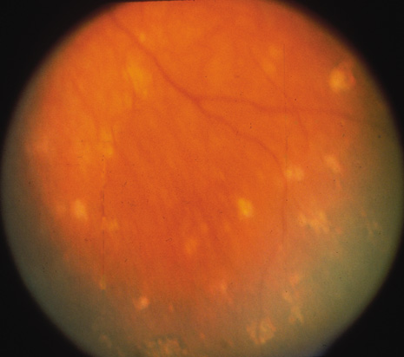
SO vs VKH
Dalen-Fuchs nodules

Slide 171
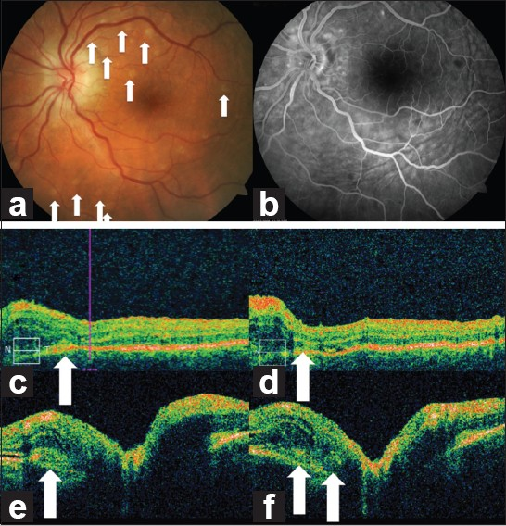
SO vs VKH
Dalen-Fuchs nodules

Slide 172
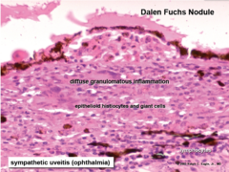
SO vs VKH
Dalen-Fuchs nodules

Slide 173
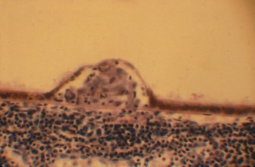
SO vs VKH
Dalen-Fuchs nodules

Slide 174
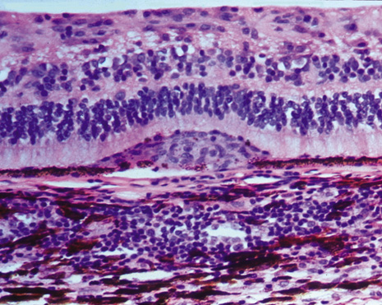
SO vs VKH
Dalen-Fuchs nodules

Slide 175
Q
SO vs VKH
For each of the following, state whether it is associated with sympathetic ophthalmia (SO), Vogt-Koyanagi-Harada (VKH) disease, or both.
Predilection for adults age 20 – 50: VKH
More common in whites: SO
Concurrent skin findings common: VKH
CNS involvement rare: SO
Dalen-Fuchs nodules present: Both
What are Dalen-Fuchs nodules?
Focal collections of inflammatory cells between Bruch’s membrane and the RPE
The classic test-association for Dalen-Fuchs nodules is SO/VKH. However, there is another condition,
vastly more common, in which they are seen as well. So, whereas during an exam your first response
to the term Dalen-Fuchs nodule should be SO/VKH, what condition should come to mind first if you
encounter them in the clinic?
Sarcoid

Slide 176
A
SO vs VKH
For each of the following, state whether it is associated with sympathetic ophthalmia (SO), Vogt-Koyanagi-Harada (VKH) disease, or both.
Predilection for adults age 20 – 50: VKH
More common in whites: SO
Concurrent skin findings common: VKH
CNS involvement rare: SO
Dalen-Fuchs nodules present: Both
What are Dalen-Fuchs nodules?
Focal collections of inflammatory cells between Bruch’s membrane and the RPE
The classic test-association for Dalen-Fuchs nodules is SO/VKH. However, there is another condition,
vastly more common, in which they are seen as well. So, whereas during an exam your first response
to the term Dalen-Fuchs nodule should be SO/VKH, what condition should come to mind first if you
encounter them in the clinic?
Sarcoid

Slide 177
Q
SO vs VKH
For each of the following, state whether it is associated with sympathetic ophthalmia (SO), Vogt-Koyanagi-Harada (VKH) disease, or both.
Predilection for adults age 20 – 50: VKH
More common in whites: SO
Concurrent skin findings common: VKH
CNS involvement rare: SO
Dalen-Fuchs nodules present: Both
Choriocapillaris is spared:

Slide 178
A
SO vs VKH
For each of the following, state whether it is associated with sympathetic ophthalmia (SO), Vogt-Koyanagi-Harada (VKH) disease, or both.
Predilection for adults age 20 – 50: VKH
More common in whites: SO
Concurrent skin findings common: VKH
CNS involvement rare: SO
Dalen-Fuchs nodules present: Both
Choriocapillaris is spared: SO

Slide 179
Q
SO vs VKH
For each of the following, state whether it is associated with sympathetic ophthalmia (SO), Vogt-Koyanagi-Harada (VKH) disease, or both.
Predilection for adults age 20 – 50: VKH
More common in whites: SO
Concurrent skin findings common: VKH
CNS involvement rare: SO
Dalen-Fuchs nodules present: Both
Choriocapillaris is spared: SO
What is the choriocapillaris?
The innermost portion of the choroid; it is a layer of highly-fenestrated capillaries

Slide 180
A
SO vs VKH
For each of the following, state whether it is associated with sympathetic ophthalmia (SO), Vogt-Koyanagi-Harada (VKH) disease, or both.
Predilection for adults age 20 – 50: VKH
More common in whites: SO
Concurrent skin findings common: VKH
CNS involvement rare: SO
Dalen-Fuchs nodules present: Both
Choriocapillaris is spared: SO
What is the choriocapillaris?
The innermost portion of the choroid; it is a layer of highly-fenestrated capillaries

Slide 181
SO vs VKH
For each of the following, state whether it is associated with sympathetic ophthalmia (SO), Vogt-Koyanagi-Harada (VKH) disease, or both.
Predilection for adults age 20 – 50: VKH
More common in whites: SO
Concurrent skin findings common: VKH
CNS involvement rare: SO
Dalen-Fuchs nodules present: Both
Choriocapillaris is spared: SO
A word of clarification is in order. Much is made about the presence/absence of choriocapillaris involvement as a feature distinguishing between SO and VKH. And it is true: The choriocapillaris is spared in SO, and it is affected in VKH.

Slide 182
SO vs VKH
For each of the following, state whether it is associated with sympathetic ophthalmia (SO), Vogt-Koyanagi-Harada (VKH) disease, or both.
Predilection for adults age 20 – 50: VKH
More common in whites: SO
Concurrent skin findings common: VKH
CNS involvement rare: SO
Dalen-Fuchs nodules present: Both
Choriocapillaris is spared: SO
A word of clarification is in order. Much is made about the presence/absence of choriocapillaris involvement as a feature distinguishing between SO and VKH. And it is true: The choriocapillaris is spared in SO, and it is affected in VKH. But note that the choriocapillaris is spared during the Acute Uveitic stage of VKH—it’s only later, during the Chronic Recurrent stage, that it becomes involved.

Slide 183
SO vs VKH
For each of the following, state whether it is associated with sympathetic ophthalmia (SO), Vogt-Koyanagi-Harada (VKH) disease, or both.
Predilection for adults age 20 – 50: VKH
More common in whites: SO
Concurrent skin findings common: VKH
CNS involvement rare: SO
Dalen-Fuchs nodules present: Both
Choriocapillaris is spared: SO
A word of clarification is in order. Much is made about the presence/absence of choriocapillaris involvement as a feature distinguishing between SO and VKH. And it is true: The choriocapillaris is spared in SO, and it is affected in VKH. But note that the choriocapillaris is spared during the Acute Uveitic stage of VKH—it’s only later, during the Chronic Recurrent stage, that it becomes involved. Thus, choriocapillaris status does not distinguish between SO and VKH so much as it distinguishes between the different stages of VKH. (We’ll drill down on the stages of VKH shortly.)

Slide 184
Q
SO vs VKH
For each of the following, state whether it is associated with sympathetic ophthalmia (SO), Vogt-Koyanagi-Harada (VKH) disease, or both.
Predilection for adults age 20 – 50: VKH
More common in whites: SO
Concurrent skin findings common: VKH
CNS involvement rare: SO
Dalen-Fuchs nodules present: Both
Choriocapillaris is spared: SO
More common in Hispanics, Asians:

Slide 185
A
SO vs VKH
For each of the following, state whether it is associated with sympathetic ophthalmia (SO), Vogt-Koyanagi-Harada (VKH) disease, or both.
Predilection for adults age 20 – 50: VKH
More common in whites: SO
Concurrent skin findings common: VKH
CNS involvement rare: SO
Dalen-Fuchs nodules present: Both
Choriocapillaris is spared: SO
More common in Hispanics, Asians: VKH

Slide 186
Q
SO vs VKH
For each of the following, state whether it is associated with sympathetic ophthalmia (SO), Vogt-Koyanagi-Harada (VKH) disease, or both.
Predilection for adults age 20 – 50: VKH
More common in whites: SO
Concurrent skin findings common: VKH
CNS involvement rare: SO
Dalen-Fuchs nodules present: Both
Choriocapillaris is spared: SO
More common in Hispanics, Asians: VKH
What other ethnic groups are frequently affected?
Native-Americans; Middle Easterners
Hispanics, Asians, Native-Americans, Middle Easterners--what is the common thread?
A relatively high level of skin pigmentation

Slide 187
A
SO vs VKH
For each of the following, state whether it is associated with sympathetic ophthalmia (SO), Vogt-Koyanagi-Harada (VKH) disease, or both.
Predilection for adults age 20 – 50: VKH
More common in whites: SO
Concurrent skin findings common: VKH
CNS involvement rare: SO
Dalen-Fuchs nodules present: Both
Choriocapillaris is spared: SO
More common in Hispanics, Asians: VKH
What other ethnic groups are frequently affected?
Native-Americans; Middle Easterners
Hispanics, Asians, Native-Americans, Middle Easterners--what is the common thread?
A relatively high level of skin pigmentation

Slide 188
Q
SO vs VKH
For each of the following, state whether it is associated with sympathetic ophthalmia (SO), Vogt-Koyanagi-Harada (VKH) disease, or both.
Predilection for adults age 20 – 50: VKH
More common in whites: SO
Concurrent skin findings common: VKH
CNS involvement rare: SO
Dalen-Fuchs nodules present: Both
Choriocapillaris is spared: SO
More common in Hispanics, Asians: VKH
What other ethnic groups are frequently affected?
Native-Americans; Middle Easterners
Hispanics, Asians, Native-Americans, Middle Easterners—what is the common thread?
A relatively high level of skin pigmentation

Slide 189
A
SO vs VKH
For each of the following, state whether it is associated with sympathetic ophthalmia (SO), Vogt-Koyanagi-Harada (VKH) disease, or both.
Predilection for adults age 20 – 50: VKH
More common in whites: SO
Concurrent skin findings common: VKH
CNS involvement rare: SO
Dalen-Fuchs nodules present: Both
Choriocapillaris is spared: SO
More common in Hispanics, Asians: VKH
What other ethnic groups are frequently affected?
Native-Americans; Middle Easterners
Hispanics, Asians, Native-Americans, Middle Easterners—what is the common thread?
A relatively high level of skin pigmentation

Slide 190
Q
SO vs VKH
For each of the following, state whether it is associated with sympathetic ophthalmia (SO), Vogt-Koyanagi-Harada (VKH) disease, or both.
Predilection for adults age 20 – 50: VKH
More common in whites: SO
Concurrent skin findings common: VKH
CNS involvement rare: SO
Dalen-Fuchs nodules present: Both
Choriocapillaris is spared: SO
More common in Hispanics, Asians: VKH
, and Africans?
Given this, it must follow that sub-Saharan Africans are at high risk, yes?
Actually, no, their relative risk is quite low
What does indicate about the disease process?
It indicates that pigmentation is not the sole contributor to the dz process
What other ethnic groups are frequently affected?
Native-Americans; Middle Easterners
Hispanics, Asians, Native-Americans, Middle Easterners—what is the common thread?
A relatively high level of skin pigmentation

Slide 191
A
SO vs VKH
For each of the following, state whether it is associated with sympathetic ophthalmia (SO), Vogt-Koyanagi-Harada (VKH) disease, or both.
Predilection for adults age 20 – 50: VKH
More common in whites: SO
Concurrent skin findings common: VKH
CNS involvement rare: SO
Dalen-Fuchs nodules present: Both
Choriocapillaris is spared: SO
More common in Hispanics, Asians: VKH
, but not Africans
Given this, it must follow that sub-Saharan Africans are at high risk, yes?
You’d think so, but no--their relative risk is quite low
What does indicate about the disease process?
It indicates that pigmentation is not the sole contributor to the dz process
What other ethnic groups are frequently affected?
Native-Americans; Middle Easterners
Hispanics, Asians, Native-Americans, Middle Easterners—what is the common thread?
A relatively high level of skin pigmentation

Slide 192
Q
SO vs VKH
For each of the following, state whether it is associated with sympathetic ophthalmia (SO), Vogt-Koyanagi-Harada (VKH) disease, or both.
Predilection for adults age 20 – 50: VKH
More common in whites: SO
Concurrent skin findings common: VKH
CNS involvement rare: SO
Dalen-Fuchs nodules present: Both
Choriocapillaris is spared: SO
More common in Hispanics, Asians: VKH
, but not Africans
Given this, it must follow that sub-Saharan Africans are at high risk, yes?
You’d think so, but no--their relative risk is quite low
What does indicate about the disease process?
It indicates that pigmentation is not the sole contributor to the dz process
What other ethnic groups are frequently affected?
Native-Americans; Middle Easterners
Hispanics, Asians, Native-Americans, Middle Easterners—what is the common thread?
A relatively high level of skin pigmentation

Slide 193
A
SO vs VKH
For each of the following, state whether it is associated with sympathetic ophthalmia (SO), Vogt-Koyanagi-Harada (VKH) disease, or both.
Predilection for adults age 20 – 50: VKH
More common in whites: SO
Concurrent skin findings common: VKH
CNS involvement rare: SO
Dalen-Fuchs nodules present: Both
Choriocapillaris is spared: SO
More common in Hispanics, Asians: VKH
, but not Africans
Given this, it must follow that sub-Saharan Africans are at high risk, yes?
You’d think so, but no--their relative risk is quite low
What does indicate about the disease process?
It indicates that pigmentation is not the sole contributor to the dz process
What other ethnic groups are frequently affected?
Native-Americans; Middle Easterners
Hispanics, Asians, Native-Americans, Middle Easterners—what is the common thread?
A relatively high level of skin pigmentation

Slide 194
Q
SO vs VKH
For each of the following, state whether it is associated with sympathetic ophthalmia (SO), Vogt-Koyanagi-Harada (VKH) disease, or both.
Predilection for adults age 20 – 50: VKH
More common in whites: SO
Concurrent skin findings common: VKH
CNS involvement rare: SO
Dalen-Fuchs nodules present: Both
Choriocapillaris is spared: SO
More common in Hispanics, Asians: VKH
Speaking of contributing to the dz process…Is there a genetic predisposition to VKH?
Very much so—strong HLA associations exist. All are of the HLA-DR* type—HLA-DR4 in Japanese pts; DR1 and DR4 among Hispanics; DRB among others.
Can these HLA types be used to differentiate between VKH and SO?
Alas no, because SO has virtually identical HLA associations
, but not Africans
Given this, it must follow that sub-Saharan Africans are at high risk, yes?
You’d think so, but no--their relative risk is quite low
What does indicate about the disease process?
It indicates that pigmentation is not the sole contributor to the dz process
What other ethnic groups are frequently affected?
Native-Americans; Middle Easterners
Hispanics, Asians, Native-Americans, Middle Easterners--what is the common thread?
A relatively high level of skin pigmentation

Slide 195
A
SO vs VKH
For each of the following, state whether it is associated with sympathetic ophthalmia (SO), Vogt-Koyanagi-Harada (VKH) disease, or both.
Predilection for adults age 20 – 50: VKH
More common in whites: SO
Concurrent skin findings common: VKH
CNS involvement rare: SO
Dalen-Fuchs nodules present: Both
Choriocapillaris is spared: SO
More common in Hispanics, Asians: VKH
Speaking of contributing to the dz process…Is there a genetic predisposition to VKH?
Very much so—strong HLA associations exist. All are of the HLA-DR* type—HLA-DR4 in Japanese pts; DR1 and DR4 among Hispanics; DRB among others.
Can these HLA types be used to differentiate between VKH and SO?
Alas no, because SO has virtually identical HLA associations
, but not Africans
Given this, it must follow that sub-Saharan Africans are at high risk, yes?
You’d think so, but no--their relative risk is quite low
What does indicate about the disease process?
It indicates that pigmentation is not the sole contributor to the dz process
What other ethnic groups are frequently affected?
Native-Americans; Middle Easterners
Hispanics, Asians, Native-Americans, Middle Easterners--what is the common thread?
A relatively high level of skin pigmentation

Slide 196
Q
SO vs VKH
For each of the following, state whether it is associated with sympathetic ophthalmia (SO), Vogt-Koyanagi-Harada (VKH) disease, or both.
Predilection for adults age 20 – 50: VKH
More common in whites: SO
Concurrent skin findings common: VKH
CNS involvement rare: SO
Dalen-Fuchs nodules present: Both
Choriocapillaris is spared: SO
More common in Hispanics, Asians: VKH
Speaking of contributing to the dz process…Is there a genetic predisposition to VKH?
Very much so—strong HLA associations exist. All are of the HLA-DR* type—HLA-DR4 in Japanese pts; DR1 and DR4 among Hispanics; DRB among others.
Can these HLA types be used to differentiate between VKH and SO?
Alas no, because SO has virtually identical HLA associations
, but not Africans
Given this, it must follow that sub-Saharan Africans are at high risk, yes?
You’d think so, but no--their relative risk is quite low
What does indicate about the disease process?
It indicates that pigmentation is not the sole contributor to the dz process
What other ethnic groups are frequently affected?
Native-Americans; Middle Easterners
Hispanics, Asians, Native-Americans, Middle Easterners--what is the common thread?
A relatively high level of skin pigmentation

Slide 197
A
SO vs VKH
For each of the following, state whether it is associated with sympathetic ophthalmia (SO), Vogt-Koyanagi-Harada (VKH) disease, or both.
Predilection for adults age 20 – 50: VKH
More common in whites: SO
Concurrent skin findings common: VKH
CNS involvement rare: SO
Dalen-Fuchs nodules present: Both
Choriocapillaris is spared: SO
More common in Hispanics, Asians: VKH
Speaking of contributing to the dz process…Is there a genetic predisposition to VKH?
Very much so—strong HLA associations exist. All are of the HLA-DR* type—HLA-DR4 in Japanese pts; DR1 and DR4 among Hispanics; DRB among others.
Can these HLA types be used to differentiate between VKH and SO?
Alas no, because SO has virtually identical HLA associations
, but not Africans
Given this, it must follow that sub-Saharan Africans are at high risk, yes?
You’d think so, but no--their relative risk is quite low
What does indicate about the disease process?
It indicates that pigmentation is not the sole contributor to the dz process
What other ethnic groups are frequently affected?
Native-Americans; Middle Easterners
Hispanics, Asians, Native-Americans, Middle Easterners--what is the common thread?
A relatively high level of skin pigmentation

Slide 198
Q
SO vs VKH
For each of the following, state whether it is associated with sympathetic ophthalmia (SO), Vogt-Koyanagi-Harada (VKH) disease, or both.
Predilection for adults age 20 – 50: VKH
More common in whites: SO
Concurrent skin findings common: VKH
CNS involvement rare: SO
Dalen-Fuchs nodules present: Both
Choriocapillaris is spared: SO
More common in Hispanics, Asians: VKH
No gender predilection:

Slide 199
Q
SO vs VKH
For each of the following, state whether it is associated with sympathetic ophthalmia (SO), Vogt-Koyanagi-Harada (VKH) disease, or both.
Predilection for adults age 20 – 50: VKH
More common in whites: SO
Concurrent skin findings common: VKH
CNS involvement rare: SO
Dalen-Fuchs nodules present: Both
Choriocapillaris is spared: SO
More common in Hispanics, Asians: VKH
No gender predilection: Depends…
VKH: M = F
>
<
=

Slide 200
A
SO vs VKH
For each of the following, state whether it is associated with sympathetic ophthalmia (SO), Vogt-Koyanagi-Harada (VKH) disease, or both.
Predilection for adults age 20 – 50: VKH
More common in whites: SO
Concurrent skin findings common: VKH
CNS involvement rare: SO
Dalen-Fuchs nodules present: Both
Choriocapillaris is spared: SO
More common in Hispanics, Asians: VKH
No gender predilection: Depends…
VKH: M < F

Slide 201
Q
SO vs VKH
For each of the following, state whether it is associated with sympathetic ophthalmia (SO), Vogt-Koyanagi-Harada (VKH) disease, or both.
Predilection for adults age 20 – 50: VKH
More common in whites: SO
Concurrent skin findings common: VKH
CNS involvement rare: SO
Dalen-Fuchs nodules present: Both
Choriocapillaris is spared: SO
More common in Hispanics, Asians: VKH
No gender predilection: Depends…
VKH: M < F
SO after surgery: M = F
>
<
=

Slide 202
A
SO vs VKH
For each of the following, state whether it is associated with sympathetic ophthalmia (SO), Vogt-Koyanagi-Harada (VKH) disease, or both.
Predilection for adults age 20 – 50: VKH
More common in whites: SO
Concurrent skin findings common: VKH
CNS involvement rare: SO
Dalen-Fuchs nodules present: Both
Choriocapillaris is spared: SO
More common in Hispanics, Asians: VKH
No gender predilection: Depends…
VKH: M < F
SO after surgery: M = F

Slide 203
Q
SO vs VKH
For each of the following, state whether it is associated with sympathetic ophthalmia (SO), Vogt-Koyanagi-Harada (VKH) disease, or both.
Predilection for adults age 20 – 50: VKH
More common in whites: SO
Concurrent skin findings common: VKH
CNS involvement rare: SO
Dalen-Fuchs nodules present: Both
Choriocapillaris is spared: SO
More common in Hispanics, Asians: VKH
No gender predilection: Depends…
VKH: M < F
SO after surgery: M = F
SO after trauma: M > F
>
<
=

Slide 204
A
SO vs VKH
For each of the following, state whether it is associated with sympathetic ophthalmia (SO), Vogt-Koyanagi-Harada (VKH) disease, or both.
Predilection for adults age 20 – 50: VKH
More common in whites: SO
Concurrent skin findings common: VKH
CNS involvement rare: SO
Dalen-Fuchs nodules present: Both
Choriocapillaris is spared: SO
More common in Hispanics, Asians: VKH
No gender predilection: Depends…
VKH: M < F
SO after surgery: M = F
SO after trauma: M > F

Slide 205
Q
Vogt-Koyanagi-Harada (VKH) Syndrome: Wadda ya know?
Recall this slide from earlier in the set. As stated then, tops on
the DDx for VKH is SO. That said, in the Masquerade Syndromes chapter of the Uveitis book, one condition is mentioned as masquerading for VKH. What is it?
Bilateral diffuse uveal melanocytic proliferation (BDUMP)
Number one on the DDx for VKH: SO.
Number one on the DDx for SO: VKH.
So let’s compare and contrast them!
Number one on the DDx for VKH: SO.
Number one on the DDx for SO: VKH.
So let’s compare and contrast them!
Sympathetic Ophthalmia (SO): Wadda ya know?

Slide 206
A
Vogt-Koyanagi-Harada (VKH) Syndrome: Wadda ya know?
Recall this slide from earlier in the set. As stated then, tops on
the DDx for VKH is SO. That said, in the Masquerade Syndromes chapter of the Uveitis book, one condition is mentioned as masquerading for VKH. What is it?
Bilateral diffuse uveal melanocytic proliferation (BDUMP)
Number one on the DDx for VKH: SO.
Number one on the DDx for SO: VKH.
So let’s compare and contrast them!
Number one on the DDx for VKH: SO.
Number one on the DDx for SO: VKH.
So let’s compare and contrast them!
Sympathetic Ophthalmia (SO): Wadda ya know?

Slide 207
Q
In a word, what sort of condition is BDUMP?
A paraneoplastic syndrome
Is BDUMP common, or rare?
Very rare
Who is the typical BDUMP pt?
An adult 50+
Is there a gender predilection?
No
With which malignancies is it associated?
Gynecologic in women; lung and pancreatic in men
What is the classic presenting ocular complaint?
Bilateral rapid vision loss
What classic DFE finding puts it on the DDx for VKH?
Bilateral serous/exudative RDs
What are the two other classic findings on exam?
Bilateral…
--rapid cataract progression
--multiple large ‘nevi’ of the posterior choroid
What is the prognosis?
Poor, in terms of both vision and life expectancy
Vogt-Koyanagi-Harada (VKH) Syndrome: Wadda ya know?
Recall this slide from earlier in the set. As stated then, tops on
the DDx for VKH is SO. That said, in the Masquerade Syndromes chapter of the Uveitis book, one condition is mentioned as masquerading for VKH. What is it?
Bilateral diffuse uveal melanocytic proliferation (BDUMP)
Number one on the DDx for VKH: SO.
Number one on the DDx for SO: VKH.
So let’s compare and contrast them!
Number one on the DDx for VKH: SO.
Number one on the DDx for SO: VKH.
So let’s compare and contrast them!
Sympathetic Ophthalmia (SO): Wadda ya know?

Slide 208
A
In a word, what sort of condition is BDUMP?
A paraneoplastic syndrome
Is BDUMP common, or rare?
Very rare
Who is the typical BDUMP pt?
An adult 50+
Is there a gender predilection?
No
With which malignancies is it associated?
Gynecologic in women; lung and pancreatic in men
What is the classic presenting ocular complaint?
Bilateral rapid vision loss
What classic DFE finding puts it on the DDx for VKH?
Bilateral serous/exudative RDs
What are the two other classic findings on exam?
Bilateral…
--rapid cataract progression
--multiple large ‘nevi’ of the posterior choroid
What is the prognosis?
Poor, in terms of both vision and life expectancy
Vogt-Koyanagi-Harada (VKH) Syndrome: Wadda ya know?
Recall this slide from earlier in the set. As stated then, tops on
the DDx for VKH is SO. That said, in the Masquerade Syndromes chapter of the Uveitis book, one condition is mentioned as masquerading for VKH. What is it?
Bilateral diffuse uveal melanocytic proliferation (BDUMP)
Number one on the DDx for VKH: SO.
Number one on the DDx for SO: VKH.
So let’s compare and contrast them!
Number one on the DDx for VKH: SO.
Number one on the DDx for SO: VKH.
So let’s compare and contrast them!
Sympathetic Ophthalmia (SO): Wadda ya know?

Slide 209
Q
In a word, what sort of condition is BDUMP?
A paraneoplastic syndrome
Is BDUMP common, or rare?
Very rare
Who is the typical BDUMP pt?
An adult 50+
Is there a gender predilection?
No
With which malignancies is it associated?
Gynecologic in women; lung and pancreatic in men
What is the classic presenting ocular complaint?
Bilateral rapid vision loss
What classic DFE finding puts it on the DDx for VKH?
Bilateral serous/exudative RDs
What are the two other classic findings on exam?
Bilateral…
--rapid cataract progression
--multiple large ‘nevi’ of the posterior choroid
What is the prognosis?
Poor, in terms of both vision and life expectancy
Vogt-Koyanagi-Harada (VKH) Syndrome: Wadda ya know?
Recall this slide from earlier in the set. As stated then, tops on
the DDx for VKH is SO. That said, in the Masquerade Syndromes chapter of the Uveitis book, one condition is mentioned as masquerading for VKH. What is it?
Bilateral diffuse uveal melanocytic proliferation (BDUMP)
Number one on the DDx for VKH: SO.
Number one on the DDx for SO: VKH.
So let’s compare and contrast them!
Number one on the DDx for VKH: SO.
Number one on the DDx for SO: VKH.
So let’s compare and contrast them!
Sympathetic Ophthalmia (SO): Wadda ya know?

Slide 210
A
In a word, what sort of condition is BDUMP?
A paraneoplastic syndrome
Is BDUMP common, or rare?
Very rare
Who is the typical BDUMP pt?
An adult 50+
Is there a gender predilection?
No
With which malignancies is it associated?
Gynecologic in women; lung and pancreatic in men
What is the classic presenting ocular complaint?
Bilateral rapid vision loss
What classic DFE finding puts it on the DDx for VKH?
Bilateral serous/exudative RDs
What are the two other classic findings on exam?
Bilateral…
--rapid cataract progression
--multiple large ‘nevi’ of the posterior choroid
What is the prognosis?
Poor, in terms of both vision and life expectancy
Vogt-Koyanagi-Harada (VKH) Syndrome: Wadda ya know?
Recall this slide from earlier in the set. As stated then, tops on
the DDx for VKH is SO. That said, in the Masquerade Syndromes chapter of the Uveitis book, one condition is mentioned as masquerading for VKH. What is it?
Bilateral diffuse uveal melanocytic proliferation (BDUMP)
Number one on the DDx for VKH: SO.
Number one on the DDx for SO: VKH.
So let’s compare and contrast them!
Number one on the DDx for VKH: SO.
Number one on the DDx for SO: VKH.
So let’s compare and contrast them!
Sympathetic Ophthalmia (SO): Wadda ya know?

Slide 211
Q
In a word, what sort of condition is BDUMP?
A paraneoplastic syndrome
Is BDUMP common, or rare?
Very rare
Who is the typical BDUMP pt?
An adult 50+
Is there a gender predilection?
No
With which malignancies is it associated?
Gynecologic in women; lung and pancreatic in men
What is the classic presenting ocular complaint?
Bilateral rapid vision loss
What classic DFE finding puts it on the DDx for VKH?
Bilateral serous/exudative RDs
What are the two other classic findings on exam?
Bilateral…
--rapid cataract progression
--multiple large ‘nevi’ of the posterior choroid
What is the prognosis?
Poor, in terms of both vision and life expectancy
Vogt-Koyanagi-Harada (VKH) Syndrome: Wadda ya know?
Recall this slide from earlier in the set. As stated then, tops on
the DDx for VKH is SO. That said, in the Masquerade Syndromes chapter of the Uveitis book, one condition is mentioned as masquerading for VKH. What is it?
Bilateral diffuse uveal melanocytic proliferation (BDUMP)
Number one on the DDx for VKH: SO.
Number one on the DDx for SO: VKH.
So let’s compare and contrast them!
Number one on the DDx for VKH: SO.
Number one on the DDx for SO: VKH.
So let’s compare and contrast them!
Sympathetic Ophthalmia (SO): Wadda ya know?

Slide 212
A
In a word, what sort of condition is BDUMP?
A paraneoplastic syndrome
Is BDUMP common, or rare?
Very rare
Who is the typical BDUMP pt?
An adult 50+
Is there a gender predilection?
No
With which malignancies is it associated?
Gynecologic in women; lung and pancreatic in men
What is the classic presenting ocular complaint?
Bilateral rapid vision loss
What classic DFE finding puts it on the DDx for VKH?
Bilateral serous/exudative RDs
What are the two other classic findings on exam?
Bilateral…
--rapid cataract progression
--multiple large ‘nevi’ of the posterior choroid
What is the prognosis?
Poor, in terms of both vision and life expectancy
Vogt-Koyanagi-Harada (VKH) Syndrome: Wadda ya know?
Recall this slide from earlier in the set. As stated then, tops on
the DDx for VKH is SO. That said, in the Masquerade Syndromes chapter of the Uveitis book, one condition is mentioned as masquerading for VKH. What is it?
Bilateral diffuse uveal melanocytic proliferation (BDUMP)
Number one on the DDx for VKH: SO.
Number one on the DDx for SO: VKH.
So let’s compare and contrast them!
Number one on the DDx for VKH: SO.
Number one on the DDx for SO: VKH.
So let’s compare and contrast them!
Sympathetic Ophthalmia (SO): Wadda ya know?

Slide 213
Q
In a word, what sort of condition is BDUMP?
A paraneoplastic syndrome
Is BDUMP common, or rare?
Very rare
Who is the typical BDUMP pt?
An adult 50+
Is there a gender predilection?
No
With which malignancies is it associated?
Gynecologic in women; lung and pancreatic in men
What is the classic presenting ocular complaint?
Bilateral rapid vision loss
What classic DFE finding puts it on the DDx for VKH?
Bilateral serous/exudative RDs
What are the two other classic findings on exam?
Bilateral…
--rapid cataract progression
--multiple large ‘nevi’ of the posterior choroid
What is the prognosis?
Poor, in terms of both vision and life expectancy
Vogt-Koyanagi-Harada (VKH) Syndrome: Wadda ya know?
Recall this slide from earlier in the set. As stated then, tops on
the DDx for VKH is SO. That said, in the Masquerade Syndromes chapter of the Uveitis book, one condition is mentioned as masquerading for VKH. What is it?
Bilateral diffuse uveal melanocytic proliferation (BDUMP)
Number one on the DDx for VKH: SO.
Number one on the DDx for SO: VKH.
So let’s compare and contrast them!
Number one on the DDx for VKH: SO.
Number one on the DDx for SO: VKH.
So let’s compare and contrast them!
Sympathetic Ophthalmia (SO): Wadda ya know?

Slide 214
A
In a word, what sort of condition is BDUMP?
A paraneoplastic syndrome
Is BDUMP common, or rare?
Very rare
Who is the typical BDUMP pt?
An adult 50+
Is there a gender predilection?
No
With which malignancies is it associated?
Gynecologic in women; lung and pancreatic in men
What is the classic presenting ocular complaint?
Bilateral rapid vision loss
What classic DFE finding puts it on the DDx for VKH?
Bilateral serous/exudative RDs
What are the two other classic findings on exam?
Bilateral…
--rapid cataract progression
--multiple large ‘nevi’ of the posterior choroid
What is the prognosis?
Poor, in terms of both vision and life expectancy
Vogt-Koyanagi-Harada (VKH) Syndrome: Wadda ya know?
Recall this slide from earlier in the set. As stated then, tops on
the DDx for VKH is SO. That said, in the Masquerade Syndromes chapter of the Uveitis book, one condition is mentioned as masquerading for VKH. What is it?
Bilateral diffuse uveal melanocytic proliferation (BDUMP)
Number one on the DDx for VKH: SO.
Number one on the DDx for SO: VKH.
So let’s compare and contrast them!
Number one on the DDx for VKH: SO.
Number one on the DDx for SO: VKH.
So let’s compare and contrast them!
Sympathetic Ophthalmia (SO): Wadda ya know?

Slide 215
Q
In a word, what sort of condition is BDUMP?
A paraneoplastic syndrome
Is BDUMP common, or rare?
Very rare
Who is the typical BDUMP pt?
An adult 50+
Is there a gender predilection?
No
With which malignancies is it associated?
Gynecologic in women; lung and pancreatic in men
What is the classic presenting ocular complaint?
Bilateral rapid vision loss
What classic DFE finding puts it on the DDx for VKH?
Bilateral serous/exudative RDs
What are the two other classic findings on exam?
Bilateral…
--rapid cataract progression
--multiple large ‘nevi’ of the posterior choroid
What is the prognosis?
Poor, in terms of both vision and life expectancy
Vogt-Koyanagi-Harada (VKH) Syndrome: Wadda ya know?
Recall this slide from earlier in the set. As stated then, tops on
the DDx for VKH is SO. That said, in the Masquerade Syndromes chapter of the Uveitis book, one condition is mentioned as masquerading for VKH. What is it?
Bilateral diffuse uveal melanocytic proliferation (BDUMP)
Number one on the DDx for VKH: SO.
Number one on the DDx for SO: VKH.
So let’s compare and contrast them!
Number one on the DDx for VKH: SO.
Number one on the DDx for SO: VKH.
So let’s compare and contrast them!
Sympathetic Ophthalmia (SO): Wadda ya know?

Slide 216
A
In a word, what sort of condition is BDUMP?
A paraneoplastic syndrome
Is BDUMP common, or rare?
Very rare
Who is the typical BDUMP pt?
An adult 50+
Is there a gender predilection?
No
With which malignancies is it associated?
Gynecologic in women; lung and pancreatic in men
What is the classic presenting ocular complaint?
Bilateral rapid vision loss
What classic DFE finding puts it on the DDx for VKH?
Bilateral serous/exudative RDs
What are the two other classic findings on exam?
Bilateral…
--rapid cataract progression
--multiple large ‘nevi’ of the posterior choroid
What is the prognosis?
Poor, in terms of both vision and life expectancy
Vogt-Koyanagi-Harada (VKH) Syndrome: Wadda ya know?
Recall this slide from earlier in the set. As stated then, tops on
the DDx for VKH is SO. That said, in the Masquerade Syndromes chapter of the Uveitis book, one condition is mentioned as masquerading for VKH. What is it?
Bilateral diffuse uveal melanocytic proliferation (BDUMP)
Number one on the DDx for VKH: SO.
Number one on the DDx for SO: VKH.
So let’s compare and contrast them!
Number one on the DDx for VKH: SO.
Number one on the DDx for SO: VKH.
So let’s compare and contrast them!
Sympathetic Ophthalmia (SO): Wadda ya know?

Slide 217
Q
In a word, what sort of condition is BDUMP?
A paraneoplastic syndrome
Is BDUMP common, or rare?
Very rare
Who is the typical BDUMP pt?
An adult 50+
Is there a gender predilection?
No
With which malignancies is it associated?
Gynecologic in women; lung and pancreatic in men
What is the classic presenting ocular complaint?
Bilateral rapid vision loss
What classic DFE finding puts it on the DDx for VKH?
Bilateral serous/exudative RDs
What are the two other classic findings on exam?
Bilateral…
--rapid cataract progression
--multiple large ‘nevi’ of the posterior choroid
What is the prognosis?
Poor, in terms of both vision and life expectancy
Vogt-Koyanagi-Harada (VKH) Syndrome: Wadda ya know?
Recall this slide from earlier in the set. As stated then, tops on
the DDx for VKH is SO. That said, in the Masquerade Syndromes chapter of the Uveitis book, one condition is mentioned as masquerading for VKH. What is it?
Bilateral diffuse uveal melanocytic proliferation (BDUMP)
Number one on the DDx for VKH: SO.
Number one on the DDx for SO: VKH.
So let’s compare and contrast them!
Number one on the DDx for VKH: SO.
Number one on the DDx for SO: VKH.
So let’s compare and contrast them!
Sympathetic Ophthalmia (SO): Wadda ya know?

Slide 218
A
In a word, what sort of condition is BDUMP?
A paraneoplastic syndrome
Is BDUMP common, or rare?
Very rare
Who is the typical BDUMP pt?
An adult 50+
Is there a gender predilection?
No
With which malignancies is it associated?
Gynecologic in women; lung and pancreatic in men
What is the classic presenting ocular complaint?
Bilateral rapid vision loss
What classic DFE finding puts it on the DDx for VKH?
Bilateral serous/exudative RDs
What are the two other classic findings on exam?
Bilateral…
--rapid cataract progression
--multiple large ‘nevi’ of the posterior choroid
What is the prognosis?
Poor, in terms of both vision and life expectancy
Vogt-Koyanagi-Harada (VKH) Syndrome: Wadda ya know?
Recall this slide from earlier in the set. As stated then, tops on
the DDx for VKH is SO. That said, in the Masquerade Syndromes chapter of the Uveitis book, one condition is mentioned as masquerading for VKH. What is it?
Bilateral diffuse uveal melanocytic proliferation (BDUMP)
Number one on the DDx for VKH: SO.
Number one on the DDx for SO: VKH.
So let’s compare and contrast them!
Number one on the DDx for VKH: SO.
Number one on the DDx for SO: VKH.
So let’s compare and contrast them!
Sympathetic Ophthalmia (SO): Wadda ya know?

Slide 219
Q
In a word, what sort of condition is BDUMP?
A paraneoplastic syndrome
Is BDUMP common, or rare?
Very rare
Who is the typical BDUMP pt?
An adult 50+
Is there a gender predilection?
No
With which malignancies is it associated?
Gynecologic in women; lung and pancreatic in men
What is the classic presenting ocular complaint?
Bilateral rapid vision loss
What classic DFE finding puts it on the DDx for VKH?
Bilateral serous/exudative RDs
What are the two other classic findings on exam?
Bilateral…
--rapid cataract progression
--multiple large ‘nevi’ of the posterior choroid
What is the prognosis?
Poor, in terms of both vision and life expectancy
Vogt-Koyanagi-Harada (VKH) Syndrome: Wadda ya know?
Recall this slide from earlier in the set. As stated then, tops on
the DDx for VKH is SO. That said, in the Masquerade Syndromes chapter of the Uveitis book, one condition is mentioned as masquerading for VKH. What is it?
Bilateral diffuse uveal melanocytic proliferation (BDUMP)
Number one on the DDx for VKH: SO.
Number one on the DDx for SO: VKH.
So let’s compare and contrast them!
Number one on the DDx for VKH: SO.
Number one on the DDx for SO: VKH.
So let’s compare and contrast them!
Sympathetic Ophthalmia (SO): Wadda ya know?

Slide 220
A
In a word, what sort of condition is BDUMP?
A paraneoplastic syndrome
Is BDUMP common, or rare?
Very rare
Who is the typical BDUMP pt?
An adult 50+
Is there a gender predilection?
No
With which malignancies is it associated?
Gynecologic in women; lung and pancreatic in men
What is the classic presenting ocular complaint?
Bilateral rapid vision loss
What classic DFE finding puts it on the DDx for VKH?
Bilateral serous/exudative RDs
What are the two other classic findings on exam?
Bilateral…
--rapid cataract progression
--multiple large ‘nevi’ of the posterior choroid
What is the prognosis?
Poor, in terms of both vision and life expectancy
Vogt-Koyanagi-Harada (VKH) Syndrome: Wadda ya know?
Recall this slide from earlier in the set. As stated then, tops on
the DDx for VKH is SO. That said, in the Masquerade Syndromes chapter of the Uveitis book, one condition is mentioned as masquerading for VKH. What is it?
Bilateral diffuse uveal melanocytic proliferation (BDUMP)
Number one on the DDx for VKH: SO.
Number one on the DDx for SO: VKH.
So let’s compare and contrast them!
Number one on the DDx for VKH: SO.
Number one on the DDx for SO: VKH.
So let’s compare and contrast them!
Sympathetic Ophthalmia (SO): Wadda ya know?

Slide 221
Q
In a word, what sort of condition is BDUMP?
A paraneoplastic syndrome
Is BDUMP common, or rare?
Very rare
Who is the typical BDUMP pt?
An adult 50+
Is there a gender predilection?
No
With which malignancies is it associated?
Gynecologic in women; lung and pancreatic in men
What is the classic presenting ocular complaint?
Bilateral rapid vision loss
What classic DFE finding puts it on the DDx for VKH?
Bilateral serous/exudative RDs
What are the two other classic findings on exam?
Bilateral…
--rapid cataract progression
--multiple large ‘nevi’ of the posterior choroid
What is the prognosis?
Poor, in terms of both vision and life expectancy
Vogt-Koyanagi-Harada (VKH) Syndrome: Wadda ya know?
Recall this slide from earlier in the set. As stated then, tops on
the DDx for VKH is SO. That said, in the Masquerade Syndromes chapter of the Uveitis book, one condition is mentioned as masquerading for VKH. What is it?
Bilateral diffuse uveal melanocytic proliferation (BDUMP)
Number one on the DDx for VKH: SO.
Number one on the DDx for SO: VKH.
So let’s compare and contrast them!
Number one on the DDx for VKH: SO.
Number one on the DDx for SO: VKH.
So let’s compare and contrast them!
Sympathetic Ophthalmia (SO): Wadda ya know?

Slide 222
A
In a word, what sort of condition is BDUMP?
A paraneoplastic syndrome
Is BDUMP common, or rare?
Very rare
Who is the typical BDUMP pt?
An adult 50+
Is there a gender predilection?
No
With which malignancies is it associated?
Gynecologic in women; lung and pancreatic in men
What is the classic presenting ocular complaint?
Bilateral rapid vision loss
What classic DFE finding puts it on the DDx for VKH?
Bilateral serous/exudative RDs
What are the two other classic findings on exam?
Bilateral…
--rapid cataract progression
--multiple large ‘nevi’ of the posterior choroid
What is the prognosis?
Poor, in terms of both vision and life expectancy
Vogt-Koyanagi-Harada (VKH) Syndrome: Wadda ya know?
Recall this slide from earlier in the set. As stated then, tops on
the DDx for VKH is SO. That said, in the Masquerade Syndromes chapter of the Uveitis book, one condition is mentioned as masquerading for VKH. What is it?
Bilateral diffuse uveal melanocytic proliferation (BDUMP)
Number one on the DDx for VKH: SO.
Number one on the DDx for SO: VKH.
So let’s compare and contrast them!
Number one on the DDx for VKH: SO.
Number one on the DDx for SO: VKH.
So let’s compare and contrast them!
Sympathetic Ophthalmia (SO): Wadda ya know?

Slide 223
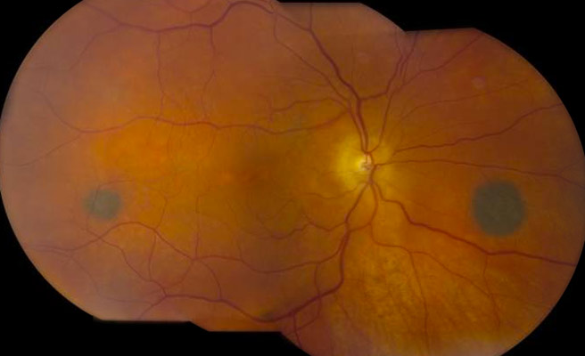
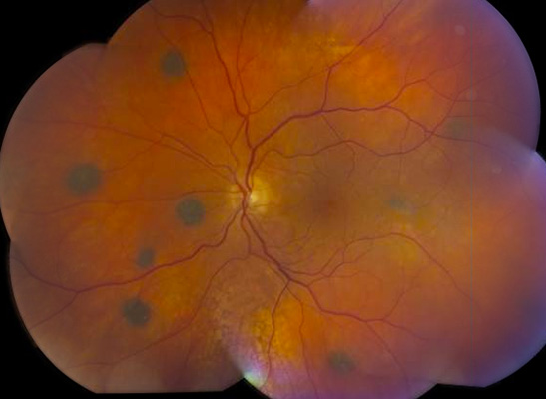
BDUMP: Posterior-pole nevus-like lesions

Slide 224
Q
In a word, what sort of condition is BDUMP?
A paraneoplastic syndrome
Is BDUMP common, or rare?
Very rare
Who is the typical BDUMP pt?
An adult 50+
Is there a gender predilection?
No
With which malignancies is it associated?
Gynecologic in women; lung and pancreatic in men
What is the classic presenting ocular complaint?
Bilateral rapid vision loss
What classic DFE finding puts it on the DDx for VKH?
Bilateral serous/exudative RDs
What are the two other classic findings on exam?
Bilateral…
--rapid cataract progression
--multiple large ‘nevi’ of the posterior choroid
What is the prognosis?
Poor, in terms of both vision and life expectancy
Vogt-Koyanagi-Harada (VKH) Syndrome: Wadda ya know?
Recall this slide from earlier in the set. As stated then, tops on
the DDx for VKH is SO. That said, in the Masquerade Syndromes chapter of the Uveitis book, one condition is mentioned as masquerading for VKH. What is it?
Bilateral diffuse uveal melanocytic proliferation (BDUMP)
Number one on the DDx for VKH: SO.
Number one on the DDx for SO: VKH.
So let’s compare and contrast them!
Number one on the DDx for VKH: SO.
Number one on the DDx for SO: VKH.
So let’s compare and contrast them!
Sympathetic Ophthalmia (SO): Wadda ya know?

Slide 225
A
In a word, what sort of condition is BDUMP?
A paraneoplastic syndrome
Is BDUMP common, or rare?
Very rare
Who is the typical BDUMP pt?
An adult 50+
Is there a gender predilection?
No
With which malignancies is it associated?
Gynecologic in women; lung and pancreatic in men
What is the classic presenting ocular complaint?
Bilateral rapid vision loss
What classic DFE finding puts it on the DDx for VKH?
Bilateral serous/exudative RDs
What are the two other classic findings on exam?
Bilateral…
--rapid cataract progression
--multiple large ‘nevi’ of the posterior choroid
What is the prognosis?
Poor, in terms of both vision and life expectancy
Vogt-Koyanagi-Harada (VKH) Syndrome: Wadda ya know?
Recall this slide from earlier in the set. As stated then, tops on
the DDx for VKH is SO. That said, in the Masquerade Syndromes chapter of the Uveitis book, one condition is mentioned as masquerading for VKH. What is it?
Bilateral diffuse uveal melanocytic proliferation (BDUMP)
Number one on the DDx for VKH: SO.
Number one on the DDx for SO: VKH.
So let’s compare and contrast them!
Number one on the DDx for VKH: SO.
Number one on the DDx for SO: VKH.
So let’s compare and contrast them!
Sympathetic Ophthalmia (SO): Wadda ya know?

Slide 226
SO vs VKH
Finally, let’s drill down on the stages of VKH

Slide 227
Q
SO vs VKH
VKH tends to present stepwise, in three stages. What are they?
Stage | ‘Phase Phrase’ | Signs/Symptoms
? | ‘Meningo-encephalitc’ | Flu-like symptoms plus multiple and varied neurologic findings
? | ‘Ophthalmic-auditory’ | The classic bilateral panuveitis plus tinnitus, hearing loss and vertigo
? | ‘Pigment changes’ | RPE changes plus the classic skin and hair depigmentation
Chronic/Recurrent |  | Occurs when VKH undertreated
(If you’re thinking ‘But VKH has four stages!’…We’ll get to that momentarily.)

Slide 228
A
SO vs VKH
VKH tends to present stepwise, in three stages. What are they?
Stage | ‘Phase Phrase’ | Signs/Symptoms
Prodromal | ‘Meningo-encephalitc’ | Flu-like symptoms plus multiple and varied neurologic findings
Acute Uveitic | ‘Ophthalmic-auditory’ | The classic bilateral panuveitis plus tinnitus, hearing loss and vertigo
Convalescent | ‘Pigment changes’ | RPE changes plus the classic skin and hair depigmentation
Chronic/Recurrent |  | Occurs when VKH undertreated

Slide 229
Q
SO vs VKH
VKH tends to present stepwise, in three stages. What are they?
What specific signs/symptoms characterize this stage?
Stage | ‘Phase Phrase’ | Signs/Symptoms
Prodromal | ‘Meningo-encephalitic’ | ?
Acute Uveitic | ‘Ophthalmic’ | The classic bilateral granulomatous panuveitis
Convalescent | ‘Depigmentation’ | Gradual depigmentation of the skin, hair, and choroid
Chronic/Recurrent |  | Occurs when VKH undertreated

Slide 230
A
SO vs VKH
VKH tends to present stepwise, in three stages. What are they?
What specific signs/symptoms characterize this stage?
Stage | ‘Phase Phrase’ | Signs/Symptoms
Prodromal | ‘Meningo-encephalitic’ | Flu-like symptoms plus multiple and varied neurologic findings
Acute Uveitic | ‘Ophthalmic’ | The classic bilateral granulomatous panuveitis
Convalescent | ‘Depigmentation’ | Gradual depigmentation of the skin, hair, and choroid
Chronic/Recurrent |  | Occurs when VKH undertreated

Slide 231
Q
SO vs VKH
VKH tends to present stepwise, in three stages. What are they?
What specific signs/symptoms characterize this stage?
Each stage can be summarized in a word or two; for this stage…
Stage | ‘Phase Phrase’ | Signs/Symptoms
Prodromal | ? | Flu-like symptoms plus multiple and varied neurologic findings
Acute Uveitic | ‘Ophthalmic’ | The classic bilateral granulomatous panuveitis
Convalescent | ‘Depigmentation’ | Gradual depigmentation of the skin, hair, and choroid
Chronic/Recurrent |  | Occurs when VKH undertreated

Slide 232
A
SO vs VKH
VKH tends to present stepwise, in three stages. What are they?
What specific signs/symptoms characterize this stage?
Each stage can be summarized in a word or two; for this stage…
Stage | ‘Phase Phrase’ | Signs/Symptoms
Prodromal | ‘Meningo-encephalitic’ | Flu-like symptoms plus multiple and varied neurologic findings
Acute Uveitic | ‘Ophthalmic’ | The classic bilateral granulomatous panuveitis
Convalescent | ‘Depigmentation’ | Gradual depigmentation of the skin, hair, and choroid
Chronic/Recurrent |  | Occurs when VKH undertreated

Slide 233
Q
SO vs VKH
VKH tends to present stepwise, in three stages. What are they?
What specific signs/symptoms characterize this stage?
Each stage can be summarized in a word or two; for this stage…
Stage | ‘Phase Phrase’ | Signs/Symptoms
Prodromal | ‘Meningo-encephalitic’ | Flu-like symptoms plus multiple and varied neurologic findings
Acute Uveitic | ‘Ophthalmic’ | ?
Convalescent | ‘Depigmentation’ | Gradual depigmentation of the skin, hair, and choroid
Chronic/Recurrent |  | Occurs when VKH undertreated

Slide 234
A
SO vs VKH
VKH tends to present stepwise, in three stages. What are they?
What specific signs/symptoms characterize this stage?
Each stage can be summarized in a word or two; for this stage…
Stage | ‘Phase Phrase’ | Signs/Symptoms
Prodromal | ‘Meningo-encephalitic’ | Flu-like symptoms plus multiple and varied neurologic findings
Acute Uveitic | ‘Ophthalmic’ | The classic bilateral granulomatous panuveitis
Convalescent | ‘Depigmentation’ | Gradual depigmentation of the skin, hair, and choroid
Chronic/Recurrent |  | Occurs when VKH undertreated

Slide 235
Q
SO vs VKH
VKH tends to present stepwise, in three stages. What are they?
What specific signs/symptoms characterize this stage?
Each stage can be summarized in a word or two; for this stage…
Stage | ‘Phase Phrase’ | Signs/Symptoms
Prodromal | ‘Meningo-encephalitic’ | Flu-like symptoms plus multiple and varied neurologic findings
Acute Uveitic | ? | The classic bilateral granulomatous panuveitis
Convalescent | ‘Depigmentation’ | Gradual depigmentation of the skin, hair, and choroid
Chronic/Recurrent |  | Occurs when VKH undertreated

Slide 236
A
SO vs VKH
VKH tends to present stepwise, in three stages. What are they?
What specific signs/symptoms characterize this stage?
Each stage can be summarized in a word or two; for this stage…
Stage | ‘Phase Phrase’ | Signs/Symptoms
Prodromal | ‘Meningo-encephalitic’ | Flu-like symptoms plus multiple and varied neurologic findings
Acute Uveitic | ‘Ophthalmic’ | The classic bilateral granulomatous panuveitis
Convalescent | ‘Depigmentation’ | Gradual depigmentation of the skin, hair, and choroid
Chronic/Recurrent |  | Occurs when VKH undertreated

Slide 237
Q
SO vs VKH
VKH tends to present stepwise, in three stages. What are they?
What specific signs/symptoms characterize this stage?
Each stage can be summarized in a word or two; for this stage…
Stage | ‘Phase Phrase’ | Signs/Symptoms
Prodromal | ‘Meningo-encephalitic’ | Flu-like symptoms plus multiple and varied neurologic findings
Acute Uveitic | ‘Ophthalmic’ | The classic bilateral granulomatous panuveitis
Convalescent |  | ?
Chronic/Recurrent |  | Occurs when VKH undertreated

Slide 238
A
SO vs VKH
VKH tends to present stepwise, in three stages. What are they?
What specific signs/symptoms characterize this stage?
Each stage can be summarized in a word or two; for this stage…
Stage | ‘Phase Phrase’ | Signs/Symptoms
Prodromal | ‘Meningo-encephalitic’ | Flu-like symptoms plus multiple and varied neurologic findings
Acute Uveitic | ‘Ophthalmic’ | The classic bilateral granulomatous panuveitis
Convalescent |  | Gradual depigmentation of the skin, hair, and choroid
Chronic/Recurrent |  | Occurs when VKH undertreated

Slide 239
Q
SO vs VKH
VKH tends to present stepwise, in three stages. What are they?
What specific signs/symptoms characterize this stage?
Each stage can be summarized in a word or two; for this stage…
Stage | ‘Phase Phrase’ | Signs/Symptoms
Prodromal | ‘Meningo-encephalitic’ | Flu-like symptoms plus multiple and varied neurologic findings
Acute Uveitic | ‘Ophthalmic’ | The classic bilateral granulomatous panuveitis
Convalescent | ? | Gradual depigmentation of the skin, hair, and choroid
Chronic/Recurrent |  | Occurs when VKH undertreated

Slide 240
A
SO vs VKH
VKH tends to present stepwise, in three stages. What are they?
What specific signs/symptoms characterize this stage?
Each stage can be summarized in a word or two; for this stage…
Stage | ‘Phase Phrase’ | Signs/Symptoms
Prodromal | ‘Meningo-encephalitic’ | Flu-like symptoms plus multiple and varied neurologic findings
Acute Uveitic | ‘Ophthalmic’ | The classic bilateral granulomatous panuveitis
Convalescent | ‘Depigmentation’ | Gradual depigmentation of the skin, hair, and choroid
Chronic/Recurrent |  | Occurs when VKH undertreated

Slide 241
SO vs VKH
Stage | ‘Phase Phrase’ | Signs/Symptoms
Prodromal | ‘Meningo-encephalitic’ | Flu-like symptoms plus multiple and varied neurologic findings
Acute Uveitic | ‘Ophthalmic’ | The classic bilateral granulomatous panuveitis
Convalescent | ‘Depigmentation’ | Gradual depigmentation of the skin, hair, and choroid
Chronic/Recurrent |  | Occurs when VKH undertreated
The above bears repeating! Generally speaking:

Slide 242
SO vs VKH
Stage | ‘Phase Phrase’ | Signs/Symptoms
Prodromal | ‘Meningo-encephalitic’ | Flu-like symptoms plus multiple and varied neurologic findings
Acute Uveitic | ‘Ophthalmic’ | The classic bilateral granulomatous panuveitis
Convalescent | ‘Depigmentation’ | Gradual depigmentation of the skin, hair, and choroid
Chronic/Recurrent |  | Occurs when VKH undertreated
The above bears repeating! Generally speaking:
VKH starts off by inflaming the CNS

Slide 243
SO vs VKH
Stage | ‘Phase Phrase’ | Signs/Symptoms
Prodromal | ‘Meningo-encephalitic’ | Flu-like symptoms plus multiple and varied neurologic findings
Acute Uveitic | ‘Ophthalmic’ | The classic bilateral granulomatous panuveitis
Convalescent | ‘Depigmentation’ | Gradual depigmentation of the skin, hair, and choroid
Chronic/Recurrent |  | Occurs when VKH undertreated
The above bears repeating! Generally speaking:
VKH starts off by inflaming the CNS; then it
inflames the eyes

Slide 244
SO vs VKH
Stage | ‘Phase Phrase’ | Signs/Symptoms
Prodromal | ‘Meningo-encephalitic’ | Flu-like symptoms plus multiple and varied neurologic findings
Acute Uveitic | ‘Ophthalmic’ | The classic bilateral granulomatous panuveitis
Convalescent | ‘Depigmentation’ | Gradual depigmentation of the skin, hair, and choroid
Chronic/Recurrent |  | Occurs when VKH undertreated
The above bears repeating! Generally speaking:
VKH starts off by inflaming the CNS; then it
inflames the eyes; and finally
goes about depigmenting everything

Slide 245
Q
SO vs VKH
Stage | ‘Phase Phrase’ | Signs/Symptoms
Prodromal | ‘Meningo-encephalitic’ | Flu-like symptoms plus multiple and varied neurologic findings
Acute Uveitic | ‘Ophthalmic’ | The classic bilateral granulomatous panuveitis
Convalescent | ‘Depigmentation’ | Gradual depigmentation of the skin, hair, and choroid
Chronic/Recurrent |  | Occurs when VKH undertreated
How much time typically passes between the onset of the Prodromal phase and the onset of the Acute Uveitic phase?
A couple of days
?

Slide 246
A
SO vs VKH
Stage | ‘Phase Phrase’ | Signs/Symptoms
Prodromal | ‘Meningo-encephalitic’ | Flu-like symptoms plus multiple and varied neurologic findings
Acute Uveitic | ‘Ophthalmic’ | The classic bilateral granulomatous panuveitis
Convalescent | ‘Depigmentation’ | Gradual depigmentation of the skin, hair, and choroid
Chronic/Recurrent |  | Occurs when VKH undertreated
How much time typically passes between the onset of the Prodromal phase and the onset of the Acute Uveitic phase?
A couple of days
(a couple of days)

Slide 247
Q
SO vs VKH
Stage | ‘Phase Phrase’ | Signs/Symptoms
Prodromal | ‘Meningo-encephalitic’ | Flu-like symptoms plus multiple and varied neurologic findings
Acute Uveitic | ‘Ophthalmic’ | The classic bilateral granulomatous panuveitis
Convalescent | ‘Depigmentation’ | Gradual depigmentation of the skin, hair, and choroid
Chronic/Recurrent |  | Occurs when VKH undertreated
(a couple of days)
How much time typically passes between the onset of the Acute Uveitic phase and onset of the Convalescent phase?
A couple of weeks
?

Slide 248
A
SO vs VKH
Stage | ‘Phase Phrase’ | Signs/Symptoms
Prodromal | ‘Meningo-encephalitic’ | Flu-like symptoms plus multiple and varied neurologic findings
Acute Uveitic | ‘Ophthalmic’ | The classic bilateral granulomatous panuveitis
Convalescent | ‘Depigmentation’ | Gradual depigmentation of the skin, hair, and choroid
Chronic/Recurrent |  | Occurs when VKH undertreated
(a couple of days)
How much time typically passes between the onset of the Acute Uveitic phase and onset of the Convalescent phase?
A couple of weeks
(a couple of weeks)

Slide 249
Q
SO vs VKH
Stage | ‘Phase Phrase’ | Signs/Symptoms
Prodromal | ‘Meningo-encephalitic’ | Flu-like symptoms plus multiple and varied neurologic findings
Acute Uveitic | ‘Ophthalmic-auditory’ | The classic bilateral granulomatous panuveitis
Convalescent | ‘Depigmentation’ | Gradual depigmentation of the skin, hair, and choroid
Chronic/Recurrent |  | Occurs when VKH undertreated
(a couple of days)
What is the most common neurologic manifestation at this stage?
Auditory difficulties
(a couple of weeks)

Slide 250
Q/A
SO vs VKH
Stage | ‘Phase Phrase’ | Signs/Symptoms
Prodromal | ‘Meningo-encephalitic’ | Flu-like symptoms plus multiple and varied neurologic findings
Acute Uveitic | ‘Ophthalmic-auditory’ | The classic bilateral granulomatous panuveitis
Convalescent | ‘Depigmentation’ | Gradual depigmentation of the skin, hair, and choroid
Chronic/Recurrent |  | Occurs when VKH undertreated
(a couple of days)
What is the most common neurologic manifestation at this stage?
Auditory difficulties, especially tinnitus
(a couple of weeks)

Slide 251
A
SO vs VKH
Stage | ‘Phase Phrase’ | Signs/Symptoms
Prodromal | ‘Meningo-encephalitic’ | Flu-like symptoms plus multiple and varied neurologic findings
Acute Uveitic | ‘Ophthalmic-auditory’ | The classic bilateral granulomatous panuveitis
Convalescent | ‘Depigmentation’ | Gradual depigmentation of the skin, hair, and choroid
Chronic/Recurrent |  | Occurs when VKH undertreated
(a couple of days)
What is the most common neurologic manifestation at this stage?
Auditory difficulties, especially tinnitus
(a couple of weeks)

Slide 252
Q
SO vs VKH
Stage | ‘Phase Phrase’ | Signs/Symptoms
Prodromal | ‘Meningo-encephalitic’ | Flu-like symptoms plus multiple and varied neurologic findings
Acute Uveitic | ‘Ophthalmic’ | The classic bilateral granulomatous panuveitis
Convalescent | ‘Depigmentation’ | Gradual depigmentation of the skin, hair, and choroid
Chronic/Recurrent |  | Occurs when VKH undertreated
(a couple of days)
(a couple of weeks)
What is the classic retinal manifestation at this stage?
Multifocal serous retinal detachments
Can these coalesce to form a substantial exudative retinal detachment?
Yes
Optic nerve edema--common, or uncommon in this phase?
Very common

Slide 253
A
SO vs VKH
Stage | ‘Phase Phrase’ | Signs/Symptoms
Prodromal | ‘Meningo-encephalitic’ | Flu-like symptoms plus multiple and varied neurologic findings
Acute Uveitic | ‘Ophthalmic’ | The classic bilateral granulomatous panuveitis
Convalescent | ‘Depigmentation’ | Gradual depigmentation of the skin, hair, and choroid
Chronic/Recurrent |  | Occurs when VKH undertreated
(a couple of days)
(a couple of weeks)
What is the classic retinal manifestation at this stage?
Multifocal serous retinal detachments
Can these coalesce to form a substantial exudative retinal detachment?
Yes
Optic nerve edema--common, or uncommon in this phase?
Very common

Slide 254
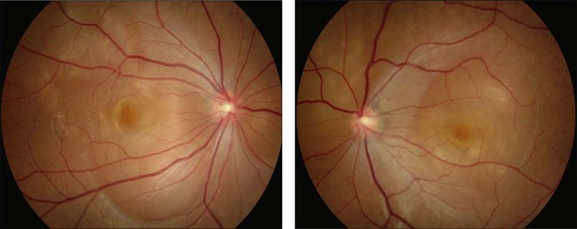
SO vs VKH
VKH: Bilateral multifocal serous RDs

Slide 255
Q
SO vs VKH
Stage | ‘Phase Phrase’ | Signs/Symptoms
Prodromal | ‘Meningo-encephalitic’ | Flu-like symptoms plus multiple and varied neurologic findings
Acute Uveitic | ‘Ophthalmic’ | The classic bilateral granulomatous panuveitis
Convalescent | ‘Depigmentation’ | Gradual depigmentation of the skin, hair, and choroid
Chronic/Recurrent |  | Occurs when VKH undertreated
(a couple of days)
(a couple of weeks)
What is the classic retinal manifestation at this stage?
Multifocal serous retinal detachments
Can these coalesce to form a substantial exudative retinal detachment?
Yes
Optic nerve edema--common, or uncommon in this phase?
Very common

Slide 256
A
SO vs VKH
Stage | ‘Phase Phrase’ | Signs/Symptoms
Prodromal | ‘Meningo-encephalitic’ | Flu-like symptoms plus multiple and varied neurologic findings
Acute Uveitic | ‘Ophthalmic’ | The classic bilateral granulomatous panuveitis
Convalescent | ‘Depigmentation’ | Gradual depigmentation of the skin, hair, and choroid
Chronic/Recurrent |  | Occurs when VKH undertreated
(a couple of days)
(a couple of weeks)
What is the classic retinal manifestation at this stage?
Multifocal serous retinal detachments
Can these coalesce to form a substantial exudative retinal detachment?
Yes
Optic nerve edema--common, or uncommon in this phase?
Very common

Slide 257
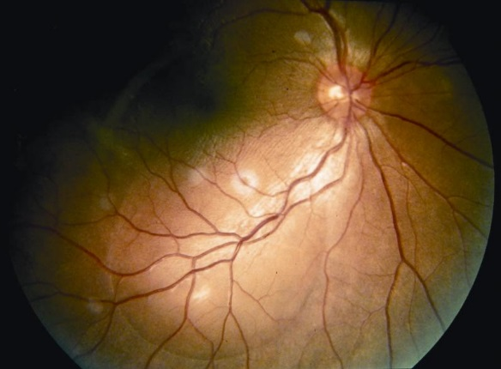
SO vs VKH
VKH: Big coalesced serous RDs

Slide 258
Q
SO vs VKH
Stage | ‘Phase Phrase’ | Signs/Symptoms
Prodromal | ‘Meningo-encephalitic’ | Flu-like symptoms plus multiple and varied neurologic findings
Acute Uveitic | ‘Ophthalmic’ | The classic bilateral granulomatous panuveitis
Convalescent | ‘Depigmentation’ | Gradual depigmentation of the skin, hair, and choroid
Chronic/Recurrent |  | Occurs when VKH undertreated
(a couple of days)
(a couple of weeks)
What is the classic retinal manifestation at this stage?
Multifocal serous retinal detachments
Can these coalesce to form a substantial exudative retinal detachment?
Yes
Optic nerve edema--common, or uncommon in this phase?
Very common

Slide 259
A
SO vs VKH
Stage | ‘Phase Phrase’ | Signs/Symptoms
Prodromal | ‘Meningo-encephalitic’ | Flu-like symptoms plus multiple and varied neurologic findings
Acute Uveitic | ‘Ophthalmic’ | The classic bilateral granulomatous panuveitis
Convalescent | ‘Depigmentation’ | Gradual depigmentation of the skin, hair, and choroid
Chronic/Recurrent |  | Occurs when VKH undertreated
(a couple of days)
(a couple of weeks)
What is the classic retinal manifestation at this stage?
Multifocal serous retinal detachments
Can these coalesce to form a substantial exudative retinal detachment?
Yes
Optic nerve edema--common, or uncommon in this phase?
Very common

Slide 260
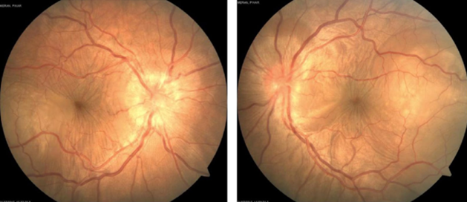
SO vs VKH
VKH: ONH edema

Slide 261
Q
SO vs VKH
Stage | ‘Phase Phrase’ | Signs/Symptoms
Prodromal | ‘Meningo-encephalitic’ | Flu-like symptoms plus multiple and varied neurologic findings
Acute Uveitic | ‘Ophthalmic’ | The classic bilateral granulomatous panuveitis
Convalescent | ‘Depigmentation’ | Gradual depigmentation of the skin, hair, and choroid
Chronic/Recurrent |  | Occurs when VKH undertreated
(a couple of days)
(a couple of weeks)
What is the classic retinal manifestation at this stage?
Multifocal serous retinal detachments
Can these coalesce to form a substantial exudative retinal detachment?
Yes
Optic nerve edema--common, or uncommon in this phase?
Very common
How does this appear on FA?
Early, as multiple scattered pinpoint leakages; late, as pooling within the serous-RD spaces

Slide 262
A
SO vs VKH
Stage | ‘Phase Phrase’ | Signs/Symptoms
Prodromal | ‘Meningo-encephalitic’ | Flu-like symptoms plus multiple and varied neurologic findings
Acute Uveitic | ‘Ophthalmic’ | The classic bilateral granulomatous panuveitis
Convalescent | ‘Depigmentation’ | Gradual depigmentation of the skin, hair, and choroid
Chronic/Recurrent |  | Occurs when VKH undertreated
(a couple of days)
(a couple of weeks)
What is the classic retinal manifestation at this stage?
Multifocal serous retinal detachments
Can these coalesce to form a substantial exudative retinal detachment?
Yes
Optic nerve edema--common, or uncommon in this phase?
Very common
How does this appear on FA?
Early, as multiple scattered pinpoint leakages; late, as pooling within the serous-RD spaces

Slide 263
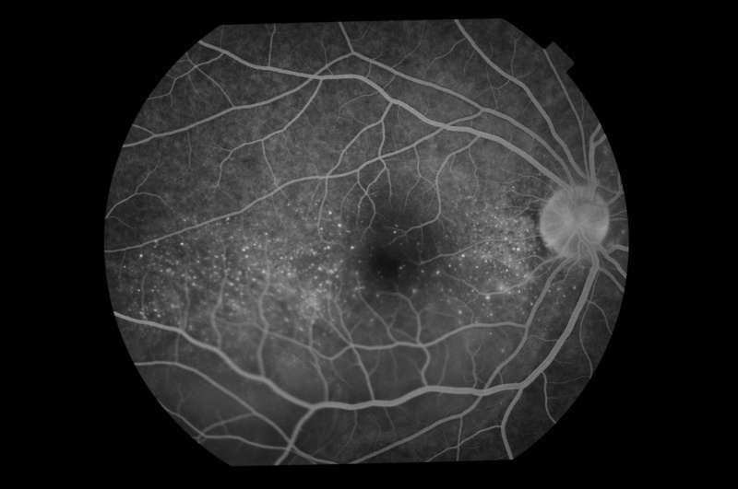
SO vs VKH
VKH FA: Pinpoint leakage (and serous RD pooling)

Slide 264
Q
SO vs VKH
Stage | ‘Phase Phrase’ | Signs/Symptoms
Prodromal | ‘Meningo-encephalitic’ | Flu-like symptoms plus multiple and varied neurologic findings
Acute Uveitic | ‘Ophthalmic’ | The classic bilateral granulomatous panuveitis
Convalescent | ‘Depigmentation’ | Gradual depigmentation of the skin, hair, and choroid
Chronic/Recurrent |  | Occurs when VKH undertreated
(a couple of days)
(a couple of weeks)
What is the classic retinal manifestation at this stage?
Multifocal serous retinal detachments
Can these coalesce to form a substantial exudative retinal detachment?
Yes
Optic nerve edema--common, or uncommon in this phase?
Very common
How does this appear on FA?
Early, as multiple scattered pinpoint leakages; late, as pooling within the serous-RD spaces
By what colorful monikers is this appearance known?
It is called ‘starry night sign’ or ‘Milky Way sign’

Slide 265
A
SO vs VKH
Stage | ‘Phase Phrase’ | Signs/Symptoms
Prodromal | ‘Meningo-encephalitic’ | Flu-like symptoms plus multiple and varied neurologic findings
Acute Uveitic | ‘Ophthalmic’ | The classic bilateral granulomatous panuveitis
Convalescent | ‘Depigmentation’ | Gradual depigmentation of the skin, hair, and choroid
Chronic/Recurrent |  | Occurs when VKH undertreated
(a couple of days)
(a couple of weeks)
What is the classic retinal manifestation at this stage?
Multifocal serous retinal detachments
Can these coalesce to form a substantial exudative retinal detachment?
Yes
Optic nerve edema--common, or uncommon in this phase?
Very common
How does this appear on FA?
Early, as multiple scattered pinpoint leakages; late, as pooling within the serous-RD spaces
By what colorful monikers is this appearance known?
It is called ‘starry night sign’ or ‘Milky Way sign’

Slide 266
Q
SO vs VKH
Stage | ‘Phase Phrase’ | Signs/Symptoms
Prodromal | ‘Meningo-encephalitic’ | Flu-like symptoms plus multiple and varied neurologic findings
Acute Uveitic | ‘Ophthalmic’ | The classic bilateral granulomatous panuveitis
Convalescent | ‘Depigmentation’ | Gradual depigmentation of the skin, hair, and choroid
Chronic/Recurrent |  | Occurs when VKH undertreated
(a couple of days)
(a couple of weeks)
What is the classic retinal manifestation at this stage?
Multifocal serous retinal detachments
Can these coalesce to form a substantial exudative retinal detachment?
Yes
Optic nerve edema--common, or uncommon in this phase?
Very common
How does this appear on FA?
Early, as multiple scattered pinpoint leakages; late, as pooling within the serous-RD spaces
Can SO present with multifocal serous RD and a ‘starry night’ FA?
Yes
By what colorful monikers is this appearance known?
It is called ‘starry night sign’ or ‘Milky Way sign’

Slide 267
A
SO vs VKH
Stage | ‘Phase Phrase’ | Signs/Symptoms
Prodromal | ‘Meningo-encephalitic’ | Flu-like symptoms plus multiple and varied neurologic findings
Acute Uveitic | ‘Ophthalmic’ | The classic bilateral granulomatous panuveitis
Convalescent | ‘Depigmentation’ | Gradual depigmentation of the skin, hair, and choroid
Chronic/Recurrent |  | Occurs when VKH undertreated
(a couple of days)
(a couple of weeks)
What is the classic retinal manifestation at this stage?
Multifocal serous retinal detachments
Can these coalesce to form a substantial exudative retinal detachment?
Yes
Optic nerve edema--common, or uncommon in this phase?
Very common
How does this appear on FA?
Early, as multiple scattered pinpoint leakages; late, as pooling within the serous-RD spaces
Can SO present with multifocal serous RD and a ‘starry night’ FA?
Yes
By what colorful monikers is this appearance known?
It is called ‘starry night sign’ or ‘Milky Way sign’

Slide 268
Q
SO vs VKH
Stage | ‘Phase Phrase’ | Signs/Symptoms
Prodromal | ‘Meningo-encephalitic’ | Flu-like symptoms plus multiple and varied neurologic findings
Acute Uveitic | ‘Ophthalmic’ | The classic bilateral granulomatous panuveitis
Convalescent | ‘Depigmentation’ | Gradual depigmentation of the skin, hair, and choroid
Chronic/Recurrent |  | Occurs when VKH undertreated
(a couple of days)
(a couple of weeks)
Depigmentation of the choroid leads to a characteristic orange-red color change of the posterior pole. What is the classic term used in describing this finding?
‘Sunset glow fundus’

Slide 269
A
‘Sunset glow’
SO vs VKH
Stage | ‘Phase Phrase’ | Signs/Symptoms
Prodromal | ‘Meningo-encephalitic’ | Flu-like symptoms plus multiple and varied neurologic findings
Acute Uveitic | ‘Ophthalmic’ | The classic bilateral granulomatous panuveitis
Convalescent | ‘Depigmentation’ | Gradual depigmentation of the skin, hair, and choroid
Chronic/Recurrent |  | Occurs when VKH undertreated
(a couple of days)
(a couple of weeks)
Depigmentation of the choroid leads to a characteristic orange-red color change of the posterior pole. What is the classic term used in describing this finding?
‘Sunset glow fundus’

Slide 270
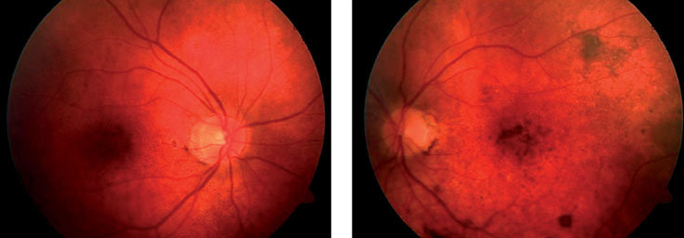
SO vs VKH
VKH: Sunset glow fundus

Slide 271
SO vs VKH
As should be apparent by now, VKH has three broad sorts of manifestations: Neurologic, Ocular and Integumentary (ie, skin and hair). These categories provide the basis for defining three “forms” of VKH.
Manifestation
Stage | ‘Phase Phrase’ | Signs/Symptoms
Prodromal | ‘Meningo-encephalitic’ | Flu-like symptoms plus multiple and varied neurologic findings
Acute Uveitic | ‘Ophthalmic’ | The classic bilateral granulomatous panuveitis
Convalescent | ‘Depigmentation’ | Gradual depigmentation of the skin, hair, and choroid
Chronic/Recurrent |  | Occurs when VKH undertreated
Neurologic
Eye
Integument

Slide 272
Q
SO vs VKH
As should be apparent by now, VKH has three broad sorts of manifestations: Neurologic, Ocular and Integumentary (ie, skin and hair). These categories provide the basis for defining three “forms” of VKH.
Manifestation
Stage | ‘Phase Phrase’ | Signs/Symptoms
Prodromal | ‘Meningo-encephalitic’ | Flu-like symptoms plus multiple and varied neurologic findings
Acute Uveitic | ‘Ophthalmic’ | The classic bilateral granulomatous panuveitis
Convalescent | ‘Depigmentation’ | Gradual depigmentation of the skin, hair, and choroid
Chronic/Recurrent |  | Occurs when VKH undertreated
Neurologic
Eye
Integument
If a pt presents with ocular signs/symptoms only, s/he has…Probable VKH

Slide 273
A
SO vs VKH
As should be apparent by now, VKH has three broad sorts of manifestations: Neurologic, Ocular and Integumentary (ie, skin and hair). These categories provide the basis for defining three “forms” of VKH.
Manifestation
Stage | ‘Phase Phrase’ | Signs/Symptoms
Prodromal | ‘Meningo-encephalitic’ | Flu-like symptoms plus multiple and varied neurologic findings
Acute Uveitic | ‘Ophthalmic’ | The classic bilateral granulomatous panuveitis
Convalescent | ‘Depigmentation’ | Gradual depigmentation of the skin, hair, and choroid
Chronic/Recurrent |  | Occurs when VKH undertreated
Neurologic
Eye
Integument
If a pt presents with ocular signs/symptoms only, s/he has…Probable VKH

Slide 274
Q
SO vs VKH
As should be apparent by now, VKH has three broad sorts of manifestations: Neurologic, Ocular and Integumentary (ie, skin and hair). These categories provide the basis for defining three “forms” of VKH.
Manifestation
Stage | ‘Phase Phrase’ | Signs/Symptoms
Prodromal | ‘Meningo-encephalitic’ | Flu-like symptoms plus multiple and varied neurologic findings
Acute Uveitic | ‘Ophthalmic’ | The classic bilateral granulomatous panuveitis
Convalescent | ‘Depigmentation’ | Gradual depigmentation of the skin, hair, and choroid
Chronic/Recurrent |  | Occurs when VKH undertreated
Neurologic
Eye
Integument
If a pt presents with ocular signs/symptoms only, s/he has…Probable VKH
If s/he presents with ocular plus neuro or skin/hair changes, s/he has…Incomplete VKH
(‘or’ here indicates ‘not both’)

Slide 275
A
SO vs VKH
As should be apparent by now, VKH has three broad sorts of manifestations: Neurologic, Ocular and Integumentary (ie, skin and hair). These categories provide the basis for defining three “forms” of VKH.
Manifestation
Stage | ‘Phase Phrase’ | Signs/Symptoms
Prodromal | ‘Meningo-encephalitic’ | Flu-like symptoms plus multiple and varied neurologic findings
Acute Uveitic | ‘Ophthalmic’ | The classic bilateral granulomatous panuveitis
Convalescent | ‘Depigmentation’ | Gradual depigmentation of the skin, hair, and choroid
Chronic/Recurrent |  | Occurs when VKH undertreated
Neurologic
Eye
Integument
If a pt presents with ocular signs/symptoms only, s/he has…Probable VKH
If s/he presents with ocular plus neuro or skin/hair changes, s/he has…Incomplete VKH

Slide 276
Q
SO vs VKH
As should be apparent by now, VKH has three broad sorts of manifestations: Neurologic, Ocular and Integumentary (ie, skin and hair). These categories provide the basis for defining three “forms” of VKH.
Manifestation
Stage | ‘Phase Phrase’ | Signs/Symptoms
Prodromal | ‘Meningo-encephalitic’ | Flu-like symptoms plus multiple and varied neurologic findings
Acute Uveitic | ‘Ophthalmic’ | The classic bilateral granulomatous panuveitis
Convalescent | ‘Depigmentation’ | Gradual depigmentation of the skin, hair, and choroid
Chronic/Recurrent |  | Occurs when VKH undertreated
Neurologic
Eye
Integument
If a pt presents with ocular signs/symptoms only, s/he has…Probable VKH
If s/he presents with ocular plus neuro or skin/hair changes, s/he has…Incomplete VKH
If s/he presents with all three, s/he has…Complete VKH

Slide 277
A
SO vs VKH
As should be apparent by now, VKH has three broad sorts of manifestations: Neurologic, Ocular and Integumentary (ie, skin and hair). These categories provide the basis for defining three “forms” of VKH.
Manifestation
Stage | ‘Phase Phrase’ | Signs/Symptoms
Prodromal | ‘Meningo-encephalitic’ | Flu-like symptoms plus multiple and varied neurologic findings
Acute Uveitic | ‘Ophthalmic’ | The classic bilateral granulomatous panuveitis
Convalescent | ‘Depigmentation’ | Gradual depigmentation of the skin, hair, and choroid
Chronic/Recurrent |  | Occurs when VKH undertreated
Neurologic
Eye
Integument
If a pt presents with ocular signs/symptoms only, s/he has…Probable VKH
If s/he presents with ocular plus neuro or skin/hair changes, s/he has…Incomplete VKH
If s/he presents with all three, s/he has…Complete VKH

Slide 278
Q
SO vs VKH
Stage | ‘Phase Phrase’ | Signs/Symptoms
Prodromal | ‘Meningo-encephalitic’ | Flu-like symptoms plus multiple and varied neurologic findings
Acute Uveitic | ‘Ophthalmic’ | The classic bilateral granulomatous panuveitis
Convalescent | ‘Depigmentation’ | Gradual depigmentation of the skin, hair, and choroid
? |  | ?
(a couple of days)
(a couple of weeks)
VKH can have a fourth phase. What is it, and why does it occur?

Slide 279
A
SO vs VKH
Stage | ‘Phase Phrase’ | Signs/Symptoms
Prodromal | ‘Meningo-encephalitic’ | Flu-like symptoms plus multiple and varied neurologic findings
Acute Uveitic | ‘Ophthalmic’ | The classic bilateral granulomatous panuveitis
Convalescent | ‘Depigmentation’ | Gradual depigmentation of the skin, hair, and choroid
Chronic Recurrent |  | Occurs when VKH is undertreated
(a couple of days)
(a couple of weeks)
VKH can have a fourth phase. What is it, and why does it occur?

Slide 280
Q
SO vs VKH
Stage | ‘Phase Phrase’ | Signs/Symptoms
Prodromal | ‘Meningo-encephalitic’ | Flu-like symptoms plus multiple and varied neurologic findings
Acute Uveitic | ‘Ophthalmic’ | The classic bilateral granulomatous panuveitis
Convalescent | ‘Depigmentation’ | Gradual depigmentation of the skin, hair, and choroid
Chronic Recurrent |  | ?
(a couple of days)
(a couple of weeks)
VKH can have a fourth phase. What is it, and why does it occur?
What specific signs/symptoms characterize this stage?

Slide 281
A
SO vs VKH
Stage | ‘Phase Phrase’ | Signs/Symptoms
Prodromal | ‘Meningo-encephalitic’ | Flu-like symptoms plus multiple and varied neurologic findings
Acute Uveitic | ‘Ophthalmic’ | The classic bilateral granulomatous panuveitis
Convalescent | ‘Depigmentation’ | Gradual depigmentation of the skin, hair, and choroid
Chronic Recurrent |  | Episodes of granulomatous anterior uveitis
(a couple of days)
(a couple of weeks)
VKH can have a fourth phase. What is it, and why does it occur?
What specific signs/symptoms characterize this stage?

