Slide 1
Refractive Surgery Overview
The goal of refractive surgery is deceptively straightforward and simple: To render the pt less reliant upon refractive accoutrements (ie, contacts and glasses). Ideally, a pt s/p refractive surgery would have 20/20 vision at all distances, under any lighting conditions, with no dysphotopsias (visual experiences that degrade vision quality), and with no risk of future negative repercussions vis a vis the long-term health and/or optical performance of the eye. Also ideally, the above could be achieved irrespective of pre-op refractive status and/or pre-existing ocular conditions.
Current technology is unable to meet this lofty ideal, and thus refractive surgery necessitates compromises and trade-offs; eg, If you had to pick one, would you rather be spectacle-free at distance, or near? Would it be acceptable if you only needed glasses in dimly-lit restaurants? How bothersome would haloes around lights at night be? Because some aspect of the pt’s post-op visual life will be less than ideal, key to successful refractive surgery is 1) developing a solid understanding of the pt’s visual preferences and requirements, and 2) communicating effectively with the pt regarding what her post-op visual life will be; ie, establishing expectations that are realistic and achievable. Further, the surgeon must have a refined eye (ahem) for recognizing pre-existing ocular conditions that render the pt a poor surgical candidate (or increase the risk of complications down the road).
Just as the goal of refractive surgery is simple, so too is its organization. Broadly speaking, there are but two types of surgery: Corneal and intraocular. Corneal (aka keratorefractive) procedures work by reshaping the cornea to offset the native refractive error of the eye; there are a plethora of techniques and technologies for doing this. In contrast, intraocular procedures are more limited in their variety: They involve either replacing the native lens with an IOL, or placing in the anterior chamber an accessory IOL that offsets the eye’s native refractive error.

Slide 2
Refractive Surgery Overview
The goal of refractive surgery is deceptively straightforward and simple: To render the pt less reliant upon refractive accoutrements (ie, contacts and glasses). Ideally, a pt s/p refractive surgery would have 20/20 vision at all distances, under any lighting conditions, with no dysphotopsias (visual experiences that degrade vision quality), and with no risk of future negative repercussions vis a vis the long-term health and/or optical performance of the eye. Also ideally, the above could be achieved irrespective of pre-op refractive status and/or pre-existing ocular conditions.
Current technology is unable to meet this lofty ideal, and thus refractive surgery necessitates compromises and trade-offs; eg, If you had to pick one, would you rather be spectacle-free at distance, or near? Would it be acceptable if you only needed glasses in dimly-lit restaurants? How bothersome would haloes around lights at night be? Because some aspect of the pt’s post-op visual life will be less than ideal, key to successful refractive surgery is 1) developing a solid understanding of the pt’s visual preferences and requirements, and 2) communicating effectively with the pt regarding what her post-op visual life will be; ie, establishing expectations that are realistic and achievable. Further, the surgeon must have a refined eye (ahem) for recognizing pre-existing ocular conditions that render the pt a poor surgical candidate (or increase the risk of complications down the road).
Just as the goal of refractive surgery is simple, so too is its organization. Broadly speaking, there are but two types of surgery: Corneal and intraocular. Corneal (aka keratorefractive) procedures work by reshaping the cornea to offset the native refractive error of the eye; there are a plethora of techniques and technologies for doing this. In contrast, intraocular procedures are more limited in their variety: They involve either replacing the native lens with an IOL, or placing in the anterior chamber an accessory IOL that offsets the eye’s native refractive error.

Slide 3
Refractive Surgery Overview
The goal of refractive surgery is deceptively straightforward and simple: To render the pt less reliant upon refractive accoutrements (ie, contacts and glasses). Ideally, a pt s/p refractive surgery would have 20/20 vision at all distances, under any lighting conditions, with no dysphotopsias (visual experiences that degrade vision quality), and with no risk of future negative repercussions vis a vis the long-term health and/or optical performance of the eye. Also ideally, the above could be achieved irrespective of pre-op refractive status and/or pre-existing ocular conditions.
Current technology is unable to meet this lofty ideal, and thus refractive surgery necessitates compromises and trade-offs; eg, If you had to pick one, would you rather be spectacle-free at distance, or near? Would it be acceptable if you only needed glasses in dimly-lit restaurants? How bothersome would haloes around lights at night be? Because some aspect of the pt’s post-op visual life will be less than ideal, key to successful refractive surgery is 1) developing a solid understanding of the pt’s visual preferences and requirements, and 2) communicating effectively with the pt regarding what her post-op visual life will be; ie, establishing expectations that are realistic and achievable. Further, the surgeon must have a refined eye (ahem) for recognizing pre-existing ocular conditions that render the pt a poor surgical candidate (or increase the risk of complications down the road).
Just as the goal of refractive surgery is simple, so too is its organization. Broadly speaking, there are but two types of surgery: Corneal and intraocular. Corneal (aka keratorefractive) procedures work by reshaping the cornea to offset the native refractive error of the eye; there are a plethora of techniques and technologies for doing this. In contrast, intraocular procedures are more limited in their variety: They involve either replacing the native lens with an IOL, or placing in the anterior chamber an accessory IOL that offsets the eye’s native refractive error.

Slide 4
Refractive Surgery Overview
The goal of refractive surgery is deceptively straightforward and simple: To render the pt less reliant upon refractive accoutrements (ie, contacts and glasses). Ideally, a pt s/p refractive surgery would have 20/20 vision at all distances, under any lighting conditions, with no dysphotopsias (visual experiences that degrade vision quality), and with no risk of future negative repercussions vis a vis the long-term health and/or optical performance of the eye. Also ideally, the above could be achieved irrespective of pre-op refractive status and/or pre-existing ocular conditions.
Current technology is unable to meet this lofty ideal, and thus refractive surgery necessitates compromises and trade-offs; eg, If you had to pick one, would you rather be spectacle-free at distance, or near? Would it be acceptable if you only needed glasses in dimly-lit restaurants? How bothersome would haloes around lights at night be? Because some aspect of the pt’s post-op visual life will be less than ideal, key to successful refractive surgery is 1) developing a solid understanding of the pt’s visual preferences and requirements, and 2) communicating effectively with the pt regarding what her post-op visual life will be; ie, establishing expectations that are realistic and achievable. Further, the surgeon must have a refined eye (ahem) for recognizing pre-existing ocular conditions that render the pt a poor surgical candidate (or increase the risk of complications down the road).
Just as the goal of refractive surgery is simple, so too is its organization. Broadly speaking, there are but two types of surgery: Corneal and intraocular. Corneal (aka keratorefractive) procedures work by reshaping the cornea to offset the native refractive error of the eye; there are a plethora of techniques and technologies for doing this. In contrast, intraocular procedures are more limited in their variety: They involve either replacing the native lens with an IOL, or placing in the anterior chamber an accessory IOL that offsets the eye’s native refractive error.

Slide 5
Refractive Surgery Overview
The goal of refractive surgery is deceptively straightforward and simple: To render the pt less reliant upon refractive accoutrements (ie, contacts and glasses). Ideally, a pt s/p refractive surgery would have 20/20 vision at all distances, under any lighting conditions, with no dysphotopsias (visual experiences that degrade vision quality), and with no risk of future negative repercussions vis a vis the long-term health and/or optical performance of the eye. Also ideally, the above could be achieved irrespective of pre-op refractive status and/or pre-existing ocular conditions.
Current technology is unable to meet this lofty ideal, and thus refractive surgery necessitates compromises and trade-offs; eg, If you had to pick one, would you rather be spectacle-free at distance, or near? Would it be acceptable if you only needed glasses in dimly-lit restaurants? How bothersome would haloes around lights at night be? Because some aspect of the pt’s post-op visual life will be less than ideal, key to successful refractive surgery is 1) developing a solid understanding of the pt’s visual preferences and requirements, and 2) communicating effectively with the pt regarding what her post-op visual life will be; ie, establishing expectations that are realistic and achievable. Further, the surgeon must have a refined eye (ahem) for recognizing pre-existing ocular conditions that render the pt a poor surgical candidate (or increase the risk of complications down the road).
Just as the goal of refractive surgery is simple, so too is its organization. Broadly speaking, there are but two types of surgery: Corneal and intraocular. Corneal (aka keratorefractive) procedures work by reshaping the cornea to offset the native refractive error of the eye; there are a plethora of techniques and technologies for doing this. In contrast, intraocular procedures are more limited in their variety: They involve either replacing the native lens with an IOL, or placing in the anterior chamber an accessory IOL that offsets the eye’s native refractive error.

Slide 6
Refractive Surgery Overview
The goal of refractive surgery is deceptively straightforward and simple: To render the pt less reliant upon refractive accoutrements (ie, contacts and glasses). Ideally, a pt s/p refractive surgery would have 20/20 vision at all distances, under any lighting conditions, with no dysphotopsias (visual experiences that degrade vision quality), and with no risk of future negative repercussions vis a vis the long-term health and/or optical performance of the eye. Also ideally, the above could be achieved irrespective of pre-op refractive status and/or pre-existing ocular conditions.
Current technology is unable to meet this lofty ideal, and thus refractive surgery necessitates compromises and trade-offs; eg, If you had to pick one, would you rather be spectacle-free at distance, or near? Would it be acceptable if you only needed glasses in dimly-lit restaurants? How bothersome would haloes around lights at night be? Because some aspect of the pt’s post-op visual life will be less than ideal, key to successful refractive surgery is 1) developing a solid understanding of the pt’s visual preferences and requirements, and 2) communicating effectively with the pt regarding what her post-op visual life will be; ie, establishing expectations that are realistic and achievable. Further, the surgeon must have a refined eye (ahem) for recognizing pre-existing ocular conditions that render the pt a poor surgical candidate (or increase the risk of complications down the road).
Just as the goal of refractive surgery is simple, so too is its organization. Broadly speaking, there are but two types of surgery: Corneal and intraocular. Corneal (aka keratorefractive) procedures work by reshaping the cornea to offset the native refractive error of the eye; there are a plethora of techniques and technologies for doing this. In contrast, intraocular procedures are more limited in their variety: They involve either replacing the native lens with an IOL, or placing in the anterior chamber an accessory IOL that offsets the eye’s native refractive error.

Slide 7
Refractive Surgery Overview
The goal of refractive surgery is deceptively straightforward and simple: To render the pt less reliant upon refractive accoutrements (ie, contacts and glasses). Ideally, a pt s/p refractive surgery would have 20/20 vision at all distances, under any lighting conditions, with no dysphotopsias (visual experiences that degrade vision quality), and with no risk of future negative repercussions vis a vis the long-term health and/or optical performance of the eye. Also ideally, the above could be achieved irrespective of pre-op refractive status and/or pre-existing ocular conditions.
Current technology is unable to meet this lofty ideal, and thus refractive surgery necessitates compromises and trade-offs; eg, If you had to pick one, would you rather be spectacle-free at distance, or near? Would it be acceptable if you only needed glasses in dimly-lit restaurants? How bothersome would haloes around lights at night be? Because some aspect of the pt’s post-op visual life will be less than ideal, key to successful refractive surgery is 1) developing a solid understanding of the pt’s visual preferences and requirements, and 2) communicating effectively with the pt regarding what her post-op visual life will be; ie, establishing expectations that are realistic and achievable. Further, the surgeon must have a refined eye (ahem) for recognizing pre-existing ocular conditions that render the pt a poor surgical candidate (or increase the risk of complications down the road).
Just as the goal of refractive surgery is simple, so too is its organization. Broadly speaking, there are but two types of surgery: Corneal and intraocular. Corneal (aka keratorefractive) procedures work by reshaping the cornea to offset the native refractive error of the eye; there are a plethora of techniques and technologies for doing this. In contrast, intraocular procedures are more limited in their variety: They involve either replacing the native lens with an IOL, or placing in the anterior chamber an accessory IOL that offsets the eye’s native refractive error.
Let’s start with a brief review of refractive error

Slide 8
Refractive Surgery Overview
The refractive state of an eye—that is, whether it is emmetropic , myopic or hyperopic—is determined by the location of its far point
two words

Slide 9
Refractive Surgery Overview
The refractive state of an eye—that is, whether it is emmetropic , myopic or hyperopic—is determined by the location of its far point

Slide 10
Refractive Surgery Overview
The refractive state of an eye—that is, whether it is emmetropic , myopic or hyperopic—is determined by the location of its far point
The far point is: The location in space conjugate to the retina when the eye is not accommodating

Slide 11
Refractive Surgery Overview
The refractive state of an eye—that is, whether it is emmetropic , myopic or hyperopic—is determined by the location of its far point
The far point is: The location in space conjugate to the retina when the eye is not accommodating
(Accommodation refers to conformational changes in the ciliary body/lens to facilitate vision at near.)

Slide 12
Refractive Surgery Overview
The refractive state of an eye—that is, whether it is emmetropic , myopic or hyperopic—is determined by the location of its far point
The far point is: The location in space conjugate to the retina when the eye is not accommodating
(Accommodation refers to conformational changes in the ciliary body/lens to facilitate vision at near.)
Far Point for this eye

Slide 13
Refractive Surgery Overview
(The Far Point of)
The Emmetropic Eye

Slide 14
Refractive Surgery Overview
(The Far Point of)
The Emmetropic Eye
Parallel rays from infinity
In the emmetropic eye, the parallel rays from a location at infinity are focused
to a point located precisely on the retina.

Slide 15
Refractive Surgery Overview
(The Far Point of)
The Emmetropic Eye
Parallel rays from infinity
In the emmetropic eye, the parallel rays from a location at infinity are focused
to a point located precisely on the retina. In other words, the far point of the
emmetropic eye is at infinity.
Far Point of the emmetropic eye: Infinity

Slide 16
Refractive Surgery Overview
(The Far Point of)
The Emmetropic Eye
Parallel rays from infinity
In the emmetropic eye, the parallel rays from a location at infinity are focused
to a point located precisely on the retina. In other words, the far point of the
emmetropic eye is at infinity. Thus, emmetropes see 20/20 (or better) at distance without correction.
Far Point of the emmetropic eye: Infinity

Slide 17
Refractive Surgery Overview
(The Far Point of)
The Myopic Eye
Parallel rays from infinity
In contrast to the sharp uncorrected distance vision of the emmetrope, consider the
plight of the myope.

Slide 18
Refractive Surgery Overview
(The Far Point of)
The Myopic Eye
?
?
?
?
Parallel rays from infinity
?
In contrast to the sharp uncorrected distance vision of the emmetrope, consider the
plight of the myope.
In the myopic eye, rays from infinity meet in the vitreous .
three words

Slide 19
Refractive Surgery Overview
(The Far Point of)
The Myopic Eye
Parallel rays from infinity
In contrast to the sharp uncorrected distance vision of the emmetrope, consider the
plight of the myope.
In the myopic eye, rays from infinity meet in the vitreous .

Slide 20
Refractive Surgery Overview
(The Far Point of)
The Myopic Eye
Parallel rays from infinity
In contrast to the sharp uncorrected distance vision of the emmetrope, consider the
plight of the myope.
In the myopic eye, rays from infinity meet in the vitreous . By the time they reach the retina, the rays have diverged to form a blur circle , not a focal point.
two words

Slide 21
Refractive Surgery Overview
(The Far Point of)
The Myopic Eye
Parallel rays from infinity
In contrast to the sharp uncorrected distance vision of the emmetrope, consider the
plight of the myope.
In the myopic eye, rays from infinity meet in the vitreous . By the time they reach the retina, the rays have diverged to form a blur circle , not a focal point.

Slide 22
Refractive Surgery Overview
(The Far Point of)
The Myopic Eye
The myopic eye has too much
converging power for its length
much v little
Parallel rays from infinity
In contrast to the sharp uncorrected distance vision of the emmetrope, consider the
plight of the myope.
In the myopic eye, rays from infinity meet in the vitreous . By the time they reach the retina, the rays have diverged to form a blur circle , not a focal point.
You could say the myopic eye has too much converging power for its length.
much v little

Slide 23
Refractive Surgery Overview
(The Far Point of)
The Myopic Eye
The myopic eye has too much
converging power for its length
Parallel rays from infinity
In contrast to the sharp uncorrected distance vision of the emmetrope, consider the
plight of the myope.
In the myopic eye, rays from infinity meet in the vitreous . By the time they reach the retina, the rays have diverged to form a blur circle , not a focal point.
You could say the myopic eye has too much converging power for its length.

Slide 24
Refractive Surgery Overview
(The Far Point of)
The Myopic Eye
The myopic eye has too much
converging power for its length
Parallel rays from infinity
Note that if the retina was here, the rays from infinity would be focused to a point.
In contrast to the sharp uncorrected distance vision of the emmetrope, consider the
plight of the myope.
In the myopic eye, rays from infinity meet in the vitreous . By the time they reach the retina, the rays have diverged to form a blur circle , not a focal point.
You could say the myopic eye has too much converging power for its length.

Slide 25
Refractive Surgery Overview
(The Far Point of)
The Myopic Eye
The myopic eye has too much
converging power for its length
Parallel rays from infinity
Far
Point?
In contrast to the sharp uncorrected distance vision of the emmetrope, consider the
plight of the myope.
In the myopic eye, rays from infinity meet in the vitreous . By the time they reach the retina, the rays have diverged to form a blur circle , not a focal point.
You could say the myopic eye has too much converging power for its length.
To be focused on the retina, the Far Point of a myopic eye will have to offset its excess convergence with an equivalent amount of divergence. To accomplish this…

Slide 26
Refractive Surgery Overview
(The Far Point of)
The Myopic Eye
The myopic eye has too much
converging power for its length
Far
Point
Diverging light
Distance << Infinity (<20 feet)
…the Far Point of a myopic eye is just anterior to the corneal plane.

Slide 27
Refractive Surgery Overview
(The Far Point of)
The Myopic Eye
The myopic eye has too much
converging power for its length
Far
Point
Diverging light
Distance << Infinity (<20 feet)
…the Far Point of a myopic eye is just anterior to the corneal plane. Rays from
this location are still quite divergent when they reach the eye, and this divergence offsets the excess convergence that is built into the myopic eye. Thus, rays originating from the far point end up sharply focused at the retina.

Slide 28
Refractive Surgery Overview
(The Far Point of)
The Myopic Eye
The myopic eye has too much
converging power for its length
Far
Point
Diverging light
Distance << Infinity (<20 feet)
…the Far Point of a myopic eye is just anterior to the corneal plane. Rays from
this location are still quite divergent when they reach the eye, and this divergence offsets the excess convergence that is built into the myopic eye. Thus, rays originating from the far point end up sharply focused at the retina. This is why nearsighted individuals can read without glasses—they’re able to put the material at or near their far point.

Slide 29
Refractive Surgery Overview
(The Far Point of)
The Hyperopic Eye
?
Parallel rays from infinity (vergence = 0)
?
?
?
Parallel rays from infinity
?
Now consider the hyperope. Where do parallel rays meet in these eyes?

Slide 30
Refractive Surgery Overview
The Hyperopic Eye
Parallel rays from infinity (vergence = 0)
This is where the rays would meet if they hadn’t run into the retina.
Parallel rays from infinity
Now consider the hyperope. Where do parallel rays meet in these eyes?
In the hyperopic eye, rays from infinity never meet—they run out of eyeball first.
Thus, like the myopic eye, the rays form a blur circle, not a focal point, at the retina.

Slide 31
Refractive Surgery Overview
(The Far Point of)
The Hyperopic Eye
much v little
The hyperopic eye has too little
converging power for its length
Parallel rays from infinity (vergence = 0)
Parallel rays from infinity
Now consider the hyperope. Where do parallel rays meet in these eyes?
In the hyperopic eye, rays from infinity never meet—they run out of eyeball first.
Thus, like the myopic eye, the rays form a blur circle, not a focal point, at the retina.
You could say the hyperopic eye has too little converging power for its length.
much v little

Slide 32
Refractive Surgery Overview
(The Far Point of)
The Hyperopic Eye
The hyperopic eye has too little
converging power for its length
Parallel rays from infinity (vergence = 0)
Parallel rays from infinity
Now consider the hyperope. Where do parallel rays meet in these eyes?
In the hyperopic eye, rays from infinity never meet—they run out of eyeball first.
Thus, like the myopic eye, the rays form a blur circle, not a focal point, at the retina.
You could say the hyperopic eye has too little converging power for its length.

Slide 33
Refractive Surgery Overview
(The Far Point of)
The Hyperopic Eye
The hyperopic eye has too little
converging power for its length
Parallel rays from infinity (vergence = 0)
Parallel rays from infinity
Now consider the hyperope. Where do parallel rays meet in these eyes?
In the hyperopic eye, rays from infinity never meet—they run out of eyeball first.
Thus, like the myopic eye, the rays form a blur circle, not a focal point, at the retina.
You could say the hyperopic eye has too little converging power for its length.
Note that if the retina was here, the rays from infinity would be focused to a point.

Slide 34
Refractive Surgery Overview
(The Far Point of)
The Hyperopic Eye
The hyperopic eye has too little
converging power for its length
Parallel rays from infinity (vergence = 0)
Parallel rays from infinity
Far
Point?
Now consider the hyperope. Where do parallel rays meet in these eyes?
In the hyperopic eye, rays from infinity never meet—they run out of eyeball first.
Thus, like the myopic eye, the rays form a blur circle, not a focal point, at the retina.
You could say the hyperopic eye has too little converging power for its length.
In order to be conjugate to the retina, the Far Point of a hyperopic eye must
contribute convergence to compensate for this lack of converging power.
To accomplish this…

Slide 35
Refractive Surgery Overview
(The Far Point of)
The Hyperopic Eye
The hyperopic eye has too little
converging power for its length
Far
Point
Converging light
A and B are conjugate points
…the far point of a hyperopic eye is behind the corneal plane.

Slide 36
Refractive Surgery Overview
(The Far Point of)
The Hyperopic Eye
The hyperopic eye has too little
converging power for its length
Far
Point
Converging light
A and B are conjugate points
…the far point of a hyperopic eye is behind the corneal plane. It contributes
convergence to make up for the inadequate native convergence of the hyperopic
eye.

Slide 37
Refractive Surgery Overview
(The Far Point of)
The Hyperopic Eye
The hyperopic eye has too little
converging power for its length
Far
Point
Converging light
A and B are conjugate points
…the far point of a hyperopic eye is behind the corneal plane. It contributes
convergence to make up for the inadequate native convergence of the hyperopic
eye. Thus, rays associated with the far point end up sharply focused at the retina.

Slide 38
Refractive Surgery Overview
(The Far Point of)
The Hyperopic Eye
The hyperopic eye has too little
converging power for its length
Far
Point
Converging light
A and B are conjugate points
…the far point of a hyperopic eye is behind the corneal plane. It contributes
convergence to make up for the inadequate native convergence of the hyperopic
eye. Thus, rays associated with the far point end up sharply focused at the retina.
Don’t get it twisted—hyperopes can’t actually see behind their heads. (Do I really have to say that?)

Slide 39
Refractive Surgery Overview
(The Far Point of)
The Hyperopic Eye
The hyperopic eye has too little
converging power for its length
Far
Point
Converging light
A and B are conjugate points
…the far point of a hyperopic eye is behind the corneal plane. It contributes
convergence to make up for the inadequate native convergence of the hyperopic
eye. Thus, rays associated with the far point end up sharply focused at the retina.
Don’t get it twisted—hyperopes can’t actually see behind their heads. (Do I really have to say that?) Unlike myopes—who can see at their far point just out in front of their faces—a hyperope is out of focus at all distances (absent correction or accommodation.)

Slide 40
Refractive Surgery Overview
The myopic eye has too much converging power for its length, as we said
Myopic Eye

Slide 41
Refractive Surgery Overview
The myopic eye has too much converging power for its length, as we said
Myopic Eye

Slide 42
Refractive Surgery Overview
The myopic eye has too much converging power for its length, as we said
Plus error lens
Myopic Eye
Think of it this way: The myopic eye refracts light as if an extra ‘plus’ lens was built into it.
This so-called error lens contributes the excess convergence that produces a myopic
refractive error.

Slide 43
Refractive Surgery Overview
The myopic eye has too much converging power for its length, as we said
Minus corrective lens
This explains why myopes wear
minus lenses to correct their
refractive error—minus lenses
are needed to offset the excess
convergence induced by the plus
error lenses in their eyes.
Plus error lens
Myopic Eye
Think of it this way: The myopic eye refracts light as if an extra ‘plus’ lens was built into it.
This so-called error lens contributes the excess convergence that produces a myopic
refractive error.

Slide 44
Refractive Surgery Overview
The myopic eye has too much converging power for its length, as we said
In contrast, the hyperopic eye has too much diverging power for its length
Hyperopic Eye

Slide 45
Refractive Surgery Overview
The myopic eye has too much converging power for its length, as we said
In contrast, the hyperopic eye has too much diverging power for its length
Hyperopic Eye

Slide 46
Refractive Surgery Overview
The myopic eye has too much converging power for its length, as we said
In contrast, the hyperopic eye has too much diverging power for its length
Minus error lens
Hyperopic Eye
Thus, the hyperopic eye acts as if it has a minus error lens within it, contributing the
excess divergence resulting in a hyperopic refractive error.

Slide 47
Refractive Surgery Overview
The myopic eye has too much converging power for its length, as we said
In contrast, the hyperopic eye has too much diverging power for its length
This explains why hyperopes
wear plus lenses to correct their
refractive error—plus lenses are
needed to offset the excess
divergence induced by the minus
error lenses in their eyes.
Plus corrective lens
Minus error lens
Hyperopic Eye
Thus, the hyperopic eye acts as if it has a minus error lens within it, contributing the
excess divergence resulting in a hyperopic refractive error.

Slide 48
Refractive Surgery Overview
The goal of refractive surgery is to produce an error-lens offset that is incorporated into the eye itself, rather than worn on (CLs) or near (glasses) its anterior surface
Plus error lens
Myopic Eye
Minus error lens
Hyperopic Eye

Slide 49
Refractive Surgery Overview
Refractive
Surgery
Two
basic
types of RS
?
?
As mentioned previously, refractive surgical procedures come in two basic forms—intraocular and corneal.

Slide 50
Refractive Surgery Overview
Refractive
Surgery
Two
basic
types of RS
Intraocular
Corneal
As mentioned previously, refractive surgical procedures come in two basic forms—intraocular and corneal.

Slide 51
Refractive Surgery Overview
Refractive
Surgery
Intraocular
Corneal
Two
types of
intraocular RS
?
?
Likewise, intraocular procedures come in two forms—pseudophakic , and phakic IOL (PIOL).

Slide 52
Refractive Surgery Overview
Refractive
Surgery
Intraocular
Corneal
Two
types of
intraocular RS
Pseudophakic
Phakic IOL
Likewise, intraocular procedures come in two forms—pseudophakic , and phakic IOL (PIOL)

Slide 53
Refractive Surgery Overview
Refractive
Surgery
Intraocular
Corneal
Pseudophakic
Phakic IOL
A pseudophakic procedure involves removing the native lens and replacing it with an IOL powered to put parallel rays on the retina. The surgery itself is identical to that performed for cataracts. (Such procedures are referred to as clear lens extraction .)
three words
Plus error lens
Myopic Eye
Minus error lens
Hyperopic Eye

Slide 54
Refractive Surgery Overview
Refractive
Surgery
Intraocular
Corneal
Pseudophakic
Phakic IOL
A pseudophakic procedure involves removing the native lens and replacing it with an IOL powered to put parallel rays on the retina. The surgery itself is identical to that performed for cataracts. (Such procedures are referred to as clear lens extraction .)
Plus error lens
Myopic Eye
Minus error lens
Hyperopic Eye

Slide 55
Refractive Surgery Overview
Refractive
Surgery
Intraocular
Corneal
Pseudophakic
Phakic IOL
In a phakic IOL procedure the native lens is left in place, and a corrective lens is placed in front of it—an ‘intraocular contact lens’ if you will.
Minus corrective implant
Plus corrective implant
Plus error lens
Myopic Eye
Minus error lens
Hyperopic Eye

Slide 56
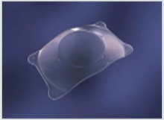
Refractive Surgery Overview
Phakic IOL

Slide 57
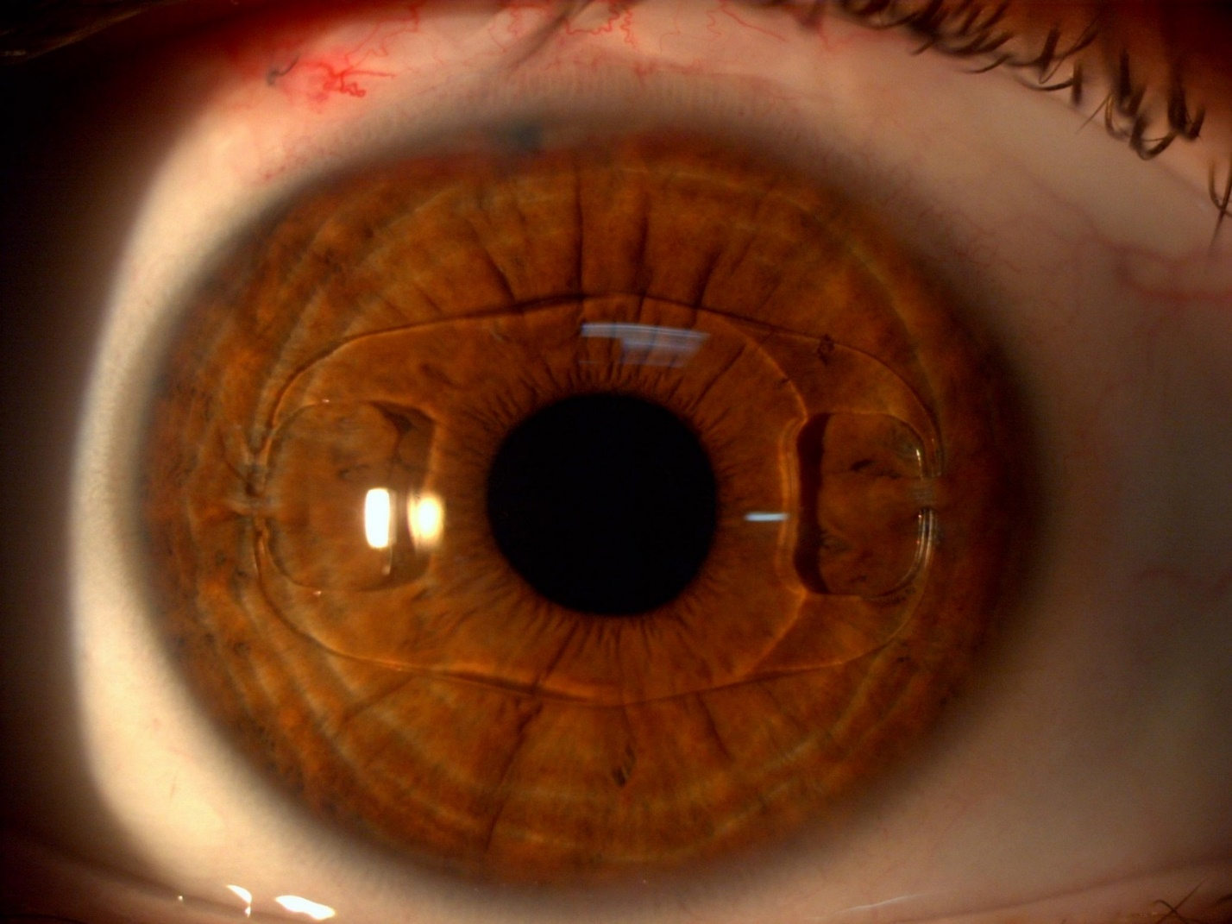
Refractive Surgery Overview
Phakic IOL

Slide 58
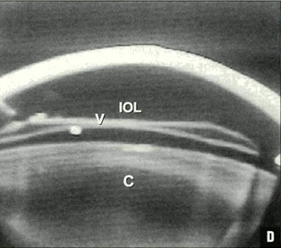
Refractive Surgery Overview
Phakic IOL vaulting over the native lens

Slide 59
Refractive Surgery Overview
Refractive
Surgery
Intraocular
Corneal
Pseudophakic
Phakic IOL
Before we get into cornea-based refractive surgeries, let’s take a look at corneal optics

Slide 60
Refractive Surgery Overview
The shape of the human cornea is prolate, meaning the central portion is steeper (ie, has a shorter radius of curvature) than the peripheral portion. On average, the central cornea is about 3-4D steeper than the periphery.
central vs peripheral
central vs peripheral

Slide 61
Refractive Surgery Overview
The shape of the human cornea is prolate, meaning the central portion is steeper (ie, has a shorter radius of curvature) than the peripheral portion. On average, the central cornea is about 3-4D steeper than the periphery.

Slide 62
Refractive Surgery Overview
The shape of the human cornea is prolate, meaning the central portion is steeper (ie, has a shorter radius of curvature) than the peripheral portion. On average, the central cornea is about 3-4D steeper than the periphery.

Slide 63
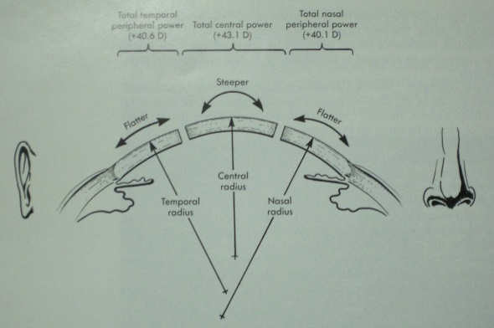
Refractive Surgery Overview
Power differential of central vs peripheral cornea (don’t memorize the numbers)

Slide 64
Refractive Surgery Overview
The anterior corneal surface adds about 49D of convergence to incoming light (note how the air-cornea interface looks like a ‘plus’ lens)
Light rays
?

Slide 65
Refractive Surgery Overview
The anterior corneal surface adds about 49D of convergence to incoming light (note how the air-cornea interface looks like a ‘plus’ lens)
Light rays
+49D

Slide 66
Refractive Surgery Overview
However, the posterior corneal surface adds about 6D of divergence as light passes through it into the AC (note how the cornea-aqueous interface looks like a minus lens)
Light rays
?

Slide 67
Refractive Surgery Overview
However, the posterior corneal surface adds about 6D of divergence as light passes through it into the AC (note how the cornea-aqueous interface looks like a minus lens)
Light rays
-6D

Slide 68
Refractive Surgery Overview
Light rays
+49D
-6D
+43D
The net result across the cornea is an overall power of about +43D

Slide 69
Refractive Surgery Overview
The human eye averages about 60D of total convergence, implying (correctly) that the cornea accounts for roughly 2/3 of its focusing power
Light rays
+49D
-6D
+43D
The net result across the cornea is an overall power of about +43D

Slide 70
Refractive Surgery Overview
The human eye averages about 60D of total convergence, implying (correctly) that the cornea accounts for roughly 2/3 of its focusing power
Light rays
+49D
-6D
+43D
The net result across the cornea is an overall power of about +43D

Slide 71
Refractive Surgery Overview
The human eye averages about 60D of total convergence, implying (correctly) that the cornea accounts for roughly 2/3 of its focusing power
Light rays
Of course, these are only averages. In order to perform keratorefractive surgery, one must have accurate measurements of central corneal power—ideally, at both its anterior and posterior surfaces.
+49D
-6D
+43D
The net result across the cornea is an overall power of about +43D

Slide 72
Refractive Surgery Overview
Two technologies are widely employed to determine central corneal power: Corneal topography , and corneal tomography
+D?
-D?
+D?

Slide 73
Refractive Surgery Overview
Two technologies are widely employed to determine central corneal power: Corneal topography , and corneal tomography
+D?
-D?
+D?

Slide 74
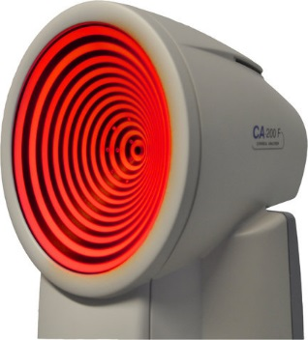
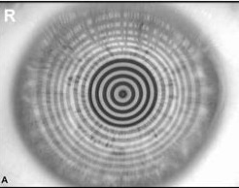
Refractive Surgery Overview
Corneal topography works by reflecting a set of concentric rings (collectively called a Placido disk ) from the anterior corneal surface, and a computer analyzes the distances between, and shapes of, the reflected rings.
two words

Slide 75
Refractive Surgery Overview
Corneal topography works by reflecting a set of concentric rings (collectively called a Placido disk ) from the anterior corneal surface, and a computer analyzes the distances between, and shapes of, the reflected rings.

Slide 76
Refractive Surgery Overview
Corneal topography works by reflecting a set of concentric rings (collectively called a Placido disk ) from the anterior corneal surface, and a computer analyzes the distances between, and shapes of, the reflected rings. Based on this analysis, the topographer creates a color-coded ‘map’ depicting the curvature across the corneal surface.

Slide 77
Refractive Surgery Overview
Corneal topography works by reflecting a set of concentric rings (collectively called a Placido disk ) from the anterior corneal surface, and a computer analyzes the distances between, and shapes of, the reflected rings. Based on this analysis, the topographer creates a color-coded ‘map’ depicting the curvature across the corneal surface.

Slide 78
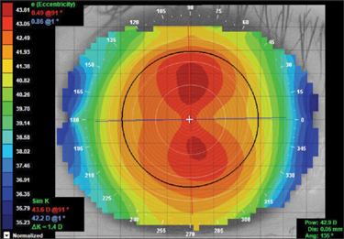
Refractive Surgery Overview
Corneal topography works by reflecting a set of concentric rings (collectively called a Placido disk ) from the anterior corneal surface, and a computer analyzes the distances between, and shapes of, the reflected rings. Based on this analysis, the topographer creates a color-coded ‘map’ depicting the curvature across the corneal surface.
Corneal Placido-disk topography: Color map demonstrating with-the-rule astigmatism (ie, the cornea is steeper in its vertical meridian)
three words

Slide 79
Refractive Surgery Overview
Corneal topography works by reflecting a set of concentric rings (collectively called a Placido disk ) from the anterior corneal surface, and a computer analyzes the distances between, and shapes of, the reflected rings. Based on this analysis, the topographer creates a color-coded ‘map’ depicting the curvature across the corneal surface.
Corneal Placido-disk topography: Color map demonstrating with-the-rule astigmatism (ie, the cornea is steeper in its vertical meridian)

Slide 80
Refractive Surgery Overview
Corneal tomography works by mapping the anterior and posterior corneal surfaces in relation to one another. It allows for 3-D modeling of the cornea, including both anterior and posterior surface curvature and corneal thickness.

Slide 81
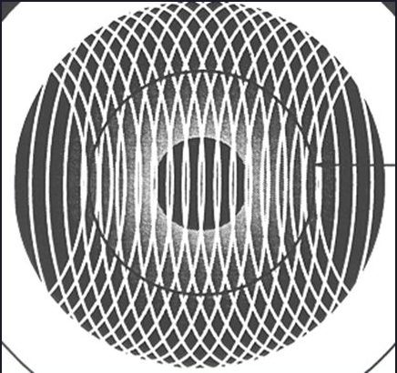
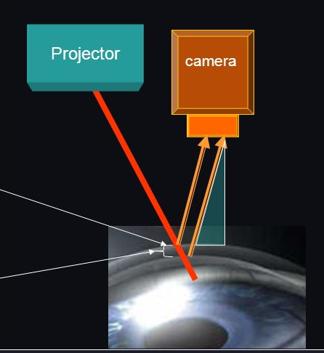
Refractive Surgery Overview
Corneal tomography works by mapping the anterior and posterior corneal surfaces in relation to one another. It allows for 3-D modeling of the cornea, including both anterior and posterior surface curvature and corneal thickness. The data are acquired via one of two technologies (or both in combination):
--Scanning-slit : A series of overlapping scans are directed at the cornea. The light reflects off both the anterior and posterior surfaces. These reflections are acquired and analyzed to produce a model of the central cornea.
two-words

Slide 82
Refractive Surgery Overview
Corneal tomography works by mapping the anterior and posterior corneal surfaces in relation to one another. It allows for 3-D modeling of the cornea, including both anterior and posterior surface curvature and corneal thickness. The data are acquired via one of two technologies (or both in combination):
--Scanning-slit : A series of overlapping scans are directed at the cornea. The light reflects off both the anterior and posterior surfaces. These reflections are acquired and analyzed to produce a model of the central cornea.

Slide 83
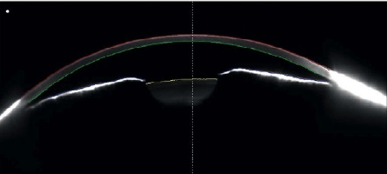
Refractive Surgery Overview
Corneal tomography works by mapping the anterior and posterior corneal surfaces in relation to one another. It allows for 3-D modeling of the cornea, including both anterior and posterior surface curvature and corneal thickness. The data are acquired via one of two technologies (or both in combination):
--Scanning-slit: A series of overlapping scans are directed at the cornea. The light reflects off both the anterior and posterior surfaces. These reflections are acquired and analyzed to produce a model of the central cornea.
--Scheimpflug imaging: A series of Scheimpflug images are taken and analyzed with respect to anterior and posterior corneal curvature and corneal thickness. The data from each image are knitted together to produce a model of the cornea.
eponym
eponym
Scheimpflug image of the cornea

Slide 84
Refractive Surgery Overview
Corneal tomography works by mapping the anterior and posterior corneal surfaces in relation to one another. It allows for 3-D modeling of the cornea, including both anterior and posterior surface curvature and corneal thickness. The data are acquired via one of two technologies (or both in combination):
--Scanning-slit: A series of overlapping scans are directed at the cornea. The light reflects off both the anterior and posterior surfaces. These reflections are acquired and analyzed to produce a model of the central cornea.
--Scheimpflug imaging: A series of Scheimpflug images are taken and analyzed with respect to anterior and posterior corneal curvature and corneal thickness. The data from each image are knitted together to produce a model of the cornea.
Scheimpflug image of the cornea

Slide 85
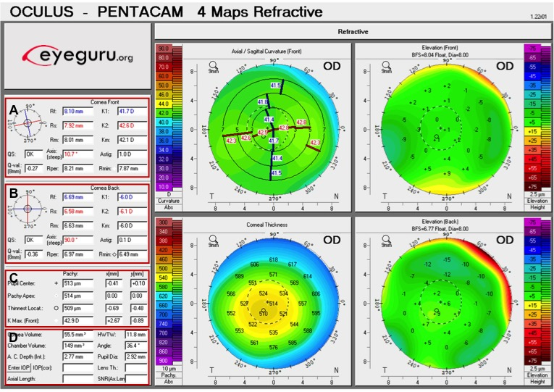
Refractive Surgery Overview
Pentacam corneal tomographer readout

Slide 86
Refractive Surgery Overview
Pentacam corneal tomographer readout
A) Anterior corneal values
K₁, K_{2,} K_{m}: The two major meridians (K₁, K₂). K_{m} is the average of K₁ and K₂
R_{f}, R_{s}, R_{m}: Radii corresponding with K₁, K₂, and K_{m}, respectively
QS: Quality score (I.e. “OK,” “Data gaps,” “Fix,” “Model)
Axis: The meridian that requires no cylinder power to correct astigmatism
Astig: The central corneal astigmatism
B) Posterior corneal values
The same variables described for the back of the cornea.
C), D) Fuggedaboudit (too much for this overview)

Slide 87
Refractive Surgery Overview
In addition to determining corneal power, pre-op corneal mapping is employed to determine whether a prospective keratorefractive pt has a corneal ectasia . An ectasia is a noninflammatory condition characterized by progressive corneal thinning, the end result of which is corneal warpage. Pre-existing ectasia is a strong contraindication to many elective keratorefractive procedures, eg, LASIK. The two most common ectasias are keratoconus (KCN) and pellucid marginal degeneration (PMD) .
two words
+D?
-D?
+D?

Slide 88
Refractive Surgery Overview
In addition to determining corneal power, pre-op corneal mapping is employed to determine whether a prospective keratorefractive pt has a corneal ectasia . An ectasia is a noninflammatory condition characterized by progressive corneal thinning, the end result of which is corneal warpage. Pre-existing ectasia is a strong contraindication to many elective keratorefractive procedures, eg, LASIK. The two most common ectasias are keratoconus (KCN) and pellucid marginal degeneration (PMD) .
+D?
-D?
+D?

Slide 89
Refractive Surgery Overview
In addition to determining corneal power, pre-op corneal mapping is employed to determine whether a prospective keratorefractive pt has a corneal ectasia . An ectasia is a noninflammatory condition characterized by progressive corneal thinning , the end result of which is corneal warpage . Pre-existing ectasia is a strong contraindication to many elective keratorefractive procedures, eg, LASIK. The two most common ectasias are keratoconus (KCN) and pellucid marginal degeneration (PMD) .
inflammatory vs non-
bad change 1
bad change 2
+D?
-D?
+D?

Slide 90
Refractive Surgery Overview
In addition to determining corneal power, pre-op corneal mapping is employed to determine whether a prospective keratorefractive pt has a corneal ectasia . An ectasia is a noninflammatory condition characterized by progressive corneal thinning , the end result of which is corneal warpage . Pre-existing ectasia is a strong contraindication to many elective keratorefractive procedures, eg, LASIK. The two most common ectasias are keratoconus (KCN) and pellucid marginal degeneration (PMD) .
+D?
-D?
+D?

Slide 91
Refractive Surgery Overview
In addition to determining corneal power, pre-op corneal mapping is employed to determine whether a prospective keratorefractive pt has a corneal ectasia . An ectasia is a noninflammatory condition characterized by progressive corneal thinning , the end result of which is corneal warpage . Pre-existing ectasia is a strong contraindication to many elective keratorefractive procedures, eg, LASIK. The two most common ectasias are keratoconus (KCN) and pellucid marginal degeneration (PMD) .
three words
+D?
-D?
+D?

Slide 92
Refractive Surgery Overview
In addition to determining corneal power, pre-op corneal mapping is employed to determine whether a prospective keratorefractive pt has a corneal ectasia . An ectasia is a noninflammatory condition characterized by progressive corneal thinning , the end result of which is corneal warpage . Pre-existing ectasia is a strong contraindication to many elective keratorefractive procedures, eg, LASIK. The two most common ectasias are keratoconus (KCN) and pellucid marginal degeneration (PMD) .
+D?
-D?
+D?

Slide 93
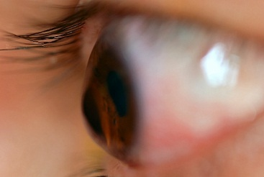
Refractive Surgery Overview
KCN

Slide 94
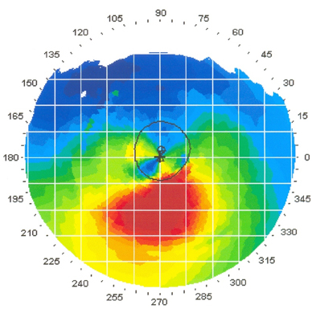
Refractive Surgery Overview
Topography in KCN: Classic inferior corneal steepening
three words

Slide 95
Refractive Surgery Overview
Topography in KCN: Classic inferior corneal steepening

Slide 96
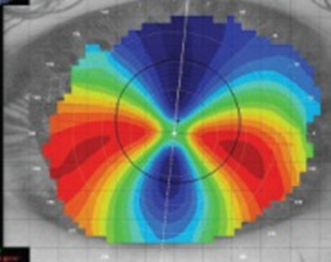
Refractive Surgery Overview
Topography in PMD: Classic kissing doves or crab claw
two words
two diff words

Slide 97
Refractive Surgery Overview
Topography in PMD: Classic kissing doves or crab claw

Slide 98
Refractive Surgery Overview
Corneal Placido-disk topography: Mires typical of KCN
KCN? PMD?

Slide 99
Refractive Surgery Overview
Corneal Placido-disk topography: Mires typical of KCN

Slide 100
Refractive Surgery Overview
Refractive
Surgery
Intraocular
Corneal
Pseudophakic
Phakic IOL
Most corneal refractive surgeries involve altering the shape of the cornea in a way that impacts the vergence it imparts to incoming light.

Slide 101
Refractive Surgery Overview
Refractive
Surgery
Intraocular
Corneal
Pseudophakic
Phakic IOL
?
?
Other
Most corneal refractive surgeries involve altering the shape of the cornea in a way that impacts the vergence it imparts to incoming light. These alterations can involve incising the cornea, lasering it, or some other means.

Slide 102
Refractive Surgery Overview
Refractive
Surgery
Intraocular
Corneal
Pseudophakic
Phakic IOL
Incisional
Laser
Other
Most corneal refractive surgeries involve altering the shape of the cornea in a way that impacts the vergence it imparts to incoming light. These alterations can involve incising the cornea, lasering it, or some other means.

Slide 103
Refractive Surgery Overview
Refractive
Surgery
Intraocular
Corneal
Pseudophakic
Phakic IOL
Incisional
Laser
Other
In a keratoablative laser procedures (eg, LASIK), the cornea is reshaped so as to offset the effect of the error lens..

Slide 104
Refractive Surgery Overview
Refractive
Surgery
Intraocular
Corneal
Pseudophakic
Phakic IOL
Incisional
Laser
Other
In a keratoablative laser procedures (eg, LASIK), the cornea is reshaped so as to offset the effect of the error lens. In myopic keratoablative surgery, the central cornea is flattened to reduce its converging power.
flattened v steepened
↑ vs ↓
Plus error lens
Myopic Eye

Slide 105
Refractive Surgery Overview
Refractive
Surgery
Intraocular
Corneal
Pseudophakic
Phakic IOL
Incisional
Laser
Other
In a keratoablative laser procedures (eg, LASIK), the cornea is reshaped so as to offset the effect of the error lens. In myopic keratoablative surgery, the central cornea is flattened to reduce its converging power.
Plus error lens
Myopic Eye

Slide 106
Refractive Surgery Overview
Refractive
Surgery
Intraocular
Corneal
Pseudophakic
Phakic IOL
Incisional
Laser
Other
Think of it as shaving down the peak of a mountain in order to make the structure more mesa-like
In a keratoablative laser procedures (eg, LASIK), the cornea is reshaped so as to offset the effect of the error lens. In myopic keratoablative surgery, the central cornea is flattened to reduce its converging power. Hyperopic
Plus error lens
Myopic Eye

Slide 107
Refractive Surgery Overview
Refractive
Surgery
Intraocular
Corneal
Pseudophakic
Phakic IOL
Incisional
Laser
Other
In a keratoablative laser procedures (eg, LASIK), the cornea is reshaped so as to offset the effect of the error lens. In myopic keratoablative surgery, the central cornea is flattened to reduce its converging power. Hyperopic keratoablative surgery is the opposite— the central cornea is steepened to increase its converging power.
flattened v steepened
↑ vs ↓
Plus error lens
Myopic Eye
Minus error lens
Hyperopic Eye

Slide 108
Refractive Surgery Overview
Refractive
Surgery
Intraocular
Corneal
Pseudophakic
Phakic IOL
Incisional
Laser
Other
In a keratoablative laser procedures (eg, LASIK), the cornea is reshaped so as to offset the effect of the error lens. In myopic keratoablative surgery, the central cornea is flattened to reduce its converging power. Hyperopic keratoablative surgery is the opposite— the central cornea is steepened to increase its converging power.
Plus error lens
Myopic Eye
Minus error lens
Hyperopic Eye

Slide 109
Refractive Surgery Overview
Refractive
Surgery
Intraocular
Corneal
Pseudophakic
Phakic IOL
Incisional
Laser
Other
In a keratoablative laser procedures (eg, LASIK), the cornea is reshaped so as to offset the effect of the error lens. In myopic keratoablative surgery, the central cornea is flattened to reduce its converging power. Hyperopic keratoablative surgery is the opposite— the central cornea is steepened to increase its converging power.
In contrast, hyperopic keratoablative surgery is akin to shaving down the rim of a mesa in order to make its structure more mountain-like
Plus error lens
Myopic Eye
Minus error lens
Hyperopic Eye

Slide 110
Refractive Surgery Overview
Refractive
Surgery
Intraocular
Corneal
Pseudophakic
Phakic IOL
Incisional
Laser
Other
In a keratoablative laser procedures (eg, LASIK), the cornea is reshaped so as to offset the effect of the error lens. In myopic keratoablative surgery, the central cornea is flattened to reduce its converging power. Hyperopic keratoablative surgery is the opposite— the central cornea is steepened to increase its converging power.
Note that, by definition, keratoablative refractive surgery involves reshaping the central cornea (and thereby altering its refractive power) via the removal (by annihilation) of corneal tissue
Plus error lens
Myopic Eye
Minus error lens
Hyperopic Eye

Slide 111
Refractive Surgery Overview
Refractive
Surgery
Intraocular
Corneal
*One laser-based keratorefractive procedure does not involve tissue annihilation, rather, in it a section of corneal stroma is carved, then removed en bloc
Pseudophakic
Phakic IOL
Incisional
Laser
Other
In a keratoablative laser procedures (eg, LASIK), the cornea is reshaped so as to offset the effect of the error lens. In myopic keratoablative surgery, the central cornea is flattened to reduce its converging power. Hyperopic keratoablative surgery is the opposite— the central cornea is steepened to increase its converging power.
Note that, by definition, keratoablative refractive surgery involves reshaping the central cornea (and thereby altering its refractive power) via the removal (by annihilation) of corneal tissue*
Plus error lens
Myopic Eye
Minus error lens
Hyperopic Eye

Slide 112
Refractive Surgery Overview
Refractive
Surgery
Intraocular
Corneal
Pseudophakic
Phakic IOL
Incisional
Laser
Other
?
?
?
?
?
What are the five laser-based keratorefractive procedures covered in the BCSC book?

Slide 113
Refractive Surgery Overview
Refractive
Surgery
Intraocular
Corneal
Pseudophakic
Phakic IOL
Incisional
Laser
Other
PhotoRefractive Keratectomy
PRK
LASer SubEpithelial Keratomileusis
LASEK
Epipolis LASer In-situ Keratomileusis
Epi-LASIK
LASer In-situ Keratomileusis
LASIK
SMall-Incision Lenticule Extraction
SMILE
What are the five laser-based keratorefractive procedures covered in the BCSC book?

Slide 114
Refractive Surgery Overview
Refractive
Surgery
Intraocular
Corneal
Pseudophakic
Phakic IOL
Incisional
Laser
Other
PhotoRefractive Keratectomy
PRK?
LASer SubEpithelial Keratomileusis
LASEK?
Epipolis LASer In-situ Keratomileusis
Epi-LASIK?
LASer In-situ Keratomileusis
LASIK?
SMall-Incision Lenticule Extraction
SMILE?
What are the five laser-based keratorefractive procedures covered in the BCSC book?
Which is the nonablative procedure referred to on a couple of slides ago?

Slide 115
Refractive Surgery Overview
Refractive
Surgery
Intraocular
Corneal
Pseudophakic
Phakic IOL
Incisional
Laser
Other
PhotoRefractive Keratectomy
PRK
LASer SubEpithelial Keratomileusis
LASEK
Epipolis LASer In-situ Keratomileusis
Epi-LASIK
LASer In-situ Keratomileusis
LASIK
SMall-Incision Lenticule Extraction
SMILE
What are the five laser-based keratorefractive procedures covered in the BCSC book?
Which is the nonablative procedure referred to on a couple of slides ago? SMILE

Slide 116
Refractive Surgery Overview
Refractive
Surgery
Intraocular
Corneal
Pseudophakic
Phakic IOL
Incisional
Laser
Other
In the SMILE procedure, the femtosecond laser, with its ability to be focused at very precise depths within the cornea, is used to carve a segment (called a lenticule) of very specific shape within the stroma without disturbing the overlying or underlying tissue. The lenticule is then removed en bloc by being extracted through a very small incision (also created by the femto) that connects the femto-created intrastromal space and the corneal surface. The resulting loss of tissue reshapes the central corneal surface in a way that produces a desired change in its refractive power.
PhotoRefractive Keratectomy
PRK
LASer SubEpithelial Keratomileusis
LASEK
Epipolis LASer In-situ Keratomileusis
Epi-LASIK
LASer In-situ Keratomileusis
LASIK
SMall-Incision Lenticule Extraction
SMILE
What are the five laser-based keratorefractive procedures covered in the BCSC book?
Which is the nonablative procedure referred to on a couple of slides ago? SMILE

Slide 117
Refractive Surgery Overview
Refractive
Surgery
Intraocular
Corneal
Pseudophakic
Phakic IOL
Incisional
Laser
Other
In the SMILE procedure, the femtosecond laser, with its ability to be focused at very precise depths within the cornea, is used to carve a segment (called a lenticule) of very specific shape within the stroma without disturbing the overlying or underlying tissue. The lenticule is then removed en bloc by being extracted through a very small incision (also created by the femto) that connects the femto-created intrastromal space and the corneal surface. The resulting loss of tissue reshapes the central corneal surface in a way that produces a desired change in its refractive power.
PhotoRefractive Keratectomy
PRK
LASer SubEpithelial Keratomileusis
LASEK
Epipolis LASer In-situ Keratomileusis
Epi-LASIK
LASer In-situ Keratomileusis
LASIK
SMall-Incision Lenticule Extraction
SMILE
What are the five laser-based keratorefractive procedures covered in the BCSC book?
Which is the nonablative procedure referred to on a couple of slides ago? SMILE

Slide 118
Refractive Surgery Overview
Refractive
Surgery
Intraocular
Corneal
Pseudophakic
Phakic IOL
Incisional
Laser
Other
In the SMILE procedure, the femtosecond laser, with its ability to be focused at very precise depths within the cornea, is used to carve a segment (called a lenticule) of very specific shape within the stroma without disturbing the overlying or underlying tissue. The lenticule is then removed en bloc by being extracted through a very small incision (also created by the femto) that connects the femto-created intrastromal space and the corneal surface. The resulting loss of tissue reshapes the central corneal surface in a way that produces a desired change in its refractive power.
PhotoRefractive Keratectomy
PRK
LASer SubEpithelial Keratomileusis
LASEK
Epipolis LASer In-situ Keratomileusis
Epi-LASIK
LASer In-situ Keratomileusis
LASIK
SMall-Incision Lenticule Extraction
SMILE
What are the five laser-based keratorefractive procedures covered in the BCSC book?
Which is the nonablative procedure referred to on a couple of slides ago? SMILE

Slide 119
Refractive Surgery Overview
SMILE

Slide 120
Refractive Surgery Overview
Refractive
Surgery
Intraocular
Corneal
Pseudophakic
Phakic IOL
Incisional
Laser
Other
In the SMILE procedure, the femtosecond laser, with its ability to be focused at very precise depths within the cornea, is used to carve a segment (called a lenticule) of very specific shape within the stroma without disturbing the overlying or underlying tissue. The lenticule is then removed en bloc by being extracted through a very small incision (also created by the femto) that connects the femto-created intrastromal space and the corneal surface. The resulting loss of tissue reshapes the central corneal surface in a way that produces a desired change in its refractive power.
PhotoRefractive Keratectomy
PRK
LASer SubEpithelial Keratomileusis
LASEK
Epipolis LASer In-situ Keratomileusis
Epi-LASIK
LASer In-situ Keratomileusis
LASIK
SMall-Incision Lenticule Extraction
SMILE
What are the five laser-based keratorefractive procedures covered in the BCSC book?
Which is the nonablative procedure referred to on a couple of slides ago? SMILE

Slide 121
Refractive Surgery Overview
Refractive
Surgery
Intraocular
Corneal
Pseudophakic
Phakic IOL
Incisional
Laser
Other
PhotoRefractive Keratectomy
PRK
LASer SubEpithelial Keratomileusis
LASEK
Epipolis LASer In-situ Keratomileusis
Epi-LASIK
LASer In-situ Keratomileusis
LASIK
SMall-Incision Lenticule Extraction
SMILE
In keratoablative procedures, remodeling of the central cornea occurs via annihilation of the corneal stroma with an excimer laser. But before the excimer can get to the stroma, the corneal epithelium has to get out of the way.
(same laser)

Slide 122
Refractive Surgery Overview
Refractive
Surgery
Intraocular
Corneal
Pseudophakic
Phakic IOL
Incisional
Laser
Other
PhotoRefractive Keratectomy
PRK
LASer SubEpithelial Keratomileusis
LASEK
Epipolis LASer In-situ Keratomileusis
Epi-LASIK
LASer In-situ Keratomileusis
LASIK
SMall-Incision Lenticule Extraction
SMILE
In keratoablative procedures, remodeling of the central cornea occurs via annihilation of the corneal stroma with an excimer laser. But before the excimer can get to the stroma, the corneal epithelium has to get out of the way.

Slide 123
Refractive Surgery Overview
Refractive
Surgery
Intraocular
Corneal
Pseudophakic
Phakic IOL
Incisional
Laser
Other
PhotoRefractive Keratectomy
PRK
LASer SubEpithelial Keratomileusis
LASEK
Epipolis LASer In-situ Keratomileusis
Epi-LASIK
LASer In-situ Keratomileusis
LASIK
SMall-Incision Lenticule Extraction
SMILE
In keratoablative procedures, remodeling of the central cornea occurs via annihilation of the corneal stroma with an excimer laser. But before the excimer can get to the stroma, the corneal epithelium has to get out of the way. The four keratoablative procedures differ solely in how the epithelium is handled.

Slide 124
Refractive Surgery Overview
Refractive
Surgery
Intraocular
Corneal
Pseudophakic
Phakic IOL
Incisional
Laser
Other
PhotoRefractive Keratectomy
PRK
LASer SubEpithelial Keratomileusis
LASEK
In PRK, the handling of the epithelium couldn’t be more straightforward. It is simply cast aside—via scraping, chemical destruction, brushing, lasing, etc. This makes PRK the simplest of the laser keratorablative procedures: get the epithelium out of the way, then forget about it.
However, PRK is associated with several post-operative complications that render it problematic, chief among them being that it is associated with significant post-op pain as well as an increased risk of post-op haze formation—a potentially sight-threatening complication.
Epipolis LASer In-situ Keratomileusis
Epi-LASIK
LASer In-situ Keratomileusis
LASIK
SMall-Incision Lenticule Extraction
SMILE
In keratoablative procedures, remodeling of the central cornea occurs via annihilation of the corneal stroma with an excimer laser. But before the excimer can get to the stroma, the corneal epithelium has to get out of the way. The four keratoablative procedures differ solely in how the epithelium is handled.

Slide 125
Refractive Surgery Overview
Refractive
Surgery
Intraocular
Corneal
Pseudophakic
Phakic IOL
Incisional
Laser
Other
PhotoRefractive Keratectomy
PRK
LASer SubEpithelial Keratomileusis
LASEK
In PRK, the handling of the epithelium couldn’t be more straightforward. It is simply cast aside—via scraping, chemical destruction, brushing, lasing, etc. This makes PRK the simplest of the laser keratorablative procedures: get the epithelium out of the way, then forget about it.
However, PRK is associated with several post-operative complications that render it problematic, two of which are 1) it produces significant post-op pain , and 2) it is associated with an increased risk of post-op haze formation—a potentially sight-threatening development.
Epipolis LASer In-situ Keratomileusis
Epi-LASIK
LASer In-situ Keratomileusis
LASIK
SMall-Incision Lenticule Extraction
SMILE
two words
In keratoablative procedures, remodeling of the central cornea occurs via annihilation of the corneal stroma with an excimer laser. But before the excimer can get to the stroma, the corneal epithelium has to get out of the way. The four keratoablative procedures differ solely in how the epithelium is handled.

Slide 126
Refractive Surgery Overview
Refractive
Surgery
Intraocular
Corneal
Pseudophakic
Phakic IOL
Incisional
Laser
Other
PhotoRefractive Keratectomy
PRK
LASer SubEpithelial Keratomileusis
LASEK
In PRK, the handling of the epithelium couldn’t be more straightforward. It is simply cast aside—via scraping, chemical destruction, brushing, lasing, etc. This makes PRK the simplest of the laser keratorablative procedures: get the epithelium out of the way, then forget about it.
However, PRK is associated with several post-operative complications that render it problematic, two of which are 1) it produces significant post-op pain , and 2) it is associated with an increased risk of post-op haze formation—a potentially sight-threatening development.
Epipolis LASer In-situ Keratomileusis
Epi-LASIK
LASer In-situ Keratomileusis
LASIK
SMall-Incision Lenticule Extraction
SMILE
In keratoablative procedures, remodeling of the central cornea occurs via annihilation of the corneal stroma with an excimer laser. But before the excimer can get to the stroma, the corneal epithelium has to get out of the way. The four keratoablative procedures differ solely in how the epithelium is handled.

Slide 127
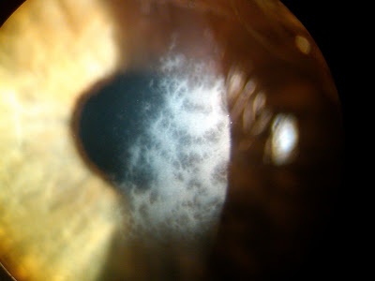
Refractive Surgery Overview
Post-PRK haze

Slide 128
Refractive Surgery Overview
Refractive
Surgery
Intraocular
Corneal
Pseudophakic
Phakic IOL
Incisional
Laser
Other
PhotoRefractive Keratectomy
PRK
LASer SubEpithelial Keratomileusis
LASEK
Epipolis LASer In-situ Keratomileusis
Epi-LASIK
LASer In-situ Keratomileusis
LASIK
SMall-Incision Lenticule Extraction
SMILE
In contrast, the well-known LASIK procedure deals with the epithelium by doing an end-run around it. A hinged flap is cut in the stroma and reflected, thereby moving the overlying epithelium out of the treatment area. The underlying stromal bed is then lased, and the flap (with its intact epithelium) is laid back in place.
In keratoablative procedures, remodeling of the central cornea occurs via annihilation of the corneal stroma with an excimer laser. But before the excimer can get to the stroma, the corneal epithelium has to get out of the way. The four keratoablative procedures differ solely in how the epithelium is handled.

Slide 129
Refractive Surgery Overview
Refractive
Surgery
Intraocular
Corneal
Pseudophakic
Phakic IOL
Incisional
Laser
Other
PhotoRefractive Keratectomy
PRK
LASer SubEpithelial Keratomileusis
LASEK
Epipolis LASer In-situ Keratomileusis
Epi-LASIK
LASer In-situ Keratomileusis
LASIK
SMall-Incision Lenticule Extraction
SMILE
In contrast, the well-known LASIK procedure deals with the epithelium by doing an end-run around it. A hinged flap is cut in the stroma and reflected, thereby moving the overlying epithelium out of the treatment area. The underlying stromal bed is then lased, and the flap (with its intact epithelium) is laid back in place. Far less pain; vastly reduced risk of haze formation.
two words
In keratoablative procedures, remodeling of the central cornea occurs via annihilation of the corneal stroma with an excimer laser. But before the excimer can get to the stroma, the corneal epithelium has to get out of the way. The four keratoablative procedures differ solely in how the epithelium is handled.

Slide 130
Refractive Surgery Overview
Refractive
Surgery
Intraocular
Corneal
Pseudophakic
Phakic IOL
Incisional
Laser
Other
PhotoRefractive Keratectomy
PRK
LASer SubEpithelial Keratomileusis
LASEK
Epipolis LASer In-situ Keratomileusis
Epi-LASIK
LASer In-situ Keratomileusis
LASIK
SMall-Incision Lenticule Extraction
SMILE
In contrast, the well-known LASIK procedure deals with the epithelium by doing an end-run around it. A hinged flap is cut in the stroma and reflected, thereby moving the overlying epithelium out of the treatment area. The underlying stromal bed is then lased, and the flap (with its intact epithelium) is laid back in place. Far less pain; vastly reduced risk of haze formation.
In keratoablative procedures, remodeling of the central cornea occurs via annihilation of the corneal stroma with an excimer laser. But before the excimer can get to the stroma, the corneal epithelium has to get out of the way. The four keratoablative procedures differ solely in how the epithelium is handled.

Slide 131
Refractive Surgery Overview
Refractive
Surgery
Intraocular
Corneal
Pseudophakic
Phakic IOL
Incisional
Laser
Other
PhotoRefractive Keratectomy
PRK
LASer SubEpithelial Keratomileusis
LASEK
Epipolis LASer In-situ Keratomileusis
Epi-LASIK
LASer In-situ Keratomileusis
LASIK
SMall-Incision Lenticule Extraction
SMILE
In contrast, the well-known LASIK procedure deals with the epithelium by doing an end-run around it. A hinged flap is cut in the stroma and reflected, thereby moving the overlying epithelium out of the treatment area. The underlying stromal bed is then lased, and the flap (with its intact epithelium) is laid back in place. Far less pain; vastly reduced risk of haze formation.
In keratoablative procedures, remodeling of the central cornea occurs via annihilation of the corneal stroma with an excimer laser. But before the excimer can get to the stroma, the corneal epithelium has to get out of the way. The four keratoablative procedures differ solely in how the epithelium is handled.

Slide 132
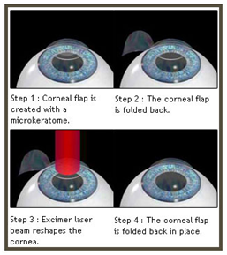
Refractive Surgery Overview
LASIK

Slide 133
Refractive Surgery Overview
Refractive
Surgery
Intraocular
Corneal
Pseudophakic
Phakic IOL
Incisional
Laser
Other
PhotoRefractive Keratectomy
PRK
LASer SubEpithelial Keratomileusis
LASEK
Epipolis LASer In-situ Keratomileusis
Epi-LASIK
Like PRK, LASEK is a ‘surface ablation’ procedure. However, it deals very differently with the corneal epithelium. In LASEK, the epithelium is chemically devitalized and loosened by bathing it in alcohol . The loosened epithelium is then folded back, and the ablation is performed. Following the ablation, this ‘epithelial flap’ is smoothed back into place and covered with a bandage CL. By re-positing the epithelium, LASEK avoids the large epi defect (and resulting severe pain) of PRK.
LASer In-situ Keratomileusis
LASIK
SMall-Incision Lenticule Extraction
SMILE
In keratoablative procedures, remodeling of the central cornea occurs via annihilation of the corneal stroma with an excimer laser. But before the excimer can get to the stroma, the corneal epithelium has to get out of the way. The four keratoablative procedures differ solely in how the epithelium is handled.

Slide 134
Refractive Surgery Overview
Refractive
Surgery
Intraocular
Corneal
Pseudophakic
Phakic IOL
Incisional
Laser
Other
PhotoRefractive Keratectomy
PRK
LASer SubEpithelial Keratomileusis
LASEK
Epipolis LASer In-situ Keratomileusis
Epi-LASIK
Like PRK, LASEK is a ‘surface ablation’ procedure. However, it deals very differently with the corneal epithelium. In LASEK, the epithelium is chemically devitalized and loosened by bathing it in alcohol . The loosened epithelium is then folded back, and the ablation is performed. Following the ablation, this ‘epithelial flap’ is smoothed back into place and covered with a bandage CL. By re-positing the epithelium, LASEK avoids the large epi defect (and resulting severe pain) of PRK.
LASer In-situ Keratomileusis
LASIK
SMall-Incision Lenticule Extraction
SMILE
In keratoablative procedures, remodeling of the central cornea occurs via annihilation of the corneal stroma with an excimer laser. But before the excimer can get to the stroma, the corneal epithelium has to get out of the way. The four keratoablative procedures differ solely in how the epithelium is handled.

Slide 135
Refractive Surgery Overview
Refractive
Surgery
Intraocular
Corneal
Pseudophakic
Phakic IOL
Incisional
Laser
Other
PhotoRefractive Keratectomy
PRK
LASer SubEpithelial Keratomileusis
LASEK
Epipolis LASer In-situ Keratomileusis
Epi-LASIK
Like PRK, LASEK is a ‘surface ablation’ procedure. However, it deals very differently with the corneal epithelium. In LASEK, the epithelium is chemically devitalized and loosened by bathing it in alcohol . The loosened epithelium is then folded back, and the ablation is performed. Following the ablation, this ‘epithelial flap’ is smoothed back into place and covered with a bandage CL. By re-positing the epithelium, LASEK avoids the large epi defect (and resulting severe pain) of PRK.
LASer In-situ Keratomileusis
LASIK
SMall-Incision Lenticule Extraction
SMILE
In keratoablative procedures, remodeling of the central cornea occurs via annihilation of the corneal stroma with an excimer laser. But before the excimer can get to the stroma, the corneal epithelium has to get out of the way. The four keratoablative procedures differ solely in how the epithelium is handled.

Slide 136
Refractive Surgery Overview
Refractive
Surgery
Intraocular
Corneal
Pseudophakic
Phakic IOL
Incisional
Laser
Other
PhotoRefractive Keratectomy
PRK
LASer SubEpithelial Keratomileusis
LASEK
Epipolis LASer In-situ Keratomileusis
Epi-LASIK
Like PRK, LASEK is a ‘surface ablation’ procedure. However, it deals very differently with the corneal epithelium. In LASEK, the epithelium is chemically devitalized and loosened by bathing it in alcohol . The loosened epithelium is then folded back, and the ablation is performed. Following the ablation, this ‘epithelial flap’ is smoothed back into place and covered with a bandage CL. By re-positing the epithelium, LASEK avoids the large epi defect (and resulting severe pain) of PRK.
LASer In-situ Keratomileusis
LASIK
SMall-Incision Lenticule Extraction
SMILE
In keratoablative procedures, remodeling of the central cornea occurs via annihilation of the corneal stroma with an excimer laser. But before the excimer can get to the stroma, the corneal epithelium has to get out of the way. The four keratoablative procedures differ solely in how the epithelium is handled.

Slide 137
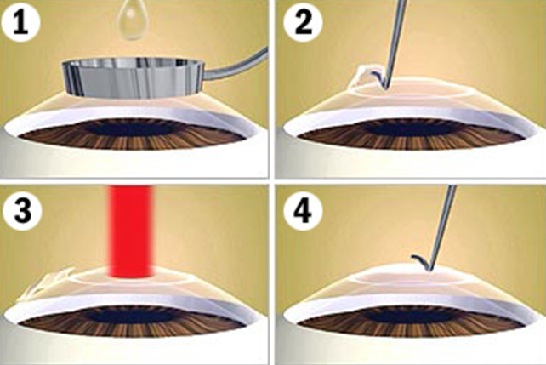
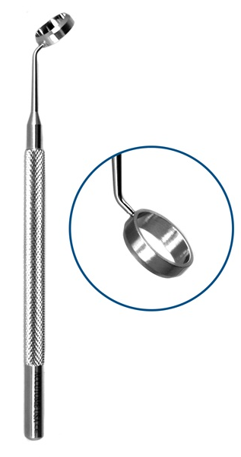
Refractive Surgery Overview
LASEK

Slide 138
Refractive Surgery Overview
Refractive
Surgery
Intraocular
Corneal
Pseudophakic
Phakic IOL
Incisional
Laser
Other
PhotoRefractive Keratectomy
PRK
LASer SubEpithelial Keratomileusis
LASEK
Epipolis LASer In-situ Keratomileusis
Epi-LASIK
Like PRK, LASEK is a ‘surface ablation’ procedure. However, it deals very differently with the corneal epithelium. In LASEK, the epithelium is chemically devitalized and loosened by bathing it in alcohol . The loosened epithelium is then folded back, and the ablation is performed. Following the ablation, this ‘epithelial flap’ is smoothed back into place and covered with a bandage CL. By re-positing the epithelium, LASEK avoids the large epi defect (and resulting severe pain) of PRK.
LASer In-situ Keratomileusis
LASIK
SMall-Incision Lenticule Extraction
SMILE
In keratoablative procedures, remodeling of the central cornea occurs via annihilation of the corneal stroma with an excimer laser. But before the excimer can get to the stroma, the corneal epithelium has to get out of the way. The four keratoablative procedures differ solely in how the epithelium is handled.

Slide 139
Refractive Surgery Overview
Refractive
Surgery
Intraocular
Corneal
Pseudophakic
Phakic IOL
Incisional
Laser
Other
PhotoRefractive Keratectomy
PRK
LASer SubEpithelial Keratomileusis
LASEK
Epipolis LASer In-situ Keratomileusis
Epi-LASIK
LASer In-situ Keratomileusis
LASIK
SMall-Incision Lenticule Extraction
SMILE
Like LASEK, epi-LASIK is a surface-ablation variant designed to avoid the drawbacks of PRK. In it, a blunt keratome (an ‘epikeratome’) slides under the epithelium, separating it. The epithelial flap thus created is folded back, then re-placed after the stroma has been ablated. (BTW, epipolis is a Greek word meaning ‘superficial.’)
the first step in the procedure
In keratoablative procedures, remodeling of the central cornea occurs via annihilation of the corneal stroma with an excimer laser. But before the excimer can get to the stroma, the corneal epithelium has to get out of the way. The four keratoablative procedures differ solely in how the epithelium is handled.

Slide 140
Refractive Surgery Overview
Refractive
Surgery
Intraocular
Corneal
Pseudophakic
Phakic IOL
Incisional
Laser
Other
PhotoRefractive Keratectomy
PRK
LASer SubEpithelial Keratomileusis
LASEK
Epipolis LASer In-situ Keratomileusis
Epi-LASIK
LASer In-situ Keratomileusis
LASIK
SMall-Incision Lenticule Extraction
SMILE
Like LASEK, epi-LASIK is a surface-ablation variant designed to avoid the drawbacks of PRK. In it, a blunt keratome (an ‘epikeratome’) slides under the epithelium, separating it. The epithelial flap thus created is folded back, then re-placed after the stroma has been ablated. (BTW, epipolis is a Greek word meaning ‘superficial.’)
In keratoablative procedures, remodeling of the central cornea occurs via annihilation of the corneal stroma with an excimer laser. But before the excimer can get to the stroma, the corneal epithelium has to get out of the way. The four keratoablative procedures differ solely in how the epithelium is handled.

Slide 141
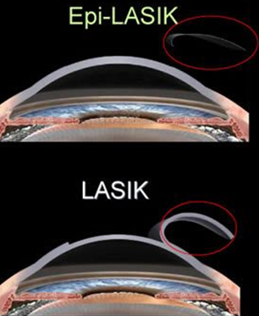
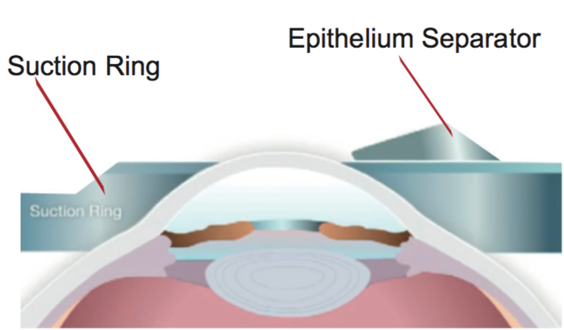
Refractive Surgery Overview
(For comparison)
Epi-LASIK

Slide 142
Refractive Surgery Overview
Refractive
Surgery
Intraocular
Corneal
Pseudophakic
Phakic IOL
Incisional
Laser
Other
PhotoRefractive Keratectomy
PRK
LASer SubEpithelial Keratomileusis
LASEK
Epipolis LASer In-situ Keratomileusis
Epi-LASIK
LASer In-situ Keratomileusis
LASIK
SMall-Incision Lenticule Extraction
SMILE
Like LASEK, epi-LASIK is a surface-ablation variant designed to avoid the drawbacks of PRK. In it, a blunt keratome (an ‘epikeratome’) slides under the epithelium, separating it. The epithelial flap thus created is folded back, then re-placed after the stroma has been ablated. (BTW, epipolis is a Greek word meaning ‘superficial.’)
In keratoablative procedures, remodeling of the central cornea occurs via annihilation of the corneal stroma with an excimer laser. But before the excimer can get to the stroma, the corneal epithelium has to get out of the way. The four keratoablative procedures differ solely in how the epithelium is handled.

Slide 143
Refractive Surgery Overview
Refractive
Surgery
Intraocular
Corneal
Pseudophakic
Phakic IOL
Incisional
Laser
Other
?
PRK
?
LASEK
?
Epi-LASIK
What are the three incisional keratorefractive procedures covered in the BCSC book?
LASIK
SMILE

Slide 144
Refractive Surgery Overview
Refractive
Surgery
Intraocular
Corneal
Pseudophakic
Phakic IOL
Incisional
Laser
Other
Radial Keratotomy
RK
PRK
Arcuate Keratotomy
AK
LASEK
Limbal Relaxing Incisions
LRI
Epi-LASIK
What are the three incisional keratorefractive procedures covered in the BCSC book?
LASIK
SMILE

Slide 145
Refractive Surgery Overview
Refractive
Surgery
Intraocular
Corneal
Pseudophakic
Phakic IOL
Incisional
Laser
Other
Radial Keratotomy
RK
PRK
Arcuate Keratotomy
AK
flatten v steepen
LASEK
A set of incisions oriented radially (radial keratotomy, RK) will flatten the central cornea, and thereby reduce its converging power. Thus, RK can be used to treat myopia . Note that because incisions cannot produce overall steepening of the central cornea, RK cannot be used to treat hyperopia. Note also that RK is considered obsolete at this juncture, and is thus no longer performed in the US.
increase v reduce
Limbal Relaxing Incisions
LRI
myopia v hyperopia
Epi-LASIK
LASIK
SMILE
Plus error lens
Myopic Eye

Slide 146
Refractive Surgery Overview
Refractive
Surgery
Intraocular
Corneal
Pseudophakic
Phakic IOL
Incisional
Laser
Other
Radial Keratotomy
RK
PRK
Arcuate Keratotomy
AK
LASEK
A set of incisions oriented radially (radial keratotomy, RK) will flatten the central cornea, and thereby reduce its converging power. Thus, RK can be used to treat myopia . Note that because incisions cannot produce overall steepening of the central cornea, RK cannot be used to treat hyperopia. Note also that RK is considered obsolete at this juncture, and is thus no longer performed in the US.
Limbal Relaxing Incisions
LRI
Epi-LASIK
LASIK
SMILE
Plus error lens
Myopic Eye

Slide 147
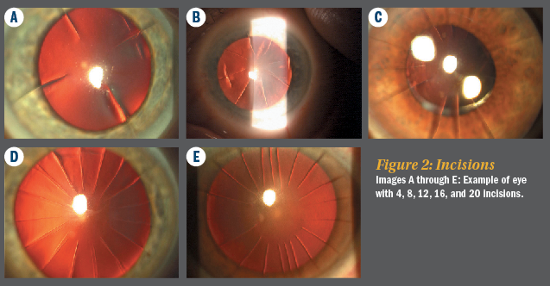
Refractive Surgery Overview
Radial keratotomy

Slide 148
Refractive Surgery Overview
Refractive
Surgery
Intraocular
Corneal
Pseudophakic
Phakic IOL
Incisional
Laser
Other
Radial Keratotomy
RK
PRK
Arcuate Keratotomy
AK
LASEK
A set of incisions oriented radially (radial keratotomy, RK) will flatten the central cornea, and thereby reduce its converging power. Thus, RK can be used to treat myopia . Note that because incisions cannot produce overall steepening of the central cornea, RK cannot be used to treat hyperopia. Note also that RK is considered obsolete at this juncture, and is thus no longer performed in the US.
Limbal Relaxing Incisions
LRI
Epi-LASIK
LASIK

Slide 149
Refractive Surgery Overview
Refractive
Surgery
Intraocular
Corneal
Pseudophakic
Phakic IOL
Incisional
Laser
Other
Radial Keratotomy
RK
PRK
Arcuate Keratotomy
AK
LASEK
A set of incisions oriented radially (radial keratotomy, RK) will flatten the central cornea, and thereby reduce its converging power. Thus, RK can be used to treat myopia . Note that because incisions cannot produce overall steepening of the central cornea, RK cannot be used to treat hyperopia. Note also that, at this juncture, RK is considered obsolete, and is thus no longer performed in the US.
Limbal Relaxing Incisions
LRI
Epi-LASIK
LASIK

Slide 150
Refractive Surgery Overview
Refractive
Surgery
Intraocular
Corneal
Pseudophakic
Phakic IOL
Incisional
Laser
Other
Radial Keratotomy
RK
PRK
Arcuate Keratotomy
AK
LASEK
A set of incisions oriented radially (radial keratotomy, RK) will flatten the central cornea, and thereby reduce its converging power. Thus, RK can be used to treat myopia . Note that because incisions cannot produce overall steepening of the central cornea, RK cannot be used to treat hyperopia. Note also that, at this juncture, RK is considered obsolete, and is thus no longer performed in the US.
Limbal Relaxing Incisions
LRI
Epi-LASIK
LASIK
OTOH, peripheral incisional procedures to offset astigmatic refractive error are an important and oft-used surgical technique

Slide 151
Refractive Surgery Overview
Refractive
Surgery
Intraocular
Corneal
Pseudophakic
Phakic IOL
Incisional
Laser
Other
Radial Keratotomy
RK
PRK
Arcuate Keratotomy
AK
LASEK
A set of incisions oriented radially (radial keratotomy, RK) will flatten the central cornea, and thereby reduce its converging power. Thus, RK can be used to treat myopia . Note that because incisions cannot produce overall steepening of the central cornea, RK cannot be used to treat hyperopia. Note also that, at this juncture, RK is considered obsolete, and is thus no longer performed in the US.
Limbal Relaxing Incisions
LRI
Epi-LASIK
LASIK
OTOH, peripheral incisional procedures to offset astigmatic refractive error are an important and oft-used surgical technique

Slide 152
Refractive Surgery Overview
Refractive
Surgery
Intraocular
Corneal
Pseudophakic
Phakic IOL
Incisional
Laser
Other
Radial Keratotomy
RK
PRK
Arcuate Keratotomy
AK
LASEK
Limbal Relaxing Incisions
LRI
Epi-LASIK
LASIK
Specifically, this refers to AK and LRI
SMILE
OTOH, peripheral incisional procedures to offset astigmatic refractive error are an important and oft-used surgical technique

Slide 153
Refractive Surgery Overview
Refractive
Surgery
Intraocular
Corneal
Pseudophakic
Phakic IOL
Incisional
Laser
Other
Radial Keratotomy
RK
PRK
Arcuate Keratotomy
AK
LASEK
Limbal Relaxing Incisions
LRI
Epi-LASIK
LASIK
Both AK and LRI incisions are placed on the steep meridian of the cornea, in pairs located on opposite sides of the cornea. AK incisions are made in the paracentral cornea, whereas LRI are made at the limbus (as their name implies). Both techniques have the effect of flattening the meridian in which they’re placed, but through a process called coupling , steepening the meridian 90 deg away. The most common indication for AK is correction of astigmatism in an eye that is s/p penetrating keratoplasty . LRI are typically placed at the time of cataract surgery to correct corneal astigmatism in hopes of producing better UCVA post-op.
Specifically, this refers to AK and LPI
steep v flat
paracentral v limbal
SMILE
paracentral K v limbal K
OTOH, peripheral incisional procedures to offset astigmatic refractive error are an important and oft-used surgical technique

Slide 154
Refractive Surgery Overview
Refractive
Surgery
Intraocular
Corneal
Pseudophakic
Phakic IOL
Incisional
Laser
Other
Radial Keratotomy
RK
PRK
Arcuate Keratotomy
AK
LASEK
Limbal Relaxing Incisions
LRI
Epi-LASIK
LASIK
Both AK and LRI incisions are placed on the steep meridian of the cornea, in pairs located on opposite sides of the cornea. AK incisions are made in the paracentral cornea, whereas LRI are made at the limbus (as their name implies).). Both techniques have the effect of flattening the meridian in which they’re placed, but through a process called coupling , steepening the meridian 90 deg away. The most common indication for AK is correction of astigmatism in an eye that is s/p penetrating keratoplasty . LRI are typically placed at the time of cataract surgery to correct corneal astigmatism in hopes of producing better UCVA post-op.
Specifically, this refers to AK and LPI
SMILE
OTOH, peripheral incisional procedures to offset astigmatic refractive error are an important and oft-used surgical technique

Slide 155
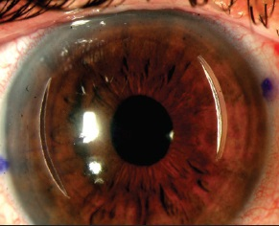
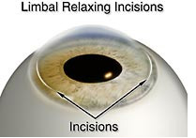
Refractive Surgery Overview
AK incisions
LR incisions

Slide 156
Refractive Surgery Overview
Refractive
Surgery
Intraocular
Corneal
Pseudophakic
Phakic IOL
Incisional
Laser
Other
Radial Keratotomy
RK
PRK
Arcuate Keratotomy
AK
LASEK
Limbal Relaxing Incisions
LRI
Epi-LASIK
LASIK
Both AK and LRI incisions are placed on the steep meridian of the cornea, in pairs located on opposite sides of the cornea. AK incisions are made in the paracentral cornea, whereas LRI are made at the limbus (as their name implies). Both techniques have the effect of flattening the meridian in which they’re placed, but through a process called coupling , steepening the meridian 90 deg away. The most common indication for AK is correction of astigmatism in an eye that is s/p penetrating keratoplasty . LRI are typically placed at the time of cataract surgery to correct corneal astigmatism in hopes of producing better UCVA post-op.
Specifically, this refers to AK and LPI
SMILE
flattening v steepening
OTOH, peripheral incisional procedures to offset astigmatic refractive error are an important and oft-used surgical technique
flattening v steepening

Slide 157
Refractive Surgery Overview
Refractive
Surgery
Intraocular
Corneal
Pseudophakic
Phakic IOL
Incisional
Laser
Other
Radial Keratotomy
RK
PRK
Arcuate Keratotomy
AK
LASEK
Limbal Relaxing Incisions
LRI
Epi-LASIK
LASIK
Both AK and LRI incisions are placed on the steep meridian of the cornea, in pairs located on opposite sides of the cornea. AK incisions are made in the paracentral cornea, whereas LRI are made at the limbus (as their name implies). Both techniques have the effect of flattening the meridian in which they’re placed, but through a process called coupling , steepening the meridian 90 deg away. The most common indication for AK is correction of astigmatism in an eye that is s/p penetrating keratoplasty . LRI are typically placed at the time of cataract surgery to correct corneal astigmatism in hopes of producing better UCVA post-op.
Specifically, this refers to AK and LPI
SMILE
OTOH, peripheral incisional procedures to offset astigmatic refractive error are an important and oft-used surgical technique

Slide 158
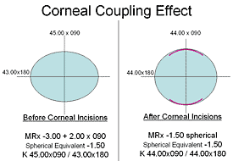
Refractive Surgery Overview
Coupling

Slide 159
Refractive Surgery Overview
Refractive
Surgery
Intraocular
Corneal
Pseudophakic
Phakic IOL
Incisional
Laser
Other
Radial Keratotomy
RK
PRK
Arcuate Keratotomy
AK
LASEK
Limbal Relaxing Incisions
LRI
Epi-LASIK
LASIK
Both AK and LRI incisions are placed on the steep meridian of the cornea, in pairs located on opposite sides of the cornea. AK incisions are made in the paracentral cornea, whereas LRI are made at the limbus (as their name implies). Both techniques have the effect of flattening the meridian in which they’re placed, but through a process called coupling , steepening the meridian 90 deg away. The most common indication for AK is correction of astigmatism in an eye that is s/p penetrating keratoplasty . LRI are typically placed at the time of cataract surgery to correct corneal astigmatism in hopes of producing better UCVA post-op.
Specifically, this refers to AK and LPI
SMILE
OTOH, peripheral incisional procedures to offset astigmatic refractive error are an important and oft-used surgical technique
surg procedure (two words)

Slide 160
Refractive Surgery Overview
Refractive
Surgery
Intraocular
Corneal
Pseudophakic
Phakic IOL
Incisional
Laser
Other
Radial Keratotomy
RK
PRK
Arcuate Keratotomy
AK
LASEK
Limbal Relaxing Incisions
LRI
Epi-LASIK
LASIK
Both AK and LRI incisions are placed on the steep meridian of the cornea, in pairs located on opposite sides of the cornea. AK incisions are made in the paracentral cornea, whereas LRI are made at the limbus (as their name implies). Both techniques have the effect of flattening the meridian in which they’re placed, but through a process called coupling , steepening the meridian 90 deg away. The most common indication for AK is correction of astigmatism in an eye that is s/p penetrating keratoplasty . LRI are typically placed at the time of cataract surgery to correct corneal astigmatism in hopes of producing better UCVA post-op.
Specifically, this refers to AK and LPI
SMILE
OTOH, peripheral incisional procedures to offset astigmatic refractive error are an important and oft-used surgical technique

Slide 161
Refractive Surgery Overview
Refractive
Surgery
Intraocular
Corneal
Pseudophakic
Phakic IOL
Incisional
Laser
Other
Radial Keratotomy
RK
PRK
Arcuate Keratotomy
AK
LASEK
Limbal Relaxing Incisions
LRI
Epi-LASIK
LASIK
Both AK and LRI incisions are placed on the steep meridian of the cornea, in pairs located on opposite sides of the cornea. AK incisions are made in the paracentral cornea, whereas LRI are made at the limbus (as their name implies). Both techniques have the effect of flattening the meridian in which they’re placed, but through a process called coupling , steepening the meridian 90 deg away. The most common indication for AK is correction of astigmatism in an eye that is s/p penetrating keratoplasty . LRI are typically placed at the time of cataract surgery to correct corneal astigmatism in hopes of producing better UCVA post-op.
Specifically, this refers to AK and LPI
SMILE
OTOH, peripheral incisional procedures to offset astigmatic refractive error are an important and oft-used surgical technique

Slide 162
Refractive Surgery Overview
Refractive
Surgery
Intraocular
Corneal
Pseudophakic
Phakic IOL
Incisional
Laser
Other
Radial Keratotomy
RK
PRK
Arcuate Keratotomy
AK
LASEK
Limbal Relaxing Incisions
LRI
Epi-LASIK
LASIK
Both AK and LRI incisions are placed on the steep meridian of the cornea, in pairs located on opposite sides of the cornea. AK incisions are made in the paracentral cornea, whereas LRI are made at the limbus (as their name implies). Both techniques have the effect of flattening the meridian in which they’re placed, but through a process called coupling , steepening the meridian 90 deg away. The most common indication for AK is correction of astigmatism in an eye that is s/p penetrating keratoplasty . LRI are typically placed at the time of cataract surgery to correct corneal astigmatism in hopes of producing better UCVA post-op.
Specifically, this refers to AK and LPI
SMILE
OTOH, peripheral incisional procedures to offset astigmatic refractive error are an important and oft-used surgical technique

Slide 163
Refractive Surgery Overview
Refractive
Surgery
Intraocular
Corneal
Pseudophakic
Phakic IOL
Incisional
Laser
Other
RK
PRK
AK
LASEK
LRI
Epi-LASIK
LASIK
SMILE
?
?
These are the ‘other’ procedures covered in the BCSC book
?
?
?

Slide 164
Refractive Surgery Overview
Refractive
Surgery
Intraocular
Corneal
Pseudophakic
Phakic IOL
Incisional
Laser
Other
RK
PRK
AK
LASEK
LRI
Epi-LASIK
LASIK
SMILE
Conductive Keratoplasty
CK
Small Aperture Inlay
SAI
These are the ‘other’ procedures covered in the BCSC book
Corneal Reshaping Inlay
CRI
Corneal CROSS Linking
CXL
Intrastromal Corneal Ring Segments
ICRS

Slide 165
Refractive Surgery Overview
Refractive
Surgery
Intraocular
Corneal
Pseudophakic
Phakic IOL
Incisional
Laser
Other
RK
PRK
AK
LASEK
LRI
Epi-LASIK
LASIK
SMILE
Conductive Keratoplasty
CK
These three treat presbyopia
Small Aperture Inlay
SAI
Corneal Reshaping Inlay
CRI
Corneal CROSS Linking
CXL
Intrastromal Corneal Ring Segments
ICRS

Slide 166
Refractive Surgery Overview
Refractive
Surgery
Intraocular
Corneal
Pseudophakic
Phakic IOL
Incisional
Laser
Other
RK
PRK
AK
LASEK
LRI
Epi-LASIK
LASIK
SMILE
Conductive Keratoplasty
CK
These three treat presbyopia
Small Aperture Inlay
SAI
Corneal Reshaping Inlay
CRI
Corneal CROSS Linking
CXL
Intrastromal Corneal Ring Segments
ICRS

Slide 167
Refractive Surgery Overview
Refractive
Surgery
Intraocular
Corneal
Pseudophakic
Phakic IOL
Incisional
Laser
Other
RK
PRK
AK
LASEK
LRI
Epi-LASIK
LASIK
SMILE
Conductive Keratoplasty
CK
These three treat presbyopia
Small Aperture Inlay
SAI
Corneal Reshaping Inlay
CRI
These two treat keratoconus
Corneal CROSS Linking
CXL
Intrastromal Corneal Ring Segments
ICRS

Slide 168
Refractive Surgery Overview
Refractive
Surgery
Intraocular
Corneal
Pseudophakic
Phakic IOL
Incisional
Laser
Other
RK
PRK
AK
LASEK
LRI
Epi-LASIK
LASIK
SMILE
Conductive Keratoplasty
CK
These three treat presbyopia
Small Aperture Inlay
SAI
Corneal Reshaping Inlay
CRI
These two treat keratoconus
Corneal CROSS Linking
CXL
Intrastromal Corneal Ring Segments
ICRS

Slide 169
Refractive Surgery Overview
Refractive
Surgery
Intraocular
Corneal
In CK, a thermal probe is used to produce a set of focal corneal scars. The scars produce local corneal steepening , thereby increasing convergence and improving vision at near.
The SAI is a tiny donut-shaped disc that is implanted in the central corneal stroma. Its central aperture produces a pinhole effect to improve near vision.
Like the SAI, the CRI is a tiny device implanted in the central corneal stroma. However, its mechanism of action is different—it is disc-shaped with a central ‘bump’ that increases the curvature of the overlying corneal surface, which in turn increases corneal convergence and thus improves near vision.
Pseudophakic
Phakic IOL
flattening v steepening
Incisional
Laser
Other
convergence v divergence
RK
PRK
AK
LASEK
LRI
Epi-LASIK
LASIK
SMILE
Conductive Keratoplasty
CK
Small Aperture Inlay
SAI
Corneal Reshaping Inlay
CRI
Corneal CROSS Linking
CXL
Intrastromal Corneal Ring Segments
ICRS

Slide 170
Refractive Surgery Overview
Refractive
Surgery
Intraocular
Corneal
In CK, a thermal probe is used to produce a set of focal corneal scars. The scars produce local corneal steepening , thereby increasing convergence and improving vision at near.
The SAI is a tiny donut-shaped disc that is implanted in the central corneal stroma. Its central aperture produces a pinhole effect to improve near vision.
Like the SAI, the CRI is a tiny device implanted in the central corneal stroma. However, its mechanism of action is different—it is disc-shaped with a central ‘bump’ that increases the curvature of the overlying corneal surface, which in turn increases corneal convergence and thus improves near vision.
Pseudophakic
Phakic IOL
Incisional
Laser
Other
RK
PRK
AK
LASEK
LRI
Epi-LASIK
LASIK
SMILE
Conductive Keratoplasty
CK
Small Aperture Inlay
SAI
Corneal Reshaping Inlay
CRI
Corneal CROSS Linking
CXL
Intrastromal Corneal Ring Segments
ICRS

Slide 171
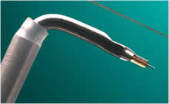
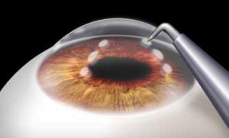
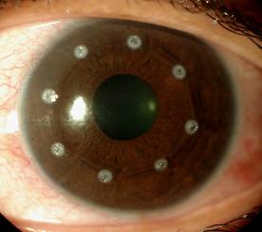
Refractive Surgery Overview
CK probe
CK in action
CK scars

Slide 172
Refractive Surgery Overview
Refractive
Surgery
Intraocular
Corneal
In CK, a thermal probe is used to produce a set of focal corneal scars. The scars produce local corneal steepening , thereby increasing convergence and improving vision at near.
The SAI is a tiny donut-shaped disc that is implanted in the central corneal stroma. Its central aperture produces a pinhole effect to improve near vision.
Like the SAI, the CRI is a tiny device implanted in the central corneal stroma. However, its mechanism of action is different—it is disc-shaped with a central ‘bump’ that increases the curvature of the overlying corneal surface, which in turn increases corneal convergence and thus improves near vision.
Pseudophakic
Phakic IOL
Incisional
Laser
Other
describe it—size, shape
RK
PRK
where?
AK
LASEK
LRI
Epi-LASIK
LASIK
SMILE
Conductive Keratoplasty
CK
Small Aperture Inlay
SAI
Corneal Reshaping Inlay
CRI
Corneal CROSS Linking
CXL
Intrastromal Corneal Ring Segments
ICRS

Slide 173
Refractive Surgery Overview
Refractive
Surgery
Intraocular
Corneal
In CK, a thermal probe is used to produce a set of focal corneal scars. The scars produce local corneal steepening , thereby increasing convergence and improving vision at near.
The SAI is a tiny donut-shaped disc that is implanted in the central corneal stroma. Its central aperture produces a pinhole effect to improve near vision.
Like the SAI, the CRI is a tiny device implanted in the central corneal stroma. However, its mechanism of action is different—it is disc-shaped with a central ‘bump’ that increases the curvature of the overlying corneal surface, which in turn increases corneal convergence and thus improves near vision.
Pseudophakic
Phakic IOL
Incisional
Laser
Other
RK
PRK
AK
LASEK
LRI
Epi-LASIK
LASIK
SMILE
Conductive Keratoplasty
CK
Small Aperture Inlay
SAI
Corneal Reshaping Inlay
CRI
Corneal CROSS Linking
CXL
Intrastromal Corneal Ring Segments
ICRS

Slide 174
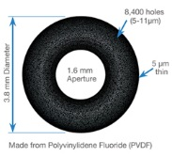
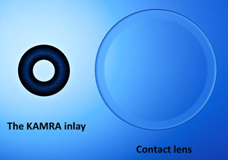
Refractive Surgery Overview
SAI

Slide 175
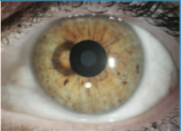
Refractive Surgery Overview
SAI

Slide 176
Refractive Surgery Overview
Refractive
Surgery
Intraocular
Corneal
In CK, a thermal probe is used to produce a set of focal corneal scars. The scars produce local corneal steepening , thereby increasing convergence and improving vision at near.
The SAI is a tiny donut-shaped disc that is implanted in the central corneal stroma. Its central aperture produces a pinhole effect to improve near vision.
Like the SAI, the CRI is a tiny device implanted in the central corneal stroma. However, its mechanism of action is different—it is disc-shaped with a central ‘bump’ that increases the curvature of the overlying corneal surface, which in turn increases corneal convergence and thus improves near vision.
Pseudophakic
Phakic IOL
Incisional
Laser
Other
RK
PRK
AK
LASEK
LRI
Epi-LASIK
shape
shape
increases v decreases
LASIK
convergence v divergence
SMILE
Conductive Keratoplasty
CK
Small Aperture Inlay
SAI
Corneal Reshaping Inlay
CRI
Corneal CROSS Linking
CXL
Intrastromal Corneal Ring Segments
ICRS

Slide 177
Refractive Surgery Overview
Refractive
Surgery
Intraocular
Corneal
In CK, a thermal probe is used to produce a set of focal corneal scars. The scars produce local corneal steepening , thereby increasing convergence and improving vision at near.
The SAI is a tiny donut-shaped disc that is implanted in the central corneal stroma. Its central aperture produces a pinhole effect to improve near vision.
Like the SAI, the CRI is a tiny device implanted in the central corneal stroma. However, its mechanism of action is different—it is disc-shaped with a central ‘bump’ that increases the curvature of the overlying corneal surface, which in turn increases corneal convergence and thus improves near vision.
Pseudophakic
Phakic IOL
Incisional
Laser
Other
RK
PRK
AK
LASEK
LRI
Epi-LASIK
LASIK
SMILE
Conductive Keratoplasty
CK
Small Aperture Inlay
SAI
Corneal Reshaping Inlay
CRI
Corneal CROSS Linking
CXL
Intrastromal Corneal Ring Segments
ICRS

Slide 178
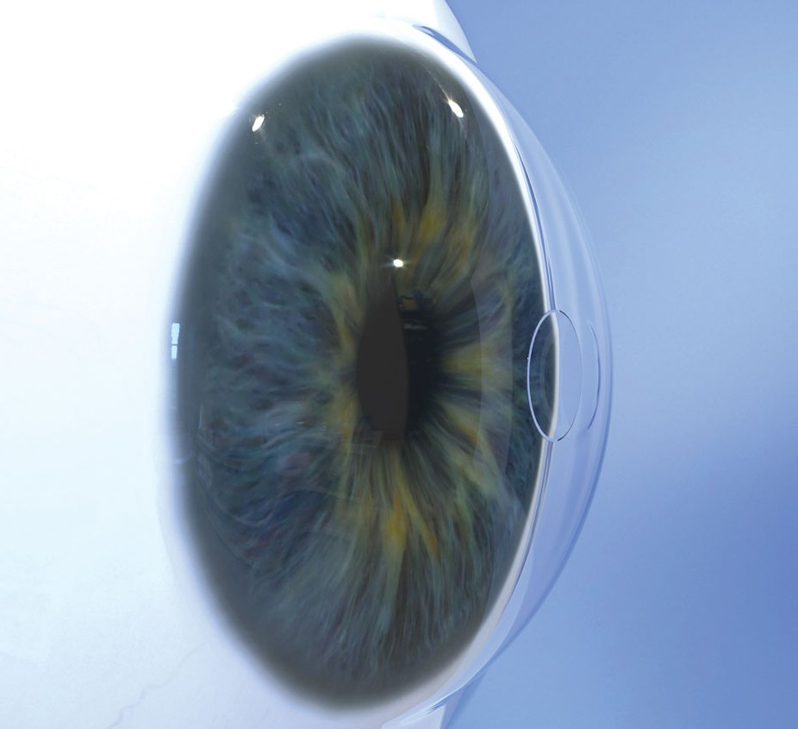
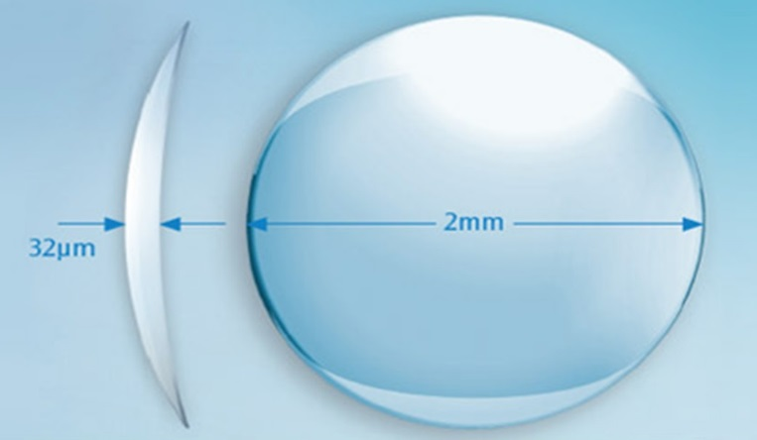
Refractive Surgery Overview
CRI

Slide 179
Refractive Surgery Overview
Refractive
Surgery
Intraocular
Corneal
Pseudophakic
Phakic IOL
Incisional
Laser
Other
RK
PRK
AK
LASEK
LRI
Epi-LASIK
LASIK
SMILE
CXL involves the induction of a chemical reaction that strengthens the bonds between corneal stroma fibrils . The result is a stabilization of the keratoconus process.
ICRS employs semicircular segments of PMMA. These segments are placed in the peripheral corneal stroma, where they produce local flattening.
Conductive Keratoplasty
CK
Small Aperture Inlay
SAI
Corneal Reshaping Inlay
CRI
Corneal CROSS Linking
CXL
Intrastromal Corneal Ring Segments
ICRS

Slide 180
Refractive Surgery Overview
Refractive
Surgery
Intraocular
Corneal
Pseudophakic
Phakic IOL
Incisional
Laser
Other
RK
PRK
AK
LASEK
LRI
Epi-LASIK
LASIK
SMILE
CXL involves the induction of a chemical reaction that strengthens the bonds between corneal stroma fibrils . The result is a stabilization of the keratoconus process.
ICRS employs semicircular segments of PMMA. These segments are placed in the peripheral corneal stroma, where they produce local flattening.
Conductive Keratoplasty
CK
Small Aperture Inlay
SAI
Corneal Reshaping Inlay
CRI
Corneal CROSS Linking
CXL
Intrastromal Corneal Ring Segments
ICRS

Slide 181
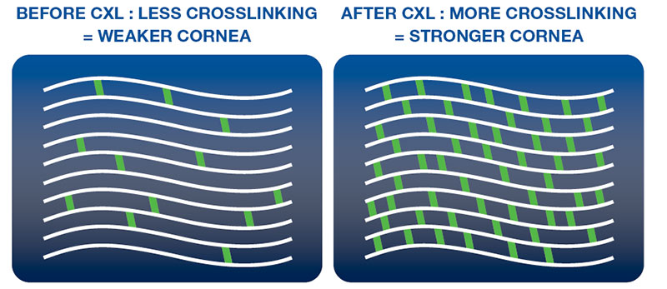
Refractive Surgery Overview
CXL concept

Slide 182
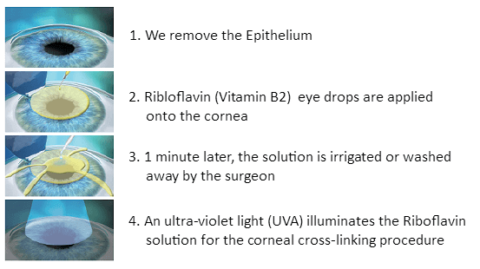
Refractive Surgery Overview
CXL: Process

Slide 183
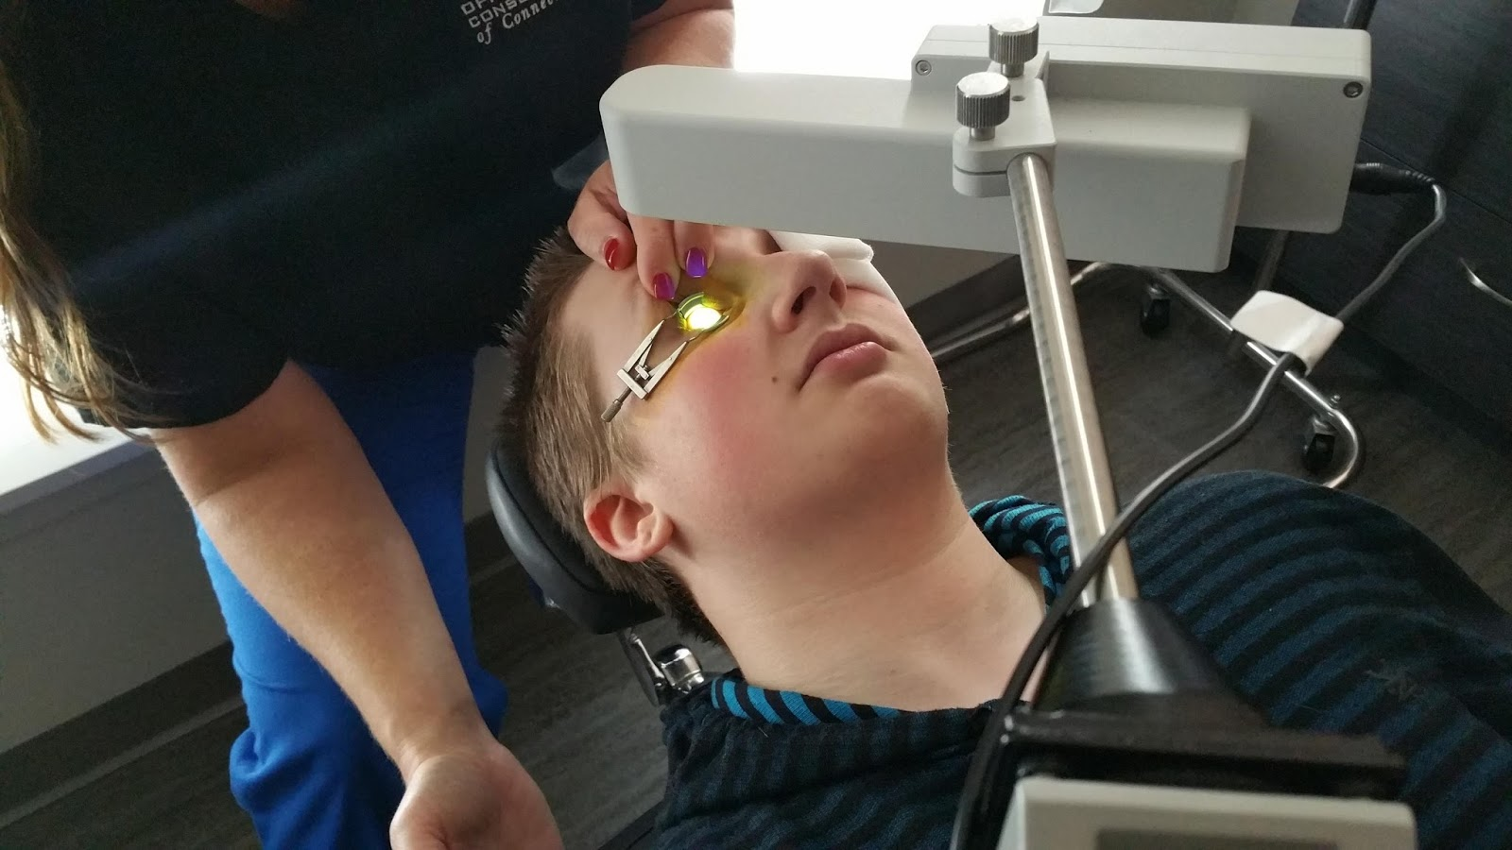
Refractive Surgery Overview
CXL: Process

Slide 184
Refractive Surgery Overview
Refractive
Surgery
Intraocular
Corneal
Pseudophakic
Phakic IOL
Incisional
Laser
Other
RK
PRK
AK
LASEK
LRI
Epi-LASIK
LASIK
SMILE
CXL involves the induction of a chemical reaction that strengthens the bonds between corneal stroma fibrils . The result is a stabilization of the keratoconus process.
ICRS employs semicircular segments of PMMA . These segments are placed in the peripheral corneal stroma , where they produce local flattening .
Conductive Keratoplasty
CK
shape
abb.
Small Aperture Inlay
SAI
layer
flattening v steepening
Corneal Reshaping Inlay
CRI
Corneal CROSS Linking
CXL
Intrastromal Corneal Ring Segments
ICRS

Slide 185
Refractive Surgery Overview
Refractive
Surgery
Intraocular
Corneal
Pseudophakic
Phakic IOL
Incisional
Laser
Other
RK
PRK
AK
LASEK
LRI
Epi-LASIK
LASIK
SMILE
CXL involves the induction of a chemical reaction that strengthens the bonds between corneal stroma fibrils . The result is a stabilization of the keratoconus process.
ICRS employs semicircular segments of PMMA . These segments are placed in the peripheral corneal stroma , where they produce local flattening .
Conductive Keratoplasty
CK
Small Aperture Inlay
SAI
Corneal Reshaping Inlay
CRI
Corneal CROSS Linking
CXL
Intrastromal Corneal Ring Segments
ICRS

Slide 186
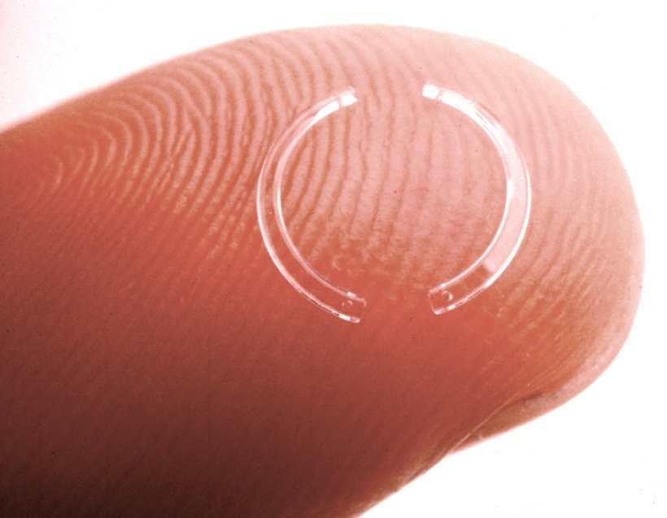
Refractive Surgery Overview
Intrastromal ring segments

Slide 187
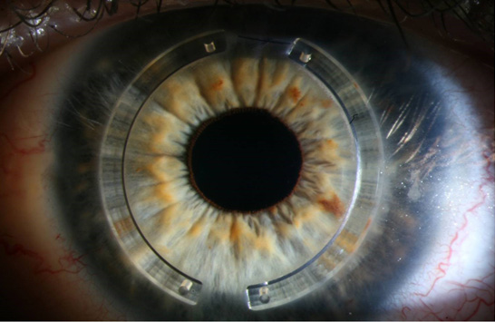
Refractive Surgery Overview
Intrastromal ring segments in situ

Slide 188
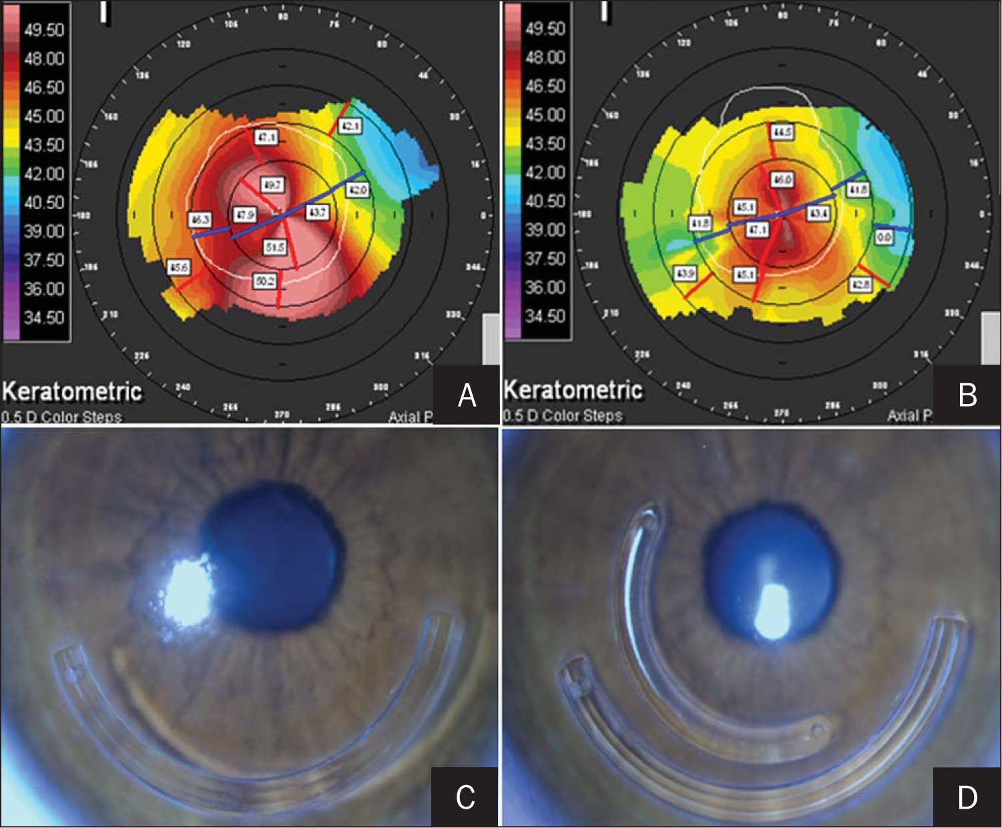
Refractive Surgery Overview
Intrastromal ring segments placed for KCN

