Slide 1
Before you begin: This is a big topic, and big topics beget big slide-sets. There’s a natural break around slide 210; I placed a break time! slide at that point.

Slide 2
Uveitis
Technically speaking, the term uveitis refers to inflammation of one or more components of the uvea .

Slide 3
Uveitis
Technically speaking, the term uveitis refers to inflammation of one or more components of the uvea .

Slide 4
Uveitis
Technically speaking, the term uveitis refers to inflammation of one or more components of the uvea . Three structures comprise the uvea: The choroid, ciliary body and iris .

Slide 5
Uveitis
Technically speaking, the term uveitis refers to inflammation of one or more components of the uvea . Three structures comprise the uvea: The choroid, ciliary body and iris .

Slide 6
Uveitis
Technically speaking, the term uveitis refers to inflammation of one or more components of the uvea . Three structures comprise the uvea: The choroid, ciliary body and iris . As is always the case with inflammatory disease, the etiology of ocular inflammation can be infectious or noninfectious .

Slide 7
Uveitis
Technically speaking, the term uveitis refers to inflammation of one or more components of the uvea . Three structures comprise the uvea: The choroid, ciliary body and iris . As is always the case with inflammatory disease, the etiology of ocular inflammation can be infectious or noninfectious .

Slide 8
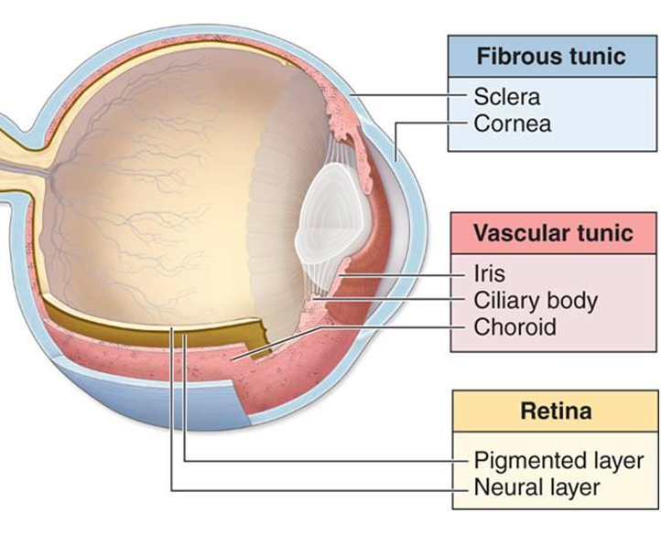
Uveitis
Uvea
Think of the eye as being composed of three layers or ‘tunics.’ The sclera and cornea comprise the tough, outer tunic.

Slide 9
Uveitis
Uvea
Think of the eye as being composed of three layers or ‘tunics.’ The sclera and cornea comprise the tough, outer tunic.

Slide 10
Uveitis
Uvea
Think of the eye as being composed of three layers or ‘tunics.’ The sclera and cornea comprise the tough, outer tunic. The RPE and neurosensory retina comprise the innermost ‘retinal’ tunic.
abb.
two words

Slide 11
Uveitis
Uvea
Think of the eye as being composed of three layers or ‘tunics.’ The sclera and cornea comprise the tough, outer tunic. The RPE and neurosensory retina comprise the innermost ‘retinal’ tunic.

Slide 12
Uveitis
Uvea
Think of the eye as being composed of three layers or ‘tunics.’ The sclera and cornea comprise the tough, outer tunic. The RPE and neurosensory retina comprise the innermost ‘retinal’ tunic. In between these two is the highly vascular, highly pigmented tunic known as the uvea. (The word uvea derives from the Greek word for ‘grape’—an acknowledgement of the deep-purple color characteristic of most of the uvea.)

Slide 13
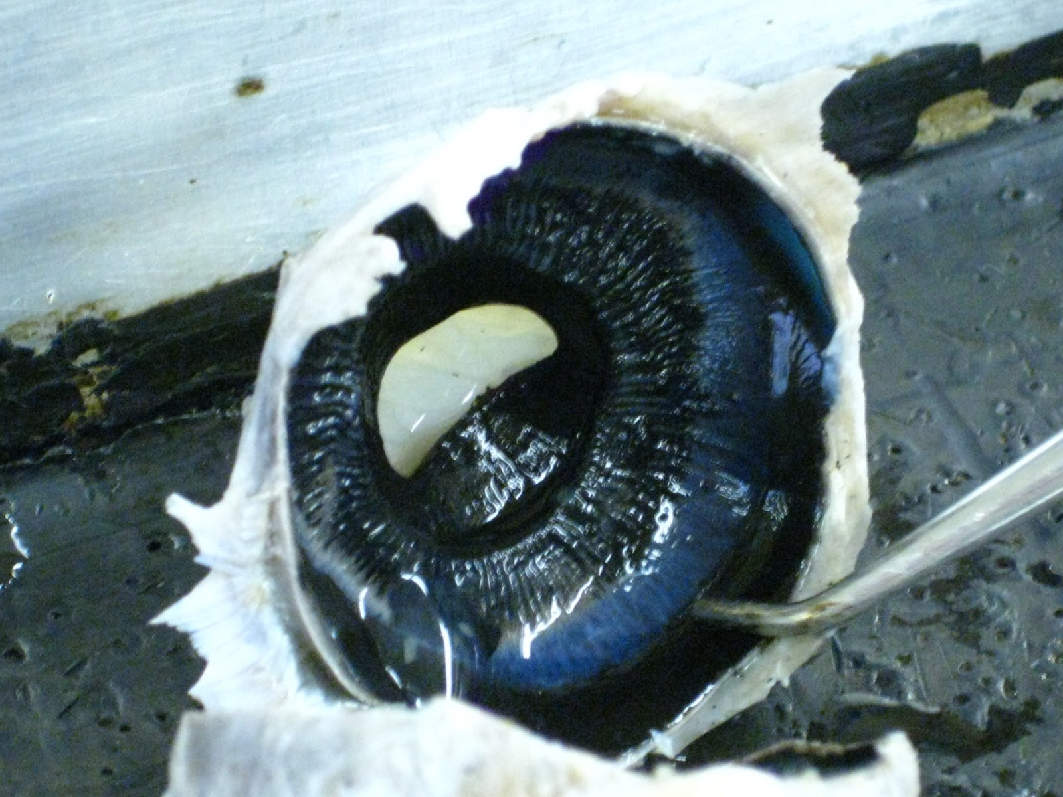
Uveitis
Uveal tissue. Note the deep purple hue

Slide 14
Uveitis
Technically speaking, the term uveitis refers to inflammation of one or more components of the uvea . Three structures comprise the uvea: The choroid, ciliary body and iris . As is always the case with inflammatory disease, the etiology of ocular inflammation can be infectious or noninfectious .
I say ‘technically speaking’ because in clinical practice, uveitis refers to inflammatory processes involving most non-uveal segments of the eye as well, including (but not limited to) the retina, optic nerve, sclera, etc.

Slide 15
Uveitis
Technically speaking, the term uveitis refers to inflammation of one or more components of the uvea . Three structures comprise the uvea: The choroid, ciliary body and iris . As is always the case with inflammatory disease, the etiology of ocular inflammation can be infectious or noninfectious .
I say ‘technically speaking’ because in clinical practice, uveitis refers to inflammatory processes involving most non-uveal segments of the eye as well, including (but not limited to) the retina, optic nerve, sclera, etc.
In many uveitis cases, the observed inflammation is the product of an ocular disease. However, in some the ocular inflammation is actually a manifestation of a systemic inflammatory condition.

Slide 16
Uveitis
Technically speaking, the term uveitis refers to inflammation of one or more components of the uvea . Three structures comprise the uvea: The choroid, ciliary body and iris . As is always the case with inflammatory disease, the etiology of ocular inflammation can be infectious or noninfectious .
I say ‘technically speaking’ because in clinical practice, uveitis refers to inflammatory processes involving most non-uveal segments of the eye as well, including (but not limited to) the retina, optic nerve, sclera, etc.
In many uveitis cases, the observed inflammation is the product of an ocular disease. However, in some the ocular inflammation is actually a manifestation of a systemic inflammatory condition. A key component of uveitis management is distinguishing between ocular-only and systemic cases, as the two require different responses on the part of the treating physician. Because of this, a significant component of uveitis education involves learning how to discern which cases are which.

Slide 17
Uveitis
Technically speaking, the term uveitis refers to inflammation of one or more components of the uvea . Three structures comprise the uvea: The choroid, ciliary body and iris . As is always the case with inflammatory disease, the etiology of ocular inflammation can be infectious or noninfectious .
I say ‘technically speaking’ because in clinical practice, uveitis refers to inflammatory processes involving most non-uveal segments of the eye as well, including (but not limited to) the retina, optic nerve, sclera, etc.
In many uveitis cases, the observed inflammation is the product of an ocular disease. However, in some the ocular inflammation is actually a manifestation of a systemic inflammatory condition. A key component of uveitis management is distinguishing between ocular-only and systemic cases, as the two require different responses on the part of the treating physician. Because of this, a significant component of uveitis education involves learning how to discern which cases are which.
Identifying a uveitis is, in essence, a pattern-recognition task. The uveitides do not present in random fashion; rather, they ‘select’ their victims based on pt demographics. Likewise, the nonocular manifestations of those 2ndry to a systemic condition tend to follow specific patterns as well. Each tends to affect the eye in a characteristic manner.

Slide 18
Uveitis
Technically speaking, the term uveitis refers to inflammation of one or more components of the uvea . Three structures comprise the uvea: The choroid, ciliary body and iris . As is always the case with inflammatory disease, the etiology of ocular inflammation can be infectious or noninfectious .
I say ‘technically speaking’ because in clinical practice, uveitis refers to inflammatory processes involving most non-uveal segments of the eye as well, including (but not limited to) the retina, optic nerve, sclera, etc.
In many uveitis cases, the observed inflammation is the product of an ocular disease. However, in some the ocular inflammation is actually a manifestation of a systemic inflammatory condition. A key component of uveitis management is distinguishing between ocular-only and systemic cases, as the two require different responses on the part of the treating physician. Because of this, a significant component of uveitis education involves learning how to discern which cases are which.
Identifying a uveitis is, in essence, a pattern-recognition task. The uveitides do not present in random fashion; rather, they ‘select’ their victims based on pt demographics. Likewise, the nonocular manifestations of those 2ndry to a systemic condition tend to follow specific patterns as well. Each tends to affect the eye in a characteristic manner.
With respect to uveitis, the most important aspects of a pt’s demographics are age, gender, and ethnicity.
three things

Slide 19
Uveitis
Technically speaking, the term uveitis refers to inflammation of one or more components of the uvea . Three structures comprise the uvea: The choroid, ciliary body and iris . As is always the case with inflammatory disease, the etiology of ocular inflammation can be infectious or noninfectious .
I say ‘technically speaking’ because in clinical practice, uveitis refers to inflammatory processes involving most non-uveal segments of the eye as well, including (but not limited to) the retina, optic nerve, sclera, etc.
In many uveitis cases, the observed inflammation is the product of an ocular disease. However, in some the ocular inflammation is actually a manifestation of a systemic inflammatory condition. A key component of uveitis management is distinguishing between ocular-only and systemic cases, as the two require different responses on the part of the treating physician. Because of this, a significant component of uveitis education involves learning how to discern which cases are which.
Identifying a uveitis is, in essence, a pattern-recognition task. The uveitides do not present in random fashion; rather, they ‘select’ their victims based on pt demographics. Likewise, the nonocular manifestations of those 2ndry to a systemic condition tend to follow specific patterns as well. Each tends to affect the eye in a characteristic manner.
With respect to uveitis, the most important aspects of a pt’s demographics are age, gender, and ethnicity.

Slide 20
Uveitis
Technically speaking, the term uveitis refers to inflammation of one or more components of the uvea . Three structures comprise the uvea: The choroid, ciliary body and iris . As is always the case with inflammatory disease, the etiology of ocular inflammation can be infectious or noninfectious .
I say ‘technically speaking’ because in clinical practice, uveitis refers to inflammatory processes involving most non-uveal segments of the eye as well, including (but not limited to) the retina, optic nerve, sclera, etc.
In many uveitis cases, the observed inflammation is the product of an ocular disease. However, in some the ocular inflammation is actually a manifestation of a systemic inflammatory condition. A key component of uveitis management is distinguishing between ocular-only and systemic cases, as the two require different responses on the part of the treating physician. Because of this, a significant component of uveitis education involves learning how to discern which cases are which.
Identifying a uveitis is, in essence, a pattern-recognition task. The uveitides do not present in random fashion; rather, they ‘select’ their victims based on pt demographics. Likewise, the nonocular manifestations of those 2ndry to a systemic condition tend to follow specific patterns as well. Each tends to affect the eye in a characteristic manner.
Other important demographic factors include:
--?
--?
--?
With respect to uveitis, the most important aspects of a pt’s demographics are age, gender, and ethnicity.

Slide 21
Uveitis
Technically speaking, the term uveitis refers to inflammation of one or more components of the uvea . Three structures comprise the uvea: The choroid, ciliary body and iris . As is always the case with inflammatory disease, the etiology of ocular inflammation can be infectious or noninfectious .
I say ‘technically speaking’ because in clinical practice, uveitis refers to inflammatory processes involving most non-uveal segments of the eye as well, including (but not limited to) the retina, optic nerve, sclera, etc.
In many uveitis cases, the observed inflammation is the product of an ocular disease. However, in some the ocular inflammation is actually a manifestation of a systemic inflammatory condition. A key component of uveitis management is distinguishing between ocular-only and systemic cases, as the two require different responses on the part of the treating physician. Because of this, a significant component of uveitis education involves learning how to discern which cases are which.
Identifying a uveitis is, in essence, a pattern-recognition task. The uveitides do not present in random fashion; rather, they ‘select’ their victims based on pt demographics. Likewise, the nonocular manifestations of those 2ndry to a systemic condition tend to follow specific patterns as well. Each tends to affect the eye in a characteristic manner.
Other important demographic factors include:
--Geographic history, ie, where they have lived or visited
--Social history (eg, sexual behaviors; dietary habits; IVDU)
--Vocational/avocational activities (eg, exposure to farm animals)
With respect to uveitis, the most important aspects of a pt’s demographics are age, gender, and ethnicity.

Slide 22
Uveitis
Technically speaking, the term uveitis refers to inflammation of one or more components of the uvea . Three structures comprise the uvea: The choroid, ciliary body and iris . As is always the case with inflammatory disease, the etiology of ocular inflammation can be infectious or noninfectious .
I say ‘technically speaking’ because in clinical practice, uveitis refers to inflammatory processes involving most non-uveal segments of the eye as well, including (but not limited to) the retina, optic nerve, sclera, etc.
In many uveitis cases, the observed inflammation is the product of an ocular disease. However, in some the ocular inflammation is actually a manifestation of a systemic inflammatory condition. A key component of uveitis management is distinguishing between ocular-only and systemic cases, as the two require different responses on the part of the treating physician. Because of this, a significant component of uveitis education involves learning how to discern which cases are which.
Identifying a uveitis is, in essence, a pattern-recognition task. The uveitides do not present in random fashion; rather, they ‘select’ their victims based on pt demographics. Likewise, the nonocular manifestations of those 2ndry to a systemic condition tend to follow specific patterns as well. Each tends to affect the eye in a characteristic manner.
Because nonocular manifestations are so important in identifying the underlying cause of a uveitis, a thorough review of systems and physical exam are absolutely essential in uveitis management. Some uveitis experts maintain that a careful and complete ROS is the single most important component of a uveitis evaluation.

Slide 23
Uveitis
Technically speaking, the term uveitis refers to inflammation of one or more components of the uvea . Three structures comprise the uvea: The choroid, ciliary body and iris . As is always the case with inflammatory disease, the etiology of ocular inflammation can be infectious or noninfectious .
I say ‘technically speaking’ because in clinical practice, uveitis refers to inflammatory processes involving most non-uveal segments of the eye as well, including (but not limited to) the retina, optic nerve, sclera, etc.
In many uveitis cases, the observed inflammation is the product of an ocular disease. However, in some the ocular inflammation is actually a manifestation of a systemic inflammatory condition. A key component of uveitis management is distinguishing between ocular-only and systemic cases, as the two require different responses on the part of the treating physician. Because of this, a significant component of uveitis education involves learning how to discern which cases are which.
Identifying a uveitis is, in essence, a pattern-recognition task. The uveitides do not present in random fashion; rather, they ‘select’ their victims based on pt demographics. Likewise, the nonocular manifestations of those 2ndry to a systemic condition tend to follow specific patterns as well. Each tends to affect the eye in a characteristic manner.
Because nonocular manifestations are so important in identifying the underlying cause of a uveitis, a thorough review of systems and physical exam are absolutely essential in uveitis management. Some uveitis experts maintain that a careful and complete ROS is the single most important component of a uveitis evaluation.

Slide 24
Uveitis
Technically speaking, the term uveitis refers to inflammation of one or more components of the uvea . Three structures comprise the uvea: The choroid, ciliary body and iris . As is always the case with inflammatory disease, the etiology of ocular inflammation can be infectious or noninfectious .
I say ‘technically speaking’ because in clinical practice, uveitis refers to inflammatory processes involving most non-uveal segments of the eye as well, including (but not limited to) the retina, optic nerve, sclera, etc.
In many uveitis cases, the observed inflammation is the product of an ocular disease. However, in some the ocular inflammation is actually a manifestation of a systemic inflammatory condition. A key component of uveitis management is distinguishing between ocular-only and systemic cases, as the two require different responses on the part of the treating physician. Because of this, a significant component of uveitis education involves learning how to discern which cases are which.
Identifying a uveitis is, in essence, a pattern-recognition task. The uveitides do not present in random fashion; rather, they ‘select’ their victims based on pt demographics. Likewise, the nonocular manifestations of those 2ndry to a systemic condition tend to follow specific patterns as well. Each tends to affect the eye in a characteristic manner.
What needs to be covered in the ROS? Everything! The following list is by no means complete:
--Constitutional: Fever; night sweats; weight loss
--Neuro: HA; cranial neuropathies; hearing loss; cognitive changes
--ENT: Oral ulcers; sinusitis; ear or nose deformities
--Skin: Rashes; poliosis, madarosis; vitiligo; erythema nodosum
--Pulmonary: SOB/DOE; cough; hemoptysis
--Cardiac; Arrythmias; pericarditis symptoms
--GI: Diarrhea; ulcers
--GU; Genital lesions; discharge; nephritis symptoms
--Musculoskeletal: Arthralgias; low back pain
Because nonocular manifestations are so important in identifying the underlying cause of a uveitis, a thorough review of systems and physical exam are absolutely essential in uveitis management. Some uveitis experts maintain that a careful and complete ROS is the single most important component of a uveitis evaluation.

Slide 25
Uveitis
Technically speaking, the term uveitis refers to inflammation of one or more components of the uvea . Three structures comprise the uvea: The choroid, ciliary body and iris . As is always the case with inflammatory disease, the etiology of ocular inflammation can be infectious or noninfectious .
I say ‘technically speaking’ because in clinical practice, uveitis refers to inflammatory processes involving most non-uveal segments of the eye as well, including (but not limited to) the retina, optic nerve, sclera, etc.
In many uveitis cases, the observed inflammation is the product of an ocular disease. However, in some the ocular inflammation is actually a manifestation of a systemic inflammatory condition. A key component of uveitis management is distinguishing between ocular-only and systemic cases, as the two require different responses on the part of the treating physician. Because of this, a significant component of uveitis education involves learning how to discern which cases are which.
Identifying a uveitis is, in essence, a pattern-recognition task. The uveitides do not present in random fashion; rather, they ‘select’ their victims based on pt demographics. Likewise, the nonocular manifestations of those 2ndry to a systemic condition tend to follow specific patterns as well. Each tends to affect the eye in a characteristic manner.
Let’s drill down on the different ways uveitis manifests within the eye. One very important manifestation issue is location, ie, the portion or segment of the eye that’s involved.

Slide 26
Uveitis
?
?
?
?
What are the four basic anatomic locations for uveitis?

Slide 27
Uveitis
Panuveitis
Posterior
Intermediate
Anterior
What are the four basic anatomic locations for uveitis?

Slide 28
Uveitis
Panuveitis
Posterior
Intermediate
Anterior
In anterior uveitis, the primary location of inflammation is the anterior chamber and/or anterior vitreous
two words
two words

Slide 29
Uveitis
Panuveitis
Posterior
Intermediate
Anterior
In anterior uveitis, the primary location of inflammation is the anterior chamber and/or anterior vitreous

Slide 30
Uveitis
Anterior uveitis
If cell is located…
Exclusively in the AC
The onset, duration and course of the uveitis
--Onset: Sudden vs insidious
--Duration: Limited vs persistent
--Course: Acute vs recurrent vs
chronic
It is called:
?
In anterior uveitis, the primary location of inflammation is the anterior chamber and/or anterior vitreous

Slide 31
Uveitis
Anterior uveitis
If cell is located…
Exclusively in the AC
The onset, duration and course of the uveitis
--Onset: Sudden vs insidious
--Duration: Limited vs persistent
--Course: Acute vs recurrent vs
chronic
It is called:
Iritis
In anterior uveitis, the primary location of inflammation is the anterior chamber and/or anterior vitreous

Slide 32
Uveitis
Anterior uveitis
If cell is located…
Exclusively in the AC
Exclusively in the AVit
The severity of the uveitis
--AC cell grade
--AC flare grade
--Vitreous haze score
The onset, duration and course of the uveitis
--Onset: Sudden vs insidious
--Duration: Limited vs persistent
--Course: Acute vs recurrent vs
chronic
It is called:
It is called:
Iritis
?
In anterior uveitis, the primary location of inflammation is the anterior chamber and/or anterior vitreous

Slide 33
Uveitis
Anterior uveitis
If cell is located…
Exclusively in the AC
Exclusively in the AVit
The severity of the uveitis
--AC cell grade
--AC flare grade
--Vitreous haze score
The onset, duration and course of the uveitis
--Onset: Sudden vs insidious
--Duration: Limited vs persistent
--Course: Acute vs recurrent vs
chronic
It is called:
It is called:
Iritis
Anterior
cyclitis
In anterior uveitis, the primary location of inflammation is the anterior chamber and/or anterior vitreous

Slide 34
Uveitis
Anterior uveitis
If cell is located…
Exclusively in the AC
In the AC and the anterior vitreous
Exclusively in the AVit
The severity of the uveitis
--AC cell grade
--AC flare grade
--Vitreous haze score
The onset, duration and course of the uveitis
--Onset: Sudden vs insidious
--Duration: Limited vs persistent
--Course: Acute vs recurrent vs
chronic
It is called:
It is called:
It is called:
Iritis
?
Anterior
cyclitis
In anterior uveitis, the primary location of inflammation is the anterior chamber and/or anterior vitreous

Slide 35
Uveitis
Anterior uveitis
If cell is located…
Exclusively in the AC
In the AC and the anterior vitreous
Exclusively in the AVit
The severity of the uveitis
--AC cell grade
--AC flare grade
--Vitreous haze score
The onset, duration and course of the uveitis
--Onset: Sudden vs insidious
--Duration: Limited vs persistent
--Course: Acute vs recurrent vs
chronic
It is called:
It is called:
It is called:
Iritis
Iridocyclitis
Anterior
cyclitis
In anterior uveitis, the primary location of inflammation is the anterior chamber and/or anterior vitreous

Slide 36
Uveitis
Panuveitis
Posterior
Intermediate
Anterior
In intermediate uveitis, the primary location of inflammation is the main vitreous cavity , +/- the peripheral retina
three words
two words

Slide 37
Uveitis
Panuveitis
Posterior
Intermediate
Anterior
In intermediate uveitis, the primary location of inflammation is the main vitreous cavity , +/- the peripheral retina

Slide 38
Uveitis
Intermediate uveitis
If condition is…
How we
divvy up IU
?
?
The onset, duration and course of the uveitis
--Onset: Sudden vs insidious
--Duration: Limited vs persistent
--Course: Acute vs recurrent vs
chronic
The onset, duration and course of the uveitis
--Onset: Sudden vs insidious
--Duration: Limited vs persistent
--Course: Acute vs recurrent vs
chronic
In intermediate uveitis, the primary location of inflammation is the main vitreous cavity , +/- the peripheral retina

Slide 39
Uveitis
Intermediate uveitis
If condition is…
How we
divvy up IU
Idiopathic
Not idiopathic
The onset, duration and course of the uveitis
--Onset: Sudden vs insidious
--Duration: Limited vs persistent
--Course: Acute vs recurrent vs
chronic
The onset, duration and course of the uveitis
--Onset: Sudden vs insidious
--Duration: Limited vs persistent
--Course: Acute vs recurrent vs
chronic
In intermediate uveitis, the primary location of inflammation is the main vitreous cavity , +/- the peripheral retina

Slide 40
Uveitis
Intermediate uveitis
If condition is…
How we
divvy up IU
Idiopathic
Not idiopathic
The onset, duration and course of the uveitis
--Onset: Sudden vs insidious
--Duration: Limited vs persistent
--Course: Acute vs recurrent vs
chronic
The onset, duration and course of the uveitis
--Onset: Sudden vs insidious
--Duration: Limited vs persistent
--Course: Acute vs recurrent vs
chronic
It is called:
?
In intermediate uveitis, the primary location of inflammation is the main vitreous cavity , +/- the peripheral retina

Slide 41
Uveitis
Intermediate uveitis
If condition is…
How we
divvy up IU
Idiopathic
Not idiopathic
The onset, duration and course of the uveitis
--Onset: Sudden vs insidious
--Duration: Limited vs persistent
--Course: Acute vs recurrent vs
chronic
The onset, duration and course of the uveitis
--Onset: Sudden vs insidious
--Duration: Limited vs persistent
--Course: Acute vs recurrent vs
chronic
It is called:
Pars planitis
In intermediate uveitis, the primary location of inflammation is the main vitreous cavity , +/- the peripheral retina

Slide 42
Uveitis
Intermediate uveitis
If condition is…
How we
divvy up IU
Idiopathic
Not idiopathic
The onset, duration and course of the uveitis
--Onset: Sudden vs insidious
--Duration: Limited vs persistent
--Course: Acute vs recurrent vs
chronic
The onset, duration and course of the uveitis
--Onset: Sudden vs insidious
--Duration: Limited vs persistent
--Course: Acute vs recurrent vs
chronic
It is called:
It is called:
Pars planitis
?
In intermediate uveitis, the primary location of inflammation is the main vitreous cavity , +/- the peripheral retina

Slide 43
Uveitis
Intermediate uveitis
If condition is…
How we
divvy up IU
Idiopathic
Not idiopathic
The onset, duration and course of the uveitis
--Onset: Sudden vs insidious
--Duration: Limited vs persistent
--Course: Acute vs recurrent vs
chronic
The onset, duration and course of the uveitis
--Onset: Sudden vs insidious
--Duration: Limited vs persistent
--Course: Acute vs recurrent vs
chronic
It is called:
It is called:
Pars planitis
Intermediate
uveitis
In intermediate uveitis, the primary location of inflammation is the main vitreous cavity , +/- the peripheral retina

Slide 44
Uveitis
Panuveitis
Posterior
Intermediate
Anterior
In posterior uveitis, the site of inflammation is the retina and/or choroid (the optic nerve head can be involved too)
three words

Slide 45
Uveitis
Panuveitis
Posterior
Intermediate
Anterior
In posterior uveitis, the site of inflammation is the retina and/or choroid (the optic nerve head can be involved too)

Slide 46
Uveitis
Posterior uveitis
If inflammation is located…
Exclusively in the choroid
The onset, duration and course of the uveitis
--Onset: Sudden vs insidious
--Duration: Limited vs persistent
--Course: Acute vs recurrent vs
chronic
The onset, duration and course of the uveitis
--Onset: Sudden vs insidious
--Duration: Limited vs persistent
--Course: Acute vs recurrent vs
chronic
It is called:
?
In posterior uveitis, the site of inflammation is the retina and/or choroid (the optic nerve head can be involved too)

Slide 47
Uveitis
Posterior uveitis
If inflammation is located…
Exclusively in the choroid
The onset, duration and course of the uveitis
--Onset: Sudden vs insidious
--Duration: Limited vs persistent
--Course: Acute vs recurrent vs
chronic
The onset, duration and course of the uveitis
--Onset: Sudden vs insidious
--Duration: Limited vs persistent
--Course: Acute vs recurrent vs
chronic
It is called:
Choroiditis
In posterior uveitis, the site of inflammation is the retina and/or choroid (the optic nerve head can be involved too)

Slide 48
Uveitis
Posterior uveitis
If inflammation is located…
Exclusively in the choroid
Exclusively in the retina
The severity of the uveitis
--AC cell grade
--AC flare grade
--Vitreous haze score
The onset, duration and course of the uveitis
--Onset: Sudden vs insidious
--Duration: Limited vs persistent
--Course: Acute vs recurrent vs
chronic
The severity of the uveitis
--AC cell grade
--AC flare grade
--Vitreous haze score
The onset, duration and course of the uveitis
--Onset: Sudden vs insidious
--Duration: Limited vs persistent
--Course: Acute vs recurrent vs
chronic
It is called:
It is called:
Choroiditis
?
In posterior uveitis, the site of inflammation is the retina and/or choroid (the optic nerve head can be involved too)

Slide 49
Uveitis
Posterior uveitis
If inflammation is located…
Exclusively in the choroid
Exclusively in the retina
The severity of the uveitis
--AC cell grade
--AC flare grade
--Vitreous haze score
The onset, duration and course of the uveitis
--Onset: Sudden vs insidious
--Duration: Limited vs persistent
--Course: Acute vs recurrent vs
chronic
The severity of the uveitis
--AC cell grade
--AC flare grade
--Vitreous haze score
The onset, duration and course of the uveitis
--Onset: Sudden vs insidious
--Duration: Limited vs persistent
--Course: Acute vs recurrent vs
chronic
It is called:
It is called:
Choroiditis
Retinitis
In posterior uveitis, the site of inflammation is the retina and/or choroid (the optic nerve head can be involved too)

Slide 50
Uveitis
Posterior uveitis
If inflammation is located…
Exclusively in the choroid
In both the choroid and the retina
Exclusively in the retina
The severity of the uveitis
--AC cell grade
--AC flare grade
--Vitreous haze score
The onset, duration and course of the uveitis
--Onset: Sudden vs insidious
--Duration: Limited vs persistent
--Course: Acute vs recurrent vs
chronic
The severity of the uveitis
--AC cell grade
--AC flare grade
--Vitreous haze score
The onset, duration and course of the uveitis
--Onset: Sudden vs insidious
--Duration: Limited vs persistent
--Course: Acute vs recurrent vs
chronic
It is called:
It is called:
It is called:
Choroiditis
?
Retinitis
In posterior uveitis, the site of inflammation is the retina and/or choroid (the optic nerve head can be involved too)

Slide 51
Uveitis
Posterior uveitis
If inflammation is located…
Exclusively in the choroid
In both the choroid and the retina
Exclusively in the retina
The severity of the uveitis
--AC cell grade
--AC flare grade
--Vitreous haze score
The onset, duration and course of the uveitis
--Onset: Sudden vs insidious
--Duration: Limited vs persistent
--Course: Acute vs recurrent vs
chronic
The severity of the uveitis
--AC cell grade
--AC flare grade
--Vitreous haze score
The onset, duration and course of the uveitis
--Onset: Sudden vs insidious
--Duration: Limited vs persistent
--Course: Acute vs recurrent vs
chronic
It is called:
It is called:
It is called:
Choroiditis
Chorioretinitis or
Retinochoroiditis
Retinitis
In posterior uveitis, the site of inflammation is the retina and/or choroid (the optic nerve head can be involved too)

Slide 52
Uveitis
Posterior uveitis
If inflammation is located…
Exclusively in the choroid
In both the choroid and the retina
Exclusively in the retina
and ONH
The severity of the uveitis
--AC cell grade
--AC flare grade
--Vitreous haze score
The onset, duration and course of the uveitis
--Onset: Sudden vs insidious
--Duration: Limited vs persistent
--Course: Acute vs recurrent vs
chronic
The severity of the uveitis
--AC cell grade
--AC flare grade
--Vitreous haze score
The onset, duration and course of the uveitis
--Onset: Sudden vs insidious
--Duration: Limited vs persistent
--Course: Acute vs recurrent vs
chronic
It is called:
It is called:
It is called:
It is called:
Choroiditis
Chorioretinitis or
Retinochoroiditis
Retinitis
?
In posterior uveitis, the site of inflammation is the retina and/or choroid (the optic nerve head can be involved too)

Slide 53
Uveitis
Posterior uveitis
If inflammation is located…
Exclusively in the choroid
In both the choroid and the retina
Exclusively in the retina
and ONH
The severity of the uveitis
--AC cell grade
--AC flare grade
--Vitreous haze score
The onset, duration and course of the uveitis
--Onset: Sudden vs insidious
--Duration: Limited vs persistent
--Course: Acute vs recurrent vs
chronic
The severity of the uveitis
--AC cell grade
--AC flare grade
--Vitreous haze score
The onset, duration and course of the uveitis
--Onset: Sudden vs insidious
--Duration: Limited vs persistent
--Course: Acute vs recurrent vs
chronic
It is called:
It is called:
It is called:
It is called:
Choroiditis
Chorioretinitis or
Retinochoroiditis
Retinitis
Neuroretinitis
In posterior uveitis, the site of inflammation is the retina and/or choroid (the optic nerve head can be involved too)

Slide 54
Uveitis
Panuveitis
Posterior
Intermediate
Anterior
In panuveitis, all three locations are equally involved

Slide 55
Uveitis
Many experts endorse a profiling and meshing approach to diagnosing uveitis.

Slide 56
1) The uveitis is profiled
2) The profiled case is meshed
3) A differential diagnosis list is generated
4) Studies are obtained to identify the etiology
5) Treatment appropriate for the etiology is initiated
Uveitis
Many experts endorse a profiling and meshing approach to diagnosing uveitis.
Profiling refers to identifying germane aspects of the pt’s personal history (age, ethnicity, occupation, etc); nonocular signs and symptoms associated with the uveitis (eg, skin findings; CNS involvement); and key features of the inflammation itself (ie, location, duration, etc).

Slide 57
Uveitis
1) The uveitis is profiled
2) The profiled case is meshed
3) A differential diagnosis list is generated
4) Studies are obtained to identify the etiology
5) Treatment appropriate for the etiology is initiated
Many experts endorse a profiling and meshing approach to diagnosing uveitis.
Profiling refers to identifying germane aspects of the pt’s personal history (age, ethnicity, occupation, etc); nonocular signs and symptoms associated with the uveitis (eg, skin findings; CNS involvement); and key features of the inflammation itself (ie, location, duration, etc). The goal of the profiling process is to generate a concise declarative statement that captures the important features of the case; eg, ‘Ms. Jones is a 40 y.o. female of Middle-Eastern descent who presents with a chronic bilateral granulomatous panuveitis associated with headache and tinnitus.’

Slide 58
Uveitis
1) The uveitis is profiled
2) The profiled case is meshed
3) A differential diagnosis list is generated
4) Studies are obtained to identify the etiology
5) Treatment appropriate for the etiology is initiated
Many experts endorse a profiling and meshing approach to diagnosing uveitis.
Profiling refers to identifying germane aspects of the pt’s personal history (age, ethnicity, occupation, etc); nonocular signs and symptoms associated with the uveitis (eg, skin findings; CNS involvement); and key features of the inflammation itself (ie, location, duration, etc). The goal of the profiling process is to generate a concise declarative statement that captures the important features of the case; eg, ‘Ms. Jones is a 40 y.o. female of Middle-Eastern descent who presents with a chronic bilateral granulomatous panuveitis associated with headache and tinnitus.’
Meshing refers to matching the profile of the pt with the known proclivities of specific uveitic entities. In this way, a DDx is generated:

Slide 59
Uveitis
1) The uveitis is profiled
2) The profiled case is meshed
3) A differential diagnosis list is generated
4) Studies are obtained to identify the etiology
5) Treatment appropriate for the etiology is initiated
Many experts endorse a profiling and meshing approach to diagnosing uveitis.
Profiling refers to identifying germane aspects of the pt’s personal history (age, ethnicity, occupation, etc); nonocular signs and symptoms associated with the uveitis (eg, skin findings; CNS involvement); and key features of the inflammation itself (ie, location, duration, etc). The goal of the profiling process is to generate a concise declarative statement that captures the important features of the case; eg, ‘Ms. Jones is a 40 y.o. female of Middle-Eastern descent who presents with a chronic bilateral granulomatous panuveitis associated with headache and tinnitus.’
Meshing refers to matching the profile of the pt with the known proclivities of specific uveitic entities. In this way, a DDx is generated:
‘VKH affects adults of ME descent, produces a bilateral granulomatous panuveitis, and is associated with CNS manifestations, especially tinnitus’
(VKH = Vogt-Koyanagi-Harada dz. You’ll come to know it well.)

Slide 60
1) The uveitis is profiled
2) The profiled case is meshed
3) A differential diagnosis list is generated
4) Studies are obtained to identify the etiology
5) Treatment appropriate for the etiology is initiated
Uveitis
Many experts endorse a profiling and meshing approach to diagnosing uveitis.
Profiling refers to identifying germane aspects of the pt’s personal history (age, ethnicity, occupation, etc); nonocular signs and symptoms associated with the uveitis (eg, skin findings; CNS involvement); and key features of the inflammation itself (ie, location, duration, etc). The goal of the profiling process is to generate a concise declarative statement that captures the important features of the case; eg, ‘Ms. Jones is a 40 y.o. female of Middle-Eastern descent who presents with a chronic bilateral granulomatous panuveitis associated with headache and tinnitus.’
Meshing refers to matching the profile of the pt with the known proclivities of specific uveitic entities. In this way, a DDx is generated:
‘VKH affects adults of ME descent, produces a bilateral granulomatous panuveitis, and is associated with CNS manifestations, especially tinnitus’
‘Lyme uveitis is granulomatous, and CNS manifestations are very common.’

Slide 61
1) The uveitis is profiled
2) The profiled case is meshed
3) A differential diagnosis list is generated
4) Studies are obtained to identify the etiology
5) Treatment appropriate for the etiology is initiated
Uveitis
Many experts endorse a profiling and meshing approach to diagnosing uveitis.
Profiling refers to identifying germane aspects of the pt’s personal history (age, ethnicity, occupation, etc); nonocular signs and symptoms associated with the uveitis (eg, skin findings; CNS involvement); and key features of the inflammation itself (ie, location, duration, etc). The goal of the profiling process is to generate a concise declarative statement that captures the important features of the case; eg, ‘Ms. Jones is a 40 y.o. female of Middle-Eastern descent who presents with a chronic bilateral granulomatous panuveitis associated with headache and tinnitus.’
Meshing refers to matching the profile of the pt with the known proclivities of specific uveitic entities. In this way, a DDx is generated:
‘VKH affects adults of ME descent, produces a bilateral granulomatous panuveitis, and is associated with CNS manifestations, especially tinnitus’
‘Lyme uveitis is granulomatous, and CNS manifestations are very common.’
‘Behçet is prevalent among people of ‘Silk Road’ ancestry. It is notorious for bilateral panuveitis and CNS symptoms. It tends not to be granulomatous, however.’

Slide 62
1) The uveitis is profiled
2) The profiled case is meshed
3) A differential diagnosis list is generated
4) Studies are obtained to identify the etiology
5) Treatment appropriate for the etiology is initiated
Uveitis
Many experts endorse a profiling and meshing approach to diagnosing uveitis.
Profiling refers to identifying germane aspects of the pt’s personal history (age, ethnicity, occupation, etc); nonocular signs and symptoms associated with the uveitis (eg, skin findings; CNS involvement); and key features of the inflammation itself (ie, location, duration, etc). The goal of the profiling process is to generate a concise declarative statement that captures the important features of the case; eg, ‘Ms. Jones is a 40 y.o. female of Middle-Eastern descent who presents with a chronic bilateral granulomatous panuveitis associated with headache and tinnitus.’
Meshing refers to matching the profile of the pt with the known proclivities of specific uveitic entities. In this way, a DDx is generated:
‘VKH affects adults of ME descent, produces a bilateral granulomatous panuveitis, and is associated with CNS manifestations, especially tinnitus’
‘Lyme uveitis is granulomatous, and CNS manifestations are very common.’
‘Behçet is prevalent among people of ‘Silk Road’ ancestry. It is notorious for bilateral panuveitis and CNS symptoms. It tends not to be granulomatous, however.’
Once a set of potential diagnoses have been identified via profiling and meshing, lab and other studies are obtained to identify the offending condition…

Slide 63
1) The uveitis is profiled
2) The profiled case is meshed
3) A differential diagnosis list is generated
4) Studies are obtained to identify the etiology
5) Treatment appropriate for the etiology is initiated
Uveitis
Many experts endorse a profiling and meshing approach to diagnosing uveitis.
Profiling refers to identifying germane aspects of the pt’s personal history (age, ethnicity, occupation, etc); nonocular signs and symptoms associated with the uveitis (eg, skin findings; CNS involvement); and key features of the inflammation itself (ie, location, duration, etc). The goal of the profiling process is to generate a concise declarative statement that captures the important features of the case; eg, ‘Ms. Jones is a 40 y.o. female of Middle-Eastern descent who presents with a chronic bilateral granulomatous panuveitis associated with headache and tinnitus.’
Meshing refers to matching the profile of the pt with the known proclivities of specific uveitic entities. In this way, a DDx is generated:
‘VKH affects adults of ME descent, produces a bilateral granulomatous panuveitis, and is associated with CNS manifestations, especially tinnitus’
‘Lyme uveitis is granulomatous, and CNS manifestations are very common.’
‘Behçet is prevalent among people of ‘Silk Road’ ancestry. It is notorious for bilateral panuveitis and CNS symptoms. It tends not to be granulomatous, however.’
Once a set of potential diagnoses have been identified via profiling and meshing, lab and other studies are obtained to identify the offending condition…After which the appropriate treatment can be instituted.

Slide 64
Uveitis
Panuveitis
Posterior
Intermediate
Anterior
Let’s drill down on anterior uveitis. Specifically, let’s look at how the BCSC organizes it by presentation

Slide 65
Uveitis
Anterior uveitis is by far the most common form encountered clinically. The classic symptoms are pain and photophobia , along with some degree of reduced vision .
two words

Slide 66
Uveitis
Anterior uveitis is by far the most common form encountered clinically. The classic symptoms are pain and photophobia , along with some degree of reduced vision .

Slide 67
Uveitis
Anterior uveitis is by far the most common form encountered clinically. The classic symptoms are pain and photophobia , along with some degree of reduced vision . Patients will also complain of surface injection (which presents often in a so-called ciliary flush pattern).
two words
two diff words

Slide 68
Uveitis
Anterior uveitis is by far the most common form encountered clinically. The classic symptoms are pain and photophobia , along with some degree of reduced vision . Patients will also complain of surface injection (which presents often in a so-called ciliary flush pattern).

Slide 69
Uveitis
Anterior uveitis is by far the most common form encountered clinically. The classic symptoms are pain and photophobia , along with some degree of reduced vision . Patients will also complain of surface injection (which presents often in a so-called ciliary flush pattern).
What is meant by the term ciliary flush?

Slide 70
Uveitis
Anterior uveitis is by far the most common form encountered clinically. The classic symptoms are pain and photophobia , along with some degree of reduced vision . Patients will also complain of surface injection (which presents often in a so-called ciliary flush pattern).
What is meant by the term ciliary flush?
It refers to dilated deep conjunctival and episcleral vessels adjacent and circumferential to the corneal limbus

Slide 71
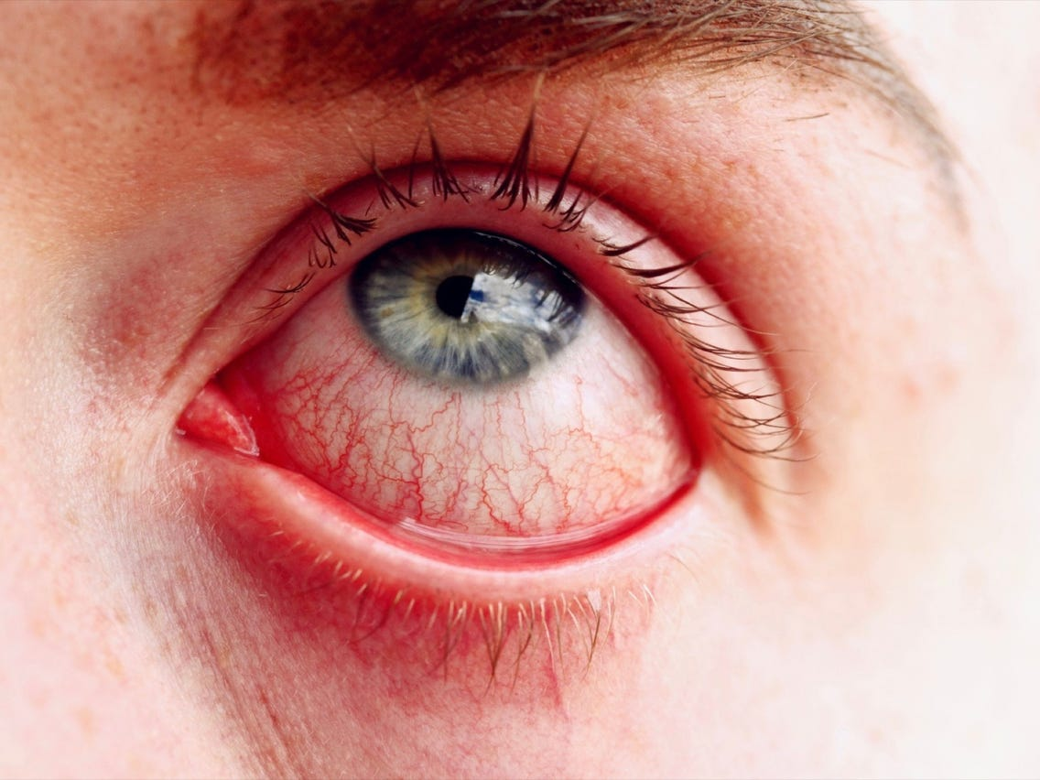
Uveitis
Injection in conjunctivitis
In surface disorders (eg, conjunctivitis), redness is either distributed uniformly across the eye, or it tapers off near the limbus.

Slide 72
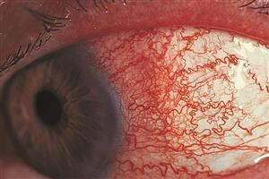
Uveitis
Injection in conjunctivitis
Injection in anterior uveitis, aka ciliary flush
In surface disorders (eg, conjunctivitis), redness is either distributed uniformly across the eye, or it tapers off near the limbus. In contrast, redness associated with anterior uveitis is usually most intense at and just behind the limbus, and may taper away from it.

Slide 73
Uveitis
Injection in conjunctivitis
Injection in anterior uveitis, aka ciliary flush
In surface disorders (eg, conjunctivitis), redness is either distributed uniformly across the eye, or it tapers off near the limbus. In contrast, redness associated with anterior uveitis is usually most intense at and just behind the limbus, and may taper away from it. This is because this area overlies the inflamed ciliary body (hence the term ciliary flush for this presentation).

Slide 74
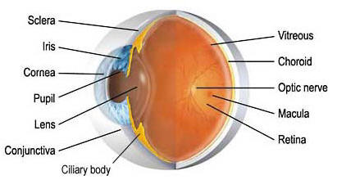
Uveitis
Ciliary body just deep to the limbal region
Injection in anterior uveitis, aka ciliary flush
In surface disorders (eg, conjunctivitis), redness is either distributed uniformly across the eye, or it tapers off near the limbus. In contrast, redness associated with anterior uveitis is usually most intense at and just behind the limbus, and may taper away from it. This is because this area overlies the inflamed ciliary body (hence the term ciliary flush for this presentation).

Slide 75
Uveitis
Anterior uveitis is by far the most common form encountered clinically. The classic symptoms are pain and photophobia , along with some degree of reduced vision . Patients will also complain of surface injection (which presents often in a so-called ciliary flush pattern).
At the slit lamp, the classic signs of anterior uveitis are WBCs and inflammatory proteins in the AC ( ‘cell and flare’ ).
word and word

Slide 76
Uveitis
Anterior uveitis is by far the most common form encountered clinically. The classic symptoms are pain and photophobia , along with some degree of reduced vision . Patients will also complain of surface injection (which presents often in a so-called ciliary flush pattern).
At the slit lamp, the classic signs of anterior uveitis are WBCs and inflammatory proteins in the AC ( ‘cell and flare’ ).

Slide 77
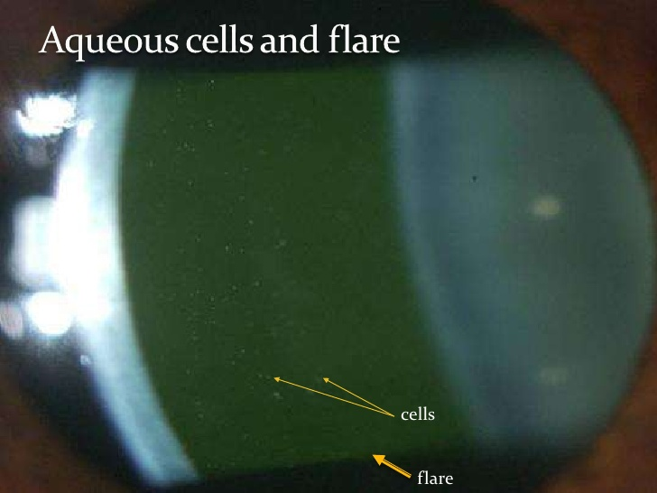
Uveitis

Slide 78
Uveitis
Anterior uveitis is by far the most common form encountered clinically. The classic symptoms are pain and photophobia , along with some degree of reduced vision . Patients will also complain of surface injection (which presents often in a so-called ciliary flush pattern).
At the slit lamp, the classic signs of anterior uveitis are WBCs and inflammatory proteins in the AC ( ‘cell and flare’ ). Keratic precipitates (KP)—deposits of inflammatory debris on the endothelial surface of the cornea—may be present.
two words

Slide 79
Uveitis
Anterior uveitis is by far the most common form encountered clinically. The classic symptoms are pain and photophobia , along with some degree of reduced vision . Patients will also complain of surface injection (which presents often in a so-called ciliary flush pattern).
At the slit lamp, the classic signs of anterior uveitis are WBCs and inflammatory proteins in the AC ( ‘cell and flare’ ). Keratic precipitates (KP)—deposits of inflammatory debris on the endothelial surface of the cornea—may be present.

Slide 80
Uveitis
Anterior Uveitis
?
?
Anterior uveitis is by far the most common form encountered clinically. The classic symptoms are pain and photophobia , along with some degree of reduced vision . Patients will also complain of surface injection (which presents often in a so-called ciliary flush pattern).
At the slit lamp, the classic signs of anterior uveitis are WBCs and inflammatory proteins in the AC ( ‘cell and flare’ ). Keratic precipitates (KP)—deposits of inflammatory debris on the endothelial surface of the cornea—may be present.
The Uveitis book employs an organizational tree on which it hangs the common causes of anterior uveitis. The first branch point in this tree is whether the inflammation is granulomatous or nongranulomatous .
word
non-word

Slide 81
Uveitis
Anterior Uveitis
Granulomatous
Nongranulomatous
Anterior uveitis is by far the most common form encountered clinically. The classic symptoms are pain and photophobia , along with some degree of reduced vision . Patients will also complain of surface injection (which presents often in a so-called ciliary flush pattern).
At the slit lamp, the classic signs of anterior uveitis are WBCs and inflammatory proteins in the AC ( ‘cell and flare’ ). Keratic precipitates (KP)—deposits of inflammatory debris on the endothelial surface of the cornea—may be present.
The Uveitis book employs an organizational tree on which it hangs the common causes of anterior uveitis. The first branch point in this tree is whether the inflammation is granulomatous or nongranulomatous .

Slide 82
Uveitis
Anterior Uveitis
Granulomatous
Nongranulomatous
Anterior uveitis is by far the most common form encountered clinically. The classic symptoms are pain and photophobia , along with some degree of reduced vision . Patients will also complain of surface injection (which presents often in a so-called ciliary flush pattern).
At the slit lamp, the classic signs of anterior uveitis are WBCs and inflammatory proteins in the AC ( ‘cell and flare’ ). Keratic precipitates (KP)—deposits of inflammatory debris on the endothelial surface of the cornea—may be present.
The Uveitis book employs an organizational tree on which it hangs the common causes of anterior uveitis. The first branch point in this tree is whether the inflammation is granulomatous or nongranulomatous . This is a reference to the appearance of KP—the term granulomatous is attributed to KP that are usually large , grayish , and ‘greasy.’
size
color
quality

Slide 83
Uveitis
Anterior Uveitis
Granulomatous
Nongranulomatous
Anterior uveitis is by far the most common form encountered clinically. The classic symptoms are pain and photophobia , along with some degree of reduced vision . Patients will also complain of surface injection (which presents often in a so-called ciliary flush pattern).
At the slit lamp, the classic signs of anterior uveitis are WBCs and inflammatory proteins in the AC ( ‘cell and flare’ ). Keratic precipitates (KP)—deposits of inflammatory debris on the endothelial surface of the cornea—may be present.
The Uveitis book employs an organizational tree on which it hangs the common causes of anterior uveitis. The first branch point in this tree is whether the inflammation is granulomatous or nongranulomatous . This is a reference to the appearance of KP—the term granulomatous is attributed to KP that are usually large , grayish , and ‘greasy.’

Slide 84
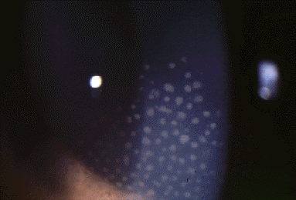
Uveitis
Granulomatous KP

Slide 85
Uveitis
Anterior Uveitis
Granulomatous
Nongranulomatous
Anterior uveitis is by far the most common form encountered clinically. The classic symptoms are pain and photophobia , along with some degree of reduced vision . Patients will also complain of surface injection (which presents often in a so-called ciliary flush pattern).
At the slit lamp, the classic signs of anterior uveitis are WBCs and inflammatory proteins in the AC ( ‘cell and flare’ ). Keratic precipitates (KP)—deposits of inflammatory debris on the endothelial surface of the cornea—may be present.
The Uveitis book employs an organizational tree on which it hangs the common causes of anterior uveitis. The first branch point in this tree is whether the inflammation is granulomatous or nongranulomatous . This is a reference to the appearance of KP—the term granulomatous is attributed to KP that are usually large , grayish , and ‘greasy.’ As you will recall from med school, histologically speaking a condition is ‘granulomatous’ if epithelioid and giant cells are present.

Slide 86
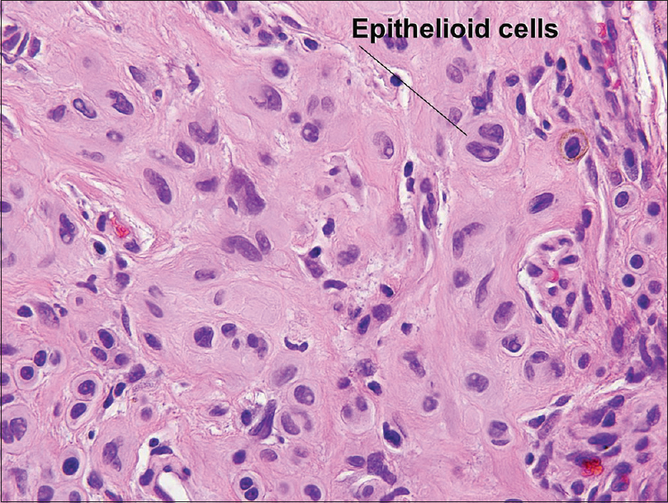
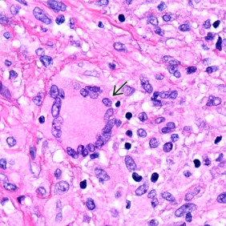
Uveitis
Anterior Uveitis
Granulomatous
Nongranulomatous
Anterior uveitis is by far the most common form encountered clinically. The classic symptoms are pain and photophobia , along with some degree of reduced vision . Patients will also complain of surface injection (which presents often in a so-called ciliary flush pattern).
At the slit lamp, the classic signs of anterior uveitis are WBCs and inflammatory proteins in the AC ( ‘cell and flare’ ). Keratic precipitates (KP)—deposits of inflammatory debris on the endothelial surface of the cornea—may be present.
The Uveitis book employs an organizational tree on which it hangs the common causes of anterior uveitis. The first branch point in this tree is whether the inflammation is granulomatous or nongranulomatous . This is a reference to the appearance of KP—the term granulomatous is attributed to KP that are usually large , grayish , and ‘greasy.’ As you will recall from med school, histologically speaking a condition is ‘granulomatous’ if epithelioid and giant cells are present.
Giant cell

Slide 87
Uveitis
Anterior Uveitis
Granulomatous
Nongranulomatous
Anterior uveitis is by far the most common form encountered clinically. The classic symptoms are pain and photophobia , along with some degree of reduced vision . Patients will also complain of surface injection (which presents often in a so-called ciliary flush pattern).
At the slit lamp, the classic signs of anterior uveitis are WBCs and inflammatory proteins in the AC ( ‘cell and flare’ ). Keratic precipitates (KP)—deposits of inflammatory debris on the endothelial surface of the cornea—may be present.
The Uveitis book employs an organizational tree on which it hangs the common causes of anterior uveitis. The first branch point in this tree is whether the inflammation is granulomatous or nongranulomatous . This is a reference to the appearance of KP—the term granulomatous is attributed to KP that are usually large , grayish , and ‘greasy.’ As you will recall from med school, histologically speaking a condition is ‘granulomatous’ if epithelioid and giant cells are present. Note that while granulomatous uveitis often involves epithelioid and/or giant cells, it is not the case that clinically granulomatous uveitis is always histologically granulomatous.

Slide 88
Uveitis
Anterior Uveitis
Granulomatous
Nongranulomatous
Anterior uveitis is by far the most common form encountered clinically. The classic symptoms are pain and photophobia , along with some degree of reduced vision . Patients will also complain of surface injection (which presents often in a so-called ciliary flush pattern).
At the slit lamp, the classic signs of anterior uveitis are WBCs and inflammatory proteins in the AC ( ‘cell and flare’ ). Keratic precipitates (KP)—deposits of inflammatory debris on the endothelial surface of the cornea—may be present.
The Uveitis book employs an organizational tree on which it hangs the common causes of anterior uveitis. The first branch point in this tree is whether the inflammation is granulomatous or nongranulomatous . This is a reference to the appearance of KP—the term granulomatous is attributed to KP that are usually large , grayish , and ‘greasy.’ As you will recall from med school, histologically speaking a condition is ‘granulomatous’ if epithelioid and giant cells are present. Note that while granulomatous uveitis often involves epithelioid and/or giant cells, it is not the case that clinically granulomatous uveitis is always histologically granulomatous. This is key: In clinical use the term granulomatous refers to the slit-lamp appearance of the KP, not to the underlying histology of the condition.

Slide 89
Uveitis
Anterior Uveitis
Granulomatous
Nongranulomatous
?
?
?
These are the common entities that can produce a granulomatous anterior uveitis. (Note: For some of these, the granulomatous anterior findings are part of an overall panuveitic presentation, ie, they typically do not present as an isolated anterior uveitis.)
?
?
?
?

Slide 90
Uveitis
Anterior Uveitis
Granulomatous
Nongranulomatous
TB
Sarcoid
Syphilis
These are the common entities that can produce a granulomatous anterior uveitis. (Note: For some of these, the granulomatous anterior findings are part of an overall panuveitic presentation, ie, they typically do not present as an isolated anterior uveitis.)
HSV
VKH
Toxoplasmosis
Lyme

Slide 91
Uveitis
Anterior Uveitis
Granulomatous
Nongranulomatous
Anterior uveitis is by far the most common form encountered clinically. The classic symptoms are pain and photophobia , along with some degree of reduced vision . Patients will also complain of surface injection (which presents often in a so-called ciliary flush pattern).
At the slit lamp, the classic signs of anterior uveitis are WBCs and inflammatory proteins in the AC ( ‘cell and flare’ ). Keratic precipitates (KP)—deposits of inflammatory debris on the endothelial surface of the cornea—may be present.
The Uveitis book employs an organizational tree on which it hangs the common causes of anterior uveitis. The first branch point in this tree is whether the inflammation is granulomatous or nongranulomatous. In clinical practice the term granulomatous refers to a particular slit-lamp appearance of KP—large, grayish, and ‘greasy.’ As you will recall from med school, histologically speaking a condition is ‘granulomatous’ if epithelioid and giant cells are present. Note that while granulomatous uveitis often contains epithelioid and/or giant cells, it is not the case that clinically granulomatous uveitis is always histologically granulomatous. This is key: In clinical parlance the term granulomatous refers to the slit-lamp appearance of the KP, not to the underlying histology of the condition.
In contrast, nongranulomatous KP are smaller, lighter in color, and do not look greasy. (Note: If no KP are present, the inflammation is considered nongranulomatous.)
Anterior uveitis is by far the most common form encountered clinically. The classic symptoms are pain and photophobia , along with some degree of reduced vision . Patients will also complain of surface injection (which presents often in a so-called ciliary flush pattern).
At the slit lamp, the classic signs of anterior uveitis are WBCs and inflammatory proteins in the AC ( ‘cell and flare’ ). Keratic precipitates (KP)—deposits of inflammatory debris on the endothelial surface of the cornea—may be present.
The Uveitis book employs an organizational tree on which it hangs the common causes of anterior uveitis. The first branch point in this tree is whether the inflammation is granulomatous or nongranulomatous . This is a reference to the appearance of KP—the term granulomatous is attributed to KP that are usually large , grayish , and ‘greasy.’ As you will recall from med school, histologically speaking a condition is ‘granulomatous’ if epithelioid and giant cells are present. Note that while granulomatous uveitis often involves epithelioid and/or giant cells, it is not the case that clinically granulomatous uveitis is always histologically granulomatous. This is key: In clinical parlance the term granulomatous refers to the slit-lamp appearance of the KP, not to the underlying histology of the condition.

Slide 92
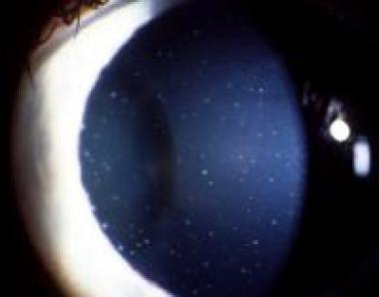
Uveitis
Nongranulomatous KP

Slide 93
Uveitis
Anterior Uveitis
Granulomatous
Nongranulomatous
The rest of the anterior-uveitis classification tree concerns nongranulomatous dz.

Slide 94
Uveitis
Anterior Uveitis
Granulomatous
Nongranulomatous
?
?
The rest of the anterior-uveitis classification tree concerns nongranulomatous dz. The first branch-point divides the etiologies into those that produce acute dz vs those producing chronic dz.

Slide 95
Uveitis
Anterior Uveitis
Granulomatous
Nongranulomatous
Acute
Chronic
The rest of the anterior-uveitis classification tree concerns nongranulomatous dz. The first branch-point divides the etiologies into those that produce acute dz vs those producing chronic dz.

Slide 96
Uveitis
Anterior Uveitis
Granulomatous
Nongranulomatous
Acute
Chronic
The rest of the anterior-uveitis classification tree concerns nongranulomatous dz. The first branch-point divides the etiologies into those that produce acute dz vs those producing chronic dz.
Acute uveitis comes on suddenly and resolves fairly quickly. Chronic uveitis also resolves, but once treatment is withdrawn, it relapses within three months.
(FYI: If a uveitis eventually relapses but is quiescent off-treatment for longer than three months, it is termed a recurrent uveitis.)

Slide 97
Uveitis
Anterior Uveitis
Granulomatous
Nongranulomatous
Acute
Chronic
The rest of the anterior-uveitis classification tree concerns nongranulomatous dz. The first branch-point divides the etiologies into those that produce acute dz vs those producing chronic dz.
Acute uveitis comes on suddenly and resolves fairly quickly. Chronic uveitis also resolves, but once treatment is withdrawn, it relapses within three months.
(FYI: If a uveitis eventually relapses but is quiescent off-treatment for longer than three months, it is termed a recurrent uveitis.)
amount of time

Slide 98
Uveitis
Anterior Uveitis
Granulomatous
Nongranulomatous
Acute
Chronic
The rest of the anterior-uveitis classification tree concerns nongranulomatous dz. The first branch-point divides the etiologies into those that produce acute dz vs those producing chronic dz.
Acute uveitis comes on suddenly and resolves fairly quickly. Chronic uveitis also resolves, but once treatment is withdrawn, it relapses within three months.
(FYI: If a uveitis eventually relapses but is quiescent off-treatment for longer than three months, it is termed a recurrent uveitis.)

Slide 99
Uveitis
Anterior Uveitis
Granulomatous
Nongranulomatous
Acute
Chronic
The rest of the anterior-uveitis classification tree concerns nongranulomatous dz. The first branch-point divides the etiologies into those that produce acute dz vs those producing chronic dz.
Acute uveitis comes on suddenly and resolves fairly quickly. Chronic uveitis also resolves, but once treatment is withdrawn, it relapses within three months.
(FYI: If a uveitis eventually relapses but is quiescent off-treatment for longer than three months, it is termed a recurrent uveitis.)

Slide 100
Uveitis
Anterior Uveitis
Granulomatous
Nongranulomatous
Acute
Chronic
The rest of the anterior-uveitis classification tree concerns nongranulomatous dz. The first branch-point divides the etiologies into those that produce acute dz vs those producing chronic dz.
Acute uveitis comes on suddenly and resolves fairly quickly. Chronic uveitis also resolves, but once treatment is withdrawn, it relapses within three months.
(FYI: If a uveitis eventually relapses but is quiescent off-treatment for longer than three months, it is termed a recurrent uveitis.)

Slide 101
Uveitis
Anterior Uveitis
Granulomatous
Nongranulomatous
Acute
Chronic
?
?
The rest of the anterior-uveitis classification tree concerns nongranulomatous dz. The first branch-point divides the etiologies into those that produce acute dz vs those producing chronic dz.
Finally, the acute uveitides are divided into those that present unilaterally vs those that tend to present bilaterally .

Slide 102
Uveitis
Anterior Uveitis
Granulomatous
Nongranulomatous
Acute
Chronic
Unilateral
Bilateral
The rest of the anterior-uveitis classification tree concerns nongranulomatous dz. The first branch-point divides the etiologies into those that produce acute dz vs those producing chronic dz.
Finally, the acute uveitides are divided into those that present unilaterally vs those that tend to present bilaterally .

Slide 103
Uveitis
Anterior Uveitis
Granulomatous
Nongranulomatous
Acute
Chronic
Unilateral
Bilateral
The rest of the anterior-uveitis classification tree concerns nongranulomatous dz. The first branch-point divides the etiologies into those that produce acute dz vs those producing chronic dz.
Finally, the acute uveitides are divided into those that present unilaterally vs those that tend to present bilaterally.
Take a good look at this—it represents how you should think about anterior uveitides encountered in the clinic or on the OKAP. It wouldn’t be a bad idea to commit this to memory at this juncture.

Slide 104
Uveitis
Anterior Uveitis
Granulomatous
Nongranulomatous
TB
Sarcoid
Acute
Chronic
Syphilis
HSV
JIA
VKH
Unilateral
Bilateral
FHI
Toxoplasmosis
HLA-B27 dz
TINU
IBD/PA
Lyme
Posner-Schlossman
Behçet
Sarcoid
HSV/VZV
Drug rxn
Syphilis
Sarcoid
Leptospirosis
TB
Syphilis
IBD/PA
TB
Sarcoid
Syphilis
TB
Just as an FYI, these are the anterior uveitides that are covered in detail in the Uveitis book. Don’t try to memorize all this now! (They will stick better if you learn them in their naturally-occurring groupings.)

Slide 105
Uveitis
Anterior Uveitis
Granulomatous
Nongranulomatous
TB
Sarcoid
Acute
Chronic
Syphilis
HSV
JIA
VKH
Unilateral
Bilateral
FHI
Toxoplasmosis
HLA-B27 dz
TINU
IBD/PA
Lyme
Posner-Schlossman
Behçet
Sarcoid
HSV/VZV
Drug rxn
Syphilis
Sarcoid
Leptospirosis
TB
Syphilis
IBD/PA
TB
Sarcoid
Syphilis
TB
Just as an FYI, these are the anterior uveitides that are covered in detail in the Uveitis book. Don’t try to memorize all this now! (They will stick better if you learn them in their naturally-occurring groupings.)
One fact you should memorize is that the vast majority of anterior-uveitis cases—about 80%—are noninfectious
%
infectious vs non-

Slide 106
Uveitis
Anterior Uveitis
Granulomatous
Nongranulomatous
TB
Sarcoid
Acute
Chronic
Syphilis
HSV
JIA
VKH
Unilateral
Bilateral
FHI
Toxoplasmosis
HLA-B27 dz
TINU
IBD/PA
Lyme
Posner-Schlossman
Behçet
Sarcoid
HSV/VZV
Drug rxn
Syphilis
Sarcoid
Leptospirosis
TB
Syphilis
IBD/PA
TB
Sarcoid
Syphilis
TB
Just as an FYI, these are the anterior uveitides that are covered in detail in the Uveitis book. Don’t try to memorize all this now! (They will stick better if you learn them in their naturally-occurring groupings.)
One fact you should memorize is that the vast majority of anterior-uveitis cases—about 80%—are noninfectious

Slide 107
Uveitis
Anterior Uveitis
Granulomatous
Nongranulomatous
TB
Sarcoid
Acute
Chronic
Syphilis
HSV
JIA
VKH
Unilateral
Bilateral
FHI
Toxoplasmosis
HLA-B27 dz
TINU
IBD/PA
Lyme
Posner-Schlossman
Behçet
Sarcoid
HSV/VZV
Drug rxn
Syphilis
Sarcoid
Leptospirosis
TB
Syphilis
IBD/PA
TB
Sarcoid
Syphilis
Note that syphilis, sarcoid and TB show up everywhere on the tree. This is because all three can manifest in so many different ways.
TB

Slide 108
Uveitis
Anterior Uveitis
Granulomatous
Nongranulomatous
TB
Sarcoid
Acute
Chronic
Syphilis
HSV
JIA
VKH
Unilateral
Bilateral
FHI
Toxoplasmosis
HLA-B27 dz
TINU
IBD/PA
Lyme
Posner-Schlossman
Behçet
Sarcoid
HSV/VZV
Drug rxn
Syphilis
Sarcoid
Leptospirosis
TB
Syphilis
IBD/PA
TB
Sarcoid
Syphilis
Note that syphilis, sarcoid and TB show up everywhere on the tree. This is because all three can manifest in so many different ways.
TB
Rule of thumb:
Syphilis, sarcoid and TB are on the DDx for every pt with any form of uveitis!

Slide 109
Uveitis
Anterior Uveitis
Granulomatous
Nongranulomatous
TB
Sarcoid
Acute
Chronic
Syphilis
HSV
JIA
VKH
Unilateral
Bilateral
FHI
Toxoplasmosis
HLA-B27 dz
TINU
IBD/PA
Lyme
Posner-Schlossman
Behçet
Sarcoid
HSV/VZV
Drug rxn
Syphilis
Sarcoid
Leptospirosis
TB
This fact is very useful early in training, a period during which you will be clueless regarding uveitis. That is, if your Uveitis attending presses you for a DDx on a pt and you have no idea what it could be, stroke your chin thoughtfully and say “Well, certainly syphilis must be considered…[pause, more chin-stroking]…and TB of course…[more pseudo-contemplation]…and I would think sarcoid should be on the differential as well.”
Syphilis
IBD/PA
TB
Sarcoid
Syphilis
Note that syphilis, sarcoid and TB show up everywhere on the tree. This is because all three can manifest in so many different ways.
TB
Rule of thumb:
Syphilis, sarcoid and TB are on the DDx for every pt with any form of uveitis!

Slide 110
Uveitis
Panuveitis
Posterior
Intermediate
Anterior
Next let’s look at intermediate uveitis

Slide 111
Uveitis
Panuveitis
Posterior
Intermediate
Anterior
The hallmark of intermediate uveitis (IU) is inflammation in the anterior vitreous that involves the vitreous base .
two words
two words

Slide 112
Uveitis
Panuveitis
Posterior
Intermediate
Anterior
The hallmark of intermediate uveitis (IU) is inflammation in the anterior vitreous that involves the vitreous base .

Slide 113
Uveitis
Panuveitis
Posterior
Intermediate
Anterior
The hallmark of intermediate uveitis (IU) is inflammation in the anterior vitreous that involves the vitreous base . The vitreous base is the primary attachment point of the vitreous; it forms a ~5 mm-wide band that straddles the ora serrata (the location where the anterior-most retina meets the posterior-most portion of the ciliary body).
two words

Slide 114
Uveitis
Panuveitis
Posterior
Intermediate
Anterior
The hallmark of intermediate uveitis (IU) is inflammation in the anterior vitreous that involves the vitreous base . The vitreous base is the primary attachment point of the vitreous; it forms a ~5 mm-wide band that straddles the ora serrata (the location where the anterior-most retina meets the posterior-most portion of the ciliary body).

Slide 115
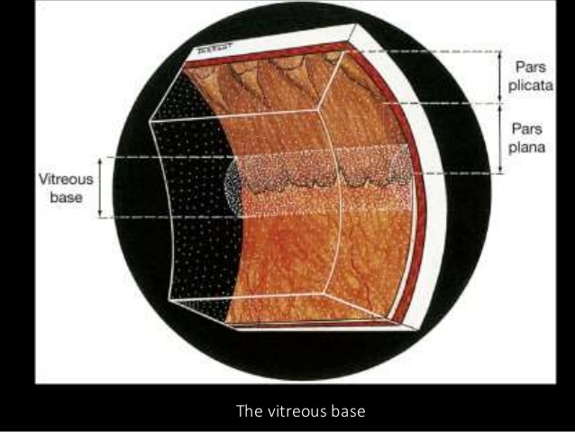
Uveitis
ciliary body
peripheral retina

Slide 116
Uveitis
Panuveitis
Posterior
Intermediate
Anterior
The hallmark of intermediate uveitis (IU) is inflammation in the anterior vitreous that involves the vitreous base . The vitreous base is the primary attachment point of the vitreous; it forms a ~5 mm-wide band that straddles the ora serrata (the location where the anterior-most retina meets the posterior-most portion of the ciliary body). AC cell is typically absent ;
absent v present

Slide 117
Uveitis
Panuveitis
Posterior
Intermediate
Anterior
The hallmark of intermediate uveitis (IU) is inflammation in the anterior vitreous that involves the vitreous base . The vitreous base is the primary attachment point of the vitreous; it forms a ~5 mm-wide band that straddles the ora serrata (the location where the anterior-most retina meets the posterior-most portion of the ciliary body). AC cell is typically absent

Slide 118
Uveitis
Panuveitis
Posterior
Intermediate
Anterior
The hallmark of intermediate uveitis (IU) is inflammation in the anterior vitreous that involves the vitreous base . The vitreous base is the primary attachment point of the vitreous; it forms a ~5 mm-wide band that straddles the ora serrata (the location where the anterior-most retina meets the posterior-most portion of the ciliary body). AC cell is typically absent ; if present, it’s usually mild, and is generally believed to be ‘spillover,’ ie, vitreous cells that migrated anteriorly.

Slide 119
Uveitis
Panuveitis
Posterior
Intermediate
Anterior
The hallmark of intermediate uveitis (IU) is inflammation in the anterior vitreous that involves the vitreous base . The vitreous base is the primary attachment point of the vitreous; it forms a ~5 mm-wide band that straddles the ora serrata (the location where the anterior-most retina meets the posterior-most portion of the ciliary body). AC cell is typically absent ; if present, it’s usually mild, and is generally believed to be ‘spillover,’ ie, vitreous cells that migrated anteriorly.
Snowballs are a classic finding in IU. So-named because of their appearance, they are clumps of inflammatory cells and detritus in the vitreous.

Slide 120
Uveitis
Panuveitis
Posterior
Intermediate
Anterior
The hallmark of intermediate uveitis (IU) is inflammation in the anterior vitreous that involves the vitreous base . The vitreous base is the primary attachment point of the vitreous; it forms a ~5 mm-wide band that straddles the ora serrata (the location where the anterior-most retina meets the posterior-most portion of the ciliary body). AC cell is typically absent ; if present, it’s usually mild, and is generally believed to be ‘spillover,’ ie, vitreous cells that migrated anteriorly.
Snowballs are a classic finding in IU. So-named because of their appearance, they are clumps of inflammatory cells and detritus in the vitreous.

Slide 121
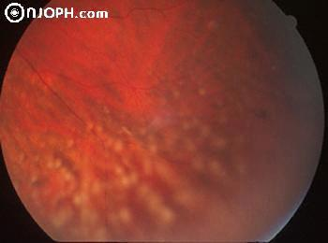
Uveitis
Snowballs in intermediate uveitis

Slide 122
Uveitis
Panuveitis
Posterior
Intermediate
Anterior
The hallmark of intermediate uveitis (IU) is inflammation in the anterior vitreous that involves the vitreous base . The vitreous base is the primary attachment point of the vitreous; it forms a ~5 mm-wide band that straddles the ora serrata (the location where the anterior-most retina meets the posterior-most portion of the ciliary body). AC cell is typically absent ; if present, it’s usually mild, and is generally believed to be ‘spillover,’ ie, vitreous cells that migrated anteriorly.
Snowballs are a classic finding in IU. So-named because of their appearance, they are clumps of inflammatory cells and detritus in the vitreous. When this material accumulates in broad swaths along the inferior pars plana, it is referred to as snowbanking .

Slide 123
Uveitis
Panuveitis
Posterior
Intermediate
Anterior
The hallmark of intermediate uveitis (IU) is inflammation in the anterior vitreous that involves the vitreous base . The vitreous base is the primary attachment point of the vitreous; it forms a ~5 mm-wide band that straddles the ora serrata (the location where the anterior-most retina meets the posterior-most portion of the ciliary body). AC cell is typically absent ; if present, it’s usually mild, and is generally believed to be ‘spillover,’ ie, vitreous cells that migrated anteriorly.
Snowballs are a classic finding in IU. So-named because of their appearance, they are clumps of inflammatory cells and detritus in the vitreous. When this material accumulates in broad swaths along the inferior pars plana, it is referred to as snowbanking .

Slide 124
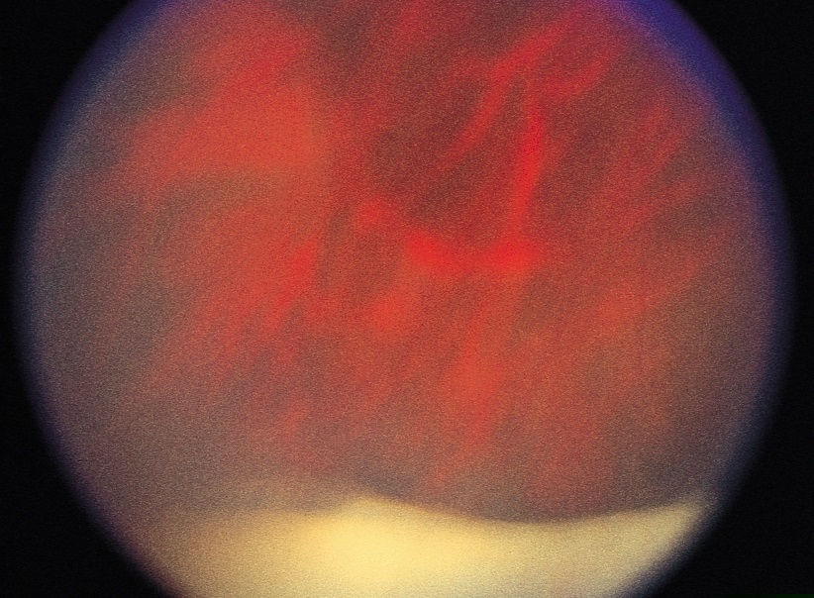
Uveitis
Snowbanking in intermediate uveitis

Slide 125
Uveitis
Panuveitis
Posterior
Intermediate
Anterior
The hallmark of intermediate uveitis (IU) is inflammation in the anterior vitreous that involves the vitreous base . The vitreous base is the primary attachment point of the vitreous; it forms a ~5 mm-wide band that straddles the ora serrata (the location where the anterior-most retina meets the posterior-most portion of the ciliary body). AC cell is typically absent ; if present, it’s usually mild, and is generally believed to be ‘spillover,’ ie, vitreous cells that migrated anteriorly.
Snowballs are a classic finding in IU. So-named because of their appearance, they are clumps of inflammatory cells and detritus in the vitreous. When this material accumulates in broad swaths along the inferior pars plana, it is referred to as snowbanking .
IU tends to be a dz of young people—teens through 40 or so.
young vs older
[age range]

Slide 126
Uveitis
Panuveitis
Posterior
Intermediate
Anterior
The hallmark of intermediate uveitis (IU) is inflammation in the anterior vitreous that involves the vitreous base . The vitreous base is the primary attachment point of the vitreous; it forms a ~5 mm-wide band that straddles the ora serrata (the location where the anterior-most retina meets the posterior-most portion of the ciliary body). AC cell is typically absent ; if present, it’s usually mild, and is generally believed to be ‘spillover,’ ie, vitreous cells that migrated anteriorly.
Snowballs are a classic finding in IU. So-named because of their appearance, they are clumps of inflammatory cells and detritus in the vitreous. When this material accumulates in broad swaths along the inferior pars plana, it is referred to as snowbanking .
IU tends to be a dz of young people—teens through 40 or so.

Slide 127
Uveitis
Panuveitis
Posterior
Intermediate
Anterior
The hallmark of intermediate uveitis (IU) is inflammation in the anterior vitreous that involves the vitreous base . The vitreous base is the primary attachment point of the vitreous; it forms a ~5 mm-wide band that straddles the ora serrata (the location where the anterior-most retina meets the posterior-most portion of the ciliary body). AC cell is typically absent ; if present, it’s usually mild, and is generally believed to be ‘spillover,’ ie, vitreous cells that migrated anteriorly.
Snowballs are a classic finding in IU. So-named because of their appearance, they are clumps of inflammatory cells and detritus in the vitreous. When this material accumulates in broad swaths along the inferior pars plana, it is referred to as snowbanking .
IU tends to be a dz of young people—teens through 40 or so. It is bilateral in most (80%) cases
uni- v bilateral

Slide 128
Uveitis
Panuveitis
Posterior
Intermediate
Anterior
The hallmark of intermediate uveitis (IU) is inflammation in the anterior vitreous that involves the vitreous base . The vitreous base is the primary attachment point of the vitreous; it forms a ~5 mm-wide band that straddles the ora serrata (the location where the anterior-most retina meets the posterior-most portion of the ciliary body). AC cell is typically absent ; if present, it’s usually mild, and is generally believed to be ‘spillover,’ ie, vitreous cells that migrated anteriorly.
Snowballs are a classic finding in IU. So-named because of their appearance, they are clumps of inflammatory cells and detritus in the vitreous. When this material accumulates in broad swaths along the inferior pars plana, it is referred to as snowbanking .
IU tends to be a dz of young people—teens through 40 or so. It is bilateral in most (80%) cases

Slide 129
Uveitis
Panuveitis
Posterior
Intermediate
Anterior
The hallmark of intermediate uveitis (IU) is inflammation in the anterior vitreous that involves the vitreous base . The vitreous base is the primary attachment point of the vitreous; it forms a ~5 mm-wide band that straddles the ora serrata (the location where the anterior-most retina meets the posterior-most portion of the ciliary body). AC cell is typically absent ; if present, it’s usually mild, and is generally believed to be ‘spillover,’ ie, vitreous cells that migrated anteriorly.
Snowballs are a classic finding in IU. So-named because of their appearance, they are clumps of inflammatory cells and detritus in the vitreous. When this material accumulates in broad swaths along the inferior pars plana, it is referred to as snowbanking .
IU tends to be a dz of young people—teens through 40 or so. It is bilateral in most (80%) cases (although it can be quite asymmetric).

Slide 130
Uveitis
Panuveitis
Posterior
Intermediate
Anterior
?
?
As indicated previously, IU is divvied up into two categories.

Slide 131
Uveitis
Panuveitis
Posterior
Intermediate
Anterior
?
?
As indicated previously, IU is divvied up into two categories. If the inflammation is associated with an identifiable condition, the uveitis is called IU.
abb.

Slide 132
Uveitis
Panuveitis
Posterior
Intermediate
Anterior
?
Intermediate uveitis
As indicated previously, IU is divvied up into two categories. If the inflammation is associated with an identifiable condition, the uveitis is called IU.

Slide 133
Uveitis
Panuveitis
Posterior
Intermediate
Anterior
?
Intermediate uveitis
As indicated previously, IU is divvied up into two categories. If the inflammation is associated with an identifiable condition, the uveitis is called IU. If it is idiopathic, ie, if no cause can be identified, it is called pars planitis.

Slide 134
Uveitis
Panuveitis
Posterior
Intermediate
Anterior
Pars planitis
Intermediate uveitis
As indicated previously, IU is divvied up into two categories. If the inflammation is associated with an identifiable condition, the uveitis is called IU. If it is idiopathic, ie, if no cause can be identified, it is called pars planitis.

Slide 135
Uveitis
Panuveitis
Posterior
Intermediate
Anterior
Pars planitis
Intermediate uveitis
?
?
The entities most likely to produce IU
?
?
?
?

Slide 136
Uveitis
Panuveitis
Posterior
Intermediate
Anterior
Pars planitis
Intermediate uveitis
MS
Lyme
The entities most likely to produce IU
Toxocariasis
Sarcoid
Syphilis
TB

Slide 137
Uveitis
Panuveitis
Posterior
Intermediate
Anterior
Pars planitis
Intermediate uveitis
MS
Lyme
Toxocariasis
Sarcoid
Syphilis
Note the appearance of these three on the IU DDx as well
TB

Slide 138
Uveitis
Panuveitis
Posterior
Intermediate
Anterior
Let’s take a closer look at posterior uveitis

Slide 139
Uveitis
Posterior uveitis
If inflammation is located…
Exclusively in the choroid
In both the choroid and the retina
Exclusively in the retina
It is called:
It is called:
It is called:
Choroiditis
Chorioretinitis or
Retinochoroiditis
Retinitis
As noted previously, here are the ways posterior uveitis can manifest.

Slide 140
Uveitis
Posterior uveitis
If inflammation is located…
Exclusively in the choroid
In both the choroid and the retina
Exclusively in the retina
and ONH
It is called:
It is called:
It is called:
It is called:
Choroiditis
Chorioretinitis or
Retinochoroiditis
Retinitis
Neuroretinitis
As noted previously, here are the ways posterior uveitis can manifest. Also noted previously was the condition neuroretinitis—inflammation involving both the retina and optic nerve.

Slide 141
Uveitis
Posterior uveitis
If inflammation is located…
Exclusively in the choroid
In both the choroid and the retina
Exclusively in the retina
and ONH
It is called:
It is called:
It is called:
It is called:
Choroiditis
Chorioretinitis or
Retinochoroiditis
Retinitis
Neuroretinitis
As noted previously, here are the ways posterior uveitis can manifest. Also noted previously was the condition neuroretinitis—inflammation involving both the retina and optic nerve.
While 80% of anterior uveitis cases are noninfectious in origin, the opposite is true for posterior uveitis: most cases are infectious—weirdly, also about 80%.

Slide 142
Uveitis
Posterior uveitis
If inflammation is located…
Exclusively in the choroid
In both the choroid and the retina
Exclusively in the retina
and ONH
It is called:
It is called:
It is called:
It is called:
Choroiditis
Chorioretinitis or
Retinochoroiditis
Retinitis
Neuroretinitis
Toxoplasmosis is a common, classic cause of posterior uveitis. It is infectious, the bug being Toxoplasma gondii , an obligate intracellular parasite. Cats are its definitive host. T gondii has a worldwide distribution; an estimated one billion people are infected. Humans usually acquire the parasite via consumption of unwashed produce or undercooked meat . Another crucial mechanism of transmission is transplacentally , which leads to devastating congenital manifestations in affected infants (it is one of the TORCH syndrome etiologies).
Toxoplasmosis typically manifests as a retinochoroiditis accompanied by a dense overlying vitritis. Taken together, the appearance has been likened to a ‘headlight in the fog.’

Slide 143
Uveitis
Posterior uveitis
If inflammation is located…
Exclusively in the choroid
In both the choroid and the retina
Exclusively in the retina
and ONH
It is called:
It is called:
It is called:
It is called:
Choroiditis
Chorioretinitis or
Retinochoroiditis
Retinitis
Neuroretinitis
Toxoplasmosis is a common, classic cause of posterior uveitis. It is infectious, the bug being Toxoplasma gondii , an obligate intracellular parasite. Cats are its definitive host. T gondii has a worldwide distribution; an estimated one billion people are infected. Humans usually acquire the parasite via consumption of unwashed produce or undercooked meat . Another crucial mechanism of transmission is transplacentally , which leads to devastating congenital manifestations in affected infants (it is one of the TORCH syndrome etiologies).
Toxoplasmosis typically manifests as a retinochoroiditis accompanied by a dense overlying vitritis. Taken together, the appearance has been likened to a ‘headlight in the fog.’

Slide 144
Uveitis
Posterior uveitis
If inflammation is located…
Exclusively in the choroid
In both the choroid and the retina
Exclusively in the retina
and ONH
It is called:
It is called:
It is called:
It is called:
Choroiditis
Chorioretinitis or
Retinochoroiditis
Retinitis
Neuroretinitis
Toxoplasmosis is a common, classic cause of posterior uveitis. It is infectious, the bug being Toxoplasma gondii , an obligate intracellular parasite. Cats are its definitive host. T gondii has a worldwide distribution; an estimated one billion people are infected. Humans usually acquire the parasite via consumption of unwashed produce or undercooked meat . Another crucial mechanism of transmission is transplacentally , which leads to devastating congenital manifestations in affected infants (it is one of the TORCH syndrome etiologies).
Toxoplasmosis typically manifests as a retinochoroiditis accompanied by a dense overlying vitritis. Taken together, the appearance has been likened to a ‘headlight in the fog.’

Slide 145
Uveitis
Posterior uveitis
If inflammation is located…
Exclusively in the choroid
In both the choroid and the retina
Exclusively in the retina
and ONH
It is called:
It is called:
It is called:
It is called:
Choroiditis
Chorioretinitis or
Retinochoroiditis
Retinitis
Neuroretinitis
Toxoplasmosis is a common, classic cause of posterior uveitis. It is infectious, the bug being Toxoplasma gondii , an obligate intracellular parasite. Cats are its definitive host. T gondii has a worldwide distribution; an estimated one billion people are infected. Humans usually acquire the parasite via consumption of unwashed produce or undercooked meat . Another crucial mechanism of transmission is transplacentally , which leads to devastating congenital manifestations in affected infants (it is one of the TORCH syndrome etiologies).
Toxoplasmosis typically manifests as a retinochoroiditis accompanied by a dense overlying vitritis. Taken together, the appearance has been likened to a ‘headlight in the fog.’

Slide 146
Uveitis
Posterior uveitis
If inflammation is located…
Exclusively in the choroid
In both the choroid and the retina
Exclusively in the retina
and ONH
It is called:
It is called:
It is called:
It is called:
Choroiditis
Chorioretinitis or
Retinochoroiditis
Retinitis
Neuroretinitis
Toxoplasmosis is a common, classic cause of posterior uveitis. It is infectious, the bug being Toxoplasma gondii , an obligate intracellular parasite. Cats are its definitive host. T gondii has a worldwide distribution; an estimated one billion people are infected. Humans usually acquire the parasite via consumption of unwashed produce or undercooked meat . Another crucial mechanism of transmission is transplacentally , which leads to devastating congenital manifestations in affected infants (it is one of the TORCH syndrome etiologies).
Toxoplasmosis typically manifests as a retinochoroiditis accompanied by a dense overlying vitritis. Taken together, the appearance has been likened to a ‘headlight in the fog.’

Slide 147
Uveitis
Posterior uveitis
If inflammation is located…
Exclusively in the choroid
In both the choroid and the retina
Exclusively in the retina
and ONH
It is called:
It is called:
It is called:
It is called:
Choroiditis
Chorioretinitis or
Retinochoroiditis
Retinitis
Neuroretinitis
Toxoplasmosis is a common, classic cause of posterior uveitis. It is infectious, the bug being Toxoplasma gondii , an obligate intracellular parasite. Cats are its definitive host. T gondii has a worldwide distribution; an estimated one billion people are infected. Humans usually acquire the parasite via consumption of unwashed produce or undercooked meat . Another crucial mechanism of transmission is transplacentally , which leads to devastating congenital manifestations in affected infants (it is one of the TORCH syndrome etiologies).
Toxoplasmosis typically manifests as a retinochoroiditis accompanied by a dense overlying vitritis. Taken together, the appearance has been likened to a ‘headlight in the fog.’

Slide 148
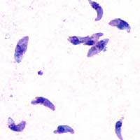
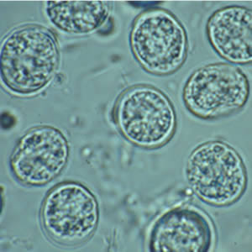
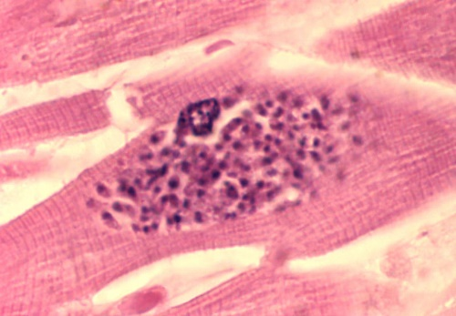
Uveitis
Oocyst form
Tachyzoite form
Tissue cyst
--Found in GI tract of cat (shed in feces)
--Acquired via ingestion of unwashed produce
--Found in circulatory system of infected mother
--Responsible for transplacental infection
--Found in tissue of infected livestock
--Acquired via consumption of undercooked meat
Toxoplasma gondii: Three infectious forms

Slide 149
Uveitis
Posterior uveitis
If inflammation is located…
Exclusively in the choroid
In both the choroid and the retina
Exclusively in the retina
and ONH
It is called:
It is called:
It is called:
It is called:
Choroiditis
Chorioretinitis or
Retinochoroiditis
Retinitis
Neuroretinitis
Toxoplasmosis is a common, classic cause of posterior uveitis. It is infectious, the bug being Toxoplasma gondii , an obligate intracellular parasite. Cats are its definitive host. T gondii has a worldwide distribution; an estimated one billion people are infected. Humans usually acquire the parasite via consumption of unwashed produce or undercooked meat . Another crucial mechanism of transmission is transplacentally , which leads to devastating congenital manifestations in affected infants (it is one of the TORCH syndrome etiologies).
Toxoplasmosis typically manifests as a retinochoroiditis accompanied by a dense overlying vitritis. Taken together, the appearance has been likened to a ‘headlight in the fog.’
four words

Slide 150
Uveitis
Posterior uveitis
If inflammation is located…
Exclusively in the choroid
In both the choroid and the retina
Exclusively in the retina
and ONH
It is called:
It is called:
It is called:
It is called:
Choroiditis
Chorioretinitis or
Retinochoroiditis
Retinitis
Neuroretinitis
Toxoplasmosis is a common, classic cause of posterior uveitis. It is infectious, the bug being Toxoplasma gondii , an obligate intracellular parasite. Cats are its definitive host. T gondii has a worldwide distribution; an estimated one billion people are infected. Humans usually acquire the parasite via consumption of unwashed produce or undercooked meat . Another crucial mechanism of transmission is transplacentally , which leads to devastating congenital manifestations in affected infants (it is one of the TORCH syndrome etiologies).
Toxoplasmosis typically manifests as a retinochoroiditis accompanied by a dense overlying vitritis. Taken together, the appearance has been likened to a ‘headlight in the fog.’

Slide 151
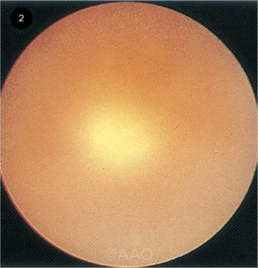
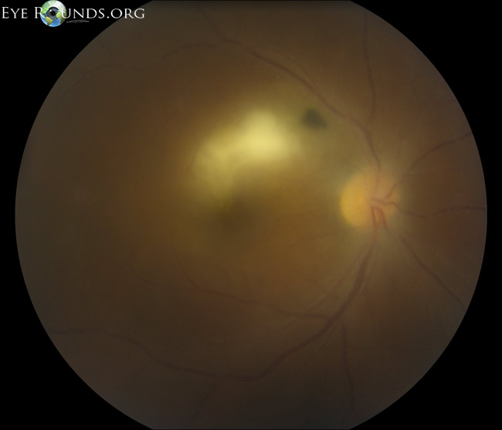
Uveitis
Ocular toxoplasmosis: ‘Headlight in the fog’

Slide 152
Uveitis
Panuveitis
Posterior
Intermediate
Let’s take a
closer look at panuveitis
Anterior

Slide 153
Uveitis
Panuveitis
Posterior
Intermediate
Anterior
To qualify as a panuveitis, all compartments of the eye—the AC, vitreous, and retina/choroid—must be equally involved in the inflammatory process.

Slide 154
Uveitis
Panuveitis
Posterior
Intermediate
Anterior
To qualify as a panuveitis, all compartments of the eye—the AC, vitreous, and retina/choroid—must be equally involved in the inflammatory process. Panuveitis is usually bilateral
uni- v bilateral

Slide 155
Uveitis
Panuveitis
Posterior
Intermediate
Anterior
To qualify as a panuveitis, all compartments of the eye—the AC, vitreous, and retina/choroid—must be equally involved in the inflammatory process. Panuveitis is usually bilateral

Slide 156
Uveitis
Panuveitis
Posterior
Intermediate
Anterior
To qualify as a panuveitis, all compartments of the eye—the AC, vitreous, and retina/choroid—must be equally involved in the inflammatory process. Panuveitis is usually bilateral, although it may be asymmetric.

Slide 157
Uveitis
Panuveitis
Posterior
Intermediate
Anterior
To qualify as a panuveitis, all compartments of the eye—the AC, vitreous, and retina/choroid—must be equally involved in the inflammatory process. Panuveitis is usually bilateral, although it may be asymmetric.
The panuveitides are divvied into Noninfectious and Infectious causes.

Slide 158
Uveitis
Panuveitis
Posterior
Intermediate
Anterior
To qualify as a panuveitis, all compartments of the eye—the AC, vitreous, and retina/choroid—must be equally involved in the inflammatory process. Panuveitis is usually bilateral, although it may be asymmetric.
The panuveitides are divvied into Noninfectious and Infectious causes.

Slide 159
Uveitis
Panuveitis
Posterior
Intermediate
Anterior
To qualify as a panuveitis, all compartments of the eye—the AC, vitreous, and retina/choroid—must be equally involved in the inflammatory process. Panuveitis is usually bilateral, although it may be asymmetric.
The panuveitides are divvied into Noninfectious and Infectious causes.
?—
?—
?—
?—

Slide 160
Uveitis
Panuveitis
Posterior
Intermediate
Anterior
To qualify as a panuveitis, all compartments of the eye—the AC, vitreous, and retina/choroid—must be equally involved in the inflammatory process. Panuveitis is usually bilateral, although it may be asymmetric.
The panuveitides are divvied into Noninfectious and Infectious causes.
Sarcoid—
Sympathetic ophthalmia—
Vogt-Koyanagi-Harada—
Behçet syndrome—

Slide 161
Uveitis
Panuveitis
Posterior
Intermediate
Anterior
To qualify as a panuveitis, all compartments of the eye—the AC, vitreous, and retina/choroid—must be equally involved in the inflammatory process. Panuveitis is usually bilateral, although it may be asymmetric.
The panuveitides are divvied into Noninfectious and Infectious causes.
Sarcoid—
Sympathetic ophthalmia—
Vogt-Koyanagi-Harada—
Behçet syndrome—
—?
—?
—?
—?
—?

Slide 162
Uveitis
Panuveitis
Posterior
Intermediate
Anterior
To qualify as a panuveitis, all compartments of the eye—the AC, vitreous, and retina/choroid—must be equally involved in the inflammatory process. Panuveitis is usually bilateral, although it may be asymmetric.
The panuveitides are divvied into Noninfectious and Infectious causes.
Sarcoid—
Sympathetic ophthalmia—
Vogt-Koyanagi-Harada—
Behçet syndrome—
—Syphilis
—TB
—Lyme
—Leptospirosis
—Whipple dz

Slide 163
Uveitis
Panuveitis
Posterior
Intermediate
Anterior
To qualify as a panuveitis, all compartments of the eye—the AC, vitreous, and retina/choroid—must be equally involved in the inflammatory process. Panuveitis is usually bilateral, although it may be asymmetric.
The panuveitides are divvied into Noninfectious and Infectious causes.
Sarcoid—
Sympathetic ophthalmia—
Vogt-Koyanagi-Harada—
Behçet syndrome—
Note that these three appear yet again
—Syphilis
—TB
—Lyme
—Leptospirosis
—Whipple dz

Slide 164
Endophthalmitis
Now we’ll change gears and look at endophthalmitis

Slide 165
Endophthalmitis
The Uveitis book defines endophthalmitis as an inflammatory process involving both the AC and vitreous cavities that is 2ndry to bacterial or fungal infection.

Slide 166
Endophthalmitis
The Uveitis book defines endophthalmitis as an inflammatory process involving both the AC and vitreous cavities that is 2ndry to bacterial or fungal infection.

Slide 167
Endophthalmitis
?
?
?
The Uveitis book defines endophthalmitis as an inflammatory process involving both the AC and vitreous cavities that is 2ndry to bacterial or fungal infection. Endophthalmitis can be posttraumatic , postoperative or endogenous .
causal event A
causal event B
causal event C

Slide 168
Endophthalmitis
Posttraumatic
Postoperative
Endogenous
The Uveitis book defines endophthalmitis as an inflammatory process involving both the AC and vitreous cavities that is 2ndry to bacterial or fungal infection. Endophthalmitis can be posttraumatic , postoperative or endogenous .

Slide 169
Endogenous
Endophthalmitis
The Uveitis book defines endophthalmitis as an inflammatory process involving both the AC and vitreous cavities that is 2ndry to bacterial or fungal infection. Endophthalmitis can be posttraumatic, postoperative or endogenous.
Endogenous endophthalmitis involves hematogenous spread of infection from a remote location to the eye. It is uncommon ,
mechanism
common vs not

Slide 170
Endogenous
Endophthalmitis
The Uveitis book defines endophthalmitis as an inflammatory process involving both the AC and vitreous cavities that is 2ndry to bacterial or fungal infection. Endophthalmitis can be posttraumatic, postoperative or endogenous.
Endogenous endophthalmitis involves hematogenous spread of infection from a remote location to the eye. It is uncommon

Slide 171
Endogenous
Endophthalmitis
The Uveitis book defines endophthalmitis as an inflammatory process involving both the AC and vitreous cavities that is 2ndry to bacterial or fungal infection. Endophthalmitis can be posttraumatic, postoperative or endogenous.
Endogenous endophthalmitis involves hematogenous spread of infection from a remote location to the eye. It is uncommon, accounting for less than 10% of all cases of endophthalmitis.

Slide 172
Endogenous
Endophthalmitis
The Uveitis book defines endophthalmitis as an inflammatory process involving both the AC and vitreous cavities that is 2ndry to bacterial or fungal infection. Endophthalmitis can be posttraumatic, postoperative or endogenous.
Endogenous endophthalmitis involves hematogenous spread of infection from a remote location to the eye. It is uncommon, accounting for less than 10% of all cases of endophthalmitis.
Note that the fact that the route is hematogenous indicates a nidus of infection is present somewhere in the body, and it is incumbent upon the pt’s care team to find and treat it!

Slide 173
Endogenous
Endophthalmitis
The Uveitis book defines endophthalmitis as an inflammatory process involving both the AC and vitreous cavities that is 2ndry to bacterial or fungal infection. Endophthalmitis can be posttraumatic, postoperative or endogenous.
Endogenous endophthalmitis involves hematogenous spread of infection from a remote location to the eye. It is uncommon, accounting for less than 10% of all cases of endophthalmitis. Individuals at increased risk of endogenous endophthalmitis include those with impaired immune status , those who recently underwent an invasive medical procedure , and those subjected to chronic and/or repeated breaching of the body’s outer barrier.
general state
three words

Slide 174
Endogenous
Endophthalmitis
The Uveitis book defines endophthalmitis as an inflammatory process involving both the AC and vitreous cavities that is 2ndry to bacterial or fungal infection. Endophthalmitis can be posttraumatic, postoperative or endogenous.
Endogenous endophthalmitis involves hematogenous spread of infection from a remote location to the eye. It is uncommon, accounting for less than 10% of all cases of endophthalmitis. Individuals at increased risk of endogenous endophthalmitis include those with impaired immune status , those who recently underwent an invasive medical procedure , and those subjected to chronic and/or repeated breaching of the body’s outer barrier.

Slide 175
Endogenous
Endophthalmitis
Bacterial
Fungal
As mentioned, endogenous endophthalmitis can be bacterial or fungal.

Slide 176
Endogenous
Endophthalmitis
Bacterial
Fungal
As mentioned, endogenous endophthalmitis can be bacterial or fungal. Bacterial endophthalmitis presents with the expected ocular signs of pain , redness , and decreased vision .
two words

Slide 177
Endogenous
Endophthalmitis
Bacterial
Fungal
As mentioned, endogenous endophthalmitis can be bacterial or fungal. Bacterial endophthalmitis presents with the expected ocular signs of pain , redness , and decreased vision .

Slide 178
Endogenous
Endophthalmitis
Bacterial
Fungal
As mentioned, endogenous endophthalmitis can be bacterial or fungal. Bacterial endophthalmitis presents with the expected ocular signs of pain , redness , and decreased vision . Additional ocular signs include periorbital/lid edema , a dense AC reaction (often with hypopyon ), and vitreous inflammation .
two words
three words
two words

Slide 179
Endogenous
Endophthalmitis
Bacterial
Fungal
As mentioned, endogenous endophthalmitis can be bacterial or fungal. Bacterial endophthalmitis presents with the expected ocular signs of pain , redness , and decreased vision . Additional ocular signs include periorbital/lid edema , a dense AC reaction (often with hypopyon ), and vitreous inflammation .

Slide 180
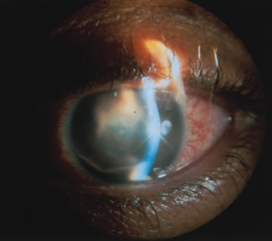
Endogenous
Endophthalmitis
Bacterial endophthalmitis

Slide 181
Endogenous
Endophthalmitis
Bacterial
Fungal
As mentioned, endogenous endophthalmitis can be bacterial or fungal. Bacterial endophthalmitis presents with the expected ocular signs of pain , redness , and decreased vision . Additional ocular signs include periorbital/lid edema , a dense AC reaction (often with hypopyon ), and vitreous inflammation . Retinal microabscesses may be present, including white-centered hemorrhages (aka Roth spots ). Systemic findings of infection—fever , elevated WBCs , malaise, etc—will likely be present as well.
two-words
two words
two-words

Slide 182
Endogenous
Endophthalmitis
Bacterial
Fungal
As mentioned, endogenous endophthalmitis can be bacterial or fungal. Bacterial endophthalmitis presents with the expected ocular signs of pain , redness , and decreased vision . Additional ocular signs include periorbital/lid edema , a dense AC reaction (often with hypopyon ), and vitreous inflammation . Retinal microabscesses may be present, including white-centered hemorrhages (aka Roth spots ). Systemic findings of infection—fever , elevated WBCs , malaise, etc—will likely be present as well.

Slide 183
Endogenous
Endophthalmitis
Bacterial
Fungal
As mentioned, endogenous endophthalmitis can be bacterial or fungal. Bacterial endophthalmitis presents with the expected ocular signs of pain , redness , and decreased vision . Additional ocular signs include periorbital/lid edema , a dense AC reaction (often with hypopyon ), and vitreous inflammation . Retinal microabscesses may be present, including white-centered hemorrhages (aka Roth spots ). Systemic findings of infection—fever , elevated WBCs , malaise, etc—will likely be present as well. Both Gram(+) bugs (esp. Staph, Strep, and Bacillus ) and Gram(-) bugs (esp. Neisseria, H flu, E coli and Klebsiella ) may be responsible.
two bugs
a third
three bugs
a fourth

Slide 184
Endogenous
Endophthalmitis
Bacterial
Fungal
As mentioned, endogenous endophthalmitis can be bacterial or fungal. Bacterial endophthalmitis presents with the expected ocular signs of pain , redness , and decreased vision . Additional ocular signs include periorbital/lid edema , a dense AC reaction (often with hypopyon ), and vitreous inflammation . Retinal microabscesses may be present, including white-centered hemorrhages (aka Roth spots ). Systemic findings of infection—fever , elevated WBCs , malaise, etc—will likely be present as well. Both Gram(+) bugs (esp. Staph, Strep, and Bacillus ) and Gram(-) bugs (esp. Neisseria, H flu, E coli and Klebsiella ) may be responsible.

Slide 185
Endogenous
Endophthalmitis
Bacterial
Fungal
As mentioned, endogenous endophthalmitis can be bacterial or fungal. Bacterial endophthalmitis presents with the expected ocular signs of pain , redness , and decreased vision . Additional ocular signs include periorbital/lid edema , a dense AC reaction (often with hypopyon ), and vitreous inflammation . Retinal microabscesses may be present, including white-centered hemorrhages (aka Roth spots ). Systemic findings of infection—fever , elevated WBCs , malaise, etc—will likely be present as well. Both Gram(+) bugs (esp. Staph, Strep, and Bacillus ) and Gram(-) bugs (esp. Neisseria, H flu, E coli and Klebsiella ) may be responsible. Often, the pt’s clinical and/or social situation provide important clues regarding the pathogen responsible.

Slide 186
Endogenous
Endophthalmitis
Bacterial
Fungal
As mentioned, endogenous endophthalmitis can be bacterial or fungal. Bacterial endophthalmitis presents with the expected ocular signs of pain , redness , and decreased vision . Additional ocular signs include periorbital/lid edema , a dense AC reaction (often with hypopyon ), and vitreous inflammation . Retinal microabscesses may be present, including white-centered hemorrhages (aka Roth spots ). Systemic findings of infection—fever , elevated WBCs , malaise, etc—will likely be present as well. Both Gram(+) bugs (esp. Staph, Strep, and Bacillus ) and Gram(-) bugs (esp. Neisseria, H flu, E coli and Klebsiella ) may be responsible. Often, the pt’s clinical and/or social situation provide important clues regarding the pathogen responsible.
Some classic bacterial pathogen associations in endogenous endophthalmitis:
--Endocarditis: ?
--Skin infections
--IVDU
--Liver abscess

Slide 187
Endogenous
Endophthalmitis
Bacterial
Fungal
As mentioned, endogenous endophthalmitis can be bacterial or fungal. Bacterial endophthalmitis presents with the expected ocular signs of pain , redness , and decreased vision . Additional ocular signs include periorbital/lid edema , a dense AC reaction (often with hypopyon ), and vitreous inflammation . Retinal microabscesses may be present, including white-centered hemorrhages (aka Roth spots ). Systemic findings of infection—fever , elevated WBCs , malaise, etc—will likely be present as well. Both Gram(+) bugs (esp. Staph, Strep, and Bacillus ) and Gram(-) bugs (esp. Neisseria, H flu, E coli and Klebsiella ) may be responsible. Often, the pt’s clinical and/or social situation provide important clues regarding the pathogen responsible.
Some classic bacterial pathogen associations in endogenous endophthalmitis:
--Endocarditis: Strep
--Skin infections: ?
--IVDU
--Liver abscess

Slide 188
Endogenous
Endophthalmitis
Bacterial
Fungal
As mentioned, endogenous endophthalmitis can be bacterial or fungal. Bacterial endophthalmitis presents with the expected ocular signs of pain , redness , and decreased vision . Additional ocular signs include periorbital/lid edema , a dense AC reaction (often with hypopyon ), and vitreous inflammation . Retinal microabscesses may be present, including white-centered hemorrhages (aka Roth spots ). Systemic findings of infection—fever , elevated WBCs , malaise, etc—will likely be present as well. Both Gram(+) bugs (esp. Staph, Strep, and Bacillus ) and Gram(-) bugs (esp. Neisseria, H flu, E coli and Klebsiella ) may be responsible. Often, the pt’s clinical and/or social situation provide important clues regarding the pathogen responsible.
Some classic bacterial pathogen associations in endogenous endophthalmitis:
--Endocarditis: Strep
--Skin infections: Staph
--IVDU: ?
--Liver abscess

Slide 189
Endogenous
Endophthalmitis
Bacterial
Fungal
As mentioned, endogenous endophthalmitis can be bacterial or fungal. Bacterial endophthalmitis presents with the expected ocular signs of pain , redness , and decreased vision . Additional ocular signs include periorbital/lid edema , a dense AC reaction (often with hypopyon ), and vitreous inflammation . Retinal microabscesses may be present, including white-centered hemorrhages (aka Roth spots ). Systemic findings of infection—fever , elevated WBCs , malaise, etc—will likely be present as well. Both Gram(+) bugs (esp. Staph, Strep, and Bacillus ) and Gram(-) bugs (esp. Neisseria, H flu, E coli and Klebsiella ) may be responsible. Often, the pt’s clinical and/or social situation provide important clues regarding the pathogen responsible.
Some classic bacterial pathogen associations in endogenous endophthalmitis:
--Endocarditis: Strep
--Skin infections: Staph
--IVDU: Bacillus
--Liver abscess: ?

Slide 190
Endogenous
Endophthalmitis
Bacterial
Fungal
As mentioned, endogenous endophthalmitis can be bacterial or fungal. Bacterial endophthalmitis presents with the expected ocular signs of pain , redness , and decreased vision . Additional ocular signs include periorbital/lid edema , a dense AC reaction (often with hypopyon ), and vitreous inflammation . Retinal microabscesses may be present, including white-centered hemorrhages (aka Roth spots ). Systemic findings of infection—fever , elevated WBCs , malaise, etc—will likely be present as well. Both Gram(+) bugs (esp. Staph, Strep, and Bacillus ) and Gram(-) bugs (esp. Neisseria, H flu, E coli and Klebsiella ) may be responsible. Often, the pt’s clinical and/or social situation provide important clues regarding the pathogen responsible.
Some classic bacterial pathogen associations in endogenous endophthalmitis:
--Endocarditis: Strep
--Skin infections: Staph
--IVDU: Bacillus
--Liver abscess: Klebsiella

Slide 191
Endogenous
Endophthalmitis
Bacterial
Fungal
In contrast to the bacterial version, endogenous fungal endophthalmitis tends to be more insidious in onset.

Slide 192
Endogenous
Endophthalmitis
Bacterial
Fungal
In contrast to the bacterial version, endogenous fungal endophthalmitis tends to be more insidious in onset.

Slide 193
Endogenous
Endophthalmitis
Bacterial
Fungal
In contrast to the bacterial version, endogenous fungal endophthalmitis tends to be more insidious in onset. It generally progresses in a particular fashion. First, isolated choroidal metastatic lesions appear.
location

Slide 194
Endogenous
Endophthalmitis
Bacterial
Fungal
In contrast to the bacterial version, endogenous fungal endophthalmitis tends to be more insidious in onset. It generally progresses in a particular fashion. First, isolated choroidal metastatic lesions appear.

Slide 195
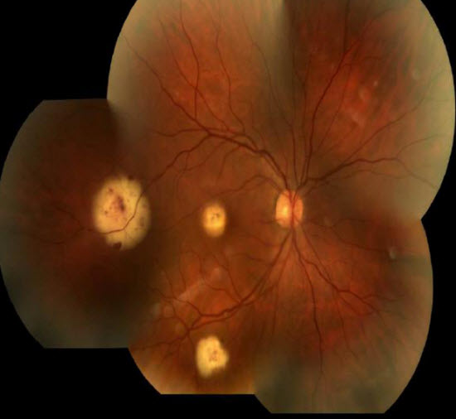
Endogenous
Endophthalmitis
Candida endophthalmitis: Choroidal lesions

Slide 196
Endogenous
Endophthalmitis
Bacterial
Fungal
In contrast to the bacterial version, endogenous fungal endophthalmitis tends to be more insidious in onset. It generally progresses in a particular fashion. First, isolated choroidal metastatic lesions appear. With time, these break through Bruch’s membrane to involve the retina.

Slide 197
Endogenous
Endophthalmitis
Bacterial
Fungal
In contrast to the bacterial version, endogenous fungal endophthalmitis tends to be more insidious in onset. It generally progresses in a particular fashion. First, isolated choroidal metastatic lesions appear. With time, these break through Bruch’s membrane to involve the retina.

Slide 198
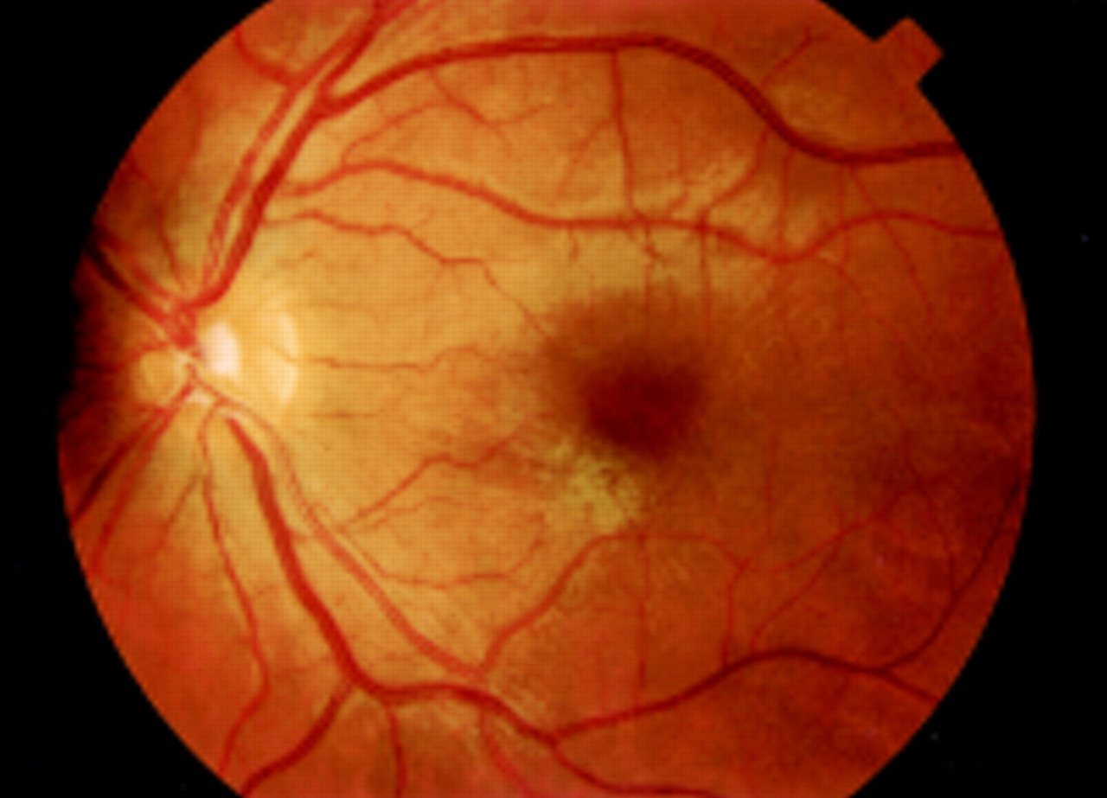
Endogenous
Endophthalmitis
Candida endophthalmitis: Retinal involvement

Slide 199
Endogenous
Endophthalmitis
Bacterial
Fungal
In contrast to the bacterial version, endogenous fungal endophthalmitis tends to be more insidious in onset. It generally progresses in a particular fashion. First, isolated choroidal metastatic lesions appear. With time, these break through Bruch’s membrane to involve the retina. Eventually, the bug reaches the vitreous, and (if still unchecked) the anterior segment.

Slide 200
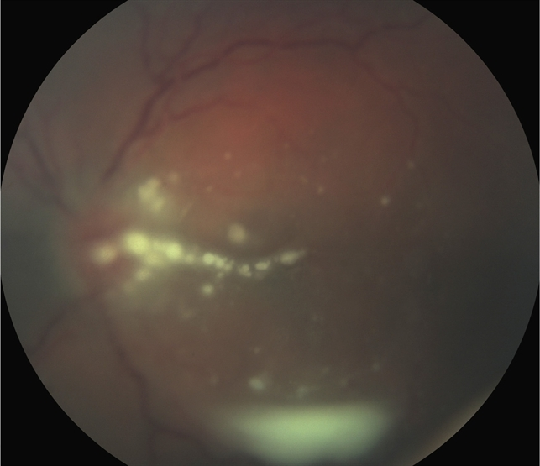
Endogenous
Endophthalmitis
three words
Candida endophthalmitis: Classic ‘string of pearls’ vitreous involvement

Slide 201
Endogenous
Endophthalmitis
Candida endophthalmitis: Classic ‘string of pearls’ vitreous involvement

Slide 202
Endogenous
Endophthalmitis
Bacterial
Fungal
In contrast to the bacterial version, endogenous fungal endophthalmitis tends to be more insidious in onset. It generally progresses in a particular fashion. First, isolated choroidal metastatic lesions appear. With time, these break through Bruch’s membrane to involve the retina. Eventually, the bug reaches the vitreous, and (if still unchecked) the anterior segment. Yeasts (esp. Candida and Cryptococcus ), molds ( Aspergillus ) and dimorphic species ( Coccidioides ) may be responsible.
yeast 1
yeast 2

Slide 203
Endogenous
Endophthalmitis
Bacterial
Fungal
In contrast to the bacterial version, endogenous fungal endophthalmitis tends to be more insidious in onset. It generally progresses in a particular fashion. First, isolated choroidal metastatic lesions appear. With time, these break through Bruch’s membrane to involve the retina. Eventually, the bug reaches the vitreous, and (if still unchecked) the anterior segment. Yeasts (esp. Candida and Cryptococcus ), molds ( Aspergillus ) and dimorphic species ( Coccidioides ) may be responsible.

Slide 204
Endogenous
Endophthalmitis
Bacterial
Fungal
In contrast to the bacterial version, endogenous fungal endophthalmitis tends to be more insidious in onset. It generally progresses in a particular fashion. First, isolated choroidal metastatic lesions appear. With time, these break through Bruch’s membrane to involve the retina. Eventually, the bug reaches the vitreous, and (if still unchecked) the anterior segment. Yeasts (esp. Candida and Cryptococcus ), molds ( Aspergillus ) and dimorphic species ( Coccidioides ) may be responsible. As with bacterial, the pt’s clinical and/or social situation can provide important clues regarding the pathogen.

Slide 205
Endogenous
Endophthalmitis
Bacterial
Fungal
In contrast to the bacterial version, endogenous fungal endophthalmitis tends to be more insidious in onset. It generally progresses in a particular fashion. First, isolated choroidal metastatic lesions appear. With time, these break through Bruch’s membrane to involve the retina. Eventually, the bug reaches the vitreous, and (if still unchecked) the anterior segment. Yeasts (esp. Candida and Cryptococcus ), molds ( Aspergillus ) and dimorphic species ( Coccidioides ) may be responsible. As with bacterial, the pt’s clinical and/or social situation can provide important clues regarding the pathogen.
Some classic fungal pathogen associations in endogenous endophthalmitis:
--Chronic indwelling lines/catheters: ?
--HIV/AIDS
--Hx liver transplantation
--San Joaquin valley

Slide 206
Endogenous
Endophthalmitis
Bacterial
Fungal
In contrast to the bacterial version, endogenous fungal endophthalmitis tends to be more insidious in onset. It generally progresses in a particular fashion. First, isolated choroidal metastatic lesions appear. With time, these break through Bruch’s membrane to involve the retina. Eventually, the bug reaches the vitreous, and (if still unchecked) the anterior segment. Yeasts (esp. Candida and Cryptococcus ), molds ( Aspergillus ) and dimorphic species ( Coccidioides ) may be responsible. As with bacterial, the pt’s clinical and/or social situation can provide important clues regarding the pathogen.
Some classic fungal pathogen associations in endogenous endophthalmitis:
--Chronic indwelling lines/catheters: Candida
--HIV/AIDS: ?
--Hx liver transplantation
--San Joaquin valley

Slide 207
Endogenous
Endophthalmitis
Bacterial
Fungal
In contrast to the bacterial version, endogenous fungal endophthalmitis tends to be more insidious in onset. It generally progresses in a particular fashion. First, isolated choroidal metastatic lesions appear. With time, these break through Bruch’s membrane to involve the retina. Eventually, the bug reaches the vitreous, and (if still unchecked) the anterior segment. Yeasts (esp. Candida and Cryptococcus ), molds ( Aspergillus ) and dimorphic species ( Coccidioides ) may be responsible. As with bacterial, the pt’s clinical and/or social situation can provide important clues regarding the pathogen.
Some classic fungal pathogen associations in endogenous endophthalmitis:
--Chronic indwelling lines/catheters: Candida
--HIV/AIDS: Cryptococcus
--Hx liver transplantation: ?
--San Joaquin valley

Slide 208
Endogenous
Endophthalmitis
Bacterial
Fungal
In contrast to the bacterial version, endogenous fungal endophthalmitis tends to be more insidious in onset. It generally progresses in a particular fashion. First, isolated choroidal metastatic lesions appear. With time, these break through Bruch’s membrane to involve the retina. Eventually, the bug reaches the vitreous, and (if still unchecked) the anterior segment. Yeasts (esp. Candida and Cryptococcus ), molds ( Aspergillus ) and dimorphic species ( Coccidioides ) may be responsible. As with bacterial, the pt’s clinical and/or social situation can provide important clues regarding the pathogen.
Some classic fungal pathogen associations in endogenous endophthalmitis:
--Chronic indwelling lines/catheters: Candida
--HIV/AIDS: Cryptococcus
--Hx liver transplantation: Aspergillus
--San Joaquin valley: ?

Slide 209
Endogenous
Endophthalmitis
Bacterial
Fungal
In contrast to the bacterial version, endogenous fungal endophthalmitis tends to be more insidious in onset. It generally progresses in a particular fashion. First, isolated choroidal metastatic lesions appear. With time, these break through Bruch’s membrane to involve the retina. Eventually, the bug reaches the vitreous, and (if still unchecked) the anterior segment. Yeasts (esp. Candida and Cryptococcus ), molds ( Aspergillus ) and dimorphic species ( Coccidioides ) may be responsible. As with bacterial, the pt’s clinical and/or social situation can provide important clues regarding the pathogen.
Some classic fungal pathogen associations in endogenous endophthalmitis:
--Chronic indwelling lines/catheters: Candida
--HIV/AIDS: Cryptococcus
--Hx liver transplantation: Aspergillus
--San Joaquin valley: Coccidioides

Slide 210
(This is a good point in the set to take a break)

Slide 211
Uveitis
Scleritis
Next let’s take a look at

Slide 212
Uveitis
Scleritis
Scleritis is an inflammatory condition characterized by painful infiltrative scleral edema and congestion of the deep episcleral plexus.
two words

Slide 213
Uveitis
Scleritis
Scleritis is an inflammatory condition characterized by painful infiltrative scleral edema and congestion of the deep episcleral plexus.

Slide 214
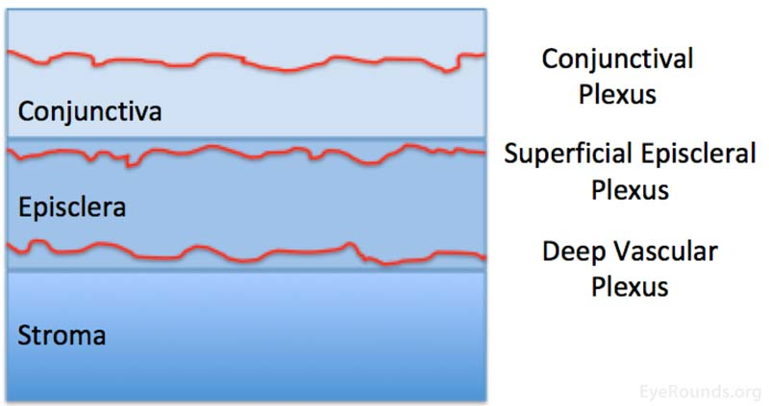
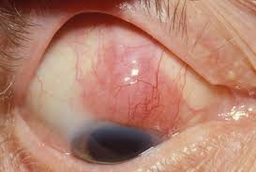
Uveitis
Anatomical depiction of the conjunctiva, episclera, and scleral stroma, and the approximate location of the conjunctival, superficial episcleral, and deep vascular plexi.
Scleritis: Deep episcleral plexus edema

Slide 215
Uveitis
Scleritis
Scleritis is an inflammatory condition characterized by painful infiltrative scleral edema and congestion of the deep episcleral plexus. It can be extremely painful, and can lead to blindness and loss of the eye .

Slide 216
Uveitis
Scleritis
Scleritis is an inflammatory condition characterized by painful infiltrative scleral edema and congestion of the deep episcleral plexus. It can be extremely painful, and can lead to blindness and loss of the eye .

Slide 217
Uveitis
Scleritis
Scleritis is an inflammatory condition characterized by painful infiltrative scleral edema and congestion of the deep episcleral plexus. It can be extremely painful, and can lead to blindness and loss of the eye . Women are more likely to be affected than are men. It is rare in children.

Slide 218
Uveitis
Scleritis
Scleritis is an inflammatory condition characterized by painful infiltrative scleral edema and congestion of the deep episcleral plexus. It can be extremely painful, and can lead to blindness and loss of the eye . Women are more likely to be affected than are men. It is rare in children.

Slide 219
Uveitis
Scleritis
Scleritis is an inflammatory condition characterized by painful infiltrative scleral edema and congestion of the deep episcleral plexus. It can be extremely painful, and can lead to blindness and loss of the eye . Women are more likely to be affected than are men. It is rare in children.
To make matters worse, scleritis can herald the presence or worsening of a systemic condition that may be potentially lethal. About 40% of scleritis pts have an identifiable systemic inflammatory condition, the most common of which is rheumatoid arthritis.
%
two words

Slide 220
Uveitis
Scleritis
Scleritis is an inflammatory condition characterized by painful infiltrative scleral edema and congestion of the deep episcleral plexus. It can be extremely painful, and can lead to blindness and loss of the eye . Women are more likely to be affected than are men. It is rare in children.
To make matters worse, scleritis can herald the presence or worsening of a systemic condition that may be potentially lethal. About 40% of scleritis pts have an identifiable systemic inflammatory condition, the most common of which is rheumatoid arthritis (RA).

Slide 221
Uveitis
Scleritis
is divvied up with respect
to whether the…

Slide 222
Uveitis
Scleritis
is divvied up with respect
to whether the…
Anterior
sclera is affected, vs the
Posterior
sclera.

Slide 223
Uveitis
Scleritis
Anterior
Posterior
There are three classic signs of anterior scleritis:
--Scleral edema
--
--

Slide 224
Uveitis
Scleritis
Anterior
Posterior
There are three classic signs of anterior scleritis:
--Scleral edema
--
--

Slide 225
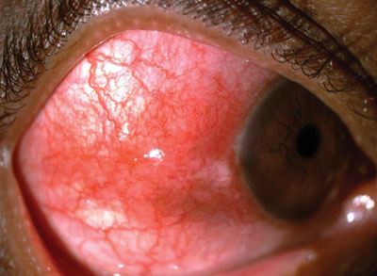
Uveitis
Anterior scleritis: Scleral edema
(a)
(b)
Anterior scleritis: Scleral edema. Note the thickening of the limbal sclera (b) in comparison to the unaffected fellow eye (a)

Slide 226
Uveitis
Scleritis
Anterior
Posterior
There are three classic signs of anterior scleritis:
--Scleral edema
--Sclera has a violaceous hue
--

Slide 227
Uveitis
Scleritis
Anterior
Posterior
There are three classic signs of anterior scleritis:
--Scleral edema
--Sclera has a violaceous hue
--

Slide 228
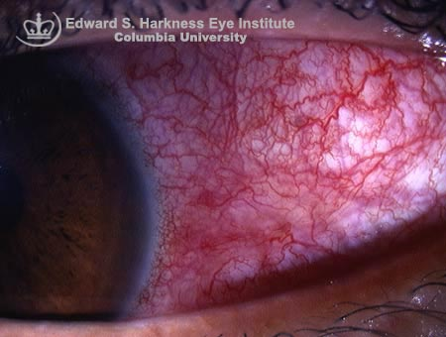
Uveitis
Anterior scleritis: Violaceous hue

Slide 229
Uveitis
Scleritis
Anterior
Posterior
There are three classic signs of anterior scleritis:
--Scleral edema
--Sclera has a violaceous hue
--Inflamed vasculature has a criss-cross pattern

Slide 230
Uveitis
Scleritis
Anterior
Posterior
There are three classic signs of anterior scleritis:
--Scleral edema
--Sclera has a violaceous hue
--Inflamed vasculature has a criss-cross pattern

Slide 231
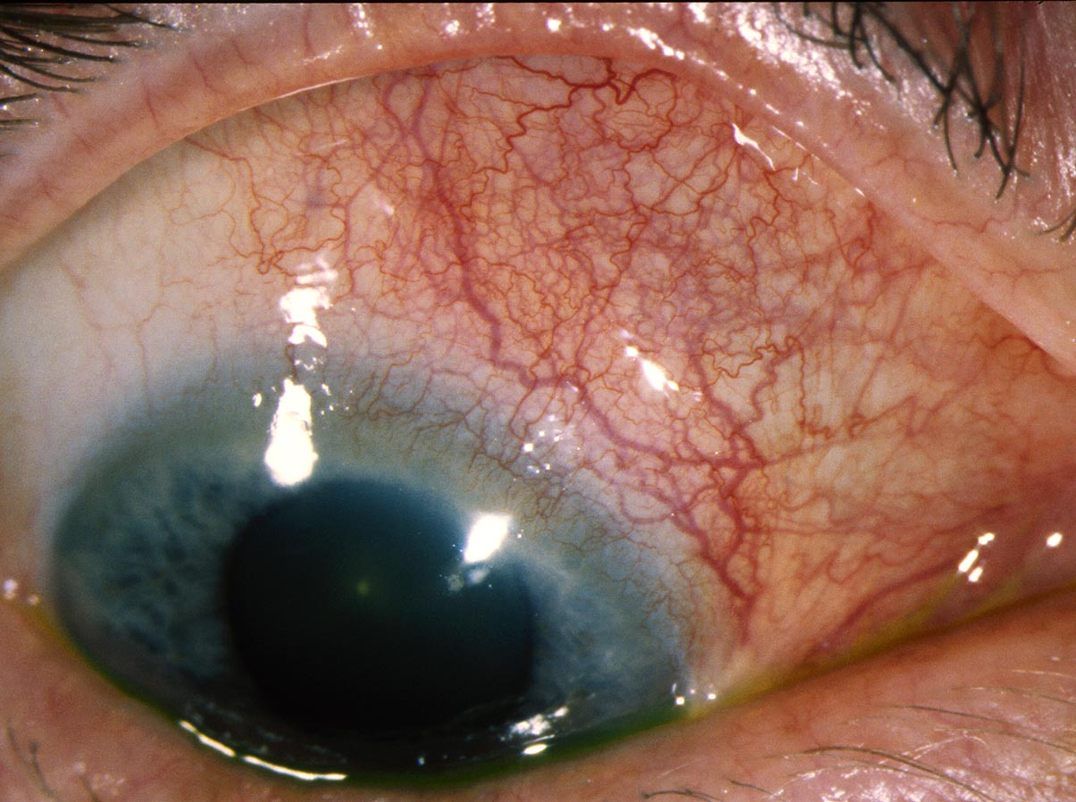
Uveitis
‘Criss-cross’ injection of the deep vasculature in anterior scleritis. (To see it, you have to ‘look past’ the brighter injection of the inflamed overlying conj vessels)

Slide 232
Uveitis
Scleritis
Anterior
Posterior
?
?
?
Anterior scleritis comes in three forms:

Slide 233
Uveitis
Scleritis
Anterior
Posterior
Diffuse
Nodular
Necrotizing
Anterior scleritis comes in three forms: Diffuse, nodular and necrotizing

Slide 234
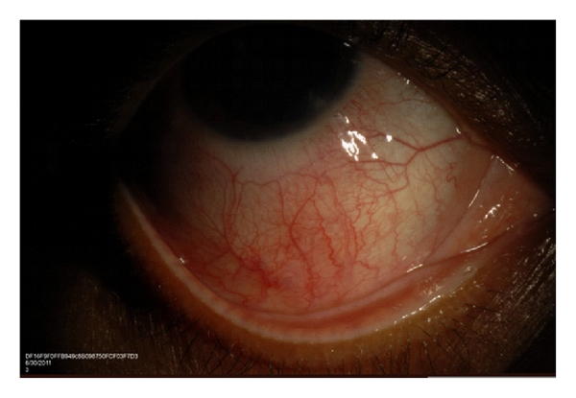
Uveitis
Diffuse anterior scleritis

Slide 235
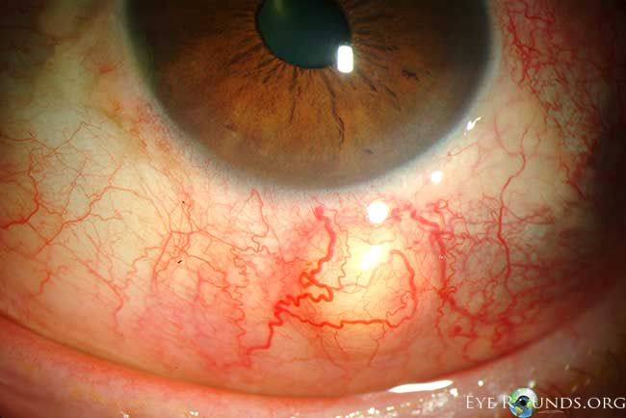
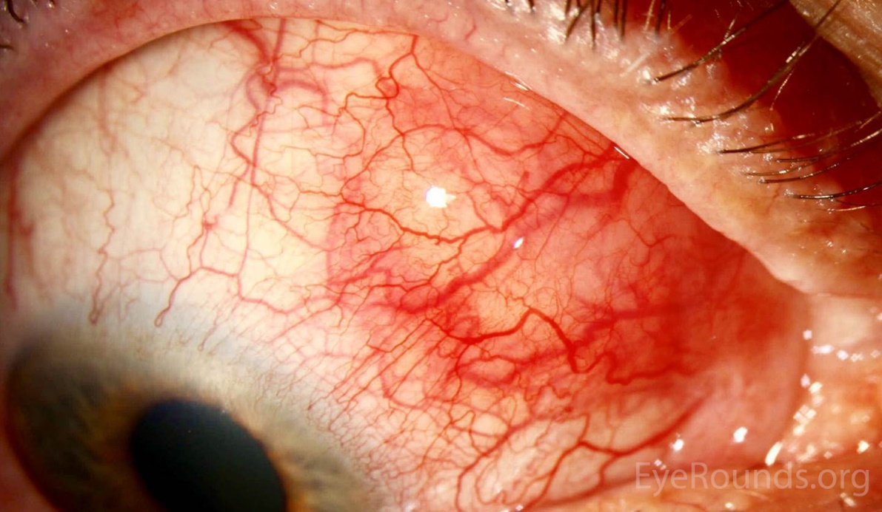
Uveitis
Nodular anterior scleritis

Slide 236
Uveitis
Scleritis
Anterior
Posterior
Diffuse
Nodular
Necrotizing
?
?
Necrotizing anterior scleritis comes in two forms:

Slide 237
Uveitis
Scleritis
Anterior
Posterior
Diffuse
Nodular
Necrotizing
w/ inflammation
w/o inflammation
Necrotizing anterior scleritis comes in two forms: With and without inflammation

Slide 238
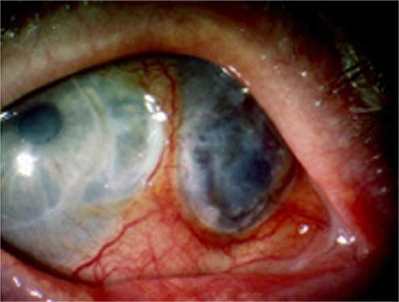
Uveitis
Necrotizing anterior scleritis with inflammation

Slide 239
Uveitis
Scleritis
Anterior
Posterior
Diffuse
Nodular
Necrotizing
w/ inflammation
w/o inflammation
Contrary to the implications of the name, inflammation is present in necrotizing scleritis w/o inflammation.

Slide 240
Uveitis
Scleritis
Anterior
Posterior
Diffuse
Nodular
Necrotizing
w/ inflammation
w/o inflammation
Contrary to the implications of the name, inflammation is present in necrotizing scleritis w/o inflammation. It is so named because, unlike its ‘with inflammation’ cousin, it is typically painless, and the eye does not appear inflamed.

Slide 241
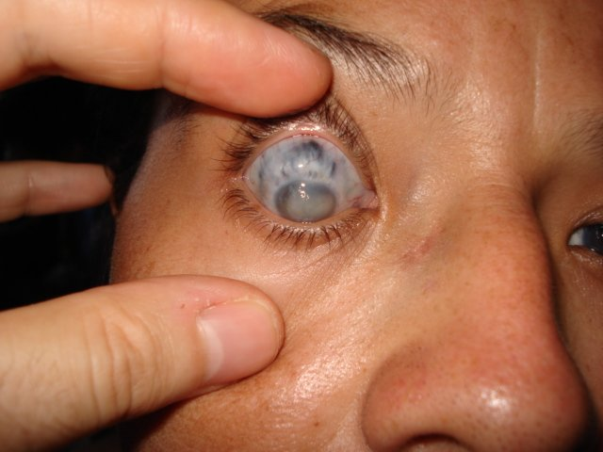
Uveitis
Necrotizing anterior scleritis without inflammation

Slide 242
Uveitis
Scleritis
Anterior
Posterior
Diffuse
Nodular
Necrotizing
w/ inflammation
w/o inflammation
Contrary to the implications of the name, inflammation is present in necrotizing scleritis w/o inflammation. It is so named because, unlike its ‘with inflammation’ cousin, it is typically painless, and the eye does not appear inflamed. Necrotizing scleritis w/o inflammation is also known as scleromalacia perforans . It is strongly associated with RA.
two words
abb.

Slide 243
Uveitis
Scleritis
Anterior
Posterior
Diffuse
Nodular
Necrotizing
w/ inflammation
w/o inflammation
Contrary to the implications of the name, inflammation is present in necrotizing scleritis w/o inflammation. It is so named because, unlike its ‘with inflammation’ cousin, it is typically painless, and the eye does not appear inflamed. Necrotizing scleritis w/o inflammation is also known as scleromalacia perforans . It is strongly associated with RA.

Slide 244
Uveitis
Scleritis
Anterior
Posterior
Unlike anterior scleritis, posterior scleritis does not present with a red eye, and nodules are not present. Instead, posterior scleritis presents with:
--Proptosis
--Disc edema
--Motility disorders
--Retinal/choroidal findings
eye ‘location’
Diffuse
Nodular
Necrotizing
w/ inflammation
w/o inflammation

Slide 245
Uveitis
Scleritis
Anterior
Posterior
Unlike anterior scleritis, posterior scleritis does not present with a red eye, and nodules are not present. Instead, posterior scleritis presents with:
--Proptosis
--Disc edema
--Motility disorders
--Retinal/choroidal findings
Diffuse
Nodular
Necrotizing
w/ inflammation
w/o inflammation

Slide 246
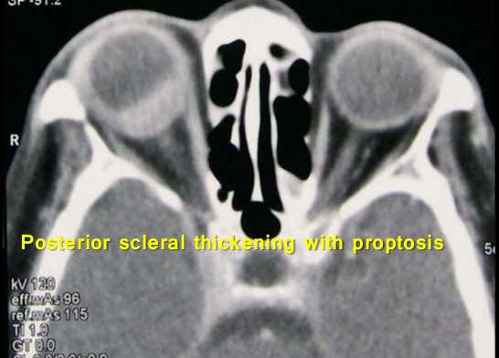
Uveitis
Posterior scleritis: Proptosis

Slide 247
Uveitis
Scleritis
Anterior
Posterior
Unlike anterior scleritis, posterior scleritis does not present with a red eye, and nodules are not present. Instead, posterior scleritis presents with:
--Proptosis
--Disc edema
--Motility disorders
--Retinal/choroidal findings
Diffuse
Nodular
Necrotizing
w/ inflammation
w/o inflammation

Slide 248
Uveitis
Scleritis
Anterior
Posterior
Unlike anterior scleritis, posterior scleritis does not present with a red eye, and nodules are not present. Instead, posterior scleritis presents with:
--Proptosis
--Disc edema
--Motility disorders
--Retinal/choroidal findings
Diffuse
Nodular
Necrotizing
w/ inflammation
w/o inflammation

Slide 249
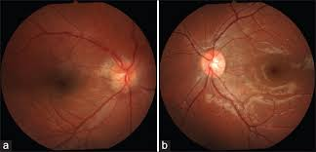
Uveitis
Posterior scleritis OD: Optic nerve edema

Slide 250
Uveitis
Scleritis
Anterior
Posterior
Unlike anterior scleritis, posterior scleritis does not present with a red eye, and nodules are not present. Instead, posterior scleritis presents with:
--Proptosis
--Disc edema
--Retinal/choroidal findings
--Motility disorders
Diffuse
Nodular
Necrotizing
w/ inflammation
w/o inflammation

Slide 251
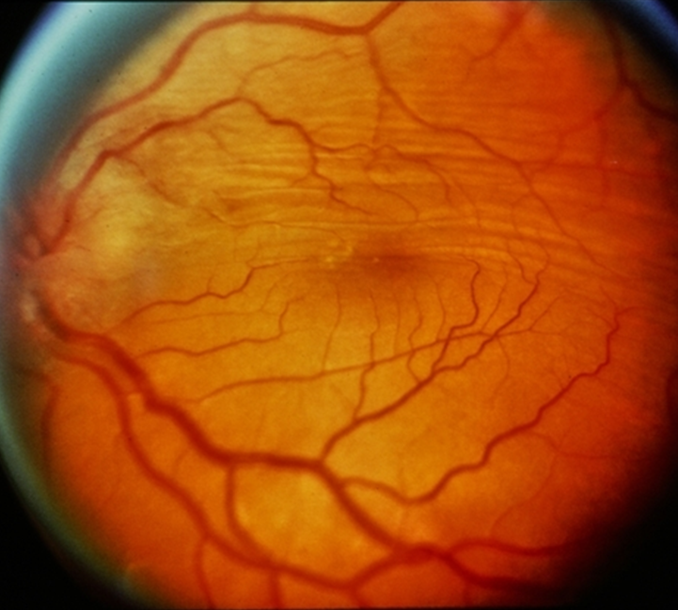
Uveitis
Posterior scleritis producing retinal folds

Slide 252
Uveitis
Scleritis
Anterior
Posterior
Unlike anterior scleritis, posterior scleritis does not present with a red eye, and nodules are not present. Instead, posterior scleritis presents with:
--Proptosis
--Disc edema
--Retinal/choroidal findings
--Motility disorders
Diffuse
Nodular
Necrotizing
function
w/ inflammation
w/o inflammation

Slide 253
Uveitis
Scleritis
Anterior
Posterior
Unlike anterior scleritis, posterior scleritis does not present with a red eye, and nodules are not present. Instead, posterior scleritis presents with:
--Proptosis
--Disc edema
--Retinal/choroidal findings
--Motility disorders
Diffuse
Nodular
Necrotizing
w/ inflammation
w/o inflammation

Slide 254
Uveitis
Scleritis
Anterior
Posterior
The pain of posterior scleritis has three characteristics that should alert you to the diagnosis:
--
--
--The pain awakens the pt at night
If you encounter descriptions such as this in the clinic (or on the OKAP), think posterior scleritis!
Diffuse
Nodular
Necrotizing
w/ inflammation
w/o inflammation

Slide 255
Uveitis
Scleritis
Anterior
Posterior
The pain of posterior scleritis has three characteristics that should alert you to the diagnosis:
--The pain radiates to the brow
--
--
If you encounter descriptions such as this in the clinic (or on the OKAP), think posterior scleritis!
Diffuse
Nodular
Necrotizing
w/ inflammation
w/o inflammation

Slide 256
Uveitis
Scleritis
Anterior
Posterior
The pain of posterior scleritis has three characteristics that should alert you to the diagnosis:
--The pain radiates to the brow
--
--
If you encounter descriptions such as this in the clinic (or on the OKAP), think posterior scleritis!
Diffuse
Nodular
Necrotizing
w/ inflammation
w/o inflammation

Slide 257
Uveitis
Scleritis
Anterior
Posterior
The pain of posterior scleritis has three characteristics that should alert you to the diagnosis:
--The pain radiates to the brow
--The pain is aggravated by eye movements
--
If you encounter descriptions such as this in the clinic (or on the OKAP), think posterior scleritis!
Diffuse
Nodular
Necrotizing
two words
w/ inflammation
w/o inflammation

Slide 258
Uveitis
Scleritis
Anterior
Posterior
The pain of posterior scleritis has three characteristics that should alert you to the diagnosis:
--The pain radiates to the brow
--The pain is aggravated by eye movements
--
If you encounter descriptions such as this in the clinic (or on the OKAP), think posterior scleritis!
Diffuse
Nodular
Necrotizing
w/ inflammation
w/o inflammation

Slide 259
Uveitis
Scleritis
Anterior
Posterior
The pain of posterior scleritis has three characteristics that should alert you to the diagnosis:
--The pain radiates to the brow
--The pain is aggravated by eye movements
--The pain awakens the pt at night
If you encounter descriptions such as this in the clinic (or on the OKAP), think posterior scleritis!
Diffuse
Nodular
Necrotizing
most classic c/o of all
w/ inflammation
w/o inflammation

Slide 260
Uveitis
Scleritis
Anterior
Posterior
The pain of posterior scleritis has three characteristics that should alert you to the diagnosis:
--The pain radiates to the brow
--The pain is aggravated by eye movements
--The pain awakens the pt at night
If you encounter descriptions such as this in the clinic (or on the OKAP), think posterior scleritis!
Diffuse
Nodular
Necrotizing
w/ inflammation
w/o inflammation

Slide 261
Uveitis
Scleritis
Anterior
Posterior
The pain of posterior scleritis has three characteristics that should alert you to the diagnosis:
--The pain radiates to the brow
--The pain is aggravated by eye movements
--The pain awakens the pt at night
If you encounter descriptions such as this in the clinic (or on the OKAP), think posterior scleritis!
Diffuse
Nodular
Necrotizing
w/ inflammation
w/o inflammation

Slide 262
Uveitis
Scleritis
Anterior
Posterior
An easy-to-obtain imaging study for confirming the diagnosis of posterior scleritis is B-scan ultrasonography . B-scan will reveal choroidal thickening and sub-Tenon’s edema . When sub-Tenon’s edema involves the space around the optic nerve, the classic T sign finding will result.
Diffuse
Nodular
Necrotizing
w/ inflammation
w/o inflammation

Slide 263
Uveitis
Scleritis
Anterior
Posterior
An easy-to-obtain imaging study for confirming the diagnosis of posterior scleritis is B-scan ultrasonography . B-scan will reveal choroidal thickening and sub-Tenon’s edema . When sub-Tenon’s edema involves the space around the optic nerve, the classic T sign finding will result.
Diffuse
Nodular
Necrotizing
w/ inflammation
w/o inflammation

Slide 264
Uveitis
Scleritis
Anterior
Posterior
An easy-to-obtain imaging study for confirming the diagnosis of posterior scleritis is B-scan ultrasonography . B-scan will reveal choroidal thickening and sub-Tenon’s edema . When sub-Tenon’s edema involves the space around the optic nerve, the classic T sign finding will result.
Nodular
Diffuse
two words
Necrotizing
three words
w/ inflammation
w/o inflammation

Slide 265
Uveitis
Scleritis
Anterior
Posterior
An easy-to-obtain imaging study for confirming the diagnosis of posterior scleritis is B-scan ultrasonography . B-scan will reveal choroidal thickening and sub-Tenon’s edema . When sub-Tenon’s edema involves the space around the optic nerve, the classic T sign finding will result.
Diffuse
Nodular
Necrotizing
w/ inflammation
w/o inflammation

Slide 266
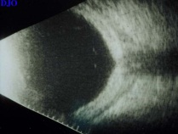
Uveitis
Posterior scleritis: Choroidal thickening; sub-Tenon’s edema

Slide 267
Uveitis
Scleritis
Anterior
Posterior
An easy-to-obtain imaging study for confirming the diagnosis of posterior scleritis is B-scan ultrasonography . B-scan will reveal choroidal thickening and sub-Tenon’s edema . When sub-Tenon’s edema involves the space around the optic nerve, the classic T sign finding will result.
Diffuse
Nodular
Necrotizing
w/ inflammation
w/o inflammation

Slide 268
Uveitis
Scleritis
Anterior
Posterior
An easy-to-obtain imaging study for confirming the diagnosis of posterior scleritis is B-scan ultrasonography . B-scan will reveal choroidal thickening and sub-Tenon’s edema . When sub-Tenon’s edema involves the space around the optic nerve, the classic T sign finding will result.
Diffuse
Nodular
Necrotizing
w/ inflammation
w/o inflammation

Slide 269
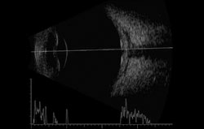
Uveitis
Posterior scleritis: T-sign (advance to next slide if you don’t see it)

Slide 270
Uveitis
T
Posterior scleritis: T-sign

Slide 271
Uveitis
Scleritis
Anterior
Posterior
Diffuse
Nodular
Necrotizing
w/ inflammation
w/o inflammation
Scleritis requires systemic treatment. Diffuse scleritis might respond to PO NSAIDs, so try them first if not contraindicated.
abb.

Slide 272
Uveitis
Scleritis
Anterior
Posterior
Diffuse
Nodular
Necrotizing
w/ inflammation
w/o inflammation
Scleritis requires systemic treatment. Diffuse scleritis might respond to PO NSAIDs, so try them first if not contraindicated.

Slide 273
Uveitis
Scleritis
Anterior
Posterior
Diffuse
Nodular
Necrotizing
w/ inflammation
w/o inflammation
Scleritis requires systemic treatment. Diffuse scleritis might respond to PO NSAIDs, so try them first if not contraindicated. For the others, PO steroids are usually the first-line med, although NSAIDs may be tried.

Slide 274
Uveitis
Scleritis
Anterior
Posterior
Diffuse
Nodular
Necrotizing
w/ inflammation
w/o inflammation
Scleritis requires systemic treatment. Diffuse scleritis might respond to PO NSAIDs, so try them first if not contraindicated. For the others, PO steroids are usually the first-line med, although NSAIDs may be tried.

Slide 275
Uveitis
Scleritis
Anterior
Posterior
Diffuse
Nodular
Necrotizing
w/ inflammation
w/o inflammation
Scleritis requires systemic treatment. Diffuse scleritis might respond to PO NSAIDs, so try them first if not contraindicated. For the others, PO steroids are usually the first-line med, although NSAIDs may be tried. Immunomodulatory therapy is often required.
two words

Slide 276
Uveitis
Scleritis
Anterior
Posterior
Diffuse
Nodular
Necrotizing
w/ inflammation
w/o inflammation
Scleritis requires systemic treatment. Diffuse scleritis might respond to PO NSAIDs, so try them first if not contraindicated. For the others, PO steroids are usually the first-line med, although NSAIDs may be tried. Immunomodulatory therapy is often required.

Slide 277
Uveitis
Scleritis
Anterior
Posterior
Diffuse
Nodular
Necrotizing
w/ inflammation
w/o inflammation
Scleritis requires systemic treatment. Diffuse scleritis might respond to PO NSAIDs, so try them first if not contraindicated. For the others, PO steroids are usually the first-line med, although NSAIDs may be tried. Immunomodulatory therapy is often required. Subconj depot steroids, long considered contraindicated, have recently gained wide acceptance as a treatment option.
two words

Slide 278
Uveitis
Scleritis
Anterior
Posterior
Diffuse
Nodular
Necrotizing
w/ inflammation
w/o inflammation
Scleritis requires systemic treatment. Diffuse scleritis might respond to PO NSAIDs, so try them first if not contraindicated. For the others, PO steroids are usually the first-line med, although NSAIDs may be tried. Immunomodulatory therapy is often required. Subconj depot steroids, long considered contraindicated, have recently gained wide acceptance as a treatment option.

Slide 279
Uveitis
In the next section we will go through the criteria regarding how one classifies/describes a uveitis with respect to its ocular findings. (Some of this will be a recapitulation of material we’ve already covered.)

Slide 280
Uveitis
In the context of uveitis, what does the acronym SUN stand for?

Slide 281
Uveitis
In the context of uveitis, what does the acronym SUN stand for?
Standardization of Uveitis Nomenclature, a working group appointed by the International Ocular Inflammation Society

Slide 282
Uveitis
In the context of uveitis, what does the acronym SUN stand for?
Standardization of Uveitis Nomenclature, a working group appointed by the International Ocular Inflammation Society
What was the task of the SUN Working Group?

Slide 283
Uveitis
In the context of uveitis, what does the acronym SUN stand for?
Standardization of Uveitis Nomenclature, a working group appointed by the International Ocular Inflammation Society
What was the task of the SUN Working Group?
To standardize uveitis nomenclature

Slide 284
Uveitis
In the context of uveitis, what does the acronym SUN stand for?
Standardization of Uveitis Nomenclature, a working group appointed by the International Ocular Inflammation Society
What was the task of the SUN Working Group?
To standardize uveitis nomenclature
The SUN classification system is based on three sets of criteria. What are they?

Slide 285
Uveitis
In the context of uveitis, what does the acronym SUN stand for?
Standardization of Uveitis Nomenclature, a working group appointed by the International Ocular Inflammation Society
What was the task of the SUN Working Group?
To standardize uveitis nomenclature
The SUN classification system is based on three sets of criteria. What are they?
The location of the uveitis
The onset, duration and course of the uveitis
The severity of the uveitis

Slide 286
Uveitis
In the context of uveitis, what does the acronym SUN stand for?
Standardization of Uveitis Nomenclature, a working group appointed by the International Ocular Inflammation Society
What was the task of the SUN Working Group?
To standardize uveitis nomenclature
The SUN classification system is based on three sets of criteria. What are they?
The location of the uveitis
The onset, duration and course of the uveitis
The severity of the uveitis

Slide 287
Uveitis
In the context of uveitis, what does the acronym SUN stand for?
Standardization of Uveitis Nomenclature, a working group appointed by the International Ocular Inflammation Society
What was the task of the SUN Working Group?
To standardize uveitis nomenclature
The SUN classification system is based on three sets of criteria. What are they?
The location of the uveitis
--?
--?
--?
--?
The onset, duration and course of the uveitis
The severity of the uveitis
What are the four locations?

Slide 288
Uveitis
In the context of uveitis, what does the acronym SUN stand for?
Standardization of Uveitis Nomenclature, a working group appointed by the International Ocular Inflammation Society
What was the task of the SUN Working Group?
To standardize uveitis nomenclature
The SUN classification system is based on three sets of criteria. What are they?
The location of the uveitis
--Anterior
--Intermediate
--Posterior
--Panuveitis
The onset, duration and course of the uveitis
The severity of the uveitis
What are the four locations?

Slide 289
Uveitis
In the context of uveitis, what does the acronym SUN stand for?
Standardization of Uveitis Nomenclature, a working group appointed by the International Ocular Inflammation Society
What was the task of the SUN Working Group?
To standardize uveitis nomenclature
The SUN classification system is based on three sets of criteria. What are they?
The location of the uveitis
--Anterior?
--Intermediate
--Posterior
--Panuveitis
The onset, duration and course of the uveitis
The severity of the uveitis
With respect to uveitis: Where is the primary location of inflammation in…
Anterior uveitis? The anterior chamber, +/- cells found no further posterior than the anterior vitreous
Intermediate uveitis? The main vitreous cavity, +/- the peripheral retina and/or pars plana
Posterior uveitis? The retina, choroid, and/or optic nerve head
Panuveitis? All three locations are equally involved

Slide 290
Uveitis
In the context of uveitis, what does the acronym SUN stand for?
Standardization of Uveitis Nomenclature, a working group appointed by the International Ocular Inflammation Society
What was the task of the SUN Working Group?
To standardize uveitis nomenclature
The SUN classification system is based on three sets of criteria. What are they?
The location of the uveitis
--Anterior?
--Intermediate
--Posterior
--Panuveitis
The onset, duration and course of the uveitis
The severity of the uveitis
With respect to uveitis: Where is the primary location of inflammation in…
Anterior uveitis? The anterior chamber (although cell ‘spillover’ into the anterior vitreous may occur)
Intermediate uveitis? The main vitreous cavity, +/- the peripheral retina and/or pars plana
Posterior uveitis? The retina, choroid, and/or optic nerve head
Panuveitis? All three locations are equally involved

Slide 291
Uveitis
In the context of uveitis, what does the acronym SUN stand for?
Standardization of Uveitis Nomenclature, a working group appointed by the International Ocular Inflammation Society
What was the task of the SUN Working Group?
To standardize uveitis nomenclature
The SUN classification system is based on three sets of criteria. What are they?
The location of the uveitis
--Anterior
--Intermediate?
--Posterior
--Panuveitis
The onset, duration and course of the uveitis
The severity of the uveitis
With respect to uveitis: Where is the primary location of inflammation in…
Anterior uveitis? The anterior chamber (although cell ‘spillover’ into the anterior vitreous may occur)
Intermediate uveitis? The main vitreous cavity, +/- the peripheral retina and/or pars plana
Posterior uveitis? The retina, choroid, and/or optic nerve head
Panuveitis? All three locations are equally involved

Slide 292
Uveitis
In the context of uveitis, what does the acronym SUN stand for?
Standardization of Uveitis Nomenclature, a working group appointed by the International Ocular Inflammation Society
What was the task of the SUN Working Group?
To standardize uveitis nomenclature
The SUN classification system is based on three sets of criteria. What are they?
The location of the uveitis
--Anterior
--Intermediate?
--Posterior
--Panuveitis
The onset, duration and course of the uveitis
The severity of the uveitis
With respect to uveitis: Where is the primary location of inflammation in…
Anterior uveitis? The anterior chamber (although cell ‘spillover’ into the anterior vitreous may occur)
Intermediate uveitis? The main vitreous cavity, +/- the peripheral retina and/or pars plana
Posterior uveitis? The retina, choroid, and/or optic nerve head
Panuveitis? All three locations are equally involved

Slide 293
Uveitis
In the context of uveitis, what does the acronym SUN stand for?
Standardization of Uveitis Nomenclature, a working group appointed by the International Ocular Inflammation Society
What was the task of the SUN Working Group?
To standardize uveitis nomenclature
The SUN classification system is based on three sets of criteria. What are they?
The location of the uveitis
--Anterior
--Intermediate
--Posterior?
--Panuveitis
The onset, duration and course of the uveitis
The severity of the uveitis
With respect to uveitis: Where is the primary location of inflammation in…
Anterior uveitis? The anterior chamber (although cell ‘spillover’ into the anterior vitreous may occur)
Intermediate uveitis? The main vitreous cavity, +/- the peripheral retina and/or pars plana
Posterior uveitis? The retina, choroid, and/or optic nerve head
Panuveitis? All three locations are equally involved

Slide 294
Uveitis
In the context of uveitis, what does the acronym SUN stand for?
Standardization of Uveitis Nomenclature, a working group appointed by the International Ocular Inflammation Society
What was the task of the SUN Working Group?
To standardize uveitis nomenclature
The SUN classification system is based on three sets of criteria. What are they?
The location of the uveitis
--Anterior
--Intermediate
--Posterior?
--Panuveitis
The onset, duration and course of the uveitis
The severity of the uveitis
With respect to uveitis: Where is the primary location of inflammation in…
Anterior uveitis? The anterior chamber (although cell ‘spillover’ into the anterior vitreous may occur)
Intermediate uveitis? The main vitreous cavity, +/- the peripheral retina and/or pars plana
Posterior uveitis? The retina, choroid, and/or optic nerve head
Panuveitis? All three locations are equally involved

Slide 295
Uveitis
In the context of uveitis, what does the acronym SUN stand for?
Standardization of Uveitis Nomenclature, a working group appointed by the International Ocular Inflammation Society
What was the task of the SUN Working Group?
To standardize uveitis nomenclature
The SUN classification system is based on three sets of criteria. What are they?
The location of the uveitis
--Anterior
--Intermediate
--Posterior
--Panuveitis?
The onset, duration and course of the uveitis
The severity of the uveitis
With respect to uveitis: Where is the primary location of inflammation in…
Anterior uveitis? The anterior chamber (although cell ‘spillover’ into the anterior vitreous may occur)
Intermediate uveitis? The main vitreous cavity, +/- the peripheral retina and/or pars plana
Posterior uveitis? The retina, choroid, and/or optic nerve head
Panuveitis? All three locations are equally involved

Slide 296
Uveitis
In the context of uveitis, what does the acronym SUN stand for?
Standardization of Uveitis Nomenclature, a working group appointed by the International Ocular Inflammation Society
What was the task of the SUN Working Group?
To standardize uveitis nomenclature
The SUN classification system is based on three sets of criteria. What are they?
The location of the uveitis
--Anterior
--Intermediate
--Posterior
--Panuveitis?
The onset, duration and course of the uveitis
The severity of the uveitis
With respect to uveitis: Where is the primary location of inflammation in…
Anterior uveitis? The anterior chamber (although cell ‘spillover’ into the anterior vitreous may occur)
Intermediate uveitis? The main vitreous cavity, +/- the peripheral retina and/or pars plana
Posterior uveitis? The retina, choroid, and/or optic nerve head
Panuveitis? All three locations are equally involved

Slide 297
Uveitis
In the context of uveitis, what does the acronym SUN stand for?
Standardization of Uveitis Nomenclature, a working group appointed by the International Ocular Inflammation Society
What was the task of the SUN Working Group?
To standardize uveitis nomenclature
The SUN classification system is based on three sets of criteria. What are they?
The location of the uveitis
--Anterior
--Intermediate
--Posterior
--Panuveitis
The onset, duration and course of the uveitis
--Onset: Sudden vs insidious
--Duration: Limited vs persistent
--Course: Acute vs recurrent vs
chronic
The severity of the uveitis
--AC cell grade
--AC flare grade
--Vitreous haze score
A pt has dense AC cell, scant anterior vitreous cell, and cystoid macular edema. Given all three locations are involved, this pt has panuveitis, yes?
No. The description clearly suggests the pt has an anterior uveitis with spillover of cell into the anterior vitreous, along with cystoid macular edema caused by the anterior uveitis. In other words, despite the fact that all three locations are involved, the primary location is anterior, making this an anterior uveitis.
With respect to uveitis, where is the primary inflammation located in…
Anterior uveitis? The anterior chamber (although cell ‘spillover’ into the anterior vitreous may occur)
Intermediate uveitis? The vitreous, peripheral retina and/or pars plana
Posterior uveitis? The retina and/or choroid
Panuveitis? All three locations are equally involved

Slide 298
Uveitis
In the context of uveitis, what does the acronym SUN stand for?
Standardization of Uveitis Nomenclature, a working group appointed by the International Ocular Inflammation Society
What was the task of the SUN Working Group?
To standardize uveitis nomenclature
The SUN classification system is based on three sets of criteria. What are they?
The location of the uveitis
--Anterior
--Intermediate
--Posterior
--Panuveitis
The onset, duration and course of the uveitis
--Onset: Sudden vs insidious
--Duration: Limited vs persistent
--Course: Acute vs recurrent vs
chronic
The severity of the uveitis
--AC cell grade
--AC flare grade
--Vitreous haze score
A pt has dense AC cell, scant anterior vitreous cell, and cystoid macular edema. Given all three locations are involved, this pt has panuveitis, yes?
No. The description clearly suggests the pt has an anterior uveitis with spillover of cell into the anterior vitreous, along with cystoid macular edema caused by the anterior uveitis. In other words, despite the fact that all three locations are involved, the primary location is anterior, making this an anterior uveitis.
With respect to uveitis, where is the primary inflammation located in…
Anterior uveitis? The anterior chamber (although cell ‘spillover’ into the anterior vitreous may occur)
Intermediate uveitis? The vitreous, peripheral retina and/or pars plana
Posterior uveitis? The retina and/or choroid
Panuveitis? All three locations are equally involved

Slide 299
Uveitis
In the context of uveitis, what does the acronym SUN stand for?
Standardization of Uveitis Nomenclature, a working group appointed by the International Ocular Inflammation Society
What was the task of the SUN Working Group?
To standardize uveitis nomenclature
The SUN classification system is based on three sets of criteria. What are they?
The location of the uveitis
--Anterior
--Intermediate
--Posterior
--Panuveitis
The onset, duration and course of the uveitis
--Onset: Sudden vs insidious
--Duration: Limited vs persistent
--Course: Acute vs recurrent vs
chronic
The severity of the uveitis
--AC cell grade
--AC flare grade
--Vitreous haze score
A pt has dense AC cell, scant anterior vitreous cell, and cystoid macular edema. Given all three locations are involved, this pt has panuveitis, yes?
No. The description clearly suggests the pt has an anterior uveitis with spillover of cell into the anterior vitreous, along with cystoid macular edema caused by the anterior uveitis. In other words, despite the fact that all three locations are involved, the primary location is anterior, making this an anterior uveitis.
With respect to uveitis, where is the primary inflammation located in…
Anterior uveitis? The anterior chamber (although cell ‘spillover’ into the anterior vitreous may occur)
Intermediate uveitis? The vitreous, peripheral retina and/or pars plana
Posterior uveitis? The retina and/or choroid
Panuveitis? All three locations are equally involved

Slide 300
Uveitis
In the context of uveitis, what does the acronym SUN stand for?
Standardization of Uveitis Nomenclature, a working group appointed by the International Ocular Inflammation Society
What was the task of the SUN Working Group?
To standardize uveitis nomenclature
The SUN classification system is based on three sets of criteria. What are they?
The location of the uveitis
--Anterior
--Intermediate
--Posterior
--Panuveitis
The onset, duration and course of the uveitis
--Onset: Sudden vs insidious
--Duration
--Course
The severity of the uveitis
something vs something
How are onset, duration and course delineated?

Slide 301
Uveitis
In the context of uveitis, what does the acronym SUN stand for?
Standardization of Uveitis Nomenclature, a working group appointed by the International Ocular Inflammation Society
What was the task of the SUN Working Group?
To standardize uveitis nomenclature
The SUN classification system is based on three sets of criteria. What are they?
The location of the uveitis
--Anterior
--Intermediate
--Posterior
--Panuveitis
The onset, duration and course of the uveitis
--Onset: Sudden vs insidious
--Duration
--Course
The severity of the uveitis
How are onset, duration and course delineated?

Slide 302
Uveitis
In the context of uveitis, what does the acronym SUN stand for?
Standardization of Uveitis Nomenclature, a working group appointed by the International Ocular Inflammation Society
What was the task of the SUN Working Group?
To standardize uveitis nomenclature
The SUN classification system is based on three sets of criteria. What are they?
The location of the uveitis
--Anterior
--Intermediate
--Posterior
--Panuveitis
The onset, duration and course of the uveitis
--Onset: Sudden vs insidious
--Duration: Limited vs persistent
--Course
The severity of the uveitis
something vs something
How are onset, duration and course delineated?

Slide 303
Uveitis
In the context of uveitis, what does the acronym SUN stand for?
Standardization of Uveitis Nomenclature, a working group appointed by the International Ocular Inflammation Society
What was the task of the SUN Working Group?
To standardize uveitis nomenclature
The SUN classification system is based on three sets of criteria. What are they?
The location of the uveitis
--Anterior
--Intermediate
--Posterior
--Panuveitis
The onset, duration and course of the uveitis
--Onset: Sudden vs insidious
--Duration: Limited vs persistent
--Course
The severity of the uveitis
How are onset, duration and course delineated?

Slide 304
Uveitis
In the context of uveitis, what does the acronym SUN stand for?
Standardization of Uveitis Nomenclature, a working group appointed by the International Ocular Inflammation Society
What was the task of the SUN Working Group?
To standardize uveitis nomenclature
The SUN classification system is based on three sets of criteria. What are they?
The location of the uveitis
--Anterior
--Intermediate
--Posterior
--Panuveitis
The onset, duration and course of the uveitis
--Onset: Sudden vs insidious
--Duration: Limited vs persistent
--Course: Acute vs recurrent vs
chronic
The severity of the uveitis
something vs something vs…
…something
How are onset, duration and course delineated?

Slide 305
Uveitis
In the context of uveitis, what does the acronym SUN stand for?
Standardization of Uveitis Nomenclature, a working group appointed by the International Ocular Inflammation Society
What was the task of the SUN Working Group?
To standardize uveitis nomenclature
The SUN classification system is based on three sets of criteria. What are they?
The location of the uveitis
--Anterior
--Intermediate
--Posterior
--Panuveitis
The onset, duration and course of the uveitis
--Onset: Sudden vs insidious
--Duration: Limited vs persistent
--Course: Acute vs recurrent vs
chronic
The severity of the uveitis
How are onset, duration and course delineated?

Slide 306
Uveitis
In the context of uveitis, what does the acronym SUN stand for?
Standardization of Uveitis Nomenclature, a working group appointed by the International Ocular Inflammation Society
What was the task of the SUN Working Group?
To standardize uveitis nomenclature
The SUN classification system is based on three sets of criteria. What are they?
The location of the uveitis
--Anterior
--Intermediate
--Posterior
--Panuveitis
The onset, duration and course of the uveitis
--Onset: Sudden vs insidious
--Duration: Limited vs persistent
--Course: Acute vs recurrent vs
chronic
The severity of the uveitis
With respect to uveitis, what is the difference between…
Sudden vs insidious onset? Sudden-onset uveitis presents with abrupt development of symptoms (pain, photophobia) and signs (injection); whereas insidious uveitis is largely sign- and symptom-free
Limited and persistent duration? Limited lasts < 3 months; persistent > 3 months
Acute, recurrent and chronic course? Acute uveitis comes on suddenly and resolves fairly quickly. Recurrent uveitis eventually relapses, but is quiescent off-treatment for at least 3 months. Chronic uveitis also relapses, but its quiescent periods off-treatment will last less than 3 months.

Slide 307
Uveitis
In the context of uveitis, what does the acronym SUN stand for?
Standardization of Uveitis Nomenclature, a working group appointed by the International Ocular Inflammation Society
What was the task of the SUN Working Group?
To standardize uveitis nomenclature
The SUN classification system is based on three sets of criteria. What are they?
The location of the uveitis
--Anterior
--Intermediate
--Posterior
--Panuveitis
The onset, duration and course of the uveitis
--Onset: Sudden vs insidious
--Duration: Limited vs persistent
--Course: Acute vs recurrent vs
chronic
The severity of the uveitis
With respect to uveitis, what is the difference between…
Sudden vs insidious onset? Sudden-onset uveitis presents with abrupt development of symptoms (pain, photophobia) and signs (injection); insidious uveitis is largely sign- and symptom-free
Limited and persistent duration? Limited lasts < 3 months; persistent > 3 months
Acute, recurrent and chronic course? Acute uveitis comes on suddenly and resolves fairly quickly. Recurrent uveitis eventually relapses, but is quiescent off-treatment for at least 3 months. Chronic uveitis also relapses, but its quiescent periods off-treatment will last less than 3 months.

Slide 308
Uveitis
In the context of uveitis, what does the acronym SUN stand for?
Standardization of Uveitis Nomenclature, a working group appointed by the International Ocular Inflammation Society
What was the task of the SUN Working Group?
To standardize uveitis nomenclature
The SUN classification system is based on three sets of criteria. What are they?
The location of the uveitis
--Anterior
--Intermediate
--Posterior
--Panuveitis
The onset, duration and course of the uveitis
--Onset: Sudden vs insidious
--Duration: Limited vs persistent
--Course: Acute vs recurrent vs
chronic
The severity of the uveitis
With respect to uveitis, what is the difference between…
Sudden vs insidious onset? Sudden-onset uveitis presents with abrupt development of symptoms (pain, photophobia) and signs (injection); insidious uveitis is largely sign- and symptom-free
Limited vs persistent duration? Limited lasts < 3 months; persistent > 3 months
Acute, recurrent and chronic course? Acute uveitis comes on suddenly and resolves fairly quickly. Recurrent uveitis eventually relapses, but is quiescent off-treatment for at least 3 months. Chronic uveitis also relapses, but its quiescent periods off-treatment will last less than 3 months.

Slide 309
Uveitis
In the context of uveitis, what does the acronym SUN stand for?
Standardization of Uveitis Nomenclature, a working group appointed by the International Ocular Inflammation Society
What was the task of the SUN Working Group?
To standardize uveitis nomenclature
The SUN classification system is based on three sets of criteria. What are they?
The location of the uveitis
--Anterior
--Intermediate
--Posterior
--Panuveitis
The onset, duration and course of the uveitis
--Onset: Sudden vs insidious
--Duration: Limited vs persistent
--Course: Acute vs recurrent vs
chronic
The severity of the uveitis
With respect to uveitis, what is the difference between…
Sudden vs insidious onset? Sudden-onset uveitis presents with abrupt development of symptoms (pain, photophobia) and signs (injection); insidious uveitis is largely sign- and symptom-free
Limited vs persistent duration? Limited lasts < 3 months; persistent > 3 months
Acute, recurrent and chronic course? Acute uveitis comes on suddenly and resolves fairly quickly. Recurrent uveitis eventually relapses, but is quiescent off-treatment for at least 3 months. Chronic uveitis also relapses, but its quiescent periods off-treatment will last less than 3 months.

Slide 310
Uveitis
In the context of uveitis, what does the acronym SUN stand for?
Standardization of Uveitis Nomenclature, a working group appointed by the International Ocular Inflammation Society
What was the task of the SUN Working Group?
To standardize uveitis nomenclature
The SUN classification system is based on three sets of criteria. What are they?
The location of the uveitis
--Anterior
--Intermediate
--Posterior
--Panuveitis
The onset, duration and course of the uveitis
--Onset: Sudden vs insidious
--Duration: Limited vs persistent
--Course: Acute vs recurrent vs
chronic
The severity of the uveitis
With respect to uveitis, what is the difference between…
Sudden vs insidious onset? Sudden-onset uveitis presents with abrupt development of symptoms (pain, photophobia) and signs (injection); insidious uveitis is largely sign- and symptom-free
Limited vs persistent duration? Limited lasts < 3 months; persistent > 3 months
Acute, recurrent vs chronic course? Acute uveitis comes on suddenly and resolves fairly quickly. Recurrent uveitis eventually relapses, but is quiescent off-treatment for at least 3 months. Chronic uveitis also relapses, but its quiescent periods off-treatment will last less than 3 months.

Slide 311
Uveitis
In the context of uveitis, what does the acronym SUN stand for?
Standardization of Uveitis Nomenclature, a working group appointed by the International Ocular Inflammation Society
What was the task of the SUN Working Group?
To standardize uveitis nomenclature
The SUN classification system is based on three sets of criteria. What are they?
The location of the uveitis
--Anterior
--Intermediate
--Posterior
--Panuveitis
The onset, duration and course of the uveitis
--Onset: Sudden vs insidious
--Duration: Limited vs persistent
--Course: Acute vs recurrent vs
chronic
The severity of the uveitis
With respect to uveitis, what is the difference between…
Sudden vs insidious onset? Sudden-onset uveitis presents with abrupt development of symptoms (pain, photophobia) and signs (injection); insidious uveitis is largely sign- and symptom-free
Limited vs persistent duration? Limited lasts < 3 months; persistent > 3 months
Acute, recurrent vs chronic course? Acute uveitis comes on suddenly and resolves fairly quickly. Recurrent uveitis eventually relapses, but is quiescent off-treatment for at least 3 months. Chronic uveitis also relapses, but its quiescent periods off-treatment last less than 3 months.

Slide 312
Uveitis
In the context of uveitis, what does the acronym SUN stand for?
Standardization of Uveitis Nomenclature, a working group appointed by the International Ocular Inflammation Society
What was the task of the SUN Working Group?
To standardize uveitis nomenclature
The SUN classification system is based on three sets of criteria. What are they?
The location of the uveitis
--Anterior
--Intermediate
--Posterior
--Panuveitis
The onset, duration and course of the uveitis
--Onset: Sudden vs insidious
--Duration: Limited vs persistent
--Course: Acute vs recurrent vs
chronic
The severity of the uveitis
With respect to uveitis, what is the difference between…
Sudden vs insidious onset? Sudden-onset uveitis presents with abrupt development of symptoms (pain, photophobia) and signs (injection); insidious uveitis is largely sign- and symptom-free
Limited vs persistent duration? Limited lasts < 3 months; persistent > 3 months
Acute, recurrent vs chronic course? Acute uveitis comes on suddenly and resolves fairly quickly. Recurrent uveitis eventually relapses, but is quiescent off-treatment for at least 3 months. Chronic uveitis also relapses, but its quiescent periods off-treatment last less than 3 months.

Slide 313
Uveitis
In the context of uveitis, what does the acronym SUN stand for?
Standardization of Uveitis Nomenclature, a working group appointed by the International Ocular Inflammation Society
What was the task of the SUN Working Group?
To standardize uveitis nomenclature
The SUN classification system is based on three sets of criteria. What are they?
The location of the uveitis
--Anterior
--Intermediate
--Posterior
--Panuveitis
The onset, duration and course of the uveitis
--Onset: Sudden vs insidious
--Duration: Limited vs persistent
--Course: Acute vs recurrent vs
chronic
The severity of the uveitis
With respect to uveitis, what is the difference between…
Sudden vs insidious onset? Sudden-onset uveitis presents with abrupt development of symptoms (pain, photophobia) and signs (injection); insidious uveitis is largely sign- and symptom-free
Limited vs persistent duration? Limited lasts < 3 months; persistent > 3 months
Acute, recurrent vs chronic course? Acute uveitis comes on suddenly and resolves fairly quickly. Recurrent uveitis eventually relapses, but is quiescent off-treatment for at least 3 months. Chronic uveitis also relapses, but its quiescent periods off-treatment last less than 3 months.

Slide 314
Uveitis
In the context of uveitis, what does the acronym SUN stand for?
Standardization of Uveitis Nomenclature, a working group appointed by the International Ocular Inflammation Society
What was the task of the SUN Working Group?
To standardize uveitis nomenclature
The SUN classification system is based on three sets of criteria. What are they?
The location of the uveitis
--Anterior
--Intermediate
--Posterior
--Panuveitis
The onset, duration and course of the uveitis
--Onset: Sudden vs insidious
--Duration: Limited vs persistent
--Course: Acute vs recurrent vs
chronic
The severity of the uveitis
--AC cell grade
--AC flare grade
--Vitreous haze score
two words
two words
two words
How is severity determined?

Slide 315
Uveitis
In the context of uveitis, what does the acronym SUN stand for?
Standardization of Uveitis Nomenclature, a working group appointed by the International Ocular Inflammation Society
What was the task of the SUN Working Group?
To standardize uveitis nomenclature
The SUN classification system is based on three sets of criteria. What are they?
The location of the uveitis
--Anterior
--Intermediate
--Posterior
--Panuveitis
The onset, duration and course of the uveitis
--Onset: Sudden vs insidious
--Duration: Limited vs persistent
--Course: Acute vs recurrent vs
chronic
The severity of the uveitis
--AC cell grade
--AC flare grade
--Vitreous haze score
How is severity determined?

Slide 316
Uveitis
In the context of uveitis, what does the acronym SUN stand for?
Standardization of Uveitis Nomenclature, a working group appointed by the International Ocular Inflammation Society
What was the task of the SUN Working Group?
To standardize uveitis nomenclature
The SUN classification system is based on three sets of criteria. What are they?
The location of the uveitis
--Anterior
--Intermediate
--Posterior
--Panuveitis
The onset, duration and course of the uveitis
--Onset: Sudden vs insidious
--Duration: Limited vs persistent
--Course: Acute vs recurrent vs
chronic
The severity of the uveitis
--AC cell grade
--AC flare grade
--Vitreous haze score
How is the severity of the AC cellular reaction graded?
By counting the number of WBCs visible within a 1 x 1 mm slit-lamp beam
What are the six grades employed in the SUN criteria, and how many cells/field correlate with each grade?

Slide 317
Uveitis
In the context of uveitis, what does the acronym SUN stand for?
Standardization of Uveitis Nomenclature, a working group appointed by the International Ocular Inflammation Society
What was the task of the SUN Working Group?
To standardize uveitis nomenclature
The SUN classification system is based on three sets of criteria. What are they?
The location of the uveitis
--Anterior
--Intermediate
--Posterior
--Panuveitis
The onset, duration and course of the uveitis
--Onset: Sudden vs insidious
--Duration: Limited vs persistent
--Course: Acute vs recurrent vs
chronic
The severity of the uveitis
--AC cell grade
--AC flare grade
--Vitreous haze score
How is the severity of the AC cellular reaction graded?
By counting the number of WBCs visible within a 1 x 1 mm slit-lamp beam
What are the six grades employed in the SUN criteria, and how many cells/field correlate with each grade?
# x #

Slide 318
Uveitis
In the context of uveitis, what does the acronym SUN stand for?
Standardization of Uveitis Nomenclature, a working group appointed by the International Ocular Inflammation Society
What was the task of the SUN Working Group?
To standardize uveitis nomenclature
The SUN classification system is based on three sets of criteria. What are they?
The location of the uveitis
--Anterior
--Intermediate
--Posterior
--Panuveitis
The onset, duration and course of the uveitis
--Onset: Sudden vs insidious
--Duration: Limited vs persistent
--Course: Acute vs recurrent vs
chronic
The severity of the uveitis
--AC cell grade
--AC flare grade
--Vitreous haze score
How is the severity of the AC cellular reaction graded?
By counting the number of WBCs visible within a 1 x 1 mm slit-lamp beam
What are the six grades employed in the SUN criteria, and how many cells/field correlate with each grade?

Slide 319
Uveitis
In the context of uveitis, what does the acronym SUN stand for?
Standardization of Uveitis Nomenclature, a working group appointed by the International Ocular Inflammation Society
What was the task of the SUN Working Group?
To standardize uveitis nomenclature
The SUN classification system is based on three sets of criteria. What are they?
Grade | Number of Cells/Field
? | ?
? | ?
? | ?
? | ?
? | ?
? | ?
The location of the uveitis
--Anterior
--Intermediate
--Posterior
--Panuveitis
The onset, duration and course of the uveitis
--Onset: Sudden vs insidious
--Duration: Limited vs persistent
--Course: Acute vs recurrent vs
chronic
The severity of the uveitis
--AC cell grade
--AC flare grade
--Vitreous haze score
How is the severity of the AC cellular reaction graded?
By counting the number of WBCs visible within a 1 x 1 mm slit-lamp beam
What are the six grades employed in the SUN criteria, and how many cells/field correlate with each grade?

Slide 320
Uveitis
In the context of uveitis, what does the acronym SUN stand for?
Standardization of Uveitis Nomenclature, a working group appointed by the International Ocular Inflammation Society
What was the task of the SUN Working Group?
To standardize uveitis nomenclature
The SUN classification system is based on three sets of criteria. What are they?
Grade | Number of Cells/Field
0 | <1
0.5+ | 1-5
1+ | 6-15
2+ | 16-25
3+ | 26-50
4+ | >50
The location of the uveitis
--Anterior
--Intermediate
--Posterior
--Panuveitis
The onset, duration and course of the uveitis
--Onset: Sudden vs insidious
--Duration: Limited vs persistent
--Course: Acute vs recurrent vs
chronic
The severity of the uveitis
--AC cell grade
--AC flare grade
--Vitreous haze score
How is the severity of the AC cellular reaction graded?
By counting the number of WBCs visible within a 1 x 1 mm slit-lamp beam
What are the six grades employed in the SUN criteria, and how many cells/field correlate with each grade?

Slide 321
Uveitis
In the context of uveitis, what does the acronym SUN stand for?
Standardization of Uveitis Nomenclature, a working group appointed by the International Ocular Inflammation Society
What was the task of the SUN Working Group?
To standardize uveitis nomenclature
The SUN classification system is based on three sets of criteria. What are they?
The location of the uveitis
--Anterior
--Intermediate
--Posterior
--Panuveitis
The onset, duration and course of the uveitis
--Onset: Sudden vs insidious
--Duration: Limited vs persistent
--Course: Acute vs recurrent vs
chronic
The severity of the uveitis
--AC cell grade
--AC flare grade
--Vitreous haze score
In addition to location, onset/duration/course, and severity, what other aspects of presentation are important in classifying a case of uveitis?
--Laterality (ie, whether it is uni- vs bilateral)
--The appearance of keratic precipitates (KP)
--Iris changes

Slide 322
Uveitis
In the context of uveitis, what does the acronym SUN stand for?
Standardization of Uveitis Nomenclature, a working group appointed by the International Ocular Inflammation Society
What was the task of the SUN Working Group?
To standardize uveitis nomenclature
The SUN classification system is based on three sets of criteria. What are they?
The location of the uveitis
--Anterior
--Intermediate
--Posterior
--Panuveitis
The onset, duration and course of the uveitis
--Onset: Sudden vs insidious
--Duration: Limited vs persistent
--Course: Acute vs recurrent vs
chronic
The severity of the uveitis
--AC cell grade
--AC flare grade
--Vitreous haze score
In addition to location, onset/duration/course, and severity, what other aspects of presentation are important in classifying a case of uveitis?
--Laterality (ie, whether it is uni- vs bilateral)
--The character of keratic precipitates (KP) if present
--Iris changes

Slide 323
Uveitis
In the context of uveitis, what does the acronym SUN stand for?
Standardization of Uveitis Nomenclature, a working group appointed by the International Ocular Inflammation Society
What was the task of the SUN Working Group?
To standardize uveitis nomenclature
The SUN classification system is based on three sets of criteria. What are they?
The location of the uveitis
--Anterior
--Intermediate
--Posterior
--Panuveitis
The onset, duration and course of the uveitis
--Onset: Sudden vs insidious
--Duration: Limited vs persistent
--Course: Acute vs recurrent vs
chronic
The severity of the uveitis
--AC cell grade
--AC flare grade
--Vitreous haze score
In addition to location, onset/duration/course, and severity, what other aspects of presentation are important in classifying a case of uveitis?
--Laterality (ie, whether it is uni- vs bilateral)
--The character of keratic precipitates (KP) if present
--Iris changes
Broadly, what two characteristics of KP are important?
--Their appearance and their distribution

Slide 324
Uveitis
In the context of uveitis, what does the acronym SUN stand for?
Standardization of Uveitis Nomenclature, a working group appointed by the International Ocular Inflammation Society
What was the task of the SUN Working Group?
To standardize uveitis nomenclature
The SUN classification system is based on three sets of criteria. What are they?
The location of the uveitis
--Anterior
--Intermediate
--Posterior
--Panuveitis
The onset, duration and course of the uveitis
--Onset: Sudden vs insidious
--Duration: Limited vs persistent
--Course: Acute vs recurrent vs
chronic
The severity of the uveitis
--AC cell grade
--AC flare grade
--Vitreous haze score
In addition to location, onset/duration/course, and severity, what other aspects of presentation are important in classifying a case of uveitis?
--Laterality (ie, whether it is uni- vs bilateral)
--The character of keratic precipitates (KP) if present
--Iris changes
Broadly, what two characteristics of KP are important?
--Their appearance and their distribution

Slide 325
Uveitis
In the context of uveitis, what does the acronym SUN stand for?
Standardization of Uveitis Nomenclature, a working group appointed by the International Ocular Inflammation Society
What was the task of the SUN Working Group?
To standardize uveitis nomenclature
The SUN classification system is based on three sets of criteria. What are they?
The location of the uveitis
--Anterior
--Intermediate
--Posterior
--Panuveitis
The onset, duration and course of the uveitis
--Onset: Sudden vs insidious
--Duration: Limited vs persistent
--Course: Acute vs recurrent vs
chronic
The severity of the uveitis
--AC cell grade
--AC flare grade
--Vitreous haze score
In addition to location, onset/duration/course, and severity, what other aspects of presentation are important in classifying a case of uveitis?
--Laterality (ie, whether it is uni- vs bilateral)
--The character of keratic precipitates (KP) if present
--Iris changes
The distribution of KP is most often described with one of two terms. What are they?
--Diffuse
--Confined to Arlt’s triangle
Broadly, what two characteristics of KP are important?
--Their appearance and their distribution

Slide 326
Uveitis
In the context of uveitis, what does the acronym SUN stand for?
Standardization of Uveitis Nomenclature, a working group appointed by the International Ocular Inflammation Society
What was the task of the SUN Working Group?
To standardize uveitis nomenclature
The SUN classification system is based on three sets of criteria. What are they?
The location of the uveitis
--Anterior
--Intermediate
--Posterior
--Panuveitis
The onset, duration and course of the uveitis
--Onset: Sudden vs insidious
--Duration: Limited vs persistent
--Course: Acute vs recurrent vs
chronic
The severity of the uveitis
--AC cell grade
--AC flare grade
--Vitreous haze score
In addition to location, onset/duration/course, and severity, what other aspects of presentation are important in classifying a case of uveitis?
--Laterality (ie, whether it is uni- vs bilateral)
--The character of keratic precipitates (KP) if present
--Iris changes
The distribution of KP is most often described with one of two terms. What are they?
--Diffuse
--Confined to Arlt’s triangle
Broadly, what two characteristics of KP are important?
--Their appearance and their distribution
two words

Slide 327
Uveitis
In the context of uveitis, what does the acronym SUN stand for?
Standardization of Uveitis Nomenclature, a working group appointed by the International Ocular Inflammation Society
What was the task of the SUN Working Group?
To standardize uveitis nomenclature
The SUN classification system is based on three sets of criteria. What are they?
The location of the uveitis
--Anterior
--Intermediate
--Posterior
--Panuveitis
The onset, duration and course of the uveitis
--Onset: Sudden vs insidious
--Duration: Limited vs persistent
--Course: Acute vs recurrent vs
chronic
The severity of the uveitis
--AC cell grade
--AC flare grade
--Vitreous haze score
In addition to location, onset/duration/course, and severity, what other aspects of presentation are important in classifying a case of uveitis?
--Laterality (ie, whether it is uni- vs bilateral)
--The character of keratic precipitates (KP) if present
--Iris changes
The distribution of KP is most often described with one of two terms. What are they?
--Diffuse
--Confined to Arlt’s triangle
Broadly, what two characteristics of KP are important?
--Their appearance and their distribution

Slide 328
Uveitis
In the context of uveitis, what does the acronym SUN stand for?
Standardization of Uveitis Nomenclature, a working group appointed by the International Ocular Inflammation Society
What was the task of the SUN Working Group?
To standardize uveitis nomenclature
The SUN classification system is based on three sets of criteria. What are they?
Where/what is
Arlt’s triangle?
It’s a triangle with its apex at the corneal center and base near the inferior border of the cornea
The location of the uveitis
--Anterior
--Intermediate
--Posterior
--Panuveitis
The onset, duration and course of the uveitis
--Onset: Sudden vs insidious
--Duration: Limited vs persistent
--Course: Acute vs recurrent vs
chronic
The severity of the uveitis
--AC cell grade
--AC flare grade
--Vitreous haze score
In addition to location, onset/duration/course, and severity, what other aspects of presentation are important in classifying a case of uveitis?
--Laterality (ie, whether it is uni- vs bilateral)
--The character of keratic precipitates (KP) if present
--Iris changes
The distribution of KP is most often described with one of two terms. What are they?
--Diffuse
--Confined to Arlt’s triangle
Broadly, what two characteristics of KP are important?
--Their appearance and their distribution

Slide 329
Uveitis
In the context of uveitis, what does the acronym SUN stand for?
Standardization of Uveitis Nomenclature, a working group appointed by the International Ocular Inflammation Society
What was the task of the SUN Working Group?
To standardize uveitis nomenclature
The SUN classification system is based on three sets of criteria. What are they?
Cornea
Where/what is
Arlt’s triangle?
It’s a triangle with its apex at the corneal center and base near the inferior border of the cornea
Arlt’s triangle
The location of the uveitis
--Anterior
--Intermediate
--Posterior
--Panuveitis
The onset, duration and course of the uveitis
--Onset: Sudden vs insidious
--Duration: Limited vs persistent
--Course: Acute vs recurrent vs
chronic
The severity of the uveitis
--AC cell grade
--AC flare grade
--Vitreous haze score
In addition to location, onset/duration/course, and severity, what other aspects of presentation are important in classifying a case of uveitis?
--Laterality (ie, whether it is uni- vs bilateral)
--The character of keratic precipitates (KP) if present
--Iris changes
The distribution of KP is most often described with one of two terms. What are they?
--Diffuse
--Confined to Arlt’s triangle
Broadly, what two characteristics of KP are important?
--Their appearance and their distribution

Slide 330
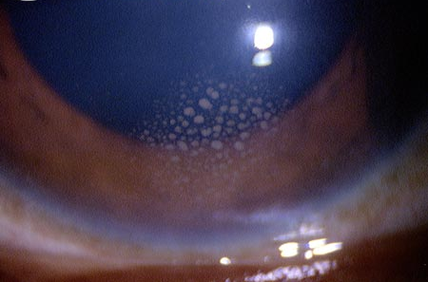
Uveitis
Diffusely distributed KP
KP concentrated in Arlt’s triangle

Slide 331
Uveitis
In the context of uveitis, what does the acronym SUN stand for?
Standardization of Uveitis Nomenclature, a working group appointed by the International Ocular Inflammation Society
What was the task of the SUN Working Group?
To standardize uveitis nomenclature
The SUN classification system is based on three sets of criteria. What are they?
The location of the uveitis
--Anterior
--Intermediate
--Posterior
--Panuveitis
The onset, duration and course of the uveitis
--Onset: Sudden vs insidious
--Duration: Limited vs persistent
--Course: Acute vs recurrent vs
chronic
The severity of the uveitis
--AC cell grade
--AC flare grade
--Vitreous haze score
In addition to location, onset/duration/course, and severity, what other aspects of presentation are important in classifying a case of uveitis?
--Laterality (ie, whether it is uni- vs bilateral)
--The character of keratic precipitates (KP) if present
--Iris changes
The appearance of KP is most often described with one of three terms. What are they?
--?
--?
--?
Broadly, what two characteristics of KP are important?
--Their appearance and their distribution

Slide 332
Uveitis
In the context of uveitis, what does the acronym SUN stand for?
Standardization of Uveitis Nomenclature, a working group appointed by the International Ocular Inflammation Society
What was the task of the SUN Working Group?
To standardize uveitis nomenclature
The SUN classification system is based on three sets of criteria. What are they?
The location of the uveitis
--Anterior
--Intermediate
--Posterior
--Panuveitis
The onset, duration and course of the uveitis
--Onset: Sudden vs insidious
--Duration: Limited vs persistent
--Course: Acute vs recurrent vs
chronic
The severity of the uveitis
--AC cell grade
--AC flare grade
--Vitreous haze score
In addition to location, onset/duration/course, and severity, what other aspects of presentation are important in classifying a case of uveitis?
--Laterality (ie, whether it is uni- vs bilateral)
--The character of keratic precipitates (KP) if present
--Iris changes
The appearance of KP is most often described with one of three terms. What are they?
--Granulomatous
--Nongranulomatous
--Stellate
Broadly, what two characteristics of KP are important?
--Their appearance and their distribution

Slide 333
Uveitis
In the context of uveitis, what does the acronym SUN stand for?
Standardization of Uveitis Nomenclature, a working group appointed by the International Ocular Inflammation Society
What was the task of the SUN Working Group?
To standardize uveitis nomenclature
The SUN classification system is based on three sets of criteria. What are they?
The location of the uveitis
--Anterior
--Intermediate
--Posterior
--Panuveitis
The onset, duration and course of the uveitis
--Onset: Sudden vs insidious
--Duration: Limited vs persistent
--Course: Acute vs recurrent vs
chronic
The severity of the uveitis
--AC cell grade
--AC flare grade
--Vitreous haze score
It can be tough to distinguish between nongranulomatous and stellate KP. Here is another distinguishing characteristic::
In addition to location, onset/duration/course, and severity, what other aspects of presentation are important in classifying a case of uveitis?
--Laterality (ie, whether it is uni- vs bilateral)
--The character of keratic precipitates (KP) if present
--Iris changes
The appearance of KP is most often described with one of three terms. What are they?
--Granulomatous
--Nongranulomatous
--Stellate
Broadly, what two characteristics of KP are important?
--Their appearance and their distribution
Always…
Always…

Slide 334
Uveitis
In the context of uveitis, what does the acronym SUN stand for?
Standardization of Uveitis Nomenclature, a working group appointed by the International Ocular Inflammation Society
What was the task of the SUN Working Group?
To standardize uveitis nomenclature
The SUN classification system is based on three sets of criteria. What are they?
The location of the uveitis
--Anterior
--Intermediate
--Posterior
--Panuveitis
The onset, duration and course of the uveitis
--Onset: Sudden vs insidious
--Duration: Limited vs persistent
--Course: Acute vs recurrent vs
chronic
The severity of the uveitis
--AC cell grade
--AC flare grade
--Vitreous haze score
It can be tough to distinguish between nongranulomatous and stellate KP. Here is another distinguishing characteristic::
In addition to location, onset/duration/course, and severity, what other aspects of presentation are important in classifying a case of uveitis?
--Laterality (ie, whether it is uni- vs bilateral)
--The character of keratic precipitates (KP) if present
--Iris changes
The appearance of KP is most often described with one of three terms. What are they?
--Granulomatous
--Nongranulomatous
--Stellate
Broadly, what two characteristics of KP are important?
--Their appearance and their distribution
Always…in Arlt’s triangle
Always…diffuse

Slide 335
Uveitis
Stellate KP
Granulomatous KP

Slide 336
Uveitis
In the context of uveitis, what does the acronym SUN stand for?
Standardization of Uveitis Nomenclature, a working group appointed by the International Ocular Inflammation Society
What was the task of the SUN Working Group?
To standardize uveitis nomenclature
The SUN classification system is based on three sets of criteria. What are they?
The location of the uveitis
--Anterior
--Intermediate
--Posterior
--Panuveitis
The onset, duration and course of the uveitis
--Onset: Sudden vs insidious
--Duration: Limited vs persistent
--Course: Acute vs recurrent vs
chronic
The severity of the uveitis
--AC cell grade
--AC flare grade
--Vitreous haze score
In addition to location, onset/duration/course, and severity, what other aspects of presentation are important in classifying a case of uveitis?
--Laterality (ie, whether it is uni- vs bilateral)
--The character of keratic precipitates (KP) if present
--Iris changes
Broadly, what sorts of iris changes must be looked for?
--Atrophy
--Synechiae
--Nodules
--Heterochromia

Slide 337
Uveitis
In the context of uveitis, what does the acronym SUN stand for?
Standardization of Uveitis Nomenclature, a working group appointed by the International Ocular Inflammation Society
What was the task of the SUN Working Group?
To standardize uveitis nomenclature
The SUN classification system is based on three sets of criteria. What are they?
The location of the uveitis
--Anterior
--Intermediate
--Posterior
--Panuveitis
The onset, duration and course of the uveitis
--Onset: Sudden vs insidious
--Duration: Limited vs persistent
--Course: Acute vs recurrent vs
chronic
The severity of the uveitis
--AC cell grade
--AC flare grade
--Vitreous haze score
In addition to location, onset/duration/course, and severity, what other aspects of presentation are important in classifying a case of uveitis?
--Laterality (ie, whether it is uni- vs bilateral)
--The character of keratic precipitates (KP) if present
--Iris changes
Broadly, what sorts of iris changes must be looked for?
--Atrophy
--Synechiae
--Nodules
--Heterochromia

Slide 338
Uveitis
In the context of uveitis, what does the acronym SUN stand for?
Standardization of Uveitis Nomenclature, a working group appointed by the International Ocular Inflammation Society
What was the task of the SUN Working Group?
To standardize uveitis nomenclature
The SUN classification system is based on three sets of criteria. What are they?
The location of the uveitis
--Anterior
--Intermediate
--Posterior
--Panuveitis
The onset, duration and course of the uveitis
--Onset: Sudden vs insidious
--Duration: Limited vs persistent
--Course: Acute vs recurrent vs
chronic
The severity of the uveitis
--AC cell grade
--AC flare grade
--Vitreous haze score
In addition to location, onset/duration/course, and severity, what other aspects of presentation are important in classifying a case of uveitis?
--Laterality (ie, whether it is uni- vs bilateral)
--The character of keratic precipitates (KP) if present
--Iris changes
The character of atrophic changes is often described with one of two terms. What are they?
--Diffuse
--Sectoral
Broadly, what sorts of iris changes must be looked for?
--Atrophy
--Synechiae
--Nodules
--Heterochromia

Slide 339
Uveitis
In the context of uveitis, what does the acronym SUN stand for?
Standardization of Uveitis Nomenclature, a working group appointed by the International Ocular Inflammation Society
What was the task of the SUN Working Group?
To standardize uveitis nomenclature
The SUN classification system is based on three sets of criteria. What are they?
The location of the uveitis
--Anterior
--Intermediate
--Posterior
--Panuveitis
The onset, duration and course of the uveitis
--Onset: Sudden vs insidious
--Duration: Limited vs persistent
--Course: Acute vs recurrent vs
chronic
The severity of the uveitis
--AC cell grade
--AC flare grade
--Vitreous haze score
In addition to location, onset/duration/course, and severity, what other aspects of presentation are important in classifying a case of uveitis?
--Laterality (ie, whether it is uni- vs bilateral)
--The character of keratic precipitates (KP) if present
--Iris changes
The character of atrophic changes is often described with one of two terms. What are they?
--Diffuse
--Sectoral
Broadly, what sorts of iris changes must be looked for?
--Atrophy
--Synechiae
--Nodules
--Heterochromia

Slide 340
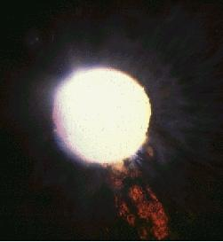
Uveitis
Diffuse
Sectoral
Iris atrophy

Slide 341
Uveitis
In the context of uveitis, what does the acronym SUN stand for?
Standardization of Uveitis Nomenclature, a working group appointed by the International Ocular Inflammation Society
What was the task of the SUN Working Group?
To standardize uveitis nomenclature
The SUN classification system is based on three sets of criteria. What are they?
The location of the uveitis
--Anterior
--Intermediate
--Posterior
--Panuveitis
The onset, duration and course of the uveitis
--Onset: Sudden vs insidious
--Duration: Limited vs persistent
--Course: Acute vs recurrent vs
chronic
The severity of the uveitis
--AC cell grade
--AC flare grade
--Vitreous haze score
In addition to location, onset/duration/course, and severity, what other aspects of presentation are important in classifying a case of uveitis?
--Laterality (ie, whether it is uni- vs bilateral)
--The character of keratic precipitates (KP) if present
--Iris changes
Broadly, what sorts of iris changes must be looked for?
--Atrophy
--Synechiae
--Nodules
--Heterochromia
Synechiae typically are found in one of two locations--where?
--
--At the angle (these are called peripheral anterior synechiae--PAS)

Slide 342
Uveitis
In the context of uveitis, what does the acronym SUN stand for?
Standardization of Uveitis Nomenclature, a working group appointed by the International Ocular Inflammation Society
What was the task of the SUN Working Group?
To standardize uveitis nomenclature
The SUN classification system is based on three sets of criteria. What are they?
The location of the uveitis
--Anterior
--Intermediate
--Posterior
--Panuveitis
The onset, duration and course of the uveitis
--Onset: Sudden vs insidious
--Duration: Limited vs persistent
--Course: Acute vs recurrent vs
chronic
The severity of the uveitis
--AC cell grade
--AC flare grade
--Vitreous haze score
In addition to location, onset/duration/course, and severity, what other aspects of presentation are important in classifying a case of uveitis?
--Laterality (ie, whether it is uni- vs bilateral)
--The character of keratic precipitates (KP) if present
--Iris changes
Broadly, what sorts of iris changes must be looked for?
--Atrophy
--Synechiae
--Nodules
--Heterochromia
Synechiae typically are found in one of two locations--where?
--At the pupillary margin (these are called posterior synechiae)
--At the angle (these are called peripheral anterior synechiae)

Slide 343
Uveitis
In the context of uveitis, what does the acronym SUN stand for?
Standardization of Uveitis Nomenclature, a working group appointed by the International Ocular Inflammation Society
What was the task of the SUN Working Group?
To standardize uveitis nomenclature
The SUN classification system is based on three sets of criteria. What are they?
The location of the uveitis
--Anterior
--Intermediate
--Posterior
--Panuveitis
The onset, duration and course of the uveitis
--Onset: Sudden vs insidious
--Duration: Limited vs persistent
--Course: Acute vs recurrent vs
chronic
The severity of the uveitis
--AC cell grade
--AC flare grade
--Vitreous haze score
In addition to location, onset/duration/course, and severity, what other aspects of presentation are important in classifying a case of uveitis?
--Laterality (ie, whether it is uni- vs bilateral)
--The character of keratic precipitates (KP) if present
--Iris changes
Broadly, what sorts of iris changes must be looked for?
--Atrophy
--Synechiae
--Nodules
--Heterochromia
Synechiae typically are found in one of two locations--where?
--At the pupillary margin (these are called posterior synechiae)
--At the angle (these are called peripheral anterior synechiae)

Slide 344
Uveitis
In the context of uveitis, what does the acronym SUN stand for?
Standardization of Uveitis Nomenclature, a working group appointed by the International Ocular Inflammation Society
What was the task of the SUN Working Group?
To standardize uveitis nomenclature
The SUN classification system is based on three sets of criteria. What are they?
The location of the uveitis
--Anterior
--Intermediate
--Posterior
--Panuveitis
The onset, duration and course of the uveitis
--Onset: Sudden vs insidious
--Duration: Limited vs persistent
--Course: Acute vs recurrent vs
chronic
The severity of the uveitis
--AC cell grade
--AC flare grade
--Vitreous haze score
In addition to location, onset/duration/course, and severity, what other aspects of presentation are important in classifying a case of uveitis?
--Laterality (ie, whether it is uni- vs bilateral)
--The character of keratic precipitates (KP) if present
--Iris changes
Broadly, what sorts of iris changes must be looked for?
--Atrophy
--Synechiae
--Nodules
--Heterochromia
Synechiae typically are found in one of two locations--where?
--At the pupillary margin (these are called posterior synechiae)
--At the angle (these are called peripheral anterior synechiae)
two words

Slide 345
Uveitis
In the context of uveitis, what does the acronym SUN stand for?
Standardization of Uveitis Nomenclature, a working group appointed by the International Ocular Inflammation Society
What was the task of the SUN Working Group?
To standardize uveitis nomenclature
The SUN classification system is based on three sets of criteria. What are they?
The location of the uveitis
--Anterior
--Intermediate
--Posterior
--Panuveitis
The onset, duration and course of the uveitis
--Onset: Sudden vs insidious
--Duration: Limited vs persistent
--Course: Acute vs recurrent vs
chronic
The severity of the uveitis
--AC cell grade
--AC flare grade
--Vitreous haze score
In addition to location, onset/duration/course, and severity, what other aspects of presentation are important in classifying a case of uveitis?
--Laterality (ie, whether it is uni- vs bilateral)
--The character of keratic precipitates (KP) if present
--Iris changes
Broadly, what sorts of iris changes must be looked for?
--Atrophy
--Synechiae
--Nodules
--Heterochromia
Synechiae typically are found in one of two locations--where?
--At the pupillary margin (these are called posterior synechiae)
--At the angle (these are called peripheral anterior synechiae)

Slide 346
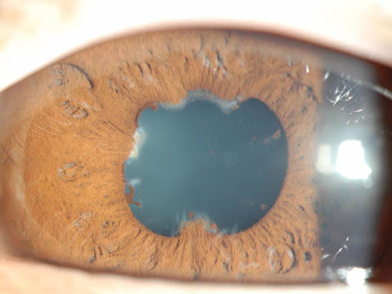
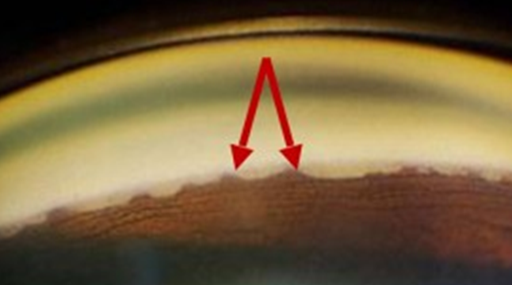
Uveitis
Posterior
Peripheral anterior
Iris synechiae

Slide 347
Uveitis
In the context of uveitis, what does the acronym SUN stand for?
Standardization of Uveitis Nomenclature, a working group appointed by the International Ocular Inflammation Society
What was the task of the SUN Working Group?
To standardize uveitis nomenclature
The SUN classification system is based on three sets of criteria. What are they?
The location of the uveitis
--Anterior
--Intermediate
--Posterior
--Panuveitis
The onset, duration and course of the uveitis
--Onset: Sudden vs insidious
--Duration: Limited vs persistent
--Course: Acute vs recurrent vs
chronic
The severity of the uveitis
--AC cell grade
--AC flare grade
--Vitreous haze score
In addition to location, onset/duration/course, and severity, what other aspects of presentation are important in classifying a case of uveitis?
--Laterality (ie, whether it is uni- vs bilateral)
--The character of keratic precipitates (KP) if present
--Iris changes
Broadly, what sorts of iris changes must be looked for?
--Atrophy
--Synechiae
--Nodules
--Heterochromia
Iris nodules typically are found in one of three locations--where?
--
--
--

Slide 348
Uveitis
In the context of uveitis, what does the acronym SUN stand for?
Standardization of Uveitis Nomenclature, a working group appointed by the International Ocular Inflammation Society
What was the task of the SUN Working Group?
To standardize uveitis nomenclature
The SUN classification system is based on three sets of criteria. What are they?
The location of the uveitis
--Anterior
--Intermediate
--Posterior
--Panuveitis
The onset, duration and course of the uveitis
--Onset: Sudden vs insidious
--Duration: Limited vs persistent
--Course: Acute vs recurrent vs
chronic
The severity of the uveitis
--AC cell grade
--AC flare grade
--Vitreous haze score
In addition to location, onset/duration/course, and severity, what other aspects of presentation are important in classifying a case of uveitis?
--Laterality (ie, whether it is uni- vs bilateral)
--The character of keratic precipitates (KP) if present
--Iris changes
Broadly, what sorts of iris changes must be looked for?
--Atrophy
--Synechiae
--Nodules
--Heterochromia
Iris nodules typically are found in one of three locations--where?
--At the pupillary margin
--The mid-iris
--At the angle

Slide 349
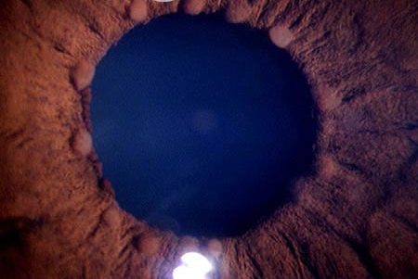
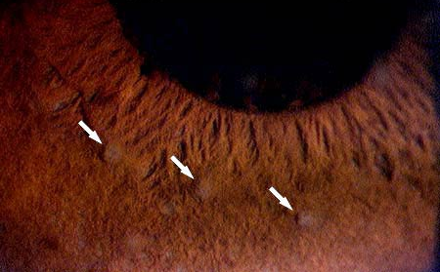
Uveitis
Marginal
Mid-iris
Iris nodules
Near the angle

Slide 350
Uveitis
In the context of uveitis, what does the acronym SUN stand for?
Standardization of Uveitis Nomenclature, a working group appointed by the International Ocular Inflammation Society
What was the task of the SUN Working Group?
To standardize uveitis nomenclature
The SUN classification system is based on three sets of criteria. What are they?
The location of the uveitis
--Anterior
--Intermediate
--Posterior
--Panuveitis
The onset, duration and course of the uveitis
--Onset: Sudden vs insidious
--Duration: Limited vs persistent
--Course: Acute vs recurrent vs
chronic
The severity of the uveitis
--AC cell grade
--AC flare grade
--Vitreous haze score
In addition to location, onset/duration/course, and severity, what other aspects of presentation are important in classifying a case of uveitis?
--Laterality (ie, whether it is uni- vs bilateral)
--The character of keratic precipitates (KP) if present
--Iris changes
Broadly, what sorts of iris changes must be looked for?
--Atrophy
--Synechiae
--Nodules
--Heterochromia
In a pt with uveitis and heterochromia, which iris is more likely to be the abnormal one--the lighter iris, or the darker?
The lighter

Slide 351
Uveitis
In the context of uveitis, what does the acronym SUN stand for?
Standardization of Uveitis Nomenclature, a working group appointed by the International Ocular Inflammation Society
What was the task of the SUN Working Group?
To standardize uveitis nomenclature
The SUN classification system is based on three sets of criteria. What are they?
The location of the uveitis
--Anterior
--Intermediate
--Posterior
--Panuveitis
The onset, duration and course of the uveitis
--Onset: Sudden vs insidious
--Duration: Limited vs persistent
--Course: Acute vs recurrent vs
chronic
The severity of the uveitis
--AC cell grade
--AC flare grade
--Vitreous haze score
In addition to location, onset/duration/course, and severity, what other aspects of presentation are important in classifying a case of uveitis?
--Laterality (ie, whether it is uni- vs bilateral)
--The character of keratic precipitates (KP) if present
--Iris changes
Broadly, what sorts of iris changes must be looked for?
--Atrophy
--Synechiae
--Nodules
--Heterochromia
In a pt with uveitis and heterochromia, which iris is more likely to be the abnormal one--the lighter iris, or the darker?
The lighter

Slide 352
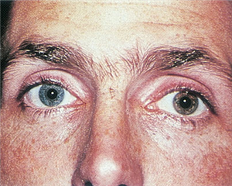
Uveitis
Heterochromia iridis in a uveitis pt

Slide 353
Uveitis
Masquerade
Syndrome
Finally, we will look at masquerade syndromes

Slide 354
Uveitis
Masquerade
Syndrome
refers to entities that mimic immune-mediated dz.

Slide 355
Uveitis
Masquerade
Syndrome
refers to entities that mimic immune-mediated dz.
In other words, these are pts who look like they have a uveitic condition, but do not.

Slide 356
Uveitis
Masquerade
Syndrome
refers to entities that mimic immune-mediated dz.
In other words, these are pts who look like they have a uveitic condition, but do not. It is very important that masquerade syndromes be recognized as such, because their prolonged (mis)diagnosis as uveitis may result in a devastating delay in the treatment of the actual underlying condition.

Slide 357
Uveitis
Masquerade
Syndrome
refers to entities that mimic immune-mediated dz.
Nonneoplastic
The entities can be broadly divided into
and causes.
Neoplastic

Slide 358
Uveitis
Masquerade
Syndrome
refers to entities that mimic immune-mediated dz.
Nonneoplastic
The entities can be broadly divided into
and causes.
Neoplastic

Slide 359
Uveitis
Masquerade
Syndrome
Nonneoplastic
Neoplastic
?
Neoplastic causes are subdivided into those stemming from hematologic vs solid neoplasms
?

Slide 360
Uveitis
Masquerade
Syndrome
Nonneoplastic
Neoplastic
Solid
Neoplastic causes are subdivided into those stemming from hematologic vs solid neoplasms
Hematologic

Slide 361
Uveitis
Masquerade
Syndrome
Nonneoplastic
Neoplastic
Solid
Hematologic
?
?
Hematologic cases are subdivided into lymphoid and leukemic causes

Slide 362
Uveitis
Masquerade
Syndrome
Nonneoplastic
Neoplastic
Solid
Hematologic
Leukemic
Lymphoid
Hematologic cases are subdivided into lymphoid and leukemic causes

Slide 363
Uveitis
Masquerade
Syndrome
Nonneoplastic
Neoplastic
Solid
Hematologic
Leukemic
Lymphoid
?
The most common entity to masquerade as intraocular uveitis is primary vitreoretinal lymphoma (PVRL)

Slide 364
Uveitis
Masquerade
Syndrome
Nonneoplastic
Neoplastic
Solid
Hematologic
Leukemic
Lymphoid
Primary vitreoretinal lymphoma
The most common entity to masquerade as intraocular uveitis is primary vitreoretinal lymphoma (PVRL)

Slide 365
Uveitis
Masquerade
Syndrome
Nonneoplastic
Neoplastic
Virtually all PVRLs are non-Hodgkin B-cell lymphomas. The typical PVRL pt is an adult in their 50s-60s . They usually present with complaints of decreased vision and/or floaters . Importantly, many will also manifest evidence of CNS involvement , the most common being changes in behavior or personality . Other, more obvious S/S include seizures, cerebellar signs, hemiparesis and cranial nerve palsies. Confusion, weakness, and memory loss may also occur. DFE in PVRL typically reveals subretinal infiltrates described as “creamy yellow” in color. The infiltrates can mimic the findings of other, more common conditions (eg, toxoplasmosis). PVRL is diagnosed by finding ‘big blue cells’ on vitreous biopsy.
cancer and cell type
Hematologic
Leukemic
Lymphoid
Primary vitreoretinal lymphoma
The most common entity to masquerade as intraocular uveitis is primary vitreoretinal lymphoma (PVRL)

Slide 366
Uveitis
Masquerade
Syndrome
Nonneoplastic
Neoplastic
Virtually all PVRLs are non-Hodgkin B-cell lymphomas. The typical PVRL pt is an adult in their 50s-60s . They usually present with complaints of decreased vision and/or floaters . Importantly, many will also manifest evidence of CNS involvement , the most common being changes in behavior or personality . Other, more obvious S/S include seizures, cerebellar signs, hemiparesis and cranial nerve palsies. Confusion, weakness, and memory loss may also occur. DFE in PVRL typically reveals subretinal infiltrates described as “creamy yellow” in color. The infiltrates can mimic the findings of other, more common conditions (eg, toxoplasmosis). PVRL is diagnosed by finding ‘big blue cells’ on vitreous biopsy.
Hematologic
Leukemic
Lymphoid
Primary vitreoretinal lymphoma
The most common entity to masquerade as intraocular uveitis is primary vitreoretinal lymphoma (PVRL)

Slide 367
Uveitis
Masquerade
Syndrome
Nonneoplastic
Neoplastic
Virtually all PVRLs are non-Hodgkin B-cell lymphomas. The typical PVRL pt is an adult in their 50s-60s . They usually present with complaints of decreased vision and/or floaters . Importantly, many will also manifest evidence of CNS involvement , the most common being changes in behavior or personality . Other, more obvious S/S include seizures, cerebellar signs, hemiparesis and cranial nerve palsies. Confusion, weakness, and memory loss may also occur. DFE in PVRL typically reveals subretinal infiltrates described as “creamy yellow” in color. The infiltrates can mimic the findings of other, more common conditions (eg, toxoplasmosis). PVRL is diagnosed by finding ‘big blue cells’ on vitreous biopsy.
adult v child
Hematologic
Leukemic
Lymphoid
Primary vitreoretinal lymphoma
The most common entity to masquerade as intraocular uveitis is primary vitreoretinal lymphoma (PVRL)

Slide 368
Uveitis
Masquerade
Syndrome
Nonneoplastic
Neoplastic
Virtually all PVRLs are non-Hodgkin B-cell lymphomas. The typical PVRL pt is an adult in their 50s-60s . They usually present with complaints of decreased vision and/or floaters . Importantly, many will also manifest evidence of CNS involvement , the most common being changes in behavior or personality . Other, more obvious S/S include seizures, cerebellar signs, hemiparesis and cranial nerve palsies. Confusion, weakness, and memory loss may also occur. DFE in PVRL typically reveals subretinal infiltrates described as “creamy yellow” in color. The infiltrates can mimic the findings of other, more common conditions (eg, toxoplasmosis). PVRL is diagnosed by finding ‘big blue cells’ on vitreous biopsy.
Hematologic
Leukemic
Lymphoid
Primary vitreoretinal lymphoma
The most common entity to masquerade as intraocular uveitis is primary vitreoretinal lymphoma (PVRL)

Slide 369
Uveitis
Masquerade
Syndrome
Nonneoplastic
Neoplastic
Virtually all PVRLs are non-Hodgkin B-cell lymphomas. The typical PVRL pt is an adult in their 50s-60s . They usually present with complaints of decreased vision and/or floaters . Importantly, many will also manifest evidence of CNS involvement , the most common being changes in behavior or personality . Other, more obvious S/S include seizures, cerebellar signs, hemiparesis and cranial nerve palsies. Confusion, weakness, and memory loss may also occur. DFE in PVRL typically reveals subretinal infiltrates described as “creamy yellow” in color. The infiltrates can mimic the findings of other, more common conditions (eg, toxoplasmosis). PVRL is diagnosed by finding ‘big blue cells’ on vitreous biopsy.
age range
Hematologic
Leukemic
Lymphoid
Primary vitreoretinal lymphoma
The most common entity to masquerade as intraocular uveitis is primary vitreoretinal lymphoma (PVRL)

Slide 370
Uveitis
Masquerade
Syndrome
Nonneoplastic
Neoplastic
Virtually all PVRLs are non-Hodgkin B-cell lymphomas. The typical PVRL pt is an adult in their 50s-60s . They usually present with complaints of decreased vision and/or floaters . Importantly, many will also manifest evidence of CNS involvement , the most common being changes in behavior or personality . Other, more obvious S/S include seizures, cerebellar signs, hemiparesis and cranial nerve palsies. Confusion, weakness, and memory loss may also occur. DFE in PVRL typically reveals subretinal infiltrates described as “creamy yellow” in color. The infiltrates can mimic the findings of other, more common conditions (eg, toxoplasmosis). PVRL is diagnosed by finding ‘big blue cells’ on vitreous biopsy.
Hematologic
Leukemic
Lymphoid
Primary vitreoretinal lymphoma
The most common entity to masquerade as intraocular uveitis is primary vitreoretinal lymphoma (PVRL)

Slide 371
Uveitis
Masquerade
Syndrome
Nonneoplastic
Neoplastic
Virtually all PVRLs are non-Hodgkin B-cell lymphomas. The typical PVRL pt is an adult in their 50s-60s . They usually present with complaints of decreased vision and/or floaters . Importantly, many will also manifest evidence of CNS involvement , the most common being changes in behavior or personality . Other, more obvious S/S include seizures, cerebellar signs, hemiparesis and cranial nerve palsies. Confusion, weakness, and memory loss may also occur. DFE in PVRL typically reveals subretinal infiltrates described as “creamy yellow” in color. The infiltrates can mimic the findings of other, more common conditions (eg, toxoplasmosis). PVRL is diagnosed by finding ‘big blue cells’ on vitreous biopsy.
two words
Hematologic
Leukemic
Lymphoid
Primary vitreoretinal lymphoma
The most common entity to masquerade as intraocular uveitis is primary vitreoretinal lymphoma (PVRL)

Slide 372
Uveitis
Masquerade
Syndrome
Nonneoplastic
Neoplastic
Virtually all PVRLs are non-Hodgkin B-cell lymphomas. The typical PVRL pt is an adult in their 50s-60s . They usually present with complaints of decreased vision and/or floaters . Importantly, many will also manifest evidence of CNS involvement , the most common being changes in behavior or personality . Other, more obvious S/S include seizures, cerebellar signs, hemiparesis and cranial nerve palsies. Confusion, weakness, and memory loss may also occur. DFE in PVRL typically reveals subretinal infiltrates described as “creamy yellow” in color. The infiltrates can mimic the findings of other, more common conditions (eg, toxoplasmosis). PVRL is diagnosed by finding ‘big blue cells’ on vitreous biopsy.
Hematologic
Leukemic
Lymphoid
Primary vitreoretinal lymphoma
The most common entity to masquerade as intraocular uveitis is primary vitreoretinal lymphoma (PVRL)

Slide 373
Uveitis
Masquerade
Syndrome
Nonneoplastic
Neoplastic
Virtually all PVRLs are non-Hodgkin B-cell lymphomas. The typical PVRL pt is an adult in their 50s-60s . They usually present with complaints of decreased vision and/or floaters . Importantly, many will also manifest evidence of CNS involvement , the most common being changes in behavior or personality . Other, more obvious S/S include seizures, cerebellar signs, hemiparesis and cranial nerve palsies. Confusion, weakness, and memory loss may also occur. DFE in PVRL typically reveals subretinal infiltrates described as “creamy yellow” in color. The infiltrates can mimic the findings of other, more common conditions (eg, toxoplasmosis). PVRL is diagnosed by finding ‘big blue cells’ on vitreous biopsy.
abb. + word
Hematologic
Leukemic
Lymphoid
Primary vitreoretinal lymphoma
The most common entity to masquerade as intraocular uveitis is primary vitreoretinal lymphoma (PVRL)

Slide 374
Uveitis
Masquerade
Syndrome
Nonneoplastic
Neoplastic
Virtually all PVRLs are non-Hodgkin B-cell lymphomas. The typical PVRL pt is an adult in their 50s-60s . They usually present with complaints of decreased vision and/or floaters . Importantly, many will also manifest evidence of CNS involvement , the most common being changes in behavior or personality . Other, more obvious S/S include seizures, cerebellar signs, hemiparesis and cranial nerve palsies. Confusion, weakness, and memory loss may also occur. DFE in PVRL typically reveals subretinal infiltrates described as “creamy yellow” in color. The infiltrates can mimic the findings of other, more common conditions (eg, toxoplasmosis). PVRL is diagnosed by finding ‘big blue cells’ on vitreous biopsy.
Hematologic
Leukemic
Lymphoid
Primary vitreoretinal lymphoma
The most common entity to masquerade as intraocular uveitis is primary vitreoretinal lymphoma (PVRL)

Slide 375
Uveitis
Masquerade
Syndrome
Nonneoplastic
Neoplastic
Virtually all PVRLs are non-Hodgkin B-cell lymphomas. The typical PVRL pt is an adult in their 50s-60s . They usually present with complaints of decreased vision and/or floaters . Importantly, many will also manifest evidence of CNS involvement , the most common being changes in behavior or personality . Other, more obvious S/S include seizures, cerebellar signs, hemiparesis and cranial nerve palsies. Confusion, weakness, and memory loss may also occur. DFE in PVRL typically reveals subretinal infiltrates described as “creamy yellow” in color. The infiltrates can mimic the findings of other, more common conditions (eg, toxoplasmosis). PVRL is diagnosed by finding ‘big blue cells’ on vitreous biopsy.
word or word
Hematologic
Leukemic
Lymphoid
Primary vitreoretinal lymphoma
The most common entity to masquerade as intraocular uveitis is primary vitreoretinal lymphoma (PVRL)

Slide 376
Uveitis
Masquerade
Syndrome
Nonneoplastic
Neoplastic
Virtually all PVRLs are non-Hodgkin B-cell lymphomas. The typical PVRL pt is an adult in their 50s-60s . They usually present with complaints of decreased vision and/or floaters . Importantly, many will also manifest evidence of CNS involvement , the most common being changes in behavior or personality . Other, more obvious S/S include seizures, cerebellar signs, hemiparesis and cranial nerve palsies. Confusion, weakness, and memory loss may also occur. DFE in PVRL typically reveals subretinal infiltrates described as “creamy yellow” in color. The infiltrates can mimic the findings of other, more common conditions (eg, toxoplasmosis). PVRL is diagnosed by finding ‘big blue cells’ on vitreous biopsy.
Hematologic
Leukemic
Lymphoid
Primary vitreoretinal lymphoma
The most common entity to masquerade as intraocular uveitis is primary vitreoretinal lymphoma (PVRL)

Slide 377
Uveitis
Masquerade
Syndrome
Nonneoplastic
Neoplastic
Virtually all PVRLs are non-Hodgkin B-cell lymphomas. The typical PVRL pt is an adult in their 50s-60s . They usually present with complaints of decreased vision and/or floaters . Importantly, many will also manifest evidence of CNS involvement , the most common being changes in behavior or personality . Other, more obvious S/S include seizures, cerebellar signs, hemiparesis and cranial nerve palsies. Confusion, weakness, and memory loss may also occur. DFE in PVRL typically reveals subretinal infiltrates described as “creamy yellow” in color. The infiltrates can mimic the findings of other, more common conditions (eg, toxoplasmosis). PVRL is diagnosed by finding ‘big blue cells’ on vitreous biopsy.
Hematologic
Leukemic
Lymphoid
Primary vitreoretinal lymphoma
The most common entity to masquerade as intraocular uveitis is primary vitreoretinal lymphoma (PVRL)

Slide 378
Uveitis
Masquerade
Syndrome
Nonneoplastic
Neoplastic
Virtually all PVRLs are non-Hodgkin B-cell lymphomas. The typical PVRL pt is an adult in their 50s-60s . They usually present with complaints of decreased vision and/or floaters . Importantly, many will also manifest evidence of CNS involvement , the most common being changes in behavior or personality . Other, more obvious S/S include seizures, cerebellar signs, hemiparesis and cranial nerve palsies. Confusion, weakness, and memory loss may also occur. DFE in PVRL typically reveals subretinal infiltrates described as “creamy yellow” in color. The infiltrates can mimic the findings of other, more common conditions (eg, toxoplasmosis). PVRL is diagnosed by finding ‘big blue cells’ on vitreous biopsy.
Hematologic
two words
two words
Leukemic
Lymphoid
Primary vitreoretinal lymphoma
The most common entity to masquerade as intraocular uveitis is primary vitreoretinal lymphoma (PVRL)

Slide 379
Uveitis
Masquerade
Syndrome
Nonneoplastic
Neoplastic
Virtually all PVRLs are non-Hodgkin B-cell lymphomas. The typical PVRL pt is an adult in their 50s-60s . They usually present with complaints of decreased vision and/or floaters . Importantly, many will also manifest evidence of CNS involvement , the most common being changes in behavior or personality . Other, more obvious S/S include seizures, cerebellar signs, hemiparesis and cranial nerve palsies. Confusion, weakness, and memory loss may also occur. DFE in PVRL typically reveals subretinal infiltrates described as “creamy yellow” in color. The infiltrates can mimic the findings of other, more common conditions (eg, toxoplasmosis). PVRL is diagnosed by finding ‘big blue cells’ on vitreous biopsy.
Hematologic
Leukemic
Lymphoid
Primary vitreoretinal lymphoma
The most common entity to masquerade as intraocular uveitis is primary vitreoretinal lymphoma (PVRL)

Slide 380
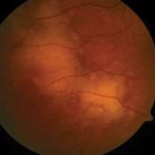
Uveitis
PVRL: Typical white-yellow subretinal infiltrates

Slide 381
Uveitis
Masquerade
Syndrome
Nonneoplastic
Neoplastic
Virtually all PVRLs are non-Hodgkin B-cell lymphomas. The typical PVRL pt is an adult in their 50s-60s . They usually present with complaints of decreased vision and/or floaters . Importantly, many will also manifest evidence of CNS involvement , the most common being changes in behavior or personality . Other, more obvious S/S include seizures, cerebellar signs, hemiparesis and cranial nerve palsies. Confusion, weakness, and memory loss may also occur. DFE in PVRL typically reveals subretinal infiltrates described as “creamy yellow” in color. The infiltrates can mimic the findings of other, more common conditions (eg, toxoplasmosis). PVRL is diagnosed by finding ‘big blue cells’ on vitreous biopsy.
Hematologic
three words
Leukemic
Lymphoid
Primary vitreoretinal lymphoma
The most common entity to masquerade as intraocular uveitis is primary vitreoretinal lymphoma (PVRL)

Slide 382
Uveitis
Masquerade
Syndrome
Nonneoplastic
Neoplastic
Virtually all PVRLs are non-Hodgkin B-cell lymphomas. The typical PVRL pt is an adult in their 50s-60s . They usually present with complaints of decreased vision and/or floaters . Importantly, many will also manifest evidence of CNS involvement , the most common being changes in behavior or personality . Other, more obvious S/S include seizures, cerebellar signs, hemiparesis and cranial nerve palsies. Confusion, weakness, and memory loss may also occur. DFE in PVRL typically reveals subretinal infiltrates described as “creamy yellow” in color. The infiltrates can mimic the findings of other, more common conditions (eg, toxoplasmosis). PVRL is diagnosed by finding ‘big blue cells’ on vitreous biopsy.
Hematologic
Leukemic
Lymphoid
Primary vitreoretinal lymphoma
The most common entity to masquerade as intraocular uveitis is primary vitreoretinal lymphoma (PVRL)

Slide 383
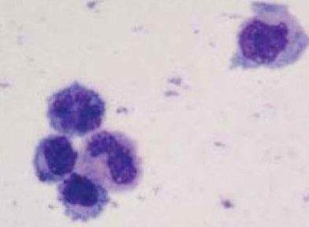
Uveitis
Typical cytology of PVRL cells from the vitreous showing several atypical lymphoid cells with basophilic cytoplasm and large prominent irregular nuclei

Slide 384
Uveitis
Masquerade
Syndrome
Nonneoplastic
Neoplastic
Solid
Hematologic
Leukemic
Lymphoid
Leukemia
Other hematologic neoplasias can masquerade as well, but are far less common than PVRL
Primary vitreoretinal lymphoma
Secondary to systemic lymphoma
Lymphoproliferative dz

Slide 385
Uveitis
Masquerade
Syndrome
Nonneoplastic
Neoplastic
Solid
Hematologic
?
?
Leukemic
Solid-tumor cases are subdivided into primary vs metastatic tumors
Lymphoid
Leukemia
Primary vitreoretinal lymphoma
Secondary to systemic lymphoma
Lymphoproliferative dz

Slide 386
Uveitis
Masquerade
Syndrome
Nonneoplastic
Neoplastic
Solid
Hematologic
Mets
Primary
Leukemic
Solid-tumor cases are subdivided into primary vs metastatic tumors
Lymphoid
Leukemia
Primary vitreoretinal lymphoma
Secondary to systemic lymphoma
Lymphoproliferative dz

Slide 387
Uveitis
Masquerade
Syndrome
Nonneoplastic
Neoplastic
Solid
Hematologic
Mets
Primary
?
?
The two ocular primaries most likely to masquerade as uveitis are probably not surprising:
Leukemic
Lymphoid
Leukemia
Primary vitreoretinal lymphoma
Secondary to systemic lymphoma
Lymphoproliferative dz

Slide 388
Uveitis
Masquerade
Syndrome
Nonneoplastic
Neoplastic
Solid
Hematologic
Mets
Primary
Uveal melanoma
Rb
The two ocular primaries most likely to masquerade as uveitis are probably not surprising:
Leukemic
Lymphoid
Leukemia
Primary vitreoretinal lymphoma
Secondary to systemic lymphoma
Lymphoproliferative dz

Slide 389
Uveitis
Masquerade
Syndrome
Nonneoplastic
Neoplastic
Solid
Hematologic
Mets
?
?
Primary
Leukemic
Uveal melanoma
Rb
Likewise, the two most common primaries involved in ‘metastatic masquerade’ are probably not surprising either:
Lymphoid
Leukemia
Primary vitreoretinal lymphoma
Secondary to systemic lymphoma
Lymphoproliferative dz

Slide 390
Uveitis
Masquerade
Syndrome
Nonneoplastic
Neoplastic
Solid
Hematologic
Mets
Lung
Breast
Primary
Leukemic
Uveal melanoma
Rb
Likewise, the two most common primaries involved in ‘metastatic masquerade’ are probably not surprising either:
Lymphoid
Leukemia
Primary vitreoretinal lymphoma
Secondary to systemic lymphoma
Lymphoproliferative dz

Slide 391
Uveitis
Masquerade
Syndrome
Nonneoplastic
Neoplastic
Solid
Hematologic
Mets
Lung
Breast
Primary
Leukemic
Uveal melanoma
Rb
Lung and breast masquerades commonly present with bilateral multifocal choroidal lesions mimicking choroiditis . An overlying vitritis may be present.
uni- v bilateral
Leukemia
uni- v multifocal
involved tissue
-itis
Lymphoid
Primary vitreoretinal lymphoma
Secondary to systemic lymphoma
Lymphoproliferative dz

Slide 392
Uveitis
Masquerade
Syndrome
Nonneoplastic
Neoplastic
Solid
Hematologic
Mets
Lung
Breast
Primary
Leukemic
Uveal melanoma
Rb
Lung and breast masquerades commonly present with bilateral multifocal choroidal lesions mimicking choroiditis . An overlying vitritis may be present.
Lymphoid
Leukemia
Primary vitreoretinal lymphoma
Secondary to systemic lymphoma
Lymphoproliferative dz

Slide 393
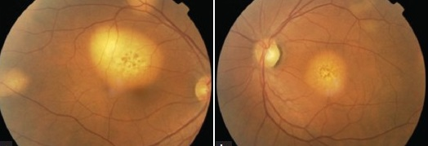
Uveitis
Bilateral metastatic lung cancer

Slide 394
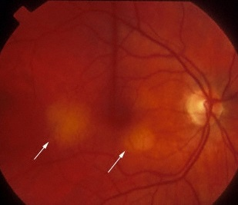
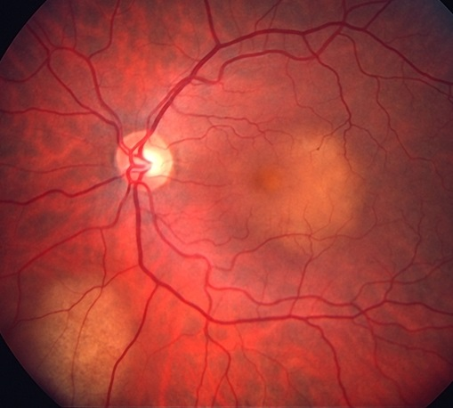
Uveitis
Bilateral metastatic breast cancer

Slide 395
Uveitis
Masquerade
Syndrome
Nonneoplastic
Neoplastic
Solid
Hematologic
Mets
Lung
Breast
Primary
Leukemic
Uveal melanoma
Rb
Lung and breast masquerades commonly present with bilateral multifocal choroidal lesions mimicking choroiditis . An overlying vitritis may be present.
Lymphoid
Leukemia
Primary vitreoretinal lymphoma
Secondary to systemic lymphoma
Lymphoproliferative dz

Slide 396
Uveitis
Masquerade
Syndrome
Nonneoplastic
Neoplastic
Solid
Hematologic
Mets
Lung
Breast
Primary
Leukemic
Uveal melanoma
Rb
Lung and breast masquerades commonly present with bilateral multifocal choroidal lesions mimicking choroiditis . An overlying vitritis may be present.
Lymphoid
Leukemia
Primary vitreoretinal lymphoma
Secondary to systemic lymphoma
Lymphoproliferative dz

Slide 397
Uveitis
Masquerade
Syndrome
Nonneoplastic
Neoplastic
?
?
?
?
?
?
These are the nonneoplastic masquerade entities discussed in the Uveitis book
Solid
Hematologic
Mets
Lung
Breast
Primary
Leukemic
Uveal melanoma
Rb
Lymphoid
Leukemia
Primary vitreoretinal lymphoma
Secondary to systemic lymphoma
Lymphoproliferative dz

Slide 398
Uveitis
Masquerade
Syndrome
Nonneoplastic
Neoplastic
Retinitis pigmentosa
Ocular ischemic syndrome
Chronic rhegmatogenous RD
Intraocular foreign body
Pigment dispersion syndrome
Juvenile xanthogranuloma
These are the nonneoplastic masquerade entities discussed in the Uveitis book
Solid
Hematologic
Mets
Lung
Breast
Primary
Leukemic
Uveal melanoma
Rb
Lymphoid
Leukemia
Primary vitreoretinal lymphoma
Secondary to systemic lymphoma
Lymphoproliferative dz

Slide 399
Uveitis
Masquerade
Syndrome
Ocular ischemic syndrome (OIS) is a constellation of ocular abnormalities stemming from chronic hypoperfusion of the globe. The classic cause is carotid stenosis ipsilateral to the eye in question. The typical pt is an elderly vasculopathic male .
Four findings, common in OIS, can (mis)lead one to conclude the pt has uveitis:
--AC cell and flare
--Low IOP
--Neovascularization of the iris and/or angle
--Cataract more advanced on that side
Nonneoplastic
Neoplastic
RP
OIS
Chronic rhegmatogenous RD
Intraocular foreign body
Pigment dispersion syndrome
Juvenile xanthogranuloma
Solid
Hematologic
Mets
Lung
Breast
Primary
Leukemic
Uveal melanoma
Rb
Lymphoid
Leukemia
Primary vitreoretinal lymphoma
Secondary to systemic lymphoma
Lymphoproliferative dz

Slide 400
Uveitis
Masquerade
Syndrome
Ocular ischemic syndrome (OIS) is a constellation of ocular abnormalities stemming from chronic hypoperfusion of the globe. The classic cause is carotid stenosis ipsilateral to the eye in question. The typical pt is an elderly vasculopathic male .
Four findings, common in OIS, can (mis)lead one to conclude the pt has uveitis:
--AC cell and flare
--Low IOP
--Neovascularization of the iris and/or angle
--Cataract more advanced on that side
Nonneoplastic
Neoplastic
RP
OIS
Chronic rhegmatogenous RD
Intraocular foreign body
Pigment dispersion syndrome
Juvenile xanthogranuloma
Solid
Hematologic
Mets
Lung
Breast
Primary
Leukemic
Uveal melanoma
Rb
Lymphoid
Leukemia
Primary vitreoretinal lymphoma
Secondary to systemic lymphoma
Lymphoproliferative dz

Slide 401
Uveitis
Masquerade
Syndrome
Ocular ischemic syndrome (OIS) is a constellation of ocular abnormalities stemming from chronic hypoperfusion of the globe. The classic cause is carotid stenosis ipsilateral to the eye in question. The typical pt is an elderly vasculopathic male .
Four findings, common in OIS, can (mis)lead one to conclude the pt has uveitis:
--AC cell and flare
--Low IOP
--Neovascularization of the iris and/or angle
--Cataract more advanced on that side
Nonneoplastic
Neoplastic
RP
OIS
Chronic rhegmatogenous RD
Intraocular foreign body
Pigment dispersion syndrome
Juvenile xanthogranuloma
two words
Solid
Hematologic
Mets
Lung
Breast
Primary
Leukemic
Uveal melanoma
Rb
Lymphoid
Leukemia
Primary vitreoretinal lymphoma
Secondary to systemic lymphoma
Lymphoproliferative dz

Slide 402
Uveitis
Masquerade
Syndrome
Ocular ischemic syndrome (OIS) is a constellation of ocular abnormalities stemming from chronic hypoperfusion of the globe. The classic cause is carotid stenosis ipsilateral to the eye in question. The typical pt is an elderly vasculopathic male .
Four findings, common in OIS, can (mis)lead one to conclude the pt has uveitis:
--AC cell and flare
--Low IOP
--Neovascularization of the iris and/or angle
--Cataract more advanced on that side
Nonneoplastic
Neoplastic
RP
OIS
Chronic rhegmatogenous RD
Intraocular foreign body
Pigment dispersion syndrome
Juvenile xanthogranuloma
Solid
Hematologic
Mets
Lung
Breast
Primary
Leukemic
Uveal melanoma
Rb
Lymphoid
Leukemia
Primary vitreoretinal lymphoma
Secondary to systemic lymphoma
Lymphoproliferative dz

Slide 403
Uveitis
Masquerade
Syndrome
Ocular ischemic syndrome (OIS) is a constellation of ocular abnormalities stemming from chronic hypoperfusion of the globe. The classic cause is carotid stenosis ipsilateral to the eye in question. The typical pt is an elderly vasculopathic male .
Four findings, common in OIS, can (mis)lead one to conclude the pt has uveitis:
--AC cell and flare
--Low IOP
--Neovascularization of the iris and/or angle
--Cataract more advanced on that side
Nonneoplastic
Neoplastic
RP
OIS
Chronic rhegmatogenous RD
Intraocular foreign body
Pigment dispersion syndrome
Juvenile xanthogranuloma
age, health status, gender
Solid
Hematologic
Mets
Lung
Breast
Primary
Leukemic
Uveal melanoma
Rb
Lymphoid
Leukemia
Primary vitreoretinal lymphoma
Secondary to systemic lymphoma
Lymphoproliferative dz

Slide 404
Uveitis
Masquerade
Syndrome
Ocular ischemic syndrome (OIS) is a constellation of ocular abnormalities stemming from chronic hypoperfusion of the globe. The classic cause is carotid stenosis ipsilateral to the eye in question. The typical pt is an elderly vasculopathic male .
Four findings, common in OIS, can (mis)lead one to conclude the pt has uveitis:
--AC cell and flare
--Low IOP
--Neovascularization of the iris and/or angle
--Cataract more advanced on that side
Nonneoplastic
Neoplastic
RP
OIS
Chronic rhegmatogenous RD
Intraocular foreign body
Pigment dispersion syndrome
Juvenile xanthogranuloma
Solid
Hematologic
Mets
Lung
Breast
Primary
Leukemic
Uveal melanoma
Rb
Lymphoid
Leukemia
Primary vitreoretinal lymphoma
Secondary to systemic lymphoma
Lymphoproliferative dz

Slide 405
Uveitis
Masquerade
Syndrome
Ocular ischemic syndrome (OIS) is a constellation of ocular abnormalities stemming from chronic hypoperfusion of the globe. The classic cause is carotid stenosis ipsilateral to the eye in question. The typical pt is an elderly vasculopathic male .
Four findings, common in OIS, can (mis)lead one to conclude the pt has uveitis:
--?
--?
--?
--?
Nonneoplastic
Neoplastic
RP
OIS
Chronic rhegmatogenous RD
Intraocular foreign body
Pigment dispersion syndrome
Juvenile xanthogranuloma
Solid
Hematologic
Mets
Lung
Breast
Primary
Leukemic
Uveal melanoma
Rb
Lymphoid
Leukemia
Primary vitreoretinal lymphoma
Secondary to systemic lymphoma
Lymphoproliferative dz

Slide 406
Uveitis
Masquerade
Syndrome
Ocular ischemic syndrome (OIS) is a constellation of ocular abnormalities stemming from chronic hypoperfusion of the globe. The classic cause is carotid stenosis ipsilateral to the eye in question. The typical pt is an elderly vasculopathic male .
Four findings, common in OIS, can (mis)lead one to conclude the pt has uveitis:
--AC…
--?
--?
--?
Nonneoplastic
Neoplastic
RP
OIS
Chronic rhegmatogenous RD
Intraocular foreign body
Pigment dispersion syndrome
Juvenile xanthogranuloma
Solid
Hematologic
Mets
Lung
Breast
Primary
Leukemic
Uveal melanoma
Rb
Lymphoid
Leukemia
Primary vitreoretinal lymphoma
Secondary to systemic lymphoma
Lymphoproliferative dz

Slide 407
Uveitis
Masquerade
Syndrome
Ocular ischemic syndrome (OIS) is a constellation of ocular abnormalities stemming from chronic hypoperfusion of the globe. The classic cause is carotid stenosis ipsilateral to the eye in question. The typical pt is an elderly vasculopathic male .
Four findings, common in OIS, can (mis)lead one to conclude the pt has uveitis:
--AC…cell and flare
--?
--?
--?
Nonneoplastic
Neoplastic
RP
OIS
Chronic rhegmatogenous RD
Intraocular foreign body
Pigment dispersion syndrome
Juvenile xanthogranuloma
Solid
Hematologic
Mets
Lung
Breast
Primary
Leukemic
Uveal melanoma
Rb
Lymphoid
Leukemia
Primary vitreoretinal lymphoma
Secondary to systemic lymphoma
Lymphoproliferative dz

Slide 408
Uveitis
Masquerade
Syndrome
Ocular ischemic syndrome (OIS) is a constellation of ocular abnormalities stemming from chronic hypoperfusion of the globe. The classic cause is carotid stenosis ipsilateral to the eye in question. The typical pt is an elderly vasculopathic male .
Four findings, common in OIS, can (mis)lead one to conclude the pt has uveitis:
--AC…cell and flare
--IOP is…
--?
--?
Nonneoplastic
Neoplastic
RP
OIS
Chronic rhegmatogenous RD
Intraocular foreign body
Pigment dispersion syndrome
Juvenile xanthogranuloma
Solid
Hematologic
Mets
Lung
Breast
Primary
Leukemic
Uveal melanoma
Rb
Lymphoid
Leukemia
Primary vitreoretinal lymphoma
Secondary to systemic lymphoma
Lymphoproliferative dz

Slide 409
Uveitis
Masquerade
Syndrome
Ocular ischemic syndrome (OIS) is a constellation of ocular abnormalities stemming from chronic hypoperfusion of the globe. The classic cause is carotid stenosis ipsilateral to the eye in question. The typical pt is an elderly vasculopathic male .
Four findings, common in OIS, can (mis)lead one to conclude the pt has uveitis:
--AC…cell and flare
--IOP is…low
--?
--?
Nonneoplastic
Neoplastic
RP
OIS
Chronic rhegmatogenous RD
Intraocular foreign body
Pigment dispersion syndrome
Juvenile xanthogranuloma
Solid
Hematologic
Mets
Lung
Breast
Primary
Leukemic
Uveal melanoma
Rb
Lymphoid
Leukemia
Primary vitreoretinal lymphoma
Secondary to systemic lymphoma
Lymphoproliferative dz

Slide 410
Uveitis
Masquerade
Syndrome
Ocular ischemic syndrome (OIS) is a constellation of ocular abnormalities stemming from chronic hypoperfusion of the globe. The classic cause is carotid stenosis ipsilateral to the eye in question. The typical pt is an elderly vasculopathic male .
Four findings, common in OIS, can (mis)lead one to conclude the pt has uveitis:
--AC…cell and flare
--IOP is…low
--Neovascularization of the…
--?
Nonneoplastic
Neoplastic
RP
OIS
Chronic rhegmatogenous RD
Intraocular foreign body
Pigment dispersion syndrome
Juvenile xanthogranuloma
Solid
Hematologic
Mets
Lung
Breast
Primary
Leukemic
Uveal melanoma
Rb
Lymphoid
Leukemia
Primary vitreoretinal lymphoma
Secondary to systemic lymphoma
Lymphoproliferative dz

Slide 411
Uveitis
Masquerade
Syndrome
Ocular ischemic syndrome (OIS) is a constellation of ocular abnormalities stemming from chronic hypoperfusion of the globe. The classic cause is carotid stenosis ipsilateral to the eye in question. The typical pt is an elderly vasculopathic male .
Four findings, common in OIS, can (mis)lead one to conclude the pt has uveitis:
--AC…cell and flare
--IOP is…low
--Neovascularization of the…iris and/or angle
--?
Nonneoplastic
Neoplastic
RP
OIS
Chronic rhegmatogenous RD
Intraocular foreign body
Pigment dispersion syndrome
Juvenile xanthogranuloma
Solid
Hematologic
Mets
Lung
Breast
Primary
Leukemic
Uveal melanoma
Rb
Lymphoid
Leukemia
Primary vitreoretinal lymphoma
Secondary to systemic lymphoma
Lymphoproliferative dz

Slide 412
Uveitis
Masquerade
Syndrome
Ocular ischemic syndrome (OIS) is a constellation of ocular abnormalities stemming from chronic hypoperfusion of the globe. The classic cause is carotid stenosis ipsilateral to the eye in question. The typical pt is an elderly vasculopathic male .
Four findings, common in OIS, can (mis)lead one to conclude the pt has uveitis:
--AC…cell and flare
--IOP is…low
--Neovascularization of the…iris and/or angle
--Ipsilateral cataract is…
Nonneoplastic
Neoplastic
RP
OIS
Chronic rhegmatogenous RD
Intraocular foreign body
Pigment dispersion syndrome
Juvenile xanthogranuloma
Solid
Hematologic
Mets
Lung
Breast
Primary
Leukemic
Uveal melanoma
Rb
Lymphoid
Leukemia
Primary vitreoretinal lymphoma
Secondary to systemic lymphoma
Lymphoproliferative dz

Slide 413
Uveitis
Masquerade
Syndrome
Ocular ischemic syndrome (OIS) is a constellation of ocular abnormalities stemming from chronic hypoperfusion of the globe. The classic cause is carotid stenosis ipsilateral to the eye in question. The typical pt is an elderly vasculopathic male .
Four findings, common in OIS, can (mis)lead one to conclude the pt has uveitis:
--AC…cell and flare
--IOP is…low
--Neovascularization of the…iris and/or angle
--Ipsilateral cataract is…more advanced
Nonneoplastic
Neoplastic
RP
OIS
Chronic rhegmatogenous RD
Intraocular foreign body
Pigment dispersion syndrome
Juvenile xanthogranuloma
Solid
Hematologic
Mets
Lung
Breast
Primary
Leukemic
Uveal melanoma
Rb
Lymphoid
Leukemia
Primary vitreoretinal lymphoma
Secondary to systemic lymphoma
Lymphoproliferative dz

Slide 414
Uveitis
Masquerade
Syndrome
Nonneoplastic
Neoplastic
RP
OIS
Chronic rhegmatogenous RD
IOFB
Pigment dispersion syndrome
Juvenile xanthogranuloma
The hallmark of PDS is the liberation of pigment from the posterior aspect of the iris . This pigment subsequently migrates into the anterior chamber, where the pigment granules can be mistaken for inflammatory cells. Typically, retroillumination of the iris will reveal transillumination defects with a radial orientation.
Solid
Hematologic
Mets
Lung
Breast
Primary
Leukemic
Uveal melanoma
Rb
Lymphoid
Leukemia
Primary vitreoretinal lymphoma
Secondary to systemic lymphoma
Lymphoproliferative dz

Slide 415
Uveitis
Masquerade
Syndrome
Nonneoplastic
Neoplastic
RP
OIS
Chronic rhegmatogenous RD
IOFB
Pigment dispersion syndrome
Juvenile xanthogranuloma
The hallmark of PDS is the liberation of pigment from the posterior aspect of the iris . This pigment subsequently migrates into the anterior chamber, where the pigment granules can be mistaken for inflammatory cells. Typically, retroillumination of the iris will reveal transillumination defects with a radial orientation.
Solid
Hematologic
Mets
Lung
Breast
Primary
Leukemic
Uveal melanoma
Rb
Lymphoid
Leukemia
Primary vitreoretinal lymphoma
Secondary to systemic lymphoma
Lymphoproliferative dz

Slide 416
Uveitis
Masquerade
Syndrome
Nonneoplastic
Neoplastic
RP
OIS
Chronic rhegmatogenous RD
IOFB
Pigment dispersion syndrome
Juvenile xanthogranuloma
The hallmark of PDS is the liberation of pigment from the posterior aspect of the iris . This pigment subsequently migrates into the anterior chamber, where the pigment granules can be mistaken for inflammatory cells. Typically, retroillumination of the iris will reveal transillumination defects with a radial orientation.
Solid
Hematologic
Mets
Lung
Breast
Primary
Leukemic
Uveal melanoma
Rb
Lymphoid
Leukemia
Primary vitreoretinal lymphoma
Secondary to systemic lymphoma
Lymphoproliferative dz

Slide 417
Uveitis
Masquerade
Syndrome
Nonneoplastic
Neoplastic
RP
OIS
Chronic rhegmatogenous RD
IOFB
Pigment dispersion syndrome
Juvenile xanthogranuloma
The hallmark of PDS is the liberation of pigment from the posterior aspect of the iris . This pigment subsequently migrates into the anterior chamber, where the pigment granules can be mistaken for inflammatory cells. Typically, retroillumination of the iris will reveal transillumination defects with a radial orientation.
Solid
Hematologic
Mets
Lung
Breast
two words
Primary
Leukemic
Uveal melanoma
Rb
Lymphoid
Leukemia
Primary vitreoretinal lymphoma
Secondary to systemic lymphoma
Lymphoproliferative dz

Slide 418
Uveitis
Masquerade
Syndrome
Nonneoplastic
Neoplastic
RP
OIS
Chronic rhegmatogenous RD
IOFB
Pigment dispersion syndrome
Juvenile xanthogranuloma
The hallmark of PDS is the liberation of pigment from the posterior aspect of the iris . This pigment subsequently migrates into the anterior chamber, where the pigment granules can be mistaken for inflammatory cells. Typically, retroillumination of the iris will reveal transillumination defects with a radial orientation.
Solid
Hematologic
Mets
Lung
Breast
Primary
Leukemic
Uveal melanoma
Rb
Lymphoid
Leukemia
Primary vitreoretinal lymphoma
Secondary to systemic lymphoma
Lymphoproliferative dz

Slide 419
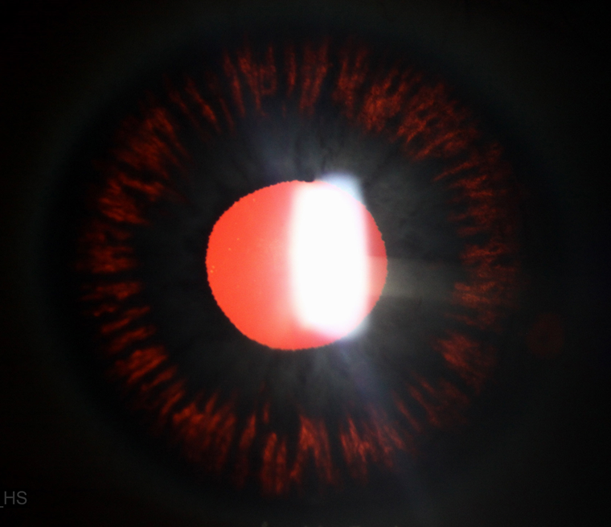
Uveitis
PDS: Radial transillumination defects

