Slide 1
Persistent Fetal Vasculature
In a nutshell: What is the issue in PFV?

Slide 2
Persistent Fetal Vasculature
In a nutshell: What is the issue in PFV?
Portions of the posterior fetal vasculature of the lens (aka the primary vitreous ) continue to exist (ie, it ‘persists’) past the developmental stage at which it should have regressed
two words

Slide 3
Persistent Fetal Vasculature
In a nutshell: What is the issue in PFV?
Portions of the posterior fetal vasculature of the lens (aka the primary vitreous ) continue to exist (ie, it ‘persists’) past the developmental stage at which it should have regressed

Slide 4
Persistent Fetal Vasculature
In a nutshell: What is the issue in PFV?
Portions of the posterior fetal vasculature of the lens (aka the primary vitreous ) continue to exist (ie, it ‘persists’) past the developmental stage at which it should have regressed
By what name was PFV formerly known?
Persistent hyperplasic primary vitreous (PHPV)

Slide 5
Persistent Fetal Vasculature
In a nutshell: What is the issue in PFV?
Portions of the posterior fetal vasculature of the lens (aka the primary vitreous ) continue to exist (ie, it ‘persists’) past the developmental stage at which it should have regressed
By what name was PFV formerly known?
Persistent hyperplasic primary vitreous (PHPV)

Slide 6
Persistent Fetal Vasculature
In a nutshell: What is the issue in PFV?
Portions of the posterior fetal vasculature of the lens (aka the primary vitreous ) continue to exist (ie, it ‘persists’) past the developmental stage at which it should have regressed
The term primary vitreous implies the existence of a secondary vitreous. Is this the case?
Indeed it is. In fact, there is also a tertiary vitreous.
By what name was PFV formerly known?
Persistent hyperplasic primary vitreous (PHPV)

Slide 7
Persistent Fetal Vasculature
In a nutshell: What is the issue in PFV?
Portions of the posterior fetal vasculature of the lens (aka the primary vitreous ) continue to exist (ie, it ‘persists’) past the developmental stage at which it should have regressed
The term primary vitreous implies the existence of a secondary vitreous. Is this the case?
Indeed it is. In fact, there is also a tertiary vitreous.
By what name was PFV formerly known?
Persistent hyperplasic primary vitreous (PHPV)

Slide 8
Persistent Fetal Vasculature
In a nutshell: What is the issue in PFV?
Portions of the posterior fetal vasculature of the lens (aka the primary vitreous ) continue to exist (ie, it ‘persists’) past the developmental stage at which it should have regressed
The term primary vitreous implies the existence of
a secondary vitreous. Is this the case?
Indeed it is. In fact, there is also a tertiary vitreous.
By what name was PFV formerly known?
Persistent hyperplasic primary vitreous (PHPV)
What are the three vitreouses, ie, what do they form?
--The primary vitreous = the fetal vasculature comprising the hyaloid system
--The secondary vitreous = the main vitreous body
--The tertiary vitreous = the zonules

Slide 9
Persistent Fetal Vasculature
In a nutshell: What is the issue in PFV?
Portions of the posterior fetal vasculature of the lens (aka the primary vitreous ) continue to exist (ie, it ‘persists’) past the developmental stage at which it should have regressed
The term primary vitreous implies the existence of
a secondary vitreous. Is this the case?
Indeed it is. In fact, there is also a tertiary vitreous.
By what name was PFV formerly known?
Persistent hyperplasic primary vitreous (PHPV)
What are the three vitreouses, ie, what do they form?
--The primary vitreous = the fetal vasculature comprising the hyaloid system
--The secondary vitreous = the main vitreous body
--The tertiary vitreous = the zonules

Slide 10
Persistent Fetal Vasculature
In a nutshell: What is the issue in PFV?
Portions of the posterior fetal vasculature of the lens (aka the primary vitreous ) continue to exist (ie, it ‘persists’) past the developmental stage at which it should have regressed
The term primary vitreous implies the existence of
a secondary vitreous. Is this the case?
Indeed it is. In fact, there is also a tertiary vitreous.
By what name was PFV formerly known?
Persistent hyperplasic primary vitreous (PHPV)
What are the three vitreouses, ie, what do they form?
--The primary vitreous = the fetal vasculature comprising the hyaloid system
--The secondary vitreous = the main vitreous body
--The tertiary vitreous

Slide 11
Persistent Fetal Vasculature
In a nutshell: What is the issue in PFV?
Portions of the posterior fetal vasculature of the lens (aka the primary vitreous ) continue to exist (ie, it ‘persists’) past the developmental stage at which it should have regressed
The term primary vitreous implies the existence of
a secondary vitreous. Is this the case?
Indeed it is. In fact, there is also a tertiary vitreous.
By what name was PFV formerly known?
Persistent hyperplasic primary vitreous (PHPV)
What are the three vitreouses, ie, what do they form?
--The primary vitreous = the fetal vasculature comprising the hyaloid system
--The secondary vitreous = the main vitreous body
--The tertiary vitreous

Slide 12
Persistent Fetal Vasculature
In a nutshell: What is the issue in PFV?
Portions of the posterior fetal vasculature of the lens (aka the primary vitreous ) continue to exist (ie, it ‘persists’) past the developmental stage at which it should have regressed
The term primary vitreous implies the existence of
a secondary vitreous. Is this the case?
Indeed it is. In fact, there is also a tertiary vitreous.
By what name was PFV formerly known?
Persistent hyperplasic primary vitreous (PHPV)
What are the three vitreouses, ie, what do they form?
--The primary vitreous = the fetal vasculature comprising the hyaloid system
--The secondary vitreous = the main vitreous body
--The tertiary vitreous =

Slide 13
Persistent Fetal Vasculature
In a nutshell: What is the issue in PFV?
Portions of the posterior fetal vasculature of the lens (aka the primary vitreous ) continue to exist (ie, it ‘persists’) past the developmental stage at which it should have regressed
The term primary vitreous implies the existence of
a secondary vitreous. Is this the case?
Indeed it is. In fact, there is also a tertiary vitreous.
By what name was PFV formerly known?
Persistent hyperplasic primary vitreous (PHPV)
What are the three vitreouses, ie, what do they form?
--The primary vitreous = the fetal vasculature comprising the hyaloid system
--The secondary vitreous = the main vitreous body
--The tertiary vitreous = the zonules

Slide 14
Persistent Fetal Vasculature
In a nutshell: What is the issue in PFV?
Portions of the posterior fetal vasculature of the lens (aka the primary vitreous ) continue to exist (ie, it ‘persists’) past the developmental stage at which it should have regressed
The term primary vitreous implies the existence of
a secondary vitreous. Is this the case?
Indeed it is. In fact, there is also a tertiary vitreous.
By what name was PFV formerly known?
Persistent hyperplasic primary vitreous (PHPV)
What are the three vitreouses, ie, what do they form?
--The primary vitreous = the fetal vasculature comprising the hyaloid system
--The secondary vitreous = the main vitreous body
--The tertiary vitreous = the zonules
What is the hyaloid system?

Slide 15
Persistent Fetal Vasculature
In a nutshell: What is the issue in PFV?
Portions of the posterior fetal vasculature of the lens (aka the primary vitreous ) continue to exist (ie, it ‘persists’) past the developmental stage at which it should have regressed
The term primary vitreous implies the existence of
a secondary vitreous. Is this the case?
Indeed it is. In fact, there is also a tertiary vitreous.
By what name was PFV formerly known?
Persistent hyperplasic primary vitreous (PHPV)
What are the three vitreouses, ie, what do they form?
--The primary vitreous = the fetal vasculature comprising the hyaloid system
--The secondary vitreous = the main vitreous body
--The tertiary vitreous = the zonules
What is the hyaloid system?
The fetal vasculature that derives from the hyaloid artery

Slide 16
Persistent Fetal Vasculature
In a nutshell: What is the issue in PFV?
Portions of the posterior fetal vasculature of the lens (aka the primary vitreous ) continue to exist (ie, it ‘persists’) past the developmental stage at which it should have regressed
The term primary vitreous implies the existence of
a secondary vitreous. Is this the case?
Indeed it is. In fact, there is also a tertiary vitreous.
By what name was PFV formerly known?
Persistent hyperplasic primary vitreous (PHPV)
What are the three vitreouses, ie, what do they form?
--The primary vitreous = the fetal vasculature comprising the hyaloid system
--The secondary vitreous = the main vitreous body
--The tertiary vitreous = the zonules
What is the hyaloid system?
The fetal vasculature that derives from the hyaloid artery
Where does the hyaloid artery run?

Slide 17
Persistent Fetal Vasculature
In a nutshell: What is the issue in PFV?
Portions of the posterior fetal vasculature of the lens (aka the primary vitreous ) continue to exist (ie, it ‘persists’) past the developmental stage at which it should have regressed
The term primary vitreous implies the existence of
a secondary vitreous. Is this the case?
Indeed it is. In fact, there is also a tertiary vitreous.
By what name was PFV formerly known?
Persistent hyperplasic primary vitreous (PHPV)
What are the three vitreouses, ie, what do they form?
--The primary vitreous = the fetal vasculature comprising the hyaloid system
--The secondary vitreous = the main vitreous body
--The tertiary vitreous = the zonules
What is the hyaloid system?
The fetal vasculature that derives from the hyaloid artery
Where does the hyaloid artery run?
From the optic nerve head to the back of the lens
(we will have much more to say about the hyaloid artery)

Slide 18
Persistent Fetal Vasculature
In a nutshell: What is the issue in PFV?
Portions of the posterior fetal vasculature of the lens (aka the primary vitreous ) continue to exist (ie, it ‘persists’) past the developmental stage at which it should have regressed
Is PFV primarily sporadic, or hereditary (or are both equally likely)?

Slide 19
Persistent Fetal Vasculature
In a nutshell: What is the issue in PFV?
Portions of the posterior fetal vasculature of the lens (aka the primary vitreous ) continue to exist (ie, it ‘persists’) past the developmental stage at which it should have regressed
Is PFV primarily sporadic, or hereditary (or are both equally likely)?
The vast majority of cases are sporadic

Slide 20
Persistent Fetal Vasculature
In a nutshell: What is the issue in PFV?
Portions of the posterior fetal vasculature of the lens (aka the primary vitreous ) continue to exist (ie, it ‘persists’) past the developmental stage at which it should have regressed
Is PFV primarily sporadic, or hereditary (or are both equally likely)?
The vast majority of cases are sporadic

Slide 21
Persistent Fetal Vasculature
In a nutshell: What is the issue in PFV?
Portions of the posterior fetal vasculature of the lens (aka the primary vitreous ) continue to exist (ie, it ‘persists’) past the developmental stage at which it should have regressed
Is PFV primarily sporadic, or hereditary (or are both equally likely)?
The vast majority of cases are sporadic
Does PFV usually present unilaterally, or bilaterally (or are both equally likely)?

Slide 22
Persistent Fetal Vasculature
In a nutshell: What is the issue in PFV?
Portions of the posterior fetal vasculature of the lens (aka the primary vitreous ) continue to exist (ie, it ‘persists’) past the developmental stage at which it should have regressed
Is PFV primarily sporadic, or hereditary (or are both equally likely)?
The vast majority of cases are sporadic
Does PFV usually present unilaterally, or bilaterally (or are both equally likely)?
It is unilateral in over 90% of cases
%

Slide 23
Persistent Fetal Vasculature
In a nutshell: What is the issue in PFV?
Portions of the posterior fetal vasculature of the lens (aka the primary vitreous ) continue to exist (ie, it ‘persists’) past the developmental stage at which it should have regressed
Is PFV primarily sporadic, or hereditary (or are both equally likely)?
The vast majority of cases are sporadic
Does PFV usually present unilaterally, or bilaterally (or are both equally likely)?
It is unilateral in over 90% of cases

Slide 24
Persistent Fetal Vasculature
The vascular supply encapsulating the developing lens is called the tunica vasculosa lentis.
three words
?

Slide 25
Persistent Fetal Vasculature
The vascular supply encapsulating the developing lens is called the tunica vasculosa lentis.
Tunica vasculosa lentis

Slide 26
Persistent Fetal Vasculature
The vascular supply encapsulating the developing lens is called the tunica vasculosa lentis. It has three sections:
1) The anterior vascular capsule derives from the long ciliary arteries
2)
3)
three words
two words
Tunica vasculosa lentis
?
?
?

Slide 27
Persistent Fetal Vasculature
The vascular supply encapsulating the developing lens is called the tunica vasculosa lentis. It has three sections:
1) The anterior vascular capsule derives from the long ciliary arteries
2)
3)
Tunica vasculosa lentis
Anterior vascular capsule
Long
ciliary
Long
ciliary

Slide 28
Persistent Fetal Vasculature
The vascular supply encapsulating the developing lens is called the tunica vasculosa lentis. It has three sections:
1) The anterior vascular capsule derives from the long ciliary arteries
2) The posterior vascular capsule arises from the hyaloid artery
3)
three words
Tunica vasculosa lentis
Anterior vascular capsule
Long
ciliary
Long
ciliary
? ?
?
op-
tic
nerve

Slide 29
Persistent Fetal Vasculature
The vascular supply encapsulating the developing lens is called the tunica vasculosa lentis. It has three sections:
1) The anterior vascular capsule derives from the long ciliary arteries
2) The posterior vascular capsule arises from the hyaloid artery
3)
Tunica vasculosa lentis
Anterior vascular capsule
Long
ciliary
Long
ciliary
Posterior vascular capsule
Hyaloid
artery
op-
tic
nerve

Slide 30
Persistent Fetal Vasculature
The vascular supply encapsulating the developing lens is called the tunica vasculosa lentis. It has three sections:
1) The anterior vascular capsule derives from the long ciliary arteries
2) The posterior vascular capsule arises from the hyaloid artery
3) The capsulopupillary portion anastomoses the anterior and posterior sections of the tunica
one long word
Tunica vasculosa lentis
Anterior vascular capsule
Long
ciliary
Long
ciliary
?
Posterior vascular capsule
Hyaloid
artery
op-
tic
nerve

Slide 31
Persistent Fetal Vasculature
The vascular supply encapsulating the developing lens is called the tunica vasculosa lentis. It has three sections:
1) The anterior vascular capsule derives from the long ciliary arteries
2) The posterior vascular capsule arises from the hyaloid artery
3) The capsulopupillary portion anastomoses the anterior and posterior sections of the tunica
Tunica vasculosa lentis
Anterior vascular capsule
Long
ciliary
Long
ciliary
Capsulopupillary portion
Posterior vascular capsule
Hyaloid
artery
op-
tic
nerve

Slide 32
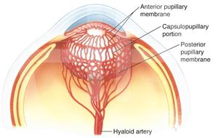
Persistent Fetal Vasculature
Tunica vasculosa lentis

Slide 33
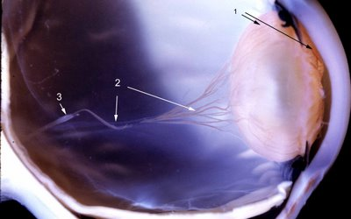
Persistent Fetal Vasculature
In the figure of this very premature infant, the tunical vasculosa lentis surrounds the lens (arrows 1) and is contiguous with the hyaloid vascular system (arrow 2). Notice the glial sheath of the hyaloid artery (arrow 3).

Slide 34
Persistent Fetal Vasculature
The vascular supply encapsulating the developing lens is called the tunica vasculosa lentis. It has three sections:
1) The anterior vascular capsule derives from the long ciliary arteries
2) The posterior vascular capsule arises from the hyaloid artery
3) The capsulopupillary portion anastomoses the anterior and posterior sections of the tunica
Tunica vasculosa lentis
Anterior vascular capsule
Long
ciliary
Long
ciliary
Capsulopupillary portion
Posterior vascular capsule
Hyaloid
artery
The hyaloid artery also send branches to the developing retina
op-
tic
nerve

Slide 35
Persistent Fetal Vasculature
What is the normal natural history of the hyaloid system specifically, and the tunica vasculosa lentis in general?
Tunica vasculosa lentis
Anterior vascular capsule
Long
ciliary
Long
ciliary
Capsulopupillary portion
Posterior vascular capsule
Hyaloid
artery
op-
tic
nerve

Slide 36
Persistent Fetal Vasculature
What is the normal natural history of the hyaloid system specifically, and the tunica vasculosa lentis in general?
The hyaloid system regresses in the 8th month, whereas the anterior portion hangs on until the 9th
nth
nth
op-
tic
nerve

Slide 37
Persistent Fetal Vasculature
What is the normal natural history of the hyaloid system specifically, and the tunica vasculosa lentis in general?
The hyaloid system regresses in the 8th month, whereas the anterior portion hangs on until the 9th
op-
tic
nerve

Slide 38
Persistent Fetal Vasculature
What is the normal natural history of the hyaloid system specifically, and the tunica vasculosa lentis in general?
The hyaloid system regresses in the 8th month, whereas the anterior portion hangs on until the 9th
What is the name of the intra-vitreal space, running from the ONH to the back of the lens, that is left behind by the regression of the hyaloid artery?
Cloquet’s canal
?
op-
tic
nerve

Slide 39
Persistent Fetal Vasculature
What is the normal natural history of the hyaloid system specifically, and the tunica vasculosa lentis in general?
The hyaloid system regresses in the 8th month, whereas the anterior portion hangs on until the 9th
What is the name of the intra-vitreal space, running from the ONH to the back of the lens, that is left behind by the regression of the hyaloid artery?
Cloquet’s canal
Cloquet Canal
op-
tic
nerve

Slide 40
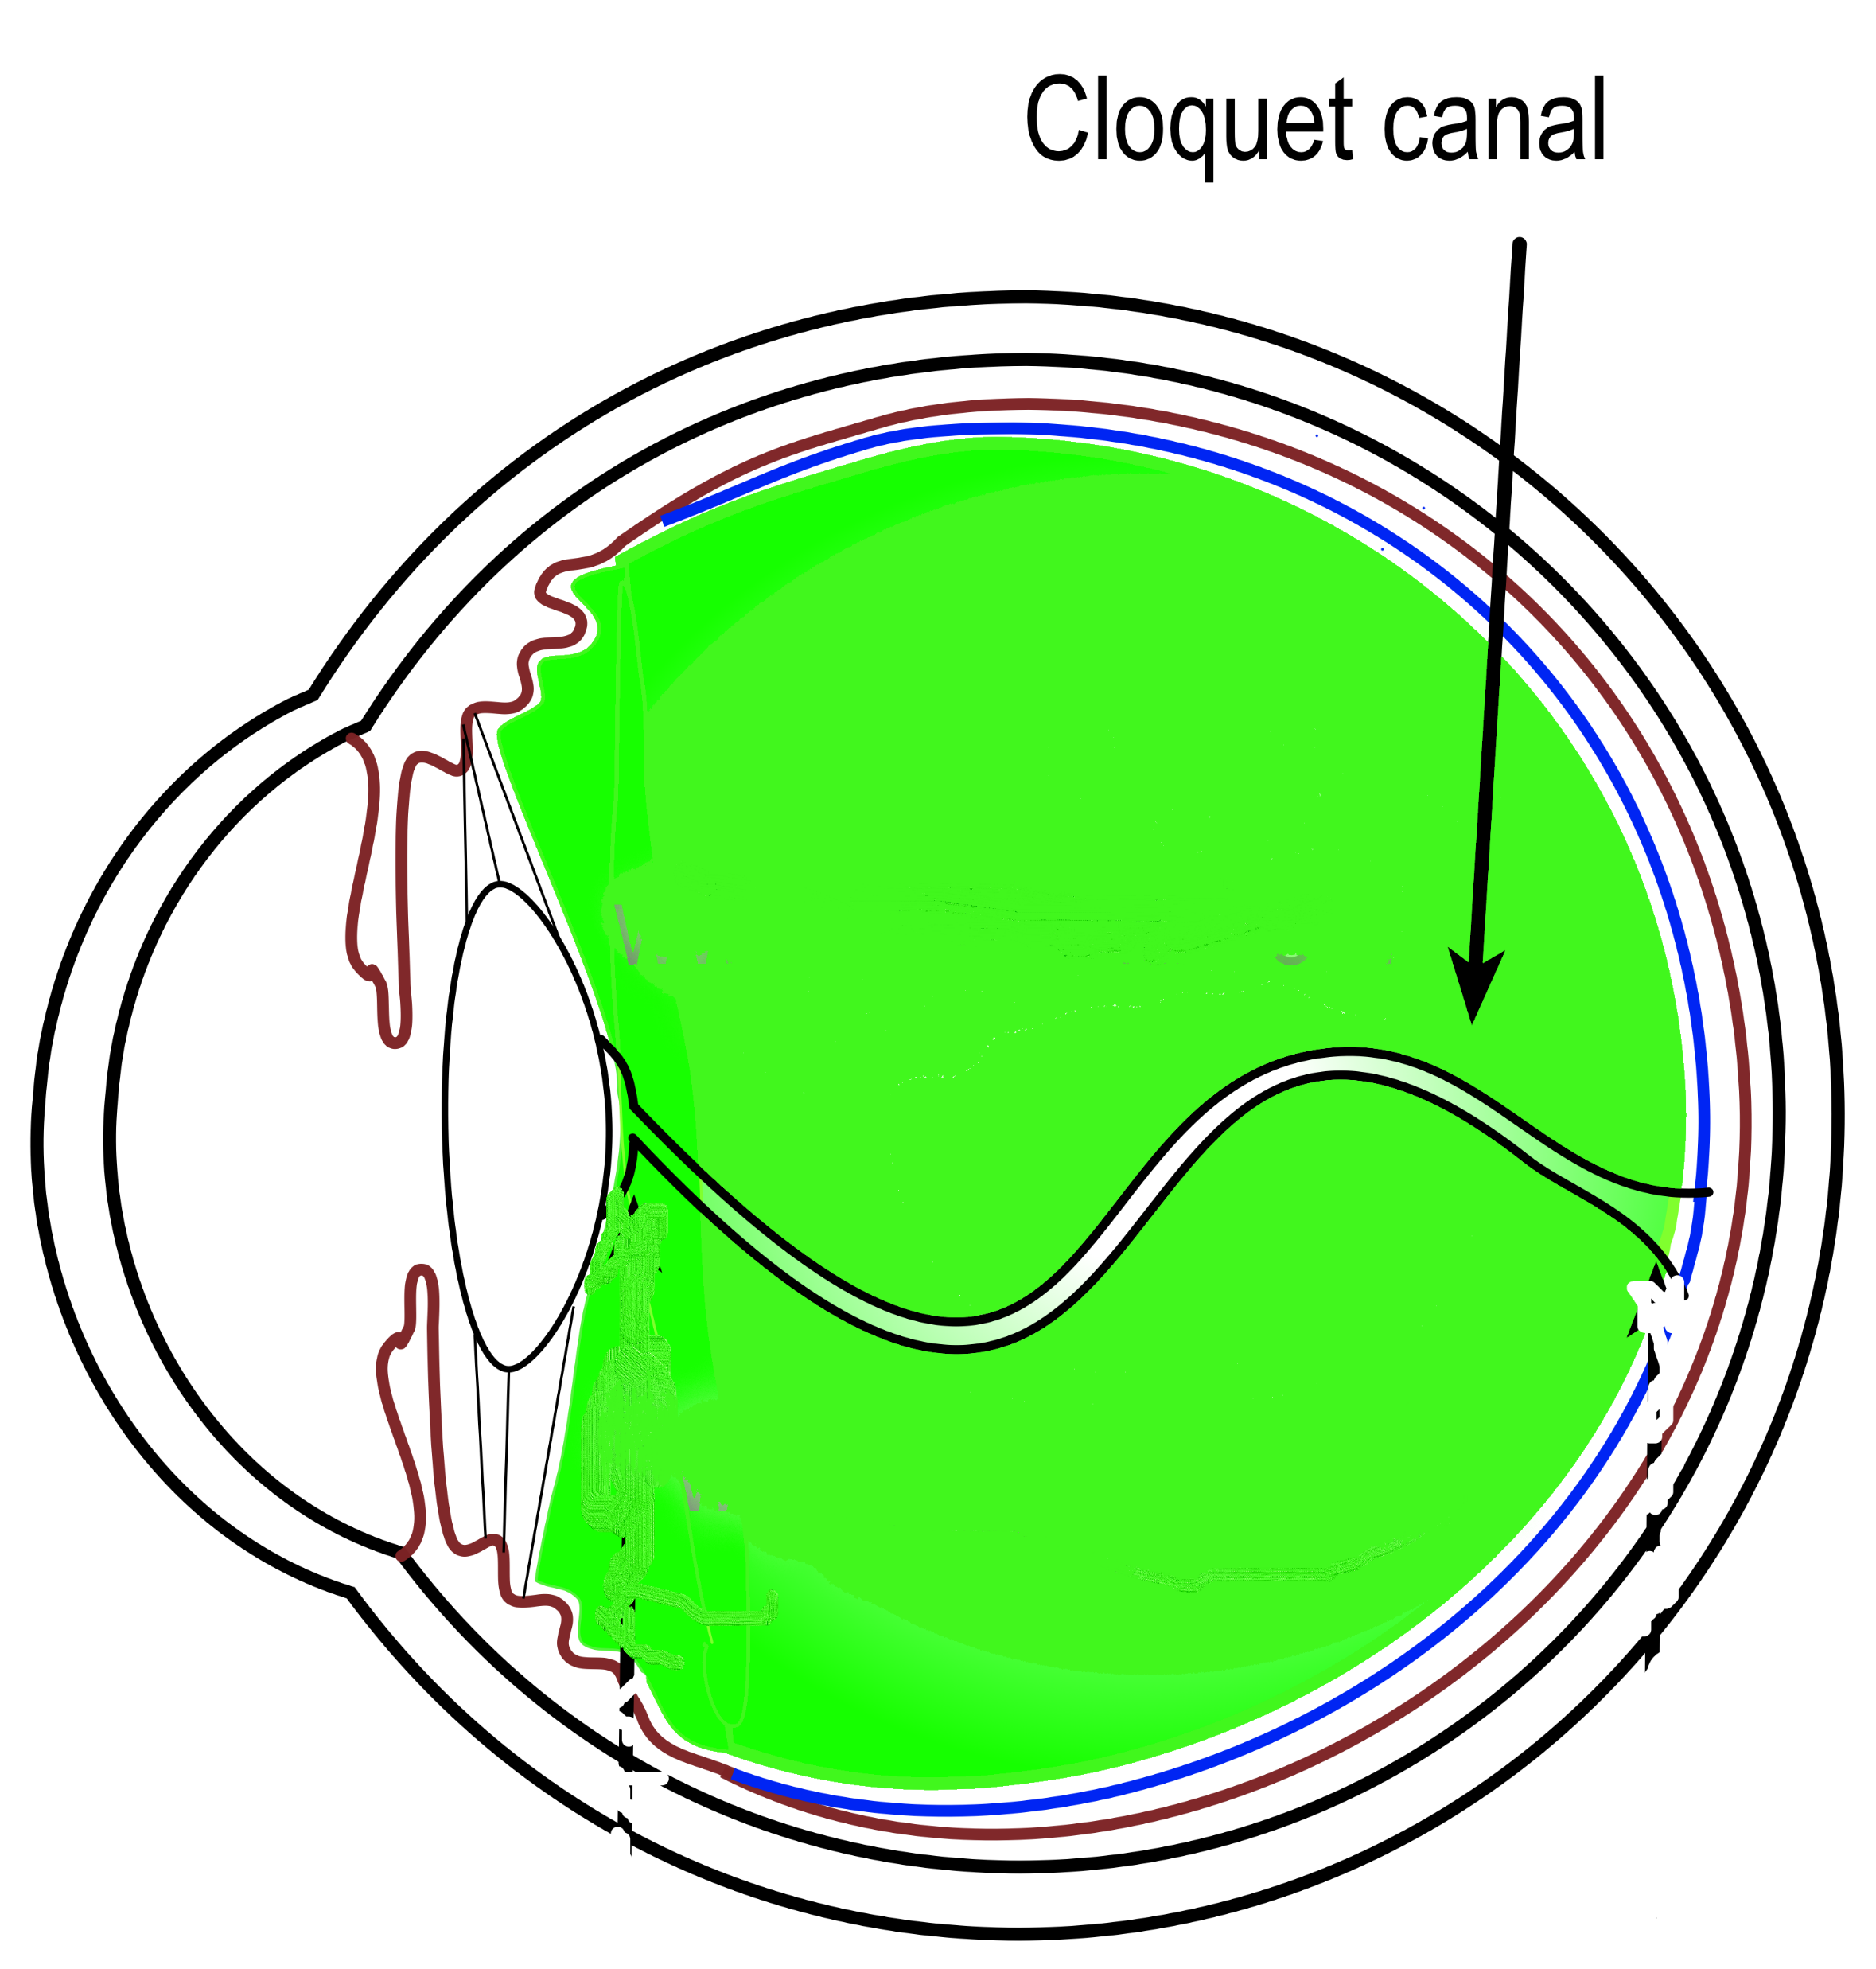
Persistent Fetal Vasculature
Cloquet’s canal

Slide 41
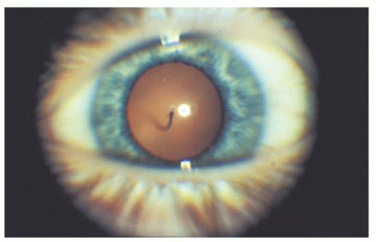
Persistent Fetal Vasculature
Single loop of a persistent hyaloid artery extending anteriorly within Cloquet’s canal to insert on the posterior capsule of the lens.

Slide 42
Persistent Fetal Vasculature
In a nutshell: What is the issue in PFV?
Hearkening back to a question from a previous slide as a refresher: What did we say was the issue in PFV?
Cloquet Canal
op-
tic
nerve

Slide 43
Persistent Fetal Vasculature
In a nutshell: What is the issue in PFV?
Portions of the posterior fetal vasculature of the lens (aka the primary vitreous ) continue to exist (ie, it ‘persists’) past the developmental stage at which it should have regressed
Hearkening back to a question from a previous slide as a refresher: What did we say was the issue in PFV?
We said the issue was a failure of the hyaloid system to fully regress
Hyaloid
artery
op-
tic
nerve

Slide 44
Persistent Fetal Vasculature
?
?
PFV comes in two forms. What are they?
Hyaloid
artery
op-
tic
nerve

Slide 45
Persistent Fetal Vasculature
Anterior
Posterior
PFV comes in two forms. What are they?
Anterior and posterior
Hyaloid
artery
op-
tic
nerve

Slide 46
Persistent Fetal Vasculature
Anterior
Posterior
PFV comes in two forms. What are they?
Anterior and posterior
What is the basic nature of each?
Anterior PFV involves pathology…in the retrolental space
Posterior PFV involves pathology…related to the retinal branches of the hyaloid artery
Hyaloid
artery
op-
tic
nerve

Slide 47
Persistent Fetal Vasculature
Anterior
Posterior
PFV comes in two forms. What are they?
Anterior and posterior
What is the basic nature of each?
Anterior PFV involves pathology…in the retrolental space
Posterior PFV involves pathology…related to the retinal branches of the hyaloid artery
[location]
Anterior PFV:
Hyaloid
artery
op-
tic
nerve

Slide 48
Persistent Fetal Vasculature
Anterior
Posterior
PFV comes in two forms. What are they?
Anterior and posterior
What is the basic nature of each?
Anterior PFV involves pathology…in the retrolental space
Posterior PFV involves pathology…related to the retinal branches of the hyaloid artery
Anterior PFV:
Retrolental space
Hyaloid
artery
op-
tic
nerve

Slide 49
Persistent Fetal Vasculature
Anterior
Posterior
PFV comes in two forms. What are they?
Anterior and posterior
What is the basic nature of each?
Anterior PFV involves pathology…in the retrolental space
Posterior PFV involves pathology…related to the retinal branches of the hyaloid artery
[anatomy issue]
Anterior PFV:
Retrolental space
Hyaloid
artery
Posterior PFV:
op-
tic
nerve

Slide 50
Persistent Fetal Vasculature
Anterior
Posterior
PFV comes in two forms. What are they?
Anterior and posterior
What is the basic nature of each?
Anterior PFV involves pathology…in the retrolental space
Posterior PFV involves pathology…related to the retinal branches of the hyaloid artery
Anterior PFV:
Retrolental space
Hyaloid
artery
Posterior PFV:
Retinal branch remnants
op-
tic
nerve

Slide 51
Persistent Fetal Vasculature
Anterior
Posterior
Can both anterior and posterior PFV be present in the same eye?
Anterior PFV:
Retrolental space
Hyaloid
artery
Posterior PFV:
Retinal branch remnants
op-
tic
nerve

Slide 52
Persistent Fetal Vasculature
Anterior
Posterior
Can both anterior and posterior PFV be present in the same eye?
Yes
Anterior PFV:
Retrolental space
Hyaloid
artery
Posterior PFV:
Retinal branch remnants
op-
tic
nerve

Slide 53
Persistent Fetal Vasculature
Anterior
Posterior
Shouldn’t a failure to regress by the anterior vascular capsule constitute anterior PFV?
Anterior PFV?
Anterior vascular capsule

Slide 54
Persistent Fetal Vasculature
Anterior
Posterior
Shouldn’t a failure to regress by the anterior vascular capsule constitute anterior PFV?
No, because the anterior vasc capsule derives from the long ciliary arteries, not the hyaloid system
Anterior PFV?
Anterior vascular capsule
Long
ciliary
Long
ciliary
Hyaloid
artery

Slide 55
Persistent Fetal Vasculature
Anterior
Posterior
Speaking of: Two remnants of a failed-to-completely-regress anterior vascular capsule are commonly encountered at the slit lamp. What are they?
--?
--?
Shouldn’t a failure to regress by the anterior vascular capsule constitute anterior PFV?
No, because the anterior vasc capsule derives from the long ciliary arteries, not the hyaloid system
Anterior vascular capsule

Slide 56
Persistent Fetal Vasculature
Anterior
Posterior
Speaking of: Two remnants of a failed-to-completely-regress anterior vascular capsule are commonly encountered at the slit lamp. What are they?
--Epicapsular star
--Persistent pupillary membrane
Shouldn’t a failure to regress by the anterior vascular capsule constitute anterior PFV?
No, because the anterior vasc capsule derives from the long ciliary arteries, not the hyaloid system
Anterior vascular capsule

Slide 57
Persistent Fetal Vasculature
Anterior
Posterior
Speaking of: Two remnants of a failed-to-completely-regress anterior vascular capsule are commonly encountered at the slit lamp. What are they?
--Epicapsular star
--Persistent pupillary membrane
Shouldn’t a failure to regress by the anterior vascular capsule constitute anterior PFV?
No, because the anterior vasc capsule derives from the long ciliary arteries, not the hyaloid system
How does an epicapsular star present?
As a tiny, star-shaped schmutz on the anterior capsule
Is it common?
Very
Is it visually significant?
Never
Anterior vascular capsule

Slide 58
Persistent Fetal Vasculature
Anterior
Posterior
Speaking of: Two remnants of a failed-to-completely-regress anterior vascular capsule are commonly encountered at the slit lamp. What are they?
--Epicapsular star
--Persistent pupillary membrane
Shouldn’t a failure to regress by the anterior vascular capsule constitute anterior PFV?
No, because the anterior vasc capsule derives from the long ciliary arteries, not the hyaloid system
How does an epicapsular star present?
As a tiny, star-shaped schmutz on the anterior capsule
Is it common?
Very
Is it visually significant?
Never

Slide 59
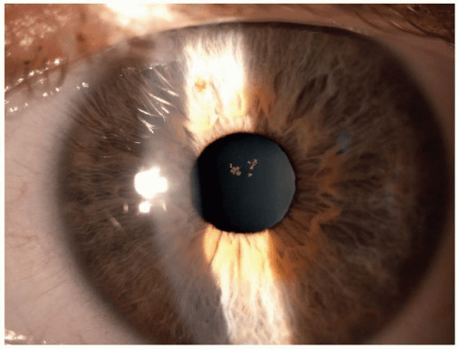
Persistent Fetal Vasculature
Epicapsular star

Slide 60
Persistent Fetal Vasculature
Anterior
Posterior
Speaking of: Two remnants of a failed-to-completely-regress anterior vascular capsule are commonly encountered at the slit lamp. What are they?
--Epicapsular star
--Persistent pupillary membrane
Shouldn’t a failure to regress by the anterior vascular capsule constitute anterior PFV?
No, because the anterior vasc capsule derives from the long ciliary arteries, not the hyaloid system
How does an epicapsular star present?
As a tiny, star-shaped schmutz on the anterior capsule
Is it common?
Very
Is it visually significant?
Never

Slide 61
Persistent Fetal Vasculature
Anterior
Posterior
Speaking of: Two remnants of a failed-to-completely-regress anterior vascular capsule are commonly encountered at the slit lamp. What are they?
--Epicapsular star
--Persistent pupillary membrane
Shouldn’t a failure to regress by the anterior vascular capsule constitute anterior PFV?
No, because the anterior vasc capsule derives from the long ciliary arteries, not the hyaloid system
How does an epicapsular star present?
As a tiny, star-shaped schmutz on the anterior capsule
Is it common?
Very
Is it visually significant?
Never

Slide 62
Persistent Fetal Vasculature
Anterior
Posterior
Speaking of: Two remnants of a failed-to-completely-regress anterior vascular capsule are commonly encountered at the slit lamp. What are they?
--Epicapsular star
--Persistent pupillary membrane
Shouldn’t a failure to regress by the anterior vascular capsule constitute anterior PFV?
No, because the anterior vasc capsule derives from the long ciliary arteries, not the hyaloid system
How does an epicapsular star present?
As a tiny, star-shaped schmutz on the anterior capsule
Is it common?
Very
Is it visually/medically significant?
Never

Slide 63
Persistent Fetal Vasculature
Anterior
Posterior
Speaking of: Two remnants of a failed-to-completely-regress anterior vascular capsule are commonly encountered at the slit lamp. What are they?
--Epicapsular star
--Persistent pupillary membrane
Shouldn’t a failure to regress by the anterior vascular capsule constitute anterior PFV?
No, because the anterior vasc capsule derives from the long ciliary arteries, not the hyaloid system
How does an epicapsular star present?
As a tiny, star-shaped schmutz on the anterior capsule
Is it common?
Very
Is it visually/medically significant?
Never

Slide 64
Persistent Fetal Vasculature
Anterior
Posterior
Speaking of: Two remnants of a failed-to-completely-regress anterior vascular capsule are commonly encountered at the slit lamp. What are they?
--Epicapsular star
--Persistent pupillary membrane
Shouldn’t a failure to regress by the anterior vascular capsule constitute anterior PFV?
No, because the anterior vasc capsule derives from the long ciliary arteries, not the hyaloid system
How does a persistent pupillary membrane present?
As fibers stretching across the pupillary aperture
How extensive is it?
It varies significantly, from a few barely-visible strands to a vast and intricate web
Is it common?
Very
Is it visually significant?
Rarely
Anterior vascular capsule

Slide 65
Persistent Fetal Vasculature
Anterior
Posterior
Speaking of: Two remnants of a failed-to-completely-regress anterior vascular capsule are commonly encountered at the slit lamp. What are they?
--Epicapsular star
--Persistent pupillary membrane
Shouldn’t a failure to regress by the anterior vascular capsule constitute anterior PFV?
No, because the anterior vasc capsule derives from the long ciliary arteries, not the hyaloid system
How does a persistent pupillary membrane present?
As fibers stretching across the pupillary aperture
How extensive is it?
It varies significantly, from a few barely-visible strands to a vast and intricate web
Is it common?
Very
Is it visually significant?
Rarely
Iris

Slide 66
Persistent Fetal Vasculature
Anterior
Posterior
Speaking of: Two remnants of a failed-to-completely-regress anterior vascular capsule are commonly encountered at the slit lamp. What are they?
--Epicapsular star
--Persistent pupillary membrane
Shouldn’t a failure to regress by the anterior vascular capsule constitute anterior PFV?
No, because the anterior vasc capsule derives from the long ciliary arteries, not the hyaloid system
How does a persistent pupillary membrane present?
As fibers stretching across the pupillary aperture
How extensive is it?
It varies significantly, from a few barely-visible strands to a vast and intricate web
Is it common?
Very
Is it visually significant?
Rarely
Iris

Slide 67
Persistent Fetal Vasculature
Anterior
Posterior
Speaking of: Two remnants of a failed-to-completely-regress anterior vascular capsule are commonly encountered at the slit lamp. What are they?
--Epicapsular star
--Persistent pupillary membrane
Shouldn’t a failure to regress by the anterior vascular capsule constitute anterior PFV?
No, because the anterior vasc capsule derives from the long ciliary arteries, not the hyaloid system
How does a persistent pupillary membrane present?
As fibers stretching across the pupillary aperture
How extensive is it?
It varies significantly, from a few barely-visible strands to a vast and intricate web
Is it common?
Very
Is it visually significant?
Rarely
Iris

Slide 68
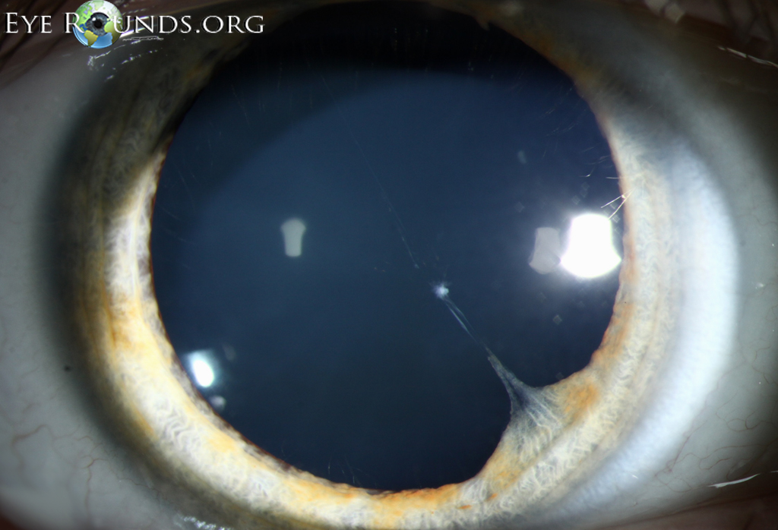
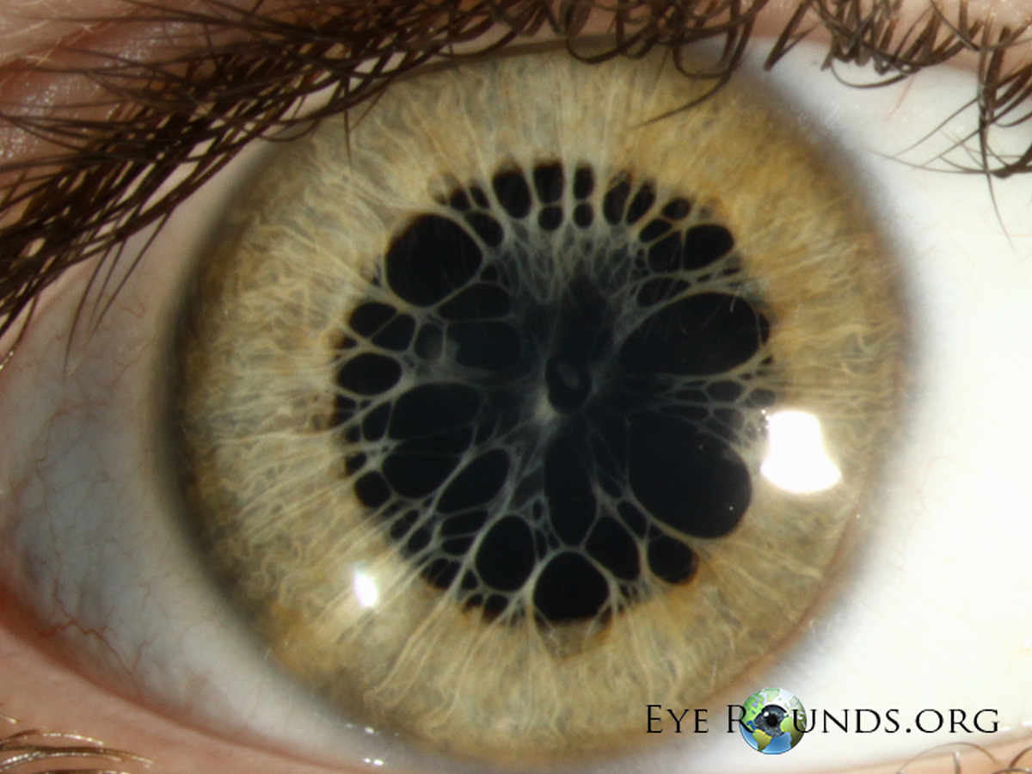
Persistent Fetal Vasculature
Persistent pupillary membrane

Slide 69
Persistent Fetal Vasculature
Anterior
Posterior
Speaking of: Two remnants of a failed-to-completely-regress anterior vascular capsule are commonly encountered at the slit lamp. What are they?
--Epicapsular star
--Persistent pupillary membrane
Shouldn’t a failure to regress by the anterior vascular capsule constitute anterior PFV?
No, because the anterior vasc capsule derives from the long ciliary arteries, not the hyaloid system
How does a persistent pupillary membrane present?
As fibers stretching across the pupillary aperture
How extensive is it?
It varies significantly, from a few barely-visible strands to a vast and intricate web
Is it common?
Very
Is it visually significant?
Rarely
Iris

Slide 70
Persistent Fetal Vasculature
Anterior
Posterior
Speaking of: Two remnants of a failed-to-completely-regress anterior vascular capsule are commonly encountered at the slit lamp. What are they?
--Epicapsular star
--Persistent pupillary membrane
Shouldn’t a failure to regress by the anterior vascular capsule constitute anterior PFV?
No, because the anterior vasc capsule derives from the long ciliary arteries, not the hyaloid system
How does a persistent pupillary membrane present?
As fibers stretching across the pupillary aperture
How extensive is it?
It varies significantly, from a few barely-visible strands to a vast and intricate web
Is it common?
Very
Is it visually significant?
Rarely
Iris

Slide 71
Persistent Fetal Vasculature
Anterior
Posterior
Speaking of: Two remnants of a failed-to-completely-regress anterior vascular capsule are commonly encountered at the slit lamp. What are they?
--Epicapsular star
--Persistent pupillary membrane
Shouldn’t a failure to regress by the anterior vascular capsule constitute anterior PFV?
No, because the anterior vasc capsule derives from the long ciliary arteries, not the hyaloid system
How does a persistent pupillary membrane present?
As fibers stretching across the pupillary aperture
How extensive is it?
It varies significantly, from a few barely-visible strands to a vast and intricate web
Is it common?
Very
Is it visually/medically significant?
Rarely
Iris

Slide 72
Persistent Fetal Vasculature
Anterior
Posterior
Speaking of: Two remnants of a failed-to-completely-regress anterior vascular capsule are commonly encountered at the slit lamp. What are they?
--Epicapsular star
--Persistent pupillary membrane
Shouldn’t a failure to regress by the anterior vascular capsule constitute anterior PFV?
No, because the anterior vasc capsule derives from the long ciliary arteries, not the hyaloid system
How does a persistent pupillary membrane present?
As fibers stretching across the pupillary aperture
How extensive is it?
It varies significantly, from a few barely-visible strands to a vast and intricate web
Is it common?
Very
Is it visually/medically significant?
Rarely
Iris

Slide 73
Persistent Fetal Vasculature
Anterior
Posterior
OK, back to PFV. Take note:
Anterior PFV:
Retrolental space
Hyaloid
artery
Posterior PFV:
Retinal branch remnants
op-
tic
nerve

Slide 74
Persistent Fetal Vasculature
Anterior
Posterior
Mild ‘dz’
continuum
Severe dz
Mild ‘dz’
continuum
Severe dz
Anterior and posterior PFV both exist on a ‘continuum of severity’ ranging from clinically insignificant to clinically devastating
OK, back to PFV. Take note:
Anterior PFV:
Retrolental space
Hyaloid
artery
Posterior PFV:
Retinal branch remnants
op-
tic
nerve

Slide 75
Persistent Fetal Vasculature
Anterior
Posterior
Mild ‘dz’
continuum
Severe dz
Mild ‘dz’
continuum
Severe dz
Why is the word disease in ‘quotes’ here?
Hyaloid
artery
op-
tic
nerve

Slide 76
Persistent Fetal Vasculature
Anterior
Posterior
Mild ‘dz’
continuum
Severe dz
Mild ‘dz’
continuum
Severe dz
Why is the word disease in ‘quotes’ here?
Because mild PFV is so clinically insignificant it doesn’t really count as a disease per se
Hyaloid
artery
op-
tic
nerve

Slide 77
Persistent Fetal Vasculature
Anterior
Posterior
Mild ‘dz’
continuum
Severe dz
Mild ‘dz’
continuum
Severe dz
What is the eponymous name of the classic manifestation of mild, clinically insignificant anterior PFV?
Anterior PFV:
Retrolental space
Hyaloid
artery
op-
tic
nerve

Slide 78
Persistent Fetal Vasculature
Anterior
Posterior
Mild ‘dz’
continuum
Severe dz
Mild ‘dz’
continuum
Severe dz
What is the eponymous name of the classic manifestation of mild, clinically insignificant anterior PFV?
A Mittendorf dot
two words
Anterior PFV:
Retrolental space
Hyaloid
artery
op-
tic
nerve

Slide 79
Persistent Fetal Vasculature
Anterior
Posterior
Mild ‘dz’
continuum
Severe dz
Mild ‘dz’
continuum
Severe dz
What is the eponymous name of the classic manifestation of mild, clinically insignificant anterior PFV?
A Mittendorf dot
Anterior PFV:
Retrolental space
Hyaloid
artery
op-
tic
nerve

Slide 80
Persistent Fetal Vasculature
Anterior
Posterior
Mild ‘dz’
continuum
Severe dz
Mild ‘dz’
continuum
Severe dz
What is the eponymous name of the classic manifestation of mild, clinically insignificant anterior PFV?
A Mittendorf dot
Anterior PFV:
Retrolental space
Hyaloid
artery
op-
tic
nerve

Slide 81
Persistent Fetal Vasculature
Anterior
Posterior
Mild ‘dz’
continuum
Severe dz
Mild ‘dz’
continuum
Severe dz
What is the eponymous name of the classic manifestation of mild, clinically insignificant anterior PFV?
A Mittendorf dot
How does a Mittendorf dot present?
As a minute white dot on the back of the lens, slightly inferonasal to center
How does it relate to the hyaloid system?
It is a vestige of the attachment of the hyaloid artery to the back of the lens
Is it common?
Very
Is it visually/medically significant?
Never
Hyaloid
artery
op-
tic
nerve

Slide 82
Persistent Fetal Vasculature
Anterior
Posterior
Mild ‘dz’
continuum
Severe dz
Mild ‘dz’
continuum
Severe dz
What is the eponymous name of the classic manifestation of mild, clinically insignificant anterior PFV?
A Mittendorf dot
How does a Mittendorf dot present?
As a minute white dot on the back of the lens, slightly inferonasal to center
How does it relate to the hyaloid system?
It is a vestige of the attachment of the hyaloid artery to the back of the lens
Is it common?
Very
Is it visually/medically significant?
Never
op-
tic
nerve

Slide 83
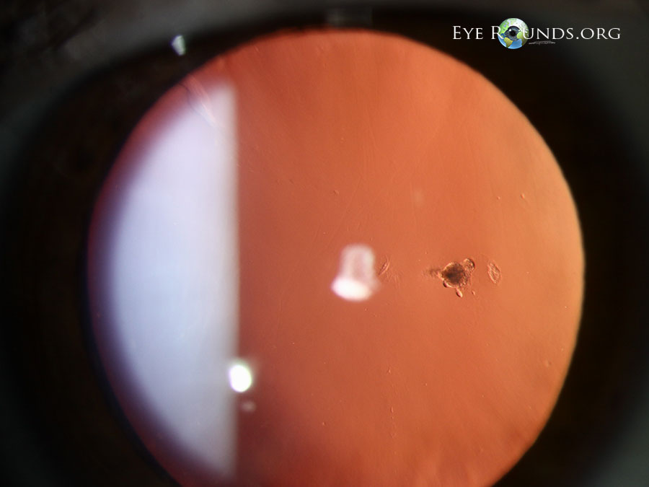
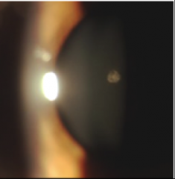
Persistent Fetal Vasculature
Mittendorf dot

Slide 84
Persistent Fetal Vasculature
Anterior
Posterior
Mild ‘dz’
continuum
Severe dz
Mild ‘dz’
continuum
Severe dz
What is the eponymous name of the classic manifestation of mild, clinically insignificant anterior PFV?
A Mittendorf dot
How does a Mittendorf dot present?
As a minute white dot on the back of the lens, slightly inferonasal to center
How does it relate to the hyaloid system?
It is a vestige of the attachment of the hyaloid artery to the back of the lens
Is it common?
Very
Is it visually/medically significant?
Never
op-
tic
nerve

Slide 85
Persistent Fetal Vasculature
Anterior
Posterior
Mild ‘dz’
continuum
Severe dz
Mild ‘dz’
continuum
Severe dz
What is the eponymous name of the classic manifestation of mild, clinically insignificant anterior PFV?
A Mittendorf dot
How does a Mittendorf dot present?
As a minute white dot on the back of the lens, slightly inferonasal to center
How does it relate to the hyaloid system?
It is a vestige of the attachment of the hyaloid artery to the back of the lens
Is it common?
Very
Is it visually/medically significant?
Never
op-
tic
nerve

Slide 86
Persistent Fetal Vasculature
Anterior
Posterior
Mild ‘dz’
continuum
Severe dz
Mild ‘dz’
continuum
Severe dz
What is the eponymous name of the classic manifestation of mild, clinically insignificant anterior PFV?
A Mittendorf dot
How does a Mittendorf dot present?
As a minute white dot on the back of the lens, slightly inferonasal to center
How does it relate to the hyaloid system?
It is a vestige of the attachment of the hyaloid artery to the back of the lens
Is it common?
Very
Is it visually/medically significant?
Never
op-
tic
nerve

Slide 87
Persistent Fetal Vasculature
Anterior
Posterior
Mild ‘dz’
continuum
Severe dz
Mild ‘dz’
continuum
Severe dz
What is the eponymous name of the classic manifestation of mild, clinically insignificant anterior PFV?
A Mittendorf dot
How does a Mittendorf dot present?
As a minute white dot on the back of the lens, slightly inferonasal to center
How does it relate to the hyaloid system?
It is a vestige of the attachment of the hyaloid artery to the back of the lens
Is it common?
Very
Is it visually/medically significant?
Never
op-
tic
nerve

Slide 88
Persistent Fetal Vasculature
Anterior
Posterior
Mild ‘dz’
continuum
Severe dz
Mild ‘dz’
continuum
Severe dz
What is the eponymous name of the classic manifestation of mild, clinically insignificant anterior PFV?
A Mittendorf dot
How does a Mittendorf dot present?
As a minute white dot on the back of the lens, slightly inferonasal to center
How does it relate to the hyaloid system?
It is a vestige of the attachment of the hyaloid artery to the back of the lens
Is it common?
Very
Is it visually/medically significant?
Never
op-
tic
nerve

Slide 89
Persistent Fetal Vasculature
Anterior
Posterior
Mild ‘dz’
continuum
Severe dz
Mild ‘dz’
continuum
Severe dz
What is the eponymous name of the classic manifestation of mild, clinically insignificant anterior PFV?
A Mittendorf dot
How does a Mittendorf dot present?
As a minute white dot on the back of the lens, slightly inferonasal to center
How does it relate to the hyaloid system?
It is a vestige of the attachment of the hyaloid artery to the back of the lens
Is it common?
Very
Is it visually/medically significant?
Never
op-
tic
nerve

Slide 90
Persistent Fetal Vasculature
Anterior
Posterior
Mild ‘dz’
continuum
Severe dz
Mild ‘dz’
continuum
Severe dz
What is the eponymous name of the classic manifestation of mild, clinically insignificant posterior PFV?
Hyaloid
artery
Posterior PFV:
Retinal branch remnants
op-
tic
nerve

Slide 91
Persistent Fetal Vasculature
Anterior
Posterior
Mild ‘dz’
continuum
Severe dz
Mild ‘dz’
continuum
Severe dz
What is the eponymous name of the classic manifestation of mild, clinically insignificant posterior PFV?
A Bergmeister papilla
two words
Hyaloid
artery
Posterior PFV:
Retinal branch remnants
op-
tic
nerve

Slide 92
Persistent Fetal Vasculature
Anterior
Posterior
Mild ‘dz’
continuum
Severe dz
Mild ‘dz’
continuum
Severe dz
What is the eponymous name of the classic manifestation of mild, clinically insignificant posterior PFV?
A Bergmeister papilla
Hyaloid
artery
Posterior PFV:
Retinal branch remnants
op-
tic
nerve

Slide 93
Persistent Fetal Vasculature
Anterior
Posterior
Mild ‘dz’
continuum
Severe dz
Mild ‘dz’
continuum
Severe dz
What is the eponymous name of the classic manifestation of mild, clinically insignificant posterior PFV?
A Bergmeister papilla
Hyaloid
artery
Posterior PFV:
Retinal branch remnants
op-
tic
nerve

Slide 94
Persistent Fetal Vasculature
Anterior
Posterior
Mild ‘dz’
continuum
Severe dz
Mild ‘dz’
continuum
Severe dz
What is the eponymous name of the classic manifestation of mild, clinically insignificant posterior PFV?
A Bergmeister papilla
How does a Bergmeister papilla present?
As a small tuft of glial tissue in the V that emanates from the ONH
How does it relate to the hyaloid system?
It is a vestige of the origin of the hyaloid artery at the ONH
Is it common?
Yes
Is it visually/medically significant?
Never
Hyaloid
artery
Posterior PFV:
Retinal branch remnants
op-
tic
nerve

Slide 95
Persistent Fetal Vasculature
Anterior
Posterior
Mild ‘dz’
continuum
Severe dz
Mild ‘dz’
continuum
Severe dz
What is the eponymous name of the classic manifestation of mild, clinically insignificant posterior PFV?
A Bergmeister papilla
How does a Bergmeister papilla present?
As a small tuft of glial tissue in the V that emanates from the ONH
How does it relate to the hyaloid system?
It is a vestige of the origin of the hyaloid artery at the ONH
Is it common?
Yes
Is it visually/medically significant?
Never
op-
tic
nerve

Slide 96
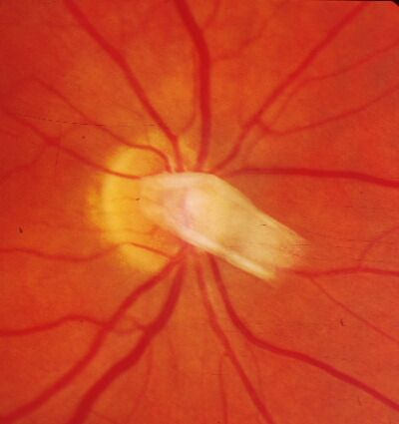
Persistent Fetal Vasculature
Bergmeister papillae

Slide 97
Persistent Fetal Vasculature
Anterior
Posterior
Mild ‘dz’
continuum
Severe dz
Mild ‘dz’
continuum
Severe dz
What is the eponymous name of the classic manifestation of mild, clinically insignificant posterior PFV?
A Bergmeister papilla
How does a Bergmeister papilla present?
As a small tuft of glial tissue in the V that emanates from the ONH
How does it relate to the hyaloid system?
It is a vestige of the origin of the hyaloid artery at the ONH
Is it common?
Yes
Is it visually/medically significant?
Never
Posterior PFV:
Retinal branch remnants
op-
tic
nerve

Slide 98
Persistent Fetal Vasculature
Anterior
Posterior
Mild ‘dz’
continuum
Severe dz
Mild ‘dz’
continuum
Severe dz
What is the eponymous name of the classic manifestation of mild, clinically insignificant posterior PFV?
A Bergmeister papilla
How does a Bergmeister papilla present?
As a small tuft of glial tissue in the V that emanates from the ONH
How does it relate to the hyaloid system?
It is a vestige of the origin of the hyaloid artery at the ONH
Is it common?
Yes
Is it visually/medically significant?
Never
Posterior PFV:
Retinal branch remnants
op-
tic
nerve

Slide 99
Persistent Fetal Vasculature
Anterior
Posterior
Mild ‘dz’
continuum
Severe dz
Mild ‘dz’
continuum
Severe dz
What is the eponymous name of the classic manifestation of mild, clinically insignificant posterior PFV?
A Bergmeister papilla
How does a Bergmeister papilla present?
As a small tuft of glial tissue in the V that emanates from the ONH
How does it relate to the hyaloid system?
It is a vestige of the origin of the hyaloid artery at the ONH
Is it common?
Yes
Is it visually/medically significant?
Never
Posterior PFV:
Retinal branch remnants
op-
tic
nerve

Slide 100
Persistent Fetal Vasculature
Anterior
Posterior
Mild ‘dz’
continuum
Severe dz
Mild ‘dz’
continuum
Severe dz
What is the eponymous name of the classic manifestation of mild, clinically insignificant posterior PFV?
A Bergmeister papilla
How does a Bergmeister papilla present?
As a small tuft of glial tissue in the V that emanates from the ONH
How does it relate to the hyaloid system?
It is a vestige of the origin of the hyaloid artery at the ONH
Is it common?
Yes
Is it visually/medically significant?
Never
Posterior PFV:
Retinal branch remnants
op-
tic
nerve

Slide 101
Persistent Fetal Vasculature
Anterior
Posterior
Mild ‘dz’
continuum
Severe dz
Mild ‘dz’
continuum
Severe dz
What is the eponymous name of the classic manifestation of mild, clinically insignificant posterior PFV?
A Bergmeister papilla
How does a Bergmeister papilla present?
As a small tuft of glial tissue in the V that emanates from the ONH
How does it relate to the hyaloid system?
It is a vestige of the origin of the hyaloid artery at the ONH
Is it common?
Yes
Is it visually/medically significant?
Never
Posterior PFV:
Retinal branch remnants
op-
tic
nerve

Slide 102
Persistent Fetal Vasculature
Anterior
Posterior
Mild ‘dz’
continuum
Severe dz
Mild ‘dz’
continuum
Severe dz
What is the eponymous name of the classic manifestation of mild, clinically insignificant posterior PFV?
A Bergmeister papilla
How does a Bergmeister papilla present?
As a small tuft of glial tissue in the V that emanates from the ONH
How does it relate to the hyaloid system?
It is a vestige of the origin of the hyaloid artery at the ONH
Is it common?
Yes
Is it visually/medically significant?
Never
Posterior PFV:
Retinal branch remnants
op-
tic
nerve

Slide 103
Persistent Fetal Vasculature
Anterior
Posterior
Mild ‘dz’
continuum
Severe dz
Mild ‘dz’
continuum
Severe dz
What is the eponymous name of the classic manifestation of mild, clinically insignificant posterior PFV?
A Bergmeister papilla
How does a Bergmeister papilla present?
As a small tuft of glial tissue in the V that emanates from the ONH
How does it relate to the hyaloid system?
It is a vestige of the origin of the hyaloid artery at the ONH
Is it common?
Yes
Is it visually/medically significant?
Never
I saw a Bergmeister papilla that was perfused. Is this a still-viable hyaloid artery remnant?
You’d think so, but no. It’s a prepapillary vascular loop.
op-
tic
nerve

Slide 104
Persistent Fetal Vasculature
Anterior
Posterior
Mild ‘dz’
continuum
Severe dz
Mild ‘dz’
continuum
Severe dz
What is the eponymous name of the classic manifestation of mild, clinically insignificant posterior PFV?
A Bergmeister papilla
How does a Bergmeister papilla present?
As a small tuft of glial tissue in the V that emanates from the ONH
How does it relate to the hyaloid system?
It is a vestige of the origin of the hyaloid artery at the ONH
Is it common?
Yes
Is it visually/medically significant?
Never
I saw a Bergmeister papilla that was perfused. Is this a still-viable hyaloid artery remnant?
You’d think so, but no. It’s a prepapillary vascular loop.
Posterior PFV:
Retinal branch remnants
op-
tic
nerve

Slide 105
Persistent Fetal Vasculature
Anterior
Posterior
Mild ‘dz’
continuum
Severe dz
Mild ‘dz’
continuum
Severe dz
What is the eponymous name of the classic manifestation of mild, clinically insignificant posterior PFV?
A Bergmeister papilla
How does a Bergmeister papilla present?
As a small tuft of glial tissue in the V that emanates from the ONH
How does it relate to the hyaloid system?
It is a vestige of the origin of the hyaloid artery at the ONH
Is it common?
Yes
Is it visually/medically significant?
Never
I saw a Bergmeister papilla that was perfused. Is this a still-viable hyaloid artery remnant?
You’d think so, but no. It’s a prepapillary vascular loop.
Posterior PFV:
Retinal branch remnants
What is a prepapillary vascular loop?
It is a normal retinal vessel that ‘loops’ into a Bergmeister papilla, then returns
op-
tic
nerve

Slide 106
Persistent Fetal Vasculature
Anterior
Posterior
Mild ‘dz’
continuum
Severe dz
Mild ‘dz’
continuum
Severe dz
What is the eponymous name of the classic manifestation of mild, clinically insignificant posterior PFV?
A Bergmeister papilla
How does a Bergmeister papilla present?
As a small tuft of glial tissue in the V that emanates from the ONH
How does it relate to the hyaloid system?
It is a vestige of the origin of the hyaloid artery at the ONH
Is it common?
Yes
Is it visually/medically significant?
Never
I saw a Bergmeister papilla that was perfused. Is this a still-viable hyaloid artery remnant?
You’d think so, but no. It’s a prepapillary vascular loop.
Posterior PFV:
Retinal branch remnants
What is a prepapillary vascular loop?
It is a normal retinal vessel that ‘loops’ into a Bergmeister papilla, then exits
op-
tic
nerve

Slide 107
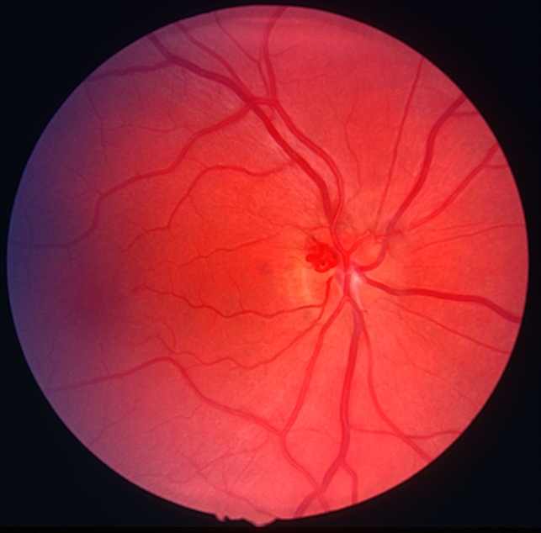
Persistent Fetal Vasculature
Prepapillary vascular loop

Slide 108
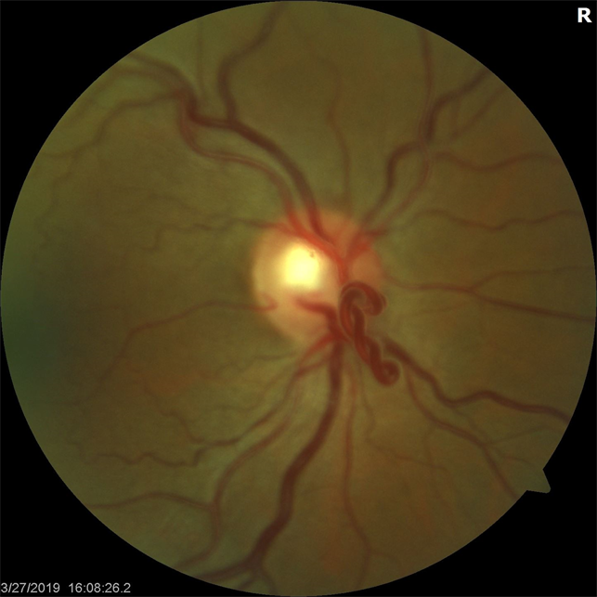
Persistent Fetal Vasculature
Prepapillary vascular loop with a figure-of-eight configuration

Slide 109
Persistent Fetal Vasculature
Anterior
Posterior
Mild ‘dz’
continuum
Severe dz
Mild ‘dz’
continuum
Severe dz
What is the main manifestation of severe anterior PFV?
Hyaloid
artery
op-
tic
nerve

Slide 110
Persistent Fetal Vasculature
Anterior
Posterior
Mild ‘dz’
continuum
Severe dz
Mild ‘dz’
continuum
Severe dz
What is the main manifestation of severe anterior PFV?
A white , vascularized retrolental membrane
color
vascular status
location
Hyaloid
artery
op-
tic
nerve

Slide 111
Persistent Fetal Vasculature
Anterior
Posterior
Mild ‘dz’
continuum
Severe dz
Mild ‘dz’
continuum
Severe dz
What is the main manifestation of severe anterior PFV?
A white , vascularized retrolental membrane
Hyaloid
artery
op-
tic
nerve

Slide 112
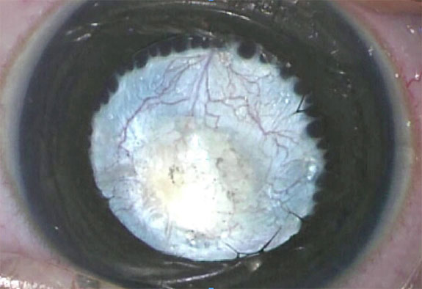
Persistent Fetal Vasculature
PFV: Retrolental membrane

Slide 113
Persistent Fetal Vasculature
Anterior
Posterior
Mild ‘dz’
continuum
Severe dz
Mild ‘dz’
continuum
Severe dz
What is the main manifestation of severe anterior PFV?
A white , vascularized retrolental membrane
What finding—described in the BCSC as “classic” for anterior PFV—is associated with the peripheral aspect of the retrolental membrane?
Elongated ciliary processes are visible through the pupil when dilated
Hyaloid
artery
op-
tic
nerve

Slide 114
Persistent Fetal Vasculature
Anterior
Posterior
Mild ‘dz’
continuum
Severe dz
Mild ‘dz’
continuum
Severe dz
What is the main manifestation of severe anterior PFV?
A white , vascularized retrolental membrane
What finding—described in the BCSC as “classic” for anterior PFV—is associated with the peripheral aspect of the retrolental membrane?
Elongated ciliary processes are visible through the pupil when dilated
two words
Hyaloid
artery
op-
tic
nerve

Slide 115
Persistent Fetal Vasculature
Anterior
Posterior
Mild ‘dz’
continuum
Severe dz
Mild ‘dz’
continuum
Severe dz
What is the main manifestation of severe anterior PFV?
A white , vascularized retrolental membrane
What finding—described in the BCSC as “classic” for anterior PFV—is associated with the peripheral aspect of the retrolental membrane?
Elongated ciliary processes are visible through the pupil when dilated
Hyaloid
artery
op-
tic
nerve

Slide 116
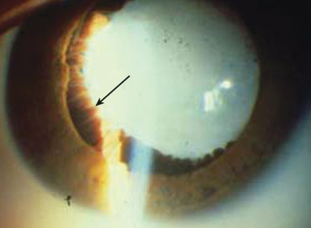
Persistent Fetal Vasculature
PFV: Retrolental membrane. Note the ciliary processes (arrow)

Slide 117
Persistent Fetal Vasculature
Anterior
Posterior
Mild ‘dz’
continuum
Severe dz
Mild ‘dz’
continuum
Severe dz
What is the main manifestation of severe anterior PFV?
A white , vascularized retrolental membrane
Three other classic manifestations of severe anterior PFV:
--The eye is…[size]
--The lens is…
--The anterior chamber is…
Hyaloid
artery
op-
tic
nerve

Slide 118
Persistent Fetal Vasculature
Anterior
Posterior
Mild ‘dz’
continuum
Severe dz
Mild ‘dz’
continuum
Severe dz
What is the main manifestation of severe anterior PFV?
A white , vascularized retrolental membrane
Three other classic manifestations of severe anterior PFV:
--The eye is…microphthalmic
--The lens is…
--The anterior chamber is…
Hyaloid
artery
op-
tic
nerve

Slide 119
Persistent Fetal Vasculature
Anterior
Posterior
Mild ‘dz’
continuum
Severe dz
Mild ‘dz’
continuum
Severe dz
What is the main manifestation of severe anterior PFV?
A white , vascularized retrolental membrane
Three other classic manifestations of severe anterior PFV:
--The eye is…microphthalmic
--The lens is…
--The anterior chamber is…
How prevalent is microphthalmia in severe anterior PFV?
Very. In fact, if an eye with apparent PFV isn’t microphthalmic, you should question the diagnosis.
Hyaloid
artery
op-
tic
nerve

Slide 120
Persistent Fetal Vasculature
Anterior
Posterior
Mild ‘dz’
continuum
Severe dz
Mild ‘dz’
continuum
Severe dz
What is the main manifestation of severe anterior PFV?
A white , vascularized retrolental membrane
Three other classic manifestations of severe anterior PFV:
--The eye is…microphthalmic
--The lens is…
--The anterior chamber is…
How prevalent is microphthalmia in severe anterior PFV?
Very. In fact, if an eye with apparent PFV isn’t microphthalmic, you should question the diagnosis.
Hyaloid
artery
op-
tic
nerve

Slide 121
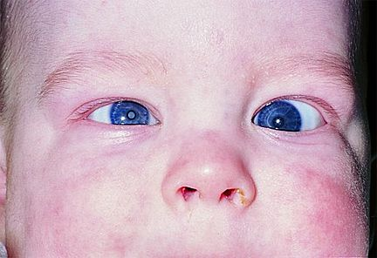
Persistent Fetal Vasculature
PFV: Microphthalmia

Slide 122
Persistent Fetal Vasculature
Anterior
Posterior
Mild ‘dz’
continuum
Severe dz
Mild ‘dz’
continuum
Severe dz
What is the main manifestation of severe anterior PFV?
A white , vascularized retrolental membrane
Three other classic manifestations of severe anterior PFV:
--The eye is…microphthalmic
--The lens is…[two key attributes]
--The anterior chamber is…
Hyaloid
artery
op-
tic
nerve

Slide 123
Persistent Fetal Vasculature
Anterior
Posterior
Mild ‘dz’
continuum
Severe dz
Mild ‘dz’
continuum
Severe dz
What is the main manifestation of severe anterior PFV?
A white , vascularized retrolental membrane
Three other classic manifestations of severe anterior PFV:
--The eye is…microphthalmic
--The lens is…small and cataractous
--The anterior chamber is…
Hyaloid
artery
op-
tic
nerve

Slide 124
Persistent Fetal Vasculature
Anterior
Posterior
Mild ‘dz’
continuum
Severe dz
Mild ‘dz’
continuum
Severe dz
What is the main manifestation of severe anterior PFV?
A white , vascularized retrolental membrane
Three other classic manifestations of severe anterior PFV:
--The eye is…microphthalmic
--The lens is…small and cataractous
--The anterior chamber is…
Where does anterior PFV rank as a cause of unilateral cataract in kids?
#1
Hyaloid
artery
op-
tic
nerve

Slide 125
Persistent Fetal Vasculature
Anterior
Posterior
Mild ‘dz’
continuum
Severe dz
Mild ‘dz’
continuum
Severe dz
What is the main manifestation of severe anterior PFV?
A white , vascularized retrolental membrane
Three other classic manifestations of severe anterior PFV:
--The eye is…microphthalmic
--The lens is…small and cataractous
--The anterior chamber is…
Where does anterior PFV rank as a cause of unilateral cataract in kids?
#1
Hyaloid
artery
op-
tic
nerve

Slide 126
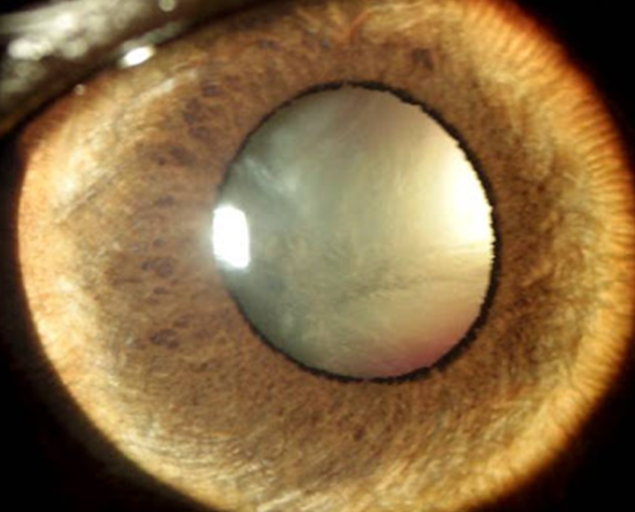
Persistent Fetal Vasculature
PFV: Cataract

Slide 127
Persistent Fetal Vasculature
Anterior
Posterior
Mild ‘dz’
continuum
Severe dz
Mild ‘dz’
continuum
Severe dz
What is the main manifestation of severe anterior PFV?
A white , vascularized retrolental membrane
Three other classic manifestations of severe anterior PFV:
--The eye is…microphthalmic
--The lens is…small and cataractous
--The anterior chamber is…[ominous status]
Hyaloid
artery
op-
tic
nerve

Slide 128
Persistent Fetal Vasculature
Anterior
Posterior
Mild ‘dz’
continuum
Severe dz
Mild ‘dz’
continuum
Severe dz
What is the main manifestation of severe anterior PFV?
A white , vascularized retrolental membrane
Three other classic manifestations of severe anterior PFV:
--The eye is…microphthalmic
--The lens is…small and cataractous
--The anterior chamber is…shallow
Hyaloid
artery
op-
tic
nerve

Slide 129
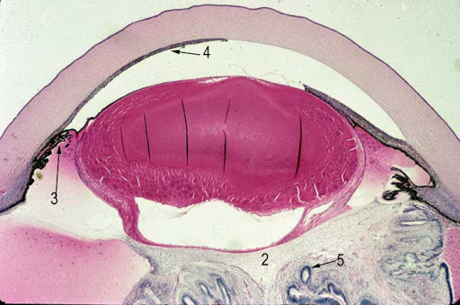
Persistent Fetal Vasculature
PFV: Shallow AC

Slide 130
Persistent Fetal Vasculature
Anterior
Posterior
Mild ‘dz’
continuum
Severe dz
Mild ‘dz’
continuum
Severe dz
What is the main manifestation of severe anterior PFV?
A white , vascularized retrolental membrane
Three other classic manifestations of severe anterior PFV:
--The eye is…microphthalmic
--The lens is…small and cataractous
--The anterior chamber is…shallow
Why refer to the shallow-ness of the anterior chamber as ‘ominous’?
Because it places the eye at significant risk for angle-closure glaucoma
Hyaloid
artery
op-
tic
nerve

Slide 131
Persistent Fetal Vasculature
Anterior
Posterior
Mild ‘dz’
continuum
Severe dz
Mild ‘dz’
continuum
Severe dz
What is the main manifestation of severe anterior PFV?
A white , vascularized retrolental membrane
Three other classic manifestations of severe anterior PFV:
--The eye is…microphthalmic
--The lens is…small and cataractous
--The anterior chamber is…shallow
Why refer to the shallow-ness of the anterior chamber as ‘ominous’?
Because it places the eye at significant risk for angle-closure glaucoma
Hyaloid
artery
op-
tic
nerve

Slide 132
Persistent Fetal Vasculature
Anterior
Posterior
Mild ‘dz’
continuum
Severe dz
Mild ‘dz’
continuum
Severe dz
What is the main manifestation of severe anterior PFV?
A white , vascularized retrolental membrane
Three other classic manifestations of severe anterior PFV:
--The eye is…microphthalmic
--The lens is…small and cataractous
--The anterior chamber is…shallow
What is the natural hx of severe anterior PFV?
Relentless progression of the cataract and AC shallowing , resulting in blindness and glaucoma
Is severe PFV amenable to surgical intervention?
Yes. The cataract and retrolental membrane can be removed, and this usually precludes development of secondary glaucoma. However, the post-op course is usually fraught, and the visual prognosis is guarded
Hyaloid
artery
op-
tic
nerve

Slide 133
Persistent Fetal Vasculature
Anterior
Posterior
Mild ‘dz’
continuum
Severe dz
Mild ‘dz’
continuum
Severe dz
What is the main manifestation of severe anterior PFV?
A white , vascularized retrolental membrane
Three other classic manifestations of severe anterior PFV:
--The eye is…microphthalmic
--The lens is…small and cataractous
--The anterior chamber is…shallow
What is the natural hx of severe anterior PFV?
Relentless progression of the cataract and AC shallowing , resulting in blindness and glaucoma
Is severe PFV amenable to surgical intervention?
Yes. The cataract and retrolental membrane can be removed, and this usually precludes development of secondary glaucoma. However, the post-op course is usually fraught, and the visual prognosis is guarded
Hyaloid
artery
op-
tic
nerve

Slide 134
Persistent Fetal Vasculature
Anterior
Posterior
Mild ‘dz’
continuum
Severe dz
Mild ‘dz’
continuum
Severe dz
What is the main manifestation of severe anterior PFV?
A white , vascularized retrolental membrane
Three other classic manifestations of severe anterior PFV:
--The eye is…microphthalmic
--The lens is…small and cataractous
--The anterior chamber is…shallow
What is the natural hx of severe anterior PFV?
Relentless progression of the cataract and AC shallowing , resulting in blindness and glaucoma
Is severe PFV amenable to surgical intervention?
Yes. The cataract and retrolental membrane can be removed, and this usually precludes development of secondary glaucoma. However, the post-op course is usually fraught, and the visual prognosis is guarded.
Hyaloid
artery
op-
tic
nerve

Slide 135
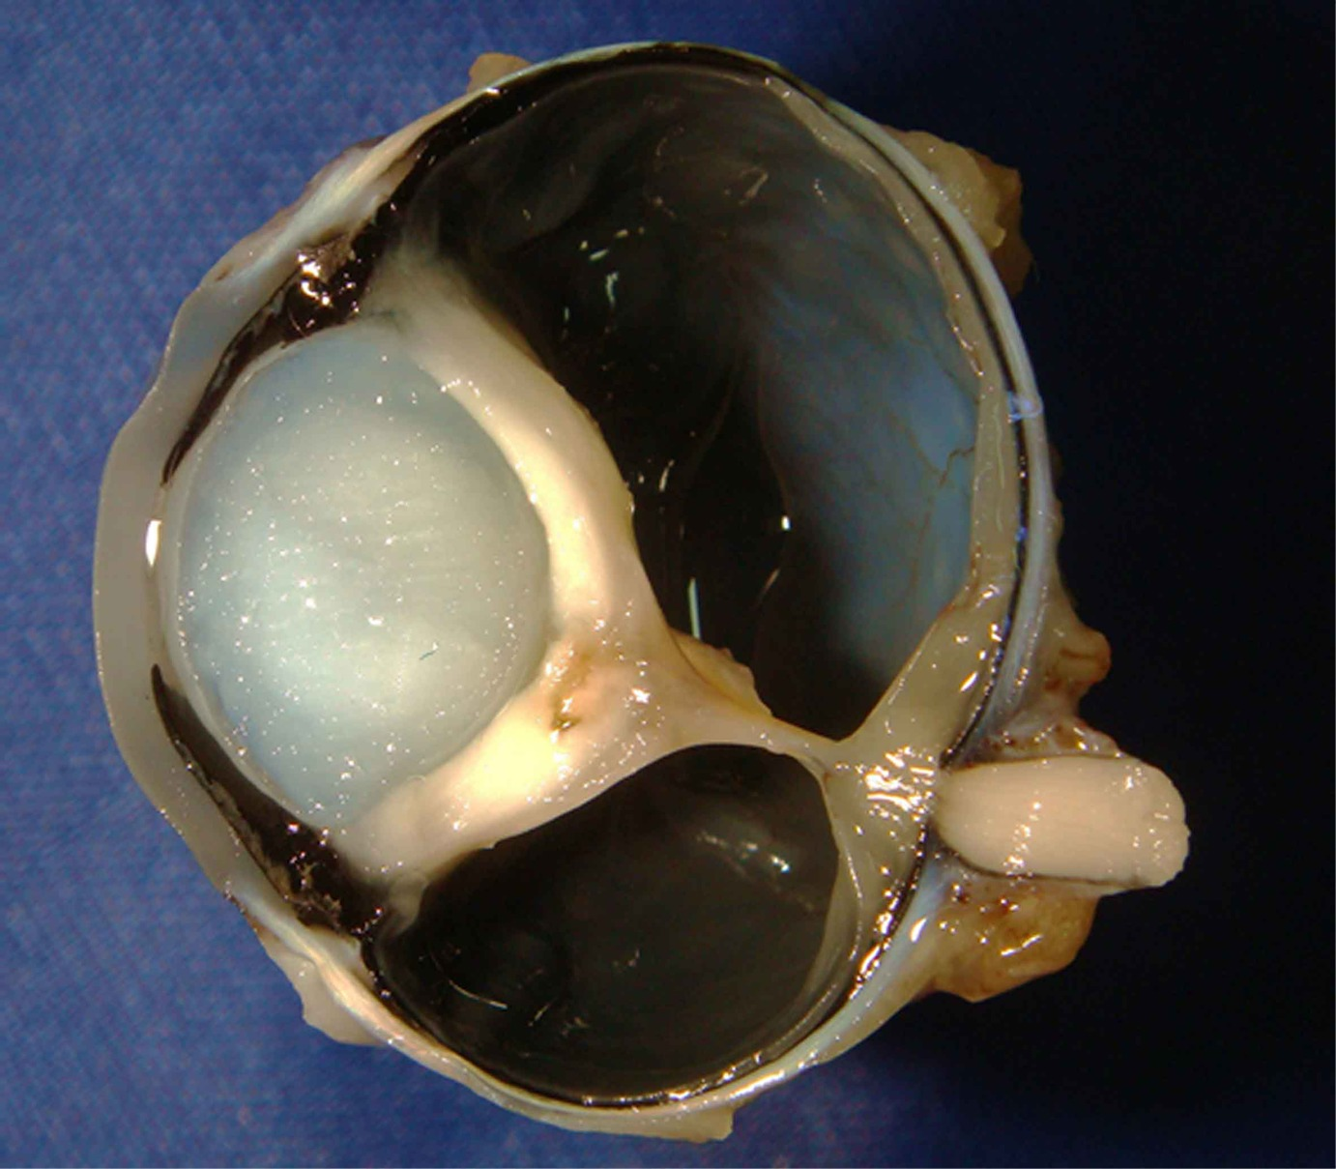
Persistent Fetal Vasculature
PFV: Note the advanced cataract and severely shallow AC. (Note also the thick white retrolental membrane, and the persistent hyaloid artery)

Slide 136
Persistent Fetal Vasculature
Anterior
Posterior
Mild ‘dz’
continuum
Severe dz
Mild ‘dz’
continuum
Severe dz
What is the main manifestation of severe anterior PFV?
A white , vascularized retrolental membrane
Three other classic manifestations of severe anterior PFV:
--The eye is…microphthalmic
--The lens is…small and cataractous
--The anterior chamber is…shallow
What is the natural hx of severe anterior PFV?
Relentless progression of the cataract and AC shallowing , resulting in blindness and glaucoma
Is severe PFV amenable to surgical intervention?
Yes. The cataract and retrolental membrane can be removed, and this usually precludes development of secondary glaucoma. However, the post-op course is usually fraught, and the visual prognosis is guarded.
Hyaloid
artery
op-
tic
nerve

Slide 137
Persistent Fetal Vasculature
Anterior
Posterior
Mild ‘dz’
continuum
Severe dz
Mild ‘dz’
continuum
Severe dz
What is the main manifestation of severe anterior PFV?
A white , vascularized retrolental membrane
Three other classic manifestations of severe anterior PFV:
--The eye is…microphthalmic
--The lens is…small and cataractous
--The anterior chamber is…shallow
What is the natural hx of severe anterior PFV?
Relentless progression of the cataract and AC shallowing , resulting in blindness and glaucoma
Is severe PFV amenable to surgical intervention?
Yes. The cataract and retrolental membrane can be removed, and this usually precludes development of secondary glaucoma. However, the post-op course is fraught, and the visual prognosis guarded.
Hyaloid
artery
op-
tic
nerve

Slide 138
At what age does severe anterior PFV present?
Birth
What is the classic clinical finding that alerts the pediatrician to the presence of a significant ocular issue?
Leukocoria. Anterior PFV is very high on the DDx for it.
What is the most feared dx on the leukocoria DDx?
Retinoblastoma (Rb)
Persistent Fetal Vasculature
Anterior
Posterior
Mild ‘dz’
continuum
Severe dz
Mild ‘dz’
continuum
Severe dz
What is the main manifestation of severe anterior PFV?
A white , vascularized retrolental membrane
Three other classic manifestations of severe anterior PFV:
--The eye is…microphthalmic
--The lens is…small and cataractous
--The anterior chamber is…shallow
Hyaloid
artery
op-
tic
nerve

Slide 139
At what age does severe anterior PFV present?
Birth
What is the classic clinical finding that alerts the pediatrician to the presence of a significant ocular issue?
Leukocoria. Anterior PFV is very high on the DDx for it.
What is the most feared dx on the leukocoria DDx?
Retinoblastoma (Rb)
Persistent Fetal Vasculature
Anterior
Posterior
Mild ‘dz’
continuum
Severe dz
Mild ‘dz’
continuum
Severe dz
What is the main manifestation of severe anterior PFV?
A white , vascularized retrolental membrane
Three other classic manifestations of severe anterior PFV:
--The eye is…microphthalmic
--The lens is…small and cataractous
--The anterior chamber is…shallow
Hyaloid
artery
op-
tic
nerve

Slide 140
At what age does severe anterior PFV present?
Birth
What is the classic clinical finding that alerts the pediatrician to the presence of a significant ocular issue?
Leukocoria. Anterior PFV is very high on the DDx for it.
What is the most feared dx on the leukocoria DDx?
Retinoblastoma (Rb)
Persistent Fetal Vasculature
Anterior
Posterior
Mild ‘dz’
continuum
Severe dz
Mild ‘dz’
continuum
Severe dz
What is the main manifestation of severe anterior PFV?
A white , vascularized retrolental membrane
Three other classic manifestations of severe anterior PFV:
--The eye is…microphthalmic
--The lens is…small and cataractous
--The anterior chamber is…shallow
Hyaloid
artery
op-
tic
nerve

Slide 141
At what age does severe anterior PFV present?
Birth
What is the classic clinical finding that alerts the pediatrician to the presence of a significant ocular issue?
Leukocoria. Anterior PFV is very high on the DDx for it.
What is the most feared dx on the leukocoria DDx?
Retinoblastoma (Rb)
Persistent Fetal Vasculature
Anterior
Posterior
Mild ‘dz’
continuum
Severe dz
Mild ‘dz’
continuum
Severe dz
What is the main manifestation of severe anterior PFV?
A white , vascularized retrolental membrane
Three other classic manifestations of severe anterior PFV:
--The eye is…microphthalmic
--The lens is…small and cataractous
--The anterior chamber is…shallow
Hyaloid
artery
op-
tic
nerve

Slide 142
At what age does severe anterior PFV present?
Birth
What is the classic clinical finding that alerts the pediatrician to the presence of a significant ocular issue?
Leukocoria. Anterior PFV is very high on the DDx for it.
What is the most feared dx on the leukocoria DDx?
Retinoblastoma (Rb)
Persistent Fetal Vasculature
Anterior
Posterior
Mild ‘dz’
continuum
Severe dz
Mild ‘dz’
continuum
Severe dz
What is the main manifestation of severe anterior PFV?
A white , vascularized retrolental membrane
Three other classic manifestations of severe anterior PFV:
--The eye is…microphthalmic
--The lens is…small and cataractous
--The anterior chamber is…shallow
Hyaloid
artery
op-
tic
nerve

Slide 143
At what age does severe anterior PFV present?
Birth
What is the classic clinical finding that alerts the pediatrician to the presence of a significant ocular issue?
Leukocoria. Anterior PFV is very high on the DDx for it.
What is the most feared dx on the leukocoria DDx?
Retinoblastoma (Rb)
Persistent Fetal Vasculature
Anterior
Posterior
Mild ‘dz’
continuum
Severe dz
Mild ‘dz’
continuum
Severe dz
What is the main manifestation of severe anterior PFV?
A white , vascularized retrolental membrane
Three other classic manifestations of severe anterior PFV:
--The eye is…microphthalmic
--The lens is…small and cataractous
--The anterior chamber is…shallow
Hyaloid
artery
op-
tic
nerve

Slide 144
At what age does severe anterior PFV present?
Birth
What is the classic clinical finding that alerts the pediatrician to the presence of a significant ocular issue?
Leukocoria. Anterior PFV is very high on the DDx for it.
What is the most feared dx on the leukocoria DDx?
Retinoblastoma (Rb)
Persistent Fetal Vasculature
It’s crucial that you be able to distinguish between anterior PFV and Rb, both in the clinic and on the OKAP/Boards. So let’s see how Rb stacks up against what we’ve learned about anterior PFV.
Anterior
Posterior
Mild ‘dz’
continuum
Severe dz
Mild ‘dz’
continuum
Severe dz
What is the main manifestation of severe anterior PFV?
A white , vascularized retrolental membrane
Three other classic manifestations of severe anterior PFV:
--The eye is…microphthalmic
--The lens is…small and cataractous
--The anterior chamber is…shallow
Hyaloid
artery
op-
tic
nerve

Slide 145
At what age does severe anterior PFV present?
Birth
What is the classic clinical finding that alerts the pediatrician to the presence of a significant ocular issue?
Leukocoria. Anterior PFV is very high on the DDx for it.
What is the most feared dx on the leukocoria DDx?
Retinoblastoma (Rb)
Persistent Fetal Vasculature
Anterior
Posterior
Mild ‘dz’
continuum
Severe dz
Mild ‘dz’
continuum
Severe dz
Does Rb present with leukocoria at birth? No
What is the main manifestation of severe anterior PFV?
A white , vascularized retrolental membrane
Three other classic manifestations of severe anterior PFV:
--The eye is…microphthalmic
--The lens is…small and cataractous
--The anterior chamber is…shallow

Slide 146
At what age does severe anterior PFV present?
Birth
What is the classic clinical finding that alerts the pediatrician to the presence of a significant ocular issue?
Leukocoria. Anterior PFV is very high on the DDx for it.
What is the most feared dx on the leukocoria DDx?
Retinoblastoma (Rb)
Persistent Fetal Vasculature
Anterior
Posterior
Mild ‘dz’
continuum
Severe dz
Mild ‘dz’
continuum
Severe dz
Does Rb present with leukocoria at birth? No
What is the main manifestation of severe anterior PFV?
A white , vascularized retrolental membrane
Three other classic manifestations of severe anterior PFV:
--The eye is…microphthalmic
--The lens is…small and cataractous
--The anterior chamber is…shallow

Slide 147
At what age does severe anterior PFV present?
Birth
What is the classic clinical finding that alerts the pediatrician to the presence of a significant ocular issue?
Leukocoria. Anterior PFV is very high on the DDx for it.
What is the most feared dx on the leukocoria DDx?
Retinoblastoma (Rb)
Persistent Fetal Vasculature
Anterior
Posterior
Mild ‘dz’
continuum
Severe dz
Mild ‘dz’
continuum
Severe dz
Does Rb present with leukocoria at birth? No
What is the main manifestation of severe anterior PFV?
A white , vascularized retrolental membrane
Three other classic manifestations of severe anterior PFV:
--The eye is…microphthalmic
--The lens is…small and cataractous
--The anterior chamber is…shallow
Does this mean Rb can’t be present at birth?
Oh no, it mos def can. It just isn’t obvious, ie, it isn’t causing leukocoria (or any other outward sign).

Slide 148
At what age does severe anterior PFV present?
Birth
What is the classic clinical finding that alerts the pediatrician to the presence of a significant ocular issue?
Leukocoria. Anterior PFV is very high on the DDx for it.
What is the most feared dx on the leukocoria DDx?
Retinoblastoma (Rb)
Persistent Fetal Vasculature
Anterior
Posterior
Mild ‘dz’
continuum
Severe dz
Mild ‘dz’
continuum
Severe dz
Does Rb present with leukocoria at birth? No
What is the main manifestation of severe anterior PFV?
A white , vascularized retrolental membrane
Three other classic manifestations of severe anterior PFV:
--The eye is…microphthalmic
--The lens is…small and cataractous
--The anterior chamber is…shallow
Does this mean Rb can’t be present at birth?
Oh no, it mos def can. It just isn’t obvious, ie, it isn’t causing leukocoria (or any other outward sign).

Slide 149
At what age does severe anterior PFV present?
Birth
What is the classic clinical finding that alerts the pediatrician to the presence of a significant ocular issue?
Leukocoria. Anterior PFV is very high on the DDx for it.
What is the most feared dx on the leukocoria DDx?
Retinoblastoma (Rb)
Persistent Fetal Vasculature
Anterior
Posterior
Mild ‘dz’
continuum
Severe dz
Mild ‘dz’
continuum
Severe dz
Does Rb present with leukocoria at birth? No
What is the main manifestation of severe anterior PFV?
A white , vascularized retrolental membrane
Three other classic manifestations of severe anterior PFV:
--The eye is…microphthalmic?
--The lens is…small and cataractous
--The anterior chamber is…shallow
Are Rb eyes microphthalmic? No

Slide 150
At what age does severe anterior PFV present?
Birth
What is the classic clinical finding that alerts the pediatrician to the presence of a significant ocular issue?
Leukocoria. Anterior PFV is very high on the DDx for it.
What is the most feared dx on the leukocoria DDx?
Retinoblastoma (Rb)
Persistent Fetal Vasculature
Anterior
Posterior
Mild ‘dz’
continuum
Severe dz
Mild ‘dz’
continuum
Severe dz
Does Rb present with leukocoria at birth? No
What is the main manifestation of severe anterior PFV?
A white , vascularized retrolental membrane
Three other classic manifestations of severe anterior PFV:
--The eye is…microphthalmic
--The lens is…small and cataractous
--The anterior chamber is…shallow
Are Rb eyes microphthalmic? No

Slide 151
At what age does severe anterior PFV present?
Birth
What is the classic clinical finding that alerts the pediatrician to the presence of a significant ocular issue?
Leukocoria. Anterior PFV is very high on the DDx for it.
What is the most feared dx on the leukocoria DDx?
Retinoblastoma (Rb)
Persistent Fetal Vasculature
Anterior
Posterior
Mild ‘dz’
continuum
Severe dz
Mild ‘dz’
continuum
Severe dz
Does Rb present with leukocoria at birth? No
What is the main manifestation of severe anterior PFV?
A white , vascularized retrolental membrane
Three other classic manifestations of severe anterior PFV:
--The eye is…microphthalmic
--The lens is…small and cataractous?
--The anterior chamber is…shallow
Are Rb eyes microphthalmic? No
Do Rb eyes have small/cataractous lenses? No

Slide 152
At what age does severe anterior PFV present?
Birth
What is the classic clinical finding that alerts the pediatrician to the presence of a significant ocular issue?
Leukocoria. Anterior PFV is very high on the DDx for it.
What is the most feared dx on the leukocoria DDx?
Retinoblastoma (Rb)
Persistent Fetal Vasculature
Anterior
Posterior
Mild ‘dz’
continuum
Severe dz
Mild ‘dz’
continuum
Severe dz
Does Rb present with leukocoria at birth? No
What is the main manifestation of severe anterior PFV?
A white , vascularized retrolental membrane
Three other classic manifestations of severe anterior PFV:
--The eye is…microphthalmic
--The lens is…small and cataractous
--The anterior chamber is…shallow
Are Rb eyes microphthalmic? No
Do Rb eyes have small/cataractous lenses? No

Slide 153
At what age does severe anterior PFV present?
Birth
What is the classic clinical finding that alerts the pediatrician to the presence of a significant ocular issue?
Leukocoria. Anterior PFV is very high on the DDx for it.
What is the most feared dx on the leukocoria DDx?
Retinoblastoma (Rb)
Persistent Fetal Vasculature
Anterior
Posterior
Mild ‘dz’
continuum
Severe dz
Mild ‘dz’
continuum
Severe dz
Does Rb present with leukocoria at birth? No
What is the main manifestation of severe anterior PFV?
A white , vascularized retrolental membrane
Three other classic manifestations of severe anterior PFV:
--The eye is…microphthalmic
--The lens is…small and cataractous
--The anterior chamber is…shallow?
Are Rb eyes microphthalmic? No
Do Rb eyes have small/cataractous lenses? No
Do Rb eyes have shallow ACs? No

Slide 154
At what age does severe anterior PFV present?
Birth
What is the classic clinical finding that alerts the pediatrician to the presence of a significant ocular issue?
Leukocoria. Anterior PFV is very high on the DDx for it.
What is the most feared dx on the leukocoria DDx?
Retinoblastoma (Rb)
Persistent Fetal Vasculature
Anterior
Posterior
Mild ‘dz’
continuum
Severe dz
Mild ‘dz’
continuum
Severe dz
Does Rb present with leukocoria at birth? No
What is the main manifestation of severe anterior PFV?
A white , vascularized retrolental membrane
Three other classic manifestations of severe anterior PFV:
--The eye is…microphthalmic
--The lens is…small and cataractous
--The anterior chamber is…shallow
Are Rb eyes microphthalmic? No
Do Rb eyes have small/cataractous lenses? No
Do Rb eyes have shallow ACs? No

Slide 155
At what age does severe anterior PFV present?
Birth
What is the classic clinical finding that alerts the pediatrician to the presence of a significant ocular issue?
Leukocoria. Anterior PFV is very high on the DDx for it.
What is the most feared dx on the leukocoria DDx?
Retinoblastoma (Rb)
Persistent Fetal Vasculature
Anterior
Posterior
 | Anterior PFV | Rb
Leukocoria at birth? | Yes | No
Microphthalmic? | Yes | No
Cataract present? | Yes | No
AC shallow? | Yes | No
Mild ‘dz’
continuum
Severe dz
Mild ‘dz’
continuum
Severe dz
What is the main manifestation of severe anterior PFV?
A white , vascularized retrolental membrane
Three other classic manifestations of severe anterior PFV:
--The eye is…microphthalmic
--The lens is…small and cataractous
--The anterior chamber is…shallow
Are Rb eyes microphthalmic? No
(Review slide—no question, proceed when ready)

Slide 156
At what age does severe anterior PFV present?
Birth
What is the classic clinical finding that alerts the pediatrician to the presence of a significant ocular issue?
Leukocoria. Anterior PFV is very high on the DDx for it.
What is the most feared dx on the leukocoria DDx?
Retinoblastoma (Rb)
Persistent Fetal Vasculature
Anterior
Posterior
 | Anterior PFV | Rb
Clinically obvious at birth? | Yes | No
Microphthalmic? | Yes | No
Cataract present? | Yes | No
AC shallow? | Yes | No
Mild ‘dz’
continuum
Severe dz
Mild ‘dz’
continuum
Severe dz
What is the main manifestation of severe anterior PFV?
A white , vascularized retrolental membrane
Three other classic manifestations of severe anterior PFV:
--The eye is…microphthalmic
--The lens is…small and cataractous
--The anterior chamber is…shallow
Next, we will change gears and consider clinically significant posterior PFV
Are Rb eyes microphthalmic? No
(Review slide—no question, proceed when ready)

Slide 157
Persistent Fetal Vasculature
Anterior
Posterior
Mild ‘dz’
continuum
Severe dz
Mild ‘dz’
continuum
Severe dz
What is the main manifestation of severe anterior PFV?
A white , vascularized retrolental membrane
Three other classic manifestations of severe anterior PFV:
--The eye is…microphthalmic
--The lens is…small and cataractous
--The anterior chamber is…shallow
In severe PFV…
Is a retrolental membrane present? No
In severe posterior PFV…
Hyaloid
artery
op-
tic
nerve

Slide 158
Persistent Fetal Vasculature
Anterior
Posterior
Mild ‘dz’
continuum
Severe dz
Mild ‘dz’
continuum
Severe dz
What is the main manifestation of severe anterior PFV?
A white , vascularized retrolental membrane?
Three other classic manifestations of severe anterior PFV:
--The eye is…microphthalmic
--The lens is…small and cataractous
--The anterior chamber is…shallow
In severe posterior PFV…
Is a retrolental membrane present? No
Hyaloid
artery
op-
tic
nerve

Slide 159
Persistent Fetal Vasculature
Anterior
Posterior
Mild ‘dz’
continuum
Severe dz
Mild ‘dz’
continuum
Severe dz
What is the main manifestation of severe anterior PFV?
A white , vascularized retrolental membrane?
Three other classic manifestations of severe anterior PFV:
--The eye is…microphthalmic
--The lens is…small and cataractous
--The anterior chamber is…shallow
In severe posterior PFV…
Is a retrolental membrane present? No
Hyaloid
artery
op-
tic
nerve

Slide 160
Persistent Fetal Vasculature
Anterior
Posterior
Mild ‘dz’
continuum
Severe dz
Mild ‘dz’
continuum
Severe dz
What is the main manifestation of severe anterior PFV?
A white , vascularized retrolental membrane?
Three other classic manifestations of severe anterior PFV:
--The eye is…microphthalmic?
--The lens is…small and cataractous
--The anterior chamber is…shallow
In severe PFV…
Is a retrolental membrane present? No
In severe posterior PFV…
Is the eye microphthalmic?
Hyaloid
artery
op-
tic
nerve

Slide 161
Persistent Fetal Vasculature
Anterior
Posterior
Mild ‘dz’
continuum
Severe dz
Mild ‘dz’
continuum
Severe dz
What is the main manifestation of severe anterior PFV?
A white , vascularized retrolental membrane?
Three other classic manifestations of severe anterior PFV:
--The eye is…microphthalmic!
--The lens is…small and cataractous
--The anterior chamber is…shallow
In severe PFV…
Is a retrolental membrane present? No
In severe posterior PFV…
Is the eye microphthalmic? Yes
Hyaloid
artery
op-
tic
nerve

Slide 162
Persistent Fetal Vasculature
Anterior
Posterior
Mild ‘dz’
continuum
Severe dz
Mild ‘dz’
continuum
Severe dz
What is the main manifestation of severe anterior PFV?
A white , vascularized retrolental membrane?
Three other classic manifestations of severe anterior PFV:
--The eye is…microphthalmic!
--The lens is…small and cataractous?
--The anterior chamber is…shallow
In severe PFV…
Is a retrolental membrane present? No
In severe posterior PFV…
Is the lens small/cataractous?
Hyaloid
artery
op-
tic
nerve

Slide 163
Persistent Fetal Vasculature
Anterior
Posterior
Mild ‘dz’
continuum
Severe dz
Mild ‘dz’
continuum
Severe dz
What is the main manifestation of severe anterior PFV?
A white , vascularized retrolental membrane?
Three other classic manifestations of severe anterior PFV:
--The eye is…microphthalmic!
--The lens is…small and cataractous
--The anterior chamber is…shallow
In severe PFV…
Is a retrolental membrane present? No
In severe posterior PFV…
Is the lens small/cataractous? No
Hyaloid
artery
op-
tic
nerve

Slide 164
Persistent Fetal Vasculature
Anterior
Posterior
Mild ‘dz’
continuum
Severe dz
Mild ‘dz’
continuum
Severe dz
What is the main manifestation of severe anterior PFV?
A white , vascularized retrolental membrane?
Three other classic manifestations of severe anterior PFV:
--The eye is…microphthalmic!
--The lens is…small and cataractous
--The anterior chamber is…shallow?
In severe PFV…
Is a retrolental membrane present? No
In severe posterior PFV…
Is the AC shallow?
Hyaloid
artery
op-
tic
nerve

Slide 165
Persistent Fetal Vasculature
Anterior
Posterior
Mild ‘dz’
continuum
Severe dz
Mild ‘dz’
continuum
Severe dz
What is the main manifestation of severe anterior PFV?
A white , vascularized retrolental membrane?
Three other classic manifestations of severe anterior PFV:
--The eye is…microphthalmic!
--The lens is…small and cataractous
--The anterior chamber is…shallow
In severe PFV…
Is a retrolental membrane present? No
In severe posterior PFV…
Is the AC shallow? No
Hyaloid
artery
op-
tic
nerve

Slide 166
Persistent Fetal Vasculature
Anterior
Posterior
Mild ‘dz’
continuum
Severe dz
Mild ‘dz’
continuum
Severe dz
What is the main manifestation of severe anterior PFV?
A white , vascularized retrolental membrane?
Three other classic manifestations of severe anterior PFV:
--The eye is…microphthalmic!
--The lens is…small and cataractous
--The anterior chamber is…shallow
What is the defining feature of severe posterior PFV?
Hyaloid
artery
op-
tic
nerve

Slide 167
Persistent Fetal Vasculature
Anterior
Posterior
Mild ‘dz’
continuum
Severe dz
Mild ‘dz’
continuum
Severe dz
What is the main manifestation of severe anterior PFV?
A white , vascularized retrolental membrane?
Three other classic manifestations of severe anterior PFV:
--The eye is…microphthalmic!
--The lens is…small and cataractous
--The anterior chamber is…shallow
What is the defining feature of severe posterior PFV?
Persistent hyaloid branches emanating from the ONH, running atop (and causing) a retinal fold
two words
op-
tic
nerve

Slide 168
Persistent Fetal Vasculature
Anterior
Posterior
Mild ‘dz’
continuum
Severe dz
Mild ‘dz’
continuum
Severe dz
What is the main manifestation of severe anterior PFV?
A white , vascularized retrolental membrane?
Three other classic manifestations of severe anterior PFV:
--The eye is…microphthalmic!
--The lens is…small and cataractous
--The anterior chamber is…shallow
What is the defining feature of severe posterior PFV?
Persistent hyaloid branches emanating from the ONH, running atop (and causing) a retinal fold
op-
tic
nerve

Slide 169
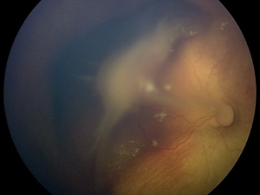
Persistent Fetal Vasculature
Posterior PFV with a fibrovascular stalk

Slide 170
Persistent Fetal Vasculature
Anterior
Posterior
Mild ‘dz’
continuum
Severe dz
Mild ‘dz’
continuum
Severe dz
What is the main manifestation of severe anterior PFV?
A white , vascularized retrolental membrane?
Three other classic manifestations of severe anterior PFV:
--The eye is…microphthalmic!
--The lens is…small and cataractous
--The anterior chamber is…shallow
What conditions top the DDx for posterior PFV?
--?
--?
--?
What is the defining feature of severe posterior PFV?
Persistent hyaloid branches emanating from the ONH, running atop (and causing) a retinal fold
op-
tic
nerve

Slide 171
Persistent Fetal Vasculature
Anterior
Posterior
Mild ‘dz’
continuum
Severe dz
Mild ‘dz’
continuum
Severe dz
What is the main manifestation of severe anterior PFV?
A white , vascularized retrolental membrane?
Three other classic manifestations of severe anterior PFV:
--The eye is…microphthalmic!
--The lens is…small and cataractous
--The anterior chamber is…shallow
What conditions top the DDx for posterior PFV?
--ROP
--FEVR
--Toxocariasis
What is the defining feature of severe posterior PFV?
Persistent hyaloid branches emanating from the ONH, running atop (and causing) a retinal fold
op-
tic
nerve

Slide 172
Persistent Fetal Vasculature
Anterior
Posterior
Mild ‘dz’
continuum
Severe dz
Mild ‘dz’
continuum
Severe dz
What is the main manifestation of severe anterior PFV?
A white , vascularized retrolental membrane?
Three other classic manifestations of severe anterior PFV:
--The eye is…microphthalmic!
--The lens is…small and cataractous
--The anterior chamber is…shallow
What conditions top the DDx for posterior PFV?
--ROP
--FEVR
--Toxocariasis
What is the defining feature of severe posterior PFV?
Persistent hyaloid branches emanating from the ONH, running atop (and causing) a retinal fold
What does ROP stand for here?
op-
tic
nerve

Slide 173
Persistent Fetal Vasculature
Anterior
Posterior
Mild ‘dz’
continuum
Severe dz
Mild ‘dz’
continuum
Severe dz
What is the main manifestation of severe anterior PFV?
A white , vascularized retrolental membrane?
Three other classic manifestations of severe anterior PFV:
--The eye is…microphthalmic!
--The lens is…small and cataractous
--The anterior chamber is…shallow
What conditions top the DDx for posterior PFV?
--ROP
--FEVR
--Toxocariasis
What is the defining feature of severe posterior PFV?
Persistent hyaloid branches emanating from the ONH, running atop (and causing) a retinal fold
What does ROP stand for here?
Retinopathy of prematurity (it has its own slide-set if you’re interested)
op-
tic
nerve

Slide 174
Persistent Fetal Vasculature
Anterior
Posterior
Mild ‘dz’
continuum
Severe dz
Mild ‘dz’
continuum
Severe dz
What is the main manifestation of severe anterior PFV?
A white , vascularized retrolental membrane?
Three other classic manifestations of severe anterior PFV:
--The eye is…microphthalmic!
--The lens is…small and cataractous
--The anterior chamber is…shallow
What conditions top the DDx for posterior PFV?
--ROP
--FEVR
--Toxocariasis
What is the defining feature of severe posterior PFV?
Persistent hyaloid branches emanating from the ONH, running atop (and causing) a retinal fold
How about FEVR?
op-
tic
nerve

Slide 175
Persistent Fetal Vasculature
Anterior
Posterior
Mild ‘dz’
continuum
Severe dz
Mild ‘dz’
continuum
Severe dz
What is the main manifestation of severe anterior PFV?
A white , vascularized retrolental membrane?
Three other classic manifestations of severe anterior PFV:
--The eye is…microphthalmic!
--The lens is…small and cataractous
--The anterior chamber is…shallow
What conditions top the DDx for posterior PFV?
--ROP
--FEVR
--Toxocariasis
What is the defining feature of severe posterior PFV?
Persistent hyaloid branches emanating from the ONH, running atop (and causing) a retinal fold
How about FEVR?
Familial exudative vitreoretinopathy (covered in slide-set R3)
op-
tic
nerve

Slide 176
Persistent Fetal Vasculature
Anterior
Posterior
Mild ‘dz’
continuum
Severe dz
Mild ‘dz’
continuum
Severe dz
What is the main manifestation of severe anterior PFV?
A white , vascularized retrolental membrane?
Three other classic manifestations of severe anterior PFV:
--The eye is…microphthalmic!
--The lens is…small and cataractous
--The anterior chamber is…shallow
What conditions top the DDx for posterior PFV?
--ROP
--FEVR
--Toxocariasis
In a word, what sort of bug is Toxocara?
What is the defining feature of severe posterior PFV?
Persistent hyaloid branches emanating from the ONH, running atop (and causing) a retinal fold
op-
tic
nerve

Slide 177
Persistent Fetal Vasculature
Anterior
Posterior
Mild ‘dz’
continuum
Severe dz
Mild ‘dz’
continuum
Severe dz
What is the main manifestation of severe anterior PFV?
A white , vascularized retrolental membrane?
Three other classic manifestations of severe anterior PFV:
--The eye is…microphthalmic!
--The lens is…small and cataractous
--The anterior chamber is…shallow
What conditions top the DDx for posterior PFV?
--ROP
--FEVR
--Toxocariasis
In a word, what sort of bug is Toxocara?
A roundworm (it has its own slide-set)
What is the defining feature of severe posterior PFV?
Persistent hyaloid branches emanating from the ONH, running atop (and causing) a retinal fold
op-
tic
nerve

Slide 178
Persistent Fetal Vasculature
The next section is a brief recapitulation of the high points for severe anterior PFV

Slide 179
Q
Persistent Fetal Vasculature
Anterior PFV: Basics
White vascularized fibrous membrane present behind lens
classic descriptors (three words)

Slide 180
A
Persistent Fetal Vasculature
Anterior PFV: Basics
White vascularized fibrous membrane present behind lens

Slide 181
Q
Persistent Fetal Vasculature
Anterior PFV: Basics
White vascularized fibrous membrane present behind lens
Associated with:
Microphthalmos
eye size

Slide 182
A
Persistent Fetal Vasculature
Anterior PFV: Basics
White vascularized fibrous membrane present behind lens
Associated with:
Microphthalmos

Slide 183
Q
Persistent Fetal Vasculature
Anterior PFV: Basics
White vascularized fibrous membrane present behind lens
Associated with:
Microphthalmos
Leukocoria at birth
how early
in life?

Slide 184
A
Persistent Fetal Vasculature
Anterior PFV: Basics
White vascularized fibrous membrane present behind lens
Associated with:
Microphthalmos
Leukocoria at birth

Slide 185
Q
Persistent Fetal Vasculature
Anterior PFV: Basics
White vascularized fibrous membrane present behind lens
Associated with:
Microphthalmos
Leukocoria at birth
Shallow anterior chamber
deep vs
shallow

Slide 186
A
Persistent Fetal Vasculature
Anterior PFV: Basics
White vascularized fibrous membrane present behind lens
Associated with:
Microphthalmos
Leukocoria at birth
Shallow anterior chamber

Slide 187
Q
Persistent Fetal Vasculature
Anterior PFV: Basics
White vascularized fibrous membrane present behind lens
Associated with:
Microphthalmos
Leukocoria at birth
Shallow anterior chamber
Long ciliary processes visible around small lens
two words

Slide 188
A
Persistent Fetal Vasculature
Anterior PFV: Basics
White vascularized fibrous membrane present behind lens
Associated with:
Microphthalmos
Leukocoria at birth
Shallow anterior chamber
Long ciliary processes visible around small lens

Slide 189
Q
Persistent Fetal Vasculature
Anterior PFV: Basics
White vascularized fibrous membrane present behind lens
Associated with:
Microphthalmos
Leukocoria at birth
Shallow anterior chamber
Long ciliary processes visible around small lens
Dehiscence of posterior capsule → lens intumescence → cataract and 2º angle closure glaucoma
one word
type of

Slide 190
A
Persistent Fetal Vasculature
Anterior PFV: Basics
White vascularized fibrous membrane present behind lens
Associated with:
Microphthalmos
Leukocoria at birth
Shallow anterior chamber
Long ciliary processes visible around small lens
Dehiscence of posterior capsule → lens intumescence → cataract and 2º angle closure glaucoma

Slide 191
Q
Persistent Fetal Vasculature
Anterior PFV: Basics
White vascularized fibrous membrane present behind lens
Associated with:
Microphthalmos
Leukocoria at birth
Shallow anterior chamber
Long ciliary processes visible around small lens
Dehiscence of posterior capsule → lens intumescence → cataract and 2º angle closure glaucoma
Anterior PFV: Management
Lensectomy and membranectomy to prevent angle closure
surgical procedure
another surgical procedure

Slide 192
A
Persistent Fetal Vasculature
Anterior PFV: Basics
White vascularized fibrous membrane present behind lens
Associated with:
Microphthalmos
Leukocoria at birth
Shallow anterior chamber
Long ciliary processes visible around small lens
Dehiscence of posterior capsule → lens intumescence → cataract and 2º angle closure glaucoma
Anterior PFV: Management
Lensectomy and membranectomy to prevent angle closure

