Slide 1
Q
Pediatric Corneal Epithelial Trauma
Corneal abrasion
Don’t bother with patching
common therapeutic
maneuver

Slide 2
A
Pediatric Corneal Epithelial Trauma
Corneal abrasion
Don’t bother with patching

Slide 3
Q
Pediatric Corneal Epithelial Trauma
Corneal abrasion
Don’t bother with patching
Do use cycloplegics and ointment
med
med

Slide 4
A
Pediatric Corneal Epithelial Trauma
Corneal abrasion
Don’t bother with patching
Do use cycloplegics and ointment

Slide 5
Q
Pediatric Corneal Epithelial Trauma
Corneal abrasion
Don’t bother with patching
Do use cycloplegics and ointment
Corneal cigarette burns
#1 cause of ocular surface thermal injury in childhood

Slide 6
A
Pediatric Corneal Epithelial Trauma
Corneal abrasion
Don’t bother with patching
Do use cycloplegics and ointment
Corneal cigarette burns
#1 cause of ocular surface thermal injury in childhood

Slide 7
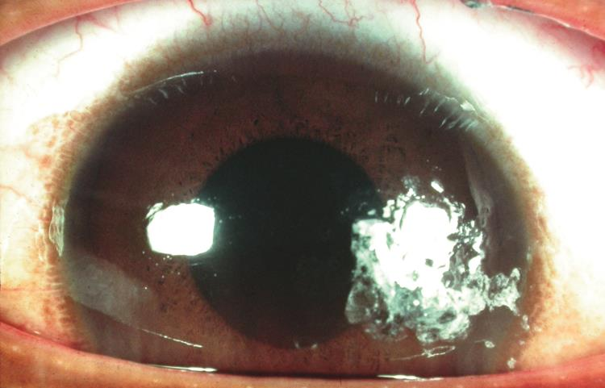
Corneal cig burn

Slide 8
Q
Pediatric Corneal Epithelial Trauma
Corneal abrasion
Don’t bother with patching
Do use cycloplegics and ointment
Corneal cigarette burns
#1 cause of ocular surface thermal injury in childhood
Usually not manifestation of abuse
is/isn’t a

Slide 9
A
Pediatric Corneal Epithelial Trauma
Corneal abrasion
Don’t bother with patching
Do use cycloplegics and ointment
Corneal cigarette burns
#1 cause of ocular surface thermal injury in childhood
Usually not manifestation of abuse

Slide 10
Q
Pediatric Corneal Epithelial Trauma
Corneal abrasion
Don’t bother with patching
Do use cycloplegics and ointment
Corneal cigarette burns
#1 cause of ocular surface thermal injury in childhood
Usually not manifestation of abuse
?
If not intentional, how is it that corneal cig burns can be common in childhood?

Slide 11
A
Pediatric Corneal Epithelial Trauma
Corneal abrasion
Don’t bother with patching
Do use cycloplegics and ointment
Corneal cigarette burns
#1 cause of ocular surface thermal injury in childhood
Usually not manifestation of abuse
Toddler is perfect height to run into a cigarette
If not intentional, how is it that corneal cig burns can be common in childhood?

Slide 12
Q
Pediatric Corneal Epithelial Trauma
Corneal abrasion
Don’t bother with patching
Do use cycloplegics and ointment
Corneal cigarette burns
#1 cause of ocular surface thermal injury in childhood
Usually not manifestation of abuse
Toddler is perfect height to run into a cigarette
Treat like mechanical abrasion
common eye injury

Slide 13
A
Pediatric Corneal Epithelial Trauma
Corneal abrasion
Don’t bother with patching
Do use cycloplegics and ointment
Corneal cigarette burns
#1 cause of ocular surface thermal injury in childhood
Usually not manifestation of abuse
Toddler is perfect height to run into a cigarette
Treat like mechanical abrasion

Slide 14
Q
Pediatric Corneal Epithelial Trauma
Corneal abrasion
Don’t bother with patching
Do use cycloplegics and ointment
Corneal cigarette burns
#1 cause of ocular surface thermal injury in childhood
Usually not manifestation of abuse
Toddler is perfect height to run into a cigarette
Treat like mechanical abrasion
Typically heals rapidly and w/o scarring
fast vs slow
with vs
without

Slide 15
A
Pediatric Corneal Epithelial Trauma
Corneal abrasion
Don’t bother with patching
Do use cycloplegics and ointment
Corneal cigarette burns
#1 cause of ocular surface thermal injury in childhood
Usually not manifestation of abuse
Toddler is perfect height to run into a cigarette
Treat like mechanical abrasion
Typically heals rapidly and w/o scarring

