Slide 1
Q
For each statement, identify whether it applies to
gyrate atrophy or choroideremia (or both, or neither)
Is a choroidal dystrophy:

Slide 2
A
For each statement, identify whether it applies to
gyrate atrophy or choroideremia (or both, or neither)
Is a choroidal dystrophy: Gyrate. Wait…Yep, gyrate. No wait--both?

Slide 3
Q
For each statement, identify whether it applies to
gyrate atrophy or choroideremia (or both, or neither)
Is a choroidal dystrophy: Gyrate. Wait…Yep, gyrate. No wait--both?
Why all the prevaricating?
When choroideremia and gyrate atrophy were first identified, they were categorized as choroidal dystrophies based on their clinical appearance. And the primary site of pathology in gyrate locates to the RPE and choroid, so it is probably fair to call it a choroidal dystrophy of sorts. However, it is now know that the fundamental pathology in choroideremia is that of a rod-cone dystrophy . Because of this, choroideremia was considered to be a form of retinitis pigmentosa (RP) .
This was the state of play in the BCSC Retina book--that is, until publication of the latest revision (the 2018-19 edition). In this edition, the Academy seems to be phasing out the term retinitis pigmentosa. (The book states the term is “no longer preferred.”) Further, the scope of conditions covered by this ‘non-preferred’ umbrella term is shrinking. And one of the no-longer-considered-RP conditions is…choroideremia.
tl;dr I don’t know if choroideremia is considered a choroidal dystrophy. Caveat emptor.

Slide 4
Q/A
For each statement, identify whether it applies to
gyrate atrophy or choroideremia (or both, or neither)
Is a choroidal dystrophy: Gyrate. Wait…Yep, gyrate. No wait--both?
Why all the prevaricating?
When choroideremia and gyrate atrophy were first identified, they were categorized as choroidal dystrophies based on their clinical appearance. And the primary site of pathology in gyrate locates to the RPE and choroid, so it is probably fair to call it a choroidal dystrophy of sorts. However, it is now know that the fundamental pathology in choroideremia is that of a rod-cone dystrophy . Because of this, choroideremia was considered to be a form of retinitis pigmentosa (RP) .
This was the state of play in the BCSC Retina book--that is, until publication of the latest revision (the 2018-19 edition). In this edition, the Academy seems to be phasing out the term retinitis pigmentosa. (The book states the term is “no longer preferred.”) Further, the scope of conditions covered by this ‘non-preferred’ umbrella term is shrinking. And one of the no-longer-considered-RP conditions is…choroideremia.
tl;dr I don’t know if choroideremia is considered a choroidal dystrophy. Caveat emptor.
three words, first two hyphenated
two words, and their abb.

Slide 5
A
For each statement, identify whether it applies to
gyrate atrophy or choroideremia (or both, or neither)
Is a choroidal dystrophy: Gyrate. Wait…Yep, gyrate. No wait--both?
Why all the prevaricating?
When choroideremia and gyrate atrophy were first identified, they were categorized as choroidal dystrophies based on their clinical appearance. And the primary site of pathology in gyrate locates to the RPE and choroid, so it is probably fair to call it a choroidal dystrophy of sorts. However, it is now know that the fundamental pathology in choroideremia is that of a rod-cone dystrophy . Because of this, choroideremia was considered to be a form of retinitis pigmentosa (RP) .
This was the state of play in the BCSC Retina book--that is, until publication of the latest revision (the 2018-19 edition). In this edition, the Academy seems to be phasing out the term retinitis pigmentosa. (The book states the term is “no longer preferred.”) Further, the scope of conditions covered by this ‘non-preferred’ umbrella term is shrinking. And one of the no-longer-considered-RP conditions is…choroideremia.
tl;dr I don’t know if choroideremia is considered a choroidal dystrophy. Caveat emptor.

Slide 6
A
For each statement, identify whether it applies to
gyrate atrophy or choroideremia (or both, or neither)
Is a choroidal dystrophy: Gyrate. Wait…Yep, gyrate. No wait--both?
Why all the prevaricating?
When choroideremia and gyrate atrophy were first identified, they were categorized as choroidal dystrophies based on their clinical appearance. And the primary site of pathology in gyrate locates to the RPE and choroid, so it is probably fair to call it a choroidal dystrophy of sorts. However, it is now know that the fundamental pathology in choroideremia is that of a rod-cone dystrophy . Because of this, choroideremia was considered to be a form of retinitis pigmentosa (RP) .
This was the state of play in the BCSC Retina book--that is, until publication of the latest revision (the 2018-19 edition). In this edition, the Academy seems to be phasing out the term retinitis pigmentosa. (The book states the term is “no longer preferred.”) Further, the scope of conditions covered by this ‘non-preferred’ umbrella term is shrinking. And one of the no-longer-considered-RP conditions is…choroideremia.
tl;dr I don’t know if choroideremia is considered a choroidal dystrophy. Caveat emptor.

Slide 7
Q
For each statement, identify whether it applies to
gyrate atrophy or choroideremia (or both, or neither)
Is a choroidal dystrophy: Gyrate. Wait…Yep, gyrate. No wait--both?
Why all the prevaricating?
When choroideremia and gyrate atrophy were first identified, they were categorized as choroidal dystrophies based on their clinical appearance. And the primary site of pathology in gyrate locates to the RPE and choroid, so it is probably fair to call it a choroidal dystrophy of sorts. However, it is now know that the fundamental pathology in choroideremia is that of a rod-cone dystrophy . Because of this, choroideremia was considered to be a form of retinitis pigmentosa (RP) .
This was the state of play in the BCSC Retina book--that is, until publication of the latest revision (the 2018-19 edition). In this edition, the Academy seems to be phasing out the term retinitis pigmentosa. (The book states the term is “no longer preferred.”) Further, the scope of conditions covered by this ‘non-preferred’ umbrella term is shrinking. And one of the no-longer-considered-RP conditions is…choroideremia.
tl;dr I don’t know if choroideremia is considered a choroidal dystrophy. Caveat emptor.
Regarding phenotype, three classic manifestations of RP are absent in choroideremia. What are they?
--
--
--

Slide 8
Q/A
For each statement, identify whether it applies to
gyrate atrophy or choroideremia (or both, or neither)
Is a choroidal dystrophy: Gyrate. Wait…Yep, gyrate. No wait--both?
Why all the prevaricating?
When choroideremia and gyrate atrophy were first identified, they were categorized as choroidal dystrophies based on their clinical appearance. And the primary site of pathology in gyrate locates to the RPE and choroid, so it is probably fair to call it a choroidal dystrophy of sorts. However, it is now know that the fundamental pathology in choroideremia is that of a rod-cone dystrophy . Because of this, choroideremia was considered to be a form of retinitis pigmentosa (RP) .
This was the state of play in the BCSC Retina book--that is, until publication of the latest revision (the 2018-19 edition). In this edition, the Academy seems to be phasing out the term retinitis pigmentosa. (The book states the term is “no longer preferred.”) Further, the scope of conditions covered by this ‘non-preferred’ umbrella term is shrinking. And one of the no-longer-considered-RP conditions is…choroideremia.
tl;dr I don’t know if choroideremia is considered a choroidal dystrophy. Caveat emptor.
Regarding phenotype, three classic manifestations of RP are absent in choroideremia. What are they?
--Waxy disc pallor
--Retinal arteriolar attenuation
--The presence of bony spicules
two words
one word
two words

Slide 9
A
For each statement, identify whether it applies to
gyrate atrophy or choroideremia (or both, or neither)
Is a choroidal dystrophy: Gyrate. Wait…Yep, gyrate. No wait--both?
Why all the prevaricating?
When choroideremia and gyrate atrophy were first identified, they were categorized as choroidal dystrophies based on their clinical appearance. And the primary site of pathology in gyrate locates to the RPE and choroid, so it is probably fair to call it a choroidal dystrophy of sorts. However, it is now know that the fundamental pathology in choroideremia is that of a rod-cone dystrophy . Because of this, choroideremia was considered to be a form of retinitis pigmentosa (RP) .
This was the state of play in the BCSC Retina book--that is, until publication of the latest revision (the 2018-19 edition). In this edition, the Academy seems to be phasing out the term retinitis pigmentosa. (The book states the term is “no longer preferred.”) Further, the scope of conditions covered by this ‘non-preferred’ umbrella term is shrinking. And one of the no-longer-considered-RP conditions is…choroideremia.
tl;dr I don’t know if choroideremia is considered a choroidal dystrophy. Caveat emptor.
Regarding phenotype, three classic manifestations of RP are absent in choroideremia. What are they?
--Waxy disc pallor (the ONH is normal in choroideremia)
--Retinal arteriolar attenuation (the retinal arterioles are normal in choroideremia)
--The presence of bony spicules (these are absent in choroideremia)

Slide 10
Q
For each statement, identify whether it applies to
gyrate atrophy or choroideremia (or both, or neither)
Is a choroidal dystrophy: Gyrate. Wait…Yep, gyrate. No wait--both?
Deficiency of enzyme geranyl geranyl transferase:

Slide 11
A
For each statement, identify whether it applies to
gyrate atrophy or choroideremia (or both, or neither)
Is a choroidal dystrophy: Gyrate. Wait…Yep, gyrate. No wait--both?
Deficiency of enzyme geranyl geranyl transferase: Choroideremia

Slide 12
Q
For each statement, identify whether it applies to
gyrate atrophy or choroideremia (or both, or neither)
Is a choroidal dystrophy: Gyrate. Wait…Yep, gyrate. No wait--both?
Deficiency of enzyme geranyl geranyl transferase: Choroideremia
Defect in ornithine aminotransferase enzyme leads to excess serum ornithine levels:

Slide 13
A
For each statement, identify whether it applies to
gyrate atrophy or choroideremia (or both, or neither)
Is a choroidal dystrophy: Gyrate. Wait…Yep, gyrate. No wait--both?
Deficiency of enzyme geranyl geranyl transferase: Choroideremia
Defect in ornithine aminotransferase enzyme leads to excess serum ornithine levels: Gyrate

Slide 14
Q
For each statement, identify whether it applies to
gyrate atrophy or choroideremia (or both, or neither)
Is a choroidal dystrophy: Gyrate. Wait…Yep, gyrate. No wait--both?
Deficiency of enzyme geranyl geranyl transferase: Choroideremia
Defect in ornithine aminotransferase enzyme leads to excess serum ornithine levels: Gyrate
Why are excess ornithine levels a problem?
Because ornithine is toxic to the RPE and choroid

Slide 15
A
For each statement, identify whether it applies to
gyrate atrophy or choroideremia (or both, or neither)
Is a choroidal dystrophy: Gyrate. Wait…Yep, gyrate. No wait--both?
Deficiency of enzyme geranyl geranyl transferase: Choroideremia
Defect in ornithine aminotransferase enzyme leads to excess serum ornithine levels: Gyrate
Why are excess ornithine levels a problem?
Because ornithine is toxic to the RPE and choroid

Slide 16
Q
For each statement, identify whether it applies to
gyrate atrophy or choroideremia (or both, or neither)
Is a choroidal dystrophy: Gyrate. Wait…Yep, gyrate. No wait--both?
Deficiency of enzyme geranyl geranyl transferase: Choroideremia
Defect in ornithine aminotransferase enzyme leads to excess serum ornithine levels: Gyrate
DFE: ’Pavingstones;’ later coalesce into scalloped areas:

Slide 17
A
For each statement, identify whether it applies to
gyrate atrophy or choroideremia (or both, or neither)
Is a choroidal dystrophy: Gyrate. Wait…Yep, gyrate. No wait--both?
Deficiency of enzyme geranyl geranyl transferase: Choroideremia
Defect in ornithine aminotransferase enzyme leads to excess serum ornithine levels: Gyrate
DFE: ’Pavingstones;’ later coalesce into scalloped areas: Gyrate

Slide 18
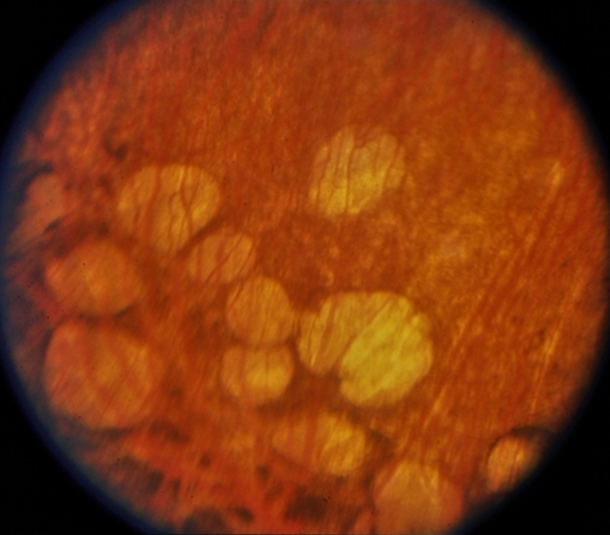
For each statement, identify whether it applies to
gyrate atrophy or choroideremia (or both, or neither)
Gyrate atrophy: Pavingstones

Slide 19
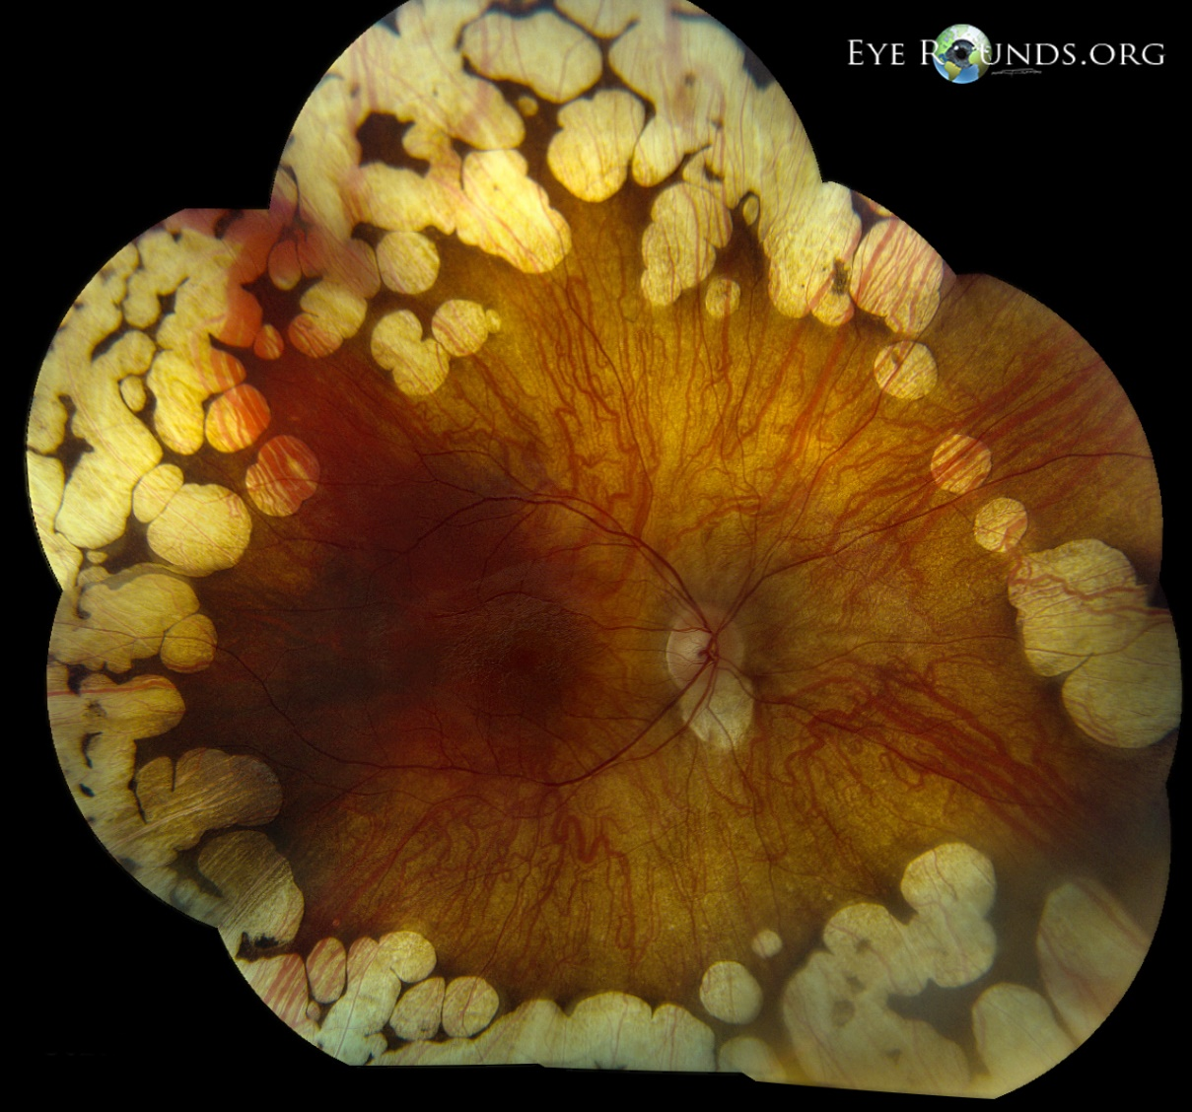
For each statement, identify whether it applies to
gyrate atrophy or choroideremia (or both, or neither)
Gyrate atrophy: Scalloped areas

Slide 20
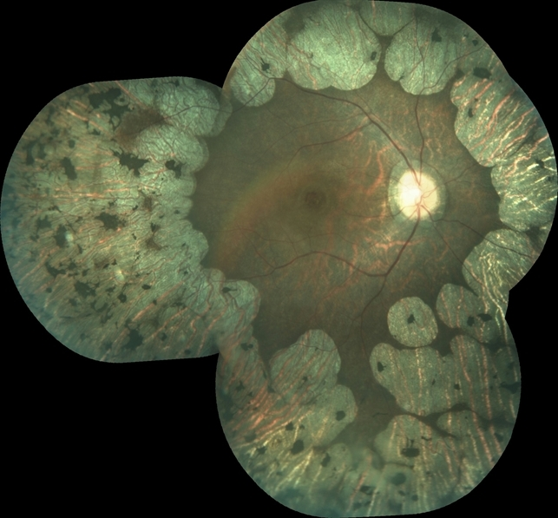
For each statement, identify whether it applies to
gyrate atrophy or choroideremia (or both, or neither)
Gyrate atrophy: Scalloped areas

Slide 21
Q
For each statement, identify whether it applies to
gyrate atrophy or choroideremia (or both, or neither)
Is a choroidal dystrophy: Gyrate. Wait…Yep, gyrate. No wait--both?
Deficiency of enzyme geranyl geranyl transferase: Choroideremia
Defect in ornithine aminotransferase enzyme leads to excess serum ornithine levels: Gyrate
DFE: ’Pavingstones;’ later coalesce into scalloped areas: Gyrate
DFE: Near total absence of choroid, choriocapillaris, and RPE:

Slide 22
A
For each statement, identify whether it applies to
gyrate atrophy or choroideremia (or both, or neither)
Is a choroidal dystrophy: Gyrate. Wait…Yep, gyrate. No wait--both?
Deficiency of enzyme geranyl geranyl transferase: Choroideremia
Defect in ornithine aminotransferase enzyme leads to excess serum ornithine levels: Gyrate
DFE: ’Pavingstones;’ later coalesce into scalloped areas: Gyrate
DFE: Near total absence of choroid, choriocapillaris, and RPE: Choroideremia

Slide 23
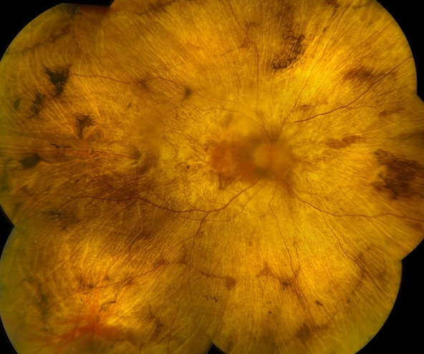
For each statement, identify whether it applies to
gyrate atrophy or choroideremia (or both, or neither)
Choroideremia

Slide 24
Q
For each statement, identify whether it applies to
gyrate atrophy or choroideremia (or both, or neither)
Is a choroidal dystrophy: Gyrate. Wait…Yep, gyrate. No wait--both?
Deficiency of enzyme geranyl geranyl transferase: Choroideremia
Defect in ornithine aminotransferase enzyme leads to excess serum ornithine levels: Gyrate
DFE: ’Pavingstones;’ later coalesce into scalloped areas: Gyrate
DFE: Near total absence of choroid, choriocapillaris, and RPE: Choroideremia
Vitamin B₆ treatment effective in a small percentage of patients:

Slide 25
A
For each statement, identify whether it applies to
gyrate atrophy or choroideremia (or both, or neither)
Is a choroidal dystrophy: Gyrate. Wait…Yep, gyrate. No wait--both?
Deficiency of enzyme geranyl geranyl transferase: Choroideremia
Defect in ornithine aminotransferase enzyme leads to excess serum ornithine levels: Gyrate
DFE: ’Pavingstones;’ later coalesce into scalloped areas: Gyrate
DFE: Near total absence of choroid, choriocapillaris, and RPE: Choroideremia
Vitamin B₆ treatment effective in a small percentage of patients: Gyrate

Slide 26
Q
For each statement, identify whether it applies to
gyrate atrophy or choroideremia (or both, or neither)
Is a choroidal dystrophy: Gyrate. Wait…Yep, gyrate. No wait--both?
Deficiency of enzyme geranyl geranyl transferase: Choroideremia
Defect in ornithine aminotransferase enzyme leads to excess serum ornithine levels: Gyrate
DFE: ’Pavingstones;’ later coalesce into scalloped areas: Gyrate
DFE: Near total absence of choroid, choriocapillaris, and RPE: Choroideremia
Vitamin B₆ treatment effective in a small percentage of patients: Gyrate
If B₆ therapy is tried, check serum ornithine level to assess response;
if level doesn’t fall, discontinue therapy
do this

Slide 27
A
For each statement, identify whether it applies to
gyrate atrophy or choroideremia (or both, or neither)
Is a choroidal dystrophy: Gyrate. Wait…Yep, gyrate. No wait--both?
Deficiency of enzyme geranyl geranyl transferase: Choroideremia
Defect in ornithine aminotransferase enzyme leads to excess serum ornithine levels: Gyrate
DFE: ’Pavingstones;’ later coalesce into scalloped areas: Gyrate
DFE: Near total absence of choroid, choriocapillaris, and RPE: Choroideremia
Vitamin B₆ treatment effective in a small percentage of patients: Gyrate
If B₆ therapy is tried, check serum ornithine level to assess response;
if level doesn’t fall, discontinue therapy

Slide 28
Q
For each statement, identify whether it applies to
gyrate atrophy or choroideremia (or both, or neither)
Is a choroidal dystrophy: Gyrate. Wait…Yep, gyrate. No wait--both?
Deficiency of enzyme geranyl geranyl transferase: Choroideremia
Defect in ornithine aminotransferase enzyme leads to excess serum ornithine levels: Gyrate
DFE: ’Pavingstones;’ later coalesce into scalloped areas: Gyrate
DFE: Near total absence of choroid, choriocapillaris, and RPE: Choroideremia
Vitamin B₆ treatment effective in a small percentage of patients: Gyrate
X-linked recessive inheritance:

Slide 29
A
For each statement, identify whether it applies to
gyrate atrophy or choroideremia (or both, or neither)
Is a choroidal dystrophy: Gyrate. Wait…Yep, gyrate. No wait--both?
Deficiency of enzyme geranyl geranyl transferase: Choroideremia
Defect in ornithine aminotransferase enzyme leads to excess serum ornithine levels: Gyrate
DFE: ’Pavingstones;’ later coalesce into scalloped areas: Gyrate
DFE: Near total absence of choroid, choriocapillaris, and RPE: Choroideremia
Vitamin B₆ treatment effective in a small percentage of patients: Gyrate
X-linked recessive inheritance: Choroideremia

Slide 30
Q
For each statement, identify whether it applies to
gyrate atrophy or choroideremia (or both, or neither)
Is a choroidal dystrophy: Gyrate. Wait…Yep, gyrate. No wait--both?
Deficiency of enzyme geranyl geranyl transferase: Choroideremia
Defect in ornithine aminotransferase enzyme leads to excess serum ornithine levels: Gyrate
DFE: ’Pavingstones;’ later coalesce into scalloped areas: Gyrate
DFE: Near total absence of choroid, choriocapillaris, and RPE: Choroideremia
Vitamin B₆ treatment effective in a small percentage of patients: Gyrate
X-linked recessive inheritance: Choroideremia
Inherited AR:

Slide 31
A
For each statement, identify whether it applies to
gyrate atrophy or choroideremia (or both, or neither)
Is a choroidal dystrophy: Gyrate. Wait…Yep, gyrate. No wait--both?
Deficiency of enzyme geranyl geranyl transferase: Choroideremia
Defect in ornithine aminotransferase enzyme leads to excess serum ornithine levels: Gyrate
DFE: ’Pavingstones;’ later coalesce into scalloped areas: Gyrate
DFE: Near total absence of choroid, choriocapillaris, and RPE: Choroideremia
Vitamin B₆ treatment effective in a small percentage of patients: Gyrate
X-linked recessive inheritance: Choroideremia
Inherited AR: Gyrate

Slide 32
Q
For each statement, identify whether it applies to
gyrate atrophy or choroideremia (or both, or neither)
Is a choroidal dystrophy: Gyrate. Wait…Yep, gyrate. No wait--both?
Deficiency of enzyme geranyl geranyl transferase: Choroideremia
Defect in ornithine aminotransferase enzyme leads to excess serum ornithine levels: Gyrate
DFE: ’Pavingstones;’ later coalesce into scalloped areas: Gyrate
DFE: Near total absence of choroid, choriocapillaris, and RPE: Choroideremia
Vitamin B₆ treatment effective in a small percentage of patients: Gyrate
X-linked recessive inheritance: Choroideremia
Inherited AR: Gyrate
Develop night blindness in childhood/teens:

Slide 33
A
For each statement, identify whether it applies to
gyrate atrophy or choroideremia (or both, or neither)
Is a choroidal dystrophy: Gyrate. Wait…Yep, gyrate. No wait--both?
Deficiency of enzyme geranyl geranyl transferase: Choroideremia
Defect in ornithine aminotransferase enzyme leads to excess serum ornithine levels: Gyrate
DFE: ’Pavingstones;’ later coalesce into scalloped areas: Gyrate
DFE: Near total absence of choroid, choriocapillaris, and RPE: Choroideremia
Vitamin B₆ treatment effective in a small percentage of patients: Gyrate
X-linked recessive inheritance: Choroideremia
Inherited AR: Gyrate
Develop night blindness in childhood/teens: Both

Slide 34
Q
For each statement, identify whether it applies to
gyrate atrophy or choroideremia (or both, or neither)
Is a choroidal dystrophy: Gyrate. Wait…Yep, gyrate. No wait--both?
Deficiency of enzyme geranyl geranyl transferase: Choroideremia
Defect in ornithine aminotransferase enzyme leads to excess serum ornithine levels: Gyrate
DFE: ’Pavingstones;’ later coalesce into scalloped areas: Gyrate
DFE: Near total absence of choroid, choriocapillaris, and RPE: Choroideremia
Vitamin B₆ treatment effective in a small percentage of patients: Gyrate
X-linked recessive inheritance: Choroideremia
Inherited AR: Gyrate
Develop night blindness in childhood/teens: Both
ERG abnormal early, extinguished late:

Slide 35
A
For each statement, identify whether it applies to
gyrate atrophy or choroideremia (or both, or neither)
Is a choroidal dystrophy: Gyrate. Wait…Yep, gyrate. No wait--both?
Deficiency of enzyme geranyl geranyl transferase: Choroideremia
Defect in ornithine aminotransferase enzyme leads to excess serum ornithine levels: Gyrate
DFE: ’Pavingstones;’ later coalesce into scalloped areas: Gyrate
DFE: Near total absence of choroid, choriocapillaris, and RPE: Choroideremia
Vitamin B₆ treatment effective in a small percentage of patients: Gyrate
X-linked recessive inheritance: Choroideremia
Inherited AR: Gyrate
Develop night blindness in childhood/teens: Both
ERG abnormal early, extinguished late: Both

Slide 36
Q
For each statement, identify whether it applies to
gyrate atrophy or choroideremia (or both, or neither)
Is a choroidal dystrophy: Gyrate. Wait…Yep, gyrate. No wait--both?
Deficiency of enzyme geranyl geranyl transferase: Choroideremia
Defect in ornithine aminotransferase enzyme leads to excess serum ornithine levels: Gyrate
DFE: ’Pavingstones;’ later coalesce into scalloped areas: Gyrate
DFE: Near total absence of choroid, choriocapillaris, and RPE: Choroideremia
Vitamin B₆ treatment effective in a small percentage of patients: Gyrate
X-linked recessive inheritance: Choroideremia
Inherited AR: Gyrate
Develop night blindness in childhood/teens: Both
ERG abnormal early, extinguished late: Both
VA ≤ 20/200 by 40s – 50s:

Slide 37
A
For each statement, identify whether it applies to
gyrate atrophy or choroideremia (or both, or neither)
Is a choroidal dystrophy: Gyrate. Wait…Yep, gyrate. No wait--both?
Deficiency of enzyme geranyl geranyl transferase: Choroideremia
Defect in ornithine aminotransferase enzyme leads to excess serum ornithine levels: Gyrate
DFE: ’Pavingstones;’ later coalesce into scalloped areas: Gyrate
DFE: Near total absence of choroid, choriocapillaris, and RPE: Choroideremia
Vitamin B₆ treatment effective in a small percentage of patients: Gyrate
X-linked recessive inheritance: Choroideremia
Inherited AR: Gyrate
Develop night blindness in childhood/teens: Both
ERG abnormal early, extinguished late: Both
VA ≤ 20/200 by 40s – 50s: Both

Slide 38
Q
For each statement, identify whether it applies to
gyrate atrophy or choroideremia (or both, or neither)
Is a choroidal dystrophy: Gyrate. Wait…Yep, gyrate. No wait--both?
Deficiency of enzyme geranyl geranyl transferase: Choroideremia
Defect in ornithine aminotransferase enzyme leads to excess serum ornithine levels: Gyrate
DFE: ’Pavingstones;’ later coalesce into scalloped areas: Gyrate
DFE: Near total absence of choroid, choriocapillaris, and RPE: Choroideremia
Vitamin B₆ treatment effective in a small percentage of patients: Gyrate
X-linked recessive inheritance: Choroideremia
Inherited AR: Gyrate
Develop night blindness in childhood/teens: Both
ERG abnormal early, extinguished late: Both
VA ≤ 20/200 by 40s – 50s: Both
Progressive loss of VF occurs:

Slide 39
A
For each statement, identify whether it applies to
gyrate atrophy or choroideremia (or both, or neither)
Is a choroidal dystrophy: Gyrate. Wait…Yep, gyrate. No wait--both?
Deficiency of enzyme geranyl geranyl transferase: Choroideremia
Defect in ornithine aminotransferase enzyme leads to excess serum ornithine levels: Gyrate
DFE: ’Pavingstones;’ later coalesce into scalloped areas: Gyrate
DFE: Near total absence of choroid, choriocapillaris, and RPE: Choroideremia
Vitamin B₆ treatment effective in a small percentage of patients: Gyrate
X-linked recessive inheritance: Choroideremia
Inherited AR: Gyrate
Develop night blindness in childhood/teens: Both
ERG abnormal early, extinguished late: Both
VA ≤ 20/200 by 40s – 50s: Both
Progressive loss of VF occurs: Both

Slide 40
Q
For each statement, identify whether it applies to
gyrate atrophy or choroideremia (or both, or neither)
Is a choroidal dystrophy: Gyrate. Wait…Yep, gyrate. No wait--both?
Deficiency of enzyme geranyl geranyl transferase: Choroideremia
Defect in ornithine aminotransferase enzyme leads to excess serum ornithine levels: Gyrate
DFE: ’Pavingstones;’ later coalesce into scalloped areas: Gyrate
DFE: Near total absence of choroid, choriocapillaris, and RPE: Choroideremia
Vitamin B₆ treatment effective in a small percentage of patients: Gyrate
X-linked recessive inheritance: Choroideremia
Inherited AR: Gyrate
Develop night blindness in childhood/teens: Both
ERG abnormal early, extinguished late: Both
VA ≤ 20/200 by 40s – 50s: Both
Progressive loss of VF occurs: Both
Treatment: Restrict dietary arginine:

Slide 41
A
For each statement, identify whether it applies to
gyrate atrophy or choroideremia (or both, or neither)
Is a choroidal dystrophy: Gyrate. Wait…Yep, gyrate. No wait--both?
Deficiency of enzyme geranyl geranyl transferase: Choroideremia
Defect in ornithine aminotransferase enzyme leads to excess serum ornithine levels: Gyrate
DFE: ’Pavingstones;’ later coalesce into scalloped areas: Gyrate
DFE: Near total absence of choroid, choriocapillaris, and RPE: Choroideremia
Vitamin B₆ treatment effective in a small percentage of patients: Gyrate
X-linked recessive inheritance: Choroideremia
Inherited AR: Gyrate
Develop night blindness in childhood/teens: Both
ERG abnormal early, extinguished late: Both
VA ≤ 20/200 by 40s – 50s: Both
Progressive loss of VF occurs: Both
Treatment: Restrict dietary arginine: Gyrate

