Slide 1
Uveitis: TB
1) The uveitis is profiled
2) The profiled case is meshed
3) A differential diagnosis list is generated
4) Studies are obtained to identify the etiology
5) Treatment appropriate for the etiology is initiated
Basics
What is the causative organism in typical TB?

Slide 2
Uveitis: TB
1) The uveitis is profiled
2) The profiled case is meshed
3) A differential diagnosis list is generated
4) Studies are obtained to identify the etiology
5) Treatment appropriate for the etiology is initiated
Basics
What is the causative organism in typical TB?
Mycobacterium tuberculosis

Slide 3
Uveitis: TB
1) The uveitis is profiled
2) The profiled case is meshed
3) A differential diagnosis list is generated
4) Studies are obtained to identify the etiology
5) Treatment appropriate for the etiology is initiated
Basics
What is the causative organism in typical TB?
Mycobacterium tuberculosis
What are its basic properties (ie, what sort of organism is it in a microbiology sense)?

Slide 4
Uveitis: TB
1) The uveitis is profiled
2) The profiled case is meshed
3) A differential diagnosis list is generated
4) Studies are obtained to identify the etiology
5) Treatment appropriate for the etiology is initiated
Basics
What is the causative organism in typical TB?
Mycobacterium tuberculosis
What are its basic properties (ie, what sort of organism is it in a microbiology sense)?
It is an obligate aerobe

Slide 5
Uveitis: TB
1) The uveitis is profiled
2) The profiled case is meshed
3) A differential diagnosis list is generated
4) Studies are obtained to identify the etiology
5) Treatment appropriate for the etiology is initiated
Basics
What is the causative organism in typical TB?
Mycobacterium tuberculosis
What are its basic properties (ie, what sort of organism is it in a microbiology sense)?
It is an obligate aerobe
Is it Gram positive, or Gram negative?

Slide 6
Uveitis: TB
1) The uveitis is profiled
2) The profiled case is meshed
3) A differential diagnosis list is generated
4) Studies are obtained to identify the etiology
5) Treatment appropriate for the etiology is initiated
Basics
What is the causative organism in typical TB?
Mycobacterium tuberculosis
What are its basic properties (ie, what sort of organism is it in a microbiology sense)?
It is an obligate aerobe
Is it Gram positive, or Gram negative?
It is neither--it is impervious to Gram’s stain. Instead, it stains with the so-called acid-fast stain.
two-words

Slide 7
Uveitis: TB
1) The uveitis is profiled
2) The profiled case is meshed
3) A differential diagnosis list is generated
4) Studies are obtained to identify the etiology
5) Treatment appropriate for the etiology is initiated
Basics
What is the causative organism in typical TB?
Mycobacterium tuberculosis
What are its basic properties (ie, what sort of organism is it in a microbiology sense)?
It is an obligate aerobe
Is it Gram positive, or Gram negative?
It is neither--it is impervious to Gram’s stain. Instead, it stains with the so-called acid-fast stain.

Slide 8
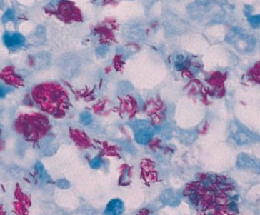
Uveitis: TB
M tuberculosis, acid-fast stain

Slide 9
Uveitis: TB
1) The uveitis is profiled
2) The profiled case is meshed
3) A differential diagnosis list is generated
4) Studies are obtained to identify the etiology
5) Treatment appropriate for the etiology is initiated
Basics
What is the causative organism in typical TB?
Mycobacterium tuberculosis
What are its basic properties (ie, what sort of organism is it in a microbiology sense)?
It is an obligate aerobe
Is it Gram positive, or Gram negative?
It is neither--it is impervious to Gram’s stain. Instead, it stains with the so-called acid-fast stain.
What proportion of the world’s population is infected with TB?

Slide 10
Uveitis: TB
1) The uveitis is profiled
2) The profiled case is meshed
3) A differential diagnosis list is generated
4) Studies are obtained to identify the etiology
5) Treatment appropriate for the etiology is initiated
Basics
What is the causative organism in typical TB?
Mycobacterium tuberculosis
What are its basic properties (ie, what sort of organism is it in a microbiology sense)?
It is an obligate aerobe
Is it Gram positive, or Gram negative?
It is neither--it is impervious to Gram’s stain. Instead, it stains with the so-called acid-fast stain.
What proportion of the world’s population is infected with TB?
Almost 1/3

Slide 11
Uveitis: TB
1) The uveitis is profiled
2) The profiled case is meshed
3) A differential diagnosis list is generated
4) Studies are obtained to identify the etiology
5) Treatment appropriate for the etiology is initiated
Basics
What is the causative organism in typical TB?
Mycobacterium tuberculosis
What are its basic properties (ie, what sort of organism is it in a microbiology sense)?
It is an obligate aerobe
Is it Gram positive, or Gram negative?
It is neither--it is impervious to Gram’s stain. Instead, it stains with the so-called acid-fast stain.
What proportion of the world’s population is infected with TB?
Almost 1/3
In the US, what characteristics put an individual at risk for TB?
--?
--?
--?
--?
--?

Slide 12
Uveitis: TB
1) The uveitis is profiled
2) The profiled case is meshed
3) A differential diagnosis list is generated
4) Studies are obtained to identify the etiology
5) Treatment appropriate for the etiology is initiated
Basics
What is the causative organism in typical TB?
Mycobacterium tuberculosis
What are its basic properties (ie, what sort of organism is it in a microbiology sense)?
It is an obligate aerobe
Is it Gram positive, or Gram negative?
It is neither--it is impervious to Gram’s stain. Instead, it stains with the so-called acid-fast stain.
What proportion of the world’s population is infected with TB?
Almost 1/3
In the US, what characteristics put an individual at risk for TB?
--Immunocompromised (eg, pts with AIDS, debilitating chronic diseases; or on immunosuppressive meds)
--Working in the healthcare field
--Recently emigrated from a developing nations
--Advanced age
--Marginal living conditions (eg, homeless; malnourished)

Slide 13
Uveitis: TB
1) The uveitis is profiled
2) The profiled case is meshed
3) A differential diagnosis list is generated
4) Studies are obtained to identify the etiology
5) Treatment appropriate for the etiology is initiated
Basics
What is the causative organism in typical TB?
Mycobacterium tuberculosis
What are its basic properties (ie, what sort of organism is it in a microbiology sense)?
It is an obligate aerobe
Is it Gram positive, or Gram negative?
It is neither--it is impervious to Gram’s stain. Instead, it stains with the so-called acid-fast stain.
What proportion of the world’s population is infected with TB?
Almost 1/3
In the US, what characteristics put an individual at risk for TB?
--Immunocompromised (eg, pts with AIDS, debilitating chronic diseases; or on immunosuppressive meds)
--Working in the healthcare field
--Recently emigrated from a developing nations
--Advanced age
--Marginal living conditions (eg, homeless; malnourished)
Which organ is most likely to be affected?

Slide 14
Uveitis: TB
1) The uveitis is profiled
2) The profiled case is meshed
3) A differential diagnosis list is generated
4) Studies are obtained to identify the etiology
5) Treatment appropriate for the etiology is initiated
Basics
What is the causative organism in typical TB?
Mycobacterium tuberculosis
What are its basic properties (ie, what sort of organism is it in a microbiology sense)?
It is an obligate aerobe
Is it Gram positive, or Gram negative?
It is neither--it is impervious to Gram’s stain. Instead, it stains with the so-called acid-fast stain.
What proportion of the world’s population is infected with TB?
Almost 1/3
In the US, what characteristics put an individual at risk for TB?
--Immunocompromised (eg, pts with AIDS, debilitating chronic diseases; or on immunosuppressive meds)
--Working in the healthcare field
--Recently emigrated from a developing nations
--Advanced age
--Marginal living conditions (eg, homeless; malnourished)
Which organ is most likely to be affected?
The lungs

Slide 15
Uveitis: TB
1) The uveitis is profiled
2) The profiled case is meshed
3) A differential diagnosis list is generated
4) Studies are obtained to identify the etiology
5) Treatment appropriate for the etiology is initiated
Basics
What is the causative organism in typical TB?
Mycobacterium tuberculosis
What are its basic properties (ie, what sort of organism is it in a microbiology sense)?
It is an obligate aerobe
Is it Gram positive, or Gram negative?
It is neither--it is impervious to Gram’s stain. Instead, it stains with the so-called acid-fast stain.
What proportion of the world’s population is infected with TB?
Almost 1/3
In the US, what characteristics put an individual at risk for TB?
--Immunocompromised (eg, pts with AIDS, debilitating chronic diseases; or on immunosuppressive meds)
--Working in the healthcare field
--Recently emigrated from a developing nations
--Advanced age
--Marginal living conditions (eg, homeless; malnourished)
Which organ is most likely to be affected?
The lungs
TB has a special affinity for what portion of the lungs?
The apices
Why the apices?
TB thrives under conditions of high O₂ tension, and pulmonary O₂ levels are highest at the apices

Slide 16
Uveitis: TB
1) The uveitis is profiled
2) The profiled case is meshed
3) A differential diagnosis list is generated
4) Studies are obtained to identify the etiology
5) Treatment appropriate for the etiology is initiated
Basics
What is the causative organism in typical TB?
Mycobacterium tuberculosis
What are its basic properties (ie, what sort of organism is it in a microbiology sense)?
It is an obligate aerobe
Is it Gram positive, or Gram negative?
It is neither--it is impervious to Gram’s stain. Instead, it stains with the so-called acid-fast stain.
What proportion of the world’s population is infected with TB?
Almost 1/3
In the US, what characteristics put an individual at risk for TB?
--Immunocompromised (eg, pts with AIDS, debilitating chronic diseases; or on immunosuppressive meds)
--Working in the healthcare field
--Recently emigrated from a developing nations
--Advanced age
--Marginal living conditions (eg, homeless; malnourished)
Which organ is most likely to be affected?
The lungs
TB has a special affinity for what portion of the lungs?
The apices
Why the apices?
TB thrives under conditions of high O₂ tension, and pulmonary O₂ levels are highest at the apices

Slide 17
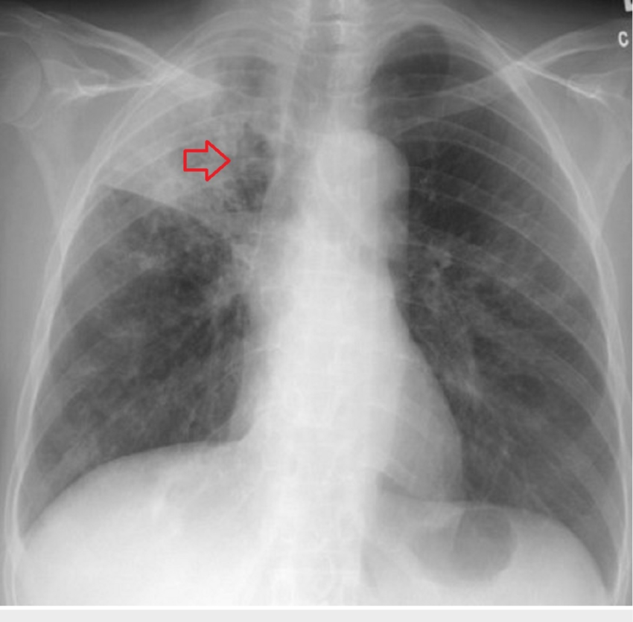
Uveitis: TB
TB: Cavity in the right lung apex with evidence of consolidation

Slide 18
Uveitis: TB
1) The uveitis is profiled
2) The profiled case is meshed
3) A differential diagnosis list is generated
4) Studies are obtained to identify the etiology
5) Treatment appropriate for the etiology is initiated
Basics
What is the causative organism in typical TB?
Mycobacterium tuberculosis
What are its basic properties (ie, what sort of organism is it in a microbiology sense)?
It is an obligate aerobe
Is it Gram positive, or Gram negative?
It is neither--it is impervious to Gram’s stain. Instead, it stains with the so-called acid-fast stain.
What proportion of the world’s population is infected with TB?
Almost 1/3
In the US, what characteristics put an individual at risk for TB?
--Immunocompromised (eg, pts with AIDS, debilitating chronic diseases; or on immunosuppressive meds)
--Working in the healthcare field
--Recently emigrated from a developing nations
--Advanced age
--Marginal living conditions (eg, homeless; malnourished)
Which organ is most likely to be affected?
The lungs
TB has a special affinity for what portion of the lungs?
The apices
Why the apices?
TB thrives under conditions of high O₂ tension, and pulmonary O₂ levels are highest at the apices

Slide 19
Uveitis: TB
1) The uveitis is profiled
2) The profiled case is meshed
3) A differential diagnosis list is generated
4) Studies are obtained to identify the etiology
5) Treatment appropriate for the etiology is initiated
Basics
What is the causative organism in typical TB?
Mycobacterium tuberculosis
What are its basic properties (ie, what sort of organism is it in a microbiology sense)?
It is an obligate aerobe
Is it Gram positive, or Gram negative?
It is neither--it is impervious to Gram’s stain. Instead, it stains with the so-called acid-fast stain.
What proportion of the world’s population is infected with TB?
Almost 1/3
In the US, what characteristics put an individual at risk for TB?
--Immunocompromised (eg, pts with AIDS, debilitating chronic diseases; or on immunosuppressive meds)
--Working in the healthcare field
--Recently emigrated from a developing nations
--Advanced age
--Marginal living conditions (eg, homeless; malnourished)
Which organ is most likely to be affected?
The lungs
TB has a special affinity for what portion of the lungs?
The apices
Why the apices?
TB thrives under conditions of high O₂ tension, and pulmonary O₂ levels are highest at the apices

Slide 20
Uveitis: TB
1) The uveitis is profiled
2) The profiled case is meshed
3) A differential diagnosis list is generated
4) Studies are obtained to identify the etiology
5) Treatment appropriate for the etiology is initiated
Basics
What is the causative organism in typical TB?
Mycobacterium tuberculosis
What are its basic properties (ie, what sort of organism is it in a microbiology sense)?
It is an obligate aerobe
Is it Gram positive, or Gram negative?
It is neither--it is impervious to Gram’s stain. Instead, it stains with the so-called acid-fast stain.
What proportion of the world’s population is infected with TB?
Almost 1/3
In the US, what characteristics put an individual at risk for TB?
--Immunocompromised (eg, pts with AIDS, debilitating chronic diseases; or on immunosuppressive meds)
--Working in the healthcare field
--Recently emigrated from a developing nations
--Advanced age
--Marginal living conditions (eg, homeless; malnourished)
Which organ is most likely to be affected?
The lungs
TB has a special affinity for what portion of the lungs?
The apices
Why the apices?
TB thrives under conditions of high O₂ tension, and pulmonary O₂ levels are highest at the apices
Foreshadowing alert!

Slide 21
Uveitis: TB
1) The uveitis is profiled
2) The profiled case is meshed
3) A differential diagnosis list is generated
4) Studies are obtained to identify the etiology
5) Treatment appropriate for the etiology is initiated
Basics
What is the causative organism in typical TB?
Mycobacterium tuberculosis
What are its basic properties (ie, what sort of organism is it in a microbiology sense)?
It is an obligate aerobe
Is it Gram positive, or Gram negative?
It is neither--it is impervious to Gram’s stain. Instead, it stains with the so-called acid-fast stain.
What proportion of the world’s population is infected with TB?
Almost 1/3
In the US, what characteristics put an individual at risk for TB?
--Immunocompromised (eg, pts with AIDS, debilitating chronic diseases; or on immunosuppressive meds)
--Working in the healthcare field
--Recently emigrated from a developing nations
--Advanced age
--Marginal living conditions (eg, homeless; malnourished)
Which organ is most likely to be affected?
The lungs
What are the three classic constitutional signs/symptoms?

Slide 22
Uveitis: TB
1) The uveitis is profiled
2) The profiled case is meshed
3) A differential diagnosis list is generated
4) Studies are obtained to identify the etiology
5) Treatment appropriate for the etiology is initiated
Basics
What is the causative organism in typical TB?
Mycobacterium tuberculosis
What are its basic properties (ie, what sort of organism is it in a microbiology sense)?
It is an obligate aerobe
Is it Gram positive, or Gram negative?
It is neither--it is impervious to Gram’s stain. Instead, it stains with the so-called acid-fast stain.
What proportion of the world’s population is infected with TB?
Almost 1/3
In the US, what characteristics put an individual at risk for TB?
--Immunocompromised (eg, pts with AIDS, debilitating chronic diseases; or on immunosuppressive meds)
--Working in the healthcare field
--Recently emigrated from a developing nations
--Advanced age
--Marginal living conditions (eg, homeless; malnourished)
Which organ is most likely to be affected?
The lungs
What are the three classic constitutional signs/symptoms?
Fever, night sweats and weight loss

Slide 23
Uveitis
1) The uveitis is profiled
2) The profiled case is meshed
3) A differential diagnosis list is generated
4) Studies are obtained to identify the etiology
5) Treatment appropriate for the etiology is initiated
Panuveitis
Posterior
Intermediate
Anterior
TB uveitis can present in any form…
Tuberculosis

Slide 24
Uveitis
1) The uveitis is profiled
2) The profiled case is meshed
3) A differential diagnosis list is generated
4) Studies are obtained to identify the etiology
5) Treatment appropriate for the etiology is initiated
Panuveitis
Posterior
Intermediate
Anterior
…including as an anterior uveitis.
Tuberculosis

Slide 25
Uveitis: Anterior
1) The uveitis is profiled
2) The profiled case is meshed
3) A differential diagnosis list is generated
4) Studies are obtained to identify the etiology
5) Treatment appropriate for the etiology is initiated
?
?
(Start here, with the first distinction the book makes)
Let’s review how the Uveitis book organizes anterior uveitis:

Slide 26
Uveitis: Anterior
1) The uveitis is profiled
2) The profiled case is meshed
3) A differential diagnosis list is generated
4) Studies are obtained to identify the etiology
5) Treatment appropriate for the etiology is initiated
Granulomatous
Nongranulomatous
Let’s review how the Uveitis book organizes anterior uveitis:

Slide 27
Uveitis: Anterior
1) The uveitis is profiled
2) The profiled case is meshed
3) A differential diagnosis list is generated
4) Studies are obtained to identify the etiology
5) Treatment appropriate for the etiology is initiated
Granulomatous
Nongranulomatous
?
?
Let’s review how the Uveitis book organizes anterior uveitis:

Slide 28
Uveitis: Anterior
1) The uveitis is profiled
2) The profiled case is meshed
3) A differential diagnosis list is generated
4) Studies are obtained to identify the etiology
5) Treatment appropriate for the etiology is initiated
Granulomatous
Nongranulomatous
Acute
Chronic
Let’s review how the Uveitis book organizes anterior uveitis:

Slide 29
Uveitis: Anterior
1) The uveitis is profiled
2) The profiled case is meshed
3) A differential diagnosis list is generated
4) Studies are obtained to identify the etiology
5) Treatment appropriate for the etiology is initiated
Granulomatous
Nongranulomatous
Acute
Chronic
?
?
Let’s review how the Uveitis book organizes anterior uveitis:

Slide 30
Uveitis: Anterior
1) The uveitis is profiled
2) The profiled case is meshed
3) A differential diagnosis list is generated
4) Studies are obtained to identify the etiology
5) Treatment appropriate for the etiology is initiated
Granulomatous
Nongranulomatous
Acute
Chronic
Unilateral
Bilateral
Let’s review how the Uveitis book organizes anterior uveitis:

Slide 31
Uveitis: Anterior
1) The uveitis is profiled
2) The profiled case is meshed
3) A differential diagnosis list is generated
4) Studies are obtained to identify the etiology
5) Treatment appropriate for the etiology is initiated
Granulomatous
Nongranulomatous
?
Syphilis
Acute
Chronic
Sarcoid
HSV
JIA
VKH
Unilateral
Bilateral
FHI
Toxoplasmosis
HLA-B27 dz
TINU
IBD/PA
Lyme
Posner-Schlossman
Behçet
Sarcoid
Sarcoid
Drug rxn
Syphilis
Syphilis
Leptospirosis
?
HSV/VZV
Sarcoid
?
Syphilis
IBD/PA
On the diagram above, where can TB present?
?

Slide 32
Uveitis: Anterior
1) The uveitis is profiled
2) The profiled case is meshed
3) A differential diagnosis list is generated
4) Studies are obtained to identify the etiology
5) Treatment appropriate for the etiology is initiated
Granulomatous
Nongranulomatous
TB
Syphilis
Acute
Chronic
Sarcoid
HSV
JIA
VKH
Unilateral
Bilateral
FHI
Toxoplasmosis
HLA-B27 dz
TINU
IBD/PA
Lyme
Posner-Schlossman
Behçet
Sarcoid
Sarcoid
Drug rxn
Syphilis
Syphilis
Leptospirosis
TB
HSV/VZV
Sarcoid
TB
Syphilis
IBD/PA
On the diagram above, where can TB present?
Anywhere!
TB

Slide 33
Uveitis: Anterior
1) The uveitis is profiled
2) The profiled case is meshed
3) A differential diagnosis list is generated
4) Studies are obtained to identify the etiology
5) Treatment appropriate for the etiology is initiated
Granulomatous
Nongranulomatous
TB
Syphilis
Acute
Chronic
Sarcoid
HSV
JIA
VKH
Unilateral
Bilateral
FHI
Toxoplasmosis
HLA-B27 dz
TINU
IBD/PA
Lyme
Posner-Schlossman
Behçet
Sarcoid
Sarcoid
Drug rxn
Syphilis
Syphilis
Leptospirosis
TB
HSV/VZV
Sarcoid
TB
Syphilis
IBD/PA
On the diagram above, where can TB present?
Anywhere!
OK, but when TB presents as an anterior uveitis, in which form is it most likely to occur?
TB

Slide 34
Uveitis: Anterior
1) The uveitis is profiled
2) The profiled case is meshed
3) A differential diagnosis list is generated
4) Studies are obtained to identify the etiology
5) Treatment appropriate for the etiology is initiated
Granulomatous
Nongranulomatous
TB
Syphilis
Acute
Chronic
Sarcoid
HSV
JIA
VKH
Unilateral
Bilateral
FHI
Toxoplasmosis
HLA-B27 dz
TINU
IBD/PA
Lyme
Posner-Schlossman
Behçet
Sarcoid
Sarcoid
Drug rxn
Syphilis
Syphilis
Leptospirosis
TB
HSV/VZV
Sarcoid
TB
Syphilis
IBD/PA
On the diagram above, where can TB present?
Anywhere!
OK, but when TB presents as an anterior uveitis, in which form is it most likely to occur?
As an acute granulomatous uveitis
TB

Slide 35
Uveitis: Anterior
1) The uveitis is profiled
2) The profiled case is meshed
3) A differential diagnosis list is generated
4) Studies are obtained to identify the etiology
5) Treatment appropriate for the etiology is initiated
Granulomatous
Nongranulomatous
TB
Syphilis
Acute
Chronic
Sarcoid
HSV
JIA
VKH
Unilateral
Bilateral
FHI
Toxoplasmosis
HLA-B27 dz
TINU
IBD/PA
Lyme
Posner-Schlossman
Behçet
Sarcoid
Sarcoid
Drug rxn
Syphilis
Syphilis
Leptospirosis
TB
HSV/VZV
Sarcoid
TB
Syphilis
IBD/PA
On the diagram above, where can TB present?
Anywhere!
OK, but when TB presents as an anterior uveitis, in which form is it most likely to occur?
As an acute granulomatous uveitis
How likely is TB to present in this manner, ie, as an isolated anterior uveitis without posterior findings?
TB

Slide 36
Uveitis: Anterior
1) The uveitis is profiled
2) The profiled case is meshed
3) A differential diagnosis list is generated
4) Studies are obtained to identify the etiology
5) Treatment appropriate for the etiology is initiated
Granulomatous
Nongranulomatous
TB
Syphilis
Acute
Chronic
Sarcoid
HSV
JIA
VKH
Unilateral
Bilateral
FHI
Toxoplasmosis
HLA-B27 dz
TINU
IBD/PA
Lyme
Posner-Schlossman
Behçet
Sarcoid
Sarcoid
Drug rxn
Syphilis
Syphilis
Leptospirosis
TB
HSV/VZV
Sarcoid
TB
Syphilis
IBD/PA
On the diagram above, where can TB present?
Anywhere!
OK, but when TB presents as an anterior uveitis, in which form is it most likely to occur?
As an acute granulomatous uveitis
How likely is TB to present in this manner, ie, as an isolated anterior uveitis without posterior findings?
Very unlikely
TB

Slide 37
Uveitis: Anterior
1) The uveitis is profiled
2) The profiled case is meshed
3) A differential diagnosis list is generated
4) Studies are obtained to identify the etiology
5) Treatment appropriate for the etiology is initiated
Granulomatous
Nongranulomatous
TB
Syphilis
Acute
Chronic
Sarcoid
HSV
JIA
VKH
Unilateral
Bilateral
FHI
Toxoplasmosis
HLA-B27 dz
TINU
IBD/PA
Lyme
Posner-Schlossman
Behçet
Sarcoid
Sarcoid
Drug rxn
Syphilis
What descriptive term is often applied to the KP in TB?
‘Mutton fat’ (just as in sarcoid)
What iris findings may occur?
Nodules (just as in sarcoid)
Are synechiae common?
Yes (just as in sarcoid)
Leptospirosis
TB
Syphilis
HSV/VZV
Sarcoid
TB
Syphilis
IBD/PA
On the diagram above, where can TB present?
Anywhere!
OK, but when TB presents as an anterior uveitis, in which form is it most likely to occur?
As an acute granulomatous uveitis
How likely is TB to present in this manner, ie, as an isolated anterior uveitis without posterior findings?
Very unlikely
TB

Slide 38
Uveitis: Anterior
1) The uveitis is profiled
2) The profiled case is meshed
3) A differential diagnosis list is generated
4) Studies are obtained to identify the etiology
5) Treatment appropriate for the etiology is initiated
Granulomatous
Nongranulomatous
TB
Syphilis
Acute
Chronic
Sarcoid
HSV
JIA
VKH
Unilateral
Bilateral
FHI
Toxoplasmosis
HLA-B27 dz
TINU
IBD/PA
Lyme
Posner-Schlossman
Behçet
Sarcoid
Sarcoid
Drug rxn
Syphilis
What descriptive term is often applied to the KP in TB?
‘Mutton fat’ (just as in sarcoid)
What iris findings may occur?
Nodules (just as in sarcoid)
Are synechiae common?
Yes (just as in sarcoid)
Leptospirosis
TB
Syphilis
HSV/VZV
Sarcoid
TB
Syphilis
IBD/PA
On the diagram above, where can TB present?
Anywhere!
OK, but when TB presents as an anterior uveitis, in which form is it most likely to occur?
As an acute granulomatous uveitis
How likely is TB to present in this manner, ie, as an isolated anterior uveitis without posterior findings?
Very unlikely
TB

Slide 39
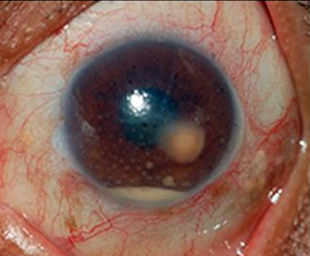
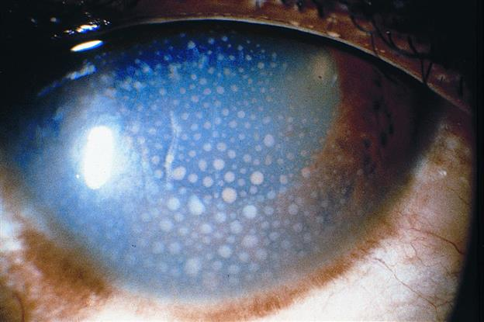
Uveitis: TB
Sarcoid: Mutton-fat KP
TB: Mutton-fat KP (note also the AC granuloma)

Slide 40
Uveitis: Anterior
1) The uveitis is profiled
2) The profiled case is meshed
3) A differential diagnosis list is generated
4) Studies are obtained to identify the etiology
5) Treatment appropriate for the etiology is initiated
Granulomatous
Nongranulomatous
TB
Syphilis
Acute
Chronic
Sarcoid
HSV
JIA
VKH
Unilateral
Bilateral
FHI
Toxoplasmosis
HLA-B27 dz
TINU
IBD/PA
Lyme
Posner-Schlossman
Behçet
Sarcoid
Sarcoid
Drug rxn
Syphilis
What descriptive term is often applied to the KP in TB?
‘Mutton fat’ (just as in sarcoid)
What iris findings may occur?
Nodules (just as in sarcoid)
Are synechiae common?
Yes (just as in sarcoid)
Leptospirosis
TB
Syphilis
HSV/VZV
Sarcoid
TB
Syphilis
IBD/PA
On the diagram above, where can TB present?
Anywhere!
OK, but when TB presents as an anterior uveitis, in which form is it most likely to occur?
As an acute granulomatous uveitis
How likely is TB to present in this manner, ie, as an isolated anterior uveitis without posterior findings?
Very unlikely
TB

Slide 41
Uveitis: Anterior
1) The uveitis is profiled
2) The profiled case is meshed
3) A differential diagnosis list is generated
4) Studies are obtained to identify the etiology
5) Treatment appropriate for the etiology is initiated
Granulomatous
Nongranulomatous
TB
Syphilis
Acute
Chronic
Sarcoid
HSV
JIA
VKH
Unilateral
Bilateral
FHI
Toxoplasmosis
HLA-B27 dz
TINU
IBD/PA
Lyme
Posner-Schlossman
Behçet
Sarcoid
Sarcoid
Drug rxn
Syphilis
What descriptive term is often applied to the KP in TB?
‘Mutton fat’ (just as in sarcoid)
What iris findings may occur?
Nodules (just as in sarcoid)
Are synechiae common?
Yes (just as in sarcoid)
Leptospirosis
TB
Syphilis
HSV/VZV
Sarcoid
TB
Syphilis
IBD/PA
On the diagram above, where can TB present?
Anywhere!
OK, but when TB presents as an anterior uveitis, in which form is it most likely to occur?
As an acute granulomatous uveitis
How likely is TB to present in this manner, ie, as an isolated anterior uveitis without posterior findings?
Very unlikely
TB

Slide 42
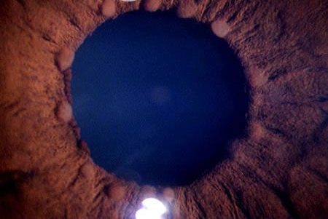
Uveitis: TB
Sarcoid: Iris nodules
TB: Iris nodules
(I couldn’t find any pics, but they should look like the sarcoid ones)

Slide 43
Uveitis: Anterior
1) The uveitis is profiled
2) The profiled case is meshed
3) A differential diagnosis list is generated
4) Studies are obtained to identify the etiology
5) Treatment appropriate for the etiology is initiated
Granulomatous
Nongranulomatous
TB
Syphilis
Acute
Chronic
Sarcoid
HSV
JIA
VKH
Unilateral
Bilateral
FHI
Toxoplasmosis
HLA-B27 dz
TINU
IBD/PA
Lyme
Posner-Schlossman
Behçet
Sarcoid
Sarcoid
Drug rxn
Syphilis
What descriptive term is often applied to the KP in TB?
‘Mutton fat’ (just as in sarcoid)
What iris findings may occur?
Nodules (just as in sarcoid)
Are synechiae common?
Yes (just as in sarcoid)
Leptospirosis
TB
Syphilis
HSV/VZV
Sarcoid
TB
Syphilis
IBD/PA
On the diagram above, where can TB present?
Anywhere!
OK, but when TB presents as an anterior uveitis, in which form is it most likely to occur?
As an acute granulomatous uveitis
How likely is TB to present in this manner, ie, as an isolated anterior uveitis without posterior findings?
Very unlikely
TB

Slide 44
Uveitis: Anterior
1) The uveitis is profiled
2) The profiled case is meshed
3) A differential diagnosis list is generated
4) Studies are obtained to identify the etiology
5) Treatment appropriate for the etiology is initiated
Granulomatous
Nongranulomatous
TB
Syphilis
Acute
Chronic
Sarcoid
HSV
JIA
VKH
Unilateral
Bilateral
FHI
Toxoplasmosis
HLA-B27 dz
TINU
IBD/PA
Lyme
Posner-Schlossman
Behçet
Sarcoid
Sarcoid
Drug rxn
Syphilis
What descriptive term is often applied to the KP in TB?
‘Mutton fat’ (just as in sarcoid)
What iris findings may occur?
Nodules (just as in sarcoid)
Are synechiae common?
Yes (just as in sarcoid)
Leptospirosis
TB
Syphilis
HSV/VZV
Sarcoid
TB
Syphilis
IBD/PA
On the diagram above, where can TB present?
Anywhere!
OK, but when TB presents as an anterior uveitis, in which form is it most likely to occur?
As an acute granulomatous uveitis
How likely is TB to present in this manner, ie, as an isolated anterior uveitis without posterior findings?
Very unlikely
TB

Slide 45
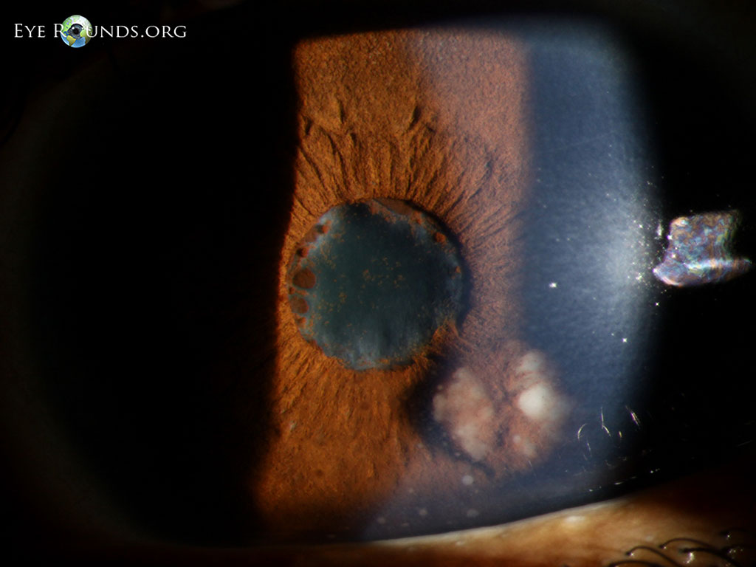
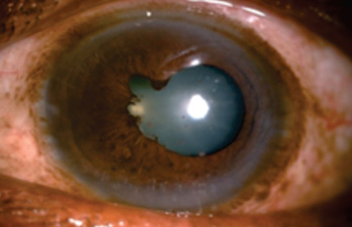
Uveitis: TB
Sarcoid: Posterior synechiae (and the world’s largest Busacca nodule)
TB: Posterior synechiae

Slide 46
Uveitis
1) The uveitis is profiled
2) The profiled case is meshed
3) A differential diagnosis list is generated
4) Studies are obtained to identify the etiology
5) Treatment appropriate for the etiology is initiated
Panuveitis
Posterior
Intermediate
Anterior
Isolated intermediate uveitis would be an unexpected presentation in TB…
Tuberculosis

Slide 47
Uveitis
1) The uveitis is profiled
2) The profiled case is meshed
3) A differential diagnosis list is generated
4) Studies are obtained to identify the etiology
5) Treatment appropriate for the etiology is initiated
Panuveitis
Posterior
Intermediate
Anterior
…but posterior uveitis is a hallmark of TB.
Tuberculosis

Slide 48
Uveitis: Posterior
1) The uveitis is profiled
2) The profiled case is meshed
3) A differential diagnosis list is generated
4) Studies are obtained to identify the etiology
5) Treatment appropriate for the etiology is initiated
Choroiditis
Chorioretinitis or
Retinochoroiditis
Retinitis
Neuroretinitis
What is the classic posterior manifestation of TB?

Slide 49
Uveitis: Posterior
1) The uveitis is profiled
2) The profiled case is meshed
3) A differential diagnosis list is generated
4) Studies are obtained to identify the etiology
5) Treatment appropriate for the etiology is initiated
Choroiditis
Chorioretinitis or
Retinochoroiditis
Retinitis
Neuroretinitis
What is the classic posterior manifestation of TB?
Choroiditis

Slide 50
Uveitis: Posterior
1) The uveitis is profiled
2) The profiled case is meshed
3) A differential diagnosis list is generated
4) Studies are obtained to identify the etiology
5) Treatment appropriate for the etiology is initiated
Choroiditis
Chorioretinitis or
Retinochoroiditis
Retinitis
Neuroretinitis
What is the classic posterior manifestation of TB?
Choroiditis
Why does TB have a special affinity for the choroid?

Slide 51
Uveitis: Posterior
1) The uveitis is profiled
2) The profiled case is meshed
3) A differential diagnosis list is generated
4) Studies are obtained to identify the etiology
5) Treatment appropriate for the etiology is initiated
Choroiditis
Chorioretinitis or
Retinochoroiditis
Retinitis
Neuroretinitis
What is the classic posterior manifestation of TB?
Choroiditis
Why does TB have a special affinity for the choroid?
Recall TB has an affinity for those areas of the body with especially high O₂ tension (eg, the lung apices).
Foreshadowing alert payoff!

Slide 52
Uveitis: Posterior
1) The uveitis is profiled
2) The profiled case is meshed
3) A differential diagnosis list is generated
4) Studies are obtained to identify the etiology
5) Treatment appropriate for the etiology is initiated
Choroiditis
Chorioretinitis or
Retinochoroiditis
Retinitis
Neuroretinitis
What is the classic posterior manifestation of TB?
Choroiditis
Why does TB have a special affinity for the choroid?
Recall TB has an affinity for those areas of the body with especially high O₂ tension (eg, the lung apices). The choroid has the highest blood flow in the entire body, and thus is extremely well oxygenated.
Foreshadowing alert payoff!

Slide 53
Uveitis: Posterior
1) The uveitis is profiled
2) The profiled case is meshed
3) A differential diagnosis list is generated
4) Studies are obtained to identify the etiology
5) Treatment appropriate for the etiology is initiated
Choroiditis
Chorioretinitis or
Retinochoroiditis
Retinitis
Neuroretinitis
What is the classic posterior manifestation of TB?
Choroiditis
Why does TB have a special affinity for the choroid?
Recall TB has an affinity for those areas of the body with especially high O₂ tension (eg, the lung apices). The choroid has the highest blood flow in the entire body, and thus is extremely well oxygenated.
How does TB choroiditis present?

Slide 54
Uveitis: Posterior
1) The uveitis is profiled
2) The profiled case is meshed
3) A differential diagnosis list is generated
4) Studies are obtained to identify the etiology
5) Treatment appropriate for the etiology is initiated
Choroiditis
Chorioretinitis or
Retinochoroiditis
Retinitis
Neuroretinitis
What is the classic posterior manifestation of TB?
Choroiditis
Why does TB have a special affinity for the choroid?
Recall TB has an affinity for those areas of the body with especially high O₂ tension (eg, the lung apices). The choroid has the highest blood flow in the entire body, and thus is extremely well oxygenated.
How does TB choroiditis present?
Usually as multiple (up to hundreds) small (1/3 - 2 DD) yellowish lesions known as tubercles .

Slide 55
Uveitis: Posterior
1) The uveitis is profiled
2) The profiled case is meshed
3) A differential diagnosis list is generated
4) Studies are obtained to identify the etiology
5) Treatment appropriate for the etiology is initiated
Choroiditis
Chorioretinitis or
Retinochoroiditis
Retinitis
Neuroretinitis
What is the classic posterior manifestation of TB?
Choroiditis
Why does TB have a special affinity for the choroid?
Recall TB has an affinity for those areas of the body with especially high O₂ tension (eg, the lung apices). The choroid has the highest blood flow in the entire body, and thus is extremely well oxygenated.
How does TB choroiditis present?
Usually as multiple (up to hundreds) small (1/3 - 2 DD) yellowish lesions known as tubercles .

Slide 56
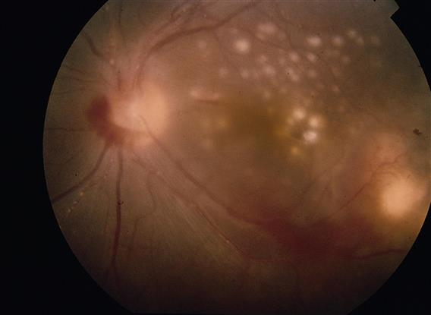
Uveitis: TB
Choroidal tubercles

Slide 57
Uveitis: Posterior
1) The uveitis is profiled
2) The profiled case is meshed
3) A differential diagnosis list is generated
4) Studies are obtained to identify the etiology
5) Treatment appropriate for the etiology is initiated
Choroiditis
Chorioretinitis or
Retinochoroiditis
Retinitis
Neuroretinitis
What is the classic posterior manifestation of TB?
Choroiditis
Why does TB have a special affinity for the choroid?
Recall TB has an affinity for those areas of the body with especially high O₂ tension (eg, the lung apices). The choroid has the highest blood flow in the entire body, and thus is extremely well oxygenated.
How does TB choroiditis present?
Usually as multiple (up to hundreds) small (1/3 - 2 DD) yellowish lesions known as tubercles . Occasionally, only one large (2 - 10 DD) tubercle will be present.

Slide 58
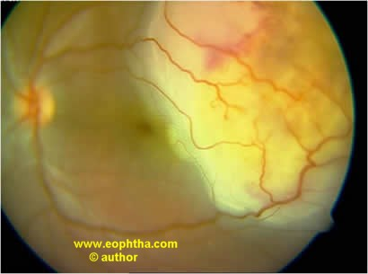
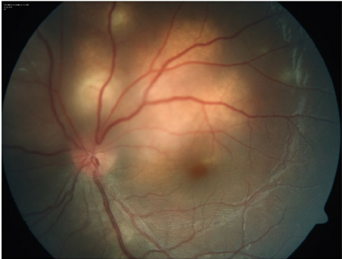
Uveitis: TB
Large choroidal tubercles

Slide 59
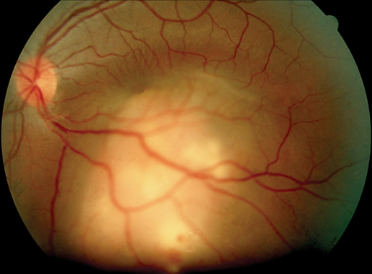
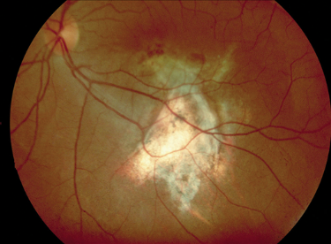
TB choroiditis: Single large tubercle pre- and post-tx

Slide 60
Uveitis: Posterior
1) The uveitis is profiled
2) The profiled case is meshed
3) A differential diagnosis list is generated
4) Studies are obtained to identify the etiology
5) Treatment appropriate for the etiology is initiated
Choroiditis
Chorioretinitis or
Retinochoroiditis
Retinitis
Neuroretinitis
What is the classic posterior manifestation of TB?
Choroiditis
Why does TB have a special affinity for the choroid?
Recall TB has an affinity for those areas of the body with especially high O₂ tension (eg, the lung apices). The choroid has the highest blood flow in the entire body, and thus is extremely well oxygenated.
How does TB choroiditis present?
Usually as multiple (up to hundreds) small (1/3 - 2 DD) yellowish lesions known as tubercles . Occasionally, only one large (2 - 10 DD) tubercle will be present.
Do these tubercles tend to be found in the posterior pole, or more peripherally?

Slide 61
Uveitis: Posterior
1) The uveitis is profiled
2) The profiled case is meshed
3) A differential diagnosis list is generated
4) Studies are obtained to identify the etiology
5) Treatment appropriate for the etiology is initiated
Choroiditis
Chorioretinitis or
Retinochoroiditis
Retinitis
Neuroretinitis
What is the classic posterior manifestation of TB?
Choroiditis
Why does TB have a special affinity for the choroid?
Recall TB has an affinity for those areas of the body with especially high O₂ tension (eg, the lung apices). The choroid has the highest blood flow in the entire body, and thus is extremely well oxygenated.
How does TB choroiditis present?
Usually as multiple (up to hundreds) small (1/3 - 2 DD) yellowish lesions known as tubercles. Occasionally, only one large (2 - 10 DD) tubercle will be present.
Do these tubercles tend to be found in the posterior pole, or more peripherally?
The posterior pole

Slide 62
Uveitis: Posterior
1) The uveitis is profiled
2) The profiled case is meshed
3) A differential diagnosis list is generated
4) Studies are obtained to identify the etiology
5) Treatment appropriate for the etiology is initiated
Choroiditis
Chorioretinitis or
Retinochoroiditis
Retinitis
Neuroretinitis
What is the classic posterior manifestation of TB?
Choroiditis
Why does TB have a special affinity for the choroid?
Recall TB has an affinity for those areas of the body with especially high O₂ tension (eg, the lung apices). The choroid has the highest blood flow in the entire body, and thus is extremely well oxygenated.
How does TB choroiditis present?
Usually as multiple (up to hundreds) small (1/3 - 2 DD) yellowish lesions known as tubercles . Occasionally, only one large (2 - 10 DD) tubercle will be present.
Do these tubercles tend to be found in the posterior pole, or more peripherally?
The posterior pole
Is the overlying retina affected?

Slide 63
Uveitis: Posterior
1) The uveitis is profiled
2) The profiled case is meshed
3) A differential diagnosis list is generated
4) Studies are obtained to identify the etiology
5) Treatment appropriate for the etiology is initiated
Choroiditis
Chorioretinitis or
Retinochoroiditis
Retinitis
Neuroretinitis
What is the classic posterior manifestation of TB?
Choroiditis
Why does TB have a special affinity for the choroid?
Recall TB has an affinity for those areas of the body with especially high O₂ tension (eg, the lung apices). The choroid has the highest blood flow in the entire body, and thus is extremely well oxygenated.
How does TB choroiditis present?
Usually as multiple (up to hundreds) small (1/3 - 2 DD) yellowish lesions known as tubercles . Occasionally, only one large (2 - 10 DD) tubercle will be present.
Do these tubercles tend to be found in the posterior pole, or more peripherally?
The posterior pole
Is the overlying retina affected?
Yes; retinal hemorrhages, edema (sometimes in the form of a macular star), and/or serous RD can result.

Slide 64
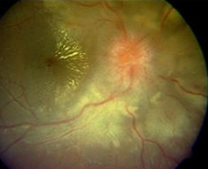
Uveitis: TB
Macular star 2ndry to TB chorioretinitis

Slide 65
Uveitis: Posterior
1) The uveitis is profiled
2) The profiled case is meshed
3) A differential diagnosis list is generated
4) Studies are obtained to identify the etiology
5) Treatment appropriate for the etiology is initiated
Choroiditis
Chorioretinitis or
Retinochoroiditis
Retinitis
Neuroretinitis
What is the classic posterior manifestation of TB?
Choroiditis
Why does TB have a special affinity for the choroid?
Recall TB has an affinity for those areas of the body with especially high O₂ tension (eg, the lung apices). The choroid has the highest blood flow in the entire body, and thus is extremely well oxygenated.
How does TB choroiditis present?
Usually as multiple (up to hundreds) small (1/3 - 2 DD) yellowish lesions known as tubercles . Occasionally, only one large (2 - 10 DD) tubercle will be present.
Do these tubercles tend to be found in the posterior pole, or more peripherally?
The posterior pole
Is the overlying retina affected?
Yes; retinal hemorrhages, edema (sometimes in the form of a macular star), and/or serous RD can result.
Can the ONH be affected?

Slide 66
Uveitis: Posterior
1) The uveitis is profiled
2) The profiled case is meshed
3) A differential diagnosis list is generated
4) Studies are obtained to identify the etiology
5) Treatment appropriate for the etiology is initiated
Choroiditis
Chorioretinitis or
Retinochoroiditis
Retinitis
Neuroretinitis
What is the classic posterior manifestation of TB?
Choroiditis
Why does TB have a special affinity for the choroid?
Recall TB has an affinity for those areas of the body with especially high O₂ tension (eg, the lung apices). The choroid has the highest blood flow in the entire body, and thus is extremely well oxygenated.
How does TB choroiditis present?
Usually as multiple (up to hundreds) small (1/3 - 2 DD) yellowish lesions known as tubercles . Occasionally, only one large (2 - 10 DD) tubercle will be present.
Do these tubercles tend to be found in the posterior pole, or more peripherally?
The posterior pole
Is the overlying retina affected?
Yes; retinal hemorrhages, edema (sometimes in the form of a macular star), and/or serous RD can result.
Can the ONH be affected?
Yes; disc edema is a common occurrence

Slide 67
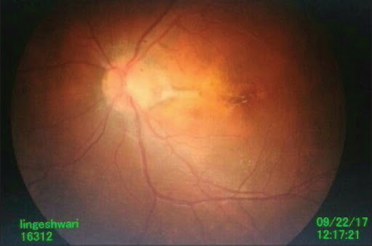
Uveitis: TB
Dis edema in TB

Slide 68
Uveitis: Posterior
1) The uveitis is profiled
2) The profiled case is meshed
3) A differential diagnosis list is generated
4) Studies are obtained to identify the etiology
5) Treatment appropriate for the etiology is initiated
Choroiditis
Chorioretinitis or
Retinochoroiditis
Retinitis
Neuroretinitis
What is the classic posterior manifestation of TB?
Choroiditis
Why does TB have a special affinity for the choroid?
Recall TB has an affinity for those areas of the body with especially high O₂ tension (eg, the lung apices). The choroid has the highest blood flow in the entire body, and thus is extremely well oxygenated.
How does TB choroiditis present?
Usually as multiple (up to hundreds) small (1/3 - 2 DD) yellowish lesions known as tubercles . Occasionally, only one large (2 - 10 DD) tubercle will be present.
Do these tubercles tend to be found in the posterior pole, or more peripherally?
The posterior pole
Is the overlying retina affected?
Yes; retinal hemorrhages, edema (sometimes in the form of a macular star), and/or serous RD can result.
Can the ONH be affected?
Yes; disc edema is a common occurrence
So, TB can present as a neuroretinitis

Slide 69
Uveitis: Posterior
1) The uveitis is profiled
2) The profiled case is meshed
3) A differential diagnosis list is generated
4) Studies are obtained to identify the etiology
5) Treatment appropriate for the etiology is initiated
Choroiditis
Chorioretinitis or
Retinochoroiditis
Retinitis
Neuroretinitis
There is another classic posterior manifestation that involves the retina. What is its eponymous name?

Slide 70
Uveitis: Posterior
1) The uveitis is profiled
2) The profiled case is meshed
3) A differential diagnosis list is generated
4) Studies are obtained to identify the etiology
5) Treatment appropriate for the etiology is initiated
Choroiditis
Chorioretinitis or
Retinochoroiditis
Retinitis
Neuroretinitis
There is another classic posterior manifestation that involves the retina. What is its eponymous name?
Eales disease

Slide 71
Uveitis: Posterior
1) The uveitis is profiled
2) The profiled case is meshed
3) A differential diagnosis list is generated
4) Studies are obtained to identify the etiology
5) Treatment appropriate for the etiology is initiated
Choroiditis
Chorioretinitis or
Retinochoroiditis
Retinitis
Neuroretinitis
There is another classic posterior manifestation that involves the retina. What is its eponymous name?
Eales disease
What specific component of the retina is primarily affected in Eales dz?

Slide 72
Uveitis: Posterior
1) The uveitis is profiled
2) The profiled case is meshed
3) A differential diagnosis list is generated
4) Studies are obtained to identify the etiology
5) Treatment appropriate for the etiology is initiated
Choroiditis
Chorioretinitis or
Retinochoroiditis
Retinitis
Neuroretinitis
(Retinal vasculitis)
There is another classic posterior manifestation that involves the retina. What is its eponymous name?
Eales disease
What specific component of the retina is primarily affected in Eales dz?
The vasculature; ie, Eales is a retinal vasculitis

Slide 73
Uveitis: Posterior
1) The uveitis is profiled
2) The profiled case is meshed
3) A differential diagnosis list is generated
4) Studies are obtained to identify the etiology
5) Treatment appropriate for the etiology is initiated
Choroiditis
Chorioretinitis or
Retinochoroiditis
Retinitis
Neuroretinitis
(Retinal vasculitis)
There is another classic posterior manifestation that involves the retina. What is its eponymous name?
Eales disease
What specific component of the retina is primarily affected in Eales dz?
The vasculature; ie, Eales is a retinal vasculitis
Does Eales tend to occur in the posterior pole, or the periphery?

Slide 74
Uveitis: Posterior
1) The uveitis is profiled
2) The profiled case is meshed
3) A differential diagnosis list is generated
4) Studies are obtained to identify the etiology
5) Treatment appropriate for the etiology is initiated
Choroiditis
Chorioretinitis or
Retinochoroiditis
Retinitis
Neuroretinitis
(Retinal vasculitis)
There is another classic posterior manifestation that involves the retina. What is its eponymous name?
Eales disease
What specific component of the retina is primarily affected in Eales dz?
The vasculature; ie, Eales is a retinal vasculitis
Does Eales tend to occur in the posterior pole, or the periphery?
The periphery

Slide 75
Uveitis: Posterior
1) The uveitis is profiled
2) The profiled case is meshed
3) A differential diagnosis list is generated
4) Studies are obtained to identify the etiology
5) Treatment appropriate for the etiology is initiated
Choroiditis
Chorioretinitis or
Retinochoroiditis
Retinitis
Neuroretinitis
(Retinal vasculitis)
There is another classic posterior manifestation that involves the retina. What is its eponymous name?
Eales disease
What specific component of the retina is primarily affected in Eales dz?
The vasculature; ie, Eales is a retinal vasculitis
Does Eales tend to occur in the posterior pole, or the periphery?
The periphery
Demographically speaking, who is the classic Eales pt?

Slide 76
Uveitis: Posterior
1) The uveitis is profiled
2) The profiled case is meshed
3) A differential diagnosis list is generated
4) Studies are obtained to identify the etiology
5) Treatment appropriate for the etiology is initiated
Choroiditis
Chorioretinitis or
Retinochoroiditis
Retinitis
Neuroretinitis
(Retinal vasculitis)
There is another classic posterior manifestation that involves the retina. What is its eponymous name?
Eales disease
What specific component of the retina is primarily affected in Eales dz?
The vasculature; ie, Eales is a retinal vasculitis
Does Eales tend to occur in the posterior pole, or the periphery?
The periphery
Demographically speaking, who is the classic Eales pt?
A healthy young adult male from India or the Middle East
Two Words

Slide 77
Uveitis: Posterior
1) The uveitis is profiled
2) The profiled case is meshed
3) A differential diagnosis list is generated
4) Studies are obtained to identify the etiology
5) Treatment appropriate for the etiology is initiated
Choroiditis
Chorioretinitis or
Retinochoroiditis
Retinitis
Neuroretinitis
(Retinal vasculitis)
There is another classic posterior manifestation that involves the retina. What is its eponymous name?
Eales disease
What specific component of the retina is primarily affected in Eales dz?
The vasculature; ie, Eales is a retinal vasculitis
Does Eales tend to occur in the posterior pole, or the periphery?
The periphery
Demographically speaking, who is the classic Eales pt?
A healthy young adult male from India or the Middle East

Slide 78
Uveitis: Posterior
1) The uveitis is profiled
2) The profiled case is meshed
3) A differential diagnosis list is generated
4) Studies are obtained to identify the etiology
5) Treatment appropriate for the etiology is initiated
Choroiditis
Chorioretinitis or
Retinochoroiditis
Retinitis
Neuroretinitis
(Retinal vasculitis)
There is another classic posterior manifestation that involves the retina. What is its eponymous name?
Eales disease
What specific component of the retina is primarily affected in Eales dz?
The vasculature; ie, Eales is a retinal vasculitis
Does Eales tend to occur in the posterior pole, or the periphery?
The periphery
Demographically speaking, who is the classic Eales pt?
A healthy young adult male from India or the Middle East
How does Eales dz present?

Slide 79
Uveitis: Posterior
1) The uveitis is profiled
2) The profiled case is meshed
3) A differential diagnosis list is generated
4) Studies are obtained to identify the etiology
5) Treatment appropriate for the etiology is initiated
Choroiditis
Chorioretinitis or
Retinochoroiditis
Retinitis
Neuroretinitis
(Retinal vasculitis)
There is another classic posterior manifestation that involves the retina. What is its eponymous name?
Eales disease
What specific component of the retina is primarily affected in Eales dz?
The vasculature; ie, Eales is a retinal vasculitis
Does Eales tend to occur in the posterior pole, or the periphery?
The periphery
Demographically speaking, who is the classic Eales pt?
A healthy young adult male from India or the Middle East
How does Eales dz present?
As a peripheral vascular occlusive disease with retinal hemorrhages. In time, retinal nonperfusion can lead to neovascularization and tractional RD

Slide 80
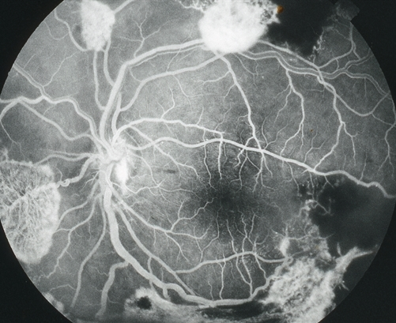
Eales disease: Peripheral neo

Slide 81
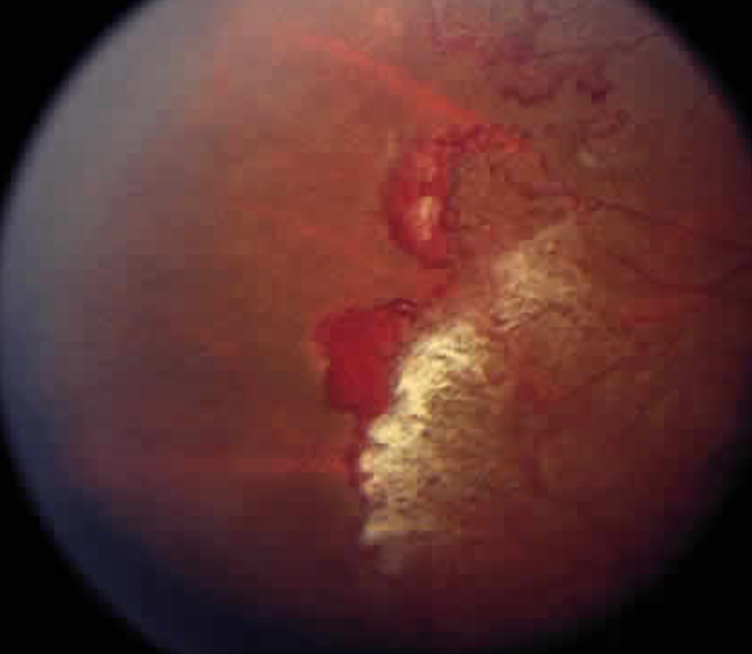
Eales disease: Peripheral neo

Slide 82
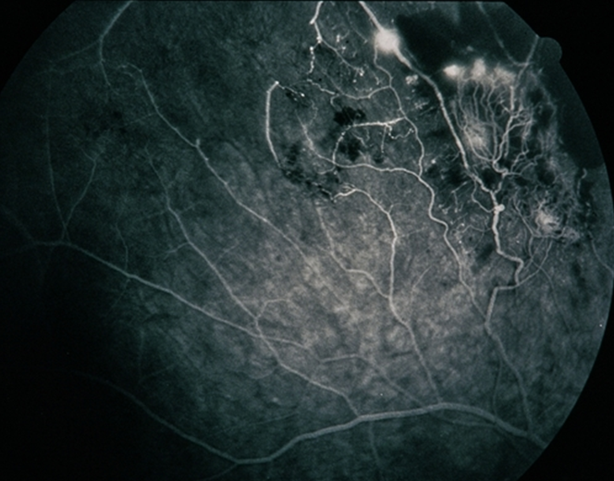
Eales disease: Peripheral neo

Slide 83
Uveitis
1) The uveitis is profiled
2) The profiled case is meshed
3) A differential diagnosis list is generated
4) Studies are obtained to identify the etiology
5) Treatment appropriate for the etiology is initiated
Panuveitis
Posterior
Intermediate
Anterior
And of course, TB can present as a panuveitis.
Tuberculosis

Slide 84
Uveitis: TB
1) The uveitis is profiled
2) The profiled case is meshed
3) A differential diagnosis list is generated
4) Studies are obtained to identify the etiology
5) Treatment appropriate for the etiology is initiated
Diagnosis
How is the diagnosis of TB made?

Slide 85
Uveitis: TB
1) The uveitis is profiled
2) The profiled case is meshed
3) A differential diagnosis list is generated
4) Studies are obtained to identify the etiology
5) Treatment appropriate for the etiology is initiated
Diagnosis
How is the diagnosis of TB made?
Definitively, only via observation of the organism on a specimen. More commonly, the diagnosis is made presumptively on other, indirect evidence.

Slide 86
Uveitis: TB
1) The uveitis is profiled
2) The profiled case is meshed
3) A differential diagnosis list is generated
4) Studies are obtained to identify the etiology
5) Treatment appropriate for the etiology is initiated
Diagnosis
How is the diagnosis of TB made?
Definitively, only via observation of the organism on a specimen. More commonly, the diagnosis is made presumptively on other, indirect evidence.
What ‘presumptive evidence’ tests are commonly employed first-line?
--?
--?

Slide 87
Uveitis: TB
1) The uveitis is profiled
2) The profiled case is meshed
3) A differential diagnosis list is generated
4) Studies are obtained to identify the etiology
5) Treatment appropriate for the etiology is initiated
Diagnosis
How is the diagnosis of TB made?
Definitively, only via observation of the organism on a specimen. More commonly, the diagnosis is made presumptively on other, indirect evidence.
What ‘presumptive evidence’ tests are commonly employed first-line?
--PPD
--QuantiFERON Gold

Slide 88
Uveitis: TB
1) The uveitis is profiled
2) The profiled case is meshed
3) A differential diagnosis list is generated
4) Studies are obtained to identify the etiology
5) Treatment appropriate for the etiology is initiated
Diagnosis
How is the diagnosis of TB made?
Definitively, only via observation of the organism on a specimen. More commonly, the diagnosis is made presumptively on other, indirect evidence.
What ‘presumptive evidence’ tests are commonly employed first-line?
--PPD
--QuantiFERON Gold
Does a positive PPD and/or QuantiFERON test prove the pt has active TB?

Slide 89
Uveitis: TB
1) The uveitis is profiled
2) The profiled case is meshed
3) A differential diagnosis list is generated
4) Studies are obtained to identify the etiology
5) Treatment appropriate for the etiology is initiated
Diagnosis
How is the diagnosis of TB made?
Definitively, only via observation of the organism on a specimen. More commonly, the diagnosis is made presumptively on other, indirect evidence.
What ‘presumptive evidence’ tests are commonly employed first-line?
--PPD
--QuantiFERON Gold
Does a positive PPD and/or QuantiFERON test prove the pt has active TB?
No—it only proves they have been infected by/exposed to it

Slide 90
Uveitis: TB
1) The uveitis is profiled
2) The profiled case is meshed
3) A differential diagnosis list is generated
4) Studies are obtained to identify the etiology
5) Treatment appropriate for the etiology is initiated
Diagnosis
How is the diagnosis of TB made?
Definitively, only via observation of the organism on a specimen. More commonly, the diagnosis is made presumptively on other, indirect evidence.
What ‘presumptive evidence’ tests are commonly employed first-line?
--PPD
--QuantiFERON Gold
Does a positive PPD and/or QuantiFERON test prove the pt has active TB?
No—it only proves they have been infected by/exposed to it
The PPD has a high false-negative rate. What characteristics put a TB-positive individual at risk for a false-negative PPD?
--?Being immunocompromised (eg, pts with AIDS, debilitating chronic diseases; on steroids or other immunosuppressive meds)
--?
--?

Slide 91
Uveitis: TB
1) The uveitis is profiled
2) The profiled case is meshed
3) A differential diagnosis list is generated
4) Studies are obtained to identify the etiology
5) Treatment appropriate for the etiology is initiated
Diagnosis
How is the diagnosis of TB made?
Definitively, only via observation of the organism on a specimen. More commonly, the diagnosis is made presumptively on other, indirect evidence.
What ‘presumptive evidence’ tests are commonly employed first-line?
--PPD
--QuantiFERON Gold
Does a positive PPD and/or QuantiFERON test prove the pt has active TB?
No—it only proves they have been infected by/exposed to it
The PPD has a high false-negative rate. What characteristics put a TB-positive individual at risk for a false-negative PPD?
--Being immunocompromised (eg, pts with AIDS, debilitating chronic diseases; on steroids or other immunosuppressive meds)
--Advanced age
--Marginal living conditions (eg, homeless; malnourished)

Slide 92
Uveitis: TB
1) The uveitis is profiled
2) The profiled case is meshed
3) A differential diagnosis list is generated
4) Studies are obtained to identify the etiology
5) Treatment appropriate for the etiology is initiated
Diagnosis
How is the diagnosis of TB made?
Definitively, only via observation of the organism on a specimen. More commonly, the diagnosis is made presumptively on other, indirect evidence.
What ‘presumptive evidence’ tests are commonly employed first-line?
--PPD
--QuantiFERON Gold
Does a positive PPD and/or QuantiFERON test prove the pt has active TB?
No—it only proves they have been infected by/exposed to it
The PPD has a high false-negative rate. What characteristics put a TB-positive individual at risk for a false-negative PPD?
--Being immunocompromised (eg, pts with AIDS, debilitating chronic diseases; on steroids or other immunosuppressive meds)
--Advanced age
--Marginal living conditions (eg, homeless; malnourished)
Note that the characteristics that increase the risk of a false-negative PPD are the same as those that put someone at risk of having TB in the first place!

Slide 93
Uveitis: TB
1) The uveitis is profiled
2) The profiled case is meshed
3) A differential diagnosis list is generated
4) Studies are obtained to identify the etiology
5) Treatment appropriate for the etiology is initiated
Diagnosis
How is the diagnosis of TB made?
Definitively, only via observation of the organism on a specimen. More commonly, the diagnosis is made presumptively on other, indirect evidence.
What ‘presumptive evidence’ tests are commonly employed first-line?
--PPD
--QuantiFERON Gold
Does a positive PPD and/or QuantiFERON test prove the pt has active TB?
No—it only proves they have been infected by/exposed to it
The PPD has a high false-negative rate. What characteristics put a TB-positive individual at risk for a false-negative PPD?
--Being immunocompromised (eg, pts with AIDS, debilitating chronic diseases; on steroids or other immunosuppressive meds)
--Advanced age
--Marginal living conditions (eg, homeless; malnourished)
Under what circumstances can the PPD yield a false-positive result?
--?
--?

Slide 94
Uveitis: TB
1) The uveitis is profiled
2) The profiled case is meshed
3) A differential diagnosis list is generated
4) Studies are obtained to identify the etiology
5) Treatment appropriate for the etiology is initiated
Diagnosis
How is the diagnosis of TB made?
Definitively, only via observation of the organism on a specimen. More commonly, the diagnosis is made presumptively on other, indirect evidence.
What ‘presumptive evidence’ tests are commonly employed first-line?
--PPD
--QuantiFERON Gold
Does a positive PPD and/or QuantiFERON test prove the pt has active TB?
No—it only proves they have been infected by/exposed to it
The PPD has a high false-negative rate. What characteristics put a TB-positive individual at risk for a false-negative PPD?
--Being immunocompromised (eg, pts with AIDS, debilitating chronic diseases; on steroids or other immunosuppressive meds)
--Advanced age
--Marginal living conditions (eg, homeless; malnourished)
Under what circumstances can the PPD yield a false-positive result?
--Hx of exposure to BCG
--Pt is infected with atypical mycobacteria

Slide 95
Uveitis: TB
1) The uveitis is profiled
2) The profiled case is meshed
3) A differential diagnosis list is generated
4) Studies are obtained to identify the etiology
5) Treatment appropriate for the etiology is initiated
Diagnosis
How is the diagnosis of TB made?
Definitively, only via observation of the organism on a specimen. More commonly, the diagnosis is made presumptively on other, indirect evidence.
What ‘presumptive evidence’ tests are commonly employed first-line?
--PPD
--QuantiFERON Gold
Does a positive PPD and/or QuantiFERON test prove the pt has active TB?
No--it only proves they have been infected by/exposed to it
The PPD has a high false-negative rate. What characteristics put a TB-positive individual at risk for a false-negative PPD?
--Being immunocompromised (eg, pts with AIDS, debilitating chronic diseases; on steroids or other immunosuppressive meds)
--Advanced age
--Marginal living conditions (eg, homeless; malnourished)
Under what circumstances can the PPD yield a false-positive result?
--Hx of exposure to BCG
--Pt is infected with atypical mycobacteria
In this context, what does BCG stand for?
bacille Calmette-Guérin
What is it?
A live-attenuated version of Mycobacterium bovis
Under what two circumstances (one far more likely than the other) is a person likely to be exposed to BCG?
--It is used in anti-TB immunization programs around the world
--It is used to treat certain forms of bladder cancer

Slide 96
Uveitis: TB
1) The uveitis is profiled
2) The profiled case is meshed
3) A differential diagnosis list is generated
4) Studies are obtained to identify the etiology
5) Treatment appropriate for the etiology is initiated
Diagnosis
How is the diagnosis of TB made?
Definitively, only via observation of the organism on a specimen. More commonly, the diagnosis is made presumptively on other, indirect evidence.
What ‘presumptive evidence’ tests are commonly employed first-line?
--PPD
--QuantiFERON Gold
Does a positive PPD and/or QuantiFERON test prove the pt has active TB?
No--it only proves they have been infected by/exposed to it
The PPD has a high false-negative rate. What characteristics put a TB-positive individual at risk for a false-negative PPD?
--Being immunocompromised (eg, pts with AIDS, debilitating chronic diseases; on steroids or other immunosuppressive meds)
--Advanced age
--Marginal living conditions (eg, homeless; malnourished)
Under what circumstances can the PPD yield a false-positive result?
--Hx of exposure to BCG
--Pt is infected with atypical mycobacteria
In this context, what does BCG stand for?
bacille Calmette-Guérin
What is it?
A live-attenuated version of Mycobacterium bovis
Under what two circumstances (one far more likely than the other) is a person likely to be exposed to BCG?
--It is used in anti-TB immunization programs around the world
--It is used to treat certain forms of bladder cancer

Slide 97
Uveitis: TB
1) The uveitis is profiled
2) The profiled case is meshed
3) A differential diagnosis list is generated
4) Studies are obtained to identify the etiology
5) Treatment appropriate for the etiology is initiated
Diagnosis
How is the diagnosis of TB made?
Definitively, only via observation of the organism on a specimen. More commonly, the diagnosis is made presumptively on other, indirect evidence.
What ‘presumptive evidence’ tests are commonly employed first-line?
--PPD
--QuantiFERON Gold
Does a positive PPD and/or QuantiFERON test prove the pt has active TB?
No--it only proves they have been infected by/exposed to it
The PPD has a high false-negative rate. What characteristics put a TB-positive individual at risk for a false-negative PPD?
--Being immunocompromised (eg, pts with AIDS, debilitating chronic diseases; on steroids or other immunosuppressive meds)
--Advanced age
--Marginal living conditions (eg, homeless; malnourished)
Under what circumstances can the PPD yield a false-positive result?
--Hx of exposure to BCG
--Pt is infected with atypical mycobacteria
In this context, what does BCG stand for?
bacille Calmette-Guérin
What is it?
A live-attenuated version of Mycobacterium bovis
Under what two circumstances (one far more likely than the other) is a person likely to be exposed to BCG?
--It is used in anti-TB immunization programs around the world
--It is used to treat certain forms of bladder cancer

Slide 98
Uveitis: TB
1) The uveitis is profiled
2) The profiled case is meshed
3) A differential diagnosis list is generated
4) Studies are obtained to identify the etiology
5) Treatment appropriate for the etiology is initiated
Diagnosis
How is the diagnosis of TB made?
Definitively, only via observation of the organism on a specimen. More commonly, the diagnosis is made presumptively on other, indirect evidence.
What ‘presumptive evidence’ tests are commonly employed first-line?
--PPD
--QuantiFERON Gold
Does a positive PPD and/or QuantiFERON test prove the pt has active TB?
No--it only proves they have been infected by/exposed to it
The PPD has a high false-negative rate. What characteristics put a TB-positive individual at risk for a false-negative PPD?
--Being immunocompromised (eg, pts with AIDS, debilitating chronic diseases; on steroids or other immunosuppressive meds)
--Advanced age
--Marginal living conditions (eg, homeless; malnourished)
Under what circumstances can the PPD yield a false-positive result?
--Hx of exposure to BCG
--Pt is infected with atypical mycobacteria
In this context, what does BCG stand for?
bacille Calmette-Guérin
What is it?
A live-attenuated version of Mycobacterium bovis
Under what two circumstances (one far more likely than the other) is a person likely to be exposed to BCG?
--It is used in anti-TB immunization programs around the world
--It is used to treat certain forms of bladder cancer

Slide 99
Uveitis: TB
1) The uveitis is profiled
2) The profiled case is meshed
3) A differential diagnosis list is generated
4) Studies are obtained to identify the etiology
5) Treatment appropriate for the etiology is initiated
Diagnosis
How is the diagnosis of TB made?
Definitively, only via observation of the organism on a specimen. More commonly, the diagnosis is made presumptively on other, indirect evidence.
What ‘presumptive evidence’ tests are commonly employed first-line?
--PPD
--QuantiFERON Gold
Does a positive PPD and/or QuantiFERON test prove the pt has active TB?
No--it only proves they have been infected by/exposed to it
The PPD has a high false-negative rate. What characteristics put a TB-positive individual at risk for a false-negative PPD?
--Being immunocompromised (eg, pts with AIDS, debilitating chronic diseases; on steroids or other immunosuppressive meds)
--Advanced age
--Marginal living conditions (eg, homeless; malnourished)
Under what circumstances can the PPD yield a false-positive result?
--Hx of exposure to BCG
--Pt is infected with atypical mycobacteria
In this context, what does BCG stand for?
bacille Calmette-Guérin
What is it?
A live-attenuated version of Mycobacterium bovis
Under what two circumstances (one far more likely than the other) is a person likely to be exposed to BCG?
--?It is used in anti-TB immunization programs around the world
--?It is used to treat certain forms of bladder cancer

Slide 100
Uveitis: TB
1) The uveitis is profiled
2) The profiled case is meshed
3) A differential diagnosis list is generated
4) Studies are obtained to identify the etiology
5) Treatment appropriate for the etiology is initiated
Diagnosis
How is the diagnosis of TB made?
Definitively, only via observation of the organism on a specimen. More commonly, the diagnosis is made presumptively on other, indirect evidence.
What ‘presumptive evidence’ tests are commonly employed first-line?
--PPD
--QuantiFERON Gold
Does a positive PPD and/or QuantiFERON test prove the pt has active TB?
No--it only proves they have been infected by/exposed to it
The PPD has a high false-negative rate. What characteristics put a TB-positive individual at risk for a false-negative PPD?
--Being immunocompromised (eg, pts with AIDS, debilitating chronic diseases; on steroids or other immunosuppressive meds)
--Advanced age
--Marginal living conditions (eg, homeless; malnourished)
Under what circumstances can the PPD yield a false-positive result?
--Hx of exposure to BCG
--Pt is infected with atypical mycobacteria
In this context, what does BCG stand for?
bacille Calmette-Guérin
What is it?
A live-attenuated version of Mycobacterium bovis
Under what two circumstances (one far more likely than the other) is a person likely to be exposed to BCG?
--It is used in anti-TB immunization programs around the world
--It is used to treat certain forms of bladder cancer
one word

Slide 101
Uveitis: TB
1) The uveitis is profiled
2) The profiled case is meshed
3) A differential diagnosis list is generated
4) Studies are obtained to identify the etiology
5) Treatment appropriate for the etiology is initiated
Diagnosis
How is the diagnosis of TB made?
Definitively, only via observation of the organism on a specimen. More commonly, the diagnosis is made presumptively on other, indirect evidence.
What ‘presumptive evidence’ tests are commonly employed first-line?
--PPD
--QuantiFERON Gold
Does a positive PPD and/or QuantiFERON test prove the pt has active TB?
No--it only proves they have been infected by/exposed to it
The PPD has a high false-negative rate. What characteristics put a TB-positive individual at risk for a false-negative PPD?
--Being immunocompromised (eg, pts with AIDS, debilitating chronic diseases; on steroids or other immunosuppressive meds)
--Advanced age
--Marginal living conditions (eg, homeless; malnourished)
Under what circumstances can the PPD yield a false-positive result?
--Hx of exposure to BCG
--Pt is infected with atypical mycobacteria
In this context, what does BCG stand for?
bacille Calmette-Guérin
What is it?
A live-attenuated version of Mycobacterium bovis
Under what two circumstances (one far more likely than the other) is a person likely to be exposed to BCG?
--It is used in anti-TB immunization programs around the world
--It is used to treat certain forms of bladder cancer

Slide 102
Uveitis: TB
1) The uveitis is profiled
2) The profiled case is meshed
3) A differential diagnosis list is generated
4) Studies are obtained to identify the etiology
5) Treatment appropriate for the etiology is initiated
Diagnosis
How is the diagnosis of TB made?
Definitively, only via observation of the organism on a specimen. More commonly, the diagnosis is made presumptively on other, indirect evidence.
What ‘presumptive evidence’ tests are commonly employed first-line?
--PPD
--QuantiFERON Gold
Does a positive PPD and/or QuantiFERON test prove the pt has active TB?
No—it only proves they have been infected by/exposed to it
The PPD has a high false-negative rate. What characteristics put a TB-positive individual at risk for a false-negative PPD?
--Being immunocompromised (eg, pts with AIDS, debilitating chronic diseases; on steroids or other immunosuppressive meds)
--Advanced age
--Marginal living conditions (eg, homeless; malnourished)
Under what circumstances can the PPD yield a false-positive result?
--Hx of exposure to BCG
--Pt is infected with atypical mycobacteria
Given the vagaries of PPD testing, how should it be employed in a low-prevalence country like the US?

Slide 103
Uveitis: TB
1) The uveitis is profiled
2) The profiled case is meshed
3) A differential diagnosis list is generated
4) Studies are obtained to identify the etiology
5) Treatment appropriate for the etiology is initiated
Diagnosis
How is the diagnosis of TB made?
Definitively, only via observation of the organism on a specimen. More commonly, the diagnosis is made presumptively on other, indirect evidence.
What ‘presumptive evidence’ tests are commonly employed first-line?
--PPD
--QuantiFERON Gold
Does a positive PPD and/or QuantiFERON test prove the pt has active TB?
No—it only proves they have been infected by/exposed to it
The PPD has a high false-negative rate. What characteristics put a TB-positive individual at risk for a false-negative PPD?
--Being immunocompromised (eg, pts with AIDS, debilitating chronic diseases; on steroids or other immunosuppressive meds)
--Advanced age
--Marginal living conditions (eg, homeless; malnourished)
Under what circumstances can the PPD yield a false-positive result?
--Hx of exposure to BCG
--Pt is infected with atypical mycobacteria
Given the vagaries of PPD testing, how should it be employed in a low-prevalence country like the US?
Thoughtfully; ie, only in those cases where the clinical index of suspicion is fairly high

Slide 104
Uveitis: TB
1) The uveitis is profiled
2) The profiled case is meshed
3) A differential diagnosis list is generated
4) Studies are obtained to identify the etiology
5) Treatment appropriate for the etiology is initiated
Diagnosis
How is the diagnosis of TB made?
Definitively, only via observation of the organism on a specimen. More commonly, the diagnosis is made presumptively on other, indirect evidence.
What ‘presumptive evidence’ tests are commonly employed?
--PPD
--QuantiFERON Gold
Does a positive PPD and/or QuantiFERON test prove the pt has active TB?
No—it only proves they have been infected by/exposed to it
The PPD has a high false-negative rate. What characteristics put a TB-positive individual at risk for a false-negative PPD?
--Being immunocompromised (eg, pts with AIDS, debilitating chronic diseases; on steroids or other immunosuppressive meds)
--Advanced age
--Marginal living conditions (eg, homeless; malnourished)
Under what circumstances can the PPD yield a false-positive result?
--Pts exposed to BCG
--Pts infected with atypical mycobacteria
Given the vagaries of PPD testing, how should it be employed in a low-prevalence country like the US?
Thoughtfully; ie, only in those cases where the clinical index of suspicion is fairly high
Given a high index of suspicion and a positive PPD, the uveitis-managing clinician should proceed by searching for further evidence of systemic infection via:
--?
--?
--?
--?Lymph node biopsy for microbiologic analysis
If all of the above are negative, what should the uveitis-managing clinician do next?
Consider aqueous, vitreous or even chorioretinal sampling for microbiologic analysis

Slide 105
Uveitis: TB
1) The uveitis is profiled
2) The profiled case is meshed
3) A differential diagnosis list is generated
4) Studies are obtained to identify the etiology
5) Treatment appropriate for the etiology is initiated
Diagnosis
How is the diagnosis of TB made?
Definitively, only via observation of the organism on a specimen. More commonly, the diagnosis is made presumptively on other, indirect evidence.
What ‘presumptive evidence’ tests are commonly employed?
--PPD
--QuantiFERON Gold
Does a positive PPD and/or QuantiFERON test prove the pt has active TB?
No—it only proves they have been infected by/exposed to it
The PPD has a high false-negative rate. What characteristics put a TB-positive individual at risk for a false-negative PPD?
--Being immunocompromised (eg, pts with AIDS, debilitating chronic diseases; on steroids or other immunosuppressive meds)
--Advanced age
--Marginal living conditions (eg, homeless; malnourished)
Under what circumstances can the PPD yield a false-positive result?
--Pts exposed to BCG
--Pts infected with atypical mycobacteria
Given the vagaries of PPD testing, how should it be employed in a low-prevalence country like the US?
Thoughtfully; ie, only in those cases where the clinical index of suspicion is fairly high
Given a high index of suspicion and a positive PPD, the uveitis-managing clinician should proceed by searching for further evidence of systemic infection via:
--Chest imaging
--PET scanning
--Culture and staining of sputum, urine, and gastric samples
--Lymph node biopsy for microbiologic analysis
If all of the above are negative, what should the uveitis-managing clinician do next?
Consider aqueous, vitreous or even chorioretinal sampling for microbiologic analysis

Slide 106
Uveitis: TB
1) The uveitis is profiled
2) The profiled case is meshed
3) A differential diagnosis list is generated
4) Studies are obtained to identify the etiology
5) Treatment appropriate for the etiology is initiated
Diagnosis
How is the diagnosis of TB made?
Definitively, only via observation of the organism on a specimen. More commonly, the diagnosis is made presumptively on other, indirect evidence.
What ‘presumptive evidence’ tests are commonly employed?
--PPD
--QuantiFERON Gold
Does a positive PPD and/or QuantiFERON test prove the pt has active TB?
No—it only proves they have been infected by/exposed to it
The PPD has a high false-negative rate. What characteristics put a TB-positive individual at risk for a false-negative PPD?
--Being immunocompromised (eg, pts with AIDS, debilitating chronic diseases; on steroids or other immunosuppressive meds)
--Advanced age
--Marginal living conditions (eg, homeless; malnourished)
Under what circumstances can the PPD yield a false-positive result?
--Pts exposed to BCG
--Pts infected with atypical mycobacteria
Given the vagaries of PPD testing, how should it be employed in a low-prevalence country like the US?
Thoughtfully; ie, only in those cases where the clinical index of suspicion is fairly high
Given a high index of suspicion and a positive PPD, the uveitis-managing clinician should proceed by searching for further evidence of systemic infection via:
--Chest imaging
--PET scanning
--Culture and staining of sputum, urine, and gastric samples
--Lymph node biopsy for microbiologic analysis
If all of the above are negative, what should the uveitis-managing clinician do next?
Consider aqueous, vitreous or even chorioretinal sampling for microbiologic analysis

Slide 107
Uveitis: TB
1) The uveitis is profiled
2) The profiled case is meshed
3) A differential diagnosis list is generated
4) Studies are obtained to identify the etiology
5) Treatment appropriate for the etiology is initiated
Diagnosis
How is the diagnosis of TB made?
Definitively, only via observation of the organism on a specimen. More commonly, the diagnosis is made presumptively on other, indirect evidence.
What ‘presumptive evidence’ tests are commonly employed?
--PPD
--QuantiFERON Gold
Does a positive PPD and/or QuantiFERON test prove the pt has active TB?
No—it only proves they have been infected by/exposed to it
The PPD has a high false-negative rate. What characteristics put a TB-positive individual at risk for a false-negative PPD?
--Being immunocompromised (eg, pts with AIDS, debilitating chronic diseases; on steroids or other immunosuppressive meds)
--Advanced age
--Marginal living conditions (eg, homeless; malnourished)
Under what circumstances can the PPD yield a false-positive result?
--Pts exposed to BCG
--Pts infected with atypical mycobacteria
Given the vagaries of PPD testing, how should it be employed in a low-prevalence country like the US?
Thoughtfully; ie, only in those cases where the clinical index of suspicion is fairly high
Given a high index of suspicion and a positive PPD, the uveitis-managing clinician should proceed by searching for further evidence of systemic infection via:
--Chest imaging
--PET scanning
--Culture and staining of sputum, urine, and gastric samples
--Lymph node biopsy for microbiologic analysis
If all of the above are negative, what should the uveitis-managing clinician do next?
Consider aqueous, vitreous or even chorioretinal sampling for microbiologic analysis

Slide 108
Uveitis: TB
1) The uveitis is profiled
2) The profiled case is meshed
3) A differential diagnosis list is generated
4) Studies are obtained to identify the etiology
5) Treatment appropriate for the etiology is initiated
Treatment
What two overarching principles guide TB treatment?
--?
--?

Slide 109
Uveitis: TB
1) The uveitis is profiled
2) The profiled case is meshed
3) A differential diagnosis list is generated
4) Studies are obtained to identify the etiology
5) Treatment appropriate for the etiology is initiated
Treatment
What two overarching principles guide TB treatment?
--Multidrug regimen is employed
--Directly-observed therapy (DOT) is utilized

Slide 110
Uveitis: TB
1) The uveitis is profiled
2) The profiled case is meshed
3) A differential diagnosis list is generated
4) Studies are obtained to identify the etiology
5) Treatment appropriate for the etiology is initiated
Treatment
What two overarching principles guide TB treatment?
--Multidrug regimen is employed
--Directly-observed therapy (DOT) is utilized
Why is it important to employ multiple anti-TB agents simultaneously?

Slide 111
Uveitis: TB
1) The uveitis is profiled
2) The profiled case is meshed
3) A differential diagnosis list is generated
4) Studies are obtained to identify the etiology
5) Treatment appropriate for the etiology is initiated
Treatment
What two overarching principles guide TB treatment?
--Multidrug regimen is employed
--Directly-observed therapy (DOT) is utilized
Why is it important to employ multiple anti-TB agents simultaneously?
In a word, resistance. There is already widespread resistance to isoniazid (INH); in some locales, TB is resistant to several agents. Multidrug regimens reduce the risk of development of further resistance.

Slide 112
Uveitis: TB
1) The uveitis is profiled
2) The profiled case is meshed
3) A differential diagnosis list is generated
4) Studies are obtained to identify the etiology
5) Treatment appropriate for the etiology is initiated
Treatment
What two overarching principles guide TB treatment?
--Multidrug regimen is employed
--Directly-observed therapy (DOT) is utilized
Why is it important to employ multiple anti-TB agents simultaneously?
In a word, resistance. There is already widespread resistance to isoniazid (INH); in some locales, TB is resistant to several agents. Multidrug regimens reduce the risk of development of further resistance.
Why is DOT so important?

Slide 113
Uveitis: TB
1) The uveitis is profiled
2) The profiled case is meshed
3) A differential diagnosis list is generated
4) Studies are obtained to identify the etiology
5) Treatment appropriate for the etiology is initiated
Treatment
What two overarching principles guide TB treatment?
--Multidrug regimen is employed
--Directly-observed therapy (DOT) is utilized
Why is it important to employ multiple anti-TB agents simultaneously?
In a word, resistance. There is already widespread resistance to isoniazid (INH); in some locales, TB is resistant to several agents. Multidrug regimens reduce the risk of development of further resistance.
Why is DOT so important?
Again, because of resistance. One of the chief causes of resistance is noncompliance with the long-term treatment regimen needed to eradicate the exceedingly slow-growing M. tuberculosis. DOT is intended to ensure compliance.

Slide 114
Uveitis: TB
1) The uveitis is profiled
2) The profiled case is meshed
3) A differential diagnosis list is generated
4) Studies are obtained to identify the etiology
5) Treatment appropriate for the etiology is initiated
Treatment
What two overarching principles guide TB treatment?
--Multidrug regimen is employed
--Directly-observed therapy (DOT) is utilized
Why is it important to employ multiple anti-TB agents simultaneously?
In a word, resistance. There is already widespread resistance to isoniazid (INH); in some locales, TB is resistant to several agents. Multidrug regimens reduce the risk of development of further resistance.
Why is DOT so important?
Again, because of resistance. One of the chief causes of resistance is noncompliance with the long-term treatment regimen needed to eradicate the exceedingly slow-growing M. tuberculosis. DOT is intended to ensure compliance.
What is a typical anti-TB drug regimen?

Slide 115
Uveitis: TB
1) The uveitis is profiled
2) The profiled case is meshed
3) A differential diagnosis list is generated
4) Studies are obtained to identify the etiology
5) Treatment appropriate for the etiology is initiated
Treatment
What two overarching principles guide TB treatment?
--Multidrug regimen is employed
--Directly-observed therapy (DOT) is utilized
Why is it important to employ multiple anti-TB agents simultaneously?
In a word, resistance. There is already widespread resistance to isoniazid (INH); in some locales, TB is resistant to several agents. Multidrug regimens reduce the risk of development of further resistance.
Why is DOT so important?
Again, because of resistance. One of the chief causes of resistance is noncompliance with the long-term treatment regimen needed to eradicate the exceedingly slow-growing M. tuberculosis. DOT is intended to ensure compliance.
What is a typical anti-TB drug regimen?
Initial therapy consists of INH, rifampin, ethambutol, and pyrazinamide for 8 weeks
four drugs

Slide 116
Uveitis: TB
1) The uveitis is profiled
2) The profiled case is meshed
3) A differential diagnosis list is generated
4) Studies are obtained to identify the etiology
5) Treatment appropriate for the etiology is initiated
Treatment
What two overarching principles guide TB treatment?
--Multidrug regimen is employed
--Directly-observed therapy (DOT) is utilized
Why is it important to employ multiple anti-TB agents simultaneously?
In a word, resistance. There is already widespread resistance to isoniazid (INH); in some locales, TB is resistant to several agents. Multidrug regimens reduce the risk of development of further resistance.
Why is DOT so important?
Again, because of resistance. One of the chief causes of resistance is noncompliance with the long-term treatment regimen needed to eradicate the exceedingly slow-growing M. tuberculosis. DOT is intended to ensure compliance.
What is a typical anti-TB drug regimen?
Initial therapy consists of INH, rifampin, ethambutol, and pyrazinamide for 8 weeks

Slide 117
Uveitis: TB
1) The uveitis is profiled
2) The profiled case is meshed
3) A differential diagnosis list is generated
4) Studies are obtained to identify the etiology
5) Treatment appropriate for the etiology is initiated
Treatment
What two overarching principles guide TB treatment?
--Multidrug regimen is employed
--Directly-observed therapy (DOT) is utilized
Why is it important to employ multiple anti-TB agents simultaneously?
In a word, resistance. There is already widespread resistance to isoniazid (INH); in some locales, TB is resistant to several agents. Multidrug regimens reduce the risk of development of further resistance.
Why is DOT so important?
Again, because of resistance. One of the chief causes of resistance is noncompliance with the long-term treatment regimen needed to eradicate the exceedingly slow-growing M. tuberculosis. DOT is intended to ensure compliance.
What is a typical anti-TB drug regimen?
Initial therapy consists of INH, rifampin, ethambutol, and pyrazinamide for 8 weeks (the ethambutol can be stopped earlier if the bug proves susceptible to the rest of the regimen)

Slide 118
Uveitis: TB
1) The uveitis is profiled
2) The profiled case is meshed
3) A differential diagnosis list is generated
4) Studies are obtained to identify the etiology
5) Treatment appropriate for the etiology is initiated
Treatment
What two overarching principles guide TB treatment?
--Multidrug regimen is employed
--Directly-observed therapy (DOT) is utilized
Why is it important to employ multiple anti-TB agents simultaneously?
In a word, resistance. There is already widespread resistance to isoniazid (INH); in some locales, TB is resistant to several agents. Multidrug regimens reduce the risk of development of further resistance.
Why is DOT so important?
Again, because of resistance. One of the chief causes of resistance is noncompliance with the long-term treatment regimen needed to eradicate the exceedingly slow-growing M. tuberculosis. DOT is intended to ensure compliance.
What is a typical anti-TB drug regimen?
Initial therapy consists of INH, rifampin, ethambutol, and pyrazinamide for 8 weeks (the ethambutol can be stopped earlier if the bug proves susceptible to the rest of the regimen)

Slide 119
Uveitis: TB
1) The uveitis is profiled
2) The profiled case is meshed
3) A differential diagnosis list is generated
4) Studies are obtained to identify the etiology
5) Treatment appropriate for the etiology is initiated
Treatment
What two overarching principles guide TB treatment?
--Multidrug regimen is employed
--Directly-observed therapy (DOT) is utilized
Why is it important to employ multiple anti-TB agents simultaneously?
In a word, resistance. There is already widespread resistance to isoniazid (INH); in some locales, TB is resistant to several agents. Multidrug regimens reduce the risk of development of further resistance.
Why is DOT so important?
Again, because of resistance. One of the chief causes of resistance is noncompliance with the long-term treatment regimen needed to eradicate the exceedingly slow-growing M. tuberculosis. DOT is intended to ensure compliance.
What is a typical anti-TB drug regimen?
Initial therapy consists of INH, rifampin, ethambutol, and pyrazinamide for 8 weeks (the ethambutol can be stopped earlier if the bug proves susceptible to the rest of the regimen). After 8 weeks the ethambutol and pyrazinamide are stopped, and the INH and rifampin are continued for another 18 weeks.
two drugs
the other two

Slide 120
Uveitis: TB
1) The uveitis is profiled
2) The profiled case is meshed
3) A differential diagnosis list is generated
4) Studies are obtained to identify the etiology
5) Treatment appropriate for the etiology is initiated
Treatment
What two overarching principles guide TB treatment?
--Multidrug regimen is employed
--Directly-observed therapy (DOT) is utilized
Why is it important to employ multiple anti-TB agents simultaneously?
In a word, resistance. There is already widespread resistance to isoniazid (INH); in some locales, TB is resistant to several agents. Multidrug regimens reduce the risk of development of further resistance.
Why is DOT so important?
Again, because of resistance. One of the chief causes of resistance is noncompliance with the long-term treatment regimen needed to eradicate the exceedingly slow-growing M. tuberculosis. DOT is intended to ensure compliance.
What is a typical anti-TB drug regimen?
Initial therapy consists of INH, rifampin, ethambutol, and pyrazinamide for 8 weeks (the ethambutol can be stopped earlier if the bug proves susceptible to the rest of the regimen). After 8 weeks the ethambutol and pyrazinamide are stopped, and the INH and rifampin are continued for another 18 weeks.

Slide 121
Uveitis: TB
1) The uveitis is profiled
2) The profiled case is meshed
3) A differential diagnosis list is generated
4) Studies are obtained to identify the etiology
5) Treatment appropriate for the etiology is initiated
Treatment
What two overarching principles guide TB treatment?
--Multidrug regimen is employed
--Directly-observed therapy (DOT) is utilized
Why is it important to employ multiple anti-TB agents simultaneously?
In a word, resistance. There is already widespread resistance to isoniazid (INH); in some locales, TB is resistant to several agents. Multidrug regimens reduce the risk of development of further resistance.
Why is DOT so important?
Again, because of resistance. One of the chief causes of resistance is noncompliance with the long-term treatment regimen needed to eradicate the exceedingly slow-growing M. tuberculosis. DOT is intended to ensure compliance.
What is a typical anti-TB drug regimen?
Initial therapy consists of INH, rifampin, ethambutol, and pyrazinamide for 8 weeks (the ethambutol can be stopped earlier if the bug proves susceptible to the rest of the regimen). After 8 weeks the ethambutol and pyrazinamide are stopped, and the INH and rifampin are continued for another 18 weeks.
All four cause side effects, but INH and EMB are notorious for causing what?
Optic neuropathy

Slide 122
Uveitis: TB
1) The uveitis is profiled
2) The profiled case is meshed
3) A differential diagnosis list is generated
4) Studies are obtained to identify the etiology
5) Treatment appropriate for the etiology is initiated
Treatment
What two overarching principles guide TB treatment?
--Multidrug regimen is employed
--Directly-observed therapy (DOT) is utilized
Why is it important to employ multiple anti-TB agents simultaneously?
In a word, resistance. There is already widespread resistance to isoniazid (INH); in some locales, TB is resistant to several agents. Multidrug regimens reduce the risk of development of further resistance.
Why is DOT so important?
Again, because of resistance. One of the chief causes of resistance is noncompliance with the long-term treatment regimen needed to eradicate the exceedingly slow-growing M. tuberculosis. DOT is intended to ensure compliance.
What is a typical anti-TB drug regimen?
Initial therapy consists of INH, rifampin, ethambutol, and pyrazinamide for 8 weeks (the ethambutol can be stopped earlier if the bug proves susceptible to the rest of the regimen). After 8 weeks the ethambutol and pyrazinamide are stopped, and the INH and rifampin are continued for another 18 weeks.
All four cause side effects, but INH and EMB are notorious for causing what?
Optic neuropathy

Slide 123
Uveitis: TB
1) The uveitis is profiled
2) The profiled case is meshed
3) A differential diagnosis list is generated
4) Studies are obtained to identify the etiology
5) Treatment appropriate for the etiology is initiated
Treatment
What two overarching principles guide TB treatment?
--Multidrug regimen is employed
--Directly-observed therapy (DOT) is utilized
Why is it important to employ multiple anti-TB agents simultaneously?
In a word, resistance. There is already widespread resistance to isoniazid (INH); in some locales, TB is resistant to several agents. Multidrug regimens reduce the risk of development of further resistance.
Why is DOT so important?
Again, because of resistance. One of the chief causes of resistance is noncompliance with the long-term treatment regimen needed to eradicate the exceedingly slow-growing M. tuberculosis. DOT is intended to ensure compliance.
What is a typical anti-TB drug regimen?
Initial therapy consists of INH, rifampin, ethambutol, and pyrazinamide for 8 weeks (the ethambutol can be stopped earlier if the bug proves susceptible to the rest of the regimen). After 8 weeks the ethambutol and pyrazinamide are stopped, and the INH and rifampin are continued for another 18 weeks.
EMB optic neuropathy is particularly concerning. Is its risk dose-dependent?
Yes
At what dose (in mg/kg/d) does the risk of EMB optic neuropathy warrant monthly follow-up?
>15
All four cause side effects, but INH and EMB are notorious for causing what?
Optic neuropathy

Slide 124
Uveitis: TB
1) The uveitis is profiled
2) The profiled case is meshed
3) A differential diagnosis list is generated
4) Studies are obtained to identify the etiology
5) Treatment appropriate for the etiology is initiated
Treatment
What two overarching principles guide TB treatment?
--Multidrug regimen is employed
--Directly-observed therapy (DOT) is utilized
Why is it important to employ multiple anti-TB agents simultaneously?
In a word, resistance. There is already widespread resistance to isoniazid (INH); in some locales, TB is resistant to several agents. Multidrug regimens reduce the risk of development of further resistance.
Why is DOT so important?
Again, because of resistance. One of the chief causes of resistance is noncompliance with the long-term treatment regimen needed to eradicate the exceedingly slow-growing M. tuberculosis. DOT is intended to ensure compliance.
What is a typical anti-TB drug regimen?
Initial therapy consists of INH, rifampin, ethambutol, and pyrazinamide for 8 weeks (the ethambutol can be stopped earlier if the bug proves susceptible to the rest of the regimen). After 8 weeks the ethambutol and pyrazinamide are stopped, and the INH and rifampin are continued for another 18 weeks.
EMB optic neuropathy is particularly concerning. Is its risk dose-dependent?
Yes
At what dose (in mg/kg/d) does the risk of EMB optic neuropathy warrant monthly follow-up?
>15
All four cause side effects, but INH and EMB are notorious for causing what?
Optic neuropathy

Slide 125
Uveitis: TB
1) The uveitis is profiled
2) The profiled case is meshed
3) A differential diagnosis list is generated
4) Studies are obtained to identify the etiology
5) Treatment appropriate for the etiology is initiated
Treatment
What two overarching principles guide TB treatment?
--Multidrug regimen is employed
--Directly-observed therapy (DOT) is utilized
Why is it important to employ multiple anti-TB agents simultaneously?
In a word, resistance. There is already widespread resistance to isoniazid (INH); in some locales, TB is resistant to several agents. Multidrug regimens reduce the risk of development of further resistance.
Why is DOT so important?
Again, because of resistance. One of the chief causes of resistance is noncompliance with the long-term treatment regimen needed to eradicate the exceedingly slow-growing M. tuberculosis. DOT is intended to ensure compliance.
What is a typical anti-TB drug regimen?
Initial therapy consists of INH, rifampin, ethambutol, and pyrazinamide for 8 weeks (the ethambutol can be stopped earlier if the bug proves susceptible to the rest of the regimen). After 8 weeks the ethambutol and pyrazinamide are stopped, and the INH and rifampin are continued for another 18 weeks.
EMB optic neuropathy is particularly concerning. Is its risk dose-dependent?
Yes
At what dose (in mg/kg/d) does the risk of EMB optic neuropathy warrant monthly follow-up?
>15
All four cause side effects, but INH and EMB are notorious for causing what?
Optic neuropathy

Slide 126
Uveitis: TB
1) The uveitis is profiled
2) The profiled case is meshed
3) A differential diagnosis list is generated
4) Studies are obtained to identify the etiology
5) Treatment appropriate for the etiology is initiated
Treatment
What two overarching principles guide TB treatment?
--Multidrug regimen is employed
--Directly-observed therapy (DOT) is utilized
Why is it important to employ multiple anti-TB agents simultaneously?
In a word, resistance. There is already widespread resistance to isoniazid (INH); in some locales, TB is resistant to several agents. Multidrug regimens reduce the risk of development of further resistance.
Why is DOT so important?
Again, because of resistance. One of the chief causes of resistance is noncompliance with the long-term treatment regimen needed to eradicate the exceedingly slow-growing M. tuberculosis. DOT is intended to ensure compliance.
What is a typical anti-TB drug regimen?
Initial therapy consists of INH, rifampin, ethambutol, and pyrazinamide for 8 weeks (the ethambutol can be stopped earlier if the bug proves susceptible to the rest of the regimen). After 8 weeks the ethambutol and pyrazinamide are stopped, and the INH and rifampin are continued for another 18 weeks.
EMB optic neuropathy is particularly concerning. Is its risk dose-dependent?
Yes
At what dose (in mg/kg/d) does the risk of EMB optic neuropathy warrant monthly follow-up?
>15
All four cause side effects, but INH and EMB are notorious for causing what?
Optic neuropathy

