Slide 1
Coats
disease
Classic retinal finding?
White-yellow subretinal exudates

Slide 2
Coats
disease
White-yellow subretinal exudates

Slide 3
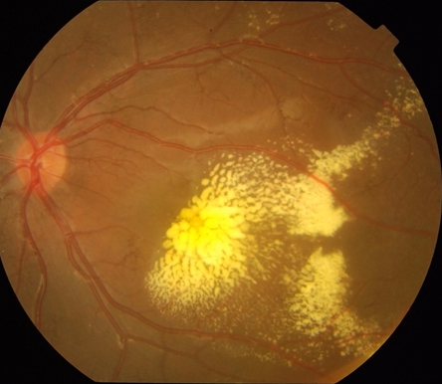
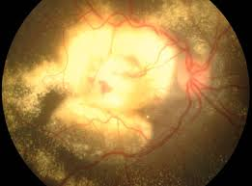
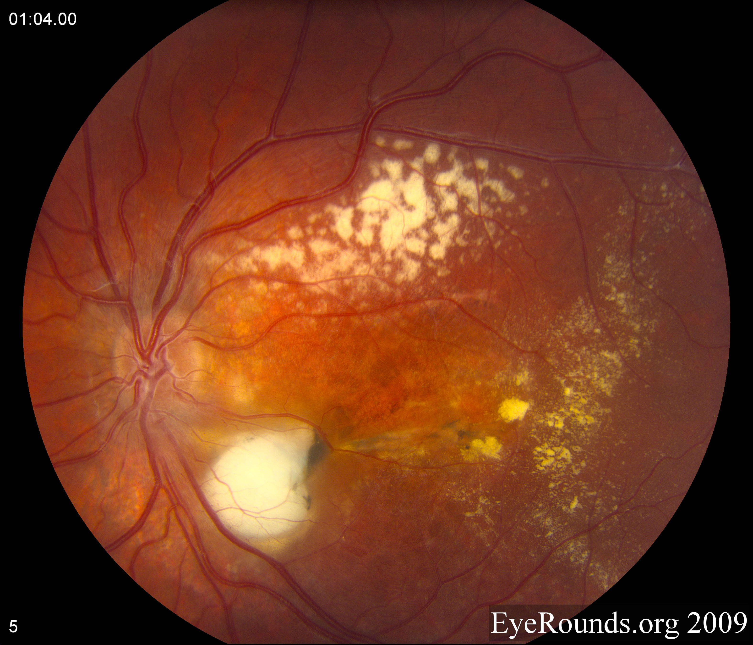
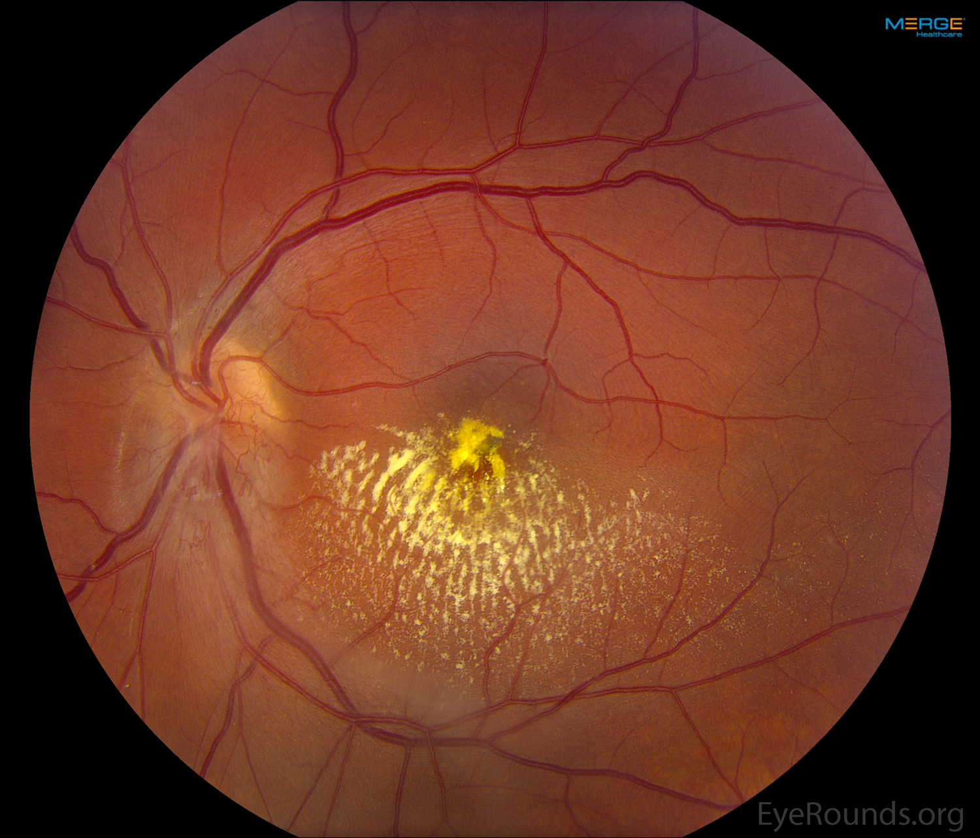
Coats dz

Slide 4
Coats
disease
White-yellow subretinal exudates
Two findings are typical of histologic examination of the subretinal exudate—what are they?

Slide 5
Coats
disease
White-yellow subretinal exudates
Two findings are typical of histologic examination of the subretinal exudate—what are they?
Foamy histocytes and cholesterol crystals
adjective
noun

Slide 6
Coats
disease
White-yellow subretinal exudates
Two findings are typical of histologic examination of the subretinal exudate—what are they?
Foamy histocytes and cholesterol crystals

Slide 7
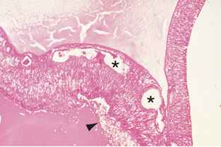
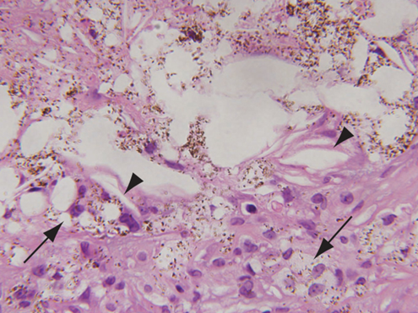
Telangiectatic retinal vessels (asterisks) and “foamy” histiocytes (arrowhead) typical of Coats disease
High-magnification of subretinal exudate showing lipid-laden and pigment-laden histiocytes (arrows) and cholesterol clefts (arrowheads).

Slide 8
Coats
disease
White-yellow subretinal exudates
Two findings are typical of histologic examination of the subretinal exudate—what are they?
Foamy histocytes and cholesterol crystals
‘Foamy histiocytes and cholesterol crystals’? Bruh, I’ve read both the Retina and Peds books on Coats, and neither says jack about this. What’s up with the extraneous detail?

Slide 9
Coats
disease
White-yellow subretinal exudates
Two findings are typical of histologic examination of the subretinal exudate—what are they?
Foamy histocytes and cholesterol crystals
‘Foamy histiocytes and cholesterol crystals’? Bruh, I’ve read both the Retina and Peds books on Coats, and neither says jack about this. What’s up with the extraneous detail?
It’s straight outta Path, G—don’t forget about Path

Slide 10
Gender predilection?
Next question
Coats
disease
White-yellow subretinal exudates

Slide 11
Gender predilection? Male
Coats
disease
White-yellow subretinal exudates

Slide 12
Typical age at presentation?
Gender predilection? Male
Coats
disease
White-yellow subretinal exudates

Slide 13
Typical age at presentation? 6-8 years
Gender predilection? Male
Coats
disease
White-yellow subretinal exudates

Slide 14
Typical age at presentation? 6-8 years
Gender predilection? Male
Laterality (ie, bi- vs uni-)?
Coats
disease
White-yellow subretinal exudates

Slide 15
Typical age at presentation? 6-8 years
Gender predilection? Male
Laterality (ie, bi- vs uni-)? Unilateral
Coats
disease
White-yellow subretinal exudates

Slide 16
Typical age at presentation? 6-8 years
Gender predilection? Male
Laterality (ie, bi- vs uni-)? Unilateral
Coats
disease
is a
White-yellow subretinal exudates
of young boys. It presents with unilateral, subretinal, white-yellow exudates.
No question—proceed when ready

Slide 17
Typical age at presentation? 6-8 years
Gender predilection? Male
What proportion of cases are male?
About 85%
Laterality (ie, bi- vs uni-)? Unilateral
Coats
disease
White-yellow subretinal exudates

Slide 18
Typical age at presentation? 6-8 years
Gender predilection? Male
What proportion of cases are male?
About 85%
Laterality (ie, bi- vs uni-)? Unilateral
Coats
disease
White-yellow subretinal exudates

Slide 19
Typical age at presentation? 6-8 years
Gender predilection? Male
Laterality (ie, bi- vs uni-)? Unilateral
Systemic associations?
Next question
Coats
disease
White-yellow subretinal exudates

Slide 20
Typical age at presentation? 6-8 years
Gender predilection? Male
Laterality (ie, bi- vs uni-)? Unilateral
Systemic associations? None
Coats
disease
White-yellow subretinal exudates

Slide 21
Typical age at presentation? 6-8 years
Gender predilection? Male
Laterality (ie, bi- vs uni-)? Unilateral
Systemic associations? None
Coats
disease
Inheritance pattern?
White-yellow subretinal exudates

Slide 22
Typical age at presentation? 6-8 years
Gender predilection? Male
Laterality (ie, bi- vs uni-)? Unilateral
Systemic associations? None
Coats
disease
Inheritance pattern? None
White-yellow subretinal exudates

Slide 23
Typical age at presentation? 6-8 years
Gender predilection? Male
Laterality (ie, bi- vs uni-)? Unilateral
Systemic associations? None
Coats
disease
Inheritance pattern? None
White-yellow subretinal exudates
is sporadic, with no known systemic associations.
No question—proceed when ready

Slide 24
Typical age at presentation? 6-8 years
Gender predilection? Male
Characterized by the presence of
abnormalities of the retinal vasculature
two words
Laterality (ie, bi- vs uni-)? Unilateral
Next Q
Systemic associations? None
Coats
disease
Inheritance pattern? None
White-yellow subretinal exudates

Slide 25
Typical age at presentation? 6-8 years
Gender predilection? Male
Characterized by the presence of
abnormalities of the retinal vasculature
Laterality (ie, bi- vs uni-)? Unilateral
Systemic associations? None
Coats
disease
Inheritance pattern? None
White-yellow subretinal exudates

Slide 26
Typical age at presentation? 6-8 years
Gender predilection? Male
Characterized by the presence of
abnormalities of the retinal vasculature:
--?
--?
--?
--?
Laterality (ie, bi- vs uni-)? Unilateral
What retinal vasculature abnormalities are commonly present?
Systemic associations? None
Coats
disease
The vascular abnormalities lead to…
Inheritance pattern? None
White-yellow subretinal exudates

Slide 27
Typical age at presentation? 6-8 years
Gender predilection? Male
Characterized by the presence of
abnormalities of the retinal vasculature:
--Telangiectasias
--Venous dilation
--Microaneurysms
--Capillary dilation
Laterality (ie, bi- vs uni-)? Unilateral
What retinal vasculature abnormalities are commonly present?
Systemic associations? None
Coats
disease
The vascular abnormalities lead to…
Inheritance pattern? None
White-yellow subretinal exudates

Slide 28
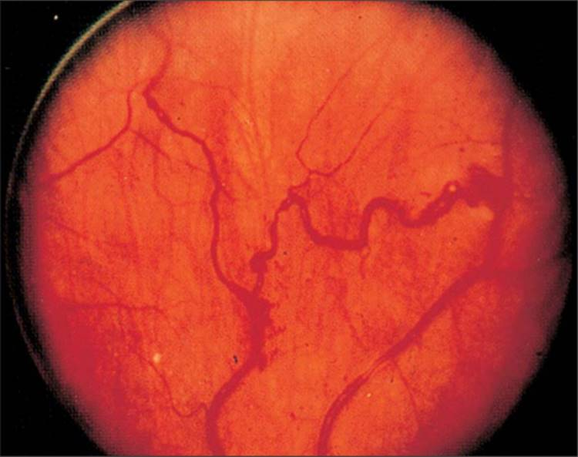
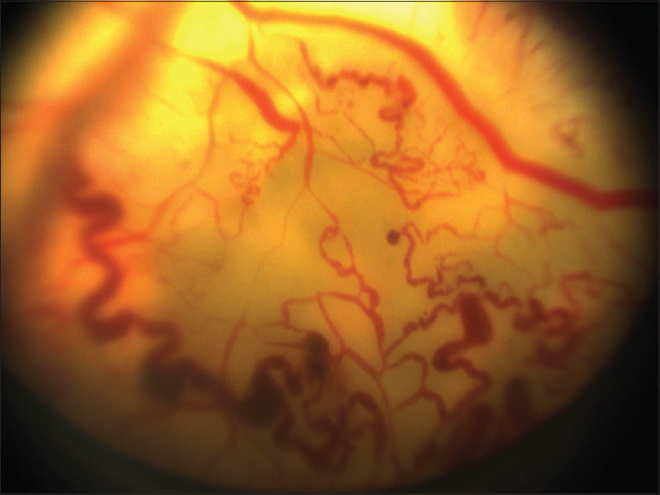
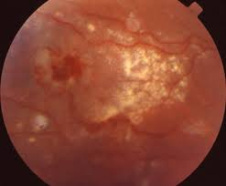
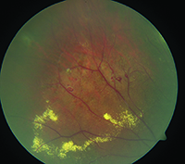
Coats: Telangiectasias, venous dilation, microaneurysms

Slide 29
Typical age at presentation? 6-8 years
Gender predilection? Male
Characterized by the presence of
abnormalities of the retinal vasculature:
--Telangiectasias
--Venous dilation
--Microaneurysms
--Capillary dilation
Laterality (ie, bi- vs uni-)? Unilateral
The retinal vascular abnormalities in
Systemic associations? None
Coats
disease
The vascular abnormalities lead to…
Inheritance pattern? None
White-yellow subretinal exudates
…
No question—proceed when ready

Slide 30
Typical age at presentation? 6-8 years
Gender predilection? Male
Characterized by the presence of
abnormalities of the retinal vasculature:
--Telangiectasias
--Venous dilation
--Microaneurysms
--Capillary dilation
Laterality (ie, bi- vs uni-)? Unilateral
The retinal vascular abnormalities in
Systemic associations? None
Coats
disease
The vascular abnormalities lead to…
Inheritance pattern? None
White-yellow subretinal exudates
…are responsible for the classic subretinal exudates
No question—proceed when ready

Slide 31
Typical age at presentation? 6-8 years
Gender predilection? Male
Characterized by the presence of
abnormalities of the retinal vasculature:
--Telangiectasias
--Venous dilation
--Microaneurysms
--Capillary dilation
Laterality (ie, bi- vs uni-)? Unilateral
Systemic associations? None
The vascular abnormalities lead to…
There is a variant of Coats in which the retinal vasculature abnormalities are limited to the temporal macula. What is this condition called?
Macular telangiectasia Type I—MacTel I
Coats
disease
Inheritance pattern? None
White-yellow subretinal exudates

Slide 32
Typical age at presentation? 6-8 years
Gender predilection? Male
Characterized by the presence of
abnormalities of the retinal vasculature:
--Telangiectasias
--Venous dilation
--Microaneurysms
--Capillary dilation
Laterality (ie, bi- vs uni-)? Unilateral
Systemic associations? None
The vascular abnormalities lead to…
There is a variant of Coats in which the retinal vasculature abnormalities are limited to the temporal macula. What is this condition called?
Macular telangiectasia Type I (MacTel I)
Coats
disease
Inheritance pattern? None
White-yellow subretinal exudates

Slide 33
Typical age at presentation? 6-8 years
Gender predilection? Male
Characterized by the presence of
abnormalities of the retinal vasculature:
--Telangiectasias
--Venous dilation
--Microaneurysms
--Capillary dilation
Laterality (ie, bi- vs uni-)? Unilateral
Systemic associations? None
The vascular abnormalities lead to…
There is a variant of Coats in which the retinal vasculature abnormalities are limited to the temporal macula. What is this condition called?
Macular telangiectasia Type I (MacTel I)
Coats
disease
Inheritance pattern? None
For more on MacTel, see slide-set R53
White-yellow subretinal exudates

Slide 34
Typical age at presentation? 6-8 years
Gender predilection? Male
Characterized by the presence of
abnormalities of the retinal vasculature:
--Telangiectasias
--Venous dilation
--Microaneurysms
--Capillary dilation
Laterality (ie, bi- vs uni-)? Unilateral
Systemic associations? None
Coats
disease
The vascular abnormalities lead to…
Inheritance pattern? None
White-yellow subretinal exudates
Next Q
If extensive, the exudates lead to…
Retinal detachment
two words

Slide 35
Typical age at presentation? 6-8 years
Gender predilection? Male
Characterized by the presence of
abnormalities of the retinal vasculature:
--Telangiectasias
--Venous dilation
--Microaneurysms
--Capillary dilation
Laterality (ie, bi- vs uni-)? Unilateral
Systemic associations? None
Coats
disease
The vascular abnormalities lead to…
Inheritance pattern? None
White-yellow subretinal exudates
If extensive, the exudates lead to…
Retinal detachment

Slide 36
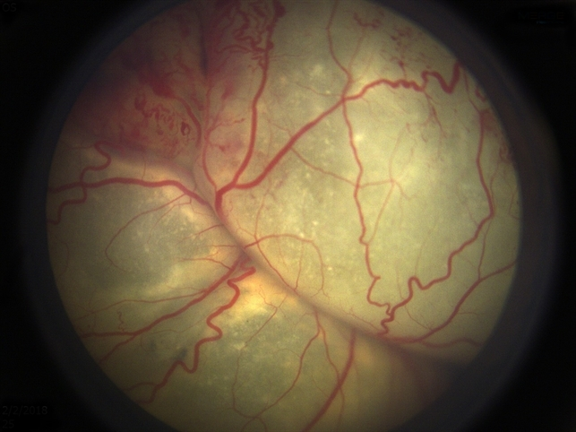
Coats: RD

Slide 37
Typical age at presentation? 6-8 years
Gender predilection? Male
Characterized by the presence of
abnormalities of the retinal vasculature:
--Telangiectasias
--Venous dilation
--Microaneurysms
--Capillary dilation
Laterality (ie, bi- vs uni-)? Unilateral
Systemic associations? None
Coats
disease
The vascular abnormalities lead to…
Inheritance pattern? None
White-yellow subretinal exudates
If extensive, the exudates lead to…
Retinal detachment
If massive, the RD can result in…
Leukocoria or xanthocoria
two words

Slide 38
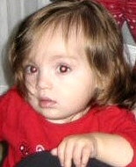
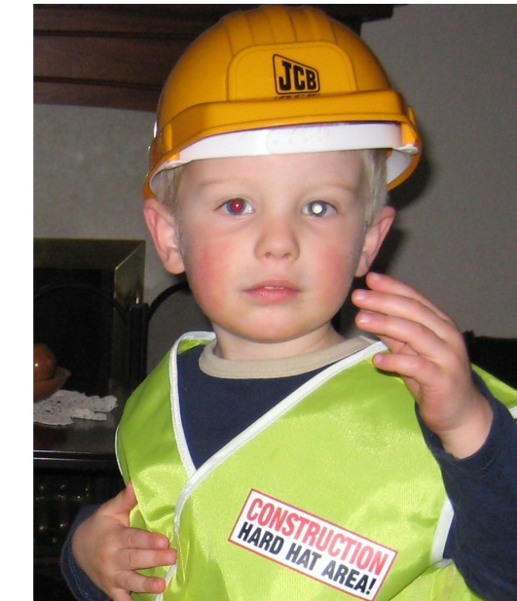
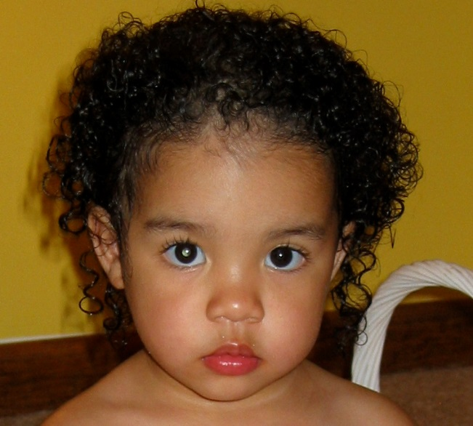
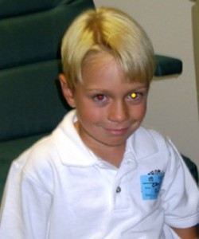
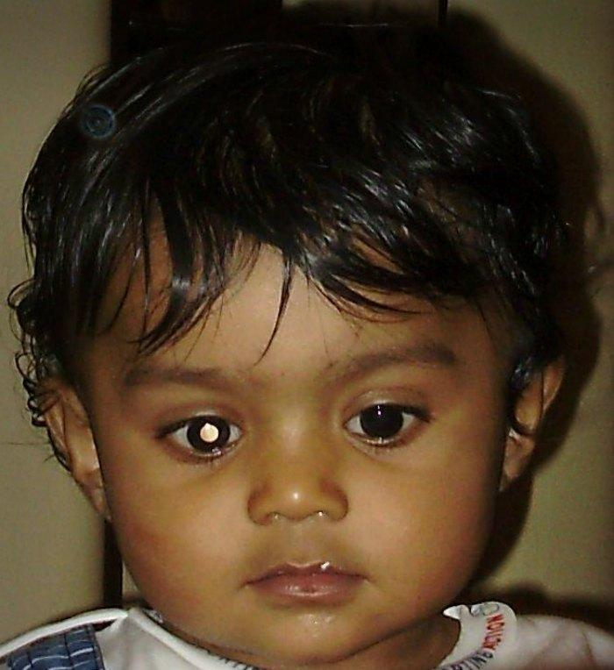
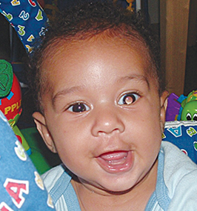
Typical age at presentation? 6-8 years
Gender predilection? Male
Characterized by the presence of
abnormalities of the retinal vasculature:
--Telangiectasias
--Venous dilation
--Microaneurysms
--Capillary dilation
Laterality (ie, bi- vs uni-)? Unilateral
Systemic associations? None
Coats
disease
The vascular abnormalities lead to…
Inheritance pattern? None
White-yellow subretinal exudates
If extensive, the exudates lead to…
Retinal detachment
If massive, the RD can result in…
Leukocoria or xanthocoria

Slide 39
Typical age at presentation? 6-8 years
Gender predilection? Male
Characterized by the presence of
abnormalities of the retinal vasculature:
--Telangiectasias
--Venous dilation
--Microaneurysms
--Capillary dilation
Laterality (ie, bi- vs uni-)? Unilateral
Systemic associations? None
Coats
disease
The vascular abnormalities lead to…
Inheritance pattern? None
White-yellow subretinal exudates
If extensive, the exudates lead to…
Retinal detachment
If massive, the RD can result in…
Leukocoria/xanthocoria place Coats on the DDx for…
Leukocoria or xanthocoria
Retinoblastoma

Slide 40
Typical age at presentation? 6-8 years
Gender predilection? Male
Characterized by the presence of
abnormalities of the retinal vasculature:
--Telangiectasias
--Venous dilation
--Microaneurysms
--Capillary dilation
Laterality (ie, bi- vs uni-)? Unilateral
Systemic associations? None
Coats
disease
The vascular abnormalities lead to…
Inheritance pattern? None
White-yellow subretinal exudates
If extensive, the exudates lead to…
Retinal detachment
If massive, the RD can result in…
Leukocoria/xanthocoria place Coats on the DDx for…
Leukocoria or xanthocoria
Retinoblastoma

Slide 41
Typical age at presentation? 6-8 years
Gender predilection? Male
Characterized by the presence of
abnormalities of the retinal vasculature:
--Telangiectasias
--Venous dilation
--Microaneurysms
--Capillary dilation
Laterality (ie, bi- vs uni-)? Unilateral
When it manifests with leukocoria,
Systemic associations? None
Coats
disease
The vascular abnormalities lead to…
Inheritance pattern? None
White-yellow subretinal exudates
must be differentiated from retinoblastoma
If extensive, the exudates lead to…
Retinal detachment
If massive, the RD can result in…
Leukocoria/xanthocoria place Coats on the DDx for…
Leukocoria or xanthocoria
Retinoblastoma
No question—proceed when ready

Slide 42
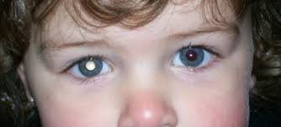
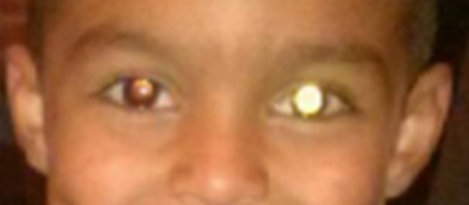
One child has Coats, the other Rb. Which is which?

Slide 43
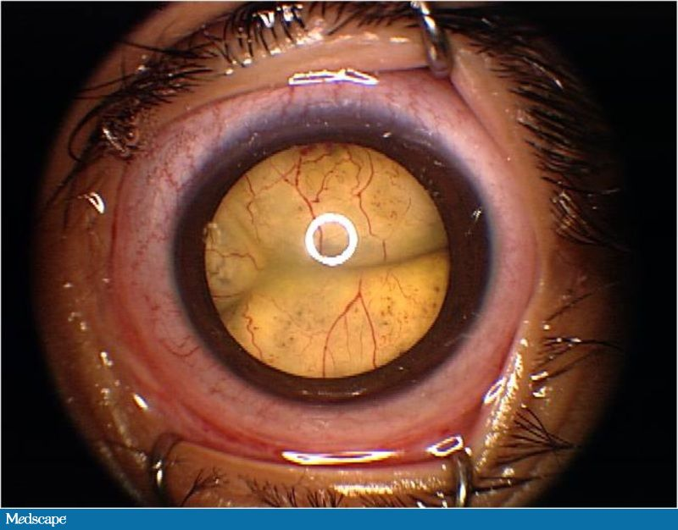
Is it Coats, or Rb?

Slide 44
To figure it out, look at the vasculature

Slide 45
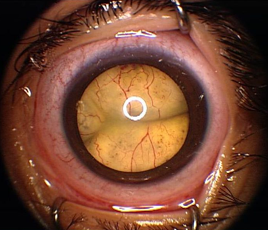
In Coats, the retinal vessels are dilated, with microaneurysms and telangiectasias. (Further, the appearance often has a yellow hue.)
No question—proceed when ready

Slide 46
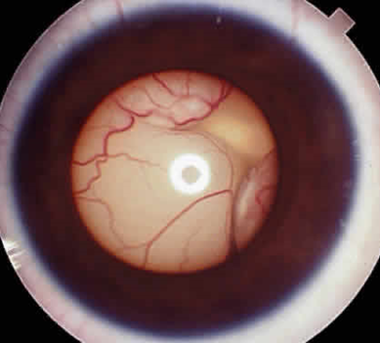
In Coats, the retinal vessels are dilated, with microaneurysms and telangiectasias. (Further, the appearance often has a yellow hue.)
Contrast with Rb, in which the retinal vessels
are normal in appearance. (And the hue tends to be white.)

Slide 47
In Coats, the retinal vessels are dilated, with microaneurysms and telangiectasias. (Further, the appearance often has a yellow hue.)
For more on Coats vs Rb, see slide-set R1
Contrast with Rb, in which the retinal vessels
are normal in appearance. (And the hue tends to be white.)

Slide 48
Typical age at presentation? 6-8 years
Gender predilection? Male
Characterized by the presence of
abnormalities of the retinal vasculature:
--Telangiectasias
--Venous dilation
--Microaneurysms
--Capillary dilation
Laterality (ie, bi- vs uni-)? Unilateral
Systemic associations? None
Coats
disease
The vascular abnormalities lead to…
Inheritance pattern? None
White-yellow subretinal exudates
If extensive, the exudates lead to…
Management?
Next question
Retinal detachment
If massive, the RD can result in…
Leukocoria/xanthocoria place Coats on the DDx for…
Leukocoria or xanthocoria
Retinoblastoma

Slide 49
Typical age at presentation? 6-8 years
Gender predilection? Male
Characterized by the presence of
abnormalities of the retinal vasculature:
--Telangiectasias
--Venous dilation
--Microaneurysms
--Capillary dilation
Laterality (ie, bi- vs uni-)? Unilateral
Systemic associations? None
Coats
disease
The vascular abnormalities lead to…
Inheritance pattern? None
White-yellow subretinal exudates
If extensive, the exudates lead to…
Management? Obliterate the vascular anomalies with cryo or photocoagulation
Retinal detachment
If massive, the RD can result in…
Leukocoria/xanthocoria place Coats on the DDx for…
Leukocoria or xanthocoria
Retinoblastoma

Slide 50
Typical age at presentation? 6-8 years
Gender predilection? Male
Characterized by the presence of
abnormalities of the retinal vasculature:
--Telangiectasias
--Venous dilation
--Microaneurysms
--Capillary dilation
Laterality (ie, bi- vs uni-)? Unilateral
Systemic associations? None
Coats
disease
The vascular abnormalities lead to…
Inheritance pattern? None
White-yellow subretinal exudates
If extensive, the exudates lead to…
Management? Obliterate the vascular anomalies with cryo or photocoagulation
Retinal detachment
If massive, the RD can result in…
Leukocoria/xanthocoria place Coats on the DDx for…
Leukocoria or xanthocoria
Retinoblastoma

Slide 51
Typical age at presentation? 6-8 years
Gender predilection? Male
Characterized by the presence of
abnormalities of the retinal vasculature:
--Telangiectasias
--Venous dilation
--Microaneurysms
--Capillary dilation
Laterality (ie, bi- vs uni-)? Unilateral
When it Progression of the exudates in
Systemic associations? None
Coats
disease
The vascular abnormalities lead to…
Inheritance pattern? None
White-yellow subretinal exudates
can be halted by treating the abnormal vessels
If extensive, the exudates lead to…
Management? Obliterate the vascular anomalies with cryo or photocoagulation
Retinal detachment
If massive, the RD can result in…
Leukocoria/xanthocoria place Coats on the DDx for…
Leukocoria or xanthocoria
Retinoblastoma
No question—proceed when ready

Slide 52
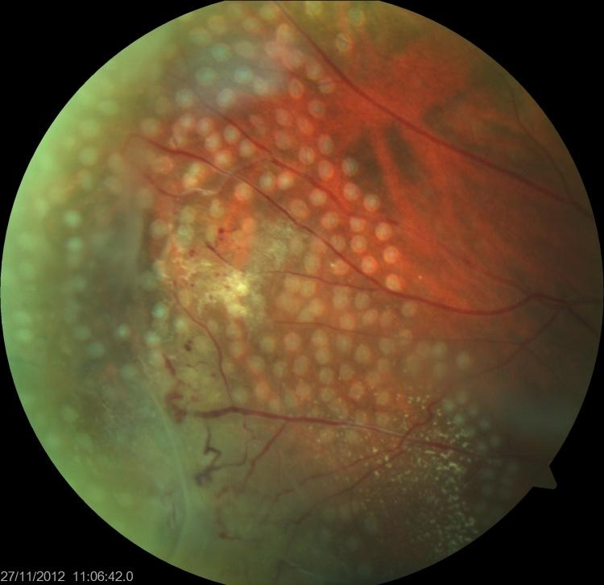
Coats s/p laser

Slide 53
Typical age at presentation? 6-8 years
Gender predilection? Male
Characterized by the presence of
abnormalities of the retinal vasculature:
--Telangiectasias
--Venous dilation
--Microaneurysms
--Capillary dilation
Laterality (ie, bi- vs uni-)? Unilateral
Systemic associations? None
Coats
disease
The vascular abnormalities lead to…
Inheritance pattern? None
White-yellow subretinal exudates
If extensive, the exudates lead to…
Management? Obliterate the vascular anomalies with
Retinal detachment
intravitreal anti-VEGF therapy?
What about intravitreal anti-VEGF injections—are they appropriate?
The BCSC is unclear on this score. The Retina book says it “may be a useful adjunctive treatment,” but the Peds book pointedly does not endorse it, and cautions it was “associated with a higher incidence” of complications in one study. Caveat emptor.
If massive, the RD can result in…
Leukocoria/xanthocoria place Coats on the DDx for…
Leukocoria or xanthocoria
Retinoblastoma

Slide 54
Typical age at presentation? 6-8 years
Gender predilection? Male
Characterized by the presence of
abnormalities of the retinal vasculature:
--Telangiectasias
--Venous dilation
--Microaneurysms
--Capillary dilation
Laterality (ie, bi- vs uni-)? Unilateral
Systemic associations? None
Coats
disease
The vascular abnormalities lead to…
Inheritance pattern? None
White-yellow subretinal exudates
If extensive, the exudates lead to…
Management? Obliterate the vascular anomalies with
Retinal detachment
intravitreal anti-VEGF therapy?
What about intravitreal anti-VEGF injections—are they appropriate?
The BCSC is unclear on this score. The Retina book says it “may be a useful adjunctive treatment,” but the Peds book pointedly does not endorse it, cautioning it was “associated with a higher incidence” of complications in one study. Caveat emptor.
If massive, the RD can result in…
Leukocoria/xanthocoria place Coats on the DDx for…
Leukocoria or xanthocoria
Retinoblastoma

Slide 55
Coats Disease: TLDR
No question—proceed when ready

Slide 56
Coats Disease: TLDR
Coats is a disease of young boys . It presents with unilateral , subretinal , white-yellow exudates.
demographic (two words)
two-words

Slide 57
Coats Disease: TLDR
Coats is a disease of young boys . It presents with unilateral , subretinal , white-yellow exudates.

Slide 58
Coats Disease: TLDR
Coats is a disease of young boys . It presents with unilateral , subretinal , white-yellow exudates.
It is sporadic , with no systemic associations
inheritance
yes/no

Slide 59
Coats Disease: TLDR
Coats is a disease of young boys . It presents with unilateral , subretinal , white-yellow exudates.
It is sporadic , with no systemic associations

Slide 60
Coats Disease: TLDR
Coats is a disease of young boys . It presents with unilateral , subretinal , white-yellow exudates.
It is sporadic , with no systemic associations
The retinal vascular abnormalities in Coats disease are responsible for the classic subretinal exudates
three words

Slide 61
Coats Disease: TLDR
Coats is a disease of young boys . It presents with unilateral , subretinal , white-yellow exudates.
It is sporadic , with no systemic associations
The retinal vascular abnormalities in Coats disease are responsible for the classic subretinal exudates

Slide 62
Coats Disease: TLDR
Coats is a disease of young boys . It presents with unilateral , subretinal , white-yellow exudates.
It is sporadic , with no systemic associations
The retinal vascular abnormalities in Coats disease are responsible for the classic subretinal exudates
When it manifests with leukocoria , Coats must be differentiated from retinoblastoma
finding
disease

Slide 63
Coats Disease: TLDR
Coats is a disease of young boys . It presents with unilateral , subretinal , white-yellow exudates.
It is sporadic , with no systemic associations
The retinal vascular abnormalities in Coats disease are responsible for the classic subretinal exudates
When it manifests with leukocoria , Coats must be differentiated from retinoblastoma

Slide 64
Coats Disease: TLDR
Coats is a disease of young boys . It presents with unilateral , subretinal , white-yellow exudates.
It is sporadic , with no systemic associations
The retinal vascular abnormalities in Coats disease are responsible for the classic subretinal exudates
When it manifests with leukocoria , Coats must be differentiated from retinoblastoma
Progression of the exudates can be halted by treating the abnormal vessels
two words

Slide 65
Coats Disease: TLDR
Coats is a disease of young boys . It presents with unilateral , subretinal , white-yellow exudates.
It is sporadic , with no systemic associations
The retinal vascular abnormalities in Coats disease are responsible for the classic subretinal exudates
When it manifests with leukocoria , Coats must be differentiated from retinoblastoma
Progression of the exudates can be halted by treating the abnormal vessels

