Slide 1
Q
Pediatric Leukemia and the Eye
Where does leukemia rank among childhood malignancies in terms of incidence?

Slide 2
A
Pediatric Leukemia and the Eye
Where does leukemia rank among childhood malignancies in terms of incidence?
It is #1 by a mile

Slide 3
Q
Pediatric Leukemia and the Eye
Where does leukemia rank among childhood malignancies in terms of incidence?
It is #1 by a mile
Leukemia accounts for what proportion of childhood malignancies?

Slide 4
A
Pediatric Leukemia and the Eye
Where does leukemia rank among childhood malignancies in terms of incidence?
It is #1 by a mile
Leukemia accounts for what proportion of childhood malignancies?
About 1/3

Slide 5
Q
Pediatric Leukemia and the Eye
Where does leukemia rank among childhood malignancies in terms of incidence?
It is #1 by a mile
Leukemia accounts for what proportion of childhood malignancies?
About 1/3
How many new cases of childhood leukemia occur every year in the US?

Slide 6
A
Pediatric Leukemia and the Eye
Where does leukemia rank among childhood malignancies in terms of incidence?
It is #1 by a mile
Leukemia accounts for what proportion of childhood malignancies?
About 1/3
How many new cases of childhood leukemia occur every year in the US?
About 4000

Slide 7
Q
Pediatric Leukemia and the Eye
Where does leukemia rank among childhood malignancies in terms of incidence?
It is #1 by a mile
Leukemia accounts for what proportion of childhood malignancies?
About 1/3
How many new cases of childhood leukemia occur every year in the US?
About 4000
To put this in perspective: How many new cases of retinoblastoma are there every year in the US?

Slide 8
A
Pediatric Leukemia and the Eye
Where does leukemia rank among childhood malignancies in terms of incidence?
It is #1 by a mile
Leukemia accounts for what proportion of childhood malignancies?
About 1/3
How many new cases of childhood leukemia occur every year in the US?
About 4000
To put this in perspective: How many new cases of retinoblastoma are there every year in the US?
Only 200-300 or so

Slide 9
Q
Pediatric Leukemia and the Eye
Where does leukemia rank among childhood malignancies in terms of incidence?
It is #1 by a mile
Re its histology: Does pediatric leukemia tend to be lymphocytic, or myelogenous?

Slide 10
A
Pediatric Leukemia and the Eye
Where does leukemia rank among childhood malignancies in terms of incidence?
It is #1 by a mile
Re its histology: Does pediatric leukemia tend to be lymphocytic, or myelogenous?
Lymphocytic

Slide 11
Q
Pediatric Leukemia and the Eye
Where does leukemia rank among childhood malignancies in terms of incidence?
It is #1 by a mile
Re its histology: Does pediatric leukemia tend to be lymphocytic, or myelogenous?
Lymphocytic
Does it tend to be acute, or chronic?

Slide 12
A
Pediatric Leukemia and the Eye
Where does leukemia rank among childhood malignancies in terms of incidence?
It is #1 by a mile
Re its histology: Does pediatric leukemia tend to be lymphocytic, or myelogenous?
Lymphocytic
Does it tend to be acute, or chronic?
Acute

Slide 13
Q
Pediatric Leukemia and the Eye
Where does leukemia rank among childhood malignancies in terms of incidence?
It is #1 by a mile
Re its histology: Does pediatric leukemia tend to be lymphocytic, or myelogenous?
Lymphocytic
Does it tend to be acute, or chronic?
Acute
Putting it all together, what sort of leukemia occurs in most pediatric cases?
Acute lymphocytic (ALL)

Slide 14
A
Pediatric Leukemia and the Eye
Where does leukemia rank among childhood malignancies in terms of incidence?
It is #1 by a mile
Re its histology: Does pediatric leukemia tend to be lymphocytic, or myelogenous?
Lymphocytic
Does it tend to be acute, or chronic?
Acute
Putting it all together, what sort of leukemia occurs in most pediatric cases?
Acute lymphocytic (ALL)

Slide 15
Pediatric Leukemia and the Eye
Where does leukemia rank among childhood malignancies in terms of incidence?
It is #1 by a mile
Re its histology: Does pediatric leukemia tend to be lymphocytic, or myelogenous?
Lymphocytic
Does it tend to be acute, or chronic?
Acute
Putting it all together, what sort of leukemia occurs in most pediatric cases?
Acute lymphocytic (ALL)
My way to remember that ALL is the pediatric leukemia:
I think of ALL as standing for ‘Adults Least Likely’

Slide 16
Pediatric Leukemia and the Eye
Where does leukemia rank among childhood malignancies in terms of incidence?
It is #1 by a mile
Re its histology: Does pediatric leukemia tend to be lymphocytic, or myelogenous?
Lymphocytic
Does it tend to be acute, or chronic?
Acute
Putting it all together, what sort of leukemia occurs in most pediatric cases?
Acute lymphocytic (ALL)
My way to remember that ALL is the pediatric leukemia:
I think of ALL as standing for ‘Adults Least Likely’
In contrast, the common form in adults is acute myelogenous leukemia, AML = ‘Adults Most Likely’

Slide 17
Q
Pediatric Leukemia and the Eye
Where does leukemia rank among childhood malignancies in terms of incidence?
It is #1 by a mile
Re its histology: Does pediatric leukemia tend to be lymphocytic, or myelogenous?
Lymphocytic
Does it tend to be acute, or chronic?
Acute
Is ophthalmic involvement common in leukemia?

Slide 18
A
Pediatric Leukemia and the Eye
Where does leukemia rank among childhood malignancies in terms of incidence?
It is #1 by a mile
Re its histology: Does pediatric leukemia tend to be lymphocytic, or myelogenous?
Lymphocytic
Does it tend to be acute, or chronic?
Acute
Is ophthalmic involvement common in leukemia?
Indeed it is

Slide 19
Q
Pediatric Leukemia and the Eye
Where does leukemia rank among childhood malignancies in terms of incidence?
It is #1 by a mile
Re its histology: Does pediatric leukemia tend to be lymphocytic, or myelogenous?
Lymphocytic
Does it tend to be acute, or chronic?
Acute
Is ophthalmic involvement common in leukemia?
Indeed it is
Clinical involvement of which ophthalmic structures is common?
--?
--?
--?
--?
--?

Slide 20
A
Pediatric Leukemia and the Eye
Where does leukemia rank among childhood malignancies in terms of incidence?
It is #1 by a mile
Re its histology: Does pediatric leukemia tend to be lymphocytic, or myelogenous?
Lymphocytic
Does it tend to be acute, or chronic?
Acute
Is ophthalmic involvement common in leukemia?
Indeed it is
Clinical involvement of which ophthalmic structures is common?
--The orbit
--The anterior chamber
--The iris
--The retina
--The optic nerve

Slide 21
Q
Pediatric Leukemia and the Eye
Where does leukemia rank among childhood malignancies in terms of incidence?
It is #1 by a mile
Re its histology: Does pediatric leukemia tend to be lymphocytic, or myelogenous?
Lymphocytic
Does it tend to be acute, or chronic?
Acute
Is ophthalmic involvement common in leukemia?
Indeed it is
Clinical involvement of which ophthalmic structures is common?
--The orbit
--The anterior chamber
--The iris
--The retina
--The optic nerve
Which structure is most commonly affected by leukemia?

Slide 22
A
Pediatric Leukemia and the Eye
Where does leukemia rank among childhood malignancies in terms of incidence?
It is #1 by a mile
Re its histology: Does pediatric leukemia tend to be lymphocytic, or myelogenous?
Lymphocytic
Does it tend to be acute, or chronic?
Acute
Is ophthalmic involvement common in leukemia?
Indeed it is
Clinical involvement of which ophthalmic structures is common?
--The orbit
--The anterior chamber
--The iris
--The retina
--The optic nerve
Which structure is most commonly affected by leukemia?
The choroid

Slide 23
Q
Pediatric Leukemia and the Eye
Where does leukemia rank among childhood malignancies in terms of incidence?
It is #1 by a mile
Re its histology: Does pediatric leukemia tend to be lymphocytic, or myelogenous?
Lymphocytic
Does it tend to be acute, or chronic?
Acute
Is ophthalmic involvement common in leukemia?
Indeed it is
Clinical involvement of which ophthalmic structures is common?
--The orbit
--The anterior chamber
--The iris
--The retina
--The optic nerve
Which structure is most commonly affected by leukemia?
The choroid
Say what? The choroid isn’t even on the list. What the deal?
The deal is this: Being the most vascular structure in the eye, it should come as no surprise that the choroid is the structure most likely to be involved with a hematologic malignancy. That said, leukemic choroidal lesions are very subtle, and thus easily missed on exam. For this reason, the choroid doesn’t make the list of ophthalmic structures likely to manifest clinical involvement in leukemia.

Slide 24
A
Pediatric Leukemia and the Eye
Where does leukemia rank among childhood malignancies in terms of incidence?
It is #1 by a mile
Re its histology: Does pediatric leukemia tend to be lymphocytic, or myelogenous?
Lymphocytic
Does it tend to be acute, or chronic?
Acute
Is ophthalmic involvement common in leukemia?
Indeed it is
Clinical involvement of which ophthalmic structures is common?
--The orbit
--The anterior chamber
--The iris
--The retina
--The optic nerve
Which structure is most commonly affected by leukemia?
The choroid
Say what? The choroid isn’t even on the list. What the deal?
The deal is this: Being the most vascular structure in the eye, it should come as no surprise that the choroid is the structure most likely to be involved with a hematologic malignancy. That said… choroidal lesions are very subtle, and thus easily missed on exam. For this reason, the choroid doesn’t make the list of ophthalmic structures likely to manifest clinical involvement in leukemia.

Slide 25
A
Pediatric Leukemia and the Eye
Where does leukemia rank among childhood malignancies in terms of incidence?
It is #1 by a mile
Re its histology: Does pediatric leukemia tend to be lymphocytic, or myelogenous?
Lymphocytic
Does it tend to be acute, or chronic?
Acute
Is ophthalmic involvement common in leukemia?
Indeed it is
Clinical involvement of which ophthalmic structures is common?
--The orbit
--The anterior chamber
--The iris
--The retina
--The optic nerve
Which structure is most commonly affected by leukemia?
The choroid
Say what? The choroid isn’t even on the list. What the deal?
The deal is this: Being the most vascular structure in the eye, it should come as no surprise that the choroid is the structure most likely to be involved with a hematologic malignancy. That said…leukemic choroidal lesions are very subtle, and thus easily missed on exam. For this reason, the choroid doesn’t make the list of ophthalmic structures likely to manifest clinical involvement in leukemia.

Slide 26
Q
Pediatric Leukemia and the Eye
Where does leukemia rank among childhood malignancies in terms of incidence?
It is #1 by a mile
Re its histology: Does pediatric leukemia tend to be lymphocytic, or myelogenous?
Lymphocytic
Does it tend to be acute, or chronic?
Acute
Is ophthalmic involvement common in leukemia?
Indeed it is
Clinical involvement of which ophthalmic structures is common?
--The orbit
--The anterior chamber
--The iris
--The retina
--The optic nerve
Which structure is most commonly affected by leukemia?
The choroid
Say what? The choroid isn’t even on the list. What the deal?
The deal is this: Being the most vascular structure in the eye, it should come as no surprise that the choroid is the structure most likely to be involved with a hematologic malignancy. That said…leukemic choroidal lesions are very subtle, and thus easily missed on exam. For this reason, the choroid doesn’t make the list of ophthalmic structures likely to manifest clinical involvement in leukemia.
If choroidal involvement isn’t clinically apparent, how on earth are you supposed to know it’s present?
It will manifest on ultrasonography as diffuse thickening

Slide 27
Q/A
Pediatric Leukemia and the Eye
Where does leukemia rank among childhood malignancies in terms of incidence?
It is #1 by a mile
Re its histology: Does pediatric leukemia tend to be lymphocytic, or myelogenous?
Lymphocytic
Does it tend to be acute, or chronic?
Acute
Is ophthalmic involvement common in leukemia?
Indeed it is
Clinical involvement of which ophthalmic structures is common?
--The orbit
--The anterior chamber
--The iris
--The retina
--The optic nerve
Which structure is most commonly affected by leukemia?
The choroid
Say what? The choroid isn’t even on the list. What the deal?
The deal is this: Being the most vascular structure in the eye, it should come as no surprise that the choroid is the structure most likely to be involved with a hematologic malignancy. That said…leukemic choroidal lesions are very subtle, and thus easily missed on exam. For this reason, the choroid doesn’t make the list of ophthalmic structures likely to manifest clinical involvement in leukemia.
If choroidal involvement isn’t clinically apparent, how on earth are you supposed to know it’s present?
It will manifest on ultrasonography
test

Slide 28
A
Pediatric Leukemia and the Eye
Where does leukemia rank among childhood malignancies in terms of incidence?
It is #1 by a mile
Re its histology: Does pediatric leukemia tend to be lymphocytic, or myelogenous?
Lymphocytic
Does it tend to be acute, or chronic?
Acute
Is ophthalmic involvement common in leukemia?
Indeed it is
Clinical involvement of which ophthalmic structures is common?
--The orbit
--The anterior chamber
--The iris
--The retina
--The optic nerve
Which structure is most commonly affected by leukemia?
The choroid
Say what? The choroid isn’t even on the list. What the deal?
The deal is this: Being the most vascular structure in the eye, it should come as no surprise that the choroid is the structure most likely to be involved with a hematologic malignancy. That said…leukemic choroidal lesions are very subtle, and thus easily missed on exam. For this reason, the choroid doesn’t make the list of ophthalmic structures likely to manifest clinical involvement in leukemia.
If choroidal involvement isn’t clinically apparent, how on earth are you supposed to know it’s present?
It will manifest on ultrasonography*
*OCT is likely correct as well, but my Academy source only mentions ultrasound

Slide 29
Q
Pediatric Leukemia and the Eye
Where does leukemia rank among childhood malignancies in terms of incidence?
It is #1 by a mile
Re its histology: Does pediatric leukemia tend to be lymphocytic, or myelogenous?
Lymphocytic
Does it tend to be acute, or chronic?
Acute
Is ophthalmic involvement common in leukemia?
Indeed it is
Clinical involvement of which ophthalmic structures is common?
--The orbit
--The anterior chamber
--The iris
--The retina
--The optic nerve
Which structure is most commonly affected by leukemia?
The choroid
Say what? The choroid isn’t even on the list. What the deal?
The deal is this: Being the most vascular structure in the eye, it should come as no surprise that the choroid is the structure most likely to be involved with a hematologic malignancy. That said…leukemic choroidal lesions are very subtle, and thus easily missed on exam. For this reason, the choroid doesn’t make the list of ophthalmic structures likely to manifest clinical involvement in leukemia.
If choroidal involvement isn’t clinically apparent, how on earth are you supposed to know it’s present?
It will manifest on ultrasonography as diffuse thickening
two words

Slide 30
A
Pediatric Leukemia and the Eye
Where does leukemia rank among childhood malignancies in terms of incidence?
It is #1 by a mile
Re its histology: Does pediatric leukemia tend to be lymphocytic, or myelogenous?
Lymphocytic
Does it tend to be acute, or chronic?
Acute
Is ophthalmic involvement common in leukemia?
Indeed it is
Clinical involvement of which ophthalmic structures is common?
--The orbit
--The anterior chamber
--The iris
--The retina
--The optic nerve
Which structure is most commonly affected by leukemia?
The choroid
Say what? The choroid isn’t even on the list. What the deal?
The deal is this: Being the most vascular structure in the eye, it should come as no surprise that the choroid is the structure most likely to be involved with a hematologic malignancy. That said…leukemic choroidal lesions are very subtle, and thus easily missed on exam. For this reason, the choroid doesn’t make the list of ophthalmic structures likely to manifest clinical involvement in leukemia.
If choroidal involvement isn’t clinically apparent, how on earth are you supposed to know it’s present?
It will manifest on ultrasonography as diffuse thickening

Slide 31
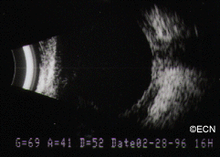
Pediatric Leukemia and the Eye
Leukemia: Choroidal thickening on b-scan

Slide 32
Q
Pediatric Leukemia and the Eye
Where does leukemia rank among childhood malignancies in terms of incidence?
It is #1 by a mile
Re its histology: Does pediatric leukemia tend to be lymphocytic, or myelogenous?
Lymphocytic
Does it tend to be acute, or chronic?
Acute
Is ophthalmic involvement common in leukemia?
Indeed it is
Clinical involvement of which ophthalmic structures is common?
--The orbit?
--The anterior chamber?
--The iris?
--The retina?
--The optic nerve?
Which structure is most commonly affected by leukemia?
The choroid
OK, smart guy, which structure is clinically involved most frequently?
The retina
clincially
^

Slide 33
A
Pediatric Leukemia and the Eye
Where does leukemia rank among childhood malignancies in terms of incidence?
It is #1 by a mile
Re its histology: Does pediatric leukemia tend to be lymphocytic, or myelogenous?
Lymphocytic
Does it tend to be acute, or chronic?
Acute
Is ophthalmic involvement common in leukemia?
Indeed it is
Clinical involvement of which ophthalmic structures is common?
--The orbit
--The anterior chamber
--The iris
--The retina!
--The optic nerve
Which structure is most commonly affected by leukemia?
The choroid
OK, smart guy, which structure is clinically involved most frequently?
The retina
clincially
^
The retina

Slide 34
Q
Pediatric Leukemia and the Eye
Where does leukemia rank among childhood malignancies in terms of incidence?
It is #1 by a mile
Re its histology: Does pediatric leukemia tend to be lymphocytic, or myelogenous?
Lymphocytic
Does it tend to be acute, or chronic?
Acute
Is ophthalmic involvement common in leukemia?
Indeed it is
Clinical involvement of which ophthalmic structures is common?
--The orbit
--The anterior chamber
--The iris
--The retina
--The optic nerve
Which structure is most commonly affected by leukemia?
The choroid
The vitreous isn’t on the list. Is it like the choroid, ie, commonly involved but clinically inapparent?
No, just the opposite--vitreous involvement is very rare in leukemia
--The vitreous?

Slide 35
A
Pediatric Leukemia and the Eye
Where does leukemia rank among childhood malignancies in terms of incidence?
It is #1 by a mile
Re its histology: Does pediatric leukemia tend to be lymphocytic, or myelogenous?
Lymphocytic
Does it tend to be acute, or chronic?
Acute
Is ophthalmic involvement common in leukemia?
Indeed it is
Clinical involvement of which ophthalmic structures is common?
--The orbit
--The anterior chamber
--The iris
--The retina
--The optic nerve
Which structure is most commonly affected by leukemia?
The choroid
The vitreous isn’t on the list. Is it like the choroid, ie, commonly involved but clinically inapparent?
No, just the opposite—vitreous involvement is very rare in leukemia
--The vitreous? No!

Slide 36
Pediatric Leukemia and the Eye
Where does leukemia rank among childhood malignancies in terms of incidence?
It is #1 by a mile
Re its histology: Does pediatric leukemia tend to be lymphocytic, or myelogenous?
Lymphocytic
Does it tend to be acute, or chronic?
Acute
Is ophthalmic involvement common in leukemia?
Indeed it is
Clinical involvement of which ophthalmic structures is common?
--The orbit
--The anterior chamber
--The iris
--The retina!
--The optic nerve
Which structure is most commonly affected by leukemia?
The choroid
Next, we will drill down on retinal involvement in leukemia
clincially
^
The retina

Slide 37
Q
Pediatric Leukemia and the Eye
Pediatric leukemia and the eye
Retinopathy less common than in adult leukemics
more vs
less

Slide 38
A
Pediatric Leukemia and the Eye
Pediatric leukemia and the eye
Retinopathy less common than in adult leukemics

Slide 39
Q
Pediatric Leukemia and the Eye
Pediatric leukemia and the eye
Retinopathy less common than in adult leukemics
Most common eye finding: RNFL hemorrhages
(abb.) + one word

Slide 40
A
Pediatric Leukemia and the Eye
Pediatric leukemia and the eye
Retinopathy less common than in adult leukemics
Most common eye finding: RNFL hemorrhages

Slide 41
Q
Pediatric Leukemia and the Eye
Pediatric leukemia and the eye
Retinopathy less common than in adult leukemics
Most common eye finding: RNFL hemorrhages
What is the mechanism by which retinal hemorrhages come to pass?

Slide 42
A
Pediatric Leukemia and the Eye
Pediatric leukemia and the eye
Retinopathy less common than in adult leukemics
Most common eye finding: RNFL hemorrhages
What is the mechanism by which retinal hemorrhages come to pass?
The interplay of three derangements produced by the leukemia:
--?
--?
--?

Slide 43
Q
Pediatric Leukemia and the Eye
Pediatric leukemia and the eye
Retinopathy less common than in adult leukemics
Most common eye finding: RNFL hemorrhages
What is the mechanism by which retinal hemorrhages come to pass?
The interplay of three derangements produced by the leukemia:
--Anemia
--Vascular occlusion
--Thrombocytopenia

Slide 44
Q
Pediatric Leukemia and the Eye
Pediatric leukemia and the eye
Retinopathy less common than in adult leukemics
Most common eye finding: RNFL hemorrhages
Can be white centered (Roth spots)
specific appearance

Slide 45
Q/A
Pediatric Leukemia and the Eye
Pediatric leukemia and the eye
Retinopathy less common than in adult leukemics
Most common eye finding: RNFL hemorrhages
Can be white centered (aka Roth spots )
eponym

Slide 46
A
Pediatric Leukemia and the Eye
Pediatric leukemia and the eye
Retinopathy less common than in adult leukemics
Most common eye finding: RNFL hemorrhages
Can be white centered (aka Roth spots )

Slide 47
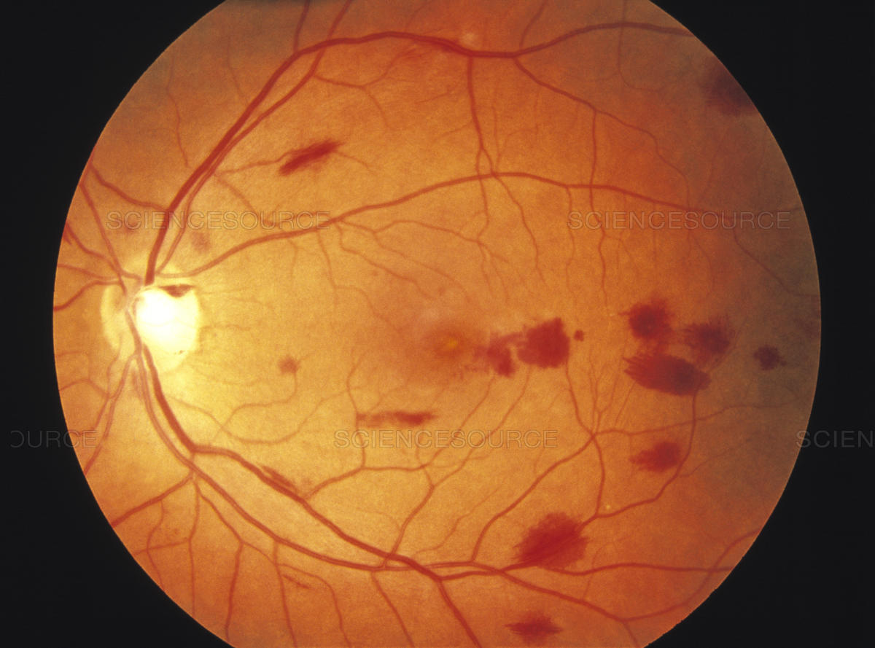
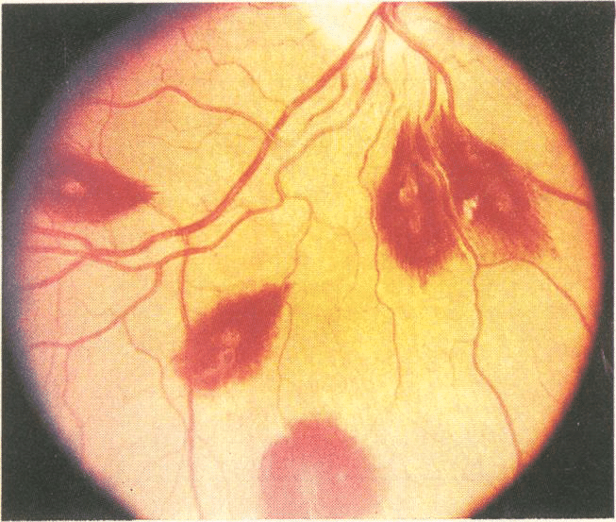
Pediatric Leukemia and the Eye
Retinal hemorrhages in leukemia
(Full disclosure: I don’t know if these are kids)

Slide 48
Q
Pediatric Leukemia and the Eye
Pediatric leukemia and the eye
Retinopathy less common than in adult leukemics
Most common eye finding: RNFL hemorrhages
Can be white centered (aka Roth spots )
What is the DDx for Roth spots?
--Leukemia
--Subacute bacterial endocarditis!
--Anemia
--Endophthalmitis
--(There are many others)
What is the DDx for Roth spots?
--Leukemia (duh)
--?Subacute bacterial endocarditis
--?
--?
--(There are many others)

Slide 49
A
Pediatric Leukemia and the Eye
Pediatric leukemia and the eye
Retinopathy less common than in adult leukemics
Most common eye finding: RNFL hemorrhages
Can be white centered (aka Roth spots )
What is the DDx for Roth spots?
--Leukemia
--Subacute bacterial endocarditis!
--Anemia
--Endophthalmitis
--(There are many others)
What is the DDx for Roth spots?
--Leukemia (duh)
--Subacute bacterial endocarditis
--Anemia
--Endophthalmitis
--(There are many others)

Slide 50
Q
Pediatric Leukemia and the Eye
Pediatric leukemia and the eye
Retinopathy less common than in adult leukemics
Most common eye finding: RNFL hemorrhages
Can be white centered (aka Roth spots )
What is the DDx for Roth spots?
--Leukemia
--Subacute bacterial endocarditis!
--Anemia
--Endophthalmitis
--(There are many others)
What is the DDx for Roth spots?
--Leukemia?
--Subacute bacterial endocarditis?
--Anemia?
--Endophthalmitis?
--(There are many others)
Of these, which is the most commonly cause of Roth spots?

Slide 51
A
Pediatric Leukemia and the Eye
Pediatric leukemia and the eye
Retinopathy less common than in adult leukemics
Most common eye finding: RNFL hemorrhages
Can be white centered (aka Roth spots )
What is the DDx for Roth spots?
--Leukemia
--Subacute bacterial endocarditis!
--Anemia
--Endophthalmitis
--(There are many others)
Of these, which is the most commonly cause of Roth spots?
SABE

Slide 52
Pediatric Leukemia and the Eye
Pediatric leukemia and the eye
Retinopathy less common than in adult leukemics
Most common eye finding: RNFL hemorrhages
Can be white centered (aka Roth spots )
Note: There is inconsistency across Academy sources with regard to the term Roth spots.
--Early in the BCSC Path book, Roth spot and white-centered hemorrhage are used interchangeably and are said to occur “in a number of conditions;” later, the term pseudo-Roth spot is used to refer to white-centered hemorrhages secondary to leukemia. (Per the master index, pseudo-Roth spot appears nowhere else in the BCSC.)
--The Uveitis book uses ‘Roth spots’ when referring to white-centered hemorrhages secondary to bacterial endophthalmitis, but not when referring to those secondary to leukemia (these are simply termed ‘white-centered hemorrhages’).
--The Peds book just says retinal hemorrhages in leukemia “may have white centers.”
--The Academy source EyeWiki uses Roth spot to refer to white-centered hemorrhages of any cause.
--Puzzlingly, neither Roth spot nor white-centered hemorrhage appear in the index of the Retina book.
What’s the correct usage? I dunno. Caveat emptor.
What is the DDx for Roth spots?
--Leukemia
--Subacute bacterial endocarditis!
--Anemia
--Endophthalmitis
--(There are many others)
Of these, which is the most commonly cause of Roth spots?
SABE

Slide 53
Q
Pediatric Leukemia and the Eye
Pediatric leukemia and the eye
Retinopathy less common than in adult leukemics
Most common eye finding: RNFL hemorrhages
Can be white centered (aka Roth spots )
Is the RNFL the only location at which intraocular leukemic hemorrhages can occur?

Slide 54
A
Pediatric Leukemia and the Eye
Pediatric leukemia and the eye
Retinopathy less common than in adult leukemics
Most common eye finding: RNFL hemorrhages
Can be white centered (aka Roth spots )
Is the RNFL the only location at which intraocular leukemic hemorrhages can occur?
Not by a long shot. Intraretinal hemorrhages can occur at any level (ie, not just the NFL).

Slide 55
Q
Pediatric Leukemia and the Eye
Pediatric leukemia and the eye
Retinopathy less common than in adult leukemics
Most common eye finding: RNFL hemorrhages
Can be white centered (aka Roth spots )
Is the RNFL the only location at which intraocular leukemic hemorrhages can occur?
Not by a long shot. Intraretinal hemorrhages can occur at any level (ie, not just the NFL). Preretinal as well as vitreous hemorrhages can also occur.
not retina
not retina

Slide 56
A
Pediatric Leukemia and the Eye
Pediatric leukemia and the eye
Retinopathy less common than in adult leukemics
Most common eye finding: RNFL hemorrhages
Can be white centered (aka Roth spots )
Is the RNFL the only location at which intraocular leukemic hemorrhages can occur?
Not by a long shot. Intraretinal hemorrhages can occur at any level (ie, not just the NFL). Preretinal as well as vitreous hemorrhages can also occur.

Slide 57
Q
Pediatric Leukemia and the Eye
Pediatric leukemia and the eye
Retinopathy less common than in adult leukemics
Most common eye finding: RNFL hemorrhages
Can be white centered (aka Roth spots )
Is the RNFL the only location at which intraocular leukemic hemorrhages can occur?
Not by a long shot. Intraretinal hemorrhages can occur at any level (ie, not just the NFL). Preretinal as well as vitreous hemorrhages can also occur. Finally, both subretinal and choroidal hemorrhages may occur as well.
not retina
not retina

Slide 58
A
Pediatric Leukemia and the Eye
Pediatric leukemia and the eye
Retinopathy less common than in adult leukemics
Most common eye finding: RNFL hemorrhages
Can be white centered (aka Roth spots )
Is the RNFL the only location at which intraocular leukemic hemorrhages can occur?
Not by a long shot. Intraretinal hemorrhages can occur at any level (ie, not just the NFL). Preretinal as well as vitreous hemorrhages can also occur. Finally, both subretinal and choroidal hemorrhages may occur as well.

Slide 59
Q
Pediatric Leukemia and the Eye
Pediatric leukemia and the eye
Retinopathy less common than in adult leukemics
Most common eye finding: RNFL hemorrhages
Can be white centered (aka Roth spots )
ONH can be infiltrated: Papilledema-like appearance
two-words

Slide 60
A
Pediatric Leukemia and the Eye
Pediatric leukemia and the eye
Retinopathy less common than in adult leukemics
Most common eye finding: RNFL hemorrhages
Can be white centered (aka Roth spots )
ONH can be infiltrated: Papilledema-like appearance

Slide 61
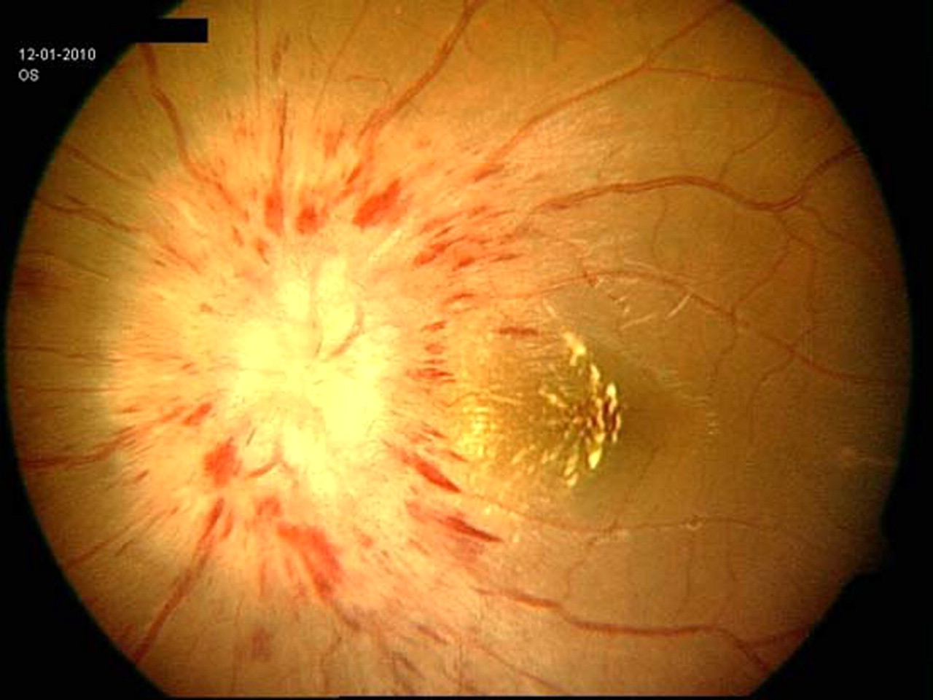
Pediatric Leukemia and the Eye
Leukemia: ONH infiltration
(20 y.o. with recurrent ALL)

Slide 62
Q
Pediatric Leukemia and the Eye
Pediatric leukemia and the eye
Retinopathy less common than in adult leukemics
Most common eye finding: RNFL hemorrhages
Can be white centered (aka Roth spots )
ONH can be infiltrated: Papilledema-like appearance
Early ONH involvement→permanent loss of central vision: Medical emergency—need emergent radiation therapy
treatment

Slide 63
A/Q
Pediatric Leukemia and the Eye
Pediatric leukemia and the eye
Retinopathy less common than in adult leukemics
Most common eye finding: RNFL hemorrhages
Can be white centered (aka Roth spots )
ONH can be infiltrated: Papilledema-like appearance
Early ONH involvement→permanent loss of central vision: Medical emergency—need emergent radiation therapy*
* Intrathecal chemotherapy is also indicated

Slide 64
A
Pediatric Leukemia and the Eye
Pediatric leukemia and the eye
Retinopathy less common than in adult leukemics
Most common eye finding: RNFL hemorrhages
Can be white centered (aka Roth spots )
ONH can be infiltrated: Papilledema-like appearance
Early ONH involvement→permanent loss of central vision: Medical emergency—need emergent radiation therapy*
* Intrathecal chemotherapy is also indicated

Slide 65
Q
Pediatric Leukemia and the Eye
Pediatric leukemia and the eye
Retinopathy less common than in adult leukemics
Most common eye finding: RNFL hemorrhages
Can be white centered (aka Roth spots )
ONH can be infiltrated: Papilledema-like appearance
Early ONH involvement→permanent loss of central vision: Medical emergency—need emergent radiation therapy
Note: Chemo patients are abnormally sensitive to radiation therapy—blinding ONH atrophy can occur!
complication

Slide 66
A
Pediatric Leukemia and the Eye
Pediatric leukemia and the eye
Retinopathy less common than in adult leukemics
Most common eye finding: RNFL hemorrhages
Can be white centered (aka Roth spots )
ONH can be infiltrated: Papilledema-like appearance
Early ONH involvement→permanent loss of central vision: Medical emergency—need emergent radiation therapy
Note: Chemo patients are abnormally sensitive to radiation therapy—blinding ONH atrophy can occur!

Slide 67
Q
Pediatric Leukemia and the Eye
Pediatric leukemia and the eye
Retinopathy less common than in adult leukemics
Most common eye finding: RNFL hemorrhages
Can be white centered (aka Roth spots )
ONH can be infiltrated: Papilledema-like appearance
Early ONH involvement→permanent loss of central vision: Medical emergency—need emergent radiation therapy
Note: Chemo patients are abnormally sensitive to radiation therapy—blinding ONH atrophy can occur!
Leukemic infiltration of anterior segment can produce:
H eterochromia iridis
H ypopyon
H yphema
The three H’s of anterior
segment leukemic infiltration

Slide 68
A
Pediatric Leukemia and the Eye
Pediatric leukemia and the eye
Retinopathy less common than in adult leukemics
Most common eye finding: RNFL hemorrhages
Can be white centered (aka Roth spots )
ONH can be infiltrated: Papilledema-like appearance
Early ONH involvement→permanent loss of central vision: Medical emergency—need emergent radiation therapy
Note: Chemo patients are abnormally sensitive to radiation therapy—blinding ONH atrophy can occur!
Leukemic infiltration of anterior segment can produce:
Heterochromia iridis
Hypopyon
Hyphema

Slide 69
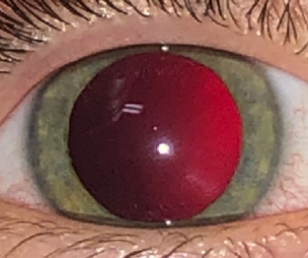
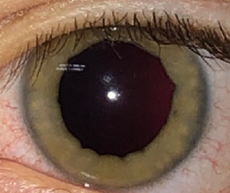
Pediatric Leukemia and the Eye
Normal right iris
Left iris: Diffuse thickening, yellowish infiltrate
Leukemia: Heterochromia iridis

Slide 70
Pediatric Leukemia and the Eye
Normal right iris
Left iris: Diffuse thickening, yellowish infiltrate
Recall what was said earlier about leukemic involvement of the choroid resulting in its diffuse thickening…
Leukemia: Heterochromia iridis

Slide 71
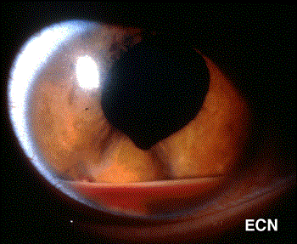
Pediatric Leukemia and the Eye
Leukemia: Hyphema (with a little hypopyon as well)

Slide 72
Q
Pediatric Leukemia and the Eye
Pediatric leukemia and the eye
Retinopathy less common than in adult leukemics
Most common eye finding: RNFL hemorrhages
Can be white centered (aka Roth spots )
ONH can be infiltrated: Papilledema-like appearance
Early ONH involvement→permanent loss of central vision: Medical emergency—need emergent radiation therapy
Note: Chemo patients are abnormally sensitive to radiation therapy—blinding ONH atrophy can occur!
Leukemic infiltration of anterior segment can produce:
Heterochromia iridis
Hypopyon?
Hyphema
Is it a hypopyon, or pseudohypopyon?
As with Roth spots vs Pseudo-Roth spots vs white-centered hemorrhages, the BCSC is unclear in this regard. Caveat emptor.
Pseudo -
^

Slide 73
A
Pediatric Leukemia and the Eye
Pediatric leukemia and the eye
Retinopathy less common than in adult leukemics
Most common eye finding: RNFL hemorrhages
Can be white centered (aka Roth spots )
ONH can be infiltrated: Papilledema-like appearance
Early ONH involvement→permanent loss of central vision: Medical emergency—need emergent radiation therapy
Note: Chemo patients are abnormally sensitive to radiation therapy—blinding ONH atrophy can occur!
Leukemic infiltration of anterior segment can produce:
Heterochromia iridis
Hypopyon?
Hyphema
Is it a hypopyon, or pseudohypopyon?
As with Roth spots vs Pseudo-Roth spots vs white-centered hemorrhages, the BCSC is unclear in this regard. Caveat emptor.
Pseudo -
^

Slide 74
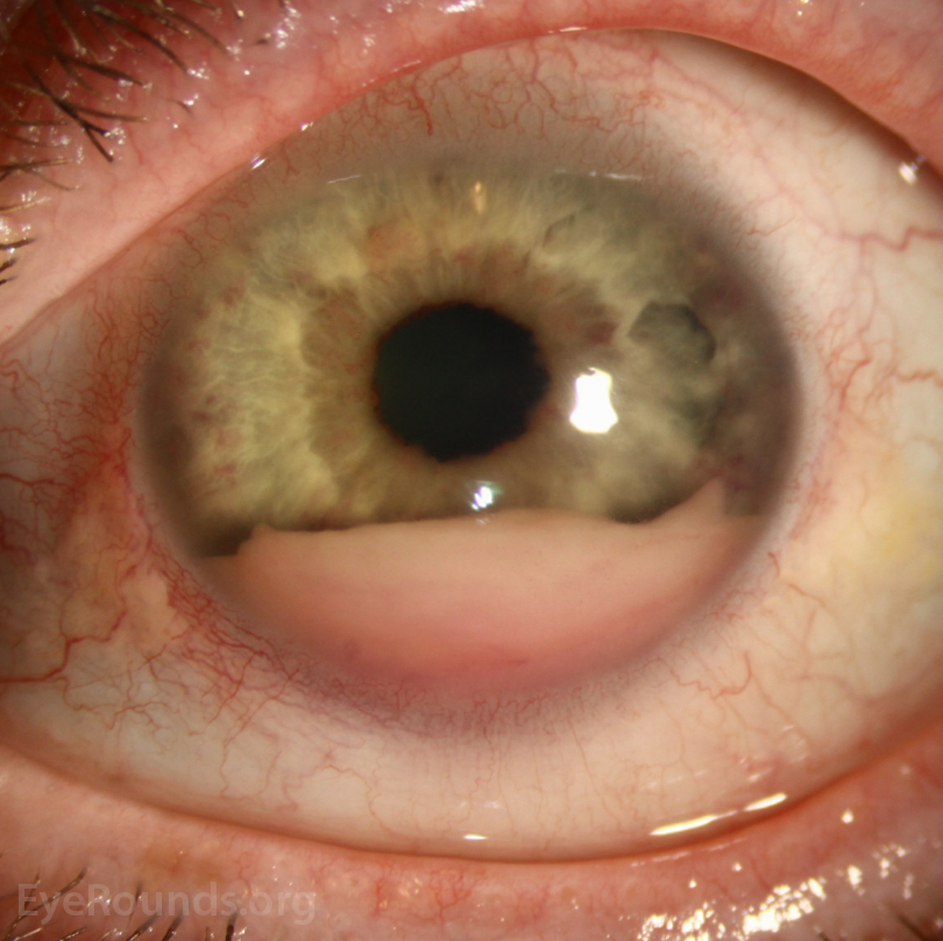
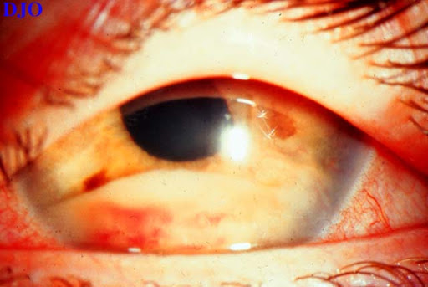
Pediatric Leukemia and the Eye
With a little hyphema as well
Leukemia: (Pseudo)hypopyon

Slide 75
Q
Pediatric Leukemia and the Eye
Pediatric leukemia and the eye
Retinopathy less common than in adult leukemics
Most common eye finding: RNFL hemorrhages
Can be white centered (aka Roth spots )
ONH can be infiltrated: Papilledema-like appearance
Early ONH involvement→permanent loss of central vision: Medical emergency—need emergent radiation therapy
Note: Chemo patients are abnormally sensitive to radiation therapy—blinding ONH atrophy can occur!
Leukemic infiltration of anterior segment can produce:
Heterochromia iridis
Hypopyon
Hyphema
Eyes with leukemic manifestations in the anterior chamber are at risk for the development of glaucoma by two separate mechanisms. What are they?
--?Tumor cells and/or RBCs can physically clog the TM, impeding aqueous egress
--?Posterior synechiae can develop, leading to pupillary seclusion and pupillary-block glaucoma

Slide 76
Q
Pediatric Leukemia and the Eye
Pediatric leukemia and the eye
Retinopathy less common than in adult leukemics
Most common eye finding: RNFL hemorrhages
Can be white centered (aka Roth spots )
ONH can be infiltrated: Papilledema-like appearance
Early ONH involvement→permanent loss of central vision: Medical emergency—need emergent radiation therapy
Note: Chemo patients are abnormally sensitive to radiation therapy—blinding ONH atrophy can occur!
Leukemic infiltration of anterior segment can produce:
Heterochromia iridis
Hypopyon
Hyphema
Eyes with leukemic manifestations in the anterior chamber are at risk for the development of glaucoma by two separate mechanisms. What are they?
--Tumor cells and/or RBCs can clog the TM, thereby impeding aqueous egress
--? synechiae can develop, leading to pupillary seclusion and thus pupillary-block glaucoma

Slide 77
A
Pediatric Leukemia and the Eye
Pediatric leukemia and the eye
Retinopathy less common than in adult leukemics
Most common eye finding: RNFL hemorrhages
Can be white centered (aka Roth spots )
ONH can be infiltrated: Papilledema-like appearance
Early ONH involvement→permanent loss of central vision: Medical emergency—need emergent radiation therapy
Note: Chemo patients are abnormally sensitive to radiation therapy—blinding ONH atrophy can occur!
Leukemic infiltration of anterior segment can produce:
Heterochromia iridis
Hypopyon
Hyphema
Eyes with leukemic manifestations in the anterior chamber are at risk for the development of glaucoma by two separate mechanisms. What are they?
--Tumor cells and/or RBCs can clog the TM, thereby impeding aqueous egress
--? synechiae can develop, leading to pupillary seclusion and thus pupillary-block glaucoma

Slide 78
Q
Pediatric Leukemia and the Eye
Pediatric leukemia and the eye
Retinopathy less common than in adult leukemics
Most common eye finding: RNFL hemorrhages
Can be white centered (aka Roth spots )
ONH can be infiltrated: Papilledema-like appearance
Early ONH involvement→permanent loss of central vision: Medical emergency—need emergent radiation therapy
Note: Chemo patients are abnormally sensitive to radiation therapy—blinding ONH atrophy can occur!
Leukemic infiltration of anterior segment can produce:
Heterochromia iridis
Hypopyon
Hyphema
Eyes with leukemic manifestations in the anterior chamber are at risk for the development of glaucoma by two separate mechanisms. What are they?
--Tumor cells and/or RBCs can clog the TM, thereby impeding aqueous egress
--Posterior synechiae can develop, leading to pupillary seclusion and thus pupillary-block glaucoma
two words

Slide 79
A
Pediatric Leukemia and the Eye
Pediatric leukemia and the eye
Retinopathy less common than in adult leukemics
Most common eye finding: RNFL hemorrhages
Can be white centered (aka Roth spots )
ONH can be infiltrated: Papilledema-like appearance
Early ONH involvement→permanent loss of central vision: Medical emergency—need emergent radiation therapy
Note: Chemo patients are abnormally sensitive to radiation therapy—blinding ONH atrophy can occur!
Leukemic infiltration of anterior segment can produce:
Heterochromia iridis
Hypopyon
Hyphema
Eyes with leukemic manifestations in the anterior chamber are at risk for the development of glaucoma by two separate mechanisms. What are they?
--Tumor cells and/or RBCs can clog the TM, thereby impeding aqueous egress
--Posterior synechiae can develop, leading to pupillary seclusion and thus pupillary-block glaucoma

Slide 80
Q
Pediatric Leukemia and the Eye
Pediatric leukemia and the eye
Retinopathy less common than in adult leukemics
Most common eye finding: RNFL hemorrhages
Can be white centered (aka Roth spots )
ONH can be infiltrated: Papilledema-like appearance
Early ONH involvement→permanent loss of central vision: Medical emergency—need emergent radiation therapy
Note: Chemo patients are abnormally sensitive to radiation therapy—blinding ONH atrophy can occur!
Leukemic infiltration of anterior segment can produce:
Heterochromia iridis
Hypopyon
Hyphema
Eyes with leukemic manifestations in the anterior chamber are at risk for the development of glaucoma by two separate mechanisms. What are they?
--Tumor cells and/or RBCs can clog the TM, thereby impeding aqueous egress
--Posterior synechiae can develop, leading to pupillary seclusion and subsequent pupillary-block glaucoma

Slide 81
A
Pediatric Leukemia and the Eye
Pediatric leukemia and the eye
Retinopathy less common than in adult leukemics
Most common eye finding: RNFL hemorrhages
Can be white centered (aka Roth spots )
ONH can be infiltrated: Papilledema-like appearance
Early ONH involvement→permanent loss of central vision: Medical emergency—need emergent radiation therapy
Note: Chemo patients are abnormally sensitive to radiation therapy—blinding ONH atrophy can occur!
Leukemic infiltration of anterior segment can produce:
Heterochromia iridis
Hypopyon
Hyphema
Eyes with leukemic manifestations in the anterior chamber are at risk for the development of glaucoma by two separate mechanisms. What are they?
--Tumor cells and/or RBCs can clog the TM, thereby impeding aqueous egress
--Posterior synechiae can develop, leading to pupillary seclusion and subsequent pupillary-block glaucoma

Slide 82
Q
Pediatric Leukemia and the Eye
Pediatric leukemia and the eye
Retinopathy less common than in adult leukemics
Most common eye finding: RNFL hemorrhages
Can be white centered (aka Roth spots )
ONH can be infiltrated: Papilledema-like appearance
Early ONH involvement→permanent loss of central vision: Medical emergency—need emergent radiation therapy
Note: Chemo patients are abnormally sensitive to radiation therapy—blinding ONH atrophy can occur!
Leukemic infiltration of anterior segment can produce:
Heterochromia iridis
Hypopyon
Hyphema
If a child (or adult, for that matter) presents with hypopyon,
what general sort of condition is likely to top the initial DDx?
Uveitis
What is the general term for the set of conditions that can present like uveitis, but are not infectious/inflammatory (ie, not uveitides)?
Masquerade syndromes

Slide 83
A
Pediatric Leukemia and the Eye
Pediatric leukemia and the eye
Retinopathy less common than in adult leukemics
Most common eye finding: RNFL hemorrhages
Can be white centered (aka Roth spots )
ONH can be infiltrated: Papilledema-like appearance
Early ONH involvement→permanent loss of central vision: Medical emergency—need emergent radiation therapy
Note: Chemo patients are abnormally sensitive to radiation therapy—blinding ONH atrophy can occur!
Leukemic infiltration of anterior segment can produce:
Heterochromia iridis
Hypopyon
Hyphema
If a child (or adult, for that matter) presents with hypopyon,
what general sort of condition is likely to top the initial DDx?
Uveitis
What is the general term for the set of conditions that can present like uveitis, but are not infectious/inflammatory (ie, not uveitides)?
Masquerade syndromes

Slide 84
Q
Pediatric Leukemia and the Eye
Pediatric leukemia and the eye
Retinopathy less common than in adult leukemics
Most common eye finding: RNFL hemorrhages
Can be white centered (aka Roth spots )
ONH can be infiltrated: Papilledema-like appearance
Early ONH involvement→permanent loss of central vision: Medical emergency—need emergent radiation therapy
Note: Chemo patients are abnormally sensitive to radiation therapy—blinding ONH atrophy can occur!
Leukemic infiltration of anterior segment can produce:
Heterochromia iridis
Hypopyon
Hyphema
If a child (or adult, for that matter) presents with hypopyon,
what general sort of condition is likely to top the initial DDx?
Uveitis
What is the general term for the set of conditions that can present like uveitis, but are not infectious/inflammatory (ie, not uveitides)?
Masquerade syndromes

Slide 85
A
Pediatric Leukemia and the Eye
Pediatric leukemia and the eye
Retinopathy less common than in adult leukemics
Most common eye finding: RNFL hemorrhages
Can be white centered (aka Roth spots )
ONH can be infiltrated: Papilledema-like appearance
Early ONH involvement→permanent loss of central vision: Medical emergency—need emergent radiation therapy
Note: Chemo patients are abnormally sensitive to radiation therapy—blinding ONH atrophy can occur!
Leukemic infiltration of anterior segment can produce:
Heterochromia iridis
Hypopyon
Hyphema
If a child (or adult, for that matter) presents with hypopyon,
what general sort of condition is likely to top the initial DDx?
Uveitis
What is the general term for the set of conditions that can present like uveitis, but are not infectious/inflammatory (ie, not uveitides)?
Masquerade syndromes

Slide 86
Pediatric Leukemia and the Eye
Pediatric leukemia and the eye
Retinopathy less common than in adult leukemics
Most common eye finding: RNFL hemorrhages
Can be white centered (aka Roth spots )
ONH can be infiltrated: Papilledema-like appearance
Early ONH involvement→permanent loss of central vision: Medical emergency—need emergent radiation therapy
Note: Chemo patients are abnormally sensitive to radiation therapy—blinding ONH atrophy can occur!
Leukemic infiltration of anterior segment can produce:
Heterochromia iridis
Hypopyon
Hyphema
If a child (or adult, for that matter) presents with hypopyon,
what general sort of condition is likely to top the initial DDx?
Uveitis
What is the general term for the set of conditions that can present like uveitis, but are not infectious/inflammatory (ie, not uveitides)?
Masquerade syndromes
Let’s do a brief overview of masquerade syndromes then call it a day…

Slide 87
Q
Masquerade
Syndrome
A
very
basic
distinction
?
?

Slide 88
A
Masquerade
Syndrome
A
very
basic
distinction
Nonneoplastic
Neoplastic

Slide 89
Q
Masquerade
Syndrome
Nonneoplastic
Neoplastic
A
very
basic
distinction
?
?

Slide 90
A
Masquerade
Syndrome
Nonneoplastic
Neoplastic
A
very
basic
distinction
Solid
Hematologic

Slide 91
Q
Masquerade
Syndrome
Nonneoplastic
Neoplastic
Solid
Hematologic
ditto
?
?

Slide 92
A
Masquerade
Syndrome
Nonneoplastic
Neoplastic
Solid
Hematologic
ditto
Leukemic
Lymphoid

Slide 93
Q
Masquerade
Syndrome
Nonneoplastic
Neoplastic
Solid
Hematologic
Leukemic
Lymphoid
?
?
?

Slide 94
A
Masquerade
Syndrome
Nonneoplastic
Neoplastic
Solid
Hematologic
Leukemic
Lymphoid
Primary CNS lymphoma
Secondary to systemic lymphoma
Lymphoproliferative dz

Slide 95
Q
Masquerade
Syndrome
Nonneoplastic
Neoplastic
Solid
Hematologic
Leukemic
Lymphoid
?
Primary CNS lymphoma
Secondary to systemic lymphoma
Lymphoproliferative dz

Slide 96
A
Masquerade
Syndrome
Nonneoplastic
Neoplastic
Solid
Hematologic
Leukemic
Leukemia
There it is…
Lymphoid
Primary CNS lymphoma
Secondary to systemic lymphoma
Lymphoproliferative dz

Slide 97
Q
Masquerade
Syndrome
Nonneoplastic
Neoplastic
Solid
ditto
?
Hematologic
?
Leukemic
Lymphoid
Leukemia
Primary CNS lymphoma
Secondary to systemic lymphoma
Lymphoproliferative dz

Slide 98
A
Masquerade
Syndrome
Nonneoplastic
Neoplastic
Solid
ditto
Mets
Hematologic
Primary
Leukemic
Lymphoid
Leukemia
Primary CNS lymphoma
Secondary to systemic lymphoma
Lymphoproliferative dz

Slide 99
Q
Masquerade
Syndrome
Nonneoplastic
Neoplastic
Solid
Hematologic
Mets
Primary
Leukemic
?
?
Lymphoid
Leukemia
Primary CNS lymphoma
Secondary to systemic lymphoma
Lymphoproliferative dz

Slide 100
A
Masquerade
Syndrome
Nonneoplastic
Neoplastic
Solid
Mets
Hematologic
Mets
Primary
Leukemic
Uveal melanoma
Rb
Lymphoid
Leukemia
Primary CNS lymphoma
Secondary to systemic lymphoma
Lymphoproliferative dz

Slide 101
Q
Masquerade
Syndrome
Nonneoplastic
Neoplastic
Solid
Mets
Hematologic
Mets
?
?
Primary
Leukemic
Uveal melanoma
Rb
Lymphoid
Leukemia
Primary CNS lymphoma
Secondary to systemic lymphoma
Lymphoproliferative dz

Slide 102
A
Masquerade
Syndrome
Nonneoplastic
Neoplastic
Solid
Hematologic
Mets
Lung
Breast
Primary
Leukemic
Uveal melanoma
Rb
Lymphoid
Leukemia
Primary CNS lymphoma
Secondary to systemic lymphoma
Lymphoproliferative dz

Slide 103
Q
Masquerade
Syndrome
Nonneoplastic
Neoplastic
?
?
?
?
?
?
Solid
Hematologic
Mets
Lung
Breast
Primary
Leukemic
Uveal melanoma
Rb
Lymphoid
Leukemia
Primary CNS lymphoma
Secondary to systemic lymphoma
Lymphoproliferative dz

Slide 104
A
Masquerade
Syndrome
Nonneoplastic
Neoplastic
Retinitis pigmentosa
Ocular ischemic syndrome
Chronic rhegmatogenous RD
Intraocular foreign body
Pigment dispersion syndrome
Juvenile xanthogranuloma
Solid
Hematologic
Mets
Lung
Breast
Primary
Leukemic
Uveal melanoma
Rb
Lymphoid
Leukemia
Primary CNS lymphoma
Secondary to systemic lymphoma
Lymphoproliferative dz

