Slide 1
Q
Fill in the IOP equation below. What is its eponymous name?
The Goldmann equation
Aqueous Formation Rate (μL/min)
Outflow Facility (μL/min/mmHg)
Episcleral Venous
Pressure (EVP)
IOP =
+

Slide 2
A
Fill in the IOP equation below. What is its eponymous name?
The Goldmann equation
Aqueous Formation Rate (μL/min)
Outflow Facility (μL/min/mmHg)
Episcleral Venous
Pressure (mmHg)
IOP =
+

Slide 3
Q
?
The Goldmann Equation
Fill in the IOP equation below. What is its eponymous name?
The Goldmann equation
Aqueous Formation Rate (μL/min)
Outflow Facility (μL/min/mmHg)
Episcleral Venous
Pressure (mmHg)
IOP =
+

Slide 4
A
The Goldmann Equation
Fill in the IOP equation below. What is its eponymous name?
The Goldmann equation
Aqueous Formation Rate (μL/min)
Outflow Facility (μL/min/mmHg)
Episcleral Venous
Pressure (mmHg)
IOP =
+

Slide 5
The Goldmann Equation
Fill in the IOP equation below. What is its eponymous name?
The Goldmann equation
Aqueous Formation Rate (μL/min)
Outflow Facility (μL/min/mmHg)
Episcleral Venous
Pressure (mmHg)
IOP =
+
Note how the μL/min cancel, leaving IOP in mmHg

Slide 6
Q
The Goldmann Equation
Fill in the IOP equation below. What is its eponymous name?
The Goldmann equation
Aqueous Formation Rate (μL/min)
Outflow Facility (μL/min/mmHg)
Episcleral Venous
Pressure (mmHg)
IOP =
+
So to lower IOP, one must:
--decrease aqueous formation, and/or
--increase outflow facility, and/or
--decrease episcleral venous pressure
…and/or dehydrate the vitreous with a
hyperosmotic agent
Three IOP-lowering maneuvers implied by the Goldmann equation

Slide 7
A
The Goldmann Equation
Fill in the IOP equation below. What is its eponymous name?
The Goldmann equation
Aqueous Formation Rate (μL/min)
Outflow Facility (μL/min/mmHg)
Episcleral Venous
Pressure (mmHg)
IOP =
+
So to lower IOP, one must:
--decrease aqueous formation, and/or
--increase outflow facility, and/or
--decrease episcleral venous pressure
…and/or dehydrate the vitreous with a
hyperosmotic agent
Three IOP-lowering maneuvers implied by the Goldmann equation

Slide 8
The Goldmann Equation
Fill in the IOP equation below. What is its eponymous name?
The Goldmann equation
Aqueous Formation Rate (μL/min)
Outflow Facility (μL/min/mmHg)
Episcleral Venous
Pressure (mmHg)
IOP =
+
So to lower IOP, one must:
--decrease aqueous formation, and/or
--increase outflow facility, and/or
--decrease episcleral venous pressure
…and/or dehydrate the vitreous with a
hyperosmotic agent
Three IOP-lowering maneuvers implied by the Goldmann equation
Foreshadowing alert! Toward the end of the set we will address an important and oft-used IOP-lowering maneuver not implied by the Goldmann equation
Important IOP-lowering maneuver not implied by the
Goldmann equation
No question—proceed when ready

Slide 9
The Goldmann Equation
Fill in the IOP equation below. What is its eponymous name?
The Goldmann equation
Aqueous Formation Rate (μL/min)
Outflow Facility (μL/min/mmHg)
Episcleral Venous
Pressure (mmHg)
IOP =
+
Let’s take a look at the process of aqueous formation…
So to lower IOP, one must:
--decrease aqueous formation, and/or
--increase outflow facility, and/or
--decrease episcleral venous pressure
No question—proceed when ready

Slide 10
Q
The Goldmann Equation
Speaking of Aqueous Formation…
Where is it formed? What cells specifically?

Slide 11
Q/A
The Goldmann Equation
Speaking of Aqueous Formation…
Where is it formed? What cells specifically? Nonpigmented epithelial cells of the pars plicata portion of the ciliary body
pigmented vs nonpigmented
two words
two different words

Slide 12
A
The Goldmann Equation
Speaking of Aqueous Formation…
Where is it formed? What cells specifically? Nonpigmented epithelial cells of the pars plicata portion of the ciliary body

Slide 13
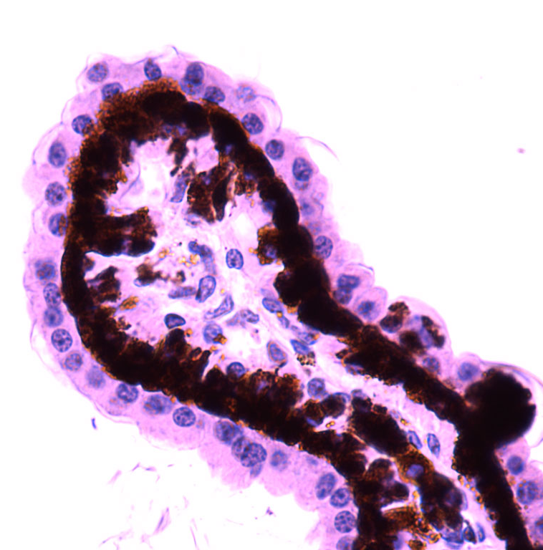
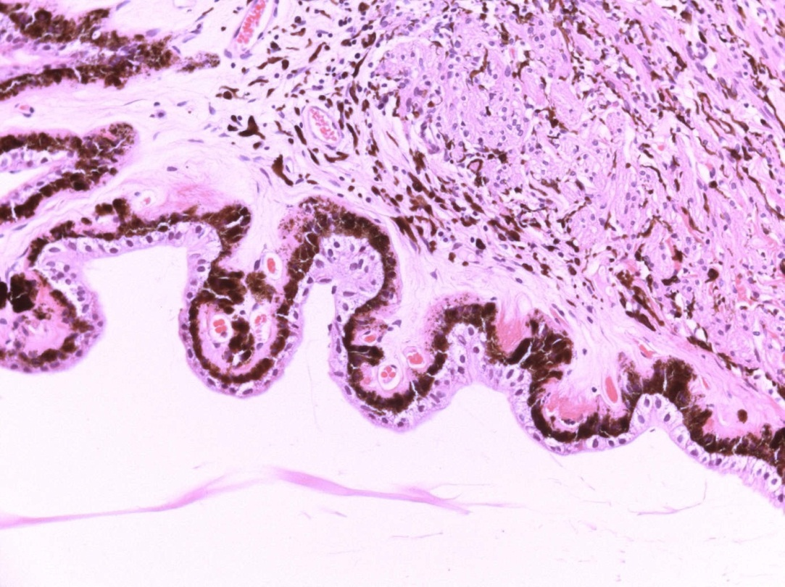
Lower mag
Higher mag
Nonpigmented epithelium of the pars plicata of the ciliary body
(note also the presence of a pigmented epithelial layer)

Slide 14
Q
The Goldmann Equation
Speaking of Aqueous Formation…
Where is it formed? What cells specifically? Nonpigmented epithelial cells of the pars plicata portion of the ciliary body
The ciliary body has two parts. One is the pars plicata; what is the other?

Slide 15
A
The Goldmann Equation
Speaking of Aqueous Formation…
Where is it formed? What cells specifically? Nonpigmented epithelial cells of the pars plicata portion of the ciliary body
The ciliary body has two parts. One is the pars plicata; what is the other?
The pars plana

Slide 16
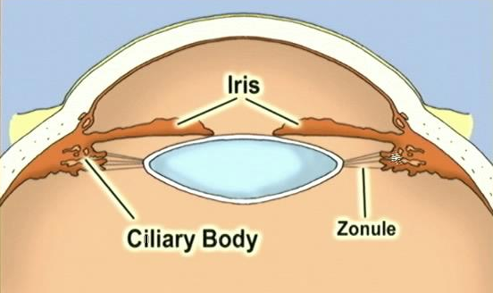
Q
This part is the…Pars plicata
This part is the…Pars plana
Ciliary body: One perspective, two questions

Slide 17
A
This part is the…Pars plicata
This part is the…Pars plana
Ciliary body: One perspective, two questions

Slide 18
Q
The Goldmann Equation
Speaking of Aqueous Formation…
Where is it formed? What cells specifically? Nonpigmented epithelial cells of the pars plicata portion of the ciliary body
What is the normal rate of production? 2-3 μL/min
#-#

Slide 19
A
The Goldmann Equation
Speaking of Aqueous Formation…
Where is it formed? What cells specifically? Nonpigmented epithelial cells of the pars plicata portion of the ciliary body
What is the normal rate of production? 2-3 μL/min

Slide 20
Q
The Goldmann Equation
Speaking of Aqueous Formation…
Where is it formed? What cells specifically? Nonpigmented epithelial cells of the pars plicata portion of the ciliary body
What is the normal rate of production? 2-3 μL/min
An important clarification is needed regarding this figure—what is it?

Slide 21
Q/A
The Goldmann Equation
Speaking of Aqueous Formation…
Where is it formed? What cells specifically? Nonpigmented epithelial cells of the pars plicata portion of the ciliary body
What is the normal rate of production? 2-3 μL/min
An important clarification is needed regarding this figure—what is it?
This is the rate of aqueous production while the individual is awake
general state

Slide 22
A
The Goldmann Equation
Speaking of Aqueous Formation…
Where is it formed? What cells specifically? Nonpigmented epithelial cells of the pars plicata portion of the ciliary body
What is the normal rate of production? 2-3 μL/min
An important clarification is needed regarding this figure—what is it?
This is the rate of aqueous production while the individual is awake

Slide 23
Q
The Goldmann Equation
Speaking of Aqueous Formation…
Where is it formed? What cells specifically? Nonpigmented epithelial cells of the pars plicata portion of the ciliary body
What is the normal rate of production? 2-3 μL/min
An important clarification is needed regarding this figure—what is it?
This is the rate of aqueous production while the individual is awake
Is the rate while sleeping higher, or lower?

Slide 24
A
The Goldmann Equation
Speaking of Aqueous Formation…
Where is it formed? What cells specifically? Nonpigmented epithelial cells of the pars plicata portion of the ciliary body
What is the normal rate of production? 2-3 μL/min
An important clarification is needed regarding this figure—what is it?
This is the rate of aqueous production while the individual is awake
Is the rate while sleeping higher, or lower? How much lower?
Lower

Slide 25
Q
The Goldmann Equation
Speaking of Aqueous Formation…
Where is it formed? What cells specifically? Nonpigmented epithelial cells of the pars plicata portion of the ciliary body
What is the normal rate of production? 2-3 μL/min
An important clarification is needed regarding this figure—what is it?
This is the rate of aqueous production while the individual is awake
Is the rate while sleeping higher, or lower? How much lower?
Lower

Slide 26
Q/A
The Goldmann Equation
Speaking of Aqueous Formation…
Where is it formed? What cells specifically? Nonpigmented epithelial cells of the pars plicata portion of the ciliary body
What is the normal rate of production? 2-3 μL/min
An important clarification is needed regarding this figure—what is it?
This is the rate of aqueous production while the individual is awake
Is the rate while sleeping higher, or lower? How much lower?
Lower. Depends on which book you read—per the Glaucoma book, the rate drops “by about 50% ” during sleep
%

Slide 27
A
The Goldmann Equation
Speaking of Aqueous Formation…
Where is it formed? What cells specifically? Nonpigmented epithelial cells of the pars plicata portion of the ciliary body
What is the normal rate of production? 2-3 μL/min
An important clarification is needed regarding this figure—what is it?
This is the rate of aqueous production while the individual is awake
Is the rate while sleeping higher, or lower? How much lower?
Lower. Depends on which book you read—per the Glaucoma book, the rate drops “by about 50% ” during sleep

Slide 28
Q
The Goldmann Equation
Speaking of Aqueous Formation…
Where is it formed? What cells specifically? Nonpigmented epithelial cells of the pars plicata portion of the ciliary body
What is the normal rate of production? 2-3 μL/min
An important clarification is needed regarding this figure—what is it?
This is the rate of aqueous production while the individual is awake
Is the rate while sleeping higher, or lower? How much lower?
Lower. Depends on which book you read—per the Glaucoma book, the rate drops “by about 50% ” during sleep, whereas the Fundamentals book gives a sleep-production rate of 1.0 μl/min.
#

Slide 29
A
The Goldmann Equation
Speaking of Aqueous Formation…
Where is it formed? What cells specifically? Nonpigmented epithelial cells of the pars plicata portion of the ciliary body
What is the normal rate of production? 2-3 μL/min
An important clarification is needed regarding this figure—what is it?
This is the rate of aqueous production while the individual is awake
Is the rate while sleeping higher, or lower? How much lower?
Lower. Depends on which book you read—per the Glaucoma book, the rate drops “by about 50% ” during sleep, whereas the Fundamentals book gives a sleep-production rate of 1.0 μl/min.

Slide 30
A
The Goldmann Equation
Speaking of Aqueous Formation…
Where is it formed? What cells specifically? Nonpigmented epithelial cells of the pars plicata portion of the ciliary body
What is the normal rate of production? 2-3 μL/min
What is the AC aqueous volume? 200-300 μL
range

Slide 31
A
The Goldmann Equation
Speaking of Aqueous Formation…
Where is it formed? What cells specifically? Nonpigmented epithelial cells of the pars plicata portion of the ciliary body
What is the normal rate of production? 2-3 μL/min
What is the AC aqueous volume? 200-300 μL

Slide 32
Q
The Goldmann Equation
Speaking of Aqueous Formation…
Where is it formed? What cells specifically? Nonpigmented epithelial cells of the pars plicata portion of the ciliary body
What is the normal rate of production? 2-3 μL/min
What is the AC aqueous volume? 200-300 μL
So, what percent of AC volume is formed per minute?

Slide 33
A
The Goldmann Equation
Speaking of Aqueous Formation…
Where is it formed? What cells specifically? Nonpigmented epithelial cells of the pars plicata portion of the ciliary body
What is the normal rate of production? 2-3 μL/min
What is the AC aqueous volume? 200-300 μL
So, what percent of AC volume is formed per minute? ~1%

Slide 34
Q
The Goldmann Equation
Speaking of Aqueous Formation…
Where is it formed? What cells specifically? Nonpigmented epithelial cells of the pars plicata portion of the ciliary body
What is the normal rate of production? 2-3 μL/min
What is the AC aqueous volume? 200-300 μL
So, what percent of AC volume is formed per minute? ~1%
Given a 1%/min rate of aqueous formation, how long does it take to have a complete turnover of aqueous in the AC?

Slide 35
A
The Goldmann Equation
Speaking of Aqueous Formation…
Where is it formed? What cells specifically? Nonpigmented epithelial cells of the pars plicata portion of the ciliary body
What is the normal rate of production? 2-3 μL/min
What is the AC aqueous volume? 200-300 μL
So, what percent of AC volume is formed per minute? ~1%
Given a 1%/min rate of aqueous formation, how long does it take to have a complete turnover of aqueous in the AC? About 100 minutes

Slide 36
Q
The Goldmann Equation
Speaking of Aqueous Formation…
Other than keeping the globe inflated, what physiologic needs are met by aqueous?

Slide 37
Q/A
The Goldmann Equation
Speaking of Aqueous Formation…
Other than keeping the globe inflated, what physiologic needs are met by aqueous? It is the chief source of nutrients for the lens and cornea . (Likewise, it removes their waste products .)
structure
structure
phrase

Slide 38
A
The Goldmann Equation
Speaking of Aqueous Formation…
Other than keeping the globe inflated, what physiologic needs are met by aqueous? It is the chief source of nutrients for the lens and cornea . (Likewise, it removes their waste products .)

Slide 39
Q
The Goldmann Equation
Speaking of Aqueous Formation…
Other than keeping the globe inflated, what physiologic needs are met by aqueous? It is the chief source of nutrients for the lens and cornea . (Likewise, it removes their waste products .)
Of the many constituents of aqueous, the Academy seems fixated on one class—what is it?

Slide 40
A
The Goldmann Equation
Speaking of Aqueous Formation…
Other than keeping the globe inflated, what physiologic needs are met by aqueous? It is the chief source of nutrients for the lens and cornea . (Likewise, it removes their waste products .)
Of the many constituents of aqueous, the Academy seems fixated on one class—what is it? Ions

Slide 41
Q
The Goldmann Equation
Speaking of Aqueous Formation…
Other than keeping the globe inflated, what physiologic needs are met by aqueous? It is the chief source of nutrients for the lens and cornea . (Likewise, it removes their waste products .)
Of the many constituents of aqueous, the Academy seems fixated on one class—what is it? Ions
What are the two general classes of ions in aqueous? (Note: Not ‘anions and cations.’)

Slide 42
A
The Goldmann Equation
Speaking of Aqueous Formation…
Other than keeping the globe inflated, what physiologic needs are met by aqueous? It is the chief source of nutrients for the lens and cornea . (Likewise, it removes their waste products .)
Of the many constituents of aqueous, the Academy seems fixated on one class—what is it? Ions
What are the two general classes of ions in aqueous? (Note: Not ‘anions and cations.’)
Inorganic and organic

Slide 43
Q
The Goldmann Equation
Speaking of Aqueous Formation…
Other than keeping the globe inflated, what physiologic needs are met by aqueous? It is the chief source of nutrients for the lens and cornea . (Likewise, it removes their waste products .)
Of the many constituents of aqueous, the Academy seems fixated on one class—what is it? Ions
What are the two general classes of ions in aqueous? (Note: Not ‘anions and cations.’)
Inorganic and organic
?
?
?
?
The BCSC fixates on four inorganic ions—which ones?

Slide 44
A
The Goldmann Equation
Speaking of Aqueous Formation…
Other than keeping the globe inflated, what physiologic needs are met by aqueous? It is the chief source of nutrients for the lens and cornea . (Likewise, it removes their waste products .)
Of the many constituents of aqueous, the Academy seems fixated on one class—what is it? Ions
What are the two general classes of ions in aqueous? (Note: Not ‘anions and cations.’)
Inorganic and organic
Na⁺
K²⁺
Mg²⁺
Ca²⁺
The BCSC fixates on four inorganic ions—which ones?

Slide 45
Q
The Goldmann Equation
Speaking of Aqueous Formation…
Other than keeping the globe inflated, what physiologic needs are met by aqueous? It is the chief source of nutrients for the lens and cornea . (Likewise, it removes their waste products .)
Of the many constituents of aqueous, the Academy seems fixated on one class—what is it? Ions
What are the two general classes of ions in aqueous? (Note: Not ‘anions and cations.’)
Inorganic and organic
Na⁺
K²⁺
Mg²⁺
Ca²⁺
?
Likewise, it fixates on one organic ion—which one?

Slide 46
A
The Goldmann Equation
Speaking of Aqueous Formation…
Other than keeping the globe inflated, what physiologic needs are met by aqueous? It is the chief source of nutrients for the lens and cornea . (Likewise, it removes their waste products .)
Of the many constituents of aqueous, the Academy seems fixated on one class—what is it? Ions
What are the two general classes of ions in aqueous? (Note: Not ‘anions and cations.’)
Inorganic and organic
Na⁺
K²⁺
Mg²⁺
Ca²⁺
Lactate
Likewise, it fixates on one organic ion—which one?

Slide 47
Q
The Goldmann Equation
Speaking of Aqueous Formation…
Other than keeping the globe inflated, what physiologic needs are met by aqueous? It is the chief source of nutrients for the lens and cornea . (Likewise, it removes their waste products .)
Of the many constituents of aqueous, the Academy seems fixated on one class—what is it? Ions
What are the two general classes of ions in aqueous? (Note: Not ‘anions and cations.’)
Inorganic and organic
Na⁺
K²⁺
Mg²⁺
Ca²⁺
Lactate
The Glaucoma book states that the concentration of the inorganic ions are all “similar” to that of plasma, with one exception—which is it?

Slide 48
A
The Goldmann Equation
Speaking of Aqueous Formation…
Other than keeping the globe inflated, what physiologic needs are met by aqueous? It is the chief source of nutrients for the lens and cornea . (Likewise, it removes their waste products .)
Of the many constituents of aqueous, the Academy seems fixated on one class—what is it? Ions
What are the two general classes of ions in aqueous? (Note: Not ‘anions and cations.’)
Inorganic and organic
Na⁺
K²⁺
Mg²⁺
Ca²⁺
Lactate
The Glaucoma book states that the concentration of the inorganic ions are all “similar” to that of plasma, with one exception—which is it?
Ca²⁺

Slide 49
Q
The Goldmann Equation
Speaking of Aqueous Formation…
Other than keeping the globe inflated, what physiologic needs are met by aqueous? It is the chief source of nutrients for the lens and cornea . (Likewise, it removes their waste products .)
Of the many constituents of aqueous, the Academy seems fixated on one class—what is it? Ions
What are the two general classes of ions in aqueous? (Note: Not ‘anions and cations.’)
Inorganic and organic
Na⁺
K²⁺
Mg²⁺
Ca²⁺
Lactate
The Glaucoma book states that the concentration of the inorganic ions are all “similar” to that of plasma, with one exception—which is it?
Ca²⁺
Is [aqueous Ca²⁺] significantly greater than, or less than, [plasma Ca²⁺]?

Slide 50
Q/A
The Goldmann Equation
Speaking of Aqueous Formation…
Other than keeping the globe inflated, what physiologic needs are met by aqueous? It is the chief source of nutrients for the lens and cornea . (Likewise, it removes their waste products .)
Of the many constituents of aqueous, the Academy seems fixated on one class—what is it? Ions
What are the two general classes of ions in aqueous? (Note: Not ‘anions and cations.’)
Inorganic and organic
Na⁺
K²⁺
Mg²⁺
Ca²⁺
Lactate
The Glaucoma book states that the concentration of the inorganic ions are all “similar” to that of plasma, with one exception—which is it?
Ca²⁺
Is [aqueous Ca²⁺] significantly greater than, or less than, [plasma Ca²⁺]?
Less than—it is about half that of [plasma Ca²⁺]
%

Slide 51
A
The Goldmann Equation
Speaking of Aqueous Formation…
Other than keeping the globe inflated, what physiologic needs are met by aqueous? It is the chief source of nutrients for the lens and cornea . (Likewise, it removes their waste products .)
Of the many constituents of aqueous, the Academy seems fixated on one class—what is it? Ions
What are the two general classes of ions in aqueous? (Note: Not ‘anions and cations.’)
Inorganic and organic
Na⁺
K²⁺
Mg²⁺
Ca²⁺
Lactate
The Glaucoma book states that the concentration of the inorganic ions are all “similar” to that of plasma, with one exception—which is it?
Ca²⁺
Is [aqueous Ca²⁺] significantly greater than, or less than, [plasma Ca²⁺]?
Less than—it is about half that of [plasma Ca²⁺]

Slide 52
Q
The Goldmann Equation
Speaking of Aqueous Formation…
Other than keeping the globe inflated, what physiologic needs are met by aqueous? It is the chief source of nutrients for the lens and cornea . (Likewise, it removes their waste products .)
Of the many constituents of aqueous, the Academy seems fixated on one class—what is it? Ions
What are the two general classes of ions in aqueous? (Note: Not ‘anions and cations.’)
Inorganic and organic
Na⁺
K²⁺
Mg²⁺
Ca²⁺
Lactate
Per the BCSC, the presence of lactate in aqueous is due primarily to what physiologic fact?

Slide 53
Q/A
The Goldmann Equation
Speaking of Aqueous Formation…
Other than keeping the globe inflated, what physiologic needs are met by aqueous? It is the chief source of nutrients for the lens and cornea . (Likewise, it removes their waste products .)
Of the many constituents of aqueous, the Academy seems fixated on one class—what is it? Ions
What are the two general classes of ions in aqueous? (Note: Not ‘anions and cations.’)
Inorganic and organic
Na⁺
K²⁺
Mg²⁺
Ca²⁺
Lactate
Per the BCSC, the presence of lactate in aqueous is due primarily to what physiologic fact?
The fact that lens metabolism is almost 100% anaerobic glycolysis (recall that lactate is the end-product of anaerobic glycolysis )
structure
two words
same two words

Slide 54
A
The Goldmann Equation
Speaking of Aqueous Formation…
Other than keeping the globe inflated, what physiologic needs are met by aqueous? It is the chief source of nutrients for the lens and cornea . (Likewise, it removes their waste products .)
Of the many constituents of aqueous, the Academy seems fixated on one class—what is it? Ions
What are the two general classes of ions in aqueous? (Note: Not ‘anions and cations.’)
Inorganic and organic
Na⁺
K²⁺
Mg²⁺
Ca²⁺
Lactate
Per the BCSC, the presence of lactate in aqueous is due primarily to what physiologic fact?
The fact that lens metabolism is almost 100% anaerobic glycolysis (recall that lactate is the end-product of anaerobic glycolysis )

Slide 55
Q
The Goldmann Equation
Speaking of Aqueous Formation…
Other than keeping the globe inflated, what physiologic needs are met by aqueous? It is the chief source of nutrients for the lens and cornea . (Likewise, it removes their waste products .)
Of the many constituents of aqueous, the Academy seems fixated on one class—what is it? Ions
What are the two general classes of ions in aqueous? (Note: Not ‘anions and cations.’)
Inorganic and organic
Na⁺
K²⁺
Mg²⁺
Ca²⁺
Lactate
Per the BCSC, the presence of lactate in aqueous is due primarily to what physiologic fact?
The fact that lens metabolism is almost 100% anaerobic glycolysis (recall that lactate is the end-product of anaerobic glycolysis )
How is [aqueous lactate] related to [plasma lactate]?

Slide 56
Q/A
The Goldmann Equation
Speaking of Aqueous Formation…
Other than keeping the globe inflated, what physiologic needs are met by aqueous? It is the chief source of nutrients for the lens and cornea . (Likewise, it removes their waste products .)
Of the many constituents of aqueous, the Academy seems fixated on one class—what is it? Ions
What are the two general classes of ions in aqueous? (Note: Not ‘anions and cations.’)
Inorganic and organic
Na⁺
K²⁺
Mg²⁺
Ca²⁺
Lactate
Per the BCSC, the presence of lactate in aqueous is due primarily to what physiologic fact?
The fact that lens metabolism is almost 100% anaerobic glycolysis (recall that lactate is the end-product of anaerobic glycolysis )
How is [aqueous lactate] related to [plasma lactate]?
[Aqueous lactate] is always greater than [plasma lactate]
sometimes
usually
always

Slide 57
A
The Goldmann Equation
Speaking of Aqueous Formation…
Other than keeping the globe inflated, what physiologic needs are met by aqueous? It is the chief source of nutrients for the lens and cornea . (Likewise, it removes their waste products .)
Of the many constituents of aqueous, the Academy seems fixated on one class—what is it? Ions
What are the two general classes of ions in aqueous? (Note: Not ‘anions and cations.’)
Inorganic and organic
Na⁺
K²⁺
Mg²⁺
Ca²⁺
Lactate
Per the BCSC, the presence of lactate in aqueous is due primarily to what physiologic fact?
The fact that lens metabolism is almost 100% anaerobic glycolysis (recall that lactate is the end-product of anaerobic glycolysis )
How is [aqueous lactate] related to [plasma lactate]?
[Aqueous lactate] is always greater than [plasma lactate]

Slide 58
Q
The Goldmann Equation
Speaking of Aqueous Formation…
Other than keeping the globe inflated, what physiologic needs are met by aqueous? It is the chief source of nutrients for the lens and cornea . (Likewise, it removes their waste products .)
Of the many constituents of aqueous, the Academy seems fixated on one class—what is it? Ions
Another, nonionic aqueous constituent also gets a lot of Academy love—which one?

Slide 59
Q/A
The Goldmann Equation
Speaking of Aqueous Formation…
Other than keeping the globe inflated, what physiologic needs are met by aqueous? It is the chief source of nutrients for the lens and cornea . (Likewise, it removes their waste products .)
Of the many constituents of aqueous, the Academy seems fixated on one class—what is it? Ions
Another, nonionic aqueous constituent also gets a lot of Academy love—which one? Ascorbate, aka Vitamin C
two ‘words’

Slide 60
A
The Goldmann Equation
Speaking of Aqueous Formation…
Other than keeping the globe inflated, what physiologic needs are met by aqueous? It is the chief source of nutrients for the lens and cornea . (Likewise, it removes their waste products .)
Of the many constituents of aqueous, the Academy seems fixated on one class—what is it? Ions
Another, nonionic aqueous constituent also gets a lot of Academy love—which one? Ascorbate, aka Vitamin C

Slide 61
Q
The Goldmann Equation
Speaking of Aqueous Formation…
Other than keeping the globe inflated, what physiologic needs are met by aqueous? It is the chief source of nutrients for the lens and cornea . (Likewise, it removes their waste products .)
Of the many constituents of aqueous, the Academy seems fixated on one class—what is it? Ions
Another, nonionic aqueous constituent also gets a lot of Academy love—which one? Ascorbate, aka Vitamin C
Is [aqueous ascorbate] greater, or less than [plasma ascorbate]?

Slide 62
Q/A
The Goldmann Equation
Speaking of Aqueous Formation…
Other than keeping the globe inflated, what physiologic needs are met by aqueous? It is the chief source of nutrients for the lens and cornea . (Likewise, it removes their waste products .)
Of the many constituents of aqueous, the Academy seems fixated on one class—what is it? Ions
Another, nonionic aqueous constituent also gets a lot of Academy love—which one? Ascorbate, aka Vitamin C
Is [aqueous ascorbate] greater, or less than [plasma ascorbate]?
Greater—10 to 50 times greater, in fact
# to #

Slide 63
A
The Goldmann Equation
Speaking of Aqueous Formation…
Other than keeping the globe inflated, what physiologic needs are met by aqueous? It is the chief source of nutrients for the lens and cornea . (Likewise, it removes their waste products .)
Of the many constituents of aqueous, the Academy seems fixated on one class—what is it? Ions
Another, nonionic aqueous constituent also gets a lot of Academy love—which one? Ascorbate, aka Vitamin C
Is [aqueous ascorbate] greater, or less than [plasma ascorbate]?
Greater—10 to 50 times greater, in fact

Slide 64
Q
The Goldmann Equation
Speaking of Aqueous Formation…
Other than keeping the globe inflated, what physiologic needs are met by aqueous? It is the chief source of nutrients for the lens and cornea . (Likewise, it removes their waste products .)
Of the many constituents of aqueous, the Academy seems fixated on one class—what is it? Ions
Another, nonionic aqueous constituent also gets a lot of Academy love—which one? Ascorbate, aka Vitamin C
Is [aqueous ascorbate] greater, or less than [plasma ascorbate]?
Greater—10 to 50 times greater, in fact
What role does aqueous ascorbate play in eye health?

Slide 65
Q/A
The Goldmann Equation
Speaking of Aqueous Formation…
Other than keeping the globe inflated, what physiologic needs are met by aqueous? It is the chief source of nutrients for the lens and cornea . (Likewise, it removes their waste products .)
Of the many constituents of aqueous, the Academy seems fixated on one class—what is it? Ions
Another, nonionic aqueous constituent also gets a lot of Academy love—which one? Ascorbate, aka Vitamin C
Is [aqueous ascorbate] greater, or less than [plasma ascorbate]?
Greater—10 to 50 times greater, in fact
What role does aqueous ascorbate play in eye health?
Ascorbate is an antioxidant
property

Slide 66
A
The Goldmann Equation
Speaking of Aqueous Formation…
Other than keeping the globe inflated, what physiologic needs are met by aqueous? It is the chief source of nutrients for the lens and cornea . (Likewise, it removes their waste products .)
Of the many constituents of aqueous, the Academy seems fixated on one class—what is it? Ions
Another, nonionic aqueous constituent also gets a lot of Academy love—which one? Ascorbate, aka Vitamin C
Is [aqueous ascorbate] greater, or less than [plasma ascorbate]?
Greater—10 to 50 times greater, in fact
What role does aqueous ascorbate play in eye health?
Ascorbate is an antioxidant

Slide 67
Q
The Goldmann Equation
Speaking of Aqueous Formation…
Other than keeping the globe inflated, what physiologic needs are met by aqueous? It is the chief source of nutrients for the lens and cornea . (Likewise, it removes their waste products .)
Of the many constituents of aqueous, the Academy seems fixated on one class—what is it? Ions
Another, nonionic aqueous constituent also gets a lot of Academy love—which one? Ascorbate, aka Vitamin C
Is [aqueous ascorbate] greater, or less than [plasma ascorbate]?
Greater—10 to 50 times greater, in fact
What role does aqueous ascorbate play in eye health?
Ascorbate is an antioxidant , and as such, its high aqueous levels prevent some UV light from reaching the lens and structures beyond
abb.

Slide 68
A
The Goldmann Equation
Speaking of Aqueous Formation…
Other than keeping the globe inflated, what physiologic needs are met by aqueous? It is the chief source of nutrients for the lens and cornea . (Likewise, it removes their waste products .)
Of the many constituents of aqueous, the Academy seems fixated on one class—what is it? Ions
Another, nonionic aqueous constituent also gets a lot of Academy love—which one? Ascorbate, aka Vitamin C
Is [aqueous ascorbate] greater, or less than [plasma ascorbate]?
Greater—10 to 50 times greater, in fact
What role does aqueous ascorbate play in eye health?
Ascorbate is an antioxidant , and as such, its high aqueous levels prevent some UV light from reaching the lens and structures beyond

Slide 69
Q
The Goldmann Equation
Fill in the IOP equation below. What is its eponymous name?
The Goldmann equation
Aqueous Formation Rate (μL/min)
Outflow Facility (μL/min/mmHg)
Episcleral Venous
Pressure (mmHg)
IOP =
+
Which three classes of meds decrease aqueous formation?
--?β blockers
--?CAIs
--?α agonists
So to lower IOP, one must:
--decrease aqueous formation, and/or
--increase outflow facility, and/or
--decrease episcleral venous pressure

Slide 70
A
The Goldmann Equation
Fill in the IOP equation below. What is its eponymous name?
The Goldmann equation
Aqueous Formation Rate (μL/min)
Outflow Facility (μL/min/mmHg)
Episcleral Venous
Pressure (mmHg)
IOP =
+
Which three classes of meds decrease aqueous formation?
--β blockers
--CAIs
--α agonists
So to lower IOP, one must:
--decrease aqueous formation, and/or
--increase outflow facility, and/or
--decrease episcleral venous pressure

Slide 71
Q
The Goldmann Equation
Fill in the IOP equation below. What is its eponymous name?
The Goldmann equation
Aqueous Formation Rate (μL/min)
Outflow Facility (μL/min/mmHg)
Episcleral Venous
Pressure (mmHg)
IOP =
+
Recall that aqueous production decreases significantly during sleep. What implication does this have for dosing aqueous suppressants?
It implies they will not be as effective if instilled at qHS (so don’t let your glaucoma pts take these at bedtime!)
Which three classes of meds decrease aqueous formation?
--β blockers
--CAIs
--α agonists
So to lower IOP, one must:
--decrease aqueous formation, and/or
--increase outflow facility, and/or
--decrease episcleral venous pressure

Slide 72
A
The Goldmann Equation
Fill in the IOP equation below. What is its eponymous name?
The Goldmann equation
Aqueous Formation Rate (μL/min)
Outflow Facility (μL/min/mmHg)
Episcleral Venous
Pressure (mmHg)
IOP =
+
Recall that aqueous production decreases significantly during sleep. What implication does this have for dosing aqueous suppressants?
It implies they will not be as effective if instilled at qHS (so be sure to inquire as to the specific time your pts take their PM dose of these!)
Which three classes of meds decrease aqueous formation?
--β blockers
--CAIs
--α agonists
So to lower IOP, one must:
--decrease aqueous formation, and/or
--increase outflow facility, and/or
--decrease episcleral venous pressure

Slide 73
Q
The Goldmann Equation
Fill in the IOP equation below. What is its eponymous name?
The Goldmann equation
Aqueous Formation Rate (μL/min)
Outflow Facility (μL/min/mmHg)
Episcleral Venous
Pressure (mmHg)
IOP =
+
Which three classes of meds decrease aqueous formation?
--β blockers
--CAIs
--α agonists
So to lower IOP, one must:
--decrease aqueous formation, and/or
--increase outflow facility, and/or
--decrease episcleral venous pressure
Which two laser procedures decrease aqueous formation?
--?Trans-scleral cyclophotocoagulation (TS-CPC)
--?Endocyclophotocoagulation (ECP)

Slide 74
A
The Goldmann Equation
Fill in the IOP equation below. What is its eponymous name?
The Goldmann equation
Aqueous Formation Rate (μL/min)
Outflow Facility (μL/min/mmHg)
Episcleral Venous
Pressure (mmHg)
IOP =
+
Which three classes of meds decrease aqueous formation?
--β blockers
--CAIs
--α agonists
So to lower IOP, one must:
--decrease aqueous formation, and/or
--increase outflow facility, and/or
--decrease episcleral venous pressure
Which two laser procedures decrease aqueous formation?
--Trans-scleral cyclophotocoagulation (TS-CPC)
--Endocyclophotocoagulation (ECP)

Slide 75
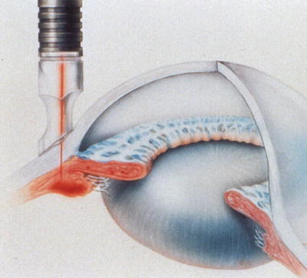
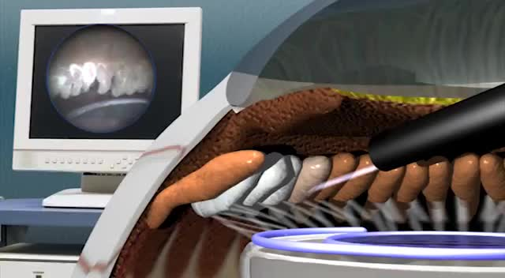
The Goldmann Equation
Trans-scleral
Endoscopic
Cyclophotocoagulation (CPC)

Slide 76
Q
The Goldmann Equation
Fill in the IOP equation below. What is its eponymous name?
The Goldmann equation
Aqueous Formation Rate (μL/min)
Outflow Facility (μL/min/mmHg)
Episcleral Venous
Pressure (mmHg)
IOP =
+
What are the two types of outflow?
--?
--?
So to lower IOP, one must:
--decrease aqueous formation, and/or
--increase outflow facility, and/or
--decrease episcleral venous pressure

Slide 77
A
The Goldmann Equation
Fill in the IOP equation below. What is its eponymous name?
The Goldmann equation
Aqueous Formation Rate (μL/min)
Outflow Facility (μL/min/mmHg)
Episcleral Venous
Pressure (mmHg)
IOP =
+
What are the two types of outflow?
--Trabecular meshwork (TM)
--Uveoscleral (U/S)
So to lower IOP, one must:
--decrease aqueous formation, and/or
--increase outflow facility, and/or
--decrease episcleral venous pressure

Slide 78
Q
The Goldmann Equation
Fill in the IOP equation below. What is its eponymous name?
The Goldmann equation
Aqueous Formation Rate (μL/min)
Outflow Facility (μL/min/mmHg)
Episcleral Venous
Pressure (mmHg)
IOP =
+
What are the two types of outflow?
--Trabecular meshwork (TM)
--Uveoscleral (U/S)
So to lower IOP, one must:
--decrease aqueous formation, and/or
--increase outflow facility, and/or
--decrease episcleral venous pressure
One of these is referred to as ‘conventional outflow,’ the other, ‘unconventional.’ Which is which?
TM = ?
U/S = ?

Slide 79
A
The Goldmann Equation
Fill in the IOP equation below. What is its eponymous name?
The Goldmann equation
Aqueous Formation Rate (μL/min)
Outflow Facility (μL/min/mmHg)
Episcleral Venous
Pressure (mmHg)
IOP =
+
What are the two types of outflow?
--Trabecular meshwork (TM)
--Uveoscleral (U/S)
So to lower IOP, one must:
--decrease aqueous formation, and/or
--increase outflow facility, and/or
--decrease episcleral venous pressure
One of these is referred to as ‘conventional outflow,’ the other, ‘unconventional.’ Which is which?
TM = conventional
U/S = unconventional

Slide 80
Q
The Goldmann Equation
Fill in the IOP equation below. What is its eponymous name?
The Goldmann equation
Aqueous Formation Rate (μL/min)
Outflow Facility (μL/min/mmHg)
Episcleral Venous
Pressure (mmHg)
IOP =
+
What are the two types of outflow?
--Trabecular meshwork (TM)
--Uveoscleral (U/S)
One of these is referred to as ‘pressure-dependent outflow,’ the other, ‘pressure-independent.’ Which is which?
TM = conventional = ?
U/S = unconventional = ?
So to lower IOP, one must:
--decrease aqueous formation, and/or
--increase outflow facility, and/or
--decrease episcleral venous pressure
One of these is referred to as ‘conventional outflow,’ the other, ‘unconventional.’ Which is which?
TM = conventional
U/S = unconventional

Slide 81
A
The Goldmann Equation
Fill in the IOP equation below. What is its eponymous name?
The Goldmann equation
Aqueous Formation Rate (μL/min)
Outflow Facility (μL/min/mmHg)
Episcleral Venous
Pressure (mmHg)
IOP =
+
What are the two types of outflow?
--Trabecular meshwork (TM)
--Uveoscleral (U/S)
One of these is referred to as ‘pressure-dependent outflow,’ the other, ‘pressure-independent.’ Which is which?
TM = conventional = pressure-dependent
U/S = unconventional = pressure-independent
So to lower IOP, one must:
--decrease aqueous formation, and/or
--increase outflow facility, and/or
--decrease episcleral venous pressure
One of these is referred to as ‘conventional outflow,’ the other, ‘unconventional.’ Which is which?
TM = conventional
U/S = unconventional

Slide 82
The Goldmann Equation
Fill in the IOP equation below. What is its eponymous name?
The Goldmann equation
Aqueous Formation Rate (μL/min)
Outflow Facility (μL/min/mmHg)
Episcleral Venous
Pressure (mmHg)
IOP =
+
What are the two types of outflow?
--Trabecular meshwork (TM)
--Uveoscleral (U/S)
One of these is referred to as ‘pressure-dependent outflow,’ the other, ‘pressure-independent.’ Which is which?
TM = conventional = pressure-dependent
U/S = unconventional = pressure-independent
So to lower IOP, one must:
--decrease aqueous formation, and/or
--increase outflow facility, and/or
--decrease episcleral venous pressure
To be clear, these constitute two sets of synonyms:
TM outflow is aka conventional outflow is aka pressure-dependent outflow
U/S outflow is aka unconventional outflow is aka pressure-independent outflow
One of these is referred to as ‘conventional outflow,’ the other, ‘unconventional.’ Which is which?
TM = conventional
U/S = unconventional
No question—proceed when ready

Slide 83
Q
The Goldmann Equation
What does it mean to say outflow is ‘pressure-dependent’ or ‘pressure-independent’?
It refers to whether the rate of outflow is influenced by IOP. Take a closer look at the denominator of the Goldmann equation. Note that, in it, outflow is a function of IOP (hence the mmHg in the term). For pressure-dependent outflow (ie, outflow via the TM), increases in IOP result in increased outflow facility. On the other hand, changes in IOP do not affect U/S outflow—it is pressure-independent. From this, it can be inferred (correctly) that Dr. Goldmann was unaware of uveoscleral outflow at the time he developed his equation.
Fill in the IOP equation below. What is its eponymous name?
The Goldmann equation
Aqueous Formation Rate (μL/min)
Outflow Facility (μL/min/mmHg)
Episcleral Venous
Pressure (mmHg)
IOP =
+
What are the two types of outflow?
--Trabecular meshwork (TM)
--Uveoscleral (U/S)
One of these is referred to as ‘pressure-dependent outflow,’ the other, ‘pressure-independent.’ Which is which?
TM = conventional = pressure-dependent
U/S = unconventional = pressure-independent
So to lower IOP, one must:
--decrease aqueous formation, and/or
--increase outflow facility, and/or
--decrease episcleral venous pressure
One of these is referred to as ‘conventional outflow,’ the other, ‘unconventional.’ Which is which?
TM = conventional
U/S = unconventional

Slide 84
A
The Goldmann Equation
What does it mean to say outflow is ‘pressure-dependent’ or ‘pressure-independent’?
It refers to whether the rate of outflow is influenced by IOP. Take a closer look at the denominator of the Goldmann equation. Note that, in it, outflow is a function of IOP (hence the mmHg in the term). For pressure-dependent outflow (ie, outflow via the TM), increases in IOP result in increased outflow facility. On the other hand, changes in IOP do not affect U/S outflow—it is pressure-independent. From this, it can be inferred (correctly) that Dr. Goldmann was unaware of uveoscleral outflow at the time he developed his equation.
Fill in the IOP equation below. What is its eponymous name?
The Goldmann equation
Aqueous Formation Rate (μL/min)
Outflow Facility (μL/min/mmHg)
Episcleral Venous
Pressure (mmHg)
IOP =
+
What are the two types of outflow?
--Trabecular meshwork (TM)
--Uveoscleral (U/S)
One of these is referred to as ‘pressure-dependent outflow,’ the other, ‘pressure-independent.’ Which is which?
TM = conventional = pressure-dependent
U/S = unconventional = pressure-independent
So to lower IOP, one must:
--decrease aqueous formation, and/or
--increase outflow facility, and/or
--decrease episcleral venous pressure
One of these is referred to as ‘conventional outflow,’ the other, ‘unconventional.’ Which is which?
TM = conventional
U/S = unconventional

Slide 85
A
The Goldmann Equation
What does it mean to say outflow is ‘pressure-dependent’ or ‘pressure-independent’?
It refers to whether the rate of outflow is influenced by IOP. Take a closer look at the denominator of the Goldmann equation. Note that, in it, outflow is a function of IOP (hence the mmHg in the term). For pressure-dependent outflow (ie, outflow via the TM), increases in IOP result in increased outflow facility. On the other hand, changes in IOP do not affect U/S outflow—it is pressure-independent. From this, it can be inferred (correctly) that Dr. Goldmann was unaware of uveoscleral outflow at the time he developed his equation.
Fill in the IOP equation below. What is its eponymous name?
The Goldmann equation
Aqueous Formation Rate (μL/min)
Outflow Facility (μL/min/mmHg)
Episcleral Venous
Pressure (mmHg)
IOP =
+
What are the two types of outflow?
--Trabecular meshwork (TM)
--Uveoscleral (U/S)
One of these is referred to as ‘pressure-dependent outflow,’ the other, ‘pressure-independent.’ Which is which?
TM = conventional = pressure-dependent
U/S = unconventional = pressure-independent
So to lower IOP, one must:
--decrease aqueous formation, and/or
--increase outflow facility, and/or
--decrease episcleral venous pressure
One of these is referred to as ‘conventional outflow,’ the other, ‘unconventional.’ Which is which?
TM = conventional
U/S = unconventional

Slide 86
A
The Goldmann Equation
What does it mean to say outflow is ‘pressure-dependent’ or ‘pressure-independent’?
It refers to whether the rate of outflow is influenced by IOP. Take a closer look at the denominator of the Goldmann equation. Note that, in it, outflow is a function of IOP (hence the mmHg in the term). For pressure-dependent outflow (ie, outflow via the TM), increases in IOP result in increased outflow facility. On the other hand, changes in IOP do not affect U/S outflow—it is pressure-independent. From this, it can be inferred (correctly) that Dr. Goldmann was unaware of uveoscleral outflow at the time he developed his equation.
Fill in the IOP equation below. What is its eponymous name?
The Goldmann equation
Aqueous Formation Rate (μL/min)
Outflow Facility (μL/min/mmHg)
Episcleral Venous
Pressure (mmHg)
IOP =
+
What are the two types of outflow?
--Trabecular meshwork (TM)
--Uveoscleral (U/S)
One of these is referred to as ‘pressure-dependent outflow,’ the other, ‘pressure-independent.’ Which is which?
TM = conventional = pressure-dependent
U/S = unconventional = pressure-independent
So to lower IOP, one must:
--decrease aqueous formation, and/or
--increase outflow facility, and/or
--decrease episcleral venous pressure
One of these is referred to as ‘conventional outflow,’ the other, ‘unconventional.’ Which is which?
TM = conventional
U/S = unconventional

Slide 87
The Goldmann Equation
What does it mean to say outflow is ‘pressure-dependent’ or ‘pressure-independent’?
It refers to whether the rate of outflow is influenced by IOP. Take a closer look at the denominator of the Goldmann equation. Note that, in it, outflow is a function of IOP (hence the mmHg in the term). For pressure-dependent outflow (ie, outflow via the TM), increases in IOP result in increased outflow facility. On the other hand, changes in IOP do not affect U/S outflow—it is pressure-independent. From this, it can be inferred (correctly) that Dr. Goldmann was unaware of uveoscleral outflow at the time he developed his equation.
Fill in the IOP equation below. What is its eponymous name?
The Goldmann equation
Aqueous Formation Rate (μL/min)
Outflow Facility (μL/min/mmHg)
Episcleral Venous
Pressure (mmHg)
IOP =
+
Next let’s take a closer look at the actual process of aqueous outflow…
What are the two types of outflow?
--Trabecular meshwork (TM)
--Uveoscleral (U/S)
One of these is referred to as ‘pressure-dependent outflow,’ the other, ‘pressure-independent.’ Which is which?
TM = conventional = pressure-dependent
U/S = unconventional = pressure-independent
So to lower IOP, one must:
--decrease aqueous formation, and/or
--increase outflow facility, and/or
--decrease episcleral venous pressure
One of these is referred to as ‘conventional outflow,’ the other, ‘unconventional.’ Which is which?
TM = conventional
U/S = unconventional

Slide 88
Q
The Goldmann Equation
And Speaking of Aqueous Outflow…
What are the major structures aqueous encounters along the conventional outflow pathway?
The TM
Schlemm’s canal
Episcleral veins
Anterior ciliary and superior ophthalmic veins
Cavernous sinus
Start here—name the first structure crossed by aqueous on the way out via the conventional pathway

Slide 89
Q/A
The Goldmann Equation
And Speaking of Aqueous Outflow…
What are the major structures aqueous encounters along the conventional outflow pathway?
The TM
Schlemm’s canal
Episcleral veins
Anterior ciliary and superior ophthalmic veins
Cavernous sinus

Slide 90
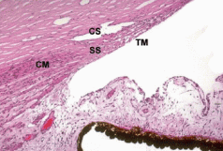
The Goldmann Equation
Canal of Schlemm (CS) and trabecular meshwork (TM) are located in anterior crotch of scleral spur (SS). Longitudinal ciliary muscle (CM) attaches to posterior aspect of spur.
The trabecular meshwork (TM)

Slide 91
Q
The Goldmann Equation
And Speaking of Aqueous Outflow…
What are the major structures aqueous encounters along the conventional outflow pathway?
The TM
Schlemm’s canal
Episcleral veins
Anterior ciliary and superior ophthalmic veins
Cavernous sinus
The TM has three layers. From innermost (ie, nearest the anterior chamber) to outermost, what are they?
--?Uveal layer
--?Corneolscleral layer
--?Juxtacanalicular layer

Slide 92
A
The Goldmann Equation
And Speaking of Aqueous Outflow…
What are the major structures aqueous encounters along the conventional outflow pathway?
The TM
Schlemm’s canal
Episcleral veins
Anterior ciliary and superior ophthalmic veins
Cavernous sinus
The TM has three layers. From innermost (ie, nearest the anterior chamber) to outermost, what are they?
--Uveal layer
--Corneolscleral layer
--Juxtacanalicular layer

Slide 93
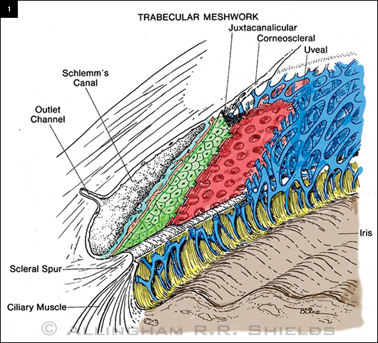
The Goldmann Equation
TM: Layers

Slide 94
Q
The Goldmann Equation
And Speaking of Aqueous Outflow…
What are the major structures aqueous encounters along the conventional outflow pathway?
The TM
Schlemm’s canal
Episcleral veins
Anterior ciliary and superior ophthalmic veins
Cavernous sinus
The TM has three layers. From innermost (ie, nearest the anterior chamber) to outermost, what are they?
--Uveal layer?
--Corneolscleral layer?
--Juxtacanalicular layer?
Of the three, which is the major site of resistance to aqueous outflow?
The juxtacanalicular layer

Slide 95
A
The Goldmann Equation
And Speaking of Aqueous Outflow…
What are the major structures aqueous encounters along the conventional outflow pathway?
The TM
Schlemm’s canal
Episcleral veins
Anterior ciliary and superior ophthalmic veins
Cavernous sinus
The TM has three layers. From innermost (ie, nearest the anterior chamber) to outermost, what are they?
--Uveal layer
--Corneolscleral layer
--Juxtacanalicular layer
Of the three, which is the major site of resistance to aqueous outflow?
The juxtacanalicular layer

Slide 96
Q/A
The Goldmann Equation
And Speaking of Aqueous Outflow…
What are the major structures aqueous encounters along the conventional outflow pathway?
The TM
Schlemm’s canal
Episcleral veins
Anterior ciliary and superior ophthalmic veins
Cavernous sinus
Next structure—a space, of sorts

Slide 97
Q/A
The Goldmann Equation
And Speaking of Aqueous Outflow…
What are the major structures aqueous encounters along the conventional outflow pathway?
The TM
Schlemm’s canal
Episcleral veins
Anterior ciliary and superior ophthalmic veins
Cavernous sinus

Slide 98
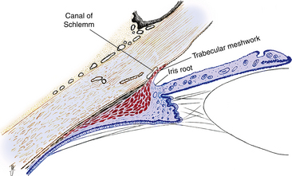
The Goldmann Equation
Schlemm’s canal

Slide 99
Q/A
The Goldmann Equation
And Speaking of Aqueous Outflow…
What are the major structures aqueous encounters along the conventional outflow pathway?
The TM
Schlemm’s canal
Episcleral veins
Anterior ciliary and superior ophthalmic veins
Cavernous sinus
Next—vascular structures

Slide 100
Q/A
The Goldmann Equation
And Speaking of Aqueous Outflow…
What are the major structures aqueous encounters along the conventional outflow pathway?
The TM
Schlemm’s canal
Episcleral veins
Anterior ciliary and superior ophthalmic veins
Cavernous sinus

Slide 101
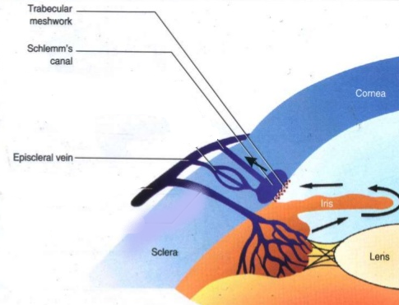
The Goldmann Equation
Episcleral veins

Slide 102
Q/A
The Goldmann Equation
And Speaking of Aqueous Outflow…
What are the major structures aqueous encounters along the conventional outflow pathway?
The TM
Schlemm’s canal
Episcleral veins
Anterior ciliary and superior ophthalmic veins
Cavernous sinus
Next, more and larger vascular structures

Slide 103
Q/A
The Goldmann Equation
And Speaking of Aqueous Outflow…
What are the major structures aqueous encounters along the conventional outflow pathway?
The TM
Schlemm’s canal
Episcleral veins
Anterior ciliary vein…
Cavernous sinus

Slide 104
The Goldmann Equation
Anterior ciliary vein

Slide 105
Q/A
The Goldmann Equation
And Speaking of Aqueous Outflow…
What are the major structures aqueous encounters along the conventional outflow pathway?
The TM
Schlemm’s canal
Episcleral veins
Anterior ciliary vein…and superior ophthalmic vein
Cavernous sinus

Slide 106
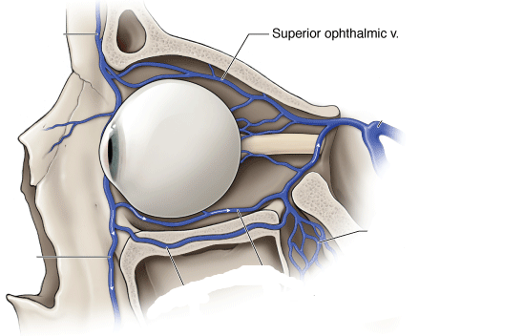
The Goldmann Equation
Superior ophthalmic vein

Slide 107
Q/A
The Goldmann Equation
And Speaking of Aqueous Outflow…
What are the major structures aqueous encounters along the conventional outflow pathway?
The TM
Schlemm’s canal
Episcleral veins
Anterior ciliary vein…and superior ophthalmic vein
Cavernous sinus
Finally, a major vascular space

Slide 108
A
The Goldmann Equation
And Speaking of Aqueous Outflow…
What are the major structures aqueous encounters along the conventional outflow pathway?
The TM
Schlemm’s canal
Episcleral veins
Anterior ciliary vein…and superior ophthalmic vein
Cavernous sinus

Slide 109
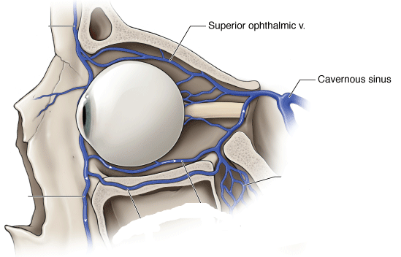
The Goldmann Equation
Cavernous sinus

Slide 110
Q
The Goldmann Equation
And Speaking of Aqueous Outflow…
What are the major structures aqueous encounters along the conventional outflow pathway?
The TM
Schlemm’s canal
Episcleral veins
Anterior ciliary vein…and superior ophthalmic vein
Cavernous sinus
What are the major structures aqueous encounters along the unconventional outflow pathway?
Ciliary body
Supraciliary/suprachoroidal spaces
Sclera
Conjunctiva
Start here—name the first structure crossed by aqueous on the way out via the unconventional pathway

Slide 111
Q/A
The Goldmann Equation
And Speaking of Aqueous Outflow…
What are the major structures aqueous encounters along the conventional outflow pathway?
The TM
Schlemm’s canal
Episcleral veins
Anterior ciliary vein…and superior ophthalmic vein
Cavernous sinus
What are the major structures aqueous encounters along the unconventional outflow pathway?
Ciliary body
Supraciliary/suprachoroidal spaces
Sclera
Conjunctiva
And next, a space(s) associated with the CB

Slide 112
Q/A
The Goldmann Equation
And Speaking of Aqueous Outflow…
What are the major structures aqueous encounters along the conventional outflow pathway?
The TM
Schlemm’s canal
Episcleral veins
Anterior ciliary vein…and superior ophthalmic vein
Cavernous sinus
What are the major structures aqueous encounters along the unconventional outflow pathway?
Ciliary body
Supraciliary/suprachoroidal spaces
Sclera
Conjunctiva
And next, another major component of the eye

Slide 113
Q/A
The Goldmann Equation
And Speaking of Aqueous Outflow…
What are the major structures aqueous encounters along the conventional outflow pathway?
The TM
Schlemm’s canal
Episcleral veins
Anterior ciliary vein…and superior ophthalmic vein
Cavernous sinus
What are the major structures aqueous encounters along the unconventional outflow pathway?
Ciliary body
Supraciliary/suprachoroidal spaces
Sclera
Conjunctiva
And finally…another major component of the eye

Slide 114
A
The Goldmann Equation
And Speaking of Aqueous Outflow…
What are the major structures aqueous encounters along the conventional outflow pathway?
The TM
Schlemm’s canal
Episcleral veins
Anterior ciliary vein…and superior ophthalmic vein
Cavernous sinus
What are the major structures aqueous encounters along the unconventional outflow pathway?
Ciliary body
Supraciliary/suprachoroidal spaces
Sclera
Conjunctiva

Slide 115
Q
The Goldmann Equation
And Speaking of Aqueous Outflow…
What are the major structures aqueous encounters along the conventional outflow pathway?
The TM
Schlemm’s canal
Episcleral veins
Anterior ciliary vein…and superior ophthalmic vein
Cavernous sinus
What are the major structures aqueous encounters along the unconventional outflow pathway?
Ciliary body
Supraciliary/suprachoroidal spaces
Sclera
Conjunctiva
What proportion of egressed aqueous leaves via the unconventional pathway?
The most recent version of the BCSC Glaucoma book in my possession puts it at 5-15%, but acknowledges that it may be higher than that
Does the proportion leaving via this pathway increase, or decrease with age?
Decrease

Slide 116
A
The Goldmann Equation
And Speaking of Aqueous Outflow…
What are the major structures aqueous encounters along the conventional outflow pathway?
The TM
Schlemm’s canal
Episcleral veins
Anterior ciliary vein…and superior ophthalmic vein
Cavernous sinus
What are the major structures aqueous encounters along the unconventional outflow pathway?
Ciliary body
Supraciliary/suprachoroidal spaces
Sclera
Conjunctiva
What proportion of egressed aqueous leaves via the unconventional pathway?
The most recent version of the BCSC Glaucoma book in my possession puts it as high as 45% (Note: The Fundamentals book puts the figure at 50%)
Does the proportion leaving via this pathway increase, or decrease with age?
Decrease

Slide 117
A
The Goldmann Equation
And Speaking of Aqueous Outflow…
What are the major structures aqueous encounters along the conventional outflow pathway?
The TM
Schlemm’s canal
Episcleral veins
Anterior ciliary vein…and superior ophthalmic vein
Cavernous sinus
What are the major structures aqueous encounters along the unconventional outflow pathway?
Ciliary body
Supraciliary/suprachoroidal spaces
Sclera
Conjunctiva
What proportion of egressed aqueous leaves via the unconventional pathway?
The most recent version of the BCSC Glaucoma book in my possession puts it as high as 45% (Note: The Fundamentals book puts the figure at 50%)
Does the proportion leaving via this pathway increase, or decrease with age?
Decrease

Slide 118
Q
The Goldmann Equation
And Speaking of Aqueous Outflow…
What are the major structures aqueous encounters along the conventional outflow pathway?
The TM
Schlemm’s canal
Episcleral veins
Anterior ciliary vein…and superior ophthalmic vein
Cavernous sinus
What are the major structures aqueous encounters along the unconventional outflow pathway?
Ciliary body
Supraciliary/suprachoroidal spaces
Sclera
Conjunctiva
What proportion of egressed aqueous leaves via the unconventional pathway?
The most recent version of the BCSC Glaucoma book in my possession puts it as high as 45% (Note: The Fundamentals book puts the figure at 50%)
Does the proportion leaving via this pathway increase, or decrease with age?
Decrease

Slide 119
A
The Goldmann Equation
And Speaking of Aqueous Outflow…
What are the major structures aqueous encounters along the conventional outflow pathway?
The TM
Schlemm’s canal
Episcleral veins
Anterior ciliary vein…and superior ophthalmic vein
Cavernous sinus
What are the major structures aqueous encounters along the unconventional outflow pathway?
Ciliary body
Supraciliary/suprachoroidal spaces
Sclera
Conjunctiva
What proportion of egressed aqueous leaves via the unconventional pathway?
The most recent version of the BCSC Glaucoma book in my possession puts it as high as 45% (Note: The Fundamentals book puts the figure at 50%)
Does the proportion leaving via this pathway increase, or decrease with age?
Decrease

Slide 120
Q
The Goldmann Equation
Fill in the IOP equation below. What is its eponymous name?
The Goldmann equation
Aqueous Formation Rate (μL/min)
Outflow Facility (μL/min/mmHg)
Episcleral Venous
Pressure (mmHg)
IOP =
+
What are the two types of outflow?
--Trabecular meshwork (TM)
--Uveoscleral (U/S)
Which class of meds increases TM outflow?
Parasympathomimetics, ie, pilo
So to lower IOP, one must:
--decrease aqueous formation, and/or
--increase outflow facility, and/or
--decrease episcleral venous pressure

Slide 121
A
The Goldmann Equation
Fill in the IOP equation below. What is its eponymous name?
The Goldmann equation
Aqueous Formation Rate (μL/min)
Outflow Facility (μL/min/mmHg)
Episcleral Venous
Pressure (mmHg)
IOP =
+
What are the two types of outflow?
--Trabecular meshwork (TM)
--Uveoscleral (U/S)
Which class of meds increases TM outflow?
Parasympathomimetics, ie, pilo
So to lower IOP, one must:
--decrease aqueous formation, and/or
--increase outflow facility, and/or
--decrease episcleral venous pressure

Slide 122
Q
The Goldmann Equation
What laser procedure enhances TM outflow?
Laser trabeculoplasty
Microinvasive glaucoma surgery (MIGS) to enhance TM outflow takes one of three general approaches. What are they?
--Disruption or removal of a portion of the TM
--Creation of an artificial conduit through it with an implanted bypass stent
--Enlargement of Schlemm’s canal via cannulation and dilation
Fill in the IOP equation below. What is its eponymous name?
The Goldmann equation
Aqueous Formation Rate (μL/min)
Outflow Facility (μL/min/mmHg)
Episcleral Venous
Pressure (mmHg)
IOP =
+
What are the two types of outflow?
--Trabecular meshwork (TM)
--Uveoscleral (U/S)
Which class of meds increases TM outflow?
Parasympathomimetics, ie, pilo
So to lower IOP, one must:
--decrease aqueous formation, and/or
--increase outflow facility, and/or
--decrease episcleral venous pressure

Slide 123
A
The Goldmann Equation
What laser procedure enhances TM outflow?
Laser trabeculoplasty
Microinvasive glaucoma surgery (MIGS) to enhance TM outflow takes one of three general approaches. What are they?
--Disruption or removal of a portion of the TM
--Creation of an artificial conduit through it with an implanted bypass stent
--Enlargement of Schlemm’s canal via cannulation and dilation
Fill in the IOP equation below. What is its eponymous name?
The Goldmann equation
Aqueous Formation Rate (μL/min)
Outflow Facility (μL/min/mmHg)
Episcleral Venous
Pressure (mmHg)
IOP =
+
What are the two types of outflow?
--Trabecular meshwork (TM)
--Uveoscleral (U/S)
Which class of meds increases TM outflow?
Parasympathomimetics, ie, pilo
So to lower IOP, one must:
--decrease aqueous formation, and/or
--increase outflow facility, and/or
--decrease episcleral venous pressure

Slide 124
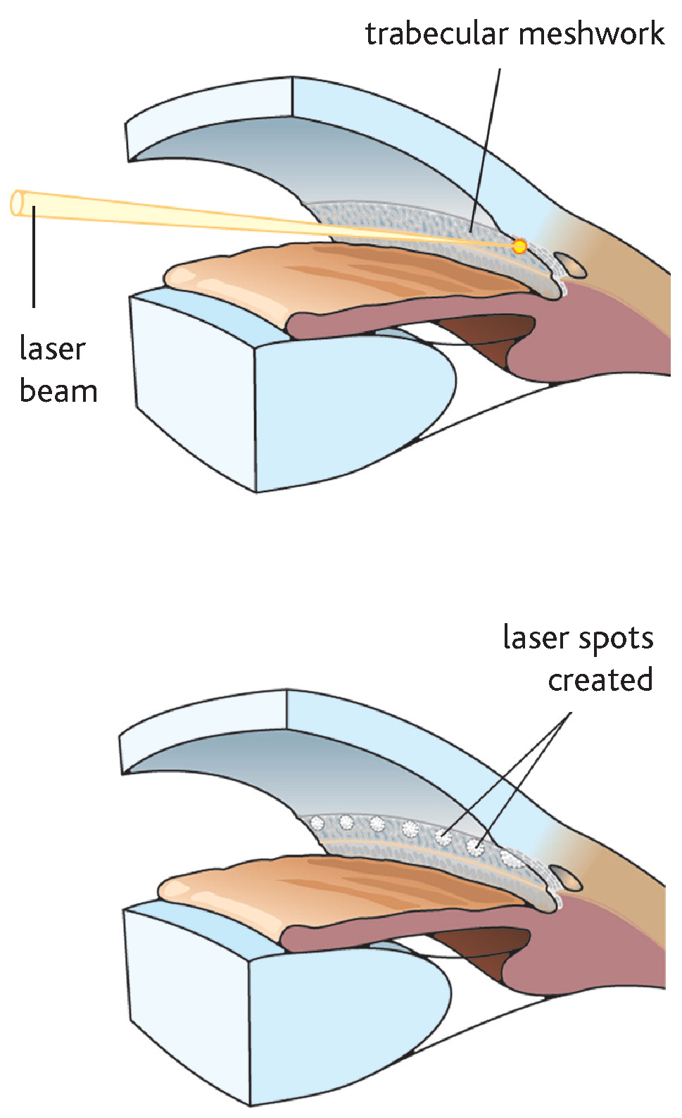
The Goldmann Equation
Laser trabeculoplasty

Slide 125
Q
The Goldmann Equation
What laser procedure enhances TM outflow?
Laser trabeculoplasty
Microinvasive glaucoma surgery (MIGS) to enhance TM outflow takes one of three general approaches. What are they?
--?Disruption or removal of a portion of the TM
--?Creation of an artificial conduit through it with an implanted bypass stent
--?Enlargement of Schlemm’s canal via cannulation and dilation
Fill in the IOP equation below. What is its eponymous name?
The Goldmann equation
Aqueous Formation Rate (μL/min)
Outflow Facility (μL/min/mmHg)
Episcleral Venous
Pressure (mmHg)
IOP =
+
What are the two types of outflow?
--Trabecular meshwork (TM)
--Uveoscleral (U/S)
Which class of meds increases TM outflow?
Parasympathomimetics, ie, pilo
So to lower IOP, one must:
--decrease aqueous formation, and/or
--increase outflow facility, and/or
--decrease episcleral venous pressure

Slide 126
A
The Goldmann Equation
What laser procedure enhances TM outflow?
Laser trabeculoplasty
Microinvasive glaucoma surgery (MIGS) to enhance TM outflow takes one of three general approaches. What are they?
--Disruption or removal of a portion of the TM
--Creation of an artificial conduit through it with an implanted bypass stent
--Enlargement of Schlemm’s canal via cannulation and dilation
Fill in the IOP equation below. What is its eponymous name?
The Goldmann equation
Aqueous Formation Rate (μL/min)
Outflow Facility (μL/min/mmHg)
Episcleral Venous
Pressure (mmHg)
IOP =
+
What are the two types of outflow?
--Trabecular meshwork (TM)
--Uveoscleral (U/S)
Which class of meds increases TM outflow?
Parasympathomimetics, ie, pilo
So to lower IOP, one must:
--decrease aqueous formation, and/or
--increase outflow facility, and/or
--decrease episcleral venous pressure

Slide 127
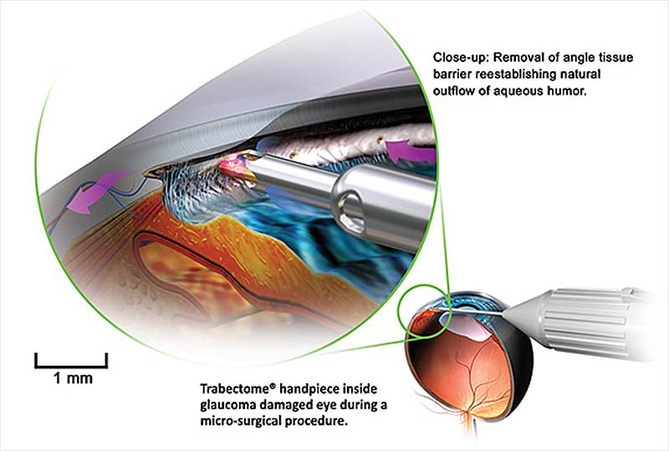
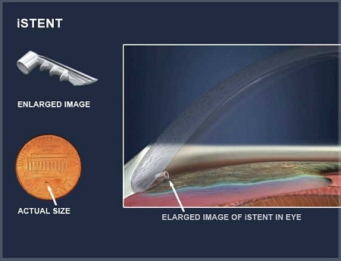
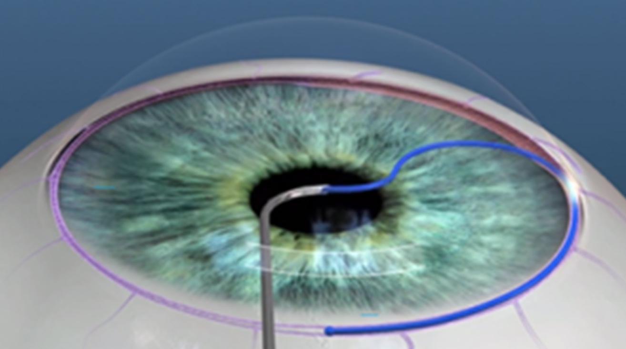
The Goldmann Equation
Disruption or removal of a portion of the TM
Creation of an artificial conduit through it with an implanted bypass stent
MIGS
Enlargement of Schlemm’s canal via cannulation and dilation

Slide 128
Q
The Goldmann Equation
Fill in the IOP equation below. What is its eponymous name?
The Goldmann equation
Aqueous Formation Rate (μL/min)
Outflow Facility (μL/min/mmHg)
Episcleral Venous
Pressure (mmHg)
IOP =
+
What are the two types of outflow?
--Trabecular meshwork (TM)
--Uveoscleral (U/S)
Which class of meds has as its main IOP-lowering effect an increase in U/S outflow?
Prostaglandin analogues
So to lower IOP, one must:
--decrease aqueous formation, and/or
--increase outflow facility, and/or
--decrease episcleral venous pressure

Slide 129
A
The Goldmann Equation
Fill in the IOP equation below. What is its eponymous name?
The Goldmann equation
Aqueous Formation Rate (μL/min)
Outflow Facility (μL/min/mmHg)
Episcleral Venous
Pressure (mmHg)
IOP =
+
What are the two types of outflow?
--Trabecular meshwork (TM)
--Uveoscleral (U/S)
Which class of meds has as its main IOP-lowering effect an increase in U/S outflow?
Prostaglandin analogues
So to lower IOP, one must:
--decrease aqueous formation, and/or
--increase outflow facility, and/or
--decrease episcleral venous pressure

Slide 130
Q
The Goldmann Equation
Fill in the IOP equation below. What is its eponymous name?
The Goldmann equation
Aqueous Formation Rate (μL/min)
Outflow Facility (μL/min/mmHg)
Episcleral Venous
Pressure (mmHg)
IOP =
+
What are the two types of outflow?
--Trabecular meshwork (TM)
--Uveoscleral (U/S)
Which class of meds has as its main IOP-lowering effect an increase in U/S outflow?
Prostaglandin analogues
So to lower IOP, one must:
--decrease aqueous formation, and/or
--increase outflow facility, and/or
--decrease episcleral venous pressure
Is there a MIGS procedure that enhances U/S outflow?
As of this writing, no. An implantable bypass device that shunted aqueous into the suprachoroidal space was available for a time, but has since been withdrawn owing to corneal complications associated with it.

Slide 131
A
The Goldmann Equation
Fill in the IOP equation below. What is its eponymous name?
The Goldmann equation
Aqueous Formation Rate (μL/min)
Outflow Facility (μL/min/mmHg)
Episcleral Venous
Pressure (mmHg)
IOP =
+
What are the two types of outflow?
--Trabecular meshwork (TM)
--Uveoscleral (U/S)
Which class of meds has as its main IOP-lowering effect an increase in U/S outflow?
Prostaglandin analogues
So to lower IOP, one must:
--decrease aqueous formation, and/or
--increase outflow facility, and/or
--decrease episcleral venous pressure
Is there a MIGS procedure that enhances U/S outflow?
As of this writing, no. An implantable bypass device that shunted aqueous into the suprachoroidal space was available for a time, but has since been withdrawn owing to corneal complications associated with it.

Slide 132
Q
132
The Goldmann Equation
Fill in the IOP equation below. What is its eponymous name?
The Goldmann equation
Aqueous Formation Rate (μL/min)
Outflow Facility (μL/min/mmHg)
Episcleral Venous
Pressure (mmHg)
IOP =
+
Are there medical options for lowering EVP?
The Glaucoma book indicates rho kinase inhibitors may lower EVP. Additionally, one selective α-agonist—apraclonidine—may lower EVP to some extent by decreasing blood flow to the eye.
Note how the μL/min cancel, leaving IOP in mmHg
Notes:
132

Slide 133
Q/A
133
The Goldmann Equation
Fill in the IOP equation below. What is its eponymous name?
The Goldmann equation
Aqueous Formation Rate (μL/min)
Outflow Facility (μL/min/mmHg)
Episcleral Venous
Pressure (mmHg)
IOP =
+
Are there medical options for lowering EVP?
The Glaucoma book indicates rho kinase inhibitors may lower EVP. Additionally, one selective α-agonist—apraclonidine—may lower EVP to some extent by decreasing blood flow to the eye.
class of glaucoma med
Note how the μL/min cancel, leaving IOP in mmHg
Notes:
133

Slide 134
A
134
The Goldmann Equation
Fill in the IOP equation below. What is its eponymous name?
The Goldmann equation
Aqueous Formation Rate (μL/min)
Outflow Facility (μL/min/mmHg)
Episcleral Venous
Pressure (mmHg)
IOP =
+
Are there medical options for lowering EVP?
The Glaucoma book indicates rho kinase inhibitors may lower EVP. Additionally, one selective α-agonist—apraclonidine—may lower EVP to some extent by decreasing blood flow to the eye.
Note how the μL/min cancel, leaving IOP in mmHg
Notes:
134

Slide 135
Q
135
The Goldmann Equation
Fill in the IOP equation below. What is its eponymous name?
The Goldmann equation
Aqueous Formation Rate (μL/min)
Outflow Facility (μL/min/mmHg)
Episcleral Venous
Pressure (mmHg)
IOP =
+
Are there medical options for lowering EVP?
The Glaucoma book indicates rho kinase inhibitors may lower EVP. Additionally, one selective α-agonist—apraclonidine—may lower EVP to some extent by decreasing blood flow to the eye.
Note how the μL/min cancel, leaving IOP in mmHg
specific drug
Notes:
135

Slide 136
A
136
The Goldmann Equation
Fill in the IOP equation below. What is its eponymous name?
The Goldmann equation
Aqueous Formation Rate (μL/min)
Outflow Facility (μL/min/mmHg)
Episcleral Venous
Pressure (mmHg)
IOP =
+
Are there medical options for lowering EVP?
The Glaucoma book indicates rho kinase inhibitors may lower EVP. Additionally, one selective α-agonist—apraclonidine—may lower EVP to some extent by decreasing blood flow to the eye.
Note how the μL/min cancel, leaving IOP in mmHg
Notes:
136

Slide 137
Q
The Goldmann Equation
Fill in the IOP equation below. What is its eponymous name?
The Goldmann equation
Aqueous Formation Rate (μL/min)
Outflow Facility (μL/min/mmHg)
Episcleral Venous
Pressure (mmHg)
IOP =
+
So to lower IOP, one must:
--decrease aqueous formation, and/or
--increase outflow facility, and/or
--decrease episcleral venous pressure
Three IOP-lowering maneuvers implied by the Goldmann equation
Important IOP-lowering maneuver not implied by the
Goldmann equation
Time to address the important and oft-used IOP-lowering maneuver not implied by the Goldmann equation that was foreshadowed early in the set
No question—proceed when ready

Slide 138
Q
The Goldmann Equation
Fill in the IOP equation below. What is its eponymous name?
The Goldmann equation
Aqueous Formation Rate (μL/min)
Outflow Facility (μL/min/mmHg)
Episcleral Venous
Pressure (mmHg)
IOP =
+
So to lower IOP, one must:
--decrease aqueous formation, and/or
--increase outflow facility, and/or
--decrease episcleral venous pressure
…and/or dehydrate the vitreous with a
hyperosmotic agent
Three IOP-lowering maneuvers implied by the Goldmann equation
Important IOP-lowering maneuver not implied by the
Goldmann equation
three words
one word

Slide 139
A
The Goldmann Equation
Fill in the IOP equation below. What is its eponymous name?
The Goldmann equation
Aqueous Formation Rate (μL/min)
Outflow Facility (μL/min/mmHg)
Episcleral Venous
Pressure (mmHg)
IOP =
+
So to lower IOP, one must:
--decrease aqueous formation, and/or
--increase outflow facility, and/or
--decrease episcleral venous pressure
…and/or dehydrate the vitreous with a
hyperosmotic agent
Three IOP-lowering maneuvers implied by the Goldmann equation
Important IOP-lowering maneuver not implied by the
Goldmann equation

Slide 140
Q
The Goldmann Equation
Fill in the IOP equation below. What is its eponymous name?
The Goldmann equation
Aqueous Formation Rate (μL/min)
Outflow Facility (μL/min/mmHg)
Episcleral Venous
Pressure (mmHg)
IOP =
+
So to lower IOP, one must:
--decrease aqueous formation, and/or
--increase outflow facility, and/or
--decrease episcleral venous pressure
…and/or dehydrate the vitreous with a
hyperosmotic agent
Three IOP-lowering maneuvers implied by the Goldmann equation
Important IOP-lowering maneuver not implied by the
Goldmann equation
Which hyperosmotic agent is used most often?
Mannitol

Slide 141
A
The Goldmann Equation
Fill in the IOP equation below. What is its eponymous name?
The Goldmann equation
Aqueous Formation Rate (μL/min)
Outflow Facility (μL/min/mmHg)
Episcleral Venous
Pressure (mmHg)
IOP =
+
So to lower IOP, one must:
--decrease aqueous formation, and/or
--increase outflow facility, and/or
--decrease episcleral venous pressure
…and/or dehydrate the vitreous with a
hyperosmotic agent
Three IOP-lowering maneuvers implied by the Goldmann equation
Important IOP-lowering maneuver not implied by the
Goldmann equation
Which hyperosmotic agent is used most often?
Mannitol

