Slide 1
Q
Phlyctenulosis
Phlyctenules are inflammatory nodules
two words

Slide 2
A
Phlyctenulosis
Phlyctenules are inflammatory nodules

Slide 3
Q
Phlyctenulosis
Phlyctenules are inflammatory nodules
Can be located at the limbus, on the cornea, or on the conj

Slide 4
A
Phlyctenulosis
Phlyctenules are inflammatory nodules
Can be located at the limbus, on the cornea, or on the conj

Slide 5
Q
Phlyctenulosis
Phlyctenules are inflammatory nodules
Can be located at the limbus, on the cornea, or on the conj
Do they typically present unilaterally, or bilaterally?

Slide 6
A
Phlyctenulosis
Phlyctenules are inflammatory nodules
Can be located at the limbus, on the cornea, or on the conj
Do they typically present unilaterally, or bilaterally?
Unilaterally (but it’s not uncommon to see scars on the fellow eye)

Slide 7
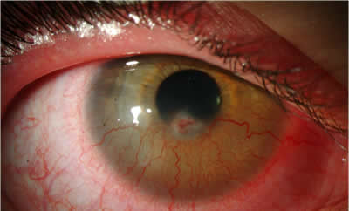
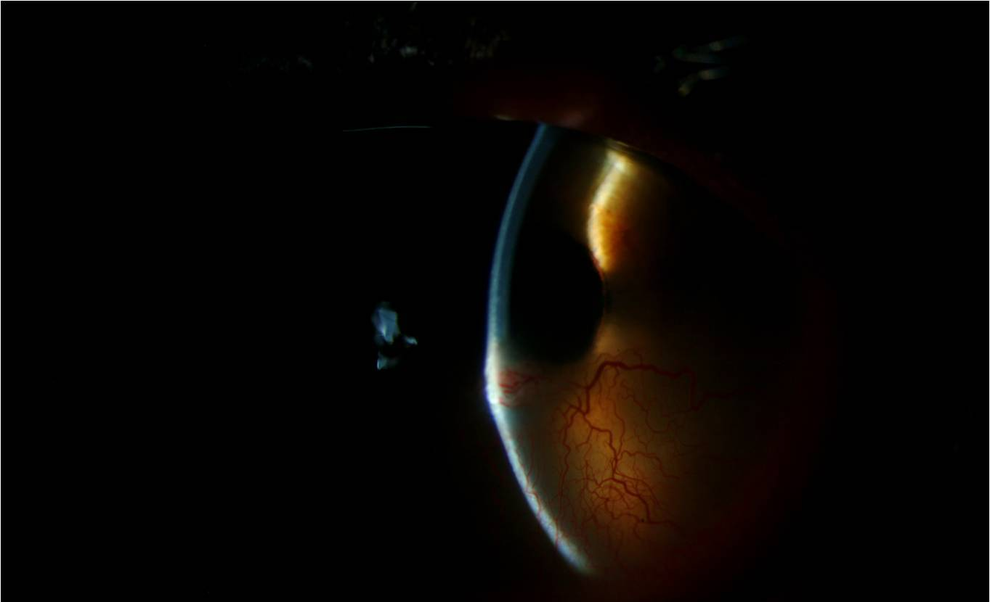
Phlyctenulosis
Phlyctenule
Same phlyctenule (pic to show elevation)
Corneal phlyctenule

Slide 8
Q
Phlyctenulosis
Phlyctenules are inflammatory nodules
Can be located at the limbus, on the cornea, or on the conj
Are small , gray or yellow in color, and are associated with engorged vasculature
big vs small
two words

Slide 9
A
Phlyctenulosis
Phlyctenules are inflammatory nodules
Can be located at the limbus, on the cornea, or on the conj
Are small , gray or yellow in color, and are associated with engorged vasculature

Slide 10
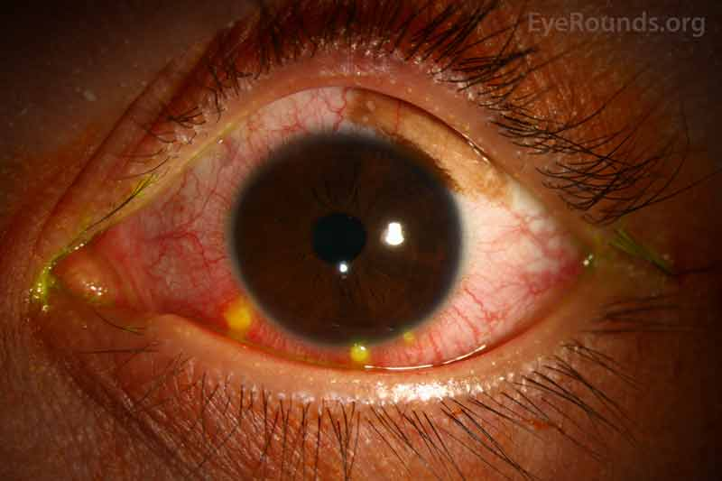
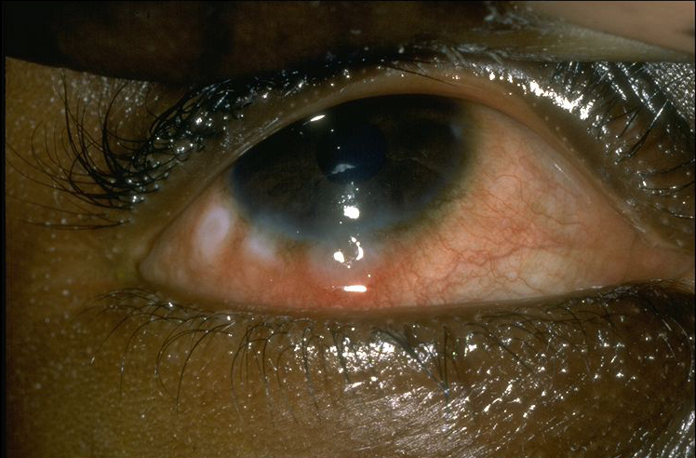
Phlyctenulosis
Phlyctenules: Yellow; gray

Slide 11
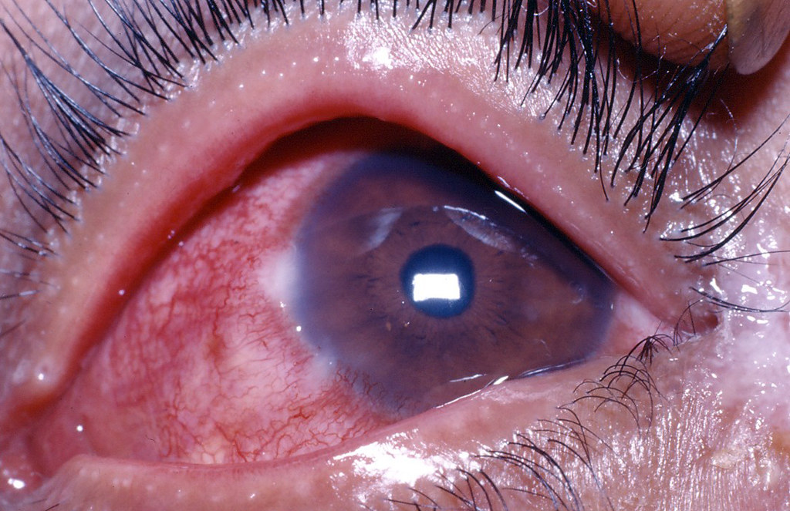
Phlyctenulosis
Phlyctenules: Engorged vasculature

Slide 12
Q
Phlyctenulosis
Phlyctenules are inflammatory nodules
Can be located at the limbus, on the cornea, or on the conj
Are small , gray or yellow in color, and are associated with engorged vasculature
Is a Type IV hypersensitivity reaction
#

Slide 13
A
Phlyctenulosis
Phlyctenules are inflammatory nodules
Can be located at the limbus, on the cornea, or on the conj
Are small , gray or yellow in color, and are associated with engorged vasculature
Is a Type IV hypersensitivity reaction

Slide 14
Q
Phlyctenulosis
Cell-mediated reactions
Speaking of hypersensitivity reactions…
How many types of ocular-surface hypersensitivity reactions are there?

Slide 15
A
Phlyctenulosis
Cell-mediated reactions
Type I Type II Type III Type IV
Speaking of hypersensitivity reactions…
How many types of ocular-surface hypersensitivity reactions are there?

Slide 16
Q
Phlyctenulosis
Immune-complex reactions
Immune-complex reactions
Cell-mediated reactions
Type I Type II Type III Type IV
Type I reactions involve…
Type II reactions involve…
Type III reactions involve…Immune-complex reactions
Type IV reactions involve…
[One word that captures the nature of this rxn]
Speaking of hypersensitivity reactions…
How many types of ocular-surface hypersensitivity reactions are there?

Slide 17
A
Phlyctenulosis
Immune-complex reactions
Immune-complex reactions
Cell-mediated reactions
Anaphylaxis
Type I Type II Type III Type IV
Type I reactions involve…Anaphylaxis
Type II reactions involve…
Type III reactions involve…Immune-complex reactions
Type IV reactions involve…
Speaking of hypersensitivity reactions…
How many types of ocular-surface hypersensitivity reactions are there?

Slide 18
Q
Phlyctenulosis
Immune-complex reactions
Immune-complex reactions
Cell-mediated reactions
Anaphylaxis
Type I Type II Type III Type IV
Type I reactions involve…Anaphylaxis
Type II reactions involve…
Type III reactions involve…Immune-complex reactions
Type IV reactions involve…
[Two words capturing this rxn]

Slide 19
A
Phlyctenulosis
Immune-complex reactions
Immune-complex reactions
Cell-mediated reactions
Anaphylaxis
Cytotoxic Ab
Type I Type II Type III Type IV
Type I reactions involve…Anaphylaxis
Type II reactions involve…Cytotoxic antibodies
Type III reactions involve…Immune-complex reactions
Type IV reactions involve…

Slide 20
Q
Phlyctenulosis
Immune-complex reactions
Immune-complex reactions
Cell-mediated reactions
Anaphylaxis
Cytotoxic Ab
Type I Type II Type III Type IV
Type I reactions involve…Anaphylaxis
Type II reactions involve…Cytotoxic antibodies
Type III reactions involve…Immune-complex reactions
Type IV reactions involve…
[Three words for this one]

Slide 21
A
Phlyctenulosis
Immune-complex reactions
Immune-complex reactions
Immune-complex reactions
Cell-mediated reactions
Anaphylaxis
Cytotoxic Ab
Type I Type II Type III Type IV
Type I reactions involve…Anaphylaxis
Type II reactions involve…Cytotoxic antibodies
Type III reactions involve…Immune-complex reactions
Type IV reactions involve…

Slide 22
Q
Phlyctenulosis
Immune-complex reactions
Immune-complex reactions
Immune-complex reactions
Cell-mediated reactions
Anaphylaxis
Cytotoxic Ab
Type I Type II Type III Type IV
Type I reactions involve…Anaphylaxis
Type II reactions involve…Cytotoxic antibodies
Type III reactions involve…Immune-complex reactions
Type IV reactions involve…
[Three words again]

Slide 23
A
Phlyctenulosis
Immune-complex reactions
Immune-complex reactions
Immune-complex reactions
Cell-mediated reactions
Anaphylaxis
Cytotoxic Ab
Type I Type II Type III Type IV
Type I reactions involve…Anaphylaxis
Type II reactions involve…Cytotoxic antibodies
Type III reactions involve…Immune-complex reactions
Type IV reactions involve…Cell-mediated reactions

Slide 24
Q
Phlyctenulosis
Immune-complex reactions
Immune-complex reactions
Immune-complex reactions
Cell-mediated reactions
Anaphylaxis
Cytotoxic Ab
Type I Type II Type III Type IV
Type I reactions involve…Anaphylaxis
Type II reactions involve…Cytotoxic antibodies
Type III reactions involve…Immune-complex reactions
Type IV reactions involve…Cell-mediated reactions
‘Cell-mediated reaction’…Which sort of immune cell is doing the mediating?

Slide 25
A
Phlyctenulosis
Immune-complex reactions
Immune-complex reactions
Immune-complex reactions
Cell-mediated reactions
Anaphylaxis
Cytotoxic Ab
Type I Type II Type III Type IV
Type I reactions involve…Anaphylaxis
Type II reactions involve…Cytotoxic antibodies
Type III reactions involve…Immune-complex reactions
Type IV reactions involve…Cell-mediated reactions
‘Cell-mediated reaction’…Which sort of immune cell is doing the mediating?
T-helper cells

Slide 26
Q
Phlyctenulosis
Immune-complex reactions
Immune-complex reactions
Immune-complex reactions
Cell-mediated reactions
Anaphylaxis
Cytotoxic Ab
Type I Type II Type III Type IV
Type I reactions involve…Anaphylaxis
Type II reactions involve…Cytotoxic antibodies
Type III reactions involve…Immune-complex reactions
Type IV reactions involve…Cell-mediated reactions
‘Cell-mediated reaction’…Which sort of immune cell is doing the mediating?
T-helper cells
In what way are T-helper cells mediating the reaction?

Slide 27
A
Phlyctenulosis
Immune-complex reactions
Immune-complex reactions
Immune-complex reactions
Cell-mediated reactions
Anaphylaxis
Cytotoxic Ab
Type I Type II Type III Type IV
Type I reactions involve…Anaphylaxis
Type II reactions involve…Cytotoxic antibodies
Type III reactions involve…Immune-complex reactions
Type IV reactions involve…Cell-mediated reactions
‘Cell-mediated reaction’…Which sort of immune cell is doing the mediating?
T-helper cells
In what way are T-helper cells mediating the reaction?
In Type IV reactions, T-helpers interact with antigens, thereby becoming activated. Once activated, the T-helpers release chemotactic factors that recruit and activate macrophages.

Slide 28
Q
Phlyctenulosis
Immune-complex reactions
Immune-complex reactions
Immune-complex reactions
Cell-mediated reactions
Anaphylaxis
Cytotoxic Ab
Type I Type II Type III Type IV
Type I reactions involve…Anaphylaxis
Type II reactions involve…Cytotoxic antibodies
Type III reactions involve…Immune-complex reactions
Type IV reactions involve…Cell-mediated reactions
‘Cell-mediated reaction’…Which sort of immune cell is doing the mediating?
T-helper cells
In what way are T-helper cells mediating the reaction?
In Type IV reactions, T-helpers interact with antigens, thereby becoming activated. Once activated, the T-helpers release chemotactic factors that recruit and activate macrophages.
That’s a convoluted process. How long does it take to become clinically apparent?

Slide 29
A
Phlyctenulosis
Immune-complex reactions
Immune-complex reactions
Immune-complex reactions
Cell-mediated reactions
Anaphylaxis
Cytotoxic Ab
Type I Type II Type III Type IV
Type I reactions involve…Anaphylaxis
Type II reactions involve…Cytotoxic antibodies
Type III reactions involve…Immune-complex reactions
Type IV reactions involve…Cell-mediated reactions
‘Cell-mediated reaction’…Which sort of immune cell is doing the mediating?
T-helper cells
In what way are T-helper cells mediating the reaction?
In Type IV reactions, T-helpers interact with antigens, thereby becoming activated. Once activated, the T-helpers release chemotactic factors that recruit and activate macrophages.
That’s a convoluted process. How long does it take to become clinically apparent?
24-72 hours, which is why this reaction is often referred to as delayed hypersensitivity

Slide 30
Phlyctenulosis
Immune-complex reactions
Immune-complex reactions
Immune-complex reactions
Cell-mediated reactions
Anaphylaxis
Cytotoxic Ab
Type I Type II Type III Type IV
Type I reactions involve…Anaphylaxis
Type II reactions involve…Cytotoxic antibodies
Type III reactions involve…Immune-complex reactions
Type IV reactions involve…Cell-mediated reactions
Delayed hypersensitivity
‘Cell-mediated reaction’…Which sort of immune cell is doing the mediating?
T-helper cells
In what way are T-helper cells mediating the reaction?
In Type IV reactions, T-helpers interact with antigens, thereby becoming activated. Once activated, the T-helpers release chemotactic factors that recruit and activate macrophages.
That’s a convoluted process. How long does it take to become clinically apparent?
24-72 hours, which is why this reaction is often referred to as delayed hypersensitivity
Note that if you remember Type IV as ‘delayed hypersensitivity’…
the four forms can be remembered with the mnemonic ACID

Slide 31
Phlyctenulosis
Immune-complex reactions
Immune-complex reactions
Immune-complex reactions
Cell-mediated reactions
Anaphylaxis
Cytotoxic Ab
Type I Type II Type III Type IV
Type I reactions involve…Anaphylaxis
Type II reactions involve…Cytotoxic antibodies
Type III reactions involve…Immune-complex reactions
Type IV reactions involve…Cell-mediated reactions
Delayed hypersensitivity
‘Cell-mediated reaction’…Which sort of immune cell is doing the mediating?
T-helper cells
In what way are T-helper cells mediating the reaction?
In Type IV reactions, T-helpers interact with antigens, thereby becoming activated. Once activated, the T-helpers release chemotactic factors that recruit and activate macrophages.
That’s a convoluted process. How long does it take to become clinically apparent?
24-72 hours, which is why this reaction is often referred to as delayed hypersensitivity
Note that if you remember Type IV as ‘delayed hypersensitivity’…
the four forms can be remembered with the mnemonic ACID

Slide 32
Q
Phlyctenulosis
Phlyctenules are inflammatory nodules
Can be located at the limbus, on the cornea, or on the conj
Are small , gray or yellow in color, and are associated with engorged vasculature
Is a Type IV hypersensitivity reaction
In developed nations, is usually associated with S aureus
bug

Slide 33
A
Phlyctenulosis
Phlyctenules are inflammatory nodules
Can be located at the limbus, on the cornea, or on the conj
Are small , gray or yellow in color, and are associated with engorged vasculature
Is a Type IV hypersensitivity reaction
In developed nations, is usually associated with S aureus

Slide 34
Q
Phlyctenulosis
Phlyctenules are inflammatory nodules
Can be located at the limbus, on the cornea, or on the conj
Are small , gray or yellow in color, and are associated with engorged vasculature
Is a Type IV hypersensitivity reaction
In developed nations, is usually associated with S aureus
^
?
less
^
What is the inciting antigen in less-developed nations?

Slide 35
A
Phlyctenulosis
Phlyctenules are inflammatory nodules
Can be located at the limbus, on the cornea, or on the conj
Are small , gray or yellow in color, and are associated with engorged vasculature
Is a Type IV hypersensitivity reaction
In developed nations, is usually associated with S aureus
^
TB
less
^
What is the inciting antigen in less-developed nations?
In such nations, the classic cause is TB (assuming its endemic)

Slide 36
Q
Phlyctenulosis
Phlyctenules are inflammatory nodules
Can be located at the limbus, on the cornea, or on the conj
Are small , gray or yellow in color, and are associated with engorged vasculature
Is a Type IV hypersensitivity reaction
In developed nations, is usually associated with S aureus
^
TB
less
^
What is the inciting antigen in less-developed nations?
In such nations, the classic cause is TB (assuming its endemic)
What subgroup/special population residing in such nations are the classic example for having TB-induced phlyctenulosis?

Slide 37
A
Phlyctenulosis
Phlyctenules are inflammatory nodules
Can be located at the limbus, on the cornea, or on the conj
Are small , gray or yellow in color, and are associated with engorged vasculature
Is a Type IV hypersensitivity reaction
In developed nations, is usually associated with S aureus
^
TB
less
^
What is the inciting antigen in less-developed nations?
In such nations, the classic cause is TB (assuming its endemic)
What subgroup/special population residing in such nations are the classic example for having TB-induced phlyctenulosis?
Malnourished children

Slide 38
Q
Phlyctenulosis
Phlyctenules are inflammatory nodules
Can be located at the limbus, on the cornea, or on the conj
Are small , gray or yellow in color, and are associated with engorged vasculature
Is a Type IV hypersensitivity reaction
In developed nations, is usually associated with S aureus
Chief complaint: Mild pain

Slide 39
A
Phlyctenulosis
Phlyctenules are inflammatory nodules
Can be located at the limbus, on the cornea, or on the conj
Are small , gray or yellow in color, and are associated with engorged vasculature
Is a Type IV hypersensitivity reaction
In developed nations, is usually associated with S aureus
Chief complaint: Mild pain

Slide 40
Q
Phlyctenulosis
Phlyctenules are inflammatory nodules
Can be located at the limbus, on the cornea, or on the conj
Are small , gray or yellow in color, and are associated with engorged vasculature
Is a Type IV hypersensitivity reaction
In developed nations, is usually associated with S aureus
Chief complaint: Mild pain
Dz progression: Elevation → ulceration → involution
first event

Slide 41
Q/A
Phlyctenulosis
Phlyctenules are inflammatory nodules
Can be located at the limbus, on the cornea, or on the conj
Are small , gray or yellow in color, and are associated with engorged vasculature
Is a Type IV hypersensitivity reaction
In developed nations, is usually associated with S aureus
Chief complaint: Mild pain
Dz progression: Elevation → ulceration → involution
next event

Slide 42
Q/A
Phlyctenulosis
Phlyctenules are inflammatory nodules
Can be located at the limbus, on the cornea, or on the conj
Are small , gray or yellow in color, and are associated with engorged vasculature
Is a Type IV hypersensitivity reaction
In developed nations, is usually associated with S aureus
Chief complaint: Mild pain
Dz progression: Elevation → ulceration → involution
final event

Slide 43
A
Phlyctenulosis
Phlyctenules are inflammatory nodules
Can be located at the limbus, on the cornea, or on the conj
Are small , gray or yellow in color, and are associated with engorged vasculature
Is a Type IV hypersensitivity reaction
In developed nations, is usually associated with S aureus
Chief complaint: Mild pain
Dz progression: Elevation → ulceration → involution

Slide 44
Q
Phlyctenulosis
Phlyctenules are inflammatory nodules
Can be located at the limbus, on the cornea, or on the conj
Are small , gray or yellow in color, and are associated with engorged vasculature
Is a Type IV hypersensitivity reaction
In developed nations, is usually associated with S aureus
Chief complaint: Mild pain
Dz progression: Elevation → ulceration → involution
How long does the elevation/ulceration/involution process take?

Slide 45
A
Phlyctenulosis
Phlyctenules are inflammatory nodules
Can be located at the limbus, on the cornea, or on the conj
Are small , gray or yellow in color, and are associated with engorged vasculature
Is a Type IV hypersensitivity reaction
In developed nations, is usually associated with S aureus
Chief complaint: Mild pain
Dz progression: Elevation → ulceration → involution
How long does the elevation/ulceration/involution process take?
A few weeks

Slide 46
Q
Phlyctenulosis
Phlyctenules are inflammatory nodules
Can be located at the limbus, on the cornea, or on the conj
Are small , gray or yellow in color, and are associated with engorged vasculature
Is a Type IV hypersensitivity reaction
In developed nations, is usually associated with S aureus
Chief complaint: Mild pain
Dz progression: Elevation → ulceration → involution
Is involution always the final outcome?

Slide 47
A
Phlyctenulosis
Phlyctenules are inflammatory nodules
Can be located at the limbus, on the cornea, or on the conj
Are small , gray or yellow in color, and are associated with engorged vasculature
Is a Type IV hypersensitivity reaction
In developed nations, is usually associated with S aureus
Chief complaint: Mild pain
Dz progression: Elevation → ulceration → involution
Is involution always the final outcome?
Yes and no—conj phlyctenules never scar, but corneal ones can; wedge-shaped inferior limbal scars are suggestive of prior occurrences

Slide 48
Q
Phlyctenulosis
Phlyctenules are inflammatory nodules
Can be located at the limbus, on the cornea, or on the conj
Are small , gray or yellow in color, and are associated with engorged vasculature
Is a Type IV hypersensitivity reaction
In developed nations, is usually associated with S aureus
Chief complaint: Mild pain
Dz progression: Elevation → ulceration → involution
Treatment: Lid hygiene + topical abx +/- topical steroids
two words
two diff words
two words (one diff)

Slide 49
A
Phlyctenulosis
Phlyctenules are inflammatory nodules
Can be located at the limbus, on the cornea, or on the conj
Are small , gray or yellow in color, and are associated with engorged vasculature
Is a Type IV hypersensitivity reaction
In developed nations, is usually associated with S aureus
Chief complaint: Mild pain
Dz progression: Elevation → ulceration → involution
Treatment: Lid hygiene + topical abx +/- topical steroids

Slide 50
Q
Phlyctenulosis
Phlyctenules are inflammatory nodules
Can be located at the limbus, on the cornea, or on the conj
Are small , gray or yellow in color, and are associated with engorged vasculature
Is a Type IV hypersensitivity reaction
In developed nations, is usually associated with S aureus
Chief complaint: Mild pain
Dz progression: Elevation → ulceration → involution
Treatment: Lid hygiene + topical abx +/- topical steroids
How should topical steroids be employed?

Slide 51
A
Phlyctenulosis
Phlyctenules are inflammatory nodules
Can be located at the limbus, on the cornea, or on the conj
Are small , gray or yellow in color, and are associated with engorged vasculature
Is a Type IV hypersensitivity reaction
In developed nations, is usually associated with S aureus
Chief complaint: Mild pain
Dz progression: Elevation → ulceration → involution
Treatment: Lid hygiene + topical abx +/- topical steroids
How should topical steroids be employed?
Reluctantly, judiciously and sparingly. While effective, over and/or chronic use runs the risk of side effects.

Slide 52
Q
Phlyctenulosis
Phlyctenules are inflammatory nodules
Can be located at the limbus, on the cornea, or on the conj
Are small , gray or yellow in color, and are associated with engorged vasculature
Is a Type IV hypersensitivity reaction
In developed nations, is usually associated with S aureus
Chief complaint: Mild pain
Dz progression: Elevation → ulceration → involution
Treatment: Lid hygiene + topical abx +/- topical steroids
Recurrent corneal phlyctenules can ‘march’ across cornea with progressive vascularization and scarring

Slide 53
A
Phlyctenulosis
Phlyctenules are inflammatory nodules
Can be located at the limbus, on the cornea, or on the conj
Are small , gray or yellow in color, and are associated with engorged vasculature
Is a Type IV hypersensitivity reaction
In developed nations, is usually associated with S aureus
Chief complaint: Mild pain
Dz progression: Elevation → ulceration → involution
Treatment: Lid hygiene + topical abx +/- topical steroids
Recurrent corneal phlyctenules can ‘march’ across cornea with progressive vascularization and scarring

Slide 54
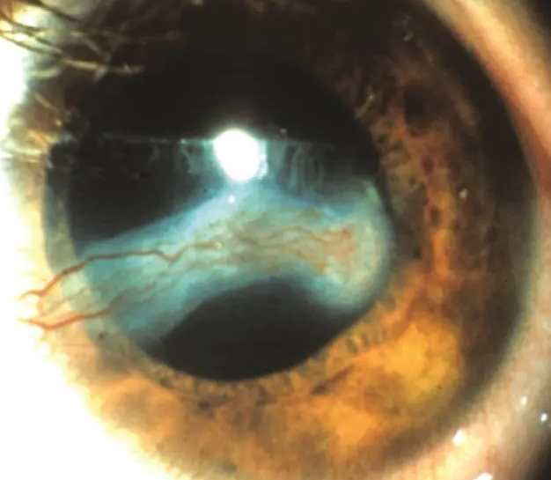
Phlyctenulosis
Recurrent corneal phlyctenule that has progressed into the visual axis

