Slide 1
Case Studies in Professional Advertising
Sample Advertisements with Problem Areas Identified

Slide 2
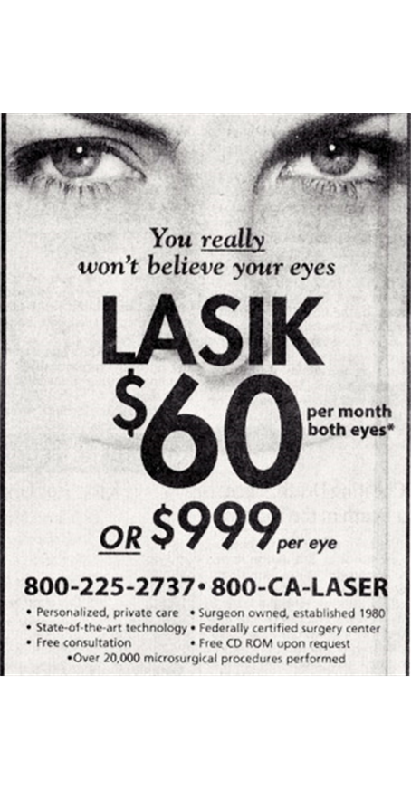
Code of Ethics Rule 13 Communications to the Public
No false, deceptive or misleading information
No deceptive omissions
No appeals to patients’ anxiety
Must not create unjustified expectations of results
Must disclose risks
Must not misrepresent credentials
No unsubstantiated claims of superiority
Notes:
When the Code of Ethics was written in the early 80’s
felt it was essential to be approved by the FTC
Rule 13 was part of the original Code
that FTC approved in 1983,
The Code was adopted by the Academy in November 1983
Went into effect January 1984.
Rule 13 governs advertising by members of the AAO
The close parallels to FTC law are obvious
(read)

Slide 3
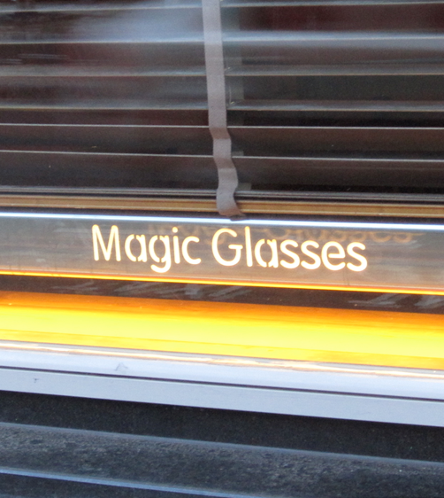
Advertising: Types of Claims
Express claims - specifically states support
“Studies show”
“Clinical research proves”
General claims – non-specific global claims
“medically proven”
Implied Claims - suggests something is true
“Throw away your glasses” (or related graphic)
Notes:
3
Express Claims -advertiser must document that research was conducted, prior to the advertisement, and that the research was performed in an objective manner using generally accepted research methods in the scientific community.
Claim: “95% of LASIK patients achieve 20/40 vision or better.”
If this claim is based on a clinical study, the surgeon making the claim needs to be sure the study is scientifically reliable, that he or she is performing the same surgery using the same protocol as was used in the study, and that the surgeon’s outcomes do not vary significantly from the reported results.
General claim (such as “medically proven”) usually requires at least two well-controlled clinical tests.
(1) the study subjects are suitable for study, assigned to test groups to minimize bias, and are controlled for variables;
(2) if comparative, the study is documented as a double-blind study; and
(3) a protocol identifies the objectives of the study, explanation of the study methods, and describes the use and comparison of the control to the study drug or procedure.
Implied Claim. The advertiser should:
1. give a source of the claim
or
2. avoid such a claim
And
The claim should not exceed the data from the source from which the claim is made.

Slide 4
Federal Trade Commission (FTC) Required Advertising Substantiation
Applies to all claims, expressed or implied
Advertising claims must be substantiable
Sufficient to support the claim
Objective fact
Competent, reliable science
Not anecdotal
Substantiation must be available at time of claim
Claims of Superiority
Must be subject to objective substantiation
Puffery or exaggeration (legal? yes…ethical?)
Notes:
These substantiation requirements are written into the Act.

Slide 5
Puffery is a Legal Term (truly)
In everyday language, “puffery” refers to exaggerated or false praise
In law, “puffery” is a promotional statement or claim that expresses subjective rather than objective views, which no "reasonable person" would take literally:
The best surgeon In the world
The best outcomes of any ophthalmologist
Notes:
Read slide
The World’s Briefest History of Puffery
The legal origins of the term “puffery” can be traced back to an 1893 English Court of Appeal case involving a manufacturer’s promise
to compensate customers with £100 pounds (in that era, a considerable sum), if they were to contract the flu after properly using the Carbolic Smoke Ball - a rubber ball with a tube that allowed users to inhale carbolic acid vapors purportedly to prevent disease.1
Eventually, a consumer sued the company after it refused to reimburse the customer who contracted the flu. During trial, the manufacturer defended its marketing claims by arguing such statements were “mere puff” and not meant to be construed literally.2 Although the three judge panel ruled against the manufacturer, the decision endorsed the notion that traditional rules relating to promises might not apply to advertisements that were clearly not meant to be taken seriously.
Thus, the legal defense of puffery was born
IN THE MODERN ERA - the legal definition of puffery depends slightly on your geographic location. Not all courts employ the same definition of puffery.
The U.S. Court of Appeals for the Third Circuit differs from the The Ninth Circuit, which again differs from the 5th Circuit.
Some memorable examples include Nike’s Air Jordan slogan, “It’s gotta be the shoes!”; Star buck’s slogan, “the best coffee for the best you”; and GEICO’s “[switch ing to GEICO is] so easy a caveman can do it.” The Federal Trade Commission has established its own definition of puffery, limiting the defense to marketing claims “that ordinary consumers do not take seriously.”7

Slide 6
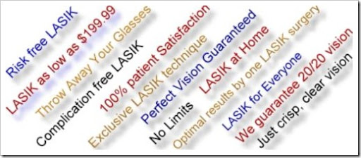
Advertising: Words and Phrases to Avoid
Safe
Pioneer, Leader, World Famous
Easy
Painless
Bloodless
Free
Guarantee
Notes:
Safe
Completely harmless?
Safer than existing technologies?
Comparatively safe?
Free – must define what is free
Guarantee – must define conditions, FTC frowns upon this claim because of how it is interpreted by the patient.

Slide 7
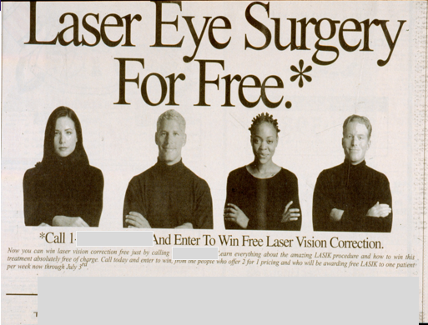
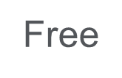
Real Advertisements
Free
Notes:
We’re not exactly sure what the first ad is about. The motorcycle is a Harley, so maybe that’s the reference to “kiss a pig”. It promotes “free” surgery.
The second ad also touts “free” surgery by entering a raffle.
No surgery is ever completely free. The ad could be deemed an “enticement” and may be problematic in the event of an unplanned outcome.

Slide 8
Notes:
Slightly over-stating the potential outcome and benefits…

Slide 9
Live Seminar Patient Promotion
FOR ALL YOU WHO WANT TO GET RID OF GLASSES AND CONTACTS FOREVER BUT ARE AFRAID OF LASIK OR THINK YOU CAN'T AFFORD IT: FIRST OF ALL, DID YOU KNOW THAT SAFESIGHT IS 10X SAFER THAN LASIK? AND CAN TREAT ALMOST EVERYONE WHO CANNOT HAVE LASIK? AND CAN FIX MOST LASIK COMPLICATIONS? You can get the Newer Safer Noncutting SafeSight procedure for FREE All you have to do is CALL US NOW and be our next LIVE SURGERY SEMINAR PATIENT
Express claim
“TrueSight™ is the most modern way to perform laser vision correction. Because it’s 100% non-cutting and 100% non-invasive, (surface ablation) it’s 10x safer than LASIK. With SafeSight™, none of the feared flap complications that may have kept you from getting LASIK is even possible–because we’re not cutting a flap to begin with!”
(Actual ad, but trademarked name changed. Problem phrases highlighted in yellow.)
Risky
Notes:
“10X SAFER” is an express claim that needs specific, scientifically verified substantiation to back it up.
“Live Surgery” is always a risky venture from several standpoints: informed consent, unplanned intraoperative event, potential poor outcome, etc.

Slide 10
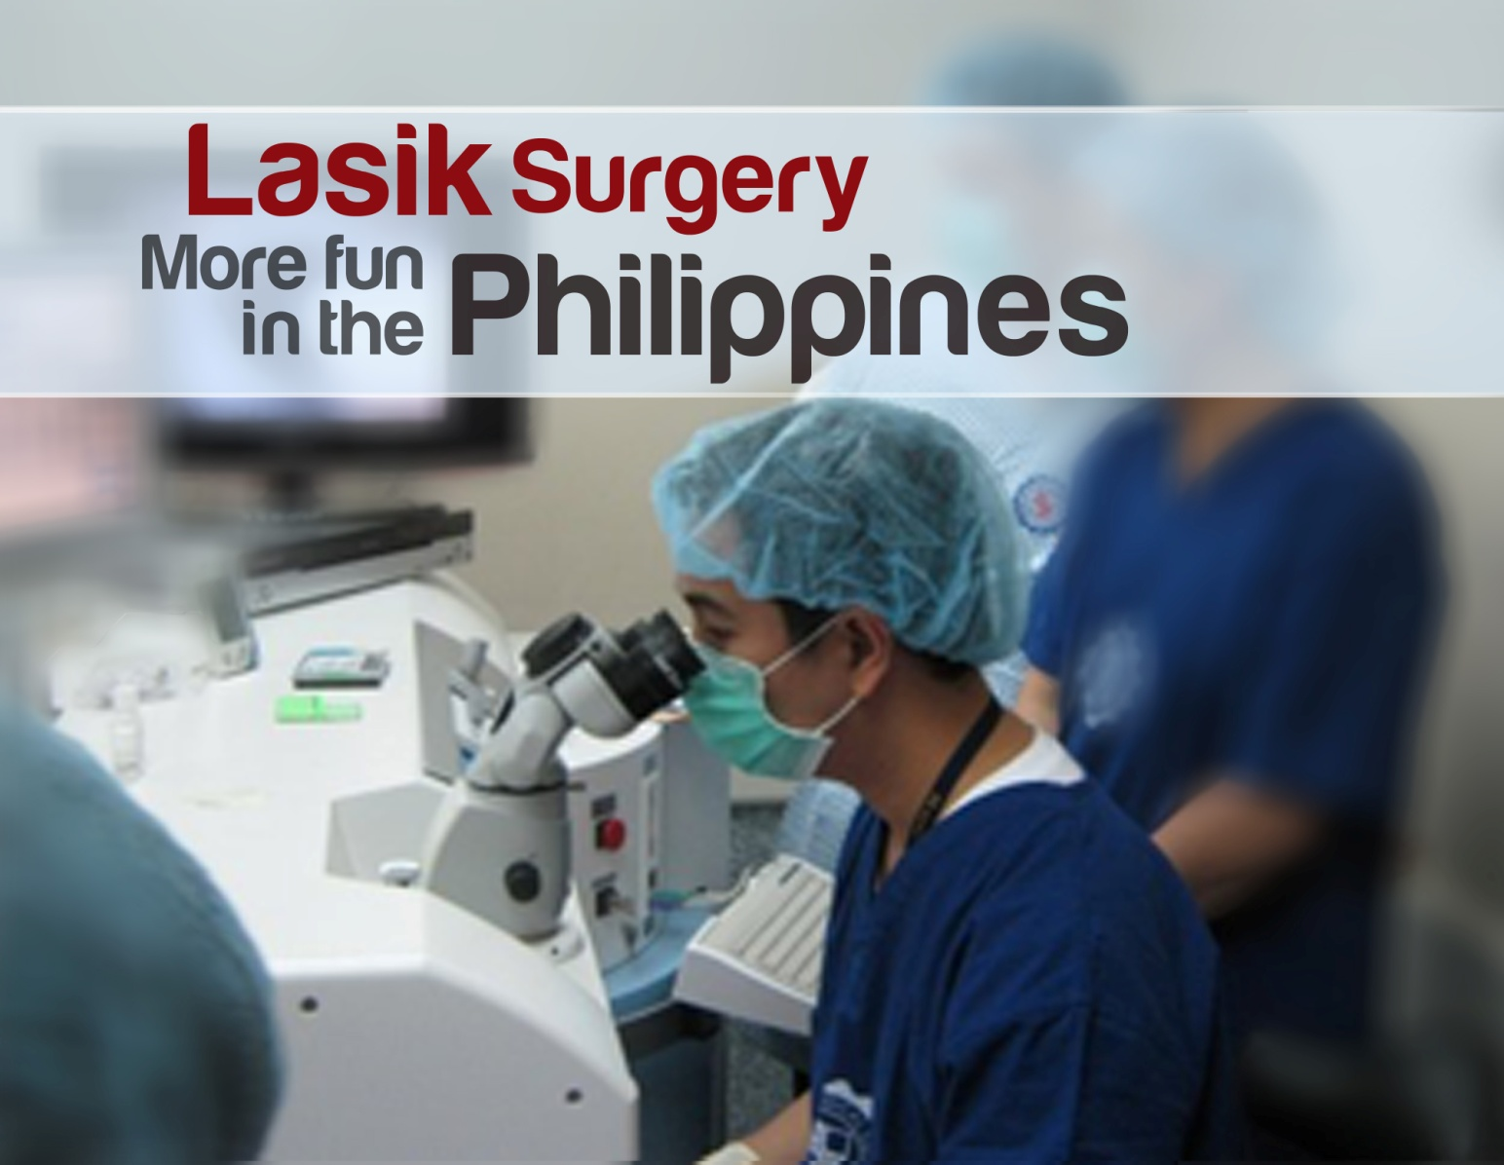
Notes:
More fun?

Slide 11
Guarantee
Express claim
Notes:
Includes claims that must be substantiable –
- The number of procedures performed
- The implied claim that patients won’t need glasses or contacts after LASIK
The double asterisks next to the money back guarantee refer to tiny type at the bottom of the ad that says: “**Preop best corrected vision must be 20/20 or better.” Not sure why you’d need LASIK if your preop vision is 20/20 or better…

Slide 12
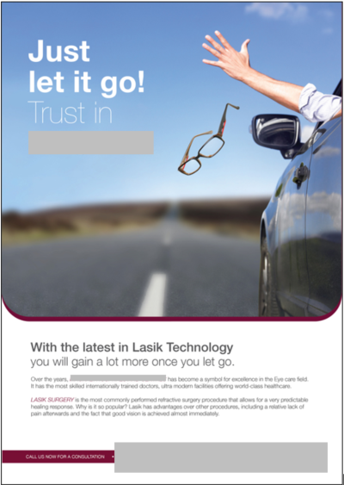
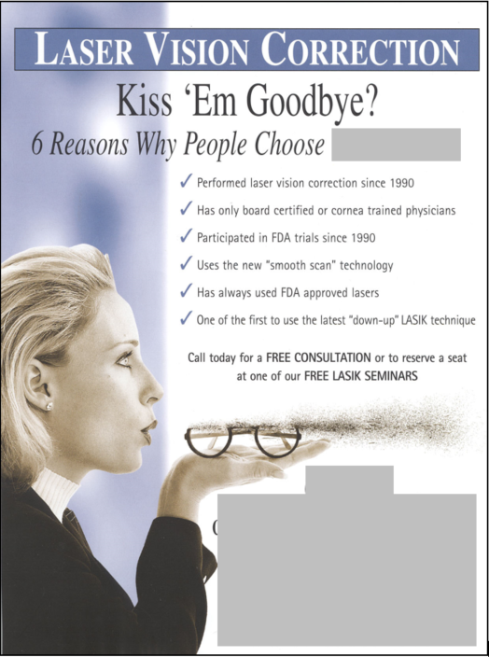
Implied claim
Implied claim
Notes:
Implies 20/20 Vision
The ad on the left states that the facility has “the most skilled internationally-trained doctors” which is a claim of superiority that must be substantiable.
“Kiss ‘Em Goodbye?” is implied claim
The ad on the right would be great without the image of the glasses blowing away and the headline question.

Slide 13
Appeals to patients’ anxieties
Notes:
This ad originally included a photo of a box cutter with the “No” symbol” and came out shortly after 9-11. After we communicated with the practice, they changed it to the single-edged razor blade – not much better. It’s still preying upon the anxieties and fears of patients.

Slide 14
Appeals to patients’ anxieties
Notes:
(Point out problems….)

Slide 15
Implied claim
Potential bait and switch
Notes:
(Point out problems….)

Slide 16
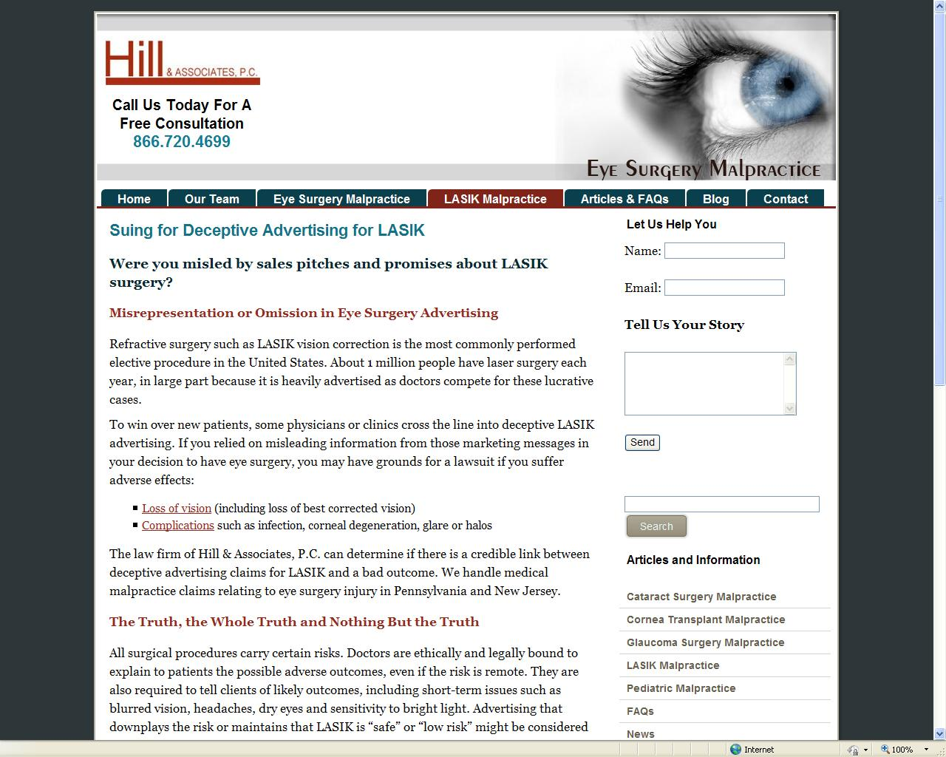
Potentially deceptive advertising may equal more damages
Notes:
These people are waiting for a refractive surgeon to have a complication. During depositions or at trial they will point to a practitioner’s advertising to boost damages.
Your advertising can work against you if you make promises, guarantees, even if you include unrealistic images of patients after surgery.

Slide 17
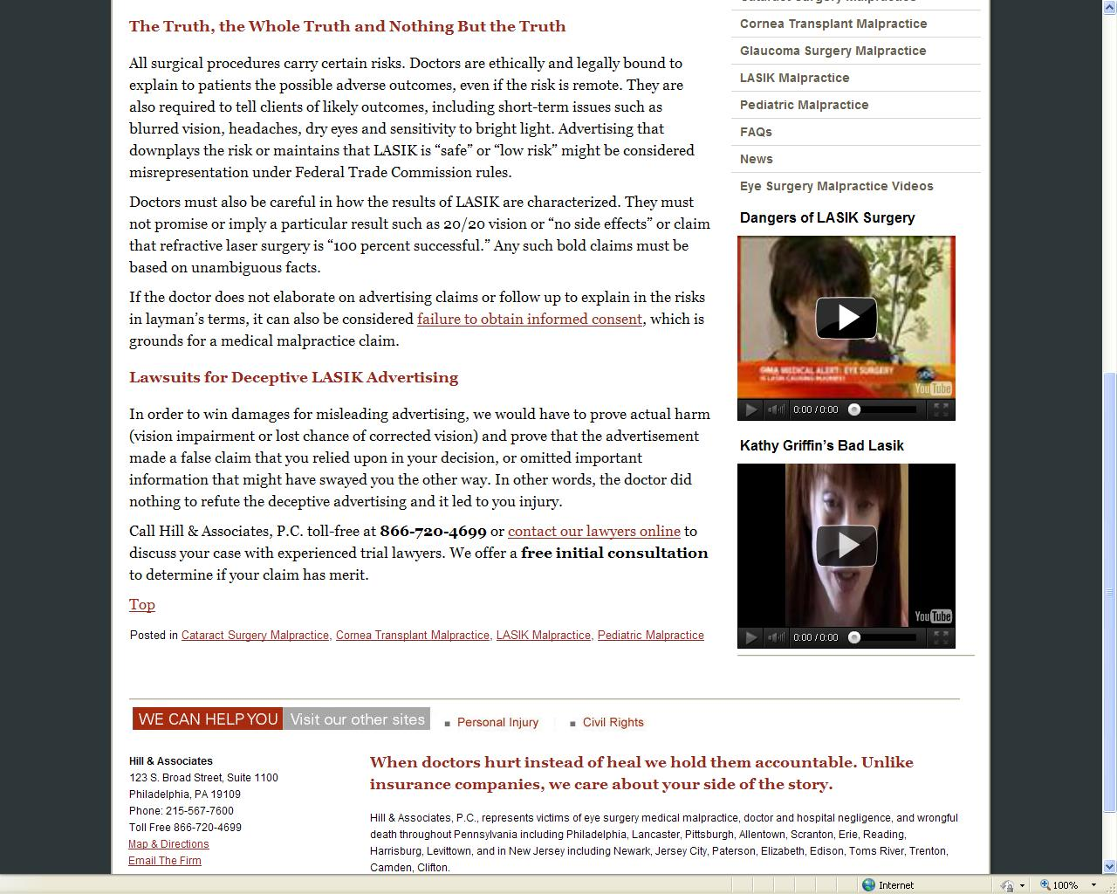
False claims may be shown
to have lured a patient into a
practice and into agreeing with the recommendation for to surgery.
“…in order to win damages for misleading advertising, we (have) to prove…that the doctor did nothing to refute the deceptive advertising and it led to your
injury…”
Notes:
More attorney ads for false claims.

Slide 18
What Do You Think?
What advertising is misleading and what is informative?
What claims of superiority are truly substantiable?
Can balanced advertising demonstrate both risks and benefits of surgical procedures?
How does imagery lead to potential deception?
Why do medical practices engage in clearly misleading advertising?

