Slide 1
Q
Glaucoma Overview
Define glaucoma.

Slide 2
A
Glaucoma Overview
Define glaucoma.
A group of optic neuropathies that present with progressive ONH damage and characteristic VF loss

Slide 3
Q
Glaucoma Overview
Define glaucoma.
A group of optic neuropathies that present with progressive ONH damage and characteristic VF loss
Why isn’t elevated IOP mentioned above?

Slide 4
A
Glaucoma Overview
Define glaucoma.
A group of optic neuropathies that present with progressive ONH damage and characteristic VF loss
Why isn’t elevated IOP mentioned above?
Elevated IOP is a strong risk factor for glaucoma, but it need not be present—IOP can be normal, or even low

Slide 5
Q
Glaucoma Overview
Define glaucoma.
A group of optic neuropathies that present with progressive ONH damage and characteristic VF loss
Why isn’t elevated IOP mentioned above?
Elevated IOP is a strong risk factor for glaucoma, but it need not be present—IOP can be normal, or even low
In addition to being the strongest risk factor for glaucoma, IOP has another quality that renders it unique—what is it?

Slide 6
A
Glaucoma Overview
Define glaucoma.
A group of optic neuropathies that present with progressive ONH damage and characteristic VF loss
Why isn’t elevated IOP mentioned above?
Elevated IOP is a strong risk factor for glaucoma, but it need not be present—IOP can be normal, or even low
In addition to being the strongest risk factor for glaucoma, IOP has another quality that renders it unique—what is it?
It is the only risk factor that is modifiable in a manner proven to influence the risk of glaucoma progression

Slide 7
Glaucoma Overview
Define glaucoma.
A group of optic neuropathies that present with progressive ONH damage and characteristic VF loss
Why isn’t elevated IOP mentioned above?
Elevated IOP is a strong risk factor for glaucoma, but it need not be present—IOP can be normal, or even low
In addition to being the strongest risk factor for glaucoma, IOP has another quality that renders it unique—what is it?
It is the only risk factor that is modifiable in a manner proven to influence the risk of glaucoma progression
That’s why glaucoma management concerns nothing but IOP-lowering maneuvers!
No question—proceed when ready

Slide 8
Glaucoma Overview
Define glaucoma.
A group of optic neuropathies that present with progressive ONH damage and characteristic VF loss
Why isn’t elevated IOP mentioned above?
Elevated IOP is a strong risk factor for glaucoma, but it need not be present—IOP can be normal, or even low
In addition to being the strongest risk factor for glaucoma, IOP has another quality that renders it unique—what is it?
It is the only risk factor that is modifiable in a manner proven to influence the risk of glaucoma progression
Speaking of IOP…Let’s drill down on the factors that determine it
No question—proceed when ready

Slide 9
Q
Glaucoma Overview
Fill in the IOP equation below. What is its eponymous name?
The Goldmann equation
Aqueous Formation Rate (μL/min)
Outflow Facility (μL/min/mmHg)
Episcleral Venous
Pressure (EVP)
IOP =
+

Slide 10
A
Glaucoma Overview
Fill in the IOP equation below. What is its eponymous name?
The Goldmann equation
Aqueous Formation Rate (μL/min)
Outflow Facility (μL/min/mmHg)
Episcleral Venous
Pressure (mmHg)
IOP =
+

Slide 11
Q
Glaucoma Overview
Fill in the IOP equation below. What is its eponymous name?
The Goldmann equation
Aqueous Formation Rate (μL/min)
Outflow Facility (μL/min/mmHg)
Episcleral Venous
Pressure (mmHg)
IOP =
+

Slide 12
A
Glaucoma Overview
Fill in the IOP equation below. What is its eponymous name?
The Goldmann equation
Aqueous Formation Rate (μL/min)
Outflow Facility (μL/min/mmHg)
Episcleral Venous
Pressure (mmHg)
IOP =
+

Slide 13
Glaucoma Overview
Fill in the IOP equation below. What is its eponymous name?
The Goldmann equation
Aqueous Formation Rate (μL/min)
Outflow Facility (μL/min/mmHg)
Episcleral Venous
Pressure (mmHg)
IOP =
+
Note how the μL/min cancel, leaving IOP in mmHg
No question—proceed when ready

Slide 14
14
Glaucoma Overview
Fill in the IOP equation below. What is its eponymous name?
The Goldmann equation
Aqueous Formation Rate (μL/min)
Outflow Facility (μL/min/mmHg)
Episcleral Venous
Pressure (mmHg)
IOP =
+
Episcleral venous pressure (EVP) normally measures about 8-12 mmHg (ie, the same as central venous pressure) in an upright pt. Looking at the Goldmann equation, you can see that, mathematically, it suggests EVP provides a baseline ‘floor’ value for IOP. That is, even if aqueous formation ceased (which would take the first term in the Goldmann equation down to zero), IOP should not fall below EVP; rather, it should be equal to zero plus whatever EVP was at the moment. Further, the Goldmann equation predicts that IOP should vary on a 1-to-1 basis with EVP—that is, each mmHg change in EVP should result in a mmHg change in IOP. However, none of these extrapolations hold up to empirical scrutiny. The point being, the Goldmann equation is a simplified, idealized model of IOP determination that does not account for all the real-world factors that influence IOP.
# to #
Note how the μL/min cancel, leaving IOP in mmHg
Notes:
14

Slide 15
15
Glaucoma Overview
Fill in the IOP equation below. What is its eponymous name?
The Goldmann equation
Aqueous Formation Rate (μL/min)
Outflow Facility (μL/min/mmHg)
Episcleral Venous
Pressure (mmHg)
IOP =
+
Episcleral venous pressure (EVP) normally measures about 8-12 mmHg (ie, the same as central venous pressure) in an upright pt. Looking at the Goldmann equation, you can see that, mathematically, it suggests EVP provides a baseline ‘floor’ value for IOP. That is, even if aqueous formation ceased (which would take the first term in the Goldmann equation down to zero), IOP should not fall below EVP; rather, it should be equal to zero plus whatever EVP was at the moment. Further, the Goldmann equation predicts that IOP should vary on a 1-to-1 basis with EVP—that is, each mmHg change in EVP should result in a mmHg change in IOP. However, none of these extrapolations hold up to empirical scrutiny. The point being, the Goldmann equation is a simplified, idealized model of IOP determination that does not account for all the real-world factors that influence IOP.
Note how the μL/min cancel, leaving IOP in mmHg
Notes:
15

Slide 16
16
Glaucoma Overview
Fill in the IOP equation below. What is its eponymous name?
The Goldmann equation
Aqueous Formation Rate (μL/min)
Outflow Facility (μL/min/mmHg)
Episcleral Venous
Pressure (mmHg)
IOP =
+
Episcleral venous pressure (EVP) normally measures about 8-12 mmHg (ie, the same as central venous pressure) in an upright pt. Looking at the Goldmann equation, you can see that, mathematically, it suggests EVP provides a baseline ‘floor’ value for IOP. That is, even if aqueous formation ceased (which would take the first term in the Goldmann equation down to zero), IOP should not fall below EVP; rather, it should be equal to zero plus whatever EVP was at the moment. Further, the Goldmann equation predicts that IOP should vary on a 1-to-1 basis with EVP—that is, each mmHg change in EVP should result in a mmHg change in IOP. However, none of these extrapolations hold up to empirical scrutiny. The point being, the Goldmann equation is a simplified, idealized model of IOP determination that does not account for all the real-world factors that influence IOP.
Note how the μL/min cancel, leaving IOP in mmHg
No question—proceed when ready
Notes:
16

Slide 17
17
Glaucoma Overview
Fill in the IOP equation below. What is its eponymous name?
The Goldmann equation
Aqueous Formation Rate (μL/min)
Outflow Facility (μL/min/mmHg)
Episcleral Venous
Pressure (mmHg)
IOP =
+
Episcleral venous pressure (EVP) normally measures about 8-12 mmHg (ie, the same as central venous pressure) in an upright pt. Looking at the Goldmann equation, you can see that, mathematically, it suggests EVP provides a baseline ‘floor’ value for IOP. That is, even if aqueous formation ceased (which would take the first term in the Goldmann equation down to zero), IOP should not fall below EVP; rather, it should be equal to zero plus whatever EVP was at the moment. Further, the Goldmann equation predicts that IOP should vary on a 1-to-1 basis with EVP—that is, each mmHg change in EVP should result in a mmHg change in IOP. However, none of these extrapolations hold up to empirical scrutiny. The point being, the Goldmann equation is a simplified, idealized model of IOP determination that does not account for all the real-world factors that influence IOP.
Note how the μL/min cancel, leaving IOP in mmHg
No question—proceed when ready
Notes:
17

Slide 18
Q
Glaucoma Overview
Fill in the IOP equation below. What is its eponymous name?
The Goldmann equation
Aqueous Formation Rate (μL/min)
Outflow Facility (μL/min/mmHg)
Episcleral Venous
Pressure (mmHg)
IOP =
+
So to lower IOP, one must:
--decrease aqueous formation, and/or
--increase outflow facility, and/or
--decrease episcleral venous pressure
…and/or dehydrate the vitreous with a
hyperosmotic agent
Three maneuvers
implied by the
Goldmann equation
the numerator
the denominator
the other thing

Slide 19
A
Glaucoma Overview
Fill in the IOP equation below. What is its eponymous name?
The Goldmann equation
Aqueous Formation Rate (μL/min)
Outflow Facility (μL/min/mmHg)
Episcleral Venous
Pressure (mmHg)
IOP =
+
So to lower IOP, one must:
--decrease aqueous formation, and/or
--increase outflow facility, and/or
--decrease episcleral venous pressure
…and/or dehydrate the vitreous with a
hyperosmotic agent
Three maneuvers
implied by the
Goldmann equation

Slide 20
Q
Glaucoma Overview
Fill in the IOP equation below. What is its eponymous name?
The Goldmann equation
Aqueous Formation Rate (μL/min)
Outflow Facility (μL/min/mmHg)
Episcleral Venous
Pressure (mmHg)
IOP =
+
So to lower IOP, one must:
--decrease aqueous formation, and/or
--increase outflow facility, and/or
--decrease episcleral venous pressure
…and/or dehydrate the vitreous with a
hyperosmotic agent
Three maneuvers
implied by the
Goldmann equation
Important maneuver
not implied by the
Goldmann equation
three words
one word

Slide 21
A
Glaucoma Overview
Fill in the IOP equation below. What is its eponymous name?
The Goldmann equation
Aqueous Formation Rate (μL/min)
Outflow Facility (μL/min/mmHg)
Episcleral Venous
Pressure (mmHg)
IOP =
+
So to lower IOP, one must:
--decrease aqueous formation, and/or
--increase outflow facility, and/or
--decrease episcleral venous pressure
…and/or dehydrate the vitreous with a
hyperosmotic agent
Three maneuvers
implied by the
Goldmann equation
Important maneuver
not implied by the
Goldmann equation

Slide 22
Q
Glaucoma Overview
Fill in the IOP equation below. What is its eponymous name?
The Goldmann equation
Aqueous Formation Rate (μL/min)
Outflow Facility (μL/min/mmHg)
Episcleral Venous
Pressure (mmHg)
IOP =
+
Which classes of meds decrease aqueous formation?
--β blockers
--CAIs
--α agonists
So to lower IOP, one must:
--decrease aqueous formation, and/or
--increase outflow facility, and/or
--decrease episcleral venous pressure
…and/or dehydrate the vitreous with a
hyperosmotic agent

Slide 23
A
Glaucoma Overview
Fill in the IOP equation below. What is its eponymous name?
The Goldmann equation
Aqueous Formation Rate (μL/min)
Outflow Facility (μL/min/mmHg)
Episcleral Venous
Pressure (mmHg)
IOP =
+
Which classes of meds decrease aqueous formation?
--β blockers
--CAIs
--α agonists
So to lower IOP, one must:
--decrease aqueous formation, and/or
--increase outflow facility, and/or
--decrease episcleral venous pressure
…and/or dehydrate the vitreous with a
hyperosmotic agent

Slide 24
Q
Glaucoma Overview
Fill in the IOP equation below. What is its eponymous name?
The Goldmann equation
Aqueous Formation Rate (μL/min)
Outflow Facility (μL/min/mmHg)
Episcleral Venous
Pressure (mmHg)
IOP =
+
Which classes of meds decrease aqueous formation?
--β blockers
--CAIs
--α agonists
So to lower IOP, one must:
--decrease aqueous formation, and/or
--increase outflow facility, and/or
--decrease episcleral venous pressure
…and/or dehydrate the vitreous with a
hyperosmotic agent
What are the two types of
outflow?
--Trabecular meshwork
--Uveoscleral

Slide 25
A
Glaucoma Overview
Fill in the IOP equation below. What is its eponymous name?
The Goldmann equation
Aqueous Formation Rate (μL/min)
Outflow Facility (μL/min/mmHg)
Episcleral Venous
Pressure (mmHg)
IOP =
+
Which classes of meds decrease aqueous formation?
--β blockers
--CAIs
--α agonists
So to lower IOP, one must:
--decrease aqueous formation, and/or
--increase outflow facility, and/or
--decrease episcleral venous pressure
…and/or dehydrate the vitreous with a
hyperosmotic agent
What are the two types of
outflow?
--Trabecular meshwork
--Uveoscleral

Slide 26
Glaucoma Overview
Fill in the IOP equation below. What is its eponymous name?
The Goldmann equation
Aqueous Formation Rate (μL/min)
Outflow Facility (μL/min/mmHg)
Episcleral Venous
Pressure (mmHg)
IOP =
+
Obviously, aqueous-humor dynamics play a central role in glaucoma. Let’s delve into its production…
Which classes of meds decrease aqueous formation?
--β blockers
--CAIs
--α agonists
So to lower IOP, one must:
--decrease aqueous formation, and/or
--increase outflow facility, and/or
--decrease episcleral venous pressure
…and/or dehydrate the vitreous with a
hyperosmotic agent
What are the two types of
outflow?
--Trabecular meshwork
--Uveoscleral

Slide 27
Q
Glaucoma Overview
Fill in the IOP equation below. What is its eponymous name?
The Goldmann equation
Aqueous Formation Rate (μL/min)
Outflow Facility (μL/min/mmHg)
Episcleral Venous
Pressure (mmHg)
IOP =
+
What is the rate of aqueous formation?

Slide 28
A
Glaucoma Overview
Fill in the IOP equation below. What is its eponymous name?
The Goldmann equation
Aqueous Formation Rate (μL/min)
Outflow Facility (μL/min/mmHg)
Episcleral Venous
Pressure (mmHg)
IOP =
+
What is the rate of aqueous formation?
2-3 μL/min

Slide 29
Q
Glaucoma Overview
Fill in the IOP equation below. What is its eponymous name?
The Goldmann equation
Aqueous Formation Rate (μL/min)
Outflow Facility (μL/min/mmHg)
Episcleral Venous
Pressure (mmHg)
IOP =
+
What is the rate of aqueous formation?
2-3 μL/min
What is the aqueous volume of the anterior chamber?

Slide 30
A
Glaucoma Overview
Fill in the IOP equation below. What is its eponymous name?
The Goldmann equation
Aqueous Formation Rate (μL/min)
Outflow Facility (μL/min/mmHg)
Episcleral Venous
Pressure (mmHg)
IOP =
+
What is the rate of aqueous formation?
2-3 μL/min
What is the aqueous volume of the anterior chamber?
200-300 μL

Slide 31
Q
Glaucoma Overview
Fill in the IOP equation below. What is its eponymous name?
The Goldmann equation
Aqueous Formation Rate (μL/min)
Outflow Facility (μL/min/mmHg)
Episcleral Venous
Pressure (mmHg)
IOP =
+
What is the rate of aqueous formation?
2-3 μL/min
What is the aqueous volume of the anterior chamber?
200-300 μL
So then, what percent of AC volume is ‘turned over’ every minute?

Slide 32
A
Glaucoma Overview
Fill in the IOP equation below. What is its eponymous name?
The Goldmann equation
Aqueous Formation Rate (μL/min)
Outflow Facility (μL/min/mmHg)
Episcleral Venous
Pressure (mmHg)
IOP =
+
What is the rate of aqueous formation?
2-3 μL/min
What is the aqueous volume of the anterior chamber?
200-300 μL
So then, what percent of AC volume is ‘turned over’ every minute?
About 1%

Slide 33
Q
Glaucoma Overview
Fill in the IOP equation below. What is its eponymous name?
The Goldmann equation
Aqueous Formation Rate (μL/min)
Outflow Facility (μL/min/mmHg)
Episcleral Venous
Pressure (mmHg)
IOP =
+
What is the rate of aqueous formation?
2-3 μL/min
What is the aqueous volume of the anterior chamber?
200-300 μL
So then, what percent of AC volume is ‘turned over’ every minute?
About 1%
Given this, how long does it take for the aqueous content of the AC to be fully replaced?

Slide 34
A
Glaucoma Overview
Fill in the IOP equation below. What is its eponymous name?
The Goldmann equation
Aqueous Formation Rate (μL/min)
Outflow Facility (μL/min/mmHg)
Episcleral Venous
Pressure (mmHg)
IOP =
+
What is the rate of aqueous formation?
2-3 μL/min
What is the aqueous volume of the anterior chamber?
200-300 μL
So then, what percent of AC volume is ‘turned over’ every minute?
About 1%
Given this, how long does it take for the aqueous content of the AC to be fully replaced?
Roughly 100 minutes

Slide 35
Q
Glaucoma Overview
Fill in the IOP equation below. What is its eponymous name?
The Goldmann equation
Aqueous Formation Rate (μL/min)
Outflow Facility (μL/min/mmHg)
Episcleral Venous
Pressure (mmHg)
IOP =
+
Which meds decrease
aqueous formation?
--β blockers
--CAIs
--α agonists
Speaking of aqueous formation…What specific tissue makes aqueous?
The nonpigmented epithelium of the pars plicata portion of the ciliary body
What is implied by the fact that aqueous is made by the ‘nonpigmented’ epithelium?
The presence of a pigmented epithelium
So to lower IOP, one must:
--decrease aqueous formation, and/or
--increase outflow facility, and/or
--decrease episcleral venous pressure
…and/or dehydrate the vitreous with a
hyperosmotic agent
What are the two types of
outflow?
--Trabecular meshwork
--Uveoscleral

Slide 36
A
Glaucoma Overview
Fill in the IOP equation below. What is its eponymous name?
The Goldmann equation
Aqueous Formation Rate (μL/min)
Outflow Facility (μL/min/mmHg)
Episcleral Venous
Pressure (mmHg)
IOP =
+
Which meds decrease
aqueous formation?
--β blockers
--CAIs
--α agonists
Speaking of aqueous formation…What specific tissue makes aqueous?
The nonpigmented epithelium of the pars plicata portion of the ciliary body
What is implied by the fact that aqueous is made by the ‘nonpigmented’ epithelium?
The presence of a pigmented epithelium
So to lower IOP, one must:
--decrease aqueous formation, and/or
--increase outflow facility, and/or
--decrease episcleral venous pressure
…and/or dehydrate the vitreous with a
hyperosmotic agent
What are the two types of
outflow?
--Trabecular meshwork
--Uveoscleral

Slide 37
Q
Glaucoma Overview
Fill in the IOP equation below. What is its eponymous name?
The Goldmann equation
Aqueous Formation Rate (μL/min)
Outflow Facility (μL/min/mmHg)
Episcleral Venous
Pressure (mmHg)
IOP =
+
Which meds decrease
aqueous formation?
--β blockers
--CAIs
--α agonists
Speaking of aqueous formation…What specific tissue makes aqueous?
The nonpigmented epithelium of the pars plicata portion of the ciliary body
What is implied by the fact that aqueous is made by the ‘nonpigmented’ epithelium?
The presence of a pigmented epithelium
So to lower IOP, one must:
--decrease aqueous formation, and/or
--increase outflow facility, and/or
--decrease episcleral venous pressure
…and/or dehydrate the vitreous with a
hyperosmotic agent
What are the two types of
outflow?
--Trabecular meshwork
--Uveoscleral

Slide 38
A
Glaucoma Overview
Fill in the IOP equation below. What is its eponymous name?
The Goldmann equation
Aqueous Formation Rate (μL/min)
Outflow Facility (μL/min/mmHg)
Episcleral Venous
Pressure (mmHg)
IOP =
+
Which meds decrease
aqueous formation?
--β blockers
--CAIs
--α agonists
Speaking of aqueous formation…What specific tissue makes aqueous?
The nonpigmented epithelium of the pars plicata portion of the ciliary body
What is implied by the fact that aqueous is made by the ‘nonpigmented’ epithelium?
The presence of a pigmented epithelium
So to lower IOP, one must:
--decrease aqueous formation, and/or
--increase outflow facility, and/or
--decrease episcleral venous pressure
…and/or dehydrate the vitreous with a
hyperosmotic agent
What are the two types of
outflow?
--Trabecular meshwork
--Uveoscleral

Slide 39
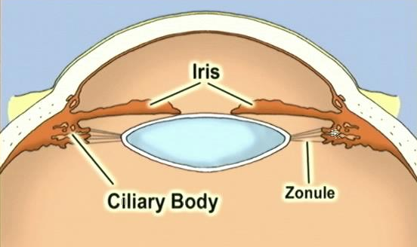
Q
Glaucoma Overview
This part is the…Pars plicata
This part is the…Pars plana
Ciliary body: One perspective, two questions

Slide 40
A
Glaucoma Overview
This part is the…Pars plicata
This part is the…Pars plana
Ciliary body: One perspective, two questions

Slide 41
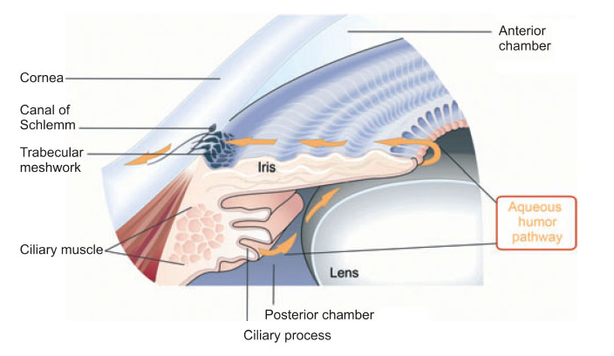
Glaucoma Overview
Ciliary body: Another perspective

Slide 42
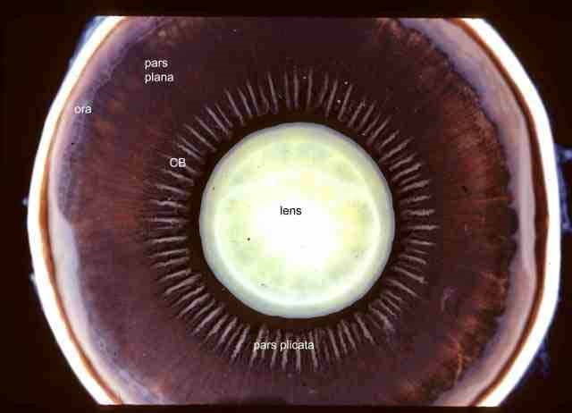
Glaucoma Overview
Ciliary body: Another

Slide 43
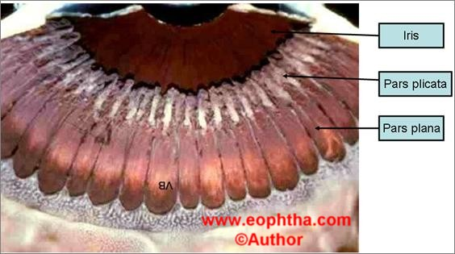
Glaucoma Overview
Ciliary body: Another

Slide 44
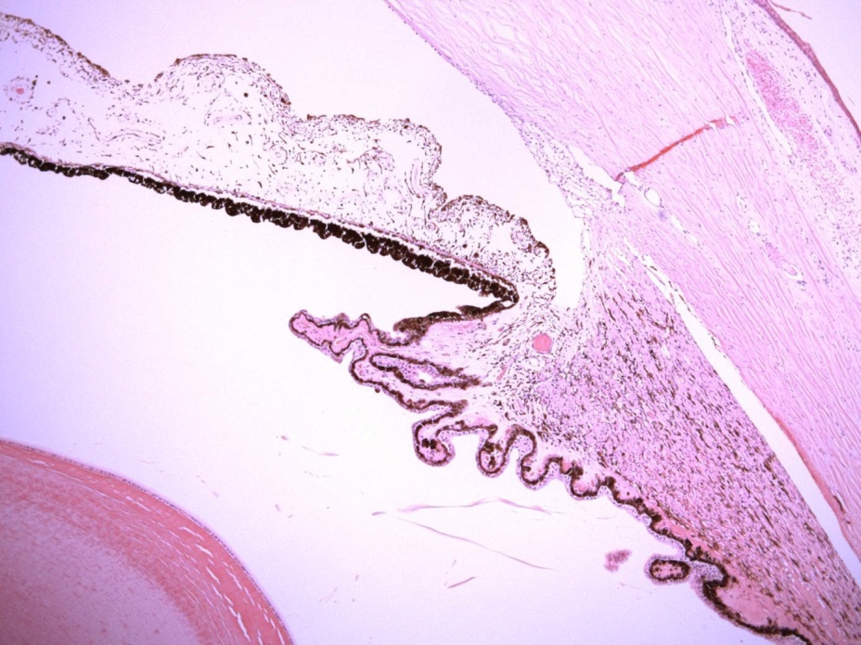
Glaucoma Overview
Iris
Now let’s look at the CB epithelium. Low power photomicrograph.
Ciliary body
Lens

Slide 45
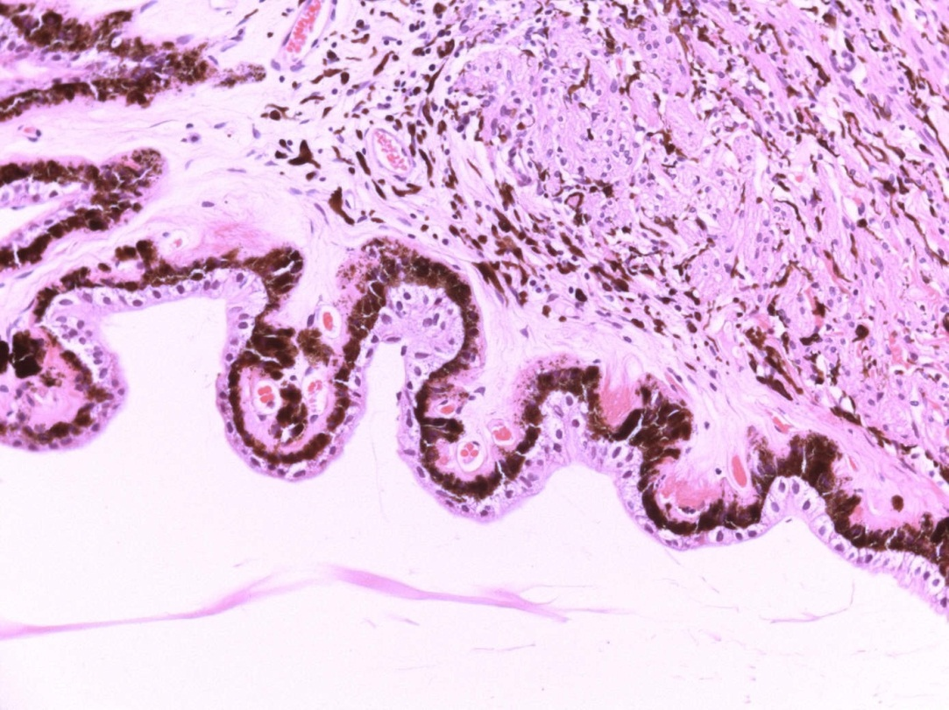
Glaucoma Overview
Now let’s look at the CB epithelium. Higher.

Slide 46
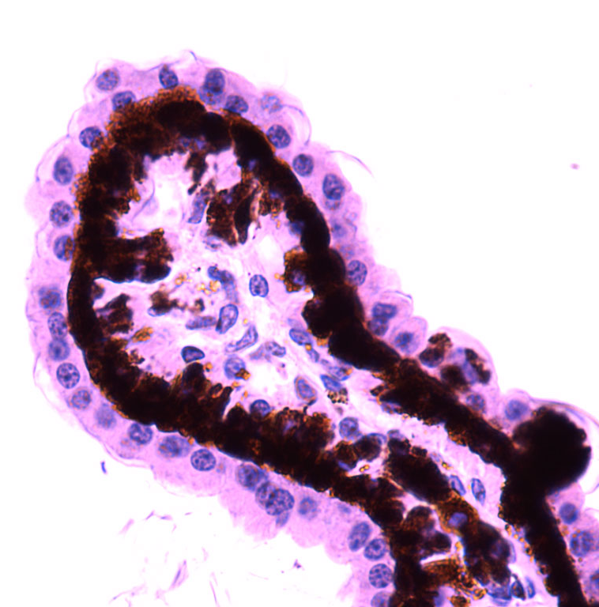
Glaucoma Overview
Speaking of aqueous formation…What specific tissue makes aqueous?
The nonpigmented epithelium of the pars plicata portion of the ciliary body
What is implied by the fact that aqueous is made by the ‘nonpigmented’ epithelium?
The presence of a pigmented epithelium
Now let’s look at the CB epithelium. High.
No question—proceed when ready

Slide 47
Q
Glaucoma Overview
Speaking of aqueous formation…What specific tissue makes aqueous?
The nonpigmented epithelium of the pars plicata portion of the ciliary body
What is implied by the fact that aqueous is made by the ‘nonpigmented’ epithelium?
The presence of a pigmented epithelium
From what embryonic tissue do the two epithelia of the CB derive?

Slide 48
A
Glaucoma Overview
Speaking of aqueous formation…What specific tissue makes aqueous?
The nonpigmented epithelium of the pars plicata portion of the ciliary body
What is implied by the fact that aqueous is made by the ‘nonpigmented’ epithelium?
The presence of a pigmented epithelium
From what embryonic tissue do the two epithelia of the CB derive?
Neuroectoderm

Slide 49
Q
Glaucoma Overview
Speaking of aqueous formation…What specific tissue makes aqueous?
The nonpigmented epithelium of the pars plicata portion of the ciliary body
What is implied by the fact that aqueous is made by the ‘nonpigmented’ epithelium?
The presence of a pigmented epithelium
From what embryonic tissue do the two epithelia of the CB derive?
Neuroectoderm
What other portion of the eye derives from neuroectoderm?

Slide 50
A
Glaucoma Overview
Speaking of aqueous formation…What specific tissue makes aqueous?
The nonpigmented epithelium of the pars plicata portion of the ciliary body
What is implied by the fact that aqueous is made by the ‘nonpigmented’ epithelium?
The presence of a pigmented epithelium
From what embryonic tissue do the two epithelia of the CB derive?
Neuroectoderm
What other portion of the eye derives from neuroectoderm?
The retina (ie, the neurosensory retina + RPE)

Slide 51
Q
Glaucoma Overview
Speaking of aqueous formation…What specific tissue makes aqueous?
The nonpigmented epithelium of the pars plicata portion of the ciliary body
What is implied by the fact that aqueous is made by the ‘nonpigmented’ epithelium?
The presence of a pigmented epithelium
From what embryonic tissue do the two epithelia of the CB derive?
Neuroectoderm
What other portion of the eye derives from neuroectoderm?
The retina (ie, the neurosensory retina + RPE)
How are the neurosensory retinal and RPE cells oriented with respect to one another?

Slide 52
A
Glaucoma Overview
Speaking of aqueous formation…What specific tissue makes aqueous?
The nonpigmented epithelium of the pars plicata portion of the ciliary body
What is implied by the fact that aqueous is made by the ‘nonpigmented’ epithelium?
The presence of a pigmented epithelium
From what embryonic tissue do the two epithelia of the CB derive?
Neuroectoderm
What other portion of the eye derives from neuroectoderm?
The retina (ie, the neurosensory retina + RPE)
How are the neurosensory retinal and RPE cells oriented with respect to one another?
Apex-to-apex

Slide 53
Q
Glaucoma Overview
Speaking of aqueous formation…What specific tissue makes aqueous?
The nonpigmented epithelium of the pars plicata portion of the ciliary body
What is implied by the fact that aqueous is made by the ‘nonpigmented’ epithelium?
The presence of a pigmented epithelium
From what embryonic tissue do the two epithelia of the CB derive?
Neuroectoderm
What other portion of the eye derives from neuroectoderm?
The retina (ie, the neurosensory retina + RPE)
How are the neurosensory retinal and RPE cells oriented with respect to one another?
Apex-to-apex
How are the two epithelial layers of the CB oriented with respect to one another?

Slide 54
A
Glaucoma Overview
Speaking of aqueous formation…What specific tissue makes aqueous?
The nonpigmented epithelium of the pars plicata portion of the ciliary body
What is implied by the fact that aqueous is made by the ‘nonpigmented’ epithelium?
The presence of a pigmented epithelium
From what embryonic tissue do the two epithelia of the CB derive?
Neuroectoderm
What other portion of the eye derives from neuroectoderm?
The retina (ie, the neurosensory retina + RPE)
How are the neurosensory retinal and RPE cells oriented with respect to one another?
Apex-to-apex
How are the two epithelial layers of the CB oriented with respect to one another?
The same way--apex-to-apex

Slide 55
Q
Glaucoma Overview
Speaking of aqueous formation…What specific tissue makes aqueous?
The nonpigmented epithelium of the pars plicata portion of the ciliary body
What is implied by the fact that aqueous is made by the ‘nonpigmented’ epithelium?
The presence of a pigmented epithelium
From what embryonic tissue do the two epithelia of the CB derive?
Neuroectoderm
What other portion of the eye derives from neuroectoderm?
The retina (ie, the neurosensory retina + RPE)
How are the neurosensory retinal and RPE cells oriented with respect to one another?
Apex-to-apex
How are the two epithelial layers of the CB oriented with respect to one another?
The same way--apex-to-apex
Which CB epithelial layer is pigmented--the inner, or the outer?

Slide 56
A
Glaucoma Overview
Speaking of aqueous formation…What specific tissue makes aqueous?
The nonpigmented epithelium of the pars plicata portion of the ciliary body
What is implied by the fact that aqueous is made by the ‘nonpigmented’ epithelium?
The presence of a pigmented epithelium
From what embryonic tissue do the two epithelia of the CB derive?
Neuroectoderm
What other portion of the eye derives from neuroectoderm?
The retina (ie, the neurosensory retina + RPE)
How are the neurosensory retinal and RPE cells oriented with respect to one another?
Apex-to-apex
How are the two epithelial layers of the CB oriented with respect to one another?
The same way--apex-to-apex
Which CB epithelial layer is pigmented--the inner, or the outer?
The outer

Slide 57
Q
Glaucoma Overview
Speaking of aqueous formation…What specific tissue makes aqueous?
The nonpigmented epithelium of the pars plicata portion of the ciliary body
What is implied by the fact that aqueous is made by the ‘nonpigmented’ epithelium?
The presence of a pigmented epithelium
From what embryonic tissue do the two epithelia of the CB derive?
Neuroectoderm
What other portion of the eye derives from neuroectoderm?
The retina (ie, the neurosensory retina + RPE)
How are the neurosensory retinal and RPE cells oriented with respect to one another?
Apex-to-apex
How are the two epithelial layers of the CB oriented with respect to one another?
The same way--apex-to-apex
Which CB epithelial layer is pigmented--the inner, or the outer?
The outer
Which portion of the retina is contiguous with the pigmented layer of the CB epithelium?

Slide 58
A
Glaucoma Overview
Speaking of aqueous formation…What specific tissue makes aqueous?
The nonpigmented epithelium of the pars plicata portion of the ciliary body
What is implied by the fact that aqueous is made by the ‘nonpigmented’ epithelium?
The presence of a pigmented epithelium
From what embryonic tissue do the two epithelia of the CB derive?
Neuroectoderm
What other portion of the eye derives from neuroectoderm?
The retina (ie, the neurosensory retina + RPE)
How are the neurosensory retinal and RPE cells oriented with respect to one another?
Apex-to-apex
How are the two epithelial layers of the CB oriented with respect to one another?
The same way--apex-to-apex
Which CB epithelial layer is pigmented--the inner, or the outer?
The outer
Which portion of the retina is contiguous with the pigmented layer of the CB epithelium?
The RPE, ie, the outer

Slide 59
Q
Glaucoma Overview
Pigmented epithelium of the CB
Nonpigmented epithelium of the CB
Note: This vesicle...
Embryology of the optic vesicle as it invaginates. What you want to take note of is:
--The pigmented layer of the CB epi derives from the same structure as the RPE (which is, as its name indicates, also pigmented), and
--the nonpigmented CB epi derives from the same structure that gives rise to the neurosensory retina.
In other words, what you already know about eye anatomy can help you understand and remember eye embryology. (For more, see the Embryology made simply ridiculous slide-set.)
…not this one!

Slide 60
A
Glaucoma Overview
Pigmented epithelium of the CB
Nonpigmented epithelium of the CB
Note: This vesicle...
Embryology of the optic vesicle as it invaginates. What you want to take note of is:
--The pigmented layer of the CB epi derives from the same structure as the RPE (which is, as its name indicates, also pigmented), and
--the nonpigmented CB epi derives from the same structure that gives rise to the neurosensory retina.
In other words, what you already know about eye anatomy can help you understand and remember eye embryology. (For more, see the Embryology made simply ridiculous slide-set.)
…not this one!

Slide 61
A
Glaucoma Overview
Pigmented epithelium of the CB
Nonpigmented epithelium of the CB
Note: This vesicle...
Embryology of the optic vesicle as it invaginates. What you want to take note of is:
--The pigmented layer of the CB epi derives from the same structure as the RPE (which is, as its name indicates, also pigmented), and
--the nonpigmented CB epi derives from the same structure that gives rise to the neurosensory retina.
In other words, what you already know about eye anatomy can help you understand and remember eye embryology. (For more, see the Embryology made simply ridiculous slide-set.)
…not this one!

Slide 62
A
Glaucoma Overview
Pigmented epithelium of the CB
Nonpigmented epithelium of the CB
Note: This vesicle...
Embryology of the optic vesicle as it invaginates. What you want to take note of is:
--The pigmented layer of the CB epi derives from the same structure as the RPE (which is, as its name indicates, also pigmented), and
--the nonpigmented CB epi derives from the same structure that gives rise to the neurosensory retina.
In other words, what you already know about eye anatomy can help you understand and remember eye embryology. (For more, see the Embryology made simply ridiculous slide-set.)
…not this one!

Slide 63
Q
Glaucoma Overview
Which intraocular structure makes aqueous?
The nonpigmented epithelium of the pars plicata portion of the ciliary body
What is implied by the fact that aqueous is made by the ‘nonpigmented’ epithelium?
The presence of a pigmented epithelium
From what embryonic tissue do the two epithelia of the CB derive?
Neuroectoderm
What other portion of the eye derives from neuroectoderm?
The retina (ie, the neurosensory retina + RPE)
How are the neurosensory retinal and RPE cells oriented with respect to one another?
Apex-to-apex
How are the two epithelial layers of the CB oriented with respect to one another?
The same way--apex-to-apex
Which CB epithelial layer is pigmented--the inner, or the outer?
The outer?
Which portion of the retina is contiguous with the pigmented layer of the CB epithelium?
The RPE, ie, the outer
Hol up Dr Flynn. Looking at this photomicrograph, the pigmented epi layer appears to be the inner one. Did you make a mistake?
Silly rabbit—mistakes are for residents! Remember, for us eye dentists the terms inner and outer are in relation to the globe itself; ie, inner means ‘closer to, or of, the inner aspect of the globe.’ Because the nonpigmented layer faces the vitreous cavity, it is the ‘inner’ layer of the two.

Slide 64
A
Glaucoma Overview
Which intraocular structure makes aqueous?
The nonpigmented epithelium of the pars plicata portion of the ciliary body
What is implied by the fact that aqueous is made by the ‘nonpigmented’ epithelium?
The presence of a pigmented epithelium
From what embryonic tissue do the two epithelia of the CB derive?
Neuroectoderm
What other portion of the eye derives from neuroectoderm?
The retina (ie, the neurosensory retina + RPE)
How are the neurosensory retinal and RPE cells oriented with respect to one another?
Apex-to-apex
How are the two epithelial layers of the CB oriented with respect to one another?
The same way--apex-to-apex
Which CB epithelial layer is pigmented--the inner, or the outer?
That’s what I said--the outer!
Which portion of the retina is contiguous with the pigmented layer of the CB epithelium?
The RPE, ie the outer
Hol up Dr Flynn. Looking at this photomicrograph, the pigmented epi layer appears to be the inner one. Did you make a mistake?
Silly rabbit—mistakes are for residents! Remember, for us eye dentists the terms inner and outer are in relation to the globe itself; ie, inner means ‘closer to, or of, the inner aspect of the globe.’ Because the nonpigmented layer faces the vitreous cavity, it is the ‘inner’ layer of the two.

Slide 65
A
Glaucoma Overview
Which intraocular structure makes aqueous?
The nonpigmented epithelium of the pars plicata portion of the ciliary body
What is implied by the fact that aqueous is made by the ‘nonpigmented’ epithelium?
The presence of a pigmented epithelium
From what embryonic tissue do the two epithelia of the CB derive?
Neuroectoderm
What other portion of the eye derives from neuroectoderm?
The retina (ie, the neurosensory retina + RPE)
How are the neurosensory retinal and RPE cells oriented with respect to one another?
Apex-to-apex
How are the two epithelial layers of the CB oriented with respect to one another?
The same way--apex-to-apex
Which CB epithelial layer is pigmented--the inner, or the outer?
That’s what I said--the outer!
Which portion of the retina is contiguous with the pigmented layer of the CB epithelium?
The RPE, ie the outer
Hol up Dr Flynn. Looking at this photomicrograph, the pigmented epi layer appears to be the inner one. Did you make a mistake?
Silly rabbit—mistakes are for residents! Remember, for us eye dentists the terms inner and outer are in relation to the globe itself; ie, inner means ‘closer to, or of, the inner aspect of the globe.’ Because the nonpigmented layer faces the vitreous cavity, it is the ‘inner’ layer of the two.

Slide 66
Glaucoma Overview
Fill in the IOP equation below. What is its eponymous name?
The Goldmann equation
Aqueous Formation Rate (μL/min)
Outflow Facility (μL/min/mmHg)
Episcleral Venous
Pressure (mmHg)
IOP =
+
Which classes of meds decrease aqueous formation?
--β blockers
--CAIs
--α agonists
Now let’s look at IOP measurement via Goldmann applanation tonometry
So to lower IOP, one must:
--decrease aqueous formation, and/or
--increase outflow facility, and/or
--decrease episcleral venous pressure
…and/or dehydrate the vitreous with a
hyperosmotic agent
What are the two types of
outflow?
--Trabecular meshwork
--Uveoscleral

Slide 67
Q
Glaucoma Overview
(P is for Pressure)
Based on the Imbert-Fick principle: P = F / A
two-name eponym

Slide 68
A
Glaucoma Overview
Based on the Imbert-Fick principle: P = F / A

Slide 69
Q
Glaucoma Overview
Based on the Imbert-Fick principle: P = F / A
Pressure inside a sphere equals force needed to flatten its surface divided by the area of flattening
what the…
…F stands for
what the A stands for
Principle
in words

Slide 70
A
Glaucoma Overview
Based on the Imbert-Fick principle: P = F / A
Pressure inside a sphere equals force needed to flatten its surface divided by the area of flattening
I-F Principle
in words

Slide 71
Q
Glaucoma Overview
Based on the Imbert-Fick principle: P = F / A
Pressure inside a sphere equals force needed to flatten its surface divided by the area of flattening
Assumes surface is infinitely thin, and dry (cornea is neither, obviously)
two words

Slide 72
A
Glaucoma Overview
Based on the Imbert-Fick principle: P = F / A
Pressure inside a sphere equals force needed to flatten its surface divided by the area of flattening
Assumes surface is infinitely thin, and dry (cornea is neither, obviously)

Slide 73
Q
Glaucoma Overview
Based on the Imbert-Fick principle: P = F / A
Pressure inside a sphere equals force needed to flatten its surface divided by the area of flattening
Assumes surface is infinitely thin, and dry (cornea is neither, obviously)
K thickness→resists applanation→increases IOP reading
increase vs
decrease

Slide 74
A
Glaucoma Overview
Based on the Imbert-Fick principle: P = F / A
Pressure inside a sphere equals force needed to flatten its surface divided by the area of flattening
Assumes surface is infinitely thin, and dry (cornea is neither, obviously)
K thickness→resists applanation→increases IOP reading

Slide 75
Glaucoma Overview
Based on the Imbert-Fick principle: P = F / A
Pressure inside a sphere equals force needed to flatten its surface divided by the area of flattening
Assumes surface is infinitely thin, and dry (cornea is neither, obviously)
K thickness→resists applanation→increases IOP reading
For the Imbert-Fick principle to hold, the only force resisting applanation should be the pressure within the sphere. However, real objects such as the cornea have intrinsic resistance to deformation owing to their physical nature, ie, because they’re made of ‘stuff.’ This inherent structural resistance of the cornea will be additive to whatever pressure is inside the eye, thereby causing the pressure reading to be falsely high. (And the thicker the cornea is, the higher the reading will be.)
No question—proceed when ready

Slide 76
Glaucoma Overview
Based on the Imbert-Fick principle: P = F / A
Pressure inside a sphere equals force needed to flatten its surface divided by the area of flattening
Assumes surface is infinitely thin, and dry (cornea is neither, obviously)
K thickness→resists applanation→increases IOP reading
For the Imbert-Fick principle to hold, the only force resisting applanation should be the pressure within the sphere. However, real objects such as the cornea have intrinsic resistance to deformation owing to their physical nature, ie, because they’re made of ‘stuff.’ This inherent structural resistance of the cornea will be additive to whatever pressure is inside the eye, thereby causing the pressure reading to be falsely high. (And the thicker the cornea is, the higher the reading will be.)
No question—proceed when ready

Slide 77
Q
Glaucoma Overview
Based on the Imbert-Fick principle: P = F / A
Pressure inside a sphere equals force needed to flatten its surface divided by the area of flattening
Assumes surface is infinitely thin, and dry (cornea is neither, obviously)
K thickness→resists applanation→increases IOP reading
Tear film→capillary attraction→decreases IOP reading
increase vs
decrease

Slide 78
A
Glaucoma Overview
Based on the Imbert-Fick principle: P = F / A
Pressure inside a sphere equals force needed to flatten its surface divided by the area of flattening
Assumes surface is infinitely thin, and dry (cornea is neither, obviously)
K thickness→resists applanation→increases IOP reading
Tear film→capillary attraction→decreases IOP reading

Slide 79
Glaucoma Overview
Based on the Imbert-Fick principle: P = F / A
Pressure inside a sphere equals force needed to flatten its surface divided by the area of flattening
Assumes surface is infinitely thin, and dry (cornea is neither, obviously)
K thickness→resists applanation→increases IOP reading
Tear film→capillary attraction→decreases IOP reading
On the other hand: The first ocular structure encountered by the applanator tip is the tear film. When contact with the tear film is made, a fluid bridge forms between the cornea and the tip. Surface tension of the water in this fluid bridge produces capillary attraction, which exerts a slight ‘pull’ on the applanator tip, drawing it toward the cornea. Because this force is drawing the applanator tip forward, it is causing the pressure reading to be falsely low.
No question—proceed when ready

Slide 80
Glaucoma Overview
Based on the Imbert-Fick principle: P = F / A
Pressure inside a sphere equals force needed to flatten its surface divided by the area of flattening
Assumes surface is infinitely thin, and dry (cornea is neither, obviously)
K thickness→resists applanation→increases IOP reading
Tear film→capillary attraction→decreases IOP reading
On the other hand: The first ocular structure encountered by the applanator tip is the tear film. When contact with the tear film is made, a fluid bridge forms between the cornea and the tip. Surface tension of the water in this fluid bridge produces capillary attraction, which exerts a slight ‘pull’ on the applanator tip, drawing it toward the cornea. Because this force is drawing the applanator tip forward, it is causing the pressure reading to be falsely low.
No question—proceed when ready

Slide 81
Glaucoma Overview
Based on the Imbert-Fick principle: P = F / A
Pressure inside a sphere equals force needed to flatten its surface divided by the area of flattening
Assumes surface is infinitely thin, and dry (cornea is neither, obviously)
K thickness→resists applanation→increases IOP reading
Tear film→capillary attraction→decreases IOP reading
To be useful, an applanator-type device has to account for these factors. Fortunately, the brilliant Dr. Goldmann was (mostly) up to the challenge…
No question—proceed when ready

Slide 82
Q
Glaucoma Overview
Based on the Imbert-Fick principle: P = F / A
Pressure inside a sphere equals force needed to flatten its surface divided by the area of flattening
Assumes surface is infinitely thin, and dry (cornea is neither, obviously)
K thickness→resists applanation→increases IOP reading
Tear film→capillary attraction→decreases IOP reading
Dr Goldmann realized if the diameter of the circle applanated by the device is 3.06 mm, capillary attraction and corneal thickness would cancel each other out (assuming CCT is 520 μm)
#.##
#
(CCT = Central corneal thickness)

Slide 83
A
Glaucoma Overview
Based on the Imbert-Fick principle: P = F / A
Pressure inside a sphere equals force needed to flatten its surface divided by the area of flattening
Assumes surface is infinitely thin, and dry (cornea is neither, obviously)
K thickness→resists applanation→increases IOP reading
Tear film→capillary attraction→decreases IOP reading
Dr Goldmann realized if the diameter of the circle applanated by the device is 3.06 mm, capillary attraction and corneal thickness would cancel each other out (assuming CCT is 520 μm)
(CCT = Central corneal thickness)

Slide 84
Glaucoma Overview
Based on the Imbert-Fick principle: P = F / A
Pressure inside a sphere equals force needed to flatten its surface divided by the area of flattening
Assumes surface is infinitely thin, and dry (cornea is neither, obviously)
K thickness→resists applanation→increases IOP reading
Tear film→capillary attraction→decreases IOP reading
Dr Goldmann realized if the diameter of the circle applanated by the device is 3.06 mm, capillary attraction and corneal thickness would cancel each other out (assuming CCT is 520 μm)
Goldmann believed CCT was ~520, with little variation
(We now know that CCT averages about 550, with wide variation among individuals)
No question—proceed when ready

Slide 85
Glaucoma Overview
Based on the Imbert-Fick principle: P = F / A
Pressure inside a sphere equals force needed to flatten its surface divided by the area of flattening
Assumes surface is infinitely thin, and dry (cornea is neither, obviously)
K thickness→resists applanation→increases IOP reading
Tear film→capillary attraction→decreases IOP reading
Dr Goldmann realized if the diameter of the circle applanated by the device is 3.06 mm, capillary attraction and corneal thickness would cancel each other out (assuming CCT is 520 μm)
Goldmann believed CCT was ~520, with little variation
When the mires line up, the diameter of the applanated area is 3.06 mm
No question—proceed when ready

Slide 86
Glaucoma Overview
Define glaucoma.
A group of optic neuropathies that present with progressive ONH damage and characteristic VF loss
Why isn’t elevated IOP mentioned above?
Elevated IOP is a strong risk factor for glaucoma, but it need not be present—IOP can be normal, or even low
In addition to being the strongest risk factor for glaucoma, IOP has another quality that renders it unique—what is it?
It is the only risk factor that is modifiable in a manner proven to influence the risk of glaucoma progression
We mentioned previously that glaucoma presents with “progressive ONH damage.” Let’s drill down on the structure of the ONH.

Slide 87
Q
Glaucoma Overview
The optic nerves are composed of what?

Slide 88
A
Glaucoma Overview
The optic nerves are composed of what?
The axons of retinal ganglion cells

Slide 89
Q
Glaucoma Overview
The optic nerves are composed of what?
The axons of retinal ganglion cells
How many fibers (axons) comprise an optic nerve?

Slide 90
A
Glaucoma Overview
The optic nerves are composed of what?
The axons of retinal ganglion cells
How many fibers (axons) comprise an optic nerve?
Depends upon which book you ask, but the answer 1.2M works
Per the…
Glaucoma book: 1.2-1.5M
Neuro book: 1-1.2M
Fundamentals book: “more than a million”

Slide 91
Q
Glaucoma Overview
The optic nerves are composed of what?
The axons of retinal ganglion cells
Do they synapse in the region of the optic nerve head?

Slide 92
A
Glaucoma Overview
The optic nerves are composed of what?
The axons of retinal ganglion cells
Do they synapse in the region of the optic nerve head?
No

Slide 93
Q
Glaucoma Overview
The optic nerves are composed of what?
The axons of retinal ganglion cells
Do they synapse in the region of the optic nerve head?
No
Where will they synapse?

Slide 94
A
Glaucoma Overview
The optic nerves are composed of what?
The axons of retinal ganglion cells
Do they synapse in the region of the optic nerve head?
No
Where will they synapse?
Most will synapse in the lateral geniculate nucleus (LGN)

Slide 95
Q
Glaucoma Overview
The optic nerves are composed of what?
The axons of retinal ganglion cells
Do they synapse in the region of the optic nerve head?
No
Where will they synapse?
Most will synapse in the lateral geniculate nucleus (LGN)
Most? Where will the others synapse, and what are they responsible for?

Slide 96
Q/A
Glaucoma Overview
The optic nerves are composed of what?
The axons of retinal ganglion cells
Do they synapse in the region of the optic nerve head?
No
Where will they synapse?
Most will synapse in the lateral geniculate nucleus (LGN)
Most? Where will the others synapse, and what are they responsible for?
Most of the others are involved in the pupillary light reflex
three words

Slide 97
A
Glaucoma Overview
The optic nerves are composed of what?
The axons of retinal ganglion cells
Do they synapse in the region of the optic nerve head?
No
Where will they synapse?
Most will synapse in the lateral geniculate nucleus (LGN)
Most? Where will the others synapse, and what are they responsible for?
Most of the others are involved in the pupillary light reflex

Slide 98
Q/A
Glaucoma Overview
The optic nerves are composed of what?
The axons of retinal ganglion cells
Do they synapse in the region of the optic nerve head?
No
Where will they synapse?
Most will synapse in the lateral geniculate nucleus (LGN)
Most? Where will the others synapse, and what are they responsible for?
Most of the others are involved in the pupillary light reflex ; they peel off just prior to reaching the LGN, heading instead to the pretectum of the dorsal midbrain to synapse in the pretectal nuclei
one word
two words
two words

Slide 99
A
Glaucoma Overview
The optic nerves are composed of what?
The axons of retinal ganglion cells
Do they synapse in the region of the optic nerve head?
No
Where will they synapse?
Most will synapse in the lateral geniculate nucleus (LGN)
Most? Where will the others synapse, and what are they responsible for?
Most of the others are involved in the pupillary light reflex ; they peel off just prior to reaching the LGN, heading instead to the pretectum of the dorsal midbrain to synapse in the pretectal nuclei

Slide 100
Q
Glaucoma Overview
The optic nerves are composed of what?
The axons of retinal ganglion cells
Do they synapse in the region of the optic nerve head?
No
Where will they synapse?
Most will synapse in the lateral geniculate nucleus (LGN)
Most? Where will the others synapse, and what are they responsible for?
Most of the others are involved in the pupillary light reflex ; they peel off just prior to reaching the LGN, heading instead to the pretectum of the dorsal midbrain to synapse in the pretectal nuclei
There’s that word again—’most.’ Where will the others synapse, and what are they responsible for?

Slide 101
A
Glaucoma Overview
The optic nerves are composed of what?
The axons of retinal ganglion cells
Do they synapse in the region of the optic nerve head?
No
Where will they synapse?
Most will synapse in the lateral geniculate nucleus (LGN)
Most? Where will the others synapse, and what are they responsible for?
Most of the others are involved in the pupillary light reflex ; they peel off just prior to reaching the LGN, heading instead to the pretectum of the dorsal midbrain to synapse in the pretectal nuclei
There’s that word again—’most.’ Where will the others synapse, and what are they responsible for?
The hypothalamus, where they are involved in modulating circadian responses

Slide 102
Q
Glaucoma Overview
The optic nerves are composed of what?
The axons of retinal ganglion cells
Do they synapse in the region of the optic nerve head?
No
Where will they synapse?
Most will synapse in the lateral geniculate nucleus (LGN)
Anatomically speaking, the optic nerve is considered to have four portions. What are they?

Slide 103
A
Glaucoma Overview
The optic nerves are composed of what?
The axons of retinal ganglion cells
Do they synapse in the region of the optic nerve head?
No
Where will they synapse?
Most will synapse in the lateral geniculate nucleus (LGN)
Anatomically speaking, the optic nerve is considered to have four portions. What are they?
The intraocular, intraorbital, intracanalicular, and intracranial

Slide 104
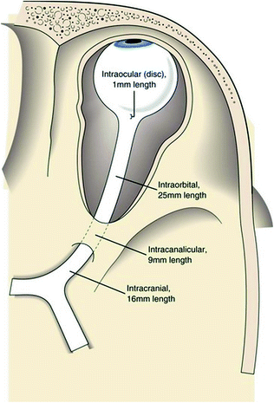
Glaucoma Overview
Optic nerve portions (don’t memorize the lengths)

Slide 105
Q
Glaucoma Overview
The optic nerves are composed of what?
The axons of retinal ganglion cells
Do they synapse in the region of the optic nerve head?
No
Where will they synapse?
Most will synapse in the lateral geniculate nucleus (LGN)
Anatomically speaking, the optic nerve is considered to have four portions. What are they?
The intraocular, intraorbital, intracanalicular, and intracranial
The intraocular portion is also considered to have four portions. What are they?
Portion | Blood supply
? | Central retinal artery (CRA)
 | Short posterior ciliary arteries
 | Arterial circle of Zinn & Haller
 | Centripetal CRA branches, centrifugal pial branches
(innermost)
(outermost)

Slide 106
Q/A
Glaucoma Overview
The optic nerves are composed of what?
The axons of retinal ganglion cells
Do they synapse in the region of the optic nerve head?
No
Where will they synapse?
Most will synapse in the lateral geniculate nucleus (LGN)
Anatomically speaking, the optic nerve is considered to have four portions. What are they?
The intraocular, intraorbital, intracanalicular, and intracranial
The intraocular portion is also considered to have four portions. What are they?
Portion | Blood supply
NFL portion | Central retinal artery (CRA)
? | Short posterior ciliary arteries
 | Arterial circle of Zinn & Haller
 | Centripetal CRA branches, centrifugal pial branches
(innermost)
(outermost)

Slide 107
Q/A
Glaucoma Overview
The optic nerves are composed of what?
The axons of retinal ganglion cells
Do they synapse in the region of the optic nerve head?
No
Where will they synapse?
Most will synapse in the lateral geniculate nucleus (LGN)
Anatomically speaking, the optic nerve is considered to have four portions. What are they?
The intraocular, intraorbital, intracanalicular, and intracranial
The intraocular portion is also considered to have four portions. What are they?
Portion | Blood supply
NFL portion | Central retinal artery (CRA)
Pre-laminar | Short posterior ciliary arteries
? | Arterial circle of Zinn & Haller
 | Centripetal CRA branches, centrifugal pial branches
(innermost)
(outermost)

Slide 108
Q/A
Glaucoma Overview
The optic nerves are composed of what?
The axons of retinal ganglion cells
Do they synapse in the region of the optic nerve head?
No
Where will they synapse?
Most will synapse in the lateral geniculate nucleus (LGN)
Anatomically speaking, the optic nerve is considered to have four portions. What are they?
The intraocular, intraorbital, intracanalicular, and intracranial
The intraocular portion is also considered to have four portions. What are they?
Portion | Blood supply
NFL portion | Central retinal artery (CRA)
Pre-laminar | Short posterior ciliary arteries
Laminar | Arterial circle of Zinn & Haller
? | Centripetal CRA branches, centrifugal pial branches
(innermost)
(outermost)

Slide 109
A
Glaucoma Overview
The optic nerves are composed of what?
The axons of retinal ganglion cells
Do they synapse in the region of the optic nerve head?
No
Where will they synapse?
Most will synapse in the lateral geniculate nucleus (LGN)
Anatomically speaking, the optic nerve is considered to have four portions. What are they?
The intraocular, intraorbital, intracanalicular, and intracranial
The intraocular portion is also considered to have four portions. What are they?
Portion | Blood supply
NFL portion | Central retinal artery (CRA)
Pre-laminar | Short posterior ciliary arteries
Laminar | Arterial circle of Zinn & Haller
Retrolaminar | Centripetal CRA branches, centrifugal pial branches
(innermost)
(outermost)

Slide 110
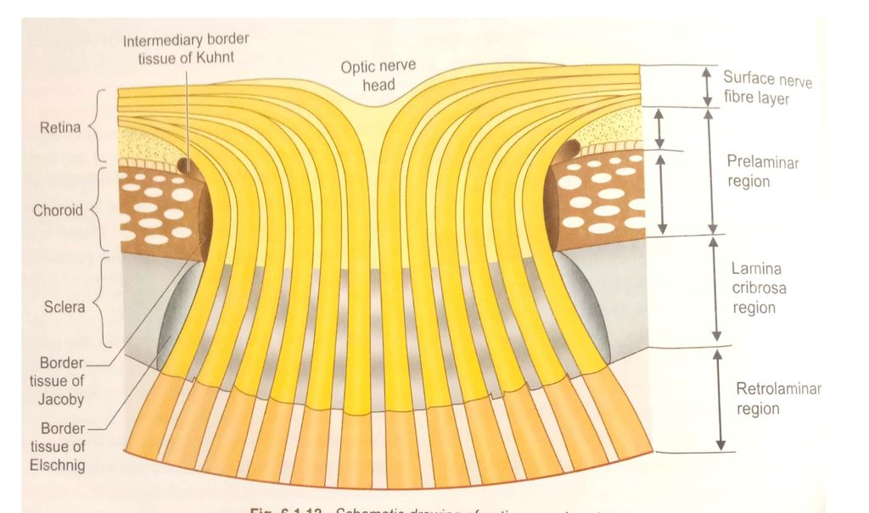
Glaucoma Overview
Optic nerve head portions

Slide 111
Q
Glaucoma Overview
The optic nerves are composed of what?
The axons of retinal ganglion cells
Do they synapse in the region of the optic nerve head?
No
Where will they synapse?
Most will synapse in the lateral geniculate nucleus (LGN)
Anatomically speaking, the optic nerve is considered to have four portions. What are they?
The intraocular, intraorbital, intracanalicular, and intracranial
The intraocular portion is also considered to have four portions. What are they?
What is the blood supply for each?
Portion | Blood supply
NFL portion | ?
Pre-laminar
Laminar
Retrolaminar
(innermost)
(outermost)

Slide 112
Q/A
Glaucoma Overview
The optic nerves are composed of what?
The axons of retinal ganglion cells
Do they synapse in the region of the optic nerve head?
No
Where will they synapse?
Most will synapse in the lateral geniculate nucleus (LGN)
Anatomically speaking, the optic nerve is considered to have four portions. What are they?
The intraocular, intraorbital, intracanalicular, and intracranial
The intraocular portion is also considered to have four portions. What are they?
What is the blood supply for each?
Portion | Blood supply
NFL portion | Central retinal artery (CRA)
Pre-laminar | ?
Laminar
Retrolaminar
(innermost)
(outermost)

Slide 113
Q/A
Glaucoma Overview
The optic nerves are composed of what?
The axons of retinal ganglion cells
Do they synapse in the region of the optic nerve head?
No
Where will they synapse?
Most will synapse in the lateral geniculate nucleus (LGN)
Anatomically speaking, the optic nerve is considered to have four portions. What are they?
The intraocular, intraorbital, intracanalicular, and intracranial
The intraocular portion is also considered to have four portions. What are they?
What is the blood supply for each?
Portion | Blood supply
NFL portion | Central retinal artery (CRA)
Pre-laminar | Short posterior ciliary arteries
Laminar | ?
Retrolaminar
(innermost)
(outermost)

Slide 114
Q/A
Glaucoma Overview
The optic nerves are composed of what?
The axons of retinal ganglion cells
Do they synapse in the region of the optic nerve head?
No
Where will they synapse?
Most will synapse in the lateral geniculate nucleus (LGN)
Anatomically speaking, the optic nerve is considered to have four portions. What are they?
The intraocular, intraorbital, intracanalicular, and intracranial
The intraocular portion is also considered to have four portions. What are they?
What is the blood supply for each?
Portion | Blood supply
NFL portion | Central retinal artery (CRA)
Pre-laminar | Short posterior ciliary arteries
Laminar | Arterial circle of Zinn & Haller
Retrolaminar | ?
(innermost)
(outermost)

Slide 115
A
Glaucoma Overview
The optic nerves are composed of what?
The axons of retinal ganglion cells
Do they synapse in the region of the optic nerve head?
No
Where will they synapse?
Most will synapse in the lateral geniculate nucleus (LGN)
Anatomically speaking, the optic nerve is considered to have four portions. What are they?
The intraocular, intraorbital, intracanalicular, and intracranial
The intraocular portion is also considered to have four portions. What are they?
What is the blood supply for each?
Portion | Blood supply
NFL portion | Central retinal artery (CRA)
Pre-laminar | Short posterior ciliary arteries
Laminar | Arterial circle of Zinn & Haller
Retrolaminar | Centrifugal CRA branches, centripetal pial branches
(innermost)
(outermost)

Slide 116
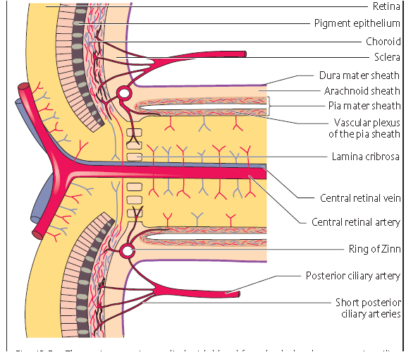
Glaucoma Overview
ONH: Blood supply

Slide 117
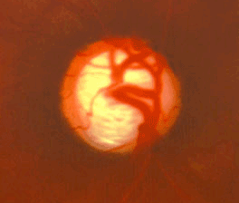
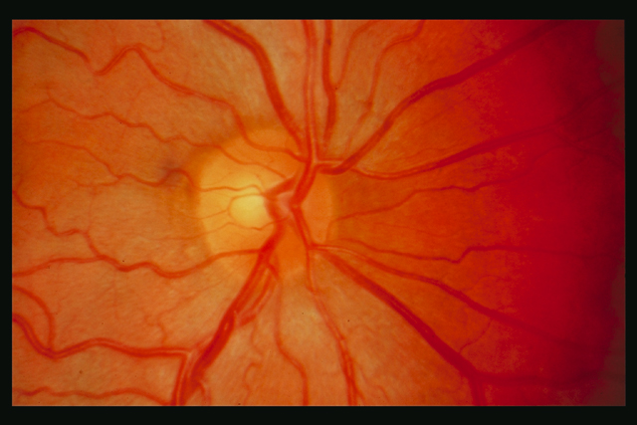
Glaucoma Overview
For reasons that have yet to be fully
elucidated, glaucomatous optic
neuropathy tends to damage the
superior and inferior poles of the ONH
preferentially and early. This leads to
thinning at the poles (focal thinning is
often referred to as a ‘notch.’)
Notch
Glaucomatous ONH
Normal ONH

Slide 118
Glaucoma Overview
For reasons that have yet to be fully
elucidated, glaucomatous optic
neuropathy tends to damage the
superior and inferior poles of the ONH
preferentially and early. This leads to
thinning at the poles (focal thinning is
often referred to as a ‘notch.’)
Because of this tendency, ophthalmologists focus on the vertical cup-disc ratio (VCDR) when assessing a pt’s glaucoma status.
VCDR ~.8
VCDR ~.35
Glaucomatous ONH
Normal ONH

Slide 119
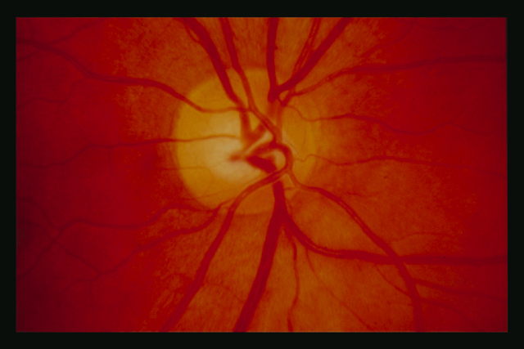
Glaucoma Overview
Note that the VCDR can be misleading in this regard, as it can be quite pronounced in some normal eyes (especially those with a large disc).
Thus, in determining the glaucomatous-ness of an ONH, don’t just rely on the VCDR--make sure you also inspect and critically evaluate the status of the neuroretinal rim.
VCDR ~.7
VCDR ~.35
Normal ONH
Normal ONH

Slide 120
Glaucoma Overview
Note that the VCDR can be misleading in this regard, as it can be quite pronounced in some normal eyes (especially those with a large disc).
Thus, in determining the glaucomatous-ness of an ONH, don’t just rely on the VCDR--make sure you also inspect and critically evaluate the status of the neuroretinal rim.
VCDR ~.7
VCDR ~.35
Normal ONH
Normal ONH

Slide 121
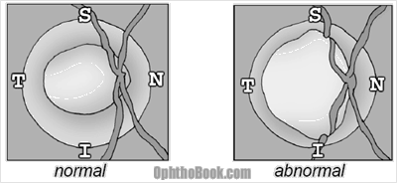
Glaucoma Overview
The nonglaucomatous neuroretinal
rim tends to follow what’s known as
the ISNT rule: In decreasing order,
the rim is thickest at its
Inferior,
Superior,
Nasal, and
Temporal
portions. If an ONH’s rim adheres to
this rule, it ISNT glaucomatous.
S
T
N
I
Normal ONH

Slide 122
Glaucoma Overview
The nonglaucomatous neuroretinal
rim tends to follow what’s known as
the ISNT rule: In decreasing order,
the rim is thickest at its
Inferior,
Superior,
Nasal, and
Temporal
portions. If an ONH’s rim adheres to
this rule, it ISNT glaucomatous.
S
T
N
Note: Not all glaucoma docs find the ISNT rule to be helpful—YMMV. Ask!
I
Normal ONH

Slide 123
Glaucoma Overview
ONH
RNFL
Now consider the ONH and retina in cross section. Note that the RNFL and ONH are both organized in a specific fashion:
No question—proceed when ready

Slide 124
Glaucoma Overview
ONH
RNFL
5 4 3 2 1
Now consider the ONH and retina in cross section. Note that the RNFL and ONH are both organized in a specific fashion:
--The RNFL is stacked vertically, with fibers that originate at points distant from the ONH running at the bottom (ie, closer to the RPE); and
No question—proceed when ready

Slide 125
Glaucoma Overview
ONH
RNFL
5 4 3 2 1
1
2
3
4
5
Now consider the ONH and retina in cross section. Note that the RNFL and ONH are both organized in a specific fashion:
--The RNFL is stacked vertically, with fibers that originate at points distant from the ONH running at the bottom (ie, closer to the RPE); and
--The ONH is stacked horizontally, with its peripheral-most fibers being those originating in the far retina, and its innermost fibers originating in the peripapillary region.
No question—proceed when ready

Slide 126
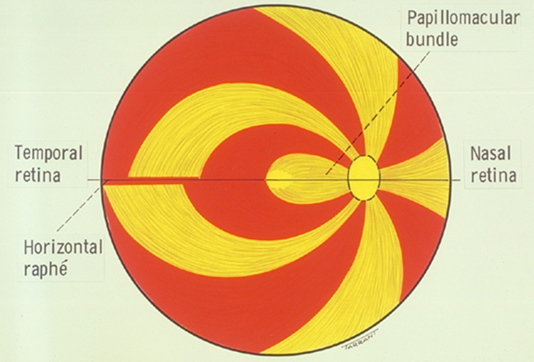
Glaucoma Overview
Now let’s look at the topography of the retinal nerve fiber layer, and how that topography relates to the structure of the ONH.
No question—proceed when ready

Slide 127
Glaucoma Overview
Now let’s look at the topography of the retinal nerve fiber layer, and how that topography relates to the structure of the ONH.
First, take note of the horizontal raphé. Fibers do not cross this anatomic boundary—those superior to it join the superior ONH, and those inferior to it, the inferior ONH.
No question—proceed when ready

Slide 128
Glaucoma Overview
Now let’s look at the topography of the retinal nerve fiber layer, and how that topography relates to the structure of the ONH.
First, take note of the horizontal raphé. Fibers do not cross this anatomic boundary—those superior to it join the superior ONH, and those inferior to it, the inferior ONH.
Next, the papillomacular (PM) bundle—the swath of nerve fibers originating in the foveal region. Note how this bundle takes up the lion’s share of the temporal ONH.
No question—proceed when ready

Slide 129
Glaucoma Overview
Now let’s look at the topography of the retinal nerve fiber layer, and how that topography relates to the structure of the ONH.
First, take note of the horizontal raphé. Fibers do not cross this anatomic boundary—those superior to it join the superior ONH, and those inferior to it, the inferior ONH.
Next, the papillomacular (PM) bundle—the swath of nerve fibers originating in the foveal region. Note how this bundle takes up the lion’s share of the temporal ONH.
Finally, note how the PM bundle impacts the structure of the ONH. Because the bundle takes up the temporal ONH, fibers from the temporal perifoveal region and beyond are forced to ‘loop around’ it, and end up joining the ONH near its superior and inferior poles.
No question—proceed when ready

Slide 130
Glaucoma Overview
Because there are so many fibers at the superior and inferior poles, the normal ONH rim tends to be thicker at these sites. (This accounts for the relative proportions of the rim segments as captured by the ISNT rule described previously.)
Normal ONH

Slide 131
Glaucoma Overview
Fovea centralis
(fixation)
Note also that a vertical meridian can be described in the retina as well. Unlike the horizontal raphé (which is physically instantiated in the anatomy of the retina), this vertical meridian is purely functional—it cannot be identified via histological examination of the retina.
No question—proceed when ready

Slide 132
Glaucoma Overview
Fovea centralis
(fixation)
PRs are temporal to fovea, so VF is nasal to fixation
PRs are nasal to fovea, so VF is temporal to fixation
Note also that a vertical meridian can be described in the retina as well. Unlike the horizontal raphé (which is physically instantiated in the anatomy of the retina), this vertical meridian is purely functional—it cannot be identified via histological examination of the retina.
Instead, it is identified via visual field testing. Fixation divides the VF into nasal and temporal fields, with the photoreceptors (PRs) responsible for the temporal VF being nasal to the vertical meridian, and those responsible for the nasal VF located temporal to it.
No question—proceed when ready

Slide 133
Q
Glaucoma Overview
Fovea centralis
(fixation)
PRs are temporal to fovea, so VF is nasal to fixation
PRs are nasal to fovea, so VF is temporal to fixation
Note also that a vertical meridian can be described in the retina as well. Unlike the horizontal raphé (which is physically instantiated in the anatomy of the retina), this vertical meridian is purely functional—it cannot be identified via histological examination of the retina.
Instead, it is identified via visual field testing. Fixation divides the VF into nasal and temporal fields, with the photoreceptors (PRs) responsible for the temporal VF being nasal to the vertical meridian, and those responsible for the nasal VF located temporal to it.
If not within the retina, where is the anatomic location for the vertical meridian found in the visual fields?
The optic chiasm. Recall that it is there that the visual field is divided vertically.

Slide 134
A
Glaucoma Overview
Fovea centralis
(fixation)
PRs are temporal to fovea, so VF is nasal to fixation
PRs are nasal to fovea, so VF is temporal to fixation
Note also that a vertical meridian can be described in the retina as well. Unlike the horizontal raphé (which is physically instantiated in the anatomy of the retina), this vertical meridian is purely functional—it cannot be identified via histological examination of the retina.
Instead, it is identified via visual field testing. Fixation divides the VF into nasal and temporal fields, with the photoreceptors (PRs) responsible for the temporal VF being nasal to the vertical meridian, and those responsible for the nasal VF located temporal to it.
If not within the retina, where is the anatomic location for the vertical meridian found in the visual fields?
The optic chiasm. Recall that it is there that the visual field is divided vertically.

Slide 135
Glaucoma Overview
PRs are superior to fovea, so VF is inferior to fixation
Fovea centralis
(fixation)
PRs are inferior to fovea, so VF is superior to fixation
Note also that a vertical meridian can be described in the retina as well. Unlike the horizontal raphé (which is physically instantiated in the anatomy of the retina), this vertical meridian is purely functional—it cannot be identified via histological examination of the retina.
Instead, it is identified via visual field testing. Fixation divides the VF into nasal and temporal fields, with the photoreceptors (PRs) responsible for the temporal VF being nasal to the vertical meridian, and those responsible for the nasal VF located temporal to it.
Finally, note that fixation also divides the VF into superior and inferior VFs. The corresponding portions of the retina related topographically to the horizontal raphé.
No question—proceed when ready

Slide 136
Glaucoma Overview
S-T PRs:
I-N VF
S-N PRs:
I-T VF
I-T PRs:
S-N VF
I-N PRs:
S-T VF
Putting it all together: The VF can be divided into four quadrants. Together, retinal topography and ONH structure dictate that each quadrants corresponds with a particular anatomic location on the ONH. This relationship is important to understand as it allows the clinician to determine whether VF changes correlate with structural changes in the ONH as detected via DFE and/or imaging technology.
No question—proceed when ready

Slide 137
Q
Glaucoma Overview
?
?
Here is a representation of the VF for each eye. Which is OD, and which OS?

Slide 138
A
Glaucoma Overview
OS
OD
Here is a representation of the VF for each eye. Which is OD, and which OS?
Remember, VFs are not drawn as if the pt is looking at you; they’re drawn as if you are the pt!

Slide 139
Q
Glaucoma Overview
?
?
?
?
?
?
?
?
OS
OD
Measured in degrees from fixation, how far does the normal VF extend superiorly, inferiorly, nasally and temporally?
(Don’t get too fixated on these specific numbers--different sources will give slightly different values.)

Slide 140
A
Glaucoma Overview
60º
60º
100º
60º
60º
100º
70º
70º
OS
OD
Measured in degrees from fixation, how far does the normal VF extend superiorly, inferiorly, nasally and temporally?
(Don’t get too fixated on these specific numbers--different sources will give slightly different values.)

Slide 141
Q
Glaucoma Overview
?
?
OS
OD
Measured in degrees from fixation, how much of the VF is assessed via the automated perimetry machines found in most ophthalmology practices?

Slide 142
A
Glaucoma Overview
24º
24º
OS
OD
Measured in degrees from fixation, how much of the VF is assessed via the automated perimetry machines found in most ophthalmology practices?
The central 24 degrees

Slide 143
Q
Glaucoma Overview
?
?
OS
OD
How far in degrees from fixation is the blind spot?

Slide 144
A
Glaucoma Overview
15º
15º
OS
OD
How far in degrees from fixation is the blind spot?
About 15 (again, don’t get too hung up on that specific number.)

Slide 145
Glaucoma Overview
For reasons that have yet to be fully elucidated, glaucoma initially ‘prefers’ to damage the superior and inferior poles of the ONH. This leads to thinning at the poles (focal thinning is referred to as a ‘notch.’) Specifically, glaucoma tends initially to affect fibers that originate on the temporal side of the vertical meridian.
VCDR ~.8
Notch
Glaucomatous ONH

Slide 146
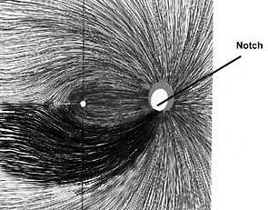
Glaucoma Overview
For reasons that have yet to be fully elucidated, glaucoma initially ‘prefers’ to damage the superior and inferior poles of the ONH. This leads to thinning at the poles (focal thinning is referred to as a ‘notch.’) Specifically, glaucoma tends initially to affect fibers that originate on the temporal side of the vertical meridian.
VCDR ~.8
Notch
Glaucomatous ONH

Slide 147
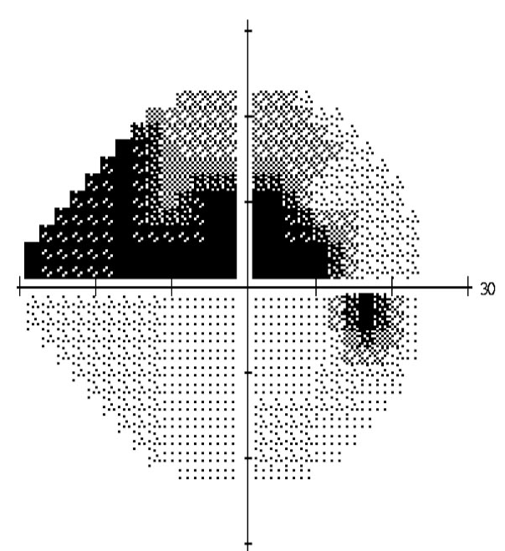
Glaucoma Overview
For reasons that have yet to be fully elucidated, glaucoma initially ‘prefers’ to damage the superior and inferior poles of the ONH. This leads to thinning at the poles (focal thinning is referred to as a ‘notch.’) Specifically, glaucoma tends initially to affect fibers that originate on the temporal side of the vertical meridian.
The result of this is that glaucomatous VF defects appear in and extend from the nasal visual field.
VCDR ~.8
Notch
Glaucomatous ONH

Slide 148
Glaucoma Overview
Define glaucoma.
A group of optic neuropathies that present with progressive ONH damage and characteristic VF loss
Why isn’t elevated IOP mentioned above?
Elevated IOP is a strong risk factor for glaucoma, but it need not be present—IOP can be normal, or even low
In addition to being the strongest risk factor for glaucoma, IOP has another quality that renders it unique—what is it?
It is the only risk factor that is modifiable in a manner proven to influence the risk of glaucoma progression
It was noted initially that glaucoma presents with “characteristic VF loss.” That’s what we’re getting at here. Let’s take a detailed look at the way glaucomatous VF defects appear and progress.

Slide 149
Glaucoma Overview
Note: The following set of VFs are from a pt who suffered severe, progressive VF loss in a manner classic for glaucomatous optic neuropathy. I am not personally familiar with this case, and thus cannot provide context regarding the clinical circumstances that resulted in such profound, unchecked VF loss.
No question—proceed when ready

Slide 150
Glaucoma Overview
‘Early superior nasal step’
(not real VF loss—going to go away)
The first location at which glaucomatous VF manifests is near the nasal limit of a 24-2 field, sitting on (or ‘hanging’ just below) the horizontal midline. This pattern of loss is called a nasal step.
No question—proceed when ready

Slide 151
Glaucoma Overview
‘Early superior nasal step’
This location in the VF…is associated with this location on the retina, meaning that the affected nerve fibers originated there
The first location at which glaucomatous VF manifests is near the nasal limit of a 24-2 field, sitting on (or ‘hanging’ just below) the horizontal midline. This pattern of loss is called a nasal step.
No question—proceed when ready

Slide 152
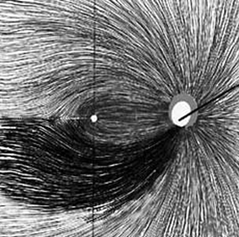
Glaucoma Overview
‘Early superior nasal step’
This location in the VF…is associated with this location on the retina, meaning that the affected nerve fibers originated there…
The first location at which glaucomatous VF manifests is near the nasal limit of a 24-2 field, sitting on (or ‘hanging’ just below) the horizontal midline. This pattern of loss is called a nasal step.
No question—proceed when ready

Slide 153
Glaucoma Overview
‘Early superior nasal step’
This location in the VF…is associated with this location on the retina, meaning that the affected nerve fibers originated there…and entered the ONH peripherally
The first location at which glaucomatous VF manifests is near the nasal limit of a 24-2 field, sitting on (or ‘hanging’ just below) the horizontal midline. This pattern of loss is called a nasal step.
ONH
RNFL
5 4 3 2 1
1
2
3
4
5
No question—proceed when ready

Slide 154
Glaucoma Overview
‘Early superior nasal step’
‘Superior nasal step’
(told ya)
If left untreated, the nasal step will gradually enlarge.
No question—proceed when ready

Slide 155
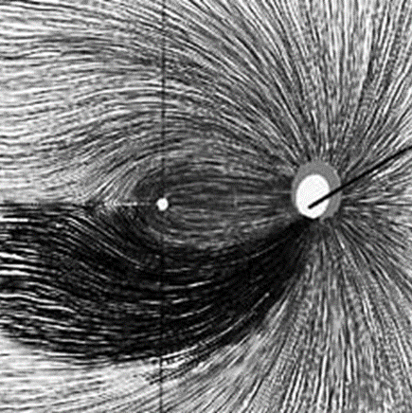
Glaucoma Overview
‘Early superior nasal step’
‘Superior nasal step’
Note the area of origin for affected fibers has grown
If left untreated, the nasal step will gradually enlarge.
No question—proceed when ready

Slide 156
Q
Glaucoma Overview
‘Early superior nasal step’
‘Superior nasal step’
‘Superior arcuate’
As glaucoma damage progresses, further loss of nerve fibers joining at that portion of the ONH will cause the VF defect to arc toward the blind spot. Once the VF loss has connected to the blind spot, the resulting defect is termed an arcuate.

Slide 157
A
Glaucoma Overview
‘Early superior nasal step’
‘Superior nasal step’
‘Superior arcuate’
As glaucoma damage progresses, further loss of nerve fibers joining at that portion of the ONH will cause the VF defect to arc toward the blind spot. Once the VF loss has connected to the blind spot, the resulting defect is termed an arcuate.

Slide 158
Glaucoma Overview
‘Early superior nasal step’
‘Superior nasal step’
‘Superior arcuate’
As glaucoma damage progresses, further loss of nerve fibers joining at that portion of the ONH will cause the VF defect to arc toward the blind spot. Once the VF loss has connected to the blind spot, the resulting defect is termed an arcuate.
Note the area of origin for affected fibers now extends all the way to the ONH itself
No question—proceed when ready

Slide 159
Glaucoma Overview
‘Early superior nasal step’
‘Superior nasal step’
‘Superior arcuate’
‘Early inferior nasal step’
As glaucoma damage progresses, further loss of nerve fibers joining at that portion of the ONH will cause the VF defect to arc toward the blind spot. Once the VF loss has connected to the blind spot, the resulting defect is termed an arcuate.
Note also that an early inferior nasal step is now present.
No question—proceed when ready

Slide 160
Glaucoma Overview
‘Early superior nasal step’
‘Superior nasal step’
‘Superior arcuate’
‘Early inferior nasal step’
‘Advanced arcuate’
If left unchecked, an arcuate will expand into the surrounding portion of the VF.
‘Early inferior nasal step’
No question—proceed when ready

Slide 161
Q
Glaucoma Overview
‘Early superior nasal step’
‘Superior nasal step’
‘Superior arcuate’
‘Early inferior nasal step’
‘Advanced arcuate’
‘Altitudinal defect’
Once an arcuate has expanded sufficiently, it becomes an altitudinal defect. The superior visual field is now all but gone.
‘Early inferior nasal step’
‘Inferior nasal step’

Slide 162
A
Glaucoma Overview
‘Early superior nasal step’
‘Superior nasal step’
‘Superior arcuate’
‘Early inferior nasal step’
‘Advanced arcuate’
‘Altitudinal defect’
Once an arcuate has expanded sufficiently, it becomes an altitudinal defect. The superior visual field is now all but gone.
‘Early inferior nasal step’
‘Inferior nasal step’

Slide 163
Glaucoma Overview
‘Early superior nasal step’
‘Superior nasal step’
‘Superior arcuate’
‘Early inferior nasal step’
‘Advanced arcuate’
‘Altitudinal defect’
Once an arcuate has expanded sufficiently, it becomes an altitudinal defect. The superior visual field is now all but gone.
Note the inferior nasal step continues to enlarge.
‘Early inferior nasal step’
‘Inferior nasal step’
No question—proceed when ready

Slide 164
Glaucoma Overview
‘Early superior nasal step’
‘Superior nasal step’
‘Superior arcuate’
‘Early inferior nasal step’
‘Advanced arcuate’
‘Altitudinal defect’
‘Altitudinal defect’
The inferior
step is now an arc, and appears
destined to become altitudinal, resulting in blindness.
‘Inferior arcuate’
‘Early inferior nasal step’
‘Inferior nasal step’

Slide 165
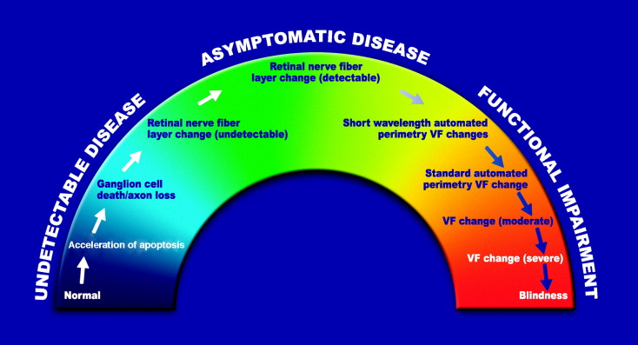
Glaucoma Overview
A note on the ‘Glaucoma Continuum’
Glaucoma is a progressive condition, passing from undetectable early disease to asymptomatic-but-detectable (via RNFL imaging) disease to functional (ie, marked by VF loss) disease, the last stage of which is severe vision loss and blindness.
No question—proceed when ready

Slide 166
Glaucoma Overview
‘Early nasal step’
In this regard, a word on the notion of ‘early’ glaucoma. We previously described the above VF defect as an ‘early’ nasal step.
No question—proceed when ready

Slide 167
Glaucoma Overview
‘Early nasal step’
In this regard, a word on the notion of ‘early’ glaucoma. We previously described the above VF defect as an ‘early’ nasal step. But take note of the point along the glaucoma continuum at which such a VF defect occurs—clearly, it doesn’t qualify as ‘early’ disease with respect to the continuum. Don’t mistake early VF changes for early disease!
No question—proceed when ready

Slide 168
Glaucoma Overview
Finally, let’s look briefly at how one should think through the new glaucoma case sitting in your exam chair

Slide 169
Q
Glaucoma Overview
Glaucoma
?
The first thought you should have when
encountering a pt you suspect has glaucoma is…

Slide 170
A
Glaucoma Overview
Glaucoma
?
Open-angle
Closed- or
narrow-angle
The first thought you should have when
encountering a pt you suspect has glaucoma is…
What is the status of the angle?

Slide 171
Q
Glaucoma Overview
Glaucoma
Open-angle
Closed- or
narrow-angle
The first thought you should have when
encountering a pt you suspect has glaucoma is…
What is the status of the angle?
How does one determine the status of the angle?

Slide 172
A
Glaucoma Overview
Glaucoma
Open-angle
Closed- or
narrow-angle
The first thought you should have when
encountering a pt you suspect has glaucoma is…
What is the status of the angle?
How does one determine the status of the angle?
Gonioscopy. Don’t assume your glaucoma pt has open angles—prove it by gonioing them!

Slide 173
Q
Glaucoma Overview
OAG
?
?
Once you have determined a pt has open-angle glaucoma,
the next ‘first thought’ is to ask…

Slide 174
A
Glaucoma Overview
OAG
↑IOP
Normal-tension
glaucoma (NTG)
Once you have determined a pt has open-angle glaucoma,
the next ‘first thought’ is to ask…
Is it high-pressure OAG, or low (aka normal) tension OAG?

Slide 175
Q
Glaucoma Overview
OAG
↑IOP
Normal-tension
glaucoma (NTG)
Untreated IOP consistently
above 22 mmHg
Untreated IOP consistently
below 22 mmHg
#
#

Slide 176
A
Glaucoma Overview
OAG
↑IOP
Normal-tension
glaucoma (NTG)
Untreated IOP consistently
above 22 mmHg
Untreated IOP consistently
below 22 mmHg
(Note that this distinction is somewhat controversial, as some glaucomalogists contend NTG is not a separate condition.)

Slide 177
Q
Glaucoma Overview
↑ IOP OAG
?
Once you have determined a pt has high-pressure open-angle glaucoma, the next ‘first thought’ is to ask…

Slide 178
A
Glaucoma Overview
↑ IOP OAG
?
Primary
Secondary
Once you have determined a pt has high-pressure open-angle glaucoma, the next ‘first thought’ is to ask…
Is it primary open-angle glaucoma (POAG), or secondary OAG?

Slide 179
Q
Glaucoma Overview
↑ IOP OAG
Primary
Secondary
How prevalent is POAG in the US?

Slide 180
Q/A
Glaucoma Overview
↑ IOP OAG
Primary
Secondary
How prevalent is POAG in the US?
Very. It affects about 2% of the over-40 population.
%

Slide 181
A
Glaucoma Overview
↑ IOP OAG
Primary
Secondary
How prevalent is POAG in the US?
Very. It affects about 2% of the over-40 population.

Slide 182
Q
Glaucoma Overview
↑ IOP OAG
Primary
Secondary
How prevalent is POAG in the US?
Very. It affects about 2% of the over-40 population.
Where does POAG rank worldwide as a cause of blindness?

Slide 183
Q/A
Glaucoma Overview
↑ IOP OAG
Primary
Secondary
How prevalent is POAG in the US?
Very. It affects about 2% of the over-40 population.
Where does POAG rank worldwide as a cause of blindness?
It is second only to cataract

Slide 184
A
Glaucoma Overview
↑ IOP OAG
Primary
Secondary
How prevalent is POAG in the US?
Very. It affects about 2% of the over-40 population.
Where does POAG rank worldwide as a cause of blindness?
It is second only to cataract

Slide 185
Q
Glaucoma Overview
↑ IOP OAG
Primary
Secondary
How prevalent is POAG in the US?
Very. It affects about 2% of the over-40 population.
Where does POAG rank worldwide as a cause of blindness?
It is second only to cataract
Is there a racial predilection?

Slide 186
Q/A
Glaucoma Overview
↑ IOP OAG
Primary
Secondary
How prevalent is POAG in the US?
Very. It affects about 2% of the over-40 population.
Where does POAG rank worldwide as a cause of blindness?
It is second only to cataract
Is there a racial predilection?
Yes, individuals of black and Hispanic heritage are at a 4x greater risk than are whites (and their relative risk of going blind is even higher than that)

Slide 187
A
Glaucoma Overview
↑ IOP OAG
Primary
Secondary
How prevalent is POAG in the US?
Very. It affects about 2% of the over-40 population.
Where does POAG rank worldwide as a cause of blindness?
It is second only to cataract
Is there a racial predilection?
Yes, individuals of black and Hispanic heritage are at a 4x greater risk than are whites (and their relative risk of going blind is even higher than that)

Slide 188
Q
Glaucoma Overview
↑ IOP OAG
Primary
Secondary
How prevalent is POAG in the US?
Very. It affects about 2% of the over-40 population.
Where does POAG rank worldwide as a cause of blindness?
It is second only to cataract
Is there a racial predilection?
Yes, individuals of black and Hispanic heritage are at a 4x greater risk than are whites (and their relative risk of going blind is even higher than that)
Is age a risk factor?

Slide 189
A
Glaucoma Overview
↑ IOP OAG
Primary
Secondary
How prevalent is POAG in the US?
Very. It affects about 2% of the over-40 population.
Where does POAG rank worldwide as a cause of blindness?
It is second only to cataract
Is there a racial predilection?
Yes, individuals of black and Hispanic heritage are at a 4x greater risk than are whites (and their relative risk of going blind is even higher than that)
Is age a risk factor?
Yes, POAG rates increase dramatically with age

Slide 190
Q
Glaucoma Overview
↑ IOP OAG
Primary
Secondary
How prevalent is POAG in the US?
Very. It affects about 2% of the over-40 population.
Where does POAG rank worldwide as a cause of blindness?
It is second only to cataract
Is there a racial predilection?
Yes, individuals of black and Hispanic heritage are at a 4x greater risk than are whites (and their relative risk of going blind is even higher than that)
Is age a risk factor?
Yes, POAG rates increase dramatically with age
What is the #1 risk factor?

Slide 191
A
Glaucoma Overview
↑ IOP OAG
Primary
Secondary
How prevalent is POAG in the US?
Very. It affects about 2% of the over-40 population.
Where does POAG rank worldwide as a cause of blindness?
It is second only to cataract
Is there a racial predilection?
Yes, individuals of black and Hispanic heritage are at a 4x greater risk than are whites (and their relative risk of going blind is even higher than that)
Is age a risk factor?
Yes, POAG rates increase dramatically with age
What is the #1 risk factor?
Elevated IOP

Slide 192
Q
Glaucoma Overview
↑ IOP OAG
The BCSC Glaucoma book lists three risk factors for POAG (not including IOP). Two are age and race. What is the third?
Family history
While not listed in the section on risk factors, the Glaucoma book alludes to two other variables as being well-established as significant risk factors for POAG. What are they?
--Central corneal thickness (CCT)
--Ocular perfusion pressure (OPP)
Primary
Secondary
How prevalent is POAG in the US?
Very. It affects about 2% of the over-40 population.
Where does POAG rank worldwide as a cause of blindness?
It is second only to cataract
Is there a racial predilection?
Yes, individuals of black and Hispanic heritage are at a 4x greater risk than are whites (and their relative risk of going blind is even higher than that)
Is age a risk factor?
Yes, POAG rates increase dramatically with age
What is the #1 risk factor?
Elevated IOP

Slide 193
A
Glaucoma Overview
↑ IOP OAG
The BCSC Glaucoma book lists three risk factors for POAG (not including IOP). Two are age and race. What is the third?
Family history
While not listed in the section on risk factors, the Glaucoma book alludes to two other variables as being well-established as significant risk factors for POAG. What are they?
--Central corneal thickness (CCT)
--Ocular perfusion pressure (OPP)
Primary
Secondary
How prevalent is POAG in the US?
Very. It affects about 2% of the over-40 population.
Where does POAG rank worldwide as a cause of blindness?
It is second only to cataract
Is there a racial predilection?
Yes, individuals of black and Hispanic heritage are at a 4x greater risk than are whites (and their relative risk of going blind is even higher than that)
Is age a risk factor?
Yes, POAG rates increase dramatically with age
What is the #1 risk factor?
Elevated IOP

Slide 194
Q
Glaucoma Overview
↑ IOP OAG
The BCSC Glaucoma book lists three risk factors for POAG (not including IOP). Two are age and race. What is the third?
Family history
While not listed in the section on risk factors, the Glaucoma book alludes to two other variables as being well-established as significant risk factors for POAG. What are they?
--?
--?
Primary
Secondary
How prevalent is POAG in the US?
Very. It affects about 2% of the over-40 population.
Where does POAG rank worldwide as a cause of blindness?
It is second only to cataract
Is there a racial predilection?
Yes, individuals of black and Hispanic heritage are at a 4x greater risk than are whites (and their relative risk of going blind is even higher than that)
Is age a risk factor?
Yes, POAG rates increase dramatically with age
What is the #1 risk factor?
Elevated IOP

Slide 195
A
Glaucoma Overview
↑ IOP OAG
The BCSC Glaucoma book lists three risk factors for POAG (not including IOP). Two are age and race. What is the third?
Family history
While not listed in the section on risk factors, the Glaucoma book alludes to two other variables as being well-established as significant risk factors for POAG. What are they?
--Central corneal thickness (CCT)
--Ocular perfusion pressure (OPP)
Primary
Secondary
How prevalent is POAG in the US?
Very. It affects about 2% of the over-40 population.
Where does POAG rank worldwide as a cause of blindness?
It is second only to cataract
Is there a racial predilection?
Yes, individuals of black and Hispanic heritage are at a 4x greater risk than are whites (and their relative risk of going blind is even higher than that)
Is age a risk factor?
Yes, POAG rates increase dramatically with age
What is the #1 risk factor?
Elevated IOP

Slide 196
Glaucoma Overview
↑ IOP OAG
Primary
Secondary
It’s critical to note that POAG is a diagnosis of exclusion—

Slide 197
Glaucoma Overview
↑ IOP OAG
Primary
Secondary
PXS
Pigmentary
Tumor-
Induced
Lens-
Induced
Inflammation-
Induced
Drug-
Induced
Trauma-
Related
EVS
Schwartz
syndrome
Posner-
Schlossman
Angle
recession
AVM
Phacolytic
Steroids
Venous
obstruction
Phacoantigenic
Cyclodialysis
cleft
Fuchs
heterochromic
iridocyclitis
Mydriatics
SVC syndrome
Lens particle
Hyphema
C-C fistula
Hemolytic
It’s critical to note that POAG is a diagnosis of exclusion—it can only be made once secondary causes of OAG have been ruled out!
Ghost cell

Slide 198
Glaucoma Overview
↑ IOP OAG
Primary
Secondary
PXS
Pigmentary
Tumor-
Induced
Lens-
Induced
Inflammation-
Induced
Drug-
Induced
Trauma-
Related
EVS
Schwartz
syndrome
Posner-
Schlossman
Angle
recession
AVM
Phacolytic
Steroids
Venous
obstruction
Phacoantigenic
Cyclodialysis
cleft
Fuchs
heterochromic
iridocyclitis
Mydriatics
SVC syndrome
Lens particle
Hyphema
C-C fistula
Hemolytic
Ghost cell
(Most of these conditions are addressed in detail in other slide-sets—see the Table of Contents)

Slide 199
Q
Glaucoma Overview
Angle-Closure Glaucoma
?
Once you have determined a pt has angle-closure glaucoma,
the next ‘first thought’ is to ask…

Slide 200
A
Glaucoma Overview
Angle-Closure Glaucoma
?
Primary
Secondary
Once you have determined a pt has angle-closure glaucoma,
the next ‘first thought’ is to ask…
is it primary or secondary?

Slide 201
Q
Glaucoma Overview
Angle-Closure Glaucoma
Primary
Secondary
Is there a racial predilection regarding the risk of PACG?

Slide 202
Q/A
Glaucoma Overview
Angle-Closure Glaucoma
Primary
Secondary
Is there a racial predilection regarding the risk of PACG?
Yes, individuals of Inuit heritage have the highest known risk of PACG

Slide 203
A
Glaucoma Overview
Angle-Closure Glaucoma
Primary
Secondary
Is there a racial predilection regarding the risk of PACG?
Yes, individuals of Inuit heritage have the highest known risk of PACG

Slide 204
Q
Glaucoma Overview
Angle-Closure Glaucoma
Primary
Secondary
Is there a racial predilection regarding the risk of PACG?
Yes, individuals of Inuit heritage have the highest known risk of PACG--their relative risk has been estimated to be as high as 40x that of whites.
#x

Slide 205
A
Glaucoma Overview
Angle-Closure Glaucoma
Primary
Secondary
Is there a racial predilection regarding the risk of PACG?
Yes, individuals of Inuit heritage have the highest known risk of PACG--their relative risk has been estimated to be as high as 40x that of whites.

Slide 206
Q
Glaucoma Overview
Angle-Closure Glaucoma
Primary
Secondary
Is there a racial predilection regarding the risk of PACG?
Yes, individuals of Inuit heritage have the highest known risk of PACG--their relative risk has been estimated to be as high as 40x that of whites.
What about people of Asian descent?

Slide 207
A
Glaucoma Overview
Angle-Closure Glaucoma
Primary
Secondary
Is there a racial predilection regarding the risk of PACG?
Yes, individuals of Inuit heritage have the highest known risk of PACG--their relative risk has been estimated to be as high as 40x that of whites.
What about people of Asian descent?
Their relative risk is somewhere between that of the Inuit and whites

Slide 208
Q
Glaucoma Overview
Angle-Closure Glaucoma
Primary
Secondary
Is there a racial predilection regarding the risk of PACG?
Yes, individuals of Inuit heritage have the highest known risk of PACG--their relative risk has been estimated to be as high as 40x that of whites.
What about people of Asian descent?
Their relative risk is somewhere between that of the Inuit and whites
Is age a risk factor?

Slide 209
Q/A
Glaucoma Overview
Angle-Closure Glaucoma
Primary
Secondary
Is there a racial predilection regarding the risk of PACG?
Yes, individuals of Inuit heritage have the highest known risk of PACG--their relative risk has been estimated to be as high as 40x that of whites.
What about people of Asian descent?
Their relative risk is somewhere between that of the Inuit and whites
Is age a risk factor?
Yes, the incidence increases with age
increases vs decreases

Slide 210
A
Glaucoma Overview
Angle-Closure Glaucoma
Primary
Secondary
Is there a racial predilection regarding the risk of PACG?
Yes, individuals of Inuit heritage have the highest known risk of PACG--their relative risk has been estimated to be as high as 40x that of whites.
What about people of Asian descent?
Their relative risk is somewhere between that of the Inuit and whites
Is age a risk factor?
Yes, the incidence increases with age

Slide 211
Q
Glaucoma Overview
Angle-Closure Glaucoma
Primary
Secondary
Is there a racial predilection regarding the risk of PACG?
Yes, individuals of Inuit heritage have the highest known risk of PACG--their relative risk has been estimated to be as high as 40x that of whites.
What about people of Asian descent?
Their relative risk is somewhere between that of the Inuit and whites
Is age a risk factor?
Yes, the incidence increases with age
Is gender a risk factor?

Slide 212
Q/A
Glaucoma Overview
Angle-Closure Glaucoma
Primary
Secondary
Is there a racial predilection regarding the risk of PACG?
Yes, individuals of Inuit heritage have the highest known risk of PACG--their relative risk has been estimated to be as high as 40x that of whites.
What about people of Asian descent?
Their relative risk is somewhere between that of the Inuit and whites
Is age a risk factor?
Yes, the incidence increases with age
Is gender a risk factor?
Yes, women are at higher risk

Slide 213
A
Glaucoma Overview
Angle-Closure Glaucoma
Primary
Secondary
Is there a racial predilection regarding the risk of PACG?
Yes, individuals of Inuit heritage have the highest known risk of PACG--their relative risk has been estimated to be as high as 40x that of whites.
What about people of Asian descent?
Their relative risk is somewhere between that of the Inuit and whites
Is age a risk factor?
Yes, the incidence increases with age
Is gender a risk factor?
Yes, women are at higher risk

Slide 214
Q
Glaucoma Overview
Angle-Closure Glaucoma
Primary
Secondary
Is there a racial predilection regarding the risk of PACG?
Yes, individuals of Inuit heritage have the highest known risk of PACG--their relative risk has been estimated to be as high as 40x that of whites.
What about people of Asian descent?
Their relative risk is somewhere between that of the Inuit and whites
Is age a risk factor?
Yes, the incidence increases with age
Is gender a risk factor?
Yes, women are at higher risk
Is refraction a risk factor?

Slide 215
Q/A
Glaucoma Overview
Angle-Closure Glaucoma
Primary
Secondary
Is there a racial predilection regarding the risk of PACG?
Yes, individuals of Inuit heritage have the highest known risk of PACG--their relative risk has been estimated to be as high as 40x that of whites.
What about people of Asian descent?
Their relative risk is somewhere between that of the Inuit and whites
Is age a risk factor?
Yes, the incidence increases with age
Is gender a risk factor?
Yes, women are at higher risk
Is refraction a risk factor?
Yes; PACG is more likely to occur in hyperopes

Slide 216
A
Glaucoma Overview
Angle-Closure Glaucoma
Primary
Secondary
Is there a racial predilection regarding the risk of PACG?
Yes, individuals of Inuit heritage have the highest known risk of PACG--their relative risk has been estimated to be as high as 40x that of whites.
What about people of Asian descent?
Their relative risk is somewhere between that of the Inuit and whites
Is age a risk factor?
Yes, the incidence increases with age
Is gender a risk factor?
Yes, women are at higher risk
Is refraction a risk factor?
Yes; PACG is more likely to occur in hyperopes

Slide 217
Q
Glaucoma Overview
Angle-Closure Glaucoma
Primary
Secondary
?
?
?
What are the four subtypes of PACG?
?

Slide 218
A
Glaucoma Overview
Angle-Closure Glaucoma
Primary
Secondary
Acute
Subacute
Chronic
What are the four subtypes of PACG?
Plateau Iris

Slide 219
Q
Glaucoma Overview
Angle-Closure Glaucoma
Primary
Secondary
Acute
?
Subacute
Chronic
Plateau Iris
The first thought you should have when encountering a pt you suspect has secondary angle-closure glaucoma is…

Slide 220
A
Glaucoma Overview
Angle-Closure Glaucoma
Primary
Secondary
Acute
?
Subacute
Chronic
w/ Pupillary Block
w/o Pupillary Block
Plateau Iris
The first thought you should have when encountering a pt you suspect has secondary angle-closure glaucoma is…
is it with or without pupillary block

Slide 221
Glaucoma Overview
Angle-Closure Glaucoma
Primary
Secondary
Acute
?
Subacute
Chronic
w/ Pupillary Block
w/o Pupillary Block
Plateau Iris
The first thought you should have when encountering a pt you suspect has secondary angle-closure glaucoma is…
is it with or without pupillary block
More information is available regarding the various forms of angle-closure glaucoma, check the Table of Contents to find it

