Slide 1
Learning Curve

Slide 2
Why is this Topic Important?
Has the potential to impact each patient interaction.
Lifelong Learning is important to the ophthalmologist and to patents.
Integrity of the profession

Slide 3
Learning New Techniques
Technology available to ophthalmologists is developing rapidly.
Not difficult for experienced ophthalmologists to assimilate new modifications of familiar techniques (IOLs, incision size, trephine)
However, formal study should be undertaken to achieve competence for new techniques requiring skills that differ significantly from prior experience.

Slide 4
Ethical Issues
What are the ethical and practical aspects of learning new techniques following residency and what is the ophthalmologist's responsibility to patients, colleagues, and him or herself, with respect to the "learning curve"?
Applicable rules of the Code of Ethics:
Rule 2: Informed Consent
Rule 9. Medical and Surgical Procedures
Rule 15. Conflict of Interest

Slide 5
Ethics of Learning New Techniques
When a decision is made to incorporate new techniques or technology into one's practice, a commitment to formal study is recommended.
The extent of formal study depends upon the degree to which the new technology varies from previously learned skills.
Additionally, new technology may require certification. However, successful completion does not necessarily signify an individual's clinical competence in a specific procedure.

Slide 6
Case History
75-year-old male
Status post cataract extraction, now with mild corneal stromal edema and reduced vision OS
Referred to a cornea specialist for evaluation

Slide 7
Patient Referral
Patient is referred to Doctor AA, a cornea specialist at a major academic institution
Doctor AA performs many penetrating keratoplasties each year, but has not performed any endothelial keratoplasties, such as DSEK (Descemet’s Stripping Endothelial Keratoplasty)

Slide 8
Dr. AA’s Learning Curve
After reviewing published data regarding outcomes and speaking with surgeons performing endothelial keratoplasty, Doctor AA decides to take a DSEK course.
In talking with the patient, Doctor AA describes the procedure as a “newer” form of transplant surgery that offers the potential for more rapid vision improvement after surgery.
Doctor AA advises the patient that he has not performed the surgery to date but will have performed several cases prior to performing the patient’s surgery.
The patient elects to proceed with DSEK surgery with Doctor AA.

Slide 9
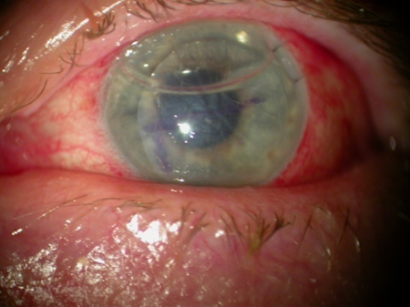
Dr. AA’s Learning Curve con’t
The patient undergoes an uneventful DSEK procedure
Patient required repositioning of the DSEK button on POD 1 and 4 after surgery.
Patient was advised before surgery that dislocation rate is approximately 50% in a surgeon’s first 10 cases but is less than 10% for experienced surgeons.

Slide 10
Case Discussion - Ethical Issues Involved
Rule 1. Competence
Obligation to provide patients with the highest quality care possible.
Necessarily involves “learning curve” while acquiring new skills.
Surgeon obligated to learn as much as possible about the procedure and outcomes before deciding to perform the surgery.
Surgeon should consider obtaining certification or training in the procedure, if available.

Slide 11
Case Discussion - Ethical Issues Involved
Rule 2. Informed Consent
Accurate description of surgeon’s experience if likely to affect the patient’s decision to proceed with surgery.
Should include discussion of complication rate for beginning and experienced surgeons, if significantly different.
Rule 9. Misrepresentation of Procedures
Truthful, accurate description of procedures
Should avoid giving the patient the perception that newer necessarily means better

Slide 12
Case Discussion - Ethical Issues Involved
Rule 15. Conflict of Interest
Recognition of factors that can influence treatment recommendations
Desire to perform new surgical procedures
Interest in expanding surgical repertoire, perceived superiority to current surgical procedures
Potential financial benefit
Ability to perform more surgeries in the same time, marketing advantage over competitors
Desire to be seen as an innovator or leader
Increased notoriety among peers, generation of data for presentations/publications

Slide 13
Guidelines & References
Learning New Techniques Following Residency, Advisory Opinion of the Code of Ethics, American Academy of Ophthalmology
Sachdeva AK, Russell TR. Safe Introduction of new procedures and emerging technologies in surgery: education, credentialing and privileging. Surg Clin North Am. 2007;87(4):853-66, vi-vii.
Univ of Iowa, EyeRounds, Cataract Surgery for Greenhorns (http://cataractsurgeryforgreenhorns.blogspot.com)

Slide 14
What Do You Think?
Did Dr. AA provide enough information to the patient so that he could make an informed decision about undergoing the surgery?
What if Dr. AA was unable to schedule other surgeries prior to this one? Should Dr. AA tell the patient and maybe postpone the surgery?

