Slide 1
General Overview of Physician Advertising
with Brief History the Federal Trade Commission’s (FTC) Involvement

Slide 2
Why is this Topic Important?
Obligation to be Truthful
Integrity of the Profession
State and Federal Regulations
Notes:
Read the slide

Slide 3
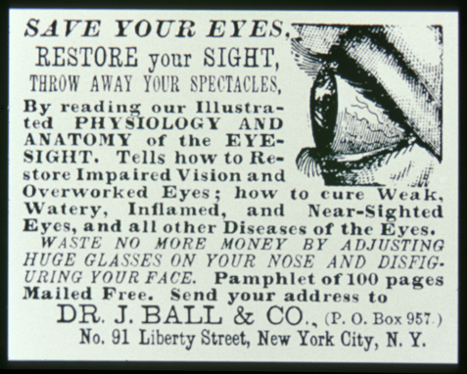
Before there was Refractive Surgery…
An advertisement from 1873 Dr. J. Ball
Notes:
Ads that were ethically problematic were appearing over 140 years ago… and led to some of the historical events we’re about to review.

Slide 4
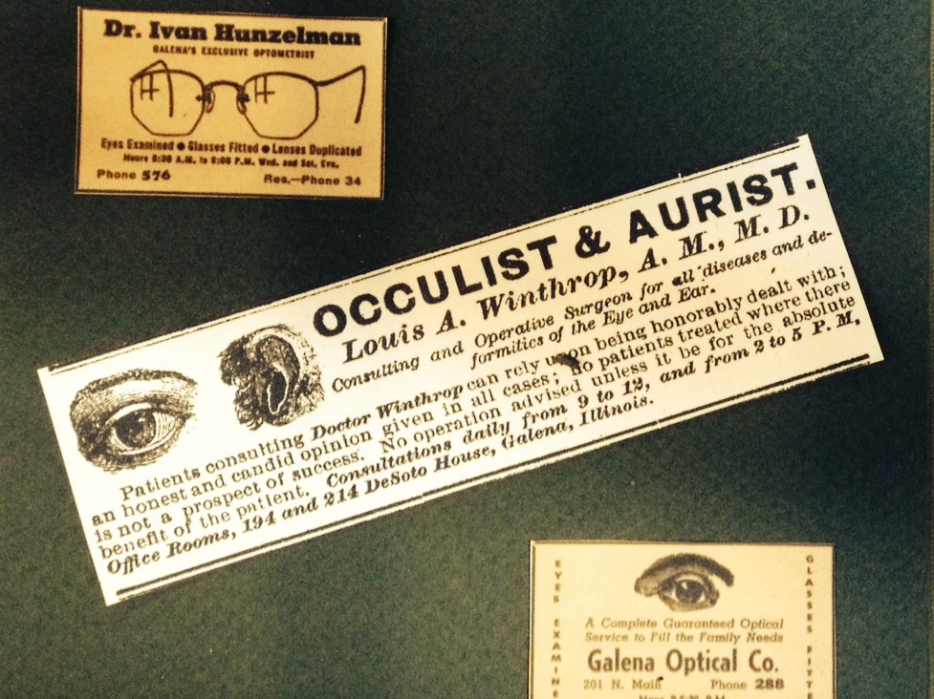
Physician Advertising – A Brief History
1847: AMA Code of Medical Ethics
(Advertising) is derogatory to the dignity of the profession…highly reprehensible”
1949: World Med. Assn. Declaration of Geneva
“The following practices are deemed unethical…any self advertisement except as expressly authorized by the national code of ethics”
1970’s: “Ethics” to discourage competition
Informal consensus
Formal codes of conduct, state regulation
Notes:
Until relatively recently, physician advertising was strongly discouraged
probably out of a sense that it was “unprofessional”.
Direct competition was regarded as less than collegial
amongst physicians in the same community.
In 1847, AMA articulated that “advertising is derogatory to the dignity of the profession…highly reprehensible”
Vestiges of these attitudes persisted into the 20th century
though perhaps less explicitly (see the Declaration of Geneva excerpt)
Importantly, consensus to restrain advertising or direct competition was codified in written policy and even
reflected in state laws reflecting physicians wishes

Slide 5
Federal Trade Committee (FTC) Complaint Against AMA, 1975-1980
Federal Trade Commission:
Declared AMA’s restriction on advertising is anticompetitive
Deprives patients information on:
Quality
Price
Availability
Medicare assignment
1979 - FTC issues Final Order
Prohibits AMA restrictions on MD ads
1980 - Upheld on appeal
Notes:
In December 1975, the FTC filed an administrative complaint against the AMA, charging that the association’s “Principles of Medical Ethics” unreasonably restrained trade by banning advertising and solicitation and derived the public of information such as Quality, Price, Availability, and insurance assignments.
Although the contested provisions did not directly set prices among the members, the FTC found that “ethical principles of the medical profession have prevented doctors and medical organizations from disseminating information on the prices and services they offer, severely inhibiting competition among health care providers.
After the FTC’s decision was upheld on appeal, there was no longer a “learned professions exception” to the antitrust laws, and thus, the antitrust laws applied to health care as it does to other aspects of the U.S. economy.
The FTC’s efforts during the 70s laid a strong foundation for analyzing competition and consumer protection issues in health care markets in the decades to come.

Slide 6
FTC Intervention Consequences of 1980 Decision
Medicine became provision of “goods and services”
Physicians became “providers”
Patients became “consumers”
Colleagues became competitors
Medical advertising subject to scrutiny
Regulatory
Peer standards

Slide 7
The FTC Act Section 5 - Regulation of Commerce
Fairness
Substantiation
Avoidance of “bait advertising”
Avoidance of deception or deceptive pricing
Misleading endorsements or testimonials
Use of problematic language (e.g. “free”)
https://www.ftc.gov/about-ftc/what-we-do/enforcement-authority
Notes:
FTC Act – Section 5 - Regulates unfair practices in commerce.
FTC definition of unfairness addresses 3 factors
Substantial injury to consumer, otherwise unavoidable
Violation of established public policy
Constitution, Laws, Judicial decisions
Unethical or unscrupulous – allows for some discretion
largely duplicative
of injury and public policy tests
Substantiation
Must be able to support claims with objective information
FTC may ask for relevant info
Avoidance of Bait advertising – meaning relatively intuitive
Deception or deceptive pricing – also self-explanatory
Testimonials (if legal in your state)
must reflect the honest opinion of endorser
must be able to stand alone re above, as if ad copy.
Use of problematic language

Slide 8
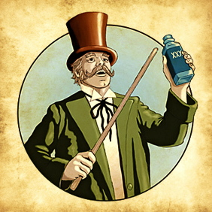
The FTC Act Section 12 – False Advertisements
Unlawful to falsely induce (directly or indirectly) the purchase of:
Food
Drugs
Devices
Services
Cosmetics
Notes:
FTC Act - Section 12: Addresses false advertising for the following goods and services.

Slide 9
The result? Section 12 – False Advertisements
Unlawful to falsely induce (directly or indirectly) the purchase of:
Food
Drugs
Devices
Services
Cosmetics
Medical care became a “service” and patients became “consumers”.
Notes:
FTC Act - Section 12: Medical care became a “service” and patients became “consumers”.

Slide 10
The FTC Act Section 12 – False Advertisements
Never mislead, by commission or omission
Never misinform
Never trick or deceive
On medical details
On financial details
Never exaggerate qualifications
Notes:
FTC Act - Section 12: Prohibits false advertising to induce purchase of drugs, or devices .
The FTC considers medical care to be a “service” and subject to section 12.

Slide 11
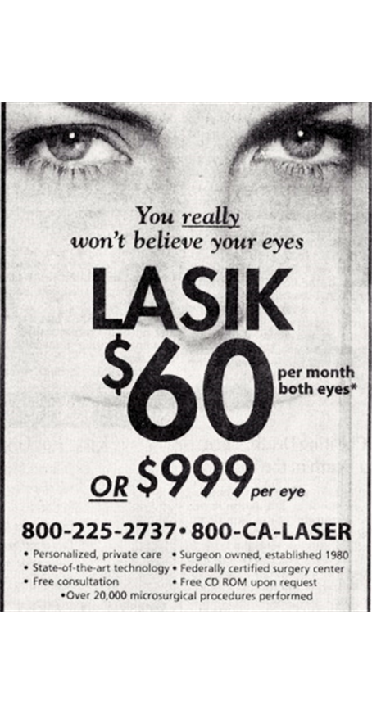
Code of Ethics Rule 13 Communications to the Public
No false, deceptive or misleading information
No deceptive omissions
No appeals to patients’ anxiety
Must not create unjustified expectations of results
Must disclose risks
Must not misrepresent credentials
No unsubstantiated claims of superiority
Notes:
When the Code of Ethics was written in the early 80’s
felt it was essential to be approved by the FTC
Rule 13 was part of the original Code
that FTC approved in 1983,
The Code was adopted by the Academy in November 1983
Went into effect January 1984.
Rule 13 governs advertising by members of the AAO
The close parallels to FTC law are obvious
(read)

Slide 12
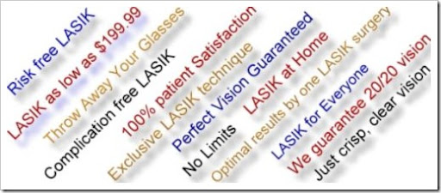
Advertising: Words and Phrases to Avoid
Safe
Pioneer, Leader, World Famous
Easy
Painless
Bloodless
Free
Guarantee
Notes:
Safe
Completely harmless?
Safer than existing technologies?
Comparatively safe?
Free – must define what is free
Guarantee – must define conditions, FTC frowns upon this claim because of how it is interpreted by the patient.

Slide 13
Medical Advertising Summary
A confluence of ethics and law
Truthfulness
Fairness
Perils for “bad” advertising
Risk of ethics scrutiny
Risk of FTC scrutiny
Risk in civil litigation
You are personally responsible
for ads in your name
Seek experienced marketing advice

