Slide 1
Scleritis
Scleritis
In a nutshell, what is scleritis?

Slide 2
Scleritis
Scleritis
In a nutshell, what is scleritis?
An inflammatory condition characterized by painful infiltrative scleral edema

Slide 3
Scleritis
Scleritis
In a nutshell, what is scleritis?
An inflammatory condition characterized by painful infiltrative scleral edema
Is it serious, or more of a nuisance?

Slide 4
Scleritis
Scleritis
In a nutshell, what is scleritis?
An inflammatory condition characterized by painful infiltrative scleral edema
Is it serious, or more of a nuisance?
Very serious--it can be extremely painful, can lead to blindness and loss of the eye,
and can be associated with systemic conditions that are potentially lethal

Slide 5
Scleritis
Scleritis
In a nutshell, what is scleritis?
An inflammatory condition characterized by painful infiltrative scleral edema
Is it serious, or more of a nuisance?
Very serious--it can be extremely painful, can lead to blindness and loss of the eye,
and can be associated with systemic conditions that are potentially lethal
Does it tend to be unilateral, or bilateral?

Slide 6
Scleritis
Scleritis
In a nutshell, what is scleritis?
An inflammatory condition characterized by painful infiltrative scleral edema
Is it serious, or more of a nuisance?
Very serious--it can be extremely painful, can lead to blindness and loss of the eye,
and can be associated with systemic conditions that are potentially lethal
Does it tend to be unilateral, or bilateral?
Both are equally likely over the course of the disease (although many bilateral cases present unilaterally initially)

Slide 7
Scleritis
Scleritis
In a nutshell, what is scleritis?
An inflammatory condition characterized by painful infiltrative scleral edema
Is it serious, or more of a nuisance?
Very serious--it can be extremely painful, can lead to blindness and loss of the eye,
and can be associated with systemic conditions that are potentially lethal
Does it tend to be unilateral, or bilateral?
Both are equally likely over the course of the disease (although many bilateral cases present unilaterally initially)
Is there an age predilection?

Slide 8
Scleritis
Scleritis
In a nutshell, what is scleritis?
An inflammatory condition characterized by painful infiltrative scleral edema
Is it serious, or more of a nuisance?
Very serious--it can be extremely painful, can lead to blindness and loss of the eye,
and can be associated with systemic conditions that are potentially lethal
Does it tend to be unilateral, or bilateral?
Both are equally likely over the course of the disease (although many bilateral cases present unilaterally initially)
Is there an age predilection?
Yes, adults are much more likely to affected than children
more v less

Slide 9
Scleritis
Scleritis
In a nutshell, what is scleritis?
An inflammatory condition characterized by painful infiltrative scleral edema
Is it serious, or more of a nuisance?
Very serious--it can be extremely painful, can lead to blindness and loss of the eye,
and can be associated with systemic conditions that are potentially lethal
Does it tend to be unilateral, or bilateral?
Both are equally likely over the course of the disease (although many bilateral cases present unilaterally initially)
Is there an age predilection?
Yes, adults are much more likely to affected than children

Slide 10
Scleritis
Scleritis
In a nutshell, what is scleritis?
An inflammatory condition characterized by painful infiltrative scleral edema
Is it serious, or more of a nuisance?
Very serious--it can be extremely painful, can lead to blindness and loss of the eye,
and can be associated with systemic conditions that are potentially lethal
Does it tend to be unilateral, or bilateral?
Both are equally likely over the course of the disease (although many bilateral cases present unilaterally initially)
Is there an age predilection?
Yes, adults are much more likely to affected than children
Is there a gender predilection?

Slide 11
Scleritis
Scleritis
In a nutshell, what is scleritis?
An inflammatory condition characterized by painful infiltrative scleral edema
Is it serious, or more of a nuisance?
Very serious--it can be extremely painful, can lead to blindness and loss of the eye,
and can be associated with systemic conditions that are potentially lethal
Does it tend to be unilateral, or bilateral?
Both are equally likely over the course of the disease (although many bilateral cases present unilaterally initially)
Is there an age predilection?
Yes, adults are much more likely to affected than children
Is there a gender predilection?
Yes, men are less likely to be affected than women
more v less

Slide 12
Scleritis
Scleritis
In a nutshell, what is scleritis?
An inflammatory condition characterized by painful infiltrative scleral edema
Is it serious, or more of a nuisance?
Very serious--it can be extremely painful, can lead to blindness and loss of the eye,
and can be associated with systemic conditions that are potentially lethal
Does it tend to be unilateral, or bilateral?
Both are equally likely over the course of the disease (although many bilateral cases present unilaterally initially)
Is there an age predilection?
Yes, adults are much more likely to affected than children
Is there a gender predilection?
Yes, men are less likely to be affected than women

Slide 13
Scleritis
Scleritis
Very basic
anatomic division
?
?

Slide 14
Scleritis
Scleritis
Very basic
anatomic division
Anterior
Posterior

Slide 15
Scleritis
Scleritis
Anterior
Posterior
?
?
?

Slide 16
Scleritis
Scleritis
Anterior
Posterior
Diffuse
Nodular
Necrotizing

Slide 17
Scleritis
Scleritis
Anterior
Posterior
Diffuse
Nodular
Necrotizing
?
?

Slide 18
Scleritis
Scleritis
Anterior
Posterior
Diffuse
Nodular
Necrotizing
w/ inflammation
w/o inflammation

Slide 19
Scleritis
Scleritis
Anterior
Posterior
Diffuse
Nodular
Necrotizing
w/ inflammation
w/o inflammation
What are three classic signs of anterior scleritis?
--?
--?Sclera has a violaceous hue
--?med vasculature has a criss-cross pattern

Slide 20
Scleritis
Scleritis
Anterior
Posterior
Diffuse
Nodular
Necrotizing
w/ inflammation
w/o inflammation
What are three classic signs of anterior scleritis?
--Scleral edema
--?Sclera has a violaceous hue
--?flamed vasculature has a criss-cross pattern

Slide 21
Scleritis
Scleritis
Anterior
Posterior
Diffuse
Nodular
Necrotizing
w/ inflammation
w/o inflammation
What are three classic signs of anterior scleritis?
--Scleral edema
--?Sclera has a violaceous hue
--?amed vasculature has a criss-cross pattern

Slide 22
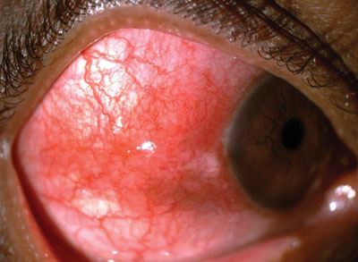
Scleritis
Scleral edema in nodular scleritis

Slide 23
Scleritis
Scleritis
Anterior
Posterior
Diffuse
Nodular
Necrotizing
w/ inflammation
w/o inflammation
What are three classic signs of anterior scleritis?
--Scleral edema
--Sclera has a violaceous hue
--??amed vasculature has a criss-cross pattern
Classic color
description

Slide 24
Scleritis
Scleritis
Anterior
Posterior
Diffuse
Nodular
Necrotizing
w/ inflammation
w/o inflammation
What are three classic signs of anterior scleritis?
--Scleral edema
--Sclera has a violaceous hue
--?lamed vasculature has a criss-cross pattern

Slide 25
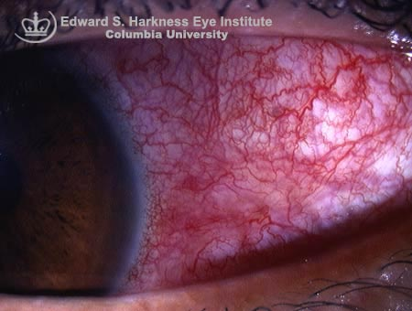
Scleritis
Violaceous hue in diffuse scleritis

Slide 26
Scleritis
Scleritis
Anterior
Posterior
Diffuse
Nodular
Necrotizing
w/ inflammation
w/o inflammation
What are three classic signs of anterior scleritis?
--Scleral edema
--Sclera has a violaceous hue
--Inflamed vasculature has a criss-cross pattern
classic pattern
description

Slide 27
Scleritis
Scleritis
Anterior
Posterior
Diffuse
Nodular
Necrotizing
w/ inflammation
w/o inflammation
What are three classic signs of anterior scleritis?
--Scleral edema
--Sclera has a violaceous hue
--Inflamed vasculature has a criss-cross pattern

Slide 28
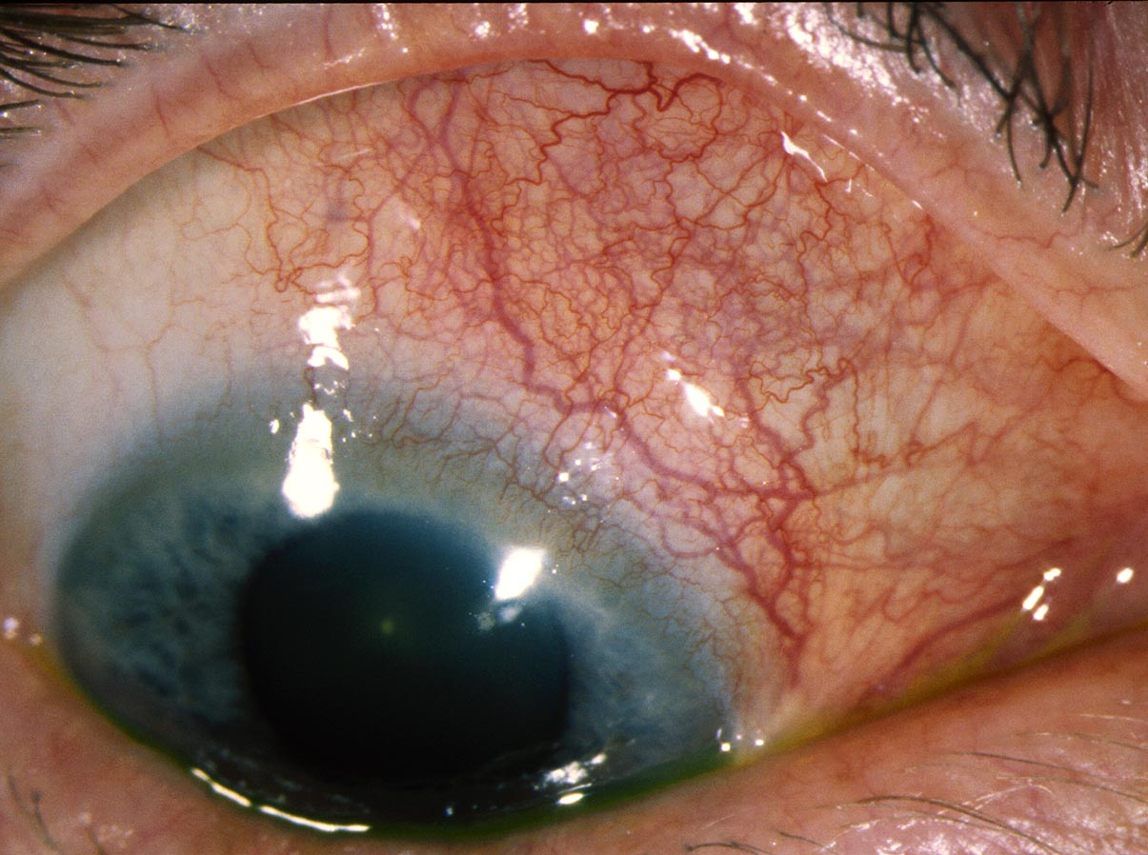
Scleritis
Criss-cross deep vasculature in scleritis (look for it until you see it)

Slide 29
Scleritis
Scleritis
Anterior
Posterior
Diffuse
Nodular
Necrotizing
Is the nodule of nodular scleritis mobile?
No
w/ inflammation
w/o inflammation

Slide 30
Scleritis
Scleritis
Anterior
Posterior
Diffuse
Nodular
Necrotizing
Is the nodule of nodular scleritis mobile?
No
w/ inflammation
w/o inflammation
Notes:
AUDIO:
The only way to tell if a nodule is mobile is to try and mobilize it, usually by pushing on it with a cotton-tip. In addition to determining the non-mobility of an anterior-scleritis nodule, you will also learn in very short order that a scleritis nodule is usually exquisitely tender.

Slide 31
Scleritis
Scleritis
Anterior
Posterior
Diffuse
Nodular
Necrotizing
w/ inflammation
w/o inflammation
If a patient has a necrotizing scleritis w/ inflammation, it’s a virtual lock that what sort of
disease is the culprit?
A vasculitis

Slide 32
Scleritis
Scleritis
Anterior
Posterior
Diffuse
Nodular
Necrotizing
w/ inflammation
w/o inflammation
If a patient has a necrotizing scleritis w/ inflammation, it’s a virtual lock that what sort of
disease is the culprit?
A vasculitis

Slide 33
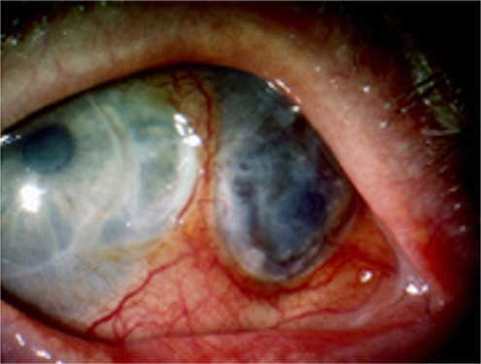
Scleritis
Necrotizing scleritis with inflammation

Slide 34
Scleritis
Scleritis
Anterior
Posterior
Diffuse
Nodular
Necrotizing
w/ inflammation
w/o inflammation
If a patient has a necrotizing scleritis w/ inflammation, it’s a virtual lock that what sort of
disease is the culprit?
A vasculitis
Is the vasculitis always systemic?
No, but it certainly can be

Slide 35
Scleritis
Scleritis
Anterior
Posterior
Diffuse
Nodular
Necrotizing
w/ inflammation
w/o inflammation
If a patient has a necrotizing scleritis w/ inflammation, it’s a virtual lock that what sort of
disease is the culprit?
A vasculitis
Is the vasculitis always systemic?
No, but it certainly can be

Slide 36
Scleritis
Scleritis
Anterior
Posterior
Diffuse
Nodular
Necrotizing
w/ inflammation
w/o inflammation
Here is where the eye dentist* can save someone’s life.
The discovery of an ocular vasculitic process should
prompt a thorough investigation Into whether the ocular
disease is a manifestation of a systemic process.
Why is this so important?
The presence of ocular vasculitis in systemic dz portends
a dismal prognosis for the pt. Five-year mortality for such
pts approaches 50%!
If a patient has a necrotizing scleritis w/ inflammation, it’s a virtual lock that what sort of
disease is the culprit?
A vasculitis
Is the vasculitis always systemic?
No, but it certainly can be
*Eye dentist (slang) Derisive nickname for an ophthalmologist

Slide 37
Scleritis
Scleritis
Anterior
Posterior
Diffuse
Nodular
Necrotizing
w/ inflammation
w/o inflammation
Here is where the eye dentist can save someone’s life.
The discovery of an ocular vasculitic process should
prompt a thorough investigation Into whether the ocular
disease is a manifestation of a systemic process.
Why is this so important?
The presence of ocular vasculitis in systemic dz portends
a dismal prognosis for the pt. Five-year mortality for such
pts approaches 50%!
If a patient has a necrotizing scleritis w/ inflammation, it’s a virtual lock that what sort of
disease is the culprit?
A vasculitis
Is the vasculitis always systemic?
No, but it certainly can be

Slide 38
Scleritis
Scleritis
Anterior
Posterior
Diffuse
Nodular
Necrotizing
w/ inflammation
w/o inflammation
Here is where the eye dentist can save someone’s life.
The discovery of an ocular vasculitic process should
prompt a thorough investigation Into whether the ocular
disease is a manifestation of a systemic process.
Why is this so important?
The presence of ocular vasculitis in systemic dz portends
a dismal prognosis for the pt. Five-year mortality for such
pts approaches 50%!
If a patient has a necrotizing scleritis w/ inflammation, it’s a virtual lock that what sort of
disease is the culprit?
A vasculitis
Is the vasculitis always systemic?
No, but it certainly can be

Slide 39
Scleritis
By what other name is necrotizing scleritis w/o inflammation known?
Scleromalacia perforans
Is it in fact a noninflammatory disease, as the name implies?
No; inflammation is present on biopsy
With what systemic disease is it most commonly associated?
Rheumatoid arthritis
How does its presentation differ from that of its ‘w/ inflammation’ cousin?
Scleromalacia perforans is typically painless, and the eye is not inflamed
Scleritis
Anterior
Posterior
Diffuse
Nodular
Necrotizing
w/ inflammation
w/o inflammation

Slide 40
Scleritis
By what other name is necrotizing scleritis w/o inflammation known?
Scleromalacia perforans
Is it in fact a noninflammatory disease, as the name implies?
No; inflammation is present on biopsy
With what systemic disease is it most commonly associated?
Rheumatoid arthritis
How does its presentation differ from that of its ‘w/ inflammation’ cousin?
Scleromalacia perforans is typically painless, and the eye is not inflamed
Scleritis
Anterior
Posterior
Diffuse
Nodular
Necrotizing
w/ inflammation
w/o inflammation

Slide 41
Scleritis
By what other name is necrotizing scleritis w/o inflammation known?
Scleromalacia perforans
Is it in fact a noninflammatory disease, as the name implies?
No; inflammation is present on biopsy
With what systemic disease is it most commonly associated?
Rheumatoid arthritis
How does its presentation differ from that of its ‘w/ inflammation’ cousin?
Scleromalacia perforans is typically painless, and the eye is not inflamed
Scleritis
Anterior
Posterior
Diffuse
Nodular
Necrotizing
w/ inflammation
w/o inflammation

Slide 42
Scleritis
By what other name is necrotizing scleritis w/o inflammation known?
Scleromalacia perforans
Is it in fact a noninflammatory disease, as the name implies?
No; inflammation is present on biopsy
With what systemic disease is it most commonly associated?
Rheumatoid arthritis
How does its presentation differ from that of its ‘w/ inflammation’ cousin?
Scleromalacia perforans is typically painless, and the eye is not inflamed
Scleritis
Anterior
Posterior
Diffuse
Nodular
Necrotizing
w/ inflammation
w/o inflammation

Slide 43
Scleritis
By what other name is necrotizing scleritis w/o inflammation known?
Scleromalacia perforans
Is it in fact a noninflammatory disease, as the name implies?
No; inflammation is present on biopsy
With what systemic disease is it most commonly associated?
Rheumatoid arthritis
How does its presentation differ from that of its ‘w/ inflammation’ cousin?
Scleromalacia perforans is typically painless, and the eye is not inflamed
Scleritis
Anterior
Posterior
Diffuse
Nodular
Necrotizing
w/ inflammation
w/o inflammation

Slide 44
Scleritis
By what other name is necrotizing scleritis w/o inflammation known?
Scleromalacia perforans
Is it in fact a noninflammatory disease, as the name implies?
No; inflammation is present on biopsy
With what systemic disease is it most commonly associated?
Rheumatoid arthritis
How does its presentation differ from that of its ‘w/ inflammation’ cousin?
Scleromalacia perforans is typically painless, and the eye is not inflamed
Scleritis
Anterior
Posterior
Diffuse
Nodular
Necrotizing
w/ inflammation
w/o inflammation

Slide 45
Scleritis
By what other name is necrotizing scleritis w/o inflammation known?
Scleromalacia perforans
Is it in fact a noninflammatory disease, as the name implies?
No; inflammation is present on biopsy
With what systemic disease is it most commonly associated?
Rheumatoid arthritis
How does its presentation differ from that of its ‘w/ inflammation’ cousin?
Scleromalacia perforans is typically painless, and the eye is not inflamed
Scleritis
Anterior
Posterior
Does scleromalacia perforans tend to occur early, or late in the RA dz course?
It tends to occur late, in longstanding cases
Diffuse
Nodular
Necrotizing
w/ inflammation
w/o inflammation

Slide 46
Scleritis
By what other name is necrotizing scleritis w/o inflammation known?
Scleromalacia perforans
Is it in fact a noninflammatory disease, as the name implies?
No; inflammation is present on biopsy
With what systemic disease is it most commonly associated?
Rheumatoid arthritis
How does its presentation differ from that of its ‘w/ inflammation’ cousin?
Scleromalacia perforans is typically painless, and the eye is not inflamed
Scleritis
Anterior
Posterior
Does scleromalacia perforans tend to occur early, or late in the RA dz course?
It tends to occur late, in longstanding cases
Diffuse
Nodular
Necrotizing
w/ inflammation
w/o inflammation

Slide 47
Scleritis
By what other name is necrotizing scleritis w/o inflammation known?
Scleromalacia perforans
Is it in fact a noninflammatory disease, as the name implies?
No; inflammation is present on biopsy
With what systemic disease is it most commonly associated?
Rheumatoid arthritis
How does its presentation differ from that of its ‘w/ inflammation’ cousin?
Scleromalacia perforans is typically painless, and the eye is not inflamed
Scleritis
Anterior
Posterior
Diffuse
Nodular
Necrotizing
w/ inflammation
w/o inflammation

Slide 48
Scleritis
By what other name is necrotizing scleritis w/o inflammation known?
Scleromalacia perforans
Is it in fact a noninflammatory disease, as the name implies?
No; inflammation is present on biopsy
With what systemic disease is it most commonly associated?
Rheumatoid arthritis
How does its presentation differ from that of its ‘w/ inflammation’ cousin?
Scleromalacia perforans is typically painless, and the eye is not inflamed
Scleritis
Anterior
Posterior
Diffuse
Nodular
Necrotizing
w/ inflammation
w/o inflammation

Slide 49
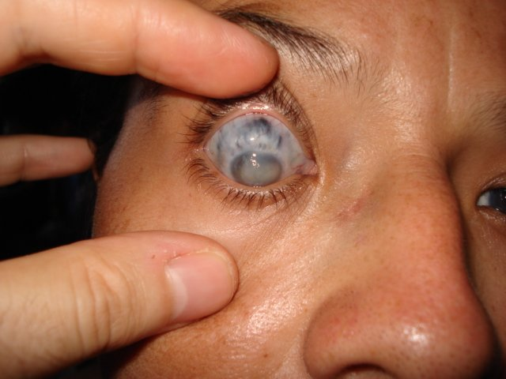
Scleritis
Necrotizing scleritis w/o inflammation

Slide 50
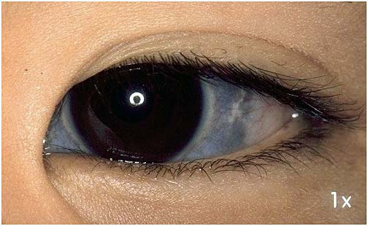
Scleritis
Is this scleromalacia perforans?

Slide 51
Scleritis
No--this is blue sclera in Ehlers-Danlos

Slide 52
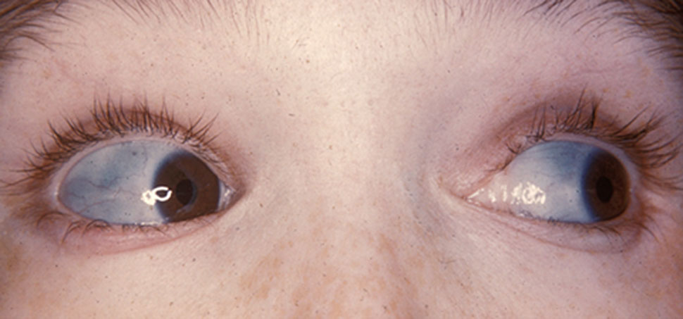
Scleritis
Is this scleromalacia perforans?

Slide 53
Scleritis
No--this is blue sclera in OI

Slide 54
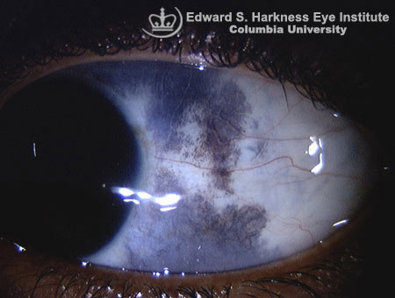
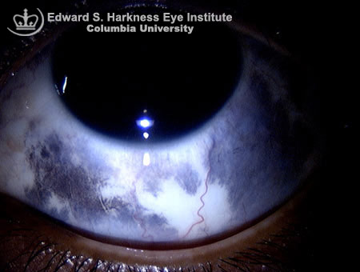
Scleritis
Is this scleromalacia perforans?

Slide 55
Scleritis
No--this is ocular melanocytosis

Slide 56
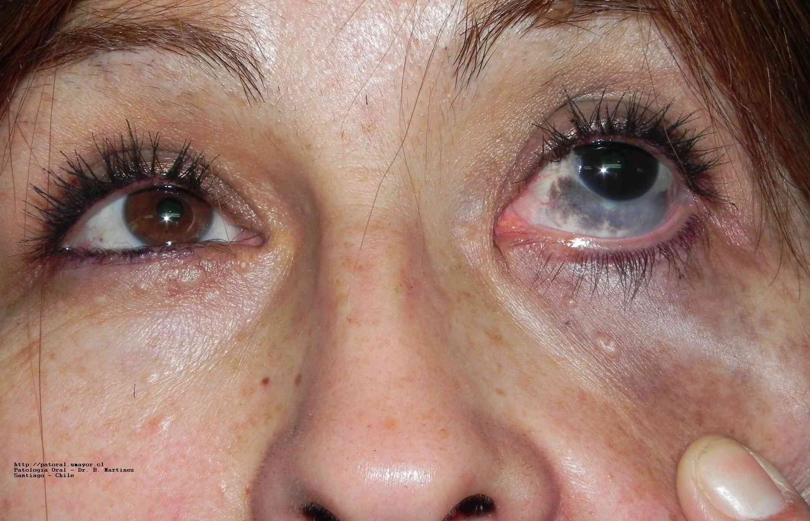
Scleritis
Is this scleromalacia perforans?

Slide 57
Scleritis
No--this is oculodermal melanocytosis (aka Nevus of Ota)

Slide 58
Scleritis
Scleritis
?
Anterior
From what related disease must scleritis be differentiated?
Episcleritis
What is the hallmark feature that separates the two?
Scleritis is painful—the eye hurts, and is usually quite tender.
In contrast, episcleritis is not painful (other than perhaps a mild
foreign-body sensation), and the globe is not tender
Posterior
Diffuse
Nodular
Necrotizing
w/ inflammation
w/o inflammation

Slide 59
Scleritis
Scleritis
Episcleritis
Anterior
From what related disease must scleritis be differentiated?
Episcleritis
What is the hallmark feature that separates the two?
Scleritis is painful—the eye hurts, and is usually quite tender.
In contrast, episcleritis is not painful (other than perhaps a mild
foreign-body sensation), and the globe is not tender
Posterior
Diffuse
Nodular
Necrotizing
w/ inflammation
w/o inflammation

Slide 60
Scleritis
Scleritis
Episcleritis
Anterior
From what related disease must scleritis be differentiated?
Episcleritis
What is the hallmark feature that separates the two?
Scleritis is painful—the eye hurts, and is usually quite tender.
In contrast, episcleritis is not painful (other than perhaps a mild
foreign-body sensation), and the globe is not tender
Posterior
Diffuse
Nodular
Necrotizing
w/ inflammation
w/o inflammation

Slide 61
Scleritis
Scleritis
Episcleritis
Anterior
From what related disease must scleritis be differentiated?
Episcleritis
What is the hallmark feature that separates the two?
Scleritis is painful—the eye hurts, and is usually quite tender.
In contrast, episcleritis is not painful (other than perhaps a mild
foreign-body sensation), and the globe is not tender.
Posterior
Diffuse
Nodular
Necrotizing
w/ inflammation
w/o inflammation

Slide 62
Scleritis
Scleritis
Episcleritis
Anterior
From what related disease must scleritis be differentiated?
Episcleritis
What is the hallmark feature that separates the two?
Scleritis is painful—the eye hurts, and is usually quite tender.
In contrast, episcleritis is not painful (other than perhaps a mild
foreign-body sensation), and the globe is not tender.
Posterior
Diffuse
Nodular
Necrotizing
Necrotizing scleritis w/o inflammation is
a notable exception to this rule
w/ inflammation
w/o inflammation

Slide 63
Scleritis
Scleritis
Anterior
Posterior
What proportion of scleritis patients
have an identifiable systemic condition?
About 1/2
Diffuse
Nodular
Necrotizing
w/ inflammation
w/o inflammation

Slide 64
Scleritis
Scleritis
Anterior
Posterior
What proportion of scleritis patients
have an identifiable systemic condition?
About 1/2
Diffuse
Nodular
Necrotizing
w/ inflammation
w/o inflammation

Slide 65
Scleritis
Scleritis
Anterior
Posterior
What proportion of scleritis patients
have an identifiable systemic condition?
About 1/2
Diffuse
≈ ?
Nodular
≈ ?
Necrotizing
≈ ?
More specifically, what proportion of Diffuse vs Nodular vs Necrotizing
pts have an identifiable systemic condition?
1/3, 1/3 and 2/3, respectively
w/ inflammation
w/o inflammation

Slide 66
Scleritis
Scleritis
Anterior
Posterior
What proportion of scleritis patients
have an identifiable systemic condition?
About 1/2
Diffuse
≈ 1/3
Nodular
≈ 1/3
Necrotizing
≈ 2/3
More specifically, what proportion of Diffuse vs Nodular vs Necrotizing
pts have an identifiable systemic condition?
1/3, 1/3 and 2/3, respectively
w/ inflammation
w/o inflammation

Slide 67
Scleritis
Scleritis
Anterior
Posterior
What proportion of scleritis patients
have an identifiable systemic condition?
About 1/2
Diffuse
Nodular
Necrotizing
Scleritis
w/ inflammation
w/o inflammation
½ w/ systemic
condition
½ no systemic
condition
(2 most common classes?)

Slide 68
Scleritis
Scleritis
Anterior
Posterior
What proportion of scleritis patients
have an identifiable systemic condition?
About 1/2
Diffuse
Nodular
Necrotizing
Scleritis
w/ inflammation
w/o inflammation
½ w/ systemic
condition
½ no systemic
condition
(CT = connective tissue)
CT Disease
Vasculitis

Slide 69
Scleritis
Scleritis
Anterior
Posterior
What proportion of scleritis patients
have an identifiable systemic condition?
About 1/2
Diffuse
Nodular
Necrotizing
Scleritis
w/ inflammation
w/o inflammation
½ w/ systemic
condition
½ no systemic
condition
CT Disease
Vasculitis
(3 most common CT diseases?)

Slide 70
Scleritis
Scleritis
Anterior
Posterior
What proportion of scleritis patients
have an identifiable systemic condition?
About 1/2
Diffuse
Nodular
Necrotizing
Scleritis
w/ inflammation
w/o inflammation
½ w/ systemic
condition
½ no systemic
condition
CT Disease
Vasculitis
RA (rheumatoid arthritis)
SLE (systemic lupus erythematosus)
SNSAs (seronegative spondyloarthropathies)

Slide 71
Scleritis
Scleritis
Anterior
Posterior
What proportion of scleritis patients
have an identifiable systemic condition?
About 1/2
Diffuse
Nodular
Necrotizing
Scleritis
To what does the term seronegative spondyloarthropathies refer?
It is an umbrella term for a group of related rheumatologic conditions
To what does the word seronegative refer?
To the fact that the rheumatoid factor test is negative in these conditions
Name three common seronegative spondyloarthropathies.
--Ankylosing spondylitis
--Reactive arthritis
--Psoriatic arthritis
w/ inflammation
w/o inflammation
½ w/ systemic
condition
½ no systemic
condition
CT Disease
Vasculitis
RA (rheumatoid arthritis)
SLE (systemic lupus erythematosus)
SNSAs (seronegative spondyloarthropathies)

Slide 72
Scleritis
Scleritis
Anterior
Posterior
What proportion of scleritis patients
have an identifiable systemic condition?
About 1/2
Diffuse
Nodular
Necrotizing
Scleritis
To what does the term seronegative spondyloarthropathies refer?
It is an umbrella term for a group of related rheumatologic conditions
To what does the word seronegative refer?
To the fact that the rheumatoid factor test is negative in these conditions
Name three common seronegative spondyloarthropathies.
--Ankylosing spondylitis
--Reactive arthritis
--Psoriatic arthritis
w/ inflammation
w/o inflammation
½ w/ systemic
condition
½ no systemic
condition
CT Disease
Vasculitis
RA (rheumatoid arthritis)
SLE (systemic lupus erythematosus)
SNSAs (seronegative spondyloarthropathies)

Slide 73
Scleritis
Scleritis
Anterior
Posterior
What proportion of scleritis patients
have an identifiable systemic condition?
About 1/2
Diffuse
Nodular
Necrotizing
Scleritis
To what does the term seronegative spondyloarthropathies refer?
It is an umbrella term for a group of related rheumatologic conditions
To what does the word seronegative refer?
To the fact that the rheumatoid factor test is negative in these conditions
Name three common seronegative spondyloarthropathies.
--Ankylosing spondylitis
--Reactive arthritis
--Psoriatic arthritis
w/ inflammation
w/o inflammation
½ w/ systemic
condition
½ no systemic
condition
CT Disease
Vasculitis
RA (rheumatoid arthritis)
SLE (systemic lupus erythematosus)
SNSAs (seronegative spondyloarthropathies)

Slide 74
Scleritis
Scleritis
Anterior
Posterior
What proportion of scleritis patients
have an identifiable systemic condition?
About 1/2
Diffuse
Nodular
Necrotizing
Scleritis
To what does the term seronegative spondyloarthropathies refer?
It is an umbrella term for a group of related rheumatologic conditions
To what does the word seronegative refer?
To the fact that the rheumatoid factor test is negative in these conditions
Name three common seronegative spondyloarthropathies.
--Ankylosing spondylitis
--Reactive arthritis
--Psoriatic arthritis
w/ inflammation
w/o inflammation
½ w/ systemic
condition
½ no systemic
condition
CT Disease
Vasculitis
RA (rheumatoid arthritis)
SLE (systemic lupus erythematosus)
SNSAs (seronegative spondyloarthropathies)

Slide 75
Scleritis
Scleritis
Anterior
Posterior
What proportion of scleritis patients
have an identifiable systemic condition?
About 1/2
Diffuse
Nodular
Necrotizing
Scleritis
To what does the term seronegative spondyloarthropathies refer?
It is an umbrella term for a group of related rheumatologic conditions
To what does the word seronegative refer?
To the fact that the rheumatoid factor test is negative in these conditions
Name three common seronegative spondyloarthropathies.
--?
--?
--?
w/ inflammation
w/o inflammation
½ w/ systemic
condition
½ no systemic
condition
CT Disease
Vasculitis
RA (rheumatoid arthritis)
SLE (systemic lupus erythematosus)
SNSAs (seronegative spondyloarthropathies)

Slide 76
Scleritis
Scleritis
Anterior
Posterior
What proportion of scleritis patients
have an identifiable systemic condition?
About 1/2
Diffuse
Nodular
Necrotizing
Scleritis
To what does the term seronegative spondyloarthropathies refer?
It is an umbrella term for a group of related rheumatologic conditions
To what does the word seronegative refer?
To the fact that the rheumatoid factor test is negative in these conditions
Name three common seronegative spondyloarthropathies.
--Ankylosing spondylitis
--Reactive arthritis
--Psoriatic arthritis
w/ inflammation
w/o inflammation
½ w/ systemic
condition
½ no systemic
condition
CT Disease
Vasculitis
RA (rheumatoid arthritis)
SLE (systemic lupus erythematosus)
SNSAs (seronegative spondyloarthropathies)

Slide 77
Scleritis
Scleritis
Anterior
Posterior
What proportion of scleritis patients
have an identifiable systemic condition?
About 1/2
Diffuse
Nodular
Necrotizing
Scleritis
w/ inflammation
w/o inflammation
½ w/ systemic
condition
½ no systemic
condition
CT Disease
Vasculitis
RA
SLE
SNSAs
?
?
?
Next question
(3 most common vasculitides?)

Slide 78
Scleritis
Scleritis
Anterior
Posterior
What proportion of scleritis patients
have an identifiable systemic condition?
About 1/2
Diffuse
Nodular
Necrotizing
Scleritis
w/ inflammation
w/o inflammation
½ w/ systemic
condition
½ no systemic
condition
CT Disease
Vasculitis
RA
SLE
SNSAs
Wegener’s
PAN (polyarteritis nodosa)
GCA (giant-cell arteritis)

Slide 79
Scleritis
Scleritis
Anterior
Posterior
episcleritis
What proportion of scleritis patients
have an identifiable systemic condition?
About 1/2
Diffuse
Nodular
Necrotizing
Episcleritis
Scleritis
Which of these disease are associated with episcleritis?
All of them! The DDx for episcleritis is the same as that
for scleritis. The difference between these conditions
concerns disease probability--the likelihood of an
underlying condition is far lower in episcleritis.
½ w/ systemic
condition
½ no systemic
condition
w/ inflammation
w/o inflammation
CT Disease
Vasculitis
RA
SLE
SNSAs
Wegener’s
PAN
GCA

Slide 80
Scleritis
Scleritis
Anterior
Posterior
episcleritis
What proportion of scleritis patients
have an identifiable systemic condition?
About 1/2
Diffuse
Nodular
Necrotizing
very low
Episcleritis
Scleritis
Very few
Most with
Which of these disease are associated with episcleritis?
All of them! The DDx for episcleritis is the same as that
for scleritis. The difference between these conditions
concerns disease probability--the likelihood of an
underlying condition is far lower in episcleritis.
½ w/ systemic
condition
½ no systemic
conition
w/ inflammation
w/o inflammation
CT Disease
Vasculitis
RA
SLE
SNSAs
Wegener’s
PAN
GCA

Slide 81
Scleritis
Scleritis
What important-but-often-overlooked source of local scleritis has yet to be mentioned?
Infectious scleritis
A review by Foster and colleagues revealed what infection rate among scleritis pts?
About 7%--yikes! Make sure you keep infectious processes in the back of your mind
when working up scleritis patients.
Anterior
Posterior
What proportion of scleritis patients
have an identifiable systemic condition?
About 1/2
Diffuse
Nodular
Necrotizing
w/ inflammation
w/o inflammation

Slide 82
Scleritis
Scleritis
What important-but-often-overlooked source of local scleritis has yet to be mentioned?
Infectious scleritis
A review by Foster and colleagues revealed what infection rate among scleritis pts?
About 7%--yikes! Make sure you keep infectious processes in the back of your mind
when working up scleritis patients.
Anterior
Posterior
What proportion of scleritis patients
have an identifiable systemic condition?
About 1/2
Diffuse
Nodular
Necrotizing
w/ inflammation
w/o inflammation

Slide 83
Scleritis
Scleritis
What important-but-often-overlooked source of local scleritis has yet to be mentioned?
Infectious scleritis
A review by Foster and colleagues revealed what infection rate among scleritis pts?
About 7%--yikes! Make sure you keep infectious processes in the back of your mind
when working up scleritis patients.
Anterior
Posterior
What proportion of scleritis patients
have an identifiable systemic condition?
About 1/2
Diffuse
Nodular
Necrotizing
w/ inflammation
w/o inflammation

Slide 84
Scleritis
Scleritis
What important-but-often-overlooked source of local scleritis has yet to be mentioned?
Infectious scleritis
A review by Foster and colleagues revealed what infection rate among scleritis pts?
About 7%. Make sure you keep infectious processes in the back of your mind when
working up scleritis patients!
Anterior
Posterior
What proportion of scleritis patients
have an identifiable systemic condition?
About 1/2
Diffuse
Nodular
Necrotizing
w/ inflammation
w/o inflammation

Slide 85
Scleritis
Scleritis
What is the most common event leading to the development of infectious scleritis?
Pterygium surgery (other surgeries, and trauma, are common inciting incidents as well)
What bug is most commonly implicated?
Pseudomonas
How should infectious scleritis be treated?
With both antibiotics and surgical debridement
What important-but-often-overlooked source of local scleritis has yet to be mentioned?
Infectious scleritis
A review by Foster and colleagues revealed what infection rate among scleritis pts?
About 7%. Make sure you keep infectious processes in the back of your mind when
working up scleritis patients!
Anterior
Posterior
What proportion of scleritis patients
have an identifiable systemic condition?
About 1/2
Diffuse
Nodular
Necrotizing
w/ inflammation
w/o inflammation

Slide 86
Scleritis
Scleritis
What is the most common event leading to the development of infectious scleritis?
Pterygium surgery (other surgeries, and trauma, are common inciting incidents as well)
What bug is most commonly implicated?
Pseudomonas
How should infectious scleritis be treated?
With both antibiotics and surgical debridement
What important-but-often-overlooked source of local scleritis has yet to be mentioned?
Infectious scleritis
A review by Foster and colleagues revealed what infection rate among scleritis pts?
About 7%. Make sure you keep infectious processes in the back of your mind when
working up scleritis patients!
Anterior
Posterior
What proportion of scleritis patients
have an identifiable systemic condition?
About 1/2
Diffuse
Nodular
Necrotizing
w/ inflammation
w/o inflammation

Slide 87
Scleritis
Scleritis
What is the most common event leading to the development of infectious scleritis?
Pterygium surgery (other surgeries, and trauma, are common inciting incidents as well)
What bug is most commonly implicated?
Pseudomonas
How should infectious scleritis be treated?
With both antibiotics and surgical debridement
What important-but-often-overlooked source of local scleritis has yet to be mentioned?
Infectious scleritis
A review by Foster and colleagues revealed what infection rate among scleritis pts?
About 7%. Make sure you keep infectious processes in the back of your mind when
working up scleritis patients!
Anterior
Posterior
What proportion of scleritis patients
have an identifiable systemic condition?
About 1/2
Diffuse
Nodular
Necrotizing
w/ inflammation
w/o inflammation

Slide 88
Scleritis
Scleritis
What is the most common event leading to the development of infectious scleritis?
Pterygium surgery (other surgeries, and trauma, are common inciting incidents as well)
What bug is most commonly implicated?
Pseudomonas
How should infectious scleritis be treated?
With both antibiotics and surgical debridement
What important-but-often-overlooked source of local scleritis has yet to be mentioned?
Infectious scleritis
A review by Foster and colleagues revealed what infection rate among scleritis pts?
About 7%. Make sure you keep infectious processes in the back of your mind when
working up scleritis patients!
Anterior
Posterior
What proportion of scleritis patients
have an identifiable systemic condition?
About 1/2
Diffuse
Nodular
Necrotizing
w/ inflammation
w/o inflammation

Slide 89
Scleritis
Scleritis
What is the most common event leading to the development of infectious scleritis?
Pterygium surgery (other surgeries, and trauma, are common inciting incidents as well)
What bug is most commonly implicated?
Pseudomonas
How should infectious scleritis be treated?
With both antibiotics and surgical debridement
What important-but-often-overlooked source of local scleritis has yet to be mentioned?
Infectious scleritis
A review by Foster and colleagues revealed what infection rate among scleritis pts?
About 7%. Make sure you keep infectious processes in the back of your mind when
working up scleritis patients!
Anterior
Posterior
What proportion of scleritis patients
have an identifiable systemic condition?
About 1/2
Diffuse
Nodular
Necrotizing
w/ inflammation
w/o inflammation

Slide 90
Scleritis
Scleritis
What is the most common event leading to the development of infectious scleritis?
Pterygium surgery (other surgeries, and trauma, are common inciting incidents as well)
What bug is most commonly implicated?
Pseudomonas
How should infectious scleritis be treated?
With both antibiotics and surgical debridement
What important-but-often-overlooked source of local scleritis has yet to be mentioned?
Infectious scleritis
A review by Foster and colleagues revealed what infection rate among scleritis pts?
About 7%. Make sure you keep infectious processes in the back of your mind when
working up scleritis patients!
Anterior
Posterior
What proportion of scleritis patients
have an identifiable systemic condition?
About 1/2
Diffuse
Nodular
Necrotizing
w/ inflammation
w/o inflammation

Slide 91
Scleritis
Scleritis
What is the most common event leading to the development of infectious scleritis?
Pterygium surgery (other surgeries, and trauma, are common inciting incidents as well)
What bug is most commonly implicated?
Pseudomonas
How should infectious scleritis be treated?
With both antibiotics and surgical debridement
What important-but-often-overlooked source of local scleritis has yet to be mentioned?
Infectious scleritis
A review by Foster and colleagues revealed what infection rate among scleritis pts?
About 7%. Make sure you keep infectious processes in the back of your mind when
working up scleritis patients!
Anterior
Posterior
What proportion of scleritis patients
have an identifiable systemic condition?
About 1/2
Diffuse
Nodular
Necrotizing
two words
w/ inflammation
w/o inflammation

Slide 92
Scleritis
Scleritis
What is the most common event leading to the development of infectious scleritis?
Pterygium surgery (other surgeries, and trauma, are common inciting incidents as well)
What bug is most commonly implicated?
Pseudomonas
How should infectious scleritis be treated?
With both antibiotics and surgical debridement
What important-but-often-overlooked source of local scleritis has yet to be mentioned?
Infectious scleritis
A review by Foster and colleagues revealed what infection rate among scleritis pts?
About 7%. Make sure you keep infectious processes in the back of your mind when
working up scleritis patients!
Anterior
Posterior
What proportion of scleritis patients
have an identifiable systemic condition?
About 1/2
Diffuse
Nodular
Necrotizing
w/ inflammation
w/o inflammation

Slide 93
Scleritis
Scleritis
What is the most common event leading to the development of infectious scleritis?
Pterygium surgery (other surgeries, and trauma, are common inciting incidents as well)
What bug is most commonly implicated?
Pseudomonas
How should infectious scleritis be treated?
With both antibiotics and surgical debridement
What important-but-often-overlooked source of local scleritis has yet to be mentioned?
Infectious scleritis
A review by Foster and colleagues revealed what infection rate among scleritis pts?
About 7%. Make sure you keep infectious processes in the back of your mind when
working up scleritis patients!
Anterior
Posterior
What proportion of scleritis patients
have an identifiable systemic condition?
About 1/2
Diffuse
Nodular
Necrotizing
Why surgical debridement? That is, why aren’t abx enough?
Because the sclera is essentially avascular, it is difficult to achieve adequate abx concentrations
w/ inflammation
w/o inflammation

Slide 94
Scleritis
Scleritis
What is the most common event leading to the development of infectious scleritis?
Pterygium surgery (other surgeries, and trauma, are common inciting incidents as well)
What bug is most commonly implicated?
Pseudomonas
How should infectious scleritis be treated?
With both antibiotics and surgical debridement
What important-but-often-overlooked source of local scleritis has yet to be mentioned?
Infectious scleritis
A review by Foster and colleagues revealed what infection rate among scleritis pts?
About 7%. Make sure you keep infectious processes in the back of your mind when
working up scleritis patients!
Anterior
Posterior
What proportion of scleritis patients
have an identifiable systemic condition?
About 1/2
Diffuse
Nodular
Necrotizing
Why surgical debridement? That is, why aren’t abx enough?
The sclera is essentially avascular, so it is difficult to achieve adequate abx concentrations within it
w/ inflammation
w/o inflammation

Slide 95
Scleritis
Scleritis
Anterior
Posterior
What signs/symptoms of anterior scleritis do not typically
appear in isolated posterior scleritis?
--?
--?
What signs/symptoms of posterior scleritis do not typically
occur in anterior scleritis?
--Proptosis
--Disc edema
--Motility disorders
--Retinal/choroidal findings
Is posterior scleritis more likely or less likely than anterior
uveitis to be associated with a systemic condition?
Less likely
Diffuse
Nodular
Necrotizing
w/ inflammation
w/o inflammation

Slide 96
Scleritis
Scleritis
Anterior
Posterior
What signs/symptoms of anterior scleritis do not typically
appear in isolated posterior scleritis?
--The eye is not red
--No nodules are present
What signs/symptoms of posterior scleritis do not typically
occur in anterior scleritis?
--
--
--
--
Is posterior scleritis more likely or less likely than anterior
uveitis to be associated with a systemic condition?
Less likely
Diffuse
Nodular
Necrotizing
w/ inflammation
w/o inflammation

Slide 97
Scleritis
Scleritis
Anterior
Posterior
What signs/symptoms of anterior scleritis do not typically
appear in isolated posterior scleritis?
--The eye is not red
--No nodules are present
What signs/symptoms of posterior scleritis do not typically
occur in anterior scleritis?
--?
--?
--?
--?
Is posterior scleritis more likely or less likely than anterior
uveitis to be associated with a systemic condition?
Less likely
Diffuse
Nodular
Necrotizing
w/ inflammation
w/o inflammation

Slide 98
Scleritis
Scleritis
Anterior
Posterior
What signs/symptoms of anterior scleritis do not typically
appear in isolated posterior scleritis?
--The eye is not red
--No nodules are present
What signs/symptoms of posterior scleritis do not typically
occur in anterior scleritis?
--Proptosis
--Disc edema
--Motility disorders
--Retinal/choroidal findings
Is posterior scleritis more likely or less likely than anterior
scleritis to be associated with a systemic condition?
Less likely
Diffuse
Nodular
Necrotizing
w/ inflammation
w/o inflammation

Slide 99
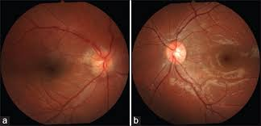
Scleritis
Posterior scleritis OD: Optic nerve edema

Slide 100
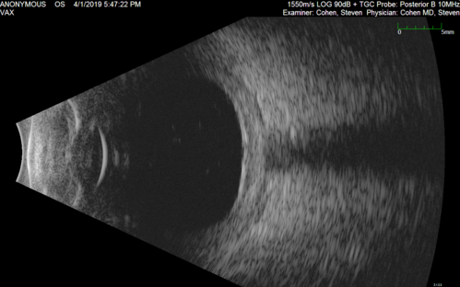
Scleritis
Posterior scleritis: Scleral thickening

Slide 101
Scleritis
Scleritis
Anterior
Posterior
What signs/symptoms of anterior scleritis do not typically
appear in isolated posterior scleritis?
--The eye is not red
--No nodules are present
What signs/symptoms of posterior scleritis do not typically
occur in anterior scleritis?
--Proptosis
--Disc edema
--Motility disorders
--Retinal/choroidal findings
Is posterior scleritis more likely or less likely than anterior
scleritis to be associated with a systemic condition?
Less likely
Diffuse
Nodular
Necrotizing
w/ inflammation
w/o inflammation

Slide 102
Scleritis
Scleritis
Anterior
Posterior
What signs/symptoms of anterior scleritis do not typically
appear in isolated posterior scleritis?
--The eye is not red
--No nodules are present
What signs/symptoms of posterior scleritis do not typically
occur in anterior scleritis?
--Proptosis
--Disc edema
--Motility disorders
--Retinal/choroidal findings
Is posterior scleritis more likely or less likely than anterior
scleritis to be associated with a systemic condition?
Less likely
Diffuse
Nodular
Necrotizing
w/ inflammation
w/o inflammation

Slide 103
Scleritis
Scleritis
Anterior
Posterior
What three characteristics of the pain are a tipoff that you’re dealing with posterior scleritis?
--?
--?
--?
Diffuse
Nodular
Necrotizing
w/ inflammation
w/o inflammation

Slide 104
Scleritis
Scleritis
Anterior
Posterior
What three characteristics of the pain are a tipoff that you’re dealing with posterior scleritis?
--The pain radiates to the brow
--?The pain is aggravated by ocular rotations
--?The pain awakens the pt at night
Nodular
location
Diffuse
Necrotizing
w/ inflammation
w/o inflammation

Slide 105
Scleritis
Scleritis
Anterior
Posterior
What three characteristics of the pain are a tipoff that you’re dealing with posterior scleritis?
--The pain radiates to the brow
--?The pain is aggravated by ocular rotations
--?The pain awakens the pt at night
Diffuse
Nodular
Necrotizing
w/ inflammation
w/o inflammation

Slide 106
Scleritis
Scleritis
Anterior
Posterior
What three characteristics of the pain are a tipoff that you’re dealing with posterior scleritis?
--The pain radiates to the brow
--The pain is aggravated by ocular rotations
--?The pain awakens the pt at night
Diffuse
Nodular
Necrotizing
two words
w/ inflammation
w/o inflammation

Slide 107
Scleritis
Scleritis
Anterior
Posterior
What three characteristics of the pain are a tipoff that you’re dealing with posterior scleritis?
--The pain radiates to the brow
--The pain is aggravated by eye movements
--?The pain awakens the pt at night
Diffuse
Nodular
Necrotizing
w/ inflammation
w/o inflammation

Slide 108
Scleritis
Scleritis
Anterior
Posterior
What three characteristics of the pain are a tipoff that you’re dealing with posterior scleritis?
--The pain radiates to the brow
--The pain is aggravated by eye movements
--The pain awakens the pt at night
Diffuse
Nodular
Necrotizing
five words
w/ inflammation
w/o inflammation

Slide 109
Scleritis
Scleritis
Anterior
Posterior
What three characteristics of the pain are a tipoff that you’re dealing with posterior scleritis?
--The pain radiates to the brow
--The pain is aggravated by eye movements
--The pain awakens the pt at night
Diffuse
Nodular
Necrotizing
w/ inflammation
w/o inflammation

Slide 110
Scleritis
Scleritis
Anterior
Posterior
What easy-to-obtain imaging study can cinch the diagnosis?
b-scan ultrasonography
What will b-scan reveal?
--Choroidal thickening
--Sub-Tenon’s edema
When sub-Tenon’s edema involves the space around the
optic nerve, what b-scan finding will result?
The classic T sign
Diffuse
Nodular
Necrotizing
w/ inflammation
w/o inflammation

Slide 111
Scleritis
Scleritis
Anterior
Posterior
What easy-to-obtain imaging study can cinch the diagnosis?
b-scan ultrasonography
What will b-scan reveal?
--
--Sub-Tenon’s edema
When sub-Tenon’s edema involves the space around the
optic nerve, what b-scan finding will result?
The classic T sign
Diffuse
Nodular
Necrotizing
w/ inflammation
w/o inflammation

Slide 112
Scleritis
Scleritis
Anterior
Posterior
What easy-to-obtain imaging study can cinch the diagnosis?
b-scan ultrasonography
What will b-scan reveal?
--?
--?Sub-Tenon’s edema
When sub-Tenon’s edema involves the space around the
optic nerve, what b-scan finding will result?
The classic T sign
Diffuse
Nodular
Necrotizing
w/ inflammation
w/o inflammation

Slide 113
Scleritis
Scleritis
Anterior
Posterior
What easy-to-obtain imaging study can cinch the diagnosis?
b-scan ultrasonography
What will b-scan reveal?
--Choroidal thickening
--Sub-Tenon’s edema
When sub-Tenon’s edema involves the space around the
optic nerve, what b-scan finding will result?
The classic T sign
Diffuse
Nodular
Necrotizing
w/ inflammation
w/o inflammation

Slide 114
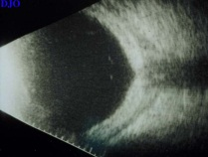
Scleritis
Posterior scleritis: Sub-Tenon’s edema

Slide 115
Scleritis
Scleritis
Anterior
Posterior
What easy-to-obtain imaging study can cinch the diagnosis?
b-scan ultrasonography
What will b-scan reveal?
--Choroidal thickening
--Sub-Tenon’s edema
When sub-Tenon’s edema involves the space around the
optic nerve, what b-scan finding will result?
The classic T sign
Diffuse
Nodular
Necrotizing
w/ inflammation
w/o inflammation

Slide 116
Scleritis
Scleritis
Anterior
Posterior
What easy-to-obtain imaging study can cinch the diagnosis?
b-scan ultrasonography
What will b-scan reveal?
--Choroidal thickening
--Sub-Tenon’s edema
When sub-Tenon’s edema involves the space around the
optic nerve, what b-scan finding will result?
The classic T sign
Diffuse
Nodular
Necrotizing
w/ inflammation
w/o inflammation

Slide 117
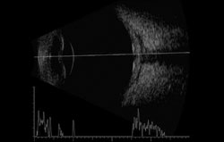
Scleritis
T
Posterior scleritis: T-sign

Slide 118
Scleritis
Scleritis
Anterior
Posterior
What studies are included in a scleritis work-up?
--?
--?
--?
--?
--?
--?
--?
Diffuse
Nodular
Necrotizing
w/ inflammation
w/o inflammation

Slide 119
Scleritis
Scleritis
Anterior
Posterior
What studies are included in a scleritis work-up?
--Serum autoantibodies
--Complete blood count with diff
--Urinalysis
--Syphilis labs
--TB testing
--Serum uric acid
--Sarcoid screening
Diffuse
Nodular
Necrotizing
w/ inflammation
w/o inflammation

Slide 120
Scleritis
Scleritis
Anterior
Posterior
What studies are included in a scleritis work-up?
--Serum autoantibodies: ? [5 studies]
--Complete blood count with diff
--Urinalysis
--Syphilis labs
--TB testing
--Serum uric acid
--Sarcoid screening
Next Q
Diffuse
Nodular
Necrotizing
w/ inflammation
w/o inflammation

Slide 121
Scleritis
Scleritis
Anterior
Posterior
What studies are included in a scleritis work-up?
--Serum autoantibodies: RF, anti-CCP Ab, ANA, ANCA, anti-DNA
--Complete blood count with diff
--Urinalysis
--Syphilis labs
--TB testing
--Serum uric acid
--Sarcoid screening
Diffuse
Nodular
Necrotizing
w/ inflammation
w/o inflammation

Slide 122
Scleritis
Scleritis
RF = ?
CCP
ANA
ANCA
Anterior
Posterior
What studies are included in a scleritis work-up?
--Serum autoantibodies: RF, anti-CCP Ab, ANA, ANCA, anti-DNA
--Complete blood count with diff
--Urinalysis
--Syphilis labs
--TB testing
--Serum uric acid
--Sarcoid screening
Diffuse
Nodular
Necrotizing
w/ inflammation
w/o inflammation

Slide 123
Scleritis
Scleritis
RF = rheumatoid factor
CCP = ?
ANA
ANCA
Anterior
Posterior
What studies are included in a scleritis work-up?
--Serum autoantibodies: RF, anti-CCP Ab, ANA, ANCA, anti-DNA
--Complete blood count with diff
--Urinalysis
--Syphilis labs
--TB testing
--Serum uric acid
--Sarcoid screening
Diffuse
Nodular
Necrotizing
w/ inflammation
w/o inflammation

Slide 124
Scleritis
Scleritis
RF = rheumatoid factor
CCP = cyclic citrullinated peptide
ANA = ?
ANCA
Anterior
Posterior
What studies are included in a scleritis work-up?
--Serum autoantibodies: RF, anti-CCP Ab, ANA, ANCA, anti-DNA
--Complete blood count with diff
--Urinalysis
--Syphilis labs
--TB testing
--Serum uric acid
--Sarcoid screening
Diffuse
Nodular
Necrotizing
w/ inflammation
w/o inflammation

Slide 125
Scleritis
Scleritis
RF = rheumatoid factor
CCP = cyclic citrullinated peptide
ANA = antinuclear antibody
ANCA = ?
Anterior
Posterior
What studies are included in a scleritis work-up?
--Serum autoantibodies: RF, anti-CCP Ab, ANA, ANCA, anti-DNA
--Complete blood count with diff
--Urinalysis
--Syphilis labs
--TB testing
--Serum uric acid
--Sarcoid screening
Diffuse
Nodular
Necrotizing
w/ inflammation
w/o inflammation

Slide 126
Scleritis
Scleritis
RF = rheumatoid factor
CCP = cyclic citrullinated peptide
ANA = antinuclear antibody
ANCA = antineutrophil cytoplasmic antibody
Anterior
Posterior
What studies are included in a scleritis work-up?
--Serum autoantibodies: RF, anti-CCP Ab, ANA, ANCA, anti-DNA
--Complete blood count with diff
--Urinalysis
--Syphilis labs
--TB testing
--Serum uric acid
--Sarcoid screening
Diffuse
Nodular
Necrotizing
w/ inflammation
w/o inflammation

Slide 127
Scleritis
Scleritis
Anterior
Posterior
What studies are included in a scleritis work-up?
--Serum autoantibodies: RF, anti-CCP Ab, ANA, ANCA, anti-DNA
--Complete blood count with diff
--Urinalysis
--Syphilis labs
--TB testing
--Serum uric acid
--Sarcoid screening: ? [5 studies]
Diffuse
Nodular
Necrotizing
Next Q
w/ inflammation
w/o inflammation

Slide 128
Scleritis
Scleritis
Anterior
Posterior
What studies are included in a scleritis work-up?
--Serum autoantibodies: RF, anti-CCP Ab, ANA, ANCA, anti-DNA
--Complete blood count with diff
--Urinalysis
--Syphilis labs
--TB testing
--Serum uric acid
--Sarcoid screening: CXR; ACE, lysozyme, Ca²⁺, alk phos
Diffuse
Nodular
Necrotizing
w/ inflammation
w/o inflammation

Slide 129
Scleritis
Scleritis
Anterior
Posterior
What studies are included in a scleritis work-up?
--Serum autoantibodies: RF, anti-CCP Ab, ANA, ANCA, anti-DNA
--Complete blood count with diff
--Urinalysis
--Syphilis labs
--TB testing
--Serum uric acid
--Sarcoid screening: CXR; ACE, lysozyme, Ca²⁺, alk phos
Diffuse
Nodular
Necrotizing
w/ inflammation
w/o inflammation
But remember—the most important source of diagnostic clues for
any sort of ocular inflammation (scleritis, uveitis, PUK, etc) is a
very careful and thorough review of systems.
three words

Slide 130
Scleritis
Scleritis
Anterior
Posterior
What studies are included in a scleritis work-up?
--Serum autoantibodies: RF, anti-CCP Ab, ANA, ANCA, anti-DNA
--Complete blood count with diff
--Urinalysis
--Syphilis labs
--TB testing
--Serum uric acid
--Sarcoid screening: CXR; ACE, lysozyme, Ca²⁺, alk phos
Diffuse
Nodular
Necrotizing
w/ inflammation
w/o inflammation
But remember—the most important source of diagnostic clues for
any sort of ocular inflammation (scleritis, uveitis, PUK, etc) is a
very careful and thorough review of systems.

Slide 131
Scleritis
Scleritis
Anterior
Posterior
Diffuse
Nodular
Necrotizing
How is scleritis treated?
Systemically
With what?
Diffuse scleritis might respond to PO NSAIDs—try these first. For the others, PO steroids are usually the first-line med. More powerful immunosuppression is frequently required.
What about depot steroids?
Long considered contraindicated, subconjunctival depot steroids have gained wide acceptance as a treatment for scleritis
w/ inflammation
w/o inflammation

Slide 132
Scleritis
Scleritis
Anterior
Posterior
Diffuse
Nodular
Necrotizing
How is scleritis treated?
Systemically
With what?
Diffuse scleritis might respond to PO NSAIDs—try these first. For the others, PO steroids are usually the first-line med. More powerful immunosuppression is frequently required.
What about depot steroids?
Long considered contraindicated, subconjunctival depot steroids have gained wide acceptance as a treatment for scleritis
w/ inflammation
w/o inflammation

Slide 133
Scleritis
Scleritis
Anterior
Posterior
Diffuse
Nodular
Necrotizing
How is scleritis treated?
Systemically
With what?
Diffuse scleritis might respond to PO NSAIDs—try these first. For the others, PO steroids are usually the first-line med. More powerful immunosuppression is frequently required.
What about depot steroids?
Long considered contraindicated, subconjunctival depot steroids have gained wide acceptance as a treatment for scleritis
w/ inflammation
w/o inflammation

Slide 134
Scleritis
Scleritis
Anterior
Posterior
Diffuse
Nodular
Necrotizing
How is scleritis treated?
Systemically
With what?
Diffuse scleritis might respond to PO NSAIDs—try these first. For the others, PO steroids are usually the first-line med. More powerful immunosuppression is frequently required.
What about depot steroids?
Long considered contraindicated, subconjunctival depot steroids have gained wide acceptance as a treatment for scleritis
w/ inflammation
w/o inflammation

Slide 135
Scleritis
Scleritis
Anterior
Posterior
Diffuse
Nodular
Necrotizing
How is scleritis treated?
Systemically
With what?
Diffuse scleritis might respond to PO NSAIDs—try these first. For the others, PO steroids are usually the first-line med. More powerful immunosuppression is frequently required.
What about depot steroids?
Long considered contraindicated, subconjunctival depot steroids have gained wide acceptance as a treatment for scleritis
w/ inflammation
w/o inflammation

Slide 136
Scleritis
Scleritis
Anterior
Posterior
Diffuse
Nodular
Necrotizing
How is scleritis treated?
Systemically
With what?
Diffuse scleritis might respond to PO NSAIDs—try these first. For the others, PO steroids are usually the first-line med. More powerful immunosuppression is frequently required.
What about depot steroids?
Long considered contraindicated, subconjunctival depot steroids have gained wide acceptance as a treatment for scleritis
w/ inflammation
w/o inflammation

