Slide 1
Q
1
Melanotic choroidal mass DDx:
?
?
?
?
?
?
?
?

Slide 2
A
2
Melanotic choroidal mass DDx:
Melanoma
Nevus
ARMD
CHRPE
Melanocytoma
Suprachoroidal detachment
Osteoma
Focal choroidal hemangioma

Slide 3
3
Melanoma DDx:
--Choroidal nevus --ARMD
--CHRPE --Melanocytoma
--Suprachoroidal detachment --Choroidal osteoma
--Focal choroidal hemangioma
For each fact, assign the appropriate diagnosis from the DDx above (some will have more than one)
(Questions start on the next slide)

Slide 4
Q
4
Melanoma DDx:
--Choroidal nevus --ARMD
--CHRPE --Melanocytoma
--Suprachoroidal detachment --Choroidal osteoma
--Focal choroidal hemangioma
For each fact, assign the
appropriate diagnosis (some
will have more than one)
U/S buzzwords--high internal reflectivity:)
(U/S = ‘ultrasound’)

Slide 5
Q
5
Melanoma DDx:
--Choroidal nevus --ARMD
--CHRPE --Melanocytoma
--Suprachoroidal detachment --Choroidal osteoma
--Focal choroidal hemangioma
For each fact, assign the
appropriate diagnosis (some
will have more than one)
U/S buzzwords--high internal reflectivity:
Hol up—before we answer this one, let’s talk about ocular ultrasonography

Slide 6
Q
6
Melanoma DDx:
--Choroidal nevus --ARMD
--CHRPE --Melanocytoma
--Suprachoroidal detachment --Choroidal osteoma
--Focal choroidal hemangioma
For each fact, assign the
appropriate diagnosis (some
will have more than one)
U/S buzzwords--high internal reflectivity:
Hol up—before we answer this one, let’s talk about ocular ultrasonography
What are the two modalities of ocular ultrasonography?

Slide 7
A
7
Melanoma DDx:
--Choroidal nevus --ARMD
--CHRPE --Melanocytoma
--Suprachoroidal detachment --Choroidal osteoma
--Focal choroidal hemangioma
For each fact, assign the
appropriate diagnosis (some
will have more than one)
U/S buzzwords--high internal reflectivity:
Hol up—before we answer this one, let’s talk about ocular ultrasonography
What are the two modalities of ocular ultrasonography?
A scan and B scan

Slide 8
Q
8
Melanoma DDx:
--Choroidal nevus --ARMD
--CHRPE --Melanocytoma
--Suprachoroidal detachment --Choroidal osteoma
--Focal choroidal hemangioma
For each fact, assign the
appropriate diagnosis (some
will have more than one)
U/S buzzwords--high internal reflectivity:
Hol up—before we answer this one, let’s talk about ocular ultrasonography
What are the two modalities of ocular ultrasonography?
A scan and B scan
What is the fundamental difference between the two?

Slide 9
A
9
Melanoma DDx:
--Choroidal nevus --ARMD
--CHRPE --Melanocytoma
--Suprachoroidal detachment --Choroidal osteoma
--Focal choroidal hemangioma
For each fact, assign the
appropriate diagnosis (some
will have more than one)
U/S buzzwords--high internal reflectivity:
Hol up—before we answer this one, let’s talk about ocular ultrasonography
What are the two modalities of ocular ultrasonography?
A scan and B scan
What is the fundamental difference between the two?
A-scan is one-dimensional, whereas B-scan is two

Slide 10
Ocular U/S. A) A-scan. B) B-scan

Slide 11
Q
11
Melanoma DDx:
--Choroidal nevus --ARMD
--CHRPE --Melanocytoma
--Suprachoroidal detachment --Choroidal osteoma
--Focal choroidal hemangioma
For each fact, assign the
appropriate diagnosis (some
will have more than one)
U/S buzzwords--high internal reflectivity:
Hol up—before we answer this one, let’s talk about ocular ultrasonography
What are the two modalities of ocular ultrasonography?
A scan and B scan
What is the fundamental difference between the two?
A-scan is one-dimensional, whereas B-scan is two
Which modality is being referenced in discussing internal reflectivity?

Slide 12
A
12
Melanoma DDx:
--Choroidal nevus --ARMD
--CHRPE --Melanocytoma
--Suprachoroidal detachment --Choroidal osteoma
--Focal choroidal hemangioma
For each fact, assign the
appropriate diagnosis (some
will have more than one)
U/S buzzwords--high internal reflectivity:
Hol up—before we answer this one, let’s talk about ocular ultrasonography
What are the two modalities of ocular ultrasonography?
A scan and B scan
What is the fundamental difference between the two?
A-scan is one-dimensional, whereas B-scan is two
Which modality is being referenced in discussing internal reflectivity?
A scan

Slide 13
Q
13
Melanoma DDx:
--Choroidal nevus --ARMD
--CHRPE --Melanocytoma
--Suprachoroidal detachment --Choroidal osteoma
--Focal choroidal hemangioma
For each fact, assign the
appropriate diagnosis (some
will have more than one)
U/S buzzwords--high internal reflectivity:
Hol up—before we answer this one, let’s talk about ocular ultrasonography
What are the two modalities of ocular ultrasonography?
A scan and B scan
What is the fundamental difference between the two?
A-scan is one-dimensional, whereas B-scan is two
Which modality is being referenced in discussing internal reflectivity?
A scan
An A-scan consists of a series of spikes of varying heights. What causes the spikes, ie, what does the sound wave encounter that makes it reflect?

Slide 14
A
14
Melanoma DDx:
--Choroidal nevus --ARMD
--CHRPE --Melanocytoma
--Suprachoroidal detachment --Choroidal osteoma
--Focal choroidal hemangioma
For each fact, assign the
appropriate diagnosis (some
will have more than one)
U/S buzzwords--high internal reflectivity:
Hol up—before we answer this one, let’s talk about ocular ultrasonography
What are the two modalities of ocular ultrasonography?
A scan and B scan
What is the fundamental difference between the two?
A-scan is one-dimensional, whereas B-scan is two
Which modality is being referenced in discussing internal reflectivity?
A scan
An A-scan consists of a series of spikes of varying heights. What causes the spikes, ie, what does the sound wave encounter that makes it reflect?
The sound reflects when it encounters an interface between substances that differ in their acoustic density; no change in density = no reflection = no spike. As a result, there is little to no spiking when the signal passes through a homogeneous structure (eg, the vitreous; a solid tumor)

Slide 15
A
15
Melanoma DDx:
--Choroidal nevus --ARMD
--CHRPE --Melanocytoma
--Suprachoroidal detachment --Choroidal osteoma
--Focal choroidal hemangioma
For each fact, assign the
appropriate diagnosis (some
will have more than one)
U/S buzzwords--high internal reflectivity:
Hol up—before we answer this one, let’s talk about ocular ultrasonography
What are the two modalities of ocular ultrasonography?
A scan and B scan
What is the fundamental difference between the two?
A-scan is one-dimensional, whereas B-scan is two
Which modality is being referenced in discussing internal reflectivity?
A scan
An A-scan consists of a series of spikes of varying heights. What causes the spikes, ie, what does the sound wave encounter that makes it reflect?
The sound reflects when it encounters an interface between substances that differ in their acoustic density; no change in density = no reflection = no spike. As a result, there is little to no spiking when the signal passes through a homogeneous structure (eg, the vitreous; a solid tumor), but lots of spiking when it encounters a heterogeneous structure (eg, a vascular tumor; the contents of the retrobulbar orbit).

Slide 16
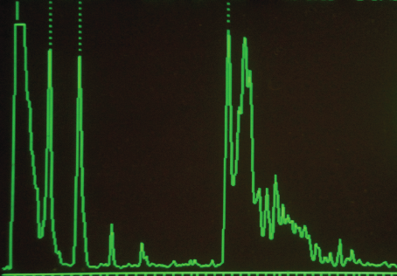
Posterior lens capsule/vitreous
Interface responsible for each spike
Aqueous/anterior lens capsule
Sclera/ orbital fat
Cornea/ aqueous
Vitreous/ retina
This relatively spike-free portion represents the homogeneous vitreous
A-scan of a phakic, normal eye. Take note of the ‘five spikes’

Slide 17
Q
17
Melanoma DDx:
--Choroidal nevus --ARMD
--CHRPE --Melanocytoma
--Suprachoroidal detachment --Choroidal osteoma
--Focal choroidal hemangioma
For each fact, assign the
appropriate diagnosis (some
will have more than one)
(2)
U/S buzzwords--high internal reflectivity:
(OK, now answer this question)
Number of answers

Slide 18
A
18
Melanoma DDx:
--Choroidal nevus --ARMD
--CHRPE --Melanocytoma
--Suprachoroidal detachment --Choroidal osteoma
--Focal choroidal hemangioma
For each fact, assign the
appropriate diagnosis (some
will have more than one)
(2)
U/S buzzwords--high internal reflectivity: Nevus; focal choroidal hemangioma

Slide 19
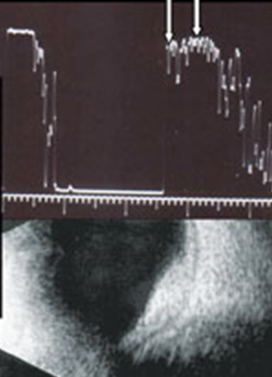
Focal choroidal hemangioma. Note the high internal reflectivity of the tumor (represented by the spikes between the arrows)

Slide 20
Q
20
Melanoma DDx:
--Choroidal nevus --ARMD
--CHRPE --Melanocytoma
--Suprachoroidal detachment --Choroidal osteoma
--Focal choroidal hemangioma
For each fact, assign the
appropriate diagnosis (some
will have more than one)
(2)
U/S buzzwords--high internal reflectivity: Nevus; focal choroidal hemangioma
By what other names is this lesion known?
Circumscribed choroidal hemangioma
Isolated choroidal hemangioma
Is it common, or rare?
Rare
How does it present?
As a reddish-orange mass in the macula
Is it associated with a systemic condition; ie, is it syndromic?
No

Slide 21
A
21
Melanoma DDx:
--Choroidal nevus --ARMD
--CHRPE --Melanocytoma
--Suprachoroidal detachment --Choroidal osteoma
--Focal choroidal hemangioma
For each fact, assign the
appropriate diagnosis (some
will have more than one)
(2)
U/S buzzwords--high internal reflectivity: Nevus; focal choroidal hemangioma
By what other names is this lesion known?
Circumscribed choroidal hemangioma
Isolated choroidal hemangioma
Is it common, or rare?
Rare
How does it present?
As a reddish-orange mass in the macula
Is it associated with a systemic condition; ie, is it syndromic?
No

Slide 22
Q
22
Melanoma DDx:
--Choroidal nevus --ARMD
--CHRPE --Melanocytoma
--Suprachoroidal detachment --Choroidal osteoma
--Focal choroidal hemangioma
For each fact, assign the
appropriate diagnosis (some
will have more than one)
(2)
U/S buzzwords--high internal reflectivity: Nevus; focal choroidal hemangioma
By what other names is this lesion known?
Circumscribed choroidal hemangioma
Isolated choroidal hemangioma
Is it common, or rare?
Rare
How does it present?
As a reddish-orange mass in the macula
Is it associated with a systemic condition; ie, is it syndromic?
No

Slide 23
A
23
Melanoma DDx:
--Choroidal nevus --ARMD
--CHRPE --Melanocytoma
--Suprachoroidal detachment --Choroidal osteoma
--Focal choroidal hemangioma
For each fact, assign the
appropriate diagnosis (some
will have more than one)
(2)
U/S buzzwords--high internal reflectivity: Nevus; focal choroidal hemangioma
By what other names is this lesion known?
Circumscribed choroidal hemangioma
Isolated choroidal hemangioma
Is it common, or rare?
Rare
How does it present?
As a reddish-orange mass in the macula
Is it associated with a systemic condition; ie, is it syndromic?
No

Slide 24
Q
24
Melanoma DDx:
--Choroidal nevus --ARMD
--CHRPE --Melanocytoma
--Suprachoroidal detachment --Choroidal osteoma
--Focal choroidal hemangioma
For each fact, assign the
appropriate diagnosis (some
will have more than one)
(2)
U/S buzzwords--high internal reflectivity: Nevus; focal choroidal hemangioma
By what other names is this lesion known?
Circumscribed choroidal hemangioma
Isolated choroidal hemangioma
Is it common, or rare?
Rare
How does it present?
As a reddish-orange mass in the macula
Is it associated with a systemic condition; ie, is it syndromic?
No

Slide 25
A
25
Melanoma DDx:
--Choroidal nevus --ARMD
--CHRPE --Melanocytoma
--Suprachoroidal detachment --Choroidal osteoma
--Focal choroidal hemangioma
For each fact, assign the
appropriate diagnosis (some
will have more than one)
(2)
U/S buzzwords--high internal reflectivity: Nevus; focal choroidal hemangioma
By what other names is this lesion known?
Circumscribed choroidal hemangioma
Isolated choroidal hemangioma
Is it common, or rare?
Rare
How does it present?
As a reddish-orange mass in the macula
Is it associated with a systemic condition; ie, is it syndromic?
No

Slide 26
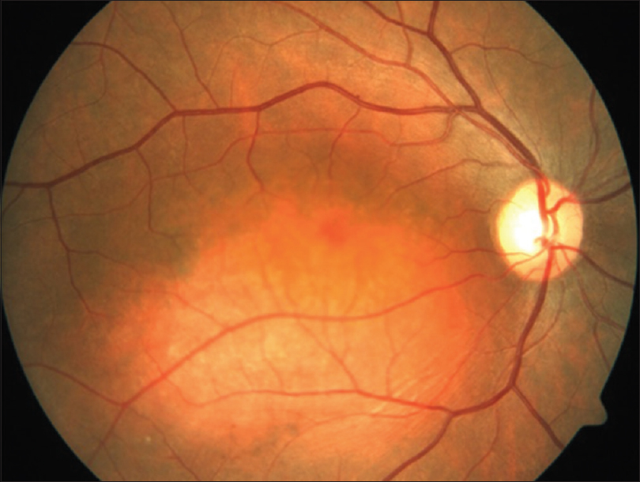
Focal choroidal hemangioma

Slide 27
Q
27
Melanoma DDx:
--Choroidal nevus --ARMD
--CHRPE --Melanocytoma
--Suprachoroidal detachment --Choroidal osteoma
--Focal choroidal hemangioma
For each fact, assign the
appropriate diagnosis (some
will have more than one)
(2)
U/S buzzwords--high internal reflectivity: Nevus; focal choroidal hemangioma
By what other names is this lesion known?
Circumscribed choroidal hemangioma
Isolated choroidal hemangioma
Is it common, or rare?
Rare
How does it present?
As a reddish-orange mass in the macula
Is it associated with a systemic condition; ie, is it syndromic?
No

Slide 28
A
28
Melanoma DDx:
--Choroidal nevus --ARMD
--CHRPE --Melanocytoma
--Suprachoroidal detachment --Choroidal osteoma
--Focal choroidal hemangioma
For each fact, assign the
appropriate diagnosis (some
will have more than one)
(2)
U/S buzzwords--high internal reflectivity: Nevus; focal choroidal hemangioma
By what other names is this lesion known?
Circumscribed choroidal hemangioma
Isolated choroidal hemangioma
Is it common, or rare?
Rare
How does it present?
As a reddish-orange mass in the macula
Is it associated with a systemic condition; ie, is it syndromic?
No

Slide 29
Q
29
Melanoma DDx:
--Choroidal nevus --ARMD
--CHRPE --Melanocytoma
--Suprachoroidal detachment --Choroidal osteoma
--Focal choroidal hemangioma
For each fact, assign the
appropriate diagnosis (some
will have more than one)
(2)
U/S buzzwords--high internal reflectivity: Nevus; focal choroidal hemangioma
By what other names is this lesion known?
Circumscribed choroidal hemangioma
Isolated choroidal hemangioma
Is it common, or rare?
Rare
How does it present?
As a reddish-orange mass in the macula
Is it associated with a systemic condition; ie, is it syndromic?
No
But isn’t choroidal hemangioma associated with Sturge-Weber syndrome?
Yes and no. SWS is associated with diffuse choroidal hemangioma; we’re talking about focal choroidal hemangioma here.

Slide 30
A
30
Melanoma DDx:
--Choroidal nevus --ARMD
--CHRPE --Melanocytoma
--Suprachoroidal detachment --Choroidal osteoma
--Focal choroidal hemangioma
For each fact, assign the
appropriate diagnosis (some
will have more than one)
(2)
U/S buzzwords--high internal reflectivity: Nevus; focal choroidal hemangioma
By what other names is this lesion known?
Circumscribed choroidal hemangioma
Isolated choroidal hemangioma
Is it common, or rare?
Rare
How does it present?
As a reddish-orange mass in the macula
Is it associated with a systemic condition; ie, is it syndromic?
No
But isn’t choroidal hemangioma associated with Sturge-Weber syndrome?
Yes and no. SWS is associated with diffuse choroidal hemangioma; we’re talking about focal choroidal hemangioma here.

Slide 31
Q
31
Melanoma DDx:
--Choroidal nevus --ARMD
--CHRPE --Melanocytoma
--Suprachoroidal detachment --Choroidal osteoma
--Focal choroidal hemangioma
For each fact, assign the
appropriate diagnosis (some
will have more than one)
(2)
U/S buzzwords--high internal reflectivity: Nevus; focal choroidal hemangioma
By what other names is this lesion known?
Circumscribed choroidal hemangioma
Isolated choroidal hemangioma
Is it common, or rare?
Rare
How does it present?
As a reddish-orange mass in the macula
Is it associated with a systemic condition; ie, is it syndromic?
No
In one word, what sort of condition is SWS?
A phakomatosis
Phakomatoses usually involve eye and skin findings. What is the classic skin finding in SWS?
The nevus flammus, aka port-wine stain
What is the appearance of the posterior pole when a diffuse choroidal hemangioma is present?
It has a uniformly deep-red appearance that has led to the nickname ‘ tomato catsup fundus’
But isn’t choroidal hemangioma associated with Sturge-Weber syndrome?
Yes and no. SWS is associated with diffuse choroidal hemangioma; we’re talking about focal choroidal hemangioma here.

Slide 32
A
32
Melanoma DDx:
--Choroidal nevus --ARMD
--CHRPE --Melanocytoma
--Suprachoroidal detachment --Choroidal osteoma
--Focal choroidal hemangioma
For each fact, assign the
appropriate diagnosis (some
will have more than one)
(2)
U/S buzzwords--high internal reflectivity: Nevus; focal choroidal hemangioma
By what other names is this lesion known?
Circumscribed choroidal hemangioma
Isolated choroidal hemangioma
Is it common, or rare?
Rare
How does it present?
As a reddish-orange mass in the macula
Is it associated with a systemic condition; ie, is it syndromic?
No
In one word, what sort of condition is SWS?
A phakomatosis
Phakomatoses usually involve eye and skin findings. What is the classic skin finding in SWS?
The nevus flammus, aka port-wine stain
What is the appearance of the posterior pole when a diffuse choroidal hemangioma is present?
It has a uniformly deep-red appearance that has led to the nickname ‘ tomato catsup fundus’
But isn’t choroidal hemangioma associated with Sturge-Weber syndrome?
Yes and no. SWS is associated with diffuse choroidal hemangioma; we’re talking about focal choroidal hemangioma here.

Slide 33
Q
33
Melanoma DDx:
--Choroidal nevus --ARMD
--CHRPE --Melanocytoma
--Suprachoroidal detachment --Choroidal osteoma
--Focal choroidal hemangioma
For each fact, assign the
appropriate diagnosis (some
will have more than one)
(2)
U/S buzzwords--high internal reflectivity: Nevus; focal choroidal hemangioma
By what other names is this lesion known?
Circumscribed choroidal hemangioma
Isolated choroidal hemangioma
Is it common, or rare?
Rare
How does it present?
As a reddish-orange mass in the macula
Is it associated with a systemic condition; ie, is it syndromic?
No
In one word, what sort of condition is SWS?
A phakomatosis
Phakomatoses usually involve eye and skin findings. What is the classic skin finding in SWS?
The nevus flammus, aka port-wine stain
What is the appearance of the posterior pole when a diffuse choroidal hemangioma is present?
It has a uniformly deep-red appearance that has led to the nickname ‘ tomato catsup fundus’
But isn’t choroidal hemangioma associated with Sturge-Weber syndrome?
Yes and no. SWS is associated with diffuse choroidal hemangioma; we’re talking about focal choroidal hemangioma here.

Slide 34
Q/A
34
Melanoma DDx:
--Choroidal nevus --ARMD
--CHRPE --Melanocytoma
--Suprachoroidal detachment --Choroidal osteoma
--Focal choroidal hemangioma
For each fact, assign the
appropriate diagnosis (some
will have more than one)
(2)
U/S buzzwords--high internal reflectivity: Nevus; focal choroidal hemangioma
By what other names is this lesion known?
Circumscribed choroidal hemangioma
Isolated choroidal hemangioma
Is it common, or rare?
Rare
How does it present?
As a reddish-orange mass in the macula
Is it associated with a systemic condition; ie, is it syndromic?
No
In one word, what sort of condition is SWS?
A phakomatosis
Phakomatoses usually involve eye and skin findings. What is the classic skin finding in SWS?
The nevus flammus, aka port-wine stain
What is the appearance of the posterior pole when a diffuse choroidal hemangioma is present?
It has a uniformly deep-red appearance that has led to the nickname ‘ tomato catsup fundus’
three words
But isn’t choroidal hemangioma associated with Sturge-Weber syndrome?
Yes and no. SWS is associated with diffuse choroidal hemangioma; we’re talking about focal choroidal hemangioma here.

Slide 35
A
35
Melanoma DDx:
--Choroidal nevus --ARMD
--CHRPE --Melanocytoma
--Suprachoroidal detachment --Choroidal osteoma
--Focal choroidal hemangioma
For each fact, assign the
appropriate diagnosis (some
will have more than one)
(2)
U/S buzzwords--high internal reflectivity: Nevus; focal choroidal hemangioma
By what other names is this lesion known?
Circumscribed choroidal hemangioma
Isolated choroidal hemangioma
Is it common, or rare?
Rare
How does it present?
As a reddish-orange mass in the macula
Is it associated with a systemic condition; ie, is it syndromic?
No
In one word, what sort of condition is SWS?
A phakomatosis
Phakomatoses usually involve eye and skin findings. What is the classic skin finding in SWS?
The nevus flammus, aka port-wine stain
What is the appearance of the posterior pole when a diffuse choroidal hemangioma is present?
It has a uniformly deep-red appearance that has led to the nickname ‘ tomato catsup fundus’
But isn’t choroidal hemangioma associated with Sturge-Weber syndrome?
Yes and no. SWS is associated with diffuse choroidal hemangioma; we’re talking about focal choroidal hemangioma here.

Slide 36
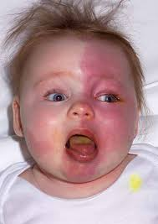
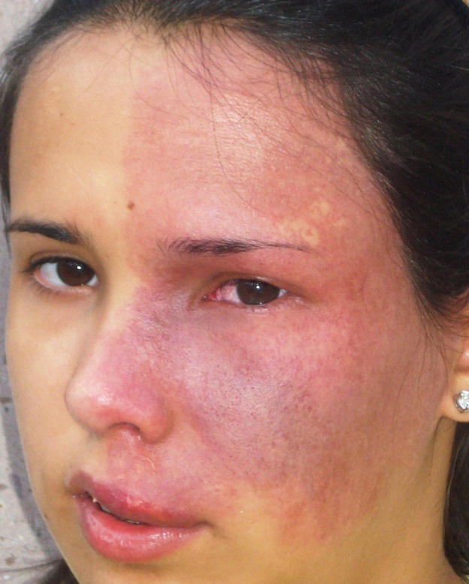
Phakomatoses
Sturge-Weber: Port-wine stain

Slide 37
Q
37
Melanoma DDx:
--Choroidal nevus --ARMD
--CHRPE --Melanocytoma
--Suprachoroidal detachment --Choroidal osteoma
--Focal choroidal hemangioma
For each fact, assign the
appropriate diagnosis (some
will have more than one)
(2)
U/S buzzwords--high internal reflectivity: Nevus; focal choroidal hemangioma
By what other names is this lesion known?
Circumscribed choroidal hemangioma
Isolated choroidal hemangioma
Is it common, or rare?
Rare
How does it present?
As a reddish-orange mass in the macula
Is it associated with a systemic condition; ie, is it syndromic?
No
In one word, what sort of condition is SWS?
A phakomatosis
Phakomatoses usually involve eye and skin findings. What is the classic skin finding in SWS?
The nevus flammus, aka port-wine stain
What is the appearance of the posterior pole when a diffuse choroidal hemangioma is present?
It has a uniformly deep-red appearance that has led to the nickname ‘ tomato catsup fundus’
But isn’t choroidal hemangioma associated with Sturge-Weber syndrome?
Yes and no. SWS is associated with diffuse choroidal hemangioma; we’re talking about focal choroidal hemangioma here.

Slide 38
Q/A
38
Melanoma DDx:
--Choroidal nevus --ARMD
--CHRPE --Melanocytoma
--Suprachoroidal detachment --Choroidal osteoma
--Focal choroidal hemangioma
For each fact, assign the
appropriate diagnosis (some
will have more than one)
(2)
U/S buzzwords--high internal reflectivity: Nevus; focal choroidal hemangioma
By what other names is this lesion known?
Circumscribed choroidal hemangioma
Isolated choroidal hemangioma
Is it common, or rare?
Rare
How does it present?
As a reddish-orange mass in the macula
Is it associated with a systemic condition; ie, is it syndromic?
No
In one word, what sort of condition is SWS?
A phakomatosis
Phakomatoses usually involve eye and skin findings. What is the classic skin finding in SWS?
The nevus flammus, aka port-wine stain
What is the appearance of the posterior pole when a diffuse choroidal hemangioma is present?
It has a uniformly deep-red appearance that has led to the nickname ‘ tomato catsup fundus ’
But isn’t choroidal hemangioma associated with Sturge-Weber syndrome?
Yes and no. SWS is associated with diffuse choroidal hemangioma; we’re talking about focal choroidal hemangioma here.
three words

Slide 39
A
39
Melanoma DDx:
--Choroidal nevus --ARMD
--CHRPE --Melanocytoma
--Suprachoroidal detachment --Choroidal osteoma
--Focal choroidal hemangioma
For each fact, assign the
appropriate diagnosis (some
will have more than one)
(2)
U/S buzzwords--high internal reflectivity: Nevus; focal choroidal hemangioma
By what other names is this lesion known?
Circumscribed choroidal hemangioma
Isolated choroidal hemangioma
Is it common, or rare?
Rare
How does it present?
As a reddish-orange mass in the macula
Is it associated with a systemic condition; ie, is it syndromic?
No
In one word, what sort of condition is SWS?
A phakomatosis
Phakomatoses usually involve eye and skin findings. What is the classic skin finding in SWS?
The nevus flammus, aka port-wine stain
What is the appearance of the posterior pole when a diffuse choroidal hemangioma is present?
It has a uniformly deep-red appearance that has led to the nickname ‘ tomato catsup fundus ’
But isn’t choroidal hemangioma associated with Sturge-Weber syndrome?
Yes and no. SWS is associated with diffuse choroidal hemangioma; we’re talking about focal choroidal hemangioma here.

Slide 40
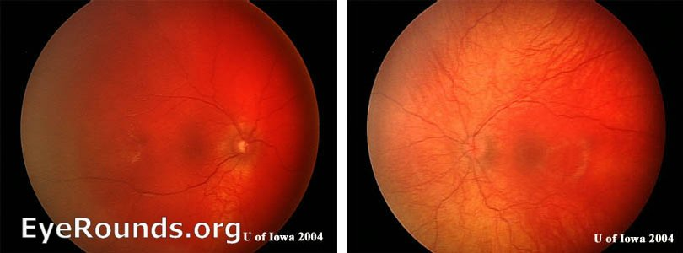
Phakomatoses
SWS: Tomato catsup fundus OD

Slide 41
Q
41
Melanoma DDx:
--Choroidal nevus --ARMD
--CHRPE --Melanocytoma
--Suprachoroidal detachment --Choroidal osteoma
--Focal choroidal hemangioma
For each fact, assign the
appropriate diagnosis (some
will have more than one)
(2)
U/S buzzwords--high internal reflectivity: Nevus; focal choroidal hemangioma
In contrast, how would one describe the internal reflectivity of choroidal melanomas?

Slide 42
A
42
Melanoma DDx:
--Choroidal nevus --ARMD
--CHRPE --Melanocytoma
--Suprachoroidal detachment --Choroidal osteoma
--Focal choroidal hemangioma
For each fact, assign the
appropriate diagnosis (some
will have more than one)
(2)
U/S buzzwords--high internal reflectivity: Nevus; focal choroidal hemangioma
In contrast, how would one describe the internal reflectivity of choroidal melanomas?
It is low

Slide 43
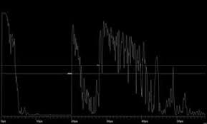
This is an A-scan of a choroidal melanoma.

Slide 44
What does this spike represent?
The retina
This is an A-scan of a choroidal melanoma.

Slide 45
What does this spike represent?
The retina
This is an A-scan of a choroidal melanoma.

Slide 46
What does this spike represent?
The retina
What does this ultrasonographically hollow portion represent?
The tumor itself
This is an A-scan of a choroidal melanoma.

Slide 47
What does this spike represent?
The retina
What does this ultrasonographically hollow portion represent?
The tumor itself
This is an A-scan of a choroidal melanoma.

Slide 48
What does this little spike represent?
The sclera
What does this spike represent?
The retina
What does this ultrasonographically hollow portion represent?
The tumor itself
This is an A-scan of a choroidal melanoma.

Slide 49
What does this little spike represent?
The sclera
What does this spike represent?
The retina
What does this ultrasonographically hollow portion represent?
The tumor itself
This is an A-scan of a choroidal melanoma.

Slide 50
What does this little spike represent?
The sclera
What does this portion represent?
The orbit
What does this spike represent?
The retina
What does this ultrasonographically hollow portion represent?
The tumor itself
This is an A-scan of a choroidal melanoma.

Slide 51
What does this little spike represent?
The sclera
What does this portion represent?
The orbit
What does this spike represent?
The retina
What does this ultrasonographically hollow portion represent?
The tumor itself
This is an A-scan of a choroidal melanoma.

Slide 52
Put it all together and you have…M for melanoma
This is an A-scan of a choroidal melanoma.

Slide 53
elanoma!
Put it all together and you have…M for melanoma
This is an A-scan of a choroidal melanoma.

Slide 54
Q
54
Melanoma DDx:
--Choroidal nevus --ARMD
--CHRPE --Melanocytoma
--Suprachoroidal detachment --Choroidal osteoma
--Focal choroidal hemangioma
For each fact, assign the
appropriate diagnosis (some
will have more than one)
(2)
U/S buzzwords--high internal reflectivity: Nevus; focal choroidal hemangioma
Can be serous or hemorrhagic: hemangioma)

Slide 55
A
55
Melanoma DDx:
--Choroidal nevus --ARMD
--CHRPE --Melanocytoma
--Suprachoroidal detachment --Choroidal osteoma
--Focal choroidal hemangioma
For each fact, assign the
appropriate diagnosis (some
will have more than one)
(2)
U/S buzzwords--high internal reflectivity: Nevus; focal choroidal hemangioma
Can be serous or hemorrhagic: Suprachoroidal detachment
hemangioma)

Slide 56
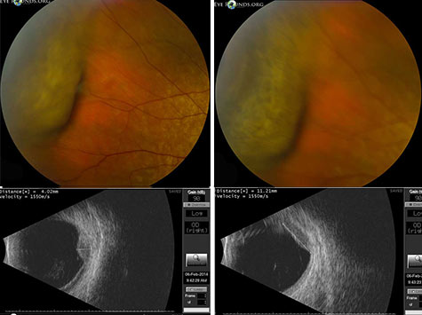
Hemorrhagic suprachoroidal detachments

Slide 57
Q
57
Melanoma DDx:
--Choroidal nevus --ARMD
--CHRPE --Melanocytoma
--Suprachoroidal detachment --Choroidal osteoma
--Focal choroidal hemangioma
For each fact, assign the
appropriate diagnosis (some
will have more than one)
(2)
U/S buzzwords--high internal reflectivity: Nevus; focal choroidal hemangioma
Can be serous or hemorrhagic: Suprachoroidal detachment
U/S buzzword--shadowing: hemangioma)

Slide 58
A
58
Melanoma DDx:
--Choroidal nevus --ARMD
--CHRPE --Melanocytoma
--Suprachoroidal detachment --Choroidal osteoma
--Focal choroidal hemangioma
For each fact, assign the
appropriate diagnosis (some
will have more than one)
(2)
U/S buzzwords--high internal reflectivity: Nevus; focal choroidal hemangioma
Can be serous or hemorrhagic: Suprachoroidal detachment
U/S buzzword--shadowing: Choroidal osteoma

Slide 59
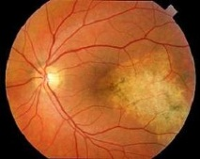
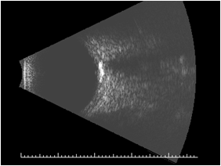
59
B-scan. Note the acoustic shadowing behind the lesion
Choroidal osteoma

Slide 60
Q
60
Melanoma DDx:
--Choroidal nevus --ARMD
--CHRPE --Melanocytoma
--Suprachoroidal detachment --Choroidal osteoma
--Focal choroidal hemangioma
For each fact, assign the
appropriate diagnosis (some
will have more than one)
(2)
U/S buzzwords--high internal reflectivity: Nevus; focal choroidal hemangioma
Can be serous or hemorrhagic: Suprachoroidal detachment
U/S buzzword--shadowing: Choroidal osteoma
In a word, what is a choroidal osteoma composed of?

Slide 61
A
61
Melanoma DDx:
--Choroidal nevus --ARMD
--CHRPE --Melanocytoma
--Suprachoroidal detachment --Choroidal osteoma
--Focal choroidal hemangioma
For each fact, assign the
appropriate diagnosis (some
will have more than one)
(2)
U/S buzzwords--high internal reflectivity: Nevus; focal choroidal hemangioma
Can be serous or hemorrhagic: Suprachoroidal detachment
U/S buzzword--shadowing: Choroidal osteoma
In a word, what is a choroidal osteoma composed of?
Bone

Slide 62
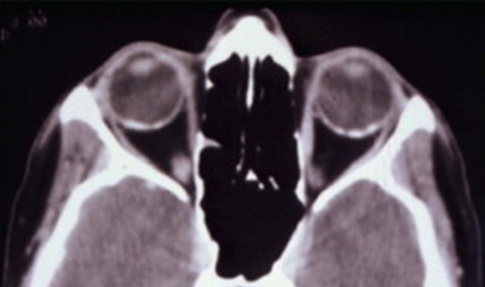
Bilateral osteomas. Note they are the same density as bone on CT

Slide 63
Q
63
Melanoma DDx:
--Choroidal nevus --ARMD
--CHRPE --Melanocytoma
--Suprachoroidal detachment --Choroidal osteoma
--Focal choroidal hemangioma
For each fact, assign the
appropriate diagnosis (some
will have more than one)
(2)
U/S buzzwords--high internal reflectivity: Nevus; focal choroidal hemangioma
Can be serous or hemorrhagic: Suprachoroidal detachment
U/S buzzword--shadowing: Choroidal osteoma
In a word, what is a choroidal osteoma composed of?
Bone
Is it common, or rare?

Slide 64
A
64
Melanoma DDx:
--Choroidal nevus --ARMD
--CHRPE --Melanocytoma
--Suprachoroidal detachment --Choroidal osteoma
--Focal choroidal hemangioma
For each fact, assign the
appropriate diagnosis (some
will have more than one)
(2)
U/S buzzwords--high internal reflectivity: Nevus; focal choroidal hemangioma
Can be serous or hemorrhagic: Suprachoroidal detachment
U/S buzzword--shadowing: Choroidal osteoma
In a word, what is a choroidal osteoma composed of?
Bone
Is it common, or rare?
Very rare

Slide 65
Q
65
Melanoma DDx:
--Choroidal nevus --ARMD
--CHRPE --Melanocytoma
--Suprachoroidal detachment --Choroidal osteoma
--Focal choroidal hemangioma
For each fact, assign the
appropriate diagnosis (some
will have more than one)
(2)
U/S buzzwords--high internal reflectivity: Nevus; focal choroidal hemangioma
Can be serous or hemorrhagic: Suprachoroidal detachment
U/S buzzword--shadowing: Choroidal osteoma
In a word, what is a choroidal osteoma composed of?
Bone
Is it common, or rare? Benign, or malignant?
Very rare.

Slide 66
A
66
Melanoma DDx:
--Choroidal nevus --ARMD
--CHRPE --Melanocytoma
--Suprachoroidal detachment --Choroidal osteoma
--Focal choroidal hemangioma
For each fact, assign the
appropriate diagnosis (some
will have more than one)
(2)
U/S buzzwords--high internal reflectivity: Nevus; focal choroidal hemangioma
Can be serous or hemorrhagic: Suprachoroidal detachment
U/S buzzword--shadowing: Choroidal osteoma
In a word, what is a choroidal osteoma composed of?
Bone
Is it common, or rare? Benign, or malignant?
Very rare. Benign.

Slide 67
Q
67
Melanoma DDx:
--Choroidal nevus --ARMD
--CHRPE --Melanocytoma
--Suprachoroidal detachment --Choroidal osteoma
--Focal choroidal hemangioma
For each fact, assign the
appropriate diagnosis (some
will have more than one)
(2)
U/S buzzwords--high internal reflectivity: Nevus; focal choroidal hemangioma
Can be serous or hemorrhagic: Suprachoroidal detachment
U/S buzzword--shadowing: Choroidal osteoma
In a word, what is a choroidal osteoma composed of?
Bone
Is it common, or rare? Benign, or malignant? Unilateral, or bilateral?
Very rare. Benign.

Slide 68
A
68
Melanoma DDx:
--Choroidal nevus --ARMD
--CHRPE --Melanocytoma
--Suprachoroidal detachment --Choroidal osteoma
--Focal choroidal hemangioma
For each fact, assign the
appropriate diagnosis (some
will have more than one)
(2)
U/S buzzwords--high internal reflectivity: Nevus; focal choroidal hemangioma
Can be serous or hemorrhagic: Suprachoroidal detachment
U/S buzzword--shadowing: Choroidal osteoma
In a word, what is a choroidal osteoma composed of?
Bone
Is it common, or rare? Benign, or malignant? Unilateral, or bilateral?
Very rare. Benign. Usually unilateral.

Slide 69
Q
69
Melanoma DDx:
--Choroidal nevus --ARMD
--CHRPE --Melanocytoma
--Suprachoroidal detachment --Choroidal osteoma
--Focal choroidal hemangioma
For each fact, assign the
appropriate diagnosis (some
will have more than one)
(2)
U/S buzzwords--high internal reflectivity: Nevus; focal choroidal hemangioma
Can be serous or hemorrhagic: Suprachoroidal detachment
U/S buzzword--shadowing: Choroidal osteoma
In a word, what is a choroidal osteoma composed of?
Bone
Is it common, or rare? Benign, or malignant? Unilateral, or bilateral?
Very rare. Benign. Usually unilateral.
Is there a gender predilection?

Slide 70
Q/A
70
Melanoma DDx:
--Choroidal nevus --ARMD
--CHRPE --Melanocytoma
--Suprachoroidal detachment --Choroidal osteoma
--Focal choroidal hemangioma
For each fact, assign the
appropriate diagnosis (some
will have more than one)
(2)
U/S buzzwords--high internal reflectivity: Nevus; focal choroidal hemangioma
Can be serous or hemorrhagic: Suprachoroidal detachment
U/S buzzword--shadowing: Choroidal osteoma
In a word, what is a choroidal osteoma composed of?
Bone
Is it common, or rare? Benign, or malignant? Unilateral, or bilateral?
Very rare. Benign. Usually unilateral.
Is there a gender predilection?
Yes, it is more common in females

Slide 71
A
71
Melanoma DDx:
--Choroidal nevus --ARMD
--CHRPE --Melanocytoma
--Suprachoroidal detachment --Choroidal osteoma
--Focal choroidal hemangioma
For each fact, assign the
appropriate diagnosis (some
will have more than one)
(2)
U/S buzzwords--high internal reflectivity: Nevus; focal choroidal hemangioma
Can be serous or hemorrhagic: Suprachoroidal detachment
U/S buzzword--shadowing: Choroidal osteoma
In a word, what is a choroidal osteoma composed of?
Bone
Is it common, or rare? Benign, or malignant? Unilateral, or bilateral?
Very rare. Benign. Usually unilateral.
Is there a gender predilection?
Yes, it is more common in females

Slide 72
Q
72
Melanoma DDx:
--Choroidal nevus --ARMD
--CHRPE --Melanocytoma
--Suprachoroidal detachment --Choroidal osteoma
--Focal choroidal hemangioma
For each fact, assign the
appropriate diagnosis (some
will have more than one)
(2)
U/S buzzwords--high internal reflectivity: Nevus; focal choroidal hemangioma
Can be serous or hemorrhagic: Suprachoroidal detachment
U/S buzzword--shadowing: Choroidal osteoma
In a word, what is a choroidal osteoma composed of?
Bone
Is it common, or rare? Benign, or malignant? Unilateral, or bilateral?
Very rare. Benign. Usually unilateral.
Is there a gender predilection?
Yes, it is more common in females
During what age range does it typically present?

Slide 73
A
73
Melanoma DDx:
--Choroidal nevus --ARMD
--CHRPE --Melanocytoma
--Suprachoroidal detachment --Choroidal osteoma
--Focal choroidal hemangioma
For each fact, assign the
appropriate diagnosis (some
will have more than one)
(2)
U/S buzzwords--high internal reflectivity: Nevus; focal choroidal hemangioma
Can be serous or hemorrhagic: Suprachoroidal detachment
U/S buzzword--shadowing: Choroidal osteoma
In a word, what is a choroidal osteoma composed of?
Bone
Is it common, or rare? Benign, or malignant? Unilateral, or bilateral?
Very rare. Benign. Usually unilateral.
Is there a gender predilection?
Yes, it is more common in females
During what age range does it typically present?
Late teens to early adulthood

Slide 74
Q
74
Melanoma DDx:
--Choroidal nevus --ARMD
--CHRPE --Melanocytoma
--Suprachoroidal detachment --Choroidal osteoma
--Focal choroidal hemangioma
For each fact, assign the
appropriate diagnosis (some
will have more than one)
(2)
U/S buzzwords--high internal reflectivity: Nevus; focal choroidal hemangioma
Can be serous or hemorrhagic: Suprachoroidal detachment
U/S buzzword--shadowing: Choroidal osteoma
In a word, what is a choroidal osteoma composed of?
Bone
Is it common, or rare? Benign, or malignant? Unilateral, or bilateral?
Very rare. Benign. Usually unilateral.
Is there a gender predilection?
Yes, it is more common in females
During what age range does it typically present?
Late teens to early adulthood
If significant vision loss occurs, what complication is usually the culprit?

Slide 75
A
75
Melanoma DDx:
--Choroidal nevus --ARMD
--CHRPE --Melanocytoma
--Suprachoroidal detachment --Choroidal osteoma
--Focal choroidal hemangioma
For each fact, assign the
appropriate diagnosis (some
will have more than one)
(2)
U/S buzzwords--high internal reflectivity: Nevus; focal choroidal hemangioma
Can be serous or hemorrhagic: Suprachoroidal detachment
U/S buzzword--shadowing: Choroidal osteoma
In a word, what is a choroidal osteoma composed of?
Bone
Is it common, or rare? Benign, or malignant? Unilateral, or bilateral?
Very rare. Benign. Usually unilateral.
Is there a gender predilection?
Yes, it is more common in females
During what age range does it typically present?
Late teens to early adulthood
If significant vision loss occurs, what complication is usually the culprit?
Choroidal neovascular membrane

Slide 76
Q
76
Melanoma DDx:
--Choroidal nevus --ARMD
--CHRPE --Melanocytoma
--Suprachoroidal detachment --Choroidal osteoma
--Focal choroidal hemangioma
For each fact, assign the
appropriate diagnosis (some
will have more than one)
(2)
U/S buzzwords--high internal reflectivity: Nevus; focal choroidal hemangioma
Can be serous or hemorrhagic: Suprachoroidal detachment
U/S buzzword--shadowing: Choroidal osteoma
Slightly more common in females:
(2)

Slide 77
A
77
Melanoma DDx:
--Choroidal nevus --ARMD
--CHRPE --Melanocytoma
--Suprachoroidal detachment --Choroidal osteoma
--Focal choroidal hemangioma
For each fact, assign the
appropriate diagnosis (some
will have more than one)
(2)
U/S buzzwords--high internal reflectivity: Nevus; focal choroidal hemangioma
Can be serous or hemorrhagic: Suprachoroidal detachment
U/S buzzword--shadowing: Choroidal osteoma
Slightly more common in females: Melanocytoma; ARMD (wet)
(2)

Slide 78
Q
78
Melanoma DDx:
--Choroidal nevus --ARMD
--CHRPE --Melanocytoma
--Suprachoroidal detachment --Choroidal osteoma
--Focal choroidal hemangioma
For each fact, assign the
appropriate diagnosis (some
will have more than one)
(2)
U/S buzzwords--high internal reflectivity: Nevus; focal choroidal hemangioma
Can be serous or hemorrhagic: Suprachoroidal detachment
U/S buzzword--shadowing: Choroidal osteoma
Slightly more common in females: Melanocytoma; ARMD (wet)
(2)
What does melanocytoma look like at the slit-lamp?

Slide 79
A
79
Melanoma DDx:
--Choroidal nevus --ARMD
--CHRPE --Melanocytoma
--Suprachoroidal detachment --Choroidal osteoma
--Focal choroidal hemangioma
For each fact, assign the
appropriate diagnosis (some
will have more than one)
(2)
U/S buzzwords--high internal reflectivity: Nevus; focal choroidal hemangioma
Can be serous or hemorrhagic: Suprachoroidal detachment
U/S buzzword--shadowing: Choroidal osteoma
Slightly more common in females: Melanocytoma; ARMD (wet)
(2)
What does melanocytoma look like at the slit-lamp?
As the name implies, it is a deeply pigmented lesion

Slide 80
Q
80
Melanoma DDx:
--Choroidal nevus --ARMD
--CHRPE --Melanocytoma
--Suprachoroidal detachment --Choroidal osteoma
--Focal choroidal hemangioma
For each fact, assign the
appropriate diagnosis (some
will have more than one)
(2)
U/S buzzwords--high internal reflectivity: Nevus; focal choroidal hemangioma
Can be serous or hemorrhagic: Suprachoroidal detachment
U/S buzzword--shadowing: Choroidal osteoma
Slightly more common in females: Melanocytoma; ARMD (wet)
(2)
What does melanocytoma look like at the slit-lamp?
As the name implies, it is a deeply pigmented lesion
Where is it always located?

Slide 81
A
81
Melanoma DDx:
--Choroidal nevus --ARMD
--CHRPE --Melanocytoma
--Suprachoroidal detachment --Choroidal osteoma
--Focal choroidal hemangioma
For each fact, assign the
appropriate diagnosis (some
will have more than one)
(2)
U/S buzzwords--high internal reflectivity: Nevus; focal choroidal hemangioma
Can be serous or hemorrhagic: Suprachoroidal detachment
U/S buzzword--shadowing: Choroidal osteoma
Slightly more common in females: Melanocytoma; ARMD (wet)
(2)
What does melanocytoma look like at the slit-lamp?
As the name implies, it is a deeply pigmented lesion
Where is it always located?
On some portion of the optic disc

Slide 82
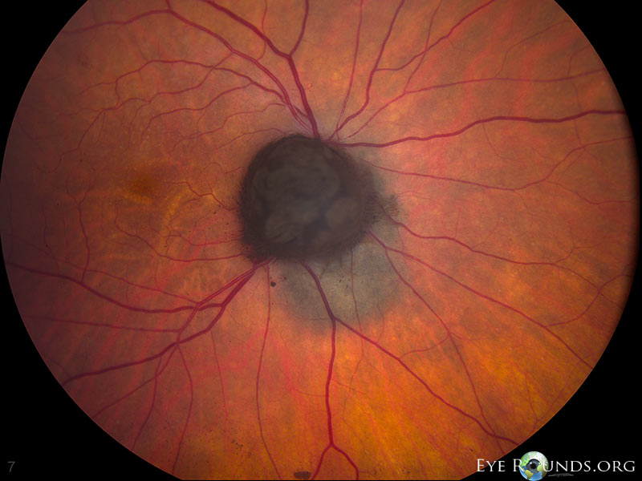
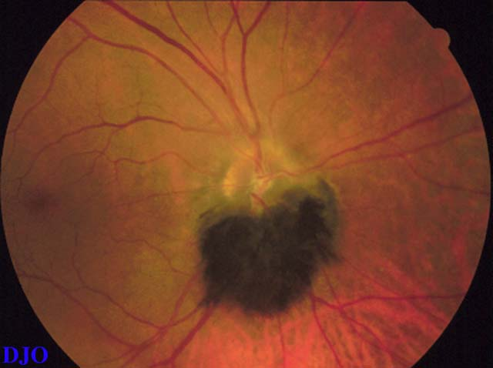
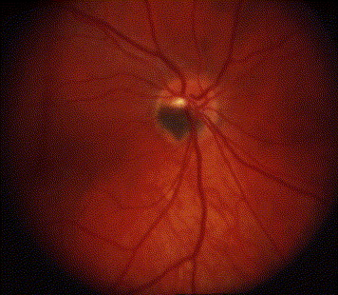
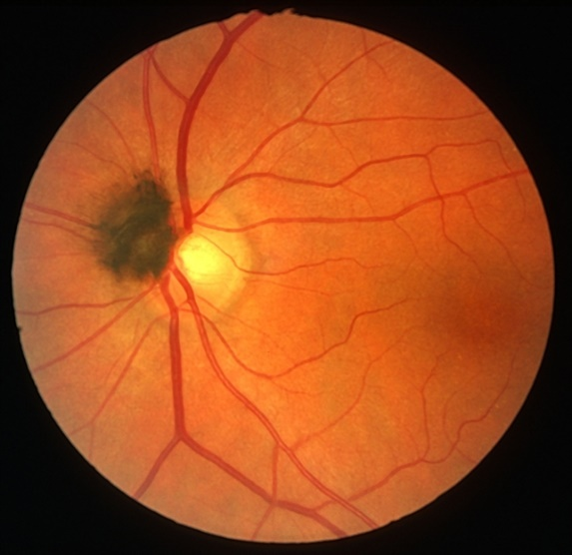
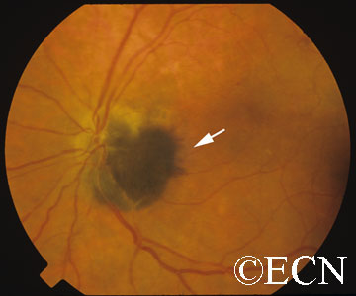
Melanocytoma

Slide 83
Q
83
Melanoma DDx:
--Choroidal nevus --ARMD
--CHRPE --Melanocytoma
--Suprachoroidal detachment --Choroidal osteoma
--Focal choroidal hemangioma
For each fact, assign the
appropriate diagnosis (some
will have more than one)
(2)
U/S buzzwords--high internal reflectivity: Nevus; focal choroidal hemangioma
Can be serous or hemorrhagic: Suprachoroidal detachment
U/S buzzword--shadowing: Choroidal osteoma
Slightly more common in females: Melanocytoma; ARMD (wet)
(2)
What does melanocytoma look like at the slit-lamp?
As the name implies, it is a deeply pigmented lesion
Where is it always located?
On some portion of the optic disc
Histologically, what sort of lesion is melanocytoma?

Slide 84
A
84
Melanoma DDx:
--Choroidal nevus --ARMD
--CHRPE --Melanocytoma
--Suprachoroidal detachment --Choroidal osteoma
--Focal choroidal hemangioma
For each fact, assign the
appropriate diagnosis (some
will have more than one)
(2)
U/S buzzwords--high internal reflectivity: Nevus; focal choroidal hemangioma
Can be serous or hemorrhagic: Suprachoroidal detachment
U/S buzzword--shadowing: Choroidal osteoma
Slightly more common in females: Melanocytoma; ARMD (wet)
(2)
What does melanocytoma look like at the slit-lamp?
As the name implies, it is a deeply pigmented lesion
Where is it always located?
On some portion of the optic disc
Histologically, what sort of lesion is melanocytoma?
It is a magnocellular nevus

Slide 85
Q
85
Melanoma DDx:
--Choroidal nevus --ARMD
--CHRPE --Melanocytoma
--Suprachoroidal detachment --Choroidal osteoma
--Focal choroidal hemangioma
For each fact, assign the
appropriate diagnosis (some
will have more than one)
(2)
U/S buzzwords--high internal reflectivity: Nevus; focal choroidal hemangioma
Can be serous or hemorrhagic: Suprachoroidal detachment
U/S buzzword--shadowing: Choroidal osteoma
Slightly more common in females: Melanocytoma; ARMD (wet)
(2)
What does melanocytoma look like at the slit-lamp?
As the name implies, it is a deeply pigmented lesion
Where is it always located?
On some portion of the optic disc
Histologically, what sort of lesion is melanocytoma?
It is a magnocellular nevus
Is it unilateral, or bilateral?

Slide 86
A
86
Melanoma DDx:
--Choroidal nevus --ARMD
--CHRPE --Melanocytoma
--Suprachoroidal detachment --Choroidal osteoma
--Focal choroidal hemangioma
For each fact, assign the
appropriate diagnosis (some
will have more than one)
(2)
U/S buzzwords--high internal reflectivity: Nevus; focal choroidal hemangioma
Can be serous or hemorrhagic: Suprachoroidal detachment
U/S buzzword--shadowing: Choroidal osteoma
Slightly more common in females: Melanocytoma; ARMD (wet)
(2)
What does melanocytoma look like at the slit-lamp?
As the name implies, it is a deeply pigmented lesion
Where is it always located?
On some portion of the optic disc
Histologically, what sort of lesion is melanocytoma?
It is a magnocellular nevus
Is it unilateral, or bilateral?
Unilateral

Slide 87
Q
87
Melanoma DDx:
--Choroidal nevus --ARMD
--CHRPE --Melanocytoma
--Suprachoroidal detachment --Choroidal osteoma
--Focal choroidal hemangioma
For each fact, assign the
appropriate diagnosis (some
will have more than one)
(2)
U/S buzzwords--high internal reflectivity: Nevus; focal choroidal hemangioma
Can be serous or hemorrhagic: Suprachoroidal detachment
U/S buzzword--shadowing: Choroidal osteoma
Slightly more common in females: Melanocytoma; ARMD (wet)
(2)
What does melanocytoma look like at the slit-lamp?
As the name implies, it is a deeply pigmented lesion
Where is it always located?
On some portion of the optic disc
Histologically, what sort of lesion is melanocytoma?
It is a magnocellular nevus
Is it unilateral, or bilateral?
Unilateral
Is it benign, or malignant?

Slide 88
A
88
Melanoma DDx:
--Choroidal nevus --ARMD
--CHRPE --Melanocytoma
--Suprachoroidal detachment --Choroidal osteoma
--Focal choroidal hemangioma
For each fact, assign the
appropriate diagnosis (some
will have more than one)
(2)
U/S buzzwords--high internal reflectivity: Nevus; focal choroidal hemangioma
Can be serous or hemorrhagic: Suprachoroidal detachment
U/S buzzword--shadowing: Choroidal osteoma
Slightly more common in females: Melanocytoma; ARMD (wet)
(2)
What does melanocytoma look like at the slit-lamp?
As the name implies, it is a deeply pigmented lesion
Where is it always located?
On some portion of the optic disc
Histologically, what sort of lesion is melanocytoma?
It is a magnocellular nevus
Is it unilateral, or bilateral?
Unilateral
Is it benign, or malignant?
Benign (but rarely undergoes malignant transformation)

Slide 89
Q
89
Melanoma DDx:
--Choroidal nevus --ARMD
--CHRPE --Melanocytoma
--Suprachoroidal detachment --Choroidal osteoma
--Focal choroidal hemangioma
For each fact, assign the
appropriate diagnosis (some
will have more than one)
(2)
U/S buzzwords--high internal reflectivity: Nevus; focal choroidal hemangioma
Can be serous or hemorrhagic: Suprachoroidal detachment
U/S buzzword--shadowing: Choroidal osteoma
Slightly more common in females: Melanocytoma; ARMD (wet)
Bilaterality → ↑ risk of colon Ca:
(2)

Slide 90
A
90
Melanoma DDx:
--Choroidal nevus --ARMD
--CHRPE --Melanocytoma
--Suprachoroidal detachment --Choroidal osteoma
--Focal choroidal hemangioma
For each fact, assign the
appropriate diagnosis (some
will have more than one)
(2)
U/S buzzwords--high internal reflectivity: Nevus; focal choroidal hemangioma
Can be serous or hemorrhagic: Suprachoroidal detachment
U/S buzzword--shadowing: Choroidal osteoma
Slightly more common in females: Melanocytoma; ARMD (wet)
Bilaterality → ↑ risk of colon Ca: None
(2)

Slide 91
Q
91
Melanoma DDx:
--Choroidal nevus --ARMD
--CHRPE --Melanocytoma
--Suprachoroidal detachment --Choroidal osteoma
--Focal choroidal hemangioma
For each fact, assign the
appropriate diagnosis (some
will have more than one)
(2)
U/S buzzwords--high internal reflectivity: Nevus; focal choroidal hemangioma
Can be serous or hemorrhagic: Suprachoroidal detachment
U/S buzzword--shadowing: Choroidal osteoma
Slightly more common in females: Melanocytoma; ARMD (wet)
Bilaterality → ↑ risk of colon Ca: None
(2)
Wadda ya mean, ‘none’? Errbody knows the answer is CHRPE. What gives?

Slide 92
A
92
Melanoma DDx:
--Choroidal nevus --ARMD
--CHRPE --Melanocytoma
--Suprachoroidal detachment --Choroidal osteoma
--Focal choroidal hemangioma
For each fact, assign the
appropriate diagnosis (some
will have more than one)
(2)
U/S buzzwords--high internal reflectivity: Nevus; focal choroidal hemangioma
Can be serous or hemorrhagic: Suprachoroidal detachment
U/S buzzword--shadowing: Choroidal osteoma
Slightly more common in females: Melanocytoma; ARMD (wet)
Bilaterality → ↑ risk of colon Ca: None
(2)
Wadda ya mean, ‘none’? Errbody knows the answer is CHRPE. What gives?
This is a common misunderstanding. Truth is, while the lesion associated with colon cancer is similar in appearance to CHRPE, it is not the same thing!
Let’s talk more about both CHRPE and the CHRPE-like lesion in question…

Slide 93
Q
93
Melanoma DDx:
--Choroidal nevus --ARMD
--CHRPE --Melanocytoma
--Suprachoroidal detachment --Choroidal osteoma
--Focal choroidal hemangioma
For each fact, assign the
appropriate diagnosis (some
will have more than one)
(2)
U/S buzzwords--high internal reflectivity: Nevus; focal choroidal hemangioma
Can be serous or hemorrhagic: Suprachoroidal detachment
U/S buzzword--shadowing: Choroidal osteoma
Slightly more common in females: Melanocytoma; ARMD (wet)
Bilaterality → ↑ risk of colon Ca: None
(2)
What is the clinical appearance of CHRPE?

Slide 94
A
94
Melanoma DDx:
--Choroidal nevus --ARMD
--CHRPE --Melanocytoma
--Suprachoroidal detachment --Choroidal osteoma
--Focal choroidal hemangioma
For each fact, assign the
appropriate diagnosis (some
will have more than one)
(2)
U/S buzzwords--high internal reflectivity: Nevus; focal choroidal hemangioma
Can be serous or hemorrhagic: Suprachoroidal detachment
U/S buzzword--shadowing: Choroidal osteoma
Slightly more common in females: Melanocytoma; ARMD (wet)
Bilaterality → ↑ risk of colon Ca: None
(2)
What is the clinical appearance of CHRPE?
Flat, mainly black lesion(s) ranging in size from a 1 mm up to ~10

Slide 95
Q
95
Melanoma DDx:
--Choroidal nevus --ARMD
--CHRPE --Melanocytoma
--Suprachoroidal detachment --Choroidal osteoma
--Focal choroidal hemangioma
For each fact, assign the
appropriate diagnosis (some
will have more than one)
(2)
U/S buzzwords--high internal reflectivity: Nevus; focal choroidal hemangioma
Can be serous or hemorrhagic: Suprachoroidal detachment
U/S buzzword--shadowing: Choroidal osteoma
Slightly more common in females: Melanocytoma; ARMD (wet)
Bilaterality → ↑ risk of colon Ca: None
(2)
What is the clinical appearance of CHRPE?
Flat, mainly black lesion(s) ranging in size from a 1 mm up to ~10
Is it common, or rare?

Slide 96
A
96
Melanoma DDx:
--Choroidal nevus --ARMD
--CHRPE --Melanocytoma
--Suprachoroidal detachment --Choroidal osteoma
--Focal choroidal hemangioma
For each fact, assign the
appropriate diagnosis (some
will have more than one)
(2)
U/S buzzwords--high internal reflectivity: Nevus; focal choroidal hemangioma
Can be serous or hemorrhagic: Suprachoroidal detachment
U/S buzzword--shadowing: Choroidal osteoma
Slightly more common in females: Melanocytoma; ARMD (wet)
Bilaterality → ↑ risk of colon Ca: None
(2)
What is the clinical appearance of CHRPE?
Flat, mainly black lesion(s) ranging in size from a 1 mm up to ~10
Is it common, or rare?
Common

Slide 97
Q
97
Melanoma DDx:
--Choroidal nevus --ARMD
--CHRPE --Melanocytoma
--Suprachoroidal detachment --Choroidal osteoma
--Focal choroidal hemangioma
For each fact, assign the
appropriate diagnosis (some
will have more than one)
(2)
U/S buzzwords--high internal reflectivity: Nevus; focal choroidal hemangioma
Can be serous or hemorrhagic: Suprachoroidal detachment
U/S buzzword--shadowing: Choroidal osteoma
Slightly more common in females: Melanocytoma; ARMD (wet)
Bilaterality → ↑ risk of colon Ca: None
(2)
What is the clinical appearance of CHRPE?
Flat, mainly black lesion(s) ranging in size from a 1 mm up to ~10
Is it common, or rare?
Common
CHRPE is characterized according to its presentation. In what two ways does it present?
--?
--?

Slide 98
Q/A
98
Melanoma DDx:
--Choroidal nevus --ARMD
--CHRPE --Melanocytoma
--Suprachoroidal detachment --Choroidal osteoma
--Focal choroidal hemangioma
For each fact, assign the
appropriate diagnosis (some
will have more than one)
(2)
U/S buzzwords--high internal reflectivity: Nevus; focal choroidal hemangioma
Can be serous or hemorrhagic: Suprachoroidal detachment
U/S buzzword--shadowing: Choroidal osteoma
Slightly more common in females: Melanocytoma; ARMD (wet)
Bilaterality → ↑ risk of colon Ca: None
(2)
What is the clinical appearance of CHRPE?
Flat, mainly black lesion(s) ranging in size from a 1 mm up to ~10
Is it common, or rare?
Common
CHRPE is characterized according to its presentation. In what two ways does it present?
--Solitary CHRPE
--Multifocal or Grouped CHRPE

Slide 99
A
99
Melanoma DDx:
--Choroidal nevus --ARMD
--CHRPE --Melanocytoma
--Suprachoroidal detachment --Choroidal osteoma
--Focal choroidal hemangioma
For each fact, assign the
appropriate diagnosis (some
will have more than one)
(2)
U/S buzzwords--high internal reflectivity: Nevus; focal choroidal hemangioma
Can be serous or hemorrhagic: Suprachoroidal detachment
U/S buzzword--shadowing: Choroidal osteoma
Slightly more common in females: Melanocytoma; ARMD (wet)
Bilaterality → ↑ risk of colon Ca: None
(2)
What is the clinical appearance of CHRPE?
Flat, mainly black lesion(s) ranging in size from a 1 mm up to ~10
Is it common, or rare?
Common
CHRPE is characterized according to its presentation. In what two ways does it present?
--Solitary CHRPE
--Multifocal or Grouped CHRPE

Slide 100
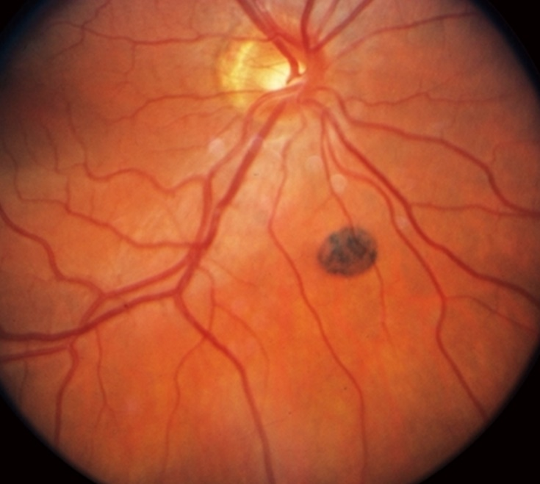
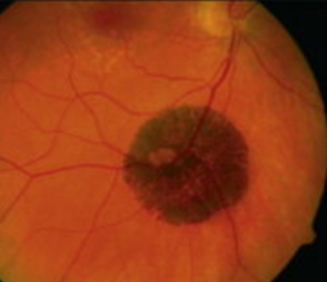
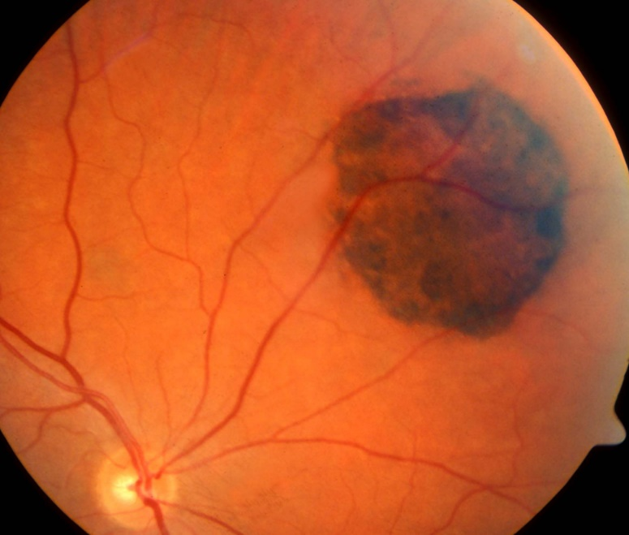
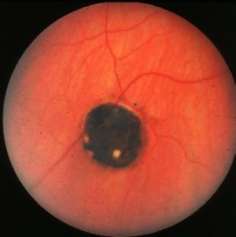
Solitary CHRPE

Slide 101
A
101
Melanoma DDx:
--Choroidal nevus --ARMD
--CHRPE --Melanocytoma
--Suprachoroidal detachment --Choroidal osteoma
--Focal choroidal hemangioma
For each fact, assign the
appropriate diagnosis (some
will have more than one)
(2)
U/S buzzwords--high internal reflectivity: Nevus; focal choroidal hemangioma
Can be serous or hemorrhagic: Suprachoroidal detachment
U/S buzzword--shadowing: Choroidal osteoma
Slightly more common in females: Melanocytoma; ARMD (wet)
Bilaterality → ↑ risk of colon Ca: None
(2)
What is the clinical appearance of CHRPE?
Flat, mainly black lesion(s) ranging in size from a 1 mm up to ~10
Is it common, or rare?
Common
CHRPE is characterized according to its presentation. In what two ways does it present?
--Solitary CHRPE
--Multifocal or Grouped CHRPE: Large lesion(s) surrounded by a few smaller ones

Slide 102
Q
102
Melanoma DDx:
--Choroidal nevus --ARMD
--CHRPE --Melanocytoma
--Suprachoroidal detachment --Choroidal osteoma
--Focal choroidal hemangioma
For each fact, assign the
appropriate diagnosis (some
will have more than one)
(2)
U/S buzzwords--high internal reflectivity: Nevus; focal choroidal hemangioma
Can be serous or hemorrhagic: Suprachoroidal detachment
U/S buzzword--shadowing: Choroidal osteoma
Slightly more common in females: Melanocytoma; ARMD (wet)
Bilaterality → ↑ risk of colon Ca: None
(2)
What is the clinical appearance of CHRPE?
Flat, mainly black lesion(s) ranging in size from a 1 mm up to ~10
Is it common, or rare?
Common
CHRPE is characterized according to its presentation. In what two ways does it present?
--Solitary CHRPE
--Multifocal or Grouped CHRPE: Large lesion(s) surrounded by a few smaller ones
What descriptive name is used with regard to the appearance of multifocal/grouped CHRPE?
‘Bear tracks’

Slide 103
A
103
Melanoma DDx:
--Choroidal nevus --ARMD
--CHRPE --Melanocytoma
--Suprachoroidal detachment --Choroidal osteoma
--Focal choroidal hemangioma
For each fact, assign the
appropriate diagnosis (some
will have more than one)
(2)
U/S buzzwords--high internal reflectivity: Nevus; focal choroidal hemangioma
Can be serous or hemorrhagic: Suprachoroidal detachment
U/S buzzword--shadowing: Choroidal osteoma
Slightly more common in females: Melanocytoma; ARMD (wet)
Bilaterality → ↑ risk of colon Ca: None
(2)
What is the clinical appearance of CHRPE?
Flat, mainly black lesion(s) ranging in size from a 1 mm up to ~10
Is it common, or rare?
Common
CHRPE is characterized according to its presentation. In what two ways does it present?
--Solitary CHRPE
--Multifocal or Grouped CHRPE: Large lesion(s) surrounded by a few smaller ones
What descriptive name is used with regard to the appearance of multifocal/grouped CHRPE?
‘Bear tracks’

Slide 104
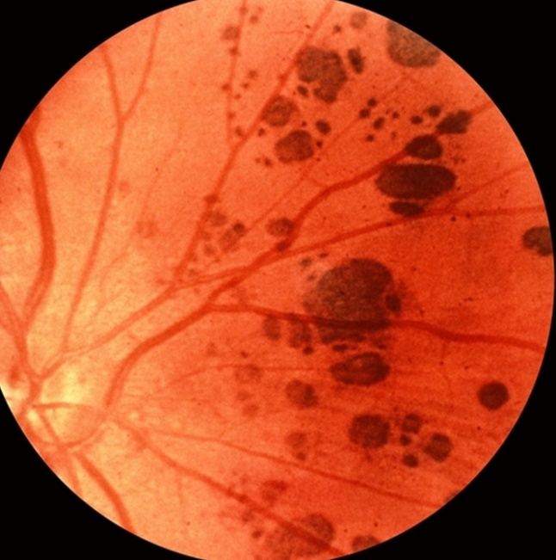
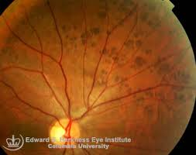
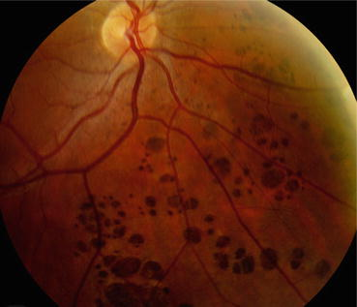
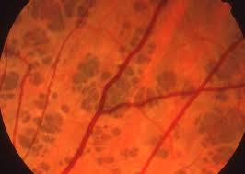
Grouped CHRPE

Slide 105
Q
105
Melanoma DDx:
--Choroidal nevus --ARMD
--CHRPE --Melanocytoma
--Suprachoroidal detachment --Choroidal osteoma
--Focal choroidal hemangioma
For each fact, assign the
appropriate diagnosis (some
will have more than one)
(2)
U/S buzzwords--high internal reflectivity: Nevus; focal choroidal hemangioma
Can be serous or hemorrhagic: Suprachoroidal detachment
U/S buzzword--shadowing: Choroidal osteoma
Slightly more common in females: Melanocytoma; ARMD (wet)
Bilaterality → ↑ risk of colon Ca: None
(2)
As mentioned previously, there is a CHRPE-like lesion associated with colon cancer, specifically, a syndrome that includes colon cancer. What is the name (both eponymous and noneponymous) of the potentially fatal syndrome with which the CHRPE-like lesion is associated?

Slide 106
A
106
Melanoma DDx:
--Choroidal nevus --ARMD
--CHRPE --Melanocytoma
--Suprachoroidal detachment --Choroidal osteoma
--Focal choroidal hemangioma
For each fact, assign the
appropriate diagnosis (some
will have more than one)
(2)
U/S buzzwords--high internal reflectivity: Nevus; focal choroidal hemangioma
Can be serous or hemorrhagic: Suprachoroidal detachment
U/S buzzword--shadowing: Choroidal osteoma
Slightly more common in females: Melanocytoma; ARMD (wet)
Bilaterality → ↑ risk of colon Ca: None
(2)
As mentioned previously, there is a CHRPE-like lesion associated with colon cancer, specifically, a syndrome that includes colon cancer. What is the name (both eponymous and noneponymous) of the potentially fatal syndrome with which the CHRPE-like lesion is associated?
Familial adenomatous polyposis, aka Gardner syndrome

Slide 107
Q
107
Melanoma DDx:
--Choroidal nevus --ARMD
--CHRPE --Melanocytoma
--Suprachoroidal detachment --Choroidal osteoma
--Focal choroidal hemangioma
For each fact, assign the
appropriate diagnosis (some
will have more than one)
(2)
U/S buzzwords--high internal reflectivity: Nevus; focal choroidal hemangioma
Can be serous or hemorrhagic: Suprachoroidal detachment
U/S buzzword--shadowing: Choroidal osteoma
Slightly more common in females: Melanocytoma; ARMD (wet)
Bilaterality → ↑ risk of colon Ca: None
(2)
As mentioned previously, there is a CHRPE-like lesion associated with colon cancer, specifically, a syndrome that includes colon cancer. What is the name (both eponymous and noneponymous) of the potentially fatal syndrome with which the CHRPE-like lesion is associated?
Familial adenomatous polyposis, aka Gardner syndrome
What is the most clinically important (and ominous) component to Gardner syndrome?
Pts develop thousands of colonic polyps, a significant number of which are malignant
Other than the colonic and RPE lesions, what are the findings in Gardner syndrome?
--Benign tumors of the skin
--Benign tumors of bone
--Dental anomalies

Slide 108
A
108
Melanoma DDx:
--Choroidal nevus --ARMD
--CHRPE --Melanocytoma
--Suprachoroidal detachment --Choroidal osteoma
--Focal choroidal hemangioma
For each fact, assign the
appropriate diagnosis (some
will have more than one)
(2)
U/S buzzwords--high internal reflectivity: Nevus; focal choroidal hemangioma
Can be serous or hemorrhagic: Suprachoroidal detachment
U/S buzzword--shadowing: Choroidal osteoma
Slightly more common in females: Melanocytoma; ARMD (wet)
Bilaterality → ↑ risk of colon Ca: None
(2)
As mentioned previously, there is a CHRPE-like lesion associated with colon cancer, specifically, a syndrome that includes colon cancer. What is the name (both eponymous and noneponymous) of the potentially fatal syndrome with which the CHRPE-like lesion is associated?
Familial adenomatous polyposis, aka Gardner syndrome
What is the most clinically important (and ominous) component to Gardner syndrome?
Pts develop thousands of colonic polyps, a significant number of which are malignant
Other than the colonic and RPE lesions, what are the findings in Gardner syndrome?
--Benign tumors of the skin
--Benign tumors of bone
--Dental anomalies

Slide 109
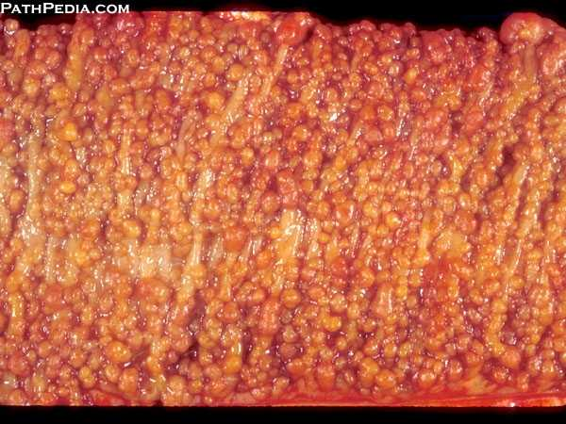
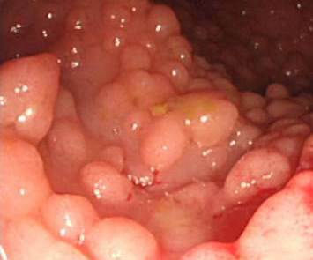
Familial adenomatous polyposis

Slide 110
Q
110
Melanoma DDx:
--Choroidal nevus --ARMD
--CHRPE --Melanocytoma
--Suprachoroidal detachment --Choroidal osteoma
--Focal choroidal hemangioma
For each fact, assign the
appropriate diagnosis (some
will have more than one)
(2)
U/S buzzwords--high internal reflectivity: Nevus; focal choroidal hemangioma
Can be serous or hemorrhagic: Suprachoroidal detachment
U/S buzzword--shadowing: Choroidal osteoma
Slightly more common in females: Melanocytoma; ARMD (wet)
Bilaterality → ↑ risk of colon Ca: None
(2)
As mentioned previously, there is a CHRPE-like lesion associated with colon cancer, specifically, a syndrome that includes colon cancer. What is the name (both eponymous and noneponymous) of the potentially fatal syndrome with which the CHRPE-like lesion is associated?
Familial adenomatous polyposis, aka Gardner syndrome
What is the most clinically important (and ominous) component to Gardner syndrome?
Pts develop thousands of colonic polyps, a significant number of which are malignant
Other than the colonic and RPE lesions, what are the findings in Gardner syndrome?
--?
--?
--?

Slide 111
A
111
Melanoma DDx:
--Choroidal nevus --ARMD
--CHRPE --Melanocytoma
--Suprachoroidal detachment --Choroidal osteoma
--Focal choroidal hemangioma
For each fact, assign the
appropriate diagnosis (some
will have more than one)
(2)
U/S buzzwords--high internal reflectivity: Nevus; focal choroidal hemangioma
Can be serous or hemorrhagic: Suprachoroidal detachment
U/S buzzword--shadowing: Choroidal osteoma
Slightly more common in females: Melanocytoma; ARMD (wet)
Bilaterality → ↑ risk of colon Ca: None
(2)
As mentioned previously, there is a CHRPE-like lesion associated with colon cancer, specifically, a syndrome that includes colon cancer. What is the name (both eponymous and noneponymous) of the potentially fatal syndrome with which the CHRPE-like lesion is associated?
Familial adenomatous polyposis, aka Gardner syndrome
What is the most clinically important (and ominous) component to Gardner syndrome?
Pts develop thousands of colonic polyps, a significant number of which are malignant
Other than the colonic and RPE lesions, what are the findings in Gardner syndrome?
--Benign tumors of the skin
--Benign tumors of bone
--Dental anomalies

Slide 112
Q
112
Melanoma DDx:
--Choroidal nevus --ARMD
--CHRPE --Melanocytoma
--Suprachoroidal detachment --Choroidal osteoma
--Focal choroidal hemangioma
For each fact, assign the
appropriate diagnosis (some
will have more than one)
(2)
U/S buzzwords--high internal reflectivity: Nevus; focal choroidal hemangioma
Can be serous or hemorrhagic: Suprachoroidal detachment
U/S buzzword--shadowing: Choroidal osteoma
Slightly more common in females: Melanocytoma; ARMD (wet)
Bilaterality → ↑ risk of colon Ca: None
(2)
As mentioned previously, there is a CHRPE-like lesion associated with colon cancer, specifically, a syndrome that includes colon cancer. What is the name (both eponymous and noneponymous) of the potentially fatal syndrome with which the CHRPE-like lesion is associated?
Familial adenomatous polyposis, aka Gardner syndrome
What proportion of untreated Gardner syndrome pts will develop colon cancer?
All of them
By what age will this occur?
40, maybe a little later
What is the most clinically important (and ominous) component to Gardner syndrome?
Pts develop thousands of colonic polyps, a significant number of which are malignant
Other than the colonic and RPE lesions, what are the findings in Gardner syndrome?
--Benign tumors of the skin
--Benign tumors of bone
--Dental anomalies

Slide 113
A
113
Melanoma DDx:
--Choroidal nevus --ARMD
--CHRPE --Melanocytoma
--Suprachoroidal detachment --Choroidal osteoma
--Focal choroidal hemangioma
For each fact, assign the
appropriate diagnosis (some
will have more than one)
(2)
U/S buzzwords--high internal reflectivity: Nevus; focal choroidal hemangioma
Can be serous or hemorrhagic: Suprachoroidal detachment
U/S buzzword--shadowing: Choroidal osteoma
Slightly more common in females: Melanocytoma; ARMD (wet)
Bilaterality → ↑ risk of colon Ca: None
(2)
As mentioned previously, there is a CHRPE-like lesion associated with colon cancer, specifically, a syndrome that includes colon cancer. What is the name (both eponymous and noneponymous) of the potentially fatal syndrome with which the CHRPE-like lesion is associated?
Familial adenomatous polyposis, aka Gardner syndrome
What proportion of untreated Gardner syndrome pts will develop colon cancer?
All of them
By what age will this occur?
40, maybe a little later
What is the most clinically important (and ominous) component to Gardner syndrome?
Pts develop thousands of colonic polyps, a significant number of which are malignant
Other than the colonic and RPE lesions, what are the findings in Gardner syndrome?
--Benign tumors of the skin
--Benign tumors of bone
--Dental anomalies

Slide 114
Q
114
Melanoma DDx:
--Choroidal nevus --ARMD
--CHRPE --Melanocytoma
--Suprachoroidal detachment --Choroidal osteoma
--Focal choroidal hemangioma
For each fact, assign the
appropriate diagnosis (some
will have more than one)
(2)
U/S buzzwords--high internal reflectivity: Nevus; focal choroidal hemangioma
Can be serous or hemorrhagic: Suprachoroidal detachment
U/S buzzword--shadowing: Choroidal osteoma
Slightly more common in females: Melanocytoma; ARMD (wet)
Bilaterality → ↑ risk of colon Ca: None
(2)
As mentioned previously, there is a CHRPE-like lesion associated with colon cancer, specifically, a syndrome that includes colon cancer. What is the name (both eponymous and noneponymous) of the potentially fatal syndrome with which the CHRPE-like lesion is associated?
Familial adenomatous polyposis, aka Gardner syndrome
What proportion of untreated Gardner syndrome pts will develop colon cancer?
All of them
By what age will this occur?
40, maybe a little later
What is the most clinically important (and ominous) component to Gardner syndrome?
Pts develop thousands of colonic polyps, a significant number of which are malignant
Other than the colonic and RPE lesions, what are the findings in Gardner syndrome?
--Benign tumors of the skin
--Benign tumors of bone
--Dental anomalies

Slide 115
A
115
Melanoma DDx:
--Choroidal nevus --ARMD
--CHRPE --Melanocytoma
--Suprachoroidal detachment --Choroidal osteoma
--Focal choroidal hemangioma
For each fact, assign the
appropriate diagnosis (some
will have more than one)
(2)
U/S buzzwords--high internal reflectivity: Nevus; focal choroidal hemangioma
Can be serous or hemorrhagic: Suprachoroidal detachment
U/S buzzword--shadowing: Choroidal osteoma
Slightly more common in females: Melanocytoma; ARMD (wet)
Bilaterality → ↑ risk of colon Ca: None
(2)
As mentioned previously, there is a CHRPE-like lesion associated with colon cancer, specifically, a syndrome that includes colon cancer. What is the name (both eponymous and noneponymous) of the potentially fatal syndrome with which the CHRPE-like lesion is associated?
Familial adenomatous polyposis, aka Gardner syndrome
What proportion of untreated Gardner syndrome pts will develop colon cancer?
All of them
By what age will this occur?
40, maybe a little later
What is the most clinically important (and ominous) component to Gardner syndrome?
Pts develop thousands of colonic polyps, a significant number of which are malignant
Other than the colonic and RPE lesions, what are the findings in Gardner syndrome?
--Benign tumors of the skin
--Benign tumors of bone
--Dental anomalies

Slide 116
Q
116
Melanoma DDx:
--Choroidal nevus --ARMD
--CHRPE --Melanocytoma
--Suprachoroidal detachment --Choroidal osteoma
--Focal choroidal hemangioma
For each fact, assign the
appropriate diagnosis (some
will have more than one)
(2)
U/S buzzwords--high internal reflectivity: Nevus; focal choroidal hemangioma
Can be serous or hemorrhagic: Suprachoroidal detachment
U/S buzzword--shadowing: Choroidal osteoma
Slightly more common in females: Melanocytoma; ARMD (wet)
Bilaterality → ↑ risk of colon Ca: None
(2)
As mentioned previously, there is a CHRPE-like lesion associated with colon cancer, specifically, a syndrome that includes colon cancer. What is the name (both eponymous and noneponymous) of the potentially fatal syndrome with which the CHRPE-like lesion is associated?
Familial adenomatous polyposis, aka Gardner syndrome
What proportion of untreated Gardner syndrome pts will develop colon cancer?
All of them
By what age will this occur?
40, maybe a little later
What is the most clinically important (and ominous) component to Gardner syndrome?
Pts develop thousands of colonic polyps, a significant number of which are malignant
Other than the colonic and RPE lesions, what are the findings in Gardner syndrome?
--Benign tumors of the skin
--Benign tumors of bone
--Dental anomalies
What is the treatment of choice?
Prophylactic colectomy

Slide 117
A
117
Melanoma DDx:
--Choroidal nevus --ARMD
--CHRPE --Melanocytoma
--Suprachoroidal detachment --Choroidal osteoma
--Focal choroidal hemangioma
For each fact, assign the
appropriate diagnosis (some
will have more than one)
(2)
U/S buzzwords--high internal reflectivity: Nevus; focal choroidal hemangioma
Can be serous or hemorrhagic: Suprachoroidal detachment
U/S buzzword--shadowing: Choroidal osteoma
Slightly more common in females: Melanocytoma; ARMD (wet)
Bilaterality → ↑ risk of colon Ca: None
(2)
As mentioned previously, there is a CHRPE-like lesion associated with colon cancer, specifically, a syndrome that includes colon cancer. What is the name (both eponymous and noneponymous) of the potentially fatal syndrome with which the CHRPE-like lesion is associated?
Familial adenomatous polyposis, aka Gardner syndrome
What proportion of untreated Gardner syndrome pts will develop colon cancer?
All of them
By what age will this occur?
40, maybe a little later
What is the most clinically important (and ominous) component to Gardner syndrome?
Pts develop thousands of colonic polyps, a significant number of which are malignant
Other than the colonic and RPE lesions, what are the findings in Gardner syndrome?
--Benign tumors of the skin
--Benign tumors of bone
--Dental anomalies
What is the treatment of choice?
Prophylactic colectomy

Slide 118
Q
118
Melanoma DDx:
--Choroidal nevus --ARMD
--CHRPE --Melanocytoma
--Suprachoroidal detachment --Choroidal osteoma
--Focal choroidal hemangioma
For each fact, assign the
appropriate diagnosis (some
will have more than one)
(2)
U/S buzzwords--high internal reflectivity: Nevus; focal choroidal hemangioma
Can be serous or hemorrhagic: Suprachoroidal detachment
U/S buzzword--shadowing: Choroidal osteoma
Slightly more common in females: Melanocytoma; ARMD (wet)
Bilaterality → ↑ risk of colon Ca: None
(2)
As mentioned previously, there is a CHRPE-like lesion associated with colon cancer, specifically, a syndrome that includes colon cancer. What is the name (both eponymous and noneponymous) of the potentially fatal syndrome with which the CHRPE-like lesion is associated?
Familial adenomatous polyposis, aka Gardner syndrome
You see a pt with a CHRPE-like presentation. What characteristics of the lesions would raise concern that these were in fact the CHRPE-like lesions of Gardner syndrome?
--?
--?
--?

Slide 119
Q/A
119
Melanoma DDx:
--Choroidal nevus --ARMD
--CHRPE --Melanocytoma
--Suprachoroidal detachment --Choroidal osteoma
--Focal choroidal hemangioma
For each fact, assign the
appropriate diagnosis (some
will have more than one)
(2)
U/S buzzwords--high internal reflectivity: Nevus; focal choroidal hemangioma
Can be serous or hemorrhagic: Suprachoroidal detachment
U/S buzzword--shadowing: Choroidal osteoma
Slightly more common in females: Melanocytoma; ARMD (wet)
Bilaterality → ↑ risk of colon Ca: None
(2)
As mentioned previously, there is a CHRPE-like lesion associated with colon cancer, specifically, a syndrome that includes colon cancer. What is the name (both eponymous and noneponymous) of the potentially fatal syndrome with which the CHRPE-like lesion is associated?
Familial adenomatous polyposis, aka Gardner syndrome
You see a pt with a CHRPE-like presentation. What characteristics of the lesions would raise concern that these were in fact the CHRPE-like lesions of Gardner syndrome?
--If the lesions were bilateral
--?
--?

Slide 120
A
120
Melanoma DDx:
--Choroidal nevus --ARMD
--CHRPE --Melanocytoma
--Suprachoroidal detachment --Choroidal osteoma
--Focal choroidal hemangioma
For each fact, assign the
appropriate diagnosis (some
will have more than one)
(2)
U/S buzzwords--high internal reflectivity: Nevus; focal choroidal hemangioma
Can be serous or hemorrhagic: Suprachoroidal detachment
U/S buzzword--shadowing: Choroidal osteoma
Slightly more common in females: Melanocytoma; ARMD (wet)
Bilaterality → ↑ risk of colon Ca: None
(2)
As mentioned previously, there is a CHRPE-like lesion associated with colon cancer, specifically, a syndrome that includes colon cancer. What is the name (both eponymous and noneponymous) of the potentially fatal syndrome with which the CHRPE-like lesion is associated?
Familial adenomatous polyposis, aka Gardner syndrome
You see a pt with a CHRPE-like presentation. What characteristics of the lesions would raise concern that these were in fact the CHRPE-like lesions of Gardner syndrome?
--If the lesions were bilateral
--?
--?

Slide 121
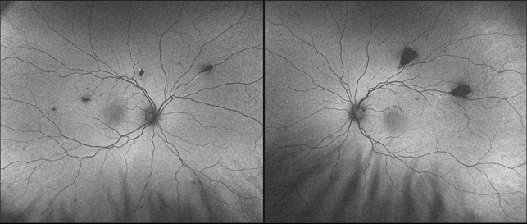
Bilateral CHRPE-like Gardner lesions

Slide 122
Q
122
Melanoma DDx:
--Choroidal nevus --ARMD
--CHRPE --Melanocytoma
--Suprachoroidal detachment --Choroidal osteoma
--Focal choroidal hemangioma
For each fact, assign the
appropriate diagnosis (some
will have more than one)
(2)
U/S buzzwords--high internal reflectivity: Nevus; focal choroidal hemangioma
Can be serous or hemorrhagic: Suprachoroidal detachment
U/S buzzword--shadowing: Choroidal osteoma
Slightly more common in females: Melanocytoma; ARMD (wet)
Bilaterality → ↑ risk of colon Ca: None
(2)
As mentioned previously, there is a CHRPE-like lesion associated with colon cancer, specifically, a syndrome that includes colon cancer. What is the name (both eponymous and noneponymous) of the potentially fatal syndrome with which the CHRPE-like lesion is associated?
Familial adenomatous polyposis, aka Gardner syndrome
You see a pt with a CHRPE-like presentation. What characteristics of the lesions would raise concern that these were in fact the CHRPE-like lesions of Gardner syndrome?
--If the lesions were bilateral
--If they were scattered throughout multiple sectors of the eyes, ie, not ‘grouped’
--?
distribution pattern when multiple lesions present in the same eye

Slide 123
A
123
Melanoma DDx:
--Choroidal nevus --ARMD
--CHRPE --Melanocytoma
--Suprachoroidal detachment --Choroidal osteoma
--Focal choroidal hemangioma
For each fact, assign the
appropriate diagnosis (some
will have more than one)
(2)
U/S buzzwords--high internal reflectivity: Nevus; focal choroidal hemangioma
Can be serous or hemorrhagic: Suprachoroidal detachment
U/S buzzword--shadowing: Choroidal osteoma
Slightly more common in females: Melanocytoma; ARMD (wet)
Bilaterality → ↑ risk of colon Ca: None
(2)
As mentioned previously, there is a CHRPE-like lesion associated with colon cancer, specifically, a syndrome that includes colon cancer. What is the name (both eponymous and noneponymous) of the potentially fatal syndrome with which the CHRPE-like lesion is associated?
Familial adenomatous polyposis, aka Gardner syndrome
You see a pt with a CHRPE-like presentation. What characteristics of the lesions would raise concern that these were in fact the CHRPE-like lesions of Gardner syndrome?
--If the lesions were bilateral
--If they were scattered throughout multiple sectors of the eyes, ie, not ‘grouped’
--?

Slide 124
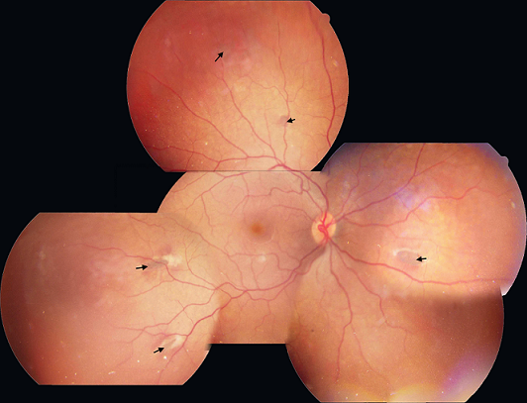
CHRPE-like Gardner lesions: Note how scattered they are

Slide 125
Q
125
Melanoma DDx:
--Choroidal nevus --ARMD
--CHRPE --Melanocytoma
--Suprachoroidal detachment --Choroidal osteoma
--Focal choroidal hemangioma
For each fact, assign the
appropriate diagnosis (some
will have more than one)
(2)
U/S buzzwords--high internal reflectivity: Nevus; focal choroidal hemangioma
Can be serous or hemorrhagic: Suprachoroidal detachment
U/S buzzword--shadowing: Choroidal osteoma
Slightly more common in females: Melanocytoma; ARMD (wet)
Bilaterality → ↑ risk of colon Ca: None
(2)
As mentioned previously, there is a CHRPE-like lesion associated with colon cancer, specifically, a syndrome that includes colon cancer. What is the name (both eponymous and noneponymous) of the potentially fatal syndrome with which the CHRPE-like lesion is associated?
Familial adenomatous polyposis, aka Gardner syndrome
You see a pt with a CHRPE-like presentation. What characteristics of the lesions would raise concern that these were in fact the CHRPE-like lesions of Gardner syndrome?
--If the lesions were bilateral
--If they were scattered throughout multiple sectors of the eyes, ie, not ‘grouped’
--If they were ovoid rather than round
shape

Slide 126
A
126
Melanoma DDx:
--Choroidal nevus --ARMD
--CHRPE --Melanocytoma
--Suprachoroidal detachment --Choroidal osteoma
--Focal choroidal hemangioma
For each fact, assign the
appropriate diagnosis (some
will have more than one)
(2)
U/S buzzwords--high internal reflectivity: Nevus; focal choroidal hemangioma
Can be serous or hemorrhagic: Suprachoroidal detachment
U/S buzzword--shadowing: Choroidal osteoma
Slightly more common in females: Melanocytoma; ARMD (wet)
Bilaterality → ↑ risk of colon Ca: None
(2)
As mentioned previously, there is a CHRPE-like lesion associated with colon cancer, specifically, a syndrome that includes colon cancer. What is the name (both eponymous and noneponymous) of the potentially fatal syndrome with which the CHRPE-like lesion is associated?
Familial adenomatous polyposis, aka Gardner syndrome
You see a pt with a CHRPE-like presentation. What characteristics of the lesions would raise concern that these were in fact the CHRPE-like lesions of Gardner syndrome?
--If the lesions were bilateral
--If they were scattered throughout multiple sectors of the eyes, ie, not ‘grouped’
--If they were ovoid rather than round

Slide 127
Q
127
Melanoma DDx:
--Choroidal nevus --ARMD
--CHRPE --Melanocytoma
--Suprachoroidal detachment --Choroidal osteoma
--Focal choroidal hemangioma
For each fact, assign the
appropriate diagnosis (some
will have more than one)
(2)
U/S buzzwords--high internal reflectivity: Nevus; focal choroidal hemangioma
Can be serous or hemorrhagic: Suprachoroidal detachment
U/S buzzword--shadowing: Choroidal osteoma
Slightly more common in females: Melanocytoma; ARMD (wet)
Bilaterality → ↑ risk of colon Ca: None
(2)
As mentioned previously, there is a CHRPE-like lesion associated with colon cancer, specifically, a syndrome that includes colon cancer. What is the name (both eponymous and noneponymous) of the potentially fatal syndrome with which the CHRPE-like lesion is associated?
Familial adenomatous polyposis, aka Gardner syndrome
You see a pt with a CHRPE-like presentation. What characteristics of the lesions would raise concern that these were in fact the CHRPE-like lesions of Gardner syndrome?
--If the lesions were bilateral
--If they were scattered throughout multiple sectors of the eyes, ie, not ‘grouped’
--If they were ovoid rather than round
What other word is often used to describe the shape of these lesions?
‘Pisciform’
What does pisciform mean?
It means ‘fish-shaped’
?
^

Slide 128
A
128
Melanoma DDx:
--Choroidal nevus --ARMD
--CHRPE --Melanocytoma
--Suprachoroidal detachment --Choroidal osteoma
--Focal choroidal hemangioma
For each fact, assign the
appropriate diagnosis (some
will have more than one)
(2)
U/S buzzwords--high internal reflectivity: Nevus; focal choroidal hemangioma
Can be serous or hemorrhagic: Suprachoroidal detachment
U/S buzzword--shadowing: Choroidal osteoma
Slightly more common in females: Melanocytoma; ARMD (wet)
Bilaterality → ↑ risk of colon Ca: None
(2)
As mentioned previously, there is a CHRPE-like lesion associated with colon cancer, specifically, a syndrome that includes colon cancer. What is the name (both eponymous and noneponymous) of the potentially fatal syndrome with which the CHRPE-like lesion is associated?
Familial adenomatous polyposis, aka Gardner syndrome
You see a pt with a CHRPE-like presentation. What characteristics of the lesions would raise concern that these were in fact the CHRPE-like lesions of Gardner syndrome?
--If the lesions were bilateral
--If they were scattered throughout multiple sectors of the eyes, ie, not ‘grouped’
--If they were ovoid rather than round
What other word is often used to describe the shape of these lesions?
‘Pisciform’
What does pisciform mean?
It means ‘fish-shaped’
pisciform
^

Slide 129
Q
129
Melanoma DDx:
--Choroidal nevus --ARMD
--CHRPE --Melanocytoma
--Suprachoroidal detachment --Choroidal osteoma
--Focal choroidal hemangioma
For each fact, assign the
appropriate diagnosis (some
will have more than one)
(2)
U/S buzzwords--high internal reflectivity: Nevus; focal choroidal hemangioma
Can be serous or hemorrhagic: Suprachoroidal detachment
U/S buzzword--shadowing: Choroidal osteoma
Slightly more common in females: Melanocytoma; ARMD (wet)
Bilaterality → ↑ risk of colon Ca: None
(2)
As mentioned previously, there is a CHRPE-like lesion associated with colon cancer, specifically, a syndrome that includes colon cancer. What is the name (both eponymous and noneponymous) of the potentially fatal syndrome with which the CHRPE-like lesion is associated?
Familial adenomatous polyposis, aka Gardner syndrome
You see a pt with a CHRPE-like presentation. What characteristics of the lesions would raise concern that these were in fact the CHRPE-like lesions of Gardner syndrome?
--If the lesions were bilateral
--If they were scattered throughout multiple sectors of the eyes, ie, not ‘grouped’
--If they were ovoid rather than round
What other word is often used to describe the shape of these lesions?
‘Pisciform’
What does pisciform mean?
It means ‘fish-shaped’
pisciform
^

Slide 130
A
130
Melanoma DDx:
--Choroidal nevus --ARMD
--CHRPE --Melanocytoma
--Suprachoroidal detachment --Choroidal osteoma
--Focal choroidal hemangioma
For each fact, assign the
appropriate diagnosis (some
will have more than one)
(2)
U/S buzzwords--high internal reflectivity: Nevus; focal choroidal hemangioma
Can be serous or hemorrhagic: Suprachoroidal detachment
U/S buzzword--shadowing: Choroidal osteoma
Slightly more common in females: Melanocytoma; ARMD (wet)
Bilaterality → ↑ risk of colon Ca: None
(2)
As mentioned previously, there is a CHRPE-like lesion associated with colon cancer, specifically, a syndrome that includes colon cancer. What is the name (both eponymous and noneponymous) of the potentially fatal syndrome with which the CHRPE-like lesion is associated?
Familial adenomatous polyposis, aka Gardner syndrome
You see a pt with a CHRPE-like presentation. What characteristics of the lesions would raise concern that these were in fact the CHRPE-like lesions of Gardner syndrome?
--If the lesions were bilateral
--If they were scattered throughout multiple sectors of the eyes, ie, not ‘grouped’
--If they were ovoid rather than round
What other word is often used to describe the shape of these lesions?
‘Pisciform’
What does pisciform mean?
It means ‘fish-shaped’
pisciform
^

Slide 131
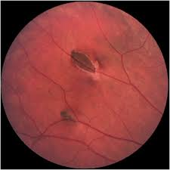
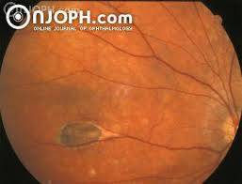
CHRPE-like Gardner lesions: Note the pisciform shape

Slide 132
Q
132
Melanoma DDx:
--Choroidal nevus --ARMD
--CHRPE --Melanocytoma
--Suprachoroidal detachment --Choroidal osteoma
--Focal choroidal hemangioma
For each fact, assign the
appropriate diagnosis (some
will have more than one)
(2)
U/S buzzwords--high internal reflectivity: Nevus; focal choroidal hemangioma
Can be serous or hemorrhagic: Suprachoroidal detachment
U/S buzzword--shadowing: Choroidal osteoma
Slightly more common in females: Melanocytoma; ARMD (wet)
Bilaterality → ↑ risk of colon Ca: None
(2)
As mentioned previously, there is a CHRPE-like lesion associated with colon cancer, specifically, a syndrome that includes colon cancer. What is the name (both eponymous and noneponymous) of the potentially fatal syndrome with which the CHRPE-like lesion is associated?
Familial adenomatous polyposis, aka Gardner syndrome
You see a pt with a CHRPE-like presentation. What characteristics of the lesions would raise concern that these were in fact the CHRPE-like lesions of Gardner syndrome?
--If the lesions were bilateral
--If they were scattered throughout multiple sectors of the eyes, ie, not ‘grouped’
--If they were ovoid rather than round
What other word is often used to describe the shape of these lesions?
‘Pisciform’
What does pisciform mean?
It means ‘fish-shaped’
pisciform
The tails of these fish-shaped lesions have two telltale (tell-tail?) characteristics—what are they?
--?
--?
^

Slide 133
Q/A
133
Melanoma DDx:
--Choroidal nevus --ARMD
--CHRPE --Melanocytoma
--Suprachoroidal detachment --Choroidal osteoma
--Focal choroidal hemangioma
For each fact, assign the
appropriate diagnosis (some
will have more than one)
(2)
U/S buzzwords--high internal reflectivity: Nevus; focal choroidal hemangioma
Can be serous or hemorrhagic: Suprachoroidal detachment
U/S buzzword--shadowing: Choroidal osteoma
Slightly more common in females: Melanocytoma; ARMD (wet)
Bilaterality → ↑ risk of colon Ca: None
(2)
As mentioned previously, there is a CHRPE-like lesion associated with colon cancer, specifically, a syndrome that includes colon cancer. What is the name (both eponymous and noneponymous) of the potentially fatal syndrome with which the CHRPE-like lesion is associated?
Familial adenomatous polyposis, aka Gardner syndrome
You see a pt with a CHRPE-like presentation. What characteristics of the lesions would raise concern that these were in fact the CHRPE-like lesions of Gardner syndrome?
--If the lesions were bilateral
--If they were scattered throughout multiple sectors of the eyes, ie, not ‘grouped’
--If they were ovoid rather than round
What other word is often used to describe the shape of these lesions?
‘Pisciform’
What does pisciform mean?
It means ‘fish-shaped’
pisciform
The tails of these fish-shaped lesions have two telltale (tell-tail?) characteristics—what are they?
--They are hypopigmented
--?
^
color-related

Slide 134
A
134
Melanoma DDx:
--Choroidal nevus --ARMD
--CHRPE --Melanocytoma
--Suprachoroidal detachment --Choroidal osteoma
--Focal choroidal hemangioma
For each fact, assign the
appropriate diagnosis (some
will have more than one)
(2)
U/S buzzwords--high internal reflectivity: Nevus; focal choroidal hemangioma
Can be serous or hemorrhagic: Suprachoroidal detachment
U/S buzzword--shadowing: Choroidal osteoma
Slightly more common in females: Melanocytoma; ARMD (wet)
Bilaterality → ↑ risk of colon Ca: None
(2)
As mentioned previously, there is a CHRPE-like lesion associated with colon cancer, specifically, a syndrome that includes colon cancer. What is the name (both eponymous and noneponymous) of the potentially fatal syndrome with which the CHRPE-like lesion is associated?
Familial adenomatous polyposis, aka Gardner syndrome
You see a pt with a CHRPE-like presentation. What characteristics of the lesions would raise concern that these were in fact the CHRPE-like lesions of Gardner syndrome?
--If the lesions were bilateral
--If they were scattered throughout multiple sectors of the eyes, ie, not ‘grouped’
--If they were ovoid rather than round
What other word is often used to describe the shape of these lesions?
‘Pisciform’
What does pisciform mean?
It means ‘fish-shaped’
pisciform
The tails of these fish-shaped lesions have two telltale (tell-tail?) characteristics—what are they?
--They are hypopigmented
--?
^

Slide 135
CHRPE-like Gardner lesions: Note the hypopigmented tails

Slide 136
Q
136
Melanoma DDx:
--Choroidal nevus --ARMD
--CHRPE --Melanocytoma
--Suprachoroidal detachment --Choroidal osteoma
--Focal choroidal hemangioma
For each fact, assign the
appropriate diagnosis (some
will have more than one)
(2)
U/S buzzwords--high internal reflectivity: Nevus; focal choroidal hemangioma
Can be serous or hemorrhagic: Suprachoroidal detachment
U/S buzzword--shadowing: Choroidal osteoma
Slightly more common in females: Melanocytoma; ARMD (wet)
Bilaterality → ↑ risk of colon Ca: None
(2)
As mentioned previously, there is a CHRPE-like lesion associated with colon cancer, specifically, a syndrome that includes colon cancer. What is the name (both eponymous and noneponymous) of the potentially fatal syndrome with which the CHRPE-like lesion is associated?
Familial adenomatous polyposis, aka Gardner syndrome
You see a pt with a CHRPE-like presentation. What characteristics of the lesions would raise concern that these were in fact the CHRPE-like lesions of Gardner syndrome?
--If the lesions were bilateral
--If they were scattered throughout multiple sectors of the eyes, ie, not ‘grouped’
--If they were ovoid rather than round
What other word is often used to describe the shape of these lesions?
‘Pisciform’
What does pisciform mean?
It means ‘fish-shaped’
pisciform
The tails of these fish-shaped lesions have two telltale (tell-tail?) characteristics—what are they?
--They are hypopigmented
--They point towards the optic nerve head
^
orientation

Slide 137
A
137
Melanoma DDx:
--Choroidal nevus --ARMD
--CHRPE --Melanocytoma
--Suprachoroidal detachment --Choroidal osteoma
--Focal choroidal hemangioma
For each fact, assign the
appropriate diagnosis (some
will have more than one)
(2)
U/S buzzwords--high internal reflectivity: Nevus; focal choroidal hemangioma
Can be serous or hemorrhagic: Suprachoroidal detachment
U/S buzzword--shadowing: Choroidal osteoma
Slightly more common in females: Melanocytoma; ARMD (wet)
Bilaterality → ↑ risk of colon Ca: None
(2)
As mentioned previously, there is a CHRPE-like lesion associated with colon cancer, specifically, a syndrome that includes colon cancer. What is the name (both eponymous and noneponymous) of the potentially fatal syndrome with which the CHRPE-like lesion is associated?
Familial adenomatous polyposis, aka Gardner syndrome
You see a pt with a CHRPE-like presentation. What characteristics of the lesions would raise concern that these were in fact the CHRPE-like lesions of Gardner syndrome?
--If the lesions were bilateral
--If they were scattered throughout multiple sectors of the eyes, ie, not ‘grouped’
--If they were ovoid rather than round
What other word is often used to describe the shape of these lesions?
‘Pisciform’
What does pisciform mean?
It means ‘fish-shaped’
pisciform
The tails of these fish-shaped lesions have two telltale (tell-tail?) characteristics—what are they?
--They are hypopigmented
--They point towards the optic nerve head
^

Slide 138
CHRPE-like Gardner lesions: Note the tail points toward the ONH

Slide 139
Q
139
Melanoma DDx:
--Choroidal nevus --ARMD
--CHRPE --Melanocytoma
--Suprachoroidal detachment --Choroidal osteoma
--Focal choroidal hemangioma
For each fact, assign the
appropriate diagnosis (some
will have more than one)
(2)
U/S buzzwords--high internal reflectivity: Nevus; focal choroidal hemangioma
Can be serous or hemorrhagic: Suprachoroidal detachment
U/S buzzword--shadowing: Choroidal osteoma
Slightly more common in females: Melanocytoma; ARMD (wet)
Bilaterality → ↑ risk of colon Ca: None
Associated with CNVM: ARMD
(2)
(2)

Slide 140
A
140
Melanoma DDx:
--Choroidal nevus --ARMD
--CHRPE --Melanocytoma
--Suprachoroidal detachment --Choroidal osteoma
--Focal choroidal hemangioma
For each fact, assign the
appropriate diagnosis (some
will have more than one)
(2)
U/S buzzwords--high internal reflectivity: Nevus; focal choroidal hemangioma
Can be serous or hemorrhagic: Suprachoroidal detachment
U/S buzzword--shadowing: Choroidal osteoma
Slightly more common in females: Melanocytoma; ARMD (wet)
Bilaterality → ↑ risk of colon Ca: None
Associated with CNVM: ARMD; osteoma
(2)
(2)

Slide 141
Q
141
Melanoma DDx:
--Choroidal nevus --ARMD
--CHRPE --Melanocytoma
--Suprachoroidal detachment --Choroidal osteoma
--Focal choroidal hemangioma
For each fact, assign the
appropriate diagnosis (some
will have more than one)
(2)
U/S buzzwords--high internal reflectivity: Nevus; focal choroidal hemangioma
Can be serous or hemorrhagic: Suprachoroidal detachment
U/S buzzword--shadowing: Choroidal osteoma
Slightly more common in females: Melanocytoma; ARMD (wet)
Bilaterality → ↑ risk of colon Ca: None
Associated with CNVM: ARMD; osteoma
10% show minimal but definite growth over 5 years:
(2)
(2)

Slide 142
A
142
Melanoma DDx:
--Choroidal nevus --ARMD
--CHRPE --Melanocytoma
--Suprachoroidal detachment --Choroidal osteoma
--Focal choroidal hemangioma
For each fact, assign the
appropriate diagnosis (some
will have more than one)
(2)
U/S buzzwords--high internal reflectivity: Nevus; focal choroidal hemangioma
Can be serous or hemorrhagic: Suprachoroidal detachment
U/S buzzword--shadowing: Choroidal osteoma
Slightly more common in females: Melanocytoma; ARMD (wet)
Bilaterality → ↑ risk of colon Ca: None
Associated with CNVM: ARMD; osteoma
10% show minimal but definite growth over 5 years: Melanocytoma
(2)
(2)

Slide 143
Q
143
Melanoma DDx:
--Choroidal nevus --ARMD
--CHRPE --Melanocytoma
--Suprachoroidal detachment --Choroidal osteoma
--Focal choroidal hemangioma
For each fact, assign the
appropriate diagnosis (some
will have more than one)
(2)
U/S buzzwords--high internal reflectivity: Nevus; focal choroidal hemangioma
Can be serous or hemorrhagic: Suprachoroidal detachment
U/S buzzword--shadowing: Choroidal osteoma
Slightly more common in females: Melanocytoma; ARMD (wet)
Bilaterality → ↑ risk of colon Ca: None
Associated with CNVM: ARMD; osteoma
10% show minimal but definite growth over 5 years: Melanocytoma
Appearance typically darker than melanoma:
(2)
(2)
(2)

Slide 144
A
144
Melanoma DDx:
--Choroidal nevus --ARMD
--CHRPE --Melanocytoma
--Suprachoroidal detachment --Choroidal osteoma
--Focal choroidal hemangioma
For each fact, assign the
appropriate diagnosis (some
will have more than one)
(2)
U/S buzzwords--high internal reflectivity: Nevus; focal choroidal hemangioma
Can be serous or hemorrhagic: Suprachoroidal detachment
U/S buzzword--shadowing: Choroidal osteoma
Slightly more common in females: Melanocytoma; ARMD (wet)
Bilaterality → ↑ risk of colon Ca: None
Associated with CNVM: ARMD; osteoma
10% show minimal but definite growth over 5 years: Melanocytoma
Appearance typically darker than melanoma: CHRPE; melanocytoma
(2)
(2)
(2)

Slide 145
Q
145
Melanoma DDx:
--Choroidal nevus --ARMD
--CHRPE --Melanocytoma
--Suprachoroidal detachment --Choroidal osteoma
--Focal choroidal hemangioma
For each fact, assign the
appropriate diagnosis (some
will have more than one)
(2)
U/S buzzwords--high internal reflectivity: Nevus; focal choroidal hemangioma
Can be serous or hemorrhagic: Suprachoroidal detachment
U/S buzzword--shadowing: Choroidal osteoma
Slightly more common in females: Melanocytoma; ARMD (wet)
Bilaterality → ↑ risk of colon Ca: None
Associated with CNVM: ARMD; osteoma
10% show minimal but definite growth over 5 years: Melanocytoma
Appearance typically darker than melanoma: CHRPE; melanocytoma
Nanophthalmos is a risk factor for this:
(2)
(2)
(2)

Slide 146
A
146
Melanoma DDx:
--Choroidal nevus --ARMD
--CHRPE --Melanocytoma
--Suprachoroidal detachment --Choroidal osteoma
--Focal choroidal hemangioma
For each fact, assign the
appropriate diagnosis (some
will have more than one)
(2)
U/S buzzwords--high internal reflectivity: Nevus; focal choroidal hemangioma
Can be serous or hemorrhagic: Suprachoroidal detachment
U/S buzzword--shadowing: Choroidal osteoma
Slightly more common in females: Melanocytoma; ARMD (wet)
Bilaterality → ↑ risk of colon Ca: None
Associated with CNVM: ARMD; osteoma
10% show minimal but definite growth over 5 years: Melanocytoma
Appearance typically darker than melanoma: CHRPE; melanocytoma
Nanophthalmos is a risk factor for this: Suprachoroidal detachment
(2)
(2)
(2)

Slide 147
Q
147
Melanoma DDx:
--Choroidal nevus --ARMD
--CHRPE --Melanocytoma
--Suprachoroidal detachment --Choroidal osteoma
--Focal choroidal hemangioma
For each fact, assign the
appropriate diagnosis (some
will have more than one)
(2)
U/S buzzwords--high internal reflectivity: Nevus; focal choroidal hemangioma
Can be serous or hemorrhagic: Suprachoroidal detachment
U/S buzzword--shadowing: Choroidal osteoma
Slightly more common in females: Melanocytoma; ARMD (wet)
Bilaterality → ↑ risk of colon Ca: None
Associated with CNVM: ARMD; osteoma
10% show minimal but definite growth over 5 years: Melanocytoma
Appearance typically darker than melanoma: CHRPE; melanocytoma
Nanophthalmos is a risk factor for this: Suprachoroidal detachment
Are also on the DDx for an amelanotic choroidal mass:
(2)
(2)
(2)
(3)

Slide 148
A
148
Melanoma DDx:
--Choroidal nevus --ARMD
--CHRPE --Melanocytoma
--Suprachoroidal detachment --Choroidal osteoma
--Focal choroidal hemangioma
For each fact, assign the
appropriate diagnosis (some
will have more than one)
(2)
U/S buzzwords--high internal reflectivity: Nevus; focal choroidal hemangioma
Can be serous or hemorrhagic: Suprachoroidal detachment
U/S buzzword--shadowing: Choroidal osteoma
Slightly more common in females: Melanocytoma; ARMD (wet)
Bilaterality → ↑ risk of colon Ca: None
Associated with CNVM: ARMD; osteoma
10% show minimal but definite growth over 5 years: Melanocytoma
Appearance typically darker than melanoma: CHRPE; melanocytoma
Nanophthalmos is a risk factor for this: Suprachoroidal detachment
Are also on the DDx for an amelanotic choroidal mass: Melanoma; osteoma; focal choroidal hemangioma
(2)
(2)
(2)
(3)

