Slide 1
Corneal Dystrophies
?
?
What are the four categories of corneal dystrophies?
?
?

Slide 2
Corneal Dystrophies
Epithelial and Subepithelial Dystrophies
Epithelial-Stromal TGFBI Dystrophies
What are the four categories of corneal dystrophies?
Stromal Dystrophies
Endothelial Dystrophies

Slide 3
Corneal Dystrophies
Epithelial and Subepithelial Dystrophies
Epithelial-Stromal TGFBI Dystrophies
What does TGFBI stand for in this context?
Stromal Dystrophies
Endothelial Dystrophies

Slide 4
Corneal Dystrophies
Epithelial and Subepithelial Dystrophies
Epithelial-Stromal TGFBI Dystrophies
What does TGFBI stand for in this context?
‘Transforming growth factor beta induced’
Stromal Dystrophies
Endothelial Dystrophies

Slide 5
Corneal Dystrophies
Epithelial and Subepithelial Dystrophies
Epithelial-Stromal TGFBI Dystrophies
What does TGFBI stand for in this context?
‘Transforming growth factor beta induced’
To what does the term growth factor refer?
To one of a diverse group of protein (or steroid) molecules that promote cell growth
Stromal Dystrophies
Endothelial Dystrophies

Slide 6
Corneal Dystrophies
Epithelial and Subepithelial Dystrophies
Epithelial-Stromal TGFBI Dystrophies
What does TGFBI stand for in this context?
‘Transforming growth factor beta induced’
To what does the term growth factor refer?
To any of a diverse group of protein (or steroid) molecules that promote cell growth
Stromal Dystrophies
Endothelial Dystrophies

Slide 7
Corneal Dystrophies
Epithelial and Subepithelial Dystrophies
Epithelial-Stromal TGFBI Dystrophies
What does TGFBI stand for in this context?
‘Transforming growth factor beta induced’
To what does the term growth factor refer?
To any of a diverse group of protein (or steroid) molecules that promote cell growth
Stromal Dystrophies
Which growth factor is likely most familiar to ophthalmologists?
Vascular endothelial growth factor
two words
Endothelial Dystrophies

Slide 8
Corneal Dystrophies
Epithelial and Subepithelial Dystrophies
Epithelial-Stromal TGFBI Dystrophies
What does TGFBI stand for in this context?
‘Transforming growth factor beta induced’
To what does the term growth factor refer?
To any of a diverse group of protein (or steroid) molecules that promote cell growth
Stromal Dystrophies
Which growth factor is likely most familiar to ophthalmologists?
Vascular endothelial growth factor
Endothelial Dystrophies

Slide 9
Corneal Dystrophies
Epithelial and Subepithelial Dystrophies
Epithelial-Stromal TGFBI Dystrophies
What does TGFBI stand for in this context?
‘Transforming growth factor beta induced’
To what does the term transforming growth factor refer?
A superfamily of related growth factors
Stromal Dystrophies
Endothelial Dystrophies

Slide 10
Corneal Dystrophies
Epithelial and Subepithelial Dystrophies
Epithelial-Stromal TGFBI Dystrophies
What does TGFBI stand for in this context?
‘Transforming growth factor beta induced’
To what does the term transforming growth factor refer?
A superfamily of related growth factors
Stromal Dystrophies
Endothelial Dystrophies

Slide 11
Corneal Dystrophies
Epithelial and Subepithelial Dystrophies
Epithelial-Stromal TGFBI Dystrophies
What does TGFBI stand for in this context?
‘Transforming growth factor beta induced’
To what does the term transforming growth factor beta refer?
A subclass of transforming growth factors (the other subclass is, not surprisingly, transforming growth factor alpha)
Stromal Dystrophies
Endothelial Dystrophies

Slide 12
Corneal Dystrophies
Epithelial and Subepithelial Dystrophies
Epithelial-Stromal TGFBI Dystrophies
What does TGFBI stand for in this context?
‘Transforming growth factor beta induced’
To what does the term transforming growth factor beta refer?
A subclass of transforming growth factors (the other subclass is, not surprisingly, transforming growth factor alpha)
Stromal Dystrophies
Endothelial Dystrophies

Slide 13
Corneal Dystrophies
Epithelial and Subepithelial Dystrophies
Epithelial-Stromal TGFBI Dystrophies
What does TGFBI stand for in this context?
‘Transforming growth factor beta induced’
To what does the term transforming growth factor beta induced refer?
It refers to a protein the production of which is controlled by a cytokine of the transforming growth factors beta family
Stromal Dystrophies
Endothelial Dystrophies

Slide 14
Corneal Dystrophies
Epithelial and Subepithelial Dystrophies
Epithelial-Stromal TGFBI Dystrophies
What does TGFBI stand for in this context?
‘Transforming growth factor beta induced’
To what does the term transforming growth factor beta induced refer?
It refers to a protein, the production of which is controlled by a product of the transforming growth factor beta family
Stromal Dystrophies
Endothelial Dystrophies

Slide 15
Corneal Dystrophies
Epithelial and Subepithelial Dystrophies
Epithelial-Stromal TGFBI Dystrophies
What does TGFBI stand for in this context?
‘Transforming growth factor beta induced’
What is the name of the protein involved in the TGFBI dystrophies?
Keratoepithelin (the Cornea book refers in passing to the TGFBI conditions as keratoepithelin dystrophies)
What is the clinical hallmark of the keratoepithelin dystrophies?
Recurrent epithelial erosions
To what does the term transforming growth factor beta induced refer?
It refers to a protein, the production of which is controlled by a product of the transforming growth factor beta family
Stromal Dystrophies
Endothelial Dystrophies

Slide 16
Corneal Dystrophies
Epithelial and Subepithelial Dystrophies
Epithelial-Stromal TGFBI Dystrophies
What does TGFBI stand for in this context?
‘Transforming growth factor beta induced’
What is the name of the protein involved in the TGFBI dystrophies?
Keratoepithelin (the Cornea book refers in passing to the TGFBI conditions as keratoepithelin dystrophies)
What is the clinical hallmark of the keratoepithelin dystrophies?
Recurrent epithelial erosions
To what does the term transforming growth factor beta induced refer?
It refers to a protein, the production of which is controlled by a product of the transforming growth factor beta family
Stromal Dystrophies
Endothelial Dystrophies

Slide 17
Corneal Dystrophies
Epithelial and Subepithelial Dystrophies
Epithelial-Stromal TGFBI Dystrophies
What does TGFBI stand for in this context?
‘Transforming growth factor beta induced’
What is the name of the protein involved in the TGFBI dystrophies?
Keratoepithelin (the Cornea book refers in passing to the TGFBI conditions as keratoepithelin dystrophies)
What is the clinical hallmark of the keratoepithelin dystrophies?
Recurrent epithelial erosions
To what does the term transforming growth factor beta induced refer?
It refers to a protein, the production of which is controlled by a product of the transforming growth factor beta family
Stromal Dystrophies
Endothelial Dystrophies

Slide 18
Corneal Dystrophies
Epithelial and Subepithelial Dystrophies
Epithelial-Stromal TGFBI Dystrophies
What does TGFBI stand for in this context?
‘Transforming growth factor beta induced’
What is the name of the protein involved in the TGFBI dystrophies?
Keratoepithelin (the Cornea book refers in passing to the TGFBI conditions as keratoepithelin dystrophies)
What is the clinical hallmark of the keratoepithelin dystrophies?
Recurrent epithelial erosions
To what does the term transforming growth factor beta induced refer?
It refers to a protein, the production of which is controlled by a product of the transforming growth factor beta family
Stromal Dystrophies
Endothelial Dystrophies

Slide 19
Corneal Dystrophies
Epithelial and Subepithelial Dystrophies
Epithelial-Stromal TGFBI Dystrophies
What does TGFBI stand for in this context?
‘Transforming growth factor beta induced’
What is the name of the protein involved in the TGFBI dystrophies?
Keratoepithelin (the Cornea book refers in passing to the TGFBI conditions as keratoepithelin dystrophies)
What is the clinical hallmark of the keratoepithelin dystrophies?
Recurrent epithelial erosions
To what does the term transforming growth factor beta induced refer?
It refers to a protein, the production of which is controlled by a product of the transforming growth factor beta family
Stromal Dystrophies
The Cornea book considered this factoid important enough to make it one of three ‘Highlights’ for the Dystrophy chapter—take note of it!
Endothelial Dystrophies

Slide 20
Corneal Dystrophies
Epithelial and Subepithelial Dystrophies
Epithelial-Stromal TGFBI Dystrophies
What does TGFBI stand for in this context?
‘Transforming growth factor beta induced’
What is TGFBI’s chromosomal location?
Stromal Dystrophies
Endothelial Dystrophies

Slide 21
Corneal Dystrophies
Epithelial and Subepithelial Dystrophies
Epithelial-Stromal TGFBI Dystrophies
What does TGFBI stand for in this context?
‘Transforming growth factor beta induced’
What is TGFBI’s chromosomal location?
5q31
Stromal Dystrophies
Endothelial Dystrophies

Slide 22
Corneal Dystrophies
Epithelial and Subepithelial Dystrophies
Epithelial-Stromal TGFBI Dystrophies
What does TGFBI stand for in this context?
‘Transforming growth factor beta induced’
What is TGFBI’s chromosomal location?
5q31
The TGFBI gene was formerly known as what?
Stromal Dystrophies
Endothelial Dystrophies

Slide 23
Corneal Dystrophies
Epithelial and Subepithelial Dystrophies
Epithelial-Stromal TGFBI Dystrophies
What does TGFBI stand for in this context?
‘Transforming growth factor beta induced’
What is TGFBI’s chromosomal location?
5q31
The TGFBI gene was formerly known as what?
BIGH3 (this factoid is important because you might encounter this name in the older literature)
Stromal Dystrophies
Endothelial Dystrophies

Slide 24
Corneal Dystrophies
Epithelial and Subepithelial Dystrophies
Epithelial-Stromal TGFBI Dystrophies
1) ?
2) ?
3) ?
4) ?
5) ?
6) ?
What are the six epithelial-stromal TGFBI corneal dystrophies?
Stromal Dystrophies
Endothelial Dystrophies

Slide 25
Corneal Dystrophies
Epithelial and Subepithelial Dystrophies
Epithelial-Stromal TGFBI Dystrophies
1) Reis-Bücklers corneal dystrophy
2) Thiel-Behnke corneal dystrophy
3) Lattice, type 1
4) Lattice, variant types (III, IIIA, I/IIIA, IV)
5) Granular type 1
6) Granular type 2
What are the six epithelial-stromal TGFBI corneal dystrophies?
Stromal Dystrophies
Endothelial Dystrophies

Slide 26
Corneal Dystrophies
Epithelial and Subepithelial Dystrophies
How do you pronounce this?
RICE BOO-kler
Epithelial-Stromal TGFBI Dystrophies
1) Reis-Bücklers corneal dystrophy
2) Thiel-Behnke corneal dystrophy
3) Lattice, type 1
4) Lattice, variant types (III, IIIA, I/IIIA, IV)
5) Granular type 1
6) Granular type 2
How do you pronounce this?
TEAL BEN-key
Stromal Dystrophies
Endothelial Dystrophies

Slide 27
Corneal Dystrophies
Epithelial and Subepithelial Dystrophies
How do you pronounce this?
RICE BOO-klerz
Epithelial-Stromal TGFBI Dystrophies
1) Reis-Bücklers corneal dystrophy
2) Thiel-Behnke corneal dystrophy
3) Lattice, type 1
4) Lattice, variant types (III, IIIA, I/IIIA, IV)
5) Granular type 1
6) Granular type 2
How do you pronounce this?
TEAL BEN-key
Stromal Dystrophies
Endothelial Dystrophies

Slide 28
Corneal Dystrophies
Epithelial and Subepithelial Dystrophies
Epithelial-Stromal TGFBI Dystrophies
1) Reis-Bücklers corneal dystrophy
2) Thiel-Behnke corneal dystrophy
3) Lattice, type 1
4) Lattice, variant types (III, IIIA, I/IIIA, IV)
5) Granular type 1
6) Granular type 2 (Avellino dystrophy)
What is the histologic hallmark of Reis-Bücklers and Thiel-Behnke?
Disruption/fragmentation of Bowman’s layer
Stromal Dystrophies
Endothelial Dystrophies

Slide 29
Corneal Dystrophies
Epithelial and Subepithelial Dystrophies
Epithelial-Stromal TGFBI Dystrophies
1) Reis-Bücklers corneal dystrophy
2) Thiel-Behnke corneal dystrophy
3) Lattice, type 1
4) Lattice, variant types (III, IIIA, I/IIIA, IV)
5) Granular type 1
6) Granular type 2 (Avellino dystrophy)
What is the histologic hallmark of Reis-Bücklers and Thiel-Behnke?
Disruption/fragmentation of Bowman’s layer
Stromal Dystrophies
Endothelial Dystrophies

Slide 30
Corneal Dystrophies
Epithelial and Subepithelial Dystrophies
Epithelial-Stromal TGFBI Dystrophies
1) Reis-Bücklers corneal dystrophy
2) Thiel-Behnke corneal dystrophy
3) Lattice, type 1
4) Lattice, variant types (III, IIIA, I/IIIA, IV)
5) Granular type 1
6) Granular type 2 (Avellino dystrophy)
What is the histologic hallmark of Reis-Bücklers and Thiel-Behnke?
Disruption/fragmentation of Bowman’s layer
Stromal Dystrophies
The corneal-dystrophy section of the Cornea book underwent a major revision recently. In what ‘category of corneal dystrophy’ were Reis-Bücklers and Thiel-Behnke in previous editions?
The ’Corneal Dystrophies of Bowmans’
Endothelial Dystrophies

Slide 31
Corneal Dystrophies
Epithelial and Subepithelial Dystrophies
Epithelial-Stromal TGFBI Dystrophies
1) Reis-Bücklers corneal dystrophy
2) Thiel-Behnke corneal dystrophy
3) Lattice, type 1
4) Lattice, variant types (III, IIIA, I/IIIA, IV)
5) Granular type 1
6) Granular type 2 (Avellino dystrophy)
What is the histologic hallmark of Reis-Bücklers and Thiel-Behnke?
Disruption/fragmentation of Bowman’s layer
Stromal Dystrophies
The corneal-dystrophy section of the Cornea book underwent a major revision recently. In what ‘category of corneal dystrophy’ were Reis-Bücklers and Thiel-Behnke in previous editions?
The ’Corneal Dystrophies of Bowmans’
Endothelial Dystrophies

Slide 32
Corneal Dystrophies
Epithelial and Subepithelial Dystrophies
Epithelial-Stromal TGFBI Dystrophies
1) Reis-Bücklers corneal dystrophy
2) Thiel-Behnke corneal dystrophy
3) Lattice, type 1
4) Lattice, variant types (III, IIIA, I/IIIA, IV)
5) Granular type 1
6) Granular type 2 (Avellino dystrophy)
What is the histologic hallmark of Reis-Bücklers and Thiel-Behnke?
Disruption/fragmentation of Bowman’s layer
Stromal Dystrophies
The corneal-dystrophy section of the Cornea book underwent a major revision recently. In what ‘category of corneal dystrophy’ were Reis-Bückler and Thiel-Behnke in previous editions?
The ’Corneal Dystrophies of Bowmans’
Important aside: When you hear ‘disruption/fragmentation of Bowman’s layer,’ a specific corneal ectatic disorder should come immediately to mind. Which one?
Keratoconus
Endothelial Dystrophies

Slide 33
Corneal Dystrophies
Epithelial and Subepithelial Dystrophies
Epithelial-Stromal TGFBI Dystrophies
1) Reis-Bücklers corneal dystrophy
2) Thiel-Behnke corneal dystrophy
3) Lattice, type 1
4) Lattice, variant types (III, IIIA, I/IIIA, IV)
5) Granular type 1
6) Granular type 2 (Avellino dystrophy)
What is the histologic hallmark of Reis-Bücklers and Thiel-Behnke?
Disruption/fragmentation of Bowman’s layer
Stromal Dystrophies
The corneal-dystrophy section of the Cornea book underwent a major revision recently. In what ‘category of corneal dystrophy’ were Reis-Bückler and Thiel-Behnke in previous editions?
The ’Corneal Dystrophies of Bowmans’
Important aside: When you hear ‘disruption/fragmentation of Bowman’s layer,’ a specific corneal ectatic disorder should come immediately to mind. Which one?
Keratoconus
Endothelial Dystrophies

Slide 34
Corneal Dystrophies
Epithelial and Subepithelial Dystrophies
Epithelial-Stromal TGFBI Dystrophies
1) Reis-Bücklers corneal dystrophy
2) Thiel-Behnke corneal dystrophy
3) Lattice, type 1
4) Lattice, variant types (III, IIIA, I/IIIA, IV)
5) Granular type 1
6) Granular type 2 (Avellino dystrophy)
What is the histologic hallmark of Reis-Bücklers and Thiel-Behnke?
Disruption/fragmentation of Bowman’s layer
Stromal Dystrophies
The corneal-dystrophy section of the Cornea book underwent a major revision recently. In what ‘category of corneal dystrophy’ were Reis-Bückler and Thiel-Behnke in previous editions?
The ’Corneal Dystrophies of Bowmans’
Important aside: When you hear ‘disruption/fragmentation of Bowman’s layer,’ a specific corneal ectatic disorder should come immediately to mind. Which one?
Keratoconus
To finish off this aside: The Cornea book addresses four ectatic conditions. What are the other three?
--Keratoconus
--?
--?
--?
Endothelial Dystrophies

Slide 35
Corneal Dystrophies
Epithelial and Subepithelial Dystrophies
Epithelial-Stromal TGFBI Dystrophies
1) Reis-Bücklers corneal dystrophy
2) Thiel-Behnke corneal dystrophy
3) Lattice, type 1
4) Lattice, variant types (III, IIIA, I/IIIA, IV)
5) Granular type 1
6) Granular type 2 (Avellino dystrophy)
What is the histologic hallmark of Reis-Bücklers and Thiel-Behnke?
Disruption/fragmentation of Bowman’s layer
Stromal Dystrophies
The corneal-dystrophy section of the Cornea book underwent a major revision recently. In what ‘category of corneal dystrophy’ were Reis-Bückler and Thiel-Behnke in previous editions?
The ’Corneal Dystrophies of Bowmans’
Important aside: When you hear ‘disruption/fragmentation of Bowman’s layer,’ a specific corneal ectatic disorder should come immediately to mind. Which one?
Keratoconus
To finish off this aside: The Cornea book addresses four ectatic conditions. What are the other three?
--Keratoconus
--Keratoglobus
--Pellucid marginal degeneration
--Iatrogenic (ie, post-keratorefractive surgery)
Endothelial Dystrophies

Slide 36
Corneal Dystrophies
Epithelial and Subepithelial Dystrophies
Epithelial-Stromal TGFBI Dystrophies
1) Reis-Bücklers corneal dystrophy
2) Thiel-Behnke corneal dystrophy
3) Lattice, type 1
4) Lattice, variant types (III, IIIA, I/IIIA, IV)
5) Granular type 1
6) Granular type 2 (Avellino dystrophy)
RBCD
TBCD
Age of onset
?
?
Stromal Dystrophies
Endothelial Dystrophies

Slide 37
Corneal Dystrophies
Epithelial and Subepithelial Dystrophies
Epithelial-Stromal TGFBI Dystrophies
1) Reis-Bücklers corneal dystrophy
2) Thiel-Behnke corneal dystrophy
3) Lattice, type 1
4) Lattice, variant types (III, IIIA, I/IIIA, IV)
5) Granular type 1
6) Granular type 2 (Avellino dystrophy)
RBCD
TBCD
Age of onset
Childhood
Childhood
Stromal Dystrophies
Endothelial Dystrophies

Slide 38
Corneal Dystrophies
Epithelial and Subepithelial Dystrophies
Epithelial-Stromal TGFBI Dystrophies
1) Reis-Bücklers corneal dystrophy
2) Thiel-Behnke corneal dystrophy
3) Lattice, type 1
4) Lattice, variant types (III, IIIA, I/IIIA, IV)
5) Granular type 1
6) Granular type 2 (Avellino dystrophy)
RBCD
TBCD
Age of onset
Childhood
Childhood
Genetics
?
?
Stromal Dystrophies
Endothelial Dystrophies

Slide 39
Corneal Dystrophies
Epithelial and Subepithelial Dystrophies
Epithelial-Stromal TGFBI Dystrophies
1) Reis-Bücklers corneal dystrophy
2) Thiel-Behnke corneal dystrophy
3) Lattice, type 1
4) Lattice, variant types (III, IIIA, I/IIIA, IV)
5) Granular type 1
6) Granular type 2 (Avellino dystrophy)
RBCD
TBCD
Age of onset
Childhood
Childhood
Genetics
TGFBI (BIGH3)
TGFBI (BIGH3)
Stromal Dystrophies
Endothelial Dystrophies

Slide 40
Corneal Dystrophies
Epithelial and Subepithelial Dystrophies
Epithelial-Stromal TGFBI Dystrophies
1) Reis-Bücklers corneal dystrophy
2) Thiel-Behnke corneal dystrophy
3) Lattice, type 1
4) Lattice, variant types (III, IIIA, I/IIIA, IV)
5) Granular type 1
6) Granular type 2 (Avellino dystrophy)
RBCD
TBCD
Age of onset
Childhood
Childhood
Genetics
TGFBI (BIGH3)
TGFBI (BIGH3)
Stromal Dystrophies
SL appearance
?
?
Endothelial Dystrophies

Slide 41
Corneal Dystrophies
Epithelial and Subepithelial Dystrophies
Epithelial-Stromal TGFBI Dystrophies
1) Reis-Bücklers corneal dystrophy
2) Thiel-Behnke corneal dystrophy
3) Lattice, type 1
4) Lattice, variant types (III, IIIA, I/IIIA, IV)
5) Granular type 1
6) Granular type 2 (Avellino dystrophy)
RBCD
TBCD
Age of onset
Childhood
Childhood
Genetics
TGFBI (BIGH3)
TGFBI (BIGH3)
Stromal Dystrophies
SL appearance
‘Geographic’
opacification
‘Honeycomb’
opacification
Endothelial Dystrophies

Slide 42
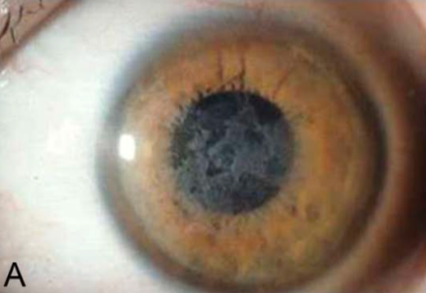
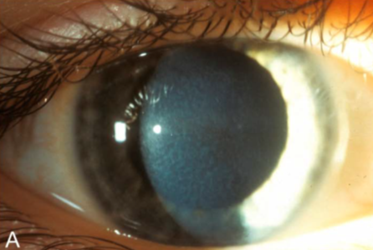
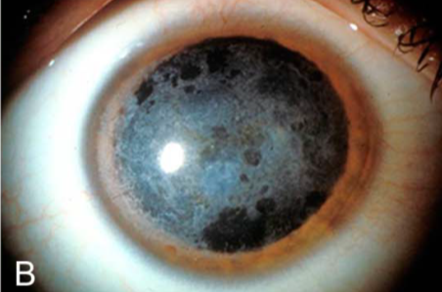
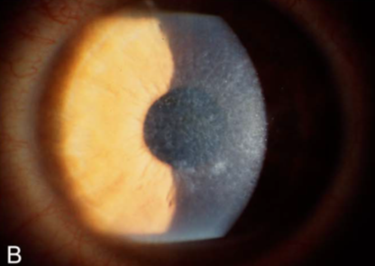
Corneal Dystrophies
Reis–Bücklers corneal dystrophy: Geographic opacities
Thiel-Benke corneal dystrophy: Honeycomb appearance

Slide 43
Corneal Dystrophies
Epithelial and Subepithelial Dystrophies
Epithelial-Stromal TGFBI Dystrophies
1) Reis-Bücklers corneal dystrophy
2) Thiel-Behnke corneal dystrophy
3) Lattice, type 1
4) Lattice, variant types (III, IIIA, I/IIIA, IV)
5) Granular type 1
6) Granular type 2 (Avellino dystrophy)
RBCD
TBCD
Age of onset
Childhood
Childhood
Genetics
TGFBI (BIGH3)
TGFBI (BIGH3)
Stromal Dystrophies
SL appearance
‘Geographic’
opacification
‘Honeycomb’
opacification
Painful?
?
?
Endothelial Dystrophies

Slide 44
Corneal Dystrophies
Epithelial and Subepithelial Dystrophies
Epithelial-Stromal TGFBI Dystrophies
1) Reis-Bücklers corneal dystrophy
2) Thiel-Behnke corneal dystrophy
3) Lattice, type 1
4) Lattice, variant types (III, IIIA, I/IIIA, IV)
5) Granular type 1
6) Granular type 2 (Avellino dystrophy)
RBCD
TBCD
Age of onset
Childhood
Childhood
Genetics
TGFBI (BIGH3)
TGFBI (BIGH3)
Stromal Dystrophies
SL appearance
‘Geographic’
opacification
‘Honeycomb’
opacification
Painful?
Yes
Yes
Endothelial Dystrophies

Slide 45
Corneal Dystrophies
Epithelial and Subepithelial Dystrophies
Epithelial-Stromal TGFBI Dystrophies
1) Reis-Bücklers corneal dystrophy
2) Thiel-Behnke corneal dystrophy
3) Lattice, type 1
4) Lattice, variant types (III, IIIA, I/IIIA, IV)
5) Granular type 1
6) Granular type 2 (Avellino dystrophy)
RBCD
TBCD
Age of onset
Childhood
Childhood
Genetics
TGFBI (BIGH3)
TGFBI (BIGH3)
Stromal Dystrophies
SL appearance
‘Geographic’
opacification
‘Honeycomb’
opacification
Painful?
Yes
Yes
Affect vision?
?
?
Endothelial Dystrophies

Slide 46
Corneal Dystrophies
Epithelial and Subepithelial Dystrophies
Epithelial-Stromal TGFBI Dystrophies
1) Reis-Bücklers corneal dystrophy
2) Thiel-Behnke corneal dystrophy
3) Lattice, type 1
4) Lattice, variant types (III, IIIA, I/IIIA, IV)
5) Granular type 1
6) Granular type 2 (Avellino dystrophy)
RBCD
TBCD
Age of onset
Childhood
Childhood
Genetics
TGFBI (BIGH3)
TGFBI (BIGH3)
Stromal Dystrophies
SL appearance
‘Geographic’
opacification
‘Honeycomb’
opacification
Painful?
Yes
Yes
Affect vision?
Yes
Yes
Endothelial Dystrophies

Slide 47
Corneal Dystrophies
Epithelial and Subepithelial Dystrophies
Epithelial-Stromal TGFBI Dystrophies
1) Reis-Bücklers corneal dystrophy
2) Thiel-Behnke corneal dystrophy
3) Lattice, type 1
4) Lattice, variant types (III, IIIA, I/IIIA, IV)
5) Granular type 1
6) Granular type 2 (Avellino dystrophy)
RBCD
TBCD
Age of onset
Childhood
Childhood
Genetics
TGFBI (BIGH3)
TGFBI (BIGH3)
Stromal Dystrophies
SL appearance
‘Geographic’
opacification
‘Honeycomb’
opacification
Painful?
Yes
Yes
Affect vision?
Yes
Yes
Stain/color
?
Endothelial Dystrophies

Slide 48
Corneal Dystrophies
Epithelial and Subepithelial Dystrophies
Epithelial-Stromal TGFBI Dystrophies
1) Reis-Bücklers corneal dystrophy
2) Thiel-Behnke corneal dystrophy
3) Lattice, type 1
4) Lattice, variant types (III, IIIA, I/IIIA, IV)
5) Granular type 1
6) Granular type 2 (Avellino dystrophy)
RBCD
TBCD
Age of onset
Childhood
Childhood
Genetics
TGFBI (BIGH3)
TGFBI (BIGH3)
Stromal Dystrophies
SL appearance
‘Geographic’
opacification
‘Honeycomb’
opacification
Painful?
Yes
Yes
Affect vision?
Yes
Yes
Stain/color
Masson trichrome/Red
Endothelial Dystrophies

Slide 49
Corneal Dystrophies
Epithelial and Subepithelial Dystrophies
Epithelial-Stromal TGFBI Dystrophies
1) Reis-Bücklers corneal dystrophy
2) Thiel-Behnke corneal dystrophy
3) Lattice, type 1
4) Lattice, variant types (III, IIIA, I/IIIA, IV)
5) Granular type 1
6) Granular type 2 (Avellino dystrophy)
RBCD
TBCD
Age of onset
Childhood
Childhood
Genetics
TGFBI (BIGH3)
TGFBI (BIGH3)
Stromal Dystrophies
SL appearance
‘Geographic’
opacification
‘Honeycomb’
opacification
Painful?
Yes
Yes
Affect vision?
Yes
Yes
Stain/color
Masson trichrome/Red
Endothelial Dystrophies
Light microscopy
appearance of Bowmans
?
?

Slide 50
Corneal Dystrophies
Epithelial and Subepithelial Dystrophies
Epithelial-Stromal TGFBI Dystrophies
1) Reis-Bücklers corneal dystrophy
2) Thiel-Behnke corneal dystrophy
3) Lattice, type 1
4) Lattice, variant types (III, IIIA, I/IIIA, IV)
5) Granular type 1
6) Granular type 2 (Avellino dystrophy)
RBCD
TBCD
Age of onset
Childhood
Childhood
Genetics
TGFBI (BIGH3)
TGFBI (BIGH3)
Stromal Dystrophies
SL appearance
‘Geographic’
opacification
‘Honeycomb’
opacification
Painful?
Yes
Yes
Affect vision?
Yes
Yes
Stain/color
Masson trichrome/Red
Endothelial Dystrophies
Light microscopy
appearance of Bowmans
‘Sheets’
‘Saw-toothed’

Slide 51
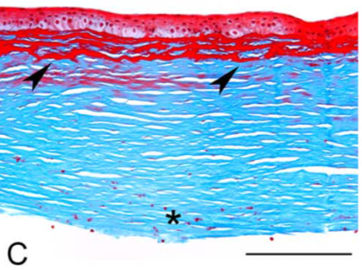
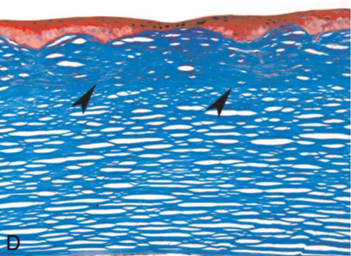
Reis-Bücklers: sheet-like layers
Corneal Dystrophies
Thiel-Behnke: Sawtooth pattern
Reis-Bücklers
Thiel-Behnke

Slide 52
Reis-Bücklers: sheet-like layers
Corneal Dystrophies
Thiel-Behnke: Sawtooth pattern
Reis-Bücklers
Thiel-Behnke
The sawtooth pattern in TBCD is also appreciable via anterior-segment OCT

Slide 53
Corneal Dystrophies
Epithelial and Subepithelial Dystrophies
Epithelial-Stromal TGFBI Dystrophies
1) Reis-Bücklers corneal dystrophy
2) Thiel-Behnke corneal dystrophy
3) Lattice, type 1
4) Lattice, variant types (III, IIIA, I/IIIA, IV)
5) Granular type 1
6) Granular type 2 (Avellino dystrophy)
RBCD
TBCD
Age of onset
Childhood
Childhood
Genetics
TGFBI (BIGH3)
TGFBI (BIGH3)
Stromal Dystrophies
SL appearance
‘Geographic’
opacification
‘Honeycomb’
opacification
Painful?
Yes
Yes
Affect vision?
Yes
Yes
Stain/color
Masson trichrome/Red
Endothelial Dystrophies
Light microscopy
appearance of Bowmans
‘Sheets’
‘Saw-toothed’
Electron microscopy
appearance
?
?

Slide 54
Corneal Dystrophies
Epithelial and Subepithelial Dystrophies
Epithelial-Stromal TGFBI Dystrophies
1) Reis-Bücklers corneal dystrophy
2) Thiel-Behnke corneal dystrophy
3) Lattice, type 1
4) Lattice, variant types (III, IIIA, I/IIIA, IV)
5) Granular type 1
6) Granular type 2 (Avellino dystrophy)
RBCD
TBCD
Age of onset
Childhood
Childhood
Genetics
TGFBI (BIGH3)
TGFBI (BIGH3)
Stromal Dystrophies
SL appearance
‘Geographic’
opacification
‘Honeycomb’
opacification
Painful?
Yes
Yes
Affect vision?
Yes
Yes
Stain/color
Masson trichrome/Red
Endothelial Dystrophies
Light microscopy
appearance of Bowmans
‘Sheets’
‘Saw-toothed’
Electron microscopy
appearance
Rod-shaped fibers
Curly fibers

Slide 55
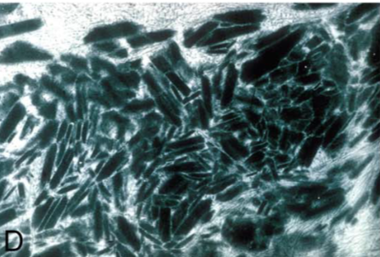
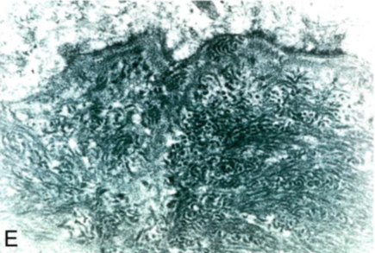
Reis-Bücklers: sheet-like layers
Corneal Dystrophies
Thiel-Behnke: Sawtooth pattern
Reis-Bücklers
Thiel-Behnke
Reis-Bücklers: Rod-shaped fibers
Thiel-Behnke: Curly fibers

Slide 56
Corneal Dystrophies
Epithelial and Subepithelial Dystrophies
Epithelial-Stromal TGFBI Dystrophies
1) Reis-Bücklers corneal dystrophy
2) Thiel-Behnke corneal dystrophy
3) Lattice, type 1
4) Lattice, variant types (III, IIIA, I/IIIA, IV)
5) Granular type 1
6) Granular type 2 (Avellino dystrophy)
Can Reis-Bücklers and Thiel-Behnke be reliably differentiated from one another at the slit lamp?
The BCSC Cornea book says doing so is “difficult” (read: no, you can’t)
How can they be differentiated clinically?
Via anterior-segment OCT, and confocal microscopy
Stromal Dystrophies
Bowman’s layer dystrophies: Which is which?
Endothelial Dystrophies

Slide 57
Corneal Dystrophies
Epithelial and Subepithelial Dystrophies
Epithelial-Stromal TGFBI Dystrophies
1) Reis-Bücklers corneal dystrophy
2) Thiel-Behnke corneal dystrophy
3) Lattice, type 1
4) Lattice, variant types (III, IIIA, I/IIIA, IV)
5) Granular type 1
6) Granular type 2 (Avellino dystrophy)
Can Reis-Bücklers and Thiel-Behnke be reliably differentiated from one another at the slit lamp?
The BCSC Cornea book says doing so is “difficult” (read: no, you can’t)
How can they be differentiated clinically?
Via anterior-segment OCT, and confocal microscopy
Stromal Dystrophies
Bowman’s layer dystrophies: Which is which?
Endothelial Dystrophies

Slide 58
Corneal Dystrophies
Epithelial and Subepithelial Dystrophies
Epithelial-Stromal TGFBI Dystrophies
1) Reis-Bücklers corneal dystrophy
2) Thiel-Behnke corneal dystrophy
3) Lattice, type 1
4) Lattice, variant types (III, IIIA, I/IIIA, IV)
5) Granular type 1
6) Granular type 2 (Avellino dystrophy)
Can Reis-Bücklers and Thiel-Behnke be reliably differentiated from one another at the slit lamp?
The BCSC Cornea book says doing so is “difficult” (read: no, you can’t)
How can they be differentiated clinically?
Via anterior-segment OCT, and confocal microscopy
Stromal Dystrophies
Bowman’s layer dystrophies: Which is which?
Endothelial Dystrophies

Slide 59
Corneal Dystrophies
Epithelial and Subepithelial Dystrophies
Epithelial-Stromal TGFBI Dystrophies
1) Reis-Bücklers corneal dystrophy
2) Thiel-Behnke corneal dystrophy
3) Lattice, type 1
4) Lattice, variant types (III, IIIA, I/IIIA, IV)
5) Granular type 1
6) Granular type 2 (Avellino dystrophy)
Can Reis-Bücklers and Thiel-Behnke be reliably differentiated from one another at the slit lamp?
The BCSC Cornea book says doing so is “difficult” (read: no, you can’t)
How can they be differentiated clinically?
Via anterior-segment OCT, and confocal microscopy
Stromal Dystrophies
Bowman’s layer dystrophies: Which is which?
Endothelial Dystrophies

Slide 60
Corneal Dystrophies
Epithelial and Subepithelial Dystrophies
Epithelial-Stromal TGFBI Dystrophies
1) Reis-Bücklers corneal dystrophy
2) Thiel-Behnke corneal dystrophy
3) Lattice, type 1
4) Lattice, variant types (III, IIIA, I/IIIA, IV)
5) Granular type 1
6) Granular type 2
Note: The Cornea book lumps together type 1 (aka ‘classic lattice’) and its variants
Stromal Dystrophies
Endothelial Dystrophies

Slide 61
Corneal Dystrophies
Epithelial and Subepithelial Dystrophies
At what age does classic lattice type 1 begin to manifest?
Childhood to teens
How does it present? What is seen at the slit lamp?
Early in the disease, fleck-like central opacities and a diffuse stromal haze are present. Later, myriad crisscrossing refractile lines in the cornea predominate.
Is it painful?
Yes; pts get recurrent epithelial erosions
Does it affect vision?
Surface irregularity and stromal haze often results in decreased vision
What is the hallmark of lattice type 1 on light microscopy?
The presence of amyloid in the subepithelial space and anterior stroma
Epithelial-Stromal TGFBI Dystrophies
1) Reis-Bücklers corneal dystrophy
2) Thiel-Behnke corneal dystrophy
3) Lattice, type 1
4) Lattice, variant types (III, IIIA, I/IIIA, IV)
5) Granular type 1
6) Granular type 2
Stromal Dystrophies
Endothelial Dystrophies

Slide 62
Corneal Dystrophies
Epithelial and Subepithelial Dystrophies
At what age does classic lattice type 1 begin to manifest?
Childhood to teens
How does it present? What is seen at the slit lamp?
Early in the disease, fleck-like central opacities and a diffuse stromal haze are present. Later, myriad crisscrossing refractile lines in the cornea predominate.
Is it painful?
Yes; pts get recurrent epithelial erosions
Does it affect vision?
Surface irregularity and stromal haze often results in decreased vision
What is the hallmark of lattice type 1 on light microscopy?
The presence of amyloid in the subepithelial space and anterior stroma
Epithelial-Stromal TGFBI Dystrophies
1) Reis-Bücklers corneal dystrophy
2) Thiel-Behnke corneal dystrophy
3) Lattice, type 1
4) Lattice, variant types (III, IIIA, I/IIIA, IV)
5) Granular type 1
6) Granular type 2
Stromal Dystrophies
Endothelial Dystrophies

Slide 63
Corneal Dystrophies
Epithelial and Subepithelial Dystrophies
At what age does classic lattice type 1 begin to manifest?
Childhood to teens
How does it present? What is seen at the slit lamp?
Early in the disease, fleck-like central opacities and a diffuse stromal haze are present. Later, myriad crisscrossing refractile lines in the cornea predominate.
Is it painful?
Yes; pts get recurrent epithelial erosions
Does it affect vision?
Surface irregularity and stromal haze often results in decreased vision
What is the hallmark of lattice type 1 on light microscopy?
The presence of amyloid in the subepithelial space and anterior stroma
Epithelial-Stromal TGFBI Dystrophies
1) Reis-Bücklers corneal dystrophy
2) Thiel-Behnke corneal dystrophy
3) Lattice, type 1
4) Lattice, variant types (III, IIIA, I/IIIA, IV)
5) Granular type 1
6) Granular type 2
Stromal Dystrophies
Endothelial Dystrophies

Slide 64
Corneal Dystrophies
Epithelial and Subepithelial Dystrophies
At what age does classic lattice type 1 begin to manifest?
Childhood to teens
How does it present? What is seen at the slit lamp?
Early in the disease, fleck-like central opacities and a diffuse stromal haze are present.. Later, myriad crisscrossing refractile lines in the cornea predominate.
Is it painful?
Yes; pts get recurrent epithelial erosions
Does it affect vision?
Surface irregularity and stromal haze often results in decreased vision
What is the hallmark of lattice type 1 on light microscopy?
The presence of amyloid in the subepithelial space and anterior stroma
Epithelial-Stromal TGFBI Dystrophies
1) Reis-Bücklers corneal dystrophy
2) Thiel-Behnke corneal dystrophy
3) Lattice, type 1
4) Lattice, variant types (III, IIIA, I/IIIA, IV)
5) Granular type 1
6) Granular type 2
Stromal Dystrophies
Endothelial Dystrophies

Slide 65
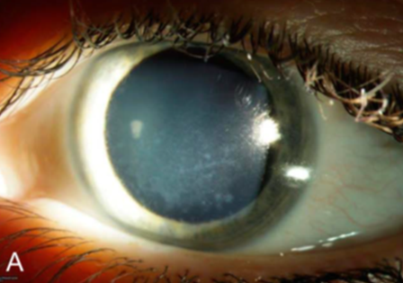
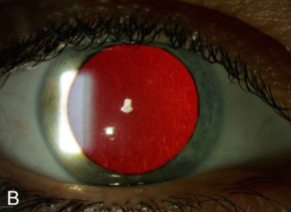
Corneal Dystrophies
Lattice corneal dystrophy, type 1 (aka classic lattice). Direct (A) and retroillumination (B) of early lattice corneal dystrophy (LCD) with dots and fine lattice lines.

Slide 66
Corneal Dystrophies
Epithelial and Subepithelial Dystrophies
At what age does classic lattice type 1 begin to manifest?
Childhood to teens
How does it present? What is seen at the slit lamp?
Early in the disease, fleck-like central opacities and a diffuse stromal haze are present. Later, myriad crisscrossing refractile lines in the cornea predominate.
Is it painful?
Yes; pts get recurrent epithelial erosions
Does it affect vision?
Surface irregularity and stromal haze often results in decreased vision
What is the hallmark of lattice type 1 on light microscopy?
The presence of amyloid in the subepithelial space and anterior stroma
Epithelial-Stromal TGFBI Dystrophies
1) Reis-Bücklers corneal dystrophy
2) Thiel-Behnke corneal dystrophy
3) Lattice, type 1
4) Lattice, variant types (III, IIIA, I/IIIA, IV)
5) Granular type 1
6) Granular type 2
Stromal Dystrophies
Endothelial Dystrophies

Slide 67
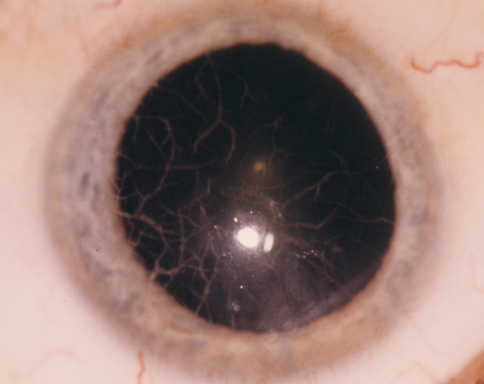
Corneal Dystrophies
Lattice corneal dystrophy, type 1 (aka classic lattice)

Slide 68
Corneal Dystrophies
Epithelial and Subepithelial Dystrophies
At what age does classic lattice type 1 begin to manifest?
Childhood to teens
How does it present? What is seen at the slit lamp?
Early in the disease, fleck-like central opacities and a diffuse stromal haze are present. Later, myriad crisscrossing refractile lines in the cornea predominate.
Is it painful?
Yes; pts get recurrent epithelial erosions
Does it affect vision?
Surface irregularity and stromal haze often results in decreased vision
What is the hallmark of lattice type 1 on light microscopy?
The presence of amyloid in the subepithelial space and anterior stroma
Why is this condition called ‘lattice’?
Because the crisscrossing lines are reminiscent of a lattice structure (eg, like one might encounter in a garden)
Epithelial-Stromal TGFBI Dystrophies
1) Reis-Bücklers corneal dystrophy
2) Thiel-Behnke corneal dystrophy
3) Lattice, type 1
4) Lattice, variant types (III, IIIA, I/IIIA, IV)
5) Granular type 1
6) Granular type 2
Stromal Dystrophies
Endothelial Dystrophies

Slide 69
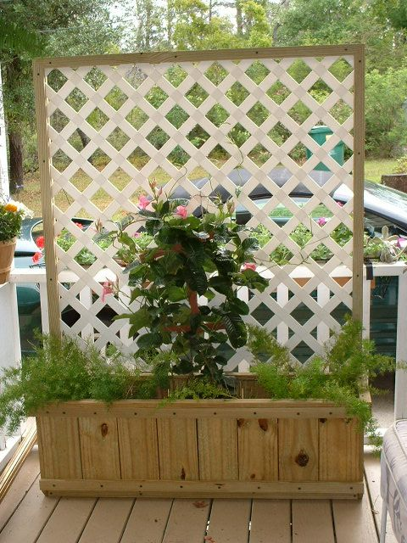
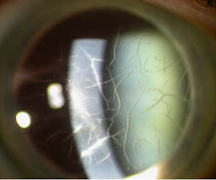
Corneal Dystrophies
Epithelial and Subepithelial Dystrophies
At what age does classic lattice type 1 begin to manifest?
Childhood to teens
How does it present? What is seen at the slit lamp?
Early in the disease, fleck-like central opacities and a diffuse stromal haze are present. Later, myriad crisscrossing refractile lines in the cornea predominate.
Is it painful?
Yes; pts get recurrent epithelial erosions
Does it affect vision?
Surface irregularity and stromal haze often results in decreased vision
What is the hallmark of lattice type 1 on light microscopy?
The presence of amyloid in the subepithelial space and anterior stroma
Why is this condition called ‘lattice’?
Because the crisscrossing lines are reminiscent of a lattice structure (eg, like one might encounter in a garden)
Epithelial-Stromal TGFBI Dystrophies
1) Reis-Bücklers corneal dystrophy
2) Thiel-Behnke corneal dystrophy
3) Lattice, type 1
4) Lattice, variant types (III, IIIA, I/IIIA, IV)
5) Granular type 1
6) Granular type 2
Stromal Dystrophies
Endothelial Dystrophies

Slide 70
Corneal Dystrophies
Epithelial and Subepithelial Dystrophies
At what age does classic lattice type 1 begin to manifest?
Childhood to teens
How does it present? What is seen at the slit lamp?
Early in the disease, fleck-like central opacities and a diffuse stromal haze are present. Later, myriad crisscrossing refractile lines in the cornea predominate.
Is it painful?
Yes; pts get recurrent epithelial erosions
Does it affect vision?
Surface irregularity and stromal haze often results in decreased vision
What is the hallmark of lattice type 1 on light microscopy?
The presence of amyloid in the subepithelial space and anterior stroma
Epithelial-Stromal TGFBI Dystrophies
1) Reis-Bücklers corneal dystrophy
2) Thiel-Behnke corneal dystrophy
3) Lattice, type 1
4) Lattice, variant types (III, IIIA, I/IIIA, IV)
5) Granular type 1
6) Granular type 2
What word is used to describe the appearance of the lines?
‘Glasslike’
Stromal Dystrophies
Endothelial Dystrophies

Slide 71
Corneal Dystrophies
Epithelial and Subepithelial Dystrophies
At what age does classic lattice type 1 begin to manifest?
Childhood to teens
How does it present? What is seen at the slit lamp?
Early in the disease, fleck-like central opacities and a diffuse stromal haze are present. Later, myriad crisscrossing refractile lines in the cornea predominate.
Is it painful?
Yes; pts get recurrent epithelial erosions
Does it affect vision?
Surface irregularity and stromal haze often results in decreased vision
What is the hallmark of lattice type 1 on light microscopy?
The presence of amyloid in the subepithelial space and anterior stroma
Epithelial-Stromal TGFBI Dystrophies
1) Reis-Bücklers corneal dystrophy
2) Thiel-Behnke corneal dystrophy
3) Lattice, type 1
4) Lattice, variant types (III, IIIA, I/IIIA, IV)
5) Granular type 1
6) Granular type 2
What word is used to describe the appearance of the lines?
‘Glasslike’
Stromal Dystrophies
Endothelial Dystrophies

Slide 72
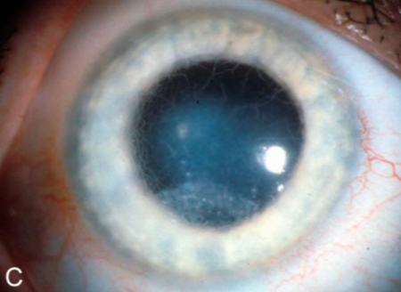
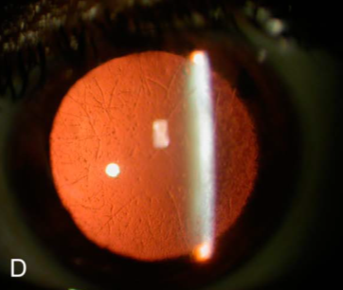
Corneal Dystrophies
Lattice corneal dystrophy, type 1 (aka classic lattice). C, Subepithelial groundglass haze of the central and inferior cornea, and diffuse lattice lines in advanced disease.
D, Dots and paracentral lattice lines in retroillumination.

Slide 73
Corneal Dystrophies
Epithelial and Subepithelial Dystrophies
At what age does classic lattice type 1 begin to manifest?
Childhood to teens
How does it present? What is seen at the slit lamp?
Early in the disease, fleck-like central opacities and a diffuse stromal haze are present. Later, myriad crisscrossing refractile lines in the cornea predominate.
Is it painful?
Yes; pts get recurrent epithelial erosions
Does it affect vision?
Surface irregularity and stromal haze often results in decreased vision
What is the hallmark of lattice type 1 on light microscopy?
The presence of amyloid in the subepithelial space and anterior stroma
Epithelial-Stromal TGFBI Dystrophies
1) Reis-Bücklers corneal dystrophy
2) Thiel-Behnke corneal dystrophy
3) Lattice, type 1
4) Lattice, variant types (III, IIIA, I/IIIA, IV)
5) Granular type 1
6) Granular type 2
Stromal Dystrophies
Endothelial Dystrophies

Slide 74
Corneal Dystrophies
Epithelial and Subepithelial Dystrophies
At what age does classic lattice type 1 begin to manifest?
Childhood to teens
How does it present? What is seen at the slit lamp?
Early in the disease, fleck-like central opacities and a diffuse stromal haze are present. Later, myriad crisscrossing refractile lines in the cornea predominate.
Is it painful?
Yes; pts get recurrent epithelial erosions
Does it affect vision?
Surface irregularity and stromal haze often results in decreased vision
What is the hallmark of lattice type 1 on light microscopy?
The presence of amyloid in the subepithelial space and anterior stroma
Epithelial-Stromal TGFBI Dystrophies
1) Reis-Bücklers corneal dystrophy
2) Thiel-Behnke corneal dystrophy
3) Lattice, type 1
4) Lattice, variant types (III, IIIA, I/IIIA, IV)
5) Granular type 1
6) Granular type 2
Stromal Dystrophies
Endothelial Dystrophies

Slide 75
Corneal Dystrophies
Epithelial and Subepithelial Dystrophies
At what age does classic lattice type 1 begin to manifest?
Childhood to teens
How does it present? What is seen at the slit lamp?
Early in the disease, fleck-like central opacities and a diffuse stromal haze are present. Later, myriad crisscrossing refractile lines in the cornea predominate.
Is it painful?
Yes; pts get recurrent epithelial erosions
Does it affect vision?
Surface irregularity and stromal haze often results in decreased vision
What is the hallmark of lattice type 1 on light microscopy?
The presence of amyloid in the subepithelial space and anterior stroma
Epithelial-Stromal TGFBI Dystrophies
1) Reis-Bücklers corneal dystrophy
2) Thiel-Behnke corneal dystrophy
3) Lattice, type 1
4) Lattice, variant types (III, IIIA, I/IIIA, IV)
5) Granular type 1
6) Granular type 2
Stromal Dystrophies
Endothelial Dystrophies

Slide 76
Corneal Dystrophies
Epithelial and Subepithelial Dystrophies
At what age does classic lattice type 1 begin to manifest?
Childhood to teens
How does it present? What is seen at the slit lamp?
Early in the disease, fleck-like central opacities and a diffuse stromal haze are present. Later, myriad crisscrossing refractile lines in the cornea predominate.
Is it painful?
Yes; pts get recurrent epithelial erosions
Does it affect vision?
Surface irregularity and stromal haze often results in decreased vision
What is the hallmark of lattice type 1 on light microscopy?
The presence of amyloid in the subepithelial space and anterior stroma
Epithelial-Stromal TGFBI Dystrophies
1) Reis-Bücklers corneal dystrophy
2) Thiel-Behnke corneal dystrophy
3) Lattice, type 1
4) Lattice, variant types (III, IIIA, I/IIIA, IV)
5) Granular type 1
6) Granular type 2
Stromal Dystrophies
Endothelial Dystrophies

Slide 77
Corneal Dystrophies
Epithelial and Subepithelial Dystrophies
At what age does classic lattice type 1 begin to manifest?
Childhood to teens
How does it present? What is seen at the slit lamp?
Early in the disease, fleck-like central opacities and a diffuse stromal haze are present. Later, myriad crisscrossing refractile lines in the cornea predominate.
Is it painful?
Yes; pts get recurrent epithelial erosions
Does it affect vision?
Surface irregularity and stromal haze often results in decreased vision
What is the hallmark of lattice type 1 on light microscopy?
The presence of amyloid in the subepithelial space and anterior stroma
Epithelial-Stromal TGFBI Dystrophies
1) Reis-Bücklers corneal dystrophy
2) Thiel-Behnke corneal dystrophy
3) Lattice, type 1
4) Lattice, variant types (III, IIIA, I/IIIA, IV)
5) Granular type 1
6) Granular type 2
Stromal Dystrophies
Endothelial Dystrophies

Slide 78
Corneal Dystrophies
Epithelial and Subepithelial Dystrophies
At what age does classic lattice type 1 begin to manifest?
Childhood to teens
How does it present? What is seen at the slit lamp?
Early in the disease, fleck-like central opacities and a diffuse stromal haze are present. Later, myriad crisscrossing refractile lines in the cornea predominate.
Is it painful?
Yes; pts get recurrent epithelial erosions
Does it affect vision?
Surface irregularity and stromal haze often results in decreased vision
What is the hallmark of lattice type 1 on light microscopy?
The presence of amyloid in the subepithelial space and anterior stroma
Epithelial-Stromal TGFBI Dystrophies
1) Reis-Bücklers corneal dystrophy
2) Thiel-Behnke corneal dystrophy
3) Lattice, type 1
4) Lattice, variant types (III, IIIA, I/IIIA, IV)
5) Granular type 1
6) Granular type 2
Stromal Dystrophies
substance
Endothelial Dystrophies

Slide 79
Corneal Dystrophies
Epithelial and Subepithelial Dystrophies
At what age does classic lattice type 1 begin to manifest?
Childhood to teens
How does it present? What is seen at the slit lamp?
Early in the disease, fleck-like central opacities and a diffuse stromal haze are present. Later, myriad crisscrossing refractile lines in the cornea predominate.
Is it painful?
Yes; pts get recurrent epithelial erosions
Does it affect vision?
Surface irregularity and stromal haze often results in decreased vision
What is the hallmark of lattice type 1 on light microscopy?
The presence of amyloid in the subepithelial space and anterior stroma
Epithelial-Stromal TGFBI Dystrophies
1) Reis-Bücklers corneal dystrophy
2) Thiel-Behnke corneal dystrophy
3) Lattice, type 1
4) Lattice, variant types (III, IIIA, I/IIIA, IV)
5) Granular type 1
6) Granular type 2
Stromal Dystrophies
Endothelial Dystrophies

Slide 80
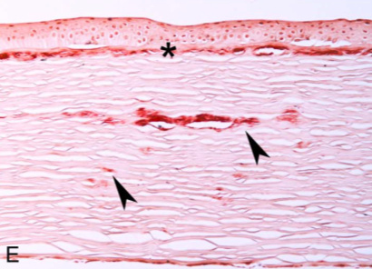
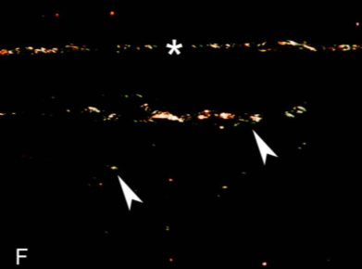
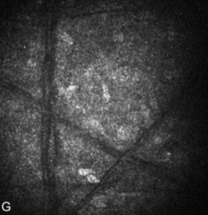
Corneal Dystrophies
Lattice corneal dystrophy, type 1 (classic lattice).
E, Light microscopy: Congo red prominently stains a continuous layer of amyloid (asterisk) that underlies and partially destroys the Bowman layer and intrastromal amyloid deposits corresponding to lattice lines (arrowheads). F, This same section viewed with polarized light confirms deposits are birefringent and red-green dichroic, thus amyloid. G, In vivo confocal microscopy image shows filaments corresponding to lattice lines within the stroma.

Slide 81
Corneal Dystrophies
Epithelial and Subepithelial Dystrophies
Epithelial-Stromal TGFBI Dystrophies
1) Reis-Bücklers corneal dystrophy
2) Thiel-Behnke corneal dystrophy
3) Lattice, type 1
4) Lattice, variant types (III, IIIA, I/IIIA, IV)
5) Granular type 1
6) Granular type 2
Why is lattice, gelsolin type not grouped with lattice?
Because it is part of a systemic syndrome, it is no longer classified as a corneal dystrophy. (But given its corneal findings, we will touch briefly on it here.)
What is the name of the syndrome?
Meretoja syndrome
What are the systemic findings in Meretoja syndrome?
Amyloid deposition in the skin and perineural space leads to dermatochalasis, saggy skin, pendulous ears, and bilateral CN7 palsies. These findings culminate in a characteristic facial appearance known as ‘bloodhound facies’
What about the corneal findings?
They are essentially identical to those of lattice type 1
Lattice, gelsolin type
Stromal Dystrophies
Endothelial Dystrophies

Slide 82
Corneal Dystrophies
Epithelial and Subepithelial Dystrophies
Epithelial-Stromal TGFBI Dystrophies
1) Reis-Bücklers corneal dystrophy
2) Thiel-Behnke corneal dystrophy
3) Lattice, type 1
4) Lattice, variant types (III, IIIA, I/IIIA, IV)
5) Granular type 1
6) Granular type 2
Why is lattice, gelsolin type not grouped with lattice?
Because it is part of a systemic syndrome, it is no longer classified as a corneal dystrophy. (But given its corneal findings, we will touch briefly on it here.)
What is the name of the syndrome?
Meretoja syndrome
What are the systemic findings in Meretoja syndrome?
Amyloid deposition in the skin and perineural space leads to dermatochalasis, saggy skin, pendulous ears, and bilateral CN7 palsies. These findings culminate in a characteristic facial appearance known as ‘bloodhound facies’
What about the corneal findings?
They are essentially identical to those of lattice type 1
Lattice, gelsolin type
Stromal Dystrophies
Endothelial Dystrophies

Slide 83
Corneal Dystrophies
Epithelial and Subepithelial Dystrophies
Epithelial-Stromal TGFBI Dystrophies
1) Reis-Bücklers corneal dystrophy
2) Thiel-Behnke corneal dystrophy
3) Lattice, type 1
4) Lattice, variant types (III, IIIA, I/IIIA, IV)
5) Granular type 1
6) Granular type 2
Why is lattice, gelsolin type not grouped with lattice?
Because it is part of a systemic syndrome, it is no longer classified as a corneal dystrophy. (But given its corneal findings, we will touch briefly on it here.)
What is the name of the syndrome?
Meretoja syndrome
What are the systemic findings in Meretoja syndrome?
Amyloid deposition in the skin and perineural space leads to dermatochalasis, saggy skin, pendulous ears, and bilateral CN7 palsies. These findings culminate in a characteristic facial appearance known as ‘bloodhound facies’
What about the corneal findings?
They are essentially identical to those of lattice type 1
Lattice, gelsolin type
(aka…Meretoja syndrome)
Stromal Dystrophies
Endothelial Dystrophies

Slide 84
Corneal Dystrophies
Epithelial and Subepithelial Dystrophies
Epithelial-Stromal TGFBI Dystrophies
1) Reis-Bücklers corneal dystrophy
2) Thiel-Behnke corneal dystrophy
3) Lattice, type 1
4) Lattice, variant types (III, IIIA, I/IIIA, IV)
5) Granular type 1
6) Granular type 2
Why is lattice, gelsolin type not grouped with lattice?
Because it is part of a systemic syndrome, it is no longer classified as a corneal dystrophy. (But given its corneal findings, we will touch briefly on it here.)
What is the name of the syndrome?
Meretoja syndrome
What are the systemic findings in Meretoja syndrome?
Amyloid deposition in the skin and perineural space leads to dermatochalasis, saggy skin, pendulous ears, and bilateral CN7 palsies. These findings culminate in a characteristic facial appearance known as ‘bloodhound facies’
What about the corneal findings?
They are essentially identical to those of lattice type 1
Lattice, gelsolin type
(aka…Meretoja syndrome)
Stromal Dystrophies
Endothelial Dystrophies

Slide 85
Corneal Dystrophies
Epithelial and Subepithelial Dystrophies
Epithelial-Stromal TGFBI Dystrophies
1) Reis-Bücklers corneal dystrophy
2) Thiel-Behnke corneal dystrophy
3) Lattice, type 1
4) Lattice, variant types (III, IIIA, I/IIIA, IV)
5) Granular type 1
6) Granular type 2
Why is lattice, gelsolin type not grouped with lattice?
Because it is part of a systemic syndrome, it is no longer classified as a corneal dystrophy. (But given its corneal findings, we will touch briefly on it here.)
What is the name of the syndrome?
Meretoja syndrome
What are the systemic findings in Meretoja syndrome?
Amyloid deposition in the skin and perineural space leads to dermatochalasis, saggy skin, pendulous ears, and bilateral CN7 palsies. These findings culminate in a characteristic facial appearance known as ‘bloodhound facies’
What about the corneal findings?
They are essentially identical to those of lattice type 1
Lattice, gelsolin type
(aka…Meretoja syndrome)
Stromal Dystrophies
Endothelial Dystrophies

Slide 86
Corneal Dystrophies
Epithelial and Subepithelial Dystrophies
Epithelial-Stromal TGFBI Dystrophies
1) Reis-Bücklers corneal dystrophy
2) Thiel-Behnke corneal dystrophy
3) Lattice, type 1
4) Lattice, variant types (III, IIIA, I/IIIA, IV)
5) Granular type 1
6) Granular type 2
Why is lattice, gelsolin type not grouped with lattice?
Because it is part of a systemic syndrome, it is no longer classified as a corneal dystrophy. (But given its corneal findings, we will touch briefly on it here.)
What is the name of the syndrome?
Meretoja syndrome
What are the systemic findings in Meretoja syndrome?
Amyloid deposition in the skin and perineural space leads to dermatochalasis, saggy skin, pendulous ears, and bilateral CN7 palsies. These findings culminate in a characteristic facial appearance known as ‘bloodhound facies’
What about the corneal findings?
They are essentially identical to those of lattice type 1
Lattice, gelsolin type
(aka…Meretoja syndrome)
Stromal Dystrophies
one word
Endothelial Dystrophies

Slide 87
Corneal Dystrophies
Epithelial and Subepithelial Dystrophies
Epithelial-Stromal TGFBI Dystrophies
1) Reis-Bücklers corneal dystrophy
2) Thiel-Behnke corneal dystrophy
3) Lattice, type 1
4) Lattice, variant types (III, IIIA, I/IIIA, IV)
5) Granular type 1
6) Granular type 2
Why is lattice, gelsolin type not grouped with lattice?
Because it is part of a systemic syndrome, it is no longer classified as a corneal dystrophy. (But given its corneal findings, we will touch briefly on it here.)
What is the name of the syndrome?
Meretoja syndrome
What are the systemic findings in Meretoja syndrome?
Amyloid deposition in the skin and perineural space leads to dermatochalasis, saggy skin, pendulous ears, and bilateral CN7 palsies. These findings culminate in a characteristic facial appearance known as ‘bloodhound facies’
What about the corneal findings?
They are essentially identical to those of lattice type 1
Lattice, gelsolin type
(aka…Meretoja syndrome)
Stromal Dystrophies
Endothelial Dystrophies

Slide 88
Corneal Dystrophies
Epithelial and Subepithelial Dystrophies
Epithelial-Stromal TGFBI Dystrophies
1) Reis-Bücklers corneal dystrophy
2) Thiel-Behnke corneal dystrophy
3) Lattice, type 1
4) Lattice, variant types (III, IIIA, I/IIIA, IV)
5) Granular type 1
6) Granular type 2
Why is lattice, gelsolin type not grouped with lattice?
Because it is part of a systemic syndrome, it is no longer classified as a corneal dystrophy. (But given its corneal findings, we will touch briefly on it here.)
What is the name of the syndrome?
Meretoja syndrome
What are the systemic findings in Meretoja syndrome?
Amyloid deposition in the skin and perineural space leads to dermatochalasis, saggy skin, pendulous ears, and bilateral CN7 palsies. These findings culminate in a characteristic facial appearance known as ‘bloodhound facies’
What about the corneal findings?
They are essentially identical to those of lattice type 1
Lattice, gelsolin type
(aka…Meretoja syndrome)
Stromal Dystrophies
Endothelial Dystrophies
‘two words’

Slide 89
Corneal Dystrophies
Epithelial and Subepithelial Dystrophies
Epithelial-Stromal TGFBI Dystrophies
1) Reis-Bücklers corneal dystrophy
2) Thiel-Behnke corneal dystrophy
3) Lattice, type 1
4) Lattice, variant types (III, IIIA, I/IIIA, IV)
5) Granular type 1
6) Granular type 2
Why is lattice, gelsolin type not grouped with lattice?
Because it is part of a systemic syndrome, it is no longer classified as a corneal dystrophy. (But given its corneal findings, we will touch briefly on it here.)
What is the name of the syndrome?
Meretoja syndrome
What are the systemic findings in Meretoja syndrome?
Amyloid deposition in the skin and perineural space leads to dermatochalasis, saggy skin, pendulous ears, and bilateral CN7 palsies. These findings culminate in a characteristic facial appearance known as ‘bloodhound facies.’
What about the corneal findings?
They are essentially identical to those of lattice type 1
Lattice, gelsolin type
(aka…Meretoja syndrome)
Stromal Dystrophies
Endothelial Dystrophies

Slide 90
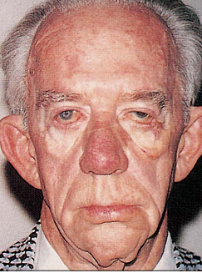
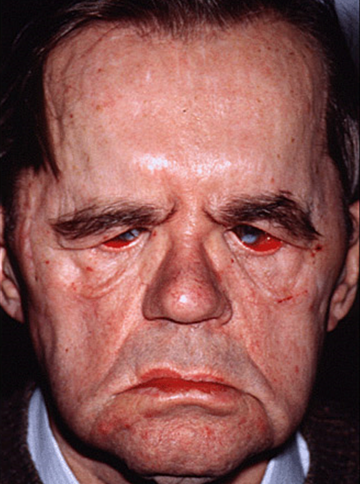
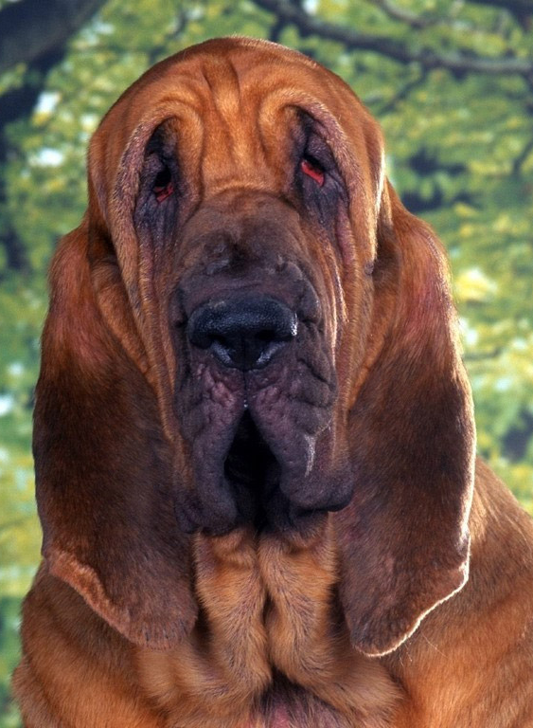
Corneal Dystrophies
Meretoja syndrome: ‘Bloodhound facies’

Slide 91
Corneal Dystrophies
Epithelial and Subepithelial Dystrophies
Epithelial-Stromal TGFBI Dystrophies
1) Reis-Bücklers corneal dystrophy
2) Thiel-Behnke corneal dystrophy
3) Lattice, type 1
4) Lattice, variant types (III, IIIA, I/IIIA, IV)
5) Granular type 1
6) Granular type 2
Why is lattice, gelsolin type not grouped with lattice?
Because it is part of a systemic syndrome, it is no longer classified as a corneal dystrophy. (But given its corneal findings, we will touch briefly on it here.)
What is the name of the syndrome?
Meretoja syndrome
What are the systemic findings in Meretoja syndrome?
Amyloid deposition in the skin and perineural space leads to dermatochalasis, saggy skin, pendulous ears, and bilateral CN7 palsies. These findings culminate in a characteristic facial appearance known as ‘bloodhound facies.’
What about the corneal findings?
They are essentially identical to those of lattice type 1
Lattice, gelsolin type
(aka…Meretoja syndrome)
Stromal Dystrophies
Endothelial Dystrophies

Slide 92
Corneal Dystrophies
Epithelial and Subepithelial Dystrophies
Epithelial-Stromal TGFBI Dystrophies
1) Reis-Bücklers corneal dystrophy
2) Thiel-Behnke corneal dystrophy
3) Lattice, type 1
4) Lattice, variant types (III, IIIA, I/IIIA, IV)
5) Granular type 1
6) Granular type 2
Why is lattice, gelsolin type not grouped with lattice?
Because it is part of a systemic syndrome, it is no longer classified as a corneal dystrophy. (But given its corneal findings, we will touch briefly on it here.)
What is the name of the syndrome?
Meretoja syndrome
What are the systemic findings in Meretoja syndrome?
Amyloid deposition in the skin and perineural space leads to dermatochalasis, saggy skin, pendulous ears, and bilateral CN7 palsies. These findings culminate in a characteristic facial appearance known as ‘bloodhound facies.’
What about the corneal findings?
They are essentially identical to those of lattice type 1
Lattice, gelsolin type
(aka…Meretoja syndrome)
Stromal Dystrophies
Endothelial Dystrophies

Slide 93
Corneal Dystrophies
Epithelial and Subepithelial Dystrophies
At what age does GCD1 begin to manifest?
Early childhood
How does it present? What is seen at the slit lamp?
In early disease, tiny crumblike granules appear. As the disease progresses, the size and density of the granules increases. The granules never reach as far as the limbus.
Is it painful?
Yes; pts get recurrent epithelial erosions
Does it affect vision?
Glare and stromal haze result in decreased vision
What is the histologic hallmark of GCD1 on light microscopy?
The presence of hyaline in the subepithelial space and anterior stroma (just like Reis-Bücklers). It stains bright red with Masson trichrome (just like Reis-Bücklers).
What is the hallmark of GCD1 on electron microscopy?
Rod-shaped fibers (just like Reis-Bücklers)
Epithelial-Stromal TGFBI Dystrophies
1) Reis-Bücklers corneal dystrophy
2) Thiel-Behnke corneal dystrophy
3) Lattice, type 1
4) Lattice, variant types (III, IIIA, I/IIIA, IV)
5) Granular type 1
6) Granular type 2
Stromal Dystrophies
Endothelial Dystrophies

Slide 94
Corneal Dystrophies
Epithelial and Subepithelial Dystrophies
At what age does GCD1 begin to manifest?
Early childhood
How does it present? What is seen at the slit lamp?
In early disease, tiny crumblike granules appear. As the disease progresses, the size and density of the granules increases. The granules never reach as far as the limbus.
Is it painful?
Yes; pts get recurrent epithelial erosions
Does it affect vision?
Glare and stromal haze result in decreased vision
What is the histologic hallmark of GCD1 on light microscopy?
The presence of hyaline in the subepithelial space and anterior stroma (just like Reis-Bücklers). It stains bright red with Masson trichrome (just like Reis-Bücklers).
What is the hallmark of GCD1 on electron microscopy?
Rod-shaped fibers (just like Reis-Bücklers)
Epithelial-Stromal TGFBI Dystrophies
1) Reis-Bücklers corneal dystrophy
2) Thiel-Behnke corneal dystrophy
3) Lattice, type 1
4) Lattice, variant types (III, IIIA, I/IIIA, IV)
5) Granular type 1
6) Granular type 2
Stromal Dystrophies
Endothelial Dystrophies

Slide 95
Corneal Dystrophies
Epithelial and Subepithelial Dystrophies
At what age does GCD1 begin to manifest?
Early childhood
How does it present? What is seen at the slit lamp?
In early disease, tiny crumblike granules appear. As the disease progresses, the size and density of the granules increases. The granules never reach as far as the limbus.
Is it painful?
Yes; pts get recurrent epithelial erosions
Does it affect vision?
Glare and stromal haze result in decreased vision
What is the histologic hallmark of GCD1 on light microscopy?
The presence of hyaline in the subepithelial space and anterior stroma (just like Reis-Bücklers). It stains bright red with Masson trichrome (just like Reis-Bücklers).
What is the hallmark of GCD1 on electron microscopy?
Rod-shaped fibers (just like Reis-Bücklers)
Epithelial-Stromal TGFBI Dystrophies
1) Reis-Bücklers corneal dystrophy
2) Thiel-Behnke corneal dystrophy
3) Lattice, type 1
4) Lattice, variant types (III, IIIA, I/IIIA, IV)
5) Granular type 1
6) Granular type 2
Stromal Dystrophies
Endothelial Dystrophies

Slide 96
Corneal Dystrophies
Epithelial and Subepithelial Dystrophies
At what age does GCD1 begin to manifest?
Early childhood
How does it present? What is seen at the slit lamp?
In early disease, tiny crumblike granules appear. As the disease progresses, the size and density of the granules increases. The granules never reach as far as the limbus.
Is it painful?
Yes; pts get recurrent epithelial erosions
Does it affect vision?
Glare and stromal haze result in decreased vision
What is the histologic hallmark of GCD1 on light microscopy?
The presence of hyaline in the subepithelial space and anterior stroma (just like Reis-Bücklers). It stains bright red with Masson trichrome (just like Reis-Bücklers).
What is the hallmark of GCD1 on electron microscopy?
Rod-shaped fibers (just like Reis-Bücklers)
Epithelial-Stromal TGFBI Dystrophies
1) Reis-Bücklers corneal dystrophy
2) Thiel-Behnke corneal dystrophy
3) Lattice, type 1
4) Lattice, variant types (III, IIIA, I/IIIA, IV)
5) Granular type 1
6) Granular type 2
Stromal Dystrophies
Endothelial Dystrophies

Slide 97
Corneal Dystrophies
Granular corneal dystrophy, type 1. A, In a child, early subepithelial verticillate-like opacities are evident by retro and direct illumination. B, With broad slit illumination, stromal deposits are both discrete and confluent, and are axially distributed in anterior stroma.

Slide 98
Corneal Dystrophies
Epithelial and Subepithelial Dystrophies
At what age does GCD1 begin to manifest?
Early childhood
How does it present? What is seen at the slit lamp?
In early disease, tiny crumblike granules appear. As the disease progresses, the size and density of the granules increases. The granules never reach as far as the limbus.
Is it painful?
Yes; pts get recurrent epithelial erosions
Does it affect vision?
Glare and stromal haze result in decreased vision
What is the histologic hallmark of GCD1 on light microscopy?
The presence of hyaline in the subepithelial space and anterior stroma (just like Reis-Bücklers). It stains bright red with Masson trichrome (just like Reis-Bücklers).
What is the hallmark of GCD1 on electron microscopy?
Rod-shaped fibers (just like Reis-Bücklers)
Epithelial-Stromal TGFBI Dystrophies
1) Reis-Bücklers corneal dystrophy
2) Thiel-Behnke corneal dystrophy
3) Lattice, type 1
4) Lattice, variant types (III, IIIA, I/IIIA, IV)
5) Granular type 1
6) Granular type 2
Stromal Dystrophies
Endothelial Dystrophies

Slide 99
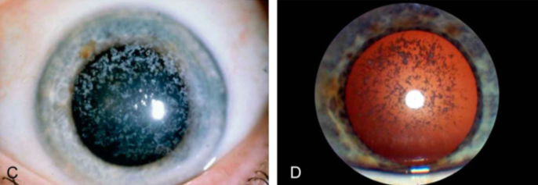
Corneal Dystrophies
Granular corneal dystrophy, type 1. In an adult, more prominent diffuse granular opacities in the form of “snowfall” are apparent with direct (C) and retroillumination (D).

Slide 100
Corneal Dystrophies
Epithelial and Subepithelial Dystrophies
At what age does GCD1 begin to manifest?
Early childhood
How does it present? What is seen at the slit lamp?
In early disease, tiny crumblike granules appear. As the disease progresses, the size and density of the granules increases. The granules never reach as far as the limbus.
Is it painful?
Yes; pts get recurrent epithelial erosions
Does it affect vision?
Glare and stromal haze result in decreased vision
What is the histologic hallmark of GCD1 on light microscopy?
The presence of hyaline in the subepithelial space and anterior stroma (just like Reis-Bücklers). It stains bright red with Masson trichrome (just like Reis-Bücklers).
What is the hallmark of GCD1 on electron microscopy?
Rod-shaped fibers (just like Reis-Bücklers)
Epithelial-Stromal TGFBI Dystrophies
1) Reis-Bücklers corneal dystrophy
2) Thiel-Behnke corneal dystrophy
3) Lattice, type 1
4) Lattice, variant types (III, IIIA, I/IIIA, IV)
5) Granular type 1
6) Granular type 2
Stromal Dystrophies
Endothelial Dystrophies

Slide 101
Corneal Dystrophies
Epithelial and Subepithelial Dystrophies
At what age does GCD1 begin to manifest?
Early childhood
How does it present? What is seen at the slit lamp?
In early disease, tiny crumblike granules appear. As the disease progresses, the size and density of the granules increases. The granules never reach as far as the limbus.
Is it painful?
Yes; pts get recurrent epithelial erosions
Does it affect vision?
Glare and stromal haze result in decreased vision
What is the histologic hallmark of GCD1 on light microscopy?
The presence of hyaline in the subepithelial space and anterior stroma (just like Reis-Bücklers). It stains bright red with Masson trichrome (just like Reis-Bücklers).
What is the hallmark of GCD1 on electron microscopy?
Rod-shaped fibers (just like Reis-Bücklers)
Epithelial-Stromal TGFBI Dystrophies
1) Reis-Bücklers corneal dystrophy
2) Thiel-Behnke corneal dystrophy
3) Lattice, type 1
4) Lattice, variant types (III, IIIA, I/IIIA, IV)
5) Granular type 1
6) Granular type 2
Stromal Dystrophies
Endothelial Dystrophies

Slide 102
Corneal Dystrophies
Epithelial and Subepithelial Dystrophies
At what age does GCD1 begin to manifest?
Early childhood
How does it present? What is seen at the slit lamp?
In early disease, tiny crumblike granules appear. As the disease progresses, the size and density of the granules increases. The granules never reach as far as the limbus.
Is it painful?
Yes; pts get recurrent epithelial erosions
Does it affect vision?
Glare and stromal haze result in decreased vision
What is the histologic hallmark of GCD1 on light microscopy?
The presence of hyaline in the subepithelial space and anterior stroma (just like Reis-Bücklers). It stains bright red with Masson trichrome (just like Reis-Bücklers).
What is the hallmark of GCD1 on electron microscopy?
Rod-shaped fibers (just like Reis-Bücklers)
Epithelial-Stromal TGFBI Dystrophies
1) Reis-Bücklers corneal dystrophy
2) Thiel-Behnke corneal dystrophy
3) Lattice, type 1
4) Lattice, variant types (III, IIIA, I/IIIA, IV)
5) Granular type 1
6) Granular type 2
Stromal Dystrophies
Endothelial Dystrophies

Slide 103
Corneal Dystrophies
Epithelial and Subepithelial Dystrophies
At what age does GCD1 begin to manifest?
Early childhood
How does it present? What is seen at the slit lamp?
In early disease, tiny crumblike granules appear. As the disease progresses, the size and density of the granules increases. The granules never reach as far as the limbus.
Is it painful?
Yes; pts get recurrent epithelial erosions
Does it affect vision?
Glare and stromal haze result in decreased vision
What is the histologic hallmark of GCD1 on light microscopy?
The presence of hyaline in the subepithelial space and anterior stroma (just like Reis-Bücklers). It stains bright red with Masson trichrome (just like Reis-Bücklers).
What is the hallmark of GCD1 on electron microscopy?
Rod-shaped fibers (just like Reis-Bücklers)
Epithelial-Stromal TGFBI Dystrophies
1) Reis-Bücklers corneal dystrophy
2) Thiel-Behnke corneal dystrophy
3) Lattice, type 1
4) Lattice, variant types (III, IIIA, I/IIIA, IV)
5) Granular type 1
6) Granular type 2
Stromal Dystrophies
Endothelial Dystrophies

Slide 104
Corneal Dystrophies
Epithelial and Subepithelial Dystrophies
At what age does GCD1 begin to manifest?
Early childhood
How does it present? What is seen at the slit lamp?
In early disease, tiny crumblike granules appear. As the disease progresses, the size and density of the granules increases. The granules never reach as far as the limbus.
Is it painful?
Yes; pts get recurrent epithelial erosions
Does it affect vision?
Glare and stromal haze result in decreased vision
What is the histologic hallmark of GCD1 on light microscopy?
The presence of hyaline in the subepithelial space and anterior stroma (just like Reis-Bücklers). It stains bright red with Masson trichrome (just like Reis-Bücklers).
What is the hallmark of GCD1 on electron microscopy?
Rod-shaped fibers (just like Reis-Bücklers)
Epithelial-Stromal TGFBI Dystrophies
1) Reis-Bücklers corneal dystrophy
2) Thiel-Behnke corneal dystrophy
3) Lattice, type 1
4) Lattice, variant types (III, IIIA, I/IIIA, IV)
5) Granular type 1
6) Granular type 2
Stromal Dystrophies
Endothelial Dystrophies

Slide 105
Corneal Dystrophies
Epithelial and Subepithelial Dystrophies
At what age does GCD1 begin to manifest?
Early childhood
How does it present? What is seen at the slit lamp?
In early disease, tiny crumblike granules appear. As the disease progresses, the size and density of the granules increases. The granules never reach as far as the limbus.
Is it painful?
Yes; pts get recurrent epithelial erosions
Does it affect vision?
Glare and stromal haze result in decreased vision
What is the histologic hallmark of GCD1 on light microscopy?
The presence of hyaline in the subepithelial space and anterior stroma (just like Reis-Bücklers). It stains bright red with Masson trichrome (just like Reis-Bücklers).
What is the hallmark of GCD1 on electron microscopy?
Rod-shaped fibers (just like Reis-Bücklers)
Epithelial-Stromal TGFBI Dystrophies
1) Reis-Bücklers corneal dystrophy
2) Thiel-Behnke corneal dystrophy
3) Lattice, type 1
4) Lattice, variant types (III, IIIA, I/IIIA, IV)
5) Granular type 1
6) Granular type 2
Stromal Dystrophies
one word
color
two words
Endothelial Dystrophies

Slide 106
Corneal Dystrophies
Epithelial and Subepithelial Dystrophies
At what age does GCD1 begin to manifest?
Early childhood
How does it present? What is seen at the slit lamp?
In early disease, tiny crumblike granules appear. As the disease progresses, the size and density of the granules increases. The granules never reach as far as the limbus.
Is it painful?
Yes; pts get recurrent epithelial erosions
Does it affect vision?
Glare and stromal haze result in decreased vision
What is the histologic hallmark of GCD1 on light microscopy?
The presence of hyaline in the subepithelial space and anterior stroma (just like Reis-Bücklers). It stains bright red with Masson trichrome (just like Reis-Bücklers).
What is the hallmark of GCD1 on electron microscopy?
Rod-shaped fibers (just like Reis-Bücklers)
Epithelial-Stromal TGFBI Dystrophies
1) Reis-Bücklers corneal dystrophy
2) Thiel-Behnke corneal dystrophy
3) Lattice, type 1
4) Lattice, variant types (III, IIIA, I/IIIA, IV)
5) Granular type 1
6) Granular type 2
Stromal Dystrophies
Endothelial Dystrophies

Slide 107
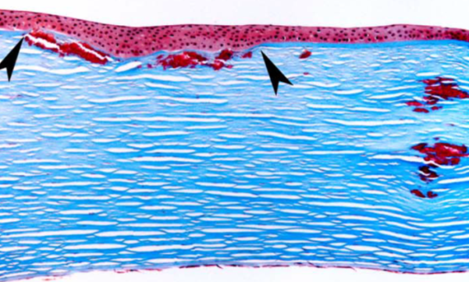
Corneal Dystrophies
Granular corneal dystrophy, type 1. Light microscopy—Masson trichrome highlights deposits of hyaline at various stromal layers and partial destruction of the Bowman layer (between arrowheads).

Slide 108
Corneal Dystrophies
Epithelial and Subepithelial Dystrophies
At what age does GCD1 begin to manifest?
Early childhood
How does it present? What is seen at the slit lamp?
In early disease, tiny crumblike granules appear. As the disease progresses, the size and density of the granules increases. The granules never reach as far as the limbus.
Is it painful?
Yes; pts get recurrent epithelial erosions
Does it affect vision?
Glare and stromal haze result in decreased vision
What is the histologic hallmark of GCD1 on light microscopy?
The presence of hyaline in the subepithelial space and anterior stroma (just like Reis-Bücklers). It stains bright red with Masson trichrome (just like Reis-Bücklers).
What is the hallmark of GCD1 on electron microscopy?
Rod-shaped fibers (just like Reis-Bücklers)
Epithelial-Stromal TGFBI Dystrophies
1) Reis-Bücklers corneal dystrophy
2) Thiel-Behnke corneal dystrophy
3) Lattice, type 1
4) Lattice, variant types (III, IIIA, I/IIIA, IV)
5) Granular type 1
6) Granular type 2
Stromal Dystrophies
Endothelial Dystrophies

Slide 109
Corneal Dystrophies
Epithelial and Subepithelial Dystrophies
At what age does GCD1 begin to manifest?
Early childhood
How does it present? What is seen at the slit lamp?
In early disease, tiny crumblike granules appear. As the disease progresses, the size and density of the granules increases. The granules never reach as far as the limbus.
Is it painful?
Yes; pts get recurrent epithelial erosions
Does it affect vision?
Glare and stromal haze result in decreased vision
What is the histologic hallmark of GCD1 on light microscopy?
The presence of hyaline in the subepithelial space and anterior stroma (just like Reis-Bücklers). It stains bright red with Masson trichrome (just like Reis-Bücklers).
What is the hallmark of GCD1 on electron microscopy?
Rod-shaped fibers (just like Reis-Bücklers)
Epithelial-Stromal TGFBI Dystrophies
1) Reis-Bücklers corneal dystrophy
2) Thiel-Behnke corneal dystrophy
3) Lattice, type 1
4) Lattice, variant types (III, IIIA, I/IIIA, IV)
5) Granular type 1
6) Granular type 2
Stromal Dystrophies
Endothelial Dystrophies
three words

Slide 110
Corneal Dystrophies
Epithelial and Subepithelial Dystrophies
At what age does GCD1 begin to manifest?
Early childhood
How does it present? What is seen at the slit lamp?
In early disease, tiny crumblike granules appear. As the disease progresses, the size and density of the granules increases. The granules never reach as far as the limbus.
Is it painful?
Yes; pts get recurrent epithelial erosions
Does it affect vision?
Glare and stromal haze result in decreased vision
What is the histologic hallmark of GCD1 on light microscopy?
The presence of hyaline in the subepithelial space and anterior stroma (just like Reis-Bücklers). It stains bright red with Masson trichrome (just like Reis-Bücklers).
What is the hallmark of GCD1 on electron microscopy?
Rod-shaped fibers (just like Reis-Bücklers)
Epithelial-Stromal TGFBI Dystrophies
1) Reis-Bücklers corneal dystrophy
2) Thiel-Behnke corneal dystrophy
3) Lattice, type 1
4) Lattice, variant types (III, IIIA, I/IIIA, IV)
5) Granular type 1
6) Granular type 2
Stromal Dystrophies
Endothelial Dystrophies

Slide 111
Corneal Dystrophies
Epithelial and Subepithelial Dystrophies
At what age does GCD1 begin to manifest?
Early childhood
How does it present? What is seen at the slit lamp?
In early disease, tiny crumblike granules appear. As the disease progresses, the size and density of the granules increases. The granules never reach as far as the limbus.
Is it painful?
Yes; pts get recurrent epithelial erosions
Does it affect vision?
Glare and stromal haze result in decreased vision
What is the histologic hallmark of GCD1 on light microscopy?
The presence of hyaline in the subepithelial space and anterior stroma (just like Reis-Bücklers). It stains bright red with Masson trichrome (just like Reis-Bücklers).
What is the hallmark of GCD1 on electron microscopy?
Rod-shaped fibers (just like Reis-Bücklers)
Epithelial-Stromal TGFBI Dystrophies
1) Reis-Bücklers corneal dystrophy
2) Thiel-Behnke corneal dystrophy
3) Lattice, type 1
4) Lattice, variant types (III, IIIA, I/IIIA, IV)
5) Granular type 1
6) Granular type 2
Stromal Dystrophies
Endothelial Dystrophies

Slide 112
Corneal Dystrophies
Epithelial and Subepithelial Dystrophies
By what other names is GCD2 known?
Combined granular-lattice dystrophy; Avellino dystrophy
At what age does GCD2 begin to manifest?
Usually in the teen to early-adult years, can be younger
How does it present? What is seen at the slit lamp?
Basically, as a combination of GCD1 and lattice dystrophy: The crumblike granules of GCD1, along with a version of the lattice lines seen in LCD
Is it painful?
Yes; pts get recurrent epithelial erosions
Does it affect vision?
Glare and stromal haze result in decreased vision
What is the histologic hallmark of GCD1 on light microscopy?
The presence of both amyloid and hyaline in the subepithelial space and anterior stroma. The hyaline stains bright red with Masson trichrome; the amyloid stains with Congo Red, birefringes under polarized light.
What is the hallmark of GCD2 on electron microscopy?
Rod-shaped fibers , albeit in reduced numbers
Epithelial-Stromal TGFBI Dystrophies
1) Reis-Bücklers corneal dystrophy
2) Thiel-Behnke corneal dystrophy
3) Lattice, type 1
4) Lattice, variant types (III, IIIA, I/IIIA, IV)
5) Granular type 1
6) Granular type 2
Stromal Dystrophies
Endothelial Dystrophies

Slide 113
Corneal Dystrophies
Epithelial and Subepithelial Dystrophies
By what other names is GCD2 known?
Combined granular-lattice dystrophy; Avellino dystrophy
At what age does GCD2 begin to manifest?
Usually in the teen to early-adult years, can be younger
How does it present? What is seen at the slit lamp?
Basically, as a combination of GCD1 and lattice dystrophy: The crumblike granules of GCD1, along with a version of the lattice lines seen in LCD
Is it painful?
Yes; pts get recurrent epithelial erosions
Does it affect vision?
Glare and stromal haze result in decreased vision
What is the histologic hallmark of GCD1 on light microscopy?
The presence of both amyloid and hyaline in the subepithelial space and anterior stroma. The hyaline stains bright red with Masson trichrome; the amyloid stains with Congo Red, birefringes under polarized light.
What is the hallmark of GCD2 on electron microscopy?
Rod-shaped fibers , albeit in reduced numbers
Epithelial-Stromal TGFBI Dystrophies
1) Reis-Bücklers corneal dystrophy
2) Thiel-Behnke corneal dystrophy
3) Lattice, type 1
4) Lattice, variant types (III, IIIA, I/IIIA, IV)
5) Granular type 1
6) Granular type 2
Stromal Dystrophies
Endothelial Dystrophies

Slide 114
Corneal Dystrophies
Epithelial and Subepithelial Dystrophies
By what other names is GCD2 known?
Combined granular-lattice dystrophy; Avellino dystrophy
At what age does GCD2 begin to manifest?
Usually in the teen to early-adult years, can be younger
How does it present? What is seen at the slit lamp?
Basically, as a combination of GCD1 and lattice dystrophy: The crumblike granules of GCD1, along with a version of the lattice lines seen in LCD
Is it painful?
Yes; pts get recurrent epithelial erosions
Does it affect vision?
Glare and stromal haze result in decreased vision
What is the histologic hallmark of GCD1 on light microscopy?
The presence of both amyloid and hyaline in the subepithelial space and anterior stroma. The hyaline stains bright red with Masson trichrome; the amyloid stains with Congo Red, birefringes under polarized light.
What is the hallmark of GCD2 on electron microscopy?
Rod-shaped fibers , albeit in reduced numbers
Epithelial-Stromal TGFBI Dystrophies
1) Reis-Bücklers corneal dystrophy
2) Thiel-Behnke corneal dystrophy
3) Lattice, type 1
4) Lattice, variant types (III, IIIA, I/IIIA, IV)
5) Granular type 1
6) Granular type 2
Stromal Dystrophies
Endothelial Dystrophies

Slide 115
Corneal Dystrophies
Epithelial and Subepithelial Dystrophies
By what other names is GCD2 known?
Combined granular-lattice dystrophy; Avellino dystrophy
At what age does GCD2 begin to manifest?
Usually in the teen to early-adult years, can be younger
How does it present? What is seen at the slit lamp?
Basically, as a combination of GCD1 and lattice dystrophy: The crumblike granules of GCD1, along with a version of the lattice lines seen in LCD
Is it painful?
Yes; pts get recurrent epithelial erosions
Does it affect vision?
Glare and stromal haze result in decreased vision
What is the histologic hallmark of GCD1 on light microscopy?
The presence of both amyloid and hyaline in the subepithelial space and anterior stroma. The hyaline stains bright red with Masson trichrome; the amyloid stains with Congo Red, birefringes under polarized light.
What is the hallmark of GCD2 on electron microscopy?
Rod-shaped fibers , albeit in reduced numbers
Epithelial-Stromal TGFBI Dystrophies
1) Reis-Bücklers corneal dystrophy
2) Thiel-Behnke corneal dystrophy
3) Lattice, type 1
4) Lattice, variant types (III, IIIA, I/IIIA, IV)
5) Granular type 1
6) Granular type 2
Stromal Dystrophies
Endothelial Dystrophies

Slide 116
Corneal Dystrophies
Epithelial and Subepithelial Dystrophies
By what other names is GCD2 known?
Combined granular-lattice dystrophy; Avellino dystrophy
At what age does GCD2 begin to manifest?
Usually in the teen to early-adult years, can be younger
How does it present? What is seen at the slit lamp?
Basically, as a combination of GCD1 and lattice dystrophy: The crumblike granules of GCD1, along with a version of the lattice lines seen in LCD
Is it painful?
Yes; pts get recurrent epithelial erosions
Does it affect vision?
Glare and stromal haze result in decreased vision
What is the histologic hallmark of GCD1 on light microscopy?
The presence of both amyloid and hyaline in the subepithelial space and anterior stroma. The hyaline stains bright red with Masson trichrome; the amyloid stains with Congo Red, birefringes under polarized light.
What is the hallmark of GCD2 on electron microscopy?
Rod-shaped fibers , albeit in reduced numbers
Epithelial-Stromal TGFBI Dystrophies
1) Reis-Bücklers corneal dystrophy
2) Thiel-Behnke corneal dystrophy
3) Lattice, type 1
4) Lattice, variant types (III, IIIA, I/IIIA, IV)
5) Granular type 1
6) Granular type 2
Stromal Dystrophies
Endothelial Dystrophies

Slide 117
Corneal Dystrophies
Epithelial and Subepithelial Dystrophies
By what other names is GCD2 known?
Combined granular-lattice dystrophy; Avellino dystrophy
At what age does GCD2 begin to manifest?
Usually in the teen to early-adult years, can be younger
How does it present? What is seen at the slit lamp?
Basically, as a combination of GCD1 and lattice dystrophy: The crumblike granules of GCD1, along with a version of the lattice lines seen in LCD
Is it painful?
Yes; pts get recurrent epithelial erosions
Does it affect vision?
Glare and stromal haze result in decreased vision
What is the histologic hallmark of GCD1 on light microscopy?
The presence of both amyloid and hyaline in the subepithelial space and anterior stroma. The hyaline stains bright red with Masson trichrome; the amyloid stains with Congo Red, birefringes under polarized light.
What is the hallmark of GCD2 on electron microscopy?
Rod-shaped fibers , albeit in reduced numbers
Epithelial-Stromal TGFBI Dystrophies
1) Reis-Bücklers corneal dystrophy
2) Thiel-Behnke corneal dystrophy
3) Lattice, type 1
4) Lattice, variant types (III, IIIA, I/IIIA, IV)
5) Granular type 1
6) Granular type 2
Stromal Dystrophies
Endothelial Dystrophies

Slide 118
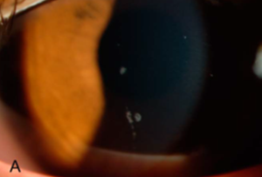
Corneal Dystrophies
Granular corneal dystrophy, type 2. 13-year-old with a few white dots.

Slide 119
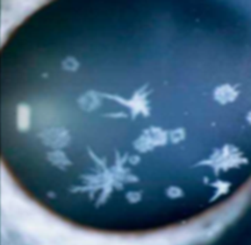
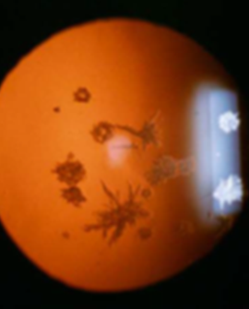
Corneal Dystrophies
Granular corneal dystrophy, type 2. Direct and retro-illumination views of an older pt demonstrate branching, star-shaped, spiny, and ring-like deposits.

Slide 120
Corneal Dystrophies
Granular corneal dystrophy, type 2. C, pt with superficial translucent flattened breadcrumb opacity beneath the Bowman layer. Denser icicles and disc-like and ring-like opacities.
D, Homozygote with denser and confluent opacities.

Slide 121
Corneal Dystrophies
Epithelial and Subepithelial Dystrophies
By what other names is GCD2 known?
Combined granular-lattice dystrophy; Avellino dystrophy
At what age does GCD2 begin to manifest?
Usually in the teen to early-adult years, can be younger
How does it present? What is seen at the slit lamp?
Basically, as a combination of GCD1 and lattice dystrophy: The crumblike granules of GCD1, along with a version of the lattice lines seen in LCD
Is it painful?
Yes; pts get recurrent epithelial erosions
Does it affect vision?
Glare and stromal haze result in decreased vision
What is the histologic hallmark of GCD1 on light microscopy?
The presence of both amyloid and hyaline in the subepithelial space and anterior stroma. The hyaline stains bright red with Masson trichrome; the amyloid stains with Congo Red, birefringes under polarized light.
What is the hallmark of GCD2 on electron microscopy?
Rod-shaped fibers , albeit in reduced numbers
Epithelial-Stromal TGFBI Dystrophies
1) Reis-Bücklers corneal dystrophy
2) Thiel-Behnke corneal dystrophy
3) Lattice, type 1
4) Lattice, variant types (III, IIIA, I/IIIA, IV)
5) Granular type 1
6) Granular type 2
Stromal Dystrophies
Endothelial Dystrophies

Slide 122
Corneal Dystrophies
Epithelial and Subepithelial Dystrophies
By what other names is GCD2 known?
Combined granular-lattice dystrophy; Avellino dystrophy
At what age does GCD2 begin to manifest?
Usually in the teen to early-adult years, can be younger
How does it present? What is seen at the slit lamp?
Basically, as a combination of GCD1 and lattice dystrophy: The crumblike granules of GCD1, along with a version of the lattice lines seen in LCD
Is it painful?
Yes; pts get recurrent epithelial erosions
Does it affect vision?
Glare and stromal haze result in decreased vision
What is the histologic hallmark of GCD1 on light microscopy?
The presence of both amyloid and hyaline in the subepithelial space and anterior stroma. The hyaline stains bright red with Masson trichrome; the amyloid stains with Congo Red, birefringes under polarized light.
What is the hallmark of GCD2 on electron microscopy?
Rod-shaped fibers , albeit in reduced numbers
Epithelial-Stromal TGFBI Dystrophies
1) Reis-Bücklers corneal dystrophy
2) Thiel-Behnke corneal dystrophy
3) Lattice, type 1
4) Lattice, variant types (III, IIIA, I/IIIA, IV)
5) Granular type 1
6) Granular type 2
Stromal Dystrophies
Endothelial Dystrophies

Slide 123
Corneal Dystrophies
Epithelial and Subepithelial Dystrophies
By what other names is GCD2 known?
Combined granular-lattice dystrophy; Avellino dystrophy
At what age does GCD2 begin to manifest?
Usually in the teen to early-adult years, can be younger
How does it present? What is seen at the slit lamp?
Basically, as a combination of GCD1 and lattice dystrophy: The crumblike granules of GCD1, along with a version of the lattice lines seen in LCD
Is it painful?
Yes; pts get recurrent epithelial erosions
Does it affect vision?
Glare and stromal haze result in decreased vision
What is the histologic hallmark of GCD1 on light microscopy?
The presence of both amyloid and hyaline in the subepithelial space and anterior stroma. The hyaline stains bright red with Masson trichrome; the amyloid stains with Congo Red, birefringes under polarized light.
What is the hallmark of GCD2 on electron microscopy?
Rod-shaped fibers , albeit in reduced numbers
Epithelial-Stromal TGFBI Dystrophies
1) Reis-Bücklers corneal dystrophy
2) Thiel-Behnke corneal dystrophy
3) Lattice, type 1
4) Lattice, variant types (III, IIIA, I/IIIA, IV)
5) Granular type 1
6) Granular type 2
Stromal Dystrophies
Endothelial Dystrophies

Slide 124
Corneal Dystrophies
Epithelial and Subepithelial Dystrophies
By what other names is GCD2 known?
Combined granular-lattice dystrophy; Avellino dystrophy
At what age does GCD2 begin to manifest?
Usually in the teen to early-adult years, can be younger
How does it present? What is seen at the slit lamp?
Basically, as a combination of GCD1 and lattice dystrophy: The crumblike granules of GCD1, along with a version of the lattice lines seen in LCD
Is it painful?
Yes; pts get recurrent epithelial erosions
Does it affect vision?
Glare and stromal haze result in decreased vision
What is the histologic hallmark of GCD1 on light microscopy?
The presence of both amyloid and hyaline in the subepithelial space and anterior stroma. The hyaline stains bright red with Masson trichrome; the amyloid stains with Congo Red, birefringes under polarized light.
What is the hallmark of GCD2 on electron microscopy?
Rod-shaped fibers , albeit in reduced numbers
Epithelial-Stromal TGFBI Dystrophies
1) Reis-Bücklers corneal dystrophy
2) Thiel-Behnke corneal dystrophy
3) Lattice, type 1
4) Lattice, variant types (III, IIIA, I/IIIA, IV)
5) Granular type 1
6) Granular type 2
Stromal Dystrophies
Endothelial Dystrophies

Slide 125
Corneal Dystrophies
Epithelial and Subepithelial Dystrophies
By what other names is GCD2 known?
Combined granular-lattice dystrophy; Avellino dystrophy
At what age does GCD2 begin to manifest?
Usually in the teen to early-adult years, can be younger
How does it present? What is seen at the slit lamp?
Basically, as a combination of GCD1 and lattice dystrophy: The crumblike granules of GCD1, along with a version of the lattice lines seen in LCD
Is it painful?
Yes; pts get recurrent epithelial erosions
Does it affect vision?
Glare and stromal haze result in decreased vision
What is the histologic hallmark of GCD1 on light microscopy?
The presence of both amyloid and hyaline in the subepithelial space and anterior stroma. The hyaline stains bright red with Masson trichrome; the amyloid stains with Congo Red, birefringes under polarized light.
What is the hallmark of GCD2 on electron microscopy?
Rod-shaped fibers , albeit in reduced numbers
Epithelial-Stromal TGFBI Dystrophies
1) Reis-Bücklers corneal dystrophy
2) Thiel-Behnke corneal dystrophy
3) Lattice, type 1
4) Lattice, variant types (III, IIIA, I/IIIA, IV)
5) Granular type 1
6) Granular type 2
Stromal Dystrophies
Endothelial Dystrophies

Slide 126
Corneal Dystrophies
Epithelial and Subepithelial Dystrophies
By what other names is GCD2 known?
Combined granular-lattice dystrophy; Avellino dystrophy
At what age does GCD2 begin to manifest?
Usually in the teen to early-adult years, can be younger
How does it present? What is seen at the slit lamp?
Basically, as a combination of GCD1 and lattice dystrophy: The crumblike granules of GCD1, along with a version of the lattice lines seen in LCD
Is it painful?
Yes; pts get recurrent epithelial erosions
Does it affect vision?
Glare and stromal haze result in decreased vision
What is the histologic hallmark of GCD1 on light microscopy?
The presence of both amyloid and hyaline in the subepithelial space and anterior stroma. The hyaline stains bright red with Masson trichrome; the amyloid stains with Congo Red, birefringes under polarized light.
What is the hallmark of GCD2 on electron microscopy?
Rod-shaped fibers , albeit in reduced numbers
Epithelial-Stromal TGFBI Dystrophies
1) Reis-Bücklers corneal dystrophy
2) Thiel-Behnke corneal dystrophy
3) Lattice, type 1
4) Lattice, variant types (III, IIIA, I/IIIA, IV)
5) Granular type 1
6) Granular type 2
Stromal Dystrophies
Endothelial Dystrophies

Slide 127
Corneal Dystrophies
Epithelial and Subepithelial Dystrophies
By what other names is GCD2 known?
Combined granular-lattice dystrophy; Avellino dystrophy
At what age does GCD2 begin to manifest?
Usually in the teen to early-adult years, can be younger
How does it present? What is seen at the slit lamp?
Basically, as a combination of GCD1 and lattice dystrophy: The crumblike granules of GCD1, along with a version of the lattice lines seen in LCD
Is it painful?
Yes; pts get recurrent epithelial erosions
Does it affect vision?
Glare and stromal haze result in decreased vision
What is the histologic hallmark of GCD1 on light microscopy?
The presence of both amyloid and hyaline in the subepithelial space and anterior stroma. The hyaline stains bright red with Masson trichrome; the amyloid stains with Congo Red, birefringes under polarized light.
What is the hallmark of GCD2 on electron microscopy?
Rod-shaped fibers , albeit in reduced numbers
Epithelial-Stromal TGFBI Dystrophies
1) Reis-Bücklers corneal dystrophy
2) Thiel-Behnke corneal dystrophy
3) Lattice, type 1
4) Lattice, variant types (III, IIIA, I/IIIA, IV)
5) Granular type 1
6) Granular type 2
Stromal Dystrophies
Endothelial Dystrophies

Slide 128
Corneal Dystrophies
Epithelial and Subepithelial Dystrophies
By what other names is GCD2 known?
Combined granular-lattice dystrophy; Avellino dystrophy
At what age does GCD2 begin to manifest?
Usually in the teen to early-adult years, can be younger
How does it present? What is seen at the slit lamp?
Basically, as a combination of GCD1 and lattice dystrophy: The crumblike granules of GCD1, along with a version of the lattice lines seen in LCD
Is it painful?
Yes; pts get recurrent epithelial erosions
Does it affect vision?
Glare and stromal haze result in decreased vision
What is the histologic hallmark of GCD1 on light microscopy?
The presence of both amyloid and hyaline in the subepithelial space and anterior stroma. The hyaline stains bright red with Masson trichrome ; the amyloid stains with Congo Red , birefringes under polarized light.
What is the hallmark of GCD2 on electron microscopy?
Rod-shaped fibers , albeit in reduced numbers
Epithelial-Stromal TGFBI Dystrophies
1) Reis-Bücklers corneal dystrophy
2) Thiel-Behnke corneal dystrophy
3) Lattice, type 1
4) Lattice, variant types (III, IIIA, I/IIIA, IV)
5) Granular type 1
6) Granular type 2
Stromal Dystrophies
two words
Endothelial Dystrophies

Slide 129
Corneal Dystrophies
Epithelial and Subepithelial Dystrophies
By what other names is GCD2 known?
Combined granular-lattice dystrophy; Avellino dystrophy
At what age does GCD2 begin to manifest?
Usually in the teen to early-adult years, can be younger
How does it present? What is seen at the slit lamp?
Basically, as a combination of GCD1 and lattice dystrophy: The crumblike granules of GCD1, along with a version of the lattice lines seen in LCD
Is it painful?
Yes; pts get recurrent epithelial erosions
Does it affect vision?
Glare and stromal haze result in decreased vision
What is the histologic hallmark of GCD1 on light microscopy?
The presence of both amyloid and hyaline in the subepithelial space and anterior stroma. The hyaline stains bright red with Masson trichrome ; the amyloid stains with Congo Red , birefringes under polarized light.
What is the hallmark of GCD2 on electron microscopy?
Rod-shaped fibers , albeit in reduced numbers
Epithelial-Stromal TGFBI Dystrophies
1) Reis-Bücklers corneal dystrophy
2) Thiel-Behnke corneal dystrophy
3) Lattice, type 1
4) Lattice, variant types (III, IIIA, I/IIIA, IV)
5) Granular type 1
6) Granular type 2
Stromal Dystrophies
Endothelial Dystrophies

Slide 130
Corneal Dystrophies
Epithelial and Subepithelial Dystrophies
By what other names is GCD2 known?
Combined granular-lattice dystrophy; Avellino dystrophy
At what age does GCD2 begin to manifest?
Usually in the teen to early-adult years, can be younger
How does it present? What is seen at the slit lamp?
Basically, as a combination of GCD1 and lattice dystrophy: The crumblike granules of GCD1, along with a version of the lattice lines seen in LCD
Is it painful?
Yes; pts get recurrent epithelial erosions
Does it affect vision?
Glare and stromal haze result in decreased vision
What is the histologic hallmark of GCD1 on light microscopy?
The presence of both amyloid and hyaline in the subepithelial space and anterior stroma. The hyaline stains bright red with Masson trichrome ; the amyloid stains with Congo Red , and birefringes green under polarized light.
What is the hallmark of GCD2 on electron microscopy?
Rod-shaped fibers , albeit in reduced numbers
Epithelial-Stromal TGFBI Dystrophies
1) Reis-Bücklers corneal dystrophy
2) Thiel-Behnke corneal dystrophy
3) Lattice, type 1
4) Lattice, variant types (III, IIIA, I/IIIA, IV)
5) Granular type 1
6) Granular type 2
Stromal Dystrophies
Endothelial Dystrophies
two words

Slide 131
Corneal Dystrophies
Epithelial and Subepithelial Dystrophies
By what other names is GCD2 known?
Combined granular-lattice dystrophy; Avellino dystrophy
At what age does GCD2 begin to manifest?
Usually in the teen to early-adult years, can be younger
How does it present? What is seen at the slit lamp?
Basically, as a combination of GCD1 and lattice dystrophy: The crumblike granules of GCD1, along with a version of the lattice lines seen in LCD
Is it painful?
Yes; pts get recurrent epithelial erosions
Does it affect vision?
Glare and stromal haze result in decreased vision
What is the histologic hallmark of GCD1 on light microscopy?
The presence of both amyloid and hyaline in the subepithelial space and anterior stroma. The hyaline stains bright red with Masson trichrome ; the amyloid stains with Congo Red , and birefringes green under polarized light.
What is the hallmark of GCD2 on electron microscopy?
Rod-shaped fibers , albeit in reduced numbers
Epithelial-Stromal TGFBI Dystrophies
1) Reis-Bücklers corneal dystrophy
2) Thiel-Behnke corneal dystrophy
3) Lattice, type 1
4) Lattice, variant types (III, IIIA, I/IIIA, IV)
5) Granular type 1
6) Granular type 2
Stromal Dystrophies
Endothelial Dystrophies

Slide 132
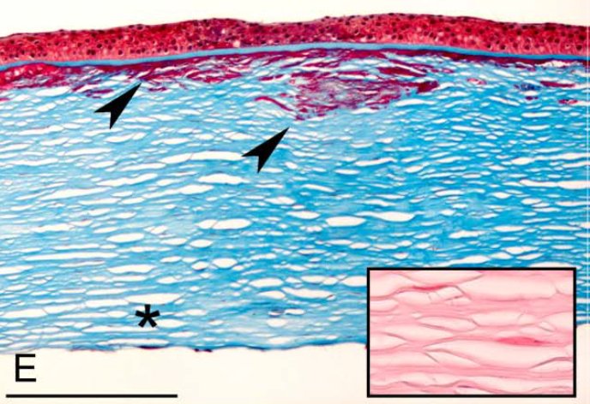
Corneal Dystrophies
Granular corneal dystrophy, type 2. E, Light microscopy—Masson trichrome stains sub-Bowman and anterior stromal hyaline deposits red (arrowheads). Note that the deeper stromal layers do not have hyaline granules (asterisk). In the deep stroma, small amyloid deposits stain with Congo red (inset).

Slide 133
Corneal Dystrophies
Epithelial and Subepithelial Dystrophies
By what other names is GCD2 known?
Combined granular-lattice dystrophy; Avellino dystrophy
At what age does GCD2 begin to manifest?
Usually in the teen to early-adult years, can be younger
How does it present? What is seen at the slit lamp?
Basically, as a combination of GCD1 and lattice dystrophy: The crumblike granules of GCD1, along with a version of the lattice lines seen in LCD
Is it painful?
Yes; pts get recurrent epithelial erosions
Does it affect vision?
Glare and stromal haze result in decreased vision
What is the histologic hallmark of GCD1 on light microscopy?
The presence of both amyloid and hyaline in the subepithelial space and anterior stroma. The hyaline stains bright red with Masson trichrome ; the amyloid stains with Congo Red , and birefringes green under polarized light.
What is the hallmark of GCD2 on electron microscopy?
Rod-shaped fibers , albeit in reduced numbers
Epithelial-Stromal TGFBI Dystrophies
1) Reis-Bücklers corneal dystrophy
2) Thiel-Behnke corneal dystrophy
3) Lattice, type 1
4) Lattice, variant types (III, IIIA, I/IIIA, IV)
5) Granular type 1
6) Granular type 2
Stromal Dystrophies
Endothelial Dystrophies

Slide 134
Corneal Dystrophies
Epithelial and Subepithelial Dystrophies
By what other names is GCD2 known?
Combined granular-lattice dystrophy; Avellino dystrophy
At what age does GCD2 begin to manifest?
Usually in the teen to early-adult years, can be younger
How does it present? What is seen at the slit lamp?
Basically, as a combination of GCD1 and lattice dystrophy: The crumblike granules of GCD1, along with a version of the lattice lines seen in LCD
Is it painful?
Yes; pts get recurrent epithelial erosions
Does it affect vision?
Glare and stromal haze result in decreased vision
What is the histologic hallmark of GCD1 on light microscopy?
The presence of both amyloid and hyaline in the subepithelial space and anterior stroma. The hyaline stains bright red with Masson trichrome ; the amyloid stains with Congo Red , and birefringes green under polarized light.
What is the hallmark of GCD2 on electron microscopy?
Rod-shaped fibers , albeit in reduced numbers
Epithelial-Stromal TGFBI Dystrophies
1) Reis-Bücklers corneal dystrophy
2) Thiel-Behnke corneal dystrophy
3) Lattice, type 1
4) Lattice, variant types (III, IIIA, I/IIIA, IV)
5) Granular type 1
6) Granular type 2
Stromal Dystrophies
Endothelial Dystrophies
three words

Slide 135
Corneal Dystrophies
Epithelial and Subepithelial Dystrophies
By what other names is GCD2 known?
Combined granular-lattice dystrophy; Avellino dystrophy
At what age does GCD2 begin to manifest?
Usually in the teen to early-adult years, can be younger
How does it present? What is seen at the slit lamp?
Basically, as a combination of GCD1 and lattice dystrophy: The crumblike granules of GCD1, along with a version of the lattice lines seen in LCD
Is it painful?
Yes; pts get recurrent epithelial erosions
Does it affect vision?
Glare and stromal haze result in decreased vision
What is the histologic hallmark of GCD1 on light microscopy?
The presence of both amyloid and hyaline in the subepithelial space and anterior stroma. The hyaline stains bright red with Masson trichrome ; the amyloid stains with Congo Red , and birefringes green under polarized light.
What is the hallmark of GCD2 on electron microscopy?
Rod-shaped fibers , albeit in reduced numbers
Epithelial-Stromal TGFBI Dystrophies
1) Reis-Bücklers corneal dystrophy
2) Thiel-Behnke corneal dystrophy
3) Lattice, type 1
4) Lattice, variant types (III, IIIA, I/IIIA, IV)
5) Granular type 1
6) Granular type 2
Stromal Dystrophies
Endothelial Dystrophies

Slide 136
Corneal Dystrophies
Epithelial and Subepithelial Dystrophies
By what other names is GCD2 known?
Combined granular-lattice dystrophy; Avellino dystrophy
At what age does GCD2 begin to manifest?
Usually in the teen to early-adult years, can be younger
How does it present? What is seen at the slit lamp?
Basically, as a combination of GCD1 and lattice dystrophy: The crumblike granules of GCD1, along with a version of the lattice lines seen in LCD
Is it painful?
Yes; pts get recurrent epithelial erosions
Does it affect vision?
Glare and stromal haze result in decreased vision
What is the histologic hallmark of GCD1 on light microscopy?
The presence of both amyloid and hyaline in the subepithelial space and anterior stroma. The hyaline stains bright red with Masson trichrome ; the amyloid stains with Congo Red , and birefringes green under polarized light.
What is the hallmark of GCD2 on electron microscopy?
Rod-shaped fibers , albeit in reduced numbers
Epithelial-Stromal TGFBI Dystrophies
1) Reis-Bücklers corneal dystrophy
2) Thiel-Behnke corneal dystrophy
3) Lattice, type 1
4) Lattice, variant types (III, IIIA, I/IIIA, IV)
5) Granular type 1
6) Granular type 2
Stromal Dystrophies
Endothelial Dystrophies

Slide 137
Corneal Dystrophies
Epithelial and Subepithelial Dystrophies
By what other names is GCD2 known?
Combined granular-lattice dystrophy; Avellino dystrophy
At what age does GCD2 begin to manifest?
Usually in the teen to early-adult years, can be younger
How does it present? What is seen at the slit lamp?
Basically, as a combination of GCD1 and lattice dystrophy: The crumblike granules of GCD1, along with a version of the lattice lines seen in LCD
Is it painful?
Yes; pts get recurrent epithelial erosions
Does it affect vision?
Glare and stromal haze result in decreased vision
What is the histologic hallmark of GCD1 on light microscopy?
The presence of both amyloid and hyaline in the subepithelial space and anterior stroma. The hyaline stains bright red with Masson trichrome ; the amyloid stains with Congo Red , and birefringes green under polarized light.
What is the hallmark of GCD2 on electron microscopy?
Rod-shaped fibers , albeit in reduced numbers
Epithelial-Stromal TGFBI Dystrophies
1) Reis-Bücklers corneal dystrophy
2) Thiel-Behnke corneal dystrophy
3) Lattice, type 1
4) Lattice, variant types (III, IIIA, I/IIIA, IV)
5) Granular type 1
6) Granular type 2
versus
Stromal Dystrophies
How do the lattice lines in GCD2 differ from those in lattice dystrophy?
--?
--?
--? tend not to cross one another (ie, so they are less reminiscent of an actual lattice structure)
Endothelial Dystrophies

Slide 138
Corneal Dystrophies
Epithelial and Subepithelial Dystrophies
By what other names is GCD2 known?
Combined granular-lattice dystrophy; Avellino dystrophy
At what age does GCD2 begin to manifest?
Usually in the teen to early-adult years, can be younger
How does it present? What is seen at the slit lamp?
Basically, as a combination of GCD1 and lattice dystrophy: The crumblike granules of GCD1, along with a version of the lattice lines seen in LCD
Is it painful?
Yes; pts get recurrent epithelial erosions
Does it affect vision?
Glare and stromal haze result in decreased vision
What is the histologic hallmark of GCD1 on light microscopy?
The presence of both amyloid and hyaline in the subepithelial space and anterior stroma. The hyaline stains bright red with Masson trichrome ; the amyloid stains with Congo Red , and birefringes green under polarized light.
What is the hallmark of GCD2 on electron microscopy?
Rod-shaped fibers , albeit in reduced numbers
Epithelial-Stromal TGFBI Dystrophies
1) Reis-Bücklers corneal dystrophy
2) Thiel-Behnke corneal dystrophy
3) Lattice, type 1
4) Lattice, variant types (III, IIIA, I/IIIA, IV)
5) Granular type 1
6) Granular type 2
versus
Stromal Dystrophies
How do the lattice lines in GCD2 differ from those in lattice dystrophy?
--They tend to be shorter
--?
--?
shorter v longer
Endothelial Dystrophies

Slide 139
Corneal Dystrophies
Epithelial and Subepithelial Dystrophies
By what other names is GCD2 known?
Combined granular-lattice dystrophy; Avellino dystrophy
At what age does GCD2 begin to manifest?
Usually in the teen to early-adult years, can be younger
How does it present? What is seen at the slit lamp?
Basically, as a combination of GCD1 and lattice dystrophy: The crumblike granules of GCD1, along with a version of the lattice lines seen in LCD
Is it painful?
Yes; pts get recurrent epithelial erosions
Does it affect vision?
Glare and stromal haze result in decreased vision
What is the histologic hallmark of GCD1 on light microscopy?
The presence of both amyloid and hyaline in the subepithelial space and anterior stroma. The hyaline stains bright red with Masson trichrome ; the amyloid stains with Congo Red , and birefringes green under polarized light.
What is the hallmark of GCD2 on electron microscopy?
Rod-shaped fibers , albeit in reduced numbers
Epithelial-Stromal TGFBI Dystrophies
1) Reis-Bücklers corneal dystrophy
2) Thiel-Behnke corneal dystrophy
3) Lattice, type 1
4) Lattice, variant types (III, IIIA, I/IIIA, IV)
5) Granular type 1
6) Granular type 2
versus
Stromal Dystrophies
How do the lattice lines in GCD2 differ from those in lattice dystrophy?
--They tend to be shorter
--?
--?
Endothelial Dystrophies

Slide 140
Corneal Dystrophies
Epithelial and Subepithelial Dystrophies
By what other names is GCD2 known?
Combined granular-lattice dystrophy; Avellino dystrophy
At what age does GCD2 begin to manifest?
Usually in the teen to early-adult years, can be younger
How does it present? What is seen at the slit lamp?
Basically, as a combination of GCD1 and lattice dystrophy: The crumblike granules of GCD1, along with a version of the lattice lines seen in LCD
Is it painful?
Yes; pts get recurrent epithelial erosions
Does it affect vision?
Glare and stromal haze result in decreased vision
What is the histologic hallmark of GCD1 on light microscopy?
The presence of both amyloid and hyaline in the subepithelial space and anterior stroma. The hyaline stains bright red with Masson trichrome ; the amyloid stains with Congo Red , and birefringes green under polarized light.
What is the hallmark of GCD2 on electron microscopy?
Rod-shaped fibers , albeit in reduced numbers
Epithelial-Stromal TGFBI Dystrophies
1) Reis-Bücklers corneal dystrophy
2) Thiel-Behnke corneal dystrophy
3) Lattice, type 1
4) Lattice, variant types (III, IIIA, I/IIIA, IV)
5) Granular type 1
6) Granular type 2
versus
Stromal Dystrophies
How do the lattice lines in GCD2 differ from those in lattice dystrophy?
--They tend to be shorter
--They tend to be whiter and less ‘glasslike’ (ie, not as refractile )
--?
shading
something-like
visual property
Endothelial Dystrophies

Slide 141
Corneal Dystrophies
Epithelial and Subepithelial Dystrophies
By what other names is GCD2 known?
Combined granular-lattice dystrophy; Avellino dystrophy
At what age does GCD2 begin to manifest?
Usually in the teen to early-adult years, can be younger
How does it present? What is seen at the slit lamp?
Basically, as a combination of GCD1 and lattice dystrophy: The crumblike granules of GCD1, along with a version of the lattice lines seen in LCD
Is it painful?
Yes; pts get recurrent epithelial erosions
Does it affect vision?
Glare and stromal haze result in decreased vision
What is the histologic hallmark of GCD1 on light microscopy?
The presence of both amyloid and hyaline in the subepithelial space and anterior stroma. The hyaline stains bright red with Masson trichrome ; the amyloid stains with Congo Red , and birefringes green under polarized light.
What is the hallmark of GCD2 on electron microscopy?
Rod-shaped fibers , albeit in reduced numbers
Epithelial-Stromal TGFBI Dystrophies
1) Reis-Bücklers corneal dystrophy
2) Thiel-Behnke corneal dystrophy
3) Lattice, type 1
4) Lattice, variant types (III, IIIA, I/IIIA, IV)
5) Granular type 1
6) Granular type 2
versus
Stromal Dystrophies
How do the lattice lines in GCD2 differ from those in lattice dystrophy?
--They tend to be shorter
--They tend to be whiter and less ‘glasslike’ (ie, not as refractile )
--?
Endothelial Dystrophies

Slide 142
Corneal Dystrophies
Epithelial and Subepithelial Dystrophies
By what other names is GCD2 known?
Combined granular-lattice dystrophy; Avellino dystrophy
At what age does GCD2 begin to manifest?
Usually in the teen to early-adult years, can be younger
How does it present? What is seen at the slit lamp?
Basically, as a combination of GCD1 and lattice dystrophy: The crumblike granules of GCD1, along with a version of the lattice lines seen in LCD
Is it painful?
Yes; pts get recurrent epithelial erosions
Does it affect vision?
Glare and stromal haze result in decreased vision
What is the histologic hallmark of GCD1 on light microscopy?
The presence of both amyloid and hyaline in the subepithelial space and anterior stroma. The hyaline stains bright red with Masson trichrome ; the amyloid stains with Congo Red , and birefringes green under polarized light.
What is the hallmark of GCD2 on electron microscopy?
Rod-shaped fibers , albeit in reduced numbers
Epithelial-Stromal TGFBI Dystrophies
1) Reis-Bücklers corneal dystrophy
2) Thiel-Behnke corneal dystrophy
3) Lattice, type 1
4) Lattice, variant types (III, IIIA, I/IIIA, IV)
5) Granular type 1
6) Granular type 2
versus
Stromal Dystrophies
How do the lattice lines in GCD2 differ from those in lattice dystrophy?
--They tend to be shorter
--They tend to be whiter and less ‘glasslike’ (ie, not as refractile )
--They tend not to cross one another (ie, so they are less reminiscent of an actual lattice structure)
amen (three words)
Endothelial Dystrophies

Slide 143
Corneal Dystrophies
Epithelial and Subepithelial Dystrophies
By what other names is GCD2 known?
Combined granular-lattice dystrophy; Avellino dystrophy
At what age does GCD2 begin to manifest?
Usually in the teen to early-adult years, can be younger
How does it present? What is seen at the slit lamp?
Basically, as a combination of GCD1 and lattice dystrophy: The crumblike granules of GCD1, along with a version of the lattice lines seen in LCD
Is it painful?
Yes; pts get recurrent epithelial erosions
Does it affect vision?
Glare and stromal haze result in decreased vision
What is the histologic hallmark of GCD1 on light microscopy?
The presence of both amyloid and hyaline in the subepithelial space and anterior stroma. The hyaline stains bright red with Masson trichrome ; the amyloid stains with Congo Red , and birefringes green under polarized light.
What is the hallmark of GCD2 on electron microscopy?
Rod-shaped fibers , albeit in reduced numbers
Epithelial-Stromal TGFBI Dystrophies
1) Reis-Bücklers corneal dystrophy
2) Thiel-Behnke corneal dystrophy
3) Lattice, type 1
4) Lattice, variant types (III, IIIA, I/IIIA, IV)
5) Granular type 1
6) Granular type 2
versus
Stromal Dystrophies
How do the lattice lines in GCD2 differ from those in lattice dystrophy?
--They tend to be shorter
--They tend to be whiter and less ‘glasslike’ (ie, not as refractile )
--They tend not to cross one another (ie, so they are less reminiscent of an actual lattice structure)
Endothelial Dystrophies

Slide 144
Corneal Dystrophies
Epithelial and Subepithelial Dystrophies
Epithelial-Stromal TGFBI Dystrophies
1) Reis-Bücklers corneal dystrophy
2) Thiel-Behnke corneal dystrophy
3) Lattice, type 1
4) Lattice, variant types (III, IIIA, I/IIIA, IV)
5) Granular type 1
6) Granular type 2
These two primarily involve Bowman’s membrane
There are two ‘lattice’ forms
Two are ‘granular’ forms
Stromal Dystrophies
As a way to help remember them, think of the TGFBI dystrophies as consisting of three pairs of conditions: Two Bowman’s dystrophies, two lattice dystrophies, and two granular dystrophies
Endothelial Dystrophies

