Slide 1
Q
Abusive Head Trauma (AHT)
AHT was formerly known as shaken baby syndrome
three words

Slide 2
A
Abusive Head Trauma (AHT)
AHT was formerly known as shaken baby syndrome

Slide 3
Q
Abusive Head Trauma (AHT)
AHT was formerly known as shaken baby syndrome
What is the classic scenario that results in AHT?
A parent, out of frustration/anger, violently shakes an infant who is crying inconsolably

Slide 4
A
Abusive Head Trauma (AHT)
AHT was formerly known as shaken baby syndrome
What is the classic scenario that results in AHT?
An adult, out of frustration/anger, violently shakes an infant who is crying inconsolably

Slide 5
Abusive Head Trauma (AHT)
AHT was formerly known as shaken baby syndrome
Typical victim age is inconsistent between the BCSC books:
Peds: ‘Usually younger than 1 year , most often younger than 5 years’
Retina: ‘Almost always younger than 1 year; frequently younger than 6 months’
(No question—proceed when ready)

Slide 6
Q
Abusive Head Trauma (AHT)
AHT was formerly known as shaken baby syndrome
Typical victim age is inconsistent between the BCSC books:
Peds: ‘Usually younger than 1 year , most often younger than 5 years’
Retina: ‘Almost always younger than 1 year; frequently younger than 6 months’
Anterior segment/lid exam is usually unremarkable
unremarkable? jacked up?

Slide 7
A
Abusive Head Trauma (AHT)
AHT was formerly known as shaken baby syndrome
Typical victim age is inconsistent between the BCSC books:
Peds: ‘Usually younger than 1 year , most often younger than 5 years’
Retina: ‘Almost always younger than 1 year; frequently younger than 6 months’
Anterior segment/lid exam is usually unremarkable

Slide 8
Q
Abusive Head Trauma (AHT)
AHT was formerly known as shaken baby syndrome
Typical victim age is inconsistent between the BCSC books:
Peds: ‘Usually younger than 1 year , most often younger than 5 years’
Retina: ‘Almost always younger than 1 year; frequently younger than 6 months’
Anterior segment/lid exam is usually unremarkable
Retinal hemorrhages in AHT:
…are strongly associated with SDH and often with SAH
SDH vs
SAH
SDH vs
SAH

Slide 9
A
Abusive Head Trauma (AHT)
AHT was formerly known as shaken baby syndrome
Typical victim age is inconsistent between the BCSC books:
Peds: ‘Usually younger than 1 year , most often younger than 5 years’
Retina: ‘Almost always younger than 1 year; frequently younger than 6 months’
Anterior segment/lid exam is usually unremarkable
Retinal hemorrhages in AHT:
…are strongly associated with SDH and often with SAH

Slide 10
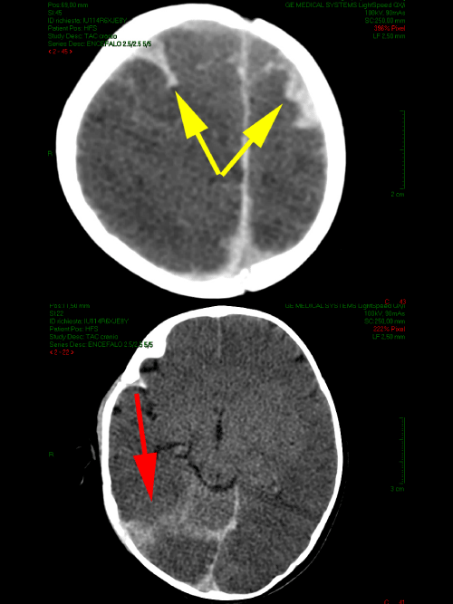
Abusive Head Trauma (AHT)
AHT: SDH/SAH

Slide 11
Q
Abusive Head Trauma (AHT)
AHT was formerly known as shaken baby syndrome
Typical victim age is inconsistent between the BCSC books:
Peds: ‘Usually younger than 1 year , most often younger than 5 years’
Retina: ‘Almost always younger than 1 year; frequently younger than 6 months’
Anterior segment/lid exam is usually unremarkable
Retinal hemorrhages in AHT:
…are strongly associated with SDH and often with SAH
…can be associated with traumatic retinoschisis
structural retina problem

Slide 12
A
Abusive Head Trauma (AHT)
AHT was formerly known as shaken baby syndrome
Typical victim age is inconsistent between the BCSC books:
Peds: ‘Usually younger than 1 year , most often younger than 5 years’
Retina: ‘Almost always younger than 1 year; frequently younger than 6 months’
Anterior segment/lid exam is usually unremarkable
Retinal hemorrhages in AHT:
…are strongly associated with SDH and often with SAH
…can be associated with traumatic retinoschisis

Slide 13
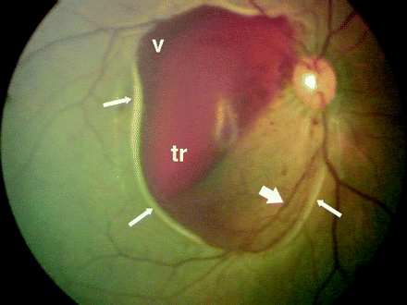
Abusive Head Trauma (AHT)
Traumatic retinoschisis of the macula in AHT. Arrows indicate the retinal fold at the edge of schisis with underlying hypopigmentation; tr, blood within the schisis cavity; v, blood escaping from the schisis cavity into the vitreous. Note the blood vessel (thick, short arrow) traveling from the optic nerve up onto the surface of the elevated schisis cavity and then down.
AHT: Retinoschisis

Slide 14
Abusive Head Trauma (AHT)
AHT was formerly known as shaken baby syndrome
Typical victim age is inconsistent between the BCSC books:
Peds: ‘Usually younger than 1 year , most often younger than 5 years’
Retina: ‘Almost always younger than 1 year; frequently younger than 6 months’
Anterior segment/lid exam is usually unremarkable
Retinal hemorrhages in AHT:
…are strongly associated with SDH and often with SAH
…can be associated with traumatic retinoschisis
Natural hx of hemorrhages is also inconsistent between BCSC books:
Peds: ‘Persist for weeks to months’
Retina: ‘Can resolve very rapidly’
(No question—proceed when ready)

Slide 15
Q
Abusive Head Trauma (AHT)
AHT was formerly known as shaken baby syndrome
Typical victim age is inconsistent between the BCSC books:
Peds: ‘Usually younger than 1 year , most often younger than 5 years’
Retina: ‘Almost always younger than 1 year; frequently younger than 6 months’
Anterior segment/lid exam is usually unremarkable
Retinal hemorrhages in AHT:
…are strongly associated with SDH and often with SAH
…can be associated with traumatic retinoschisis
Natural hx of hemorrhages is also inconsistent between BCSC books:
Peds: ‘Persist for weeks to months’
Retina: ‘Can resolve very rapidly’
How extensive are the hemorrhages in AHT?
Very extensive--too numerous to count
Which layers of the retina are involved?
All layers
Where in the eye are they located?
Always in the posterior pole, but often extending well into the periphery
Are the unilateral, or bilateral?
Usually bilateral, can be either
Can the heme reach the vitreous, resulting in an apparent vitreous hemorrhage?
Yes

Slide 16
A
Abusive Head Trauma (AHT)
AHT was formerly known as shaken baby syndrome
Typical victim age is inconsistent between the BCSC books:
Peds: ‘Usually younger than 1 year , most often younger than 5 years’
Retina: ‘Almost always younger than 1 year; frequently younger than 6 months’
Anterior segment/lid exam is usually unremarkable
Retinal hemorrhages in AHT:
…are strongly associated with SDH and often with SAH
…can be associated with traumatic retinoschisis
Natural hx of hemorrhages is also inconsistent between BCSC books:
Peds: ‘Persist for weeks to months’
Retina: ‘Can resolve very rapidly’
How extensive are the hemorrhages in AHT?
Very extensive--too numerous to count
Which layers of the retina are involved?
All layers
Where in the eye are they located?
Always in the posterior pole, but often extending well into the periphery
Are the unilateral, or bilateral?
Usually bilateral, can be either
Can the heme reach the vitreous, resulting in an apparent vitreous hemorrhage?
Yes

Slide 17
Q
Abusive Head Trauma (AHT)
AHT was formerly known as shaken baby syndrome
Typical victim age is inconsistent between the BCSC books:
Peds: ‘Usually younger than 1 year , most often younger than 5 years’
Retina: ‘Almost always younger than 1 year; frequently younger than 6 months’
Anterior segment/lid exam is usually unremarkable
Retinal hemorrhages in AHT:
…are strongly associated with SDH and often with SAH
…can be associated with traumatic retinoschisis
Natural hx of hemorrhages is also inconsistent between BCSC books:
Peds: ‘Persist for weeks to months’
Retina: ‘Can resolve very rapidly’
How extensive are the hemorrhages in AHT?
Very extensive--too numerous to count
Which layers of the retina are involved?
All layers
Where in the eye are they located?
Always in the posterior pole, but often extending well into the periphery
Are the unilateral, or bilateral?
Usually bilateral, can be either
Can the heme reach the vitreous, resulting in an apparent vitreous hemorrhage?
Yes

Slide 18
A
Abusive Head Trauma (AHT)
AHT was formerly known as shaken baby syndrome
Typical victim age is inconsistent between the BCSC books:
Peds: ‘Usually younger than 1 year , most often younger than 5 years’
Retina: ‘Almost always younger than 1 year; frequently younger than 6 months’
Anterior segment/lid exam is usually unremarkable
Retinal hemorrhages in AHT:
…are strongly associated with SDH and often with SAH
…can be associated with traumatic retinoschisis
Natural hx of hemorrhages is also inconsistent between BCSC books:
Peds: ‘Persist for weeks to months’
Retina: ‘Can resolve very rapidly’
How extensive are the hemorrhages in AHT?
Very extensive--too numerous to count
Which layers of the retina are involved?
All layers
Where in the eye are they located?
Always in the posterior pole, but often extending well into the periphery
Are the unilateral, or bilateral?
Usually bilateral, can be either
Can the heme reach the vitreous, resulting in an apparent vitreous hemorrhage?
Yes

Slide 19
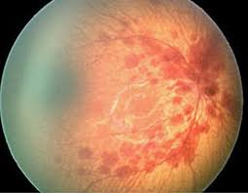
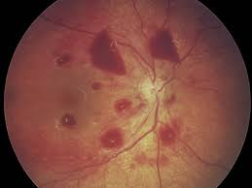
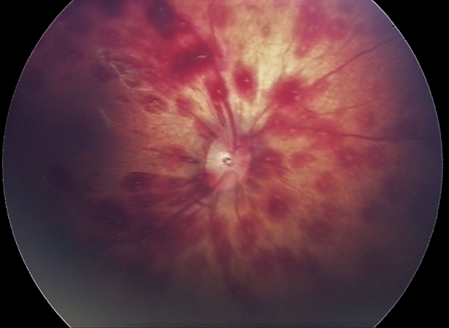
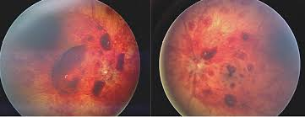
Abusive Head Trauma (AHT)
AHT: Retinal hemorrhages at all levels

Slide 20
Q
Abusive Head Trauma (AHT)
AHT was formerly known as shaken baby syndrome
Typical victim age is inconsistent between the BCSC books:
Peds: ‘Usually younger than 1 year , most often younger than 5 years’
Retina: ‘Almost always younger than 1 year; frequently younger than 6 months’
Anterior segment/lid exam is usually unremarkable
Retinal hemorrhages in AHT:
…are strongly associated with SDH and often with SAH
…can be associated with traumatic retinoschisis
Natural hx of hemorrhages is also inconsistent between BCSC books:
Peds: ‘Persist for weeks to months’
Retina: ‘Can resolve very rapidly’
How extensive are the hemorrhages in AHT?
Very extensive--too numerous to count
Which layers of the retina are involved?
All layers
Where in the eye are they located?
Always in the posterior pole, but often extending well into the periphery
Are the unilateral, or bilateral?
Usually bilateral, can be either
Can the heme reach the vitreous, resulting in an apparent vitreous hemorrhage?
Yes

Slide 21
A
Abusive Head Trauma (AHT)
AHT was formerly known as shaken baby syndrome
Typical victim age is inconsistent between the BCSC books:
Peds: ‘Usually younger than 1 year , most often younger than 5 years’
Retina: ‘Almost always younger than 1 year; frequently younger than 6 months’
Anterior segment/lid exam is usually unremarkable
Retinal hemorrhages in AHT:
…are strongly associated with SDH and often with SAH
…can be associated with traumatic retinoschisis
Natural hx of hemorrhages is also inconsistent between BCSC books:
Peds: ‘Persist for weeks to months’
Retina: ‘Can resolve very rapidly’
How extensive are the hemorrhages in AHT?
Very extensive--too numerous to count
Which layers of the retina are involved?
All layers
Where in the eye are they located?
Always in the posterior pole, but often extending well into the periphery
Are the unilateral, or bilateral?
Usually bilateral, can be either
Can the heme reach the vitreous, resulting in an apparent vitreous hemorrhage?
Yes

Slide 22
Q
Abusive Head Trauma (AHT)
AHT was formerly known as shaken baby syndrome
Typical victim age is inconsistent between the BCSC books:
Peds: ‘Usually younger than 1 year , most often younger than 5 years’
Retina: ‘Almost always younger than 1 year; frequently younger than 6 months’
Anterior segment/lid exam is usually unremarkable
Retinal hemorrhages in AHT:
…are strongly associated with SDH and often with SAH
…can be associated with traumatic retinoschisis
Natural hx of hemorrhages is also inconsistent between BCSC books:
Peds: ‘Persist for weeks to months’
Retina: ‘Can resolve very rapidly’
How extensive are the hemorrhages in AHT?
Very extensive--too numerous to count
Which layers of the retina are involved?
All layers
Where in the eye are they located?
Always in the posterior pole, but often extending well into the periphery
Are the unilateral, or bilateral?
Usually bilateral, can be either
Can the heme reach the vitreous, resulting in an apparent vitreous hemorrhage?
Yes

Slide 23
A
Abusive Head Trauma (AHT)
AHT was formerly known as shaken baby syndrome
Typical victim age is inconsistent between the BCSC books:
Peds: ‘Usually younger than 1 year , most often younger than 5 years’
Retina: ‘Almost always younger than 1 year; frequently younger than 6 months’
Anterior segment/lid exam is usually unremarkable
Retinal hemorrhages in AHT:
…are strongly associated with SDH and often with SAH
…can be associated with traumatic retinoschisis
Natural hx of hemorrhages is also inconsistent between BCSC books:
Peds: ‘Persist for weeks to months’
Retina: ‘Can resolve very rapidly’
How extensive are the hemorrhages in AHT?
Very extensive--too numerous to count
Which layers of the retina are involved?
All layers
Where in the eye are they located?
Always in the posterior pole, but often extending well into the periphery
Are the unilateral, or bilateral?
Usually bilateral, can be either
Can the heme reach the vitreous, resulting in an apparent vitreous hemorrhage?
Yes

Slide 24
Q
Abusive Head Trauma (AHT)
AHT was formerly known as shaken baby syndrome
Typical victim age is inconsistent between the BCSC books:
Peds: ‘Usually younger than 1 year , most often younger than 5 years’
Retina: ‘Almost always younger than 1 year; frequently younger than 6 months’
Anterior segment/lid exam is usually unremarkable
Retinal hemorrhages in AHT:
…are strongly associated with SDH and often with SAH
…can be associated with traumatic retinoschisis
Natural hx of hemorrhages is also inconsistent between BCSC books:
Peds: ‘Persist for weeks to months’
Retina: ‘Can resolve very rapidly’
How extensive are the hemorrhages in AHT?
Very extensive--too numerous to count
Which layers of the retina are involved?
All layers
Where in the eye are they located?
Always in the posterior pole, but often extending well into the periphery
Are the unilateral, or bilateral?
Usually bilateral, can be either
Can the heme reach the vitreous, resulting in an apparent vitreous hemorrhage?
Yes

Slide 25
A
Abusive Head Trauma (AHT)
AHT was formerly known as shaken baby syndrome
Typical victim age is inconsistent between the BCSC books:
Peds: ‘Usually younger than 1 year , most often younger than 5 years’
Retina: ‘Almost always younger than 1 year; frequently younger than 6 months’
Anterior segment/lid exam is usually unremarkable
Retinal hemorrhages in AHT:
…are strongly associated with SDH and often with SAH
…can be associated with traumatic retinoschisis
Natural hx of hemorrhages is also inconsistent between BCSC books:
Peds: ‘Persist for weeks to months’
Retina: ‘Can resolve very rapidly’
How extensive are the hemorrhages in AHT?
Very extensive--too numerous to count
Which layers of the retina are involved?
All layers
Where in the eye are they located?
Always in the posterior pole, but often extending well into the periphery
Are the unilateral, or bilateral?
Usually bilateral, can be either
Can the heme reach the vitreous, resulting in an apparent vitreous hemorrhage?
Yes

Slide 26
Q
Abusive Head Trauma (AHT)
AHT was formerly known as shaken baby syndrome
Typical victim age is inconsistent between the BCSC books:
Peds: ‘Usually younger than 1 year , most often younger than 5 years’
Retina: ‘Almost always younger than 1 year; frequently younger than 6 months’
Anterior segment/lid exam is usually unremarkable
Retinal hemorrhages in AHT:
…are strongly associated with SDH and often with SAH
…can be associated with traumatic retinoschisis
Natural hx of hemorrhages is also inconsistent between BCSC books:
Peds: ‘Persist for weeks to months’
Retina: ‘Can resolve very rapidly’
Retinal hemorrhages associated with…
…CPR are rare , and never extensive
rare vs
common
how extensive?

Slide 27
A
Abusive Head Trauma (AHT)
AHT was formerly known as shaken baby syndrome
Typical victim age is inconsistent between the BCSC books:
Peds: ‘Usually younger than 1 year , most often younger than 5 years’
Retina: ‘Almost always younger than 1 year; frequently younger than 6 months’
Anterior segment/lid exam is usually unremarkable
Retinal hemorrhages in AHT:
…are strongly associated with SDH and often with SAH
…can be associated with traumatic retinoschisis
Natural hx of hemorrhages is also inconsistent between BCSC books:
Peds: ‘Persist for weeks to months’
Retina: ‘Can resolve very rapidly’
Retinal hemorrhages associated with…
…CPR are rare , and never extensive

Slide 28
Q
Abusive Head Trauma (AHT)
AHT was formerly known as shaken baby syndrome
Typical victim age is inconsistent between the BCSC books:
Peds: ‘Usually younger than 1 year , most often younger than 5 years’
Retina: ‘Almost always younger than 1 year; frequently younger than 6 months’
Anterior segment/lid exam is usually unremarkable
Retinal hemorrhages in AHT:
…are strongly associated with SDH and often with SAH
…can be associated with traumatic retinoschisis
Natural hx of hemorrhages is also inconsistent between BCSC books:
Peds: ‘Persist for weeks to months’
Retina: ‘Can resolve very rapidly’
Retinal hemorrhages associated with…
…CPR are rare , and never extensive
…birth are common , but resolve by age 1 month
rare vs
common

Slide 29
A
Abusive Head Trauma (AHT)
AHT was formerly known as shaken baby syndrome
Typical victim age is inconsistent between the BCSC books:
Peds: ‘Usually younger than 1 year , most often younger than 5 years’
Retina: ‘Almost always younger than 1 year; frequently younger than 6 months’
Anterior segment/lid exam is usually unremarkable
Retinal hemorrhages in AHT:
…are strongly associated with SDH and often with SAH
…can be associated with traumatic retinoschisis
Natural hx of hemorrhages is also inconsistent between BCSC books:
Peds: ‘Persist for weeks to months’
Retina: ‘Can resolve very rapidly’
Retinal hemorrhages associated with…
…CPR are rare , and never extensive
…birth are common , but resolve by age 1 month

Slide 30
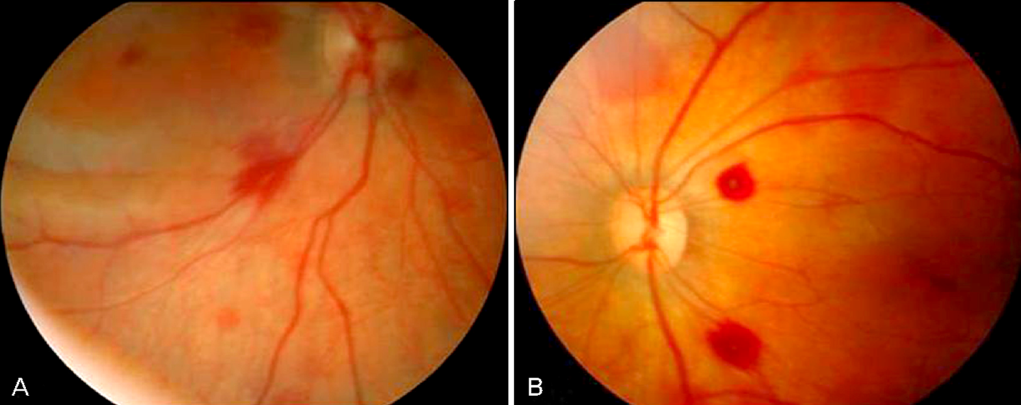
Abusive Head Trauma (AHT)
Fundus photographs of retinal hemorrhages in neonates that had a history of birth asphyxia and amniotic fluid aspiration
Retinal hemorrhages after birth trauma

Slide 31
Q
Abusive Head Trauma (AHT)
AHT was formerly known as shaken baby syndrome
Typical victim age is inconsistent between the BCSC books:
Peds: ‘Usually younger than 1 year , most often younger than 5 years’
Retina: ‘Almost always younger than 1 year; frequently younger than 6 months’
Anterior segment/lid exam is usually unremarkable
Retinal hemorrhages in AHT:
…are strongly associated with SDH and often with SAH
…can be associated with traumatic retinoschisis
Natural hx of hemorrhages is also inconsistent between BCSC books:
Peds: ‘Persist for weeks to months’
Retina: ‘Can resolve very rapidly’
Retinal hemorrhages associated with…
…CPR are rare , and never extensive
…birth are common , but resolve by age 1 month
…severe head trauma are never extensive
how extensive?

Slide 32
A
Abusive Head Trauma (AHT)
AHT was formerly known as shaken baby syndrome
Typical victim age is inconsistent between the BCSC books:
Peds: ‘Usually younger than 1 year , most often younger than 5 years’
Retina: ‘Almost always younger than 1 year; frequently younger than 6 months’
Anterior segment/lid exam is usually unremarkable
Retinal hemorrhages in AHT:
…are strongly associated with SDH and often with SAH
…can be associated with traumatic retinoschisis
Natural hx of hemorrhages is also inconsistent between BCSC books:
Peds: ‘Persist for weeks to months’
Retina: ‘Can resolve very rapidly’
Retinal hemorrhages associated with…
…CPR are rare , and never extensive
…birth are common , but resolve by age 1 month
…severe head trauma are never extensive

Slide 33
Q
Abusive Head Trauma (AHT)
AHT was formerly known as shaken baby syndrome
Typical victim age is inconsistent between the BCSC books:
Peds: ‘Usually younger than 1 year , most often younger than 5 years’
Retina: ‘Almost always younger than 1 year; frequently younger than 6 months’
Anterior segment/lid exam is usually unremarkable
Retinal hemorrhages in AHT:
…are strongly associated with SDH and often with SAH
…can be associated with traumatic retinoschisis
Natural hx of hemorrhages is also inconsistent between BCSC books:
Peds: ‘Persist for weeks to months’
Retina: ‘Can resolve very rapidly’
Retinal hemorrhages associated with…
…CPR are rare , and never extensive
…birth are common , but resolve by age 1 month
…severe head trauma are never extensive
1/4 to 1/3 of AHT victims will succumb to their injuries
proportion (range)

Slide 34
A
Abusive Head Trauma (AHT)
AHT was formerly known as shaken baby syndrome
Typical victim age is inconsistent between the BCSC books:
Peds: ‘Usually younger than 1 year , most often younger than 5 years’
Retina: ‘Almost always younger than 1 year; frequently younger than 6 months’
Anterior segment/lid exam is usually unremarkable
Retinal hemorrhages in AHT:
…are strongly associated with SDH and often with SAH
…can be associated with traumatic retinoschisis
Natural hx of hemorrhages is also inconsistent between BCSC books:
Peds: ‘Persist for weeks to months’
Retina: ‘Can resolve very rapidly’
Retinal hemorrhages associated with…
…CPR are rare , and never extensive
…birth are common , but resolve by age 1 month
…severe head trauma are never extensive
1/4 to 1/3 of AHT victims will succumb to their injuries

Slide 35
Abusive Head Trauma (AHT)
AHT was formerly known as shaken baby syndrome
Typical victim age is inconsistent between the BCSC books:
Peds: ‘Usually younger than 1 year , most often younger than 5 years’
Retina: ‘Almost always younger than 1 year; frequently younger than 6 months’
Anterior segment/lid exam is usually unremarkable
Retinal hemorrhages in AHT:
…are strongly associated with SDH and often with SAH
…can be associated with traumatic retinoschisis
Natural hx of hemorrhages is also inconsistent between BCSC books:
Peds: ‘Persist for weeks to months’
Retina: ‘Can resolve very rapidly’
Retinal hemorrhages associated with…
…CPR are rare , and never extensive
…birth are common , but resolve by age 1 month
…severe head trauma are never extensive
1/4 to 1/3 of AHT victims will succumb to their injuries
Survivors often have lifelong cognitive/motor deficits 2ndry to neurotrauma
(No question—proceed when ready)

Slide 36
Q
Abusive Head Trauma (AHT)
AHT was formerly known as shaken baby syndrome
Typical victim age is inconsistent between the BCSC books:
Peds: ‘Usually younger than 1 year , most often younger than 5 years’
Retina: ‘Almost always younger than 1 year; frequently younger than 6 months’
Anterior segment/lid exam is usually unremarkable
Retinal hemorrhages in AHT:
…are strongly associated with SDH and often with SAH
…can be associated with traumatic retinoschisis
Natural hx of hemorrhages is also inconsistent between BCSC books:
Peds: ‘Persist for weeks to months’
Retina: ‘Can resolve very rapidly’
Retinal hemorrhages associated with…
…CPR are rare , and never extensive
…birth are common , but resolve by age 1 month
…severe head trauma are never extensive
1/4 to 1/3 of AHT victims will succumb to their injuries
Survivors often have lifelong cognitive/motor deficits 2ndry to neurotrauma
Vision loss usually cortical in nature
structure

Slide 37
A
Abusive Head Trauma (AHT)
AHT was formerly known as shaken baby syndrome
Typical victim age is inconsistent between the BCSC books:
Peds: ‘Usually younger than 1 year , most often younger than 5 years’
Retina: ‘Almost always younger than 1 year; frequently younger than 6 months’
Anterior segment/lid exam is usually unremarkable
Retinal hemorrhages in AHT:
…are strongly associated with SDH and often with SAH
…can be associated with traumatic retinoschisis
Natural hx of hemorrhages is also inconsistent between BCSC books:
Peds: ‘Persist for weeks to months’
Retina: ‘Can resolve very rapidly’
Retinal hemorrhages associated with…
…CPR are rare , and never extensive
…birth are common , but resolve by age 1 month
…severe head trauma are never extensive
1/4 to 1/3 of AHT victims will succumb to their injuries
Survivors often have lifelong cognitive/motor deficits 2ndry to neurotrauma
Vision loss usually cortical in nature

Slide 38
Q
Abusive Head Trauma (AHT)
AHT was formerly known as shaken baby syndrome
Typical victim age is inconsistent between the BCSC books:
Peds: ‘Usually younger than 1 year , most often younger than 5 years’
Retina: ‘Almost always younger than 1 year; frequently younger than 6 months’
Anterior segment/lid exam is usually unremarkable
Retinal hemorrhages in AHT:
…are strongly associated with SDH and often with SAH
…can be associated with traumatic retinoschisis
Natural hx of hemorrhages is also inconsistent between BCSC books:
Peds: ‘Persist for weeks to months’
Retina: ‘Can resolve very rapidly’
Retinal hemorrhages associated with…
…CPR are rare , and never extensive
…birth are common , but resolve by age 1 month
…severe head trauma are never extensive
1/4 to 1/3 of AHT victims will succumb to their injuries
Survivors often have lifelong cognitive/motor deficits 2ndry to neurotrauma
Vision loss usually cortical in nature
If you see an infant with retinal hemorrhages, what conditions must be considered before diagnosing AHT?
--
--
--
--
--
--

Slide 39
A
Abusive Head Trauma (AHT)
AHT was formerly known as shaken baby syndrome
Typical victim age is inconsistent between the BCSC books:
Peds: ‘Usually younger than 1 year , most often younger than 5 years’
Retina: ‘Almost always younger than 1 year; frequently younger than 6 months’
Anterior segment/lid exam is usually unremarkable
Retinal hemorrhages in AHT:
…are strongly associated with SDH and often with SAH
…can be associated with traumatic retinoschisis
Natural hx of hemorrhages is also inconsistent between BCSC books:
Peds: ‘Persist for weeks to months’
Retina: ‘Can resolve very rapidly’
Retinal hemorrhages associated with…
…CPR are rare , and never extensive
…birth are common , but resolve by age 1 month
…severe head trauma are never extensive
1/4 to 1/3 of AHT victims will succumb to their injuries
Survivors often have lifelong cognitive/motor deficits 2ndry to neurotrauma
Vision loss usually cortical in nature
If you see an infant with retinal hemorrhages, what conditions must be considered before diagnosing AHT?
--Leukemia
--Anemia
--HTN
--Elevated intracranial pressure
--Meningitis
--ROP

