Slide 1
1
Shallow Anterior Chamber After Cataract Surgery
Shallow/flat AC after CE
(early post-op period)
Re shallow AC after CE: What is our chief concern, ie, what do we want to keep from occurring?
We want to avoid cornea-iris touch and cornea-IOL touch

Slide 2
2
Shallow Anterior Chamber After Cataract Surgery
Shallow/flat AC after CE
(early post-op period)
Re shallow AC after CE: What is our chief concern, ie, what do we want to keep from occurring?
We want to avoid cornea-iris touch and cornea-IOL touch
We want to avoid cornea-iris touch and cornea-IOL touch
two words
word + abb.

Slide 3
3
Shallow Anterior Chamber After Cataract Surgery
Shallow/flat AC after CE
(early post-op period)
Re shallow AC after CE: What is our chief concern, ie, what do we want to keep from occurring?
We want to avoid cornea-iris touch and cornea-IOL touch
We want to avoid cornea-iris touch and cornea-IOL touch

Slide 4
4
Shallow Anterior Chamber After Cataract Surgery
Shallow/flat AC after CE
(early post-op period)
Re shallow AC after CE: What is our chief concern, ie, what do we want to keep from occurring?
We want to avoid cornea-iris touch and cornea-IOL touch
What dreaded complication can result from prolonged cornea-iris touch?

Slide 5
5
Shallow Anterior Chamber After Cataract Surgery
Shallow/flat AC after CE
(early post-op period)
Re shallow AC after CE: What is our chief concern, ie, what do we want to keep from occurring?
We want to avoid cornea-iris touch and cornea-IOL touch
What dreaded complication can result from prolonged cornea-iris touch?
Peripheral anterior synechiae (PAS)

Slide 6
6
Shallow Anterior Chamber After Cataract Surgery
Shallow/flat AC after CE
(early post-op period)
Re shallow AC after CE: What is our chief concern, ie, what do we want to keep from occurring?
We want to avoid cornea-iris touch and cornea-IOL touch
What dreaded complication can result from prolonged cornea-iris touch?
Peripheral anterior synechiae (PAS)
What dreaded complication can result from prolonged cornea-IOL touch?

Slide 7
7
Shallow Anterior Chamber After Cataract Surgery
Shallow/flat AC after CE
(early post-op period)
Re shallow AC after CE: What is our chief concern, ie, what do we want to keep from occurring?
We want to avoid cornea-iris touch and cornea-IOL touch
What dreaded complication can result from prolonged cornea-iris touch?
Peripheral anterior synechiae (PAS)
What dreaded complication can result from prolonged cornea-IOL touch?
K endothelium decompensation resulting in intractable corneal edema

Slide 8
8
Shallow Anterior Chamber After Cataract Surgery
Shallow/flat AC after CE
(early post-op period)
The
question:
?
?
When faced with a flat anterior chamber in the immediate post-CE period, your DDx is determined by the answer to one key question:

Slide 9
9
Shallow Anterior Chamber After Cataract Surgery
Shallow/flat AC after CE
(early post-op period)
IOP?
Low
Normal or high
When faced with a flat anterior chamber in the immediate post-CE period, your DDx is determined by the answer to one key question:
Is the IOP low, or normal/high?

Slide 10
10
Shallow Anterior Chamber After Cataract Surgery
Shallow/flat AC after CE
(early post-op period)
IOP?
Low
Normal or high
When faced with a flat anterior chamber in the immediate post-CE period, your DDx is determined by the answer to one key question:
Is the IOP low, or normal/high?
How low is low, ie, at what IOP should push us to this side of the DDx?

Slide 11
11
Shallow Anterior Chamber After Cataract Surgery
Shallow/flat AC after CE
(early post-op period)
IOP?
Low
Normal or high
When faced with a flat anterior chamber in the immediate post-CE period, your DDx is determined by the answer to one key question:
Is the IOP low, or normal/high?
How low is low, ie, at what IOP should push us to this side of the DDx?
Less than 10

Slide 12
12
Shallow Anterior Chamber After Cataract Surgery
Shallow/flat AC after CE
(early post-op period)
IOP?
Low
Normal or high
Two entities
?
?

Slide 13
13
Shallow Anterior Chamber After Cataract Surgery
Shallow/flat AC after CE
(early post-op period)
IOP?
Low
Normal or high
Two entities
Wound
leak
Choroidal
detachment

Slide 14
14
Shallow Anterior Chamber After Cataract Surgery
Shallow/flat AC after CE
(early post-op period)
IOP?
Low
Normal or high
Wound
leak
Choroidal
detachment
How is a wound leak diagnosed?
Via Seidel testing at the slit-lamp

Slide 15
15
Shallow Anterior Chamber After Cataract Surgery
Shallow/flat AC after CE
(early post-op period)
IOP?
Low
Normal or high
Wound
leak
Choroidal
detachment
How is a wound leak diagnosed?
Via Seidel testing at the slit-lamp

Slide 16
16
Shallow Anterior Chamber After Cataract Surgery
Shallow/flat AC after CE
(early post-op period)
IOP?
Low
Normal or high
Wound
leak
Choroidal
detachment
How is a wound leak managed medically? It’s as simple as ABC(D):
--A queous suppressants
--B CL or patching
--C ycloplegia
--d /c steroids

Slide 17
17
Shallow Anterior Chamber After Cataract Surgery
Shallow/flat AC after CE
(early post-op period)
IOP?
Low
Normal or high
Wound
leak
Choroidal
detachment
How is a wound leak managed medically? It’s as simple as ABC(D):
--A queous suppressants
--B CL or patching
--C ycloplegia
--D /c steroids

Slide 18
18
Shallow Anterior Chamber After Cataract Surgery
Shallow/flat AC after CE
(early post-op period)
IOP?
Low
Normal or high
Wound
leak
Choroidal
detachment
How is a wound leak managed medically? It’s as simple as ABC(D):
--Aqueous suppressants
--Bandage contact lens (BCL)
--Cycloplegia
--Discontinue (or at least Diminish) topical steroids

Slide 19
19
Shallow Anterior Chamber After Cataract Surgery
Shallow/flat AC after CE
(early post-op period)
IOP?
Low
Normal or high
Wound
leak
Choroidal
detachment
How is a wound leak managed medically? It’s as simple as ABC(D):
--Aqueous suppressants
--Bandage contact lens (BCL)
--Cycloplegia
--Discontinue (or at least Diminish) topical steroids
What is the purpose of the aqueous suppressants?
To promote closure of the leak by decreasing the flow
of aqueous across it

Slide 20
20
Shallow Anterior Chamber After Cataract Surgery
Shallow/flat AC after CE
(early post-op period)
IOP?
Low
Normal or high
Wound
leak
Choroidal
detachment
How is a wound leak managed medically? It’s as simple as ABC(D):
--Aqueous suppressants
--Bandage contact lens (BCL)
--Cycloplegia
--Discontinue (or at least Diminish) topical steroids
What is the purpose of the aqueous suppressants?
To promote closure of the leak by decreasing the flow
of aqueous across it

Slide 21
21
Shallow Anterior Chamber After Cataract Surgery
Shallow/flat AC after CE
(early post-op period)
IOP?
Low
Normal or high
Wound
leak
Choroidal
detachment
Which 3 drug classes are aqueous suppressants?
--α agonists (brimonidine probably best)
--β blockers
--CAIs
How is a wound leak managed medically? It’s as simple as ABC(D):
--Aqueous suppressants
--Bandage contact lens (BCL)
--Cycloplegia
--Discontinue (or at least Diminish) topical steroids
What is the purpose of the aqueous suppressants?
To promote closure of the leak by decreasing the flow
of aqueous across it

Slide 22
22
Shallow Anterior Chamber After Cataract Surgery
Shallow/flat AC after CE
(early post-op period)
IOP?
Low
Normal or high
Wound
leak
Choroidal
detachment
Which 3 drug classes are aqueous suppressants?
--α agonists (brimonidine probably best)
--β blockers
--Carbonic anhydrase inhibitors (CAIs)
How is a wound leak managed medically? It’s as simple as ABC(D):
--Aqueous suppressants
--Bandage contact lens (BCL)
--Cycloplegia
--Discontinue (or at least Diminish) topical steroids
What is the purpose of the aqueous suppressants?
To promote closure of the leak by decreasing the flow
of aqueous across it

Slide 23
23
Shallow Anterior Chamber After Cataract Surgery
Shallow/flat AC after CE
(early post-op period)
IOP?
Low
Normal or high
Wound
leak
Choroidal
detachment
How is a wound leak managed medically? It’s as simple as ABC(D):
--Aqueous suppressants
--Bandage contact lens (BCL)
--Cycloplegia
--Discontinue (or at least Diminish) topical steroids
What is the purpose of cycloplegia?
To deepen the AC by rotating the ciliary body back

Slide 24
24
Shallow Anterior Chamber After Cataract Surgery
Shallow/flat AC after CE
(early post-op period)
IOP?
Low
Normal or high
Wound
leak
Choroidal
detachment
How is a wound leak managed medically? It’s as simple as ABC(D):
--Aqueous suppressants
--Bandage contact lens (BCL)
--Cycloplegia
--Discontinue (or at least Diminish) topical steroids
What is the purpose of cycloplegia?
To deepen the AC by rotating the ciliary body back

Slide 25
25
Shallow Anterior Chamber After Cataract Surgery
Shallow/flat AC after CE
(early post-op period)
IOP?
Low
Normal or high
Wound
leak
Choroidal
detachment
How is a wound leak managed medically? It’s as simple as ABC(D):
--Aqueous suppressants
--Bandage contact lens (BCL)
--Cycloplegia
--Discontinue (or at least Diminish) topical steroids
Why stop steroids? Won’t that increase inflammation?
Yes, but it will also promote leak closure by removing
any steroid-induced inhibition of wound healing.

Slide 26
26
Shallow Anterior Chamber After Cataract Surgery
Shallow/flat AC after CE
(early post-op period)
IOP?
Low
Normal or high
Wound
leak
Choroidal
detachment
How is a wound leak managed medically? It’s as simple as ABC(D):
--Aqueous suppressants
--Bandage contact lens (BCL)
--Cycloplegia
--Discontinue (or at least Diminish) topical steroids
Why stop steroids? Won’t that increase inflammation?
Yes, but it will also promote leak closure by removing
any steroid-induced inhibition of wound healing

Slide 27
27
Shallow Anterior Chamber After Cataract Surgery
Shallow/flat AC after CE
(early post-op period)
IOP?
Low
Normal or high
Wound
leak
Choroidal
detachment
Under what circumstances should a wound leak be managed surgically?
1)
2)
3)
4)

Slide 28
28
Shallow Anterior Chamber After Cataract Surgery
Shallow/flat AC after CE
(early post-op period)
IOP?
Low
Normal or high
Wound
leak
Choroidal
detachment
Under what circumstances should a wound leak be managed surgically?
1) No improvement for 48 hours
2) Obvious wound gape
3) IOL-cornea touch
4) Iris prolapse

Slide 29
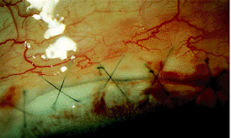
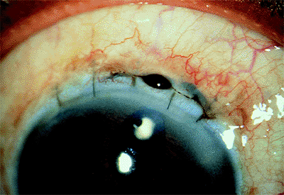
Shallow Anterior Chamber After Cataract Surgery
Wound gap
Iris prolapse

Slide 30
30
Shallow Anterior Chamber After Cataract Surgery
Shallow/flat AC after CE
(early post-op period)
IOP?
Low
Normal or high
Wound
leak
Choroidal
detachment
Under what circumstances should a wound leak be managed surgically?
--No improvement for 48 hours
--Obvious wound gape
--IOL-cornea touch
--Iris prolapse
What stop-gap measure could you try for this?
Injection of viscoelastic to re-form the AC and push the IOL back

Slide 31
31
Shallow Anterior Chamber After Cataract Surgery
Shallow/flat AC after CE
(early post-op period)
IOP?
Low
Normal or high
Wound
leak
Choroidal
detachment
Under what circumstances should a wound leak be managed surgically?
--No improvement for 48 hours
--Obvious wound gape
--IOL-cornea touch
--Iris prolapse
What stop-gap measure could you try for this?
Injection of viscoelastic to re-form the AC and push the IOL back

Slide 32
32
Shallow Anterior Chamber After Cataract Surgery
Shallow/flat AC after CE
(early post-op period)
What does the term choroidal detachment mean? What is detached from what?
Under normal circumstances, the outer aspect of the choroid is closely apposed to the inner wall of the sclera. However, the choroid and sclera are actually affixed to one another only at the vortex veins and around the ONH ; everywhere else there is a potential space between them. If/when fluid accumulates in this space, the choroid detaches from the sclera.
Is choroidal detachment a common cause of low IOP + shallow/flat AC after CE?
This is a tricky question. Certainly, choroidal detachments are not an uncommon finding when a post-CE pt presents with a shallow AC and low IOP. However, it is likely that, in the majority of such cases, the choroidal detachment is a result of the low IOP, not a cause of it.
IOP?
Low
Normal or high
Wound
leak
Choroidal
detachment

Slide 33
33
Shallow Anterior Chamber After Cataract Surgery
Shallow/flat AC after CE
(early post-op period)
What does the term choroidal detachment mean? What is detached from what?
Under normal circumstances, the outer aspect of the choroid is closely apposed to the inner wall of the sclera. However, the choroid and sclera are actually affixed to one another only at the vortex veins and around the ONH ; everywhere else there is a potential space between them. If/when fluid accumulates in this space, the choroid detaches from the sclera.
Is choroidal detachment a common cause of low IOP + shallow/flat AC after CE?
This is a tricky question. Certainly, choroidal detachments are not an uncommon finding when a post-CE pt presents with a shallow AC and low IOP. However, it is likely that, in the majority of such cases, the choroidal detachment is a result of the low IOP, not a cause of it.
IOP?
Low
Normal or high
Wound
leak
Choroidal
detachment

Slide 34
34
Shallow Anterior Chamber After Cataract Surgery
Shallow/flat AC after CE
(early post-op period)
What does the term choroidal detachment mean? What is detached from what?
Under normal circumstances, the outer aspect of the choroid is closely apposed to the inner wall of the sclera. However, the choroid and sclera are actually affixed to one another only at the vortex veins and around the ONH ; everywhere else there is a potential space between them. If/when fluid accumulates in this space, the choroid detaches from the sclera.
Is choroidal detachment a common cause of low IOP + shallow/flat AC after CE?
This is a tricky question. Certainly, choroidal detachments are not an uncommon finding when a post-CE pt presents with a shallow AC and low IOP. However, it is likely that, in the majority of such cases, the choroidal detachment is a result of the low IOP, not a cause of it.
IOP?
Low
Normal or high
two words
abb.
Wound
leak
Choroidal
detachment

Slide 35
35
Shallow Anterior Chamber After Cataract Surgery
Shallow/flat AC after CE
(early post-op period)
What does the term choroidal detachment mean? What is detached from what?
Under normal circumstances, the outer aspect of the choroid is closely apposed to the inner wall of the sclera. However, the choroid and sclera are actually affixed to one another only at the vortex veins and around the ONH ; everywhere else there is a potential space between them. If/when fluid accumulates in this space, the choroid detaches from the sclera.
Is choroidal detachment a common cause of low IOP + shallow/flat AC after CE?
This is a tricky question. Certainly, choroidal detachments are not an uncommon finding when a post-CE pt presents with a shallow AC and low IOP. However, it is likely that, in the majority of such cases, the choroidal detachment is a result of the low IOP, not a cause of it.
IOP?
Low
Normal or high
Wound
leak
Choroidal
detachment
What is the name of this potential space?
The suprachoroidal space

Slide 36
36
Shallow Anterior Chamber After Cataract Surgery
Shallow/flat AC after CE
(early post-op period)
What does the term choroidal detachment mean? What is detached from what?
Under normal circumstances, the outer aspect of the choroid is closely apposed to the inner wall of the sclera. However, the choroid and sclera are actually affixed to one another only at the vortex veins and around the ONH ; everywhere else there is a potential space between them. If/when fluid accumulates in this space, the choroid detaches from the sclera.
Is choroidal detachment a common cause of low IOP + shallow/flat AC after CE?
This is a tricky question. Certainly, choroidal detachments are not an uncommon finding when a post-CE pt presents with a shallow AC and low IOP. However, it is likely that, in the majority of such cases, the choroidal detachment is a result of the low IOP, not a cause of it.
IOP?
Low
Normal or high
Wound
leak
Choroidal
detachment
What is the name of this potential space?
The suprachoroidal space

Slide 37
37
Shallow Anterior Chamber After Cataract Surgery
Shallow/flat AC after CE
(early post-op period)
What does the term choroidal detachment mean? What is detached from what?
Under normal circumstances, the outer aspect of the choroid is closely apposed to the inner wall of the sclera. However, the choroid and sclera are actually affixed to one another only at the vortex veins and around the ONH ; everywhere else there is a potential space between them. If/when fluid accumulates in this space, the choroid detaches from the sclera.
Is choroidal detachment a common cause of low IOP + shallow/flat AC after CE?
This is a tricky question. Certainly, choroidal detachments are not an uncommon finding when a post-CE pt presents with a shallow AC and low IOP. However, it is likely that, in the majority of such cases, the choroidal detachment is a result of the low IOP, not a cause of it.
IOP?
Low
Normal or high
Wound
leak
Choroidal
detachment

Slide 38
38
Shallow Anterior Chamber After Cataract Surgery
Shallow/flat AC after CE
(early post-op period)
What does the term choroidal detachment mean? What is detached from what?
Under normal circumstances, the outer aspect of the choroid is closely apposed to the inner wall of the sclera. However, the choroid and sclera are actually affixed to one another only at the vortex veins and around the ONH ; everywhere else there is a potential space between them. If/when fluid accumulates in this space, the choroid detaches from the sclera.
Is choroidal detachment a common cause of low IOP + shallow/flat AC after CE?
This is a tricky question. Certainly, choroidal detachments are not an uncommon finding when a post-CE pt presents with a shallow AC and low IOP. However, it is likely that, in the majority of such cases, the choroidal detachment is a result of the low IOP, not a cause of it.
IOP?
Low
Normal or high
Wound
leak
Choroidal
detachment
There are two broad categories of fluid that are associated with choroidal detachment--what are they?
--
--

Slide 39
39
Shallow Anterior Chamber After Cataract Surgery
Shallow/flat AC after CE
(early post-op period)
What does the term choroidal detachment mean? What is detached from what?
Under normal circumstances, the outer aspect of the choroid is closely apposed to the inner wall of the sclera. However, the choroid and sclera are actually affixed to one another only at the vortex veins and around the ONH ; everywhere else there is a potential space between them. If/when fluid accumulates in this space, the choroid detaches from the sclera.
Is choroidal detachment a common cause of low IOP + shallow/flat AC after CE?
This is a tricky question. Certainly, choroidal detachments are not an uncommon finding when a post-CE pt presents with a shallow AC and low IOP. However, it is likely that, in the majority of such cases, the choroidal detachment is a result of the low IOP, not a cause of it.
IOP?
Low
Normal or high
Wound
leak
Choroidal
detachment
There are two broad categories of fluid that are associated with choroidal detachment--what are they?
--Serum (via transudation )
--Blood (via hemorrhage )
a process
a diff process

Slide 40
40
Shallow Anterior Chamber After Cataract Surgery
Shallow/flat AC after CE
(early post-op period)
What does the term choroidal detachment mean? What is detached from what?
Under normal circumstances, the outer aspect of the choroid is closely apposed to the inner wall of the sclera. However, the choroid and sclera are actually affixed to one another only at the vortex veins and around the ONH ; everywhere else there is a potential space between them. If/when fluid accumulates in this space, the choroid detaches from the sclera.
Is choroidal detachment a common cause of low IOP + shallow/flat AC after CE?
This is a tricky question. Certainly, choroidal detachments are not an uncommon finding when a post-CE pt presents with a shallow AC and low IOP. However, it is likely that, in the majority of such cases, the choroidal detachment is a result of the low IOP, not a cause of it.
IOP?
Low
Normal or high
Wound
leak
Choroidal
detachment
There are two broad categories of fluid that are associated with choroidal detachment--what are they?
--Serum (via transudation )
--Blood (via hemorrhage )

Slide 41
41
Shallow Anterior Chamber After Cataract Surgery
Shallow/flat AC after CE
(early post-op period)
What does the term choroidal detachment mean? What is detached from what?
Under normal circumstances, the outer aspect of the choroid is closely apposed to the inner wall of the sclera. However, the choroid and sclera are actually affixed to one another only at the vortex veins and around the ONH ; everywhere else there is a potential space between them. If/when fluid accumulates in this space, the choroid detaches from the sclera.
Is choroidal detachment a common cause of low IOP + shallow/flat AC after CE?
This is a tricky question. Certainly, choroidal detachments are not an uncommon finding when a post-CE pt presents with a shallow AC and low IOP. However, it is likely that, in the majority of such cases, the choroidal detachment is a result of the low IOP, not a cause of it.
IOP?
Low
Normal or high
Wound
leak
Choroidal
detachment
There are two broad categories of fluid that are associated with choroidal detachment--what are they?
--Serum? (via transudation )
--Blood? (via hemorrhage )
When a choroidal detachment is present in association with a shallow chamber and low IOP, is it typically serous, or hemorrhagic?
In this scenario, the detachment is virtually always serous

Slide 42
42
Shallow Anterior Chamber After Cataract Surgery
Shallow/flat AC after CE
(early post-op period)
What does the term choroidal detachment mean? What is detached from what?
Under normal circumstances, the outer aspect of the choroid is closely apposed to the inner wall of the sclera. However, the choroid and sclera are actually affixed to one another only at the vortex veins and around the ONH ; everywhere else there is a potential space between them. If/when fluid accumulates in this space, the choroid detaches from the sclera.
Is choroidal detachment a common cause of low IOP + shallow/flat AC after CE?
This is a tricky question. Certainly, choroidal detachments are not an uncommon finding when a post-CE pt presents with a shallow AC and low IOP. However, it is likely that, in the majority of such cases, the choroidal detachment is a result of the low IOP, not a cause of it.
IOP?
Low
Normal or high
Wound
leak
Choroidal
detachment
There are two broad categories of fluid that are associated with choroidal detachment--what are they?
--Serum! (via transudation )
--Blood (via hemorrhage )
When a choroidal detachment is present in association with a shallow chamber and low IOP, is it typically serous, or hemorrhagic?
In this scenario, the detachment is virtually always serous

Slide 43
43
Shallow Anterior Chamber After Cataract Surgery
Shallow/flat AC after CE
(early post-op period)
What does the term choroidal detachment mean? What is detached from what?
Under normal circumstances, the outer aspect of the choroid is closely apposed to the inner wall of the sclera. However, the choroid and sclera are actually affixed to one another only at the vortex veins and around the ONH ; everywhere else there is a potential space between them. If/when fluid accumulates in this space, the choroid detaches from the sclera.
Is choroidal detachment a common cause of low IOP + shallow/flat AC after CE?
This is a tricky question. Certainly, choroidal detachments are not an uncommon finding when a post-CE pt presents with a shallow AC and low IOP. However, it is likely that, in the majority of such cases, the choroidal detachment is a result of the low IOP, not a cause of it.
IOP?
Low
Normal or high
Wound
leak
Choroidal
detachment

Slide 44
44
Shallow Anterior Chamber After Cataract Surgery
Shallow/flat AC after CE
(early post-op period)
What does the term choroidal detachment mean? What is detached from what?
Under normal circumstances, the outer aspect of the choroid is closely apposed to the inner wall of the sclera. However, the choroid and sclera are actually affixed to one another only at the vortex veins and around the ONH ; everywhere else there is a potential space between them. If/when fluid accumulates in this space, the choroid detaches from the sclera.
Is choroidal detachment a common cause of low IOP + shallow/flat AC after CE?
This is a tricky question. Certainly, choroidal detachments are not an uncommon finding when a post-CE pt presents with a shallow AC and low IOP. However, it is likely that, in the majority of such cases, the choroidal detachment is a result of the low IOP, not a cause of it.
IOP?
Low
Normal or high
Wound
leak
Choroidal
detachment

Slide 45
45
Shallow Anterior Chamber After Cataract Surgery
Shallow/flat AC after CE
(early post-op period)
What does the term choroidal detachment mean? What is detached from what?
Under normal circumstances, the outer aspect of the choroid is closely apposed to the inner wall of the sclera. However, the choroid and sclera are actually affixed to one another only at the vortex veins and around the ONH ; everywhere else there is a potential space between them. If/when fluid accumulates in this space, the choroid detaches from the sclera.
Is choroidal detachment a common cause of low IOP + shallow/flat AC after CE?
This is a tricky question. Certainly, choroidal detachments are not an uncommon finding when a post-CE pt presents with a shallow AC and low IOP. However, it is likely that, in the majority of such cases, the choroidal detachment is a result of the low IOP, not a cause of it.
IOP?
Low
Normal or high
Wound
leak
Choroidal
detachment

Slide 46
46
Shallow Anterior Chamber After Cataract Surgery
Shallow/flat AC after CE
(early post-op period)
What does the term choroidal detachment mean? What is detached from what?
Under normal circumstances, the outer aspect of the choroid is closely apposed to the inner wall of the sclera. However, the choroid and sclera are actually affixed to one another only at the vortex veins and around the ONH ; everywhere else there is a potential space between them. If/when fluid accumulates in this space, the choroid detaches from the sclera.
Is choroidal detachment a common cause of low IOP + shallow/flat AC after CE?
This is a tricky question. Certainly, choroidal detachments are not an uncommon finding when a post-CE pt presents with a shallow AC and low IOP. However, it is likely that, in the majority of such cases, the choroidal detachment is a result of the low IOP, not a cause of it.
IOP?
Low
Normal or high
Wound
leak
Choroidal
detachment
So if a pt with a flat AC is found to have a choroidal detachment, don’t assume the detachment is the cause. Be sure to check carefully for a wound leak!

Slide 47
47
Shallow Anterior Chamber After Cataract Surgery
Shallow/flat AC after CE
(early post-op period)
What does the term choroidal detachment mean? What is detached from what?
Under normal circumstances, the outer aspect of the choroid is closely apposed to the inner wall of the sclera. However, the choroid and sclera are actually affixed to one another only at the vortex veins and around the ONH ; everywhere else there is a potential space between them. If/when fluid accumulates in this space, the choroid detaches from the sclera.
Is choroidal detachment a common cause of low IOP + shallow/flat AC after CE?
This is a tricky question. Certainly, choroidal detachments are not an uncommon finding when a post-CE pt presents with a shallow AC and low IOP. However, it is likely that, in the majority of such cases, the choroidal detachment is a result of the low IOP, not a cause of it.
IOP?
Low
Normal or high
Wound
leak
Choroidal
detachment
How is choroidal detachment diagnosed?
b-scan

Slide 48
48
Shallow Anterior Chamber After Cataract Surgery
Shallow/flat AC after CE
(early post-op period)
What does the term choroidal detachment mean? What is detached from what?
Under normal circumstances, the outer aspect of the choroid is closely apposed to the inner wall of the sclera. However, the choroid and sclera are actually affixed to one another only at the vortex veins and around the ONH ; everywhere else there is a potential space between them. If/when fluid accumulates in this space, the choroid detaches from the sclera.
Is choroidal detachment a common cause of low IOP + shallow/flat AC after CE?
This is a tricky question. Certainly, choroidal detachments are not an uncommon finding when a post-CE pt presents with a shallow AC and low IOP. However, it is likely that, in the majority of such cases, the choroidal detachment is a result of the low IOP, not a cause of it.
IOP?
Low
Normal or high
Wound
leak
Choroidal
detachment
How is choroidal detachment diagnosed?
b-scan

Slide 49
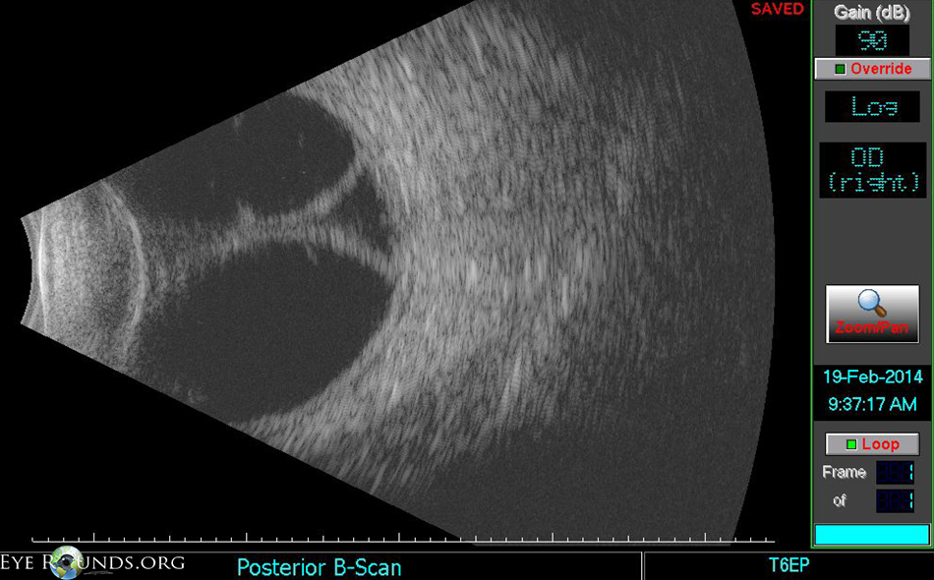
Shallow Anterior Chamber After Cataract Surgery
Choroidal detachment (Confession: I don’t think this was post-CE)

Slide 50
50
Shallow Anterior Chamber After Cataract Surgery
Shallow/flat AC after CE
(early post-op period)
What does the term choroidal detachment mean? What is detached from what?
Under normal circumstances, the outer aspect of the choroid is closely apposed to the inner wall of the sclera. However, the choroid and sclera are actually affixed to one another only at the vortex veins and around the ONH ; everywhere else there is a potential space between them. If/when fluid accumulates in this space, the choroid detaches from the sclera.
Is choroidal detachment a common cause of low IOP + shallow/flat AC after CE?
This is a tricky question. Certainly, choroidal detachments are not an uncommon finding when a post-CE pt presents with a shallow AC and low IOP. However, it is likely that, in the majority of such cases, the choroidal detachment is a result of the low IOP, not a cause of it.
IOP?
Low
Normal or high
Wound
leak
Choroidal
detachment
How should a flat chamber owing to a choroidal detachment be managed?
--
--Mydriatics and cycloplegics should be employed in an attempt to rotate the lens-iris diaphragm posteriorly

Slide 51
51
Shallow Anterior Chamber After Cataract Surgery
Shallow/flat AC after CE
(early post-op period)
What does the term choroidal detachment mean? What is detached from what?
Under normal circumstances, the outer aspect of the choroid is closely apposed to the inner wall of the sclera. However, the choroid and sclera are actually affixed to one another only at the vortex veins and around the ONH ; everywhere else there is a potential space between them. If/when fluid accumulates in this space, the choroid detaches from the sclera.
Is choroidal detachment a common cause of low IOP + shallow/flat AC after CE?
This is a tricky question. Certainly, choroidal detachments are not an uncommon finding when a post-CE pt presents with a shallow AC and low IOP. However, it is likely that, in the majority of such cases, the choroidal detachment is a result of the low IOP, not a cause of it.
IOP?
Low
Normal or high
Wound
leak
Choroidal
detachment
How should a flat chamber owing to a choroidal detachment be managed?
--Topical (+/- systemic) corticosteroids should be started (or increased)
--Mydriatics and cycloplegics should be employed in an attempt to rotate the lens-iris diaphragm posteriorly

Slide 52
52
Shallow Anterior Chamber After Cataract Surgery
Shallow/flat AC after CE
(early post-op period)
What does the term choroidal detachment mean? What is detached from what?
Under normal circumstances, the outer aspect of the choroid is closely apposed to the inner wall of the sclera. However, the choroid and sclera are actually affixed to one another only at the vortex veins and around the ONH ; everywhere else there is a potential space between them. If/when fluid accumulates in this space, the choroid detaches from the sclera.
Is choroidal detachment a common cause of low IOP + shallow/flat AC after CE?
This is a tricky question. Certainly, choroidal detachments are not an uncommon finding when a post-CE pt presents with a shallow AC and low IOP. However, it is likely that, in the majority of such cases, the choroidal detachment is a result of the low IOP, not a cause of it.
IOP?
Low
Normal or high
Wound
leak
Choroidal
detachment
How should a flat chamber owing to a choroidal detachment be managed?
--Topical (+/- systemic) corticosteroids should be started (or increased)
--Mydriatics and cycloplegics should be employed in an attempt to rotate the lens-iris diaphragm posteriorly
Recall that managing the other diagnosis of flat AC+low IOP (wound leak) included taking the opposite step, ie, stopping or decreasing steroids. So, it’s vitally important that you differentiate accurately between these two conditions!

Slide 53
53
Shallow Anterior Chamber After Cataract Surgery
Shallow/flat AC after CE
(early post-op period)
What does the term choroidal detachment mean? What is detached from what?
Under normal circumstances, the outer aspect of the choroid is closely apposed to the inner wall of the sclera. However, the choroid and sclera are actually affixed to one another only at the vortex veins and around the ONH ; everywhere else there is a potential space between them. If/when fluid accumulates in this space, the choroid detaches from the sclera.
Is choroidal detachment a common cause of low IOP + shallow/flat AC after CE?
This is a tricky question. Certainly, choroidal detachments are not an uncommon finding when a post-CE pt presents with a shallow AC and low IOP. However, it is likely that, in the majority of such cases, the choroidal detachment is a result of the low IOP, not a cause of it.
IOP?
Low
Normal or high
Wound
leak
Choroidal
detachment
Under what circumstances should the detachment be addressed surgically?
There are no hard-and-fast rules in this regard, but indications include detachments refractory to medical management for a week or so
How should a flat chamber owing to a choroidal detachment be managed?
--Topical (+/- systemic) corticosteroids should be started (or increased)
--Mydriatics and cycloplegics should be employed in an attempt to rotate the lens-iris diaphragm posteriorly

Slide 54
54
Shallow Anterior Chamber After Cataract Surgery
Shallow/flat AC after CE
(early post-op period)
What does the term choroidal detachment mean? What is detached from what?
Under normal circumstances, the outer aspect of the choroid is closely apposed to the inner wall of the sclera. However, the choroid and sclera are actually affixed to one another only at the vortex veins and around the ONH ; everywhere else there is a potential space between them. If/when fluid accumulates in this space, the choroid detaches from the sclera.
Is choroidal detachment a common cause of low IOP + shallow/flat AC after CE?
This is a tricky question. Certainly, choroidal detachments are not an uncommon finding when a post-CE pt presents with a shallow AC and low IOP. However, it is likely that, in the majority of such cases, the choroidal detachment is a result of the low IOP, not a cause of it.
IOP?
Low
Normal or high
Wound
leak
Choroidal
detachment
Under what circumstances should the detachment be addressed surgically?
There are no hard-and-fast rules in this regard, but indications include detachments refractory to medical management for a week or so.
How should a flat chamber owing to a choroidal detachment be managed?
--Topical (+/- systemic) corticosteroids should be started (or increased)
--Mydriatics and cycloplegics should be employed in an attempt to rotate the lens-iris diaphragm posteriorly

Slide 55
55
Shallow Anterior Chamber After Cataract Surgery
Shallow/flat AC after CE
(early post-op period)
IOP?
Low
Normal or high
Wound
leak
Choroidal
detachment
?
?
?

Slide 56
56
Shallow Anterior Chamber After Cataract Surgery
Shallow/flat AC after CE
(early post-op period)
IOP?
Low
Normal or high
Wound
leak
Choroidal
detachment
Pupillary
block
Ciliary
block
Suprachoroidal
hemorrhage

Slide 57
57
Shallow Anterior Chamber After Cataract Surgery
Shallow/flat AC after CE
(early post-op period)
IOP?
Low
Normal or high
Wound
leak
Choroidal
detachment
Pupillary
block
Ciliary
block
Suprachoroidal
hemorrhage
aka ‘aqueous misdirection syndrome’
Note: The Lens book refers to this condition as ciliary block glaucoma, but the Glaucoma book refers to it as aqueous misdirection syndrome.

Slide 58
58
Shallow Anterior Chamber After Cataract Surgery
Shallow/flat AC after CE
(early post-op period)
IOP?
Low
Normal or high
Wound
leak
Choroidal
detachment
Pupillary
block
Ciliary
block
Suprachoroidal
hemorrhage
aka ‘aqueous misdirection syndrome’, aka ‘malignant glaucoma’
Note: The Lens book refers to this condition as ciliary block glaucoma, but the Glaucoma book refers to it as aqueous misdirection syndrome.
Both books also aka it as malignant glaucoma.

Slide 59
59
Shallow Anterior Chamber After Cataract Surgery
What is the mechanism underlying pupillary block?
Apposition between the pupil margin and the IOL prevents the normal flow of aqueous from the posterior chamber to the AC. This results in a pressure gradient across the iris, causing it to bow forward. In doing so, the peripheral iris interferes with the egress of aqueous through the TM. The net result is a normal-to-high IOP and shallowed AC.
Which pt population is particularly prone to pseudophakic pupillary block?
The pediatric population. As a general rule, the younger the pt, the more likely they are to develop pseudophakic pupillary block.
In adults, what class of IOL is most likely to produce pseudophakic pupillary block?
AC IOLs, especially if the surgeon fails to perform an iridotomy at the time of IOL implantation
Shallow/flat AC after CE
(early post-op period)
IOP?
Low
Normal or high
Wound
leak
Choroidal
detachment
Pupillary
block
Ciliary
block
Suprachoroidal
hemorrhage

Slide 60
60
Shallow Anterior Chamber After Cataract Surgery
What is the mechanism underlying pupillary block?
Apposition between the pupil margin and the IOL prevents the normal flow of aqueous from the posterior chamber to the AC. This results in a pressure gradient across the iris, causing it to bow forward. In doing so, the peripheral iris interferes with the egress of aqueous through the TM. The net result is a normal-to-high IOP and shallowed AC.
Which pt population is particularly prone to pseudophakic pupillary block?
The pediatric population. As a general rule, the younger the pt, the more likely they are to develop pseudophakic pupillary block.
In adults, what class of IOL is most likely to produce pseudophakic pupillary block?
AC IOLs, especially if the surgeon fails to perform an iridotomy at the time of IOL implantation
Shallow/flat AC after CE
(early post-op period)
IOP?
Low
Normal or high
Wound
leak
Choroidal
detachment
Pupillary
block
Ciliary
block
Suprachoroidal
hemorrhage

Slide 61
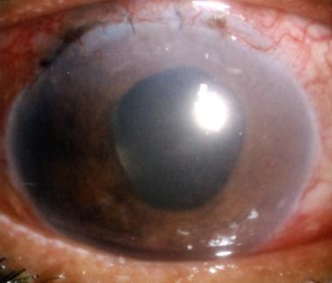
Shallow Anterior Chamber After Cataract Surgery
PC IOL pupillary block after wound leak

Slide 62
62
Shallow Anterior Chamber After Cataract Surgery
What is the mechanism underlying pupillary block?
Apposition between the pupil margin and the IOL prevents the normal flow of aqueous from the posterior chamber to the AC. This results in a pressure gradient across the iris, causing it to bow forward. In doing so, the peripheral iris interferes with the egress of aqueous through the TM. The net result is a normal-to-high IOP and shallowed AC.
Which pt population is particularly prone to pseudophakic pupillary block?
The pediatric population. As a general rule, the younger the pt, the more likely they are to develop pseudophakic pupillary block.
In adults, what class of IOL is most likely to produce pseudophakic pupillary block?
AC IOLs, especially if the surgeon fails to perform an iridotomy at the time of IOL implantation
Shallow/flat AC after CE
(early post-op period)
In the acute post-op period, what process commonly leads to the IOL being apposed to the pupillary margin?
One common cause is a wound leak, which can allow the vitreous body to push the IOL up against the pupil, resulting in pseudophakic pupillary block. So, a post-op eye that initially has a shallow chamber + a low IOP ends up having a shallow chamber + a normal high IOP.
IOP?
Low
Normal or high
Choroidal
detachment
Pupillary
block
Ciliary
block
Suprachoroidal
hemorrhage

Slide 63
63
Shallow Anterior Chamber After Cataract Surgery
What is the mechanism underlying pupillary block?
Apposition between the pupil margin and the IOL prevents the normal flow of aqueous from the posterior chamber to the AC. This results in a pressure gradient across the iris, causing it to bow forward. In doing so, the peripheral iris interferes with the egress of aqueous through the TM. The net result is a normal-to-high IOP and shallowed AC.
Which pt population is particularly prone to pseudophakic pupillary block?
The pediatric population. As a general rule, the younger the pt, the more likely they are to develop pseudophakic pupillary block.
In adults, what class of IOL is most likely to produce pseudophakic pupillary block?
AC IOLs, especially if the surgeon fails to perform an iridotomy at the time of IOL implantation
Shallow/flat AC after CE
(early post-op period)
In the acute post-op period, what process commonly leads to the IOL being apposed to the pupillary margin?
One common cause is a wound leak, which can allow the vitreous body to push the IOL up against the pupil, resulting in pseudophakic pupillary block. So, a post-op eye that initially has a shallow chamber + low IOP ends up having a shallow chamber + a normal/high IOP.
IOP?
Low
Normal or high
Wound
leak
Choroidal
detachment
Pupillary
block
Ciliary
block
Suprachoroidal
hemorrhage

Slide 64
64
Shallow Anterior Chamber After Cataract Surgery
What is the mechanism underlying pupillary block?
Apposition between the pupil margin and the IOL prevents the normal flow of aqueous from the posterior chamber to the AC. This results in a pressure gradient across the iris, causing it to bow forward. In doing so, the peripheral iris interferes with the egress of aqueous through the TM. The net result is a normal-to-high IOP and shallowed AC.
Which pt population is particularly prone to pseudophakic pupillary block?
The pediatric population. As a general rule, the younger the pt, the more likely they are to develop pseudophakic pupillary block.
In adults, what class of IOL is most likely to produce pseudophakic pupillary block?
AC IOLs, especially if the surgeon fails to perform an iridotomy at the time of IOL implantation
Shallow/flat AC after CE
(early post-op period)
In the late post-op period, what process commonly leads to the IOL being apposed to the pupillary margin?
Severe/longlasting post-op inflammation can result in posterior synechiae formation
IOP?
Low
Normal or high
Choroidal
detachment
Pupillary
block
Ciliary
block
Suprachoroidal
hemorrhage

Slide 65
65
Shallow Anterior Chamber After Cataract Surgery
What is the mechanism underlying pupillary block?
Apposition between the pupil margin and the IOL prevents the normal flow of aqueous from the posterior chamber to the AC. This results in a pressure gradient across the iris, causing it to bow forward. In doing so, the peripheral iris interferes with the egress of aqueous through the TM. The net result is a normal-to-high IOP and shallowed AC.
Which pt population is particularly prone to pseudophakic pupillary block?
The pediatric population. As a general rule, the younger the pt, the more likely they are to develop pseudophakic pupillary block.
In adults, what class of IOL is most likely to produce pseudophakic pupillary block?
AC IOLs, especially if the surgeon fails to perform an iridotomy at the time of IOL implantation
Shallow/flat AC after CE
(early post-op period)
In the late post-op period, what process commonly leads to the IOL being apposed to the pupillary margin?
Severe/long-lasting post-op inflammation can result in posterior synechiae formation
IOP?
Low
Normal or high
Choroidal
detachment
Pupillary
block
Ciliary
block
Suprachoroidal
hemorrhage

Slide 66
Shallow Anterior Chamber After Cataract Surgery
Late-onset PSK pupillary-block shallow AC 2ndry to posterior synechiae

Slide 67
67
Shallow Anterior Chamber After Cataract Surgery
What is the mechanism underlying pupillary block?
Apposition between the pupil margin and the IOL prevents the normal flow of aqueous from the posterior chamber to the AC. This results in a pressure gradient across the iris, causing it to bow forward. In doing so, the peripheral iris interferes with the egress of aqueous through the TM. The net result is a normal-to-high IOP and shallowed AC.
Which pt population is particularly prone to pseudophakic pupillary block?
The pediatric population. As a general rule, the younger the pt, the more likely they are to develop pseudophakic pupillary block.
In adults, what class of IOL is most likely to produce pseudophakic pupillary block?
AC IOLs, especially if the surgeon fails to perform an iridotomy at the time of IOL implantation
Shallow/flat AC after CE
(early post-op period)
IOP?
Low
Normal or high
Wound
leak
Choroidal
detachment
Pupillary
block
Ciliary
block
Suprachoroidal
hemorrhage

Slide 68
68
Shallow Anterior Chamber After Cataract Surgery
What is the mechanism underlying pupillary block?
Apposition between the pupil margin and the IOL prevents the normal flow of aqueous from the posterior chamber to the AC. This results in a pressure gradient across the iris, causing it to bow forward. In doing so, the peripheral iris interferes with the egress of aqueous through the TM. The net result is a normal-to-high IOP and shallowed AC.
Which pt population is particularly prone to pseudophakic pupillary block?
The pediatric population. As a general rule, the younger the pt, the more likely they are to develop pseudophakic pupillary block.
In adults, what class of IOL is most likely to produce pseudophakic pupillary block?
AC IOLs, especially if the surgeon fails to perform an iridotomy at the time of IOL implantation
Shallow/flat AC after CE
(early post-op period)
IOP?
Low
Normal or high
Wound
leak
Choroidal
detachment
Pupillary
block
Ciliary
block
Suprachoroidal
hemorrhage

Slide 69
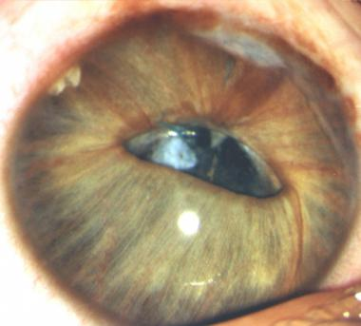
Shallow Anterior Chamber After Cataract Surgery
The patient is 6 years old. Closure of peripheral iridectomy, lens decentration, partial pupil capture, and adhesions between the optic and the iris have produced pupillary block. One of the loops has started cheese-wiring the iris. Iris bombé is all around. Iris incision line adhesions are visible.

Slide 70
70
Shallow Anterior Chamber After Cataract Surgery
What is the mechanism underlying pupillary block?
Apposition between the pupil margin and the IOL prevents the normal flow of aqueous from the posterior chamber to the AC. This results in a pressure gradient across the iris, causing it to bow forward. In doing so, the peripheral iris interferes with the egress of aqueous through the TM. The net result is a normal-to-high IOP and shallowed AC.
Which pt population is particularly prone to pseudophakic pupillary block?
The pediatric population. As a general rule, the younger the pt, the more likely they are to develop pseudophakic pupillary block.
In adults, what class of IOL is most likely to produce pseudophakic pupillary block?
AC IOLs, especially if the surgeon fails to perform an iridotomy at the time of IOL implantation
Shallow/flat AC after CE
(early post-op period)
IOP?
Low
Normal or high
Wound
leak
Choroidal
detachment
Pupillary
block
Ciliary
block
Suprachoroidal
hemorrhage

Slide 71
71
Shallow Anterior Chamber After Cataract Surgery
What is the mechanism underlying pupillary block?
Apposition between the pupil margin and the IOL prevents the normal flow of aqueous from the posterior chamber to the AC. This results in a pressure gradient across the iris, causing it to bow forward. In doing so, the peripheral iris interferes with the egress of aqueous through the TM. The net result is a normal-to-high IOP and shallowed AC.
Which pt population is particularly prone to pseudophakic pupillary block?
The pediatric population. As a general rule, the younger the pt, the more likely they are to develop pseudophakic pupillary block.
In adults, what class of IOL is most likely to produce pseudophakic pupillary block?
AC IOLs, especially if the surgeon fails to perform an iridectomy at the time of IOL implantation
Shallow/flat AC after CE
(early post-op period)
IOP?
Low
Normal or high
Wound
leak
Choroidal
detachment
Pupillary
block
Ciliary
block
Suprachoroidal
hemorrhage

Slide 72
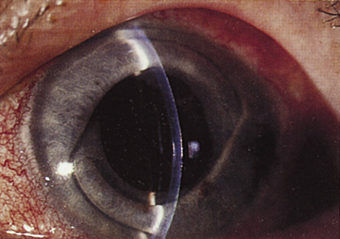
Shallow Anterior Chamber After Cataract Surgery
That feeling when an AC IOL is implanted, but the surgeon forgets to create a PI

Slide 73
73
Shallow Anterior Chamber After Cataract Surgery
What is ciliary block glaucoma?
A rare condition in which anterior rotation of the ciliary body causes newly-produced aqueous to be directed posteriorly, toward and perhaps into or behind the vitreous body.
Is it common, or rare?
Rare
What is the chief risk factor?
Intraocular surgery in an eye with tight angles
How is ciliary block glaucoma managed medically?
--Aqueous suppressants
--Aggressive cycloplegia (atropine 1% and phenylephrine 10% qid)
--Dehydration of the vitreous with hyperosmotic agents
What about surgical management--is it usually necessary?
Yes; surgical or laser disruption of the vitreous face is often required for resolution
Shallow/flat AC after CE
(early post-op period)
IOP?
Low
Normal or high
Wound
leak
Choroidal
detachment
Pupillary
block
Ciliary
block
Suprachoroidal
hemorrhage

Slide 74
74
Shallow Anterior Chamber After Cataract Surgery
What is ciliary block glaucoma?
A rare condition in which anterior rotation of the ciliary body causes newly-produced aqueous to be directed posteriorly, toward and perhaps into or behind the vitreous body
Is it common, or rare?
Rare
What is the chief risk factor?
Intraocular surgery in an eye with tight angles
How is ciliary block glaucoma managed medically?
--Aqueous suppressants
--Aggressive cycloplegia (atropine 1% and phenylephrine 10% qid)
--Dehydration of the vitreous with hyperosmotic agents
What about surgical management--is it usually necessary?
Yes; surgical or laser disruption of the vitreous face is often required for resolution
Shallow/flat AC after CE
(early post-op period)
IOP?
Low
Normal or high
Wound
leak
Choroidal
detachment
Pupillary
block
Ciliary
block
Suprachoroidal
hemorrhage

Slide 75
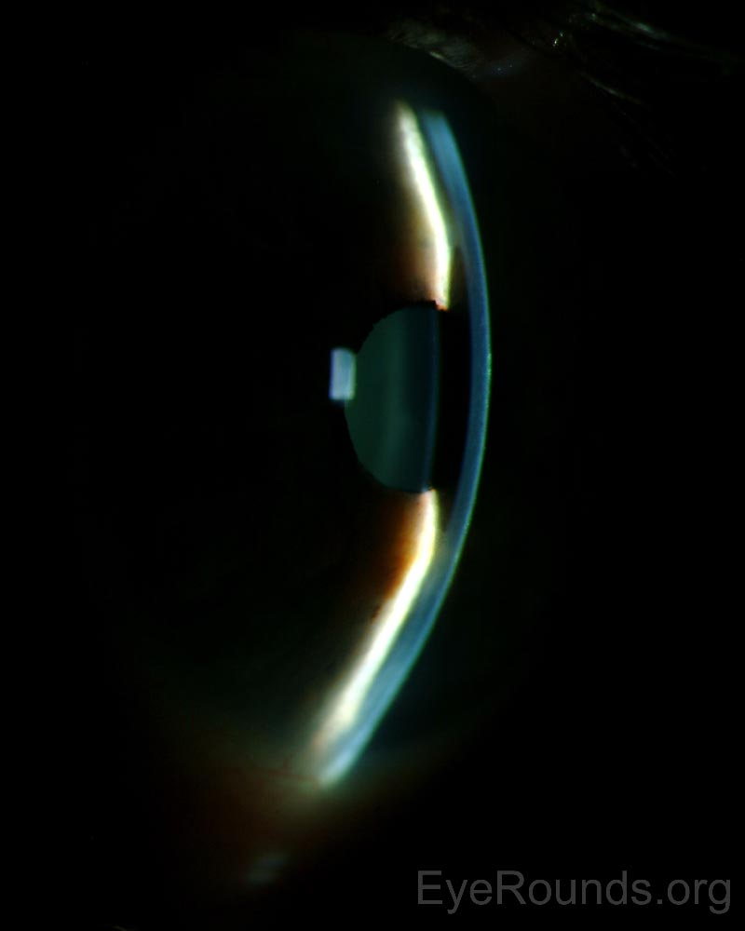
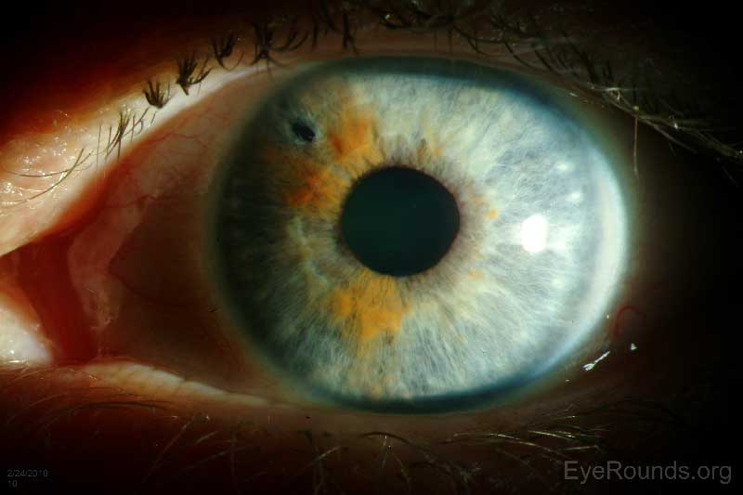
Shallow Anterior Chamber After Cataract Surgery
Ciliary block glaucoma. Lateral illumination produces shadowing nasally, revealing the extent of AC shallowing. Note the presence of an LPI, ineffective because pupillary block is not present.

Slide 76
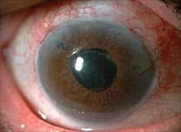
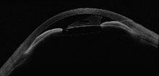
Shallow Anterior Chamber After Cataract Surgery
Ciliary block glaucoma. AS-OCT reveals the extent of AC shallowing. Note again the presence of an ineffective LPI.

Slide 77
77
Shallow Anterior Chamber After Cataract Surgery
What is ciliary block glaucoma?
A rare condition in which anterior rotation of the ciliary body causes newly-produced aqueous to be directed posteriorly, toward and perhaps into or behind the vitreous body
Is it common, or rare?
Rare
What is the chief risk factor?
Intraocular surgery in an eye with tight angles
How is ciliary block glaucoma managed medically?
--Aqueous suppressants
--Aggressive cycloplegia (atropine 1% and phenylephrine 10% qid)
--Dehydration of the vitreous with hyperosmotic agents
What about surgical management--is it usually necessary?
Yes; surgical or laser disruption of the vitreous face is often required for resolution
Shallow/flat AC after CE
(early post-op period)
IOP?
Low
Normal or high
Wound
leak
Choroidal
detachment
Pupillary
block
Ciliary
block
Suprachoroidal
hemorrhage

Slide 78
78
Shallow Anterior Chamber After Cataract Surgery
What is ciliary block glaucoma?
A rare condition in which anterior rotation of the ciliary body causes newly-produced aqueous to be directed posteriorly, toward and perhaps into or behind the vitreous body
Is it common, or rare?
Rare
What is the chief risk factor?
Intraocular surgery in an eye with tight angles
How is ciliary block glaucoma managed medically?
--Aqueous suppressants
--Aggressive cycloplegia (atropine 1% and phenylephrine 10% qid)
--Dehydration of the vitreous with hyperosmotic agents
What about surgical management--is it usually necessary?
Yes; surgical or laser disruption of the vitreous face is often required for resolution
Shallow/flat AC after CE
(early post-op period)
IOP?
Low
Normal or high
Wound
leak
Choroidal
detachment
Pupillary
block
Ciliary
block
Suprachoroidal
hemorrhage

Slide 79
79
Shallow Anterior Chamber After Cataract Surgery
What is ciliary block glaucoma?
A rare condition in which anterior rotation of the ciliary body causes newly-produced aqueous to be directed posteriorly, toward and perhaps into or behind the vitreous body
Is it common, or rare?
Rare
What is the chief risk factor?
Intraocular surgery in an eye with tight angles
How is ciliary block glaucoma managed medically?
--Aqueous suppressants
--Aggressive cycloplegia (atropine 1% and phenylephrine 10% qid)
--Dehydration of the vitreous with hyperosmotic agents
What about surgical management--is it usually necessary?
Yes; surgical or laser disruption of the vitreous face is often required for resolution
Shallow/flat AC after CE
(early post-op period)
IOP?
Low
Normal or high
Wound
leak
Choroidal
detachment
Pupillary
block
Ciliary
block
Suprachoroidal
hemorrhage

Slide 80
80
Shallow Anterior Chamber After Cataract Surgery
What is ciliary block glaucoma?
A rare condition in which anterior rotation of the ciliary body causes newly-produced aqueous to be directed posteriorly, toward and perhaps into or behind the vitreous body
Is it common, or rare?
Rare
What is the chief risk factor?
Intraocular surgery in an eye with tight angles
How is ciliary block glaucoma managed medically?
--Aqueous suppressants
--Aggressive cycloplegia (atropine 1% and phenylephrine 10% qid)
--Dehydration of the vitreous with hyperosmotic agents
What about surgical management--is it usually necessary?
Yes; surgical or laser disruption of the vitreous face is often required for resolution
Shallow/flat AC after CE
(early post-op period)
IOP?
Low
Normal or high
Wound
leak
Choroidal
detachment
Pupillary
block
Ciliary
block
Suprachoroidal
hemorrhage

Slide 81
81
Shallow Anterior Chamber After Cataract Surgery
What is ciliary block glaucoma?
A rare condition in which anterior rotation of the ciliary body causes newly-produced aqueous to be directed posteriorly, toward and perhaps into or behind the vitreous body
Is it common, or rare?
Rare
What is the chief risk factor?
Intraocular surgery in an eye with tight angles
How is ciliary block glaucoma managed medically?
--
--Aggressive cycloplegia (atropine 1% and phenylephrine 10% qid)
--Dehydration of the vitreous with hyperosmotic agents
What about surgical management--is it usually necessary?
Yes; surgical or laser disruption of the vitreous face is often required for resolution
Shallow/flat AC after CE
(early post-op period)
IOP?
Low
Normal or high
Wound
leak
Choroidal
detachment
Pupillary
block
Ciliary
block
Suprachoroidal
hemorrhage

Slide 82
82
Shallow Anterior Chamber After Cataract Surgery
What is ciliary block glaucoma?
A rare condition in which anterior rotation of the ciliary body causes newly-produced aqueous to be directed posteriorly, toward and perhaps into or behind the vitreous body
Is it common, or rare?
Rare
What is the chief risk factor?
Intraocular surgery in an eye with tight angles
How is ciliary block glaucoma managed medically?
--Aqueous suppressants
--Aggressive cycloplegia (atropine 1% and phenylephrine 10% qid)
--Dehydration of the vitreous with hyperosmotic agents
What about surgical management--is it usually necessary?
Yes; surgical or laser disruption of the vitreous face is often required for resolution
Shallow/flat AC after CE
(early post-op period)
IOP?
Low
Normal or high
Wound
leak
Choroidal
detachment
Pupillary
block
Ciliary
block
Suprachoroidal
hemorrhage

Slide 83
83
Shallow Anterior Chamber After Cataract Surgery
What is ciliary block glaucoma?
A rare condition in which anterior rotation of the ciliary body causes newly-produced aqueous to be directed posteriorly, toward and perhaps into or behind the vitreous body
Is it common, or rare?
Rare
What is the chief risk factor?
Intraocular surgery in an eye with tight angles
How is ciliary block glaucoma managed medically?
--Aqueous suppressants
--Aggressive cycloplegia (atropine 1% and phenylephrine 10% qid)
--Dehydration of the vitreous with hyperosmotic agents
What about surgical management--is it usually necessary?
Yes; surgical or laser disruption of the vitreous face is often required for resolution
Shallow/flat AC after CE
(early post-op period)
IOP?
Low
Normal or high
Wound
leak
Choroidal
detachment
Pupillary
block
Ciliary
block
Suprachoroidal
hemorrhage

Slide 84
84
Shallow Anterior Chamber After Cataract Surgery
What is ciliary block glaucoma?
A rare condition in which anterior rotation of the ciliary body causes newly-produced aqueous to be directed posteriorly, toward and perhaps into or behind the vitreous body
Is it common, or rare?
Rare
What is the chief risk factor?
Intraocular surgery in an eye with tight angles
How is ciliary block glaucoma managed medically?
--Aqueous suppressants
--Aggressive cycloplegia (atropine 1% and phenylephrine 10% qid)
--Dehydration of the vitreous with hyperosmotic agents
What about surgical management--is it usually necessary?
Yes; surgical or laser disruption of the vitreous face is often required for resolution
Shallow/flat AC after CE
(early post-op period)
IOP?
Low
Normal or high
Wound
leak
Choroidal
detachment
Pupillary
block
Ciliary
block
Suprachoroidal
hemorrhage

Slide 85
85
Shallow Anterior Chamber After Cataract Surgery
Aqueous misdirection. The anterior chamber is
shallow. Two patent peripheral iridotomies are
barely seen at the 10- and 1-o'clock positions.
Intraocular pressure was 42 mmHg.

Slide 86
86
Shallow Anterior Chamber After Cataract Surgery
Aqueous misdirection. The anterior chamber is
shallow. Two patent peripheral iridotomies are
barely seen at the 10- and 1-o'clock positions.
Intraocular pressure was 42 mmHg.
Same eye 4 weeks after pars plana tube insertion
of aqueous shunt with vitrectomy. The anterior
chamber is deep. The temporal iridectomy is
enlarged. Intraocular pressure was 12 mmHg.

Slide 87
87
Shallow Anterior Chamber After Cataract Surgery
Shallow/flat AC after CE
(early post-op period)
IOP?
Low
Normal or high
Wound
leak
Choroidal
detachment
Pupillary
block
Ciliary
block
Suprachoroidal
hemorrhage
What is the classic presentation of a post-op suprachoroidal hemorrhage, ie, what will the pt complain of?
The pt will complain of the sudden onset of vision loss and excruciating pain

Slide 88
88
Shallow Anterior Chamber After Cataract Surgery
Shallow/flat AC after CE
(early post-op period)
IOP?
Low
Normal or high
Wound
leak
Choroidal
detachment
Pupillary
block
Ciliary
block
Suprachoroidal
hemorrhage
What is the classic presentation of a post-op suprachoroidal hemorrhage, ie, what will the pt complain of?
The pt will complain of the sudden onset of vision loss and excruciating pain
two words
two diff words

Slide 89
89
Shallow Anterior Chamber After Cataract Surgery
Shallow/flat AC after CE
(early post-op period)
IOP?
Low
Normal or high
Wound
leak
Choroidal
detachment
Pupillary
block
Ciliary
block
Suprachoroidal
hemorrhage
What is the classic presentation of a post-op suprachoroidal hemorrhage, ie, what will the pt complain of?
The pt will complain of the sudden onset of vision loss and excruciating pain

Slide 90
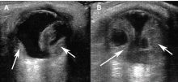
Shallow Anterior Chamber After Cataract Surgery
Suprachoroidal hemorrhage

Slide 91
91
Shallow Anterior Chamber After Cataract Surgery
Shallow/flat AC after CE
(early post-op period)
IOP?
Low
Normal or high
Wound
leak
Choroidal
detachment
Pupillary
block
Ciliary
block
Suprachoroidal
hemorrhage
What is the classic presentation of a post-op suprachoroidal hemorrhage, ie, what will the pt complain of?
The pt will complain of the sudden onset of vision loss and excruciating pain
Is the vision loss usually mild, or severe?
Severe

Slide 92
92
Shallow Anterior Chamber After Cataract Surgery
Shallow/flat AC after CE
(early post-op period)
IOP?
Low
Normal or high
Wound
leak
Choroidal
detachment
Pupillary
block
Ciliary
block
Suprachoroidal
hemorrhage
What is the classic presentation of a post-op suprachoroidal hemorrhage, ie, what will the pt complain of?
The pt will complain of the sudden onset of vision loss and excruciating pain
Is the vision loss usually mild, or severe?
Severe

Slide 93
93
Shallow Anterior Chamber After Cataract Surgery
Shallow/flat AC after CE
(early post-op period)
IOP?
Low
Normal or high
Wound
leak
Choroidal
detachment
Pupillary
block
Ciliary
block
Suprachoroidal
hemorrhage
What is the classic presentation of a post-op suprachoroidal hemorrhage, ie, what will the pt complain of?
The pt will complain of the sudden onset of vision loss and excruciating pain
What word classically characterizes the nature of the pain?
‘Throbbing’

Slide 94
94
Shallow Anterior Chamber After Cataract Surgery
Shallow/flat AC after CE
(early post-op period)
IOP?
Low
Normal or high
Wound
leak
Choroidal
detachment
Pupillary
block
Ciliary
block
Suprachoroidal
hemorrhage
What is the classic presentation of a post-op suprachoroidal hemorrhage, ie, what will the pt complain of?
The pt will complain of the sudden onset of vision loss and excruciating pain
What word classically characterizes the nature of the pain?
‘Throbbing’

Slide 95
95
Shallow Anterior Chamber After Cataract Surgery
Shallow/flat AC after CE
(early post-op period)
IOP?
Low
Normal or high
Is a serous choroidal detachment associated with pain?
No
Is it associated with severe vision loss?
It depends. If a serous choroidal detachment is very extensive, it can prevent light from reaching the fovea, in which case SVL would result
Serous
Wound
leak
Choroidal
detachment
Pupillary
block
Aqueous
misdirection
Suprachoroidal
hemorrhage
^
Serous choroidal detachment
What is the classic presentation of a post-op suprachoroidal hemorrhage, ie, what will the pt complain of?
The pt will complain of the sudden onset of vision loss and excruciating pain?

Slide 96
96
Shallow Anterior Chamber After Cataract Surgery
Shallow/flat AC after CE
(early post-op period)
IOP?
Low
Normal or high
Is a serous choroidal detachment associated with pain?
No, it is almost always painless
Is it associated with severe vision loss?
It depends. If a serous choroidal detachment is very extensive, it can prevent light from reaching the fovea, in which case SVL would result
Serous
Wound
leak
Choroidal
detachment
Pupillary
block
Aqueous
misdirection
Suprachoroidal
hemorrhage
^
Serous choroidal detachment
What is the classic presentation of a post-op suprachoroidal hemorrhage, ie, what will the pt complain of?
The pt will complain of the sudden onset of vision loss and excruciating pain?
No

Slide 97
97
Shallow Anterior Chamber After Cataract Surgery
Shallow/flat AC after CE
(early post-op period)
IOP?
Low
Normal or high
Is a serous choroidal detachment associated with pain?
No, it is almost always painless
Is it associated with severe vision loss?
It depends. If a serous choroidal detachment is very extensive, it can prevent light from reaching the fovea, in which case SVL would result
Serous
Wound
leak
Choroidal
detachment
Pupillary
block
Aqueous
misdirection
Suprachoroidal
hemorrhage
^
Serous choroidal detachment
What is the classic presentation of a post-op suprachoroidal hemorrhage, ie, what will the pt complain of?
The pt will complain of the sudden onset of vision loss? and excruciating pain

Slide 98
98
Shallow Anterior Chamber After Cataract Surgery
Shallow/flat AC after CE
(early post-op period)
IOP?
Low
Normal or high
Is a serous choroidal detachment associated with pain?
No, it is almost always painless
Is it associated with severe vision loss?
It depends. If a serous choroidal detachment is very extensive, it can block light from reaching the fovea, in which case SVL would result
Serous
Wound
leak
Choroidal
detachment
Pupillary
block
Aqueous
misdirection
Suprachoroidal
hemorrhage
^
Serous choroidal detachment
What is the classic presentation of a post-op suprachoroidal hemorrhage, ie, what will the pt complain of?
The pt will complain of the sudden onset of vision loss? and excruciating pain
Maybe

Slide 99
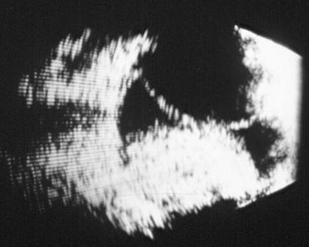
Shallow Anterior Chamber After Cataract Surgery
Is this suprachoroidal effusion serous, or hemorrhagic?

Slide 100
Shallow Anterior Chamber After Cataract Surgery
Serous
Hemorrhagic
Is this suprachoroidal effusion serous, or hemorrhagic? It’s both

Slide 101
101
Shallow Anterior Chamber After Cataract Surgery
Shallow/flat AC after CE
(early post-op period)
IOP?
Low
Normal or high
Wound
leak
Choroidal
detachment
Pupillary
block
Ciliary
block
Suprachoroidal
hemorrhage
What factors put an eye at risk for post-op suprachoroidal hemorrhage?
--
--
--
--Coumadinized patients
--
--(there are a number of others)

Slide 102
102
Shallow Anterior Chamber After Cataract Surgery
Shallow/flat AC after CE
(early post-op period)
IOP?
Low
Normal or high
Wound
leak
Choroidal
detachment
Pupillary
block
Ciliary
block
Suprachoroidal
hemorrhage
What factors put an eye at risk for post-op suprachoroidal hemorrhage?
--High myopia
--Nanophthalmia
--Sturge-Weber syndrome
--Hypertension
--Glaucoma
--(there are a number of others)

Slide 103
103
Shallow Anterior Chamber After Cataract Surgery
Shallow/flat AC after CE
(early post-op period)
IOP?
Low
Normal or high
Wound
leak
Choroidal
detachment
Pupillary
block
Ciliary
block
Suprachoroidal
hemorrhage
What factors put an eye at risk for post-op suprachoroidal hemorrhage?
--High myopia
--Nanophthalmia
--Sturge-Weber syndrome
--Hypertension
--Glaucoma
--(there are a number of others)
Do the others include being in anticoagulated state?
Surprisingly, no. Long thought to be a risk factor for intra- and post-op hemorrhage, a large clinical trial found no evidence for this.

Slide 104
104
Shallow Anterior Chamber After Cataract Surgery
Shallow/flat AC after CE
(early post-op period)
IOP?
Low
Normal or high
Wound
leak
Choroidal
detachment
Pupillary
block
Ciliary
block
Suprachoroidal
hemorrhage
What factors put an eye at risk for post-op suprachoroidal hemorrhage?
--High myopia
--Nanophthalmia
--Sturge-Weber syndrome
--Hypertension
--Glaucoma
--(there are a number of others)
Do the others include being in anticoagulated state?
Surprisingly, no. Long thought to be a risk factor for intra- and post-op hemorrhage, a large clinical trial found no evidence for this.

Slide 105
105
Shallow Anterior Chamber After Cataract Surgery
Shallow/flat AC after CE
(early post-op period)
IOP?
Low
Normal or high
Wound
leak
Choroidal
detachment
Pupillary
block
Ciliary
block
Suprachoroidal
hemorrhage
What is the classic precipitating event for a post-op suprachoroidal hemorrhage?
A Valsalva maneuver on the part of the pt (eg, sneezing; coughing; straining at stool)

Slide 106
106
Shallow Anterior Chamber After Cataract Surgery
Shallow/flat AC after CE
(early post-op period)
IOP?
Low
Normal or high
Wound
leak
Choroidal
detachment
Pupillary
block
Ciliary
block
Suprachoroidal
hemorrhage
What is the classic precipitating event for a post-op suprachoroidal hemorrhage?
A Valsalva maneuver on the part of the pt (eg, sneezing; coughing; straining at stool)

Slide 107
107
Shallow Anterior Chamber After Cataract Surgery
Shallow/flat AC after CE
(early post-op period)
IOP?
Low
Normal or high
Wound
leak
Choroidal
detachment
Pupillary
block
Ciliary
block
Suprachoroidal
hemorrhage
How is a suprachoroidal hemorrhage managed?
If not too severe (ie, the AC is not flat; the IOP not too high; the pt not in too much pain; no kissing choroidal present), medical management with aggressive cycloplegia and aqueous suppressants can be attempted. Otherwise, sclerotomy surgery is indicated.

Slide 108
108
Shallow Anterior Chamber After Cataract Surgery
Shallow/flat AC after CE
(early post-op period)
IOP?
Low
Normal or high
Wound
leak
Choroidal
detachment
Pupillary
block
Ciliary
block
Suprachoroidal
hemorrhage
How is a suprachoroidal hemorrhage managed?
If not too severe (ie, the AC is not flat; the IOP not too high; the pt not in too much pain; no kissing choroidal present), medical management with aggressive cycloplegia and aqueous suppressants can be attempted. Otherwise, sclerotomy surgery is indicated.

Slide 109
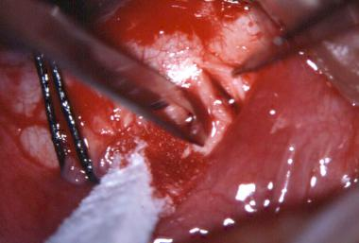
Shallow Anterior Chamber After Cataract Surgery
Suprachoroidal hemorrhage: Drainage via sclerotomy

Slide 110
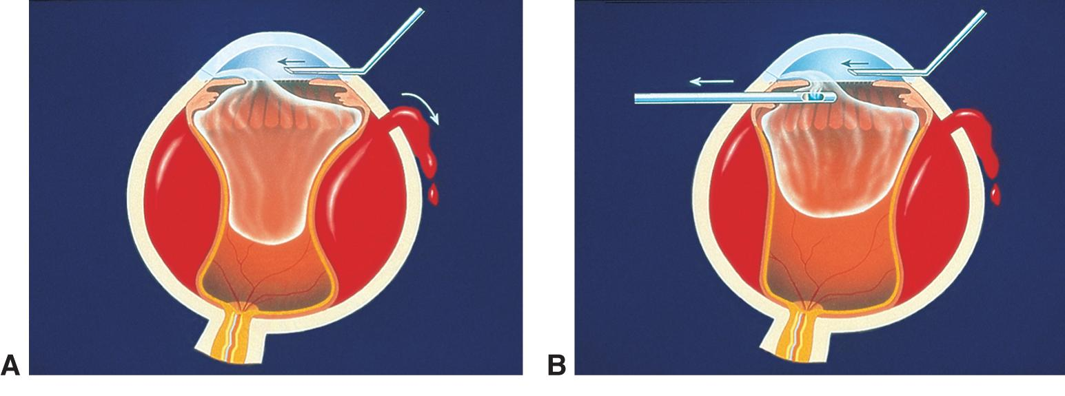
Shallow Anterior Chamber After Cataract Surgery
Suprachoroidal hemorrhage. A, Schematic shows anterior infusion and simultaneous drainage of suprachoroidal hemorrhage through pars plana sclerotomy.
B, Schematic shows pars plana vitrectomy to remove vitreous prolapse as drainage of suprachoroidal hemorrhage continues

Slide 111
111
During
Shallow Anterior Chamber After Cataract Surgery
^
during
Shallow/flat AC after CE
^
With regard to an intraoperative shallowing of the AC, one of these entities is closely related to the most dreaded intraoperative complication of all. What is that most dreaded of complications?
Wound
leak
Choroidal
detachment
Pupillary
block
Ciliary
block
Suprachoroidal
hemorrhage

Slide 112
112
During
Shallow Anterior Chamber After Cataract Surgery
^
during
Shallow/flat AC after CE
^
With regard to an intraoperative shallowing of the AC, one of these entities is closely related to the most dreaded intraoperative complication of all. What is that most dreaded of complications? The expulsive choroidal hemorrhage
Expulsive
Wound
leak
Choroidal
detachment
Pupillary
block
Ciliary
block
Suprachoroidal
hemorrhage

Slide 113
During
Shallow Anterior Chamber After Cataract Surgery
^
Expulsive choroidal hemorrhage is the most feared intraoperative complication of CE surgery. What is the classic first sign?

Slide 114
During
Shallow Anterior Chamber After Cataract Surgery
^
Expulsive choroidal hemorrhage is the most feared intraoperative complication of CE surgery. What is the classic first sign? Darkening of the red reflex

Slide 115
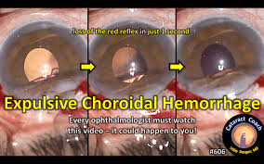
During
Shallow Anterior Chamber After Cataract Surgery
^
Still from a video depicting an expulsive choroidal hemorrhage

Slide 116
During
Shallow Anterior Chamber After Cataract Surgery
^
Expulsive choroidal hemorrhage is the most feared intraoperative complication of CE surgery. What is the classic first sign? Darkening of the red reflex
What is the classic ‘late’ sign?

Slide 117
During
Shallow Anterior Chamber After Cataract Surgery
^
Expulsive choroidal hemorrhage is the most feared intraoperative complication of CE surgery. What is the classic first sign? Darkening of the red reflex
What is the classic ‘late’ sign? Expulsion of the intraocular contents through the wound

Slide 118
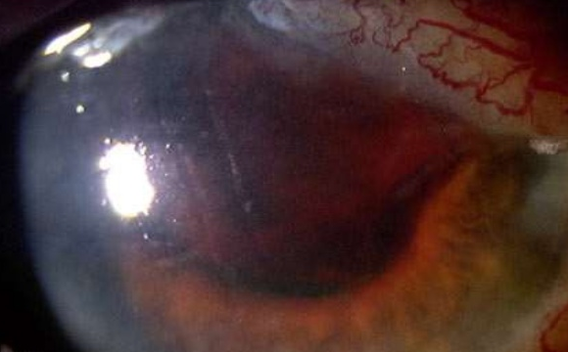
During
Shallow Anterior Chamber After Cataract Surgery
^
Expulsive suprachoroidal hemorrhage

Slide 119
During
Shallow Anterior Chamber After Cataract Surgery
^
Expulsive choroidal hemorrhage is the most feared intraoperative complication of CE surgery. What is the classic first sign? Darkening of the red reflex
What is the classic ‘late’ sign? Expulsion of the intraocular contents through the wound
How should it be managed intraoperatively?
1)
2)
3)

Slide 120
During
Shallow Anterior Chamber After Cataract Surgery
^
Expulsive choroidal hemorrhage is the most feared intraoperative complication of CE surgery. What is the classic first sign? Darkening of the red reflex
What is the classic ‘late’ sign? Expulsion of the intraocular contents through the wound
How should it be managed intraoperatively?
1) Put your finger on the wound to seal it
2) Suture the wound closed
3) Consider posterior sclerotomies to drain blood

Slide 121
During
Shallow Anterior Chamber After Cataract Surgery
^
Expulsive choroidal hemorrhage is the most feared intraoperative complication of CE surgery. What is the classic first sign? Darkening of the red reflex
What is the classic ‘late’ sign? Expulsion of the intraocular contents through the wound
How should it be managed intraoperatively?
1) Put your finger on the wound to seal it
2) Suture the wound closed
3) Consider posterior sclerotomies to drain blood
Post-op, how should IOP be managed?

Slide 122
During
Shallow Anterior Chamber After Cataract Surgery
^
Expulsive choroidal hemorrhage is the most feared intraoperative complication of CE surgery. What is the classic first sign? Darkening of the red reflex
What is the classic ‘late’ sign? Expulsion of the intraocular contents through the wound
How should it be managed intraoperatively?
1) Put your finger on the wound to seal it
2) Suture the wound closed
3) Consider posterior sclerotomies to drain blood
Post-op, how should IOP be managed? Leave it elevated (will tamponade the bleed)

Slide 123
123
Shallow Anterior Chamber After Cataract Surgery
Shallow/flat AC after CE
(early post-op period)
Late
IOP?
What is the differential for a shallow AC in the late post-op period?
--
--
--
--
--
Low
Normal or high
Wound
leak
Choroidal
detachment
Pupillary
block
Aqueous
misdirection
Suprachoroidal
hemorrhage

Slide 124
124
Shallow Anterior Chamber After Cataract Surgery
Shallow/flat AC after CE
(early post-op period)
Late
IOP?
What is the differential for a shallow AC in the late post-op period?
--RD
--Bleb formation
--Chronic uveitis
--Cyclodialysis
--Delayed choroidal hemorrhage
Low
Normal or high
Wound
leak
Choroidal
detachment
Pupillary
block
Aqueous
misdirection
Suprachoroidal
hemorrhage

Slide 125
125
Shallow Anterior Chamber After Cataract Surgery
Shallow/flat AC after CE
(early post-op period)
Late
IOP?
What is the differential for a shallow AC in the late post-op period?
--RD
--Bleb formation
--Chronic uveitis
--Cyclodialysis
--Delayed choroidal hemorrhage
Low
Normal or high
What sort of incision makes inadvertent bleb formation more likely?
A limbal incision
Wound
leak
Choroidal
detachment
Pupillary
block
Aqueous
misdirection
Suprachoroidal
hemorrhage

Slide 126
126
Shallow Anterior Chamber After Cataract Surgery
Shallow/flat AC after CE
(early post-op period)
Late
IOP?
What is the differential for a shallow AC in the late post-op period?
--RD
--Bleb formation
--Chronic uveitis
--Cyclodialysis
--Delayed choroidal hemorrhage
Low
Normal or high
What sort of incision makes inadvertent bleb formation more likely?
A limbal incision
Wound
leak
Choroidal
detachment
Pupillary
block
Aqueous
misdirection
Suprachoroidal
hemorrhage

Slide 127
127
Shallow Anterior Chamber After Cataract Surgery
Shallow/flat AC after CE
(early post-op period)
Late
IOP?
What is the differential for a shallow AC in the late post-op period?
--RD
--Bleb formation
--Chronic uveitis
--Cyclodialysis
--Delayed choroidal hemorrhage
Low
Normal or high
What sort of incision makes cyclodialysis more likely?
A scleral-tunnel incision
Wound
leak
Choroidal
detachment
Pupillary
block
Aqueous
misdirection
Suprachoroidal
hemorrhage

Slide 128
128
Shallow Anterior Chamber After Cataract Surgery
Shallow/flat AC after CE
(early post-op period)
Late
IOP?
What is the differential for a shallow AC in the late post-op period?
--RD
--Bleb formation
--Chronic uveitis
--Cyclodialysis
--Delayed choroidal hemorrhage
Low
Normal or high
What sort of incision makes cyclodialysis more likely?
A scleral-tunnel incision
Wound
leak
Choroidal
detachment
Pupillary
block
Aqueous
misdirection
Suprachoroidal
hemorrhage

Slide 129
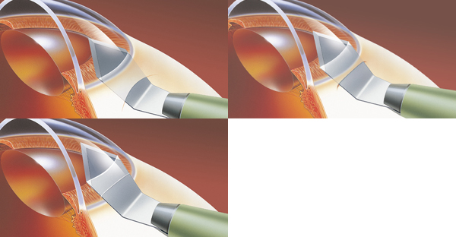
Shallow Anterior Chamber After Cataract Surgery
‘Scleral tunnel’
‘Limbal’
‘Clear cornea’

Slide 130
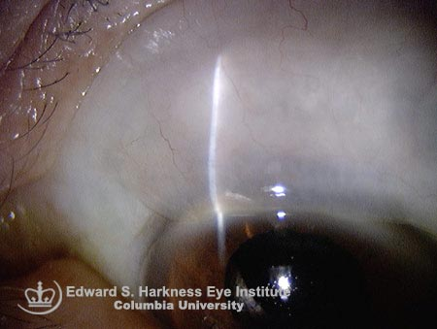
Shallow Anterior Chamber After Cataract Surgery
Bleb formation after limbal-incision CE

Slide 131
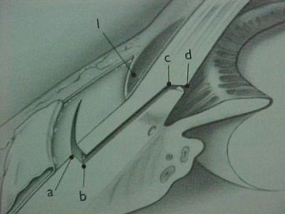
Shallow Anterior Chamber After Cataract Surgery
CB
Scleral-tunnel CE incision. Note the proximity to the ciliary body (CB)

Slide 132
132
Shallow Anterior Chamber After Cataract Surgery
Shallow/flat AC after CE
(early post-op period)
Late
IOP?
What is the differential for a shallow AC in the late post-op period?
--RD
--Bleb formation
--Chronic uveitis
--Cyclodialysis
--Delayed choroidal hemorrhage
Low
Normal or high
What exam maneuver should be performed to check for cyclodialysis?
Gonioscopy
Wound
leak
Choroidal
detachment
Pupillary
block
Aqueous
misdirection
Suprachoroidal
hemorrhage

Slide 133
133
Shallow Anterior Chamber After Cataract Surgery
Shallow/flat AC after CE
(early post-op period)
Late
IOP?
What is the differential for a shallow AC in the late post-op period?
--RD
--Bleb formation
--Chronic uveitis
--Cyclodialysis
--Delayed choroidal hemorrhage
Low
Normal or high
What exam maneuver should be performed to check for cyclodialysis?
Gonioscopy
Wound
leak
Choroidal
detachment
Pupillary
block
Aqueous
misdirection
Suprachoroidal
hemorrhage

