Slide 1
Professional Advertising
Who is responsible for an institution’s marketing?

Slide 2
The Power of Commercial Marketing
Marketing is essential to create an informed public. Marketing departments and agencies design promotions to increase traffic to your office.
Sometimes they are not fully aware of federal marketing standards* and the AAO’s Code of Ethics Rule 13, Communications to the Public.
* See Ppt – General Overview of Physician Advertising

Slide 3
Case Study
Who is Responsible for the Ad?

Slide 4
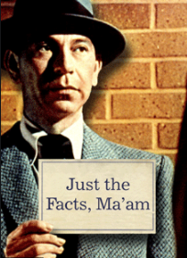
Standard Print Marketing Information
A university Eye Institute’s print ad featured basic information about the practice:
Name and Logo
Services / Specialties
Contact Information
Address

Slide 5
In-House Marketing Department
The university’s marketing department decided to “beef up” an ad to compete with other local practitioners.
No one in the Institute's leadership was asked to review the ad before it went to press

Slide 6
The Result – What is Wrong With This Ad?
Inaccurate
Deceptive
Appeals to anxieties
Misrepresents credentials
Infers claim of superiority over local practitioners
This was an AAO Ethics Committee member at the time the ad was published.

Slide 7
You Are Responsible for Content
Require prepublication review of any ad containing your name.
Prepublication review ensures that information proposed for public release contains no false, deceptive or misleading information.
If your name, or your practice name, is in the promotional material, you are responsible.

Slide 8
Code of Ethics Rule 13 Communications to the public
No false, deceptive or misleading information
No deceptive omissions
No appeals to patients’ anxiety
Must not create unjustified expectations of results
Must disclose risks
Must not misrepresent credentials
No unsubstantiated claims of superiority

