Slide 1
Dry Eye Syndrome
DES is an extremely common condition, estimated to affect 10% or more of adults. It can be a significant health problem, with studies indicating that moderate-to-severe DES impacts quality-of-life to the same degree as moderate-to-severe angina.

Slide 2
Dry Eye Syndrome
DES is an extremely common condition, estimated to affect 10% or more of adults. It can be a significant health problem, with studies indicating that moderate-to-severe DES impacts quality-of-life to the same degree as moderate-to-severe angina. Women are more likely to suffer DES than men (high A/E* are protective against DES, whereas low A/E exacerbate it).
*A/E = androgen/estrogen ratio

Slide 3
Dry Eye Syndrome
DES is an extremely common condition, estimated to affect 10% or more of adults. It can be a significant health problem, with studies indicating that moderate-to-severe DES impacts quality-of-life to the same degree as moderate-to-severe angina. Women are more likely to suffer DES than men (high A/E* are protective against DES, whereas low A/E exacerbate it).
The research on race as a risk factor are mixed, with some suggesting Asians and possibly Hispanics are at greater risk.

Slide 4
Dry Eye Syndrome
DES is an extremely common condition, estimated to affect 10% or more of adults. It can be a significant health problem, with studies indicating that moderate-to-severe DES impacts quality-of-life to the same degree as moderate-to-severe angina. Women are more likely to suffer DES than men (high A/E* are protective against DES, whereas low A/E exacerbate it).
The research on race as a risk factor are mixed, with some suggesting Asians and possibly Hispanics are at greater risk.
The tear film plays three key roles in ocular health and function:
--Facilitating diffusion of oxygen to the avascular cornea;
--clearing debris from the corneal surface; and
--providing a glassy-smooth refracting surface at the air-cornea interface (or more accurately, the air-tear film interface).

Slide 5
Dry Eye Syndrome
DES is an extremely common condition, estimated to affect 10% or more of adults. It can be a significant health problem, with studies indicating that moderate-to-severe DES impacts quality-of-life to the same degree as moderate-to-severe angina. Women are more likely to suffer DES than men (high A/E* are protective against DES, whereas low A/E exacerbate it).
The research on race as a risk factor are mixed, with some suggesting Asians and possibly Hispanics are at greater risk.
The tear film plays three key roles in ocular health and function:
--Facilitating diffusion of oxygen to the avascular cornea;
--clearing debris from the corneal surface; and
--providing a glassy-smooth refracting surface at the air-cornea interface (or more accurately, the air-tear film interface).
The tear film resides in the tear strip/lake resting on the lower-lid margin, and is pulled up and onto the ocular surface via the action of the upper lid.

Slide 6
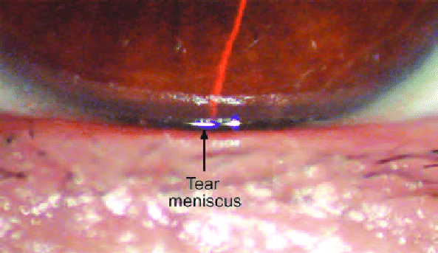
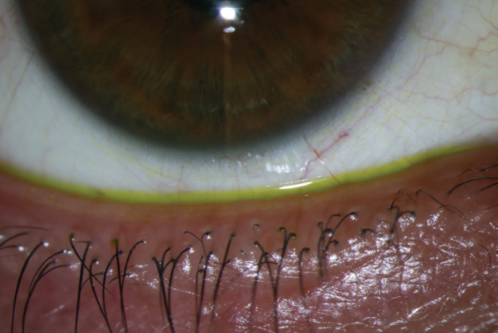
Dry Eye Syndrome
Tear lake (aka tear strip; tear meniscus)

Slide 7
Dry Eye Syndrome
DES is an extremely common condition, estimated to affect 10% or more of adults. It can be a significant health problem, with studies indicating that moderate-to-severe DES impacts quality-of-life to the same degree as moderate-to-severe angina. Women are more likely to suffer DES than men (high A/E* are protective against DES, whereas low A/E exacerbate it).
The research on race as a risk factor are mixed, with some suggesting Asians and possibly Hispanics are at greater risk.
The tear film plays three key roles in ocular health and function:
--Facilitating diffusion of oxygen to the avascular cornea;
--clearing debris from the corneal surface; and
--providing a glassy-smooth refracting surface at the air-cornea interface (or more accurately, the air-tear film interface).
The tear film resides in the tear strip/lake resting on the lower-lid margin, and is pulled up and onto the ocular surface via the action of the upper lid. As it goes up, the upper lid exerts a capillary-attraction force on the tear lake, thereby pulling it up and across the ocular surface.

Slide 8
Dry Eye Syndrome
The tear film is comprised of three basic components: Lipid, aqueous, and mucin. These components interact to produce the two-phase model of the tear film: The aqueous and mucus intermix into a single, gel-like layer (the mucoaqueous phase), which is covered by the lipids in a lipid phase.

Slide 9
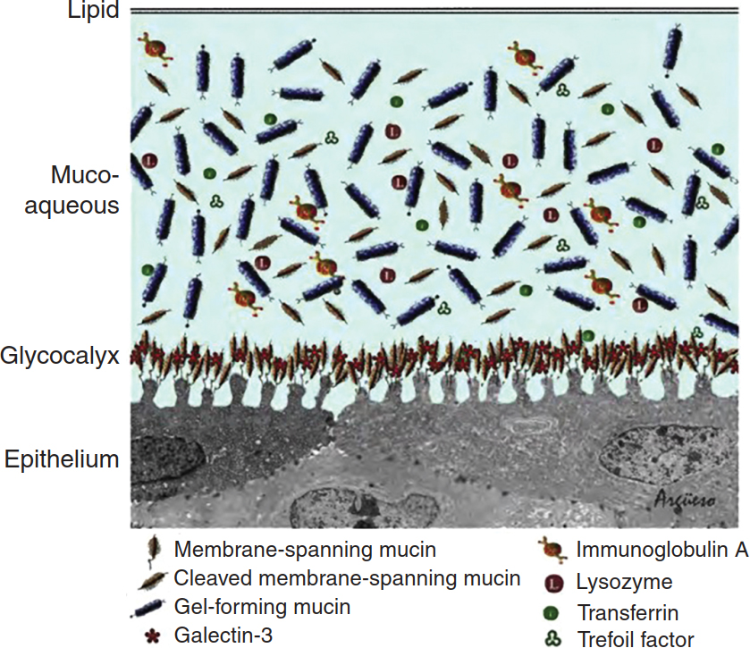
Dry Eye Syndrome
Two-phase model of the tear film. Schematic drawing of the structure of the tear film showing the outer lipid layer and the mucoaqueous layer.

Slide 10
Dry Eye Syndrome
The tear film is comprised of three basic components: Lipid, aqueous, and mucin. These components interact to produce the two-phase model of the tear film: The aqueous and mucus intermix into a single, gel-like layer (the mucoaqueous phase), which is covered by the lipids in a lipid phase.
The older tripartite model of the tear film posited that the three components formed distinct mucus (inner), aqueous (middle) and lipid (outer) layers, but the consensus now is this model is incorrect, and it has largely been supplanted by the two-phase model.

Slide 11
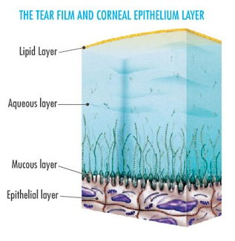
Dry Eye Syndrome
The old/obsolete tripartite model of the tear film

Slide 12
Dry Eye Syndrome
The tear film is comprised of three basic components: Lipid, aqueous, and mucin. These components interact to produce the two-phase model of the tear film: The aqueous and mucus intermix into a single, gel-like layer (the mucoaqueous phase), which is covered by the lipids in a lipid phase.
The older tripartite model of the tear film posited that the three components formed distinct mucus (inner), aqueous (middle) and lipid (outer) layers, but the consensus now is this model is incorrect, and it has largely been supplanted by the two-phase model.
The specific lipid is meibum, a product of the meibomian glands. These glands are embedded within the tarsal plates of both the upper and lower lids. There are ~2x as many glands in the upper lids. They are innervated by the parasympathetic system.
The lipid layer makes several key contributions to the stability and effectiveness of the tear film. It inhibits tear film evaporation and reduce its surface tension, both of which serve to maintain the tear film on the eye. (Without a lipid layer, surface tension would pull the tear film down off the surface.) The lipid layer also facilitates visual acuity by producing a glassy-smooth surface at the air-tear film interface.

Slide 13
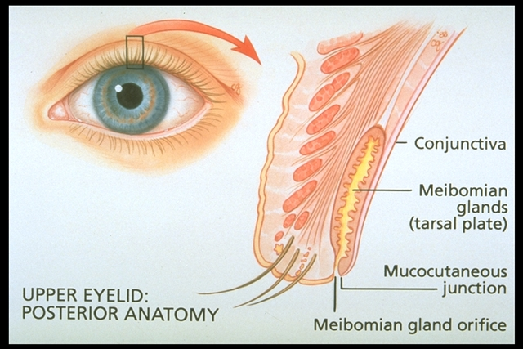
Dry Eye Syndrome
Meibomian glands

Slide 14
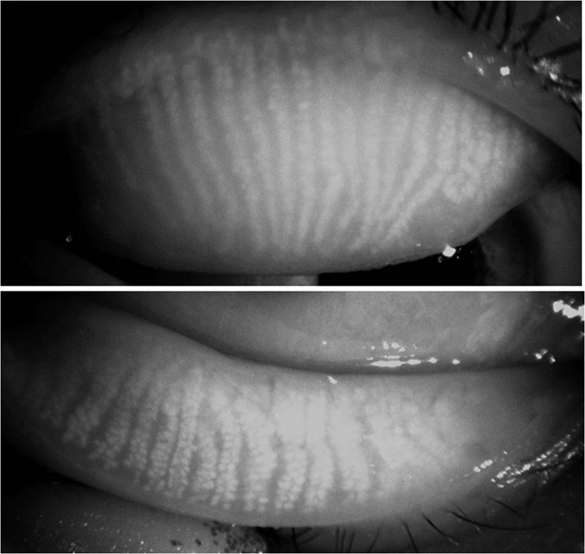
Dry Eye Syndrome
Upper lid
Lower lid
Meibomian glands

Slide 15
Dry Eye Syndrome
The tear film is comprised of three basic components: Lipid, aqueous, and mucin. These components interact to produce the two-phase model of the tear film: The aqueous and mucus intermix into a single, gel-like layer (the mucoaqueous phase), which is covered by the lipids in a lipid phase.
The older tripartite model of the tear film posited that the three components formed distinct mucus (inner), aqueous (middle) and lipid (outer) layers, but the consensus now is this model is incorrect, and it has largely been supplanted by the two-phase model.
The specific lipid is meibum, a product of the meibomian glands. These glands are embedded within the tarsal plates of both the upper and lower lids. There are ~2x as many glands in the upper lids. They are innervated by the parasympathetic system.
The lipid layer makes several key contributions to the stability and effectiveness of the tear film. It inhibits tear film evaporation and reduce its surface tension, both of which serve to maintain the tear film on the eye. (Without a lipid layer, surface tension would pull the tear film down off the surface.) The lipid layer also facilitates visual acuity by producing a glassy-smooth surface at the air-tear film interface.

Slide 16
Dry Eye Syndrome
The tear film is comprised of three basic components: Lipid, aqueous, and mucin. These components interact to produce the two-phase model of the tear film: The aqueous and mucus intermix into a single, gel-like layer (the mucoaqueous phase), which is covered by the lipids in a lipid phase.
The older tripartite model of the tear film posited that the three components formed distinct mucus (inner), aqueous (middle) and lipid (outer) layers, but the consensus now is this model is incorrect, and it has largely been supplanted by the two-phase model.
Aqueous is produced by the lacrimal glands, which includes the main lacrimal gland (found in the superotemporal orbit) and the accessory lacrimal glands of Krauss and Wolfring (found scattered throughout the forniceal and palpebral conj). All of the lacrimal glands are innervated by parasympathetics as well.

Slide 17
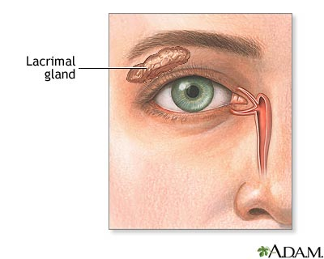
Dry Eye Syndrome
The main lacrimal gland

Slide 18
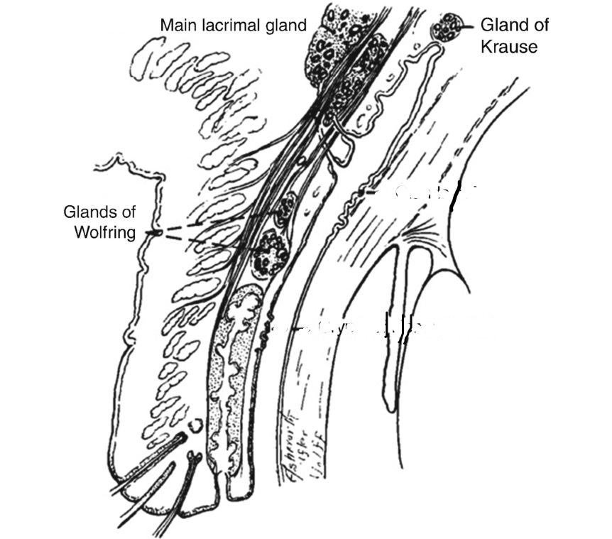
Dry Eye Syndrome
The lacrimal glands of Krause and Wolfring

Slide 19
Dry Eye Syndrome
The tear film is comprised of three basic components: Lipid, aqueous, and mucin. These components interact to produce the two-phase model of the tear film: The aqueous and mucus intermix into a single, gel-like layer (the mucoaqueous phase), which is covered by the lipids in a lipid phase.
The older tripartite model of the tear film posited that the three components formed distinct mucus (inner), aqueous (middle) and lipid (outer) layers, but the consensus now is this model is incorrect, and it has largely been supplanted by the two-phase model.
Mucin is produced by goblet cells located in the conjunctival epithelium, and also are parasympathetically innervated. The chief function of the mucin component of the mucoaqueous layer is facilitating ocular-surface wetting. Recall that the ocular surface is highly hydrophobic and thus repellant to aqueous. The amphiphilic nature of mucin allows it to ‘bridge’ between the epi surface and the aqueous component.

Slide 20
Dry Eye Syndrome
The tear film is comprised of three basic components: Lipid, aqueous, and mucin. These components interact to produce the two-phase model of the tear film: The aqueous and mucus intermix into a single, gel-like layer (the mucoaqueous phase), which is covered by the lipids in a lipid phase.
The older tripartite model of the tear film posited that the three components formed distinct mucus (inner), aqueous (middle) and lipid (outer) layers, but the consensus now is this model is incorrect, and it has largely been supplanted by the two-phase model.
Mucin is produced by goblet cells located in the conjunctival epithelium, and also are parasympathetically innervated. The chief function of the mucin component of the mucoaqueous layer is facilitating ocular-surface wetting. (Recall that the ocular surface is highly hydrophobic and thus repellant to aqueous. The amphiphilic nature of mucin allows it to ‘bridge’ between the epi surface and the aqueous component.)

Slide 21
Dry Eye Syndrome
Soluble mucin
Membrane-bound mucin
We saw this depiction of the two-phase model of the tear film earlier in the set. But are now ready to note the presence and location of mucin. Note that there are ‘membrane-bound’ mucins in the glycocalyx of the corneal epithelium.

Slide 22
Dry Eye Syndrome
The tear film contains a number of constituent molecules that serve important roles in ocular health. Among these are proteins and electrolytes.

Slide 23
Dry Eye Syndrome
The tear film contains a number of constituent molecules that serve important roles in ocular health. Among these are proteins and electrolytes. The main protein to be aware of is IgA, which plays a key role in ocular-surface defense.

Slide 24
Dry Eye Syndrome
The tear film contains a number of constituent molecules that serve important roles in ocular health. Among these are proteins and electrolytes. The main protein to be aware of is IgA, which plays a key role in ocular-surface defense. The primary role of electrolytes in the tear film is to regulate tear-film osmolarity. Recall that osmolarity refers to the concentration of solutes in a fluid—literally, the number of solute-particles in a given amount of fluid. Normal tear osmolarity is 296 ± 10 milliosmoles per liter (mOsm/L).

Slide 25
Dry Eye Syndrome
The tear film contains a number of constituent molecules that serve important roles in ocular health. Among these are proteins and electrolytes. The main protein to be aware of is IgA, which plays a key role in ocular-surface defense. The primary role of electrolytes in the tear film is to regulate tear-film osmolarity. Recall that osmolarity refers to the concentration of solutes in a fluid—literally, the number of solute-particles in a given amount of fluid. Normal tear osmolarity is 296 ± 10 milliosmoles per liter (mOsm/L). In DES, tear osmolarity is higher, which makes sense: If the tear film is inadequate—if there’s not enough fluid there—it means the solute-particles are dissolved in a smaller amount of fluid, which in turn means the concentration of the particles will be higher.

Slide 26
Dry Eye Syndrome
The tear film contains a number of constituent molecules that serve important roles in ocular health. Among these are proteins and electrolytes. The main protein to be aware of is IgA, which plays a key role in ocular-surface defense. The primary role of electrolytes in the tear film is to regulate tear-film osmolarity. Recall that osmolarity refers to the concentration of solutes in a fluid—literally, the number of solute-particles in a given amount of fluid. Normal tear osmolarity is 296 ± 10 milliosmoles per liter (mOsm/L). In DES, tear osmolarity is significantly higher than this, which makes sense: If the tear film is inadequate—if there’s not enough fluid there—it means the solute-particles are dissolved in a smaller amount of fluid, which in turn means the concentration of the particles will be higher.
But why is tear-film osmolarity important? For one reason: The osmotic-pressure gradient it can exert on the underlying ocular-surface epi cells. The membranes of these cells are freely permeable to water but not solutes (ie, they are semi-permeable). Recall the rule regarding semi-permeable membranes: Solvent follows solute. What this means is, if tear-film osmolarity gets too high, water within the epi cells will be pulled out via the resulting osmotic gradient, resulting in intracellular stress and a subsequent inflammatory response among these surface cells.

Slide 27
Dry Eye Syndrome
The tear film contains a number of constituent molecules that serve important roles in ocular health. Among these are proteins and electrolytes. The main protein to be aware of is IgA, which plays a key role in ocular-surface defense. The primary role of electrolytes in the tear film is to regulate tear-film osmolarity. Recall that osmolarity refers to the concentration of solutes in a fluid—literally, the number of solute-particles in a given amount of fluid. Normal tear osmolarity is 296 ± 10 milliosmoles per liter (mOsm/L). In DES, tear osmolarity is significantly higher than this, which makes sense: If the tear film is inadequate—if there’s not enough fluid there—it means the solute-particles are dissolved in a smaller amount of fluid, which in turn means the concentration of the particles will be higher.
But why is tear-film osmolarity important? For one reason: The osmotic-pressure gradient it can exert on the underlying ocular-surface epi cells. The membranes of these cells are freely permeable to water but not solutes (ie, they are semi-permeable). Recall the rule regarding semi-permeable membranes: Solvent follows solute. What this means is, if tear-film osmolarity gets too high, water within the epi cells will be pulled out via the resulting osmotic gradient, resulting in intracellular stress and a subsequent inflammatory response among these surface cells.

Slide 28
Dry Eye Syndrome
Next we turn to the concept of the lacrimal functional unit (LFU). The LFU is the system responsible for the regulation, production, and health of the tear film.

Slide 29
Dry Eye Syndrome
Next we turn to the concept of the lacrimal functional unit (LFU). The LFU is the system responsible for the regulation, production, and health of the tear film. Think of it as a ‘reflex arc’ responsible for the production of the components of the tear film.

Slide 30
Dry Eye Syndrome
CNS integration center
Sensory limb
Motor limb
Sensory receptors
Afferent nerves
Efferent nerves
Effectors
Recall that a reflex arc has three components: A sensory limb consisting of sensory receptors and afferent nerves, a motor limb consisting of efferent nerves and the effector end-organ, and a CNS integration center that connects the afferent and efferent limbs.
Next we turn to the concept of the lacrimal functional unit (LFU). The LFU is the system responsible for the regulation, production, and health of the tear film. Think of it as a ‘reflex arc’ responsible for the production of the components of the tear film.

Slide 31
Dry Eye Syndrome
The LFU
CNS integration center
Sensory limb
Motor limb
Sensory receptors
Afferent nerves
Brainstem
Efferent nerves
Effectors
Ocular-surface nociceptors
Branches of
V₁ and V₂
In the LFU, the sensory limb consists of ocular-surface nociceptors connected to branches of V1 and V2.
Next we turn to the concept of the lacrimal functional unit (LFU). The LFU is the system responsible for the regulation, production, and health of the tear film. Think of it as a ‘reflex arc’ responsible for the production of the components of the tear film.

Slide 32
Dry Eye Syndrome
The LFU
CNS integration center
Sensory limb
Motor limb
Sensory receptors
Afferent nerves
Brainstem
Efferent nerves
Effectors
Ocular-surface nociceptors
Branches of
V₁ and V₂
--P’sympathetics
--CN7
--Glands
----Lacrimal
----M’bomian
----Goblet
--Orbicularis
In the LFU, the sensory limb consists of ocular-surface nociceptors connected to branches of V1 and V2. The motor limb consisting of the lacrimal, meibomian, and goblet glands/cells (innervated by parasympathetics) as well as the orbicularis oculi muscle (innervated by CN7).
Next we turn to the concept of the lacrimal functional unit (LFU). The LFU is the system responsible for the regulation, production, and health of the tear film. Think of it as a ‘reflex arc’ responsible for the production of the components of the tear film.

Slide 33
Dry Eye Syndrome
The LFU
CNS integration center
Sensory limb
Motor limb
Sensory receptors
Afferent nerves
Brainstem
Efferent nerves
Effectors
Ocular-surface nociceptors
Branches of
V₁ and V₂
--P’sympathetics
--CN7
--Glands
----Lacrimal
----M’bomian
----Goblet
--Orbicularis
In the LFU, the sensory limb consists of ocular-surface nociceptors connected to branches of V1 and V2. The motor limb consisting of the lacrimal, meibomian, and goblet glands/cells (innervated by parasympathetics) as well as the orbicularis oculi muscle (innervated by CN7). CNS integration takes place in the brainstem.
Next we turn to the concept of the lacrimal functional unit (LFU). The LFU is the system responsible for the regulation, production, and health of the tear film. Think of it as a ‘reflex arc’ responsible for the production of the components of the tear film.

Slide 34
Dry Eye Syndrome
We are ready (finally!) to tackle the pathophysiology of DES…
Which commences with tear hyperosmolarity

Slide 35
Dry Eye Syndrome
The pathophysiology for DES damage starts with derangement of the tear film in the form of Tear Hyperosmolarity.
We are ready (finally!) to tackle the pathophysiology of DES…
Which commences with tear hyperosmolarity
Tear
hyperosmolarity

Slide 36
Dry Eye Syndrome
The pathophysiology for DES damage starts with derangement of the tear film in the form of Tear Hyperosmolarity.
There are two basic ways in which the status of the aqueous component of the tear film could lead to tear hyperosmolarity:
Tear
hyperosmolarity

Slide 37
Dry Eye Syndrome
The pathophysiology for DES damage starts with derangement of the tear film in the form of Tear Hyperosmolarity.
There are two basic ways in which the status of the aqueous component of the tear film could lead to tear hyperosmolarity:
1) The amount of aqueous produced can be inadequate to maintain normal osmolarity.
or…
Tear
hyperosmolarity

Slide 38
Dry Eye Syndrome
The pathophysiology for DES damage starts with derangement of the tear film in the form of Tear Hyperosmolarity.
There are two basic ways in which the status of the aqueous component of the tear film could lead to tear hyperosmolarity:
1) The amount of aqueous produced can be inadequate to maintain normal osmolarity.
2) The amount of aqueous lost can be too high to maintain normal osmolarity.
or…
Tear
hyperosmolarity

Slide 39
Dry Eye Syndrome
The pathophysiology for DES damage starts with derangement of the tear film in the form of Tear Hyperosmolarity.
There are two basic ways in which the status of the aqueous component of the tear film could lead to tear hyperosmolarity:
1) The amount of aqueous produced can be inadequate to maintain normal osmolarity. This state is known as…
2) The amount of aqueous lost can be too high to maintain normal osmolarity.
Aqueous Tear Deficiency
Tear
hyperosmolarity

Slide 40
Dry Eye Syndrome
The pathophysiology for DES damage starts with derangement of the tear film in the form of Tear Hyperosmolarity.
There are two basic ways in which the status of the aqueous component of the tear film could lead to tear hyperosmolarity:
1) The amount of aqueous produced can be inadequate to maintain normal osmolarity. This state is known as…
2) The amount of aqueous lost can be too high to maintain normal osmolarity. This state is known as…
Aqueous Tear Deficiency
Evaporative Dry Eye
Tear
hyperosmolarity

Slide 41
Dry Eye Syndrome
The pathophysiology for DES damage starts with derangement of the tear film in the form of Tear Hyperosmolarity.
There are two basic ways in which the status of the aqueous component of the tear film could lead to tear hyperosmolarity:
While it’s a bit of an oversimplification, we can associate the components of the tear film with the pathologic states underlying DES:
Aqueous Tear Deficiency
Evaporative Dry Eye
Tear
hyperosmolarity

Slide 42
Dry Eye Syndrome
The pathophysiology for DES damage starts with derangement of the tear film in the form of Tear Hyperosmolarity.
There are two basic ways in which the status of the aqueous component of the tear film could lead to tear hyperosmolarity:
While it’s a bit of an oversimplification, we can associate the components of the tear film with the pathologic states underlying DES:
Problem with the aqueous component
Aqueous Tear Deficiency
Evaporative Dry Eye
Tear
hyperosmolarity

Slide 43
Dry Eye Syndrome
The pathophysiology for DES damage starts with derangement of the tear film in the form of Tear Hyperosmolarity.
There are two basic ways in which the status of the aqueous component of the tear film could lead to tear hyperosmolarity:
While it’s a bit of an oversimplification, we can associate the components of the tear film with the pathologic states underlying DES:
Problem with the aqueous component
Problem with the lipid component
Aqueous Tear Deficiency
Evaporative Dry Eye
Tear
hyperosmolarity

Slide 44
Dry Eye Syndrome
The pathophysiology for DES damage starts with derangement of the tear film in the form of Tear Hyperosmolarity.
Head’s up: Shortly we’re gonna add a third mechanism leading to tear hyperosmolarity
three
There are two basic ways in which the status of the aqueous component of the tear film could lead to tear hyperosmolarity:
Aqueous Tear Deficiency
?
Evaporative Dry Eye
Tear
hyperosmolarity

Slide 45
Dry Eye Syndrome
The pathophysiology for DES damage starts with derangement of the tear film in the form of Tear Hyperosmolarity.
Let’s drill down on both, starting with ATD.
Problem with the aqueous component
Problem with the lipid component
Aqueous Tear Deficiency
Evaporative Dry Eye
Tear
hyperosmolarity

Slide 46
Dry Eye Syndrome
The pathophysiology for DES damage starts with derangement of the tear film in the form of Tear Hyperosmolarity.
But first—
Let’s drill down on both, starting with ATD.
Problem with the aqueous component
Problem with the lipid component
Aqueous Tear Deficiency
Evaporative Dry Eye
Tear
hyperosmolarity

Slide 47
Dry Eye Syndrome
But first—there are three classic tests of aqueous tear production:
Test name | Assesses… | Protocol | Interpretation
Basal secretion test | Basal secretion (duh) | Instill anesthetic, blot, place strip, measure saturation at 5 minutes | Less than 3 mm wetting after 5 min = ATD
Schirmer I | Basal and reflex secretion | Place strip without instilling anesthetic | Less than 5 mm wetting after 5 min = ATD
Schirmer II | Reflex secretion only | Instill anesthetic, blot, place strip, irritate nasal mucosa w/ a cotton-tip | Less than 15 mm wetting after 2 min = reflex secretion defect

Slide 48
Dry Eye Syndrome
But first—there are three classic tests of aqueous tear production:
What each assesses:
Test name | Assesses… | Protocol | Interpretation
Basal secretion test | Basal secretion (duh) | Instill anesthetic, blot, place strip, measure saturation at 5 minutes | Less than 3 mm wetting after 5 min = ATD
Schirmer I | Basal and reflex secretion | Place strip without instilling anesthetic | Less than 5 mm wetting after 5 min = ATD
Schirmer II | Reflex secretion only | Instill anesthetic, blot, place strip, irritate nasal mucosa w/ a cotton-tip | Less than 15 mm wetting after 2 min = reflex secretion defect

Slide 49
Dry Eye Syndrome
But first—there are three classic tests of aqueous tear production:
What each assesses: How each is performed:
Test name | Assesses… | Protocol | Interpretation
Basal secretion test | Basal secretion (duh) | Instill anesthetic, blot, place strip, measure saturation at 5 min | Less than 3 mm wetting after 5 min = ATD
Schirmer I | Basal and reflex secretion | Same, but without instilling anesthetic | Less than 5 mm wetting after 5 min = ATD
Schirmer II | Reflex secretion only | Instill anesthetic, blot, place strip, irritate nasal mucosa w/ a cotton-tip | Less than 15 mm wetting after 2 min = reflex secretion defect

Slide 50
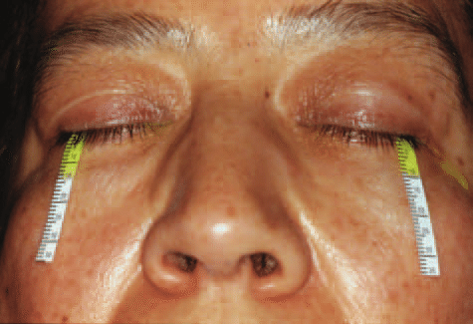
Dry Eye Syndrome
Aqueous tear production testing

Slide 51
Dry Eye Syndrome
But first—there are three classic tests of aqueous tear production:
What each assesses: How each is performed: How each is interpreted:
Test name | Assesses… | Protocol | Interpretation
Basal secretion test | Basal secretion (duh) | Instill anesthetic, blot, place strip, measure saturation at 5 min | Less than 3 mm wetting after 5 min = ATD
Schirmer I | Basal and reflex secretion | Same, but without instilling anesthetic | Less than 5 mm wetting after 5 min = ATD
Schirmer II | Reflex secretion only | Instill anesthetic, blot, place strip, irritate nasal mucosa w/ a cotton-tip | Less than 15 mm wetting after 2 min = reflex secretion defect

Slide 52
Dry Eye Syndrome
ATD is subdivided into two categories: Sjögren’s and non-Sjögren’s
Sjögren’s
Non-Sjögren’s
Aqueous Tear Deficiency
Evaporative Dry Eye
Tear
hyperosmolarity

Slide 53
Dry Eye Syndrome
Sjögren’s syndrome (SS) is a chronic autoimmune disorder characterized by lymphocytic infiltration of exocrine glands. The vast majority of pts are female. It is divided into primary and secondary forms, the key distinction being that secondary SS is associated with a systemic connective-tissue disease (eg, RA, SLE, scleroderma).
Sjögren’s
Non-Sjögren’s
Aqueous Tear Deficiency
Evaporative Dry Eye
Tear
hyperosmolarity

Slide 54
Dry Eye Syndrome
Sjögren’s syndrome (SS) is a chronic autoimmune disorder characterized by lymphocytic infiltration of exocrine glands. The vast majority of pts are female. It is divided into primary and secondary forms, the key distinction being that secondary SS is associated with a systemic connective-tissue disease (eg, RA, SLE, scleroderma). In both forms, aqueous hyposecretion (and thus ATD) results from autoimmune-mediated lymphocytic infiltration of the lacrimal glands.
Sjögren’s
Non-Sjögren’s
Aqueous Tear Deficiency
Evaporative Dry Eye
Tear
hyperosmolarity

Slide 55
Dry Eye Syndrome
In non-Sjögren’s ATD, other causes of lacrimal gland hyposecretion are at work:
Lacrimal duct
obstruction
Reflex
block
Systemic
drug effect
Sjögren’s
Non-Sjögren’s
Aqueous Tear Deficiency
Evaporative Dry Eye
Tear
hyperosmolarity

Slide 56
Dry Eye Syndrome
Reflex block refers to anything that disrupts the normal functioning of the LFU ‘reflex circuit.’
Lacrimal duct
obstruction
Reflex
block
Systemic
drug effect
Sjögren’s
Non-Sjögren’s
Ocular surface nociceptors
Receptors
Cranial nerve 5
Afferent limb
Aqueous Tear Deficiency
Evaporative Dry Eye
(A no-frills version of the LFU for reference)
Brainstem integration
Nucleus
Tear
hyperosmolarity
Efferent limb
Cranial nerve 7
Lacrimal apparatus
Effector

Slide 57
Dry Eye Syndrome
Reflex block refers to anything that disrupts the normal functioning of the LFU ‘reflex circuit.’ Afferent limb block is often due to corneal hypoesthesia from corneal surgery, post-herpetic neuropathy, and contact-lens wear.
Lacrimal duct
obstruction
Reflex
block
Systemic
drug effect
Sjögren’s
Non-Sjögren’s
Ocular surface nociceptors
Receptors
Cranial nerve 5
Afferent limb
Aqueous Tear Deficiency
Evaporative Dry Eye
(A no-frills version of the LFU for reference)
Brainstem integration
Nucleus
Tear
hyperosmolarity
Efferent limb
Cranial nerve 7
Lacrimal apparatus
Effector

Slide 58
Dry Eye Syndrome
Reflex block refers to anything that disrupts the normal functioning of the LFU ‘reflex circuit.’ Afferent limb block is often due to corneal hypoesthesia from corneal surgery, post-herpetic neuropathy, and contact-lens wear. Efferent limb block is usually due to compromised CN7 function, eg, Bell’s palsy.
Lacrimal duct
obstruction
Reflex
block
Systemic
drug effect
Sjögren’s
Non-Sjögren’s
Ocular surface nociceptors
Receptors
Cranial nerve 5
Afferent limb
Aqueous Tear Deficiency
Evaporative Dry Eye
(A no-frills version of the LFU for reference)
Brainstem integration
Nucleus
Tear
hyperosmolarity
Efferent limb
Cranial nerve 7
Lacrimal apparatus
Effector

Slide 59
Dry Eye Syndrome
A substantial number of systemic drugs are implicated in inducing DES. (Eg, 22 of the 100 best-selling drugs in the US list ‘dry eye’ as a side effect!)
Lacrimal duct
obstruction
Reflex
block
Systemic
drug effect
Sjögren’s
Non-Sjögren’s
Aqueous Tear Deficiency
Evaporative Dry Eye
Tear
hyperosmolarity

Slide 60
Dry Eye Syndrome
A substantial number of systemic drugs are implicated in inducing DES. (Eg, 22 of the 100 best-selling drugs in the US list ‘dry eye’ as a side effect!) These include anti-histamines, anti-cholinergics (eg, antidepressants), anti-hypertensives, Parkinson’s meds, and OCPs (because of their effect on androgens and estrogen).
Lacrimal duct
obstruction
Reflex
block
Systemic
drug effect
Sjögren’s
Non-Sjögren’s
Aqueous Tear Deficiency
Evaporative Dry Eye
Tear
hyperosmolarity

Slide 61
Dry Eye Syndrome
EDE is also subdivided into two categories: Intrinsic and Extrinsic
Sjögren’s
Non-Sjögren’s
Intrinsic
Extrinsic
Aqueous Tear Deficiency
Evaporative Dry Eye
Tear
hyperosmolarity

Slide 62
Dry Eye Syndrome
In this context, intrinsic EDE refers to any cause related to the eyelids, whereas extrinsic EDE refers to any non-eyelid factor that promotes evaporation.
EDE is also subdivided into two categories: Intrinsic and Extrinsic
Sjögren’s
Non-Sjögren’s
Intrinsic
Extrinsic
Aqueous Tear Deficiency
Evaporative Dry Eye
Tear
hyperosmolarity

Slide 63
Dry Eye Syndrome
There are three common causes of intrinsic EDE:
Meibomian gland
dysfunction (MGD)
Widened
lid fissure
Reduced
blink rate
Sjögren’s
Non-Sjögren’s
Intrinsic
Extrinsic
Aqueous Tear Deficiency
Evaporative Dry Eye
Tear
hyperosmolarity

Slide 64
Dry Eye Syndrome
MGD refers to a broad group of disorders characterized by dysfunction of the meibomian glands. Individual of Asian heritage are at especially high risk.
Meibomian gland
dysfunction (MGD)
Widened
lid fissure
Reduced
blink rate
Sjögren’s
Non-Sjögren’s
Intrinsic
Extrinsic
Aqueous Tear Deficiency
Evaporative Dry Eye
Tear
hyperosmolarity

Slide 65
Dry Eye Syndrome
MGD refers to a broad group of disorders characterized by dysfunction of the meibomian glands. Individual of Asian heritage are at especially high risk.
In many cases, the dysfunction is due to obstruction of gland output leading to an inadequate volume of meibum in the tear-film; in others, the meibum’s chemical composition has been altered, rendering it ineffective. (Chemical alteration and obstruction commonly co-exist in the same pt.)
Meibomian gland
dysfunction (MGD)
Widened
lid fissure
Reduced
blink rate
Sjögren’s
Non-Sjögren’s
Intrinsic
Extrinsic
Aqueous Tear Deficiency
Evaporative Dry Eye
Tear
hyperosmolarity

Slide 66
Dry Eye Syndrome
MGD refers to a broad group of disorders characterized by dysfunction of the meibomian glands. Individual of Asian heritage are at especially high risk.
In many cases, the dysfunction is due to obstruction of gland output leading to an inadequate volume of meibum in the tear-film; in others, the meibum’s chemical composition has been altered, rendering it ineffective. (Chemical alteration and obstruction commonly co-exist in the same pt.)
We will have more to say about MGD later in the set
Meibomian gland
dysfunction (MGD)
Widened
lid fissure
Reduced
blink rate
Sjögren’s
Non-Sjögren’s
Intrinsic
Extrinsic
Aqueous Tear Deficiency
Evaporative Dry Eye
Tear
hyperosmolarity

Slide 67
Dry Eye Syndrome
A widened lid fissure can be 2ndry to forward displacement of the globe (ie, proptosis/exophthalmos); increased innervation to the lid retractors such as occurs in thyroid eye disease; and/or to congenital craniofacial malformations resulting in shallow orbits (eg, Crouzon syndrome).
Meibomian gland
dysfunction (MGD)
Widened
lid fissure
Reduced
blink rate
Sjögren’s
Non-Sjögren’s
Intrinsic
Extrinsic
Aqueous Tear Deficiency
Evaporative Dry Eye
Tear
hyperosmolarity

Slide 68
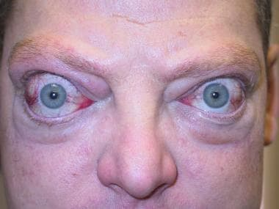
Dry Eye Syndrome
TED: Lid retraction + exophthalmos->surface exposure->EDE

Slide 69
Dry Eye Syndrome
Crouzon syndrome: Shallow orbits->surface exposure->EDE

Slide 70
Dry Eye Syndrome
Causes of reduced blink rate include normal phenomena such as seen during sustained participation in a visually intensive task (eg, reading; computer work) as well as pathological causes such as Parkinson’s dz.
Meibomian gland
dysfunction (MGD)
Widened
lid fissure
Reduced
blink rate
Sjögren’s
Non-Sjögren’s
Intrinsic
Extrinsic
Aqueous Tear Deficiency
Evaporative Dry Eye
Tear
hyperosmolarity

Slide 71
Dry Eye Syndrome
The pathophysiology for DES damage starts with derangement of the tear film in the form of Tear Hyperosmolarity.
Head’s up: Shortly we’re gonna add a third mechanism leading to tear hyperosmolarity
three
There are two basic ways in which the status of the aqueous component of the tear film could lead to tear hyperosmolarity:
Recall that earlier in the set we alluded to a third means by which tear-film status could produce hyperosmolarity and dry eye. The time to address this has arrived!
Aqueous Tear Deficiency
Evaporative Dry Eye
Tear
hyperosmolarity

Slide 72
Dry Eye Syndrome
The pathophysiology for DES damage starts with derangement of the tear film in the form of Tear Hyperosmolarity.
The other fundamental way could the status of the tear film lead to tear hyperosmolarity:
Aqueous Tear Deficiency
?
Evaporative Dry Eye
Tear
hyperosmolarity

Slide 73
Dry Eye Syndrome
The pathophysiology for DES damage starts with derangement of the tear film in the form of Tear Hyperosmolarity.
The other fundamental way could the status of the tear film lead to tear hyperosmolarity:
The tear film can break up too quickly, exposing the ocular surface.
Aqueous Tear Deficiency
?
Evaporative Dry Eye
Tear
hyperosmolarity

Slide 74
Dry Eye Syndrome
The pathophysiology for DES damage starts with derangement of the tear film in the form of Tear Hyperosmolarity.
The other fundamental way could the status of the tear film lead to tear hyperosmolarity:
The tear film can break up too quickly, exposing the ocular surface. This state is known as one of…
Aqueous Tear Deficiency
Tear Film Instability
Evaporative Dry Eye
Tear
hyperosmolarity

Slide 75
Dry Eye Syndrome
The pathophysiology for DES damage starts with derangement of the tear film in the form of Tear Hyperosmolarity.
Recalling our answers to this issue previously:
What is the answer vis a vis tear-film instability?
While it’s a bit of an oversimplification, we can associate the components of the tear film with the pathologic states underlying DES:
Problem with the aqueous component
Problem with the lipid component
Aqueous Tear Deficiency
Tear Film Instability
Evaporative Dry Eye
Tear
hyperosmolarity

Slide 76
Dry Eye Syndrome
The pathophysiology for DES damage starts with derangement of the tear film in the form of Tear Hyperosmolarity.
Recalling our answers to this issue previously:
With respect to tear-film instability, problems with the mucin (and lipid) components lead to tear-film instability.
Problem with the aqueous component
Problem with the mucin component
Problem with the lipid component
Aqueous Tear Deficiency
(lipid too)
Evaporative Dry Eye
Tear Film Instability
Tear
hyperosmolarity

Slide 77
Dry Eye Syndrome
Tear-film instability is quantified via the tear-film break-up time (TBUT or TFBUT) assessment. A little fluorescein is instilled, and the pt is asked to hold their eyes open after blinking a couple of times. The tear film is observed with the cobalt-blue filter in place, and the length of time that passes until a dry spot appears is noted. A TBUT of less than ~10s is considered abnormal.
Sjögren’s
Non-Sjögren’s
Aqueous Tear Deficiency
Tear Film Instability
Evaporative Dry Eye
Tear
hyperosmolarity

Slide 78
Dry Eye Syndrome
Tear-film instability is quantified via the tear-film break-up time (TBUT or TFBUT) assessment. A little fluorescein is instilled, and the pt is asked to hold their eyes open after blinking a couple of times. The tear film is observed with the cobalt-blue filter in place, and the length of time that passes until a dry spot appears is noted. A TBUT of less than ~10s is considered abnormal.
Sjögren’s
Non-Sjögren’s
Aqueous Tear Deficiency
Tear Film Instability
Evaporative Dry Eye
Tear
hyperosmolarity

Slide 79
Dry Eye Syndrome
Three categories of conditions leading to TFI have been identified:
Xerophthalmia
Topical
preservatives
Ocular
allergy
Sjögren’s
Non-Sjögren’s
Aqueous Tear Deficiency
Tear Film Instability
Evaporative Dry Eye
Tear
hyperosmolarity

Slide 80
Dry Eye Syndrome
The leading cause of xerophthalmia worldwide is hypovitaminosis A, a potentially fatal condition.
Xerophthalmia
Topical
preservatives
Ocular
allergy
Sjögren’s
Non-Sjögren’s
Aqueous Tear Deficiency
Tear Film Instability
Evaporative Dry Eye
Tear
hyperosmolarity

Slide 81
Dry Eye Syndrome
The leading cause of xerophthalmia worldwide is hypovitaminosis A, a potentially fatal condition. Hypovitaminosis A xerosis of the ocular surface produces Bitôt spots—foamy, white/gray area on the interpalpebral conjunctiva.
Xerophthalmia
Topical
preservatives
Ocular
allergy
Sjögren’s
Non-Sjögren’s
Aqueous Tear Deficiency
Tear Film Instability
Evaporative Dry Eye
Tear
hyperosmolarity

Slide 82
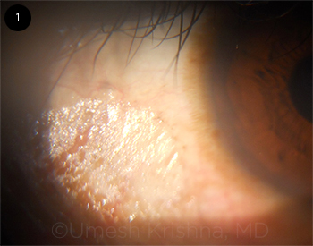
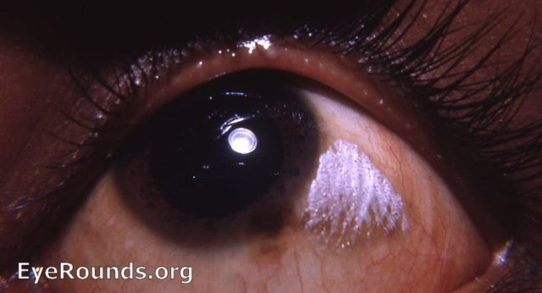
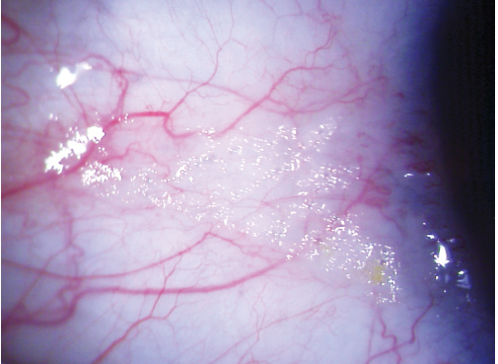
Dry Eye Syndrome
Bitôt spots: Conj finding temporal to the cornea, with typical dry/foamy appearance

Slide 83
Dry Eye Syndrome
Preservatives in ophthalmic preparations lead to TFI by provoking an inflammatory response in the conj epithelium, which in turn promotes goblet cell apoptosis.
Xerophthalmia
Topical
preservatives
Ocular
allergy
Sjögren’s
Non-Sjögren’s
Aqueous Tear Deficiency
Tear Film Instability
Evaporative Dry Eye
Tear
hyperosmolarity

Slide 84
Dry Eye Syndrome
Preservatives in ophthalmic preparations lead to TFI by provoking an inflammatory response in the conj epithelium, which in turn promotes goblet cell apoptosis. The preservative benzalkonium chloride (aka BAK or BAC) is especially notorious for doing this.
Xerophthalmia
Topical
preservatives
Ocular
allergy
Sjögren’s
Non-Sjögren’s
Aqueous Tear Deficiency
Tear Film Instability
Evaporative Dry Eye
Tear
hyperosmolarity

Slide 85
Dry Eye Syndrome
Allergic antigens produce TFI by initiating an IgE-mediated inflammatory cascade, leading to goblet-cell loss.
Xerophthalmia
Topical
preservatives
Ocular
allergy
Sjögren’s
Non-Sjögren’s
Aqueous Tear Deficiency
Tear Film Instability
Evaporative Dry Eye
Tear
hyperosmolarity

Slide 86
Dry Eye Syndrome
Now that we understand how ATD, TFI and EDE lead to tear hyperosmolarity…
Let’s examine how tear hyperosmolarity leads to DES
Aqueous Tear Deficiency
Tear Film Instability
Evaporative Dry Eye
Tear
hyperosmolarity

Slide 87
Dry Eye Syndrome
Now that we understand how ATD, TFI and EDE lead to tear hyperosmolarity…
Let’s examine how tear hyperosmolarity leads to DES
Aqueous Tear Deficiency
Tear Film Instability
Evaporative Dry Eye
Tear
hyperosmolarity

Slide 88
Dry Eye Syndrome
Surface epithelium damage
First:
Tear-film hyperosmolarity initiates the DES cascade by stressing surface epithelium, significantly damaging it.
Hyperosmolar stress
Aqueous Tear Deficiency
Tear Film Instability
Evaporative Dry Eye
Tear
hyperosmolarity

Slide 89
Dry Eye Syndrome
Then:
Inflammatory cytokine release
In turn, damaged epi cells release cytokines that promote and/or facilitate inflammation. These cytokines include TNF, MMP-9, and IL-1.
Surface epithelium damage
Tear-film hyperosmolarity initiates the DES cascade by stressing surface epithelium, significantly damaging it.
Hyperosmolar stress
Aqueous Tear Deficiency
Tear Film Instability
Evaporative Dry Eye
Tear
hyperosmolarity

Slide 90
Dry Eye Syndrome
Then:
Inflammatory cytokine release
In turn, damaged epi cells release cytokines that promote and/or facilitate inflammation. These cytokines include TNF, MMP-9, and IL-1. TNF and IL-1 promote epi-cell apoptosis, whereas MMP-9 cleaves epi cells from their BM.
Surface epithelium damage
Tear-film hyperosmolarity initiates the DES cascade by stressing surface epithelium, significantly damaging it.
Hyperosmolar stress
Aqueous Tear Deficiency
Tear Film Instability
Evaporative Dry Eye
Tear
hyperosmolarity

Slide 91
Dry Eye Syndrome
Inflammatory cytokine release
In turn, damaged epi cells release cytokines that promote and/or facilitate inflammation. These cytokines include TNF, MMP-9, and IL-1. TNF and IL-1 promote epi-cell apoptosis, whereas MMP-9 cleaves epi cells from their BM.
DES feedback loop!
Surface epithelium damage
Note that surface epi damage induces cytokine release…And cytokine release induces surface epi damage. Thus, a vicious cycle/circle develops in which epi damage leads directly to further epi damage.
Tear-film hyperosmolarity initiates the DES cascade by stressing surface epithelium, significantly damaging it.
Hyperosmolar stress
Aqueous Tear Deficiency
Tear Film Instability
Evaporative Dry Eye
Tear
hyperosmolarity

Slide 92
Dry Eye Syndrome
Note that
Cytokines also impede function of the afferent arm of the LFU reflex arc…
Neural reflex arc disruption
Inflammatory cytokine release
In turn, damaged epi cells release cytokines that promote and/or facilitate inflammation. These cytokines include TNF, MMP-9, and IL-1. TNF and IL-1 promote epi-cell apoptosis, whereas MMP-9 cleaves epi cells from their BM.
Surface epithelium damage
Tear-film hyperosmolarity initiates the DES cascade by stressing surface epithelium, significantly damaging it.
Hyperosmolar stress
Aqueous Tear Deficiency
Tear Film Instability
Evaporative Dry Eye
Tear
hyperosmolarity

Slide 93
Dry Eye Syndrome
Note that
Decreased aqueous production
Cytokines also impede function of the afferent arm of the LFU reflex arc…resulting in decreased aqueous production.
Neural reflex arc disruption
Inflammatory cytokine release
In turn, damaged epi cells release cytokines that promote and/or facilitate inflammation. These cytokines include TNF, MMP-9, and IL-1. TNF and IL-1 promote epi-cell apoptosis, whereas MMP-9 cleaves epi cells from their BM.
Surface epithelium damage
Tear-film hyperosmolarity initiates the DES cascade by stressing surface epithelium, significantly damaging it.
Hyperosmolar stress
Aqueous Tear Deficiency
Tear Film Instability
Evaporative Dry Eye
Tear
hyperosmolarity

Slide 94
Dry Eye Syndrome
Decreased aqueous production
Cytokines also impede function of the afferent arm of the LFU reflex arc…resulting in decreased aqueous production.
Neural reflex arc disruption
Inflammatory cytokine release
So neural reflex arc disruption decreases aqueous production…And decreased aqueous production worsens tear hyperosmolarity, which in turn starts the entire process over again. Thus, a vicious cycle/circle develops in which decreased aqueous production leads directly to further decreases in aqueous production.
In turn, damaged epi cells release cytokines that promote and/or facilitate inflammation. These cytokines include TNF, MMP-9, and IL-1. TNF and IL-1 promote epi-cell apoptosis, whereas MMP-9 cleaves epi cells from their BM.
Surface epithelium damage
Tear-film hyperosmolarity initiates the DES cascade by stressing surface epithelium, significantly damaging it.
Hyperosmolar stress
Aqueous Tear Deficiency
Tear Film Instability
Evaporative Dry Eye
Tear
hyperosmolarity

Slide 95
Dry Eye Syndrome
Decreased aqueous production
Cytokines also impede function of the afferent arm of the LFU reflex arc…resulting in decreased aqueous production.
DES feedback loop!
Neural reflex arc disruption
Inflammatory cytokine release
So neural reflex arc disruption decreases aqueous production…And decreased aqueous production worsens tear hyperosmolarity, which in turn starts the entire process over again. Thus, a vicious cycle/circle develops in which decreased aqueous production leads directly to further decreases in aqueous production.
In turn, damaged epi cells release cytokines that promote and/or facilitate inflammation. These cytokines include TNF, MMP-9, and IL-1. TNF and IL-1 promote epi-cell apoptosis, whereas MMP-9 cleaves epi cells from their BM.
Surface epithelium damage
Tear-film hyperosmolarity initiates the DES cascade by stressing surface epithelium, significantly damaging it.
Hyperosmolar stress
Aqueous Tear Deficiency
Tear Film Instability
Evaporative Dry Eye
Tear
hyperosmolarity

Slide 96
Dry Eye Syndrome
Decreased aqueous production
Cytokines also impede function of the afferent arm of the LFU reflex arc…resulting in decreased aqueous production.
DES feedback loop!
Neural reflex arc disruption
Inflammatory cytokine release
So neural reflex arc disruption decreases aqueous production…And decreased aqueous production worsens tear hyperosmolarity, which in turn starts the entire process over again. Thus, another vicious cycle/circle develops in which decreased aqueous production leads directly to further decreases in aqueous production.
In turn, damaged epi cells release cytokines that promote and/or facilitate inflammation. These cytokines include TNF, MMP-9, and IL-1. TNF and IL-1 promote epi-cell apoptosis, whereas MMP-9 cleaves epi cells from their BM.
Surface epithelium damage
Tear-film hyperosmolarity initiates the DES cascade by stressing surface epithelium, significantly damaging it.
Hyperosmolar stress
Aqueous Tear Deficiency
Tear Film Instability
Evaporative Dry Eye
Tear
hyperosmolarity

Slide 97
Dry Eye Syndrome
Decreased aqueous production
Neural reflex arc disruption
Inflammatory cytokine release
Surface epithelium damage
Hyperosmolar stress
Aqueous Tear Deficiency
Tear Film Instability
Evaporative Dry Eye
Tear
hyperosmolarity
With regards to treating DES—there are three obvious interdiction points in its pathogenesis:

Slide 98
Dry Eye Syndrome
Decreased aqueous production
Neural reflex arc disruption
Inflammatory cytokine release
Surface epithelium damage
Hyperosmolar stress
1) Increase tear volume
Tear volume
Aqueous Tear Deficiency
Tear Film Instability
Evaporative Dry Eye
Tear
hyperosmolarity
With regards to treating DES—there are three obvious interdiction points in its pathogenesis:

Slide 99
Dry Eye Syndrome
Decreased aqueous production
Neural reflex arc disruption
Inflammatory cytokine release
Surface epithelium damage
Hyperosmolar stress
1) Increase tear volume
2) Decrease tear evaporation
Tear volume
Aqueous Tear Deficiency
Tear Film Instability
Evaporative Dry Eye
Tear evaporation
Tear
hyperosmolarity
With regards to treating DES—there are three obvious interdiction points in its pathogenesis:

Slide 100
Dry Eye Syndrome
Decreased aqueous production
Neural reflex arc disruption
3) Prevent cytokine release and/or mitigate their effects
Inflammatory cytokine release
Surface epithelium damage
Hyperosmolar stress
1) Increase tear volume
2) Decrease tear evaporation
Tear volume
Aqueous Tear Deficiency
Tear Film Instability
Evaporative Dry Eye
Tear evaporation
Tear
hyperosmolarity
With regards to treating DES—there are three obvious interdiction points in its pathogenesis:

Slide 101
Dry Eye Syndrome
Decreased aqueous production
Neural reflex arc disruption
3) Prevent cytokine release and/or mitigate their effects
Inflammatory cytokine release
The most straightforward means of increasing aqueous volume is supplementing the tear lake with artificial tears. (The Cornea book says tear substitutes are “the mainstay of treatment for aqueous tear deficiency.”) In more severe cases punctal occlusion may be indicated.
Surface epithelium damage
Hyperosmolar stress
1) Increase tear volume
2) Decrease tear evaporation
Tear volume
Aqueous Tear Deficiency
Tear Film Instability
Evaporative Dry Eye
Tear evaporation
Tear
hyperosmolarity
With regards to treating DES—there are three obvious interdiction points in its pathogenesis:

Slide 102
Dry Eye Syndrome
Decreased aqueous production
Neural reflex arc disruption
3) Prevent cytokine release and/or mitigate their effects
Inflammatory cytokine release
The most straightforward means of increasing aqueous volume is supplementing the tear lake with artificial tears. (The Cornea book says tear substitutes are “the mainstay of treatment for aqueous tear deficiency.”) In more severe cases punctal occlusion may be indicated.
Surface epithelium damage
Hyperosmolar stress
1) Increase tear volume
2) Decrease tear evaporation
Tear volume
Aqueous Tear Deficiency
Tear Film Instability
Evaporative Dry Eye
Tear evaporation
Tear
hyperosmolarity
With regards to treating DES—there are three obvious interdiction points in its pathogenesis:

Slide 103
Dry Eye Syndrome
Decreased aqueous production
Neural reflex arc disruption
3) Prevent cytokine release and/or mitigate their effects
Inflammatory cytokine release
The mainstay tx of EDE is lid hygiene. (The Cornea book says lid hygiene is “an essential part [of tx] at all stages of the disease.”) The two fundamental steps involved in lid hygiene are:
1) Application of heat to the eyelids to soften the abnormal meibum; and
2) Compression/massage of the lid margin to express the abnormal meibum.
Surface epithelium damage
Hyperosmolar stress
1) Increase tear volume
2) Decrease tear evaporation
Tear volume
Aqueous Tear Deficiency
Tear Film Instability
Evaporative Dry Eye
Tear evaporation
Tear
hyperosmolarity
With regards to treating DES—there are three obvious interdiction points in its pathogenesis:

Slide 104
Dry Eye Syndrome
Decreased aqueous production
Neural reflex arc disruption
3) Prevent cytokine release and/or mitigate their effects
Inflammatory cytokine release
The mainstay tx of EDE is lid hygiene. (The Cornea book says lid hygiene is “an essential part [of tx] at all stages of the disease.”)
The two fundamental steps involved in lid hygiene are:
1) Application of heat to the eyelids to soften the abnormal meibum; and
2) Compression/massage of the lid margin to express the abnormal meibum.
Surface epithelium damage
Hyperosmolar stress
1) Increase tear volume
2) Decrease tear evaporation
Tear volume
Aqueous Tear Deficiency
Tear Film Instability
Evaporative Dry Eye
Tear evaporation
Tear
hyperosmolarity
With regards to treating DES—there are three obvious interdiction points in its pathogenesis:

Slide 105
Dry Eye Syndrome
Decreased aqueous production
Quick sidebar on ‘abnormal meibum’: What makes it abnormal is its chemical composition, which has been altered (and not for the better). Because of this altered composition, its melting point is higher than normal. Normal meibum is a liquid at body temperature, which is why expressed normal meibum looks like tiny drops of vegetable oil resting on the lid margin. In contrast, the chemically-altered meibum in MGD is a semisolid at body temp, which is why expressed abnormal meibum looks like toothpaste. So not only is the meibum in MGD altered (and thus less effective), the fact that it’s a semisolid means it can’t even get out of the glands and onto the tear film.
Neural reflex arc disruption
3) Prevent cytokine release and/or mitigate their effects
Inflammatory cytokine release
The mainstay tx of EDE is lid hygiene. (The Cornea book says lid hygiene is “an essential part [of tx] at all stages of the disease.”) The two fundamental steps involved in lid hygiene are:
1) Application of heat to the eyelids to soften the abnormal meibum; and
2) Compression/massage of the lid margin to express the abnormal meibum.
Surface epithelium damage
Hyperosmolar stress
1) Increase tear volume
2) Decrease tear evaporation
Tear volume
Aqueous Tear Deficiency
Tear Film Instability
Evaporative Dry Eye
Tear evaporation
Tear
hyperosmolarity
With regards to treating DES—there are three obvious interdiction points in its pathogenesis:

Slide 106
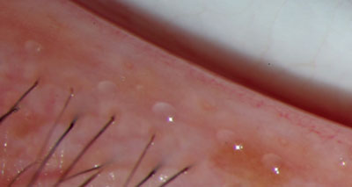
Dry Eye Syndrome
Normal meibum

Slide 107
Dry Eye Syndrome
Decreased aqueous production
Quick sidebar on ‘abnormal meibum’: What makes it abnormal is its chemical composition, which has been altered (and not for the better). Because of this altered composition, its melting point is higher than normal. Normal meibum is a liquid at body temperature, which is why expressed normal meibum looks like tiny drops of vegetable oil resting on the lid margin. In contrast, the chemically-altered meibum in MGD is a semisolid at body temp, which is why expressed abnormal meibum looks like toothpaste. So not only is the meibum in MGD altered (and thus less effective), the fact that it’s a semisolid means it can’t even get out of the glands and onto the tear film.
Neural reflex arc disruption
3) Prevent cytokine release and/or mitigate their effects
Inflammatory cytokine release
The mainstay tx of EDE is lid hygiene. (The Cornea book says lid hygiene is “an essential part [of tx] at all stages of the disease.”) The two fundamental steps involved in lid hygiene are:
1) Application of heat to the eyelids to soften the abnormal meibum; and
2) Compression/massage of the lid margin to express the abnormal meibum.
Surface epithelium damage
Hyperosmolar stress
1) Increase tear volume
2) Decrease tear evaporation
Tear volume
Aqueous Tear Deficiency
Tear Film Instability
Evaporative Dry Eye
Tear evaporation
Tear
hyperosmolarity
With regards to treating DES—there are three obvious interdiction points in its pathogenesis:

Slide 108
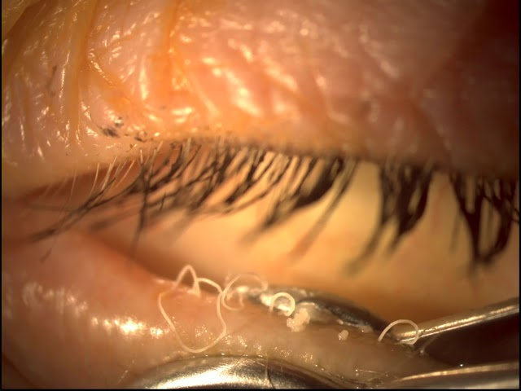
Dry Eye Syndrome
Ewwww

Slide 109
Dry Eye Syndrome
Decreased aqueous production
Quick sidebar on ‘abnormal meibum’: What makes it abnormal is its chemical composition, which has been altered (and not for the better). Because of this altered composition, its melting point is higher than normal. Normal meibum is a liquid at body temperature, which is why expressed normal meibum looks like tiny drops of vegetable oil resting on the lid margin. In contrast, the chemically-altered meibum in MGD is a semisolid at body temp, which is why expressed abnormal meibum looks like toothpaste. So not only is the meibum in MGD altered (and thus less effective), the fact that it’s a semisolid means it can’t even get out of the glands and onto the tear film.
Neural reflex arc disruption
3) Prevent cytokine release and/or mitigate their effects
Inflammatory cytokine release
The mainstay tx of EDE is lid hygiene. (The Cornea book says lid hygiene is “an essential part [of tx] at all stages of the disease.”) The two fundamental steps involved in lid hygiene are:
1) Application of heat to the eyelids to soften the abnormal meibum; and
2) Compression/massage of the lid margin to express the abnormal meibum.
Surface epithelium damage
Hyperosmolar stress
1) Increase tear volume
2) Decrease tear evaporation
Tear volume
Aqueous Tear Deficiency
Tear Film Instability
Evaporative Dry Eye
Tear evaporation
Tear
hyperosmolarity
With regards to treating DES—there are three obvious interdiction points in its pathogenesis:

Slide 110
Dry Eye Syndrome
Decreased aqueous production
Quick sidebar on ‘abnormal meibum’: What makes it abnormal is its chemical composition, which has been altered (and not for the better). Because of this altered composition, its melting point is higher than normal. Normal meibum is a liquid at body temperature, which is why expressed normal meibum looks like tiny drops of vegetable oil resting on the lid margin. In contrast, the chemically-altered meibum in MGD is a semisolid at body temp, which is why expressed abnormal meibum looks like toothpaste. So not only is the meibum in MGD altered (and thus less effective), the fact that it’s a semisolid means it can’t even get out of the glands and onto the tear film.
Neural reflex arc disruption
3) Prevent cytokine release and/or mitigate their effects
Inflammatory cytokine release
So to reiterate, the logic underpinning lid hygiene is:
--Step 1: Liquify the semisolid abnormal meibum clogging the glands
--Step 2: Express the now-liquefied abnormal meibum from the glands
The mainstay tx of EDE is lid hygiene. (The Cornea book says lid hygiene is “an essential part [of tx] at all stages of the disease.”) The two fundamental steps involved in lid hygiene are:
1) Application of heat to the eyelids to soften the abnormal meibum; and
2) Compression/massage of the lid margin to express the abnormal meibum.
Surface epithelium damage
Hyperosmolar stress
1) Increase tear volume
2) Decrease tear evaporation
Tear volume
Aqueous Tear Deficiency
Tear Film Instability
Evaporative Dry Eye
Tear evaporation
Tear
hyperosmolarity
With regards to treating DES—there are three obvious interdiction points in its pathogenesis:

Slide 111
Dry Eye Syndrome
Decreased aqueous production
But using heat and massage to get the abnormal meibum flowing is not sufficient. Why? Because once the lids cool back down to body temp, the subsequent (abnormal) meibum will again be semisolid—that is, unless steps are taken to normalize its chemical composition. To accomplish this, interventions include:
--Topical abx to reduce bacterial load (bacterial lipases play an important role in altering meibum’s chemical composition)
--Topical steroids and nonsteroidal anti-inflammatories
--PO tetracyclines—not as an antibacterial, but for its anti-inflammatory properties (it reduces cytokine release and inhibits MMP-9 activity)
Neural reflex arc disruption
3) Prevent cytokine release and/or mitigate their effects
Inflammatory cytokine release
Surface epithelium damage
Hyperosmolar stress
1) Increase tear volume
2) Decrease tear evaporation
Tear volume
Aqueous Tear Deficiency
Tear Film Instability
Evaporative Dry Eye
Tear evaporation
Tear
hyperosmolarity
With regards to treating DES—there are three obvious interdiction points in its pathogenesis:

Slide 112
Dry Eye Syndrome
Decreased aqueous production
But using heat and massage to get the abnormal meibum flowing is not sufficient. Why? Because once the lids cool back down to body temp, the subsequent (abnormal) meibum will again be semisolid—that is, unless steps are taken to normalize its chemical composition. To accomplish this, interventions include:
--Topical abx to reduce bacterial load (bacterial lipases play an important role in altering meibum’s chemical composition)
--Topical steroids and nonsteroidal anti-inflammatories
--PO tetracyclines—not as an antibacterial, but for its anti-inflammatory properties (it reduces cytokine release and inhibits MMP-9 activity)
Neural reflex arc disruption
3) Prevent cytokine release and/or mitigate their effects
Inflammatory cytokine release
Surface epithelium damage
Hyperosmolar stress
1) Increase tear volume
2) Decrease tear evaporation
Tear volume
Aqueous Tear Deficiency
Tear Film Instability
Evaporative Dry Eye
Tear evaporation
Tear
hyperosmolarity
With regards to treating DES—there are three obvious interdiction points in its pathogenesis:

Slide 113
Dry Eye Syndrome
Decreased aqueous production
But using heat and massage to get the abnormal meibum flowing is not sufficient. Why? Because once the lids cool back down to body temp, the subsequent (abnormal) meibum will again be semisolid—that is, unless steps are taken to normalize its chemical composition. To accomplish this, interventions include:
--Topical abx to reduce bacterial load (bacterial lipases play an important role in altering meibum’s chemical composition)
--Topical steroids and nonsteroidal anti-inflammatories
--PO tetracyclines—not as an antibacterial, but for its anti-inflammatory properties (it reduces cytokine release and inhibits MMP-9 activity)
Neural reflex arc disruption
3) Prevent cytokine release and/or mitigate their effects
Inflammatory cytokine release
Surface epithelium damage
Hyperosmolar stress
1) Increase tear volume
2) Decrease tear evaporation
Tear volume
Aqueous Tear Deficiency
Tear Film Instability
Evaporative Dry Eye
Tear evaporation
Tear
hyperosmolarity
With regards to treating DES—there are three obvious interdiction points in its pathogenesis:

Slide 114
Dry Eye Syndrome
Decreased aqueous production
But using heat and massage to get the abnormal meibum flowing is not sufficient. Why? Because once the lids cool back down to body temp, the subsequent (abnormal) meibum will again be semisolid—that is, unless steps are taken to normalize its chemical composition. To accomplish this, interventions include:
--Topical abx to reduce bacterial load (bacterial lipases play an important role in altering meibum’s chemical composition)
--Topical steroids and nonsteroidal anti-inflammatories
--PO tetracyclines—not as an antibacterial, but for its anti-inflammatory properties (it reduces cytokine release and inhibits MMP-9 activity)
Neural reflex arc disruption
3) Prevent cytokine release and/or mitigate their effects
Inflammatory cytokine release
Surface epithelium damage
Hyperosmolar stress
1) Increase tear volume
2) Decrease tear evaporation
Tear volume
Aqueous Tear Deficiency
Tear Film Instability
Evaporative Dry Eye
Tear evaporation
Tear
hyperosmolarity
With regards to treating DES—there are three obvious interdiction points in its pathogenesis:

Slide 115
Dry Eye Syndrome
Decreased aqueous production
But using heat and massage to get the abnormal meibum flowing is not sufficient. Why? Because once the lids cool back down to body temp, the subsequent (abnormal) meibum will again be semisolid—that is, unless steps are taken to normalize its chemical composition. To accomplish this, interventions include:
--Topical abx to reduce bacterial load (bacterial lipases play an important role in altering meibum’s chemical composition)
--Topical steroids and nonsteroidal anti-inflammatories
--PO tetracyclines—not as an antibacterial, but for its anti-inflammatory properties (it reduces cytokine release and inhibits MMP-9 activity)
Neural reflex arc disruption
3) Prevent cytokine release and/or mitigate their effects
Two steroid-sparing topical anti-inflammatories are used in the US: Cyclosporine and lifitegrast. Both work by interfering with the activation and/or function of T-cells.
Inflammatory cytokine release
Surface epithelium damage
Hyperosmolar stress
1) Increase tear volume
2) Decrease tear evaporation
Tear volume
Aqueous Tear Deficiency
Tear Film Instability
Evaporative Dry Eye
Tear evaporation
Tear
hyperosmolarity
With regards to treating DES—there are three obvious interdiction points in its pathogenesis:

Slide 116
Dry Eye Syndrome
Decreased aqueous production
But using heat and massage to get the abnormal meibum flowing is not sufficient. Why? Because once the lids cool back down to body temp, the subsequent (abnormal) meibum will again be semisolid—that is, unless steps are taken to normalize its chemical composition. To accomplish this, interventions include:
--Topical abx to reduce bacterial load (bacterial lipases play an important role in altering meibum’s chemical composition)
--Topical steroids and nonsteroidal anti-inflammatories
--PO tetracyclines—not as an antibacterial, but for its anti-inflammatory properties (it reduces cytokine release and inhibits MMP-9 activity)
Neural reflex arc disruption
3) Prevent cytokine release and/or mitigate their effects
Two steroid-sparing topical anti-inflammatories are used in the US: Cyclosporine and lifitegrast. Both work by interfering with the activation and/or function of T-cells.
Inflammatory cytokine release
Surface epithelium damage
Hyperosmolar stress
1) Increase tear volume
2) Decrease tear evaporation
Tear volume
Aqueous Tear Deficiency
Tear Film Instability
Evaporative Dry Eye
Tear evaporation
Tear
hyperosmolarity
With regards to treating DES—there are three obvious interdiction points in its pathogenesis:

Slide 117
Dry Eye Syndrome
Decreased aqueous production
Neural reflex arc disruption
To this point we’ve discussed treatment strategies for ATD and EDE as distinct entities (which they are). However, ATD and EDE frequently coexist in DES pts, and this has important implications for management. Most interventions (ATs, anti-inflammatory meds) are useful in both conditions. However, there is one relatively common ATD intervention that must be used with caution in pts who also have MGD: Punctal occlusion. Why must punctal occlusion be used with caution in ATD pts with concurrent MGD? Because in addition to increasing the amount of aqueous on the ocular surface (good), occlusion will also increase/maintain the proinflammatory abnormal meibum on the ocular surface (bad). As a general rule, you want to control the inflammatory component of a pt’s DES before you occlude their puncta.
Inflammatory cytokine release
Surface epithelium damage
Hyperosmolar stress
Aqueous Tear Deficiency
Tear Film Instability
Evaporative Dry Eye
Tear
hyperosmolarity

Slide 118
Dry Eye Syndrome
Decreased aqueous production
Neural reflex arc disruption
To this point we’ve discussed treatment strategies for ATD and EDE as distinct entities (which they are). However, ATD and EDE frequently coexist in DES pts, and this has important implications for management. Most interventions (ATs, anti-inflammatory meds) are useful in both conditions. However, there is one relatively common ATD intervention that must be used with caution in pts who also have MGD: Punctal occlusion. Why must punctal occlusion be used with caution in ATD pts with concurrent MGD? Because in addition to increasing the amount of aqueous on the ocular surface (good), occlusion will also increase/maintain the proinflammatory cytokines on the ocular surface (bad). As a general rule, you want to control the inflammatory component of a pt’s DES before you occlude their puncta.
Inflammatory cytokine release
Surface epithelium damage
Hyperosmolar stress
Aqueous Tear Deficiency
Tear Film Instability
Evaporative Dry Eye
Tear
hyperosmolarity

Slide 119
Dry Eye Syndrome
Decreased aqueous production
Neural reflex arc disruption
To this point we’ve discussed treatment strategies for ATD and EDE as distinct entities (which they are). However, ATD and EDE frequently coexist in DES pts, and this has important implications for management. Most interventions (ATs, anti-inflammatory meds) are useful in both conditions. However, there is one relatively common ATD intervention that must be used with caution in pts who also have MGD: Punctal occlusion. Why must punctal occlusion be used with caution in ATD pts with concurrent MGD? Because in addition to increasing the amount of aqueous on the ocular surface (good), occlusion will also increase/maintain the proinflammatory cytokines on the ocular surface (bad). As a general rule, you want to control the inflammatory component of a pt’s DES before you occlude their puncta.
Inflammatory cytokine release
Surface epithelium damage
Hyperosmolar stress
Aqueous Tear Deficiency
Tear Film Instability
Evaporative Dry Eye
Tear
hyperosmolarity

Slide 120
Dry Eye Syndrome
Finally: The Cornea book discusses several conditions that mimic DES in their presentation:
--Conjunctivochalasis
--Superior limbic keratoconjunctivitis (SLK)
--Floppy eyelid syndrome
--Nighttime lagophthalmos
--Parkinson’s
--Mucous-membrane pemphigoid/OCP

Slide 121
Dry Eye Syndrome
Finally: The Cornea book discusses several conditions that mimic DES in their presentation:
--Conjunctivochalasis
----Superior limbic keratoconjunctivitis (SLK)
--Floppy eyelid syndrome
--Nighttime lagophthalmos
--Parkinson’s
--Mucous-membrane pemphigoid/OCP
Conj’chalasis refers to loose, redundant, nonedematous conj. It usually manifests as a ‘fold’ of conj draping on the lower-lid margin. The cause is likely mechanical trauma of the lids rubbing against the bulbar conj during blinking. The redundant conj chafes against itself during blinking and eye movements, causing conj’chalasis pts to have many of the same symptoms as DES pts: FBS, red eyes, and tearing.
Conj’chalasis is managed in a stepwise manner. It’s reasonable to start with ATs, antihistamines, steroids etc—although one of the hallmarks of conj’chalasis is that it doesn’t respond well to DES-tx maneuvers. Often, surgical intervention (in the form of excision or thermal cicatrization) is required for resolution.

Slide 122
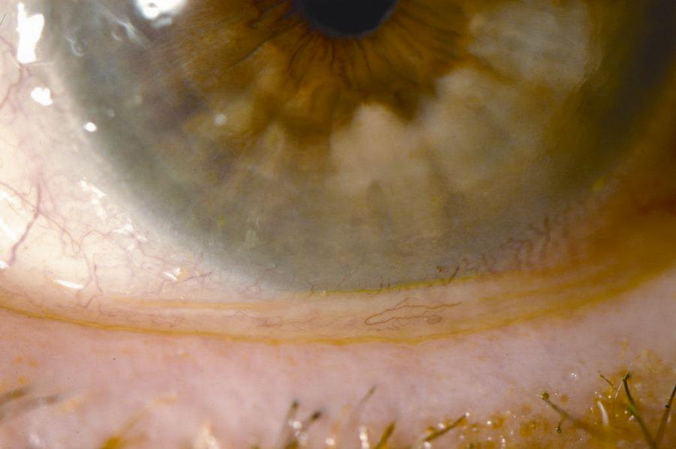
Dry Eye Syndrome
Conjunctivochalasis

Slide 123
Dry Eye Syndrome
Finally: The Cornea book discusses several conditions that mimic DES in their presentation:
--Conjunctivochalasis
----Superior limbic keratoconjunctivitis (SLK)
--Floppy eyelid syndrome
--Nighttime lagophthalmos
--Parkinson’s
--Mucous-membrane pemphigoid/OCP
Conj’chalasis refers to loose, redundant, nonedematous conj. It usually manifests as a ‘fold’ of conj draping on the lower-lid margin. The cause is likely mechanical trauma of the lids rubbing against the bulbar conj during blinking. The redundant conj chafes against itself during blinking and eye movements, causing conj’chalasis pts to have many of the same symptoms as DES pts: FBS, red eyes, and tearing.
Conj’chalasis is managed in a stepwise manner. It’s reasonable to start with ATs, antihistamines, steroids etc—although one of the hallmarks of conj’chalasis is that it doesn’t respond well to DES-tx maneuvers. Often, surgical intervention (in the form of excision or thermal cicatrization) is required for resolution.

Slide 124
Dry Eye Syndrome
Finally: The Cornea book discusses several conditions that mimic DES in their presentation:
--Conjunctivochalasis
----Superior limbic keratoconjunctivitis (SLK)
--Floppy eyelid syndrome
--Nighttime lagophthalmos
--Parkinson’s
--Mucous-membrane pemphigoid/OCP
Conj’chalasis refers to loose, redundant, nonedematous conj. It usually manifests as a ‘fold’ of conj draping on the lower-lid margin. The cause is likely mechanical trauma of the lids rubbing against the bulbar conj during blinking. The redundant conj chafes against itself during blinking and eye movements, causing conj’chalasis pts to have many of the same symptoms as DES pts: FBS, red eyes, and tearing.
Conj’chalasis is managed in a stepwise manner. It’s reasonable to start with ATs, antihistamines, steroids etc—although one of the characteristics of conj’chalasis is that it doesn’t respond well to DES-tx maneuvers. Often, surgical intervention (in the form of excision or thermal cicatrization) is required for resolution.

Slide 125
Dry Eye Syndrome
Finally: The Cornea book discusses several conditions that mimic DES in their presentation:
--Conjunctivochalasis
--Superior limbic keratoconjunctivitis (SLK)
--Floppy eyelid syndrome
--Nighttime lagophthalmos
--Parkinson’s
--Mucous-membrane pemphigoid/OCP
SLK is a chronic/recurrent inflammatory condition of the superior limbal cornea and adjacent conj. It is rare, and the vast majority of sufferers are women. SLK pts share many of the same symptoms as DES pts (FBS, red eyes, and tearing). However, the signs in the two differ enough to allow them to be distinguished from one another. For example: Whereas the conj and corneal findings (eg, injection; staining) in DES tend to be found in the interpalpebral fissure zone, in SLK they are limited to the superior conj and cornea. Further, in SLK the superior bulbar conj is redundant/loose, a finding not seen in DES. Finally, the superior tarsal conj in SLK manifests a fine papillary reaction—again, something not typically seen in DES.
The pathogenesis of the superior conj/cornea damage in SLK stems from
excessive contact and rubbing between the upper lid and the superior conj/cornea. SLK pts have overly tight superior lids, usually as a result of orbital congestion stemming from thyroid eye dz—a classic (and highly testable) association with SLK.

Slide 126
Dry Eye Syndrome
Finally: The Cornea book discusses several conditions that mimic DES in their presentation:
--Conjunctivochalasis
--Superior limbic keratoconjunctivitis (SLK)
--Floppy eyelid syndrome
--Nighttime lagophthalmos
--Parkinson’s
--Mucous-membrane pemphigoid/OCP
SLK is a chronic/recurrent inflammatory condition of the superior limbal cornea and adjacent conj. It is rare, and the vast majority of sufferers are women. SLK pts share many of the same symptoms as DES pts (FBS, red eyes, and tearing). However, the signs in the two differ enough to allow them to be distinguished from one another. For example: Whereas the conj and corneal findings (eg, injection; staining) in DES tend to be found in the interpalpebral fissure zone, in SLK they are limited to the superior conj and cornea. Further, in SLK the superior bulbar conj is redundant/loose, a finding not seen in DES. Finally, the superior tarsal conj in SLK manifests a fine papillary reaction—again, something not typically seen in DES.
The pathogenesis of the superior conj/cornea damage in SLK stems from
excessive contact and rubbing between the upper lid and the superior conj/cornea. SLK pts have overly tight superior lids, usually as a result of orbital congestion stemming from thyroid eye dz—a classic (and highly testable) association with SLK.

Slide 127
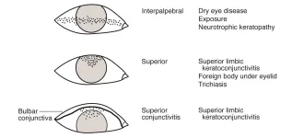
Dry Eye Syndrome
K and conj staining in SLK vs DES

Slide 128
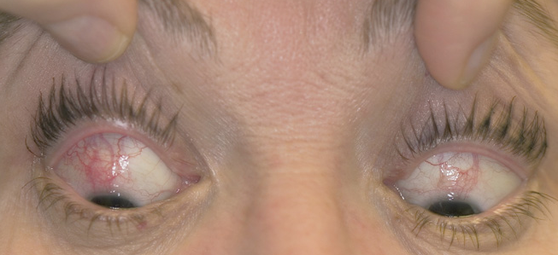
Dry Eye Syndrome
SLK: Superior conj injection

Slide 129
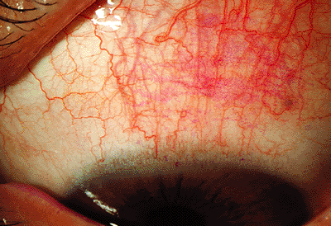
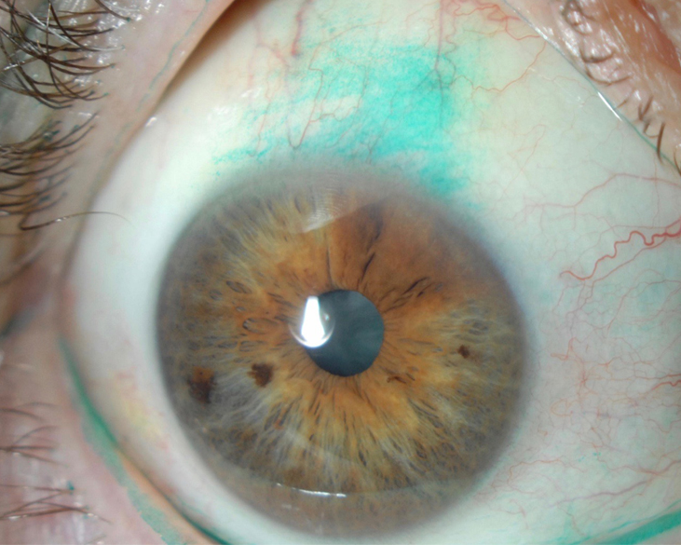
Dry Eye Syndrome
Superior rose bengal staining
Superior lissamine green staining
SLK: Superior conj staining

Slide 130
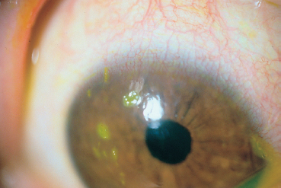
Dry Eye Syndrome
SLK: Superior corneal filaments

Slide 131
Dry Eye Syndrome
Finally: The Cornea book discusses several conditions that mimic DES in their presentation:
--Conjunctivochalasis
--Superior limbic keratoconjunctivitis (SLK)
--Floppy eyelid syndrome
--Nighttime lagophthalmos
--Parkinson’s
--Mucous-membrane pemphigoid/OCP
SLK is a chronic/recurrent inflammatory condition of the superior limbal cornea and adjacent conj. It is rare, and the vast majority of sufferers are women. SLK pts share many of the same symptoms as DES pts (FBS, red eyes, and tearing). However, the signs in the two differ enough to allow them to be distinguished from one another. For example: Whereas the conj and corneal findings (eg, injection; staining) in DES tend to be found in the interpalpebral fissure zone, in SLK they are limited to the superior conj and cornea. Further, in SLK the superior bulbar conj is redundant/loose, a finding not seen in DES. Finally, the superior tarsal conj in SLK manifests a fine papillary reaction—again, something not typically seen in DES.
The pathogenesis of the superior conj/cornea damage in SLK stems from
excessive contact and rubbing between the upper lid and the superior conj/cornea. SLK pts have overly tight superior lids, usually as a result of orbital congestion stemming from thyroid eye dz—a classic (and highly testable) association with SLK.

Slide 132
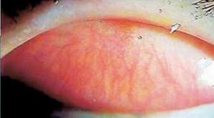
Dry Eye Syndrome
SLK: Superior tarsal conj papillary rxn

Slide 133
Dry Eye Syndrome
Finally: The Cornea book discusses several conditions that mimic DES in their presentation:
--Conjunctivochalasis
--Superior limbic keratoconjunctivitis (SLK)
--Floppy eyelid syndrome
--Nighttime lagophthalmos
--Parkinson’s
--Mucous-membrane pemphigoid/OCP
SLK is a chronic/recurrent inflammatory condition of the superior limbal cornea and adjacent conj. It is rare, and the vast majority of sufferers are women. SLK pts share many of the same symptoms as DES pts (FBS, red eyes, and tearing). However, the signs in the two differ enough to allow them to be distinguished from one another. For example: Whereas the conj and corneal findings (eg, injection; staining) in DES tend to be found in the interpalpebral fissure zone, in SLK they are limited to the superior conj and cornea. Further, in SLK the superior bulbar conj is redundant/loose, a finding not seen in DES. Finally, the superior tarsal conj in SLK manifests a fine papillary reaction—again, something not typically seen in DES.
The pathogenesis of the superior conj/cornea damage in SLK stems from
excessive contact and rubbing between the upper lid and the superior conj/cornea. SLK pts have overly tight superior lids, usually as a result of orbital congestion stemming from thyroid eye dz—a classic (and highly testable) association with SLK.

Slide 134
Dry Eye Syndrome
Finally: The Cornea book discusses several conditions that mimic DES in their presentation:
--Conjunctivochalasis
--Superior limbic keratoconjunctivitis (SLK)
--Floppy eyelid syndrome
--Nighttime lagophthalmos
--Parkinson’s
--Mucous-membrane pemphigoid/OCP
Floppy eyelid syndrome (FES) is a condition characterized by upper-lid laxity along with chronic inflammation of the ocular surface. FES pts complain of FBS and mucous discharge that are worse in the morning. The main risk factor for FES is obesity.
The presumed pathogenic process in FES is that during sleep, their laxity allows the upper lids to evert in response to face-rubbing against a pillow while sleeping in the prone position. Lid eversion results in contact between the eye and the bedding which traumatizes the ocular epithelia.
Initial management is conservative—ointment qHS, and preventing eversion by shielding the eye or taping them shut. If FES fails to respond to this, surgical tightening of the lax upper lid is in order. FES strongly associated with obstructive sleep apnea, and all FES pts should be evaluated for OSA.

Slide 135
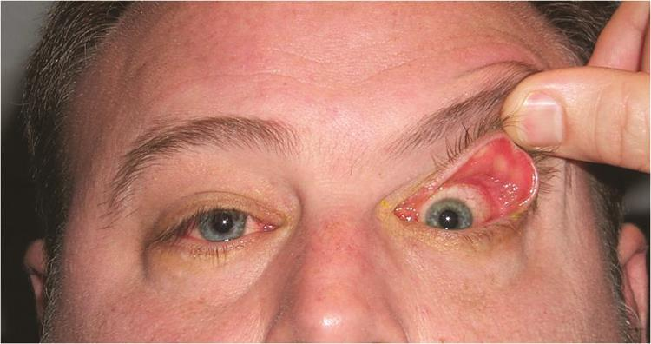
Dry Eye Syndrome
FES. Wow.

Slide 136
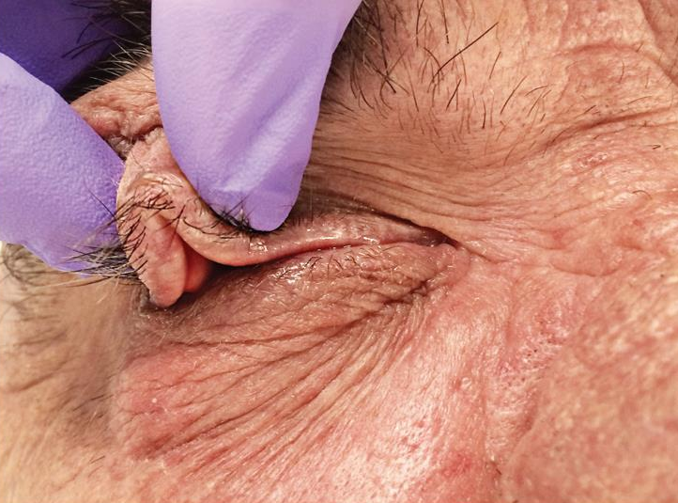
Dry Eye Syndrome
If you can’t tell, that’s an upper lid so lax it can be pinched like this

Slide 137
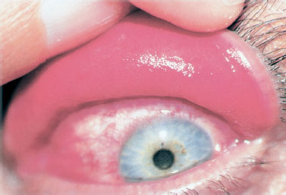
Dry Eye Syndrome
FES. Note the fine papillary rxn (another common finding) on the easily-everted lid

Slide 138
Dry Eye Syndrome
Finally: The Cornea book discusses several conditions that mimic DES in their presentation:
--Conjunctivochalasis
--Superior limbic keratoconjunctivitis (SLK)
--Floppy eyelid syndrome
--Nighttime lagophthalmos
--Parkinson’s
--Mucous-membrane pemphigoid/OCP
Floppy eyelid syndrome (FES) is a condition characterized by upper-lid laxity along with chronic inflammation of the ocular surface. FES pts complain of FBS and mucous discharge that are worse in the morning. The main risk factor for FES is obesity.
The presumed pathogenic process in FES is that during sleep, their laxity allows the upper lids to evert in response to face-rubbing against a pillow while sleeping in the prone position. Lid eversion results in contact between the eye and the bedding which traumatizes the ocular epithelia.
Initial management is conservative—ointment qHS, and preventing eversion by shielding the eye or taping them shut. If FES fails to respond to this, surgical tightening of the lax upper lid is in order. FES strongly associated with obstructive sleep apnea, and all FES pts should be evaluated for OSA.

Slide 139
Dry Eye Syndrome
Finally: The Cornea book discusses several conditions that mimic DES in their presentation:
--Conjunctivochalasis
--Superior limbic keratoconjunctivitis (SLK)
--Floppy eyelid syndrome
--Nighttime lagophthalmos
--Parkinson’s
--Mucous-membrane pemphigoid/OCP
Floppy eyelid syndrome (FES) is a condition characterized by upper-lid laxity along with chronic inflammation of the ocular surface. FES pts complain of FBS and mucous discharge that are worse in the morning. The main risk factor for FES is obesity.
The presumed pathogenic process in FES is that during sleep, their laxity allows the upper lids to evert in response to face-rubbing against a pillow while sleeping in the prone position. Lid eversion results in contact between the eye and the bedding which traumatizes the ocular epithelia.
Initial management is conservative—ointment qHS, and preventing eversion by shielding the eye or taping them shut during sleep. If FES fails to respond to this, surgical tightening of the lax upper lid is in order. FES is strongly associated with obstructive sleep apnea, and all FES pts should be evaluated for OSA.

Slide 140
Dry Eye Syndrome
That’s it! Go through this slide-set a couple of times (at least) until you feel like you have a handle on it. When you’re ready, do slide-set K48, which covers this material in a Q&A format (and more detail).

